Slide 1
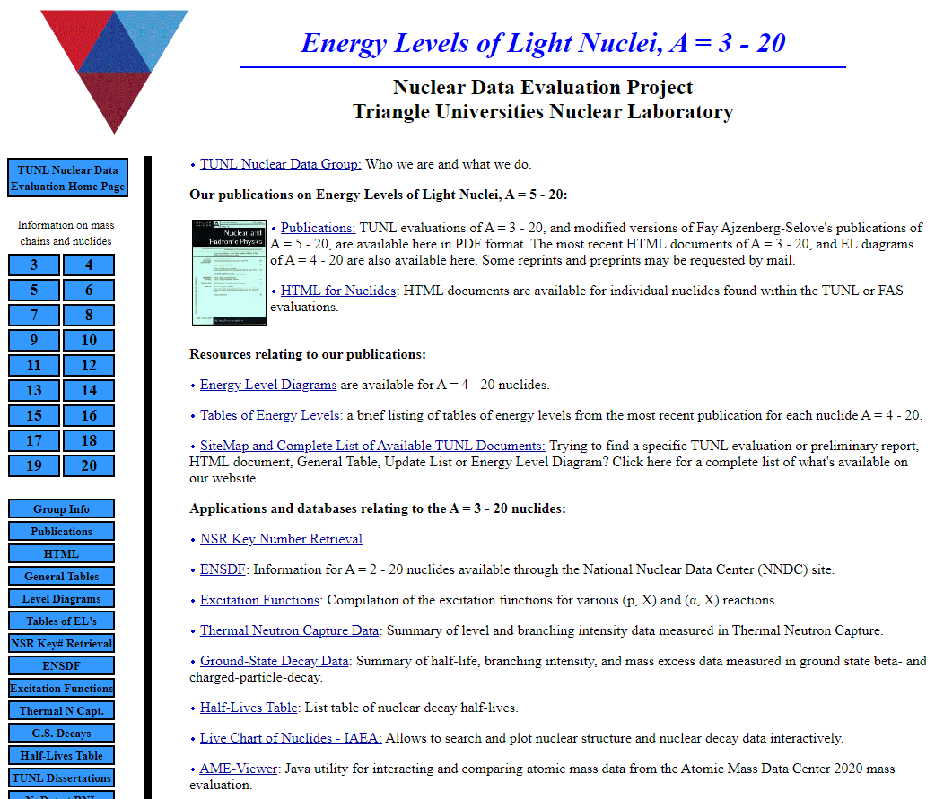
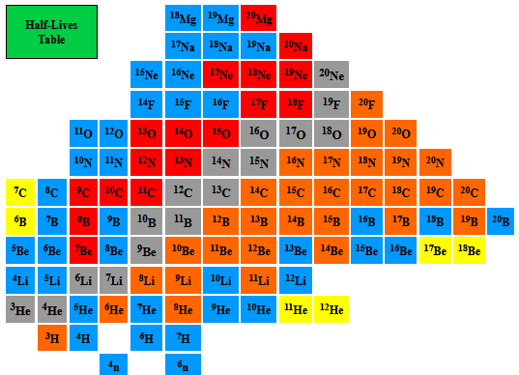
Triangle Universities Nuclear Lab: Data Evaluation Group
TUNL is involved in data evaluation as part of the US Nuclear Data Program and as part of the international Nuclear Structure and Decay Data Network (IAEA).
Effort is focused on production of ENSDF evaluations and XUNDL compilations for light nuclei.
We also maintain a website that includes archival Fay Ajzenberg-Selove reviews and other information relevant to light nuclei.

Slide 2
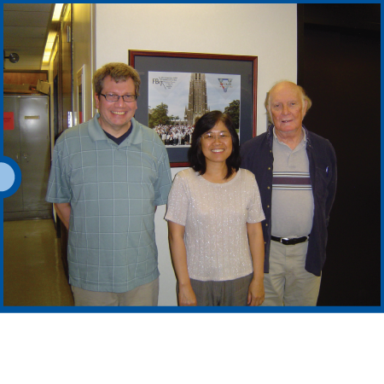
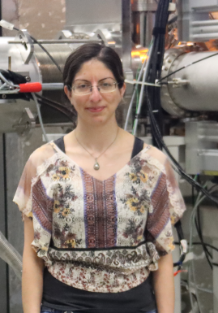
Contributors
John Kelley NCSU
Grace Sheu
(retired 2022)
Jim Purcell
Emeritus
Georgia State U.
Kiana Setoodehnia
Ph.D. McMaster: Alan Chen
Stellar evolution/nuclear astrophysics
Postdocs: Notre Dame
NC State/TUNL
FRIB: SECAR Device Scientist
Rejoined TUNL in June 2023

Slide 3
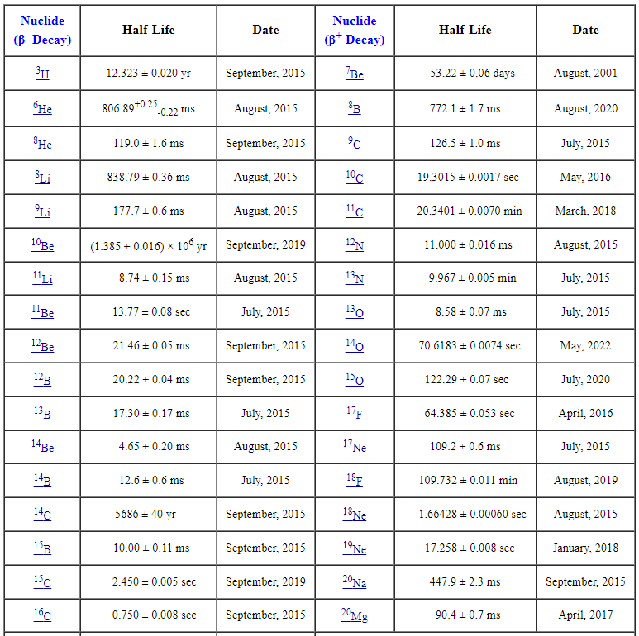
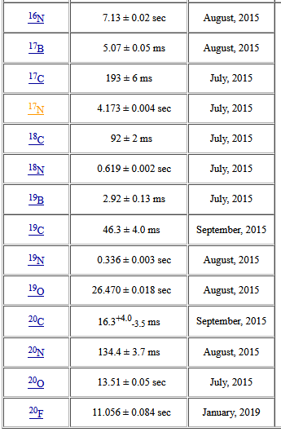

Types of things we keep on our website
T_{1/2} table
Research Experience for Undergraduate Project (Susan Olmstead) in 2015:
Compiled relevant articles
Use McMaster data group’s Java averaging program
Evaluated lifetimes using a variety of averaging methods
Produced a table of recommended values
Kept up-to-date

Slide 4
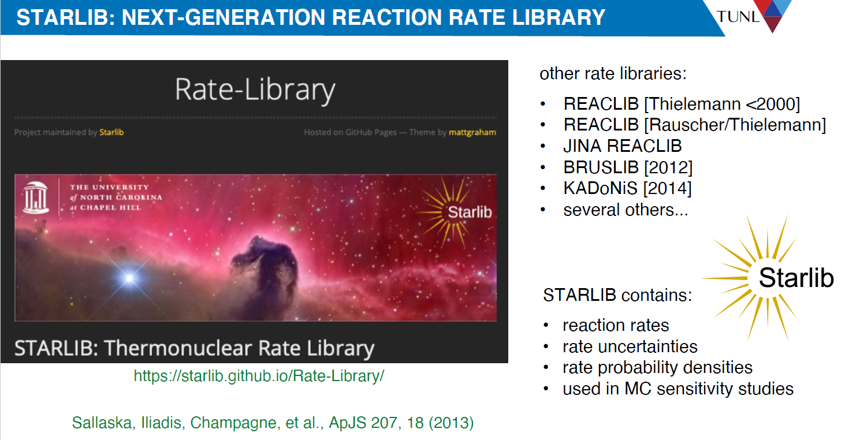
Kiana plans to spend a small amount of time contributing to STARLIB

