Slide 1
The National Nuclear Data Center as a Public Reusable Research (PuRe) Data Resource
Libby Ricard – on behalf of the National Nuclear Data Center

Slide 2
What is PuRe?
(https://science.osti.gov/Initiatives/PuRe-Data/Policies-and-Procedures/Definition)
  A Department of Energy Office of Science Public Reusable Research Data Resource (SC PuRe Data Resource) is a data repository, knowledge base, analysis platform or other such activity sponsored by the Office of Science for the purpose of making data reusable and publicly available to advance scientific or technical knowledge.

Slide 3
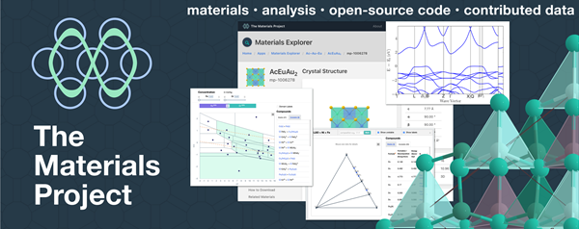



Initial cohort of PuRe data resources
Most PuRe resources from DOE-BES & DOE-BER

Slide 4

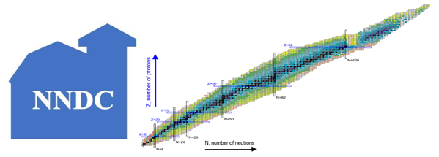
Initial cohort of PuRe data resources
DOE-HEP: Particle Data Group
Review of Particle Properties
Elementary particles & hadron properties
Small overlap with ENSDF (n, p)
In June 2021, the NNDC was designated as a PuRe data resource
DOE-NP: National Nuclear Data Center
Nuclear structure (experimental & evaluated)
Nuclear reactions (experimental & evaluated)
Bibliographic data

Slide 5

Data Metrics Document Available on Indico
Access procedures
Database sizes
Download statistics
Outreach
Scientific impact
  and highlights
Some aspects will be covered in talks
  Web Dissemination
  DEI Activities
  Open Data

Slide 6
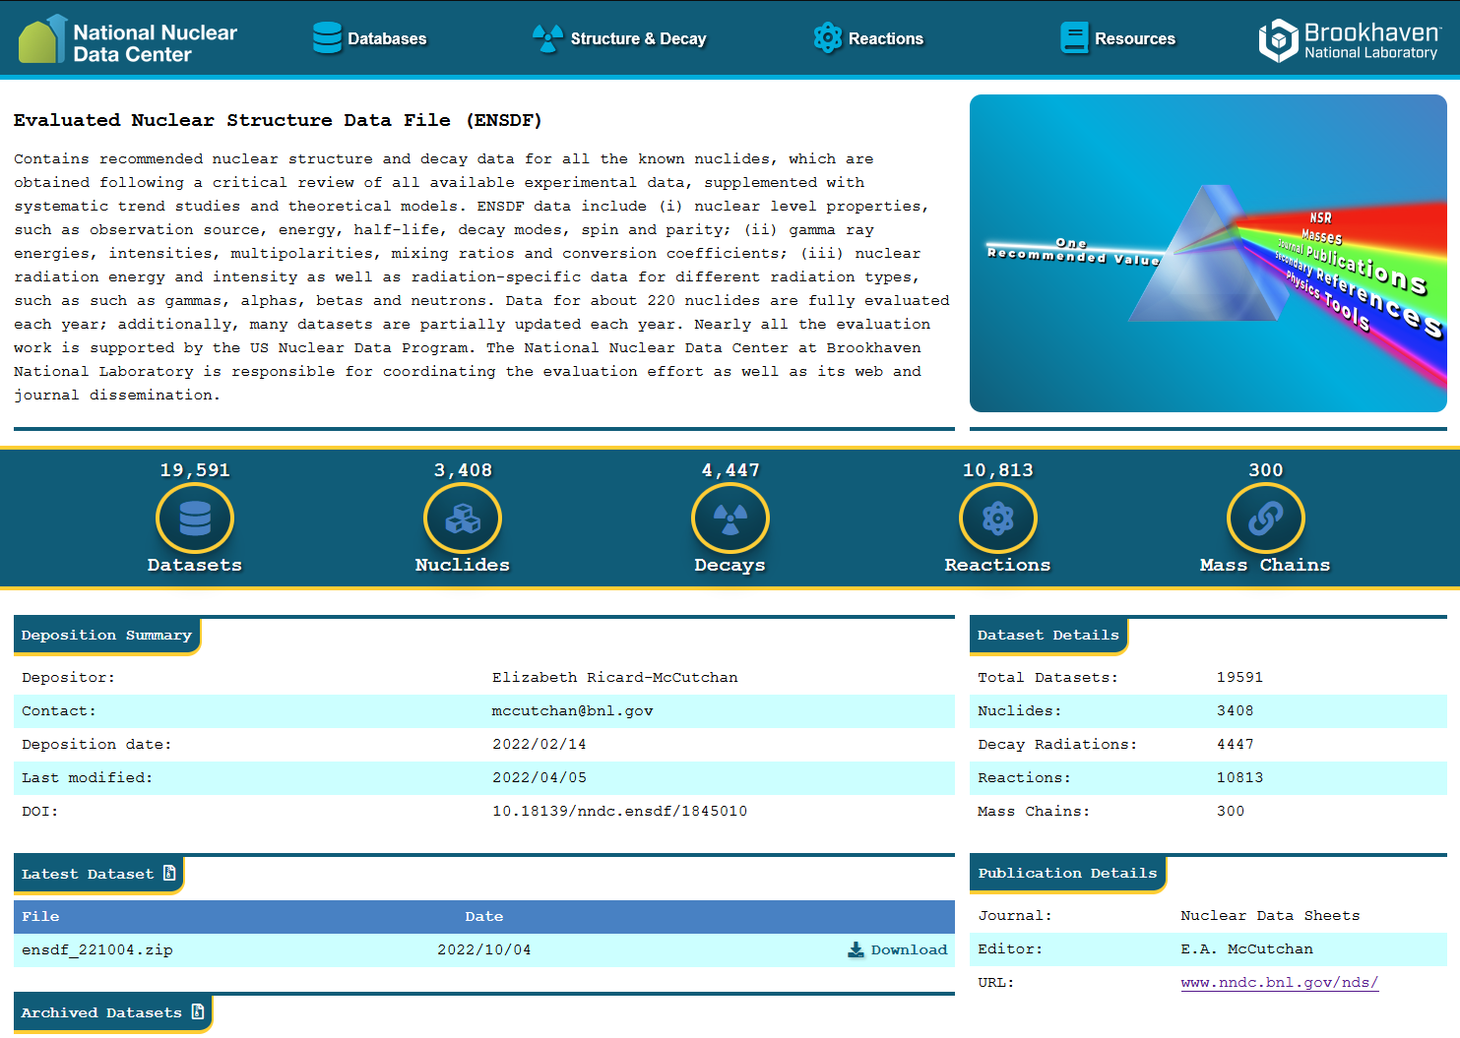
Digital Object Identifiers (DOIs)
As a Public Reusable Research (PuRe) Data Repository the NNDC strives to make data publicly available to advance scientific knowledge
3 major libraries now have library-wide DOIs:
ENSDF
XUNDL
NSR
ENDF is next!

Slide 7
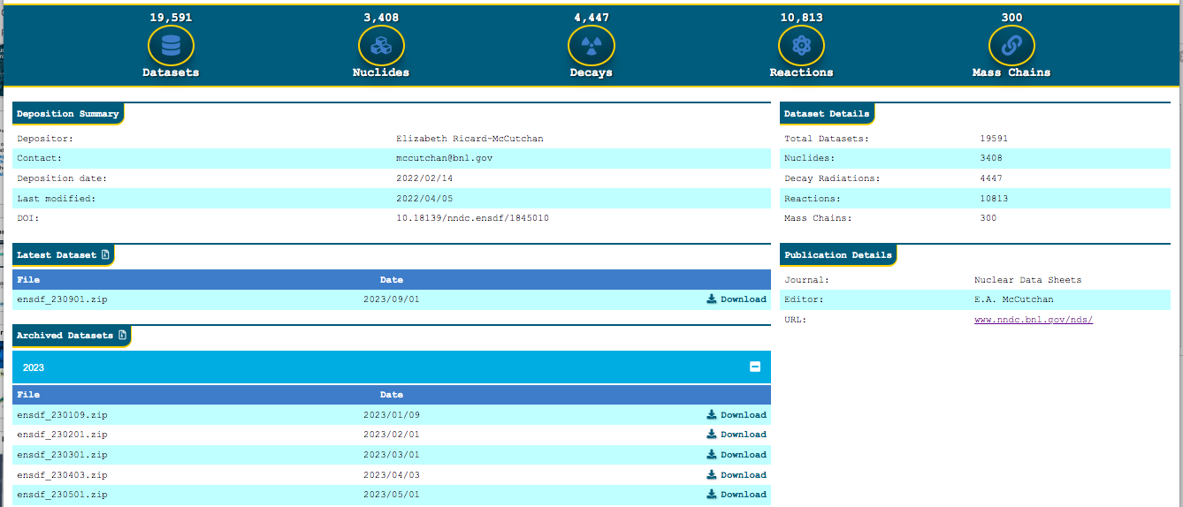
Archival pages to move towards FAIR
FINDABLE : DOI assignment
ACCESSIBLE : Versioned files for download

Slide 8
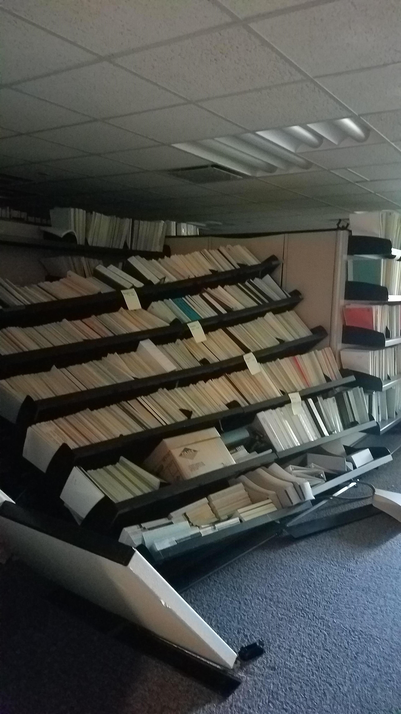
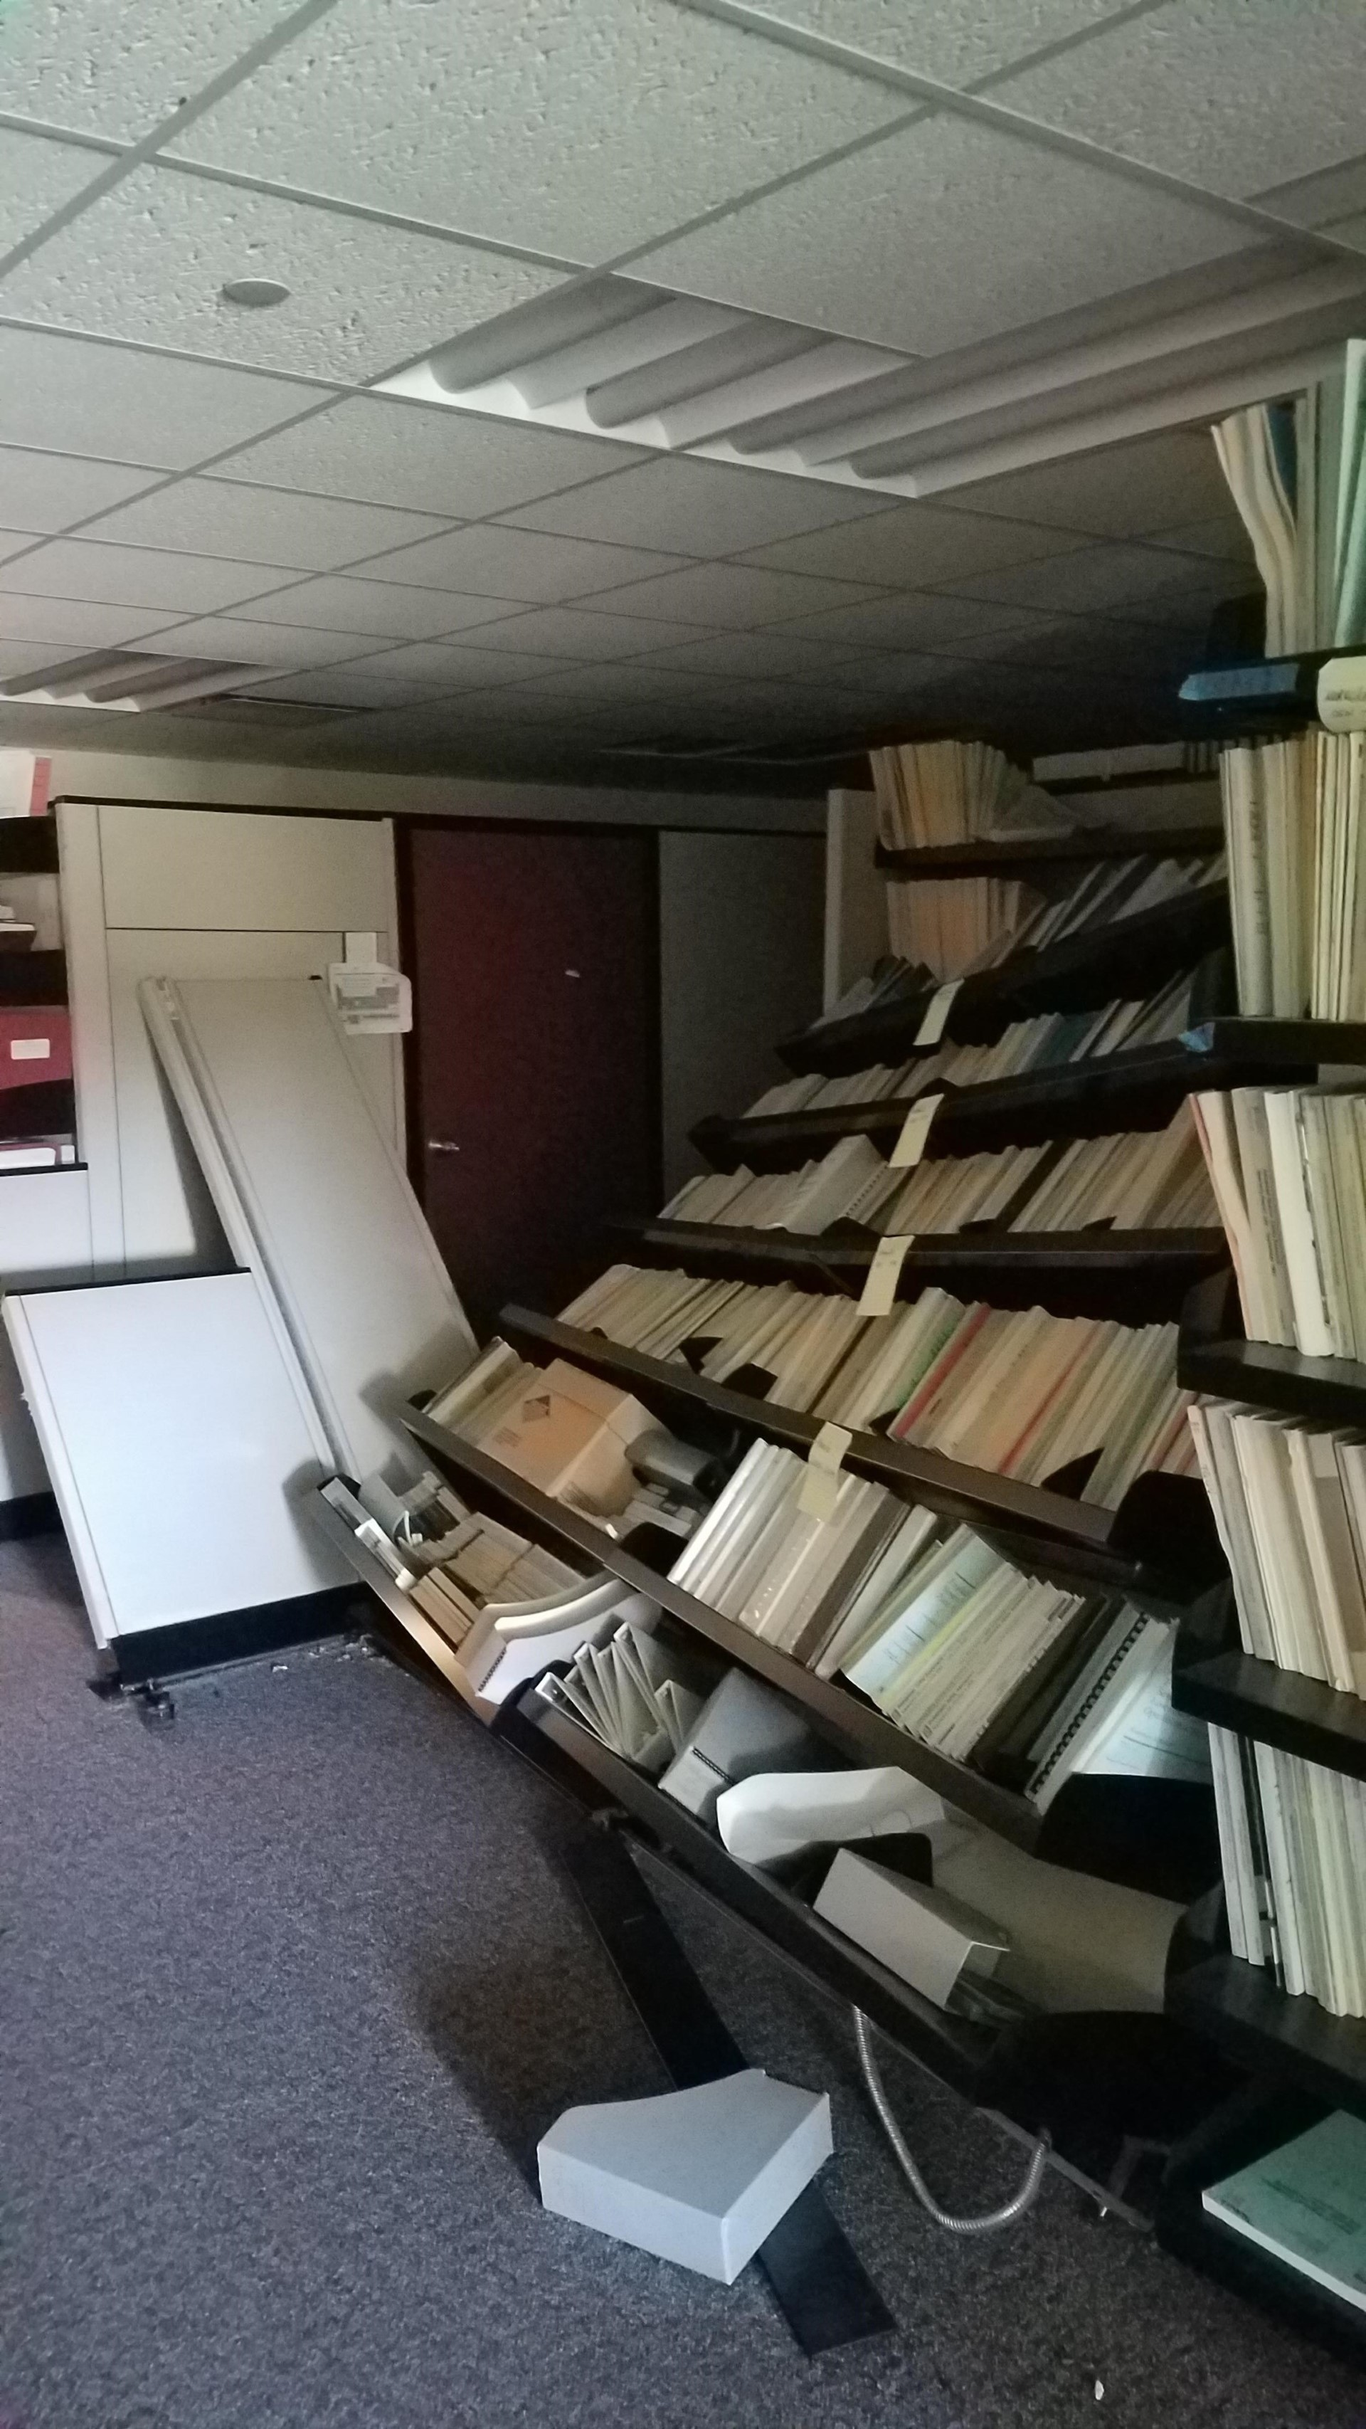
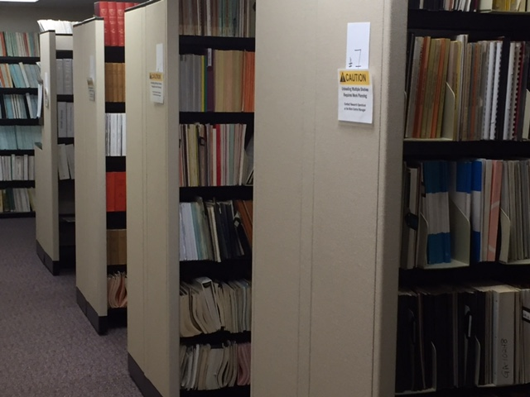
NNDC Library Transformation
Pre-COVID
During COVID

Slide 9
Library Disaster Solves 12 year old scientific puzzle
Summation calculations in good agreement with ORNL data
Digitized 260 tables !!
Created EXFOR entries
ORNL reports by Dicken’s et al.,
Delayed gamma and electron data following thermal fission of ²³⁵U, and ^{239,241}Pu

Slide 10


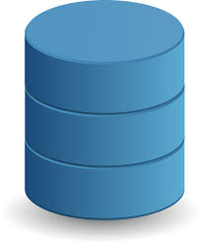

Optimal Downsizing of Library
Cross referenced paper material with online availability
Downloaded pdfs of material available on-line, added to NSR
Scanned missing NSR refs
Cataloged and searched >2,000 books and conference proceedings
BNL librarian – effort at no cost to USNDP
Cat Dunn
Stacy Kuczewski
NSR
ALL metadata
Metadata
PDFs
Non-copyrighted pdfs
More than 2 year project – highly leveraged by support from BNL main library

Slide 11

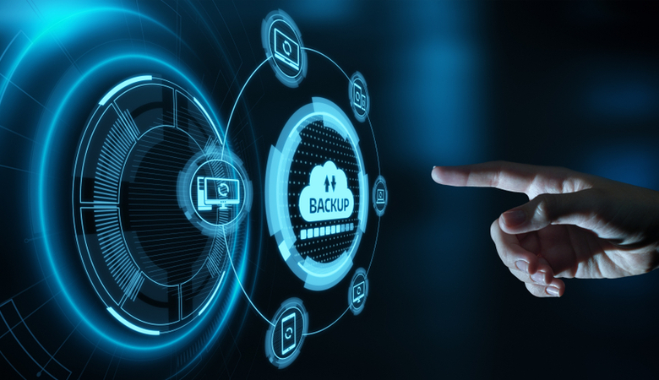
Data management plan
Robust cloud backup since Sep. 2021
One of a kind at BNL
Backup of up to 15 TB of data from on-premise, mission-critical servers to AWS GovCloud
Continuous replication
During a disaster:
  Server backup restored from AWS GovCloud to create production-ready instance.
  Accessible within 2 hours.
Annual cost: ~$30k fully burdened

Slide 12
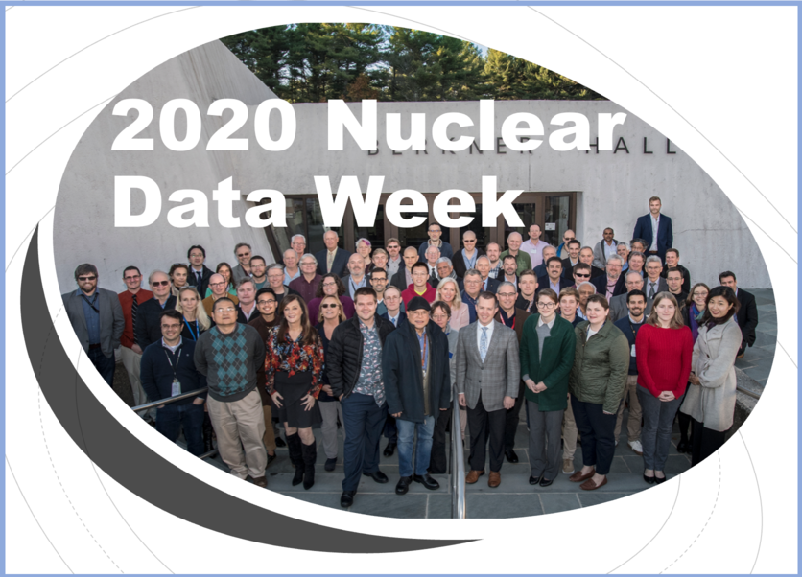
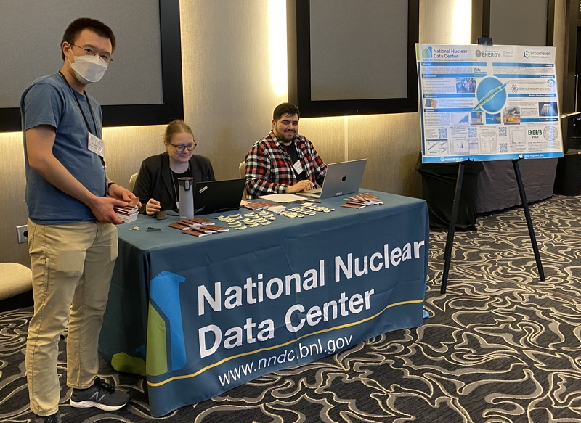
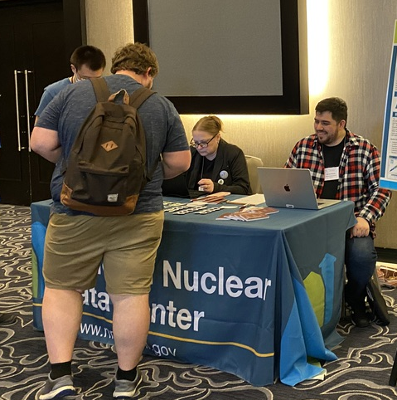

Outreach
Host of Annual Nuclear Data Week including CSWEG and USNDP
www.youtube.com/watch?v=PI7UnRYalVA
General public science talks, summer school seminars, nuclear data colloquiums
Booth at April and October APS meetings
Virtual booths at ND2022, INMN, …

Slide 13
