Slide 1
NucScholar: Natural Language Processing for Nuclear Science References
Lee Bernstein for Bethany Goldblum
Nuclear Science Division
Lawrence Berkeley National Laboratory
September 13, 2023

Slide 2
NucScholar: Natural Language Processing to accelerate nuclear science literature search
pdf to text conversion
transformer models
preprocessing
named entity recognition
topic
modeling
semantic similarity search
question answering
Keyword and natural language queries
User
Notes:
Goal of NucScholar is to automate generation of NSR entries, increasing database volume, scope, and throughput. Named entity recognition gives metadata (author, journal, etc.) and most important nuclides. Topic modeling gives experiment v. theory paper, NSR categories (e.g., nuclear reactions, nuclear structure, etc.), NSR subject areas (e.g., alpha decay, cross section, etc.). Semantic similarity search and Question Answering tools provide automated summary generation.

Slide 3
NucScholar: Natural Language Processing to accelerate nuclear science literature search
pdf to text conversion
transformer models
preprocessing
named entity recognition
topic
modeling
semantic similarity search
question answering
Keyword and natural language queries
User
Notes:
Now we will show you some progress in topic modeling

Slide 4
AI/ML Classifier for NSR Topic Area
Goal: Sort papers into NSR topic area (e.g., ATOMIC MASSES, NUCLEAR REACTIONS, NUCLEAR STRUCTURE, etc.) using full text as input
Method: Latent Semantic Analysis (LSA) + Support Vector Machine (SVM) classification; Model maps each document from word frequency space to smaller LSA topic space
Train
Train
Vectorize
Fit
Train
Model (LSA worked best)
Support Vector Machine
(map to NSR items)
Raw
Papers
Preprocessed
Papers
Validation
Test on NSR
Validation
Notes:
LSA assumes that words that are close in meaning will occur in similar pieces of text (the distributional hypothesis). A matrix containing word counts per document (rows represent unique words and columns represent each document) is constructed from a large piece of text and a mathematical technique called singular value decomposition (SVD) is used to reduce the number of rows while preserving the similarity structure among columns.
Given a set of training examples, each marked as belonging to one of two categories, an SVM training algorithm builds a model that assigns new examples to one category or the other, making it a non-probabilistic binary linear classifier

Slide 5
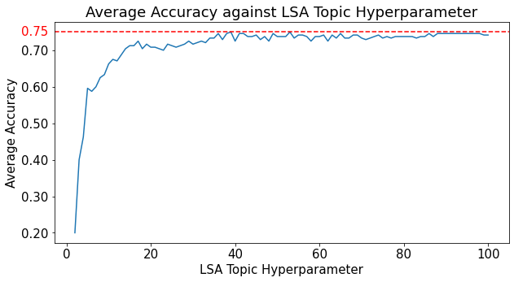
Classifier for NSR Topics: Good performance across 6 NSR Topic Areas
Data: Topic area from NSR entries; arXiv paper text and category
240 papers total
40 papers per NSR subject area (excluding compilation)
NSR Topics
Atomic Masses
Atomic Physics
Nuclear Moments
Nuclear Reactions
Nuclear Structure
Radioactivity
Compilation
Average accuracy of 75% across 5-fold segmentation and cross validation
Not NSR Topic (derived from many papers)
Notes:
Can we get access to the PRC/EPJ paper flow to the NNDC for XUNDL compilation

Slide 6
Some example of misclassification “The Topic is in the eye of the beholder (NSR compiler)” – B. Goldblum
Calculations of Gamow-Teller Transition Strengths in some fp-Shell Nuclei using Shell Model: DOI: 10.1139/cjp-2019-0693
NSR Topic: Radioactivity Predicted NSR Topic: Nuclear Structure
Laser Spectroscopy of Neutron-Rich 207;208Hg Isotopes: Illuminating the Kink and Odd-Even Staggering in Charge Radii across the N = 126 Shell Closure DOI: 10.1103/PhysRevLett.126.032502
NSR Topic: Nuclear Moments Predicted NSR Topic: Nuclear Structure
Possible quenching of static neutron pairing near the N = 98 deformed shell gap: Rotational structures in 160,161Gd DOI: 10.1103/PhysRevC.103.034322
NSR Topic: Nuclear Reactions
Predicted: Nuclear Structure
Except here ;-)
Notes:
This paper sits on the boundary of what NSR says (Radioactivity) and what the model says (Nuclear Structure). Both make sense to me.
Again, the model behaves reasonably (Nuclear Structure, vs Nuclear Moments for NSR). There is a lot of discussion of shell closures and single particle states so I am not surprised.

Slide 7
AI/ML Classifier for NSR Subject Area
Goal: Sort papers into NSR subject areas (e.g., “A-DECAY”, “FISSION”, “G-SPECTRA”, ...) using paper title and abstract as input
Method: Bidirectional Encoder Representations from Transformers (BERT) core + multilabel classification head
Data: Titles and subject areas from NSR entries; arXiv abstracts
Performance metric: F₁ score = harmonic mean of precision and recall; MCC = discrete Pearson correlation coefficient
$precision≡\frac{TP}{TP +FP}$
$recall≡\frac{TP}{TP +FN}$
$MCC≡\frac{TP×TN−FP×FN}{\sqrt{(TP+FP)(TP+FN)(TN+FP)(TN+FN)}}$
The closer F1 and MCC are to 1, the better the model performance
Notes:
F1 represents both precision and recall in one metric. F1=2TP/(2TP+FP+FN)
Precision is how many retrieved items are relevant.
Recall is how many relevant items are retrieved.
MCC is the Matthews Correlation Coefficient is used as a measure of the quality of binary (two-class) classifications
TP, FP, TN, FN are true and false positives and true and false negatives
BERT is a pre-trained language model trained on the Toronto Book Corpus and English Wikipedia. It converts each english word into an integer code.

Slide 8
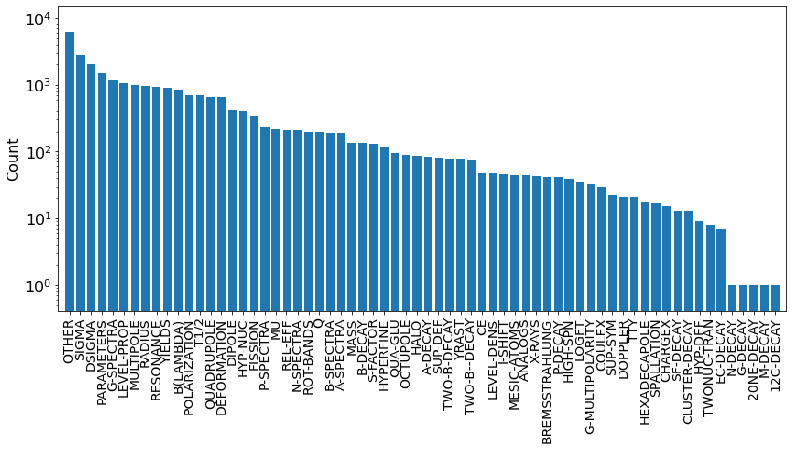
NSR subjects sorted by available samples (title + arXiv abstract)
Emergent topics could be in this bin
(Along with some mis-classifications)
Notes:
There are some errors in NSR classification.
Emergent topics could be in the “Other”. We need to let the papers tell us what the important tags should be.

Slide 9
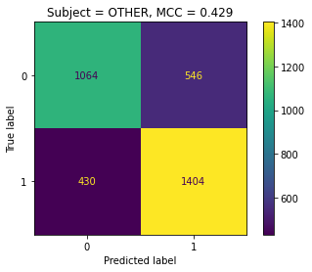
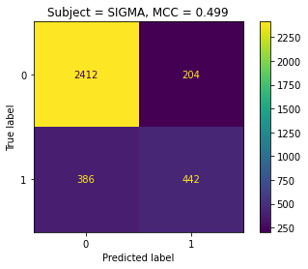
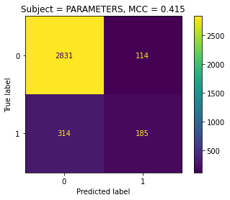
Classifier for Top 5 NSR Subjects: Strong positive correlation but clearly room for improvement
Data: titles and subjects from NSR entries; arXiv abstracts
top 5 subjects: 'OTHER', 'SIGMA', 'DSIGMA', 'PARAMETERS', 'G-SPECTRA'
8109 samples for training
3444 samples for validation
Performance metric after training:
Training set: F₁ = 0.70 (model is barely capturing the information)
Validation set: F₁ = 0.63 (eh?)
Future Work:
Improve performance for top 5 NSR subjects
Extend model to all NSR subjects
Notes:
How good are MCCs of 0.429 to 0.512? How about F1 of 0.7 and 0.63?
SIGMA and DSIGMA are cross section and differential cross section; G-SPECTRA are γ spectra, Eγ, γγ-coin; PARAMETERS are parameters/form factors and OTHER

Slide 10
NucScholar: Natural Language Processing to accelerate Nuclear Science literature search
pdf to text conversion
transformer models
preprocessing
named entity recognition
topic
modeling
semantic similarity search
question answering
Keyword and natural language queries
Current work focused on topic modeling
User
10

Slide 11
Tailored training data for semantic search enables BERT model fine tuning for NSR summary generation
Goal: Generate nuclear physics specific training data to enable fine-tuning of BERT semantic search model
Method: Generate paraphrases using Large Language Models (LLMs)
Data: 5 sentences; Each paraphrased 5 times using each of Chat GPT3.5, Chat GPT4, Bing, Bard, Pegasus, and Parrot
Performance metrics: Levenshtein distance (similarity in syntax) and Semantic Similarity metric (similarity in meaning)
Bing maximizes variation in syntax while also maximizing similarity in meaning. Plus, it’s free!
Model | GPT4 | GPT3.5 | Bing | Bard | Pegasus | Parrot
Average Levenshtein Ratio | 0.878 | 0.884 | 0.854 | 0.867 | 0.877 | 0.891
Variance of Levenshtein Ratio | TBD | TBD | TBD | TBD | TBD | TBD
Average Semantic Similarity | 0.968 | 0.971 | 0.984 | 0.932 | 0.917 | 0.954

Slide 12
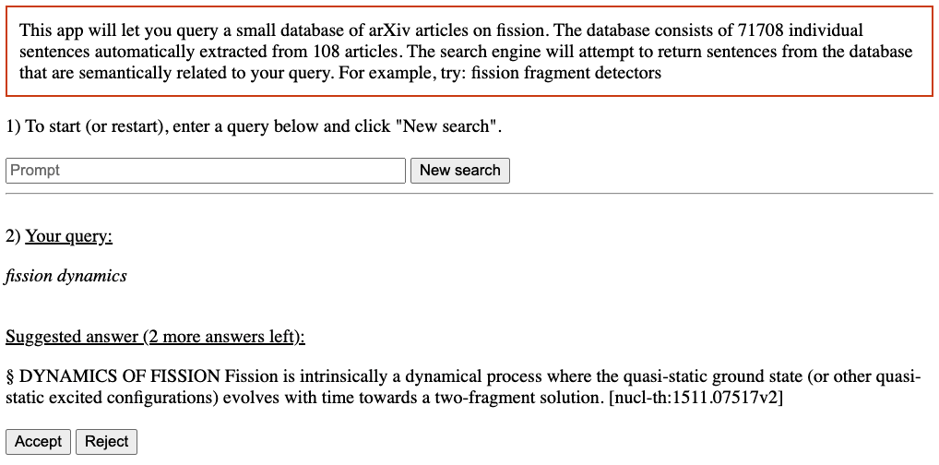
NucScholar Training Engine
nucscholar.lbl.gov

Slide 13
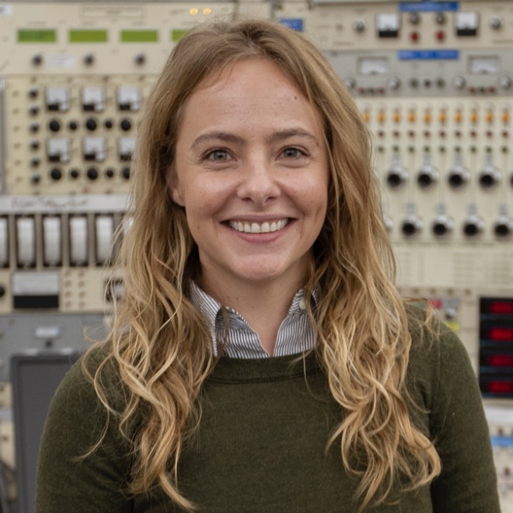
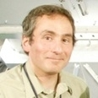
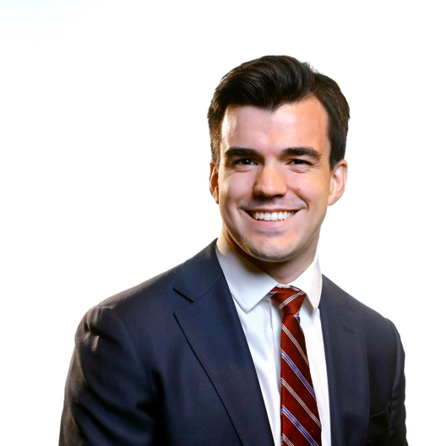
Conclusions & Acknowledgements
The current NSR topics may not be the best fit to current literature (e.g., research/programmatic interests).
Even with this, we achieved an accuracy of 75% for the six topic areas. Decent performance for subject areas (including OTHER!)
This project is at a cross-road. More resources are needed.
This work was performed under the auspices of the U.S. Department of Energy by Lawrence Berkeley National Laboratory under Contract DE-AC02-05CH11231.
Bethany Goldblum
Scientist (LBNL/UCB)
Walid Younes
Consultant (LBNL)
Juan Manfredi
Professor (AFIT)
Suggestions?
bethany@lbl.gov
Char Juin Chin
CS & Linguistics,
UCB
Shi Hao Lee
CS & Applied Math, UCB
Mingqi Zeng
Data Science & Econ, UCB
Notes:
Minqqi left to get a MS @ CMU
Walid is a retiree
Juan is a volunteer
We need a post-doc (preferred). Perhaps one who is interested in transitioning to Data Science from Nuclear Science

