Slide 1
EXFOR Database Modernization
Presenter(s) Boris Pritychenko on behalf of USNDP
National Nuclear Data Center, Brookhaven National Laboratory
September 14, 2023

Slide 2
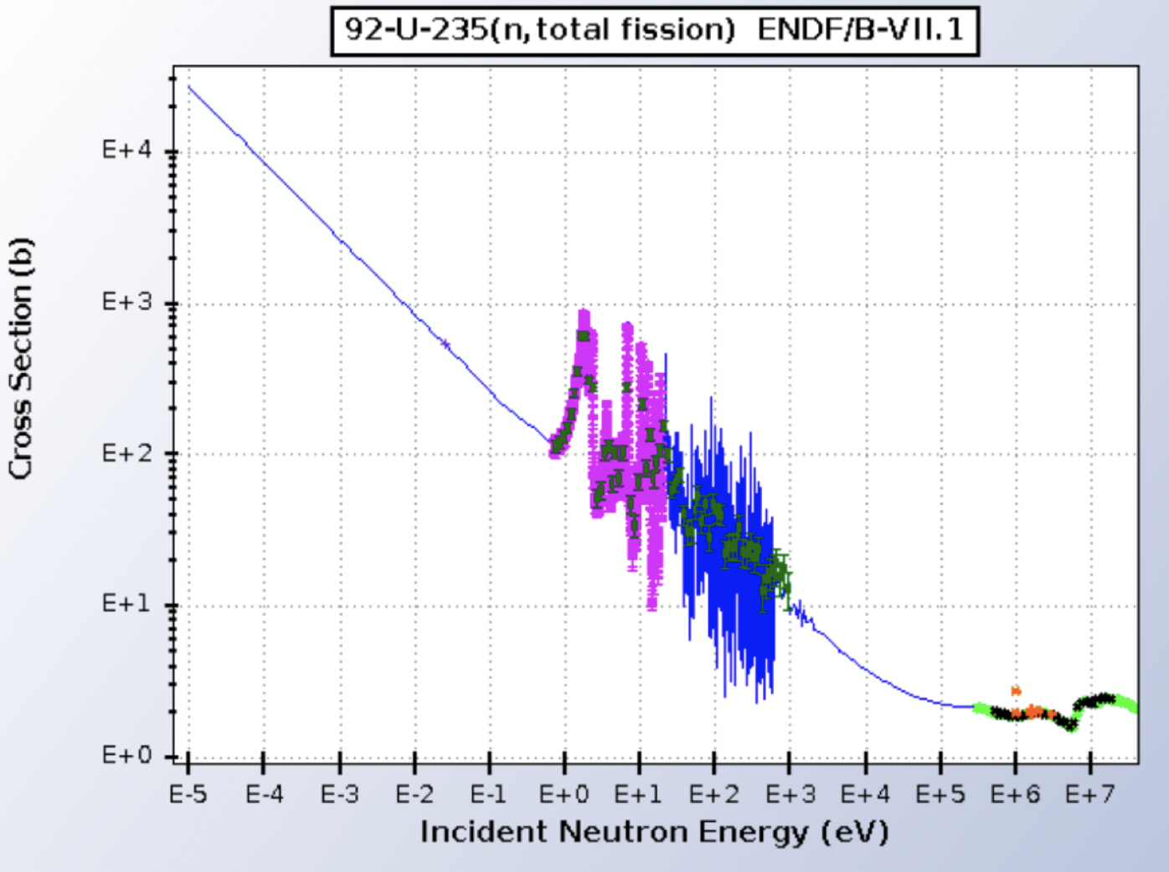
EXFOR Database
The EXchange FORmat (EXFOR) experimental nuclear reaction database and format for low- and intermediate-energy physics (August 29, 2023)
24,683 compilations of experimental works
183,495 reaction data tables
Total and differential cross sections, resonance parameters, fission yields, thick-target and product yields, multiplicities, ….
Originally neutrons, charged particles and photonuclear reactions were added later.
All compilations go through a strict quality assurance process.
Main users: ENDF evaluators, nuclear model code developers, activation and TOF communities.
EXFOR is the best and the most complete collection of experimental nuclear reaction data worldwide.
Nuclear data evaluation often starts from EXFOR library analysis.

Slide 3
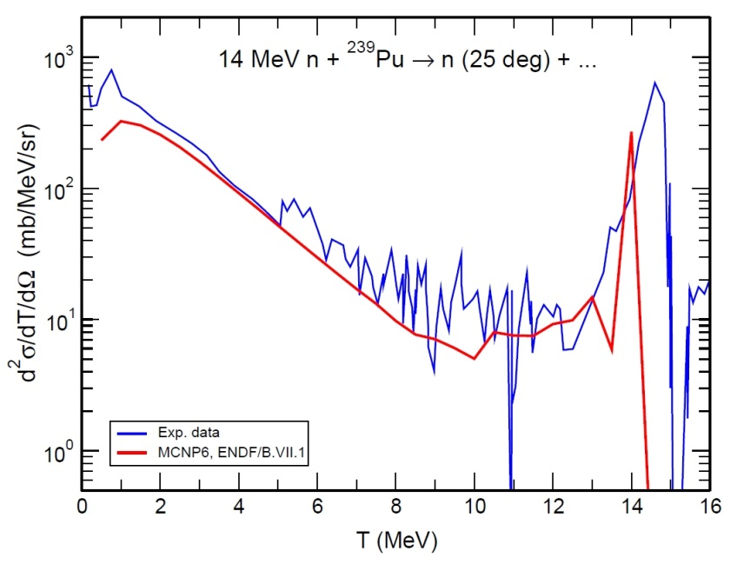
EXFOR Value
The price tag of a single experiment in $1 M brings the library lower value to $ 25 B.
Recent recovery of the previously missed data from the UC Davis Ph.D. Thesis of J.L. Kammerdiener increases its value for applications.
MCNP calculations would improve after inclusion of EXFOR compilation.
Kammerdiener data are now incorporated in ENDF/B-VIII.1 library.
EXFOR database is a gold mine for nuclear physics, ML/AI applications.

Slide 4
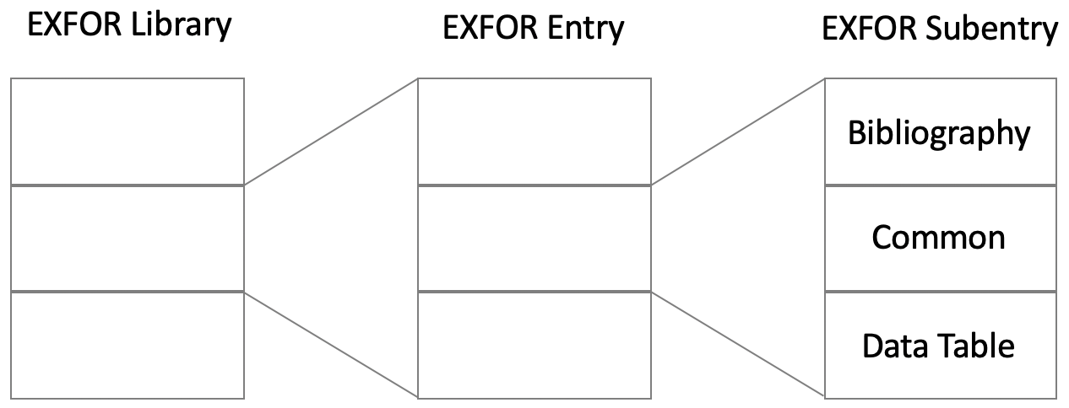
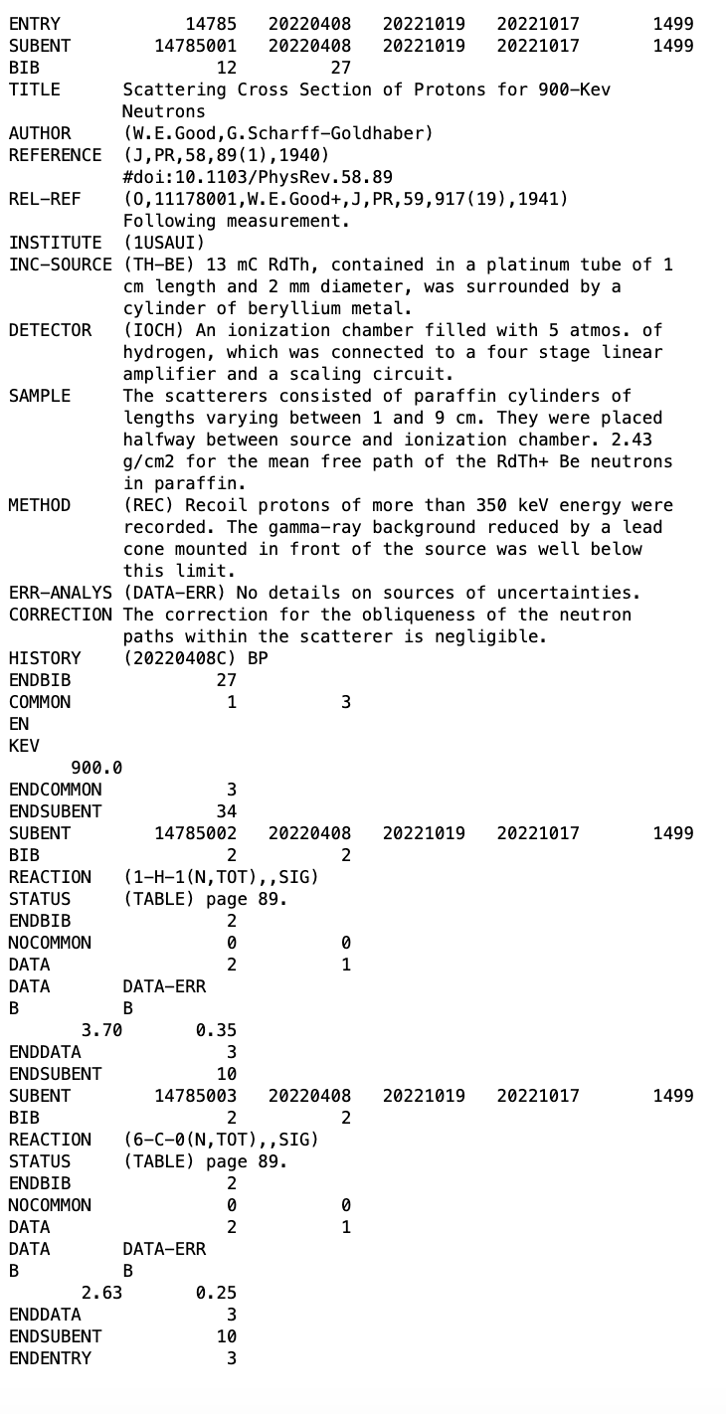
Present State of EXFOR
EXFOR format was designed in 1970s.
EXFOR compilation entry combines (groups) data from the all publications on a particular experiment.
EXFOR entry includes a unique identifier or accession number (14785), bibliographical information, keywords, record history, and cross section data.
EXFOR entry contains a wealth of data while the format is not very suitable for modern software and data mining tools.
Experiments and data compilations are produced by humans; humans and experimental techniques are not perfect and evolve.
This leads to errors, discrepant, and incomplete data sets in EXFOR.
In all evaluations, physicists often re-analyze the same data sets again and again.

Slide 5
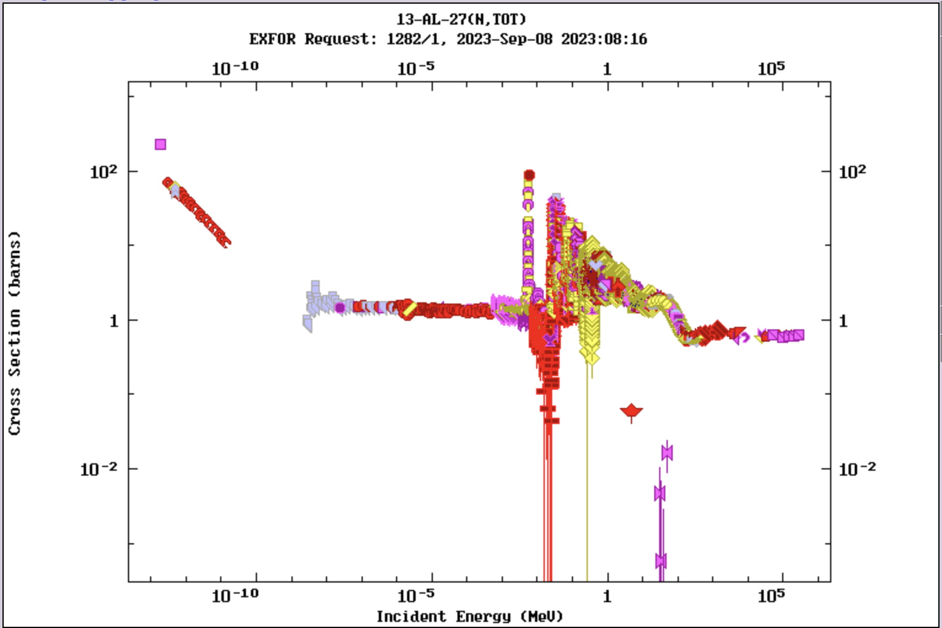
Issues with EXFOR
Discrepant data sets: ²⁷Al(n,tot) -137 cross section experiments in EXFOR.
Historical (changing library scope) and technological reasons are behind missing data sets in EXFOR.
DATA-ERR: No details on sources of uncertainties, experimental errors, 48%. In the past, this header was used too often, uncertainties details were not compiled.
ERR-T: Errors are clearly defined, 19.9%.
ERR-S: Statistical errors, probable errors, 14.1%.
ERR-SYS: Systematic errors, 2.1%.
No ERRORS, 15.9%.
~15% of EXFOR subentries do not have data uncertainties, and ~85% of EXFOR subentries do not have incident beam uncertainties (considering spontaneous fission subentries: Subentries:1,585 => 0.1447).

Slide 6
SG-50 was the community’s first big attempt to address shortcomings
EXFOR issues and needs for improvements were recognized by NEA-DB SG50.
SG50 (SubGroup 50) is an international collaboration of experts analyzing a problem and proposing the way forward.
The group recommendations imply the strong needs for EXFOR modernization.

Slide 7
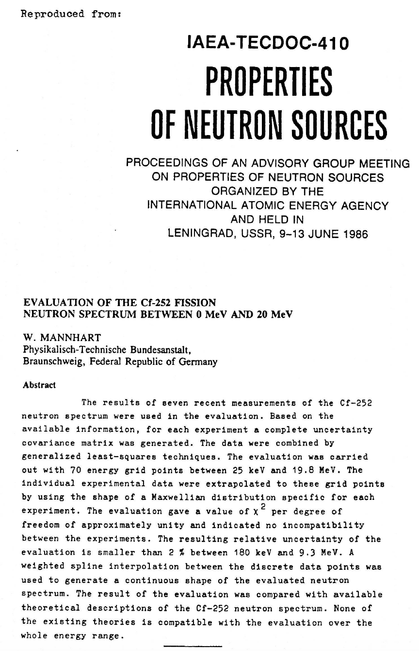
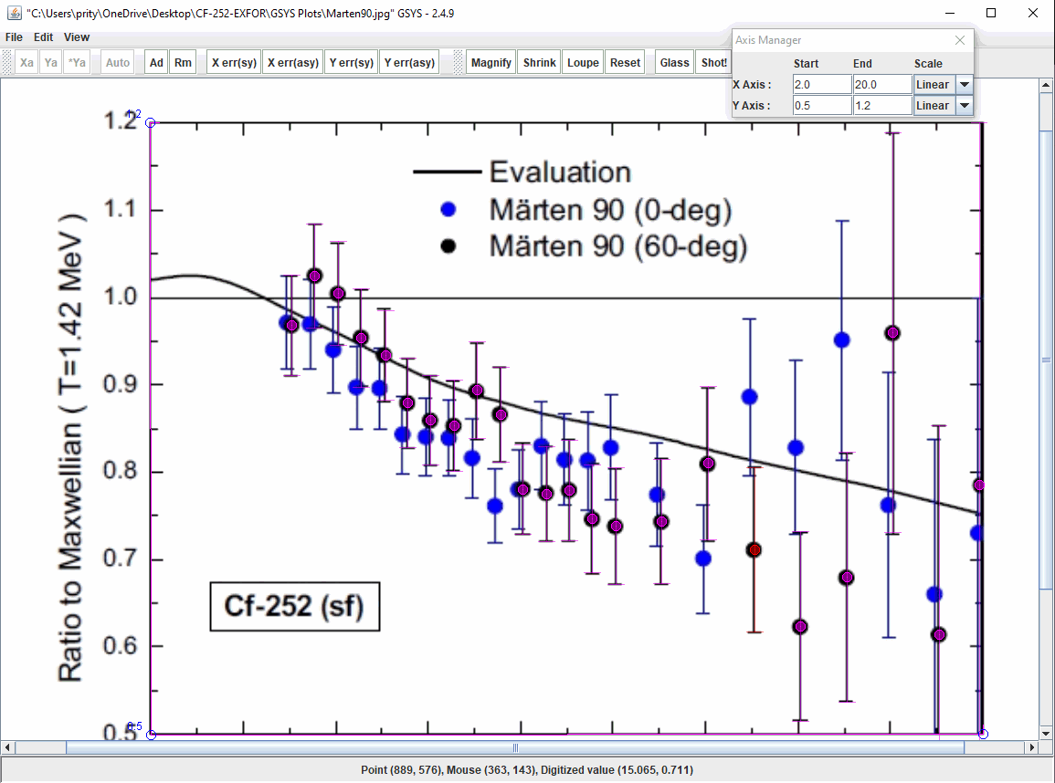
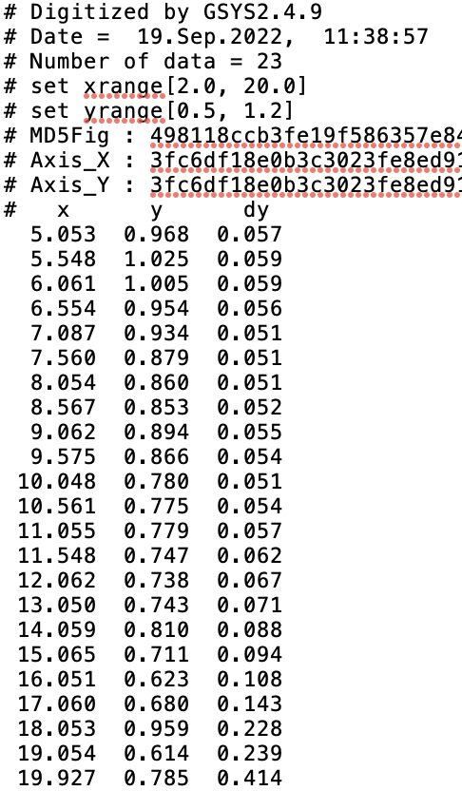
AIACHNE (AI/ML Informed cAlifornium CHi Nuclear data Experiment): Los Alamos/BNL
Evaluation of the Cf-252 fission neutron spectrum between 0 MeV and 20 MeV, W. Mannhart (Braunschweig (Germany, F.R.)).
Mannhart evaluation is a unique artwork that cannot be reproduced and updated because of lost inputs and data sets.
²⁵²Cf(SF) is a neutron standard that used for detector calibrations.
EXFOR and Mannhart data can be recovered and re-analyzed.
New ²⁵²Cf measurement will capitalize on the project findings to resolve discrepancies.
²⁵²Cf(SF) evaluation will be transformed from an art to exact science because all inputs and methods will be preserved.
Verified EXFOR data sets for a parallel EXFOR library (NEA-DB SG50).

Slide 8
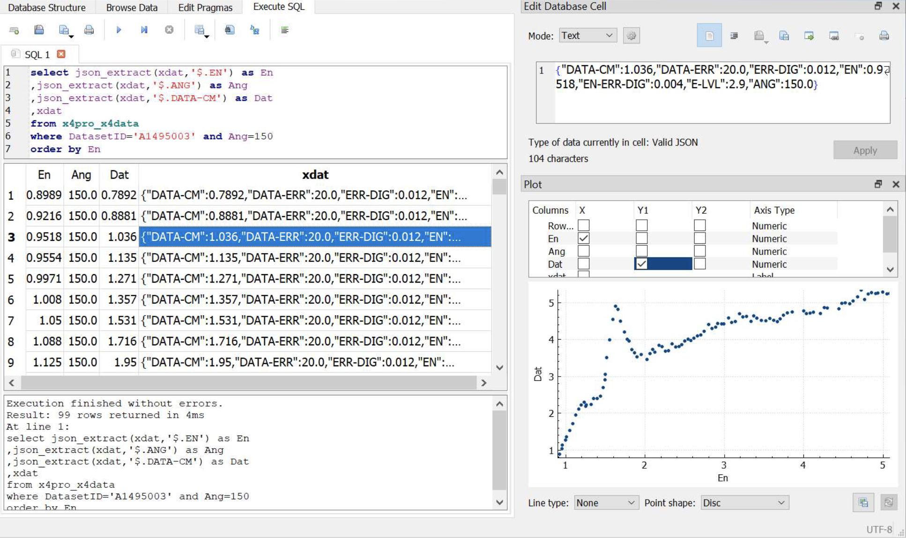
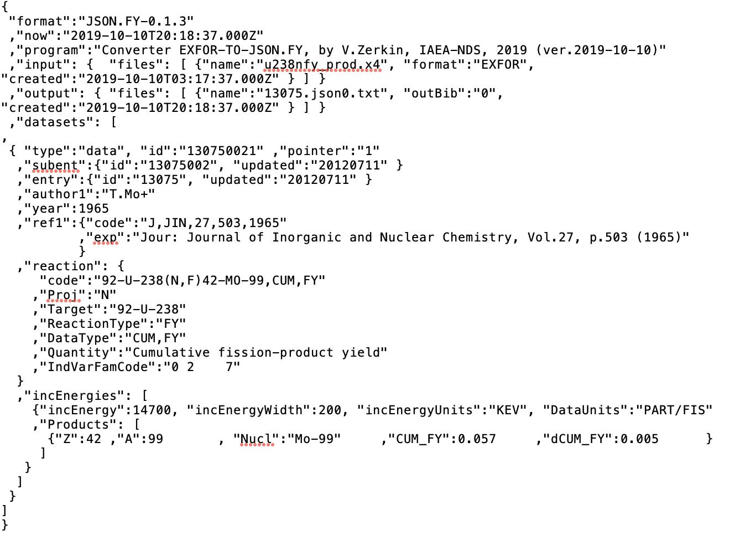
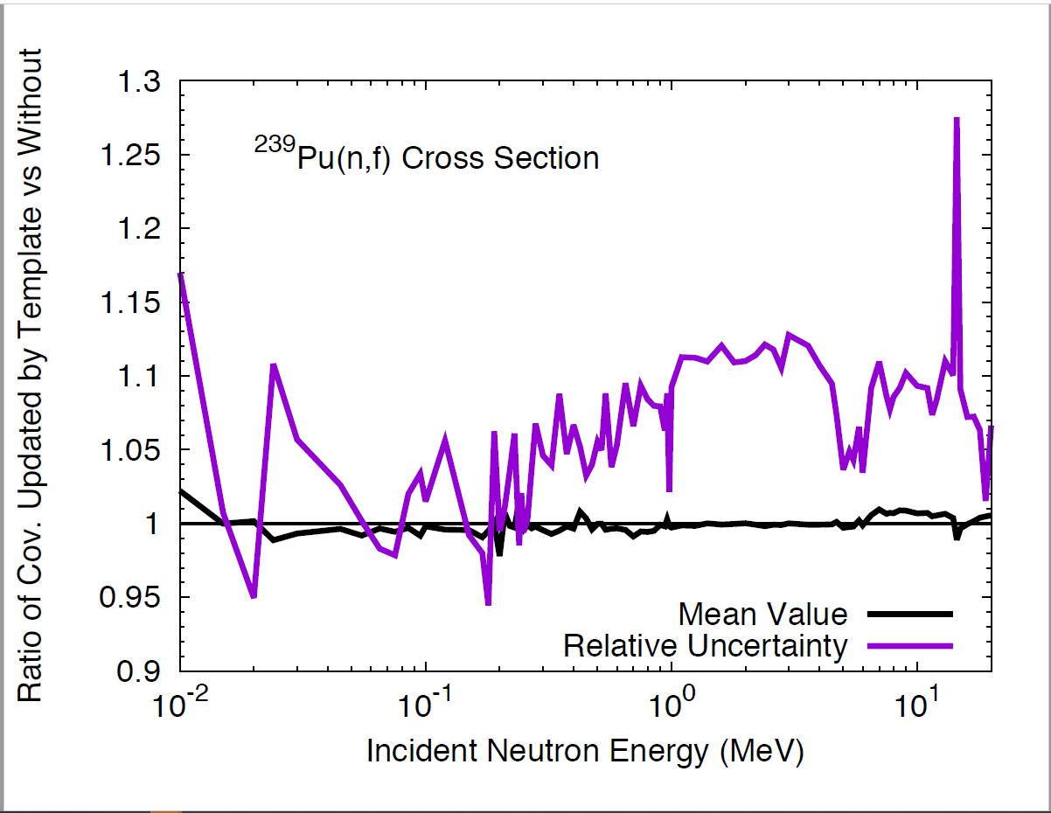
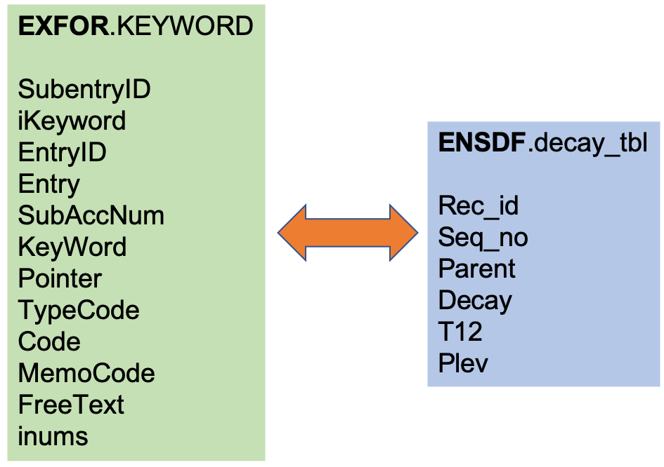
Modernization Needs
Automatization of the EXFOR life and production cycle.
Development of EXFOR Application Programming Interface (API): IAEA X4Pro, …
New data formats: JSON (JavaScript Object Notation) lightweight data interchange format for EXFOR is now in progress at the NNDC and IAEA-NDS.
Content verification with ENSDF database to flag deficient data sets.
Implementation of uncertainty templates developed by Denise Neudecker et al. (LANL) for resolving issues with missing uncertainties and covariances.

Slide 9
EXFOR Modernization Proposal
USNDP wrote multiple EXFOR modernization proposals.
The latest proposal recommends:
Modernize the EXFOR format with input from Subgroup 50 and in coordination with the NRDC to be easily automatically interpretable, indicate data that has been proven inaccurate as well as flag data that has been used in ENDF, JEFF or JENDL evaluations.
Develop an API to facilitate code interfacing and provide an interface between experimentalists, compilers and evaluators.
Use tabular recognition being developed for the Evaluated Nuclear Structure Data File (ENSDF) modernization project to incorporate data from articles, including charged-particle reactions not included in the early years.
Migrate to an object-oriented database and develop a new web interface as well as a stand-alone web application.

Slide 10
EXFOR Modernization … (Continued)
With a new modernized EXFOR we will be able to
Create in tight collaboration with Subgroup 50 a parallel library to EXFOR that stores and incorporate corrections to data and uncertainties that were undertaken by evaluators.
Store expert judgment on these data. Ensure strong interconnectivity with other USNDP databases, such as NSR, ENSDF and ENDF, which at the moment is quite deficient due to incompatible formats.
Assess uncertainties reported in EXFOR for several measurement types with respect to templates of expected measurement uncertainties developed by the CSEWG community.
Use artificial-intelligence and machine-learning algorithms in conjunction with comprehensive physics models for outlier identification.
It is a multi-year project that requires considerable resources.

Slide 11
Outlook
EXFOR and its data represent a big asset for nuclear science and application developments communities.
It was designed in 1970s, and many things are outdated.
EXFOR modernization is needed.
EXFOR modernization will complement the Open Data project.
Potential collaboration: BNL, Los Alamos, IAEA, LBNL, NEA-DB, LLNL, …

