Slide 1
Web Dissemination
Benjamin Shu, Donnie Mason, on behalf of the USNDP
National Nuclear Data Center (NNDC)
September 14th, 2023

Slide 2
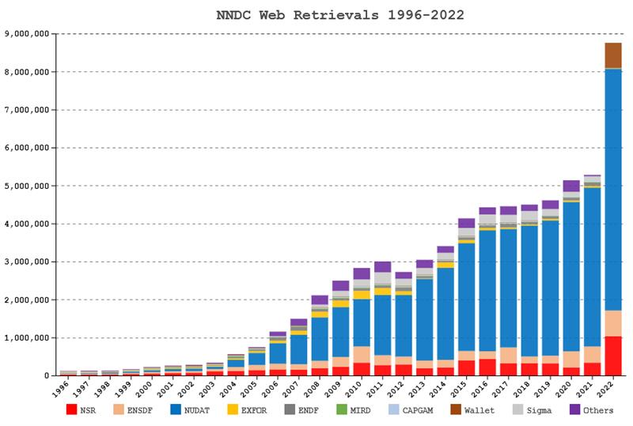
Web Statistics
Consistent growth
>8 million retrievals in FY22
Every web application saw growth, notably NuDat, ENSDF, Wallet Cards and NSR
>6 million retrievals from NuDat 3
Only a lower limit for the reach of our databases
Modernization

Slide 3
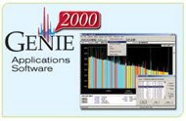
Database Users
Reactor design, simulation and licensing codes
Nuclear waste and repositories
Radiation spectroscopy, dose, detectors, and shielding
Defense and CTBTO
A few examples
Scale
Geant
Gadras
RadWare
And many more

Slide 4
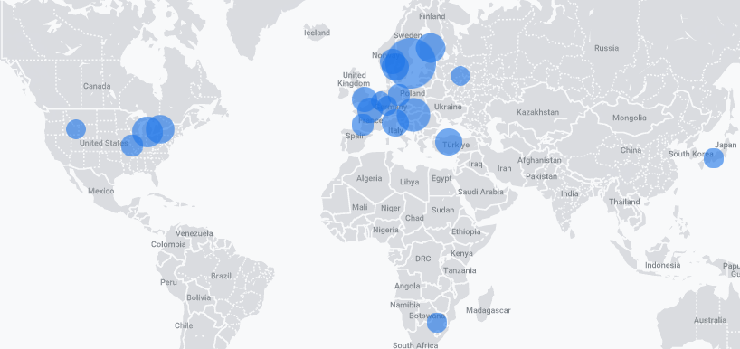
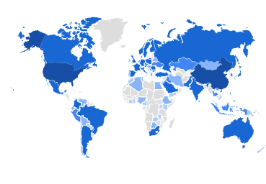
Google Analytics
Google analytics for broad overview
Overviews per web application
Focus modernization efforts
Provide a better experience for the most users possible
Real-time Geolocation data (09/12/23 9am EST)
Life-time Geolocation data

Slide 5
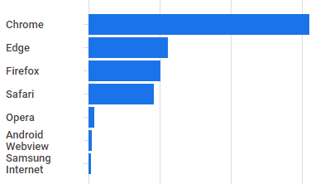
Google Analytics
Web browser
Google analytics for broad overview
Overviews per web application
Focus modernization efforts
Provide a better experience for the most users possible

Slide 6
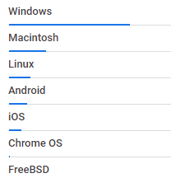
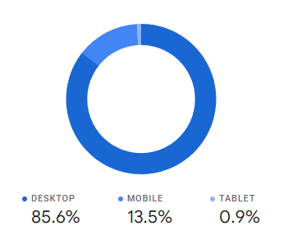
Google Analytics
Device type / Operating system
Google analytics for broad overview
Overviews per web application
Focus modernization efforts
Provide a better experience for the most users possible

Slide 7
Custom Analytics
Web application specific analytics
NuDat 3 nuclide ‘popularity’ by date (right)
Physics insights
Prioritization of evaluations
Only possible due to modernization efforts

Slide 8
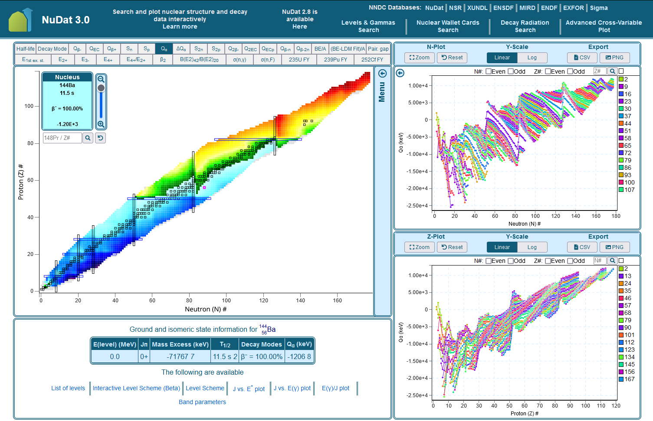
NuDat 3.0
Major overhaul to one of our most frequently visited web applications
Transitioned from to server-side to client-side image generation
Significant performance improvements
Dramatically reduced load times
Responsive visualizations for better UX
Overwhelmingly positive user feedback
Future plans
Ongoing optimization
Additional features
Similar modernization overhauls for other web applications

Slide 9
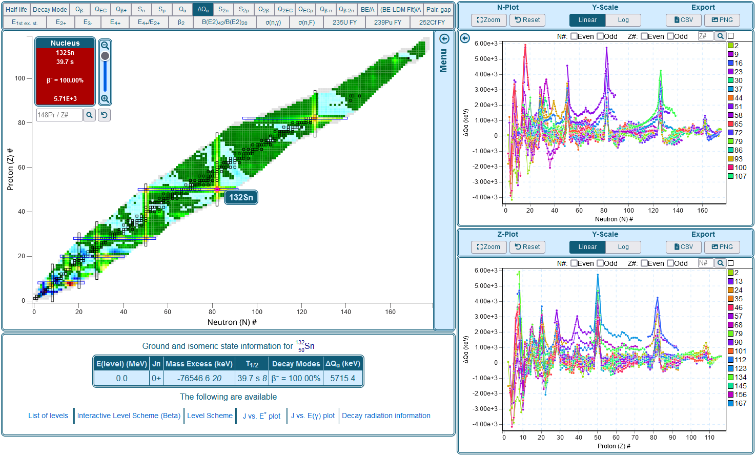
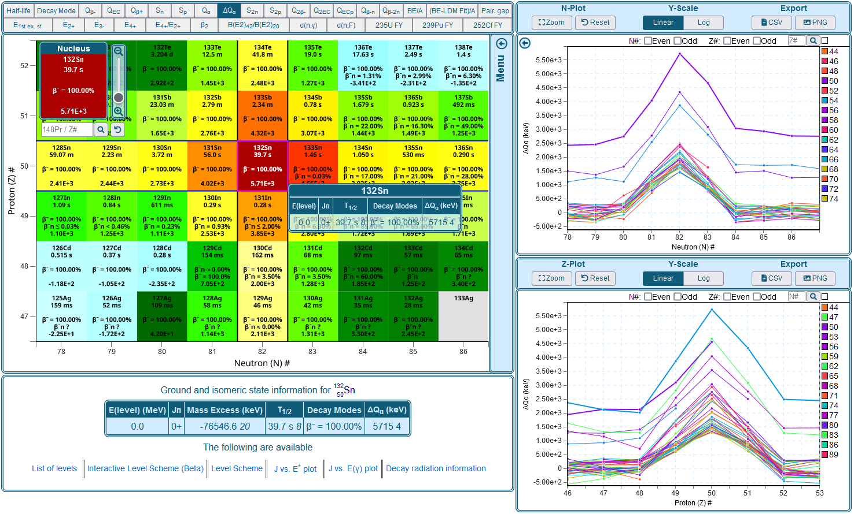
NuDat 3.0 Features
Responsive visualizations
Seamless pan/zoom controls
Synchronized plots
Advanced data filtering
Export data as CSV/JSON
Export chart or selection as PNG/SVG
Upcoming features
Improved user interface
3D visualizations
Additional datasets

Slide 10
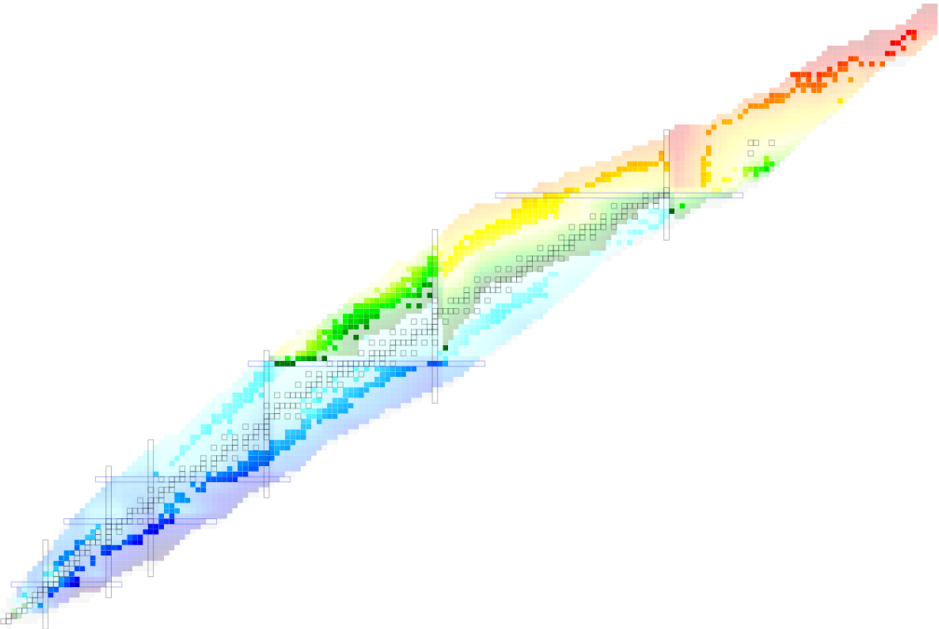
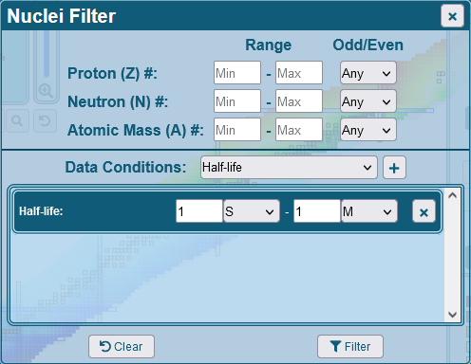
NuDat 3.0 Features
Responsive visualizations
Seamless pan/zoom controls
Synchronized plots
Advanced data filtering
Export data as CSV/JSON
Export chart or selection as PNG/SVG
Upcoming features
Improved user interface
3D visualizations
Additional datasets

Slide 11
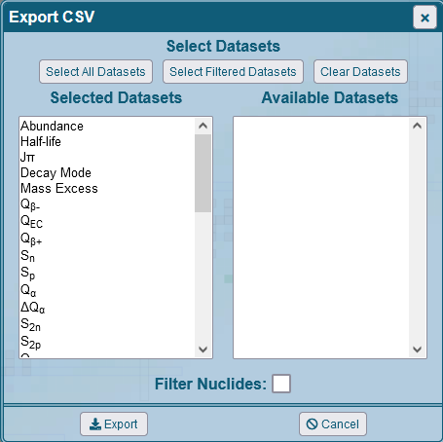
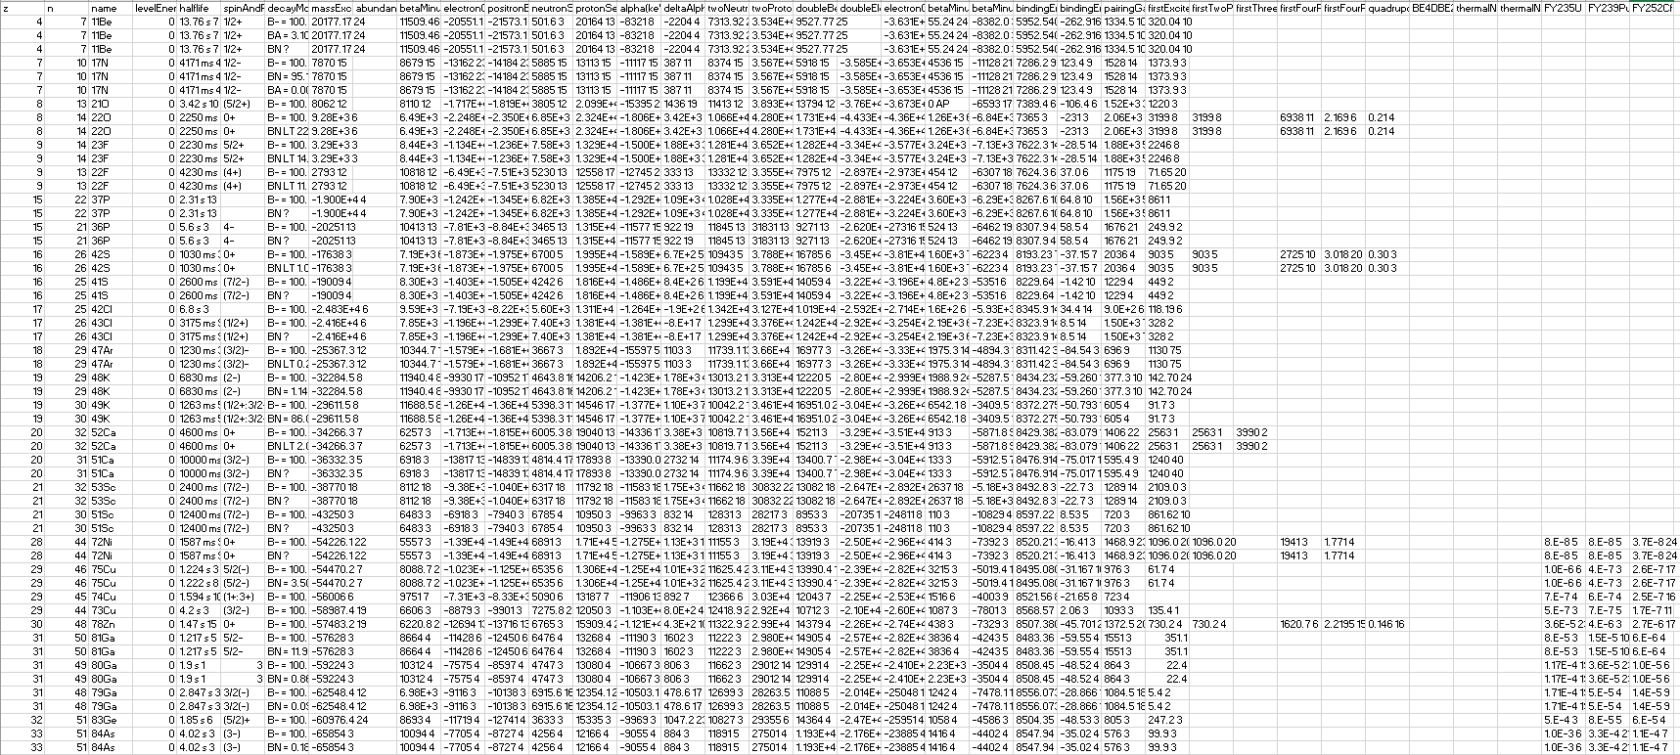
NuDat 3.0 Features
Responsive visualizations
Seamless pan/zoom controls
Synchronized plots
Advanced data filtering
Export data as CSV/JSON
Export chart or selection as PNG/SVG
Upcoming features
Improved user interface
3D visualizations
Additional datasets
Lots of data…

Slide 12
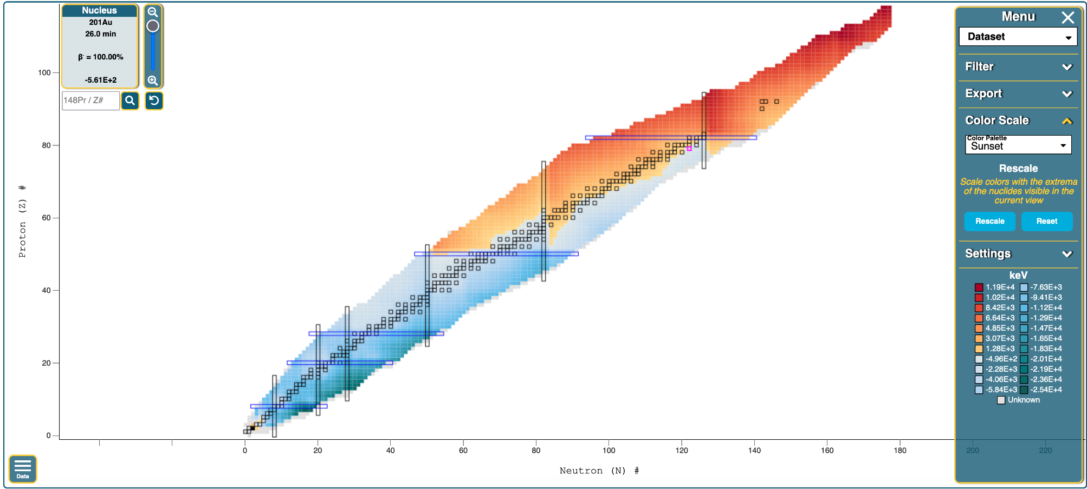
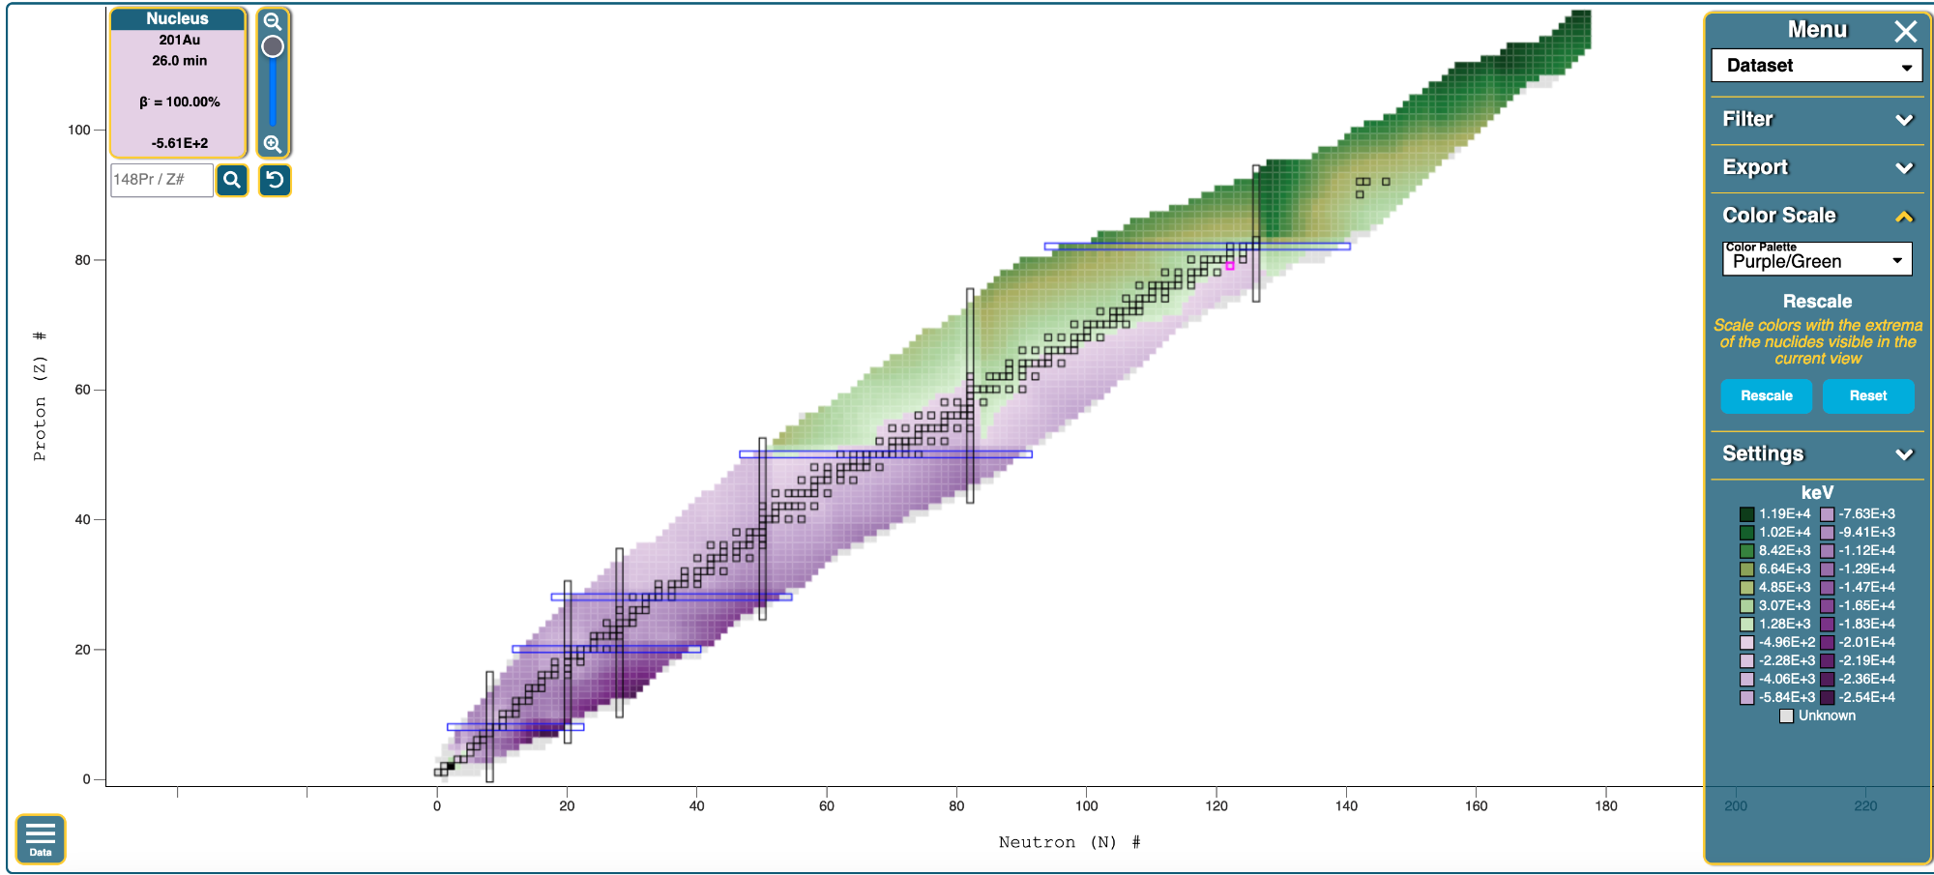
NuDat 3.0 Features
Responsive visualizations
Seamless pan/zoom controls
Synchronized plots
Advanced data filtering
Export data as CSV/JSON
Export chart or selection as PNG/SVG
Upcoming features
Improved user interface
3D visualizations
Additional datasets
Additional color palettes
Accessibility

Slide 13
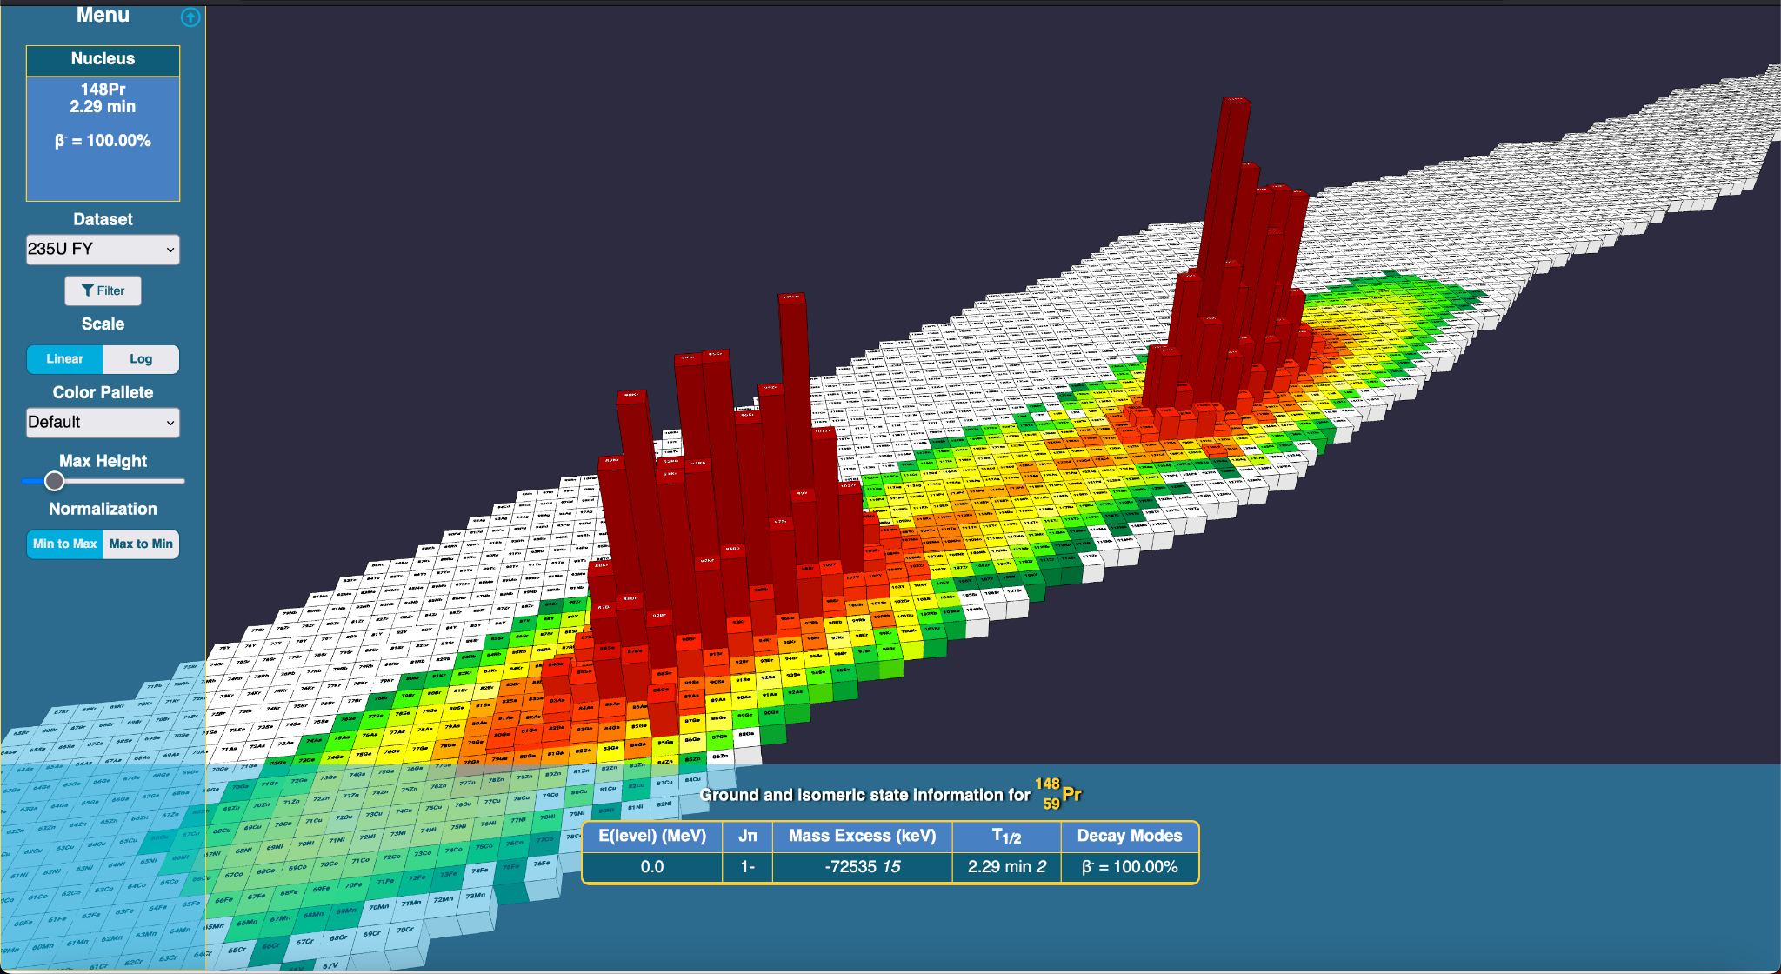
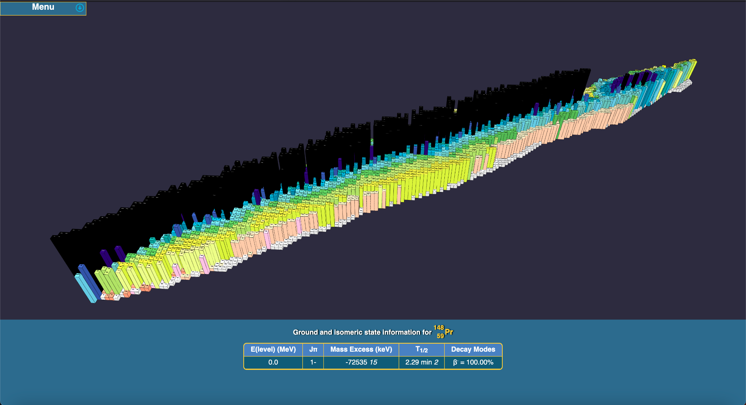
3D Chart of Nuclides (Coming soon)
235U FY
Half-life
Q(ß-)
Q(ß+)
(BE-LDM Fit) / A
Q(α)
ΔQ(α)

Slide 14
Unified Web Design
New header/footer added to help users navigate
Links to major data sources as well as new contact page

Slide 15
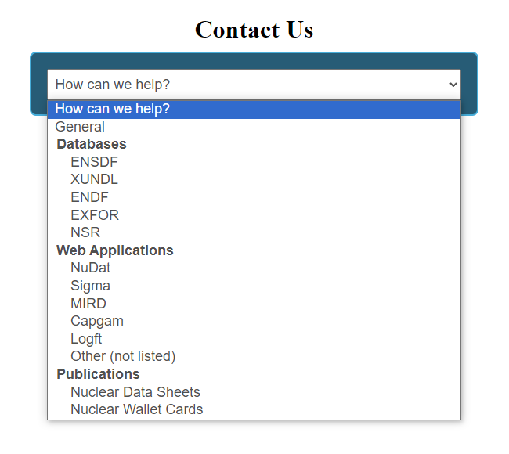
Unified Web Design (contd.)
Updated contact page to streamline user feedback
Sends emails to NNDC staff based on selected library/website
Has led to a noticeable increase in user emails

Slide 16
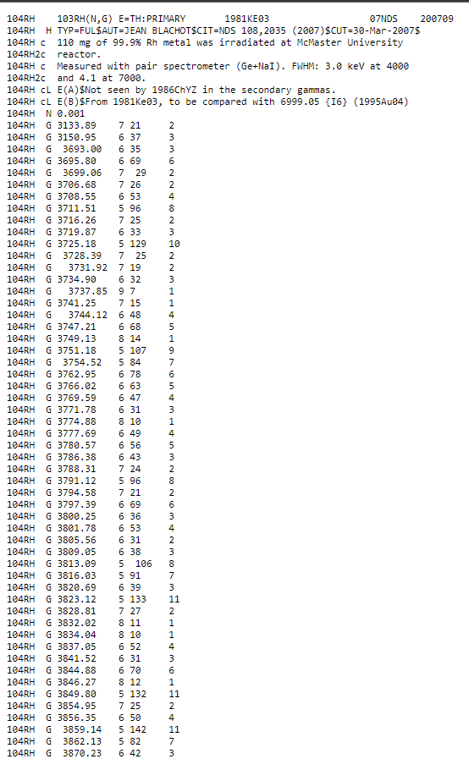
Ease-of-Access Features

Slide 17
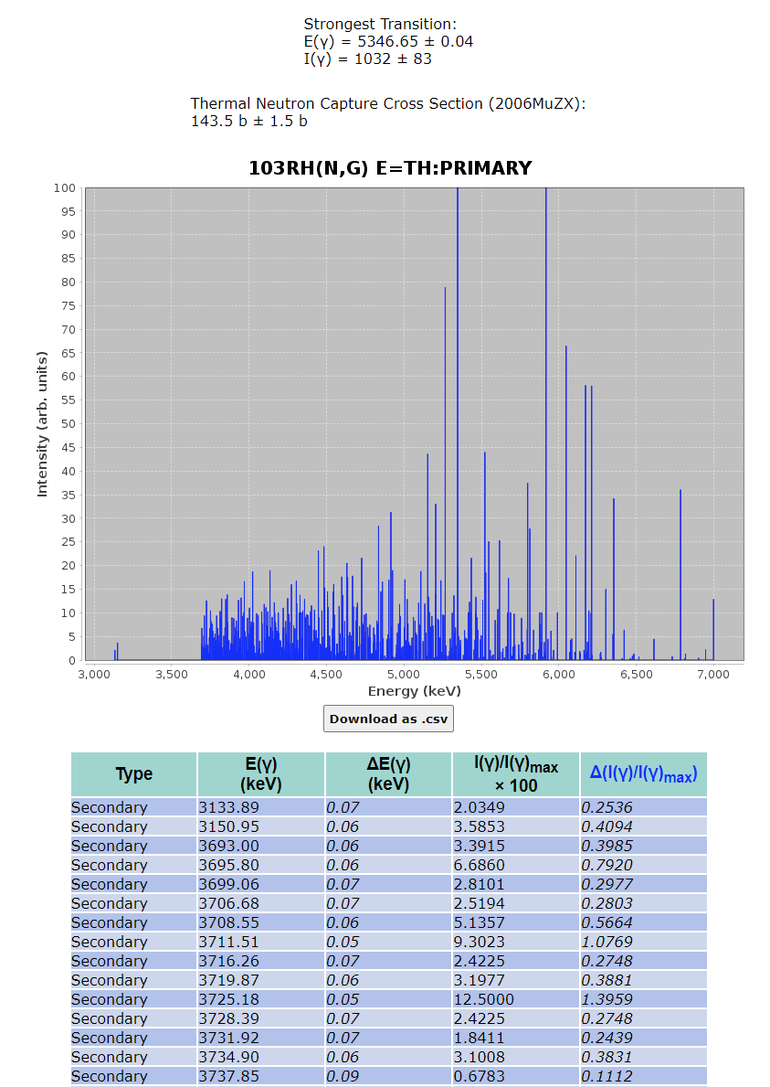
Ease-of-Access Features (contd.)

Slide 18
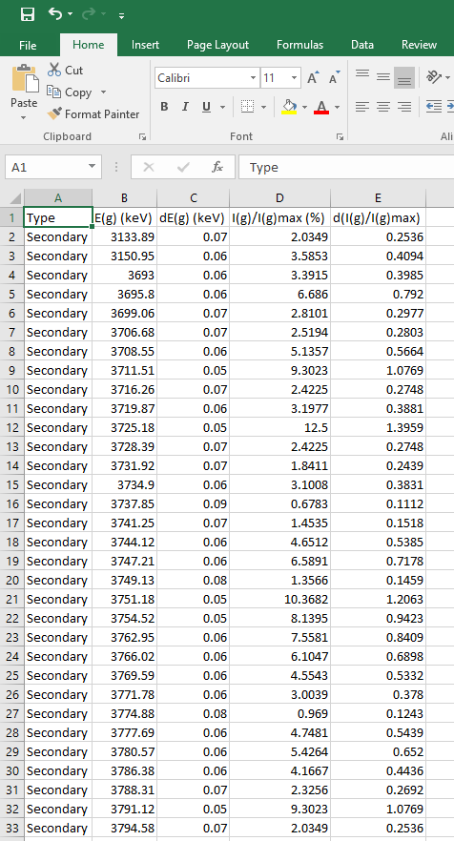
Ease-of-Access Features (contd.)

Slide 19
New Web Servers
Replacing current web servers due to 5-year end-of-life
New servers already present at BNL
Specifications:
1 CPU: Intel® Xeon® Gold, 28 cores, 2.6 GHz
RAM: 384 GB, 12 x 32 GB, DDR4, 2933 MHz, ECC
2 Solid-State Drives (OS): 480 GB, M.2, PCIe NVMe, SSD, Class 40
8 Hard Drives (RAID-6) (Users): 2.4-TB, SAS 12Gbps 10kRPM, 512e 2.5in Hot-Plug
5-year Red Hat OS Subscription and Software Support
7-year ProSupport 7x24 Hardware Technical Support

Slide 20
Containerization
All NNDC webapps have been converted into Docker containers
Security – restricted access to servers and databases
Portability – can be re-created on different machines
Robustness – containers can be managed/restarted individually
Currently in use, and will be installed on new web servers

Slide 21
Future Plans
Database APIs
Linking Databases
One-Stop Shop
Done
ENSDF
EXFOR
ENDF
To Do
NSR
CSISRS
Atlas
ENSDF > ENDF
Atlas > ENDF
NSR > Everything
Seamless transitions
across databases &
web applications

