Slide 1

ePIC Collaboration Status
J. Lajoie, S. Dalla Torre
January 12, 2024

Slide 2

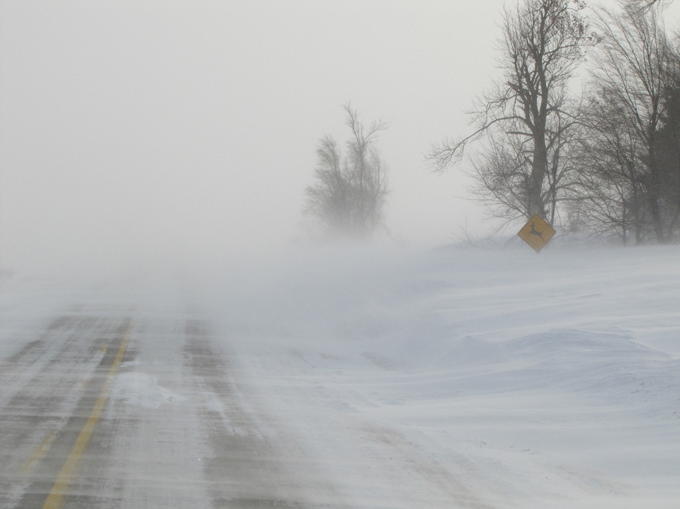
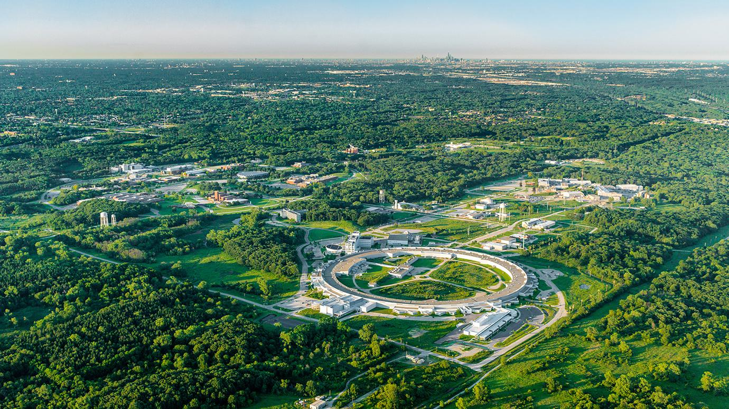
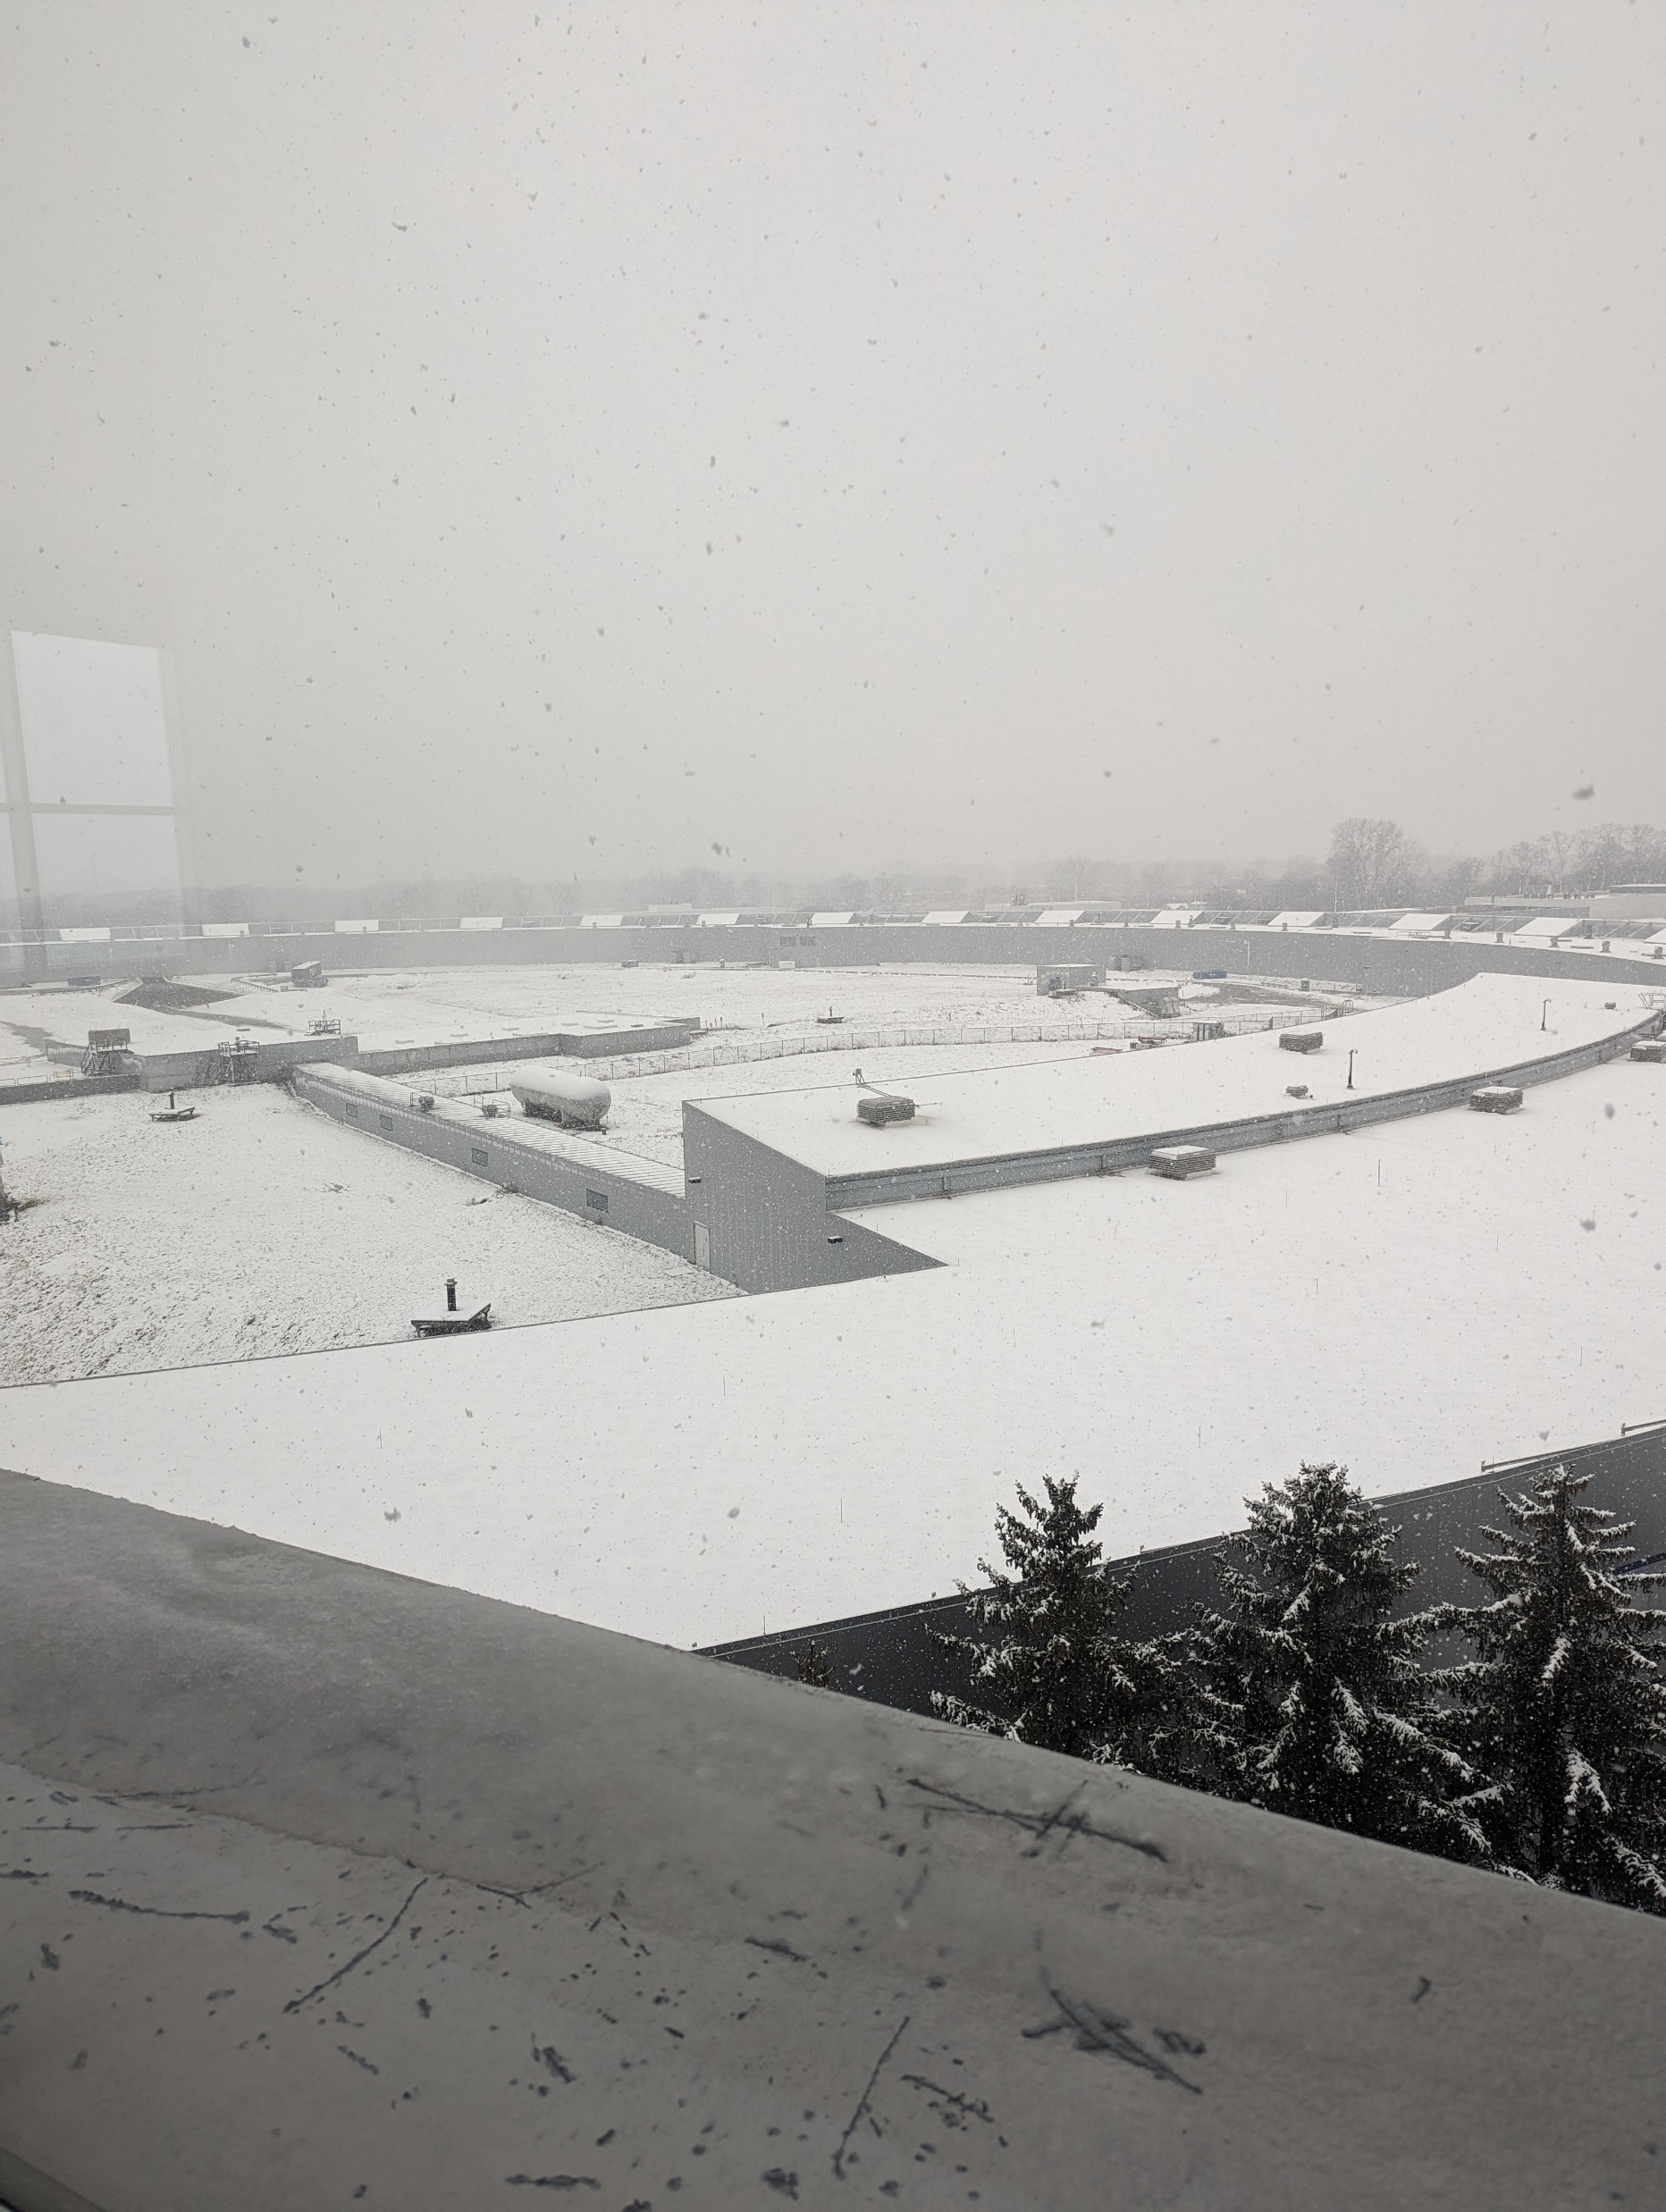

Welcome to Argonne!
Thanks to our hosts for this wonderful venue and support!

Slide 3
Structure of this Collaboration Meeting
As you have probably noticed, the structure of this meeting is different from our last meeting in Warsaw
  Three days of “Workfest” sessions
  Two days of plenary sessions
This is an experiment:
  Goal is to make the collaboration meeting more “active” and less “passive”
  Attendance (in-person and virtual) has exceeded expectations
  Feedback appreciated!
Theme of this meeting is focused on organizing and planning the work to prepare the ePIC contributions to the EIC TDR

Slide 4
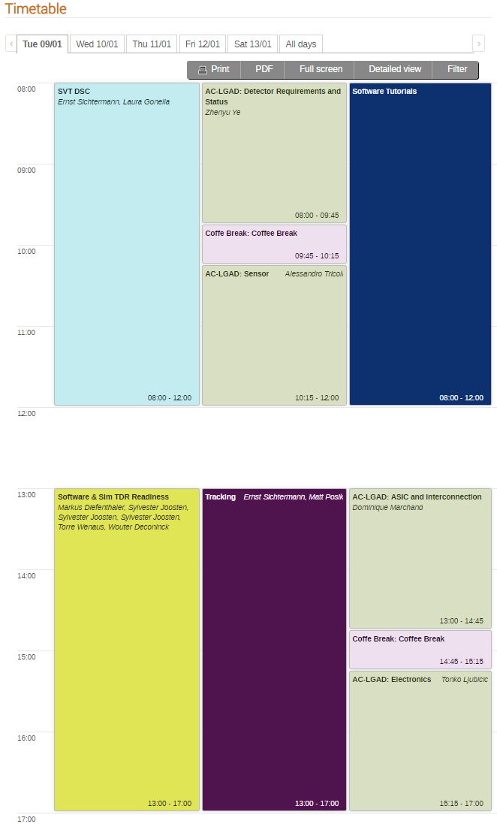
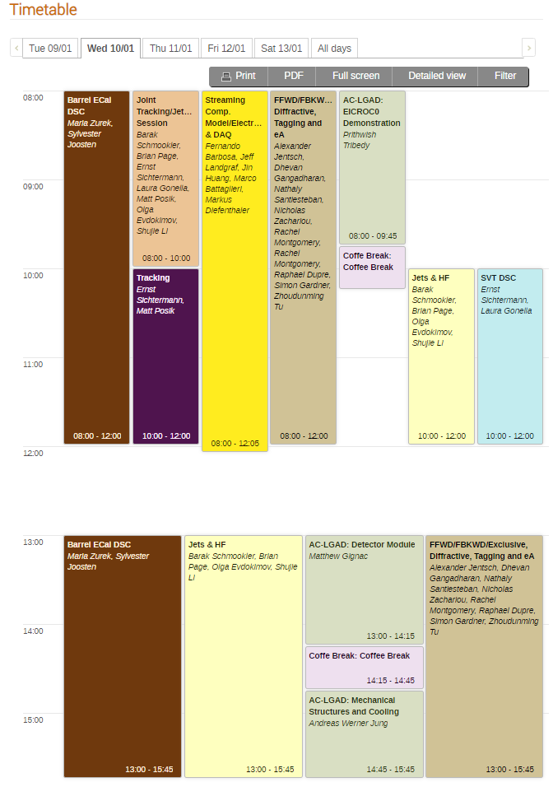
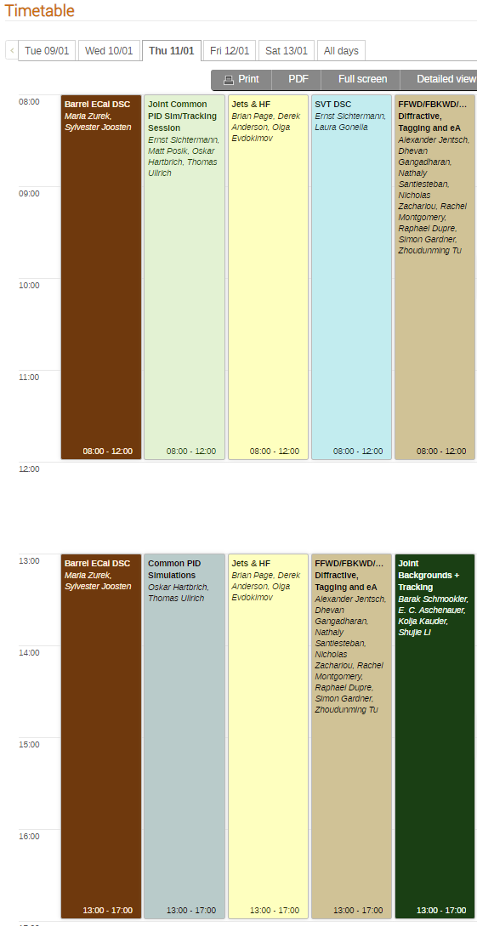
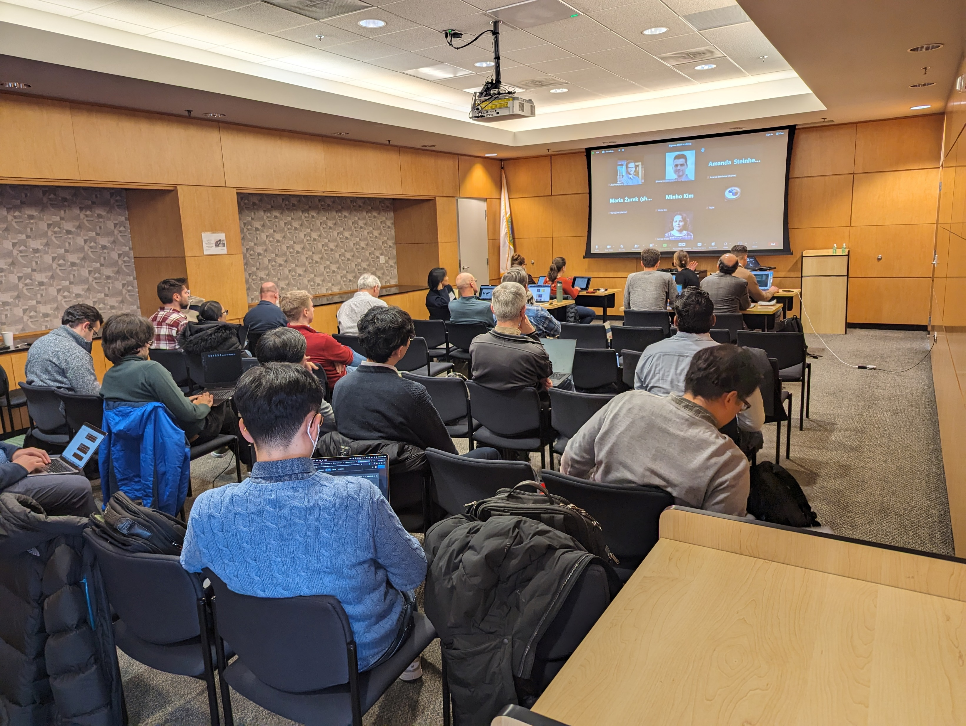
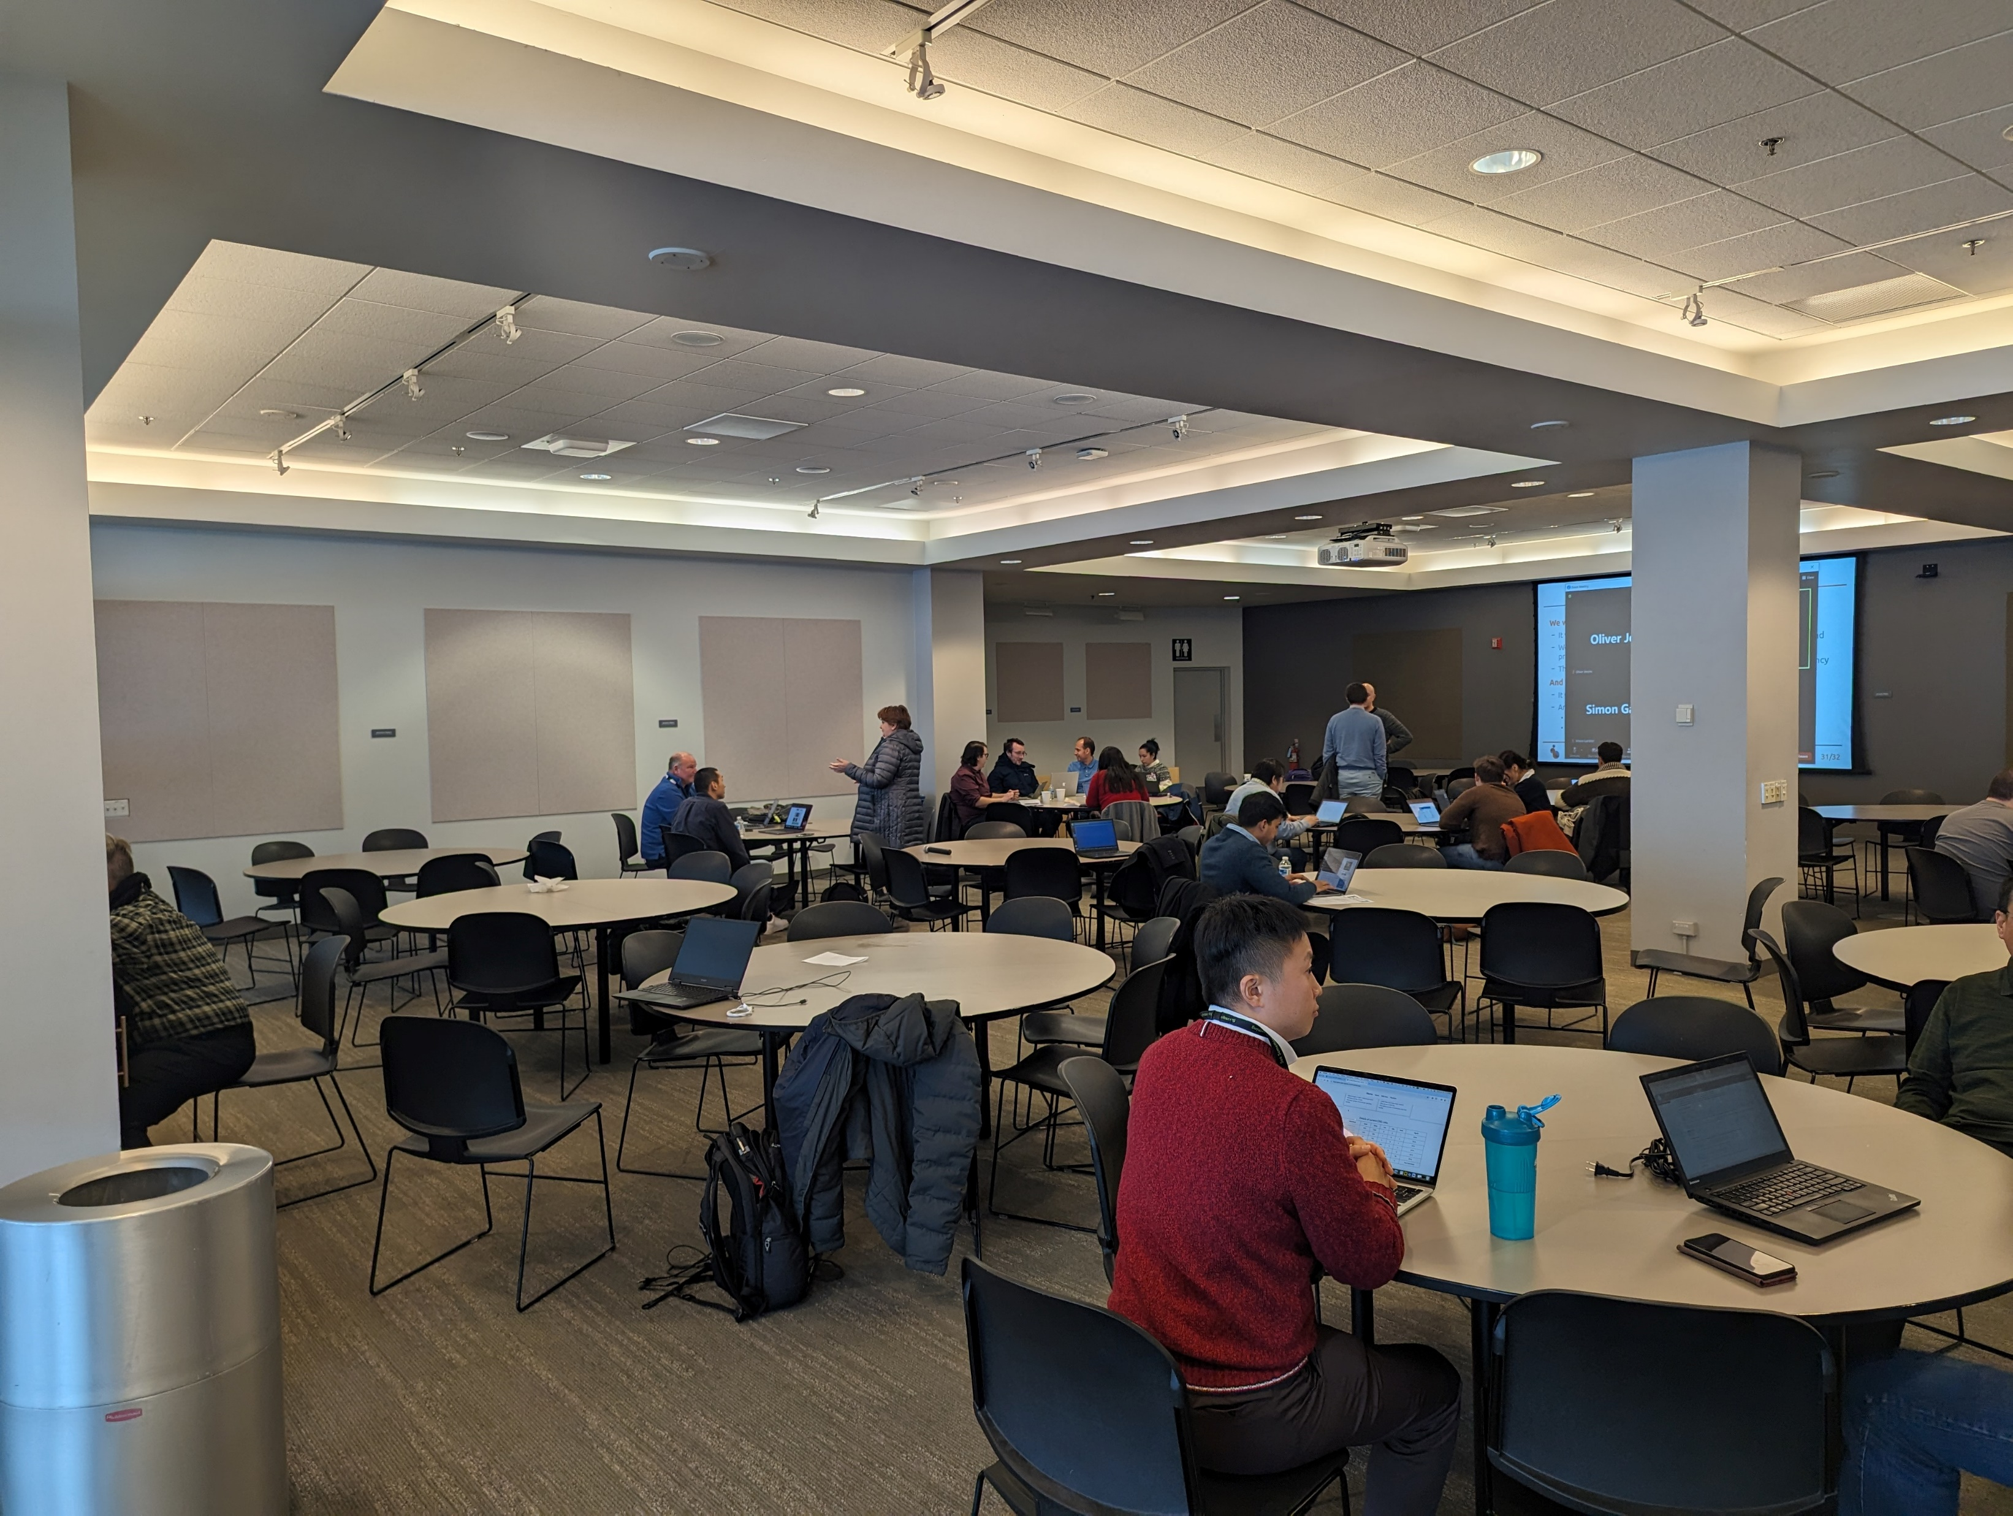
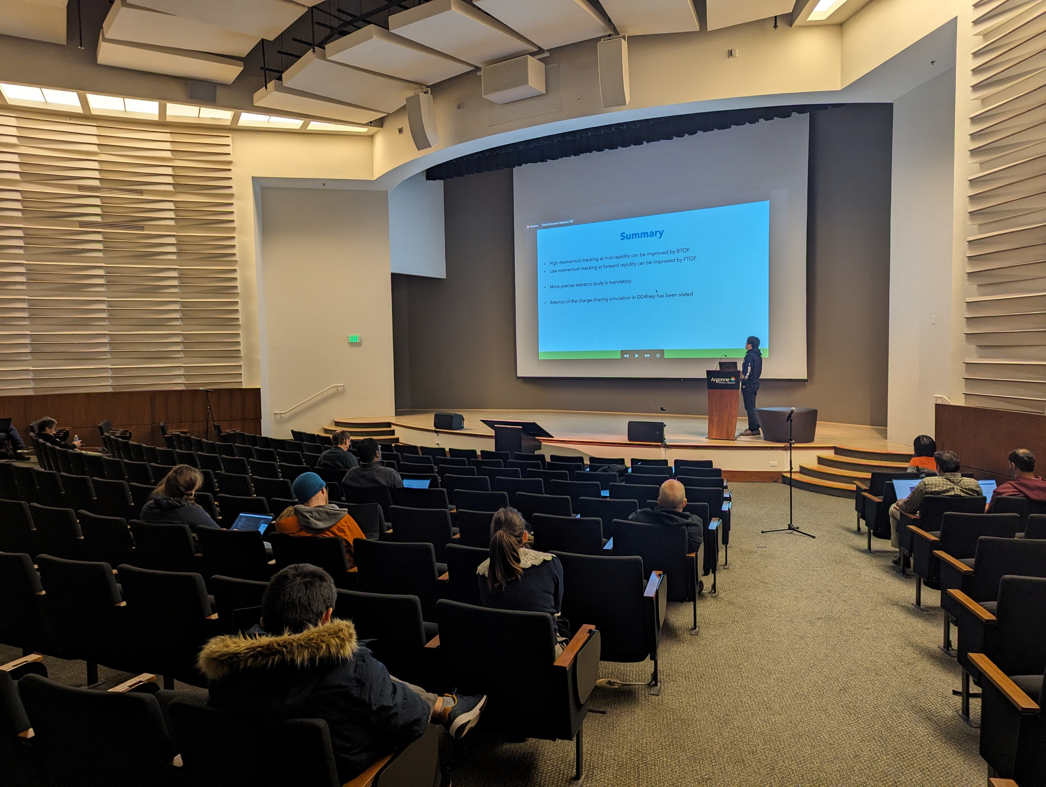
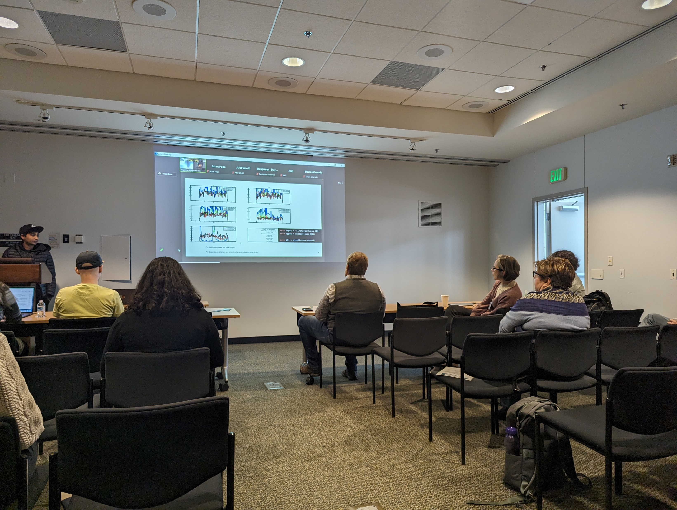
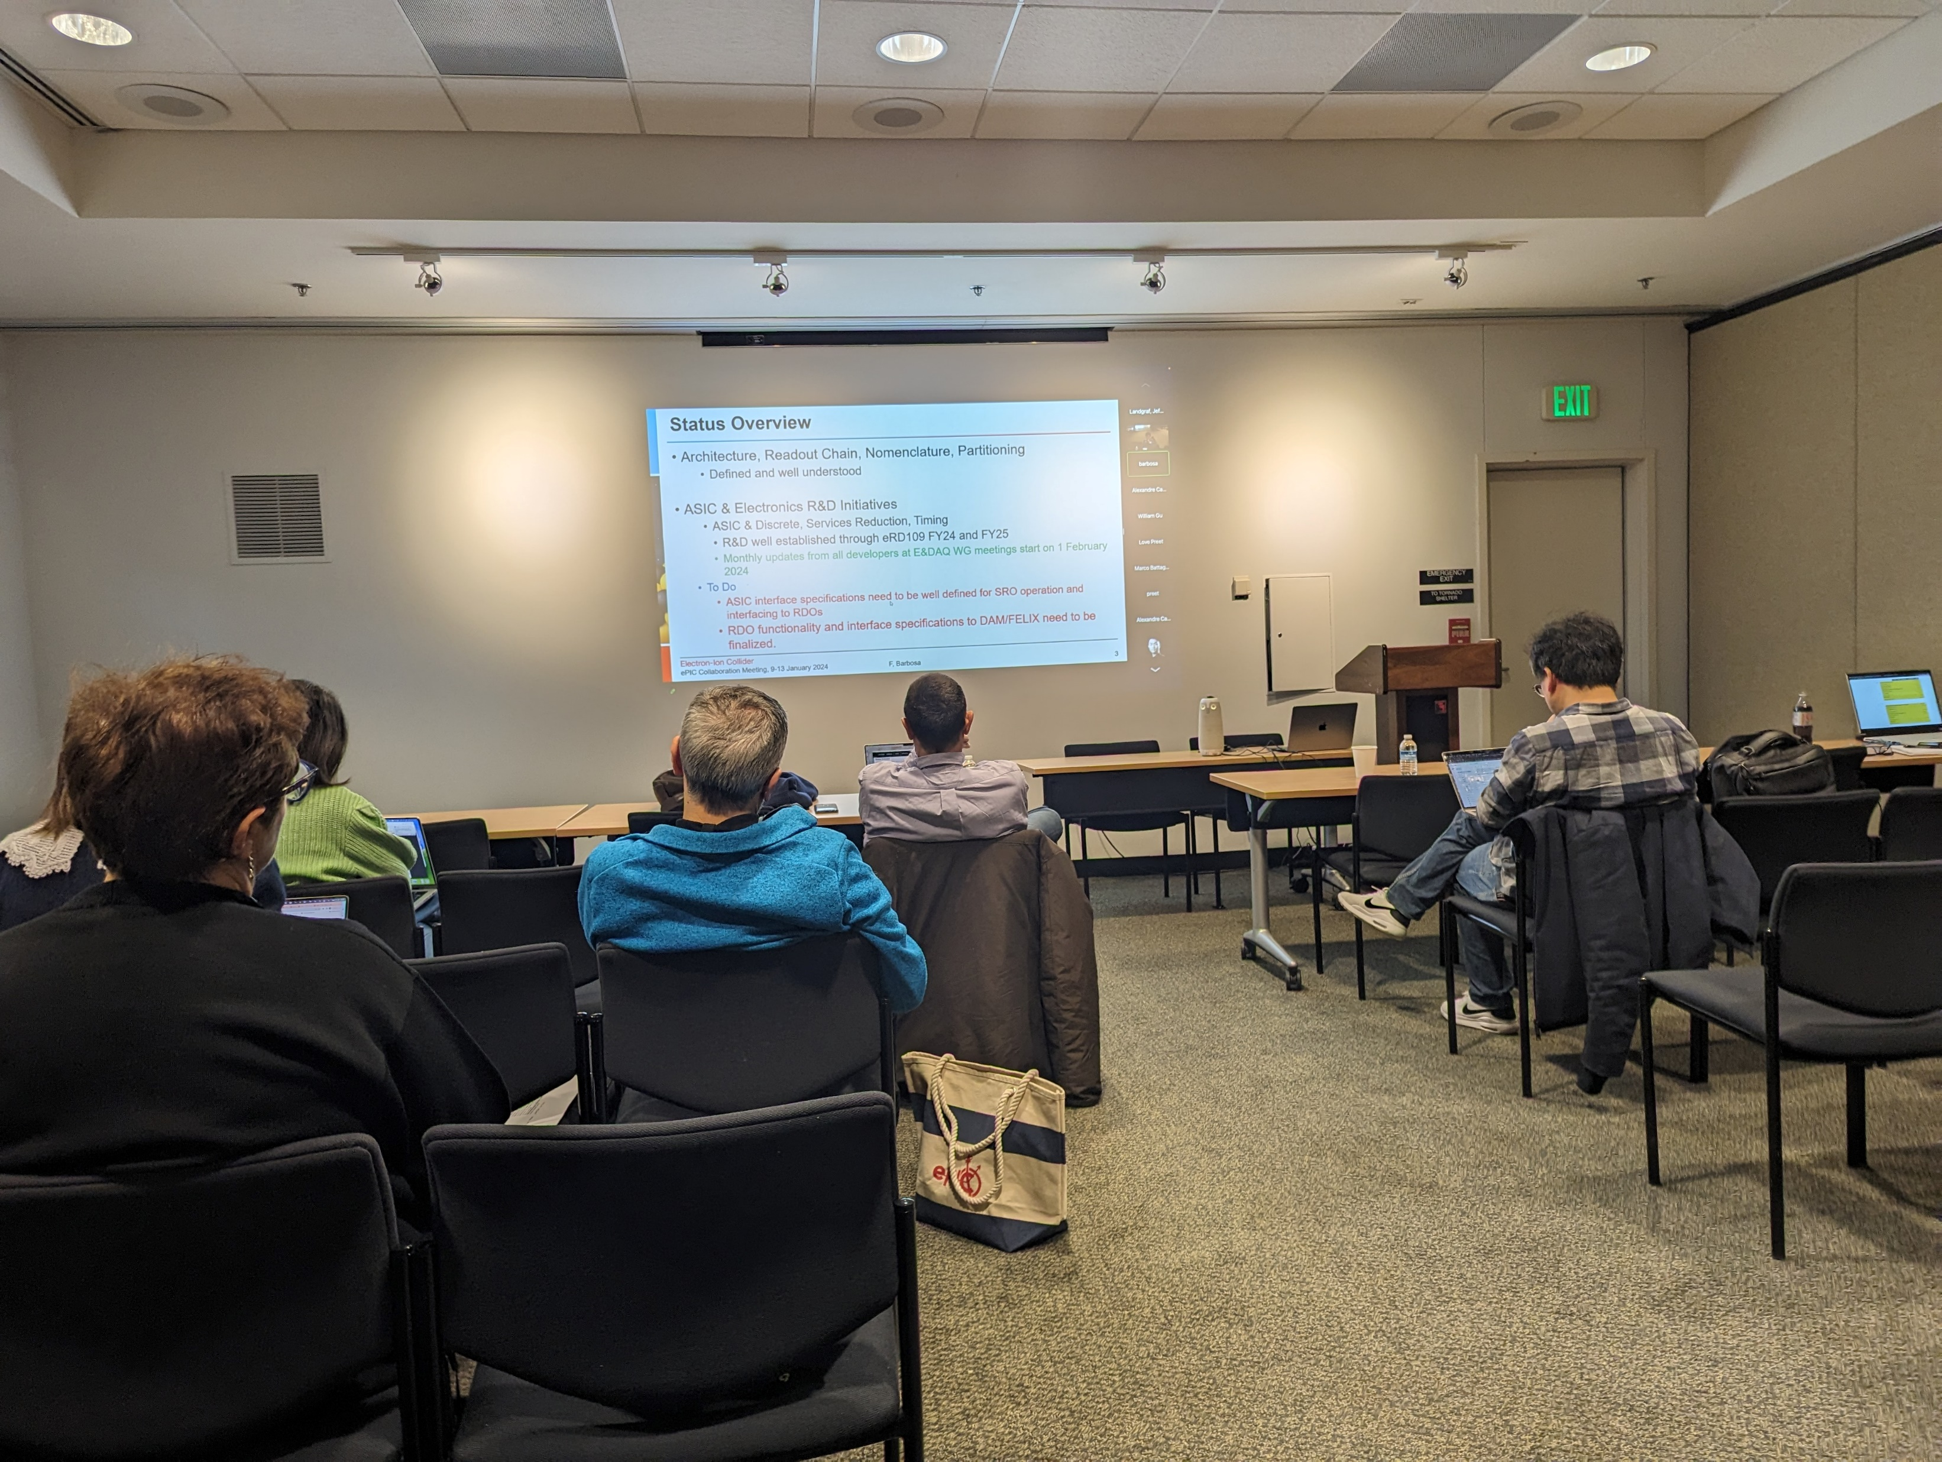
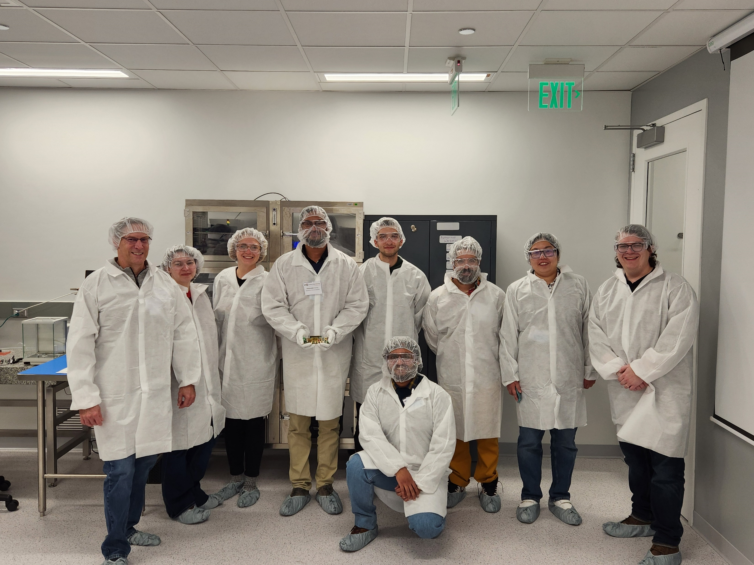
Workfests!
A great three days full of both progress and planning!
Very good attendance both online and virtual.
We will have workfest summaries today and tomorrow.
A huge THANK YOU to the workfest organizers!
DSC’s / PWG’s should consider holding their own workfests in the future as they see fit.

Slide 5

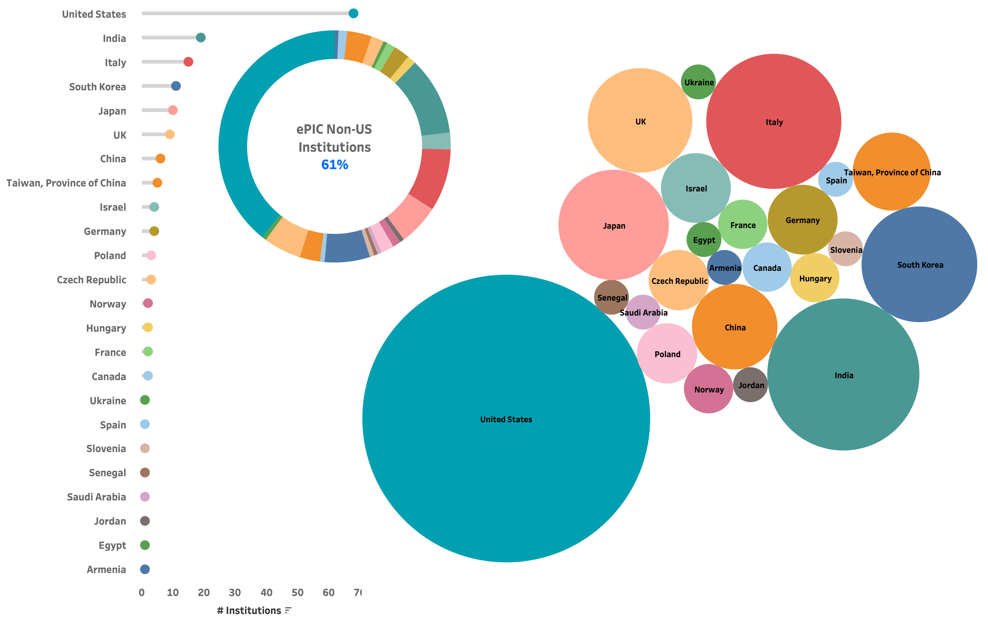









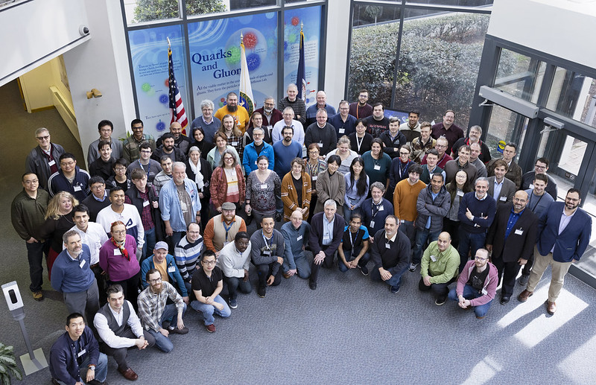








The ePIC Collaboration
173 institutions (Jan 2024)
24 countries
A truly global pursuit for the first experiment at the EIC!
Institutions that Joined ePIC in 2023:
New Institutions Applying for ePIC Membership:
Gangneung-Wonju National University
Hanyang University
Karlsruhe (ADL)
Nara Women’s University
NASA Goddard
Oklahoma State
Sungkyunkwan University
The Ohio State
University of Debrecen
University of Liverpool
University of Seoul
University of Tokyo (CNS)
Yonsei University
University of Texas at Austin
University Mohammed V in Rabat
University Ibn Tofail in Kénitra
University Mohammed Premier in Oujda
University Mohammed VI in Bengurir
Notes:
24 countries total

Slide 6
Lots of Progress since Warsaw Collab. Mtg.
August 28 + 31: DAC Review of Detector R&D
August 29 + 30: ePIC Comprehensive Design Review by DAC
September 13: SciFi Applications Final Design Review (LLP)
September 14: SiPM Applications Final Design Review (LLP)
September 25: Final Design Review Forward HCAL W & Steel (LLP)
October 5-6: Final Design Review of Magnet (MARCO)
October 10-12: DOE CD-3A Director’s Review
October 19-20: ePIC Computing Model Review
November 14-16: DOE CD-3A Independent Project Review
December 7 + 8: 2nd Resource Review Board meeting @ CUA
December 11: SP Office Meeting with DOE NP
… plus everything I forgot…

Slide 7
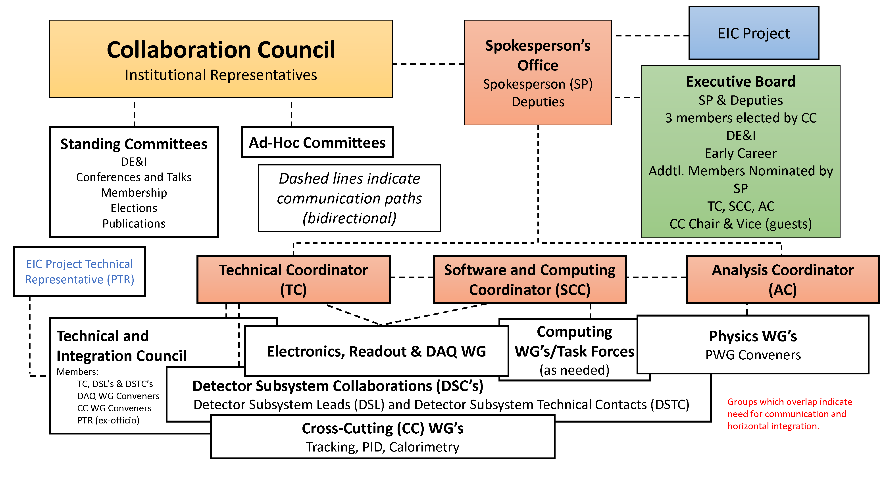
ePIC Collaboration Structure
Technical Coordination Office
• Silvia Dalla Torre (INFN, Acting)
Deputy TC’s:
Prakhar Garg (Yale)
Oskar Hartbrich (ORNL)
Matt Posik (Temple)
SCC Coordinator
• Markus Diefenthaler (JLab)
• Wouter Deconinck
(U. of Manitoba,
Deputy SCC for Operations)
• Sylvester Joosten
(ANL, Deputy SCC for Development)
• Torre Wenaus
(BNL, Deputy SCC for Infrastructure)
Analysis Co-Coordinators
• Rosi Reed (Lehigh Univ.)
• Salvatore Fazio (Univ. Calabria)

Slide 8
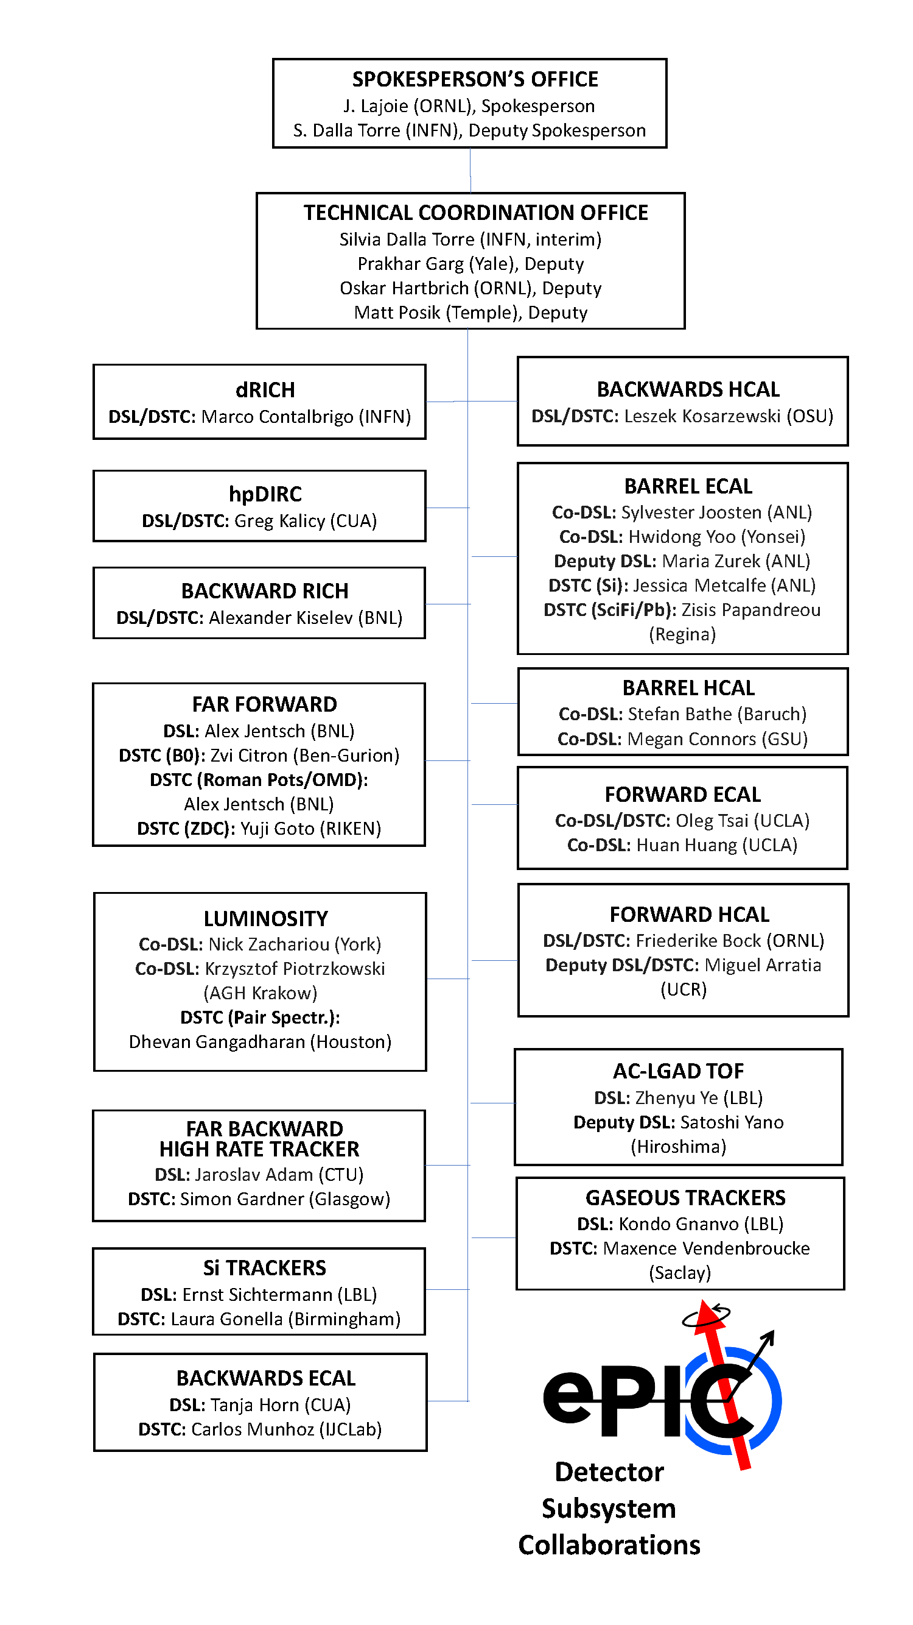
Detector Subsystem
Collaborations
Combined Luminosity DSC
New leadership in Barrel HCAL DSC

Slide 9
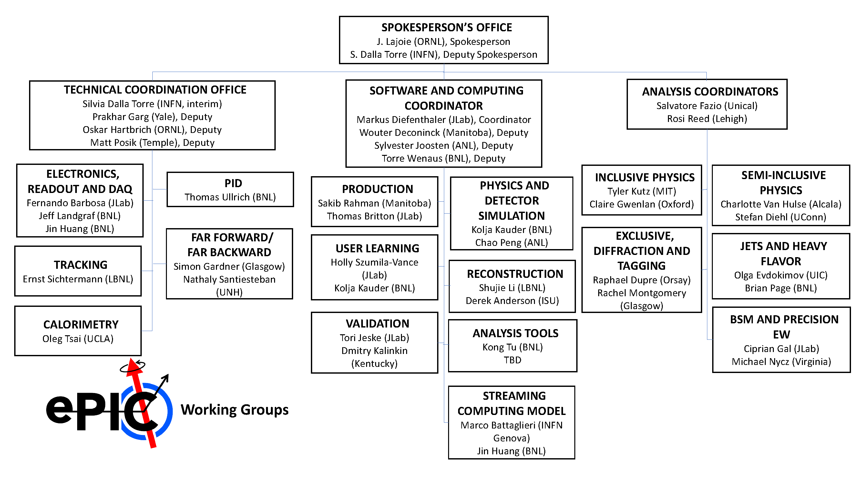
Working Groups

Slide 10
Newly Formed ePIC Committees
Committee Chair/Vice-Chair elected by Collaboration Council.
Chair/Vice-Chair propose committee membership, endorsed by CC vote.
Collaboration Council
Institutional Representatives
Elections Committee:
Chair: John Arrington (LBL)
Helen Caines (Yale), Or Hen (MIT),
Domenico Elia (INFN)
Standing Committees
DE&I
Conferences and Talks
Membership
Elections
Publications
Ad-Hoc Committees
Membership Committee:
Chair: Peter Steinberg (BNL)
Vice-Chair: Pietro Anontioli (INFN-Bologna)
Friederike Bock (ORNL), Helen Caines (Yale), Doug Higinbotham (JLab), Bedhangas Moharty (NISER), Silvia Niccolai (IJCLAB), Marzia Rosati (ISU)
Conferences and Talks:
Chair: Maria Zurek (ANL)
Vice-Chair: Brain Page (BNL)
Barbara Jacak (Berkeley), Daniel Brandenburg (OSU), Dmitry Kalinkin (Kentucky), Nick Zachariou (York), Xuan Li (LANL), Nicola Rubini (Bologna),
Wouter Deconinck (Manitoba)
DE&I Committee:
Chair: Megan Connors (GSU)
Vice-Chair: Christine Nattrass (UTK)
committee formation underway
Publications Committee:
Chair: Rene Bellwied (U. Houston)
Vice –Chair: Annalisa Mastroserio (INFN Bari)
committee formation underway

Slide 11
ePIC Executive Board
Spokesperson’s Office
Spokesperson (SP)
Deputies
Executive Board
SP & Deputies
3 members elected by CC
DE&I
Early Career
Addtl. Members Nominated by SP
TC, SCC, AC
CC Chair & Vice (guests)
The EB provides input to the Spokespersons on physics policy, instrumentation choices, and candidate suggestions for leadership positions. In addition to the 3 at-large members who will be elected by the Collaboration Council (CC), two members will be selected by the early-career group and the DEI committee. The Spokespersons can appoint additional members after endorsement by the CC. It is expected that top level activity coordinators will be members of the EB.
"From the perspective of the Spokesperson, it is essential to have an advisory body that represents the breadth of the collaboration that can be consulted on a regular basis. The real benefit comes when facing major decisions or crises – the Executive Board guarantees that the Spokesperson will receive recommendations and advice that enables a consideration of all perspectives within the collaboration. An Executive Board can help support the Spokesperson’s office by endorsing decisions after careful consideration, or more importantly, forcing the Spokesperson’s office to adequately consider aspects that might not have been part of their original considerations.
From the perspective of the Collaboration, it creates a body where the membership is known and deliberately balanced by the CC process and the SP nominations. The Collaboration knows who is on the Executive Board and advising the Spokesperson’s Office on key decisions, which provides transparency. Of course, major decisions (like technology selections) will go before the CC for endorsement, but whatever is brought before the CC must be well considered and worked out beforehand. The Executive Board is key to that process.”
At-large members:
Barbara Jacak (Berkeley), Taku Gunji (Tokyo),
Paul Newman (U. of Birmingham)
DEI member: Megan Connors (GSU)
Early Career member: Fernando Flor (Yale U.)
Top level coordinators: Markus Diefenthaler (JLab), Salvatore Fazio (Calabria), Rosi Reed (Lehigh U.), TC (vacant)
CC chair and vice-chair (non-voting): Ernst Sichtermann (LBNL), Bernd Surrow (Temple U.)
EB Meetings Nov. 17th, Dec. 21st - planning to meet ~monthly

Slide 12
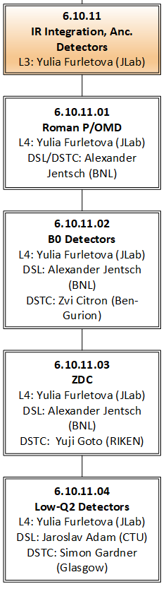
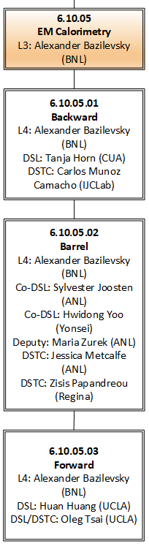
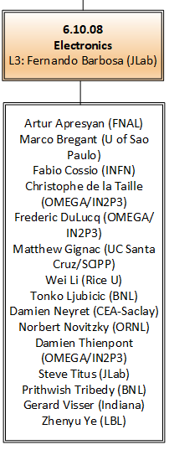
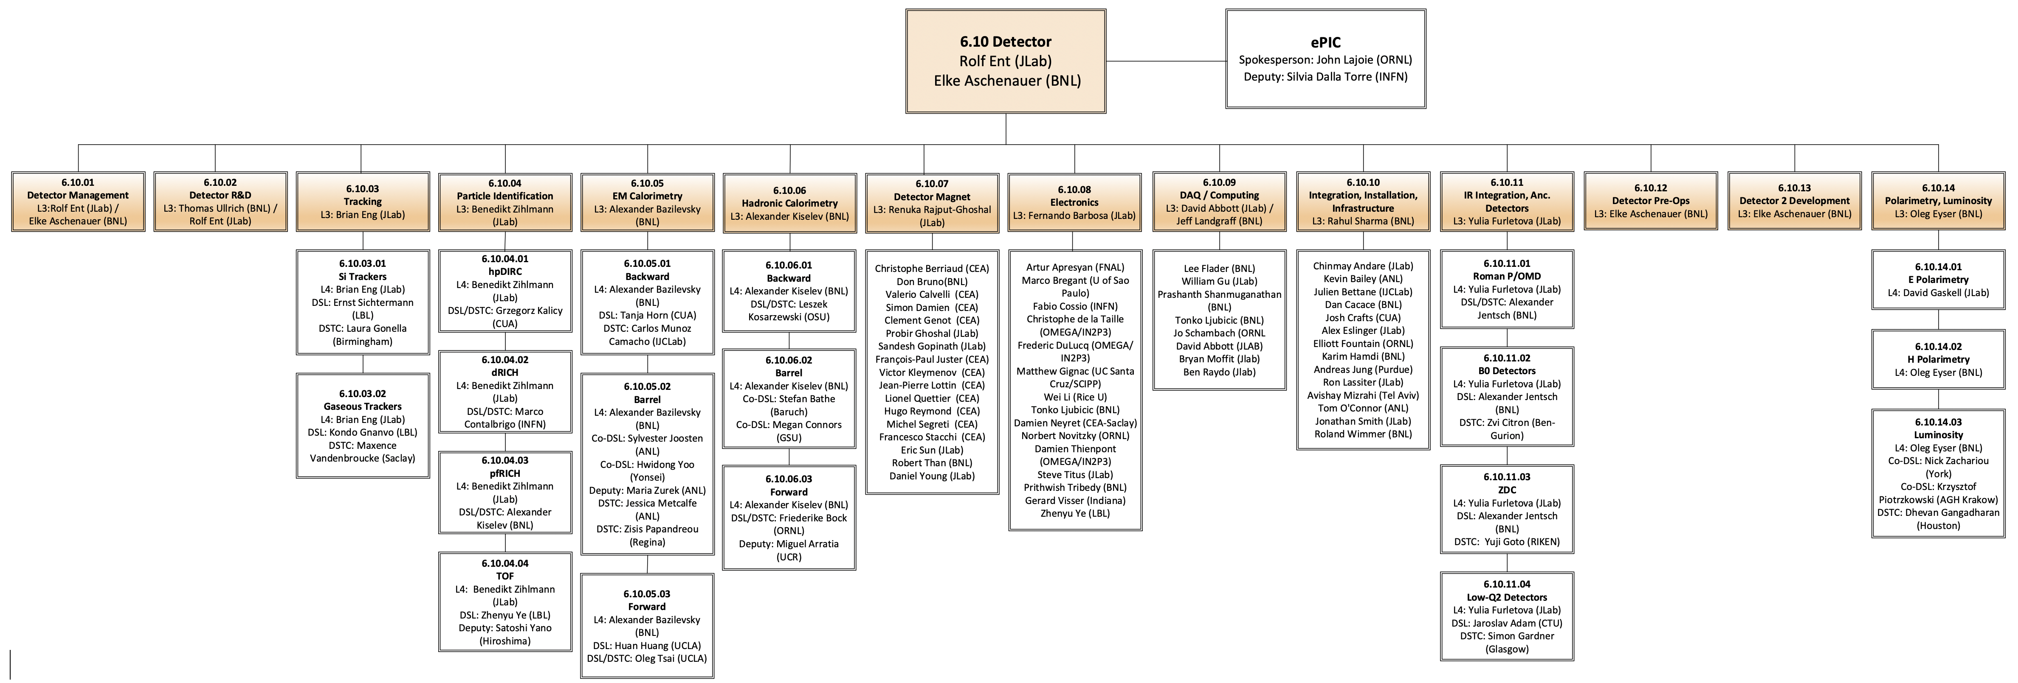
Integrating and the EIC Project
Work packages integrated at Level-5 and lower. The Project and ePIC have been through a major review together,
the Project CAMs and Collaboration DSL/DSTC’s are working together.

Slide 13
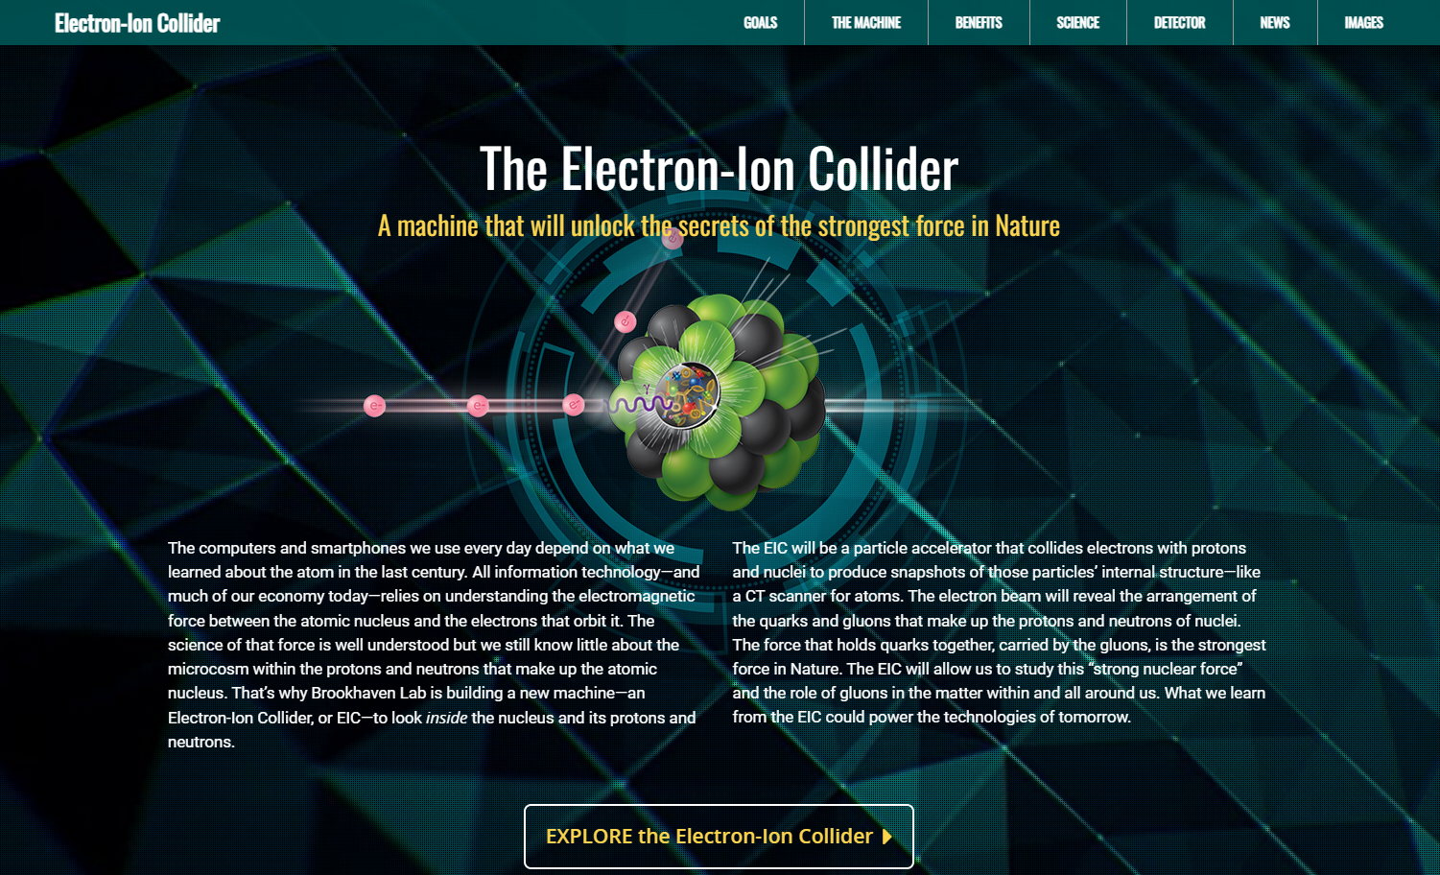
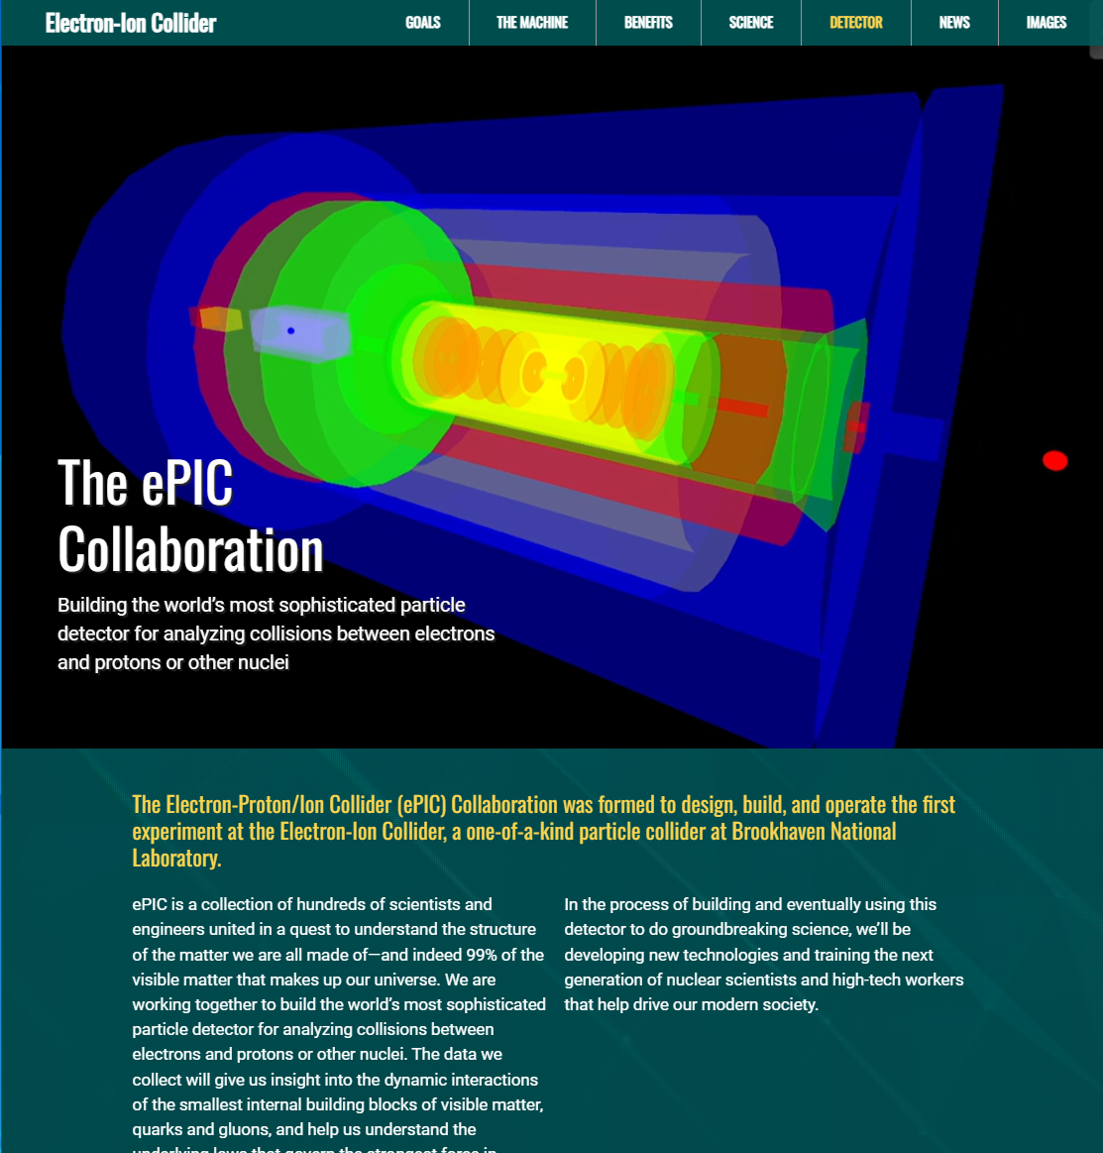
ePIC Collaboration Web Presence
Integrated into the main EIC website through the top navigation. Page contains contact information and link to the ePIC Wiki.
Gary Schroeder, Karen McNulty Walsch, Thomas Ullrich, JGL
Animations courtesy of UC Riverside group.
Continuing to update and improve.
https://www.bnl.gov/eic/epic.php

Slide 14

Second EIC RRB Meeting
Held Dec. 7-8 in Washington D.C. on the CUA campus
Comprised of the representatives of the international funding agencies supporting institutions collaborating on the EIC detector(s) and representatives from the two host labs.
  The EIC-RRB will provide coordination during detector development, construction, and operations.
Agenda included presentations by ePIC Spokesperson, TC and SCC
Discussions centered on formalizing in-kind contributions (iCRADA’s), computing, and common fund.
  Next RRB meeting June 2024 in Italy

Slide 15
SP Office Meeting with Tim Hallman
Met with Tim at DOE HQ in Germantown Monday, Dec. 11th
Agenda was discussion of support for EIC/ePIC in the University and Laboratory research programs
  Informed by survey of CC representatives sent out 11/28 (31 responses)
  Focused on DOE support, but important information collected from international collaborators as well
Talking Points:
  Support for the University/Lab research programs is essential to build the foundation of the EIC scientific community
    Inconsistent response to requests for support has led to confusion among collaborators
  DOE NP plans to create EIC Research Program following appointment of Physics Research Director

Slide 16








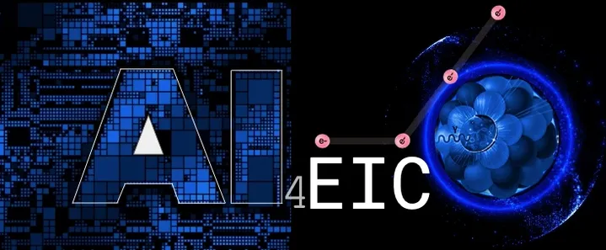


ePIC Conference Presentations 2023
A selection of ePIC presentations at conferences in the past year:
10TH WORKSHOP OF THE APS TOPICAL GROUP ON HADRONIC PHYSICS
SESAPS 2023: invited talk
HP 2023: invited talk
Three invited talks
GHP 2023: invited talk
2nd workshop on advancing the understanding of non-perturbative QCD using energy flow
Forward Physics and QCD at the LHC and the EIC - 798 WE-Heraeus Seminar
DIS 2023: two invited talk, five contributed
Spin 2023: two invited talks
invited talk
Keynote, plenary and five contributed
invited talk
One invited, two contributed
two invited talks
Multiple contributed,
posters
Six contributed talks
… and many more
AI4EIC: four talks
EPIPHANY 2023:
two invited talks

Slide 17
What to look forward to in 2024…

Slide 18
From the Spokesperson’s Perspective
What do we need to accomplish in 2024?
  We need to continue to evolve the ePIC Technical Design towards 90% completion and document this in the ePIC contributions to the EIC TDR.
  We need to continue to grow the ePIC collaboration
    The collaboration needs to grow to realize our goal of building ePIC
    Continue to talk about EIC science to the NP community
  We need to keep people engaged in ePIC
    Continue to work to make ePIC a collaboration where people’s contributions are valued, recognized and encouraged

Slide 19
TDR Strategy and Publications
In 2024 the ePIC collaboration will produce:
The ePIC contributions to the EIC TDR
  The EIC TDR is the top priority
    Chapters on Physics Goals and Requirements and Experimental Systems
    Not just the document, but the simulations and detector R&D that form the basis
    Requires close cooperation between the collaboration and the project!
An ePIC Detector Design paper:
    Derived and expanded from the Experimental Systems TDR chapter
An ePIC Physics Performance paper:
    Derived and expanded from the Physics Goals and Requirements TDR chapter
Both to be published in a scientific journal (such as NIMA, JINST, or PRC, etc.)
These publications will serve as a focus in developing the ePIC Membership and Publication policies.
TDR Strategy discussion Saturday morning.
Simulation and Software Readiness Saturday afternoon
process design phase
structuring the
effort
finalizing EIC TDR
Preparing papers for
publication
writing
(TDR/notes)
Mid Jan.24
End Sep.24
End Dec.24
Mid Mar.24
End July 24

Slide 20
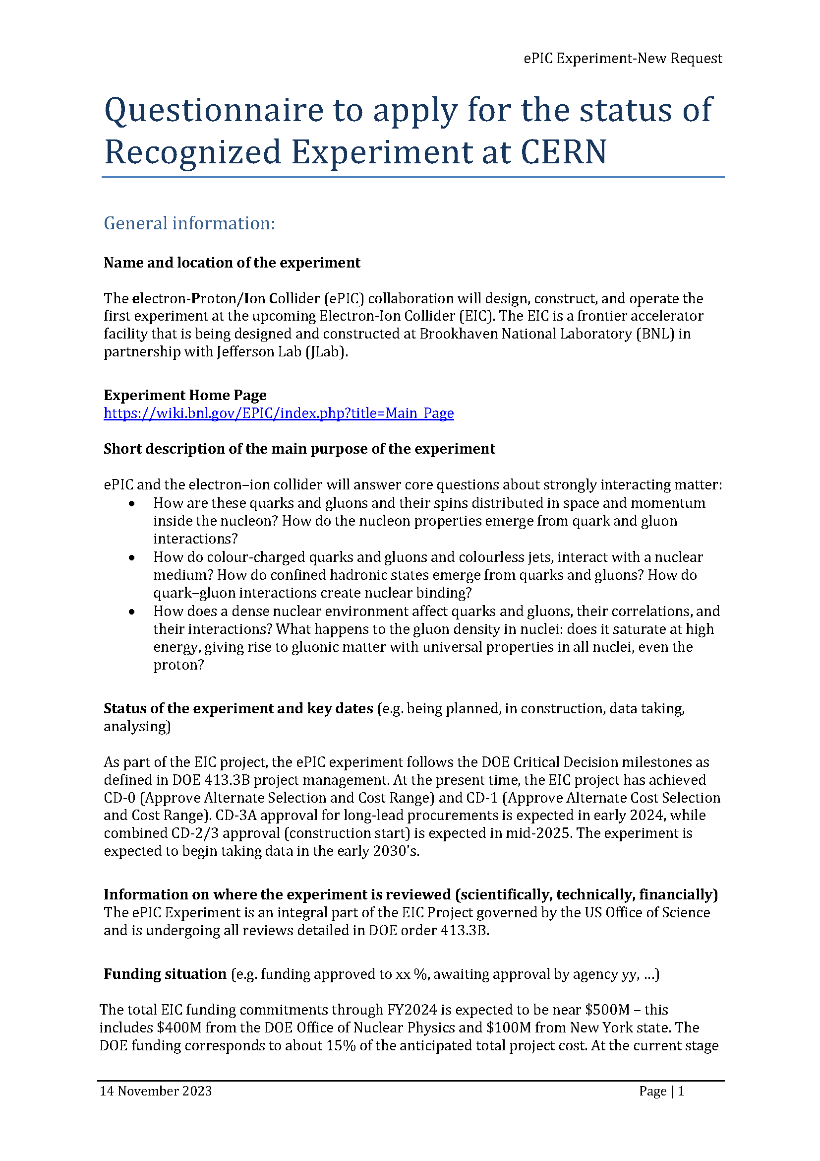
CERN Recognized Experiment
ePIC Application for CERN Recognized Experiment:
  ePIC leadership has submitted an application to become a CERN Recognized Experiment
  Strong synergies between CERN and EIC
  Important for access to CERN resources (test beams, …)
  Increase visibility in the European community
ePIC presentation scheduled for Thursday, Feb 8th at 1:15M @ CERN

Slide 21
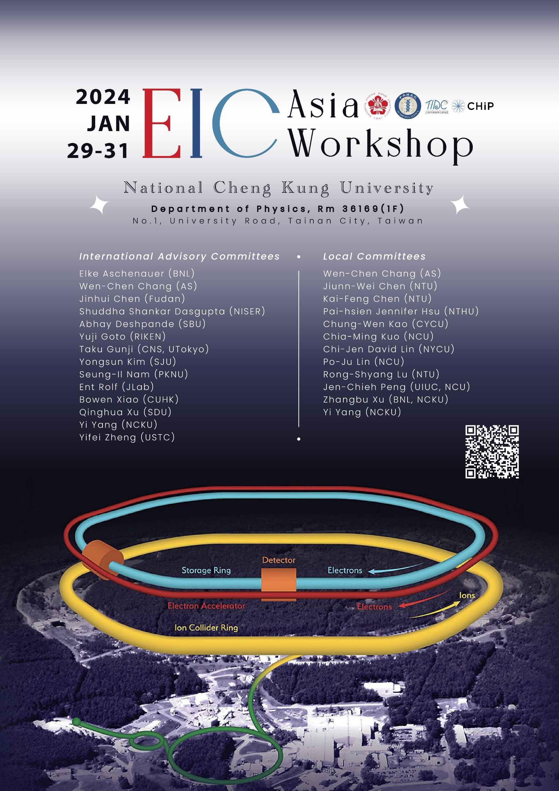

Upcoming Events…
3rd EIC-Asia Workshop in Taiwan Jan. 29-31, 2024
  https://indico.phys.sinica.edu.tw/event/88/
CERN Recognized Experiment - Feb 8th , 2024
FFWD/FBKWD Preliminary Design Review
  February 12, 2024
DIS 2024 in Grenoble, France April 8-12th , 2024
  https://lpsc-indico.in2p3.fr/event/3268/
ePIC Software and Computing meeting
@ CERN April 22nd-26th
  https://indico.cern.ch/event/1343984/
4th EIC-Asia Workshop in Shanghai July 1-5, 2024
  https://indico.cern.ch/event/1361239/
Joint EICUG/ePIC Collaboration Meeting
@ Lehigh University July 22nd-28th
  https://indico.bnl.gov/event/20727/

Slide 22
Upcoming Meeting Schedule
Regularly scheduled General Meetings:
  Fri, Feb 2nd 2024 @ 10:30AM ET
  Remaining dates TBA soon
CC Meetings will be called by the CC Chair as needed
EB Meetings planned by the SP Office:
  2024 dates TBD

Slide 23
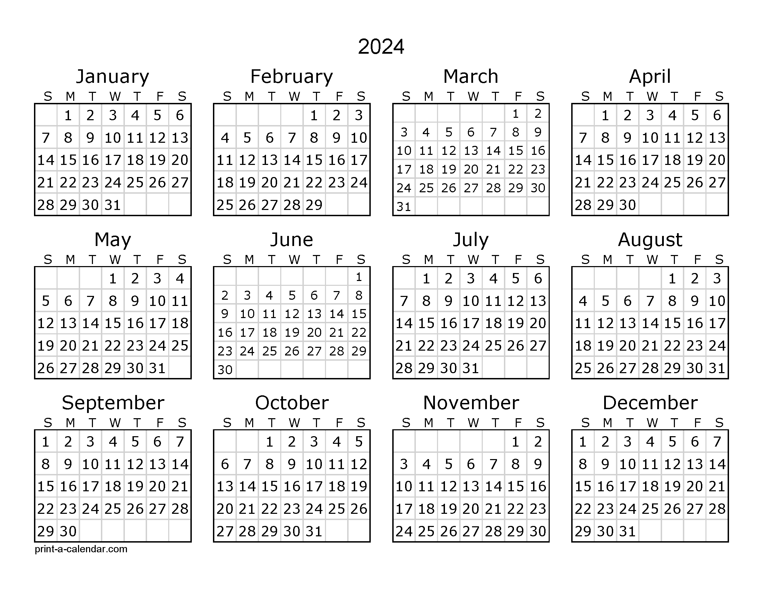

China
Combined International Holiday Calendar
Japan
Korea
Taiwan
Israel
Israel (no travel)
Europe
India
US

Slide 24
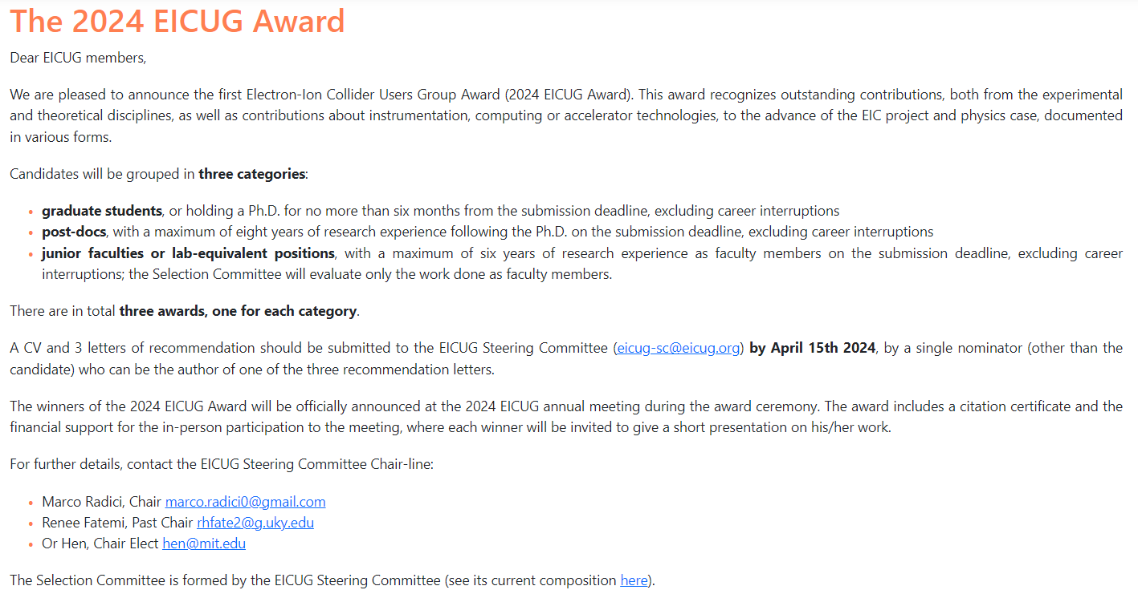
EICUG 2024 Award
https://www.eicug.org/content/award.html

Slide 25
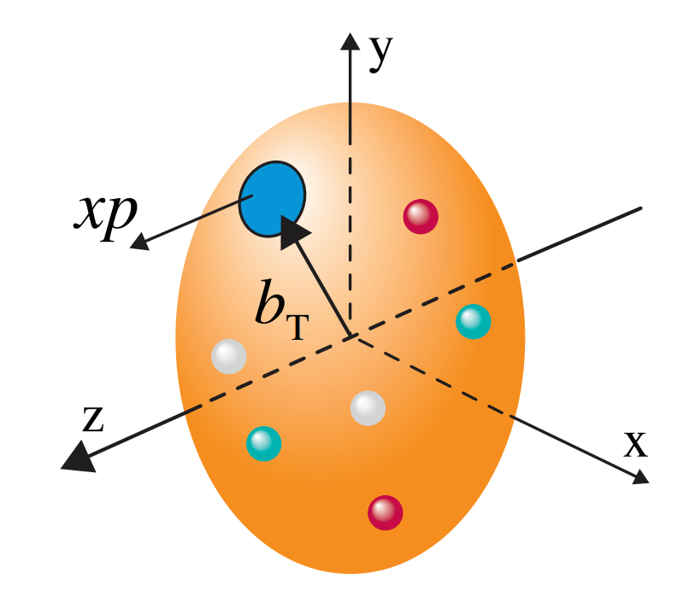
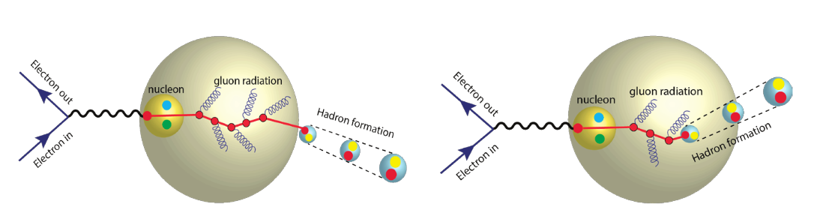
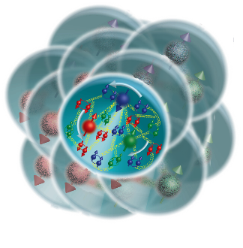
The Collaboration Pursues the Science
How do the nucleon properties like mass and spin emerge from quarks and their interactions?
How are the sea quarks and gluons distributed in space and momentum inside the nucleon? How is spin dynamically generated?
What is the mechanism through which quark-gluon interactions give rise to nuclear binding?
Is there a saturation point for the density of gluons in nuclei at high energies, and does this lead to the formation of gluonic matter with universal properties across all nuclei, including the proton?
In what manner do color-charged quarks and gluons, along with colorless jets, interact with the nuclear medium? And how do the confined hadronic states emerge from these quarks and gluons?
What impact does a high-density nuclear environment have on the interactions, correlations, and behaviors of quarks and gluons?
25

Slide 26
Summary
The ePIC Collaboration has grown stronger over the past six months:
  The collaboration has grown and continues to grow
  The structure of the collaboration is evolving to better meet challenges
ePIC is poised for an amazing 2024:
  Planning a coordinated effort to evolve the ePIC technical design and document it in a TDR and publications
  The collaboration will continue to grow and evolve in a deliberate and well-planned way
This is all a lot of work – keep in mind that we are all working to accomplish something truly amazing!

Slide 27


Slide 28


Just one more thing….
many thanks to Oskar Hartbrich, Maria Zurek and Sylvester Joosten

Slide 29
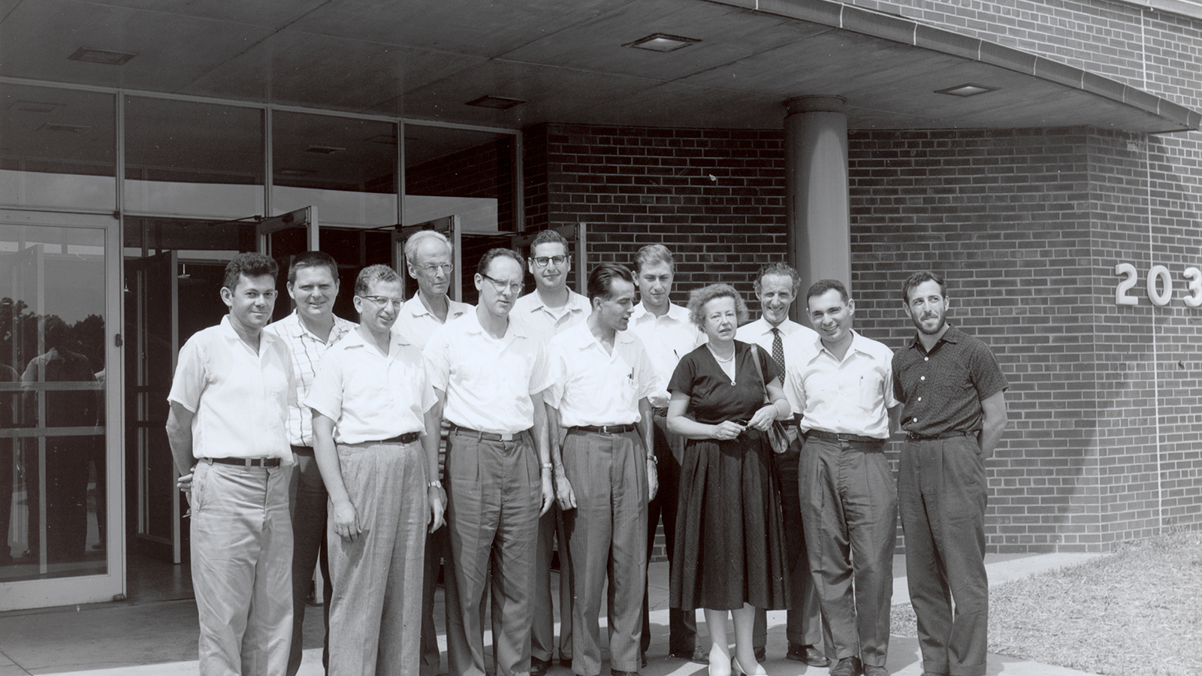
Why Maria Goeppert
Mayer?
75 Years of the Nuclear Shell Model!
In 1949 M. Goeppert Mayer and H. Jensen (independently) developed and published a model in which nucleons were distributed in shells with different energy levels.
Maria Goeppert Mayer and Argonne (1946-1960)
In 1946, Maria received a faculty appointment, splitting her time between the University of Chicago’s Institute for Nuclear Studies and the newly opened Argonne National Laboratory, as a Senior Physicist in the Theoretical Physics Division.
It was during this time that she developed the nuclear shell model, the work for which she was awarded the Nobel Prize in Physics in 1963, shared with Hans Jensen and Eugene Wigner.
Learn more: https://www.nobelprize.org/prizes/physics/1963/mayer/biographical/
https://www.anl.gov/phy/maria-goeppert-mayer-argonnes-nobel-laureate

Slide 30
ePIC Resources
Mailing Lists – https://lists.bnl.gov/mailman/listinfo
Indico Agenda - https://indico.bnl.gov/category/402/
  ePIC Software and Computing: https://indico.bnl.gov/category/435/
Wiki - https://wiki.bnl.gov/EPIC
ePIC Software Training:
  Landing Page: https://eic.github.io/documentation/landingpage.html
  Tutorials: https://eic.github.io/documentation/tutorials.html
Mattermost: https://chat.epic-eic.org

Slide 31


EICUG Membership
The EICUG is a vital organization to promote the interests of the EIC community!
  Without the EICUG we would never have gotten far enough to form ePIC!
Please register your institution!
Check with your EICUG IB representative to get registered as a member
https://www.eicug.org/content/join.html

Slide 32
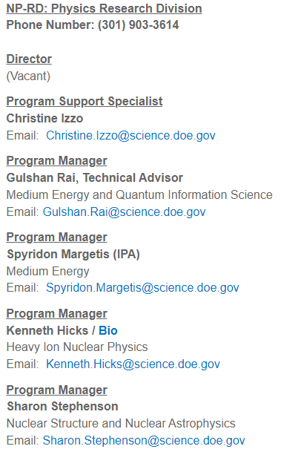
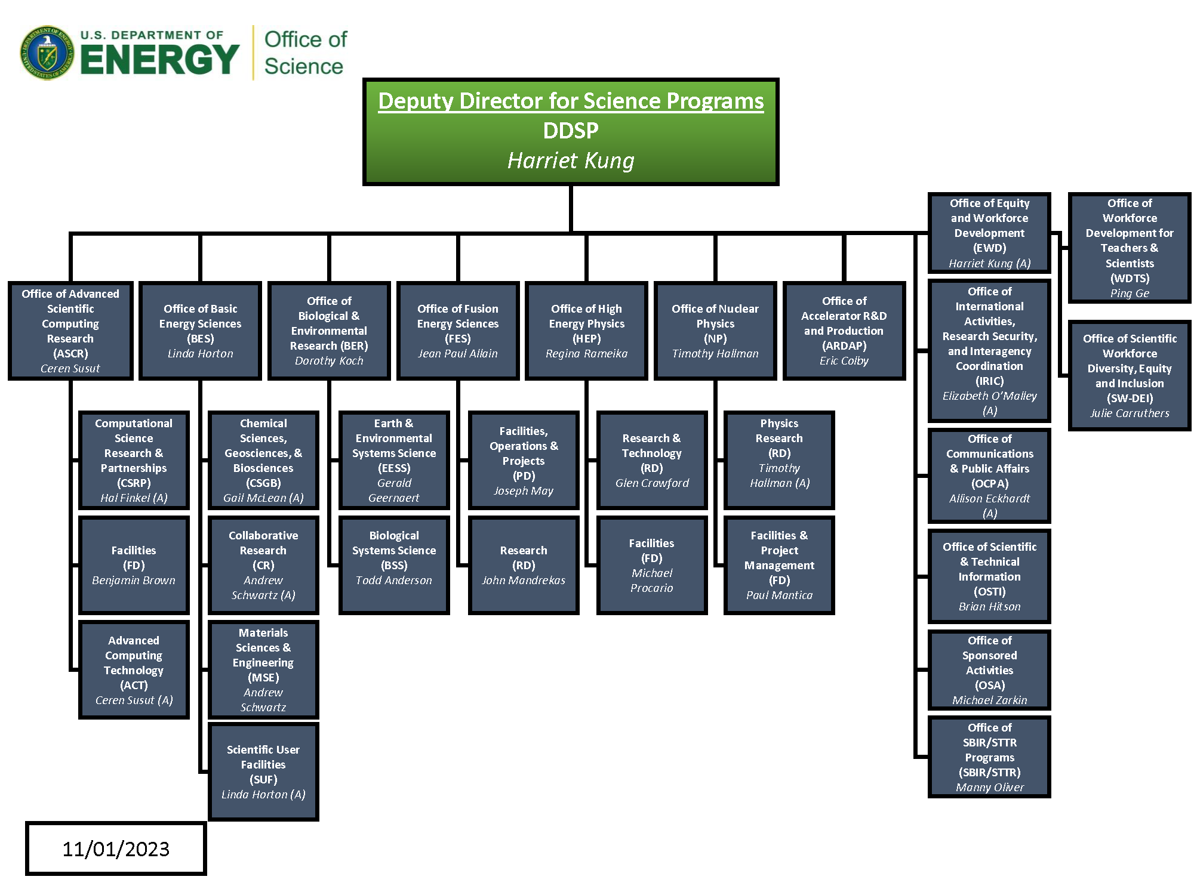
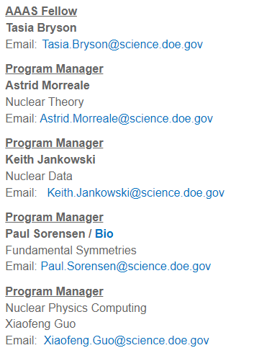
DOE SC NP Organization
+ EIC Program Manager (future)

