Slide 1
EIC Project News
E.C. Aschenauer (BNL), R. Ent (JLab)
Co-Associate Directors for the Experimental Program
EIC Detector Leads
ePIC Colllaboration Meeting
Argonne National Lab
January 9-13, 2024

Slide 2
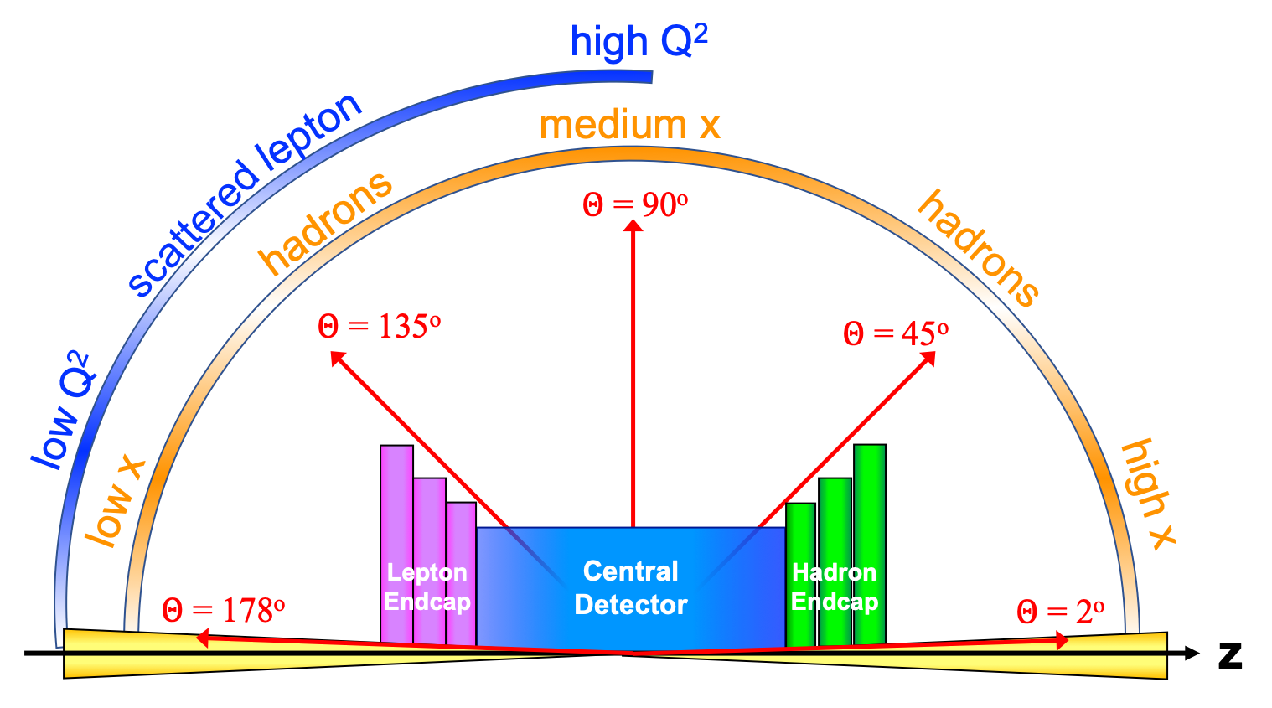
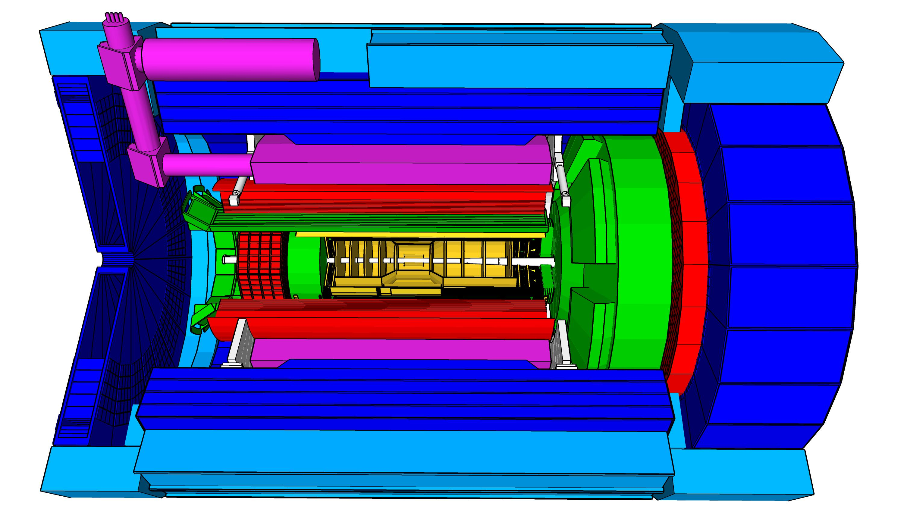
Experimental Equipment Scope
High Luminosity: L= 10³³ – 10³⁴cm⁻²sec⁻¹,
10 – 100 fb⁻¹/year
Highly Polarized Beams: 70%
→ requires high precision electron and hadron polarimetry
Large Center of Mass Energy Range:
E_{cm} = 29 – 140 GeV
→ Large Detector Acceptance
Asymmetric beam energies
→ require an asymmetric detector Barrel
with electron and hadron endcap → 9.5 m
→ equal coverage (-4 < η < 4) Tracking, particle dentification,
electromagnetic and hadronic calorimetry
  High precision low mass tracking
  good e/h separation critical for scattered electron identification
  separate e, π, K, p on track level
Science program required momentum resolution
→ requires a large bore 2T magnet
(1.7 T magnet operation point, stretch goal 2T)
that has same geometry as the BaBAR magnet.
Imaging science program → Large Ion Species Range:
protons to Uranium
→ requires specialized detectors integrated in the Interaction Region over 80 m
Streaming readout electronics model
→ highest scientific flexibility
very compact Detector → Integration is key
Good Background Conditions
25 Subsystems incl. Polarimetry
local hadron polarimeter
hadronic calorimeters
Time.of.Flight,
DIRC,
RICH detectors
MPGD trackers
Solenoidal Magnet
MAPS tracker
e/m calorimeters
Luminosity
Monitor
low Q² electron-tagger
off-Momentum
taggers
Roman
Pots
Zero-Degree
Calorimeter
p: 41 GeV, 100 to 275 GeV
p/A beam
e beam
e: 5 GeV to 18 GeV
lepton and hadron polarimeters not shown

Slide 3
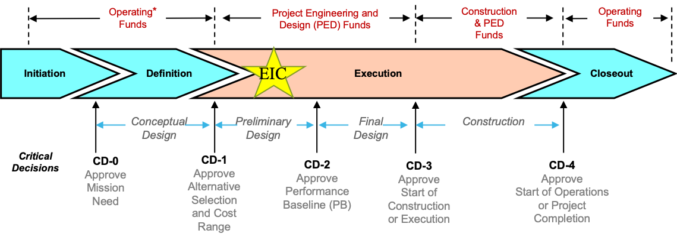
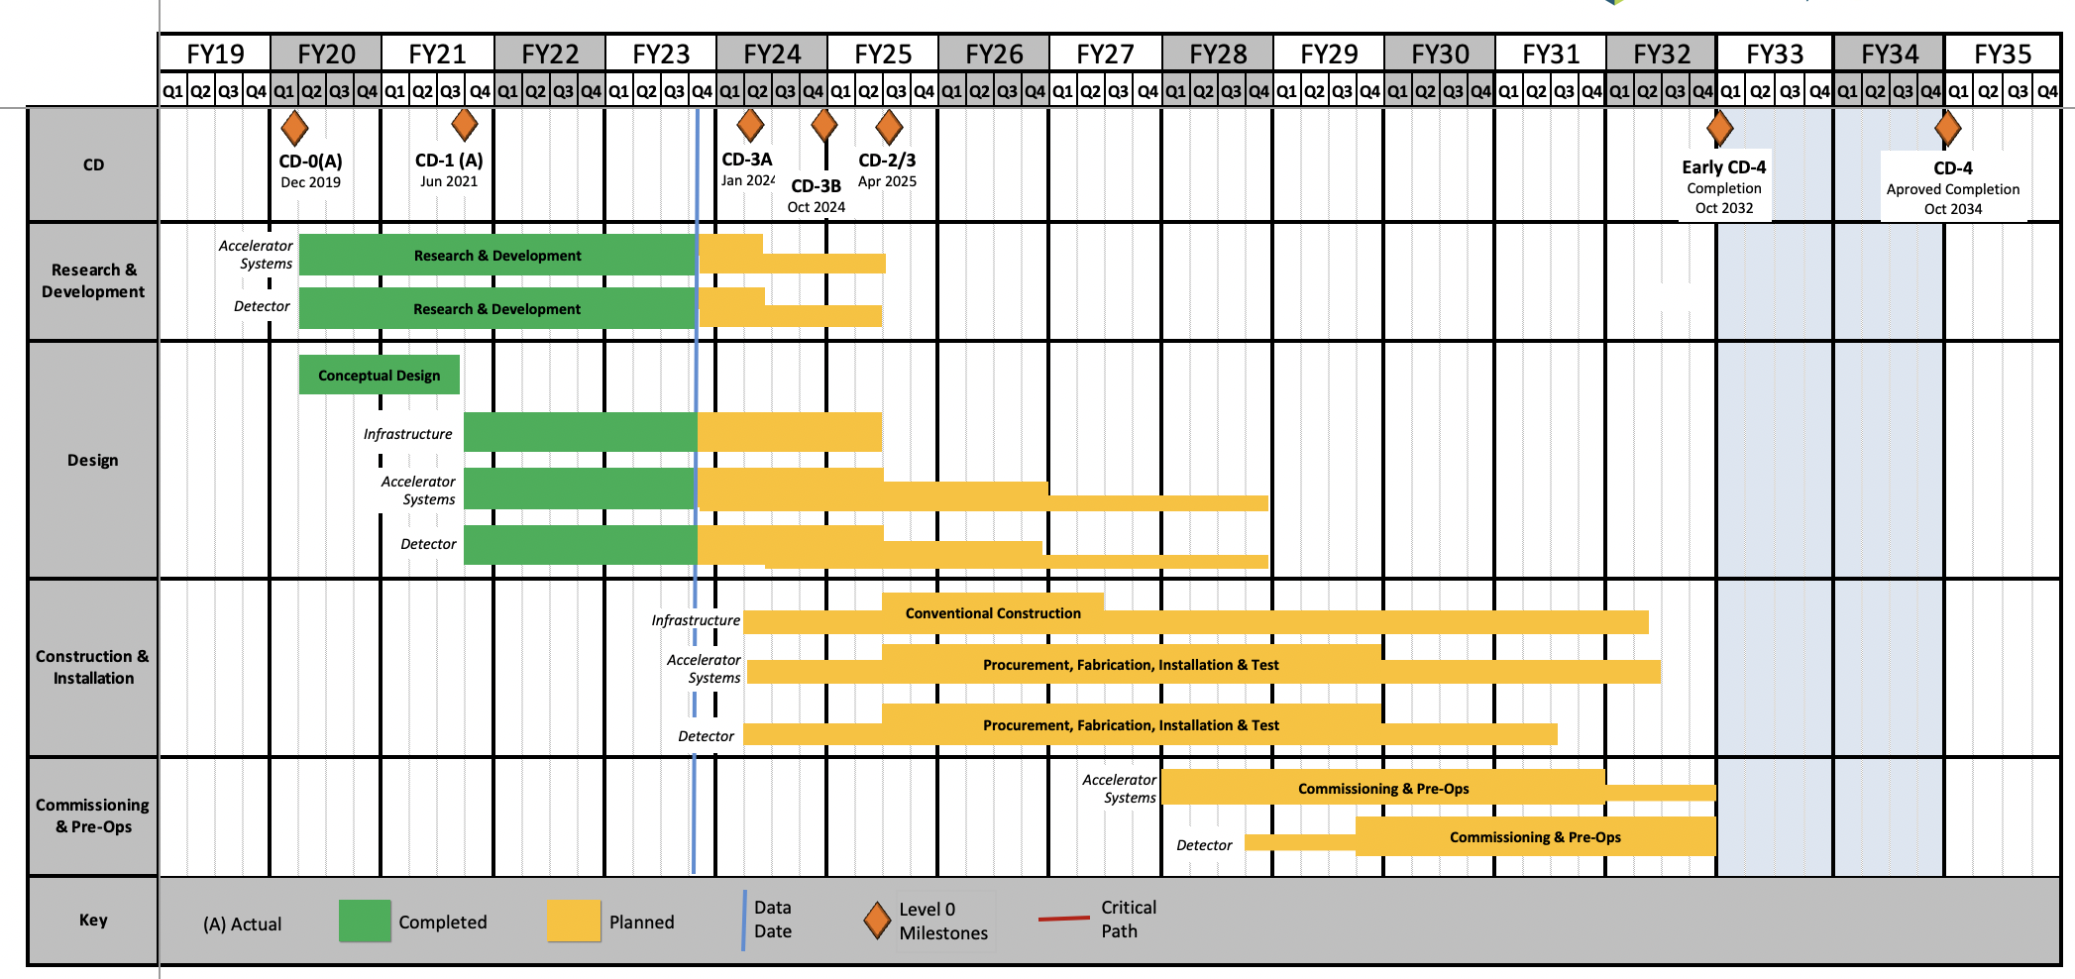
EIC Schedule
    EIC Critical Decision Plan
    CD-0/Site Selection December 2019 ✓
    CD-1 June 2021 ✓
    CD-3A January 2024
    CD-3B October 2024
    CD-2/3 April 2025
    early CD-4 October 2032
    CD-4 October 2034
CD-2:
Approve preliminary design for all subdetectors
Design Maturity: >60%
Need “pre-”TDR
Baseline project in scope, cost, schedule
Construction Phase
Conclusion of
RHIC Operation
Science Phase
The thinner bars indicate that R&D and design
can continue at a small level beyond CD-2 and CD-3
CD-3:
Approve final design for all subdetectors
Design Maturity: ~90%
Need full TDR
3

Slide 4
High Level Installation Schedule
Oct 2028
Jan 2029
Milestone
PO_0305_0900
Apr. 2031
CD-3
04/2025
April 2029
Dec 2029
early CD-4
10/2032
CD-4
10/2034
June 2030
Oct 2030
Jan 2031
Construction
Pre-OPS
IR-6 ready
for installation
Detector Assembled and Ready for Cosmic Data Taking
Early start of
Operations
&
Science
Start of
Operations
&
Science
lower half
barrel Hcal
installed
Solenoid
delivered
Endcap HCals
completed
Solenoid
Field mapping
done in beam position
Hadron Endcap
Detectors
installed
Trackers, dRICH
ECal
done in Assembly Hall
Barrel Ecal
ready
for installation
Barrel Hcal
& Solenoid
installed
followed by low
power test
Lepton Endcap
Detectors
installed
Trackers, bRICH
ECal
Barrel Detectors
installed
ECal, DIRC,
ToF, Trackers
Take Away:
Solenoid and Barrel HCal need to be ready by Jan 2029
all other subdetectors need to be ready between 06/29 to 06/30 depending on their location in the detector
4

Slide 5
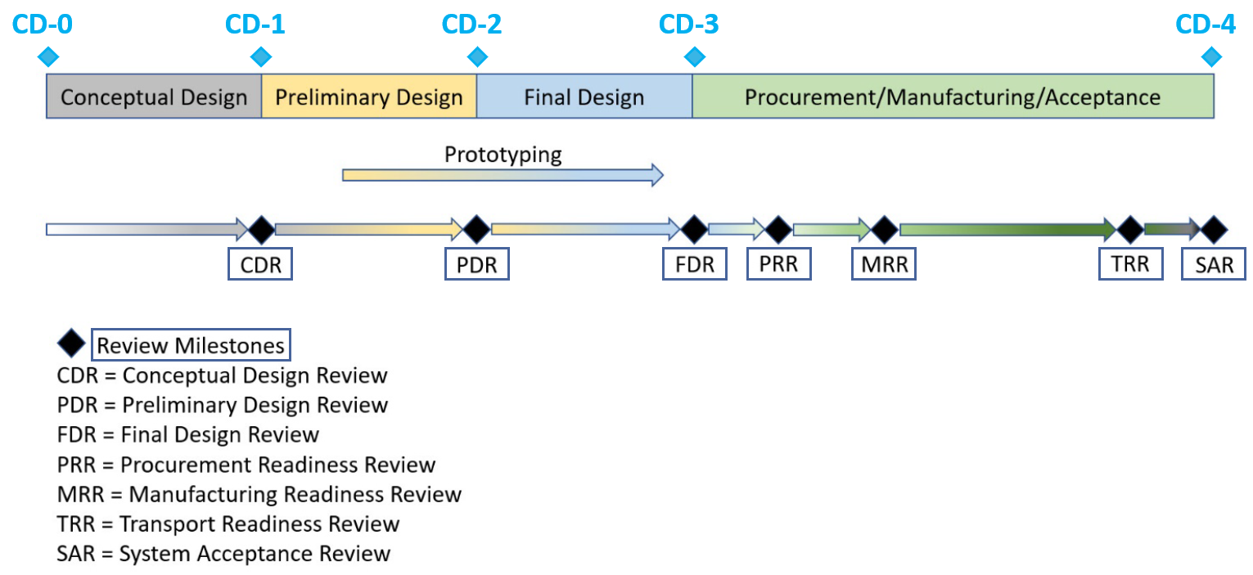
Design Review Progress
Preliminary Design Reviews:
  Magnet (6.10.07) – 30% design, Feb. 23, 2022
  IR Integration and Ancillary Detectors (6.10.11) – April 27, 2022
  Electronics/Computing Subsystems (6.10.08 & 6.10.09) – August 29-30, 2022
  Magnet (6.10.07) – 60% design, October 18-19, 2022
  Calorimetry (6.10.05 & 6.10.06) – December 6-8, 2022
  Polarimetry (6.10.14) – January 17-18, 2023
  Particle Identification Detectors (6.10.04) – July 5-6, 2023
Final Design Reviews (for CD-3A scope):
  PbWO4 Crystals (6.10.05) – July 14, 2023
  Scintillating Fibers (6.10.05) – September 13, 2023
  Silicon Photomultipliers (6.10.06, 6.10.05, 6.10.04) – September 14, 2023
  Forward Hadron Calorimeter Steel and Tungsten (6.10.06) – September 25, 2023
  Magnet (6.10.07) – October 5-6, 2023
Project detector R&D (6.10.02) is annually reviewed by the DAC
  Last one was August 28+31, 2023; Details: https://indico.bnl.gov/event/20113/
Scientific computing & associated infrastructure is a dependency for the EIC
  EIC Detector Software Infrastructure Review, in collaboration with host labs (https://indico.bnl.gov/event/16676/) – August 22-23, 2022
  ePIC Computing & Software review by host labs (https://indico.bnl.gov/event/20481/) – October 19-20, 2023

Slide 6
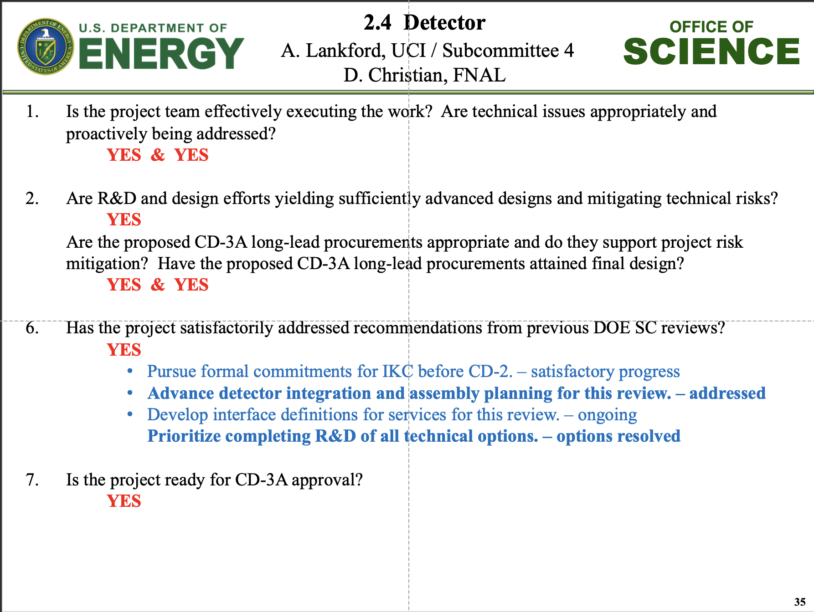
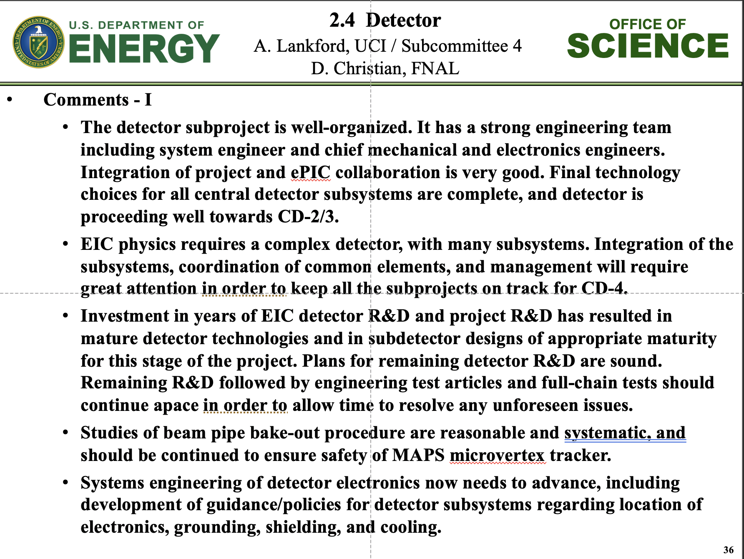
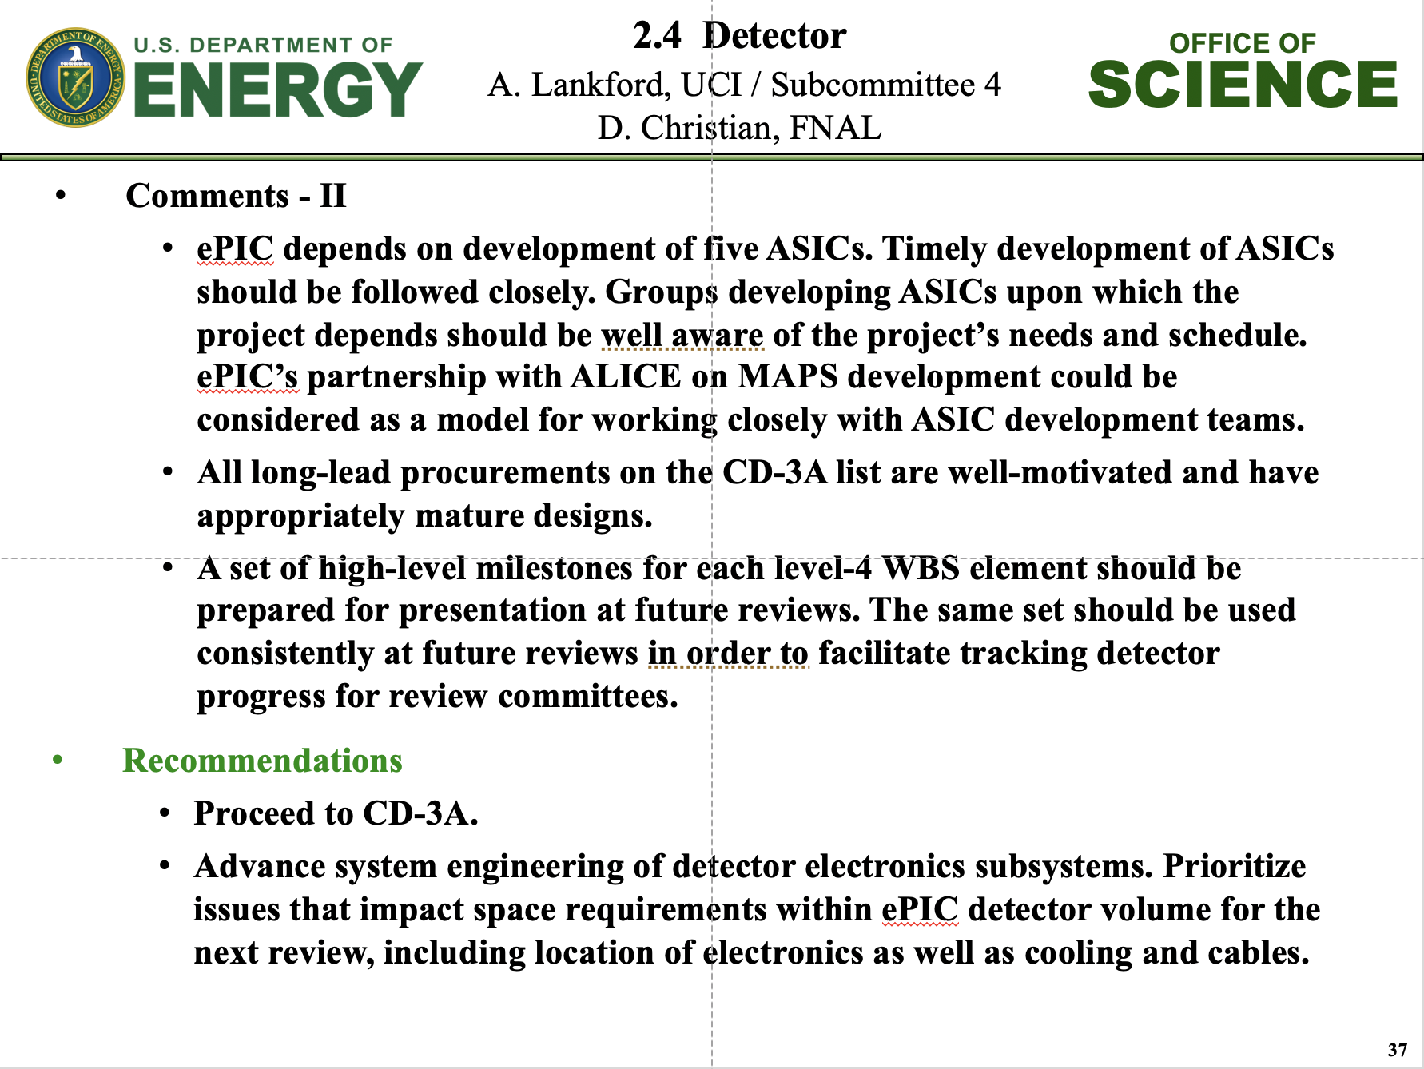
Design Review Progress
Global Project Reviews:
  DOE CD-3A Design Review by DAC August 29 + 30, 2023
  DOE CD-3A Director’s Review October 10-12, 2023
  Integrated Design Review reports of DAC, MAC, Infrastructure Committee, Focus on CD-3A Long Lead Procurement Items
  DOE CD-3A Independent Project Review November 14-16, 2023

Slide 7
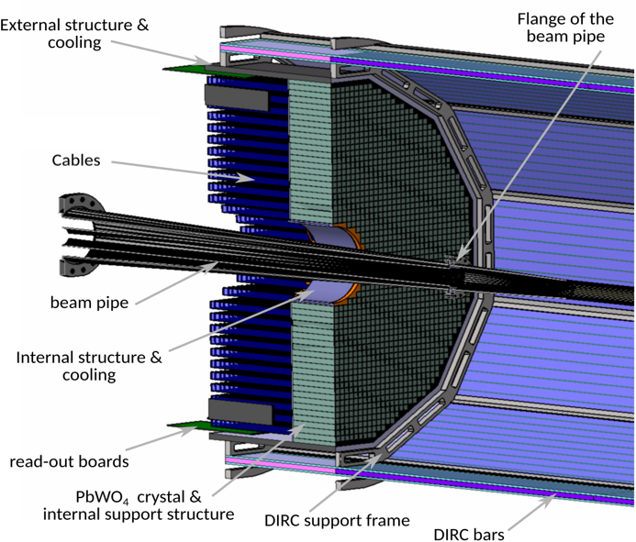
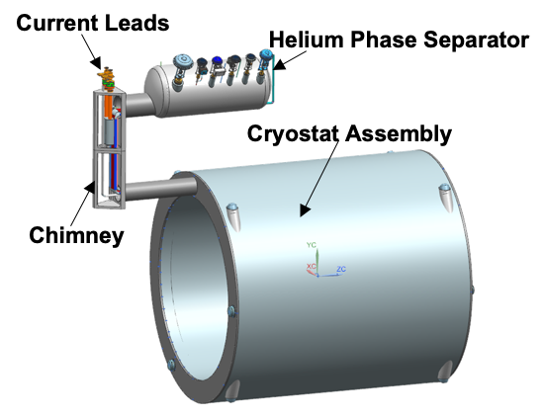
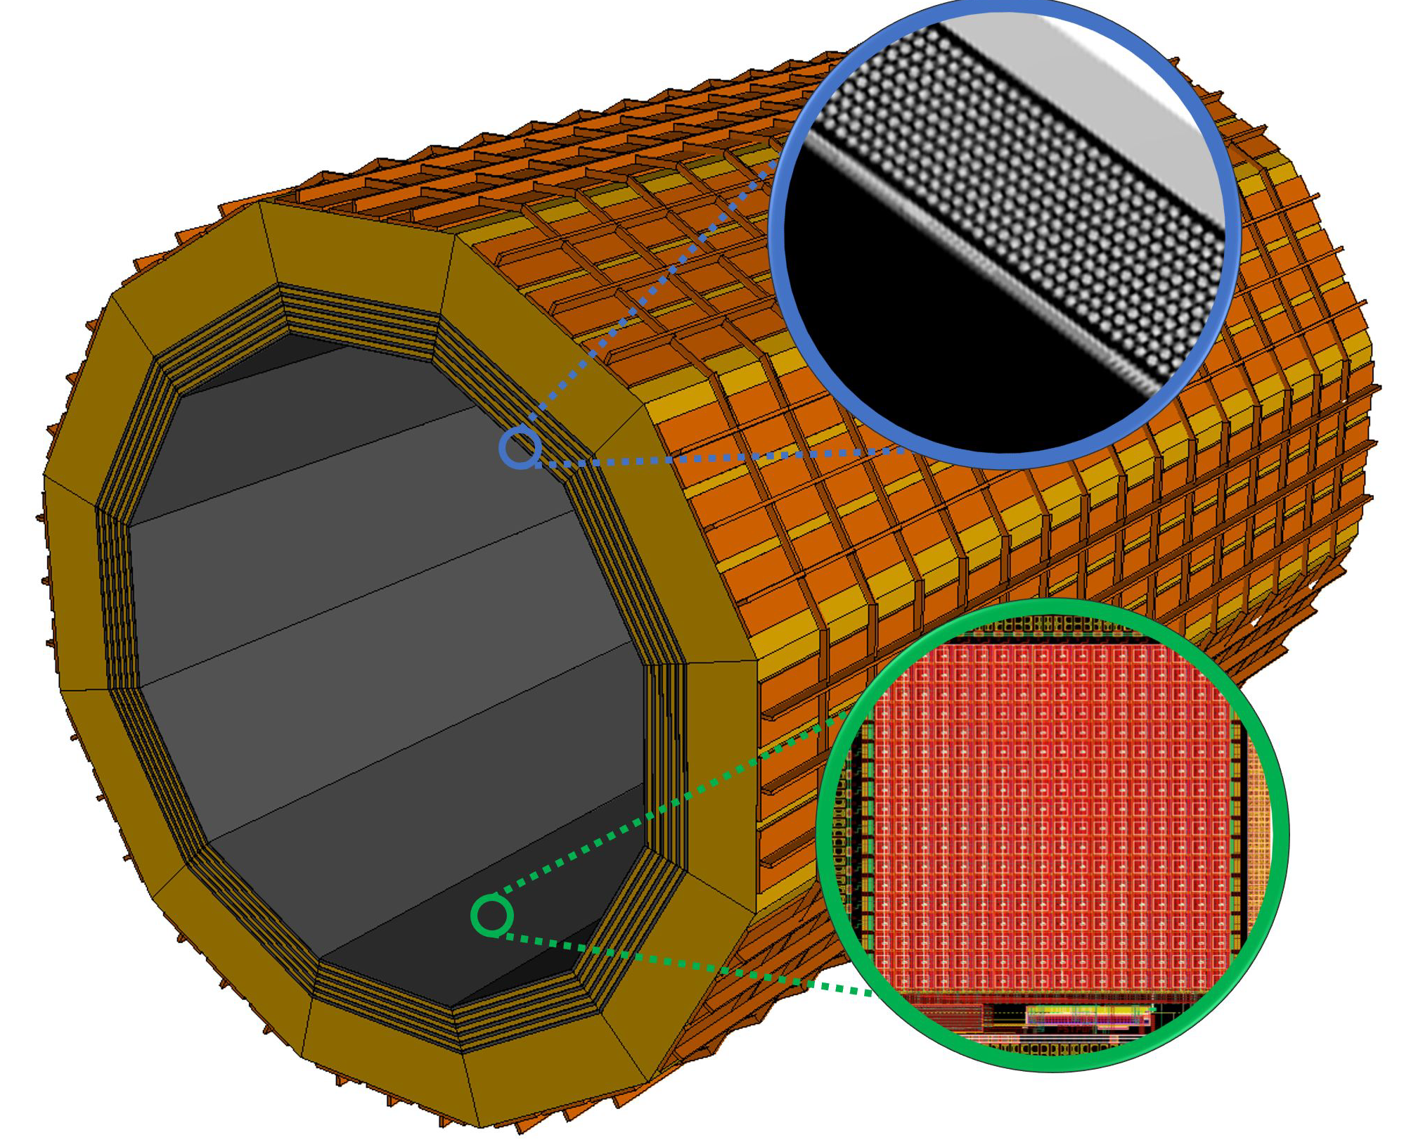
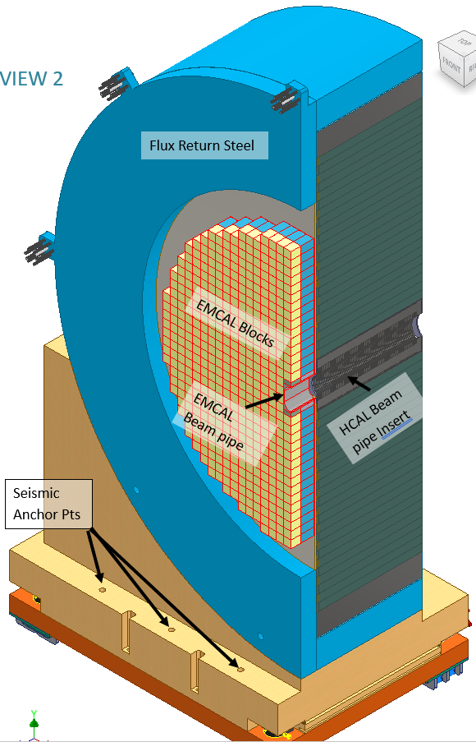
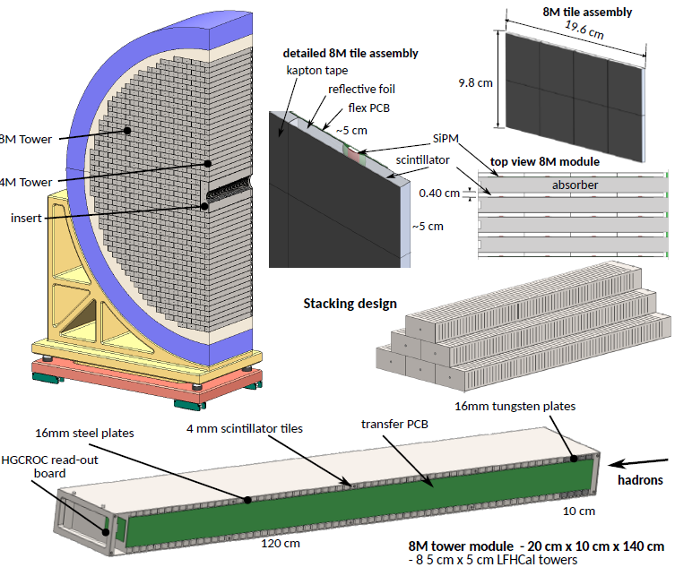
CD-3A Scope Overview for Detector Systems
Detector Systems CD-3A Scope
  WBS 6.10.05: Lead Tungstate Crystals for the Detector Backward EM Calorimeter
    CD-3A scope is first two years of procurements (1500 pieces)
  WBS 6.10.05: Scintillating Fibers for the Detector Barrel and Forward EM Calorimeters
    CD-3A scope is 1875 km first of four phases
  WBS 6.10.06: Silicon Photomultipliers for the Detector Foward Hadronic Calorimeter
    CD-3A scope is one phase (320K SiPMs) out of two for the forward Hadron Calorimeter
  WBS 6.10.06: Steel and Tungsten Plates for the Detector Forward Hadronic Calorimeter
    CD-3A scope is first of two phases (~50%)
  WBS 6.10.07: Detector Solenoid Magnet Design and Fabrication and Conductor
    CD-3A scope is for the conductor and the full magnet construction.
Designs driving CD-3A Detector Systems scope are stable – final design reviews are completed for all LLP scope. Review committees concurred there is minimal risk of change that could impact CD-3A LLPs following contract award.
CD-3A Detector System scope justifications are based on:
  Reduction of cost and technical risk
  Limited world-wide vendors
  Production times and capability and/or labor-intensive manufacturing tasks
  Evade competition by other projects around the world
Critical:
To close all LLP FDR recommendations
→ take missing decisions by end of January
It is critical to keep the trust of DOE to keep the timeline of the LLP procurements
→ need you to work with us
SciFi

Slide 8
Goals for 2024 (towards CD-2!)
DAC meetings in ~April (topics: detector status, international engagement, R&D status) and ~August (topic: Detector R&D advise)
  Completion of Non-Si R&D
  Advise on follow-up of MAPS/ITS3, ASICs, and AC-LGAD
Quantify (time, cost, performance) and document, before CD2, mitigation plans for the possibility that some R&D components will not meet expectations
  Tracking layout with branching points defined and documented
  HRPPD backup option documented, etc.
Ensure good project progress
  Implement procurements for CD-3A scope and manage progress
  Continue work on design maturity for all (non-CD-3A) systems.
  Define CD-3B needs: next phases of CD-3A, magnet power supply, perhaps VTRx+ optical transceivers, perhaps magnet steel
  PDRs of Tracking, Far-Forward/Far-Backward, Electronics/DAQ, Particle Identification
  FDRs of Magnet Power Supply, Calorimetry
Continue work on integration aspects, e.g., service needs of various detectors, cable routing, electronic rack layouts, survey & alignment planning, monitoring systems, controls needs.
  System engineering for electrical and services (per DOE/OPA recommendation)
  Document controls needs
  Collect interfaces beyond CD-3A scope, and document towards ICDs
Simulations with Full Materials, Background and Reconstruction
Draft Technical Design Report in collaboration with ePIC
Formalize in-kind agreements in form of high-level agreements and project planning documents, as appropriate: Italy/INFN (Detector, Magnet), France/IN2P3, France/IRFU, UK/STFC, perhaps NSF, other

Slide 9
Design Review 2024 Plans -
Design Reviews
  PDR2: IR Integration and Auxiliary Detectors – February 12, 2024 – main emphasis on baseline choices and progress
  PDR1: Tracking Detectors – 2nd half of March 2024 – main emphasis on baseline tracking layout, if we are on track and plans
  PDR2: Electronics/DAQ – May 2024? – continuation of PDR1 to ensure we are on track and show progress
  PDR: Integration, Infrastructure and Installation – Summer/Autumn 2024? – includes detector support structures
  PDR2: Particle Identification Detectors – Summer 2024?
  PDR2: Barrel EM Cal – Summer/Fall 2024 – emphasis on mechanical design & AstroPix readiness
  FDR: Backward & Forward EM Calorimetry, Barrel & Forward HCAL – Fall 2024
  PDR2: Polarimetry – timescale TBD (but before CD-2)
  FDR for any potential CD-3B scope: Magnet Power Supply, perhaps VTRx+/lpGBT, perhaps magnet steel – see NOTE
  FDR Magnet Power Supply – Spring 2024; Magnet Steel perhaps Summer 2024; VTRx+/lpGBT add ½ day to electronics/DAQ PDR2
Detector R&D Day - late March? – check R&D progress and outlook to FY25
  Recall that completion of Non-Si R&D is expected well before baselining (i.e., in 2024)
  MAPS/ITS3, ASICs, and AC-LGAD are expected to continue although we may do later engineering runs as PED effort
Next ePIC Computing & Software review by host labs – Late Summer 2024?
NOTE: CD-3B for detector will include continuation phases for SiPMs, SciFi, PbWO4, Forward HCAL. Further scope has to be known essentially now and needs FDRs.

Slide 10
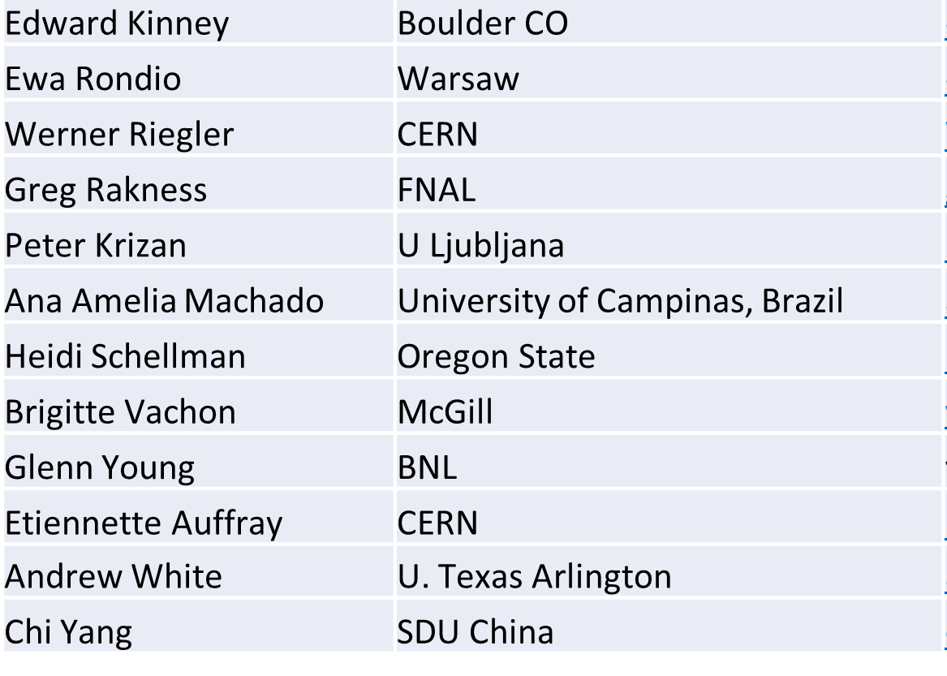
Detector Advisory Committee
We assembled the DAC in 2020
Per the charter, 1/3 of the committee was replaced early 2023, we are in the process of early 2024 changes
Will replace in 2024: Heidi Schellman, Chi Yang and Etiennette Auffray
Transition Chair from Ed Kinney to Andrew White
Meetings 2024 under planning:
  ~April 2024: Project Status, Baseline Detector, International Engagement, Detector R&D progress (expect 1+ day)
  ~August 2024: Detector R&D annual review (expect 2 days) – deadline for submission July 1, 2024
Edward Kinney (Chair) | Boulder CO
Ken Wyllie | CERN
Petra Merkel | FNAL
Antonis Papanestis | Rutherford Appleton Laboratory
Peter Krizan | U Ljubljana
Ana Amelia Machado | University of Campinas, Brazil
Heidi Schellman | Oregon State
Brigitte Vachon | McGill
Stefano Miscetti | INFN Frascati
Etiennette Auffray | CERN
Andrew White | U. Texas Arlington
Chi Yang | SDU China

Slide 11

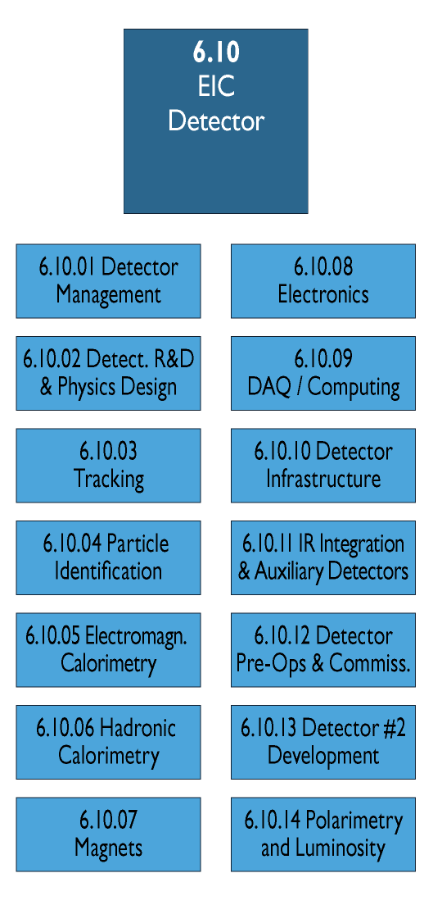
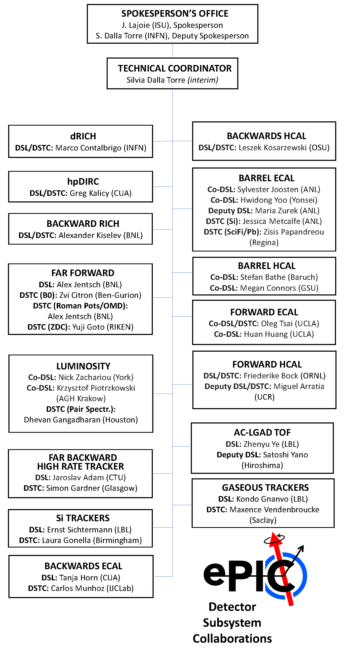
Integrating collaboration in Project WBS
DSL:
Detector Subsystem Leader
DSTC:
Detector Subsystem Technical
Coordinator
Detector
Subsystem
Work Packages
need to be
integrated in WBS

Slide 12
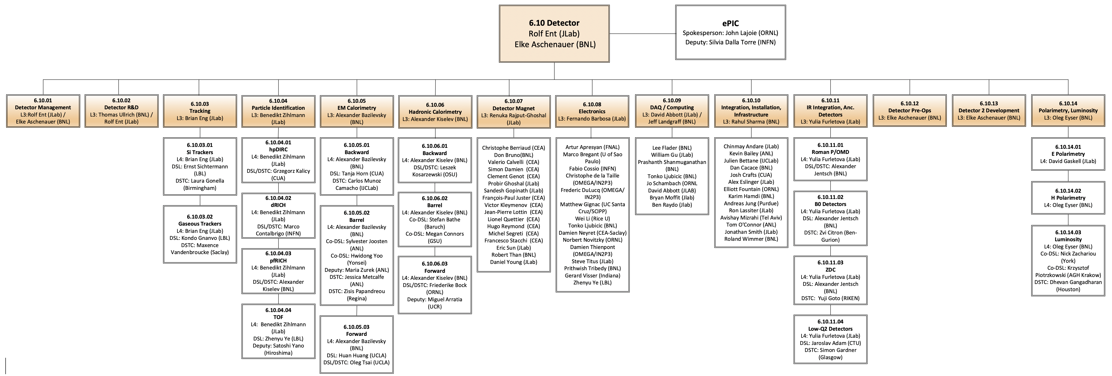
Integrating collaboration in Project WBS
Work-packages are implemented on Level-5 and lower.
Need to finalize in the next 6 month, please work with your CAM
Milestones cannot move and cost should not increase

Slide 13
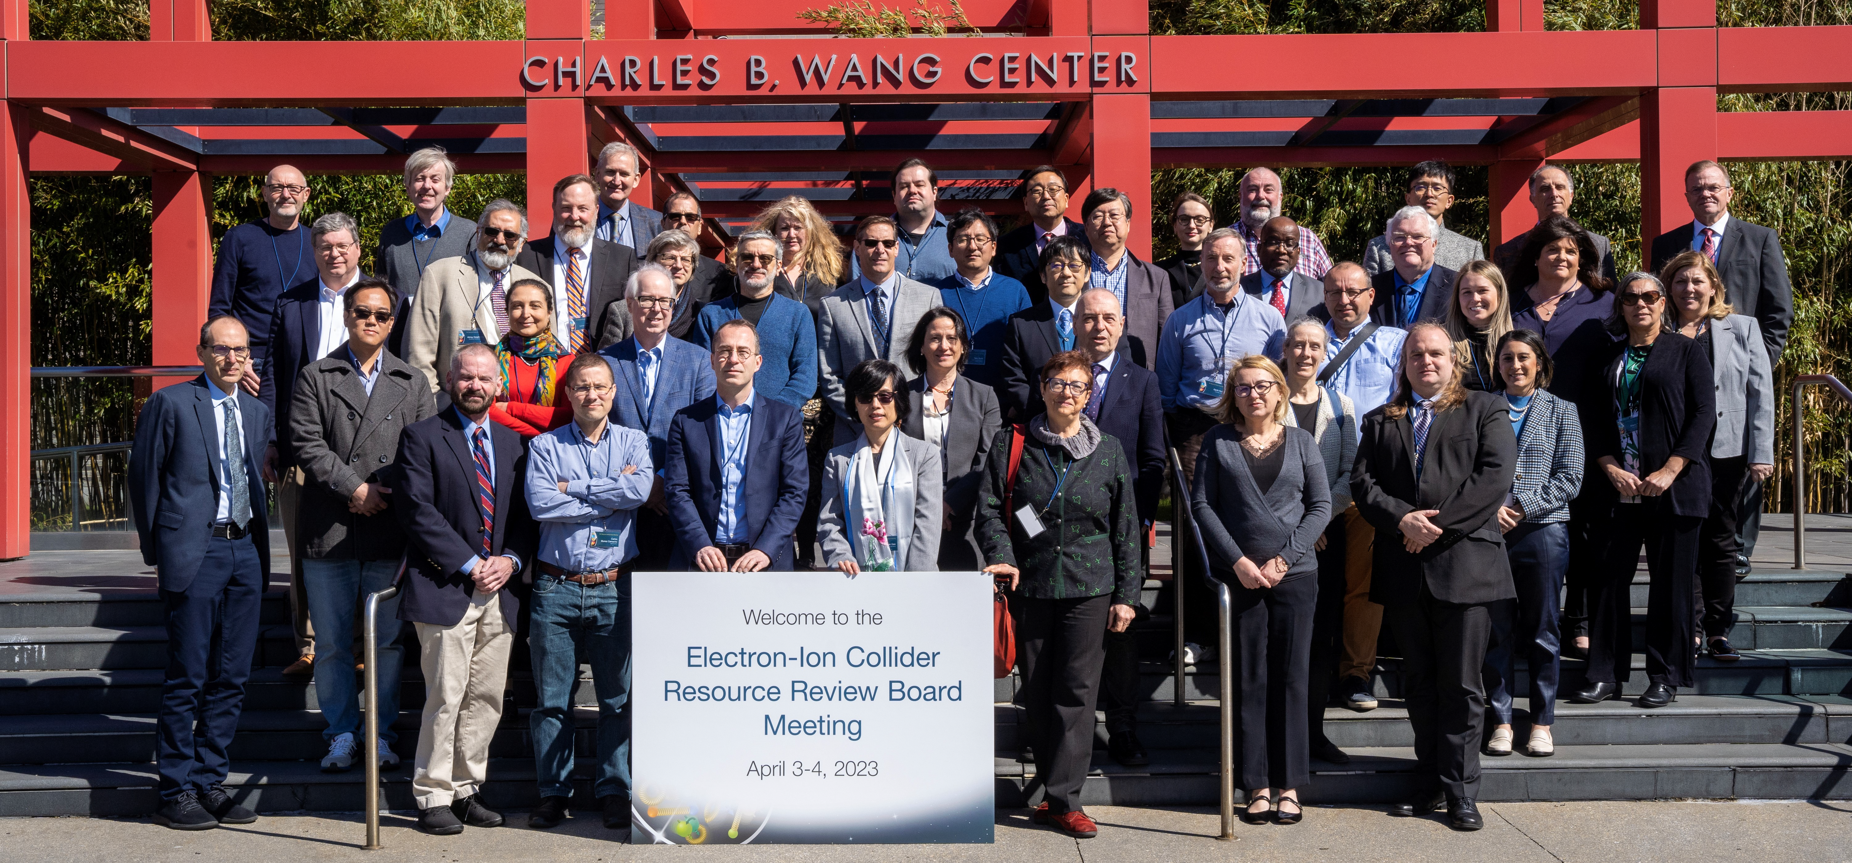
International Engagement: Resource Review Board (RRB) Meetings
DOE and the host labs promoting the EIC as a facility “fully international in character.”
Initial RRB Co-Chairs:
Haiyan Gao (BNL)
Diego Bettoni (INFN)
https://www.bnl.gov/eic-rrbmeeting/
1st RRB meeting on April 3-4, 2023 at Stony Brook University.
2nd RRB meeting on December 7 + 8 at Catholic University of America.
3rd RRB meeting planned for June 3 + 4 hosted by INFN/Italy

Slide 14



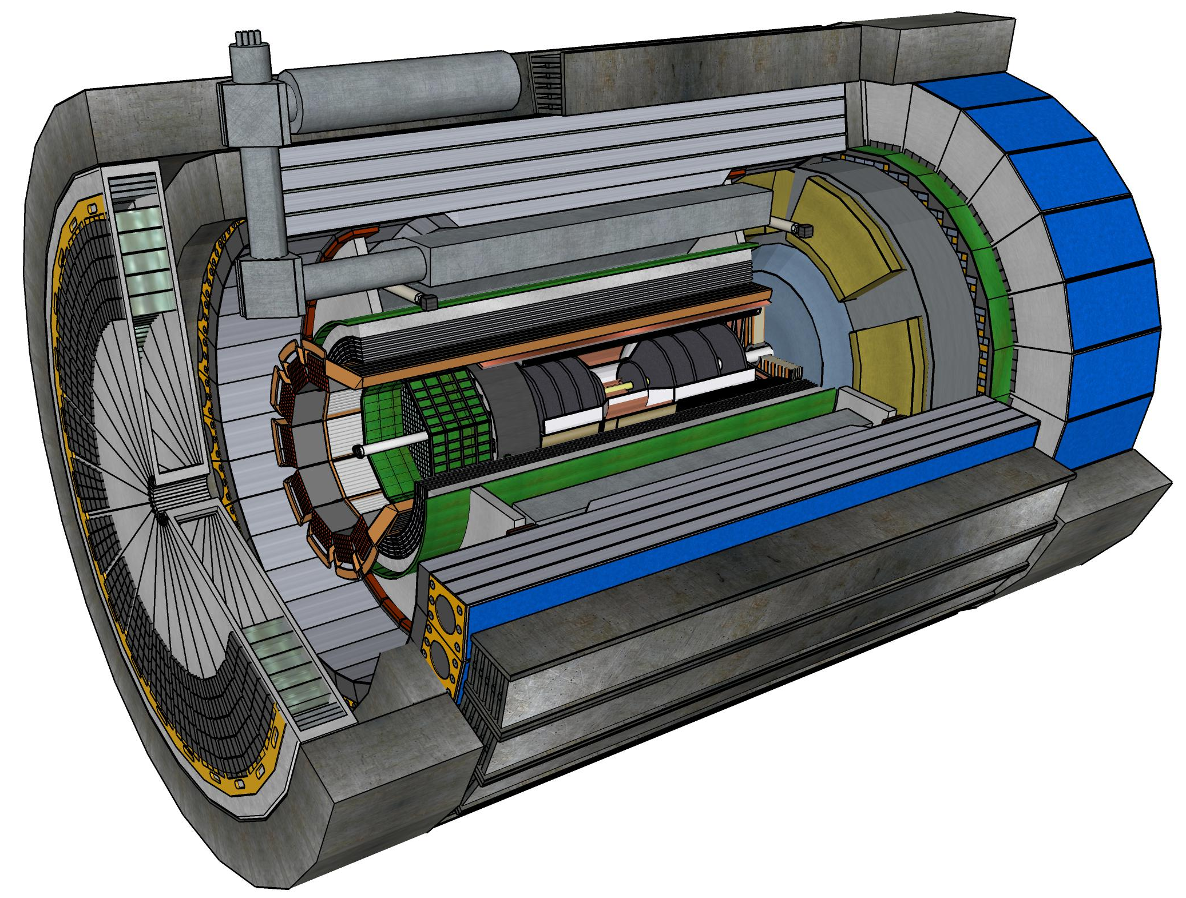










Central Detector Non-DOE Interest & In-Kind
Superconducting
Solenoid
Dual-radiator
RICH
Forward Electromagnetic
Calorimeter
Barrel
Electromagnetic
Calorimeter
Tracking
Detectors
Backward
Electromagnetic
Calorimeter
Time-of-Flight
Backward Hadronic
Calorimeter
Data-Acquisition
Electronics

Slide 15
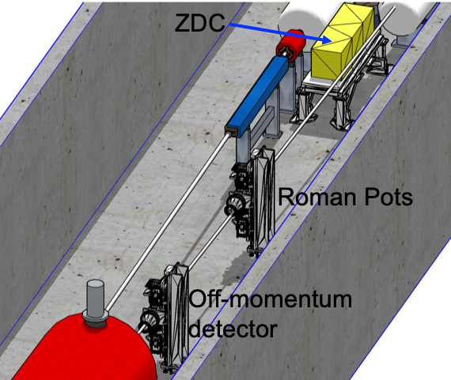
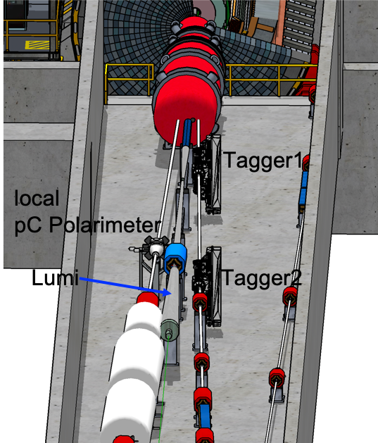

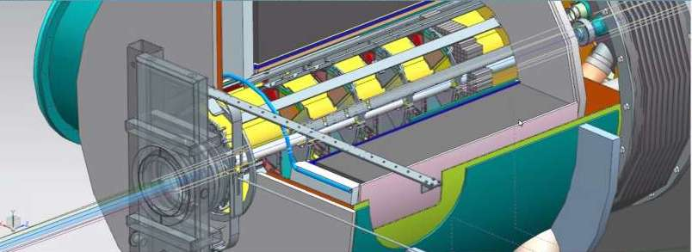

Far-Forward/Far-Backward Detectors Non-DOE Interest & In-kind
Detectors along the hadron and electron beam-lines
B0-Tracker & Electromagnetic Calorimeter

Slide 16
Detector Non-DOE Interest & In-Kind
Entity | Interest and Important Facts
NSF | NSF-MSRI pre-proposal submitted by 10 US universities – aims at full scope of backward EM calorimetry (eECal). Armenia, Czech, France/IN2P3 as unfunded contributors. Invited to submit proposal. Final internal NSF review is ongoing.
CERN | MAPS sensor design developed by CERN/ITS-3 Group providing synergy with ALICE. Synergy of gaseous-based Cherenkov detectors and photon-sensors with ALICE & LHCb. Synergy of Forward AC-LGAD design with CMS endcap timing layer.
Armenia | Contributions, mainly labor to eECal and many EM calorimetry and particle id detectors component tests.
Canada | EIC included in 2022 Canadian Subatomic Physics Long-Range Plan; Interested in Compton Polarimetry, Barrel Electromagnetic Calorimetry and Software
China | Interested in Forward EM Calorimeter – working on NSF-China proposal.
Czech | Working with funding agency; Interested in eECal (PbWO4 crystals and glass) and Silicon
France/IRFU | Interested in MPGD/racking, electronics. Provided in-kind contributions to SC magnet design and interested to continue labor oversight during magnet construction.
France/IN2P3 | International contribution to backward EM calorimetry (including in-kind design) and to readout electronics (two ASICs for AC-LGAD detectors and Calorimetry). IRFU & IN2P3 discussing together for higher-level contributions.
India | Consortium is working with Funding agency; Interested in detector software (non-project scientific contribution), contributions to DAQ/slow controls. Investigating further hardware contributions (including possible links with Si groups and plants).
Italy/INFN | Aims at major scope of forward particle identification detector (dRICH), at (part of) the Si/MAPS tracker scope, and at photo-sensor contributions as well as contributions to the μRwell. tracker. Further investigating possible interest in EIC detector magnet scope.
Israel | B0 Detectors (Si tracking and PbWO4)
Japan | Interested in a US-Japan agreement; Aims at full scope of Zero-Degree Calorimeter in collaboration with Taiwan/Korea. Pursuit of full scope of barrel AC-LGAD detector as EIC-Asia consortium. Contribution to DAQ/streaming.
Korea | Aims at major scope for fiber-based barrel EM calorimeter, Also work packages for barrel AC-LGAD and Si-based hadronic calorimetry for ZDC.as part of EIC-Asia consortium (includes also Japan,Taiwan), Collaboration on Si tracking detector.
Poland | Actively working with ministry/funding agency; Interested in detectors along the beam line (luminosity detector, Roman Pots)
Taiwan | Pursuit of full scope of barrel AC-LGAD as part of EIC-Asia consortium. LYSO-based EM calorimeter for ZDC, Also optical readout/fiber. Possible later interest in PCBs. Computing.
UK | STFC seed funding for UK detector R&D (3M£). Interest in Si/MAPS tracker, polarimetry and detectors along the beams (Low-Q2/TimePix). Follow-up STFC/UKRI request for 5-7 years submitted early 2023 (includes accelerator part).

Slide 17
EIC In-Kind CD-2 Expectations
Government to Government
Science & Technology (S&T) Agreement
binding (contractual)
not-binding
Agency to Agency
Implementing Agreement
DOE led/ signed
Project Annex
Statement of Interest
US Lab led/ signed
iCRADA
Project Planning Documents (PPDs)
DOE agreements do not contain EIC Project IKC scope details.
Project Planning Documents (PPDs) contain IKC scope details.
PPDs are not required for all IKC. EIC will have ~ 5-10.
Laboratory (BNL or JLab) iCRADA binding agreements are suggested for IKC items requiring a PPD.

Slide 18
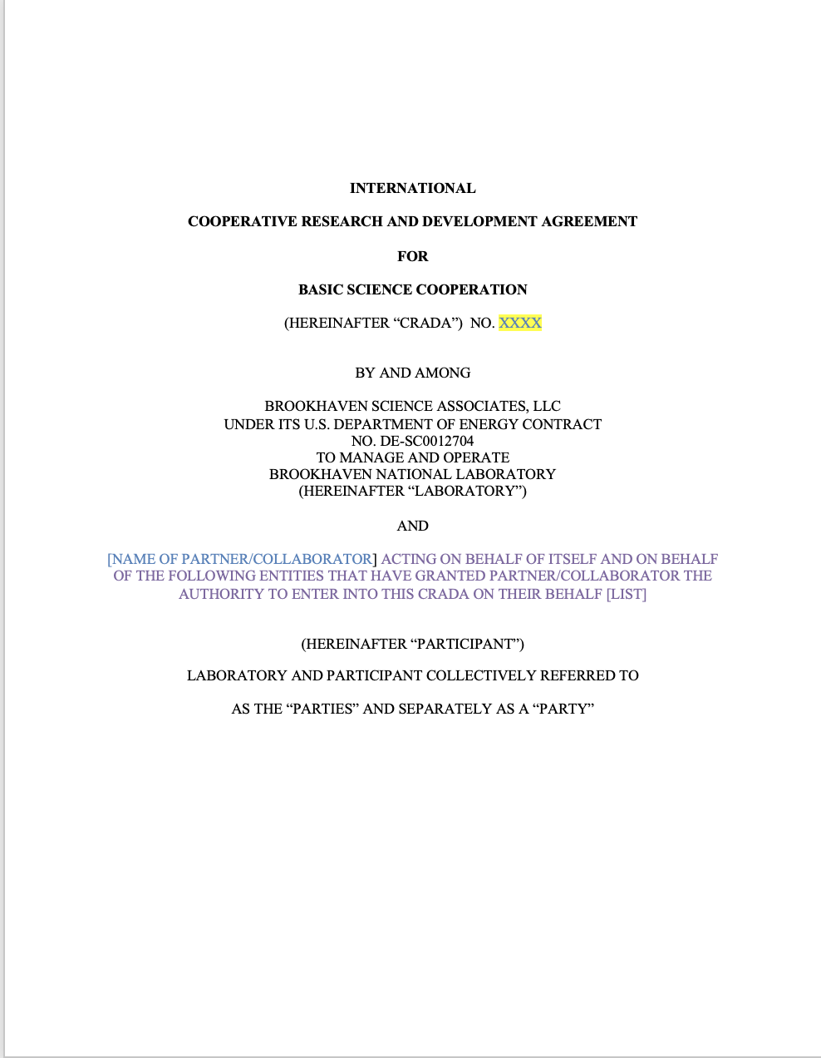
Why iCRADA?
iCRADA = international Cooperative Research And Development Agreement.
iCRADA is needed to carry out the cooperative activities set forth in the Annex.
iCRADA first 8 pages can not be modified by the Parties i.e. the first 8 pages are not negotiable (Please note that the first 8 pages might look familiar too many of you.)
iCRADA Annex need to be develop with each EIC Partner with a preference to maintain separate the Detector and Accelerator scope.
iCRADA Annex contains a high level description of the EIC specific IKC scope from a EIC Partner.
iCRADA Annex contains an estimation of the IKC work “up to/do not exceed” US $ calculated as the IKC work will be performed by DOE $.
Template posted on the RRB indico page

Slide 19
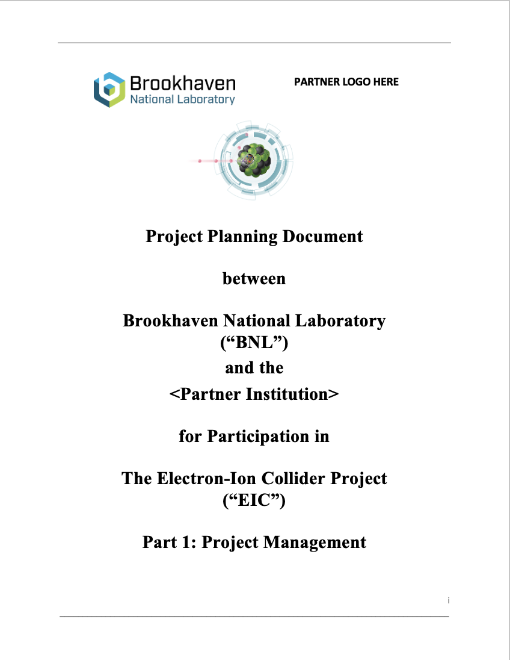
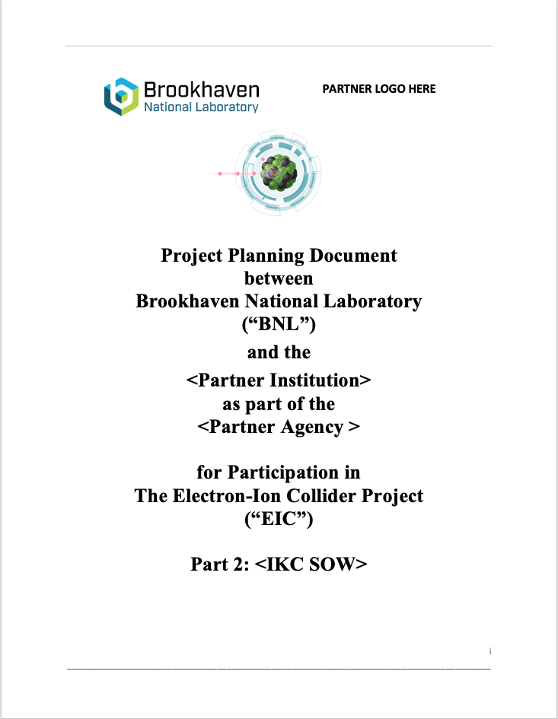
Why are PPDs needed
The EIC Project requests PPDs for the following cases:
Technical complex items;
Critical technical items;
High-risk items;
High-cost items;
Templates posted on the RRB indico page
PPDs are needed to align step by step the IKC scope/expectation to the project requirements.

Slide 20
1st Wave of Milestones for Detector IKC
Agency | Milestone | Target Date
Italy-INFN | Outcome on detector solenoid funding (CD-3A scope) | December 2023
US-NSF | Outcome on MSRI funding (CD-3A scope) | January 2024
UK | UKRI outcome on funding proposal | January 2024
Italy-INFN | JLab iCRADA draft on magnet | February 2024
Italy-INFN | BNL iCRADA draft on magnet | March 2024
Italy-INFN | iCRADAs on magnet signed | May 2024
France-IN2P3 | PPD draft | May 2024
France-CEA | PPD draft | June 2024
UK | PPD draft | August 2024
Italy-INFN | JLab iCRADA signed (excluding magnet scope) | August 2024
Italy-INFN | PPD draft / excluding magnet scope | August 2024
France-IN2P3 | JLab iCRADA and BNL iCRADA signed (draft in Jun/Jul) | September 2024
France-CEA | JLab iCRADA signed (draft in Jun/Jul) | September 2024
UK | JLab iCRADA signed (draft in Jun/Jul) | September 2024
 | CD-2/CD-3 Director’s Review / All PPDs signed | November 2024
 | CD-2/3 OPA review | January 2025
 | CD-2/3 ESAAB | April 2025
There will be amble opportunity
to make in-kind contributions
after CD-2 as fits best with
your funding agency cycle.
To achieve these timelines, it
will be critical to have a dedicated
team from the in-kind partner
and the project team working
in sync to get the documents
done and signed.
Would appreciate to get contact
persons defined asap.
Note after review:
for magnet it makes more sense to constrain to:
JLab-INFN iCRADA
JLab-CEA iCRADA
Magnet PPD

Slide 21
IKC Not Addressed in iCRADA / PPDs
At the time of the DOE CD-2/3 Review, currently planned for early 2025, scope without identified IKC partners will be assumed as DOE scope, and pursued as opportunities.
IKC are expected to be identified and agreed upon at all stages of the EIC project, e.g., detector upgrades, accelerator installation and commissioning, and the timing of approval cycles in different countries (for example in the detector area, we would like to mention in this categories Countries with which we are already working such as Canada, Japan, Korea, Taiwan, etc.).

Slide 22
Beam Background and Detector Performance
Accelerator Changes impacting Beam Background
new incoming and outgoing electron beam lattice → SR and electron beam gas
potential changes in injection scheme of leptons → SR
Impact on Detector Performance:
Background hits will impact the track finding and reconstruction
  Embedding of beam background events in DIS signal event in MC simulations
  Impact depends on speed of subdetector readout speed, MAPS 2 μs AC-LGAD 30 ps
Background will impact of energy reconstruction in calorimeters
Need to know the total rate per readout channel (== Background + DIS) for DAQ
  impact needed data rate capabilities
Total Radiation (== Background + DIS) impact subdetector lifetimes
→ need the thresholds per subdetector on hit level and summed energy,
see EPIC Detector DigitizationModel.09.2023.xlsx, to get the correct rates
→ All implemented in December campaign
→ Impact on backgrounds currently actively analyzed
→ https://wiki.bnl.gov/EPIC/index.php?title=Background will be updated

Slide 23
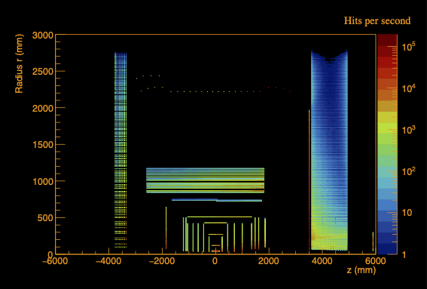
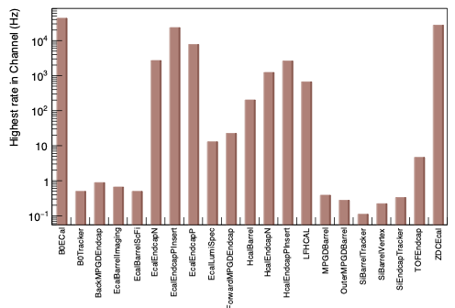
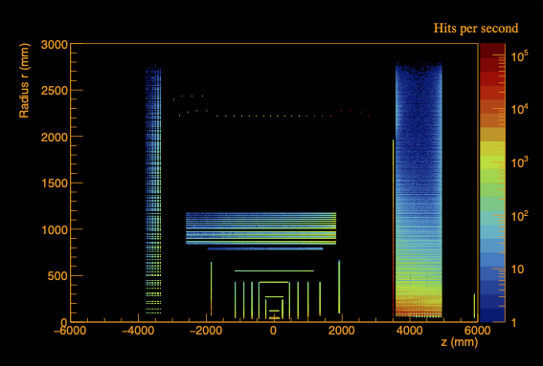
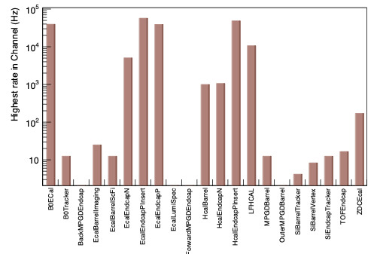
Rates per Channel – first Results
eP – no Q2
Hadron Beam Gas
– 275 GeV

Slide 24
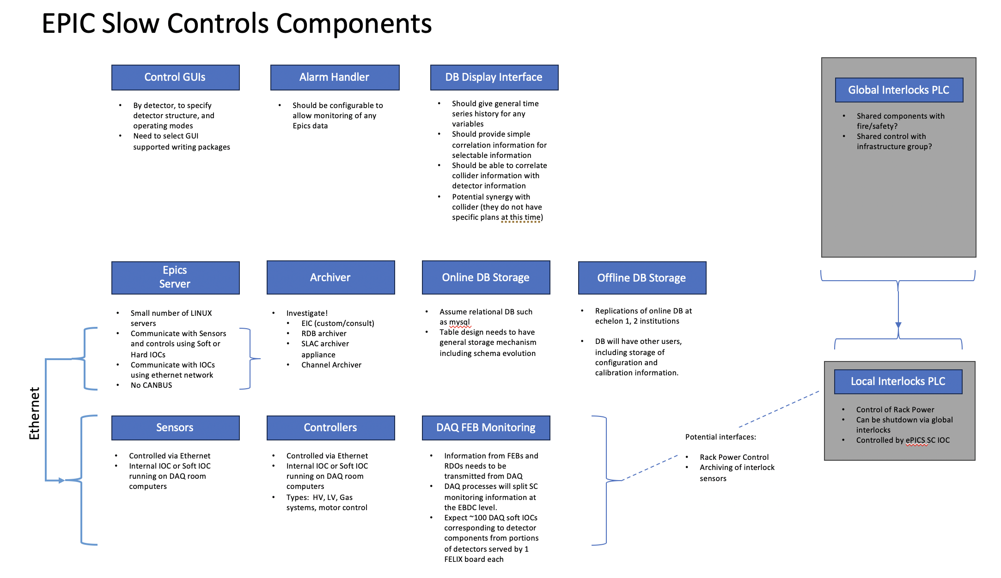
Request for Information – Readout and Controls
Need to start to pay attention on controls → developed a survey
Slow Controls Survey.xlsx click insert and on view survey in the pull-down menu from survey
→ will follow up with detailed email to all DSCs
thanks to Lee Flader,
Jeff and Dave

Slide 25
Request for Information – Readout and Controls
Need input from all DSCs to help the ASIC Designers
Document to be filled: ePIC Detector Information Request.xlsx
Details have been discussed in Fernando’s email from December 12th
“Hello Everyone,
We need your help with some specifications for the Electronics & DAQ, which will help the ASIC designers and SRO and further developments.
Please enter the requested information for Qmin, Qmax and Expression of Interest for the various electronics & DAQ developments under each detector sub-system (a few entries are already filled). The Expression of Interest will let us know if resources (scientists, engineers, technicians) are already identified to address the design and implementation of the various parts of the readout (Adapters, FEBs, etc.)
The maximum rate per channel, per detector, is another critical specification that will be available soon.
In advance, my apologies for the large distribution list but I wanted to keep everyone in the loop. In the event I missed some people, please feel free to forward this email, as well.
Thanks for your support and best regards,
Fernando”

Slide 26
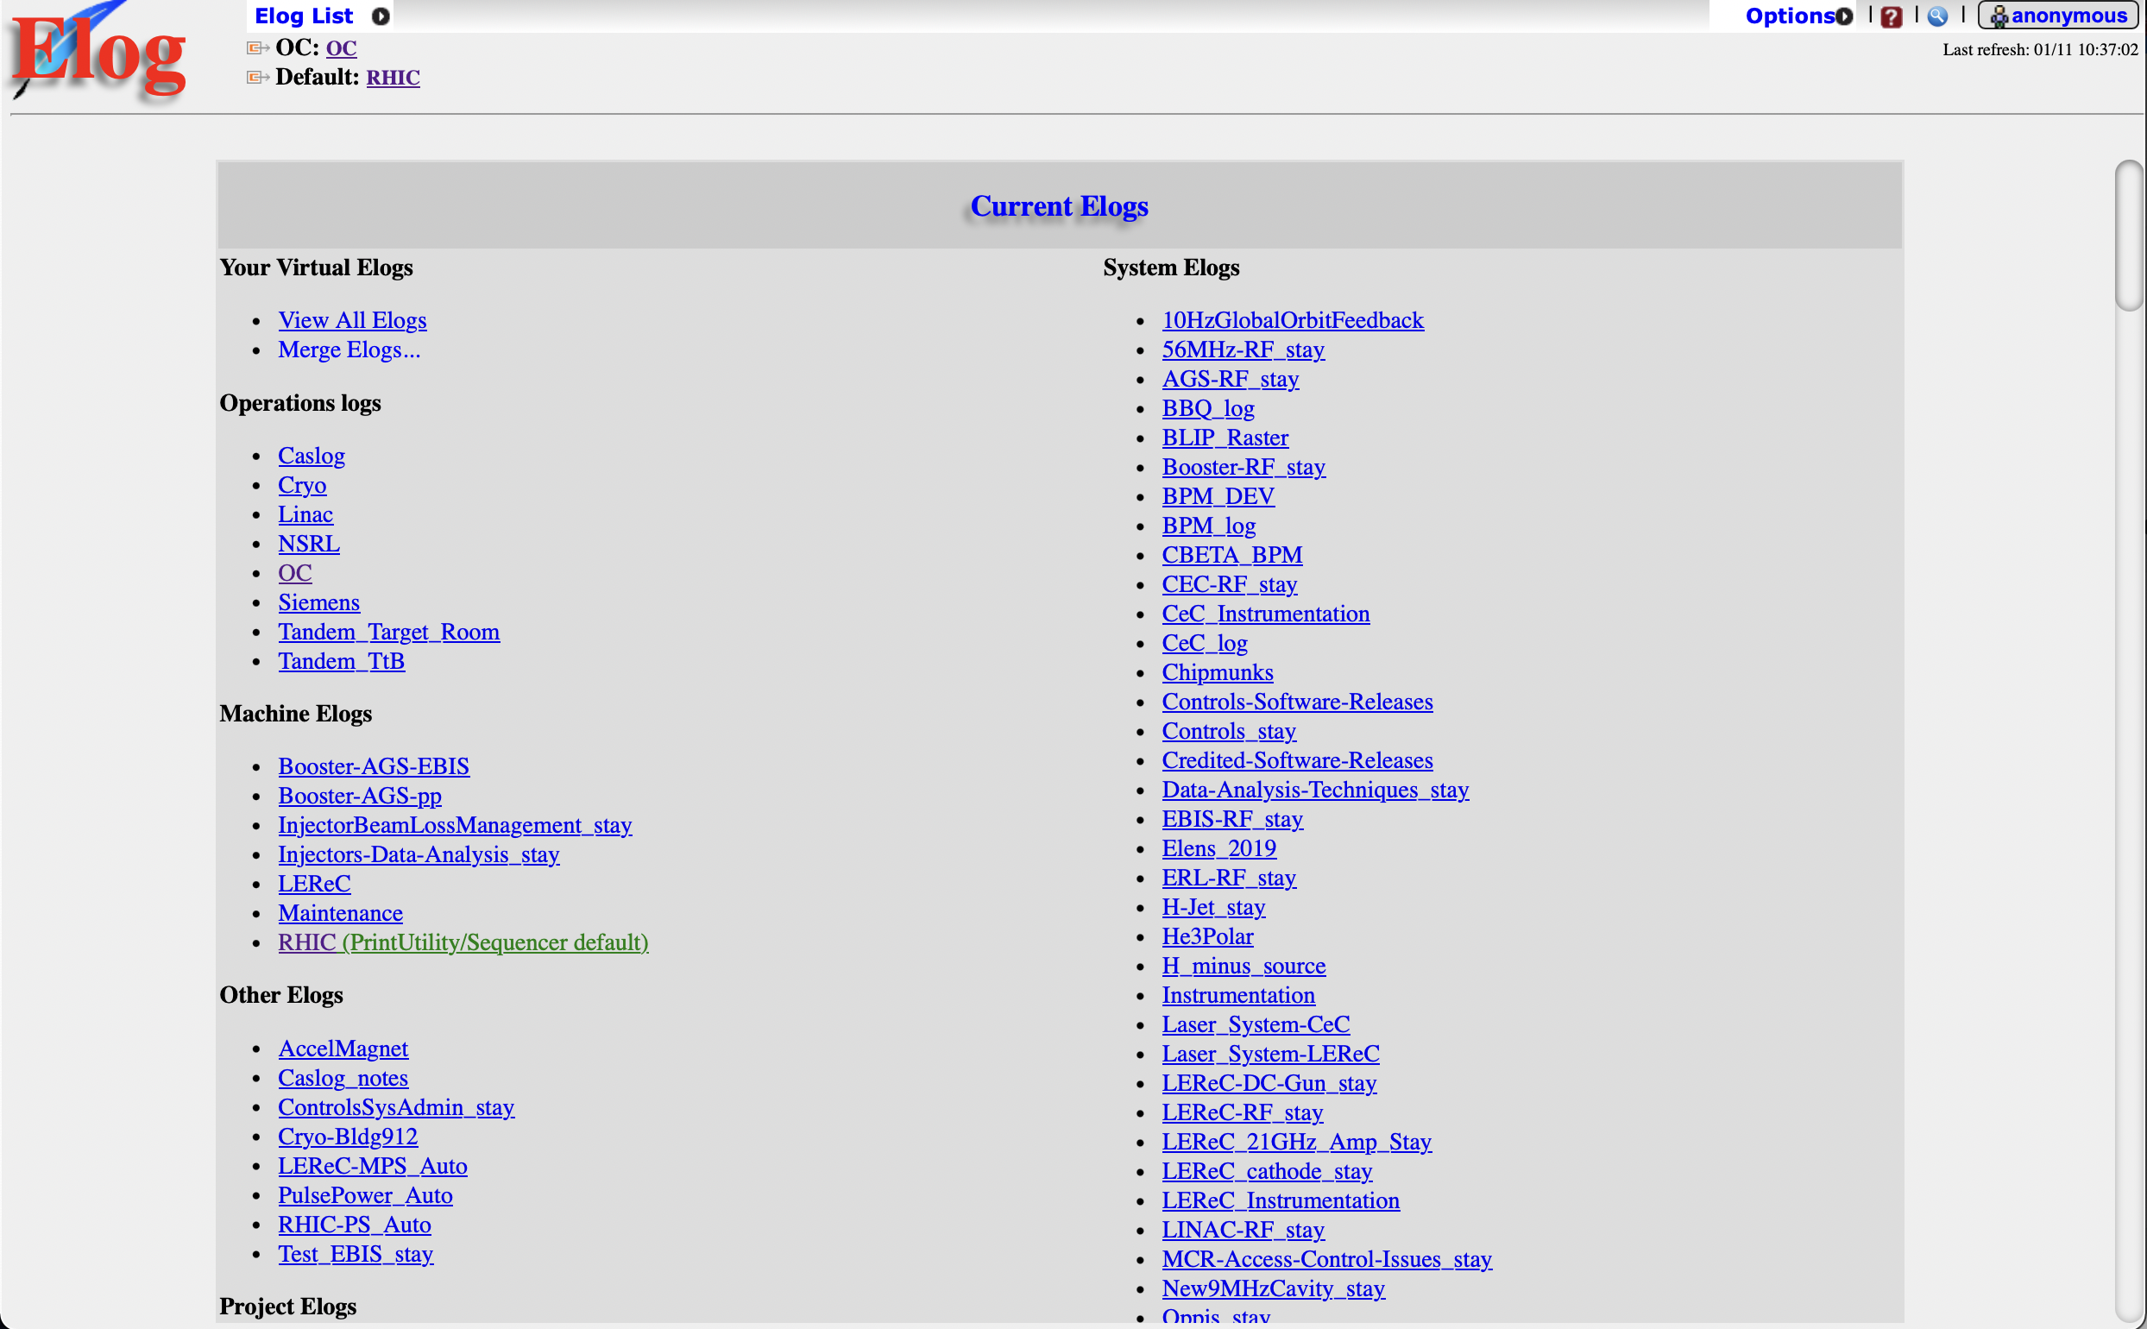
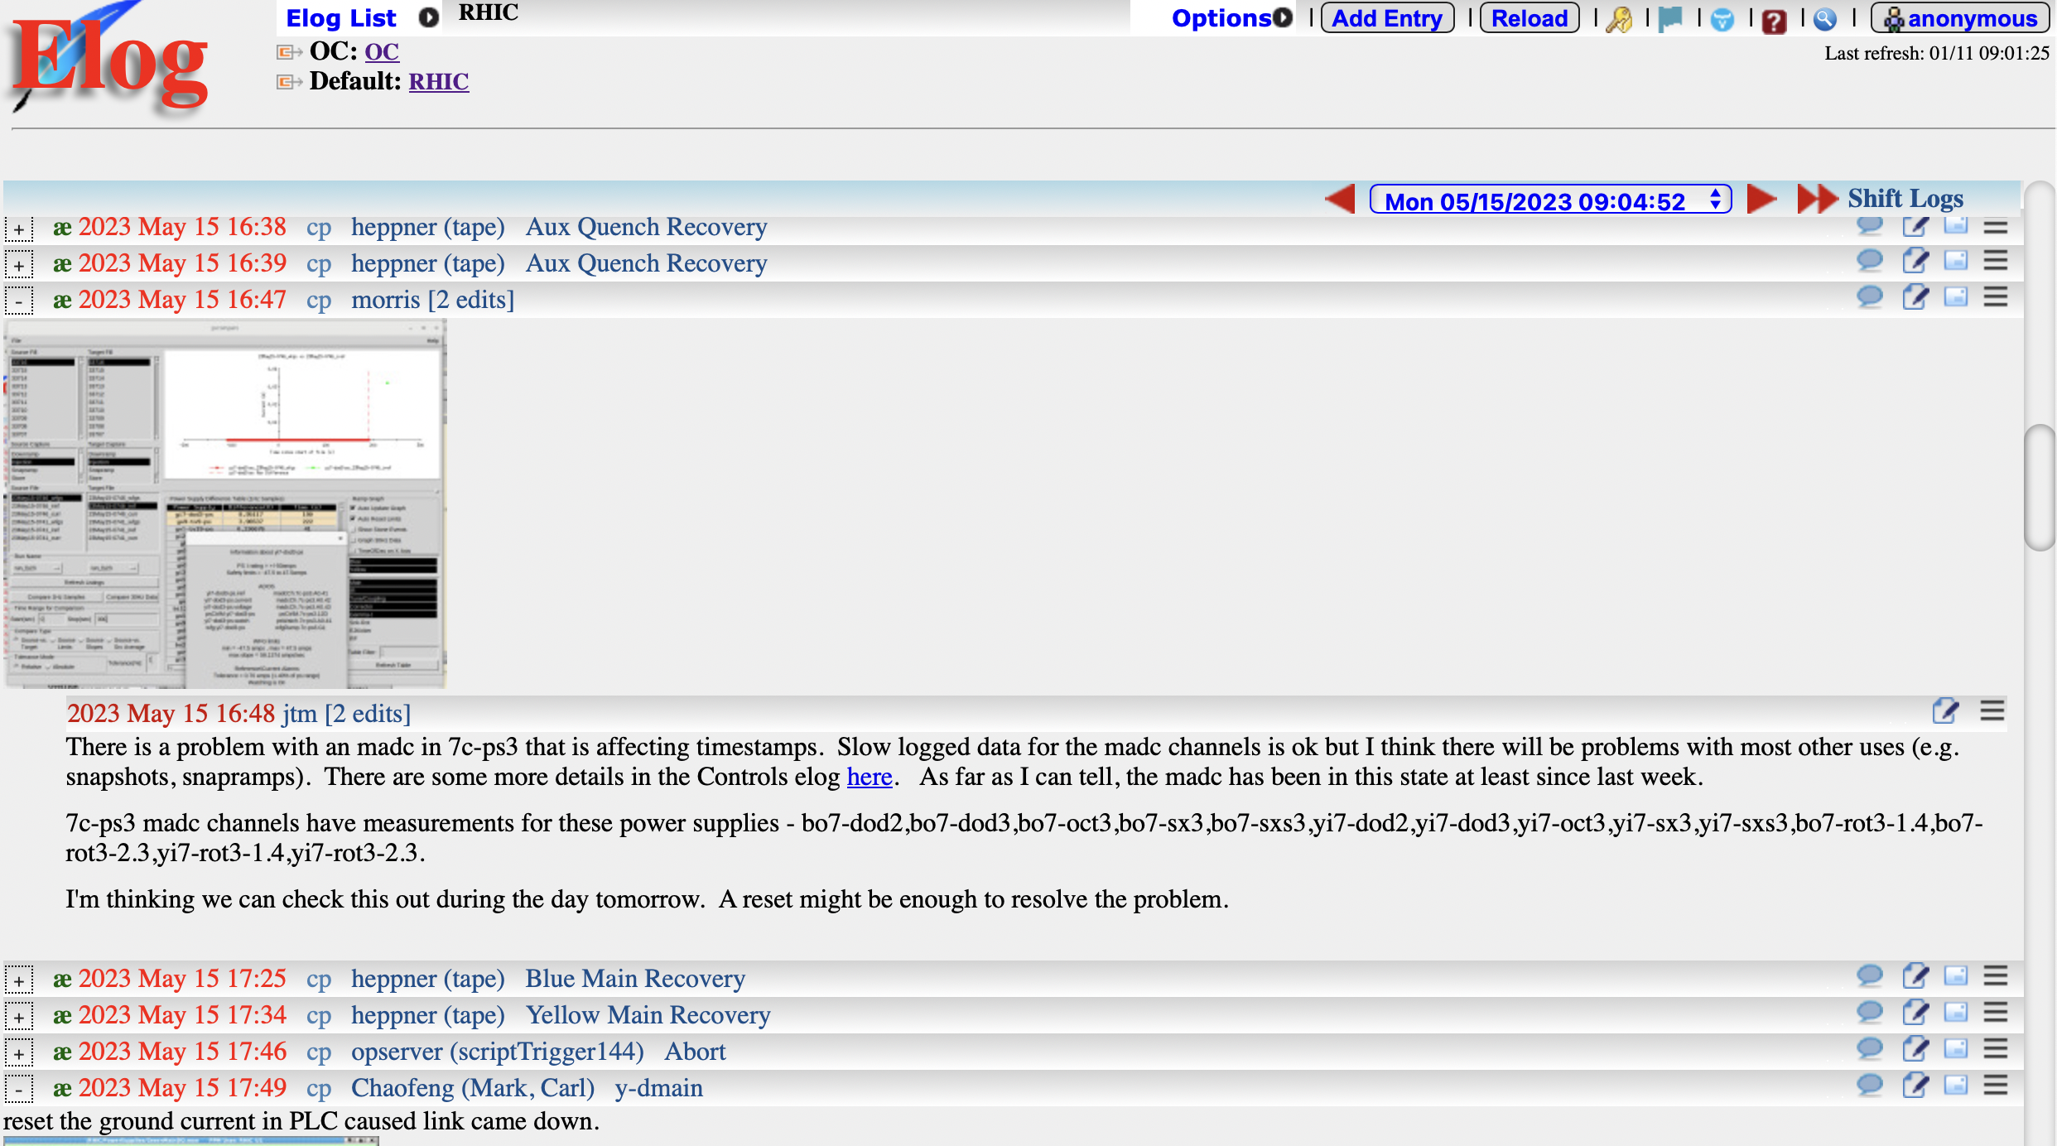
Needed Tools for Experiment
Need to make sure we have all the tools available to efficiently store our information we collect over the next years
Information and Data from test beams
→ one common logbook for ePIC which has different “sections” for different subdetectors test
beam campaigns and so on
→ proposal use the existing RHIC logbook software and make it publicly available for ePIC

Slide 27
Needed Tools for Experiment
Need to document the Q&A results of all our equipment each individual SiPM, CHIPs, FED, ….
→ will have to have travelers for all equipment pieces and document each step of the production and Q&A
Common solution: Hardware/Assets Database for ePIC
  Purpose
    Keep track of detector components, especially electronic components (power supplies, sensors, ASICs, boards)
    Each component tracks: purchase (manufacturer, builder, delivery date), SN, installation details, repairs, problems, ,QA status, locations and more
    Allows tracking problems, knowledge not tied to individuals
  Past
    HW databases not common in past at RHIC and JLab experiments
    JLab is using one for CEBAF machine (HW not RHIC)
  Now
    CERN/LHC https://eam-opensource.web.cern.ch/content/eam-light
    sPHENIX for some sub detectors (e.g. EMCal, TPC)
    All LHC experiment
      Example: ATLAS ITK - sophisticated complex DB build by Unicorn University, Prague
      Example: ALICE - Hardware Database build by Peter Glässel (used by sPHENIX)
  Potential Solutions for ePIC
    Reuse existing HW database software (e.g. ALICE, ATLAS, CMS version) and tune for our purpose
    Build own version - needs new group, substantial effort
    Use “RHIC logbook” equivalent instead
thanks to Thomas

Slide 28
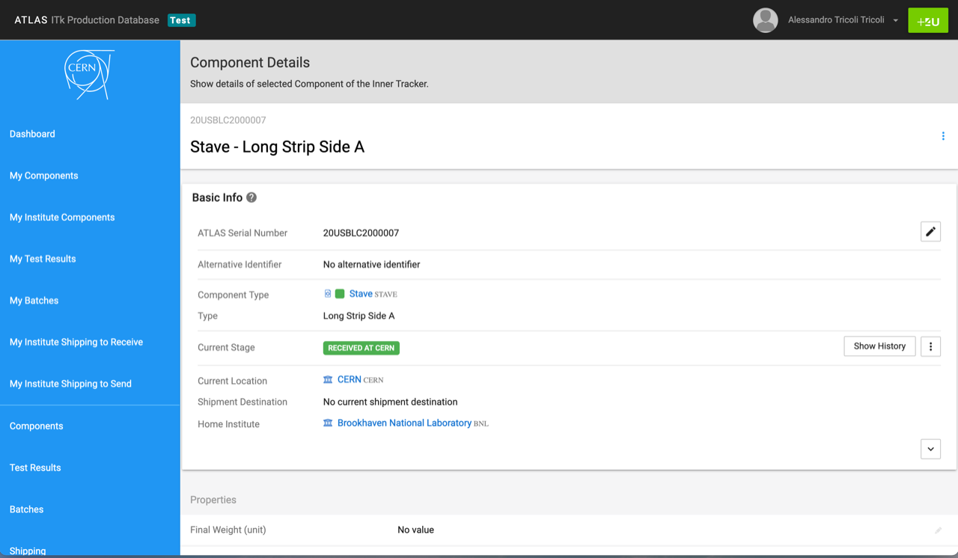
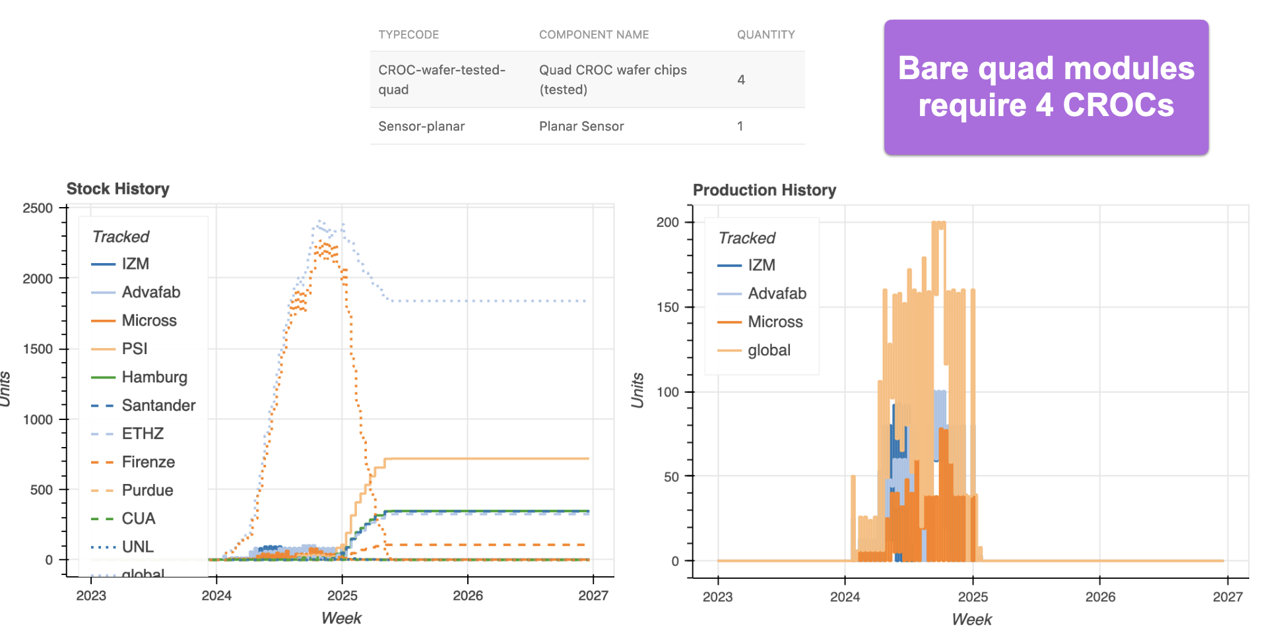
Screenshots of ATLAS ITk database
(here: ID, SN, Location)
courtesy Alessandro Tricoli
Screenshots of CMS database
(here: production statistics)
courtesy Andreas Jung
Screenshots of sPHENIX TPC database
(here: QA steps/table)
courtesy Prakhar Garg

Slide 29
Summary
2024 will not be different: A lot of work for all of us.
We need all to be engaged and responsive
as individual responses impact the progress of others.
This is just the nature of the high integration level of the EIC detector and science.
29

Slide 30


Slide 31


Slide 32
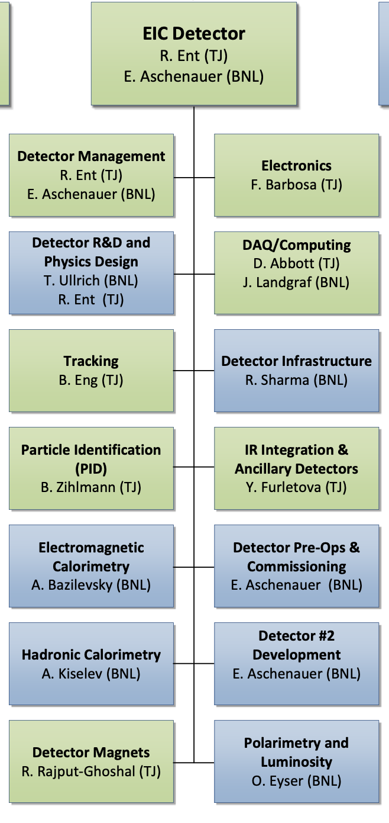
WBS 6.10 EIC Detector & 6.10.01 Management
How We Work:
The highest-level detector management consists of:
Elke & Rolf L2 Leads
Walt Akers 6.10 Systems Engineer
Fernando Barbosa Chief Electrical Engineer
Rahul Sharma Chief Mechanical Engineer
Do not use this CAM responsibility organization as Black and White, we work together as a scientific collaboration and use expertise from each lab as it fits independent of high-level responsibility
We include user efforts where it makes sense, and lean to more
We have
Weekly meetings with ePIC spokesperson and deputy
Weekly meetings with the mechanical engineering team
Biweekly meetings with the electrical engineering team
Weekly meetings with the Detector Control Account Managers
As needed meetings with various detector subsystems
Walt, Fernando and Rahul have also separate meetings, for Walt with the Systems Engineering Group, for Rahul with also various non-BNL/non-Jlab engineers/designers, etc.
We report at the biweekly ePIC meetings and many other meetings on general detector progress or requested topics
Blue/Green show nominal BNL/JLAB responsibility

Slide 33
1st Wave of Milestones for Accelerator IKC
Agency | Milestone | Target Date
France – IN2P3 | Proposed scope accelerator | End December 2023
UK | UKRI outcome on funding proposal | January 2024
France – CEA/IN2P3 | Joint Proposal submitted to French Ministry | February 2024
Canada – TRIUMF | JLab iCRADA draft | February 2024
Canada – TRIUMF | BNL iCRADA draft | March 2024
Canada – TRIUMF | iCRADAs signed | May 2024
Canada – TRIUMF | PPD draft | June 2024
France – CEA | BNL iCRADA draft | June/July 2024
UK | Jlab iCRADA draft | June/July 2024
France – CEA | PPD draft | August 2024
UK | PPD draft | August 2024
France-CEA | BNL iCRADA signed | August 2024
UK | JLab iCRADA signed | August 2024
 | CD-2/CD-3 Director’s Review / All PPDs signed | November 2024
 | CD-2/3 OPA review | January 2025
 | CD-2/3 ESAAB | April 2025

