Slide 1
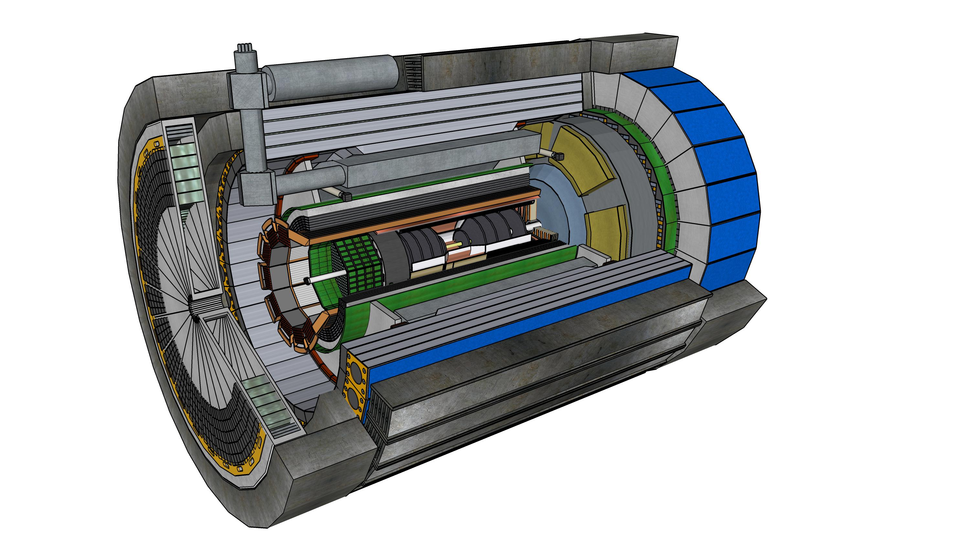

Electronics and DAQ WG Report
ePIC Electronics & DAQ WG Conveners: Fernando Barbosa, Jin Huang, Jeff Landgraf

Slide 2
Outline
Overview of ePIC DAQ architecture
Component status
Other Electronics and DAQ activities
Summary of Joint Electronics and DAQ WG and Streaming Working Group Workfest

Slide 3
Streaming in ePIC
ePIC DAQ
Definition of streaming is “No L0 trigger”
  No system wide deadtime in normal operation
    Detectors will have minimum double hit times for channels or modules, as well as throughput limitations.
  Collaboration should have the full ability to make data selection cuts on the widest possible criteria
    Full flexibility for event selection
    As full flexibility for data selection as possible
    As full background characterization as possible
  But subject to an overall throughput budget of ~100Gb/sec
ePIC Streaming will include technical capability for
  Zero suppression & aggregation within data packets
  Software (hardware) tagging & filtering
  Flow control (application of deadtime for data coherence)
  Pre-scaling (application of arbitrary deadtime by detector)
ePIC Computing
Definition of streaming is “Process data as it arrives”
  Physics event selection and tagging
  Fast Analysis (~3 weeks not months or years) using automation of calibration and reconstruction.
    Fast understanding of operations needs
    Fast understanding of calibration
    Fast publication
  Distributed analysis
  Efficient use of diverse architectures (eg. Support for GPU)
  Efficient use of diverse software (eg. AI)
  Incorporate worldwide computing facility contributions
Overlap between DAQ and computing
      Automation of Calibrations
      QA and monitoring
      Consistent schemes and language for managing data and metadata
      Event Selection and Tagging

Slide 4
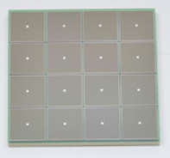
ePIC Readout Chain
Global Timing Unit (GTU)
-Interfaces to Collider, Run Control & DAM
-Config & Control
-Clock & Timing
Echelon 1
(BNL)
On Detector
SMT BGA
Echelon 0
Echelon 1
(JLAB)
Name
Design
Function
Attributes
Sensor
Detector Specific
Multi-Channel Sensor
MAPS, AC-LGAD
MPGD, MCP-PMT
SiPM, LAPPD
Adapter
Detector Specific
-HV/Bias Distribution
-HV divider
-Interconnect Routing
-Sensor Specific
-Passive
Front End Board
(FEB)
Detector Specific
-Amplification
-Shaping
-Digitization
-Zero Suppression
-Bias Control & Monitoring
-ASIC/ADC
-Discrete
-Serial Link
Readout Board
(RDO)
Few Variants
-Communication
-Aggregation
-Formatting
-Data Readout
-Config & Control
-Clock & Timing
-FPGA
-Fiber Link
Data Aggregation Module (DAM)
Common
-Computing Interface
-Aggregation
-Software Trigger
-Config & Control
-Clock & Timing
-Large FPGA
-PCIe
-Ethernet
Computing
Common
-Data Buffering and Sinking
-Calibration Support
-QA/Scalers
-Collider Feedback
-Event ID/Building
-Software Trigger
-Monitoring
-COTS
-Ethernet

Slide 5
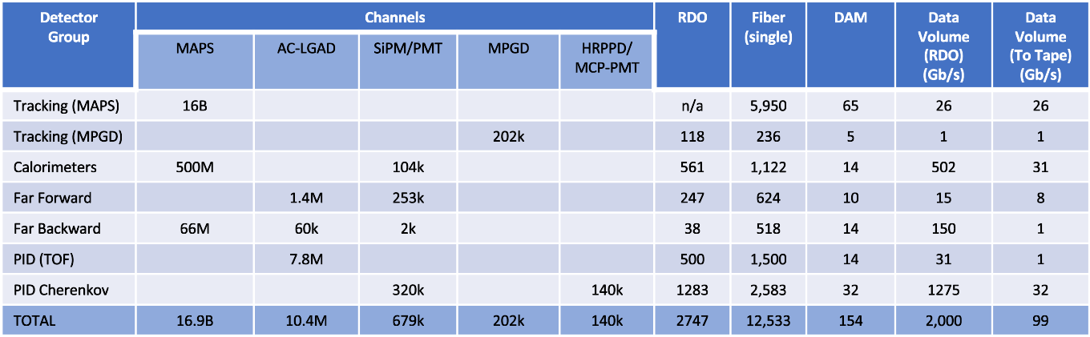
Summary of Channel Counts and Data Flow
New DIS/Background numbers first shown yesterday!
Correct Thresholds
Simulation Properties
Updated Collider Lattice
Distributions of hits within detectors
More realistic ASIC behavior
Better understanding of filtering scheme
See Elke’s talk, background group workfest presentations, and ePIC background group wiki
For now, these are the old numbers
Summary of Data Flow
Detector
FEB
Copper
RDO
Fiber
DAM
PCI/Eth
Readout Computer
Eth
100% Occupancy | 27.5-1760 Pb/sec
Aggregate | 96 Gb/sec
Collision Signal | 38 Gb/sec
Synchrotron Rad | .01 Gb/sec
Electron Beam | 22 Gb/sec
Hadron Beam | 4 Gb/sec
Noise | 32 Gb/sec
Aggregate | 2.0 Tb/sec
Noise | 1.6 Tb /sec
Signal from Physics + Background | 400 Gb / sec
Aggregate | 2.0 Tb/sec
Per RDO (Avg) | 0.7 Gb/sec

Slide 6
Summary of Channel Counts and Data Flow
Significant Filtering Challenges:
Far Backward
  Lumi Detector – sum energy deposited / moments each Bunch Crossing (or) integrate each channels signal over short time periods
  Low Q2 tagger – Software/firmware trigger (or) apply pre-scale (arbitrary deadtime to single detector)
dRICH – SiPMs requiring single photon sensitivity
  Dark currents increase with radiation damage
  Expect several years before annealing necessary to reduce dark currents
  After several years in a radiation environment, “noise” dominates signal at the RDO by factors up to x4
  Supply enough bandwidth to account for maximum data volume to the DAM boards
  Apply cross-detector correlation filter in nearby detectors in DAM / Readout computers to reduce recorded data volume
New numbers coming
out with improvements:
Correct Thresholds
Simulation Properties
Updated Collider Lattice
Distributions of hits within detectors
More realistic ASIC behavior
Better understanding of filtering scheme
See Elke’s talk and ePIC background group wiki
For now, these are the old numbers
Summary of Data Flow
Detector
FEB
Copper
RDO
Fiber
DAM
PCI/Eth
Readout Computer
Eth
100% Occupancy | 27.5-1760 Pb/sec
Aggregate | 96 Gb/sec
Collision Signal | 38 Gb/sec
Synchrotron Rad | .01 Gb/sec
Electron Beam | 22 Gb/sec
Hadron Beam | 4 Gb/sec
Noise | 32 Gb/sec
Aggregate | 2.0 Tb/sec
Noise | 1.6 Tb /sec
Signal from Physics + Background | 400 Gb / sec
Aggregate | 2.0 Tb/sec
Per RDO (Avg) | 0.7 Gb/sec

Slide 7
Summary of Channel Counts and Data Flow
New numbers coming
out with improvements:
Correct Thresholds
Simulation Properties
Updated Collider Lattice
Distributions of hits within detectors
More realistic ASIC behavior
Better understanding of filtering scheme
See Elke’s talk and ePIC background group wiki
For now, these are the old numbers
After echelon 0 processing we expect roughly equal contributions from collision hits, beam background hits, and noise.
Summary of Data Flow
Detector
FEB
Copper
RDO
Fiber
DAM
PCI/Eth
Readout Computer
Eth
100% Occupancy | 27.5-1760 Pb/sec
Aggregate | 96 Gb/sec
Collision Signal | 38 Gb/sec
Synchrotron Rad | .01 Gb/sec
Electron Beam | 22 Gb/sec
Hadron Beam | 4 Gb/sec
Noise | 32 Gb/sec
Aggregate | 2.0 Tb/sec
Noise | 1.6 Tb /sec
Signal from Physics + Background | 400 Gb / sec
Aggregate | 2.0 Tb/sec
Per RDO (Avg) | 0.7 Gb/sec

Slide 8
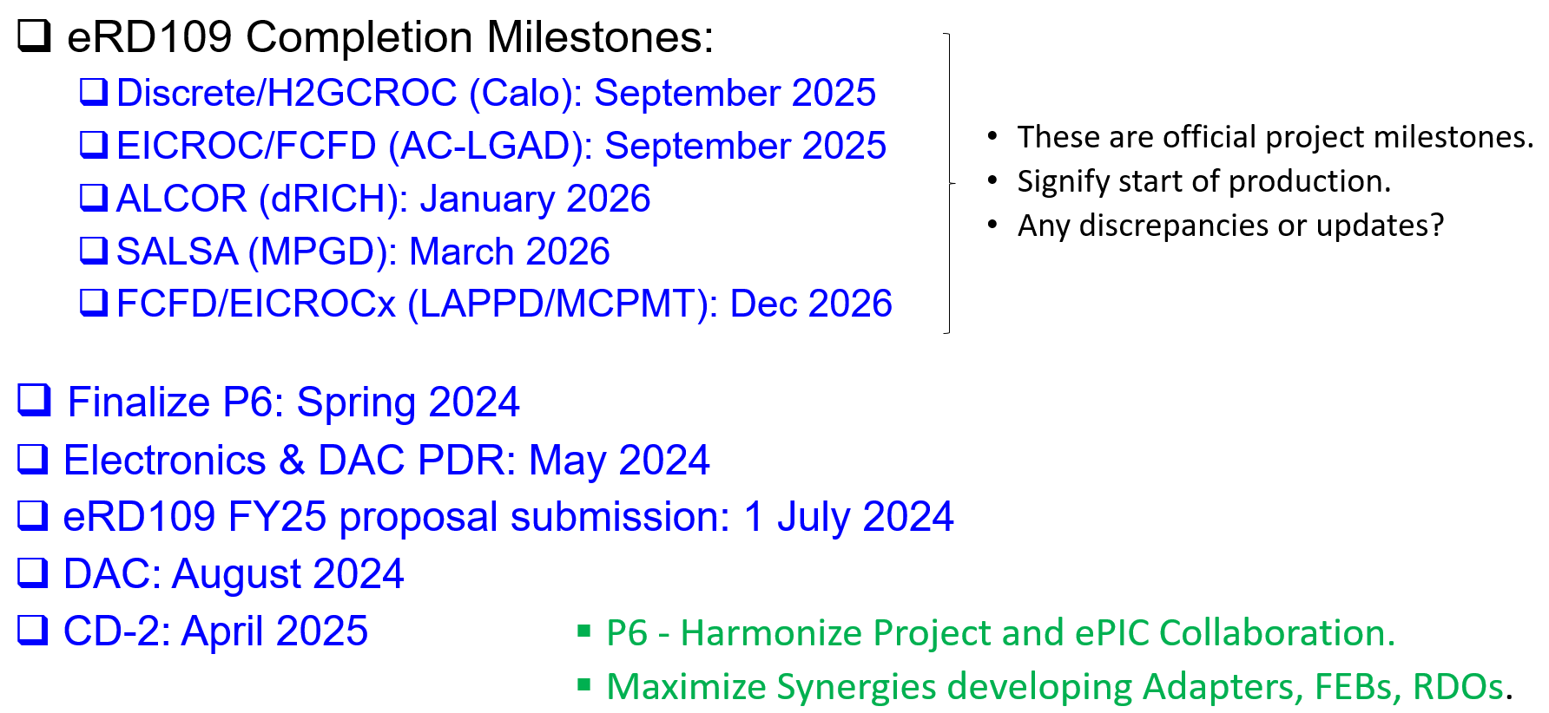
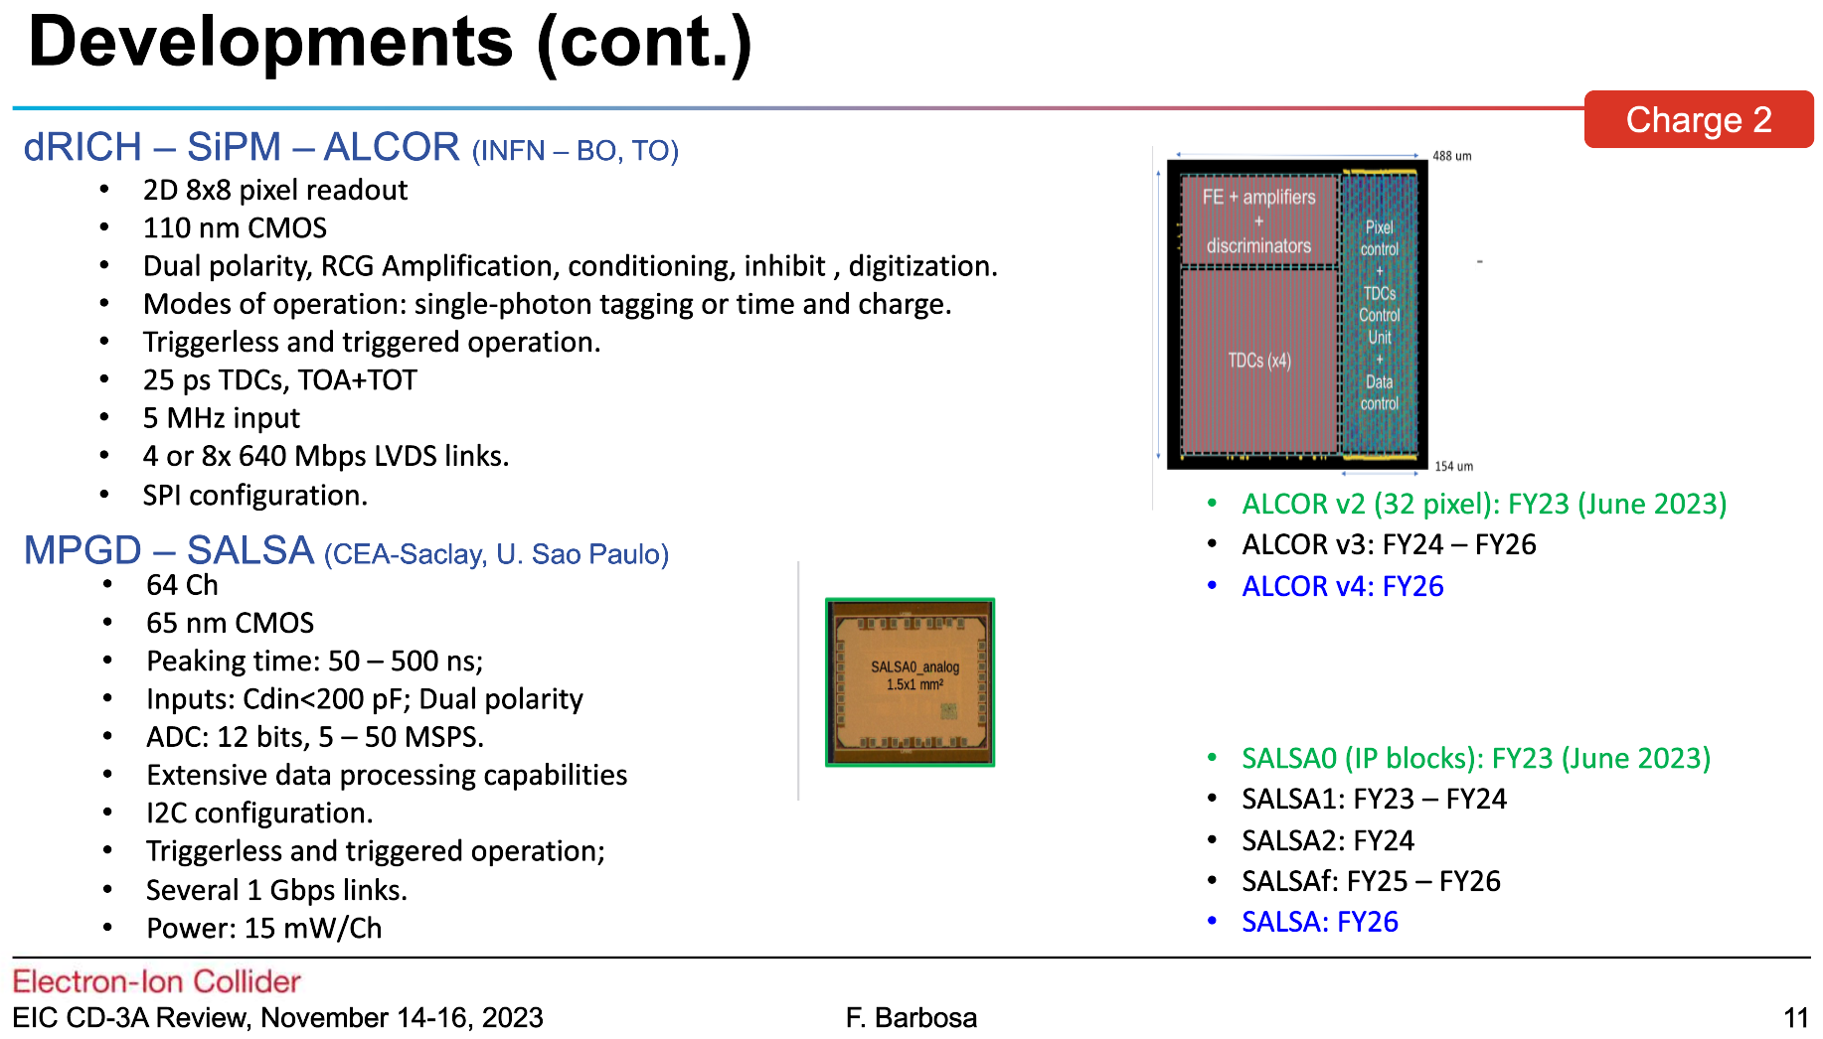
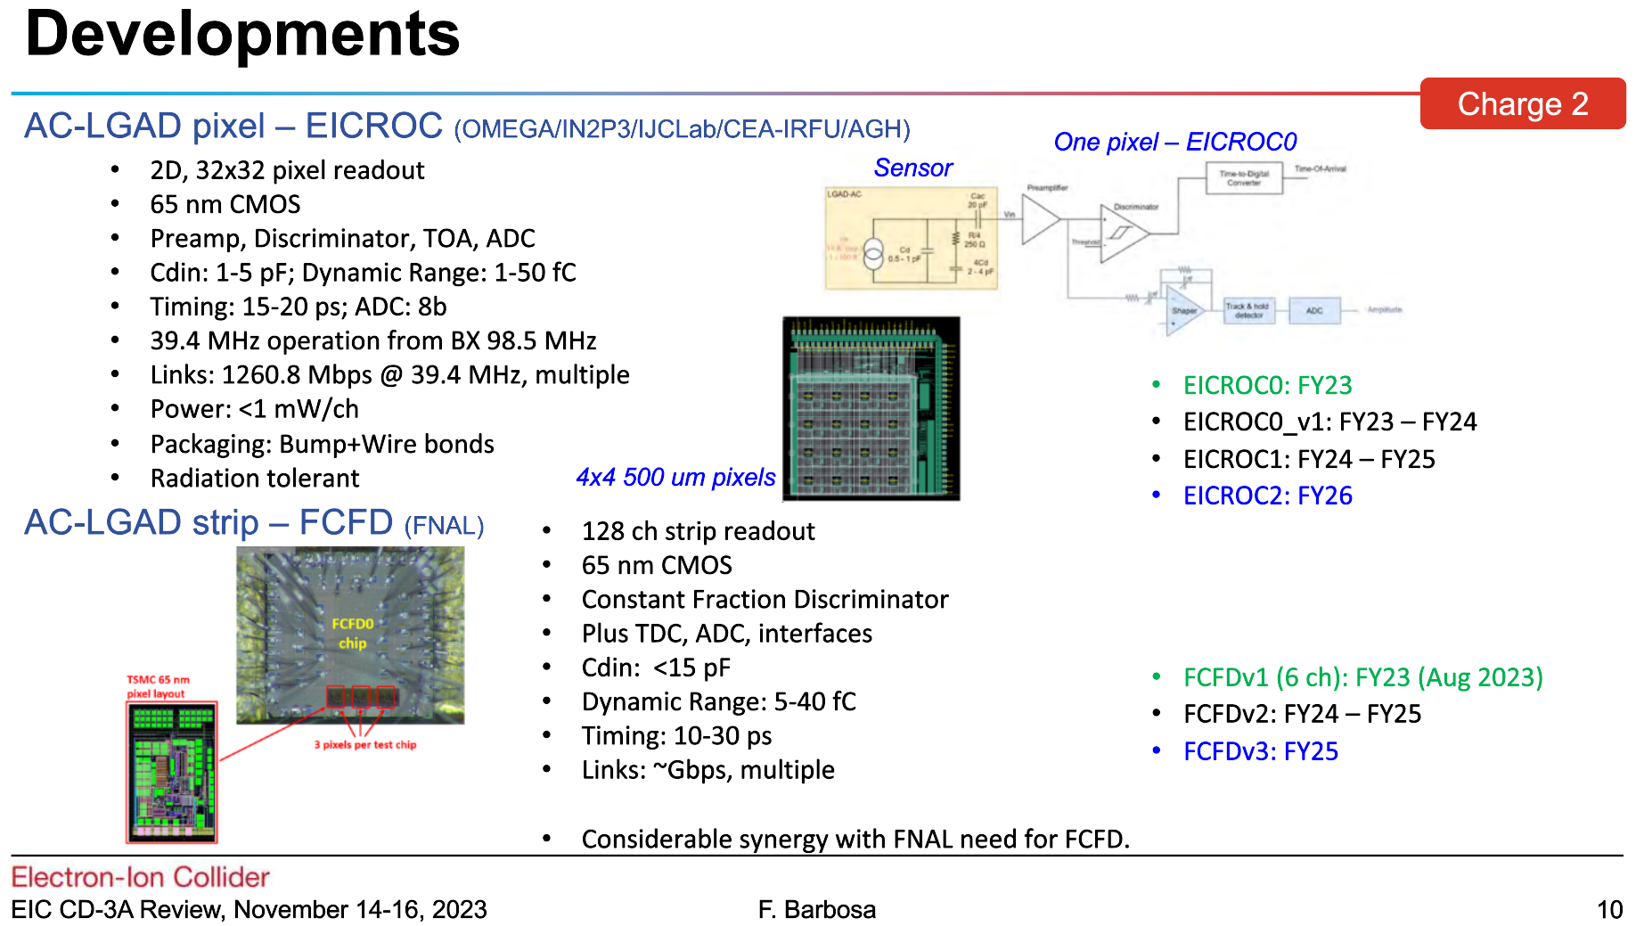
Electronics Milestones
Fernando Barbosa

Slide 9
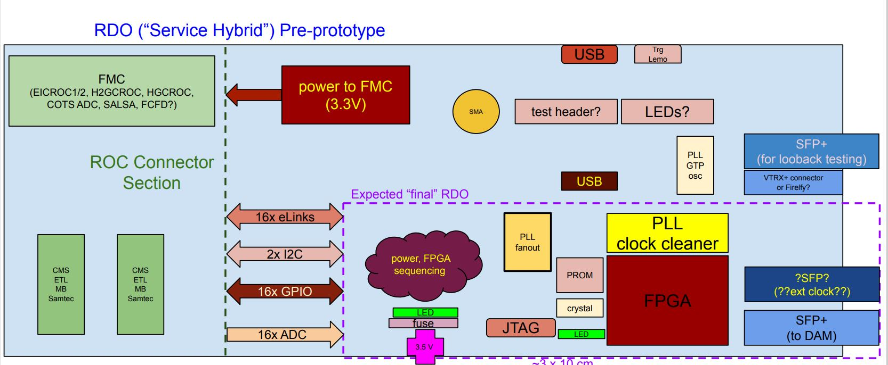
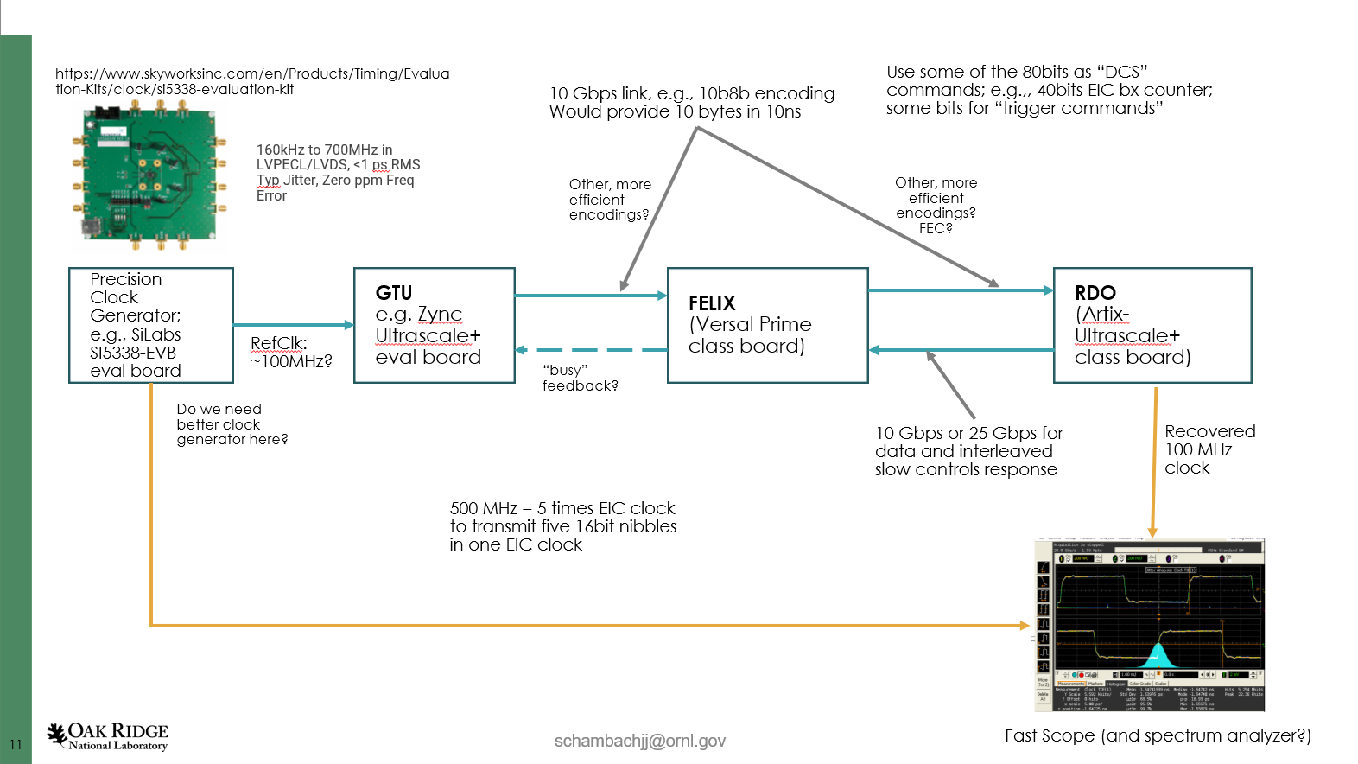
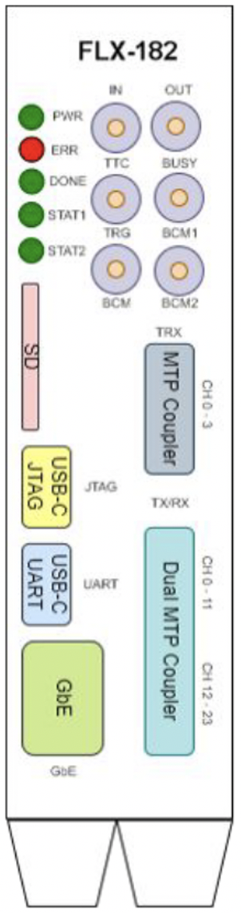
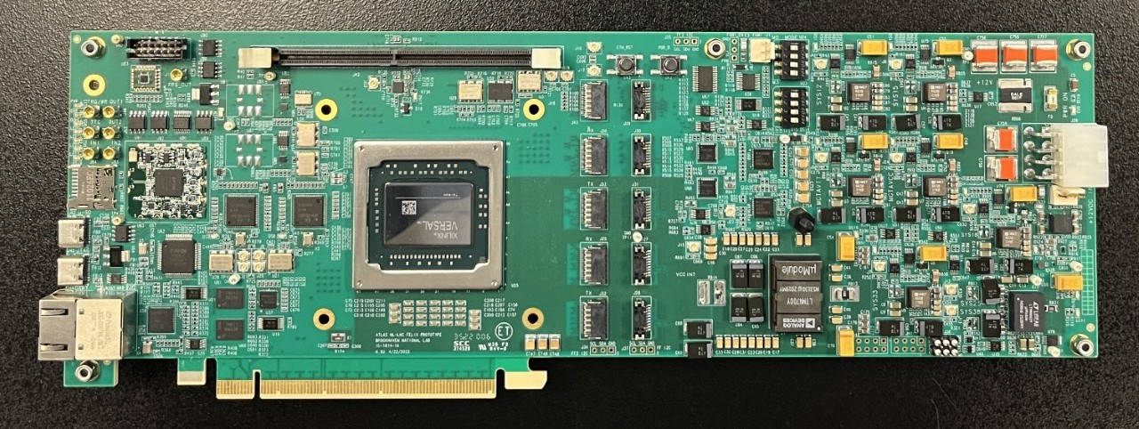
System Component Status
We are evaluating the timing protocol
Studying the FELIX 182
Starting work on RDO pre-prototype
RDO Status:
eRD109
Working on Schematics
Assembled board expected Summer 2024
William Gu Dec 21st, 2023
Optical Protocol
Defines the data flow between the GTU, RDO, and DAM boards
Optical Protocol Requirements
  Timing (<=5ps Hi-Res Detectors)
  Timing (<=100ps Lo-Res Detectors)
  Timing phase stability on power cycle
  Configuration and slow control monitoring passthrough for ASICS/FEBs
  Real-Time Command / Control
  Data Transfer (>=10Gb/s per RDO)
Optical protocol choices under evaluation
  Need board level requirements and specification documents in next few months
  Reconstructed clock jitter meets requirements
  Stability and reproducibility on power cycle under investigation
GTU status:
Mocking up with devkits for initial studies
Interface to collider (Bunch crossing clock, Spin Patterns per bunch crossing)
Distribution of timing to ~100 DAMs + ~220 RDOs of Hi-Res Timing Detectors
User command interface & distribution
Interface to Run Control
DAM Status:
FELIX 182s in hand
Xilinx Versal FPGA
PCIe Gen4 x16 or 100Gb Ethernet output
24 Firefly links up to 25Gb/s options
FELIX 155 (48 links) early 2024
Design suggestions being discussed

Slide 10
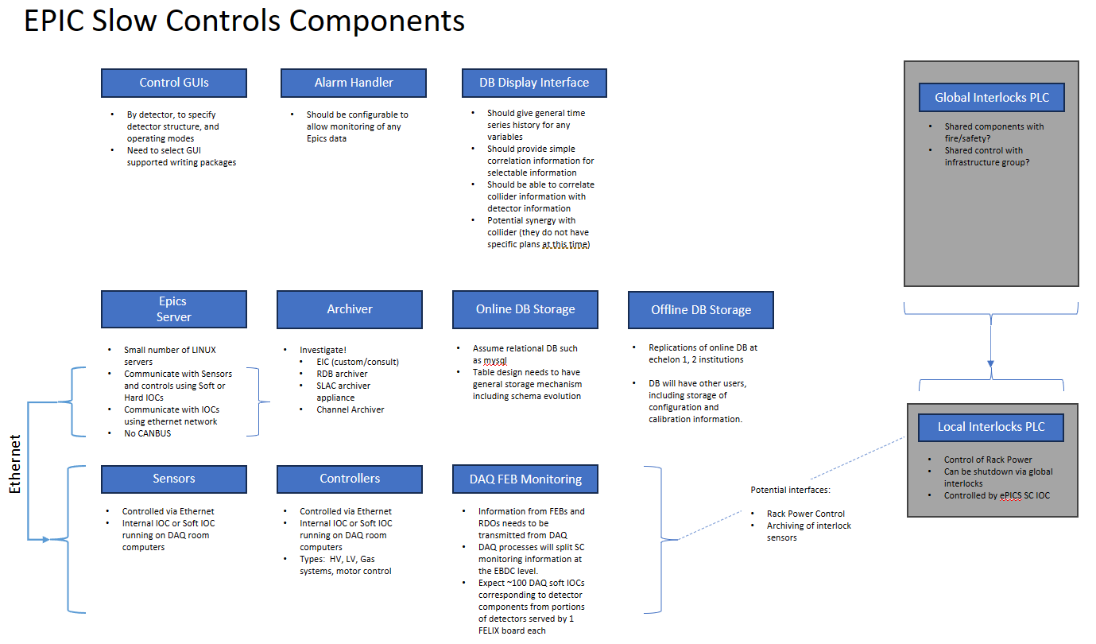
Other Electronics and DAQ related activities
Slow controls
  Outlining design
    Interlocks
    SC infrastructure
    Gather info regarding detector needs

Slide 11
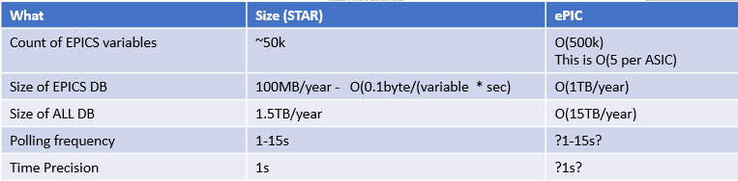
Other Electronics and DAQ related activities
Slow controls
  Outlining design
    Interlocks
    SC infrastructure
    Gather info regarding detector needs

Slide 12
Information Requests
Lee Flader is collecting detector slow control needs
  https://brookhavenlab.sharepoint.com/:x:/r/sites/EICPublicSharingDocs/_layouts/15/Doc.aspx?sourcedoc=%7B3D02F6DB-AAD0-44CB-B791-5FF70D56ED96%7D&file=Slow%20Controls%20Survey.xlsx&action=default&mobileredirect=true
Detectors
      Need specifications/requirements for ASICs: Qmin, Qmax, Rates
      Need expression of interest/commitments for development of the electronics and DAQ (Scientists, Engineers, Technicians)
  https://brookhavenlab.sharepoint.com/sites/EICPublicSharingDocs/Shared%20Documents/Forms/AllItems.aspx?id=%2Fsites%2FEICPublicSharingDocs%2FShared%20Documents%2FExperimental%20Program%2FePIC%2FDAQ%26Electronics&p=true&ga=1

Slide 13
Other Electronics and DAQ related activities
DAQ Room Facility
  Project has facility funds but needs to be specified by us
  Dave Abbott compiling information regarding compute facility specification
Wide angle hall rack map development (Tim Camarda)
RDO functionality and interface specifications to DAM/FELIX need to be written
ASIC interface specifications need to be well defined for RDO and streaming readout
  ASIC R&D monthly updates planned in DAQ WG starting January

Slide 14
Streaming Readout Workfest Summary
Joint Electronics and DAQ WG & SRO WG Meeting (Wednesday Morning)
Overview of Electronics & DAQ (Fernando Barbosa)
Overview of SRO WG (Marco Battaglieri)
SPADI-Alliance (Taku Gunji)
  Opportunities for collaboration
3 Discussion sessions (Calibrations, Data Filtering, Timing Orchestration)
Take away summary from the whole session:
We are in the phase where we need to turn our discussions into documents:
  Board level requirements / specifications
  Microservice chain design for calibration & event selection & reconstruction
  Dependencies among calibrations

Slide 15
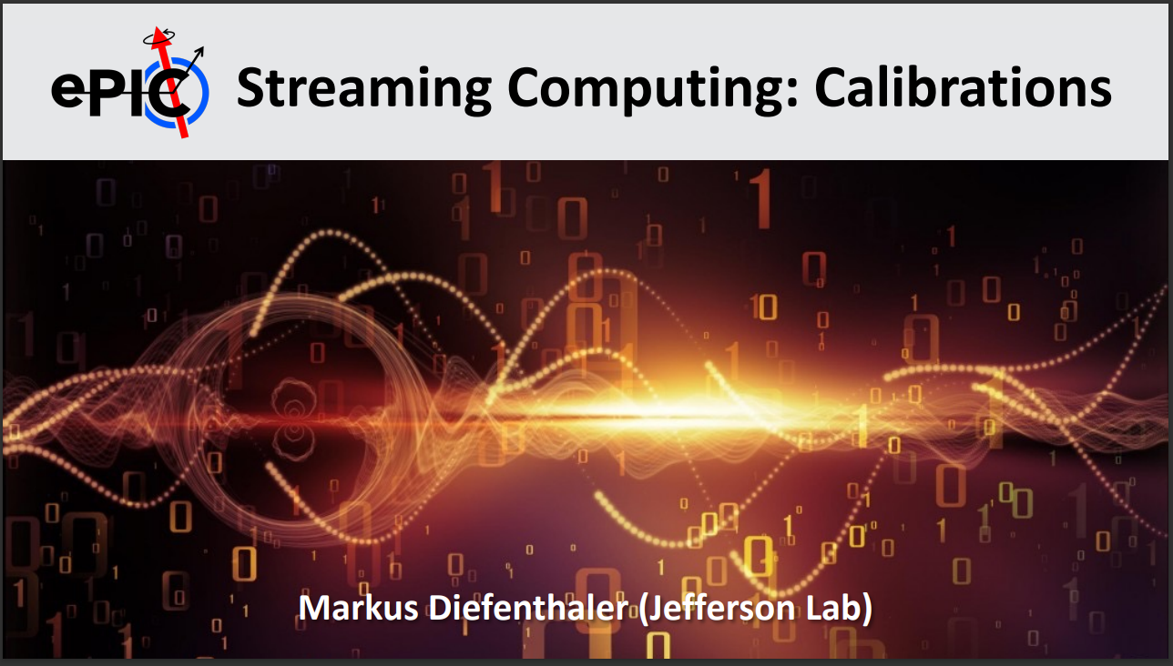
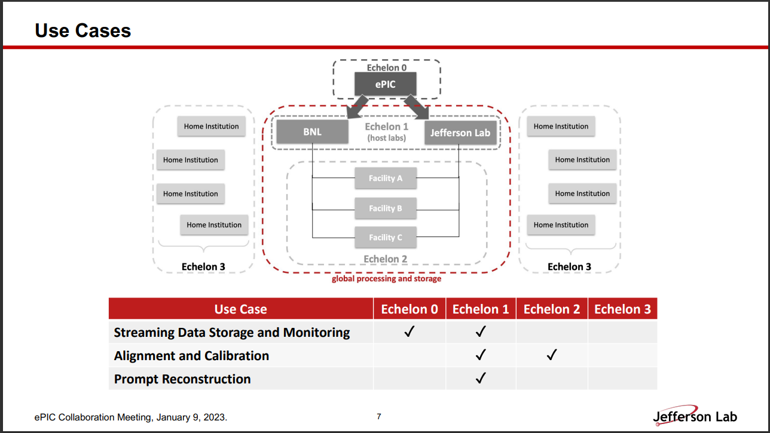
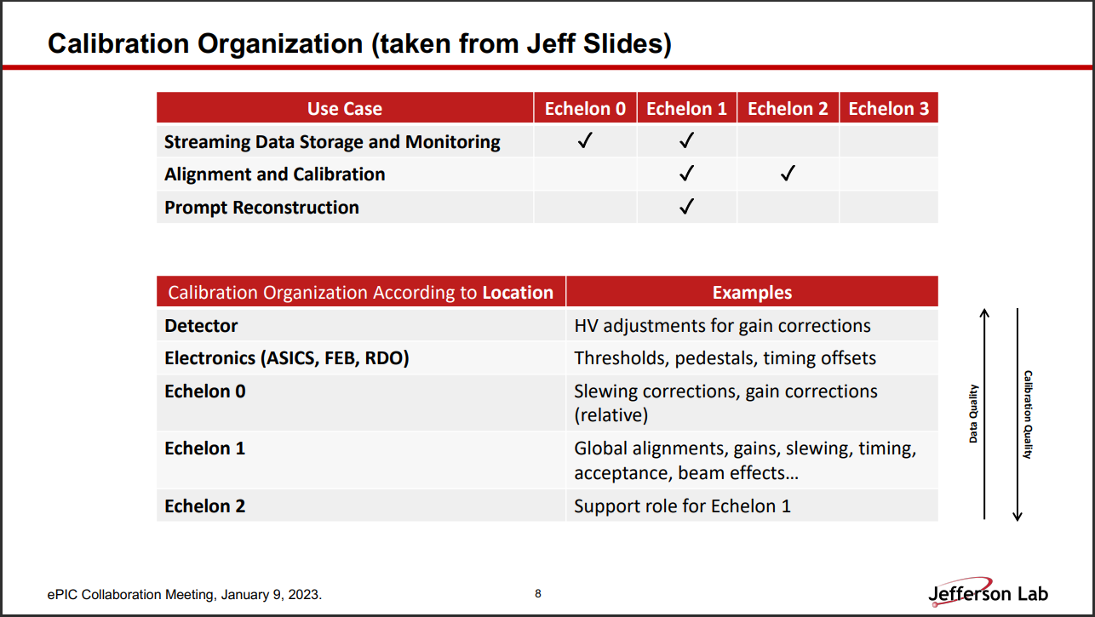
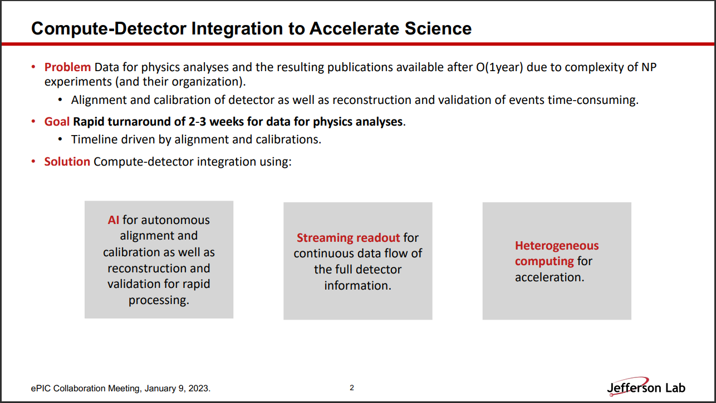
SRO Workfest (Calibrations – Markus Diefenthaler)
Time dependence
  Frequency
  Versioning
  Deployment
Positions of calibration in SRO chain
Need to document tree of calibration dependencies
Iterated reconstruction plans
Need define concrete timelines and connect them to DAQ/development
Conception of SRO as a microservice chain, and that the current task is to define that chain and its requirements

Slide 16
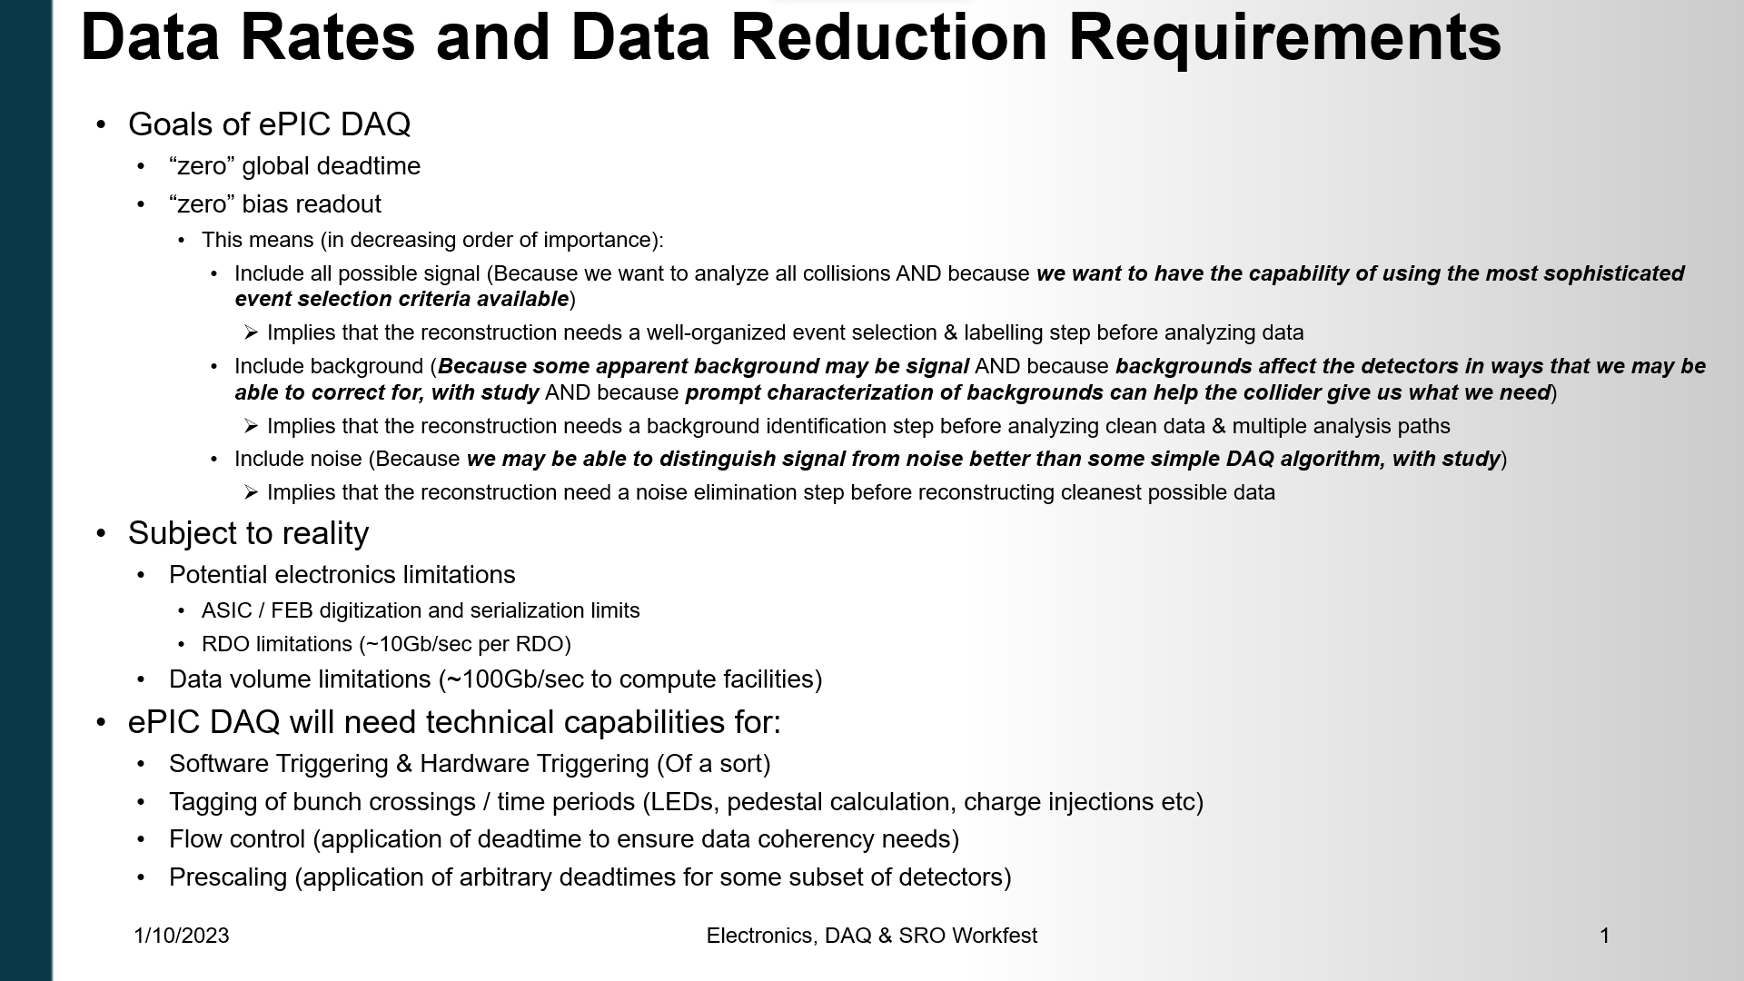
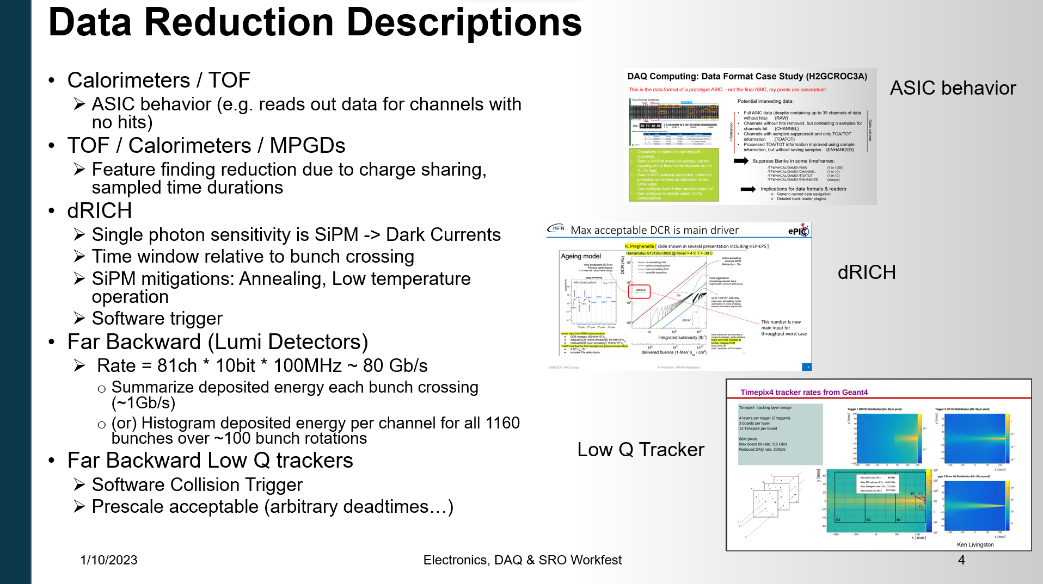
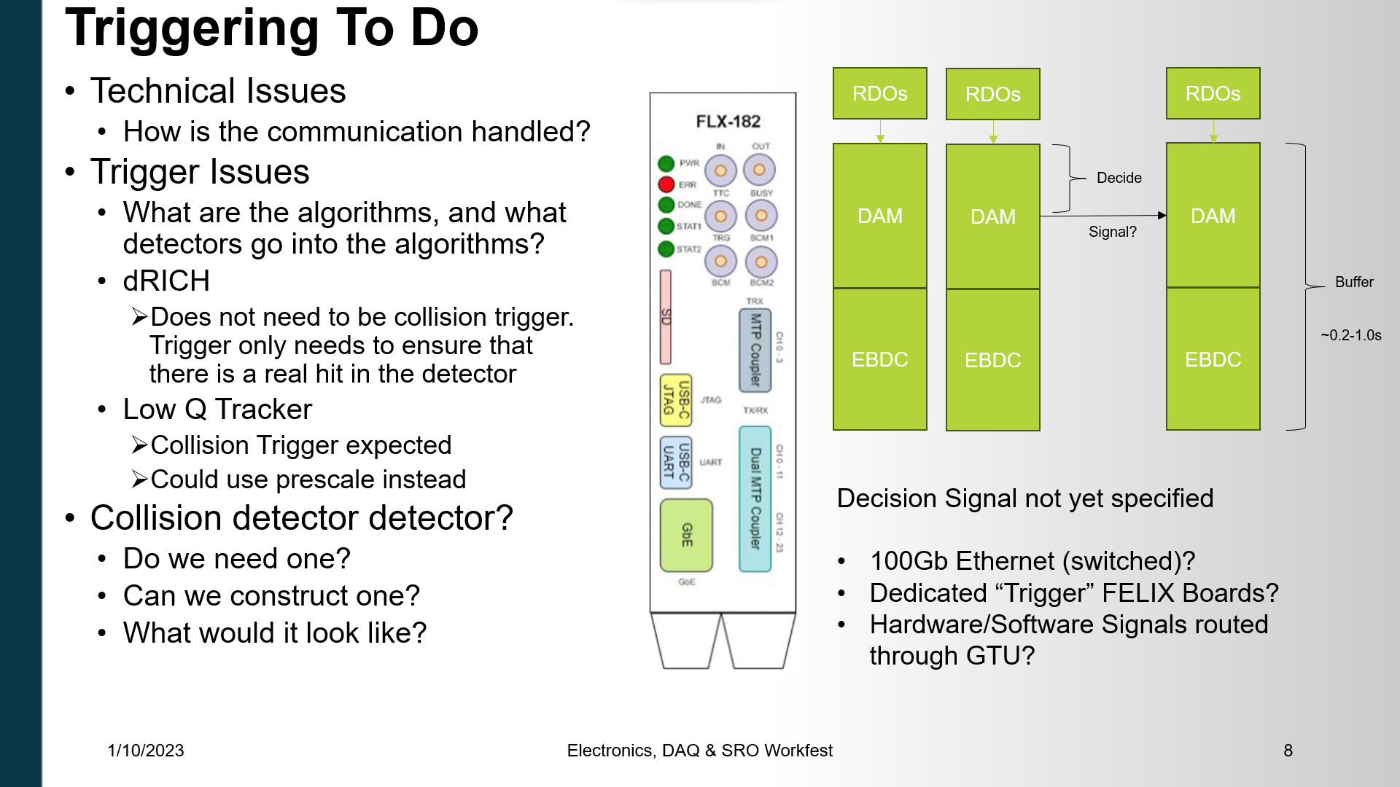
SRO Workfest (Data Volume and Reduction – Jeff Landgraf)
Event Selection: streaming readout allows us to have the most sophisticated event selection criteria available, but we must implement it!
Types of data filtering needed
SRO goal is to filter data as little as possible -> Adjusting bandwidth to fixed rate and increasing filtering as luminosity, noise increases
  Data rates in early years
  Implementation
Technical issues, and hardware communication needed for “software triggering”

Slide 17
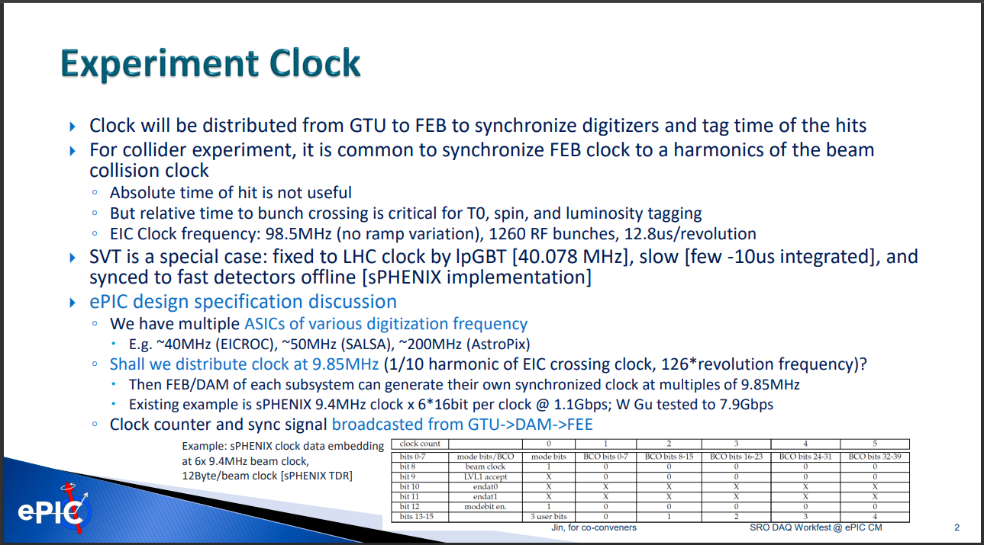
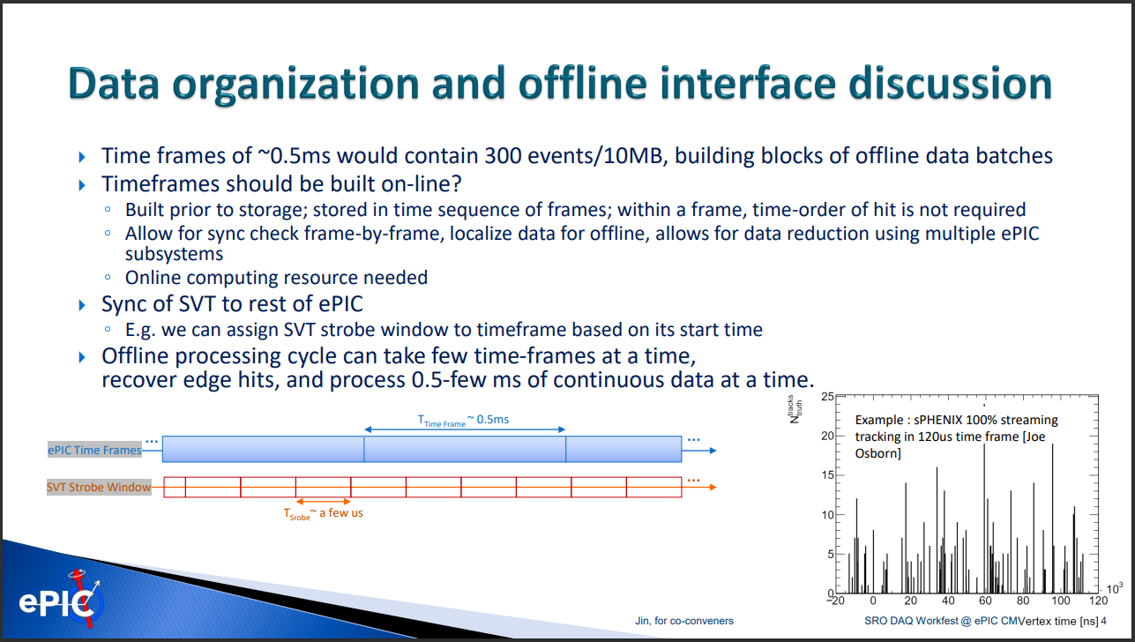
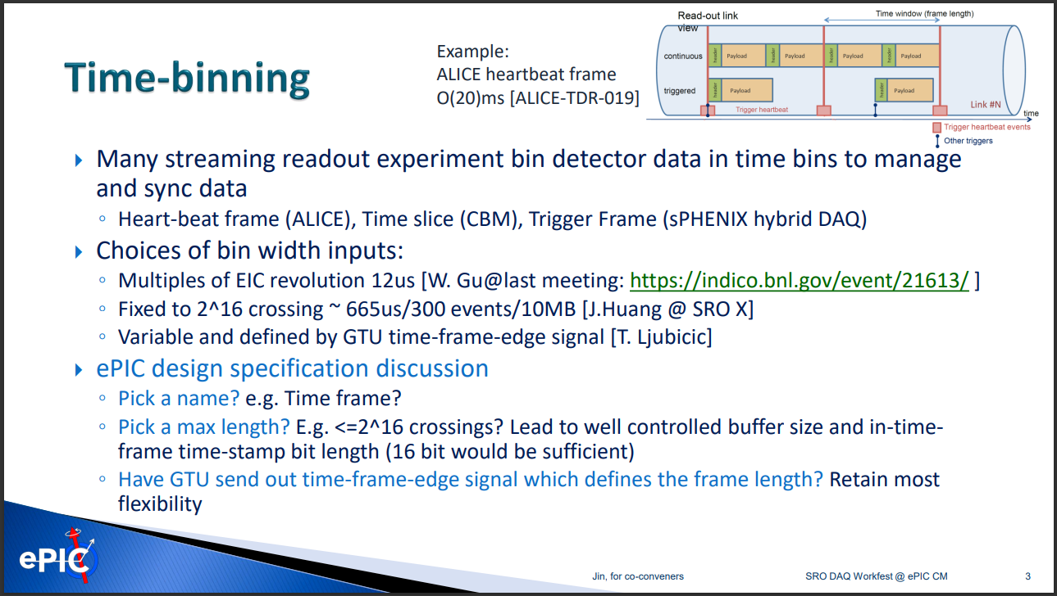
SRO Workfest (Timing Orchestration and Data Organization – Jin Huang)
Details of clock distribution
  Synchronizing ASICS (~40MHz, ~50MHz, ~200MHz, 98.5MHz)
  Identifying identity of RF buckets
  Linking information protocol with clock distribution
Definition of the time frame
  2^16 Bunch crossings (.67ms)
  Multiple of EIC bunch revolution
  Variable defined by GTU
Organization of data passed between “echelon 0” and “echelon 1”

Slide 18
Summary
Mailing list: https://lists.bnl.gov/mailman/admin/eic-projdet-daq-l
Indico page: https://indico.bnl.gov/category/409/
Questions?

Slide 19
Back-up slides

Slide 20
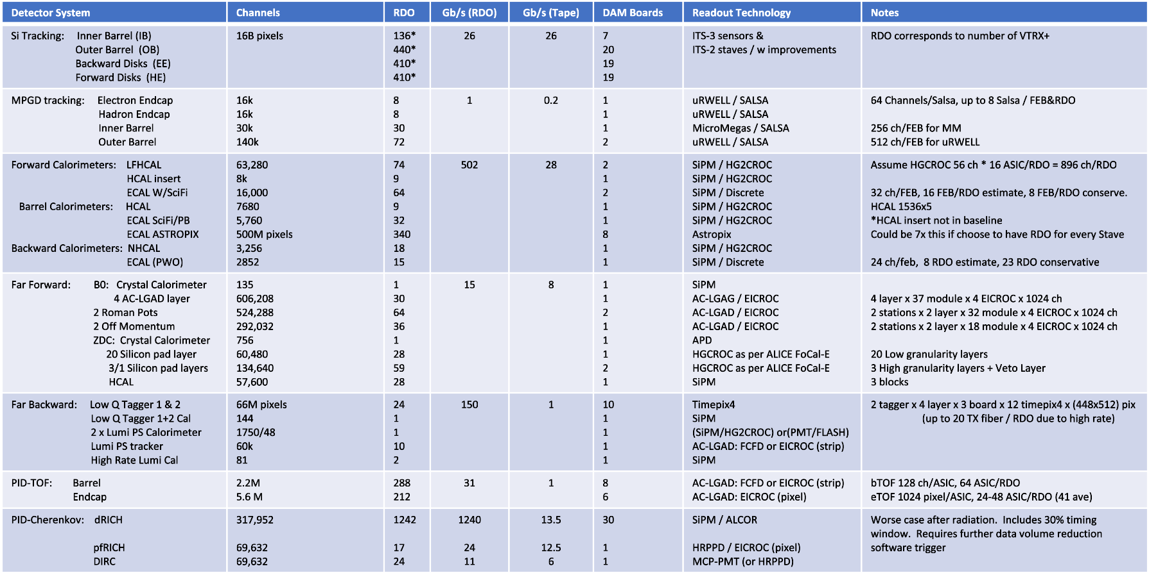
EPIC Detector Scale and Technology Summary

