Slide 1
Accelerator and IR Update
Christoph Montag, BNL
ePIC Collaboration Meeting
January 2024

Slide 2
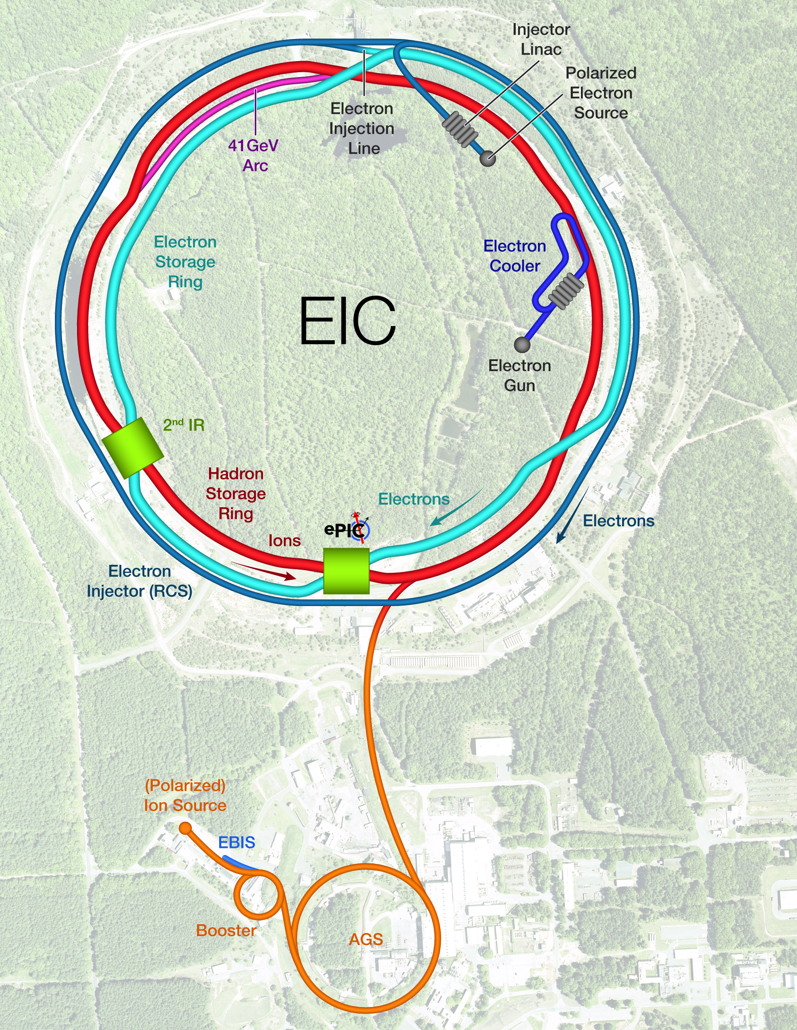
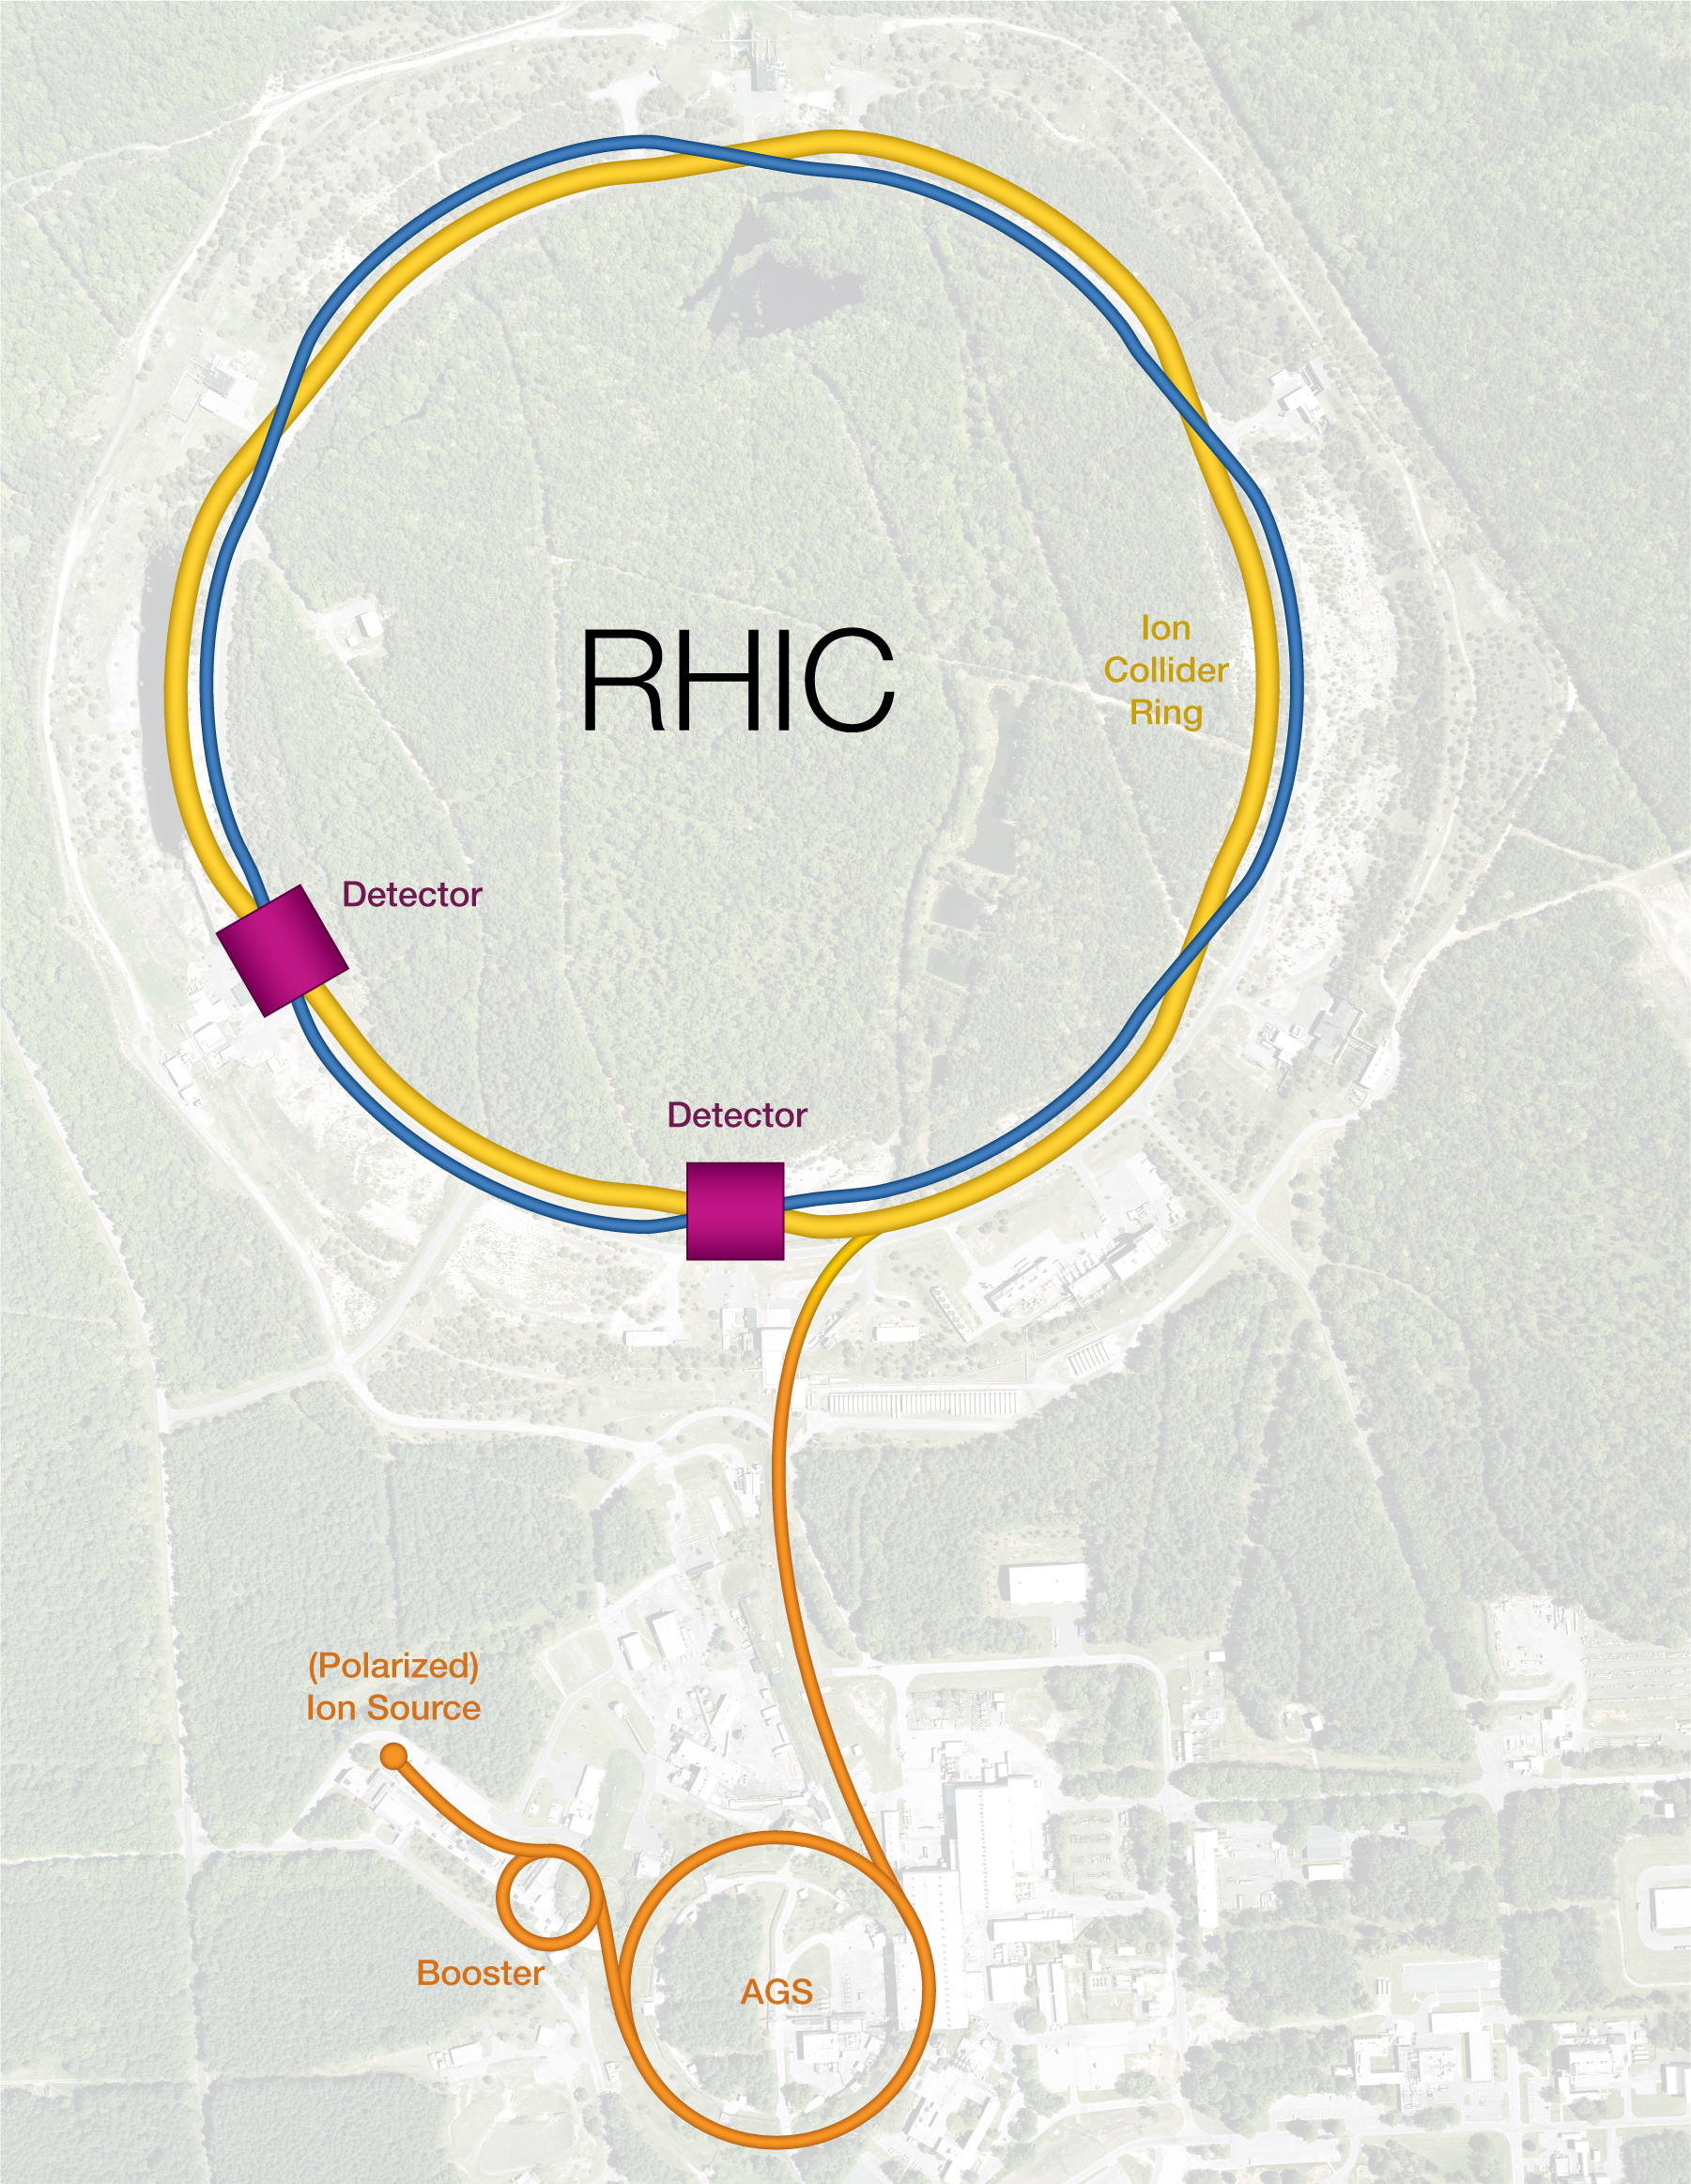
Facility layout
Hadron Storage Ring comprised of “Blue” and “Yellow” RHIC arcs
Layout breaks RHIC symmetry
Retaining RHIC injector chain, using “Blue” arc as transfer line
Strong Hadron Cooling in IR12
Electron complex to be installed in existing RHIC tunnel – cost effective

Slide 3
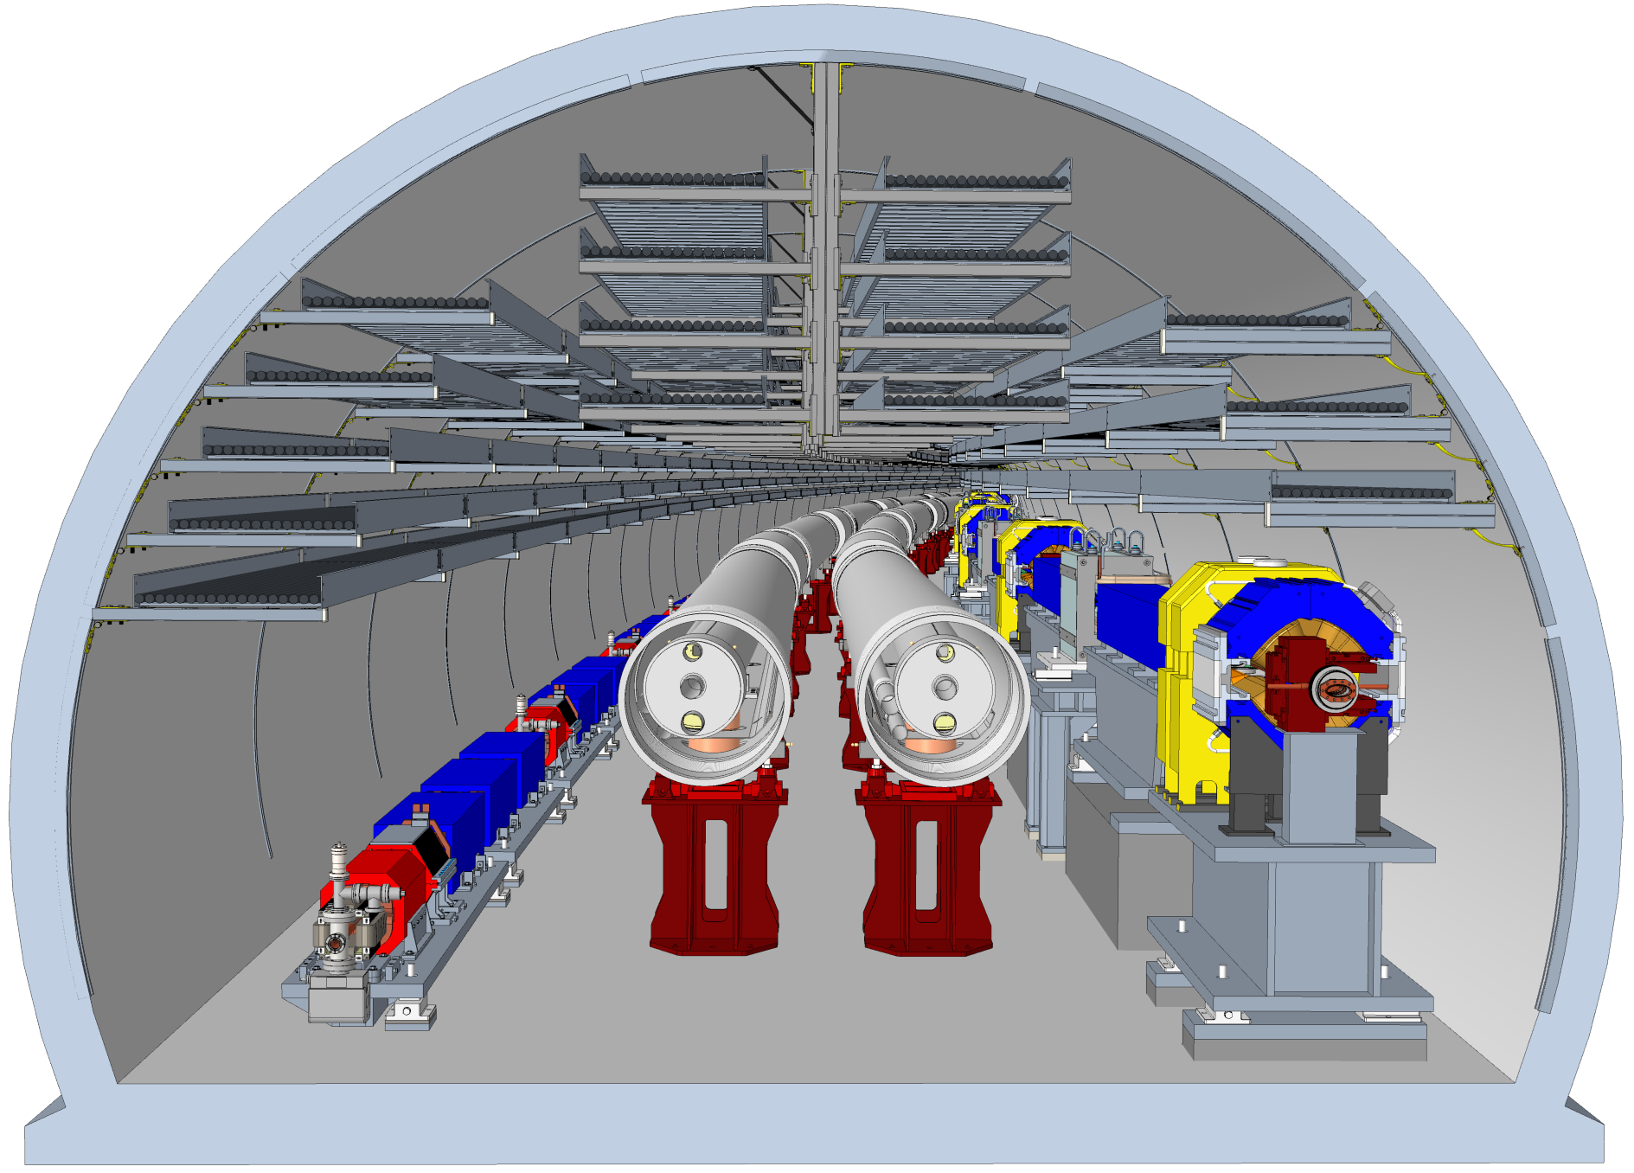
Tunnel Cross Section
All accelerators fit into the existing tunnel
ESR at same height as RHIC, tilted by 200 urad around axis through IPs 6 and 6 to simplify cross-overs in IRs 4 and 12
RCS at ~60 cm above tunnel floor, underneath ESR in three arcs (not shown here)

Slide 4
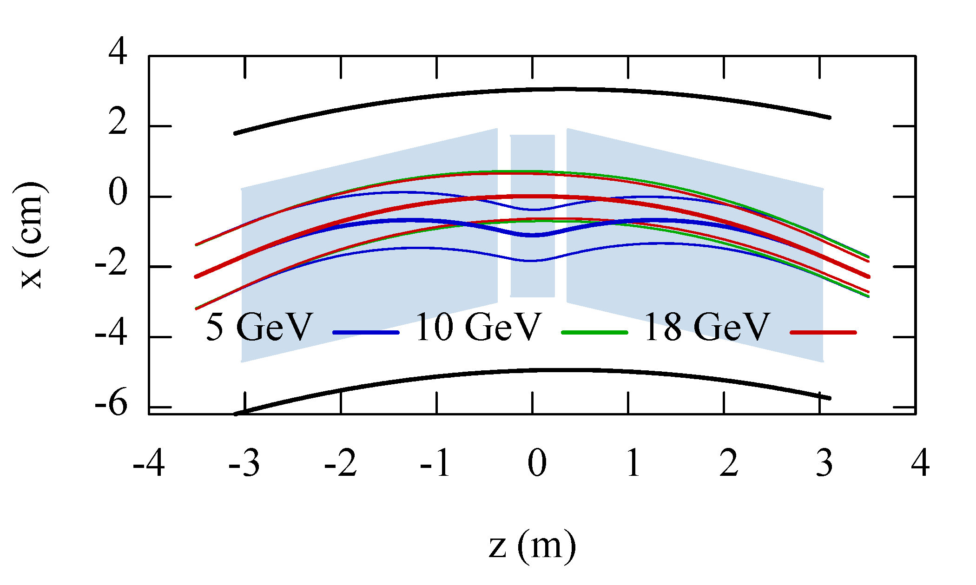
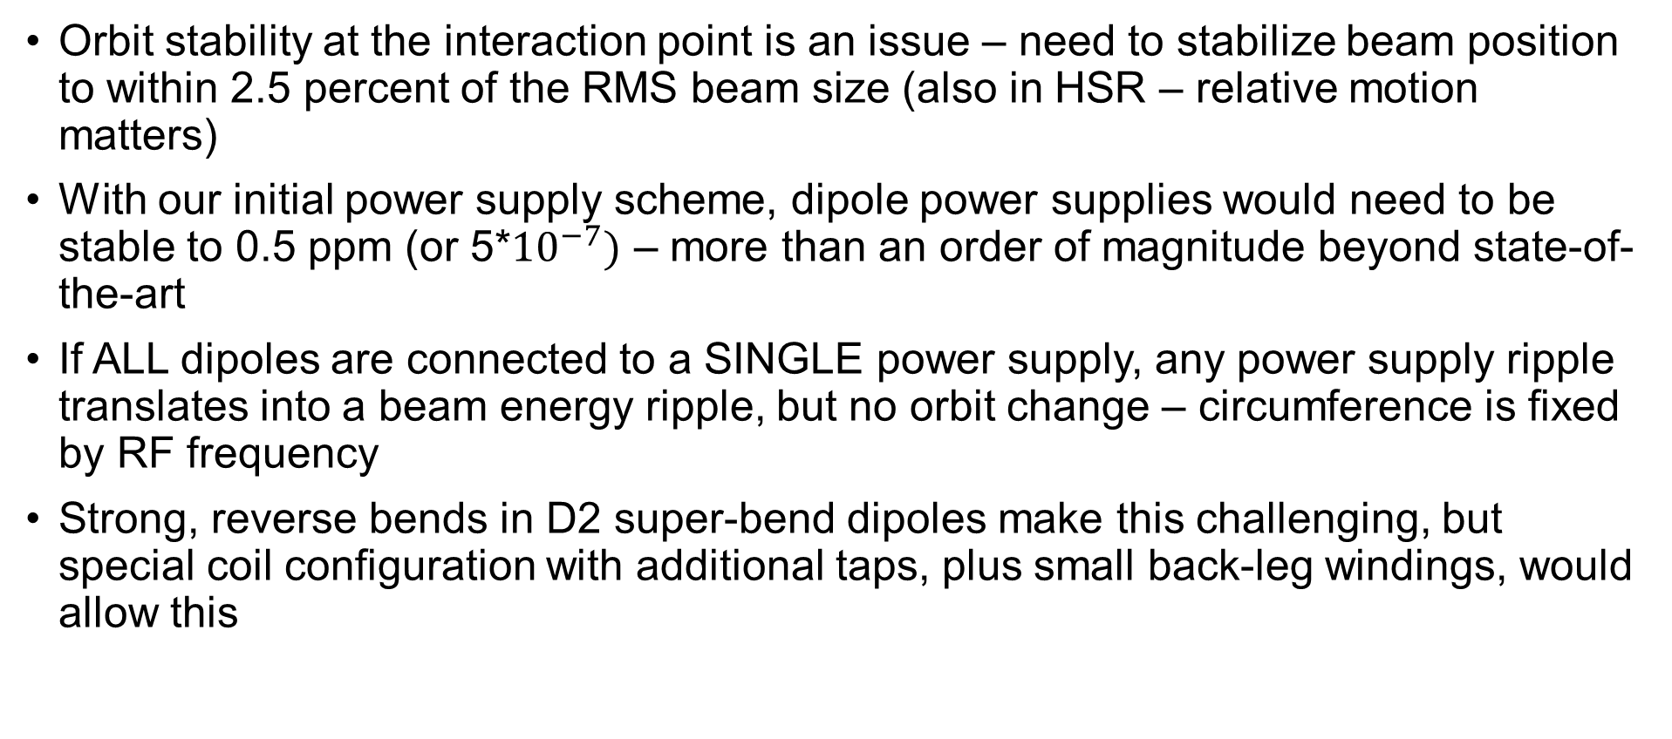
ESR Updates
Orbit stability at the interaction point is an issue – need to stabilize beam position to within 2.5 percent of the RMS beam size (also in HSR – relative motion matters)
With our initial power supply scheme, dipole power supplies would need to be stable to 0.5 ppm (or 5*${10}^{−7})$ – more than an order of magnitude beyond state-of-the-art
If ALL dipoles are connected to a SINGLE power supply, any power supply ripple translates into a beam energy ripple, but no orbit change – circumference is fixed by RF frequency
Strong, reverse bends in D2 super-bend dipoles make this challenging, but special coil configuration with additional taps, plus small back-leg windings, would allow this

Slide 5
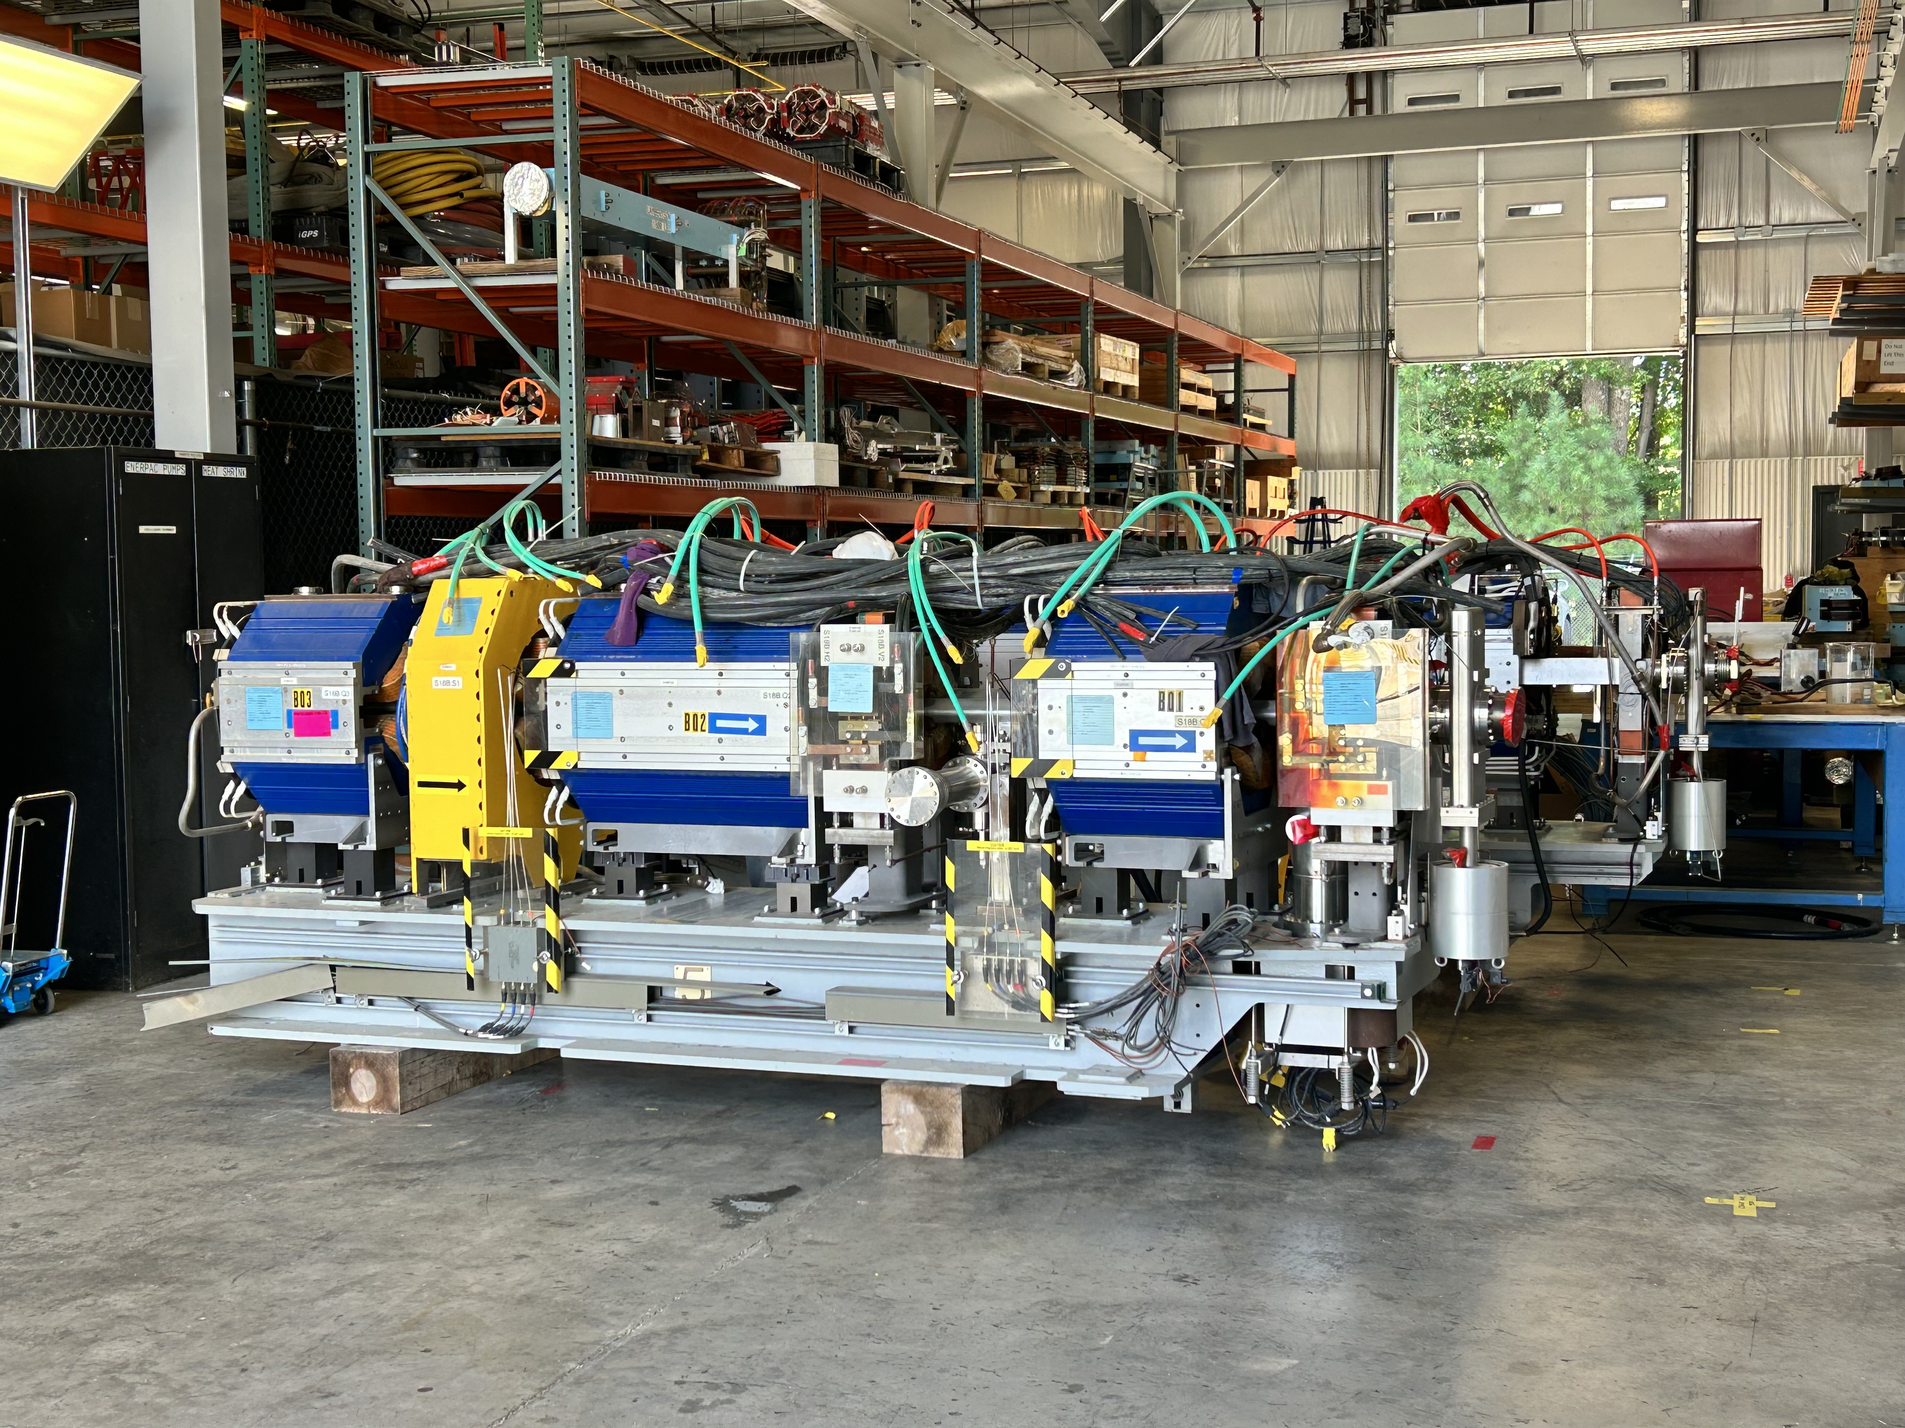
Recycling APS Magnets for the ESR
400 Quadrupoles and 280 Sextupoles from the Advanced Photon Source at ANL to be repurposed for ESR
~ $7M cost savings
All girders have been shipped to BNL and TJNAF
Disassembly well underway at BNL, recently started at TJNAF

Slide 6
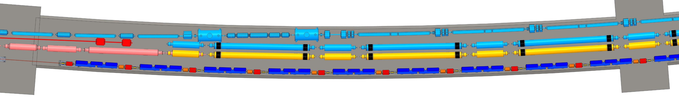
HSR Updates
Current design assumes that “Blue” arc between IR6 and IR4 will be utilized as a transfer line to the new injection area in IR4
Tunnel space is tight, especially near the IR6 end due to ESR spin rotator solenoids
Warm transfer line, partially built from unused “Blue” injection line (“X-arc”) magnets, along the outer tunnel wall would free up valuable tunnel space
Developed a preliminary design, working on cost estimate to compare with “cold” scheme

Slide 7
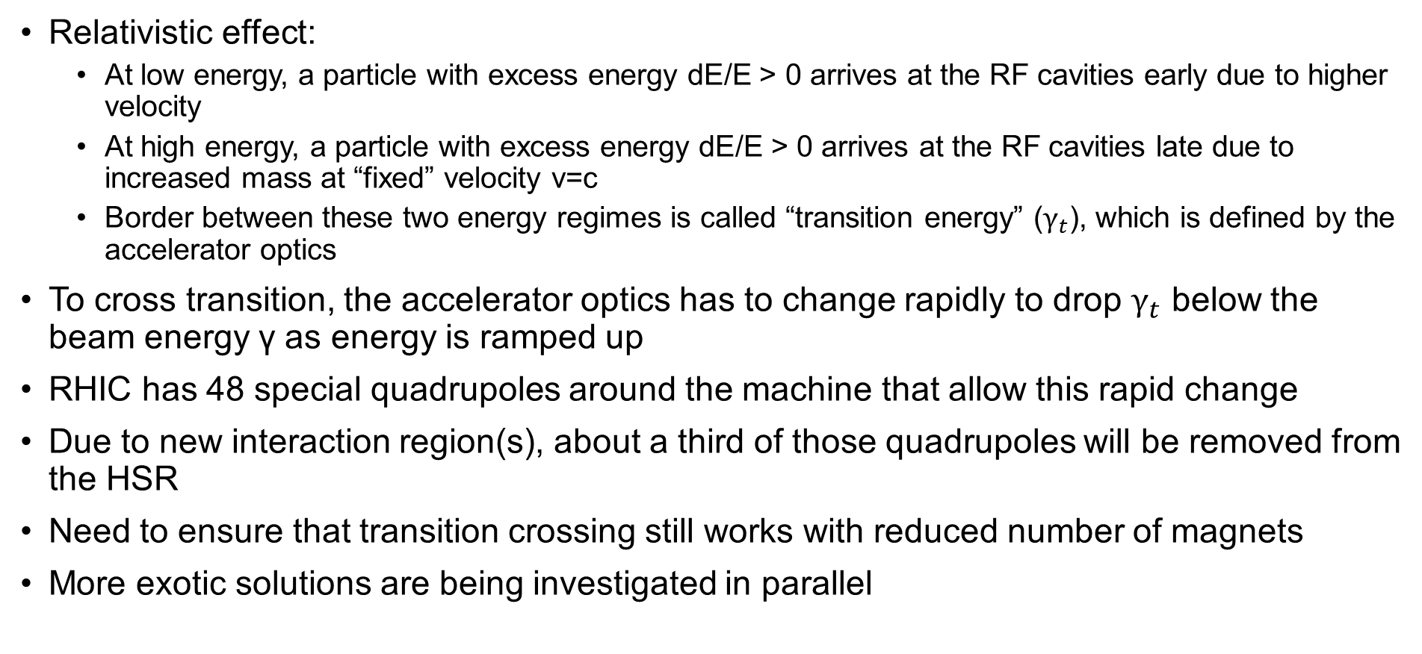
Transition Crossing
Relativistic effect:
  At low energy, a particle with excess energy dE/E > 0 arrives at the RF cavities early due to higher velocity
  At high energy, a particle with excess energy dE/E > 0 arrives at the RF cavities late due to increased mass at “fixed” velocity v=c
  Border between these two energy regimes is called “transition energy” ($γ_{t}$), which is defined by the accelerator optics
To cross transition, the accelerator optics has to change rapidly to drop $γ_{t}$ below the beam energy γ as energy is ramped up
RHIC has 48 special quadrupoles around the machine that allow this rapid change
Due to new interaction region(s), about a third of those quadrupoles will be removed from the HSR
Need to ensure that transition crossing still works with reduced number of magnets
More exotic solutions are being investigated in parallel

Slide 8
Strong Hadron Cooling
Work continues on Strong Hadron Cooling, both the Coherent electron Cooling (CeC) approach and a backup solution based on a ring cooler
Both approaches were reviewed in summer, no show stoppers found in either one
Downselect planned for fall 2024
Pre-cooling at injection energy needed, so Strong Hadron Cooling only has to maintain emittances, not cool the beam to achieve them
Incorporated pre-cooler into IR2 cooler design

Slide 9
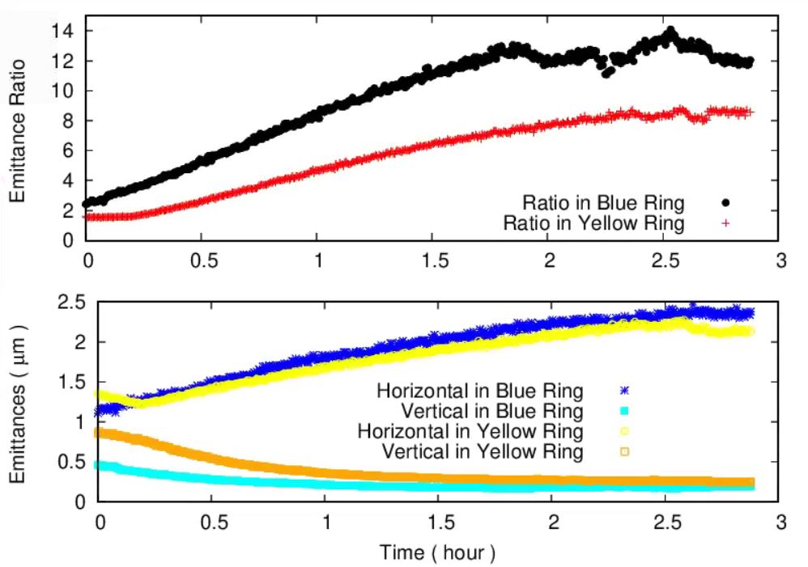
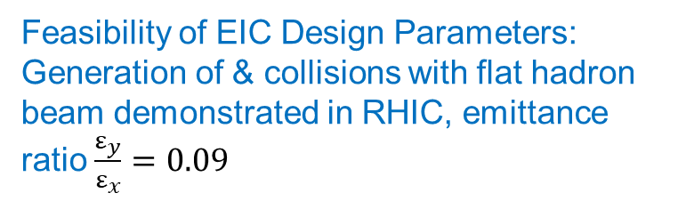
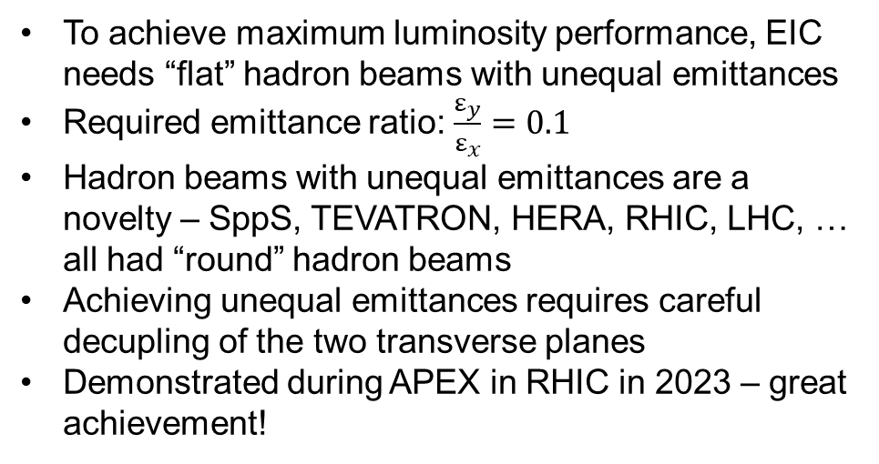
Demonstration of Flat Beams in RHIC
Feasibility of EIC Design Parameters:
Generation of & collisions with flat hadron beam demonstrated in RHIC, emittance ratio $\frac{ε_{y}}{ε_{x}}=0.09$
To achieve maximum luminosity performance, EIC needs “flat” hadron beams with unequal emittances
Required emittance ratio: $\frac{ε_{y}}{ε_{x}}=0.1$
Hadron beams with unequal emittances are a novelty – SppS, TEVATRON, HERA, RHIC, LHC, … all had “round” hadron beams
Achieving unequal emittances requires careful decupling of the two transverse planes
Demonstrated during APEX in RHIC in 2023 – great achievement!
RHIC
Hadron Ring

Slide 10
RCS Updates
Dipole field is limited to ~0.2 T at 18 GeV to limit synchrotron radiation power
At 400 MeV injection energy, this results in only ~50 G – just about 100 times the Earth magnetic field
It is unclear how μ of the steel actually behaves at these low fields – is the field quality preserved?
Potential remedy: use non-magnetic laminations sandwiched between steel laminations in magnet yokes (LEP dipoles used concrete!)
Longitudinal field variation between steel and non-magnetic material averages out to ~0.2 T at beam location while pole tip field with some 0.8 T in steel
Increased quadrupole apertures to raise pole tip field to ~0.8 T at 18 GeV
Stray fields in the tunnel are another concern; considering μ-metal shielding in field-free drift section

Slide 11
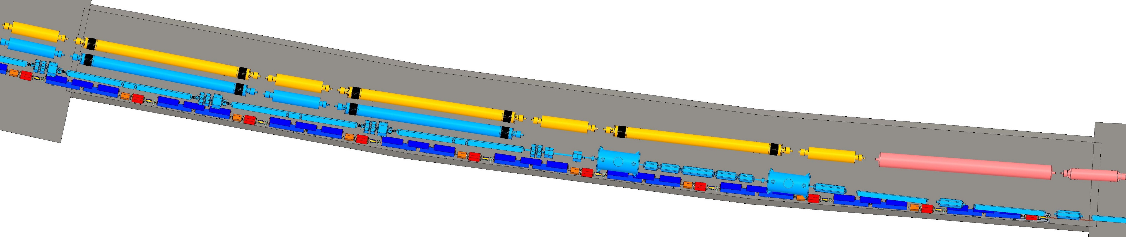
IR Updates
ESR spin rotator solenoids have high field, 8.5 T
High field means bulky return yoke – large cryostat diameter
Possible interference with RCS magnets underneath, as well as tunnel wall
Working on reducing solenoid field to ~7 T by lengthening the magnets
solenoids

Slide 12
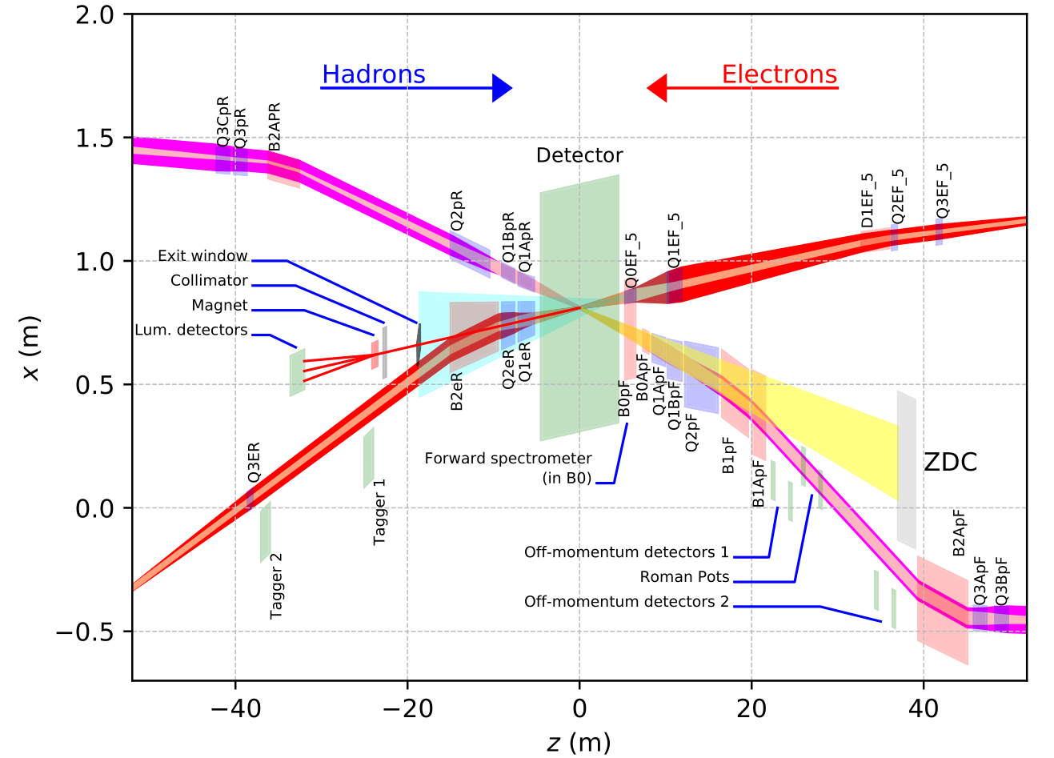
B2ER Relocation
B2ER is the only superconducting dipole in the ESR
Weak dipole, but inside the same cryostat as cold HSR IR magnets – needs to be cold as well
Direct wind magnets with only 60 amps, vs. ~1000 amps for arc dipoles – B2ER cannot be connected to the same power supply to relax PS stability requirements
Working on a scheme based on a warm B2ER “behind” the cryostat
Preliminary results look promising, only minor mechanical interferences
B2ER

Slide 13
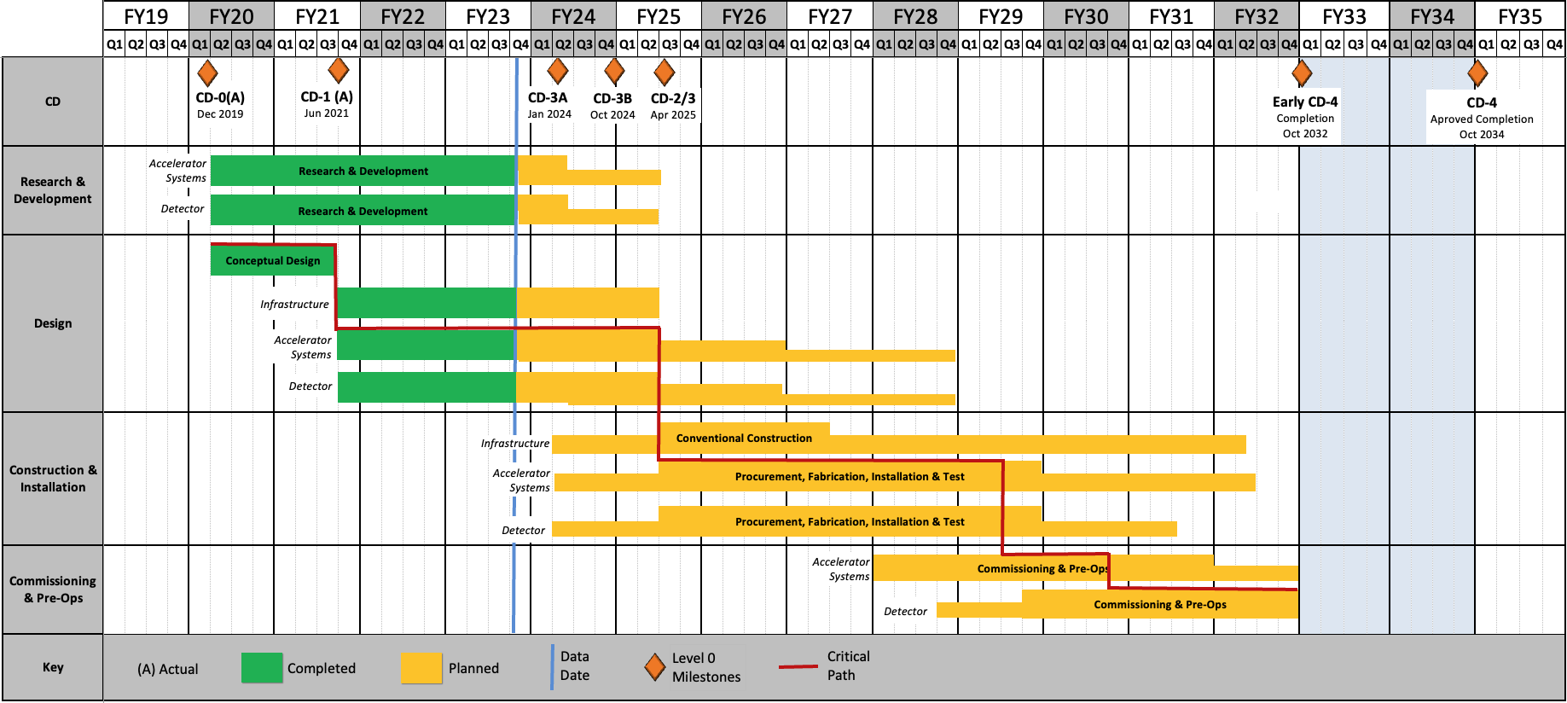
Project Status and Schedule
Project milestones:
CD-0: mission need
CD-1: alternative selection, cost range
CD-2: project baseline
CD-3: start of construction
CD-4: project completion, start of operations
CD-3A, CD-3B: early procurements

Slide 14
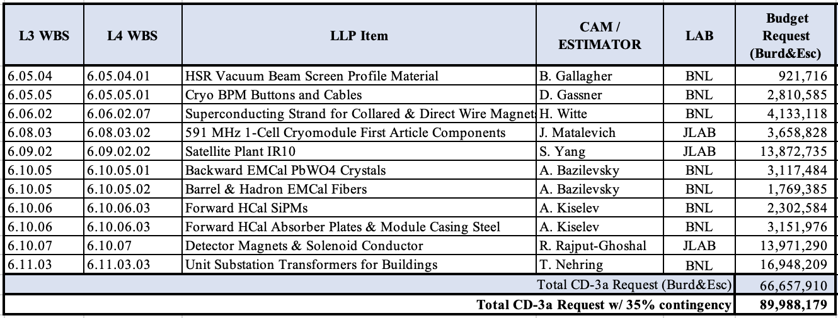
CD-3A Review, November 2023
The EIC project requested authority to execute ~$90M in Long Lead Procurements, including 35% contingency.
Successful Review, unanimous recommendation to grant CD-3A

Slide 15
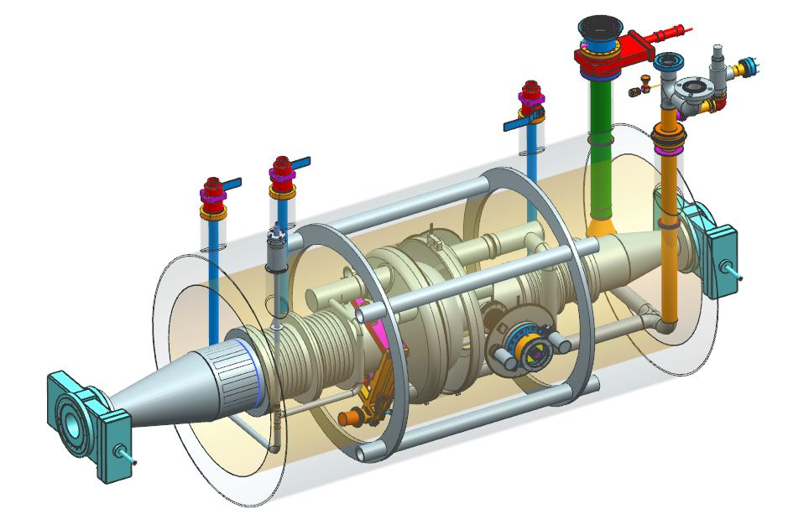
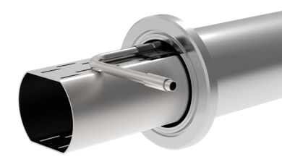
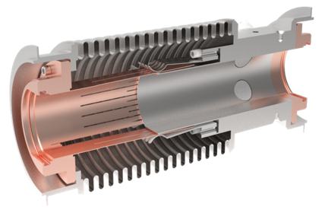
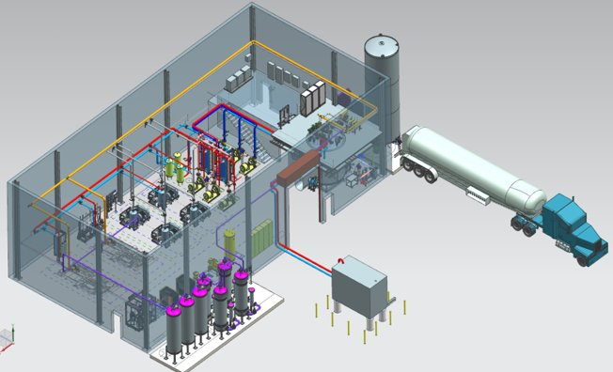
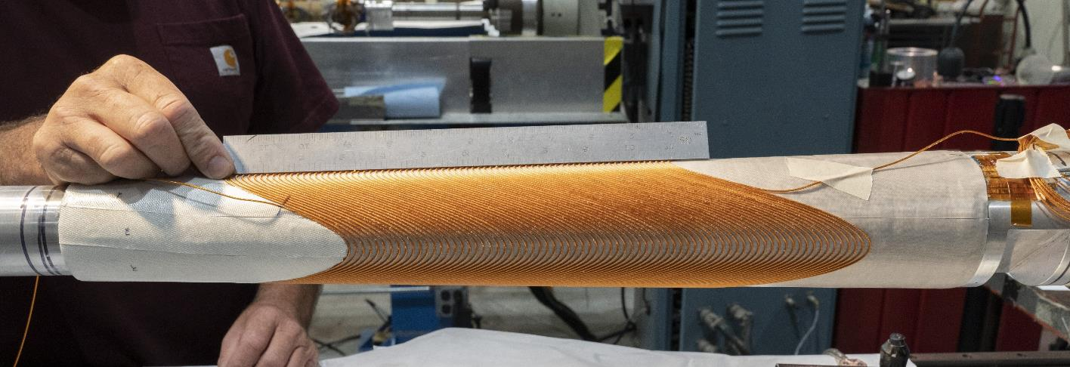
Accelerator 5 LLP Items
591 MHz Single Cell Cryomodule First Article
HSR Beam Screen Material
HSR BPM Buttons at Cryogenic
Temperatures
Strands for Superconducting IR Magnets
Cryogenic 2K Satellite Plant for IR 10

Slide 16
Reference DOE Funding Profile- V4
Funding Profile Scenarios
V4 (Version 4) is based on actuals through FY23 and forecasts.
V5 will use FY24 actual and revised forecasts.
V6 will be the CD-2 Performance Baseline.
Transition to Operations
Total EIC funding commitments through FY2024 are expected to be $492.5M: 1) DOE funding through FY2023, including $138M of IRA funding = $294M; 2) FY2024 President’s Budget Request = $98.5M; and, 3) Pending NYS commitment = $100M.
Significant RHIC operations funding is reprioritized to EIC construction starting in FY2025 reaching ~$150M/year.

Slide 17
Summary
The EIC design is making steady progress
The level of detail of the remaining design issues shows hos mature the design actually is
We are working on cost-effective solutions for the remaining challenges
Design maturity has been recognized by reviewers during the CD-3A review, resulting in unanimous recommendation to grant CD-3A
Thank you!

