Slide 1
Detector Solenoid Design Overview and Status
Renuka Rajput-Ghoshal (JLab)
EIC UG Meeting
January 12, 2024

Slide 2
Outline
Team Members
How we work
Timeline
High Level View
ePIC Detector Solenoid (MARCO) Overview
Magnet Specification
News from RRB
News from the EIC Resource Review Board
Magnet Assembly
Magnetic Design Results
Magnetic Circuit
Conductor Definition, Conductor Margin,
Mechanical, Cryogenic and Thermal Analysis
Instrumentation
Magnet Interface document
Advance Procurement Plan
Plans for 2024
Summary

Slide 3
Team Members
JLab
  Renuka Rajput-Ghoshal, Probir Ghoshal, Eric Sun, Sandesh Gopinath, Dan Young, Rachel Reese and Kaiyi Hall- JLab Magnet Group
  Mitch Laney, Giuseppina (Jessie) Tenbusch, and DeAnn Maddox- Procurement
  Rolf Ent- Co-Associate Director for the Experimental Program, Detector Management
CEA, Saclay
  Valerio Calvelli, Hugo Reymond, Michel Segreti, Jean-Pierre Lottin, Christophe Berriaud, Francesco Stacchi, Francois-Paul Juster, and Damien Simon
  Lionel Quettier- Resource manager and Expert Engineer
BNL
  Rahul Sharma, Roberto Than, Alexander Kiselev, and Roland Wimmer
  Elke Aschenauer- Co-Associate Director for the Experimental Program, Detector Management

Slide 4
How we work
Collaboration of Jefferson Lab, CEA Saclay and Brookhaven National Lab
30% Design done as in-kind contribution by CEA Saclay in collaboration with Jefferson Lab Magnet Group
BNL provides subject matter expert information on infrastructure and integration
60% and 90% design done as contract with CEA Saclay augmented with Jefferson Lab work and further in-kind contributions of CEA Saclay.
Expectation is that magnet construction follows a similar pattern for vendor oversight. Final design review committee also commented “The collaboration between CEA-Saclay, JLab and BNL has continued to make excellent progress and the review committee strongly supports extending this collaboration into the procurement, fabrication and commissioning phases”

Slide 5
Timeline
CD-0 Approval December 2019
CD-1 Approval June 2021
Incremental (30%) Design and Safety Review February 2022
DPAP closeout report – led to reduced field (< 3 T) March 2022
60% design team formation and kick off meeting May 3, 2022
60% Mid-Project Progress meeting June 28, 2022
Point design adjusted to stretch goal of 2 T August 10, 2022
60% Design and safety Review October 18, 2022
90% design contract with CEA, Saclay in place December 2022
Found qualified vendor willing to make conductor January 2023
Magnet RFI out March 2, 2023
Sample Conductor order April 14, 2023
90% Mid-Project Progress meeting April 18, 2023
Long Lead Procurement Review June 26, 2023
90% Design completion and review October 5-6, 2023
CD-3A Review November 14-16, 2023

Slide 6
High Level View
Magnet Design is ready for long lead procurement, the two most important design parameters are conservative: large temperature margin and large critical current margin.
  Sample Conductor order is placed, and we located the possible sample conductor test facility.
  The conductor will be “Government Furnished Item” to the magnet manufacturing vendor.
  Magnet RFI was out last year in April, 5 responses received for magnet RFI, 2 response are very reasonable.
30% Design Review- February 23, 2022
  Reviewers: Ruben Fair (PPPL) - Chair, Vladimir Kashikhin (FNAL), Gianluca Sabbi (LBNL)
60% Design Review- October 18-19, 2022
  Reviewers: Ruben Fair (PPPL) - Chair, Vladimir Kashikhin (FNAL), Gianluca Sabbi (LBNL)
Final Design Review - October 5 and 6, 2023
  Gianluca Sabbi (LBL)- Chair, Ruben Fair (JLab), Vladimir Kashikhin (FNAL),
  William Schneider (JLab‐retired)
  FDR is 90% magnet design review, equivalent to 100% for “Vendor Design-Build” procurement)

Slide 7
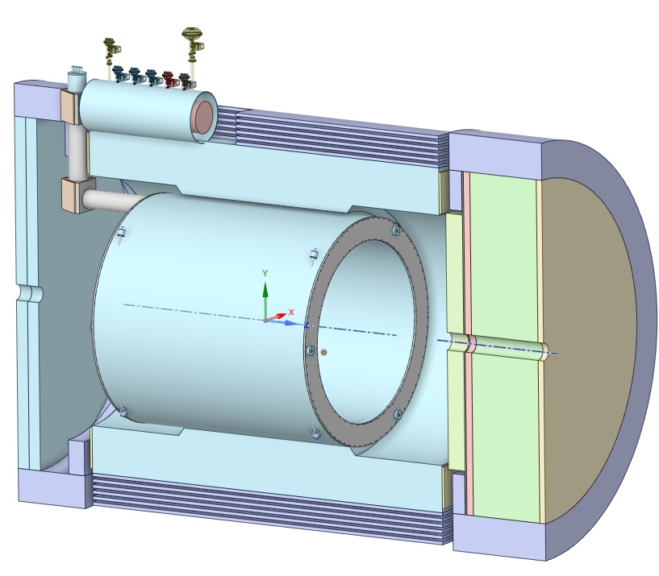
ePIC Detector Solenoid (MARCO) Overview
Superconducting Detector Solenoid
3.5 m long coil, 2.84 m room temperature bore diameter
2 T on-axis field
Operating Temperature 4.5 K
Conductor: Copper Cladded, Rutherford Cable made with NbTi superconducting strands

Slide 8
ePIC Detector Solenoid Magnet Specifications

Slide 9
News from the December RRB
Italy/INFN and France/CEA affirmed early December that the EIC detector solenoid magnet construction can be done as in-kind. Work has started on drafting the needed in-kind agreement documentation between JLab, Italy, and France.
This agreement is with JLab as JLab will be responsible for accepting the magnet (in close collaboration with BNL subject matter experts).
Model is that the conductor is provided as government-furnished equipment, Italy implements the magnet construction contract, and CEA and JLab continue their successful working model to provide the vendor oversight, quality assurance and testing.

Slide 10
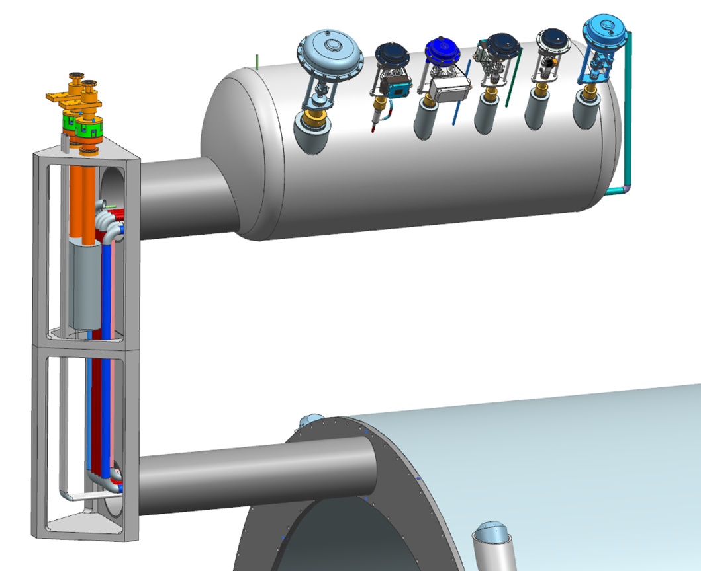
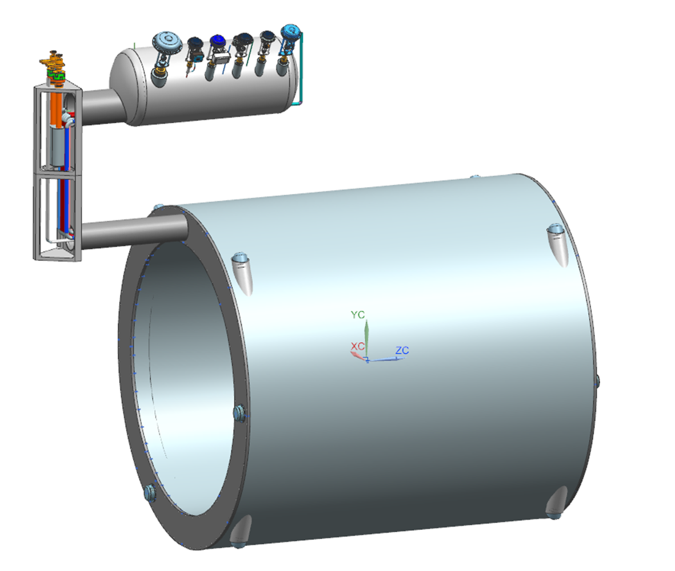
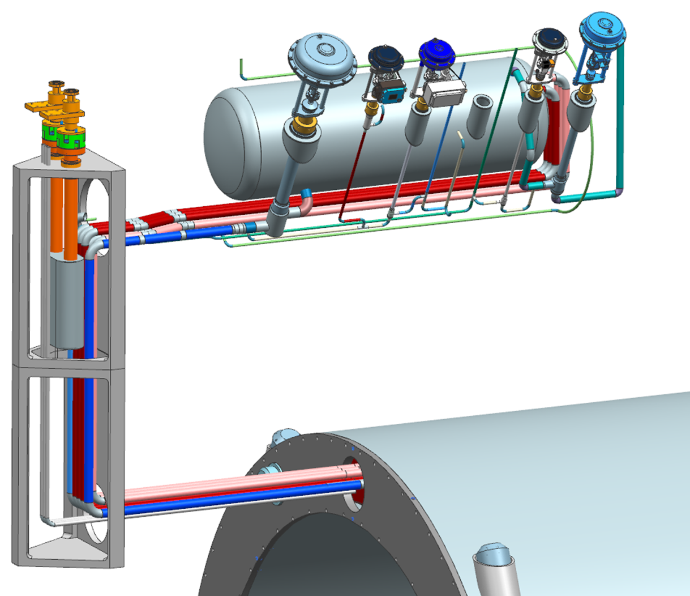
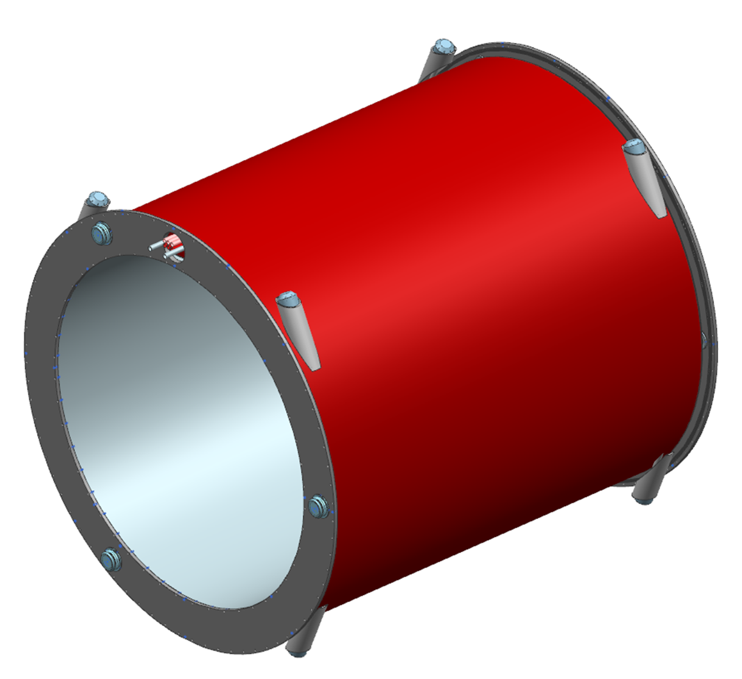
Magnet Assembly
Current Leads
Current Leads
Helium Phase Separator
Cryostat Assembly
Conductor and Current Lead exit currently being developed
Chimney
Final Chimney geometry and design TBD
Chimney Components - In Work
Helium Return
(Primary)
Conductor, Plumbing and Instrumentation
Exiting magnet and routing to Chimney
Thermal Shield
Current Leads
Radial Tie-Rods
Helium Supply
(Redundant)
Helium Return
(Redundant)
Helium Supply
Helium Supply
(Primary)
Instrumentation
Axial Tie-Rods
Axial Tie-Rods

Slide 11
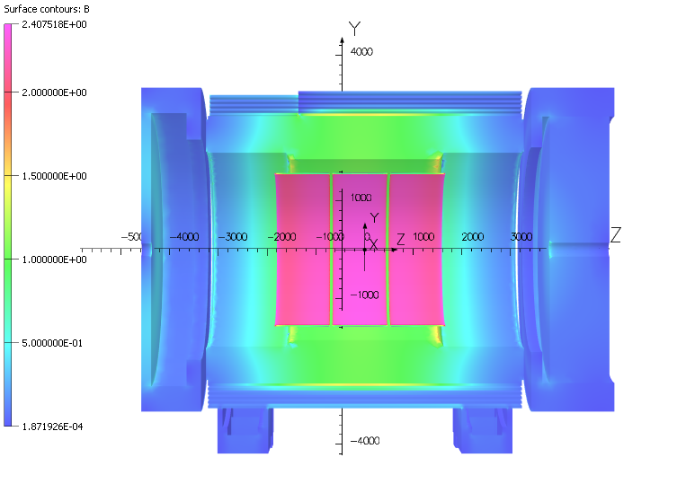
Magnetic Design Results
Coil is divided in 3 module
Each module has 6 layers
Parameter | V7.6.2.2.10 3D | Units
Current | 3924 | A
# turns | 1668
B₀ | 2.000 | T
Homogeneity | 12.7 | %
Projectivity | 3.28 | Tmm²/A
Bpeak (MOD 3) | 2.671 | T
Energy | 45.010 | MJ
Inductance | 5.846 | H
Fz MOD 1 | 11.88 | MN
Fz MOD 2 | 57.5 | kN
Fz MOD 3 | -11.97 | MN
Fz tot | -32.4 | kN
Fr Tot | 112 | N
B5300 | 15.3 | G
B7200 | 10.9 | G
B3400 | 2.4 | G
Magnet is 10 cm off center
3 modules are chosen, mainly
Feasible single length conductor manufacture
Ease of coil manufacturing
Magnet quench protection
Note: Mitigation of higher stray field on lepton is in progress, latest model B5300 <10G, verification is in progress

Slide 12
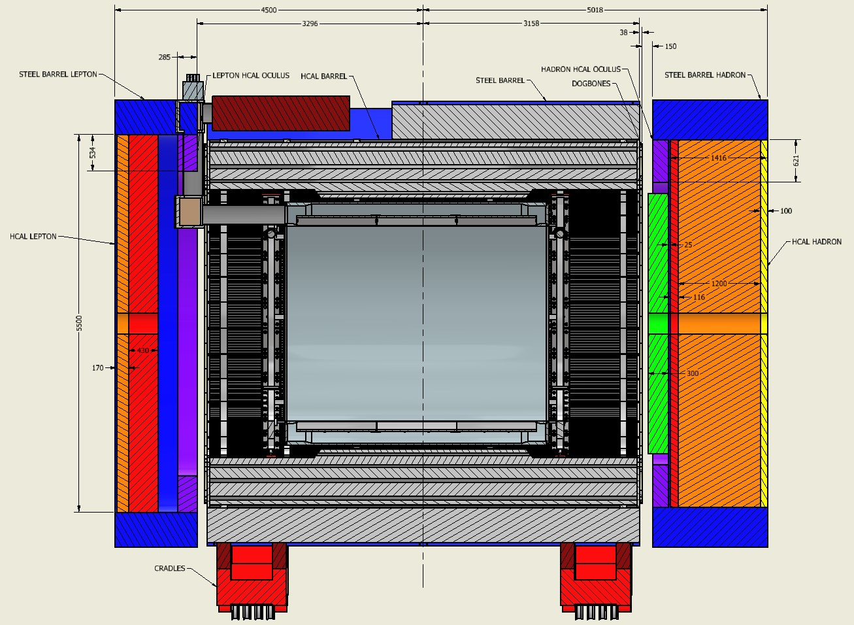
Magnetic Circuit
Any deviation from the above layout and simplifications must be approved by the responsible magnet engineers as subject matter experts before it can be implemented.
Any addition of magnetic material in this layout must also be approved first.

Slide 13
Conductor Definition
 | Parameters | Values | Units
Strand | Strand diameter | 0.7 | mm
 | Cu/NbTi | 1.3
 | Ic @ 2.6T & 4.7K | > 680 | A
 | Filament diameter | < 30 | µm
 | RRR Cu | > 80
Cable | NbTi strands | 20
 | Transposition pitch | 50 | mm
Channel | RRR Cu | > 100
 | Copper section (Final) | 43.7 | mm²
Conductor | Nominal current | 3924 | A
 | RRR conductor | > 100
 | Temp. margin @ 2.6T & 4.7K | 2.5 | K
 | Hot spot Temperature | 71.4 | K
 | σ_{0.2%} @ 293K | > 165 | MPa
 | Unit length (supposed) | 1.05 | km
 | Total length (supposed) | 18.9 | km
Order of conductor samples put in place based on these specifications !
Working on sample conductor qualification
  Discussed with test facilities around the world
  Bid is out for sample test characterization
Conductor is similar to the conductor used for 11.7 T MRI magnet at CEA, Saclay

Slide 14
Conductor Margin @ 4.7 K
B₀ | 1.5 T | 1.7 T | 2.0 T | Units
Current | 2942 | 3335 | 3924 | A
T_{op} | 4.7 | 4.7 | 4.7 | K
B_{peak} | 2.00 | 2.27 | 2.67 | T
Temp. margin | 3.06 | 2.82 | 2.45 | K
Load line margin | 59.6 | 54.2 | 46.1 | %
I / Ic(T,B_{peak}) | 17.9 | 22.1 | 29.3 | %
> 1.5 K
Robust and safe operating parameters
<30 %
Bottura scaling law [1]
Parameters for the fit (C.R. Spencer)
Bc20 | 14.5 [T] | α | 0.57
Tc0 | 9.2 [K] | β | 0.9
n | 1.7 | γ | 1.9
C0 | 73000 [TA/mm²]
I_{c} degradation: 15%
Iseult conductor | Ic degradation
Cabling process | <5%
Soldering process | <5%
[1] Luca Bottura. A practical fit for the critical surface of NbTi. IEEE transactions on applied superconductivity, 10(1):1054–1057, 2000.

Slide 15
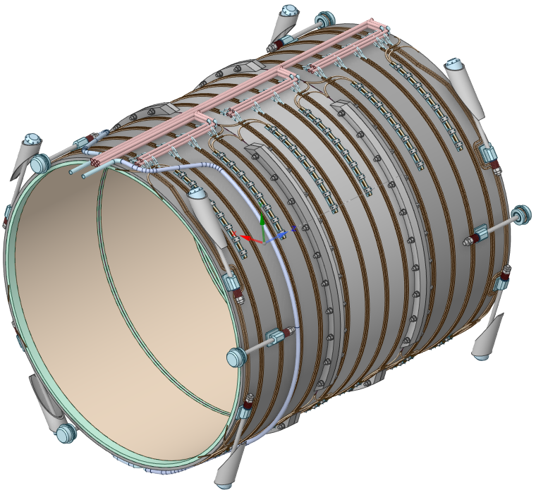
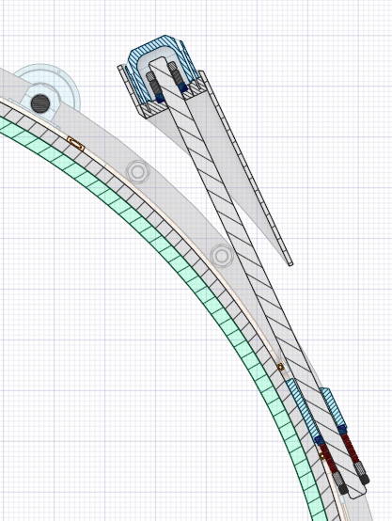
Mechanical Design
2D and 3D simulations were done on the overall magnet assembly, coils, mandrel and tie-rods.
Analysis is done for
  Gravitational load
  Cool down
  Transportation load
  Seismic load
  Energization loads
All the stresses, displacement are well within the acceptable limits.
Radial tie rod

Slide 16
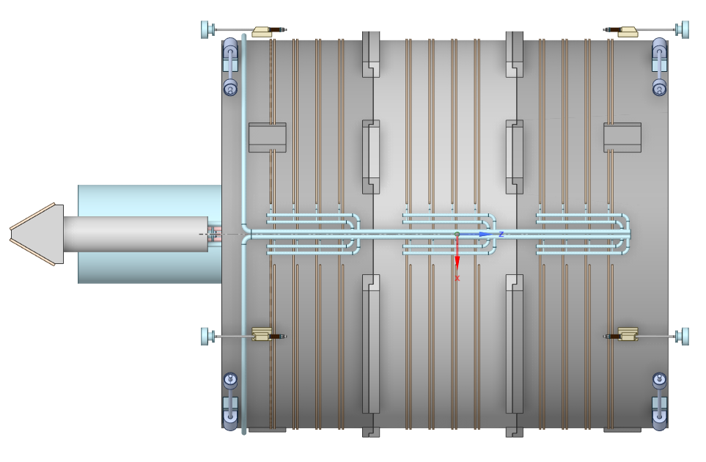
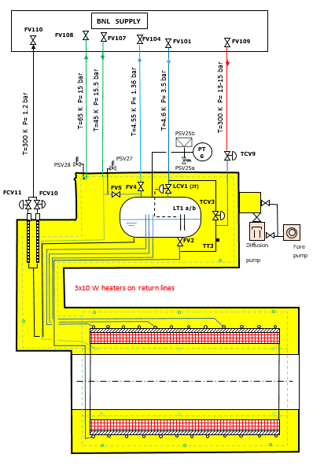
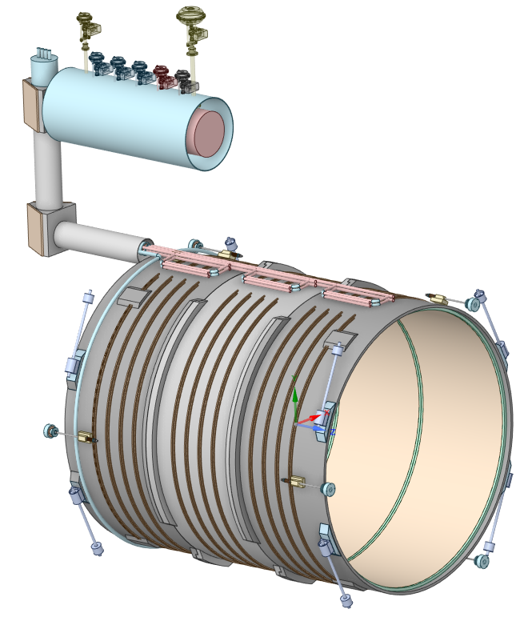
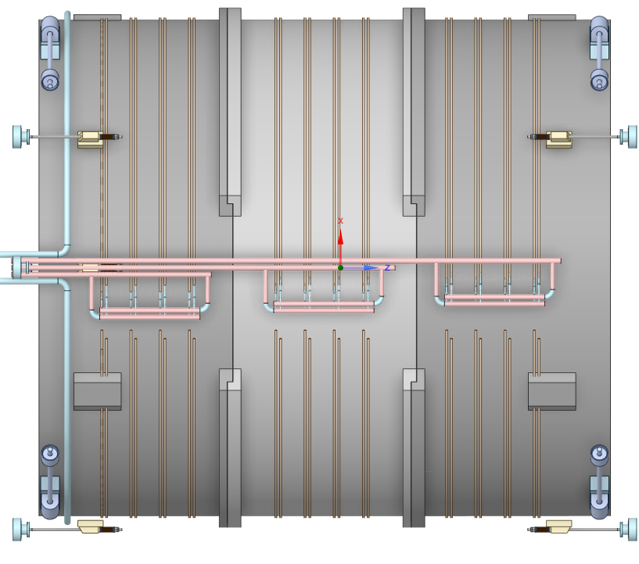
Cryogenics Design
Bottom view
Top view
Redundant cooling system to ensure thermosiphon working properly
2 thermosiphons (main + spare)

Slide 17
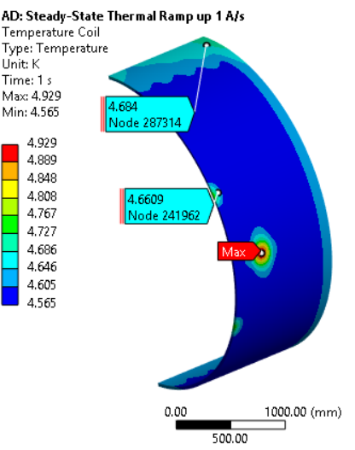
FEA Thermal
Detailed analysis were performed that show the temperature gradient across coil and helium flow path is acceptable during:
  Operation
  Ramp up
  Cool-down
Steady State and Transient analysis were completed
Fluid density variation during operation was validated
Magnet can be ramped to full field at 1A/s (total ramp up time 1 hr 15 minutes)
Estimated time to cool down magnet from room temperature to operating temperature 8-10 days
Current Ramp mode Coil Temp

Slide 18
Instrumentation
Voltage taps (eventually double for redundancy)
  36 for the solenoids (18 DP)
  4 for the busbars (2 DP)
  4 for the current leads (2 DP)
  2 for Utot (1 DP)
2 DCCT (1 for PS and one for magnet)
3 Heaters
2 Vacuum gages
PT 100 thermal sensors:
  10 on the thermal shield
  6 on the current leads
Flow meter:
  2 for the current leads
  2 to 4 for the thermosiphons inlet and outlet
  2 for the 50 K shield inlet and outlet
2 He level gages
2 Manometer (pressure sensor)
One load sensor by tie-rods
CERNOX thermal sensors:
  12 distributed on the magnet and the shell
  6 on the phase separator and thermosiphon inlet and outlet
Magnet is well instrumented with proper redundancy in instrumentation

Slide 19
Magnet Interface document
Note that all magnet interfaces are presently frozen.
This is required to start the construction contract.
Any change in interface needs now to follow a sign-off process by the magnet team and others.

Slide 20
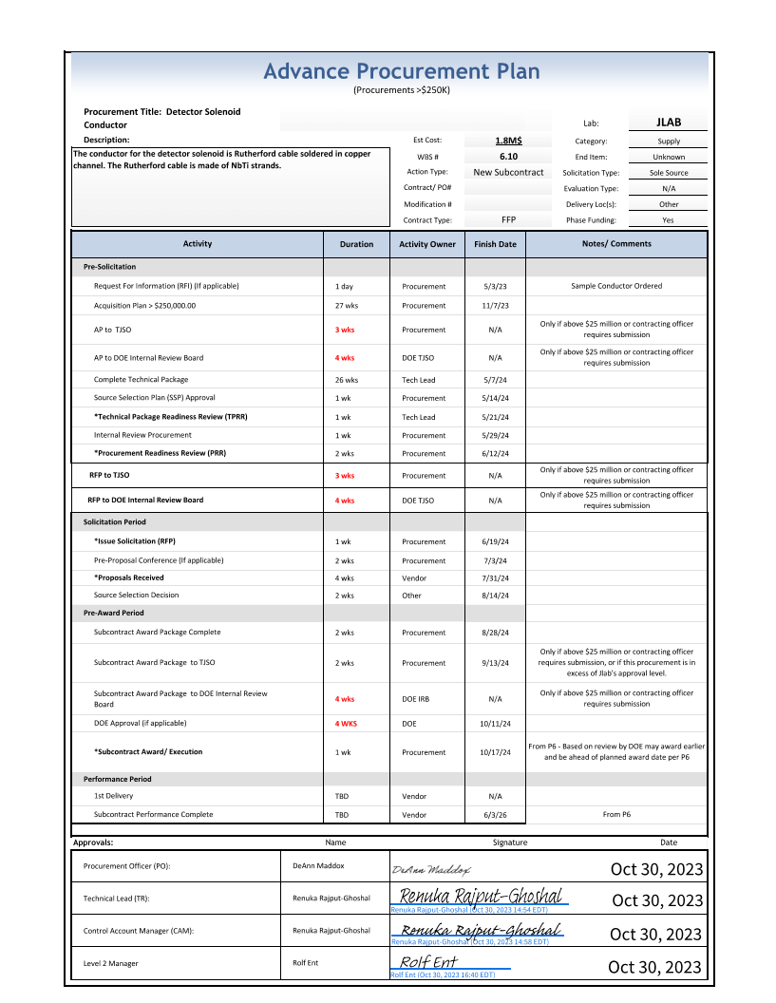
Advance Procurement Plan
According to current APP Magnet Contract is awarded by Mid-July 2024.
Plan is to keep the same schedule with INFN
Complete magnet system delivery date according to the project plan is August 2029

Slide 21
Plans for 2024
Working on implementing local measures to further reduce fringe field,
Finalize the sample conductor testing plan and facility, award contract
Finalize the Final Magnet Design Report
Finalize the reference drawings for the magnet
Finalize Acceptance and quality plan for the magnet
Final design review for Magnet power supply (tentatively April 2024)- Magnet power supply is being considered to be included in CD-3B package
Initiate the magnet construction phase (August 2024)
Finalize documents for the overall conductor procurement (June 2024)

Slide 22
Summary and What Next
Magnet design to initiate vendor design-built contract is complete.
Magnet RFI was done in April 2023, received 5 responses, 2 responses looks very reasonable.
Working on the final design report and quality documents to initiate procurement.
Sample conductor order was placed 04-21-2023
Sample conductor qualification work is progressing well.

Slide 23
Questions?

Slide 24
ESH &Q- Electrical & Pressure Vessel
Magnet Power supply, electrical and Instrumentation feedthroughs will comply as per 6210 Electrical Safety Manual
    NFPA 70E, 2015 - Standards for Electrical Safety in the Workplace
    National Electric Code (NEC) Handbook
    DOE–HDBK-1092, 2013 – Department of Energy Electrical Safety Handbook
    ES&H Manual 6230 Electrical Safety Manual
    JLAB-6220 AC Electrical Equipment Safe Work Program
All the vessel are designed according to the requirements of ASME codes
Pressure piping is governed by ASMEB31.3

Slide 25
FMEA
Focused on the following categories:
Magnet design - Electro-magnetic, electro-mechanical, magnet protection, magnetic field mapping
Mechanical design – coil manufacturing, tooling, magnet or coil assembly, alignment, coil support and magnet support structure, vacuum, pressure, Cryo-thermal design and safety
Electrical design – electrical insulation, power requirements, electrical faults and safety
Controls - instrumentation, interface with other sub-systems, firmware, software, hardware, and electronics
Total number of risks identified for analysis for the categories are-
Magnet design - 41
Mechanical design - 51
Electrical design - 44
Controls – 28

Slide 26
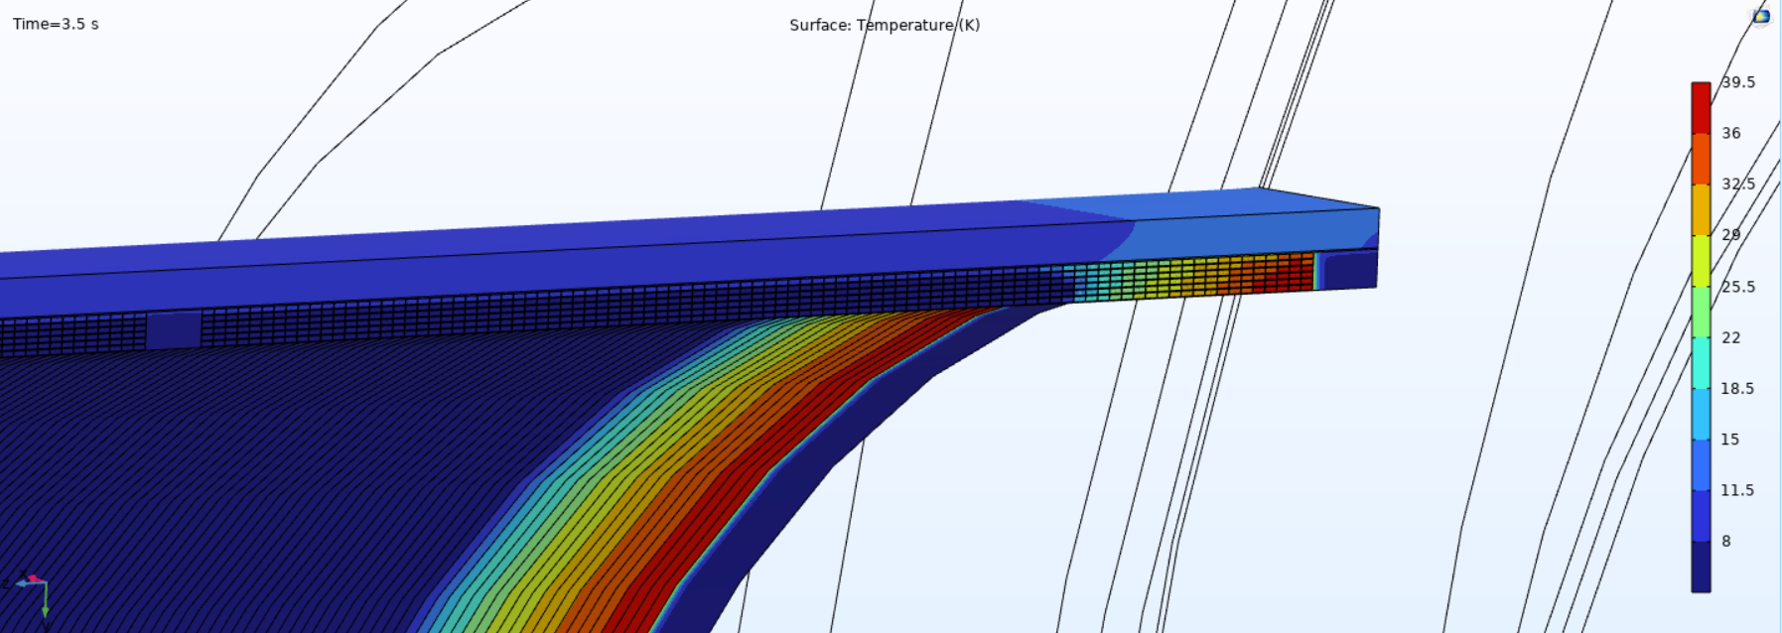
Quench Analysis
Single coil quench analysis
  Single coil quench analysis shows hot spot temperature and maximum temperature well below the accepted limits
  MIITS calculations were done with and without dump resistor, with dump resistor magnet is in safe quench limits.
The transient analysis shows the effect of mandrel in quenchback
Quench Analysis was also done using COMSOL

