Slide 1
Report on the Joint
Background TF & Tracking Meeting
Elke Aschenauer (BNL), Kolja Kauder (BNL), Shujie Li (LBNL), Barak Schmookler (UCR)
Minjung Kim, Benjamen Sterwerf (UC Berkeley)
ePIC Collaboration Meeting, Argonne
January 13th, 2024

Slide 2
Overarching Background Goals
Embed physics event(s) into backgrounds from multiple sources ✅
  Action Item: Convert merger to C++ for hepmc.root support, speedup, and better memory control
  Action Item: Far Backward region requires more fine-grained correlation of background event times with beam crossings, WIP with Simon Gardner
Take advantage of faster detectors to separate background from signal
  Special focus on tracking
Prerequisite: Support of timing and time resolution in digitization of simulated hits
  Note that time in hepmc is implemented (modulo FB) and propagation through Geant4/npsim is automatic
Agenda: https://indico.bnl.gov/event/20473/sessions/6748/#20240111

Slide 3
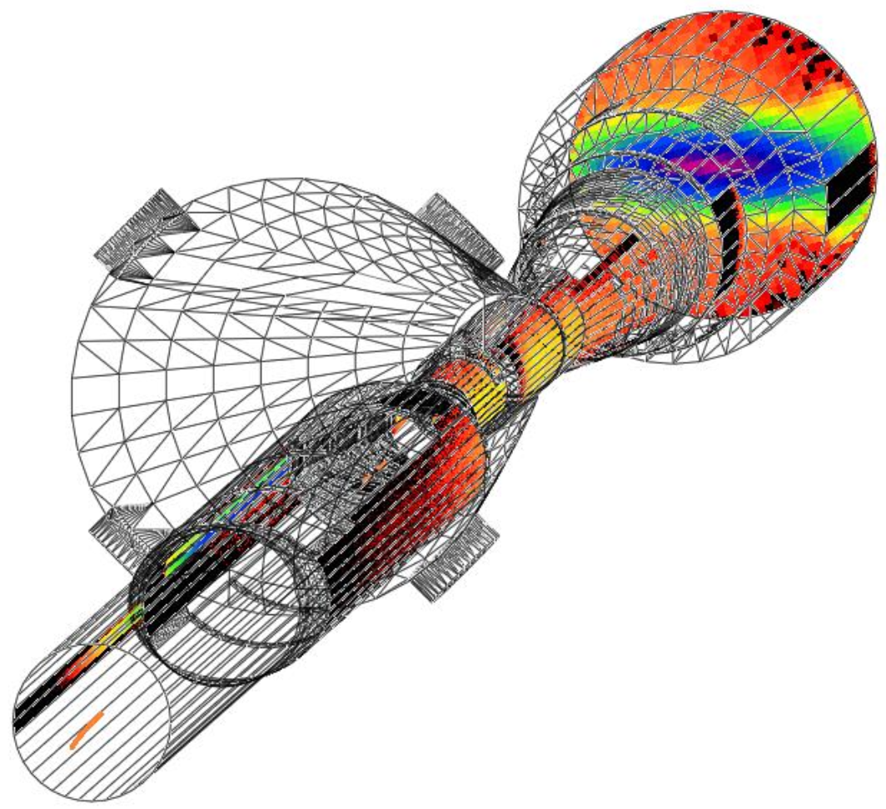
Background Source: Synchrotron Radiation
Electron beam:
Synchrotron radiation
  extensive simulations by of SR accelerator background WG group
  SynRad+ modeling software
  Input:
  3D model of beampipe
  Beam emittance, current Magnet locations and fields
  bunch geometry – core and tails
  Output:
  Synchrotron Radiation – Position, Flux, Energy, Direction
  Synchrotron Radiation Mitigation:
  Photon absorber configuration:
  Horizontal plane only
  Annular configuration
  Length, diameter, position
  Beamline dimensions:
  Wider beam pipe for
    13.5 σ clearance in x
    23 σ clearance in y
  Beampipe material/structure
  2-5 μm Au coating
  Sawtooth/ridge texture for photon absorption
Elke Aschenauer

Slide 4
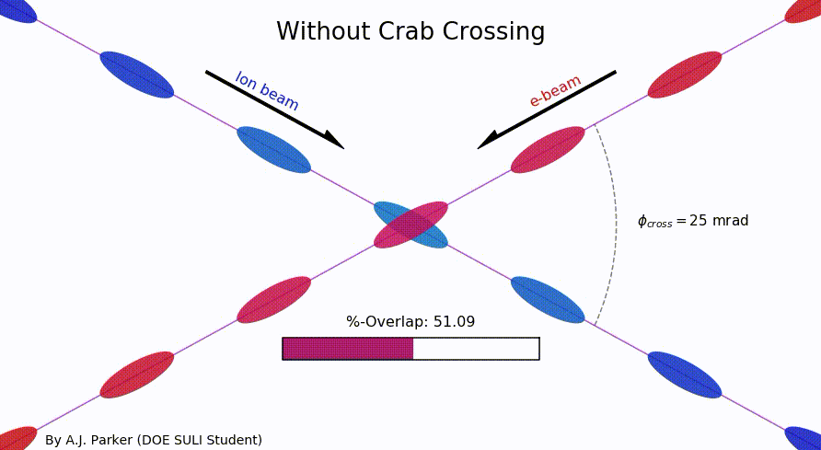
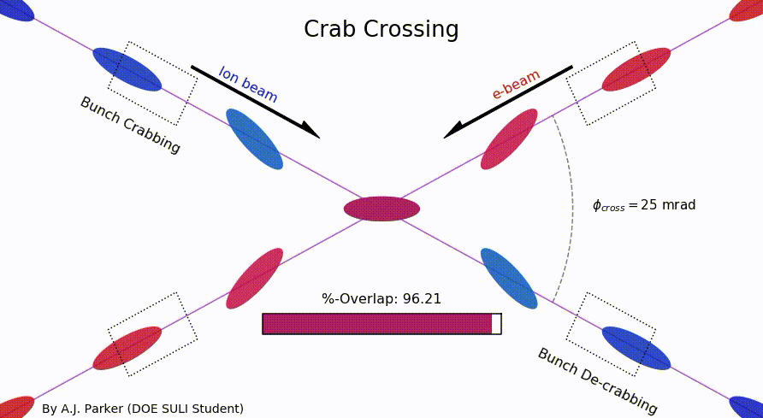
SR-Mitigation → Crossing Angle
Brings focusing magnets close to IP
→ high luminosity
Beam separation without separation dipoles
→ reduced synchrotron radiation
background
But significant loss of luminosity
Solution: Crab crossing
Head-on collision geometry is restored by rotating the bunches before colliding (“crab crossing”)
Bunch rotation (“crabbing”) is accomplished by transversely deflecting RF resonators (“crab cavities”)
Actual collision point moves laterally during bunch interaction
Completely new concept for a collider
Elke Aschenauer

Slide 5
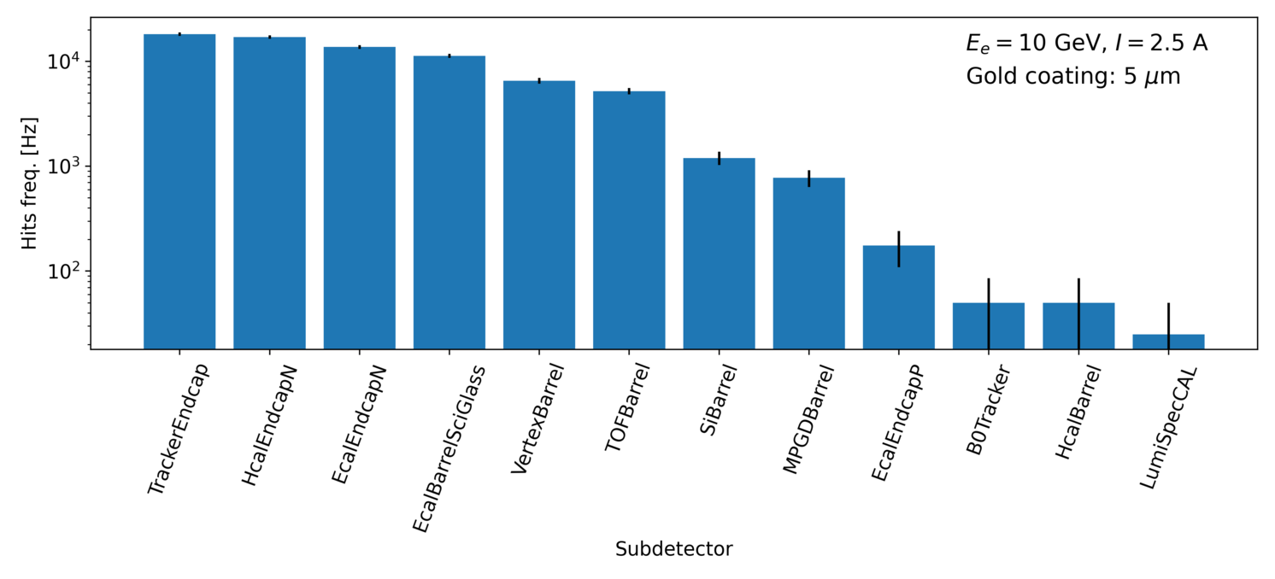
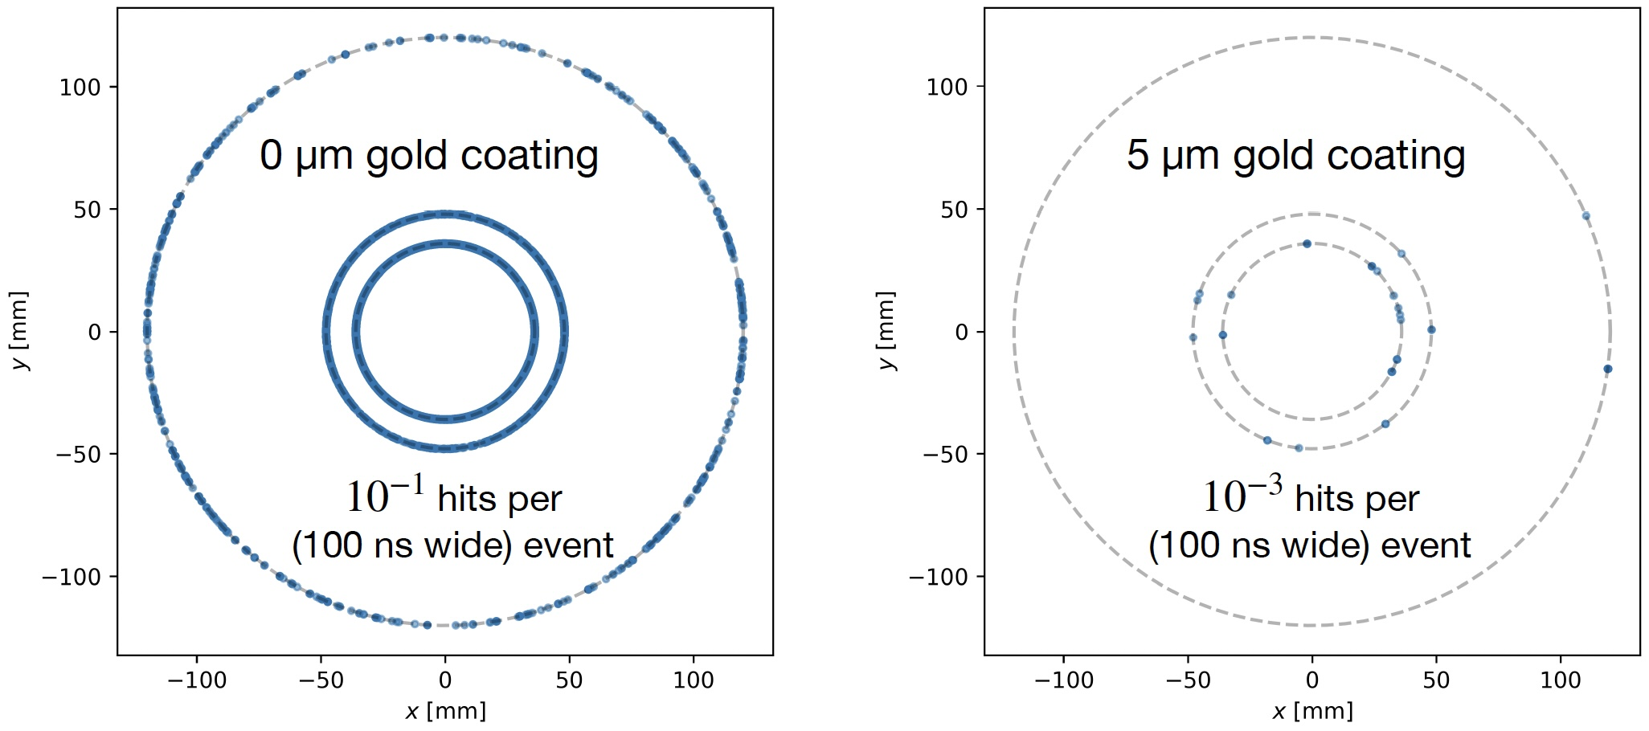
Synchrotron Radiation Results
Elke Aschenauer
Rates in different subdetectors:
Effect of gold coating on SR
→ Example μvertex MAPS layers
Need to repeat all synchrotron radiation studies due to recent lattice change
Now fully in Geant4, with big advantages for framework integration, flexibility, …
On-going but delayed by visa issues – write to your congressperson!

Slide 6
Background Source: Beam Gas
Electron beam:
Beam gas interactions
  generation of non-gaussian tails → accounted in accelerator simulations
    Off momentum electrons → will be shielded by collimators → simulations of collimation system underway
  Big contribution for detector background
  Bethe-Heitler process: e_{Beam} + H²_{restgas} → e’ + γ + H²_{restgas}
  Kinematics: fixed target → particles boosted towards outgoing electron direction
  Generate real tracks not random hit pattern like SR
  Mitigation: excellent vacuum
Proton beam:
Low beam lifetime during injection and ramping → collimator setup → simulation by accelerator colleagues, but ample experience for 21 y of RHIC running
Beam gas interactions
concern: large hadronic cross section p/A + H²_{restgas}
  Secondary interactions with aperture limitations, i.e. magnets, beam pipe, masks
  Beam-gas interactions are also a source of neutrons that thermalize within the detector hall and can cause damage → need still to model it
  Kinematics: fixed target → particles boosted towards outgoing hadron direction
  Generate real tracks not random hit pattern like SR
  Mitigation: excellent vacuum
GEANT4
Elke Aschenauer

Slide 7
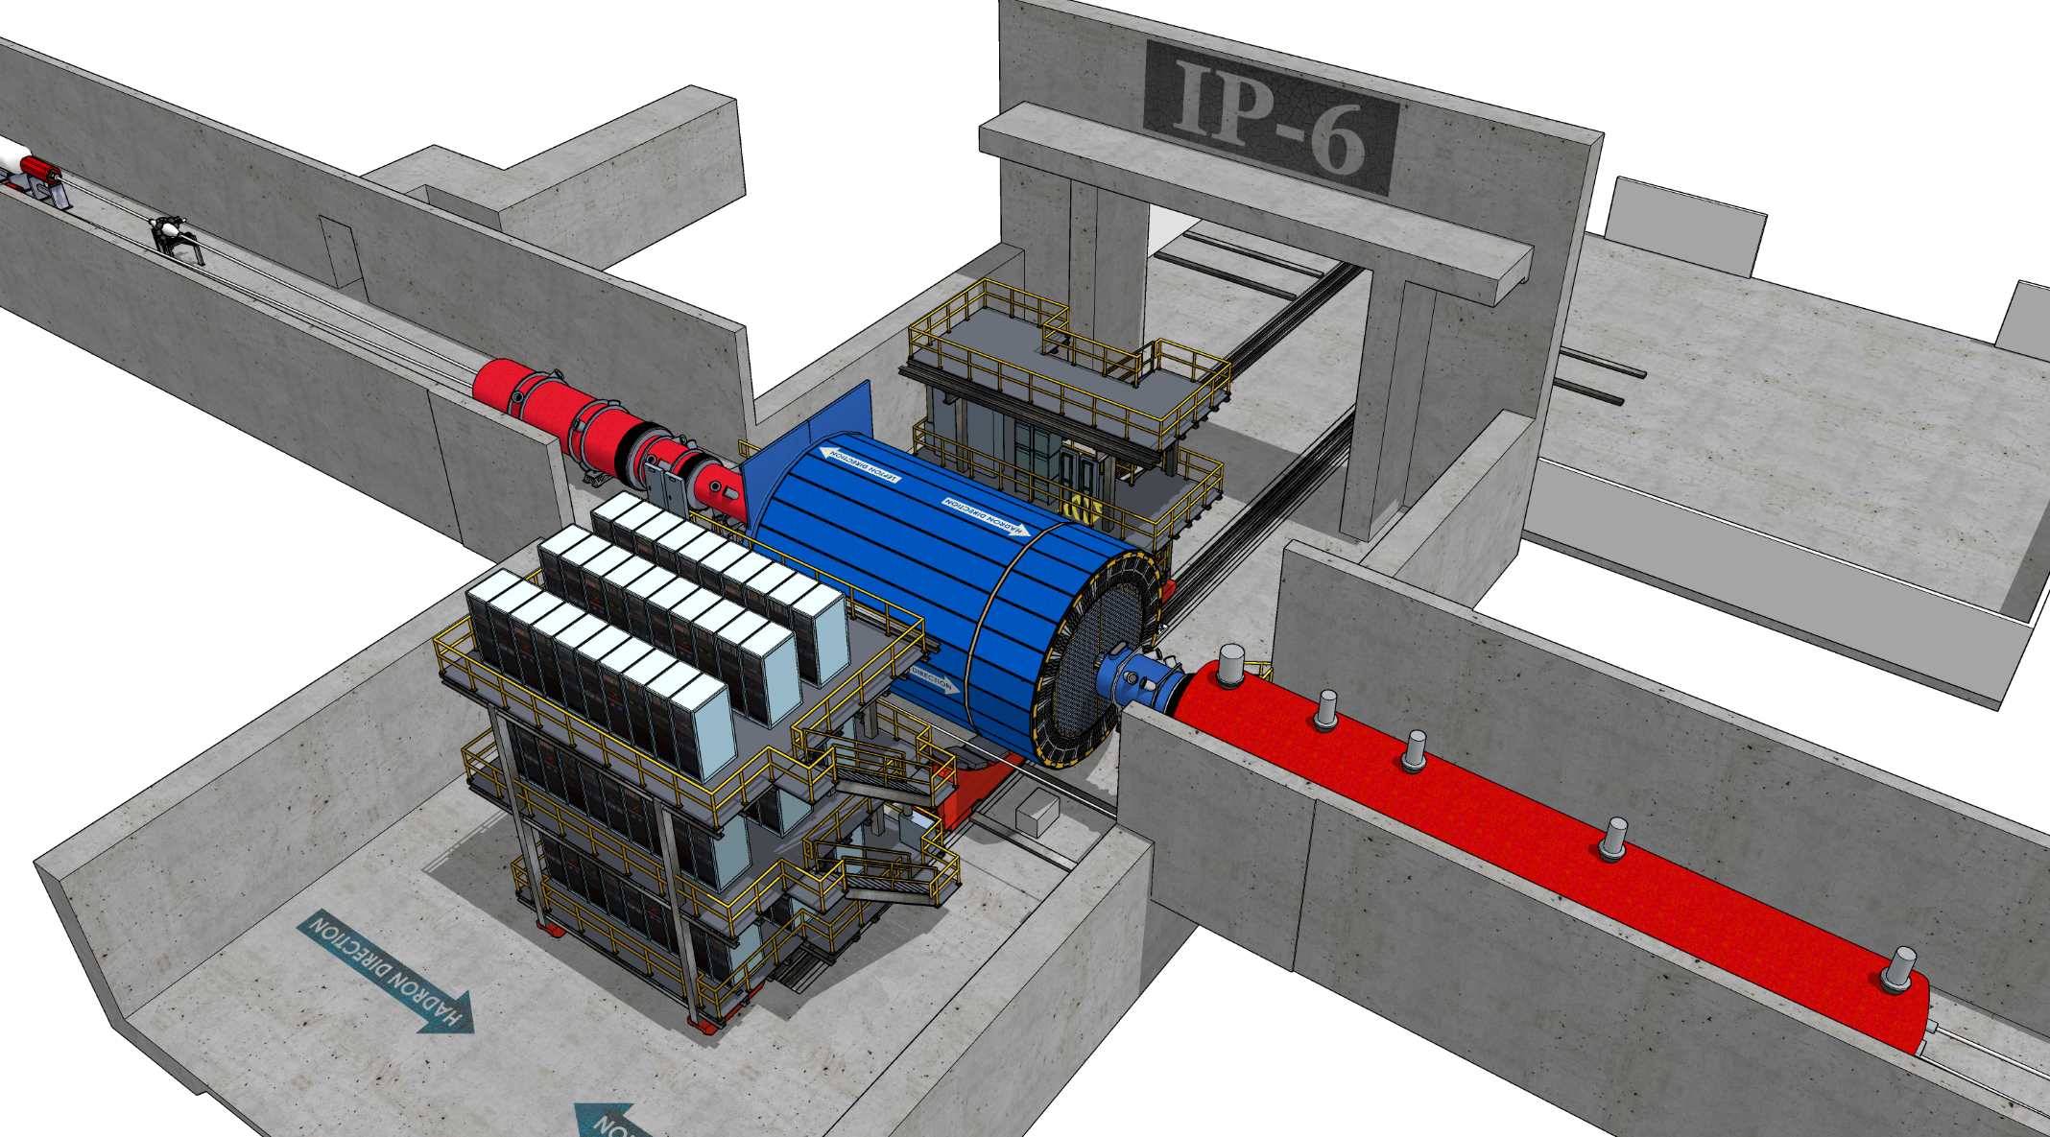
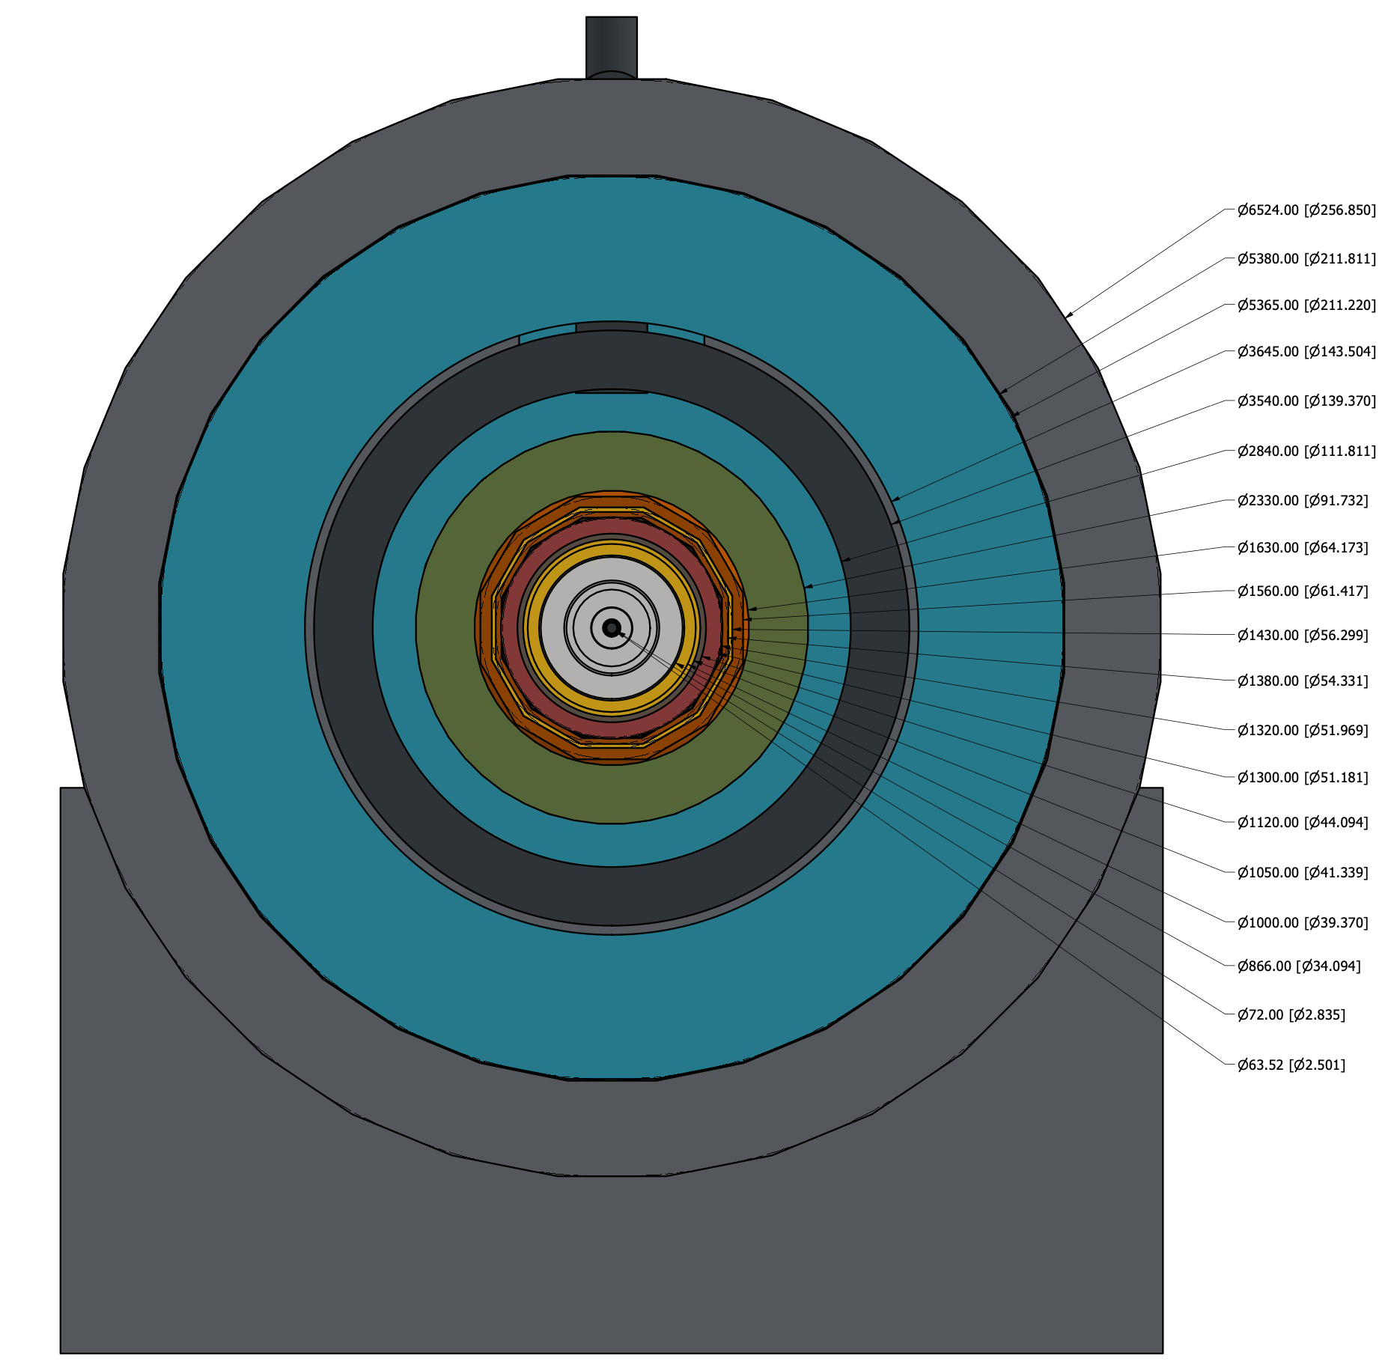
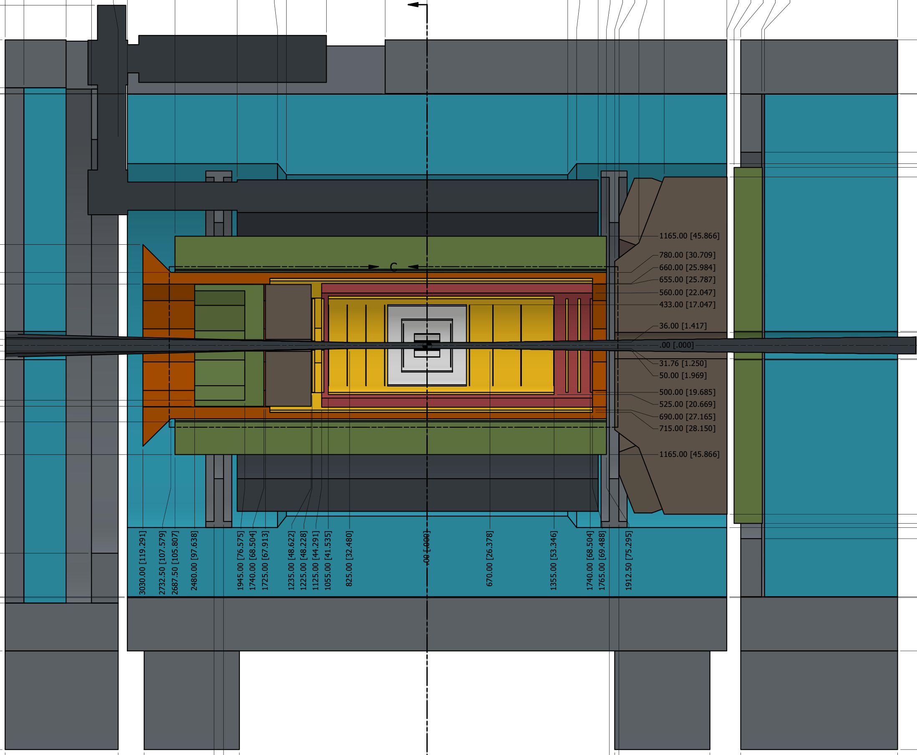
Beam Pipe Bake-Out
10000 Ah correspond to 5month @ 10³⁴ cm²s⁻¹
Remember: limited installation and maintenance possible in Collider Hall due to space constrains
Will have to break vacuum each time we roll into the assembly hall for maintenance
  will have separation valves around the detector
    no pumping over 9.5 m
  will vent under nitrogen and keep beam pipe rolling
  with detector under nitrogen
  will need to bake-out beam pipe integrated in central detector
Considerations for central beam pipe bake-out
  1st MAPS μvertex tracker sits at 36 mm radius, so 5 mm from the beam pipe
  MAPS sensor cannot go higher as 30ºC
    rules out std. bake-out methods and NEC
    pumping
    want to cool with air to keep material budget
    as low as possible
  Investigate baking out the central beam pipe
  with hot gas at > 100ºC to break water bonds
rolling to
assembly hall
Elke Aschenauer

Slide 8
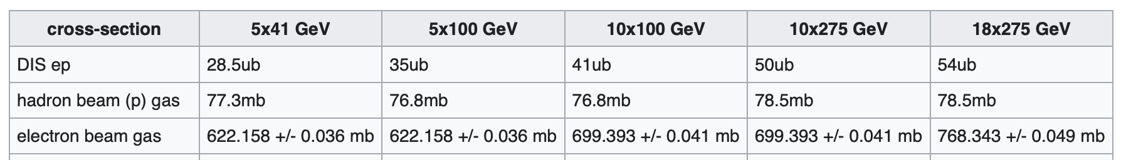
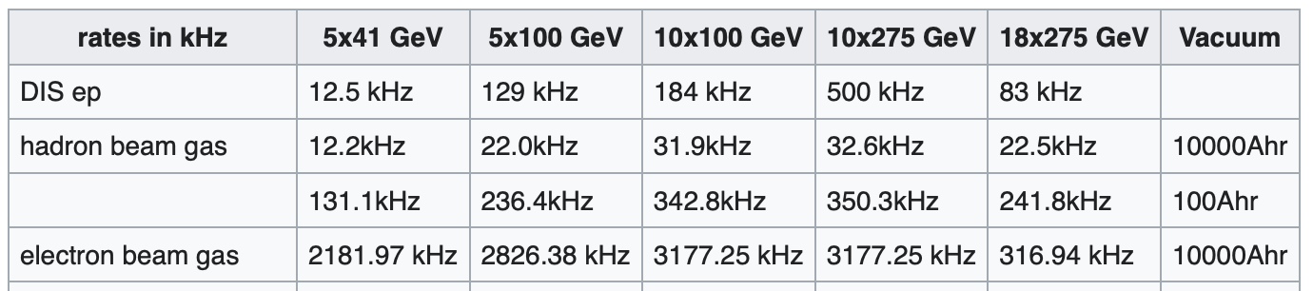
Cross Section and Rate Comparisons
Elke Aschenauer
Total ep
Different to hadron-hadron colliders beam related background cross-sections are larger than signal cross-section
Note: For “minbias” DIS simulations it is critical to ensure the correct PDFs are used and the MC
settings are correct see my email from December
Remember:
electron beam current and energy impact electron beam gas background and synchrotron radiation
hadron beam current impacts hadron beam gas

Slide 9
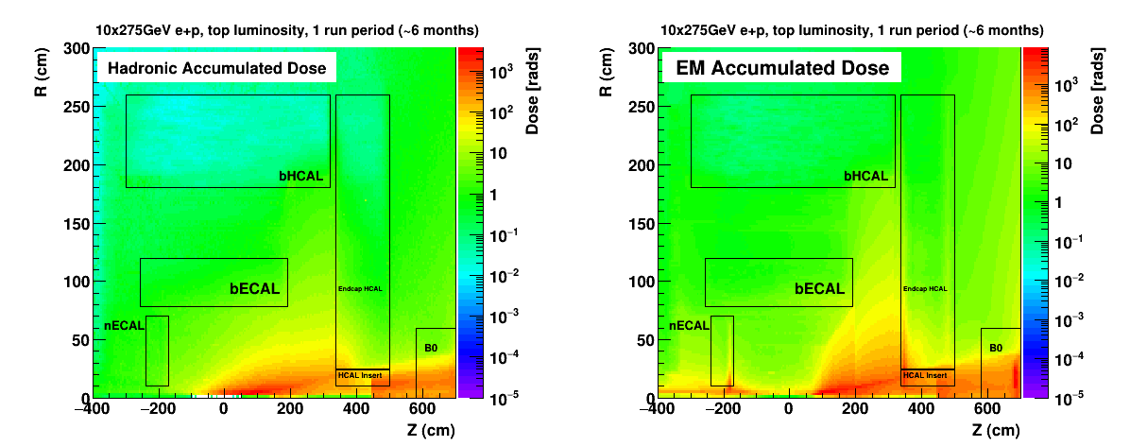
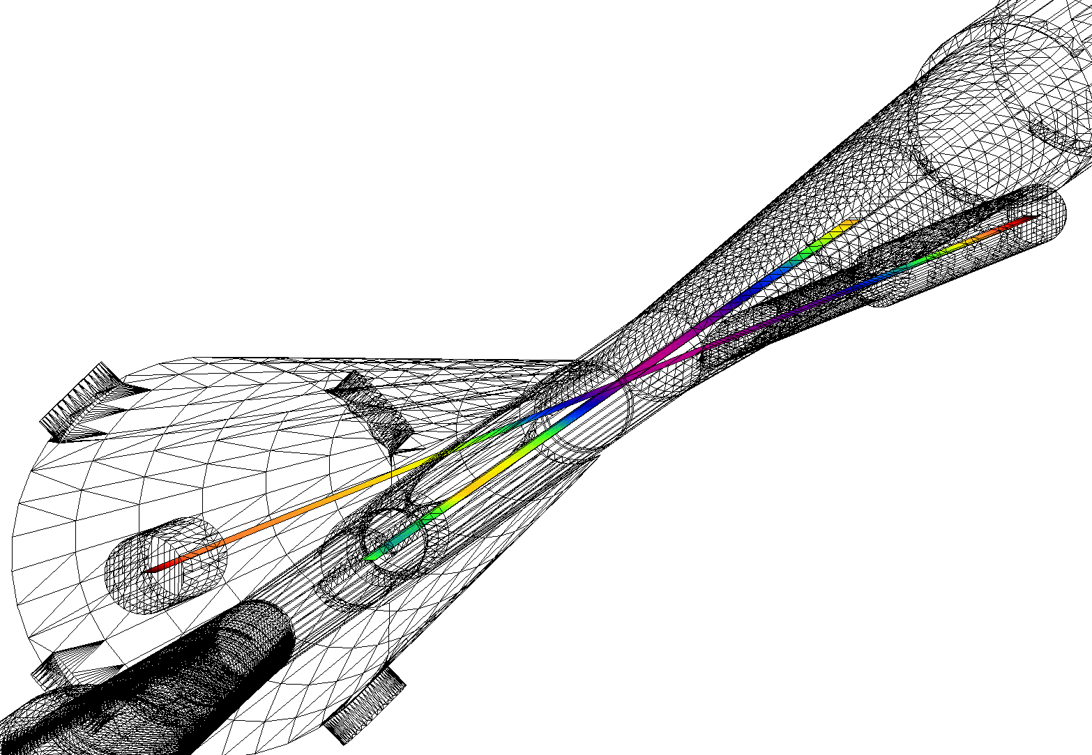
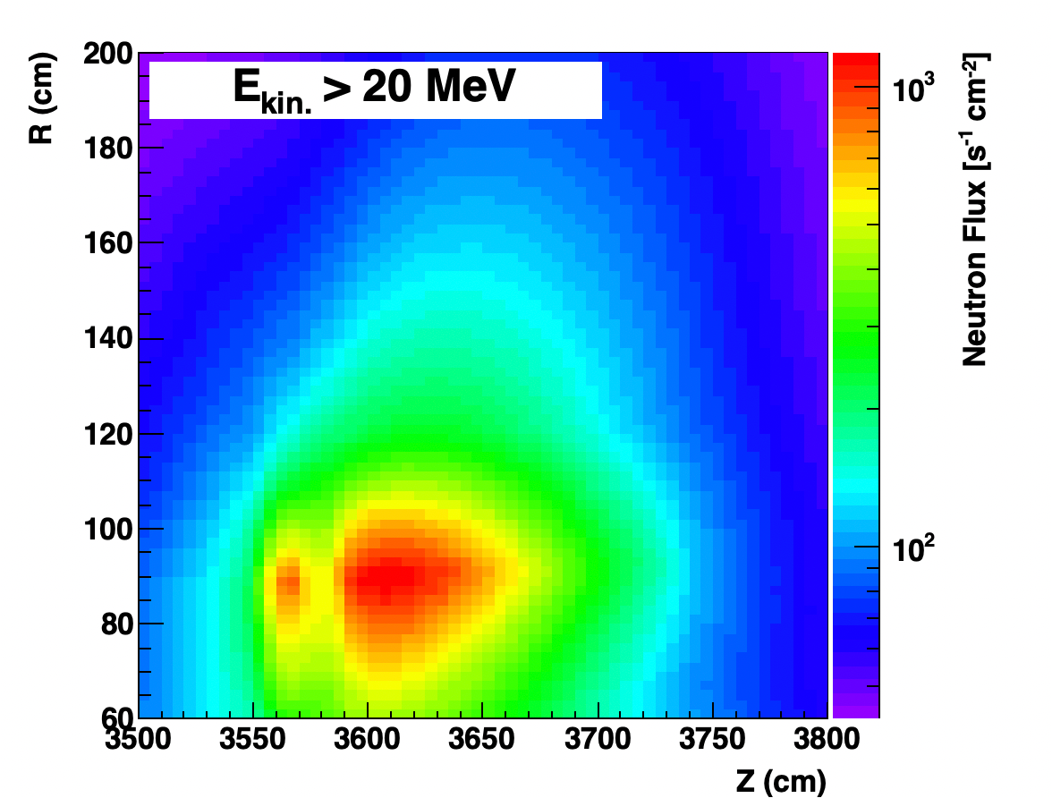
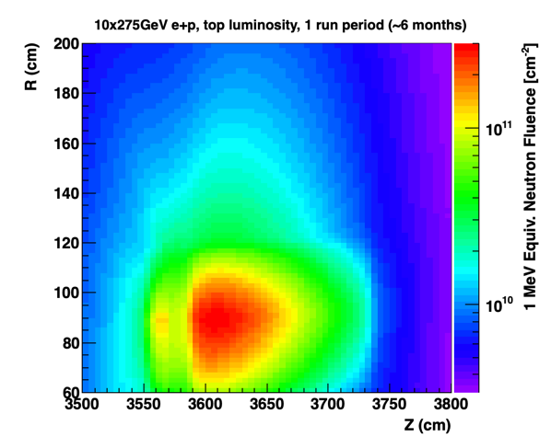
More Studies
Please see Elke’s presentations many more studies on ionizing radiation, low energy neutron fluence, SR effect on vacuum, first results on rates per channel, DIS and beam gas background rates, more sources determined to be negligible, etc.
Elke Aschenauer

Slide 10
Impact of Beam Background on Detector Performance
Background hits will impact the track finding and reconstruction
  Embedding of beam background events in DIS signal event in MC simulations
  Impact depends on speed of subdetector readout speed, MAPS 2 μs AC-LGAD 30 ps
Background will impact of energy reconstruction in calorimeters
Need to know the total rate per readout channel (== Background + DIS) for DAQ
  impact needed data rate capabilities
Total Radiation (== Background + DIS) impact subdetector lifetimes
→ need the thresholds per subdetector on hit level and summed energy, see EPIC Detector DigitizationModel.09.2023.xlsx, to get the correct rates
→ All implemented in December campaign
→ Impact on backgrounds currently analyzed
Elke Aschenauer

Slide 11
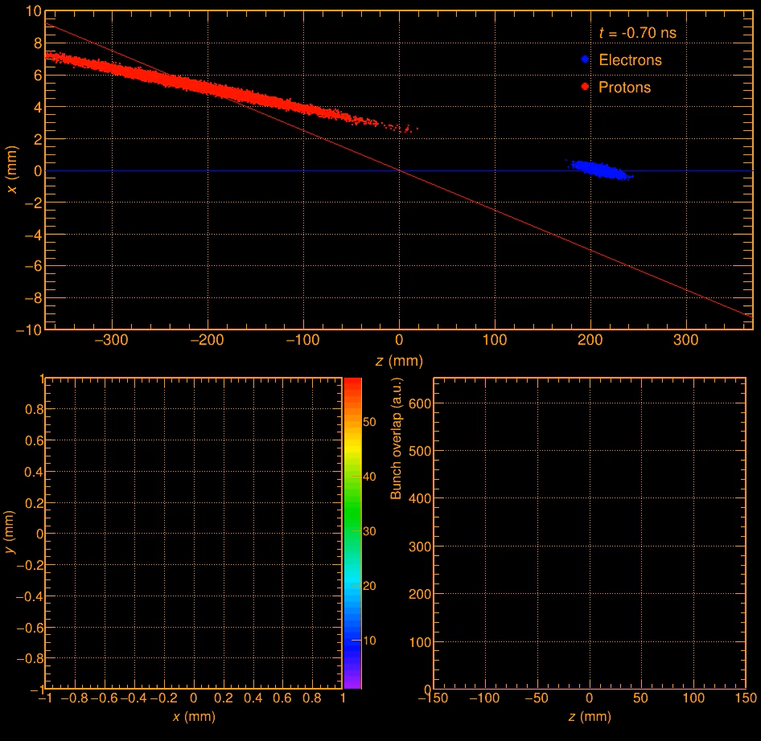
Impact of Beam Background on Detector Performance
need to start thinking how to deal with background in our data
timing of hits will be key
need a good time of the collision → t₀ → vertex will give excellent t₀
need to integrate in our software
Elke Aschenauer

Slide 12
Backgrounds Summary
All background sources are understood and simulated
  well documented on the wiki: https://wiki.bnl.gov/EPIC/index.php?title=Background
  good vacuum is critical to keep beam gas related backgrounds under control
Impact of SR and beam gas events on detector performance understudy
  embedding of beam backgrounds in DIS events under way
Next studies
  determine rated per readout channel (tower, pixel, or stave)
  update all background numbers with new based on new simulation input and new lattice setups
Information:
  wiki: https://wiki.bnl.gov/EPIC/index.php?title=Background
  email-list: eic-projdet-background-l@lists.bnl.gov
  Indigo: https://indico.bnl.gov/category/461/
  Meetings: bi-weekly Tuesday at 1:00 pm to 2:00 pm
Elke Aschenauer

Slide 13
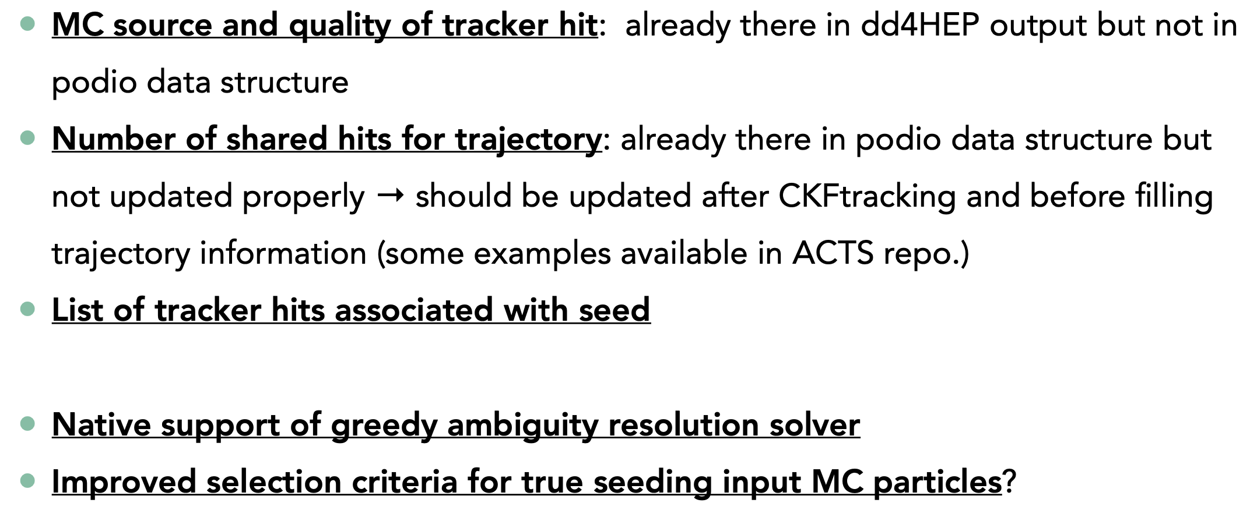
Tracking: A Wish List for Performance Improvements
Each bullet supported by studies in great detail, see Minjung’s slides!
Minjung Kim

Slide 14
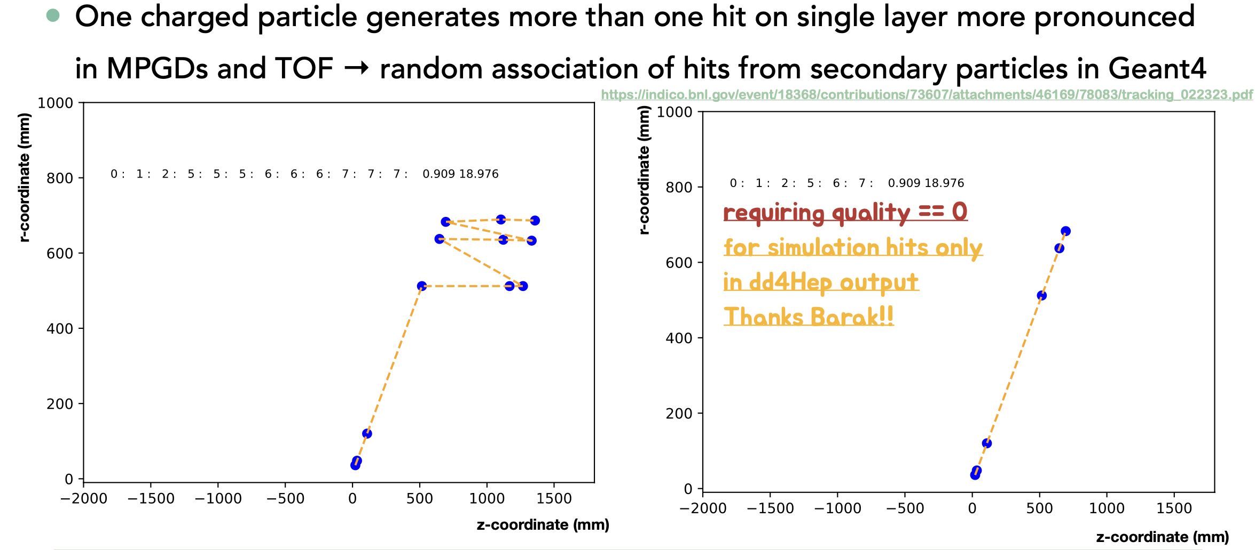
Multiple generated hits on single layer (npsim)
Note: Important to consider quality==0, see Barak’s investigation at https://indico.bnl.gov/event/18368/contributions/73607/attachments/46169/78083/tracking_022323.pdf
Minjung Kim

Slide 15
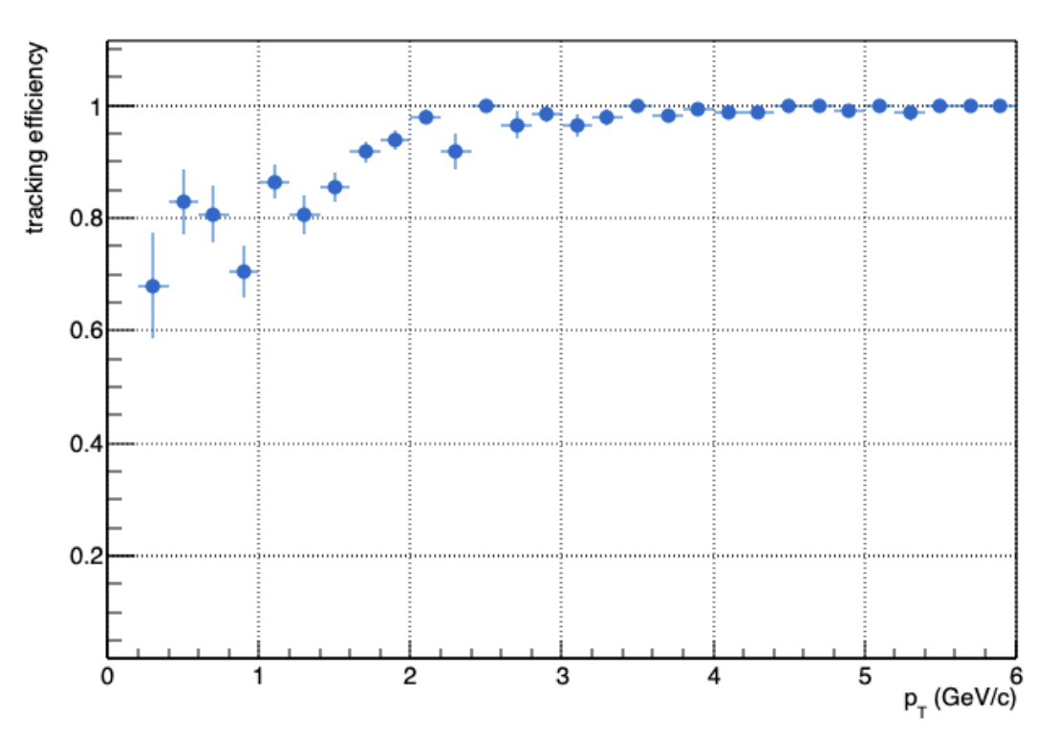
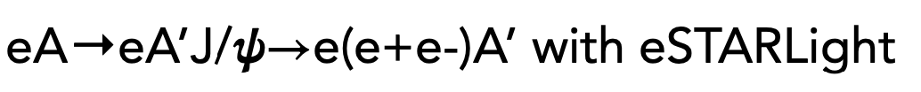
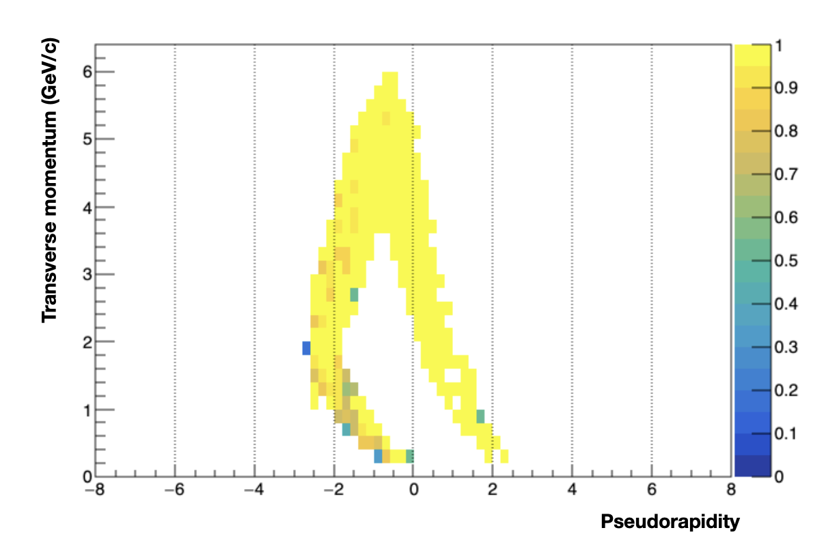
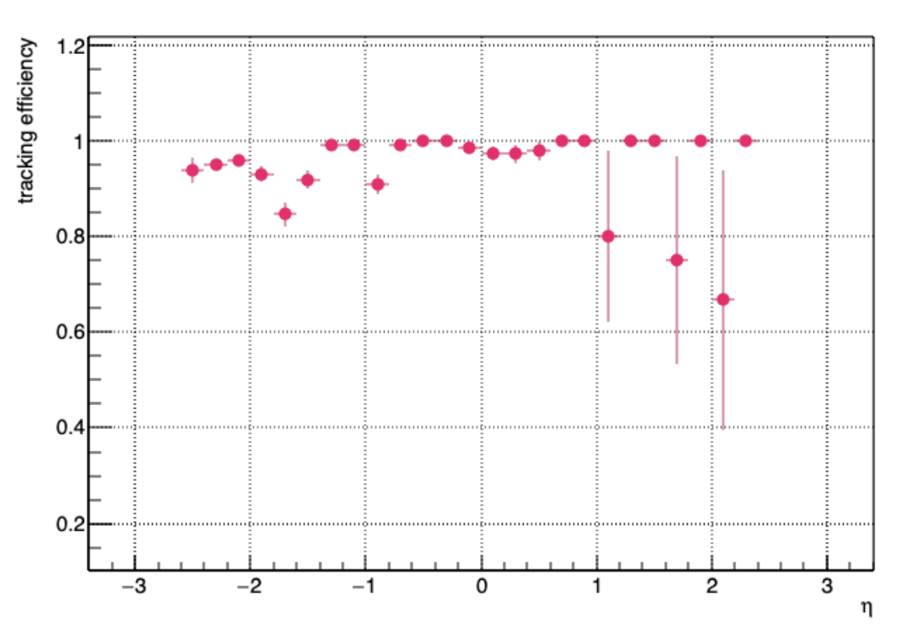
First Look at Tracking Efficiency, Ideal Conditions
Realistic seeding, looking very good!
Minjung Kim

Slide 16
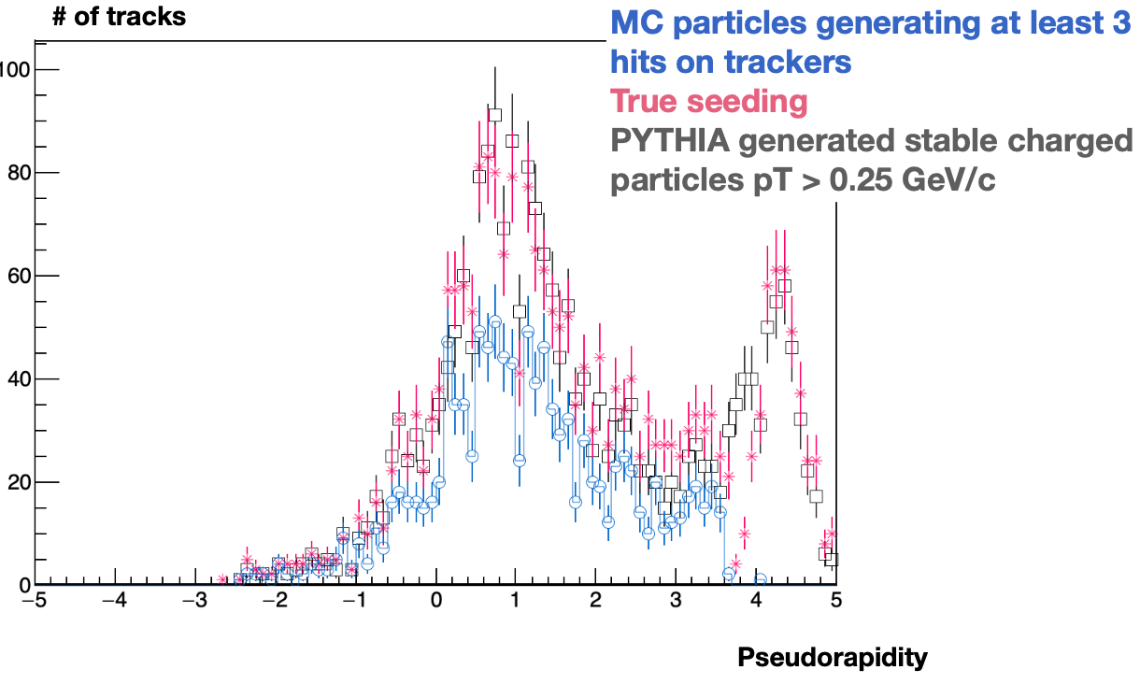
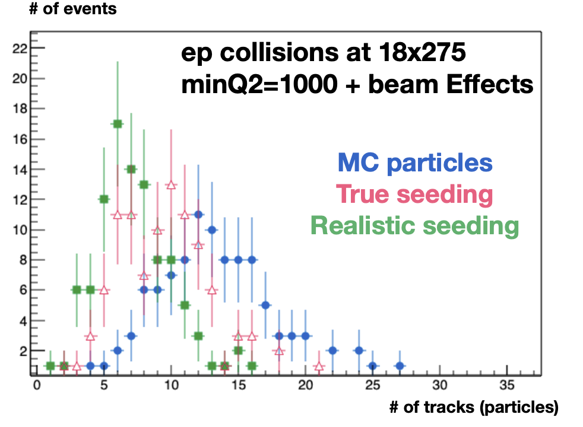
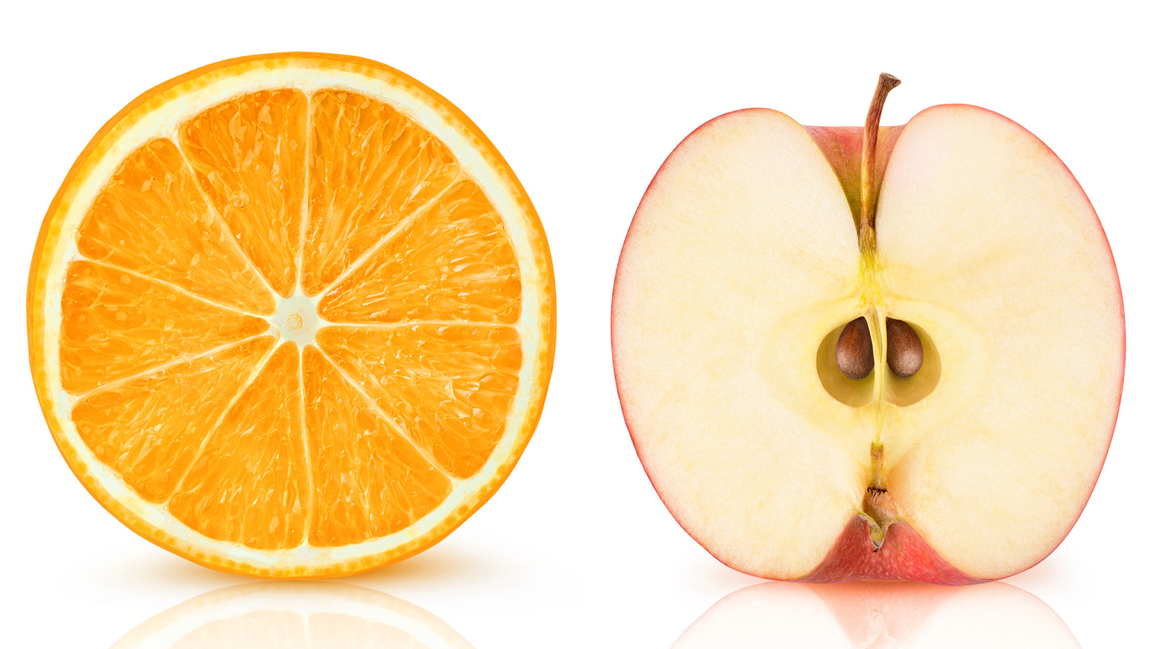
DIS is More Challenging
But beware what you compare!
Larger entries in true seeding w.r.t. MC particles in true seeding, with seeds in B0 acceptance
True seeding takes PYTHIA generated charged particle with min. p_{T}: doesn’t guarantee whether they are really trackable in the detector!
This study is on-going
Realistic seeding seems to not work all that great
Minjung Kim

Slide 17
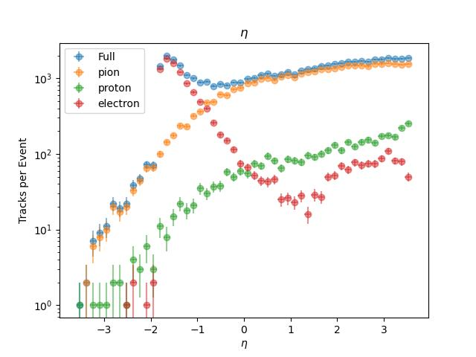
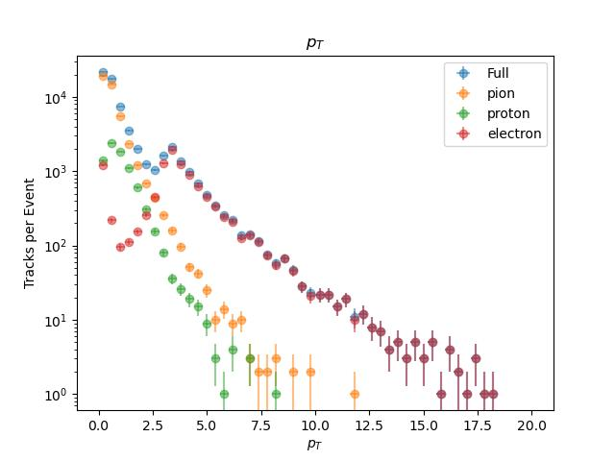
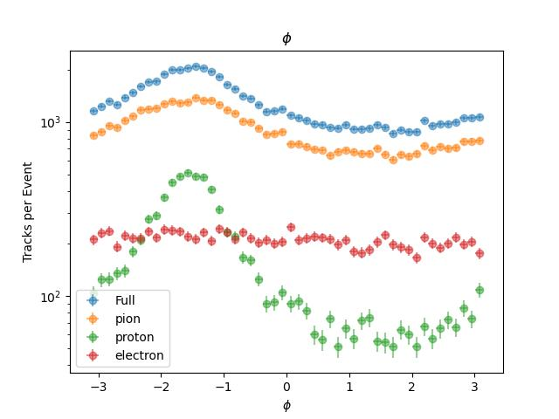
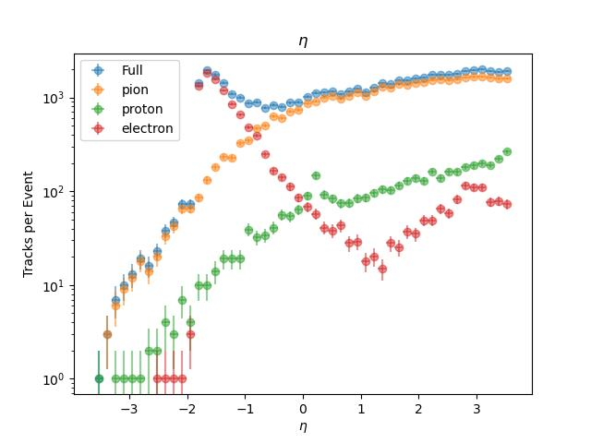
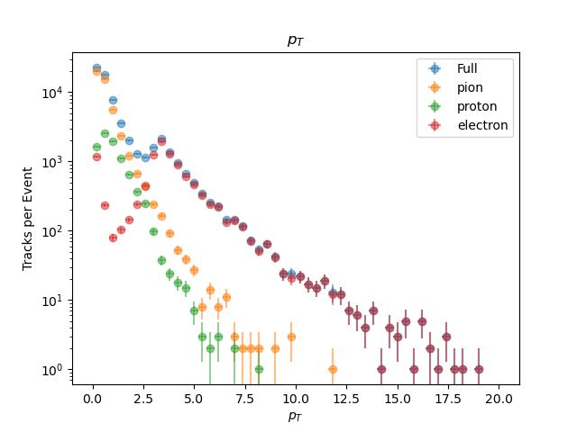
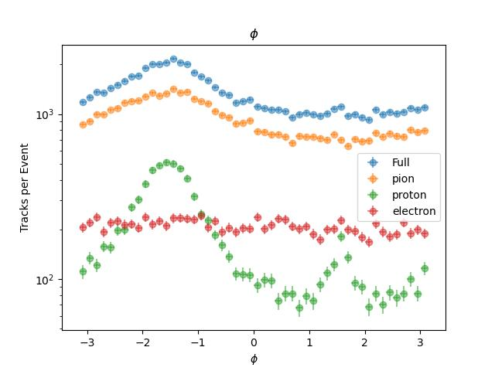
First Look at DIS + Proton Gas
Benjamen Sterwerf

Slide 18
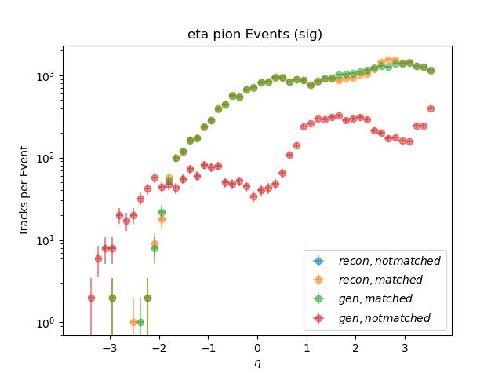
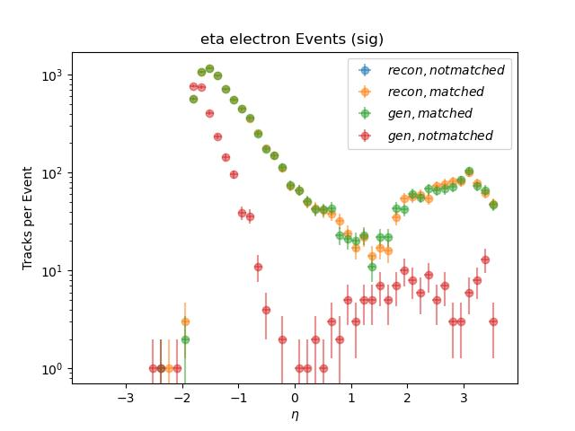
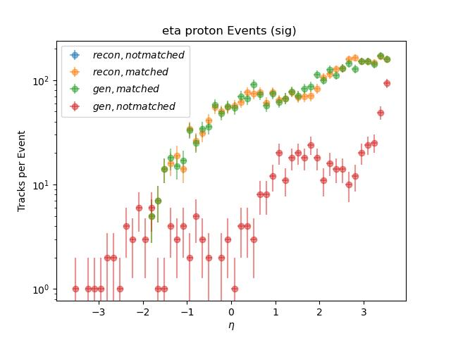
Not Reconstructed
We see that the majority of not reconstructed MC particles are pions except in low eta regime where there is a strong electron peak
Blue=Reconstructed Particles that do not get matched
Yellow=Reconstructed Particles that get matched
Green=MC Particles that get Reconstructed
Red=MC Particles that do not get Reconstructed
Benjamen Sterwerf

Slide 19
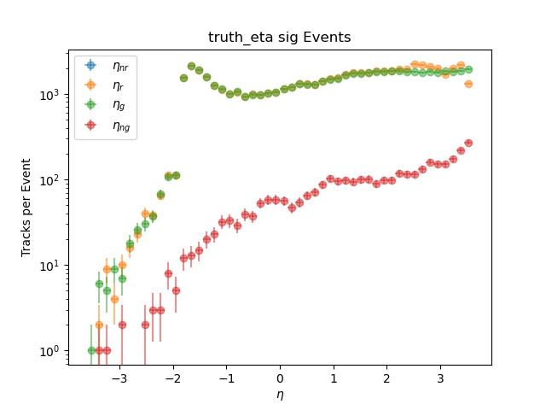
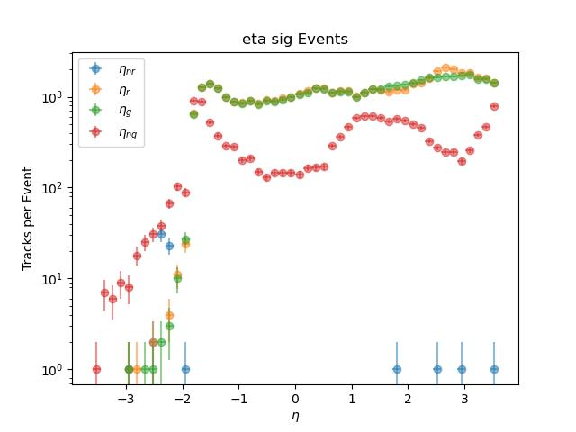
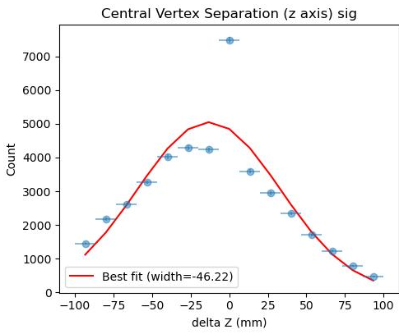
Truth vs Realistic Seeding; Vertex
Important not to fool ourselves with truth seeding
True minus reconstructed vertex-z: curious, broad shape.
To be investigated
Benjamen Sterwerf

Slide 20
Observations
First look at reconstruction with a single background source looks promising
  Note that this is in a sense the worst case – no timing information was used to separate BG from signal
Multiple observables and separation of PID allows fine-grained studies
Caveats:
Only a single background source
Reminder:
Soon: Studies of all other sources, look at only affected events
Benjamen Sterwerf

Slide 21
Recent updates to real-seeded tracking
We plan to repeat single-particle track reconstruction studies with embedded background from September ’23 incorporating recent changes to the real seeded tracking.
These changes include:
  Update of ACTS version
  Fix to globalToLocal seed conversion. EICRecon PR #1185
  Fix to seed charge calculation. EICRecon PRs #1213, #1214
  Updates to seed covariance matrix. In progress.
  Removal of seed duplicates. In progress; see Minjung’s talk.
Barak Schmookler

Slide 22
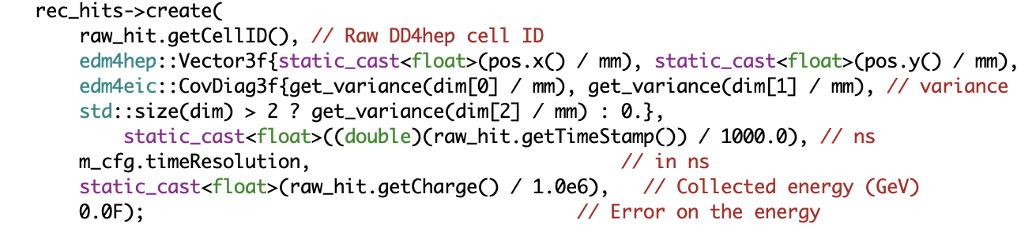
Workfest Starting Point
Both SiliconTrackerDigi and CalorimeterHitDigi integrate over the entire slice time and assign just one time value
→ problematic for length ~2 ms
Time resolutions exist, currently only used for
  smearing in silicon
  ADC resolution in calorimeters (similar in spirit)
TrackerHitReconstruction.cc:
→ Raw Hits do have timing resolution information (not as covariance)
(Calorimeter Raw Hits do have a timeResolution field, currently unfilled)

Slide 23
Questions/Tasks
What actually is the integration time? Every time I think I know, somebody tells me I don’t.
We need to start a new time bucket after the integration time (inside a slice).
  What triggers such a new bucket?
  What time should it have (the exact time at the beginning? In the middle? The beginning == end of previous bucket?
Apart from the far backward region, do we need to take beam crossing times, and offsets due to z-position, into account?
How does the time resolution included in the raw tracker hits currently enter into ACTS? How should it?
Any reason to use a 4-covariance in raw hits already?
Future, not now: A full daq length slice almost must be pre-processed into candidate events, especially if seeding cannot use time information.

Slide 24
1.5+ Hours Later
What actually is the integration time?
No one-size-fits-all explanation, but a great deal of clarification from the MAPS and readout perspective
We need to start a new time bucket after the integration time (inside a slice).
  What triggers such a new bucket?
  What time should it have (the exact time at the beginning? In the middle? The beginning == end of previous bucket?
  MAPS runs continuously, end == new beginning. Otherwise: first hit in the middle of the bucket
Apart from the far backward region, do we need to take beam crossing times, and offsets due to z-position, into account?
Almost certainly not. Can’t hurt though once we have it for FB anyway
How does the time resolution included in the raw tracker hits currently enter into ACTS? How should it?
It does not. Major takeaway: It should not. Instead of combining fast and slow in the fit and use a chi^2 (which would be close to meaningless due to the slow detectors), match all slow candidates to fast hits to determine precise trajectory time, also use t₀
Any reason to use a 4-covariance in raw hits already? No, see above
Bonus: A full daq length slice is naturally divided by MAPS, and can start on a crossing

Slide 25
Final Thoughts
Great opportunity to touch base, get a comprehensive BG overview, and see the great progress of tracking
  After-talk discussions already triggered multiple work plans before the workfest part started
The Workfest was a great success in clarifying requirements, and in reducing the actual work needed!
A Workfest doesn’t mean that we all gather around a text editor and spurn out C++ code ☺

Slide 26


Slide 27
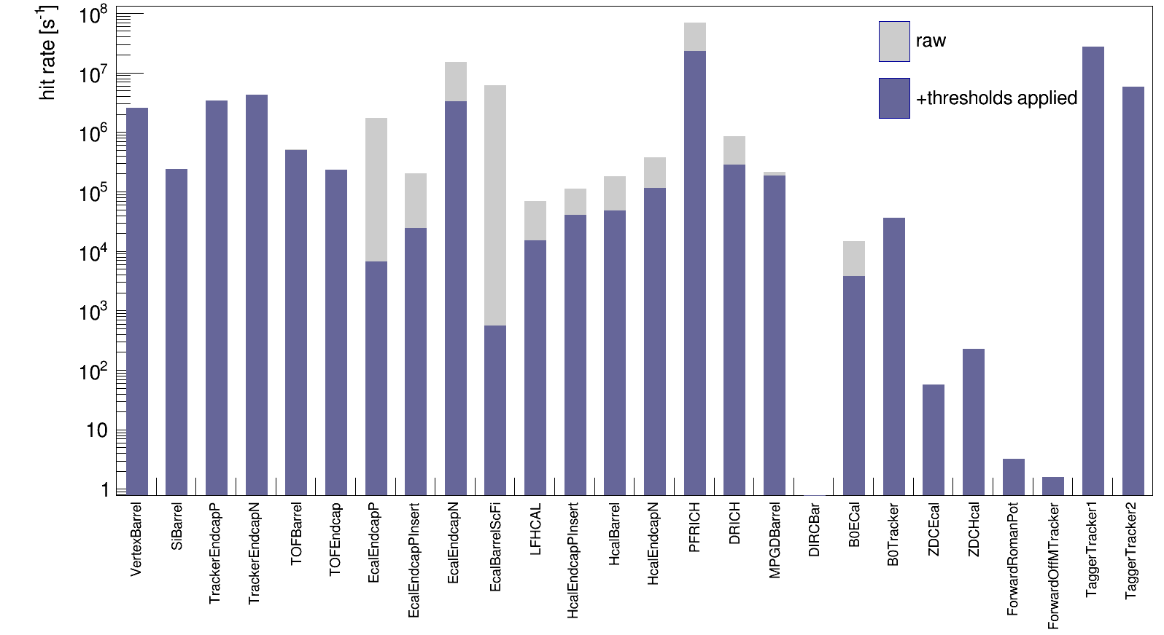
DIS and Beam Gas Background Rates
Elke Aschenauer
ep: 18x275 GeV Q² < 1 GeV
Hadron Beam Gas
protons: 275 GeV
vacuum after 10000 Ah
Electron Beam Gas
10 GeV
vacuum after 10000 Ah
Need to update with the new subdetector
hit thresholds

Slide 28
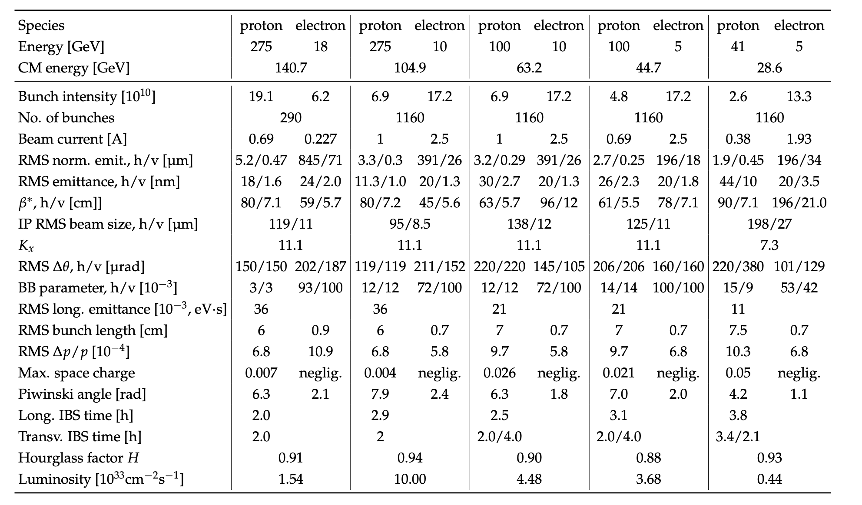
EIC Beam Parameters
electron beam current and energy impact electron beam gas background and synchrotron radiation
→ Radiated SR power: P(kW)=88.46 E_{B}(GeV)⁴ / r(m)² I (A)
hadron beam current impacts hadron beam gas
beam energies and luminosity impact the radiation and neutron fluence
Elke Aschenauer

Slide 29
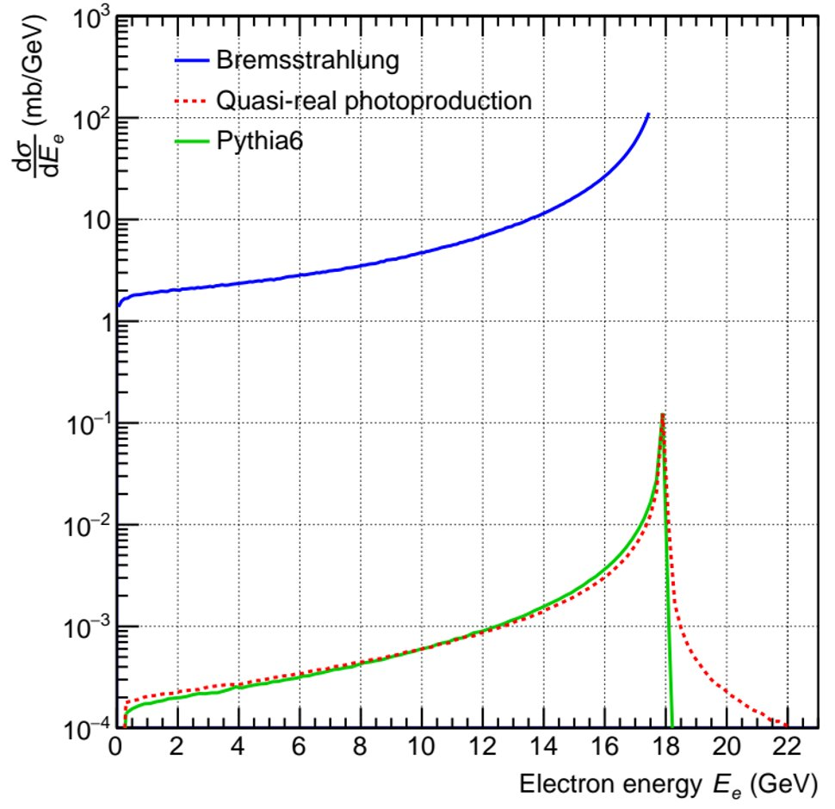
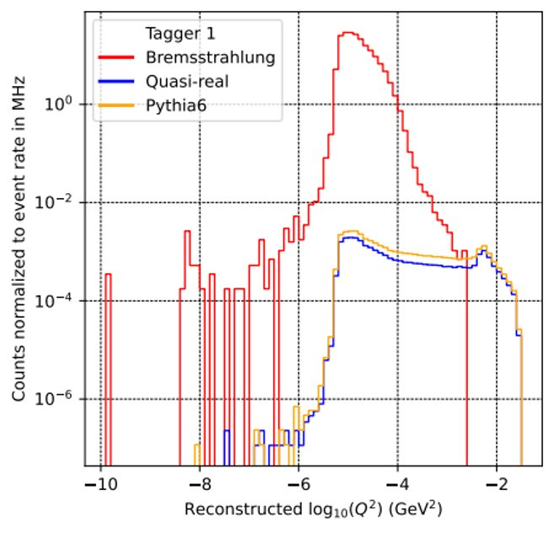
Notes on Far-Forward and Backward
Far-Forward:
”no” contribution from synchrotron radiation and electron beam gas
hadron beam gas contribution
  good vacuum in hadron beam pipe → acceptance only for limited region along beam pipe
Far-Backward:
”no” contribution from hadron beam gas
electron beam gas contribution
  vacuum level good in this part of electron beam pipe – 5 x 10⁻¹⁰ mbar
Need still to simulate synchrotron radiation for this region
low-Q2 tagger sees large rate from process used to measure luminosity
→ Bethe Heitler ep → e’p’γ lepton goes to the low-Q2 taggers
Total cross section for elastic bremsstrahlung and for two models for inelastic ep scattering​
Large bremsstrahlung cross section implies a pile-up interaction in each bunch crossing​
The bremsstrahlung makes a background in photoproduction measurement​
Reconstructed Q² shown for bremsstrahlung and photoproduction
True Q² for bremsstrahlung in consistent with zero​
Distributions are normalized to event rates​
Opportunity to extract clean photoproduction signal over a limited interval in Q^2
Elke Aschenauer

Slide 30
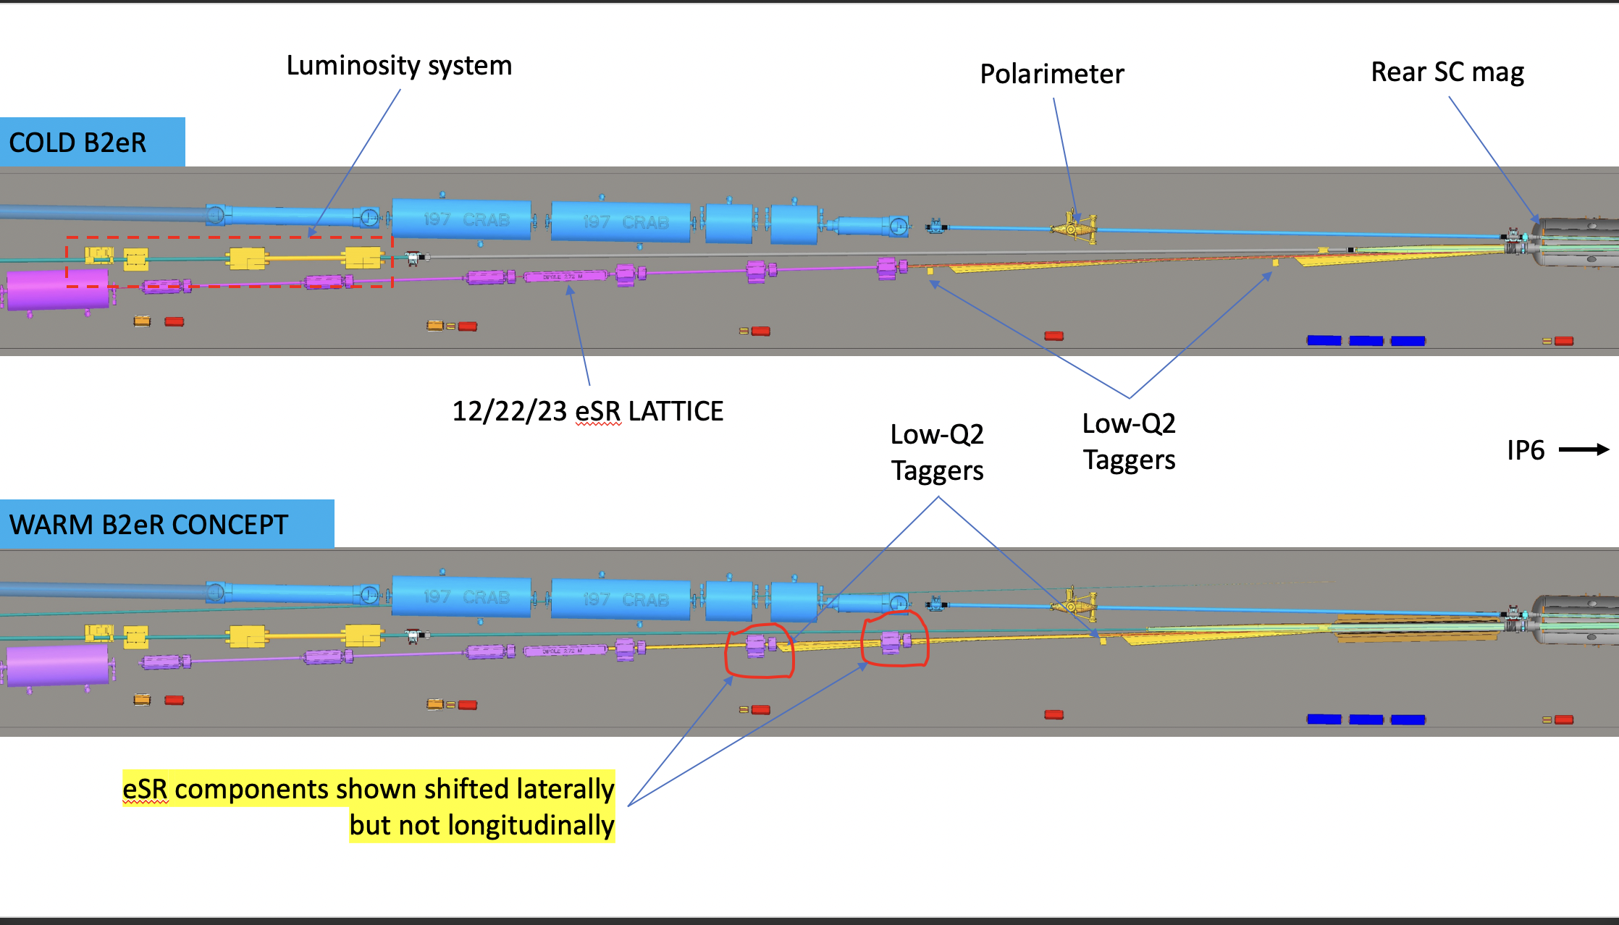
Notes on Far-Forward and Backward
Current
Potential New Layout
Will have to redo all background estimated for Far-Backward and iterate location of
low-Q2 tagger position and maybe luminosity monitor
Elke Aschenauer

Slide 31
Lessons from HERA II upgrade
HERA performed an upgrade to increase luminosity by a factor of 5
  Mainly by squeezing the beam more at the IP by redesign of the IR
The upgrade increased backgrounds dramatically → Several month shutdown to implement improvements
Main culprits:
  no careful simulations prior to the upgrade
  Proton beam-gas interactions most severe background
    Needed an extremely good vacuum to mitigate this
  Synchrotron radiation background
    Background to detectors
    Excess heating of beam pipe
      Can damage flanges, etc.
      Can heat beam pipe, decreasing vacuum
  Electron beam-gas

