Slide 1
ePIC Collaboration Meeting
January 11, 2024
BIC Mechanical Design

Slide 2
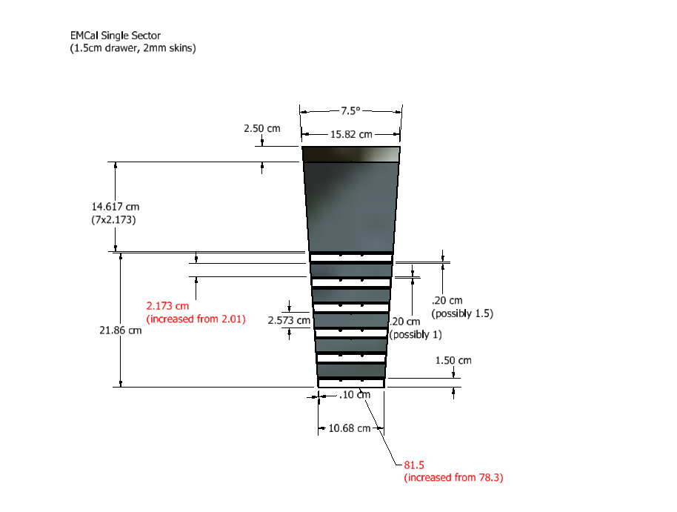
BIC, Single Sector
5mm inner plate for internal detectors not shown!

Slide 3
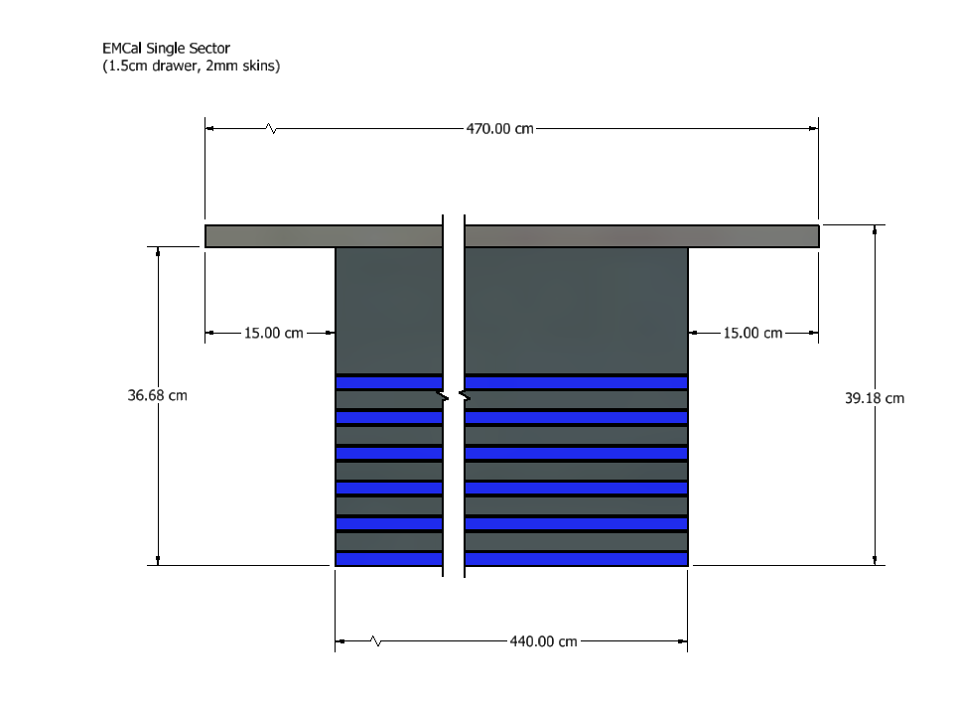
BIC, Single Sector
(sector weight = 1829 pounds)

Slide 4
BIC design changes since June 2023:
Increased inner radius by 3.2cm to accommodate inner detectors
Increased (longitudinal) space for services by 5cm
Reduced Astropix shelf height from 2cm to 1.5cm
Additional Al sheets for imaging Pb/SciFi layers. 2mm thick – for now
Increased Pb/SciFi thickness to match fiber/glue geometry

Slide 5
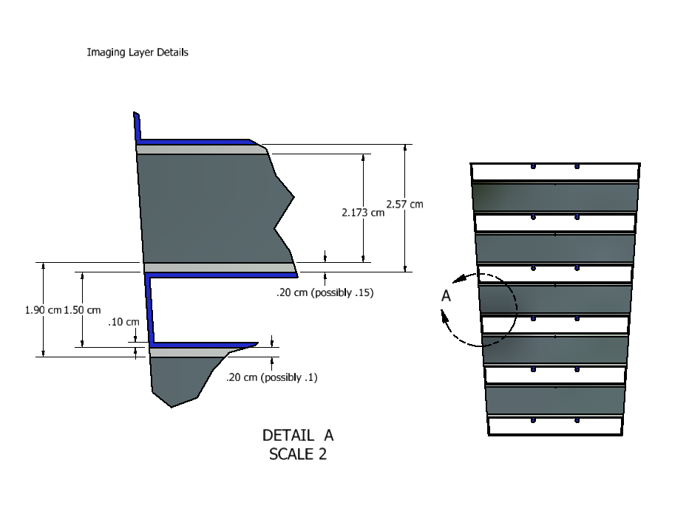
BIC Imaging Region
5mm inner plate for internal detectors not shown!

Slide 6
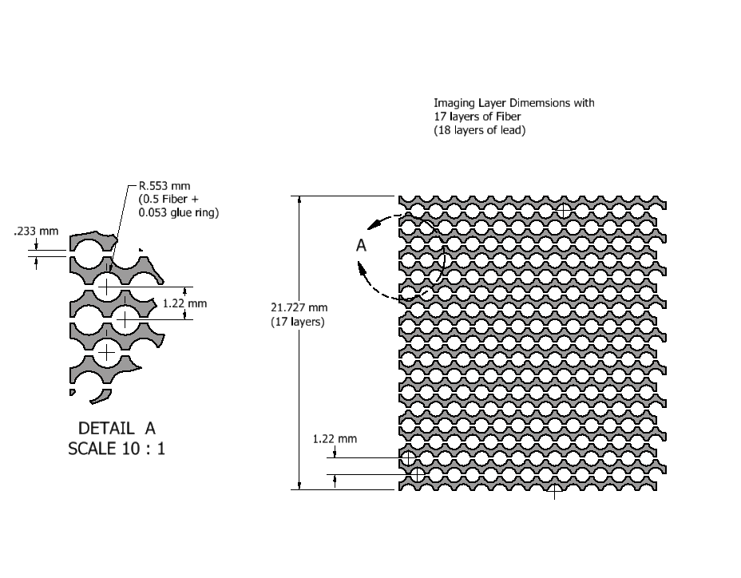
Imaging Layer Details

Slide 7
Non-Imaging Layer Details

Slide 8
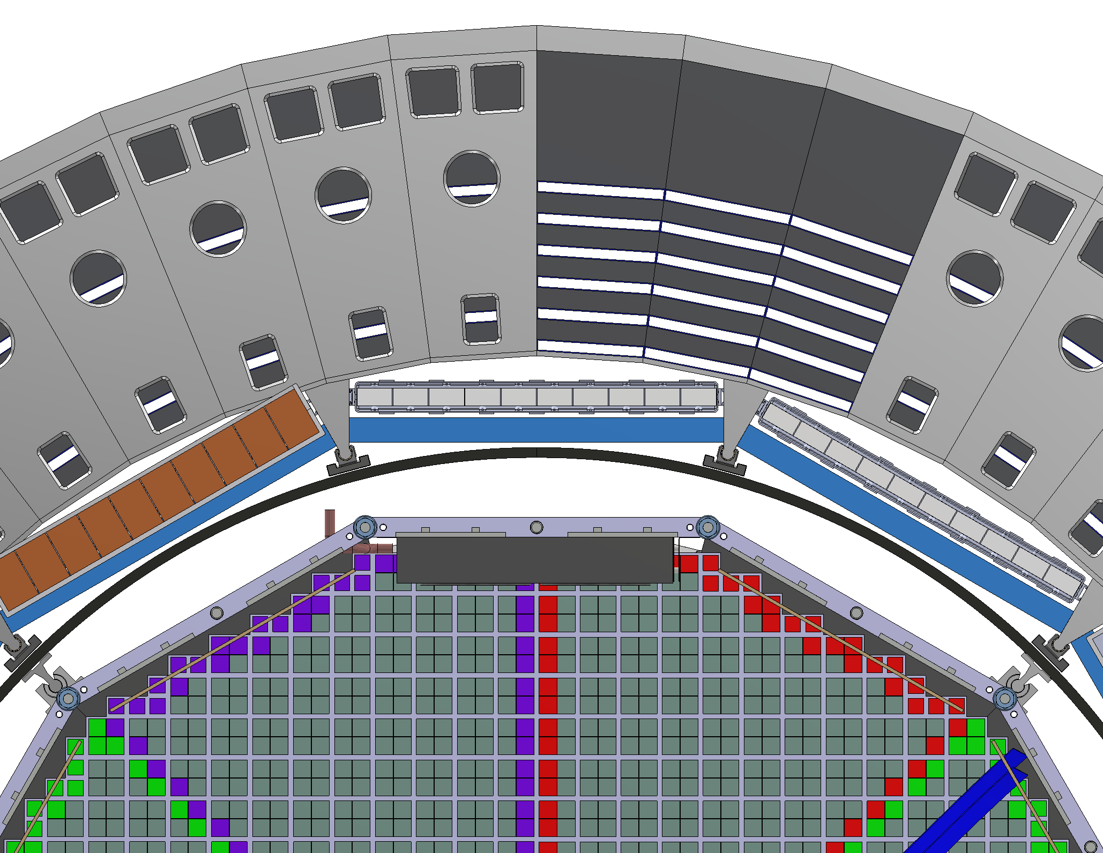
Inner Detector Mounting:
5mm plate on inside of inner astropix layer
Outer MPGD and DIRC Boxes mounted to sides of support rail
Carbon Fiber tube mounted to support rail
Inner detectors mounted to carbon tube
Design saves space and takes advantage of rigid BIC to support inner detectors (not end mounted)
Carbon Fiber
Tube

Slide 9
Open Questions:
Actual thickness of aluminum skins (less than 2mm if possible)
Sector assembly procedure (assemble machined components vs. machining complete assembly)
Rail/carriage parts for Astropix
Where to install 5mm inner plate (probably Argonne)
Actual length of services section (15cm?)
Barrel assembly procedure

