Slide 1
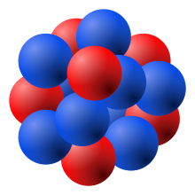
SIPM READOUT CHOICE INTRO
y
HENRY KLEST
ZISIS PAPANDREOU
P

Slide 2
READOUT CONSIDERATIONS
5760 Readout channels
Each channel sees the summed signals of 4 or 16 SiPMs
High dynamic range desirable, few N_{pe} to ~20k
Application slightly different than the other ePIC calorimeters due to the time-projection aspect
Real signals can arrive fairly late w.r.t a bunch crossing
Travel time for light from one side to the other is ~20 ns
Signal ToA is important to know well for matching hits in SciFi to hits in AstroPix
Also important for attenuation length correction
Power dissipation (and fluctuations thereof) of electronics should not affect the SiPM & AstroPix temperature during stable running

Slide 3
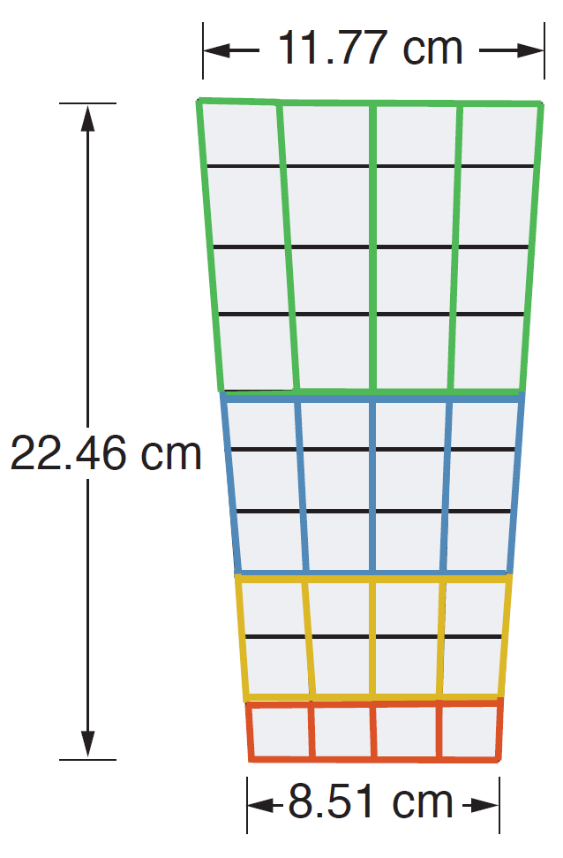
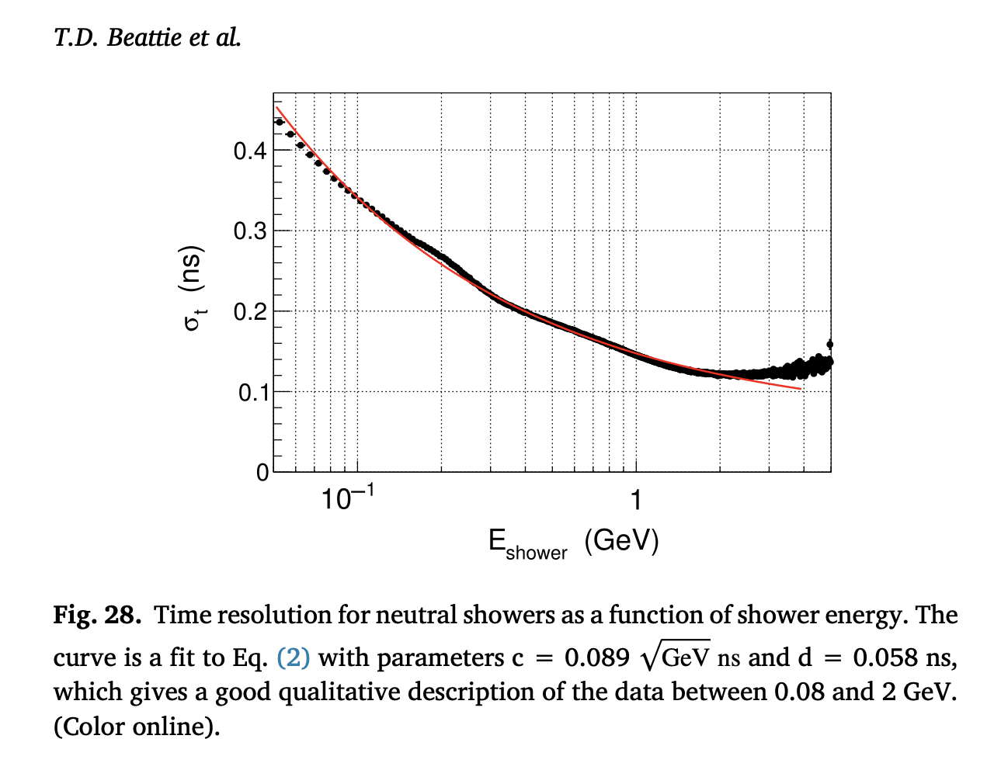
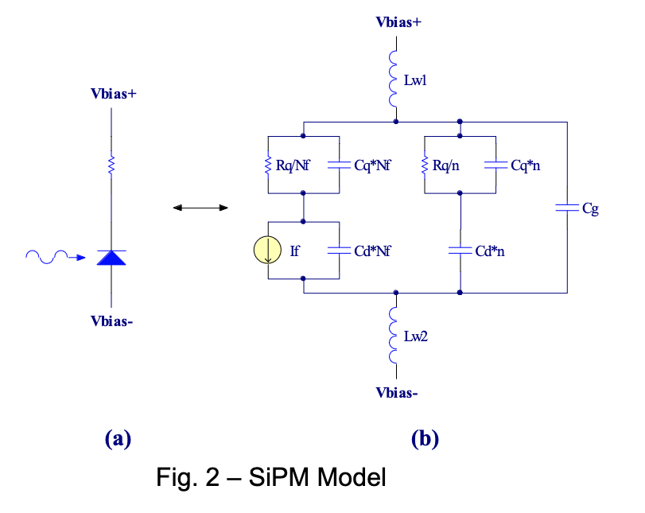
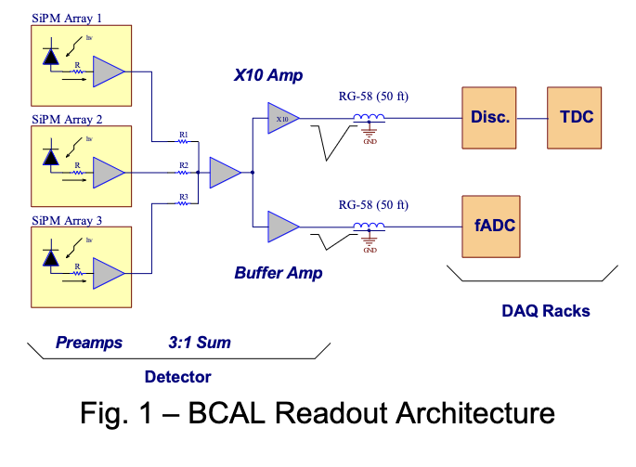
GLUEX READOUT
One array = 4x4 3mm SiPMs in parallel
GlueX scheme used JLab 250 MHz fADCs as well as TDCs
Achieved time resolution of O(few 100) ps and intrinsic risetime of ~5 ns
Readout electronics were in racks, not on-detector
Helps maintain thermal stability of SiPMs & electronics
Summed signals from multiple arrays into a single readout channel, 16 ADCs per sector
4 arrays for back (green), 3 arrays for 2nd to back (blue), etc.
Exclude single-side hits
https://halldweb.jlab.org/DocDB/0017/001795/002/The%20BCAL%20SiPM%20Array%20Readout.pdf

Slide 4
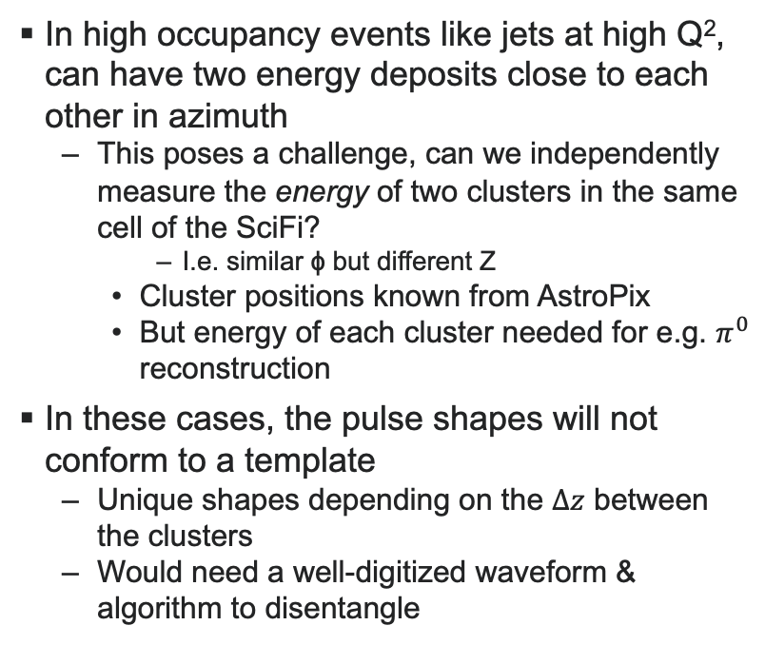
SAME-CELL HITS
If we can resolve properly the sum of the two clusters, can use AstroPix to split cluster energy

Slide 5
SAME-CELL HITS
SAME-CELL HITS
Impact of same-cell hits on physics
Compared to GlueX, KLOE, much higher
multiplicities expected
Most challenging events are at high Q²
Use Pythia8: Q² > 500 GeV²
Benchmarked against H1 data, provides a reasonable description of the hadronic final state for these events
Typically collimated single-jet events
Kinematically favored to be in the barrel
Currently just looking at azimuthal angle of particle production
Ignoring shower size

Slide 6
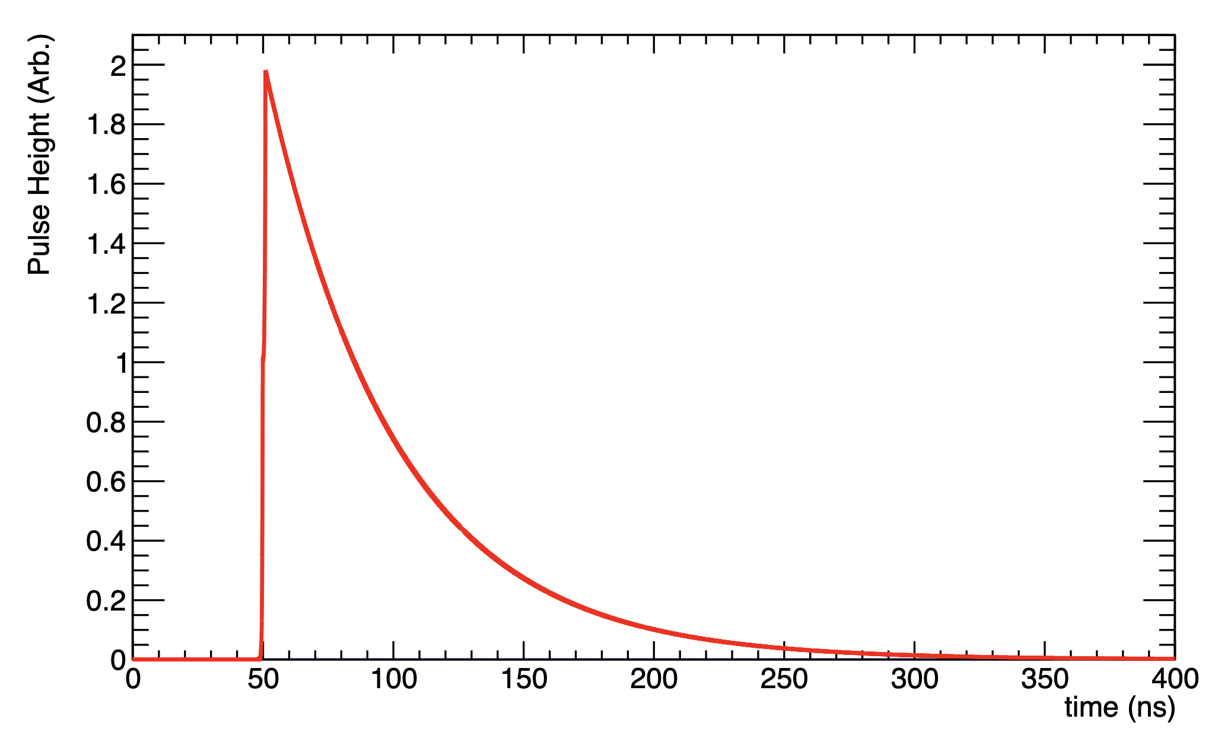
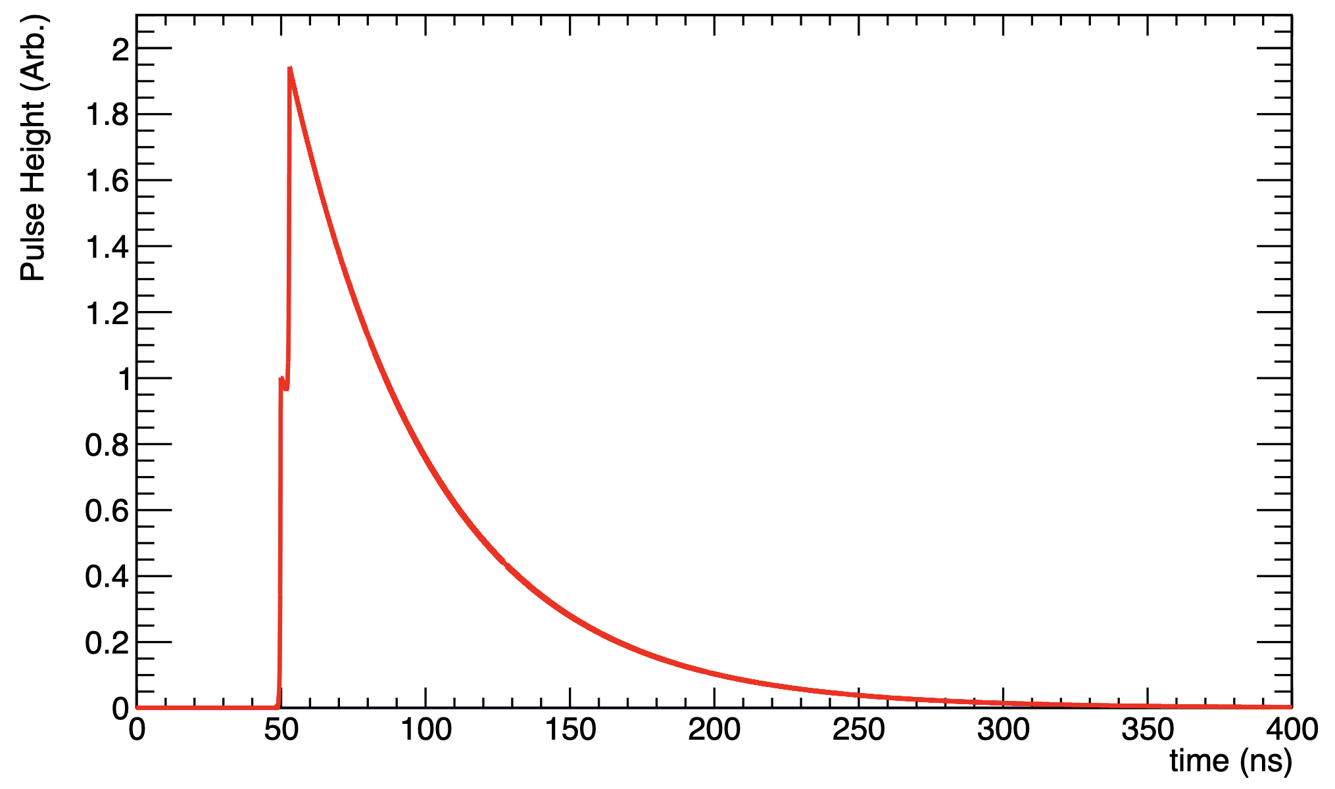
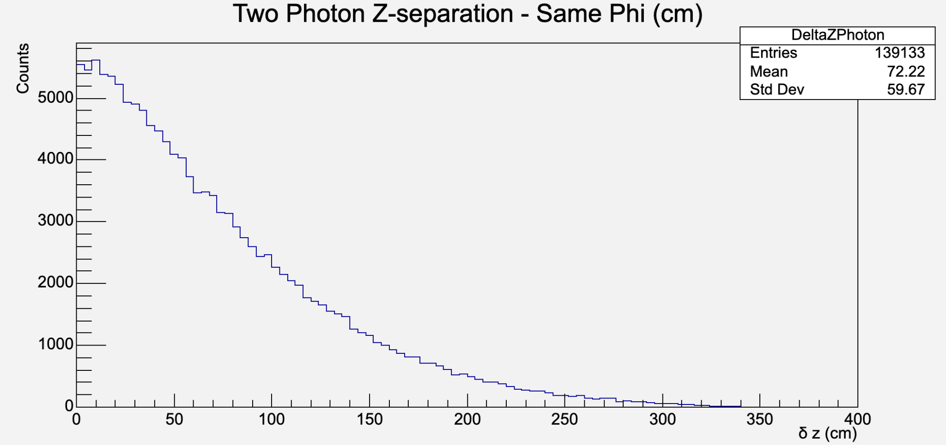
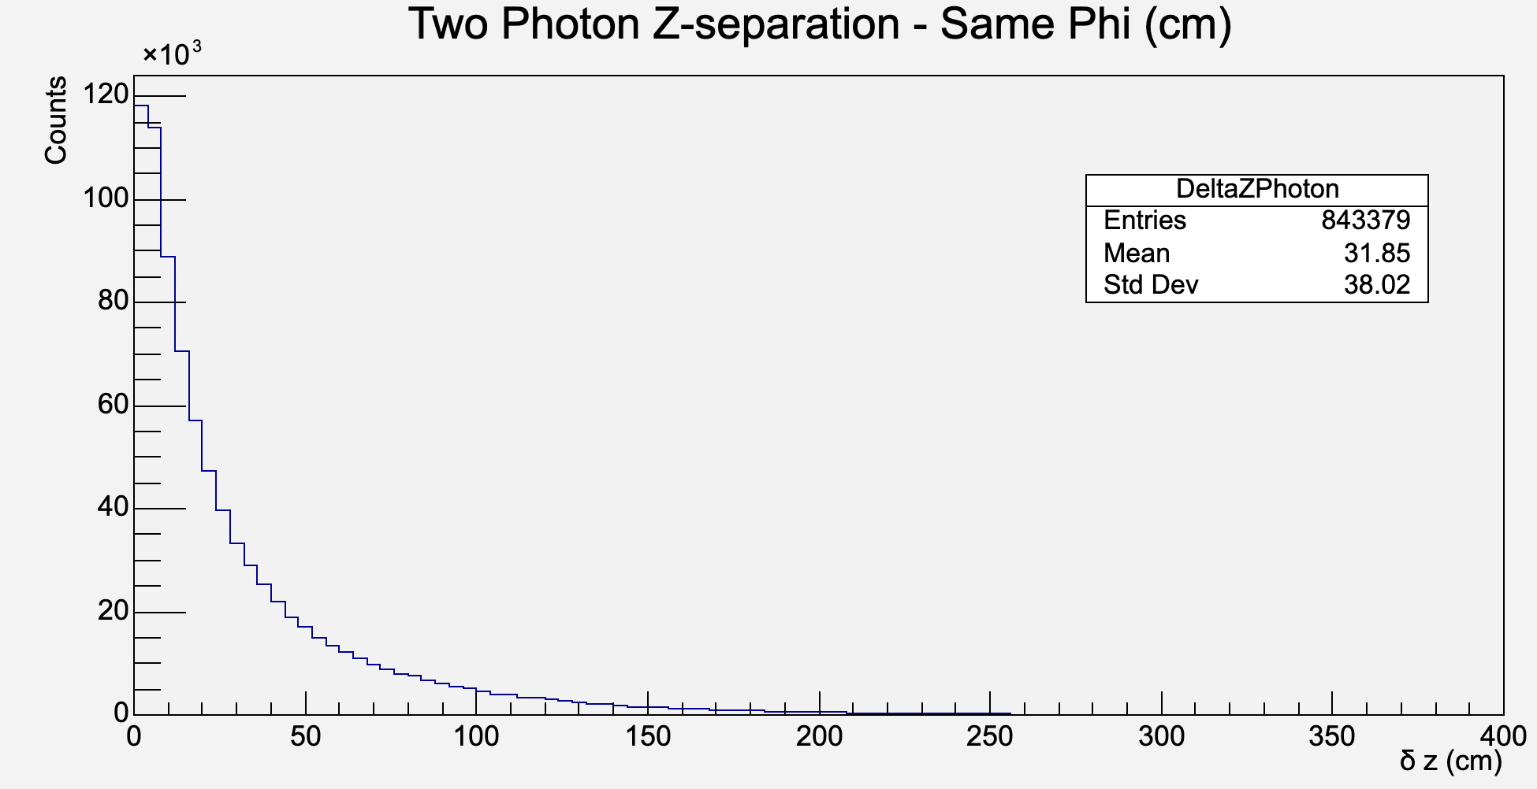
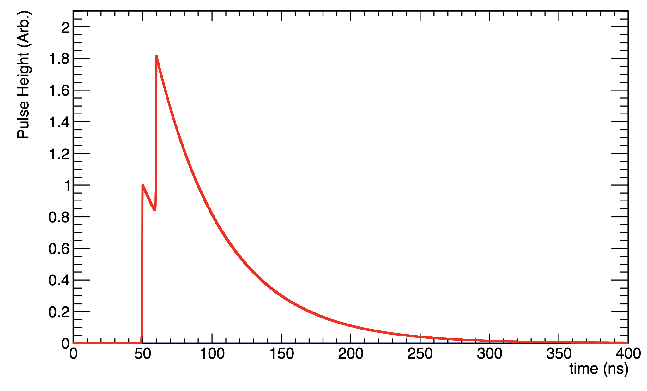
SAME-CELL HITS
SAME-CELL HITS
In ~25% of Q² > 500 GeV² events, those same-cell photons will be within Δz = 20 cm (<Δz> = 32 cm)
Δz = 20 cm ~ 1 ns of Δt
Fastest we could imagine digitizing a waveform is probably ~ 1 GHz (HDSoc), still need 3 ns ~ 60 cm to actually resolve the two pulse heights
In ~60% of Q² > 500 GeV² events, there will be at least two particles in the same phi cell
In ~40% of events, those two particles will be photons with <E> ~ 1.5 GeV
For ~15% of Q² > 5 GeV² events, have two photons in same phi cell
In either case, this is a non-trivial occurrence rate
Driven largely by decays
<Δz> ~ 60 cm
<Δz> ~ 20 cm
Q² > 500 GeV²
<Δz> ~ 200 cm
Q² > 5 GeV²

Slide 7
OPEN/DISCUSSION QUESTIONS
Do we want to use HGCROC?
What do we gain/lose if we do?
Are there other options? HDSoC?
Can we use “templated” readout?
Is trading precise ToA for more precise waveform digitizing worth it?
Will we require hits on both sides?
How much bandwidth will we have & what does streaming readout look like for us?
At what step in the readout chain will we analyze the waveforms?

Slide 8
BACKUP

Slide 9
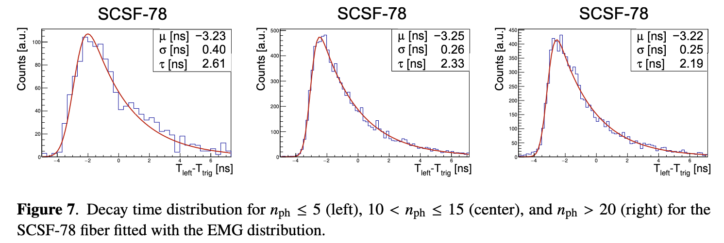

Slide 10
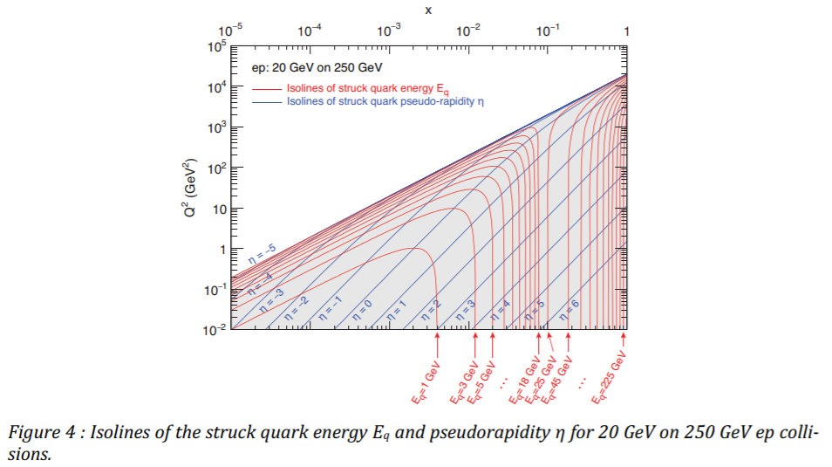
GOALS & SETUP
Determine necessary SciFi resolution in Z
Most challenging for us will probably be jets at very high Q²
High multiplicity & likelihood to be in the barrel
Pythia 8.303 + Dire
Used in HERA high Q² event shape analysis
Acceptable to first order, but fewer multi-jet events than in data
Non-radiative, lepton PDF off
Study Q² > 500 GeV²
Cross section of ~280 pb
10M events simulated, corresponds to something like 35 fb⁻¹

Slide 11
MOTIVATION
Pulse 1
Pulse 2
Summed Pulses

Slide 12
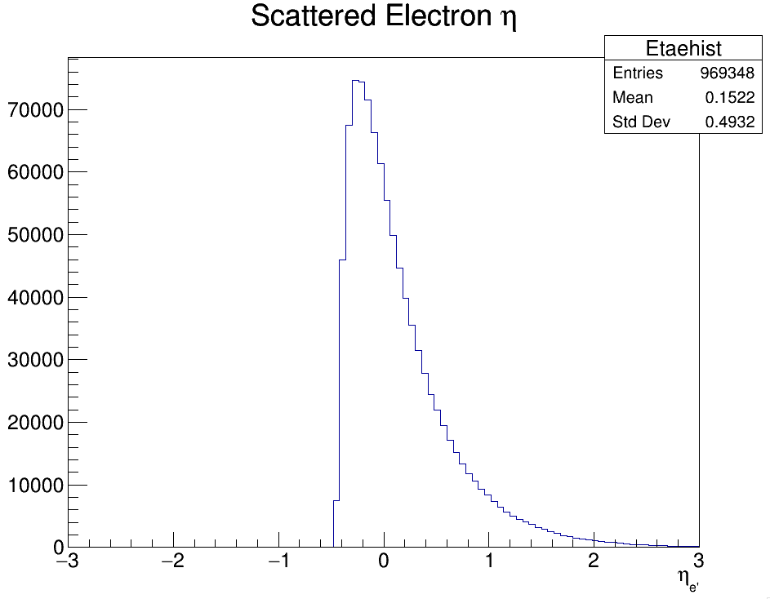
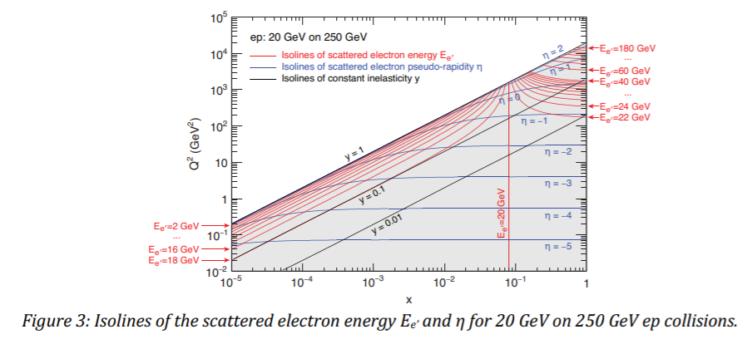
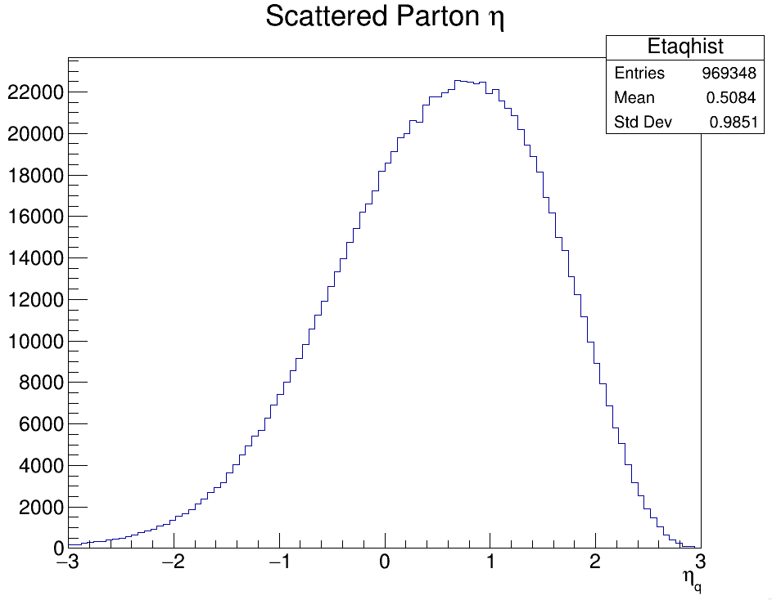
KINEMATICS

Slide 13
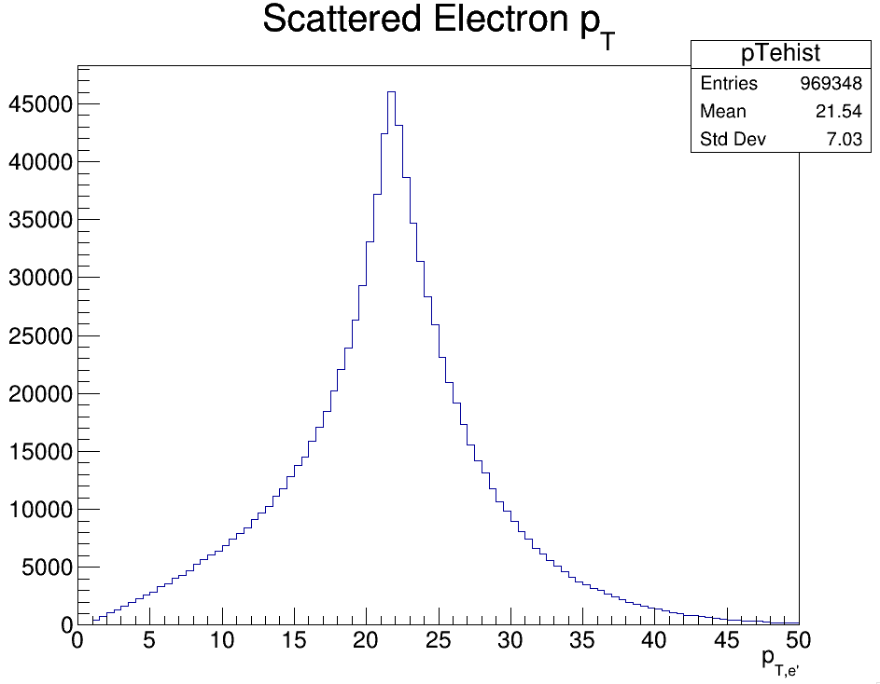
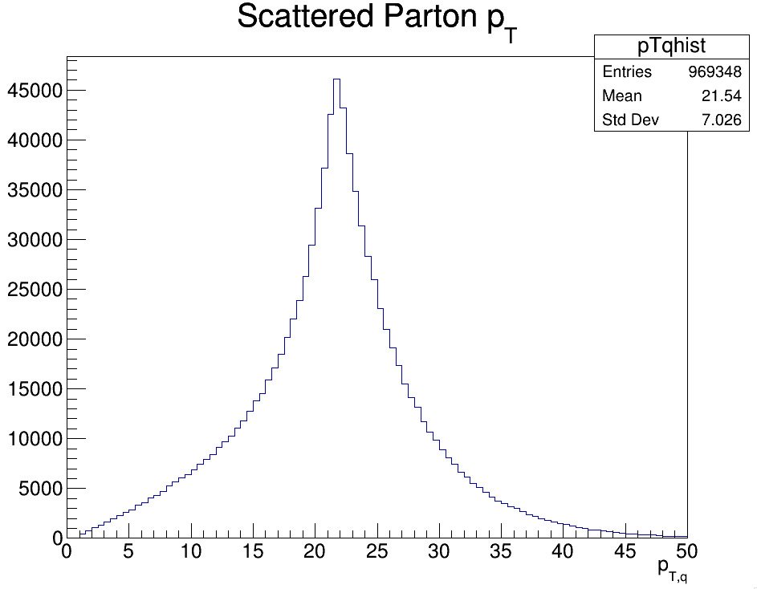
KINEMATICS

Slide 14
SAME-CELL HITS
SAME-CELL HITS
Impact of same-cell hits on physics
Compared to GlueX, KLOE, much higher
multiplicities expected
Most challenging events are at high Q²
Use Pythia8: Q² > 500 GeV²
Typically collimated single-jet events
Kinematically favored to be in the barrel
In ~60% of Q² > 500 GeV² events, there will be at least two particles in the same phi cell
In ~50% of events, those two particles will be photons <E> ~ 1.5 GeV
In ~25% of events, those photons will be within Δz = 20 cm of each other
Δz = 20 cm ~ 1 ns Δt, very challenging to resolve
This ignores the physical size of the showers
For 15% of Q² > 5 GeV² events, have two photons in same phi cell

Slide 15
SIMULATION
For these high Q² events, how likely are we to have two photons in the same event registered by the same SiPM*
48 Modules, 5 SiPMs wide, each SiPM covers 1/240th of the azimuth
Assume for now that particles striking the same phi slice are integrated
Charged particles will have energy well measured by inner detectors, likely to deposit only MIP energy
Can subtract tracker energy from total measured in Ecal
Big worry is neutrals, especially photons
*If signals are too slow, could even have photons from different events overlapping

Slide 16
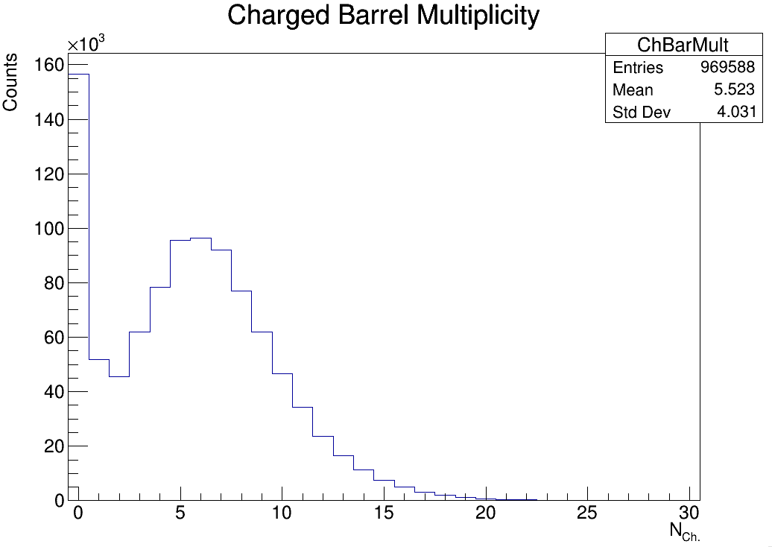
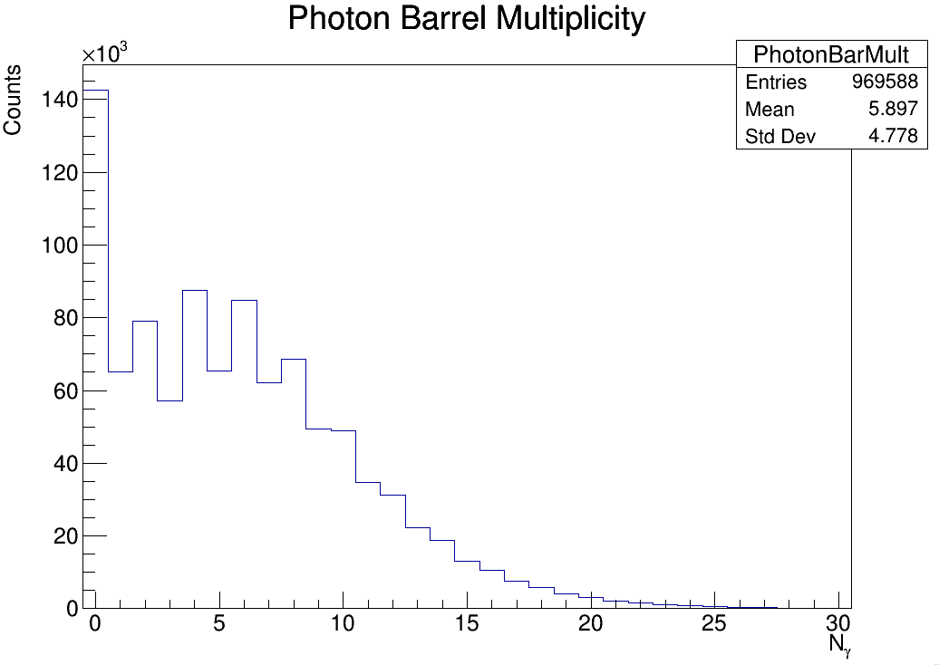
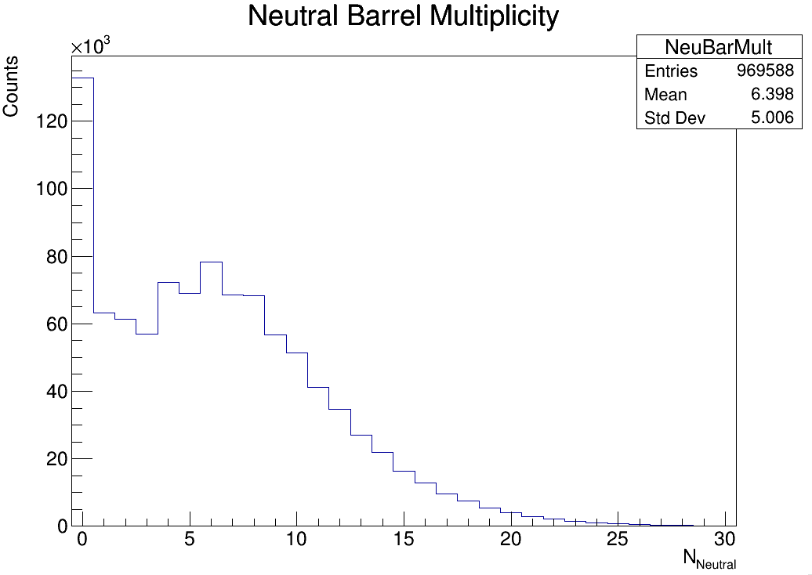
MULTIPLICITIES IN BARREL
Peaks at 0 could be an artifact
Barrel defined as pseudorapidities between -1.7 and 1.3

Slide 17
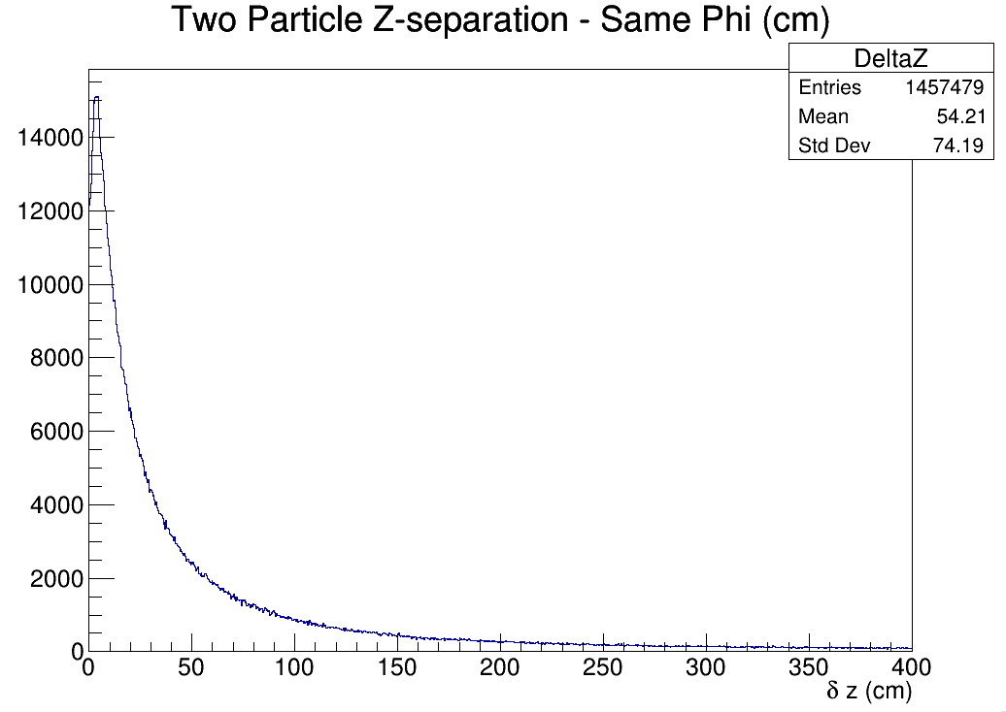
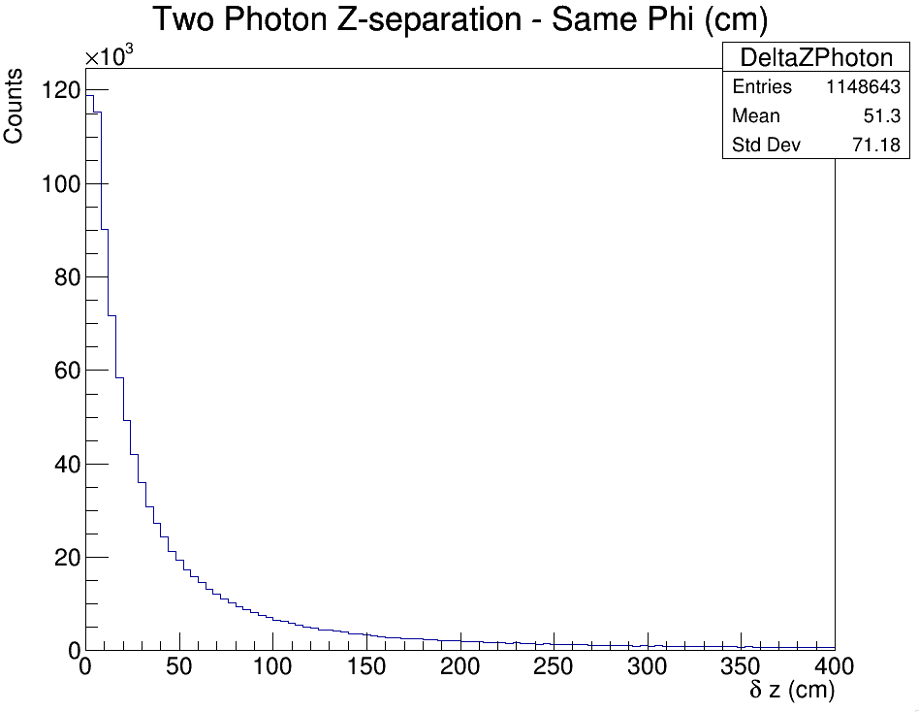
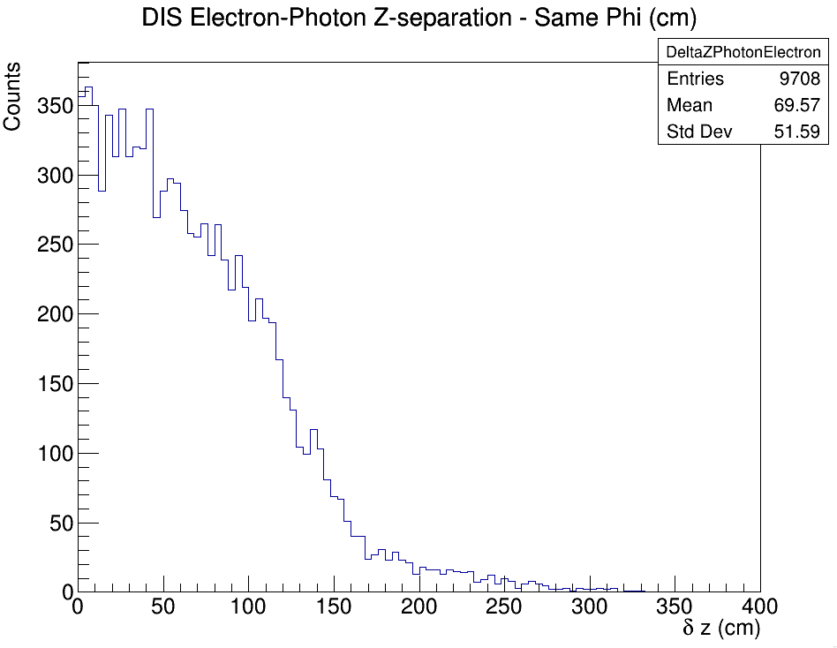
PARTICLES IN SAME PHI SLICE
Unfortunately, particles in the same phi slice tend to also be close in Z
Imagine a Gaussian jet in x,y space

Slide 18
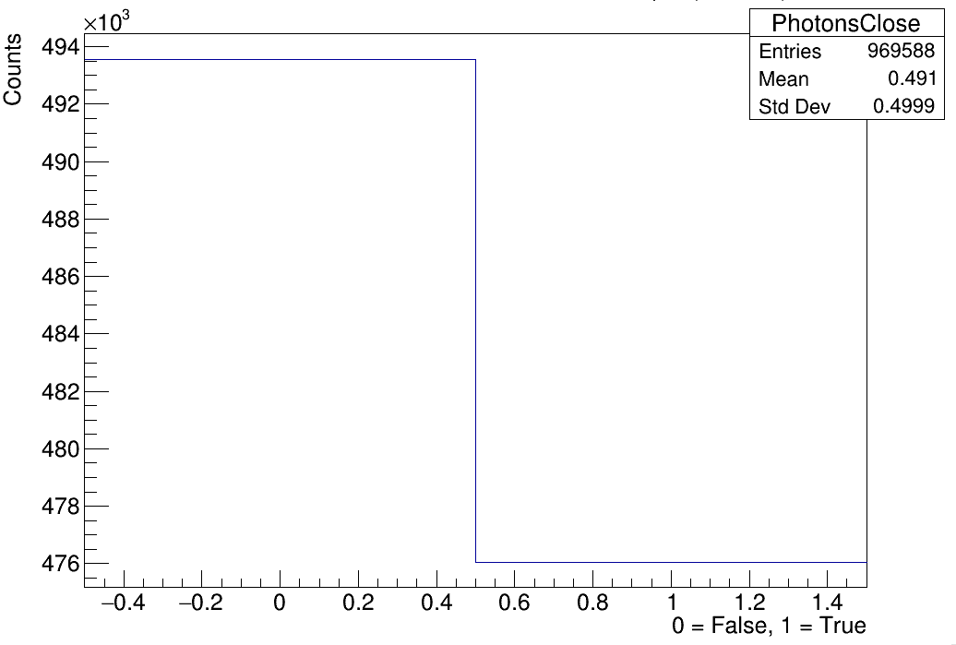
LIKELIHOOD THAT AN EVENT HAS TWO PHOTONS IN THE SAME PHI SLICE
~50%

Slide 19
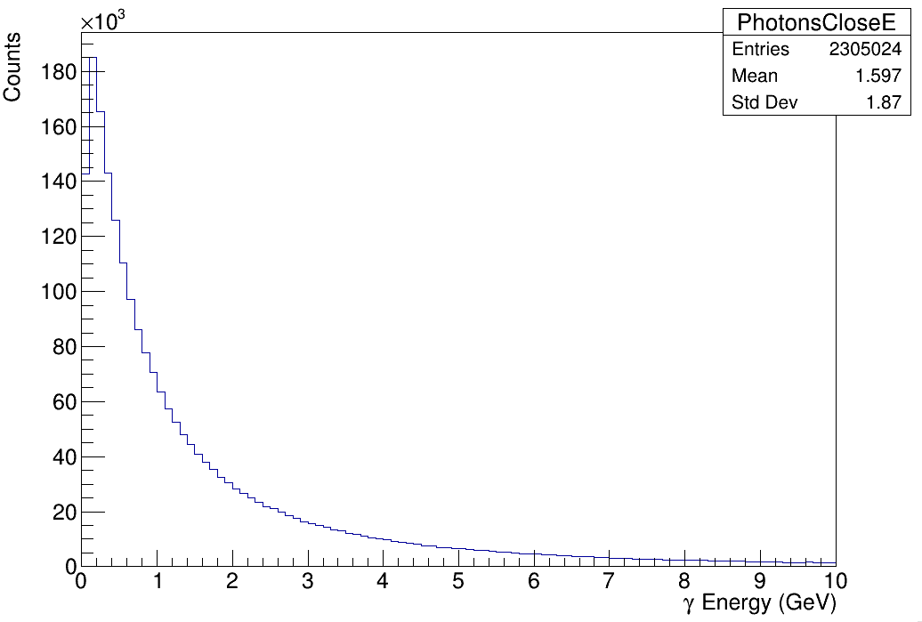
ENERGY OF THOSE TWO PHOTONS IN THE SAME PHI SLICE

Slide 20
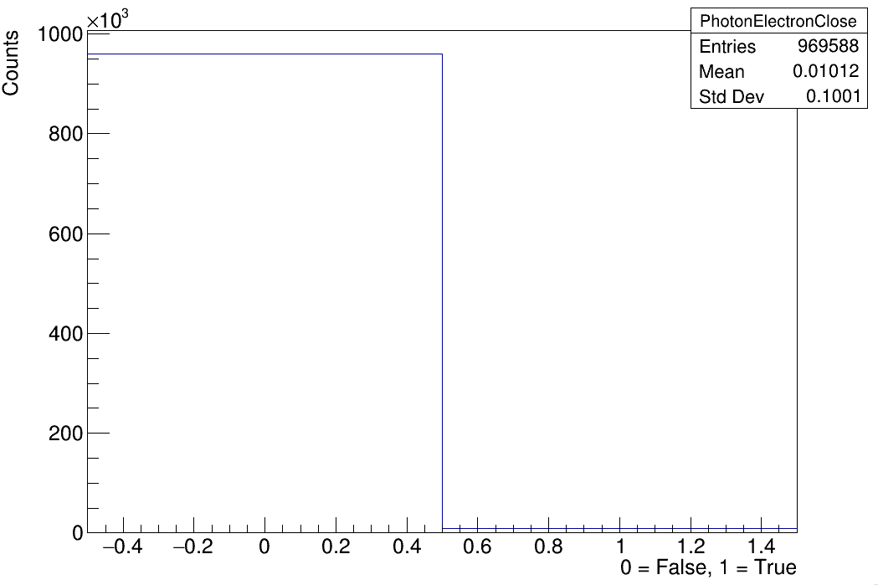
LIKELIHOOD THAT AN EVENT HAS A PHOTON IN THE SAME PHI SLICE AS THE DIS ELECTRON
1%

Slide 21
CONCLUSION
High Q² will be challenging on the SciFi
Considering here only impact position, no spreading of showers between SiPMs which will certainly happen, real case is likely worse
Would be nice if we could somehow distinguish two hits in the same phi slice
Faster SiPM? Faster scintillation? Higher refractive index fiber?
Which factor dominated the GlueX pulse width?

Slide 22
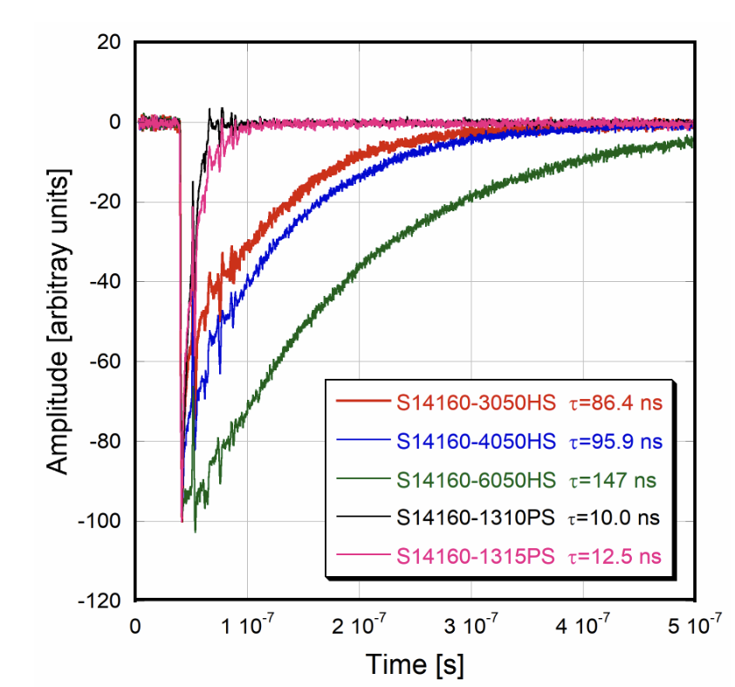

Slide 23
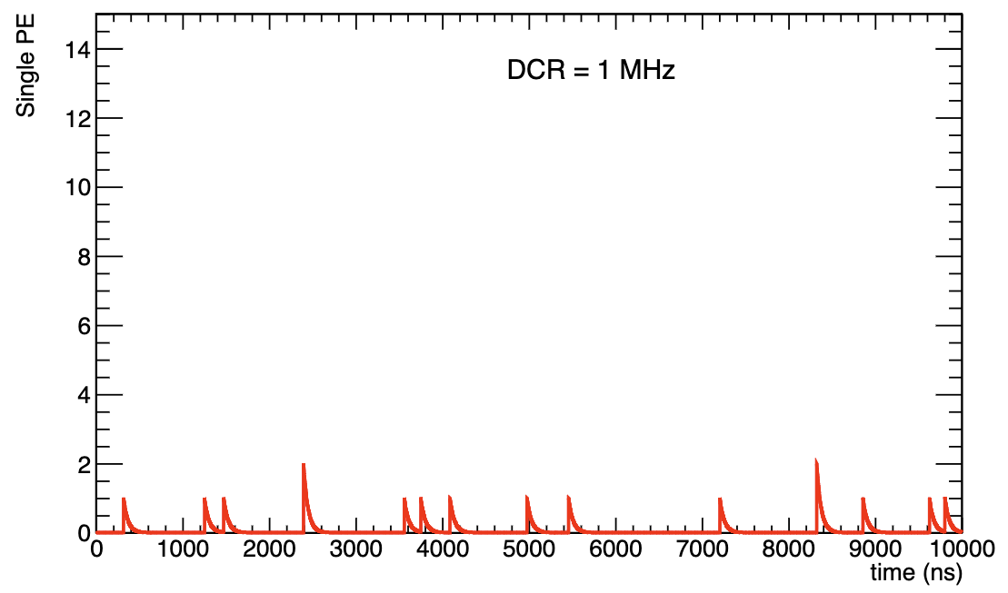
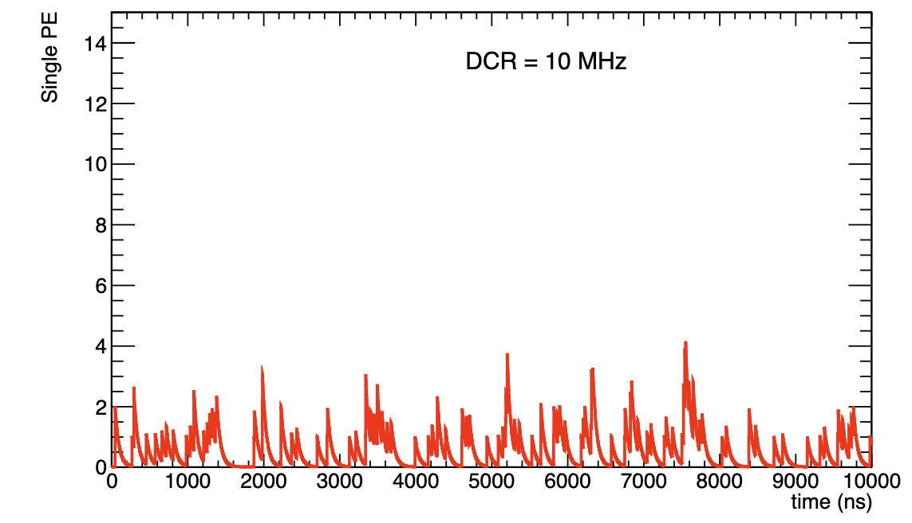
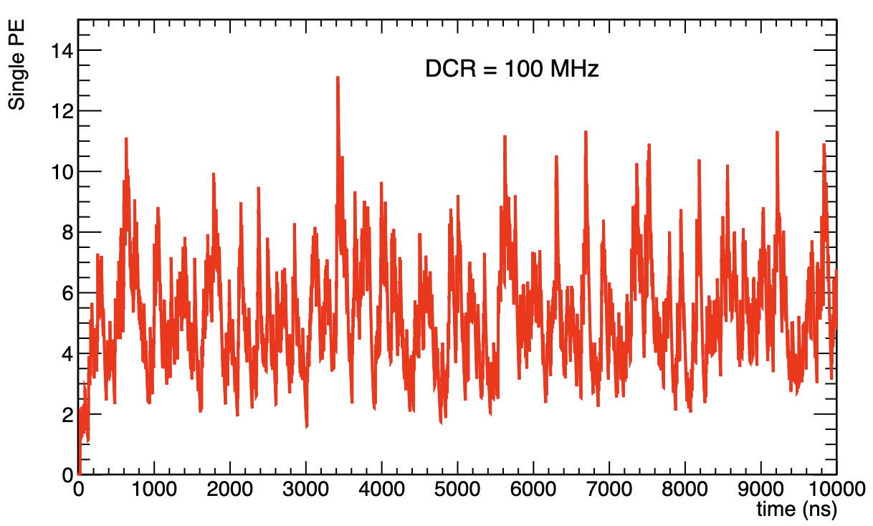
NOISE
Specification | S13360-3050 (3x3 mm) | S14160-3050 (3x3 mm)
DCR (Typ.) | 500 kHz | 1 MHz***
Crosstalk (%) | 3 | 7
Dark count rate (DCR) determines threshold
MIPs at midrapidity will generate 3-6 N_{pe} on average
Would be good to have threshold slightly below MIP
DCR above a few 10s of MHz will endanger the MIP
*** Differing values in literature
Signal will gang 1.2 cm x 1.2 cm area (16 3x3 mm or 4 6x6 mm)
DCR for one BIC channel will be ~16x value in table
Plan to test S14160 SiPMs at ANL & Regina

Slide 24
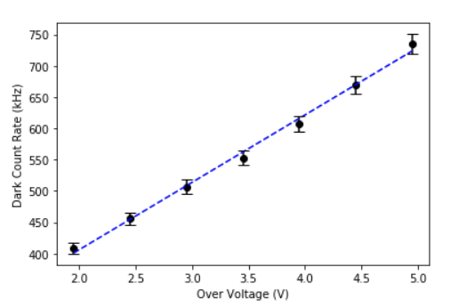
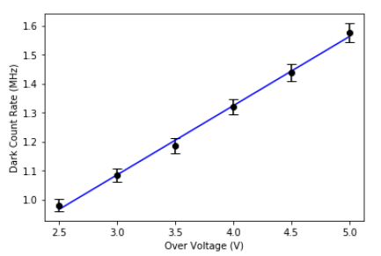
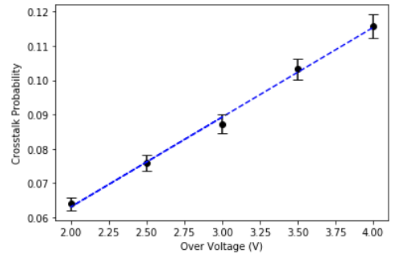
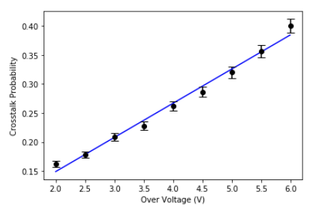
S13360-3050 (3x3 mm)
S14160-3050 (3x3 mm)

Slide 25
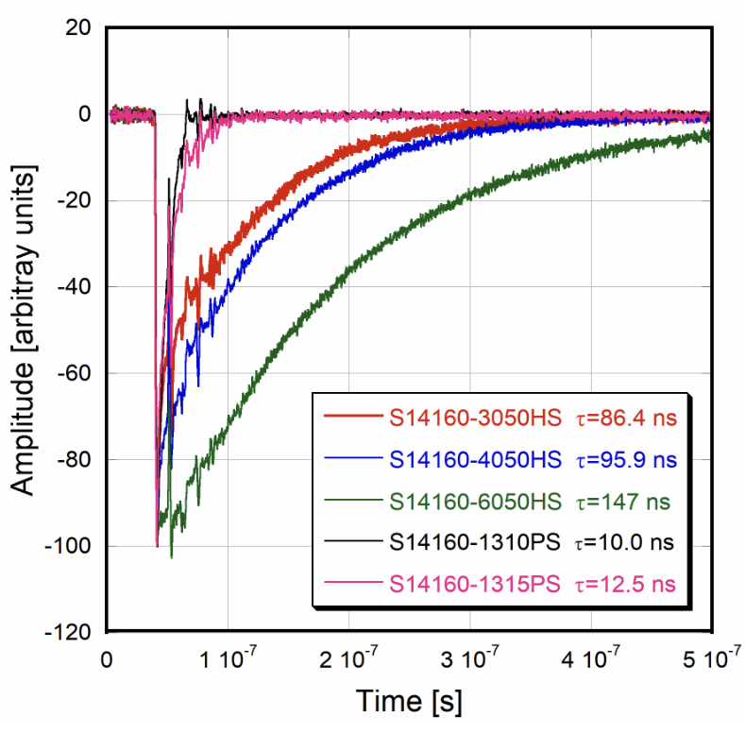
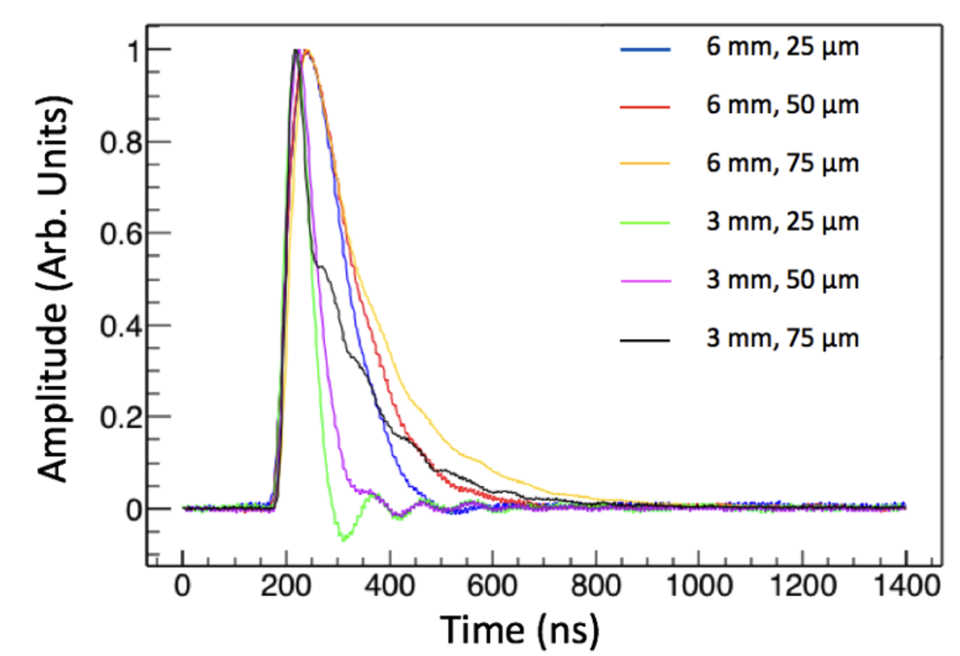
PULSE SHAPE
Pulse shape strongly defined by how signals are handled
S14160 has faster rise time, slower fall time
Larger SiPMs (6x6 mm) have ~2x longer fall times due to capacitance
Can we mitigate this in our ganging scheme?

Slide 26
NOISE
Literature seems divided on noise characteristics of S14160 series
Plan to test S14160 SiPMs at ANL & Regina
Dark count rate (DCR) determines threshold
MIPs at midrapidity will generate 3-6 N_{pe} on average
Would be good to have threshold slightly below MIP
DCR above a few 10s of MHz at the readout will swamp the MIP

Slide 27
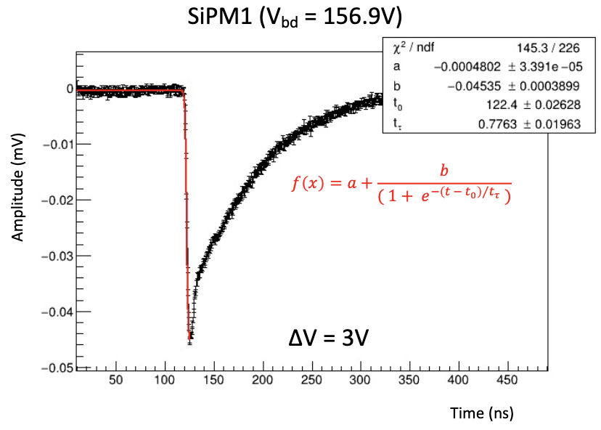
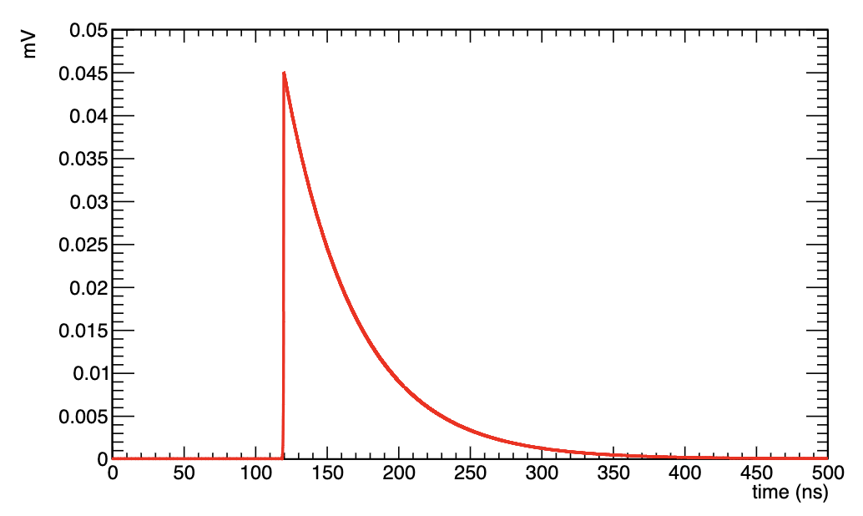
WAVEFORMS
Parameterize S14161 waveform based on presentation from AMS-100 (here)
Exponential rise and exponential fall
Different time constants
Pulse height around 0.045 mV
Take this as 1 Npe

Slide 28
WAVEFORMS
Agreement not good but also not so terrible
Tail a bit wider in the data
Good enough for now

Slide 29
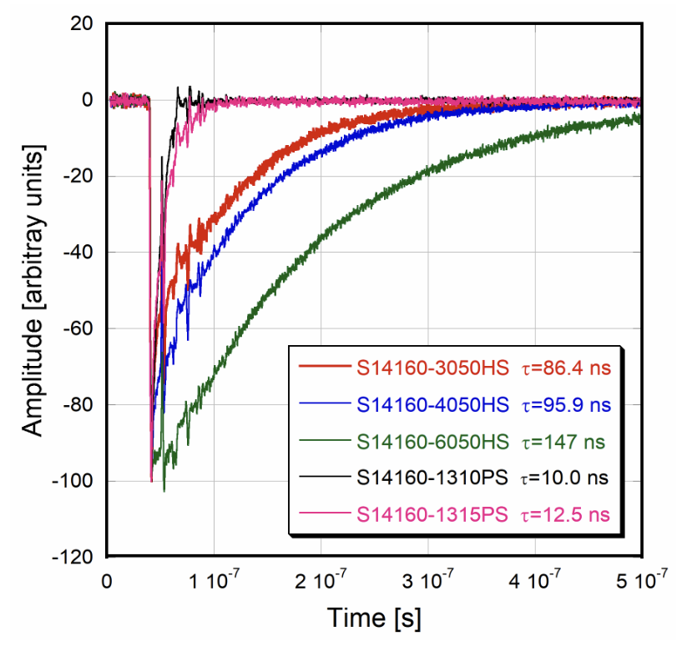
WAVEFORMS
Agreement not good but also not so terrible
Tail a bit wider in the data
Good enough for now

Slide 30
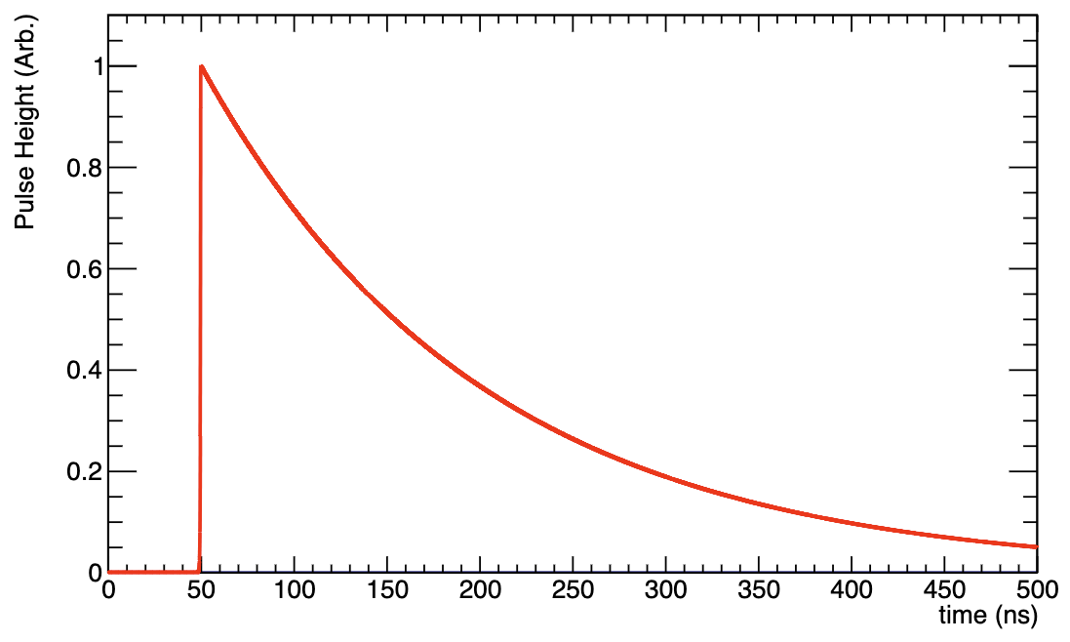
WAVEFORMS
Agreement not good but also not so terrible
Tail a bit wider in the data
Good enough for now

Slide 31
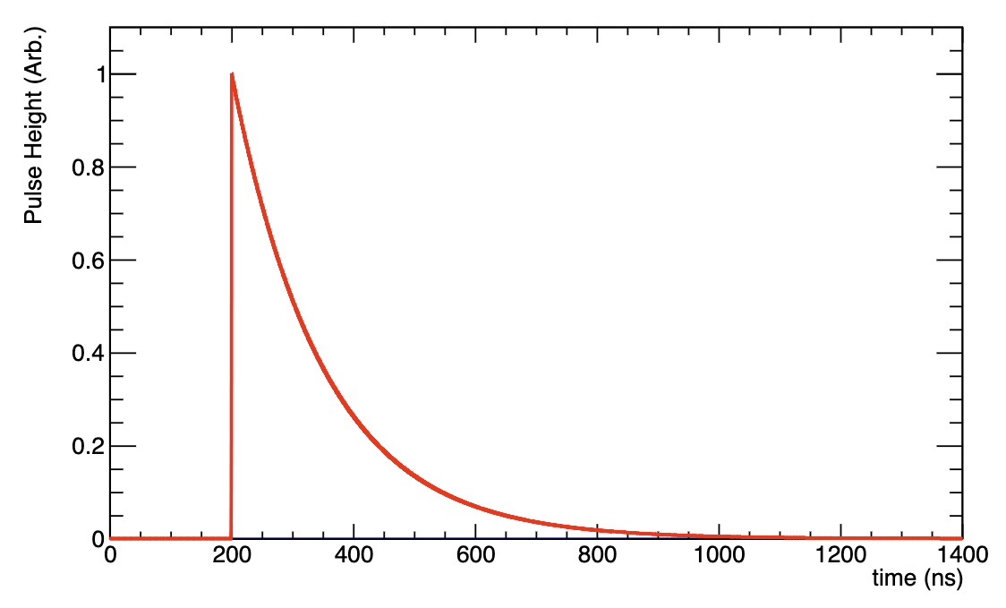

Slide 32
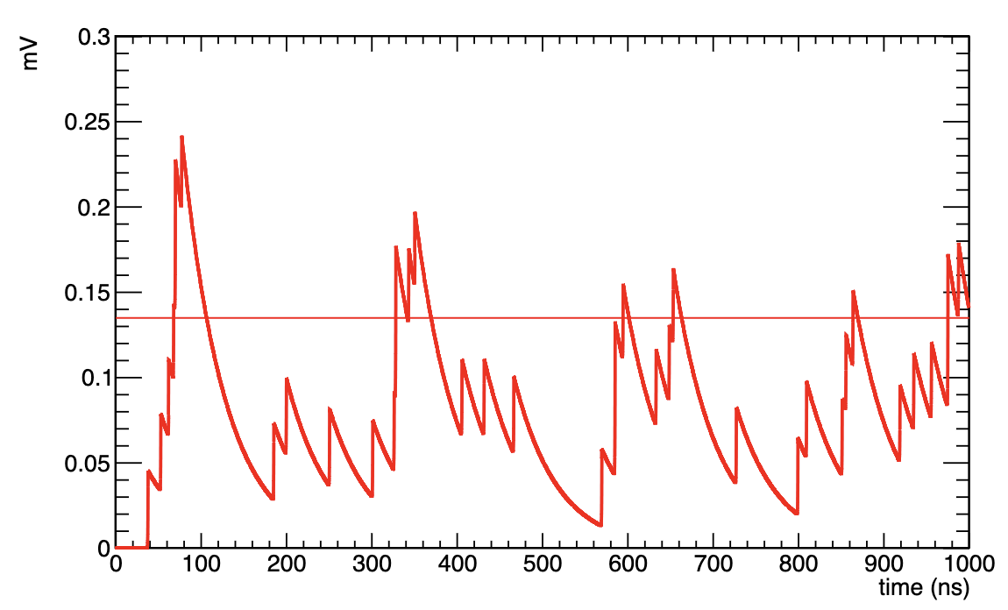
WAVEFORMS
Monte Carlo throwing signals with expected rate
32 MHz
1 microsecond
Crosstalk probability of 7% included (should it be, or is it included in the number from Hamamatsu?)
Up to two crosstalk hits
3 and greater is a less than 1% effect
Line drawn at 3 * single photoelectron peak

Slide 33
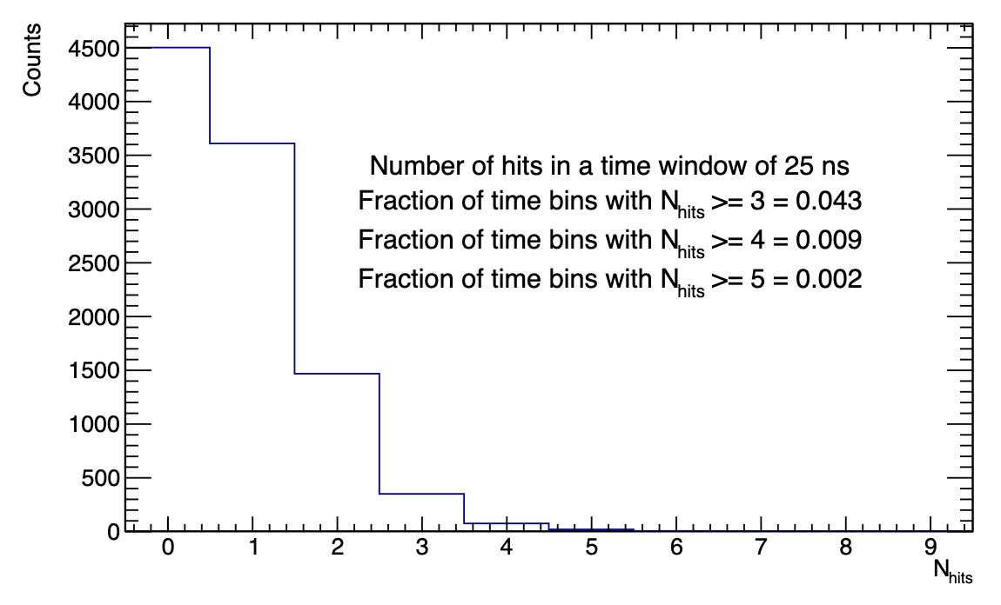
HITS IN HGCROC WINDOW
Take 25 ns window of HGCROC
Poissonian distribution with a mean of 0.8
25 ns * 32 MHz
If threshold is set to 3 * SPE pulse height, 4% of time bins will be triggered
4% of the channels of the detector will be active in ToT mode at any given time

Slide 34
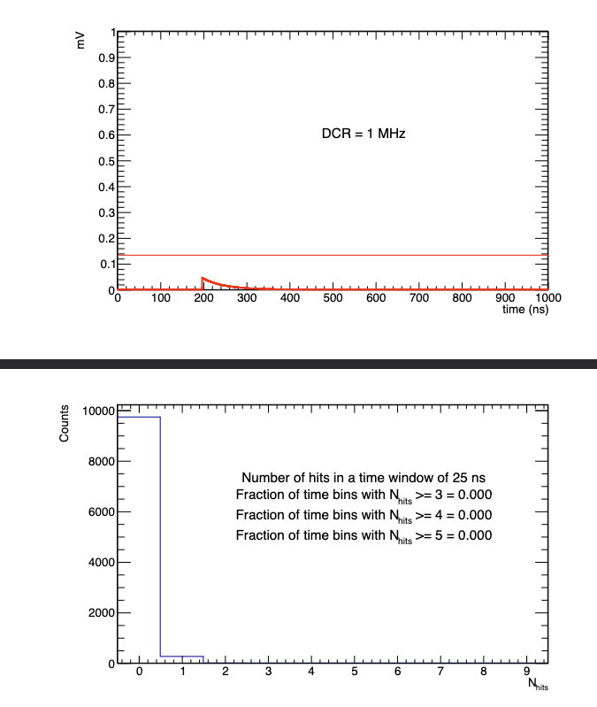
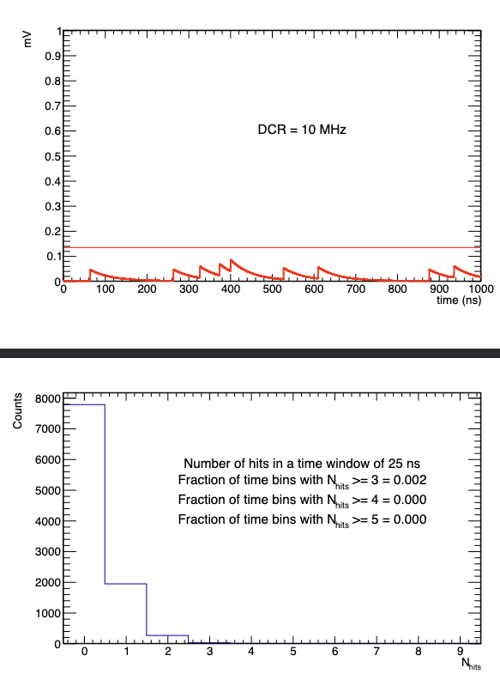
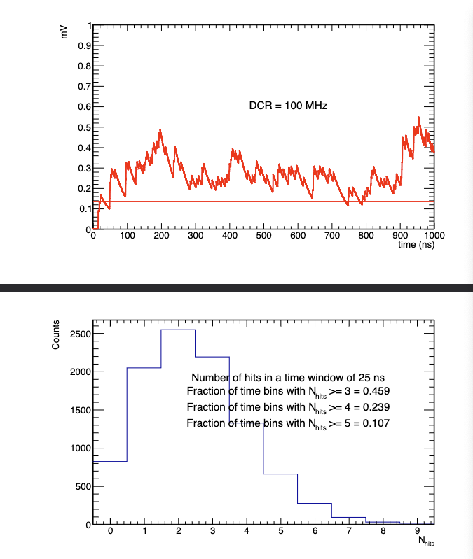
Threshold of 3 p.e. likely excluded if DCR reaches 100 MHz
This also poses an issue because we can’t get around it with timing cuts in the same way as the dRICH, the detector could have a signal at any time
Bunch crossings every 10 ns, shorter than light propagation time

Slide 35
Threshold (p.e.) | Prob. Above threshold @ 1 MHz | Prob. Above threshold @ 10 MHz | Prob. Above threshold @ 30 MHz | Prob. Above threshold @ 50 MHz | Prob. Above threshold @ 100 MHz
2 | 0.01% | 2% | 29% | 69% | 99%
3 | 0.0005% | 0.3% | 8% | 36% | 94%
4 | 0% | 0.04% | 1.7% | 14% | 79%
5 | 0% | 0.005% | 0.2% | 4% | 57%
6 | 0% | 0%* | 0.03% | 1.1% | 35%
7 | 0% | 0%* | 0.005% | 0.4% | 17%
Numerical uncertainty of 0.03%

Slide 36
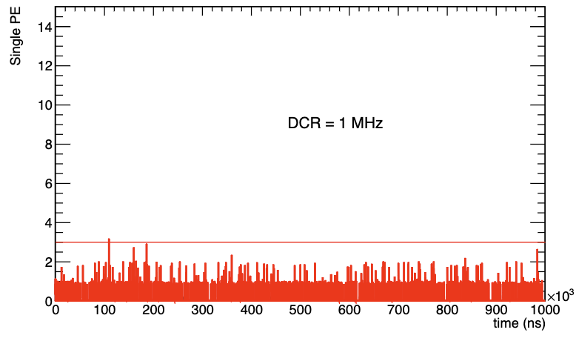

Slide 37
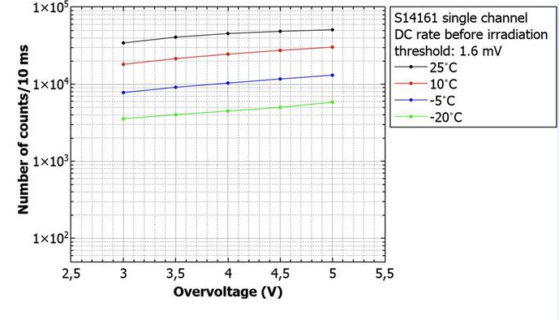
TEMPERATURE DEPENDENCE
Conventional wisdom is that DCR is halved for every decrease of 10° C
“Single-channel” here refers to 1/16 of a 4x4 array (S14161-6050HS-04)
DCR numbers for ganged array should be 16x higher
To reach the ~4 MHz of GlueX with S14161-6050HS-04, need to go to -20° C or lower
Proton irradiation of SiPM arrays for POLAR-2

Slide 38
TEMPERATURE DEPENDENCE
The authors of this paper report that DCR of the S14161 is 60% higher than S13361 at 25° C, and a factor of 5 higher at -20° C
The DCR of the S14161 is apparently a much slower function of temperature
This is bad, because it renders less effective the only handle we have over the DCR
On the flip side, probably the DCR increases less if we go above 25° C…
On such a critical point, should consult an expert (Hamamatsu directly?) to see if this behavior is expected or not

Slide 39
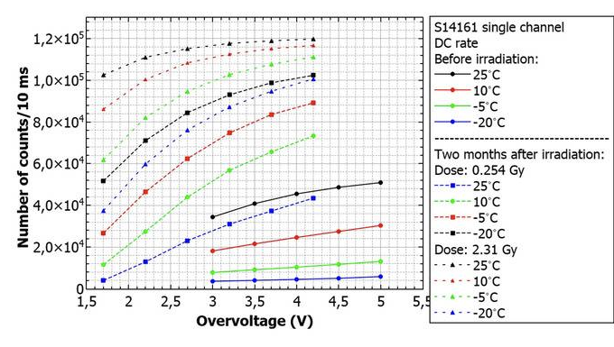
RADIATION DAMAGE
Proton irradiation of SiPM arrays for POLAR-2
Pre-radiation DCR around 3 MHz (single channel)
At 3V overvoltage
After ~200 Rad of proton radiation (and two months of waiting), DCR larger by factor of 4
Half our expected dose

Slide 40
RADIATION DAMAGE
If we take the numbers provided in this paper seriously, expect 192 MHz of DCR after 200 Rad of radiation damage at room temperature
This is clearly too large, likely would swamp the MIP
Threshold would need to be set at something like 9 Npe or higher

Slide 41
S14161
S13361

