Slide 1
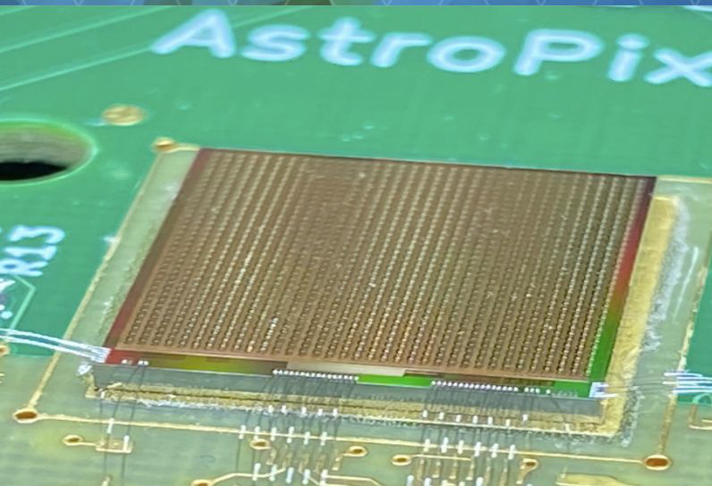
AstroPix tracker production model
Jessica metcalfe
January 10, 2024
EIC Users Collaboration Meeting

Slide 2
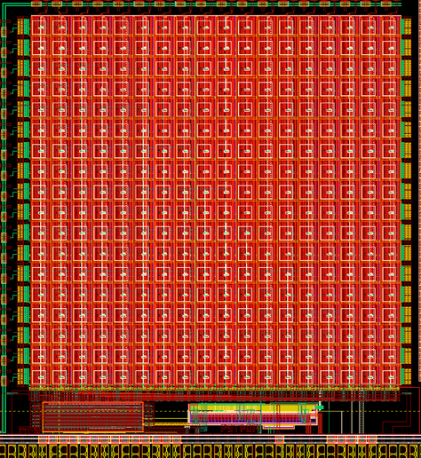
AstroPix tracker production
BIC Tracker
~100 m² of silicon
~5,000 wafers
~250,000 chips
Optimize the design & building procedures for industrial scale production
1 module flavor x31,200
1 stave flavor x2,400

Slide 3
AstroPix chips
~5,000 wafers
~250,000 chips
=
Probe wafers using a fully automated machine
Load a cartridge of 10 wafers, let the machine do the work
Identify failing chips (digital/analog) and failing bumps
Wafers are diced

Slide 4
AstroPix Module
Build ~31,200
AstroPix Chip
2 cm x 2 cm
Module PCB
8 chips
Current model uses an 8 chip module
Mounted on a rigid pcb for easy handling
For space and cooling reasons, the pcb may need to go on top of the chips…
Chips are mounted using an automatic pick-and-place machine
Chips are wire bonded to the pcb
Chips undergo mechanical and electrical QC to verify they work

Slide 5
AstroPix stave(Step 1)
Build ~2,400
~208 cm → 2 meters!
Stave
13 modules
Current model has 13 modules on a stave
This will be frozen ASAP
Plan to use Aluminum staves
Nice to have some easy screw mounting to the staves
Or could use tooling similar to SLAC for ATLAS Pixels
Or could be automated with pick-and-place machine
Metrology QC is done at this stage

Slide 6
AstroPix stave+bus tape (step 2)
Build ~2,400
Bus Tape
Power/data lines to each module
~208 cm → 2 meters!
Connect the modules to the bust tape
Bus tape will provide power, command, data, and any types of monitoring lines
Easiest to have a connector(s) on each module that connects to the bus tape
Also used for module testing

Slide 7
AstroPix stave+bus tape+EOS (step 3)
Build ~2,400
Bus Tape
Power/data lines to each module
End of Stave Card
~208 cm → 2 meters!
Stave will be connected to the end-of-stave card via the bus tape
End-of-stave card will interface to the ePIC DAQ
This end-of-stave card is used for QC testing the stave
It could be the final EOS or one associated with a test stand
Assume that the modules are relatively easy to rework on a stave, then the majority of detailed electrical tests will happen at this stage

Slide 8
AstroPix Trays
Tray
(very conceptual)
Tray integration with 6 or 7 staves
Slightly overlapping for coverage
Needs to slide into the shelf hole

Slide 9
AstroPix tracker production
 | # On-Detector | Yield | Total to Build | Total Good After Yield | Hours/piece | Total Hours*
wafers |  |  | 4838
chips | 249,600 | 89% | 290,304 | 261,274 | 0.05 | 14,515
modules | 31,200 | 98% | 32,659 | 32,006 | 0.21 | 6,858
staves | 2,400 | 99% | 2,462 | 2,437 | 0.63 | 1551
trays | 384 | 99% | 390 | 386 | 2.5 | 975
Module PCB | 31,200 | 95% | 34,378 | 32,659 | 0.025 | 860
Bus tape | 2,400 | 90% | 2,736 | 2,462 | 0.025 | 68
EOS cards | 2,400? | 90% | 433 | 390
*Total hours don’t reflect parallelization or people hours
All yields and times are a first assumption and will change

Slide 10
backup

Slide 11
Argonne National Laboratory
NASA Goddard Space Flight Center
Oklahome State University
University of Connecticut
University of California Santa Cruz
USA
University of Manitoba
University of Regina
Mount Allison University
NSERC
Canada Fund for Innovation
Canada
Thank You
Kyungpook National University
Yonsei University
University
of Seoul
Pusan National University
Korea University
Sungkyunkwan University
Hanyang University
Gangneung- Wonju National University
Korea
Karlsruhe Institute of Technology
University of Giessen
ePIC BIC Detector Subsystem Collaboration
AstroPix
Collaboration:
Hiroshima
University
Nagoya
University
Germany

Slide 12
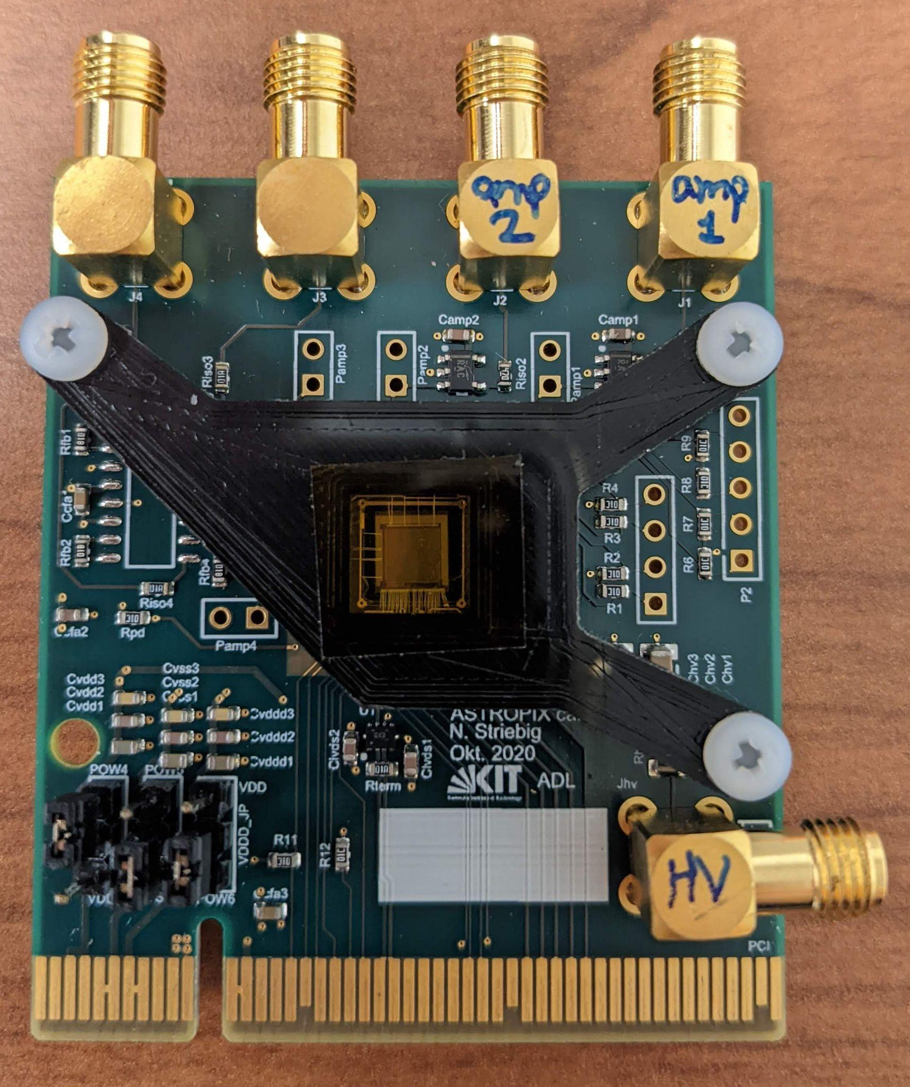
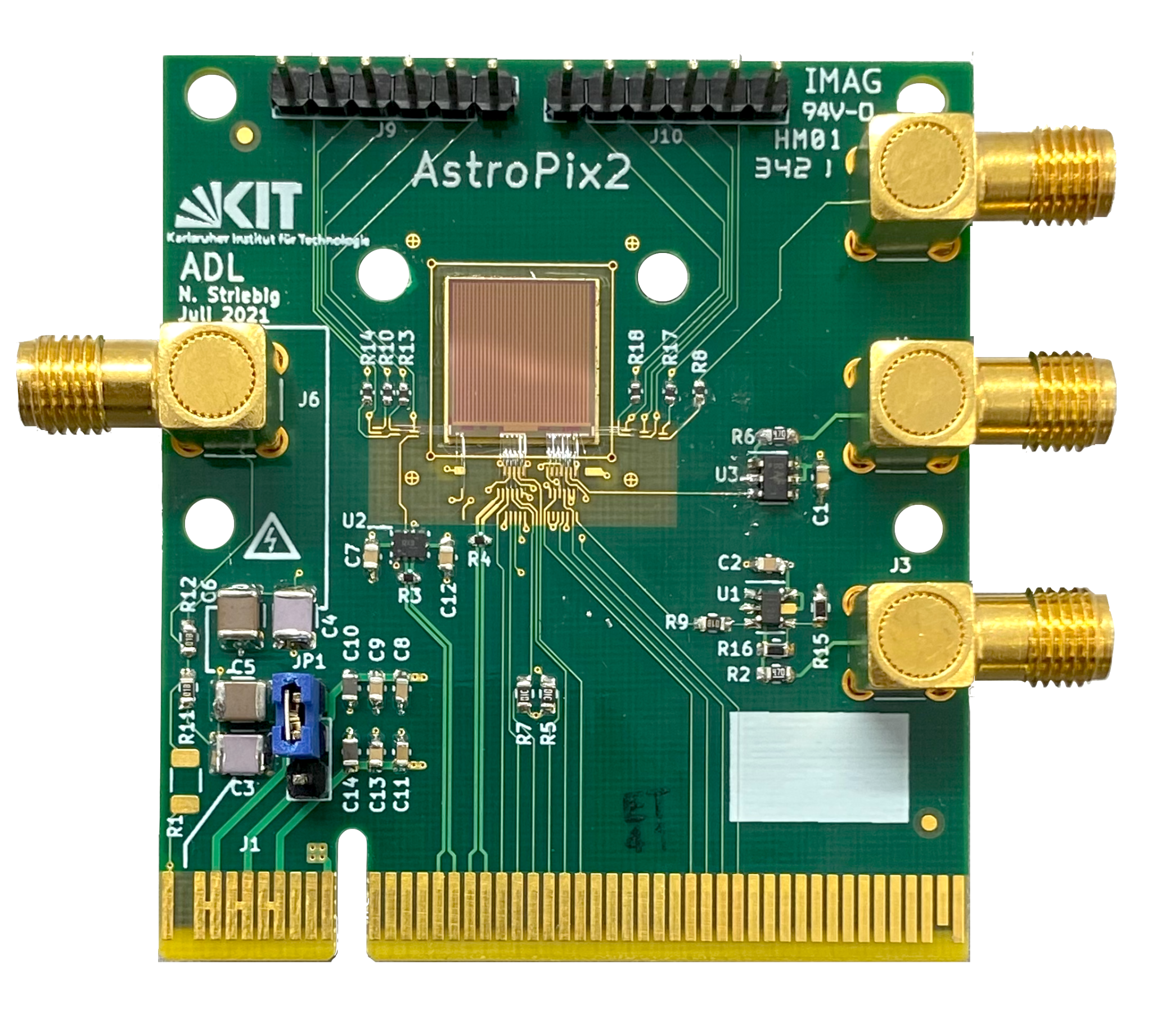
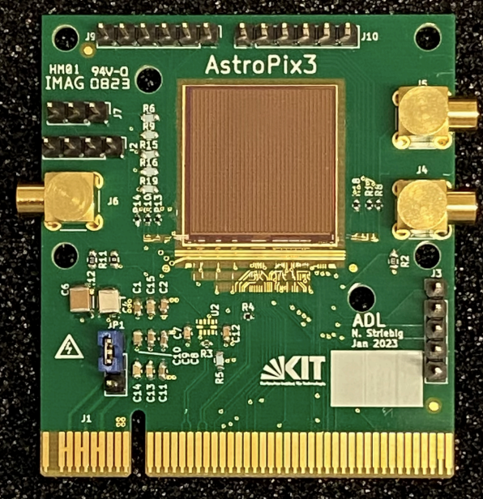
AstroPix development
ATLASPix AstroPix_v1 AstroPix_v2 AstroPix_v3
100 μm thick wafer -----------------------------------------720 μm thick wafer -------------------------------------------
40 x 130 μm² pitch 175 x 175 μm² pitch 250 x 250 μm² pitch 500 x 500 μm² pitch
0.3 x 1.6 cm² chip 0.5 x 0.5 cm² chip 1 x 1 cm² chip 2 x 2 cm² chip
150 mW/cm² 14.7 mW/cm² 3.4 mW/cm² 1.06 mW/cm²
(Power numbers represent amplifier+comparator only, not full digital power. Full v3 power draw = 4.12 mW/cm²)

Slide 13
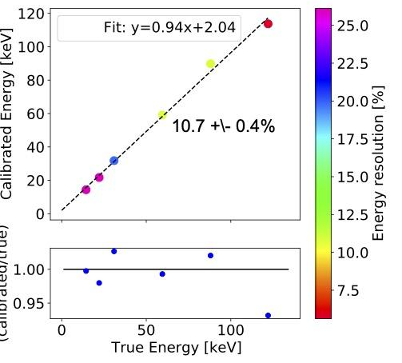
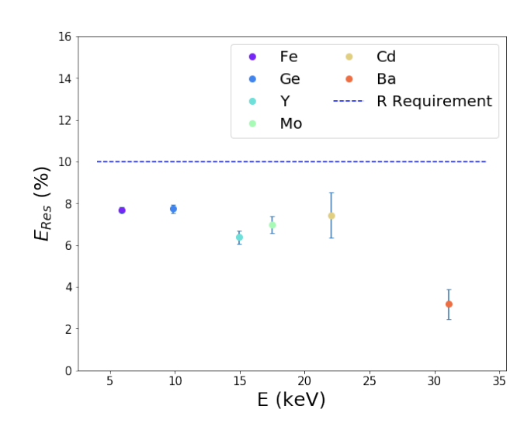
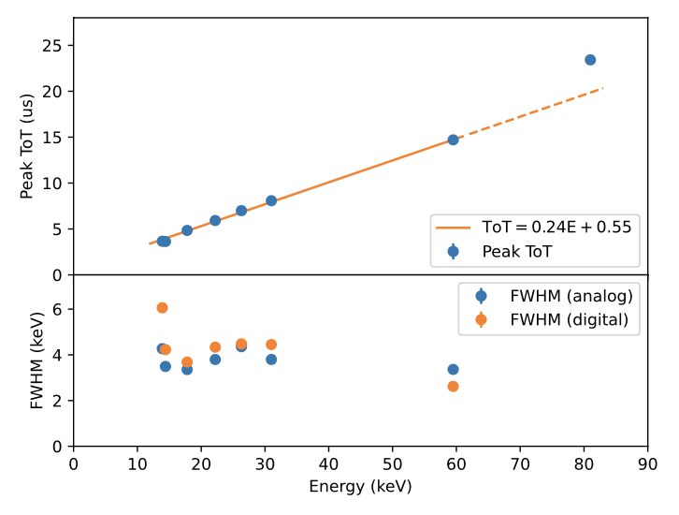
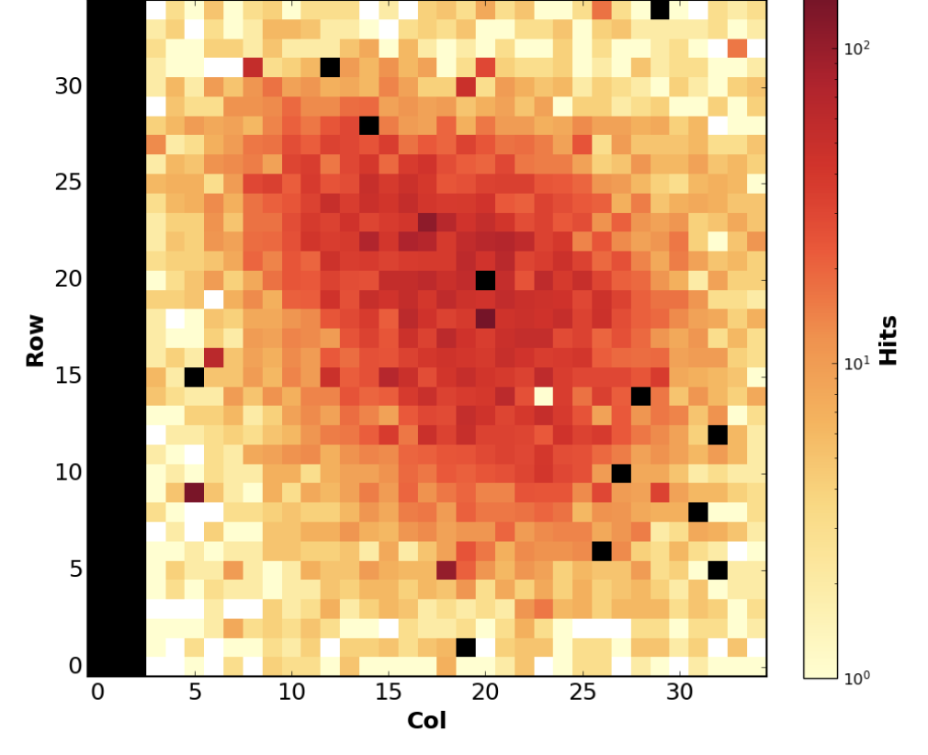
AstroPix development
ATLASPix AstroPix_v1 AstroPix_v2 AstroPix_v3
Analog data from a single pixel
Digital data from a single pixel
Beam Spot (FTBF)
Preliminary
I. Brewer et al, 2021
A. Steinhebel et al, 2022
Y. Suda et al, 2023

Slide 14
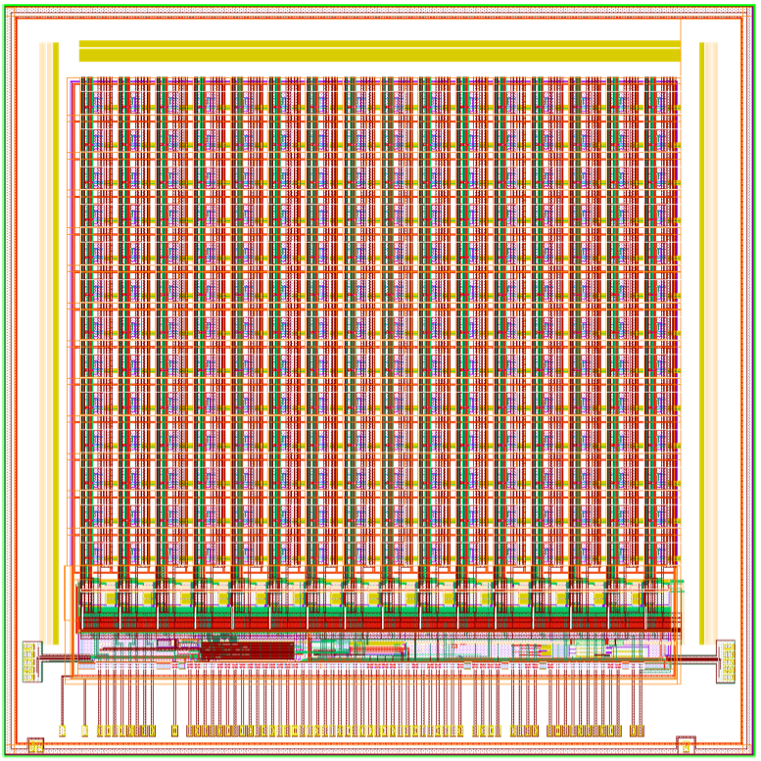
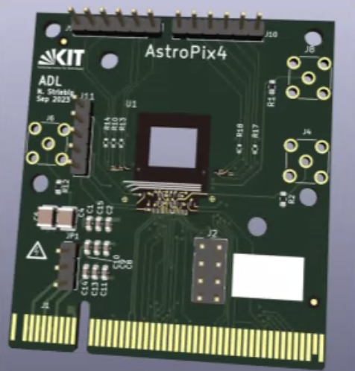
AstroPix: v4
~1 cm
AstroPix Features (v4):
Potentially the final design in small size 1 cm x 1 cm
500 um pixel pitch
Wafers recently delivered by foundry
Previous versions needed to meet certain ’flyable’ specifications like low power
Implement more features for better performance
Features:
Time stamp w/ 3.125 ns time resolution
Row & Column from individual pixel hitbuffer
Increase Time-Over-Threshold (ToT) bits
Improve Threshold tuning (5-bit)
Mask noisy pixels
Pass hits to next chip (daisy chain)
Self-triggered (only read out active hits)
~1 cm
N. Striebig et al, in prep

Slide 15
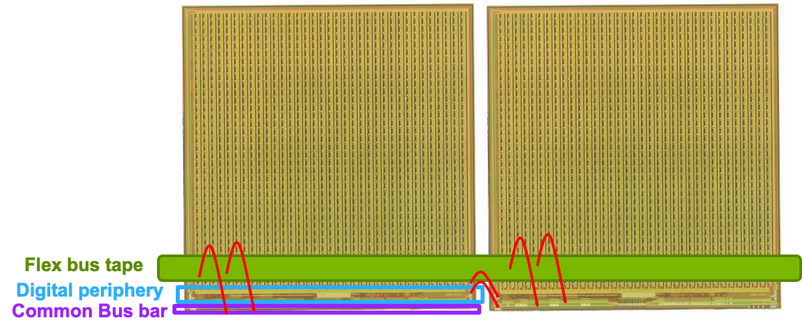
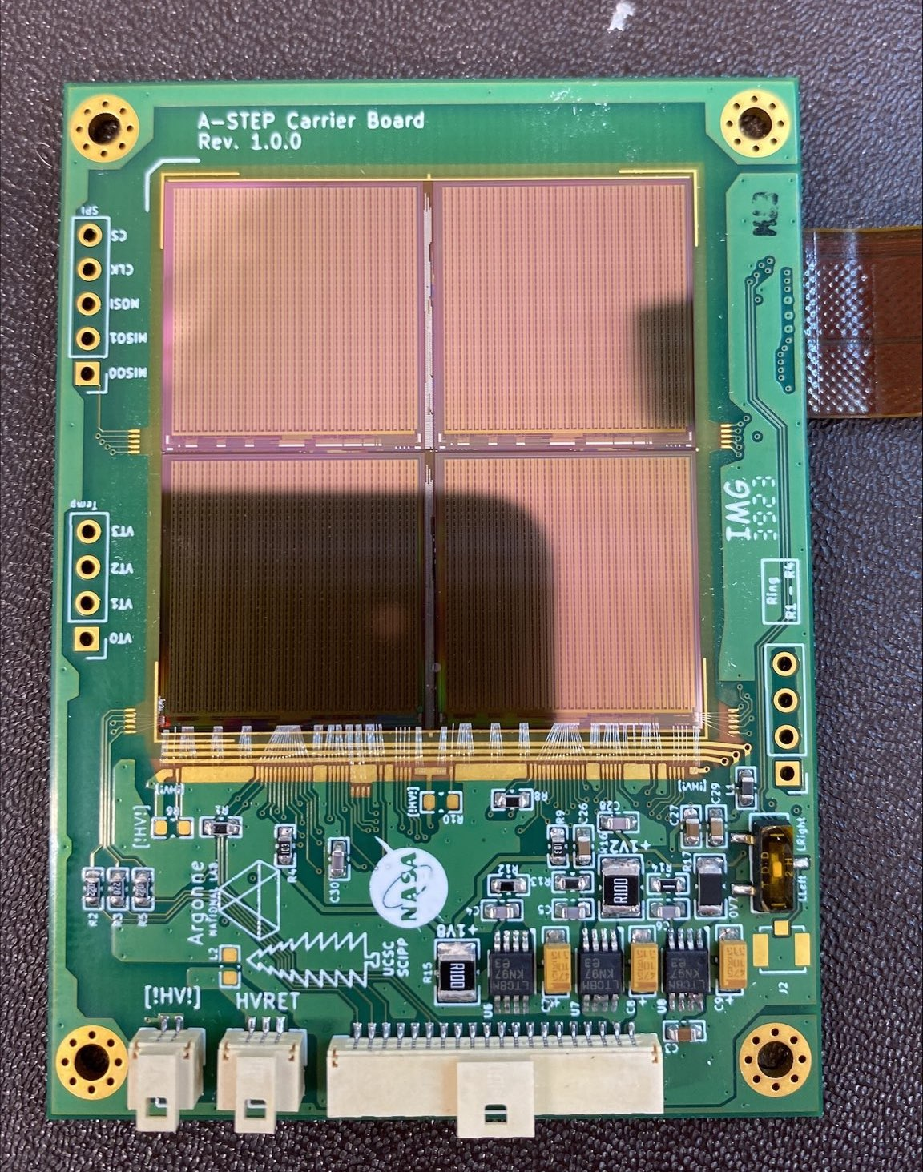
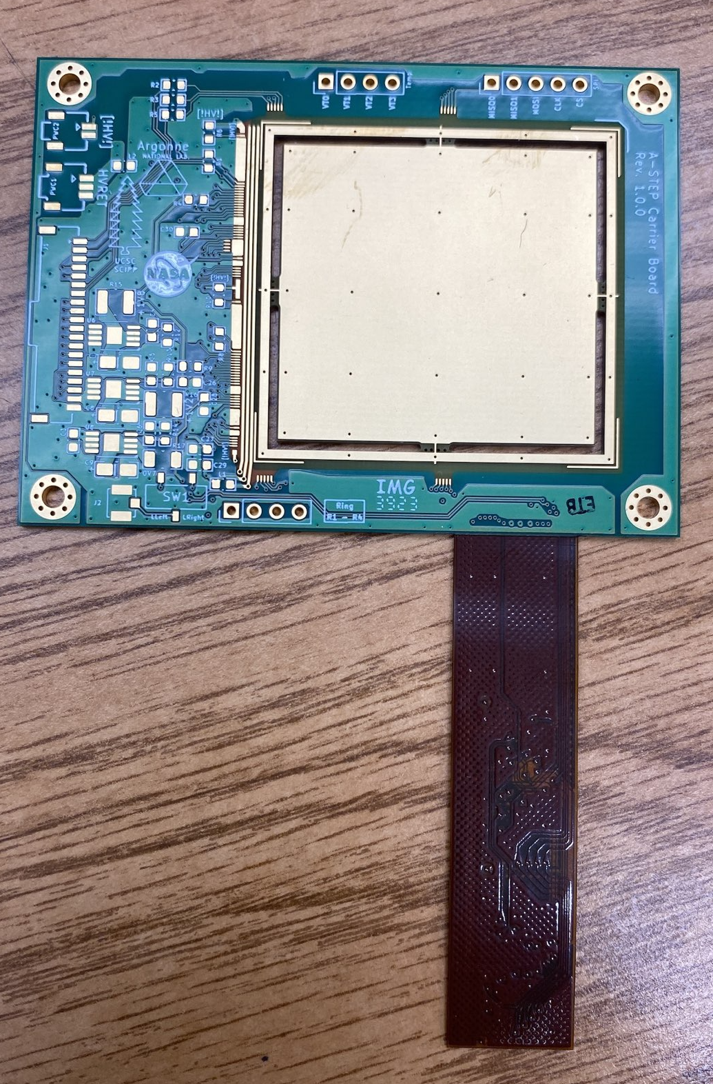
AstroPix: NEXT Steps
Several Features to Validate Performance:
Daisy chain readout
Multi-chip module read-out board
Check for data loss/max occupancy
Sensor efficiency between pixels, depth
Preparing for edge-TCT measurements
Charge collection efficiency
Flex bus tape design
DAQ development
Update previous results with v4
Test Beam
Irradiation: SEU, LET, Total Dose
Command/Power is distributed through a bus tape
Wire bonded from bust tape
Signals are digitized and routed out to the neighbor chip via wire bonds

Slide 16
BIC
Addressing the unique challenges for the barrel region in ePIC
Hybrid concept: 6(4 now) layers of Astropix interleaved with the first 5 Pb/ScFi layers, followed by a large volume with the rest of the Pb/ScFi layers
Deep calorimeter (21 X₀) but still very compact at ~ 40 cm
Excellent energy resolution (5.2% /√𝑬 ⨁ 1.0%)
Unrivaled low-energy electron-pion separation by combining the energy measurement with shower imaging
Unrivaled position resolution due to the silicon layers
Deep enough to serve as inner HCal
Very good low-energy performance
Wealth of information enables new measurements, ideally suited for particle-flow
Makes the tracking MPGD layer behind the DIRC unnecessary
AstroPix: silicon sensor with 500x500μm² pixel size developed for the Amego-X NASA mission
BIC Tracker
~100 m² of silicon
~5,000 wafers
~250,000 chips
Optimize the design & building procedures for industrial scale production
1 module flavor x31,200
1 stave flavor x2,400
ScFi Layers with two-sided SiPM readout

Slide 17
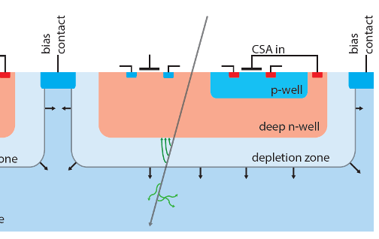
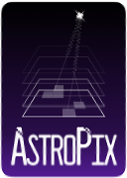
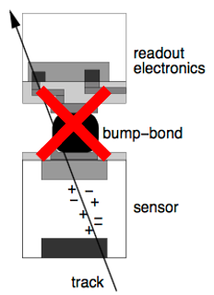
Sensors: Monolithic HVCMOS
(Monolithics Active Pixel Sensor (MAPS)
Monolithic: combines a traditional silicon pixel sensor wafer and the Front-End ASIC in a single wafer
Each pixel has it’s own amplifier in a deep n-well
High-resistivity substrates enable sensor depletion for collection via drift rather than diffusion
Technology uses more typical CMOS wafer processing for cost effective production
Single wafer enables shorter design cycle
History: HVCMOS developed by Ivan Peric at Karlsruhe Institute of Technology (KIT). He has designed MuPix, ATLASPix, AstroPix, etc.
AstroPix: initially for space-based applications
Upgrade to the next generation Fermi Telescope—AMEGO-X

Slide 18
Astropix timeline & Production
AstroPix versions
v1 early prototype
v2 current test bench & test beam studies
extensive test bench characterization
higher noise due to larger pixel size
LET radiation testing
first test beam run a few weeks ago
v3 full size chip
minor fixes from v2
OR’d rows & columns
just received
v4 new features for better performance (MPW)
‘final version’, but smaller chip (1 cm x 1 cm)
plan to submit in May 2023
better noise/threshold performance
per pixel hitbuffer
v5 full size chip
fix any bugs from v4
Final production version
chips available November 2024
Design Validation
test bench characterization complete
LET irradiations done
test beam measurements on-going
multi-chip DAQ development
daisy chain readout validation
compare-1 NASA balloon test Fall 2023
DSSD’s
A-STEP sounding rocket January 2025
ComPair-2 balloon launch 2026
Multi-layer calorimeter prototype (ANL)
full scale prototype to be built and tested w/ v3
DAQ development joint with NASA
Production
fabrication by TSI
AMS is a backup, but need a large order

Slide 19
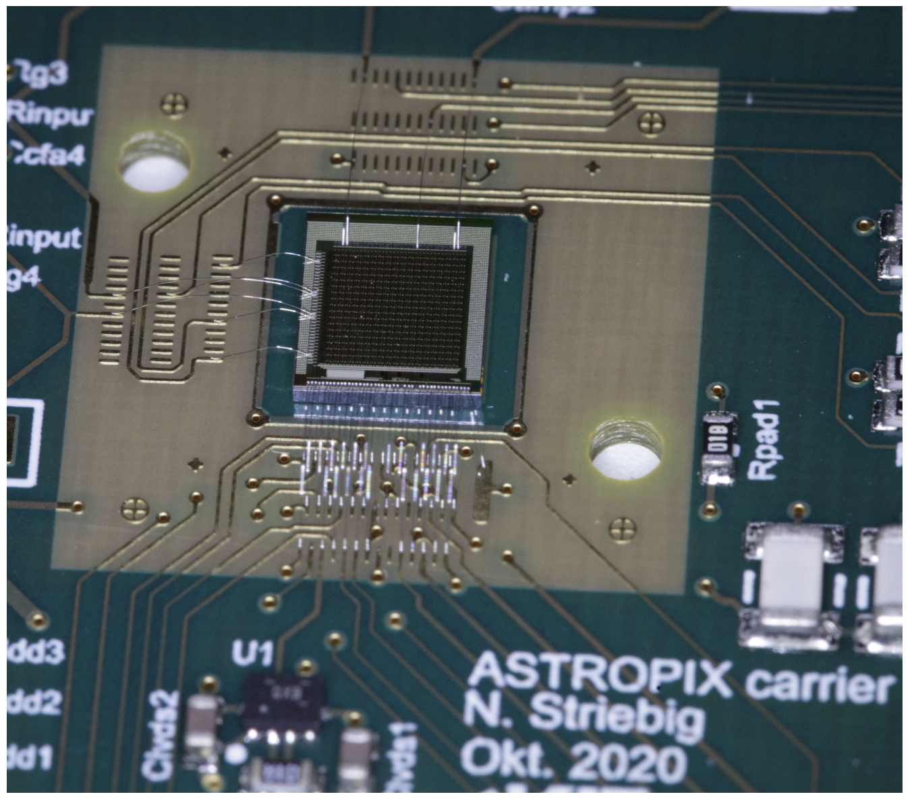
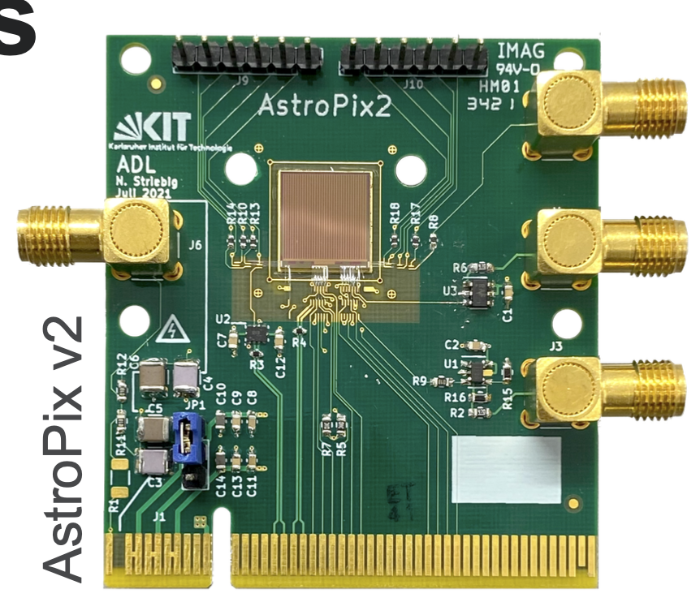
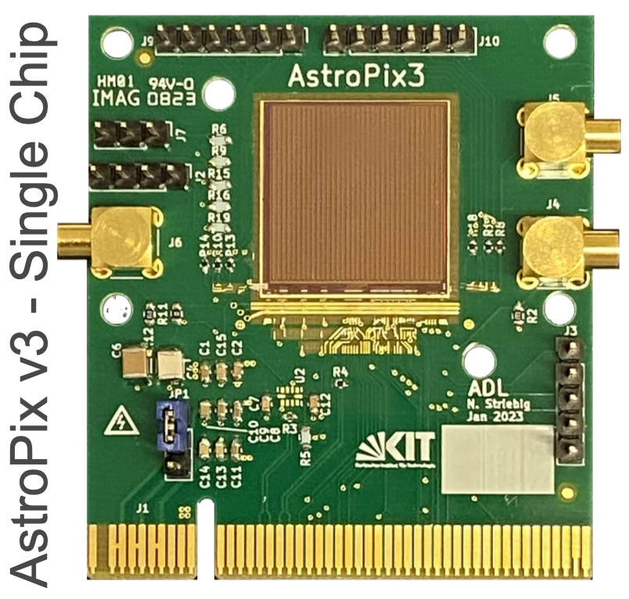
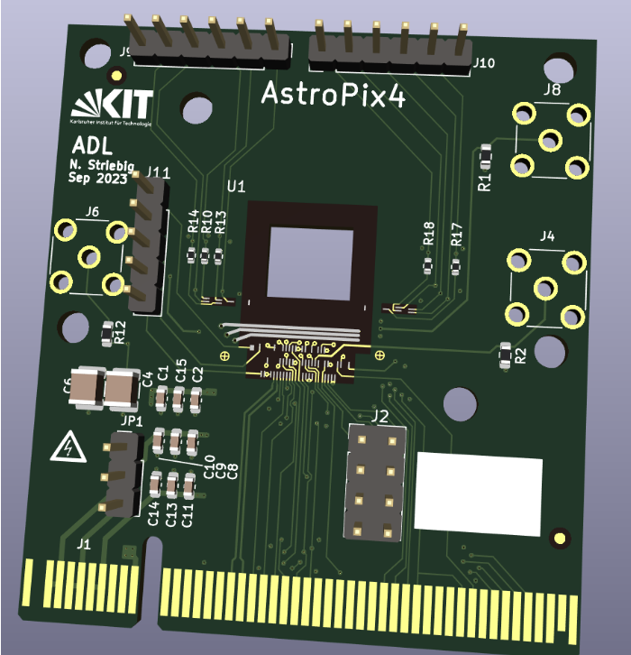
AstroPix Development Schedule
Not shown: Early CD4 (Oct 2032) CD4 (Oct 2034)
We are here
FY19
FY20
FY21
FY22
FY23
FY24
FY25
FY26
FY27
FY28
FY29
Q3
Q4
Q1
Q2
Q3
Q4
Q1
Q2
Q3
Q4
Q1
Q2
Q3
Q4
Q1
Q2
Q3
Q4
Q1
Q2
Q3
Q4
Q1
Q2
Q3
Q4
Q1
Q2
Q3
Q4
Q1
Q2
Q3
Q4
Q1
Q2
Q3
Q4
Q1
Q2
Q3
AstroPix v1
Design & Fabr.
Test
v3 has comprehensive test program: benchtop and testbeam, irradiation, quad-chip readout for NASA payload mission (A-STEP), integration with Pb/SciFi for ePIC (R&D studies and test article production)
AstroPix v2
Design & Fabr.
Test
AstroPix v3
Design & Fabr.
Test
Test
AstroPix v4
Design & Fabr.
Test
first v5 wafers used for preproduction
EIC Project Milestone
Design & Fabr.
Start of production driven by project fund availability (estimated ~ 1 year after CD2/3)
AstroPix v5
New AstroPix version
AstroPix v5 (production)
Production Fab.
ePIC BIC Timeline
Design and generic R&D
Final design and EIC R&D
BIC Preproduction
BIC Production
CD0
CD1
CD3a
CD3b
CD2/3
AstroPix v1
HV-CMOS MAPS based on ATLASPix3, designed for the AMEGO-X NASA mission, optimized for power dissipation and energy resolution Nucl.Instrum.Meth.A 1019 (2021) 165795
0.45 x 0.45 cm² chip, 175 µm pixel pitch
18 x 18 pixel matrix
Power dissipation 14.7 mW/cm²
Start of BIC installation at BNL
AstroPix v2
1 x 1 cm² chip, 250 µm pixel pitch
35 x 35 pixel matrix
Row/column readout
Power dissipation 3.4 mW/cm²
AstroPix v3
First full-size chip
2 x 2 cm² chip, 500 µm pixel pitch
Row/column readout
Power dissipation <1 mW/cm²
2.5 MHz timestamp, 200 MHz ToT
AstroPix v4
Final design but smaller size
1 x 1 cm² chip, 500 µm pixel pitch
Individual pixel readout
3 timestamps, 3.25ns time resolution
TuneDAC for pixel-by-pixel thresholds
AstroPix v5
Full-size production chip
2 x 2 cm² chip, 500 µm pixel pitch
Design identical to v4 (with bug fixes)

Slide 20
BIC High-level Schedule
Barrel
Installation in BNL
Jun 29
ePIC decision about Barrel ECAL
April 23
CD-3a
Jan 24
CD-2/3
Apr 25
Today
2022
2023
2024
2025
2026
2027
2028
2029
AstroPix v3
Feb 2023
AstroPix v4
Nov 2023
AstroPix v5
Nov 2024
Prototype R&D
Final Design/PED
Pre-production
Scintillating Fiber Fabrication
Production SciFi/local support layers and testing
Production wafer fabrication v5
Wafer testing
Sectors/Trays production assembly and testing
Integration
Delivery
Sector Assembly in a Barrel and Integration with Si Trays

Slide 21
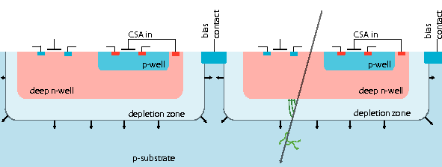
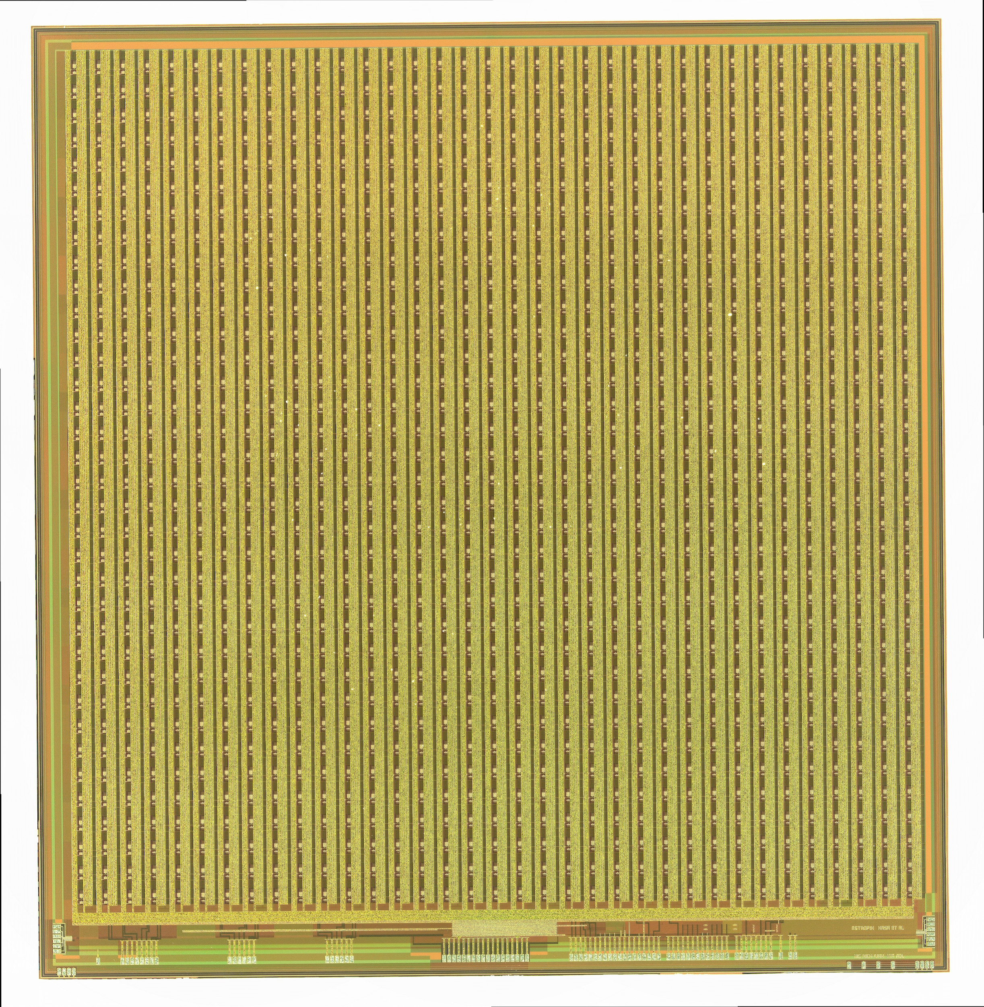
AstroPix
HV-CMOS Monolithic Active Pixel Sensor (MAPS):
Combination of silicon pixel & Front-End ASIC
On-pixel charge amplification and digitization
Technology uses more typical CMOS wafer processing for cost effective mass production
Fabrication on single wafer enables shorter design cycle
No need to bump-bond to each pixel - improves yield
AstroPix (based on ATLASPix3 arXiv:2109.13409)
180nm HV-CMOS MAPS sensor designed at KIT (also designed ATLASPix, MuPix, etc.)
Developed for AMEGO-X GSFC/NASA mission (Upgrade to the Fermi’s LAT)
Power consumption <1.5 mW/cm²
Energy resolution target of 2% @ 662keV
~1 cm
AstroPix v3 (Under test)
&
~1 cm
~2 cm
AstroPix v4
(MPW - delivered)
~2 cm

Slide 22
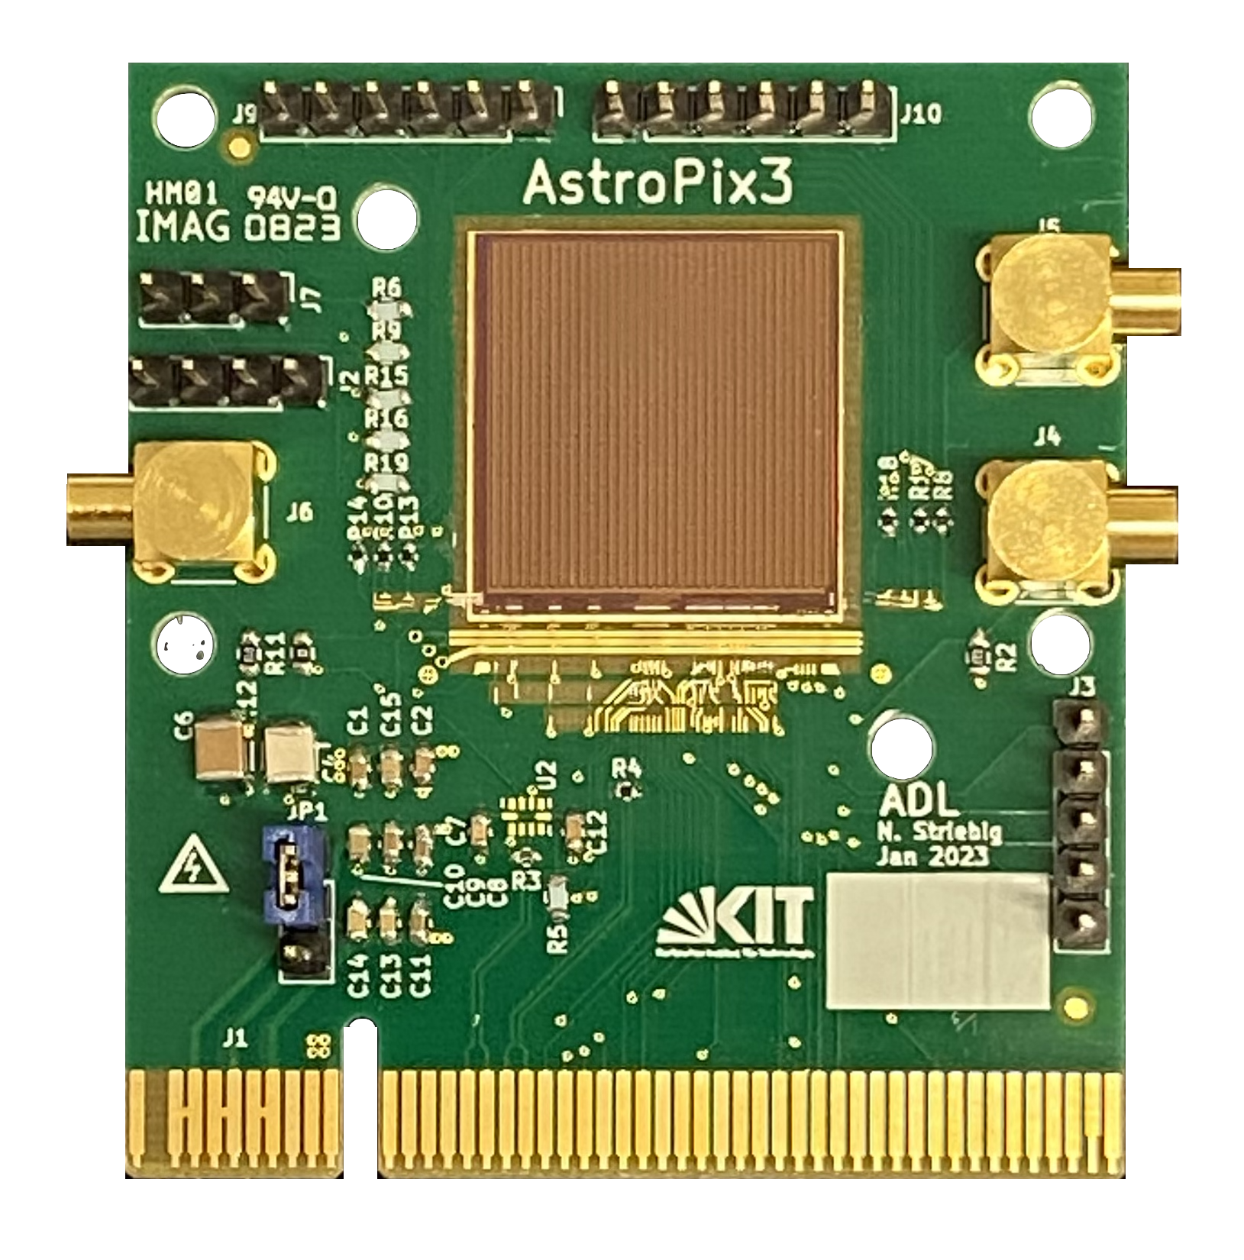
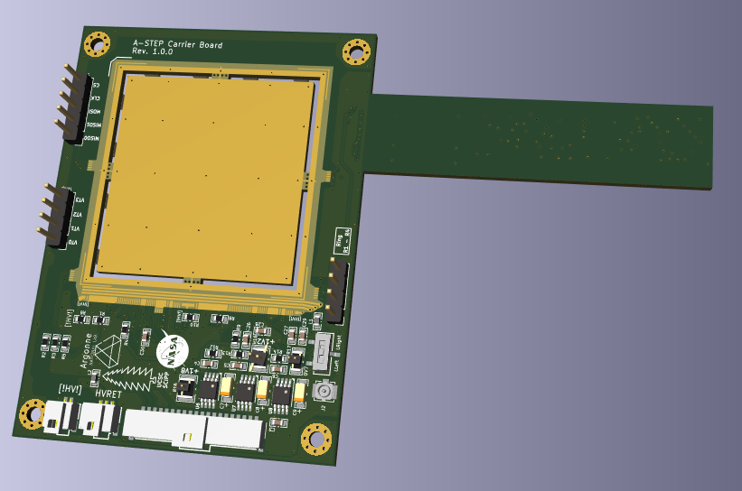
AstroPix Developments
AstroPix v1 - January 2021
0.45 ⨉ 0.45 cm² chip, 175 μm pixel pitch
18 ⨉ 18 pixel matrix
Power dissipation ~14.7 mW/cm²
AstroPix v2 - December 2021
1 ⨉ 1 cm² chip with 250 μm pixel pitch
35 ⨉ 35 pixel matrix
Hit identification with Row/Column readout
Power dissipation ~3.4 mW/cm²
AstroPix v3 - February 2023
2 ⨉ 2 cm² chip with 500 μm pixel pitch
Power dissipation <1 mW/cm² (targeted)
Timestamp clock 2.5MHz, ToT 200 MHz
10 byte data frame per hit
AstroPix v2
Will be available this week
Quad Chip
AstroPix v3 Quad-chip Carrier Board

Slide 23
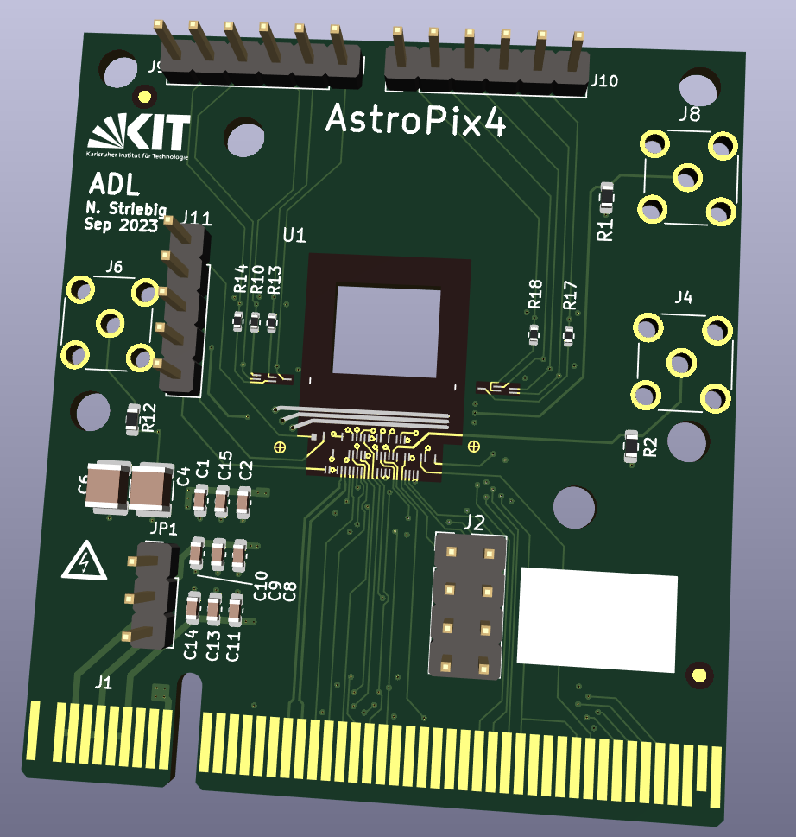
AstroPix v4/v5
AstroPix v4
AstroPix v4 : Final design version will small size
Chip size 1 ⨉ 1 cm²; Thickness 700 μm, V_{BD} ~ 400V
Pixel pitch 500 μm with pixel size 300 μm, 16 ⨉ 16 pixel matrix
Individual pixel readout with individual hit buffer
No identification issue due to ghost hits
3 Timestamps - 2.5MHz (TS), 20 MHz (Fine TS), and 16 bit Flash TDC
Fast ToT and Timestamp with 3.125 ns time resolution
TuneDACs - Pixel-by-pixel threshold tuning and pixel masking
Daisy Chain readout - pass hits to next chip through QSPI
Self-triggered (reads out active hits)
AstroPix v5 : Full size final design
No planned design changes
Fix any bug from v4
Full size chip - 2 ⨉ 2 cm², pixel pitch 500 μm,
35 ⨉ 35 pixel matrix → 1225 hit buffers

Slide 24
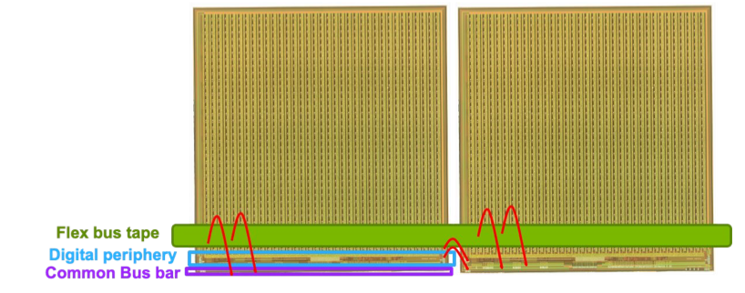
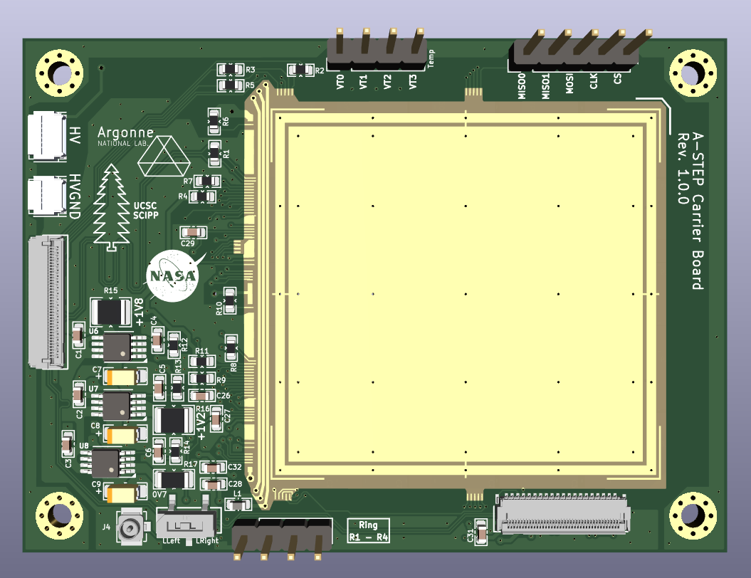
AstroPix Readout
8 bytes data per hit - header (chipID, payload), row/column, timestamp, ToT
SPI I/O daisy chained - chip-to-chip signal transfer
signals are digitized & routed out to the neighboring chip using 5 SPI lines via wire bond
Power/Logic I/O distribution on the module (through a bus tape)
4 power lines (LV, HV), ~20 Logic I/O (SPI, clk, timestamp, interrupt, digital Injection, etc.)
HV, VDDA/VDDD(1.8V), VSSA(1.2V), Vminuspix(0.7V)
power distribution can be controlled using voltage regulators
mostly part of end of the stave services
Data will be received by FPGA at the end of stave
FPGA aggregates data before sending off-detector
Low heat load at chip, only cooling of end of the stave card
Operational temperature for AstroPix is at room temperature and considered to be operated at 22 ℃
Chip 0
Chip 3
Chip 1
Chip 2
AstroPix v3 quad-chip carrier board
Demonstrate required services
Daisy chaining

Slide 25
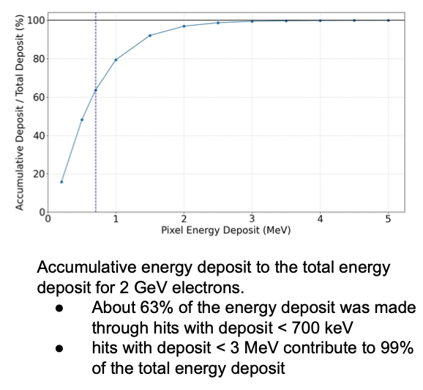
AstroPix at ePIC
Low Rates
The expected hit rate for all imaging layers together is well below < 3 ⨉ 10⁷ Hz
This translates to a maximum hit rate per tracker stave (1 x 104 chips) < 36 kHz
Zero-suppression below threshold 20 keV (4 ⨉ noise floor) well suited for EIC electromagnetic showers
Timing requirement: 3.125 ns (v4/v5) - driven by 10 ns bunch crossing
Low Ionization radiation dose and neutron flux
The maximum ionizing radiation dose < 1 kRad/year for the barrel region
Max neutron flux - order of 10⁹ n_{equivalent}/cm² per year
Dynamic range (see plot for 2 GeV e⁻) ~ 3 MeV

Slide 26
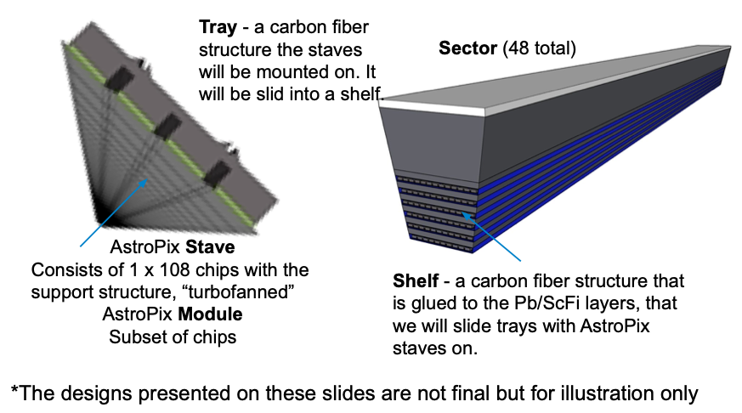
AstroPix Assembly
Module Strategy
QC testing with wafer probing + Module and stave level QC testing and tuning
“Baseline” model of Modules on Stave
Module - 8 single chips
Stave - 13 Modules - 104 chips
12 or 14 Staves per AstroPix layer per Calorimeter Sector
Total 249600 chips
All staves are identical and gets combined in a separate production step
Data transmitted to end of the Stave card using flex base tape
Institutions - ANL, GSFC/NASA, KIT ,UCSC, Korea, Oklahoma State

Slide 27
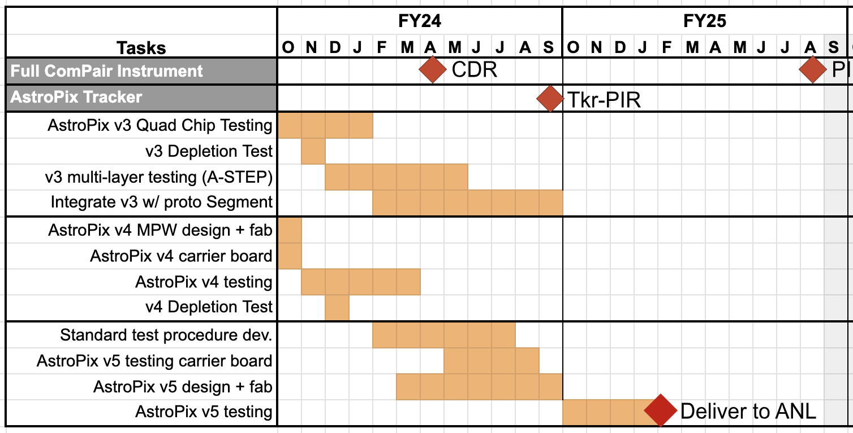
AstroPix Timeline and Production
v3 full size chip (ongoing testing)
Test bench characterization (ongoing)
Testbeam performance studies
Active and passive irradiation ~10¹⁵ n_{equivalent}/cm²
Quad-chip readout (ready to test) for NASA’s hosted payload mission (A-Step) - January 2025
Integration with Pb/SciFi - FY2024
v4 new features for better performance (MWP)
Final design version, smaller chip (1cm ⨉ 1cm)
Fabricated wafers delivered last week
Chip carrier board design for bench test is ready for the PCB fabrication
v5 full size final chip
Fix any bugs from v4
v5 chips available November 2024
GSFC/NASA ComPair-2 AstroPix timeline
BIC@ePIC Timeline
Prototype R&D (v3) Ongoing - till Nov 24
Pre-Production (v5) chips starts Nov 2024
Production
Fabrication by TSI - with a large production order, AMS is a backup

