Slide 1
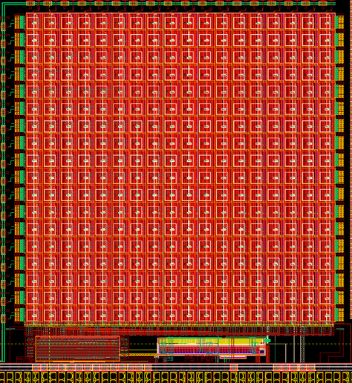
Barrel Imaging Calorimeter (BIC) IMAGING LAYER == TRACKER
ePIC Collaboration Meeting
January 10, 2024
Sylvester Joosten & Wouter Deconinck
Argonne National Laboratory & U. Manitoba

Slide 2
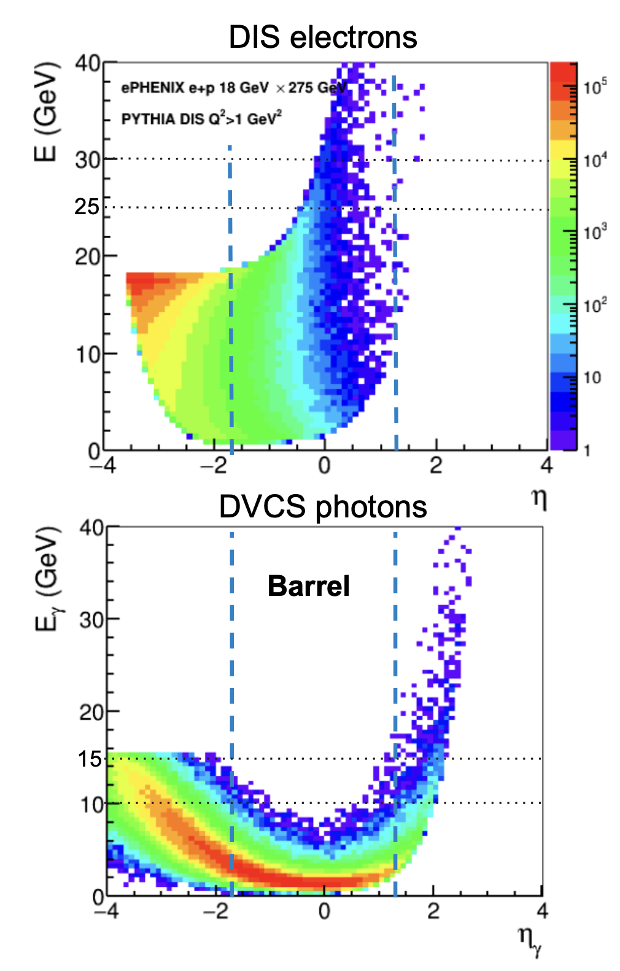
Why electromagnetic calorimetry at EIC is hard
From the EIC Yellow Report: stringent barrel ECal requirements
EIC is an electron scattering machine and identifying scattered electrons mainly depends on the electromagnetic calorimetry.
The electromagnetic calorimeter is the main detector for electron-pion separation. The inclusive physics program requires up to 10⁴ pion suppression at low momenta in the barrel.
The exclusive program requires decent energy resolution (< 7%/√𝐸 ⨁ 1-3%) for photon energy reconstruction, and also the fine granularity for good π⁰-ɣ separation up to 10 GeV.
The bECal should be capable of measuring low energy photons down to 100 MeV, while having the range to measure energies well above 10 GeV
The system is space-constrained to very limited space inside the solenoid.

Slide 3
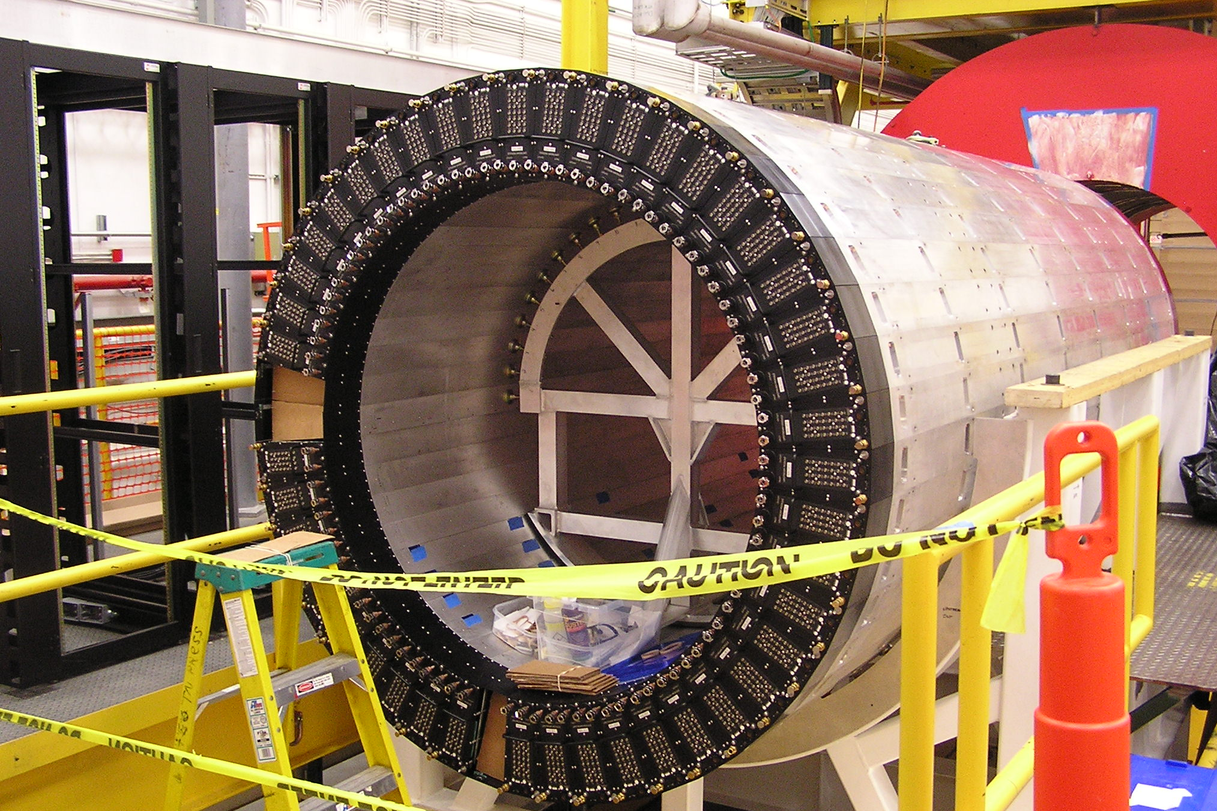
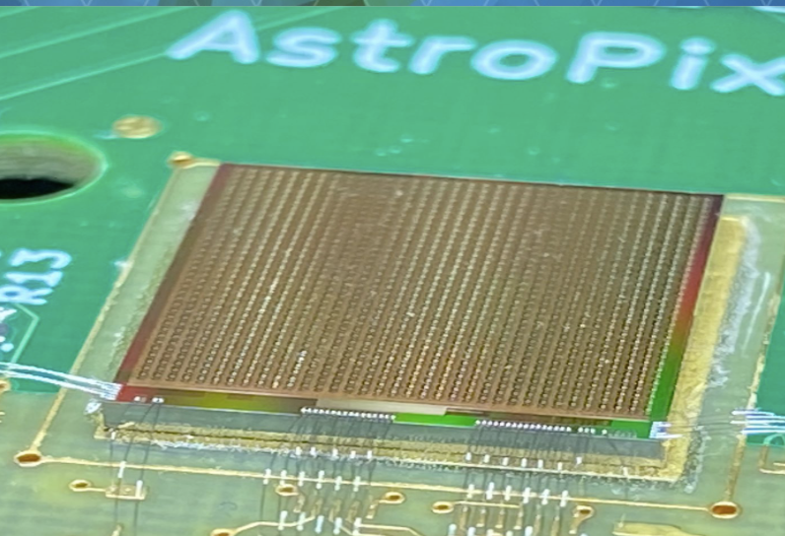
CONCEPT: A HYBRID IMAGING CALORIMETER
Combination of a high-performance sampling calorimeter with inexpensive silicon sensors for shower profiling
ENERGY RESOLUTION
POSITION RESOLUTION
NIM, A 896 (2018) 24-42
NIM, A 1019 (2021) 165795
Start from mature layered Pb/ScFi technology with side-readout (same as the GlueX calorimeter) for state-of-the-art sampling calorimeter performance
Insert layers of monolithic AstroPix sensors (inexpensive ultra-low-power silicon sensor developed for NASA) in the first half of the calorimeter to capture a 3-D image of the developing shower

Slide 4
BARREL IMAGING CALORIMETER (BIC)
Addressing the unique challenges for the barrel region in ePIC
Hybrid concept: 4 (+2) layers of Astropix interleaved with the first 5 Pb/ScFi layers, followed by a large volume with the rest of the Pb/ScFi layers
Deep calorimeter (η = 0 ~17.1 X₀) while compact at ~ 40 cm
Excellent energy resolution (5.2% /√𝑬 ⨁ 1.0%)
Unrivaled low-energy electron-pion separation by combining the energy measurement with shower imaging
Unrivaled position resolution due to the silicon layers
Deep enough to serve as inner HCal
Very good low-energy performance
Wealth of information enables new measurements, ideally suited for particle-flow
Serves as tracking layer behind the DIRC
AstroPix: silicon sensor with 500x500μm² pixel size developed for the Amego-X NASA mission
ScFi Layers with two-sided SiPM readout (~10.3% sampling fraction)
This work is supported by the U.S. Department of Energy, Office of Science, Office of Nuclear Physics, under contract DE-AC02-06CH11357.
Checks all the boxes!

Slide 5
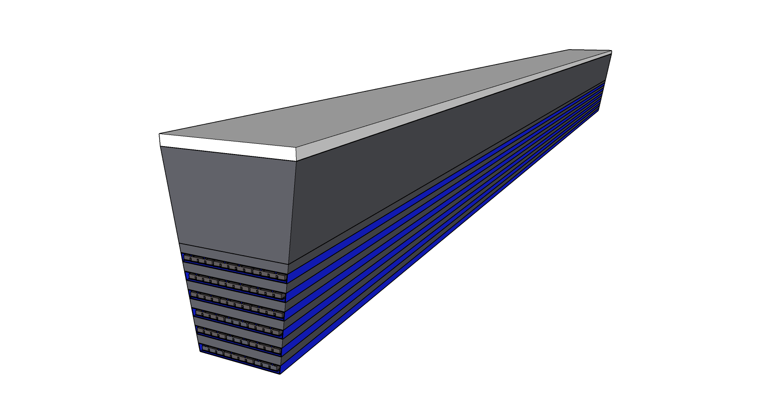
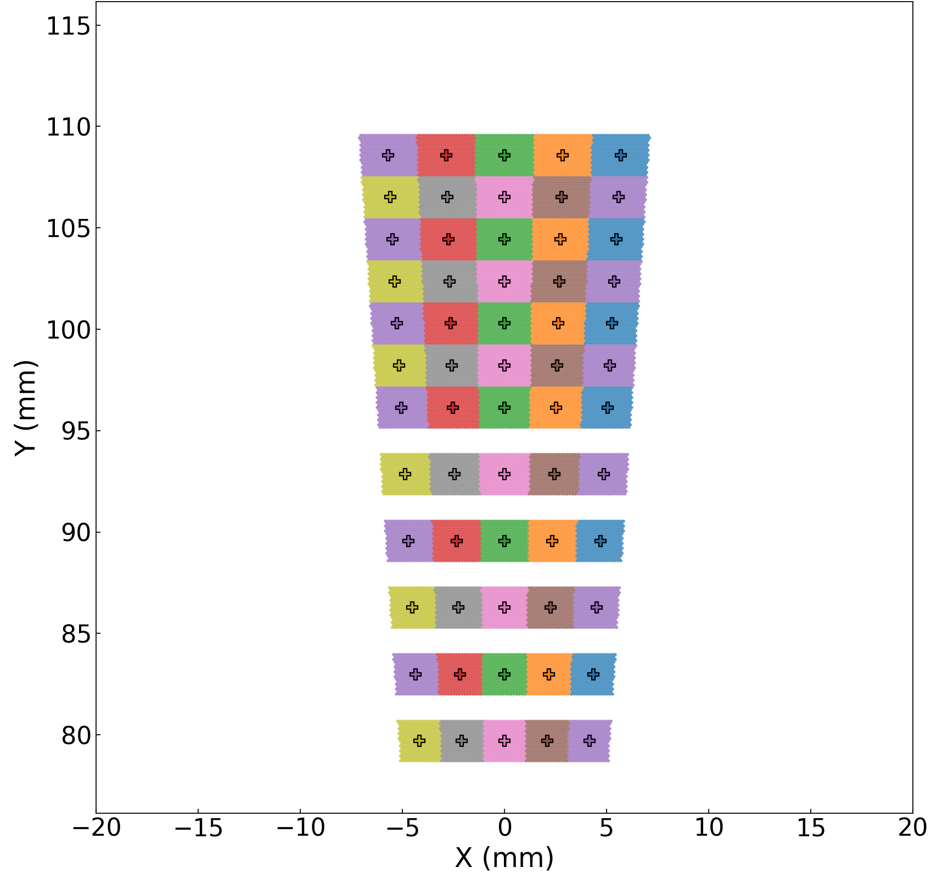
BARREL IMAGING CALORIMETER (BIC)
Components
Tray - Structure holding the AstroPix staves for a single layer
Detector Structure
Fiber Direction
Single sector
Bulk Pb/SciFi section
Slots for AstroPix sensor layers
Length: ~ 200 cm (half length)
Structure: 6-7 “turbofanned” staves per tray
Stave Structure: ~ 13 Modules per stave
Length: 432.5 cm
Radius: ~ 80 cm radius,
Structure: 48 sectors
η Range: -1.71 < η < 1.31
Sector side view
Pb/SciFi Layer - 12 layers per sector
Structure: 5 readout cells (one light-guide per readout cell)
Construction: 17 rows of fiber
Module - Several AstroPix chips daisy-chained together on Flex PCB
Length: ~ 16 cm
Width: ~ 2 cm
Gaps: < 200 µm
Structure: ~ 8 chips/module

Slide 6
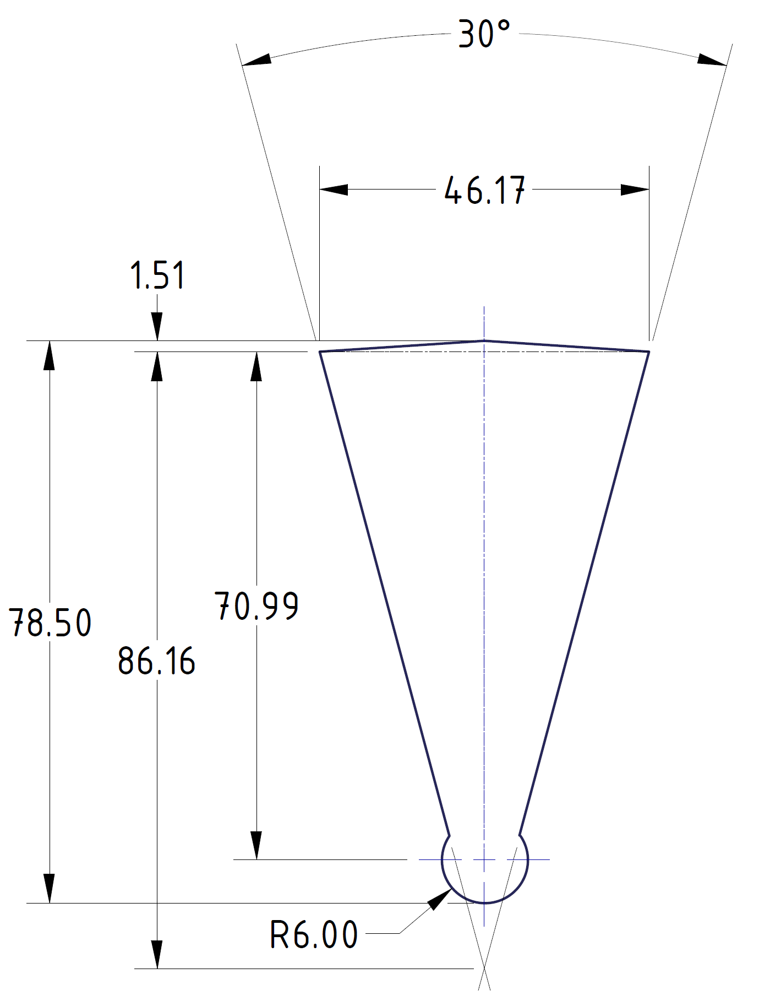
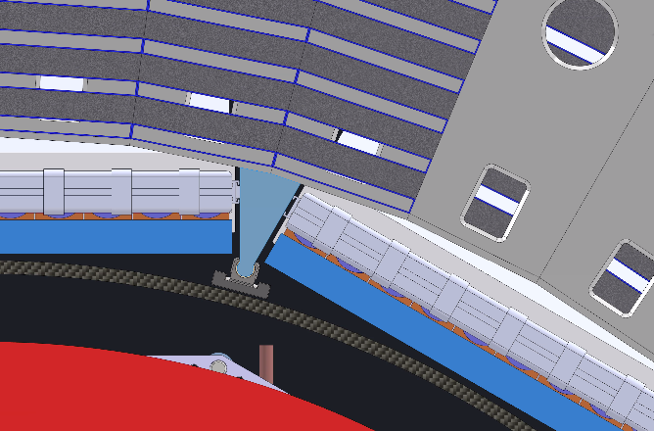
INTEGRATION
Newest Engineering Design: outward shift and integrated support rail
Newest CAD design of detector includes a 3cm outer shift to accommodate the inner detector support and services.
New integrated support structure attaches inner detector rails directly to the BIC
Pro: No support frame needed: less material in front; minimize outward shift
Pro: Simpler structure at end of sectors
Con: Discontinuities in first tracker layer (frame needed to transfer forces as BIC supports the entire inner detector
Con: Extra material for support rail (can be optimized)
Alternative (extra inner detector support frame ) less desirable:
requires more space (outward shift → more cost and weight)
adds more material at larger distances from the calorimeter.

Slide 7
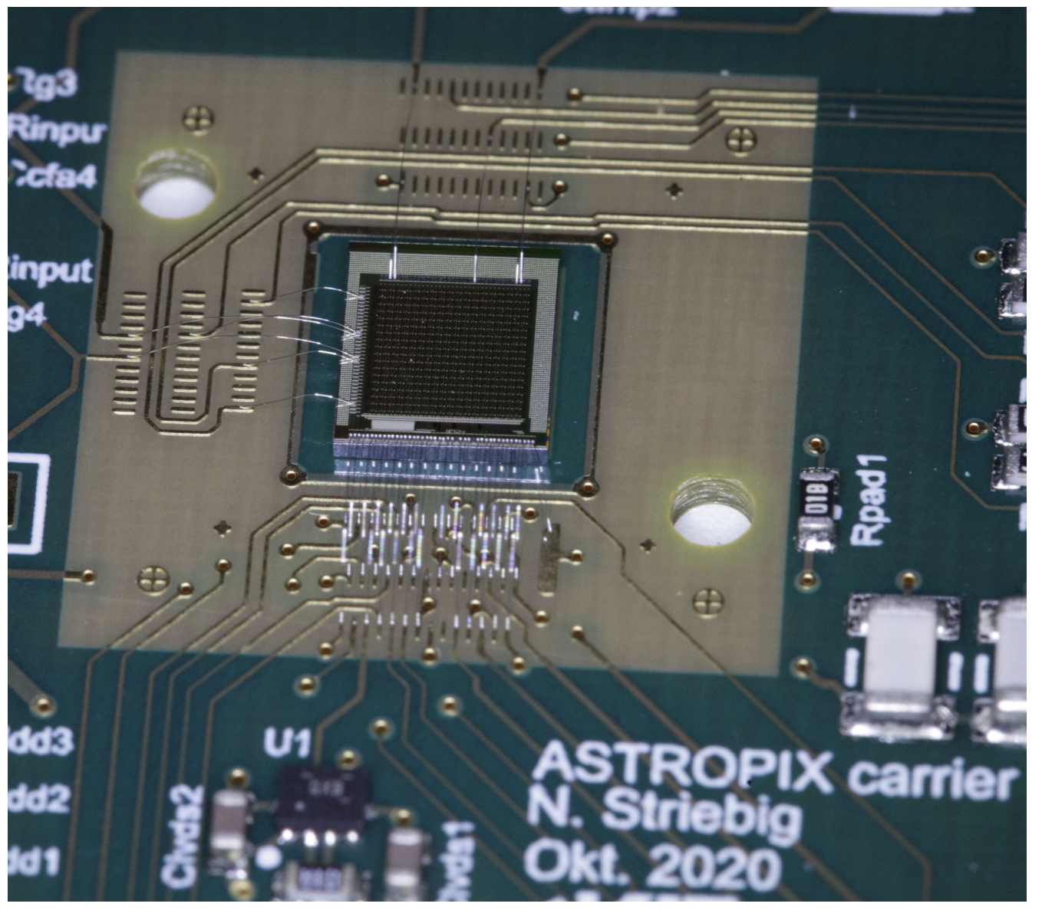
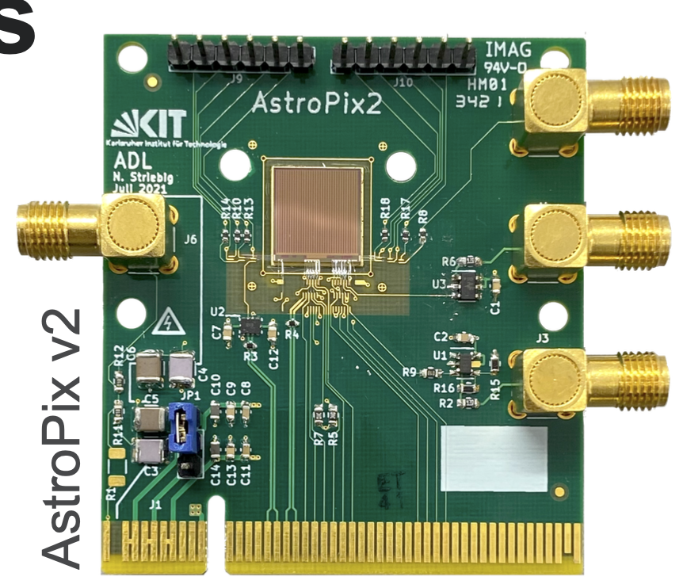
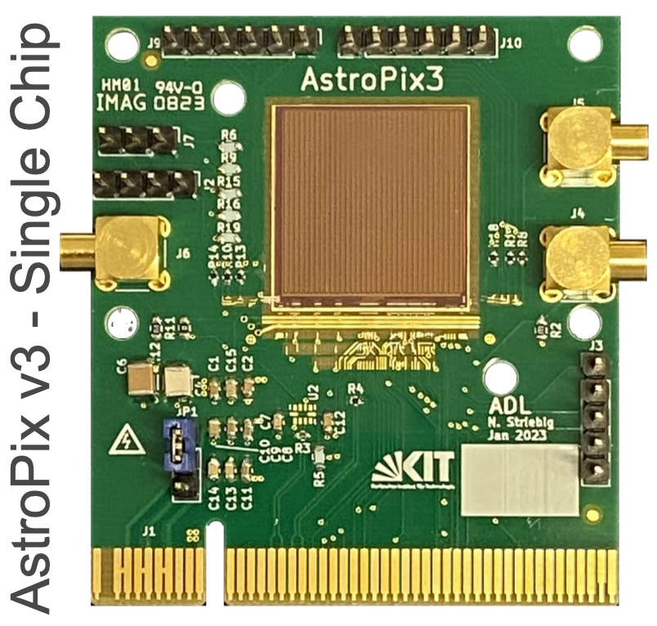
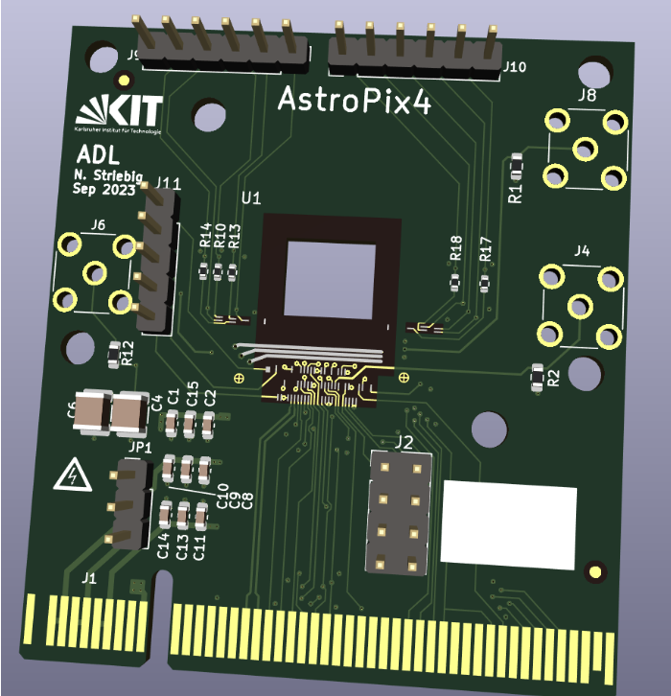
AstroPix Development Schedule
Not shown: Early CD4 (Oct 2032) CD4 (Oct 2034)
We are here
FY19
FY20
FY21
FY22
FY23
FY24
FY25
FY26
FY27
FY28
FY29
Q3
Q4
Q1
Q2
Q3
Q4
Q1
Q2
Q3
Q4
Q1
Q2
Q3
Q4
Q1
Q2
Q3
Q4
Q1
Q2
Q3
Q4
Q1
Q2
Q3
Q4
Q1
Q2
Q3
Q4
Q1
Q2
Q3
Q4
Q1
Q2
Q3
Q4
Q1
Q2
Q3
AstroPix v1
Design & Fabr.
Test
v3 has comprehensive test program: benchtop and testbeam, irradiation, quad-chip readout for NASA payload mission (A-STEP), integration with Pb/SciFi for ePIC (R&D studies and test article production)
AstroPix v2
Design & Fabr.
Test
AstroPix v3
Design & Fabr.
Test
Test
AstroPix v4
Design & Fabr.
Test
first v5 wafers used for preproduction
EIC Project Milestone
Design & Fabr.
Start of production driven by project fund availability (estimated ~ 1 year after CD2/3)
AstroPix v5
New AstroPix version
AstroPix v5 (production)
Production Fab.
ePIC BIC Timeline
Design and generic R&D
Final design and EIC R&D
BIC Preproduction
BIC Production
CD0
CD1
CD3a
CD3b
CD2/3
AstroPix v1
HV-CMOS MAPS based on ATLASPix3, designed for the AMEGO-X NASA mission, optimized for power dissipation and energy resolution Nucl.Instrum.Meth.A 1019 (2021) 165795
0.45 x 0.45 cm² chip, 175 µm pixel pitch
18 x 18 pixel matrix
Power dissipation 14.7 mW/cm²
Start of BIC installation at BNL
AstroPix v2
1 x 1 cm² chip, 250 µm pixel pitch
35 x 35 pixel matrix
Row/column readout
Power dissipation 3.4 mW/cm²
AstroPix v3
First full-size chip
2 x 2 cm² chip, 500 µm pixel pitch
Row/column readout
Power dissipation <1 mW/cm²
2.5 MHz timestamp, 200 MHz ToT
AstroPix v4
Final design but smaller size
1 x 1 cm² chip, 500 µm pixel pitch
Individual pixel readout
3 timestamps, 3.25ns time resolution
TuneDAC for pixel-by-pixel thresholds
AstroPix v5
Full-size production chip
2 x 2 cm² chip, 500 µm pixel pitch
Design identical to v4 (with bug fixes)

Slide 8
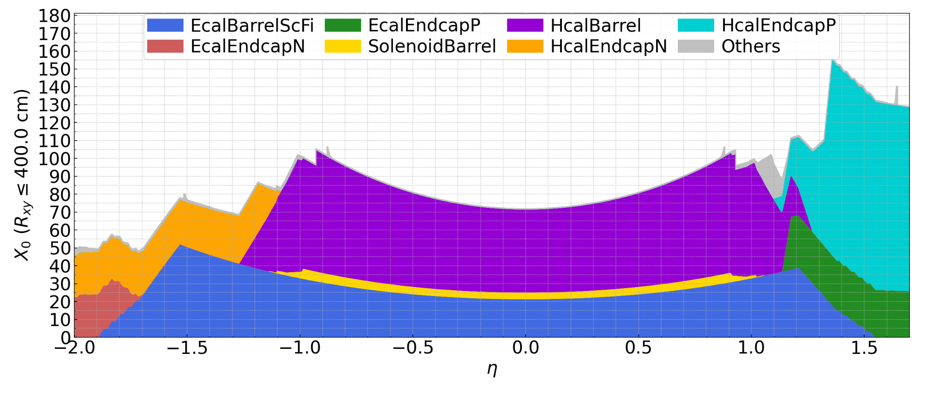
First layer coverage
BIC is responsible for calorimetry between -1.7 < η < 1.3
First layer covers a larger range ~ -1.8 < η < 1.5
ePIC Simulation (BryceCanyon)
45(!) X0
BIC

Slide 9
Current Status of DD4hep Implementation
Primary focus so far: accurate material description
Implemented geometry:
Turbofan layers implemented for all 4 tracking layers, 6-7 staves, populated with ~200 AstroPix chips (integer), 500um xy segmentation
AstroPix chips layered: 500um Si sensitive with ~500um Si/Cu/kapton
Carbon-fiber trays implemented as effective model (square tubular)
Missing geometry (with focus on importance for first layer):
5mm Al support in front of first tracking layer (in progress)
Modify and merge full to hollow inner detector rail design (in progress)

Slide 10
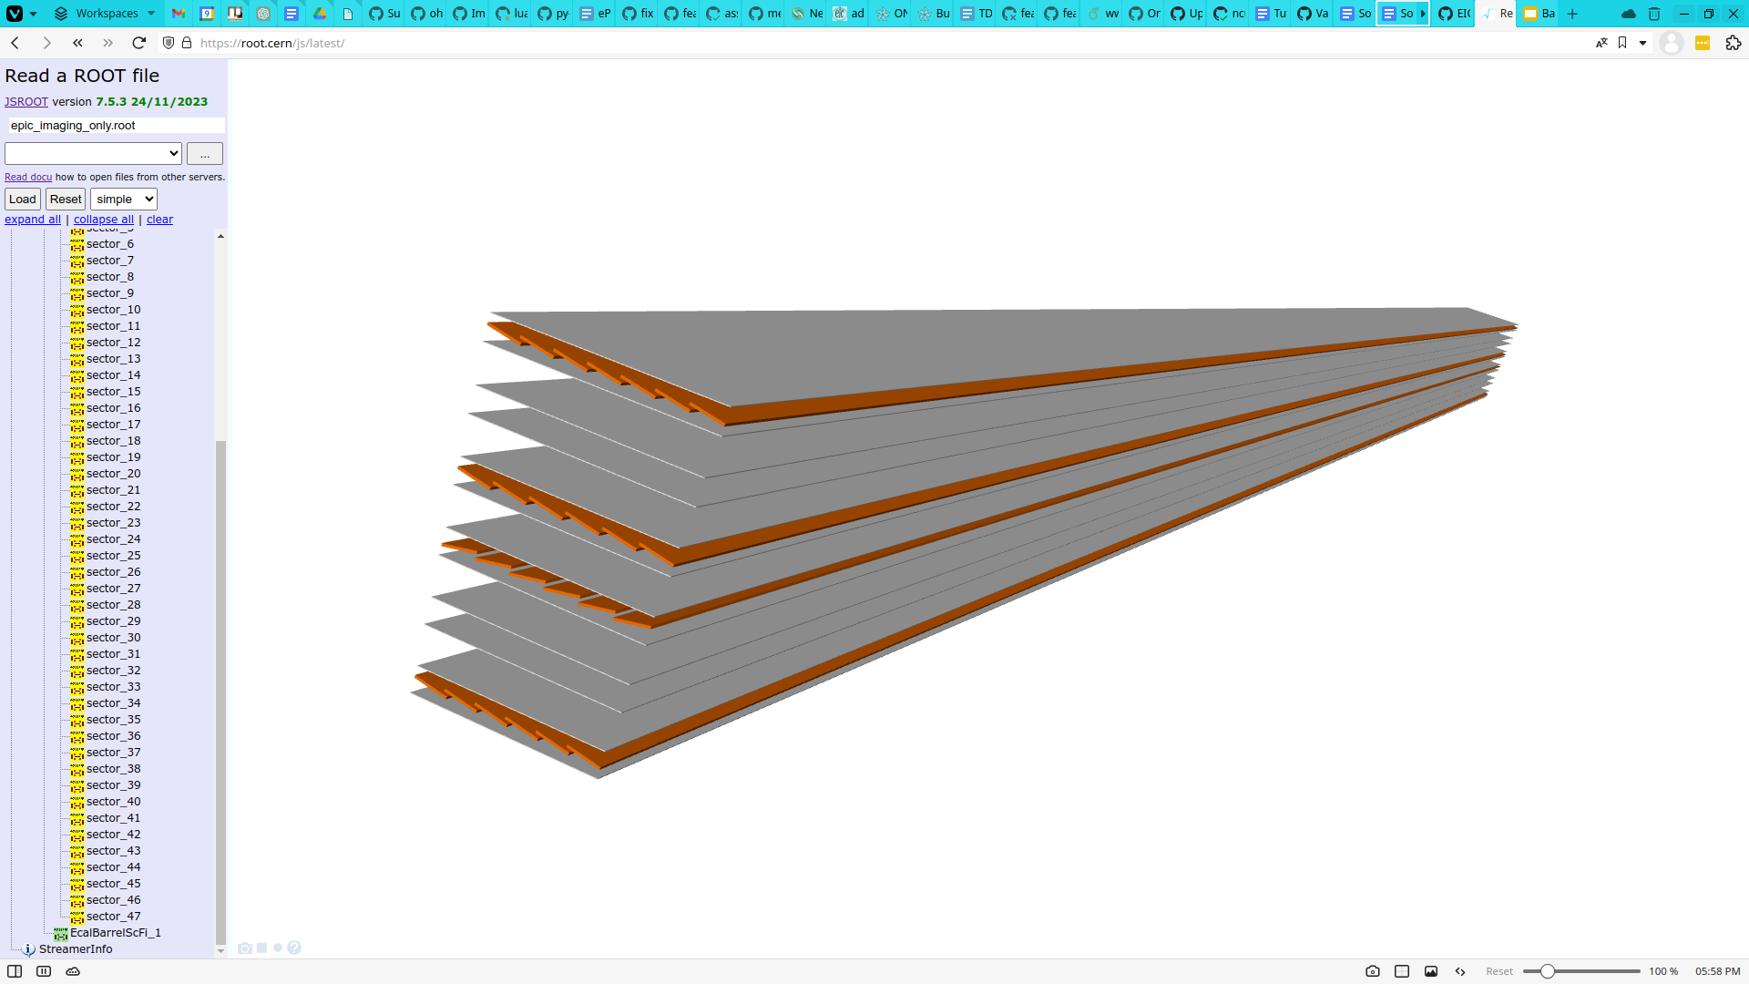
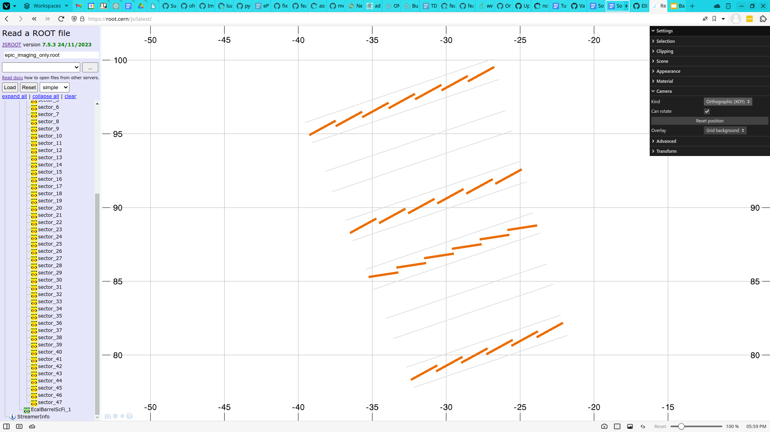
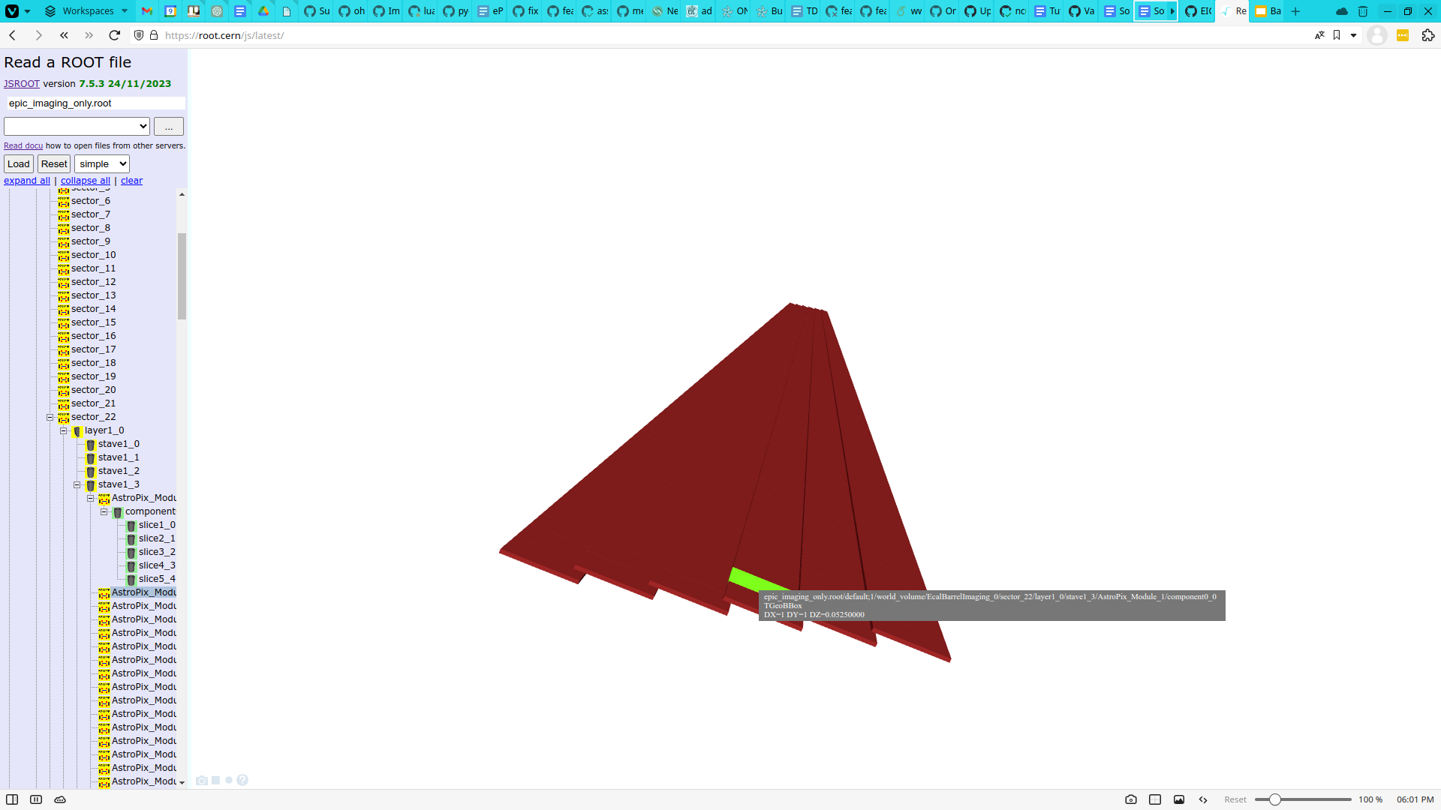
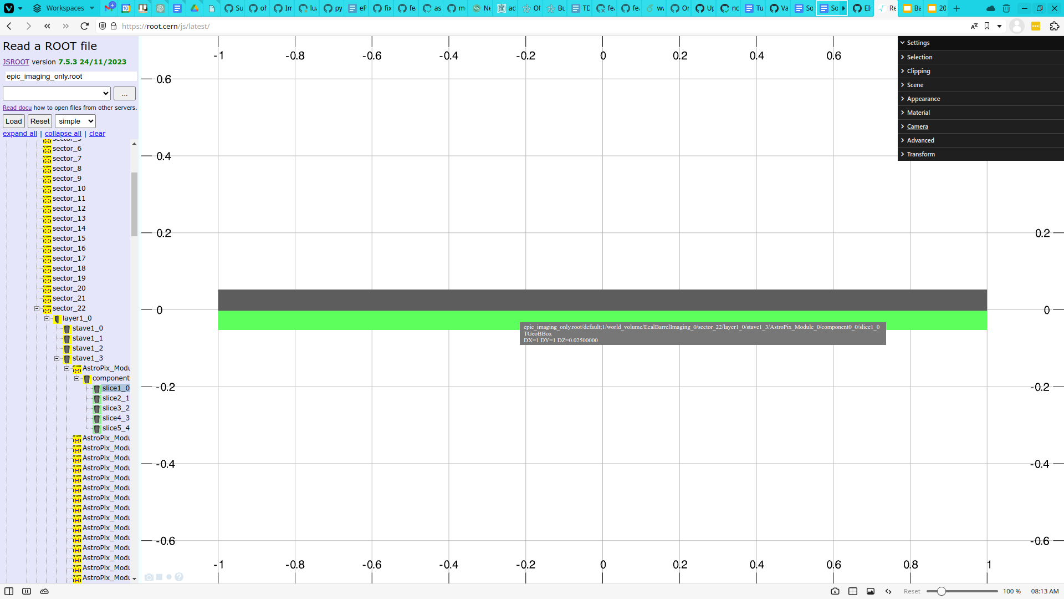

Slide 11
Current Status of Acts Integration
DD4hep geometry to Acts conversion support (todo):
Barrel envelope layers: needs ~2mm clearance at 80cm, 360°/48 to inscribe cylinder inside support tube without intersecting with chips, e.g. <barrel_envelope inner_r="SiBarrelLayer2_rmin-1.0*mm" outer_r="SiBarrelLayer2_rmax" z_length="SiBarrelLayer2_length" /> <layer_material surface="inner" binning="binPhi,binZ" bins0="128" bins1="100"/>
Needs implementation of DD4hep_ParametersPlugin layer patterns
Inclusion of 5mm Al support layer and inner detector support rails into tracking material map due to non-negligible radiation length impact

Slide 12
Argonne National Laboratory
NASA Goddard Space Flight Center
Oklahome State University
University of Connecticut
University of California Santa Cruz
USA
University of Manitoba
University of Regina
Mount Allison University
NSERC
Canada Fund for Innovation
Canada
Kyungpook National University
Yonsei University
University
of Seoul
Pusan National University
Korea University
Sungkyunkwan University
Hanyang University
Gangneung- Wonju National University
Korea
Karlsruhe Institute of Technology
University of Giessen
ePIC BIC Detector Subsystem Collaboration
Germany

