Slide 1



MOSAIX and LAS
9th January 2024
Notes:
The abstract pattern can be removed or repositioned if required. Be careful to ‘Send to Back’ so that it does not obscure any important information.

Slide 2


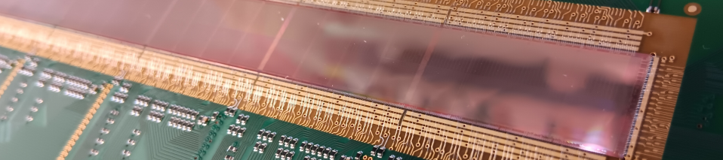
Introduction
MOSAIX
  Brief recap
  ITS3 to ePIC
Towards an EIC-LAS
  Data Multiplexing
  Slow Control
  Powering
  Support Chip
  Power Density
  First thoughts
All numbers in these slides only preliminary

Slide 3


MOSAIX
Notes:
The abstract pattern can be removed or repositioned if required. Be careful to ‘Send to Back’ so that it does not obscure any important information.

Slide 4
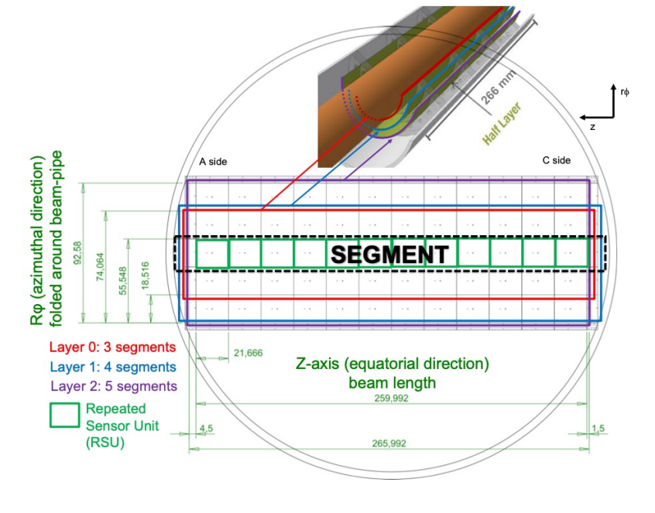
Background - MOSAIX
ITS3 Chip development
  CERN currently developing a new chip for the ITS3 upgrade of ALICE – MOSAIX
  Will be “wafer scale” – full length, one reticle wide
  Idea is to thin and bend them around the beampipe. Dicing to different width will give the three required layers.
Most recent data from the ITS3 plenary: https://indico.cern.ch/event/1341665/

Slide 5
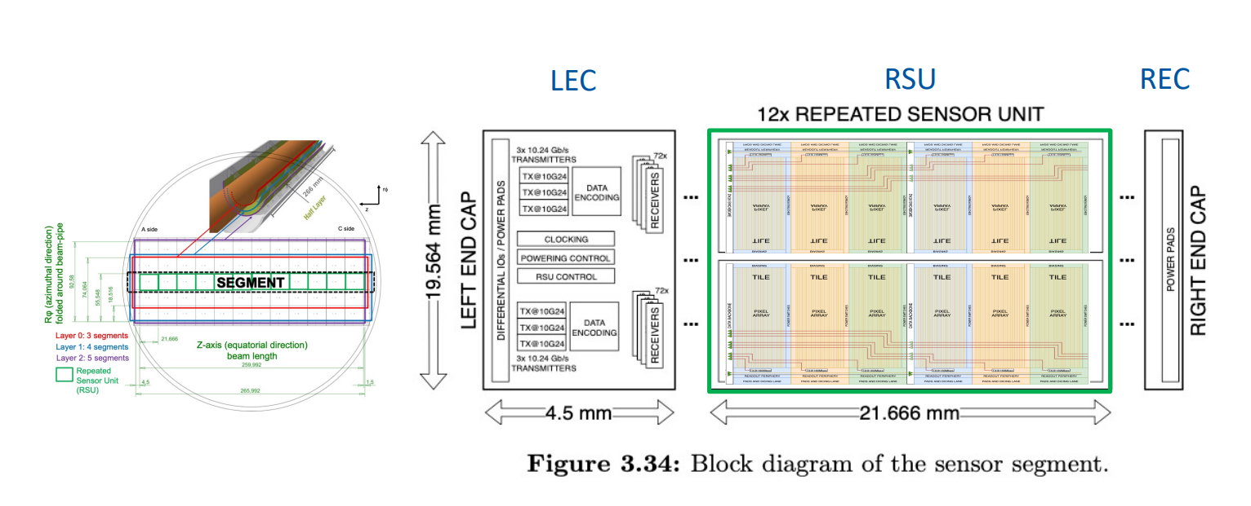
Background - MOSAIX

Slide 6
ITS3 to ePIC
8
8
8
8
Inner Barrel
Use MOSAIX directly
Requires supply agreement with CERN (in negotiation)
Planning difficult since design in flux – need to account for this
Inner Barrel (IB)
3 curved layers
Outer Barrel (OB)
2 stave-based layers
Outer Barrel/Discs
Improve Yield – reduce number of RSUs
Need to reduce mass at system level
Requires agreement for database access with CERN (in negotiation)
  Develop an EIC-LAS plus support chip for staves and discs
  Keep up to date with MOSAIC developments (TDR next major release)
Electron/Hadron Endcaps (EE, HE)
5 disks on either side of the IP

Slide 7
Towards an EIC-LAS
Notes:
The abstract pattern can be removed or repositioned if required. Be careful to ‘Send to Back’ so that it does not obscure any important information.

Slide 8
MOSAIX to EIC-LAS
Inner Barrel
12 RSUs
8 data links
7 slow control links
Direct powering
Outer Barrel
Reduced number of RSUs
Single data link
Multiplex slow control
Serial powering
Yield likely too low
Must be done on 65nm MOSAIX database
Excess material for required data rate
Excess material when built into stave
Could be on support chip
Excess material when built into stave

Slide 9
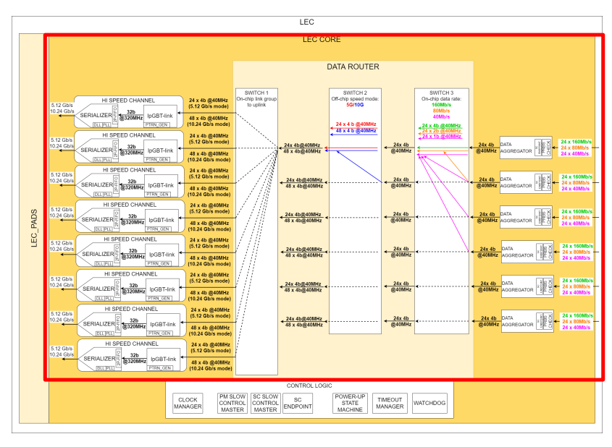
MOSAIX to EIC-LAS: Data
Data Multiplexing
  ePIC data requirements less than ITS3
  Potential for mass reduction by reducing data channels
  MOSAIX considering the risk of VTRX (or channel) failures
  Idea is to include redundant channels
  Further edits to this could meet ePIC requirements

Slide 10
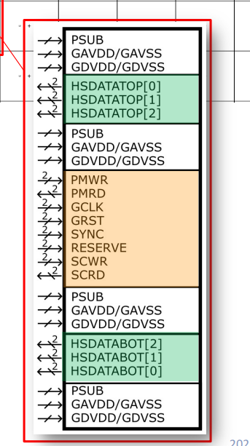
MOSAIX to EIC-LAS: Slow Control
Slow Control
  MOSAIX has 5 down links, 2 up links (and 1 spare down link)
  Undesirable in an application with multi-chip staves and low mass requirements
  Multiplexing needed:
    In 65nm?
    In 180nm? Separate support chip
  Simple multiplexer? I2C control? TBD

Slide 11
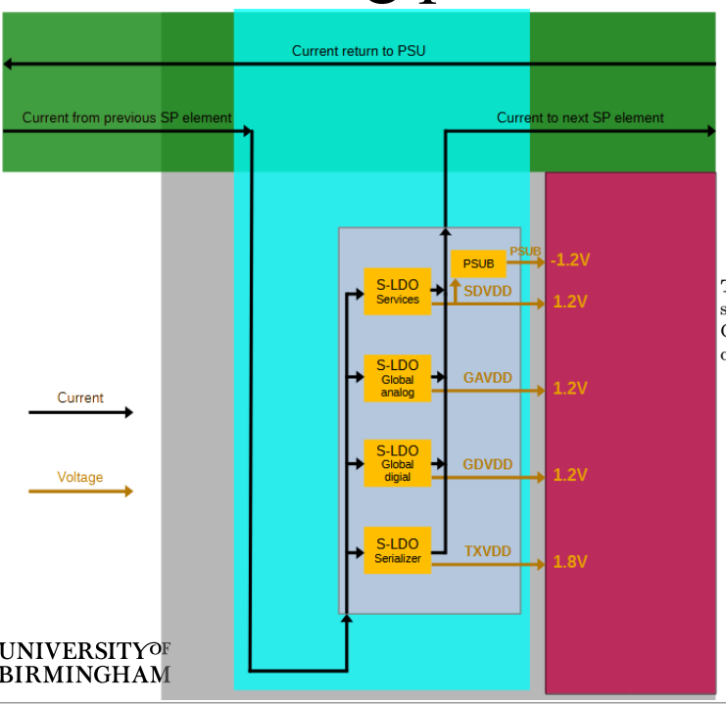
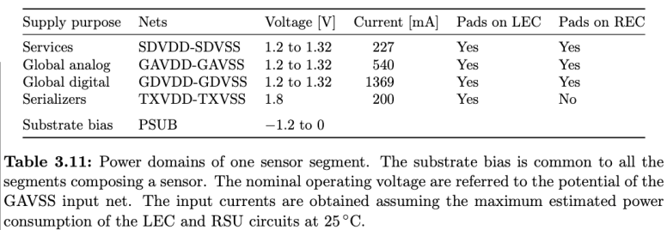
MOSAIX to EIC-LAS: Power
https://indico.bnl.gov/event/21518/contributions/84437/attachments/51554/88190/23-12-12_SerialPoweringScheme_JGlover_r1.pdf
Serial Powering
  Most recent MOSAIX power numbers from here -https://indico.cern.ch/event/1339888/contribution s/5680443/attachments/2755393/4797584/2023 1120-ER2-Stitched-Sensor.pdf
  MOSAIX will be powered directly. To reduce mass, we propose serial powering for EIC-LAS.
227mA
Note: Numbers for 12RSUs. PVT variations not considered.
540mA
1369mA
200mA

Slide 12
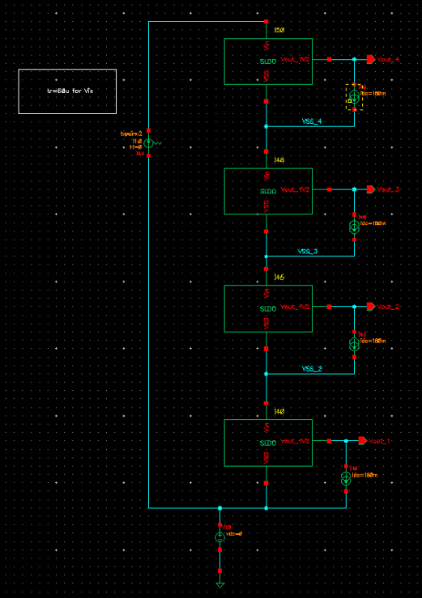
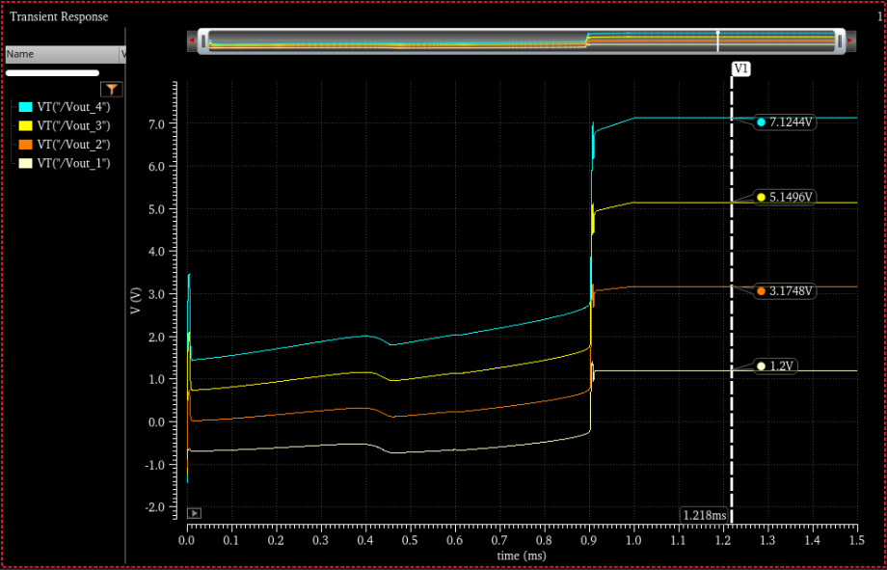
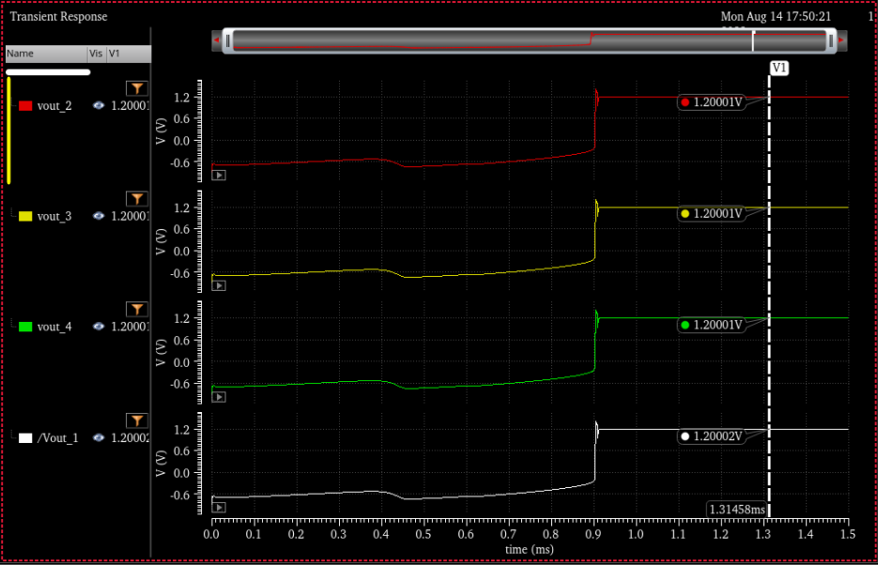
MOSAIX to EIC-LAS: Power
Serial Powering
  First simulations

Slide 13
MOSAIX to EIC-LAS: Power
Serial Powering
  First ITS3 plans envisaged fully separate domains to every tile
  First SLDO design was intended to supply these - ~90mA (180mA for safety)
  New plan has single chip supply with switches
  Also now 4 currents with a total value up to around 2.5A (12 RSUs)
Specifications
Vin | 2V
Iin | 200mA
Iload | 180mA
Cout | Simulated for 10pF (This needs to changed depends on the sensor module effective capacitance.
Out of date
65nm to 180nm
  Original plan was to work in 65nm and add to ITS3 die
  Not clear there will be space
  Limited prototyping runs
  So…from single channel 65nm 200mA SLDO to 4 channel 180nm 2.5A SLDO…

Slide 14
MOSAIX to EIC-LAS: Complete System
Changes to MOSAIX
  Reduce number of RSUs (probably 5 or 6)
  Edit data multiplexer to reduce to one channel
Support Chip (only for outer barrel/discs)
  4x SLDO
  PSUB Generation
  Slow control multiplexing
SLDO - Services
SLDO - GDIG
Iin
Iout
Single data link
SLDO - GANA
SLDO - Serial
Slow Control MUX
8
PSUB (-ve)

Slide 15
MOSAIX to EIC-LAS
Summary
  What work is needed?
  What is the status?
Requirement for ePIC | Work currently under way | Work planned | Institutes involved
Contribute to ITS3 | LLDFM logic cells |  | RAL, LBNL
Reduced number of RSUs | N/A – requires database
Multiplexing to single data link | N/A – requires database
Multiplexed slow control | Early discussions | Include in 180nm chip? | BNL
Serial powering | 65nm first schematic complete | Port to 180nm, increase current capacity | RAL/Oxford
Negative bias generation |  |  | BNL

Slide 16
Power Density
Notes:
The abstract pattern can be removed or repositioned if required. Be careful to ‘Send to Back’ so that it does not obscure any important information.

Slide 17
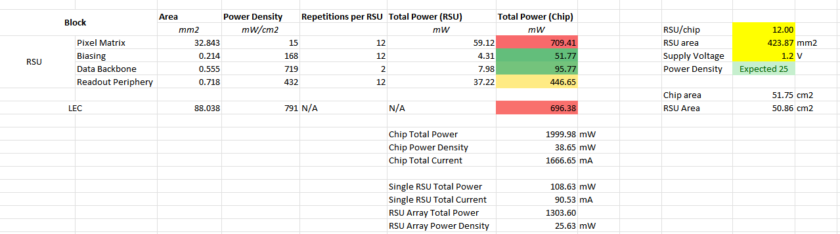
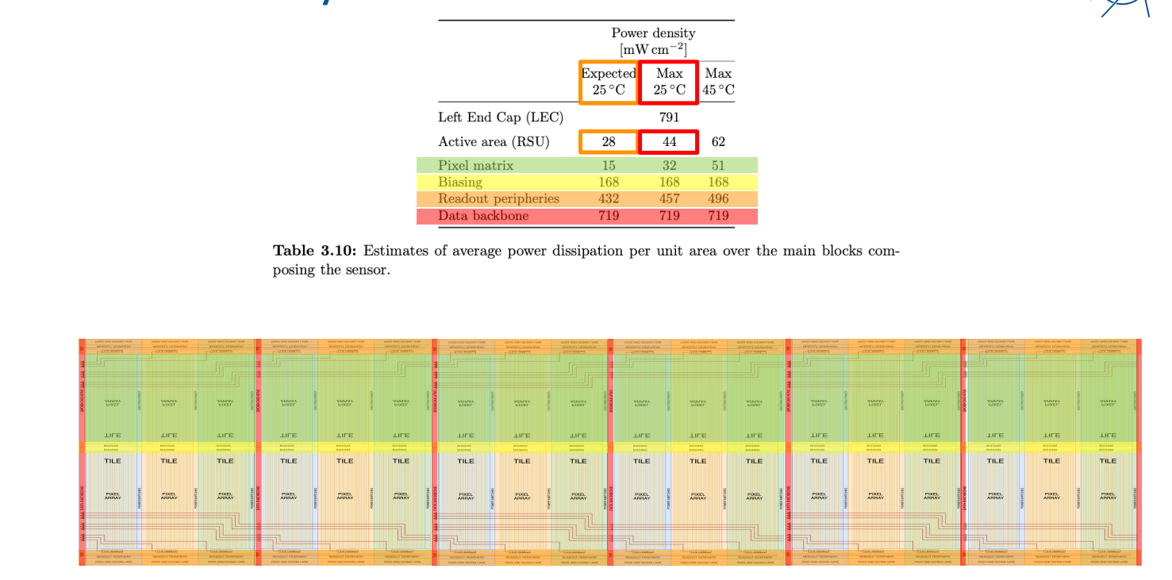
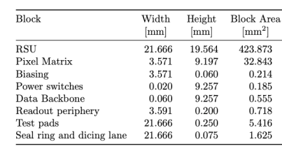
Power Density: MOSAIX
Recent MOSAIX Numbers
  Calculate consumption based on ITS3 estimates
  Spreadsheet to determine current based on RSUs

Slide 18
Power Density: Estimate for LAS Options

Slide 19
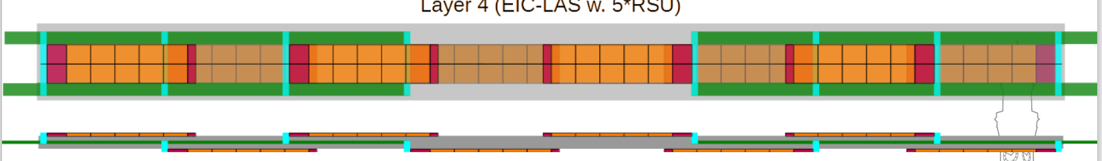
Power Density: Staves
696mW
543mW
696mW
889mW
~500mW
Expected 25
Support Chip (very preliminary)
Max 25

Slide 20

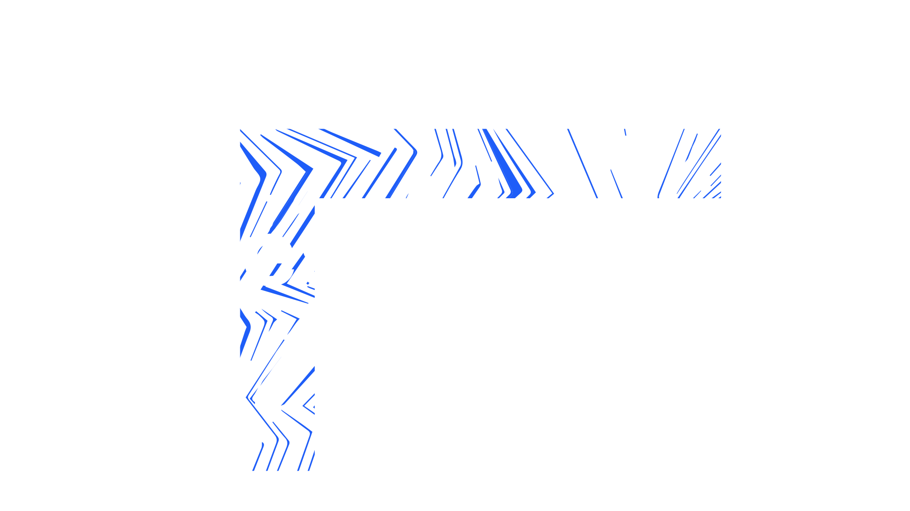
Notes:
The abstract pattern can be removed or repositioned if required. Be careful to ‘Send to Back’ so that it does not obscure any important information.

Slide 21

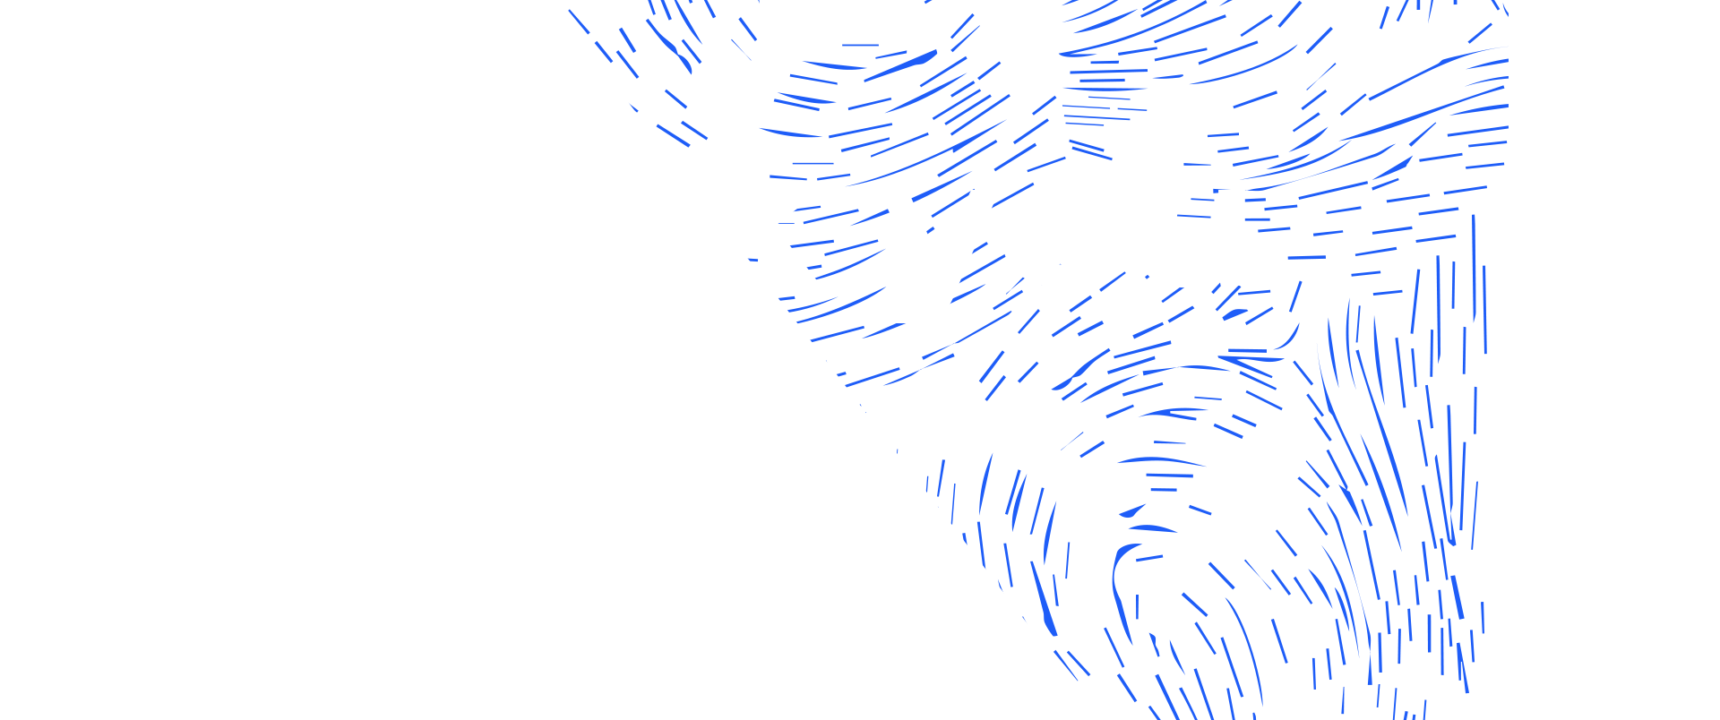



Science and Technology Facilities Council
@STFC_matters
Science and Technology Facilities Council
Notes:
The abstract pattern can be removed or repositioned if required. Be careful to ‘Send to Back’ so that it does not obscure any important information.

