Slide 1
SVT Readout Considerations
J. Schambach
On behalf of the SVT Collaboration

Slide 2
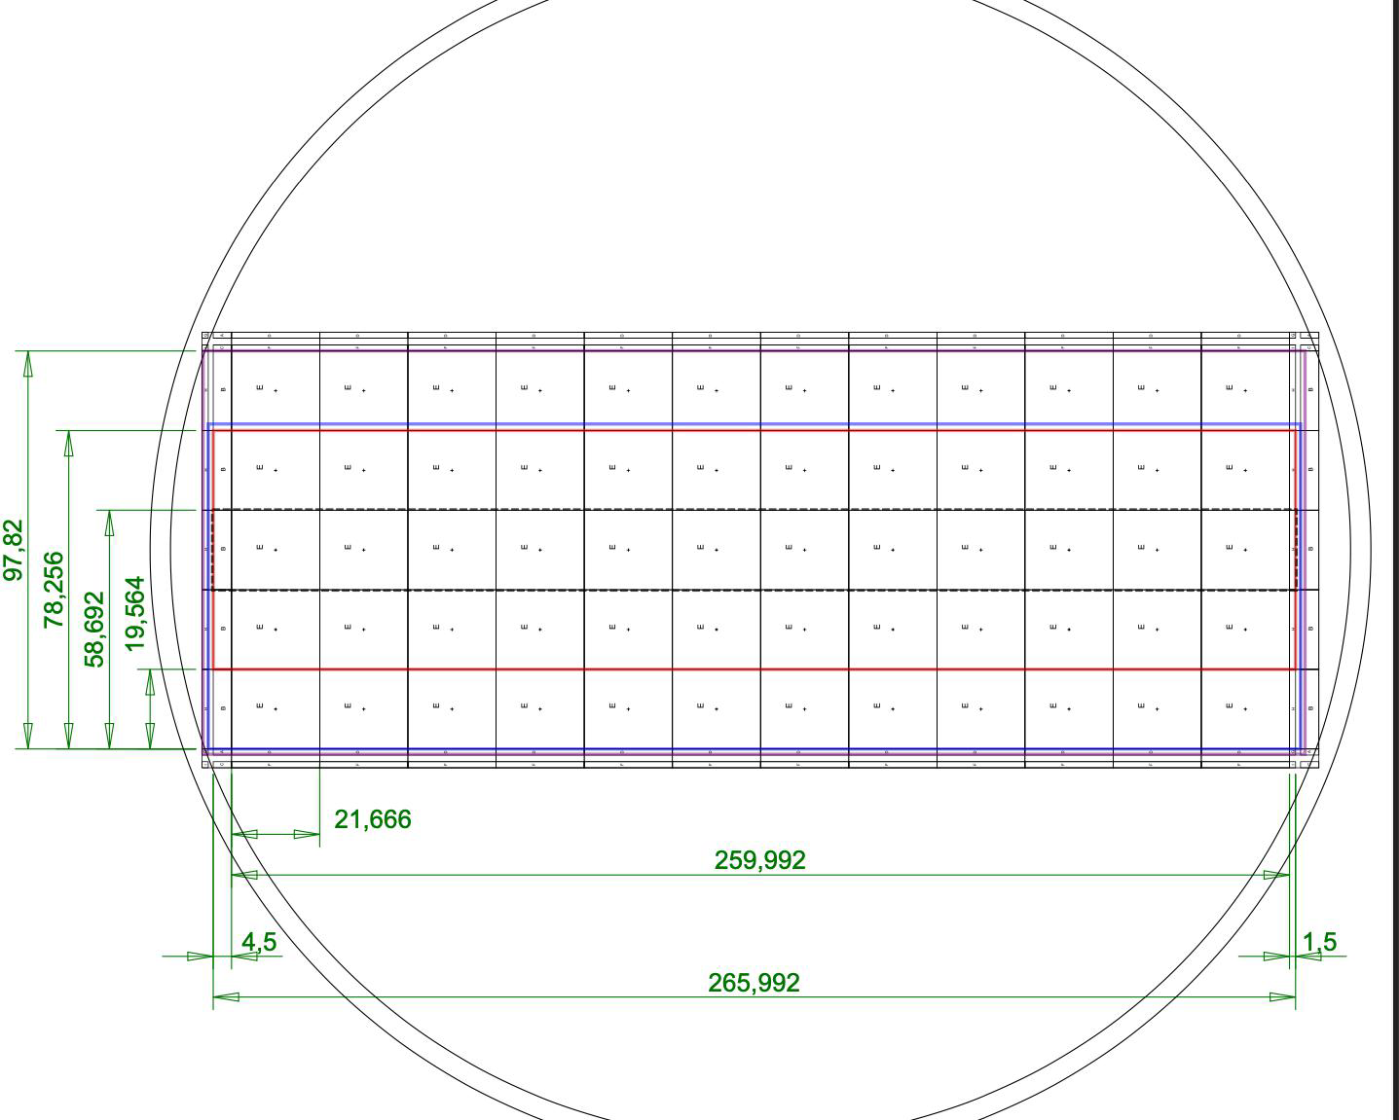
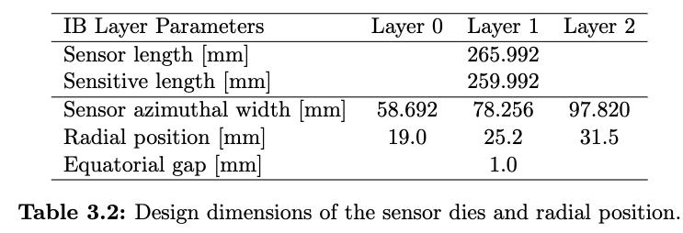
“MOSAIX” Stitched Sensor (ER2)
wafer
Layer 0: 12 x 3 repeated units+endcaps
Layer 1: 12 x 4 repeated units+endcaps
Layer 2: 12 x 5 repeated units+endcaps
Repeated (Stitched) Sensing Unit (RSU)
SEGMENT
ITS-3
Sensitive z-length
Physical z-length

Slide 3
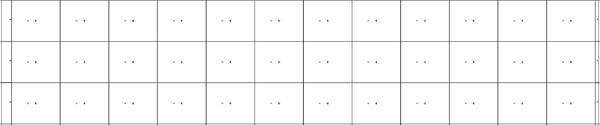
MOSAIX Stitched Sensor Detail
Supplies
I/Os
Supplies
Supplies
I/Os
RSU
SEGMENT
Supplies
Supplies
I/Os
Supplies
12 x Repeated Sensor Unit

Slide 4
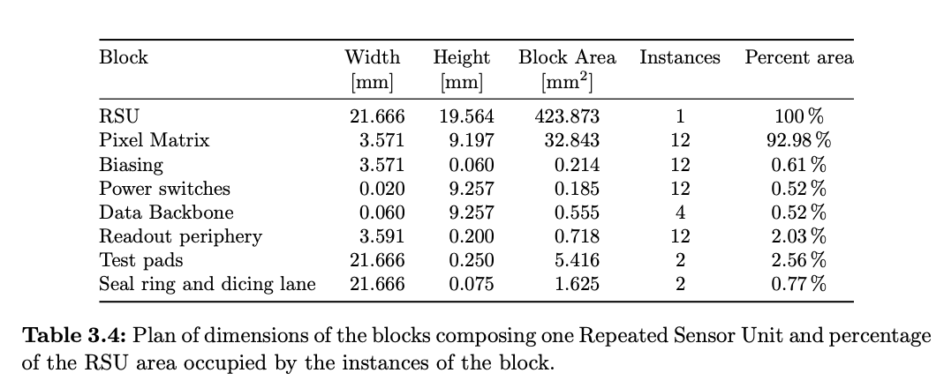
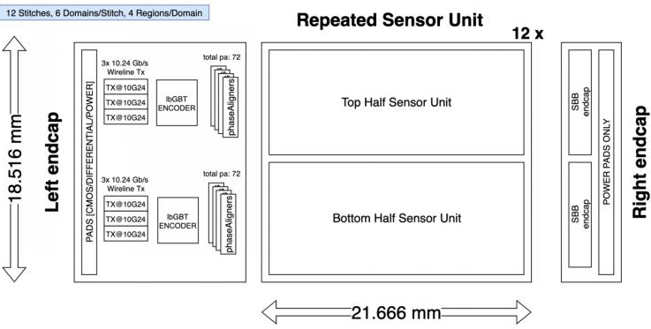
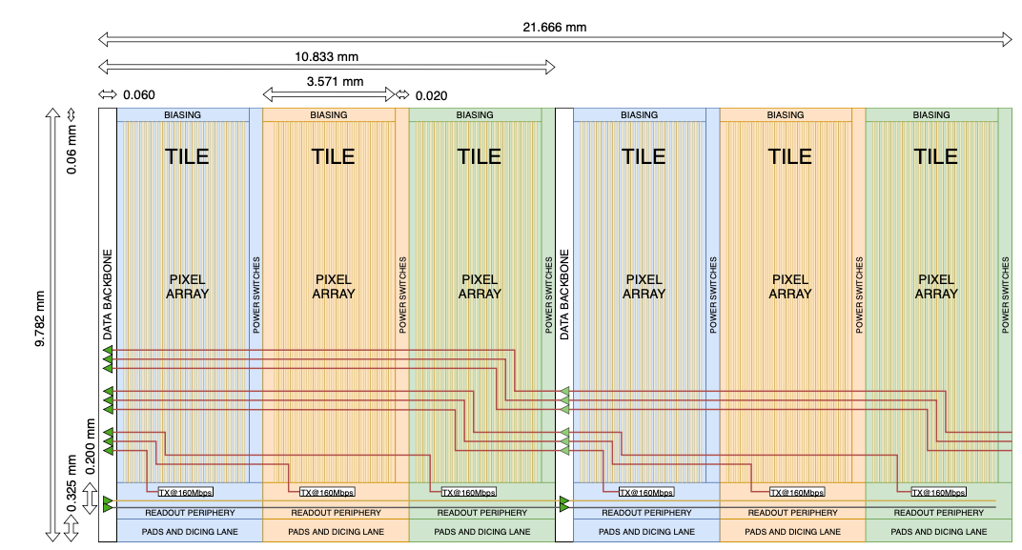
Half Repeated Sensor Unit
19.564 mm
Each Half Unit is segmented in Tiles (Domains)
Each tile acts as an
independent sensor
Separate Local Power
Configuration
Readout Link (160 Mb/s)
Each Tile data output has
direct connection to the left endcap

Slide 5
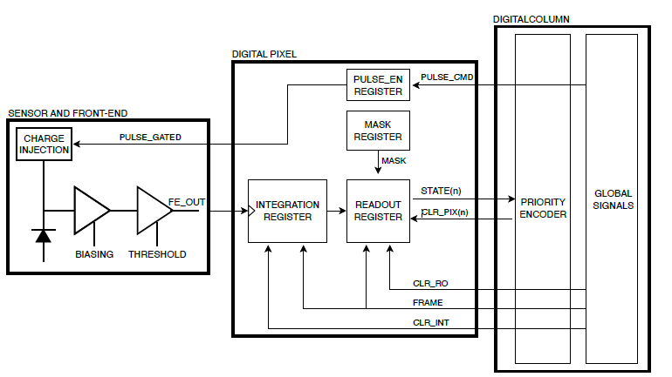
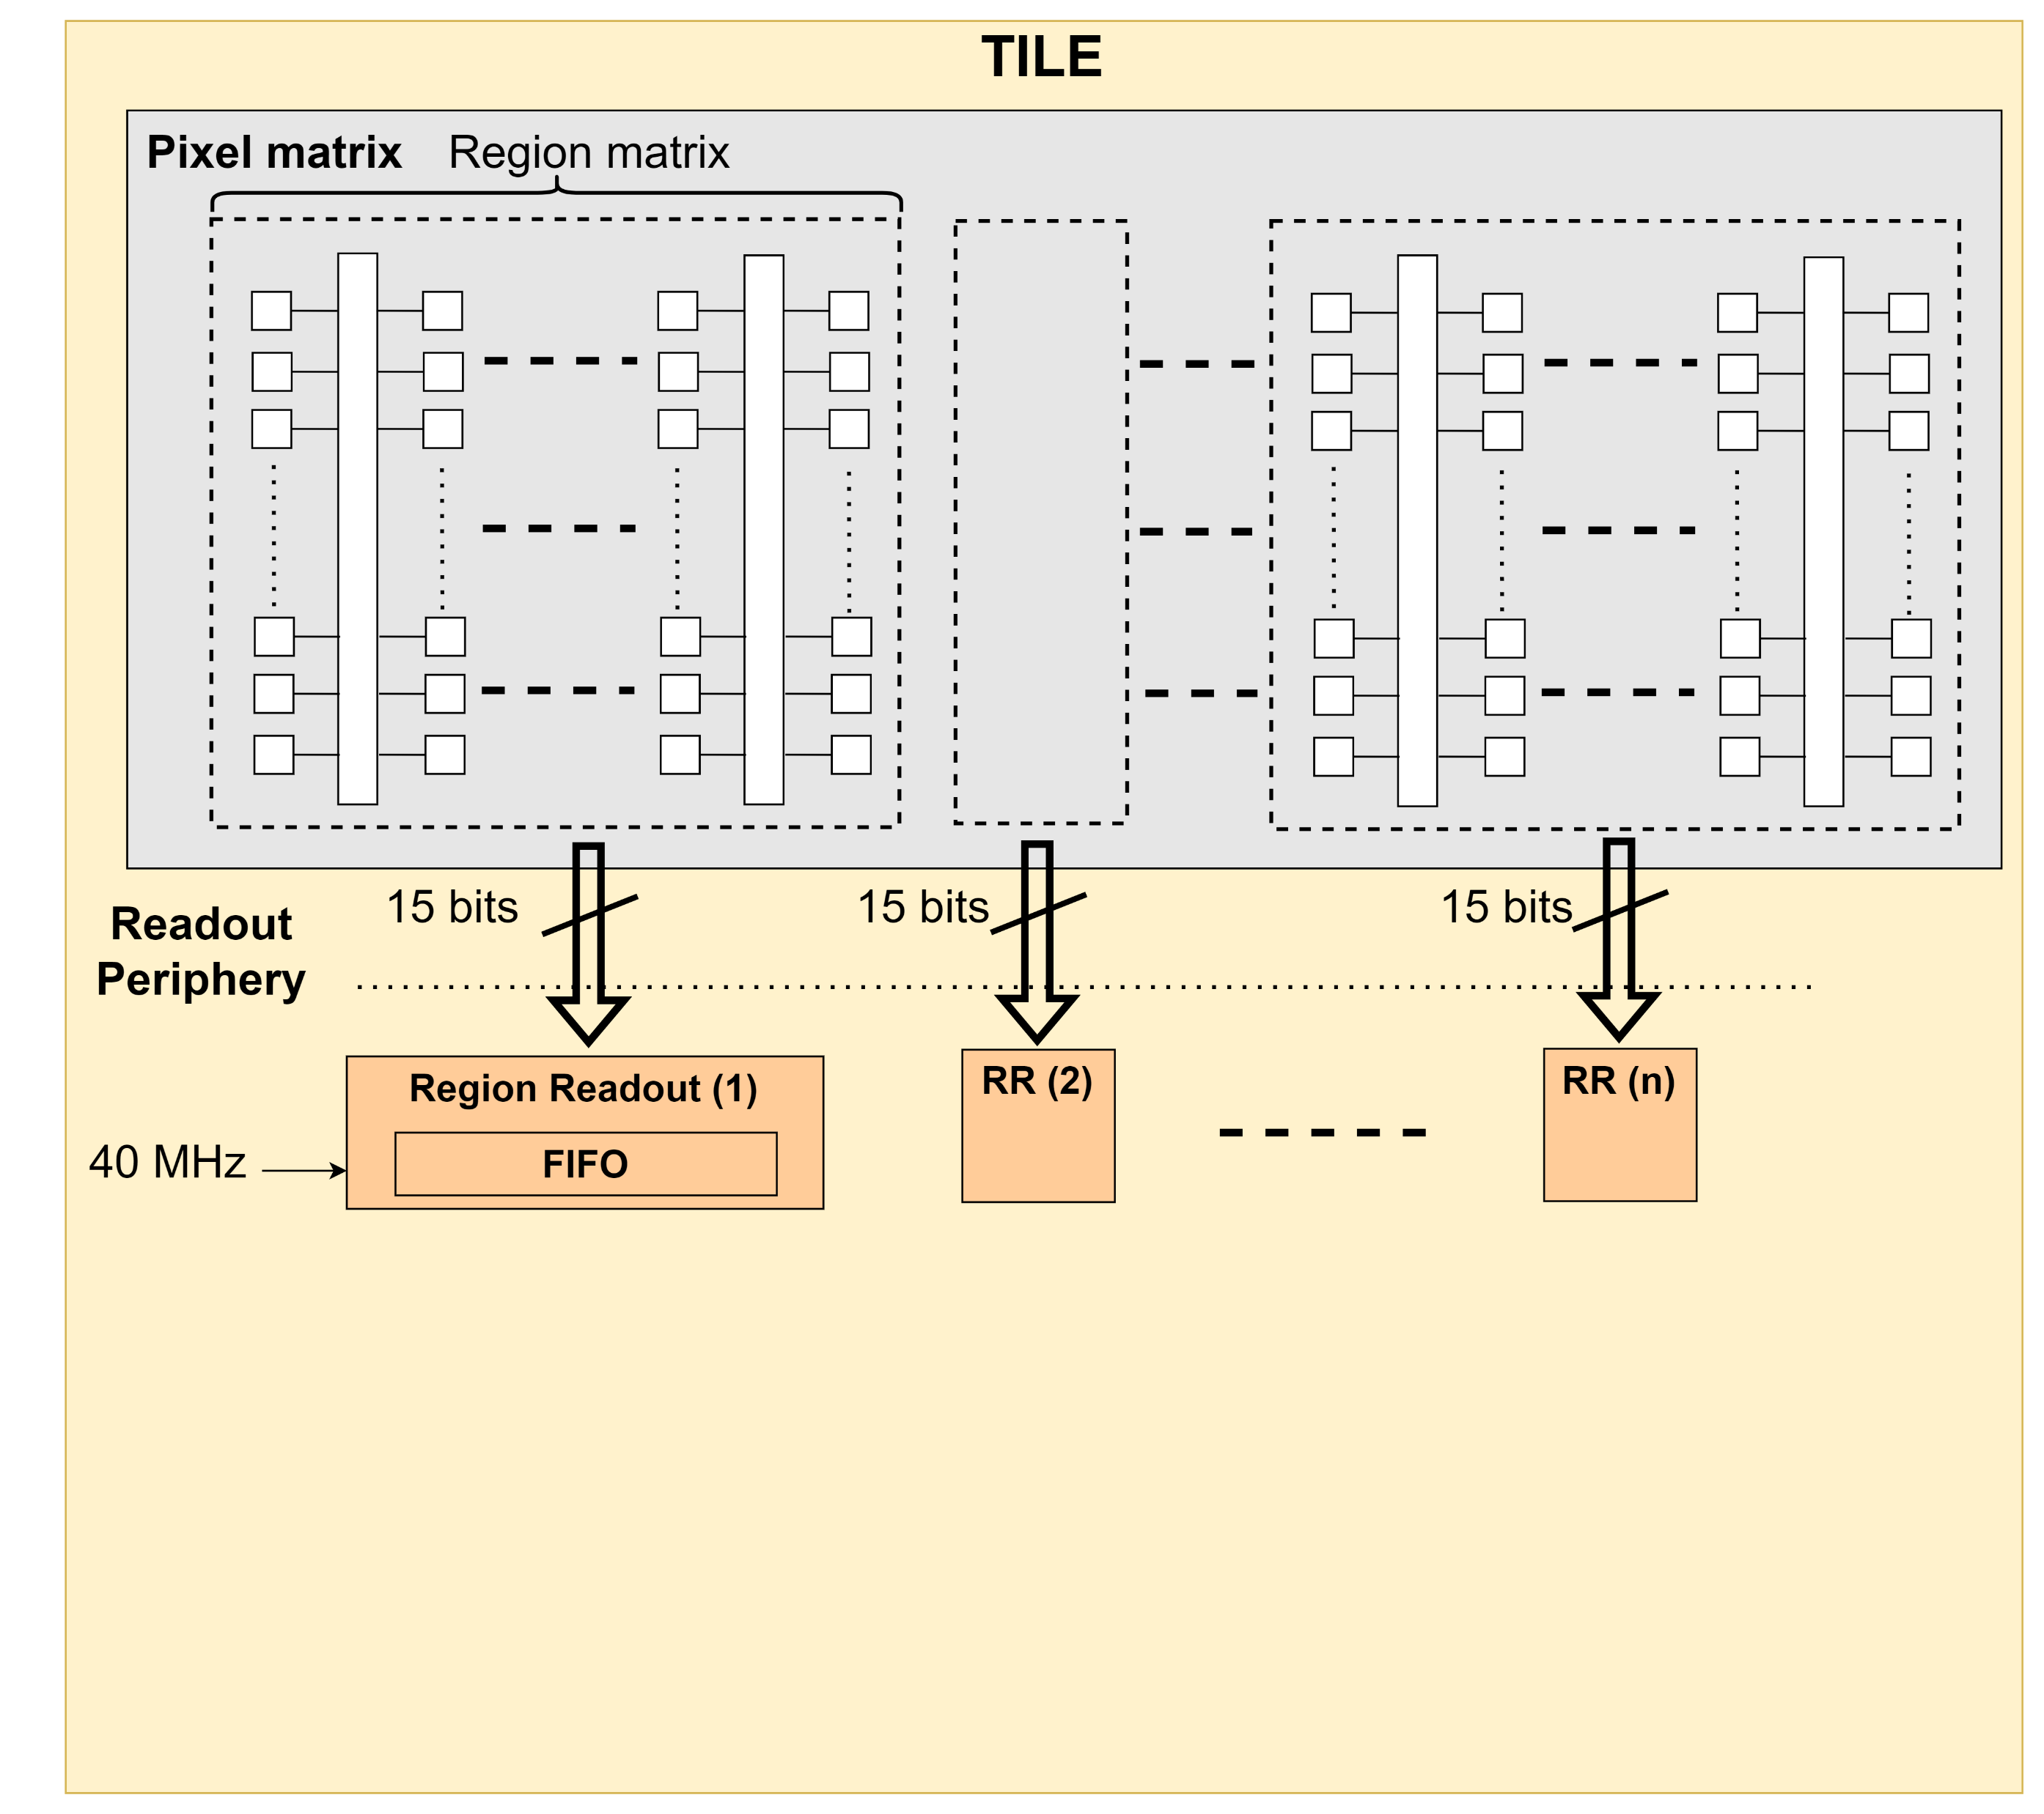
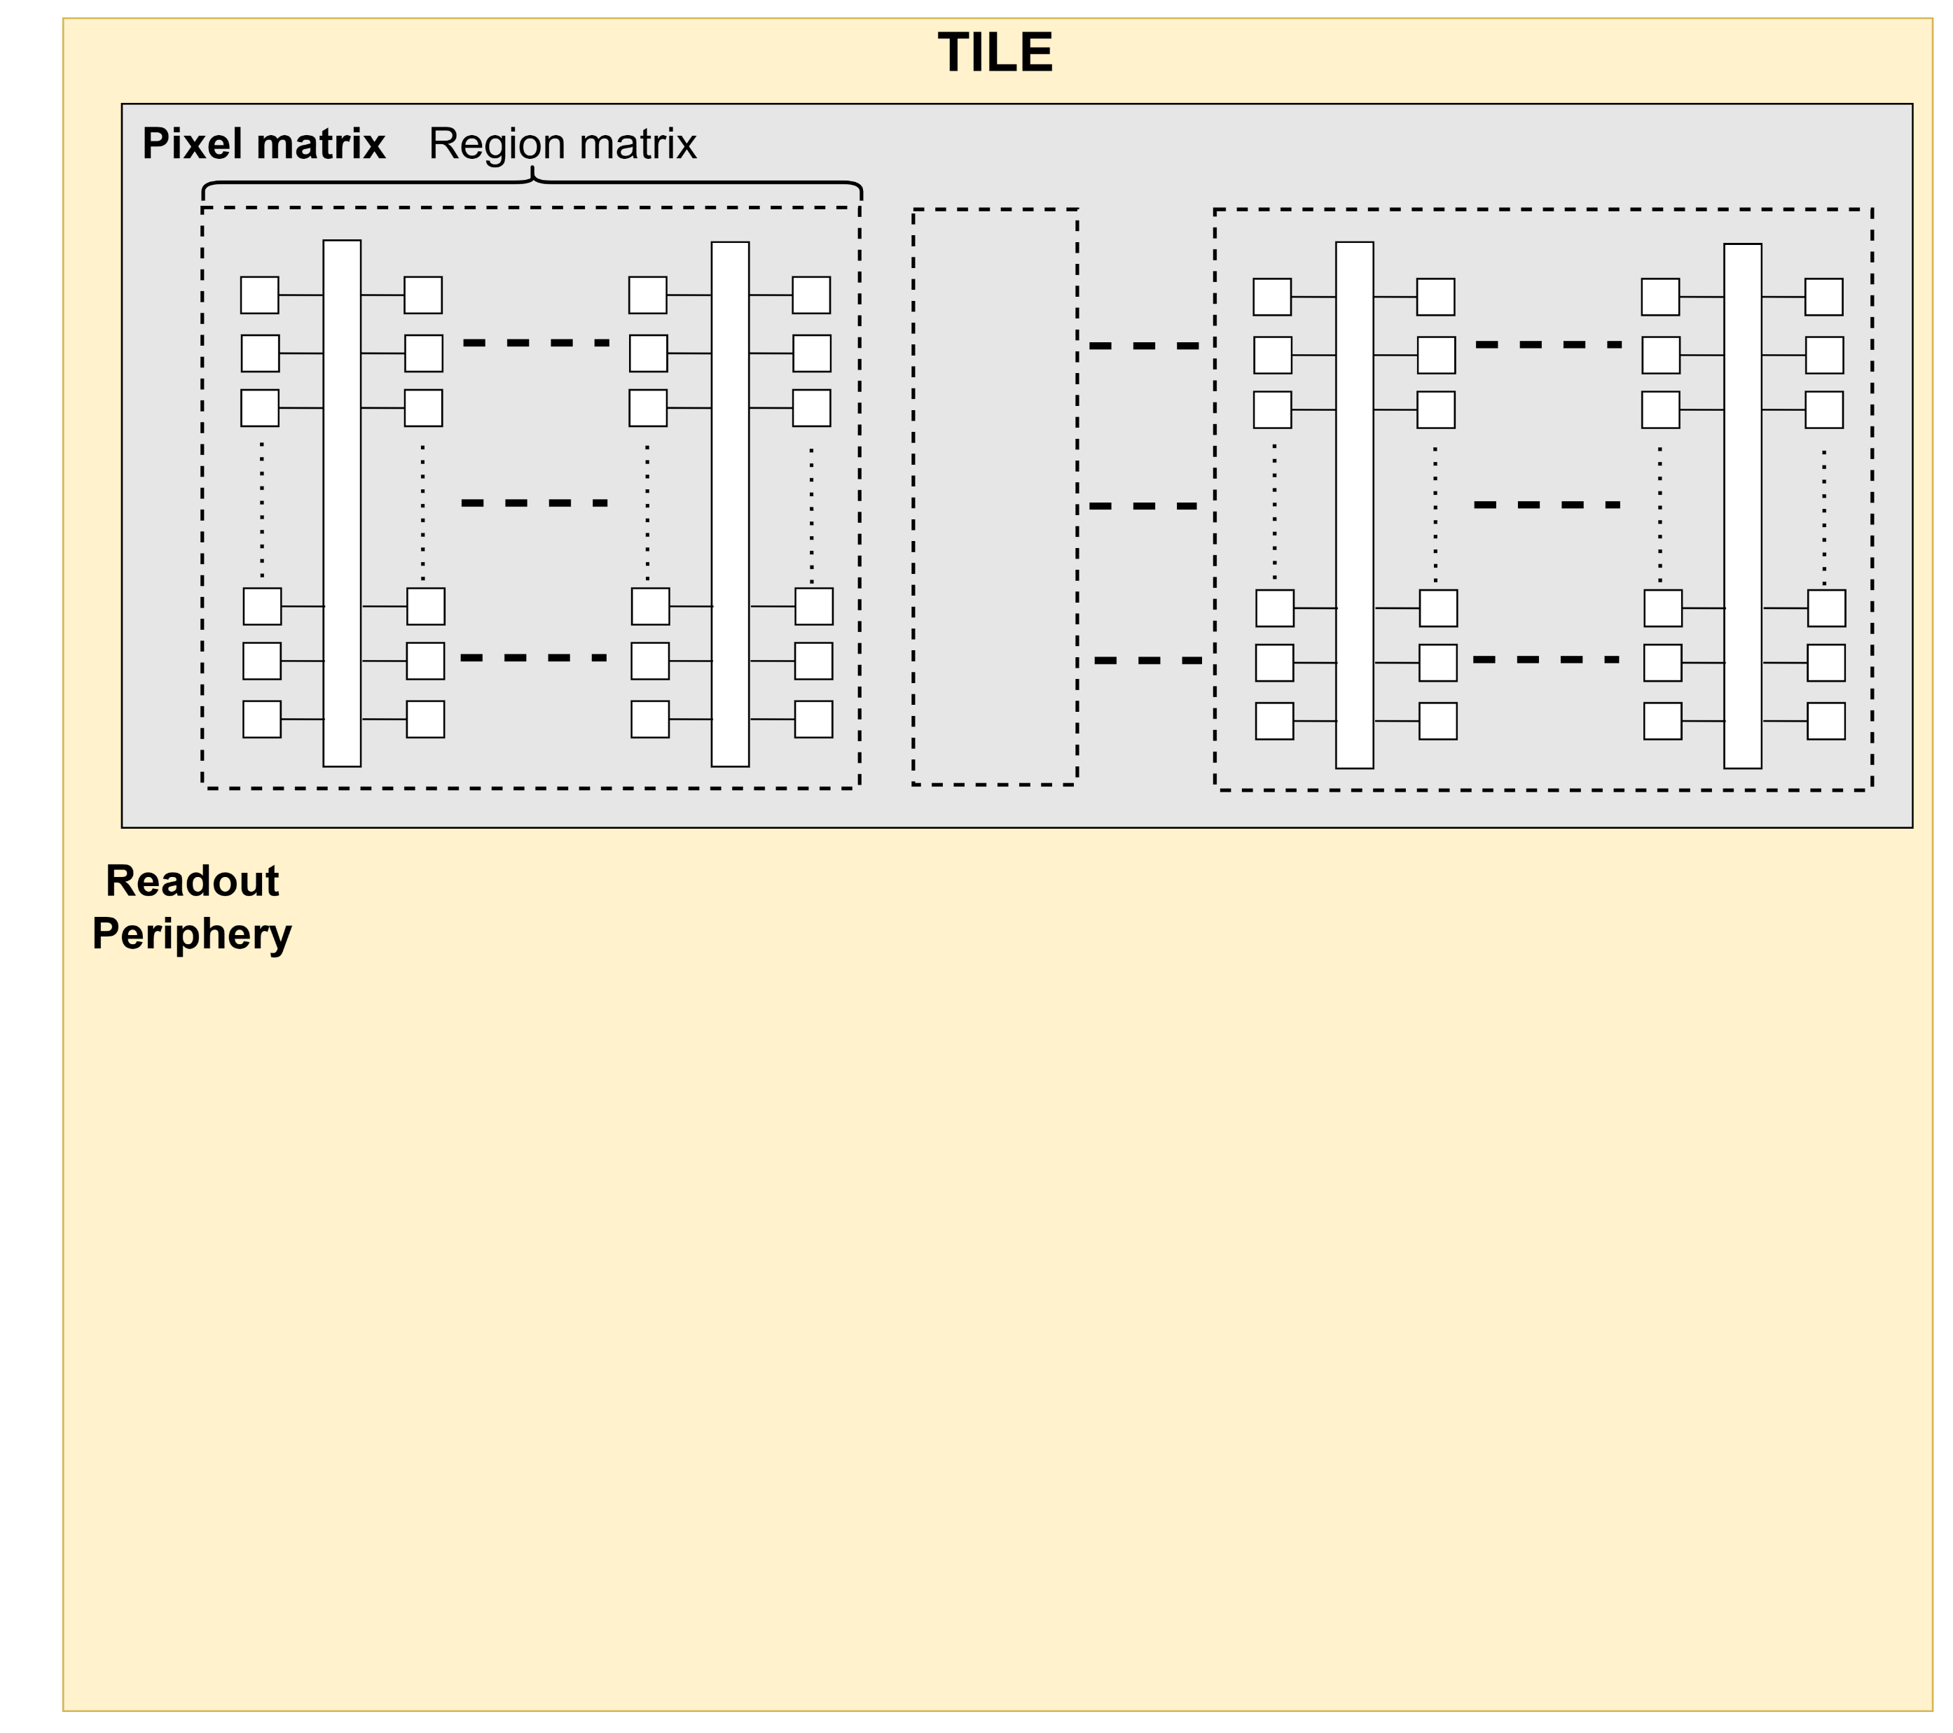
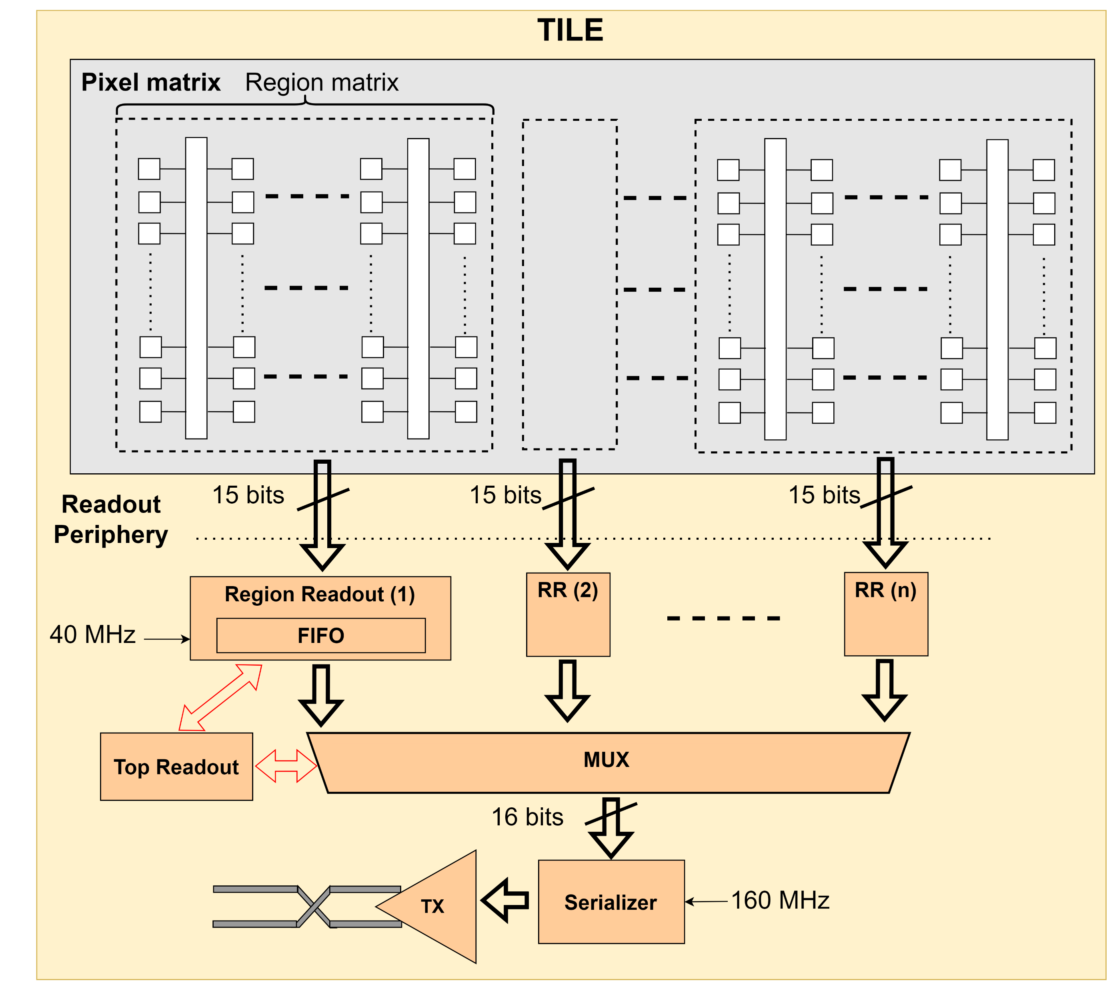
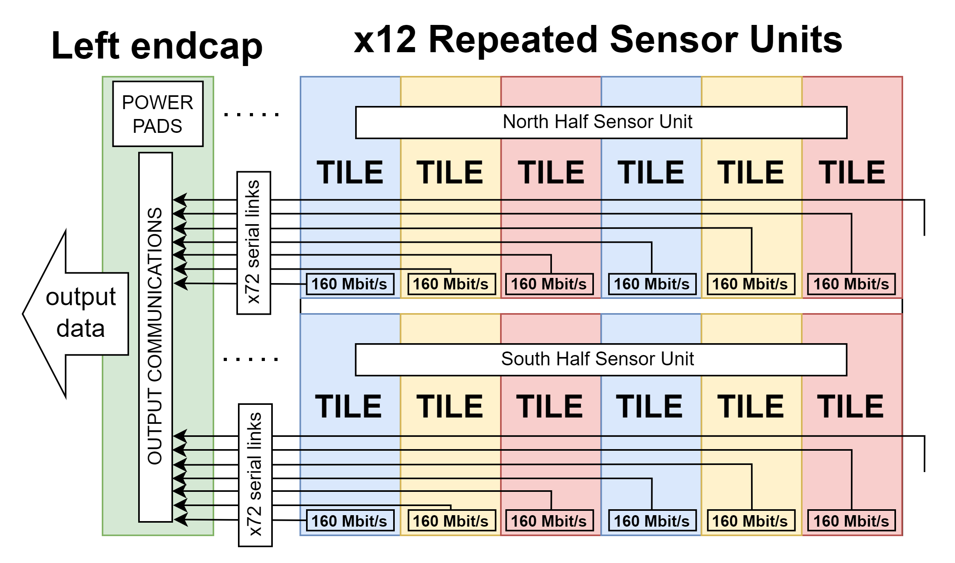
On-chip Readout Scheme
442 x 156 pixels per tile

Slide 6
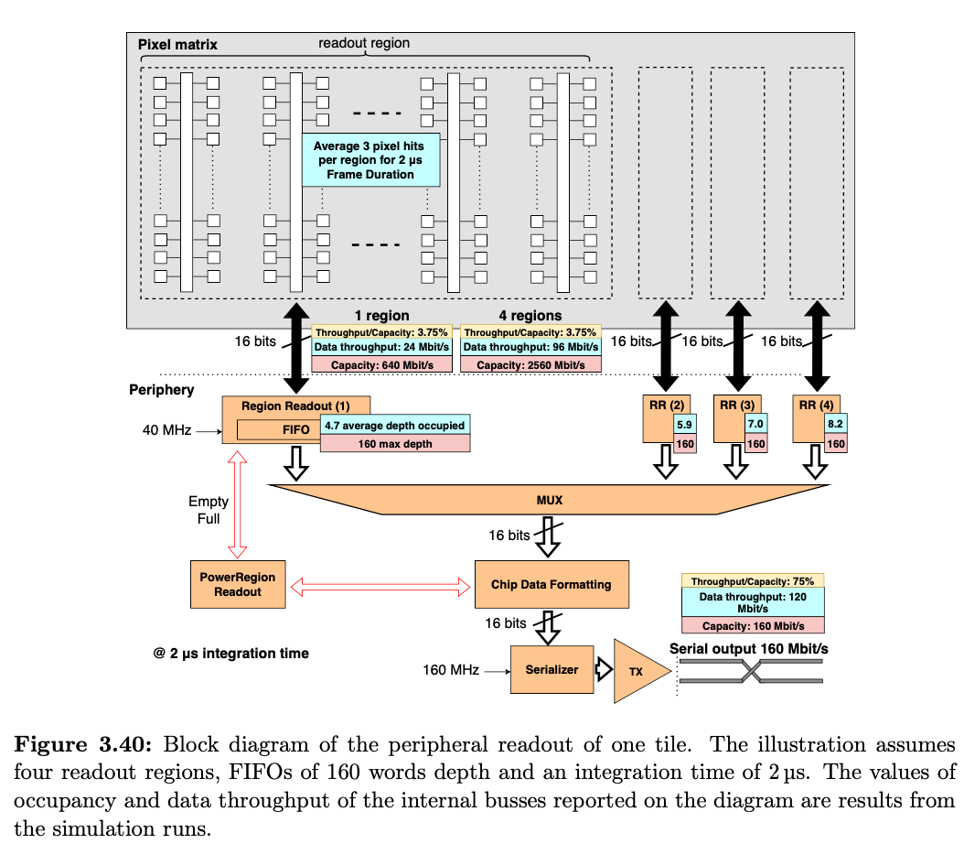
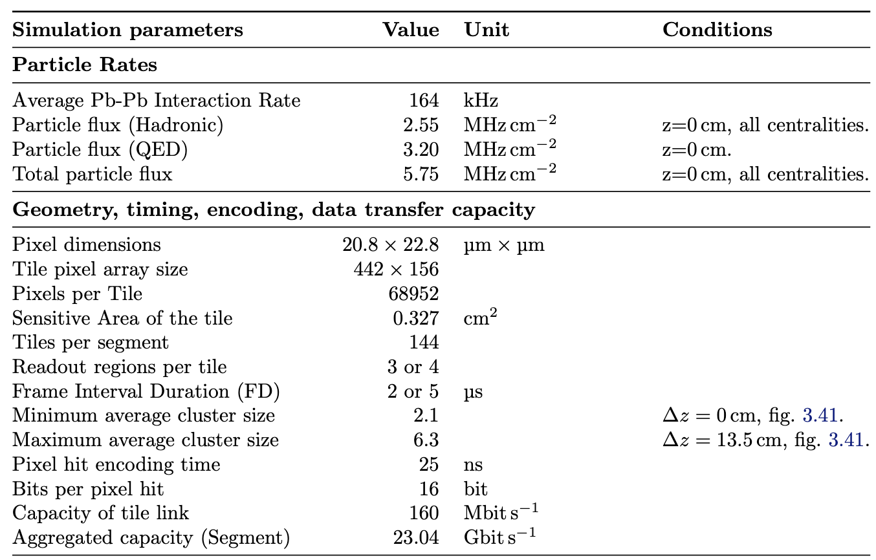
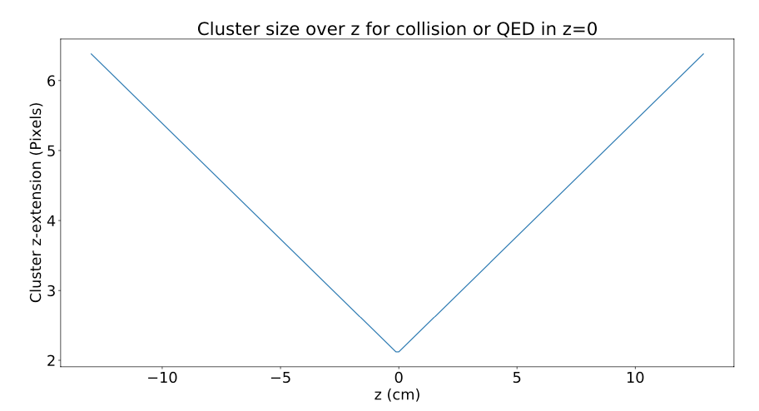
Readout Model

Slide 7
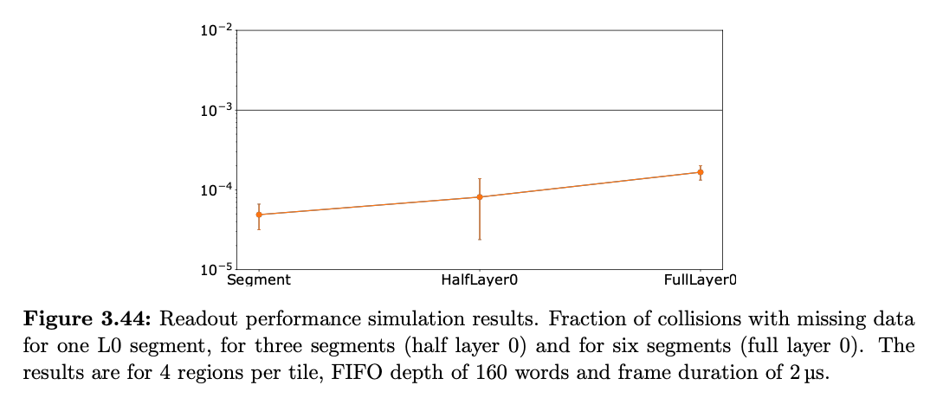
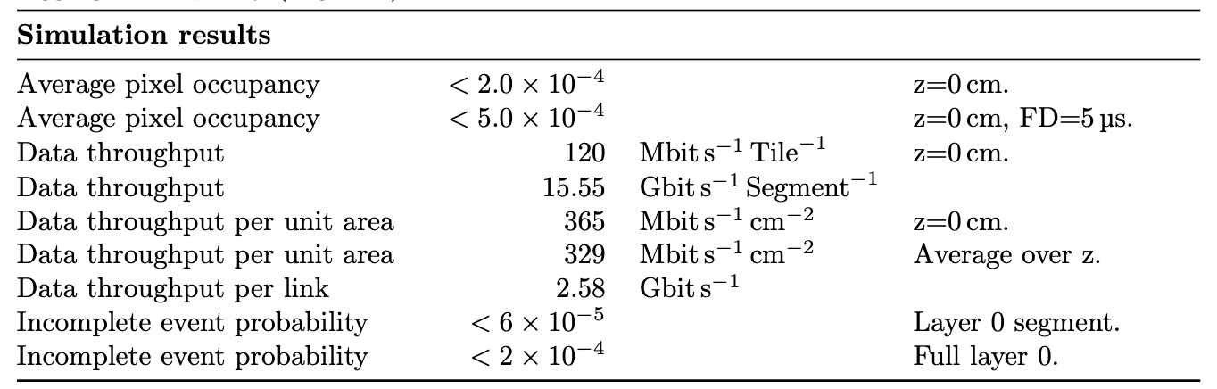
Results

Slide 8
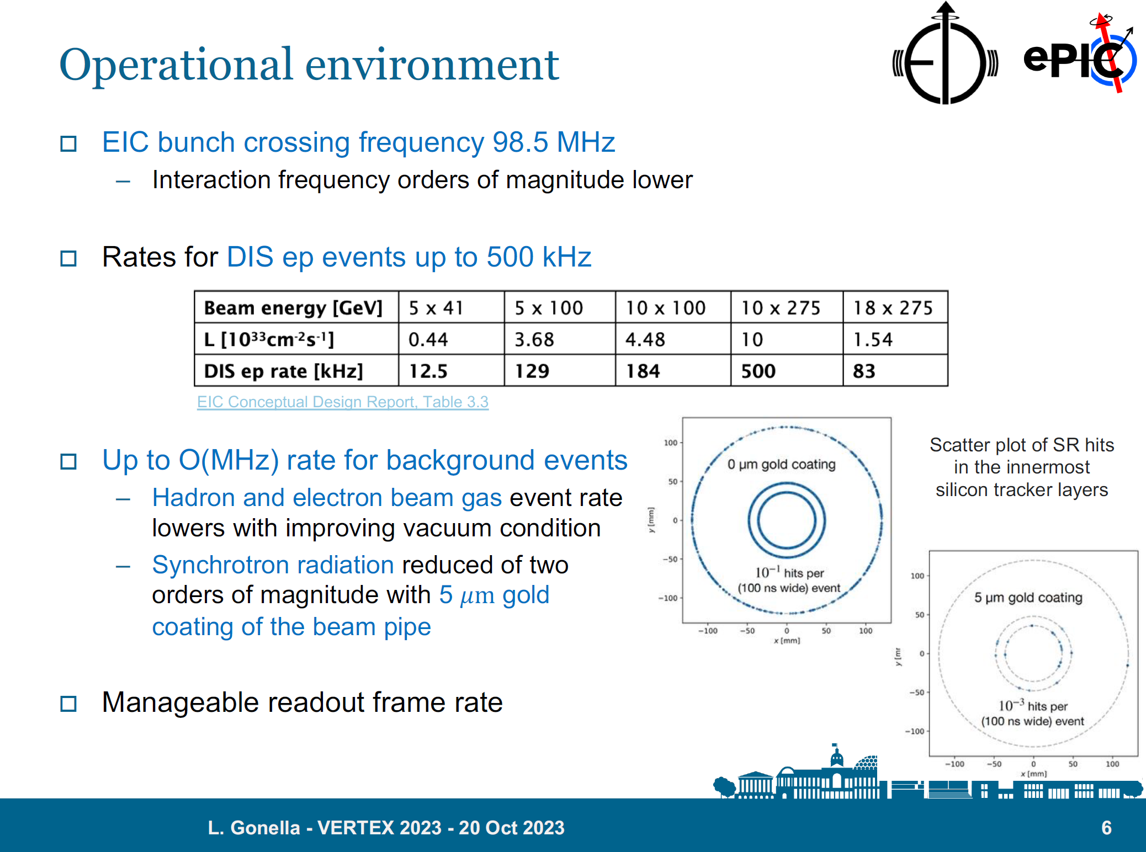

Slide 9
S. Maple’s Presentation
10x100 GeV ep, 4.48 x 10³³ cm⁻²s⁻¹, 184 kHz DIS event rate
10 GeV SR
10 GeV e beam gas, 10000 Ahr
100 GeV proton beam gas, 100 Ahr
10x275 GeV:
Factor 2 in luminosity
Factor 3 in e-p rate
Factor 2 for pixels per hit
Pixel occupancy at most ~ 10⁻⁶ per pixel per frame
Factor 100?

Slide 10
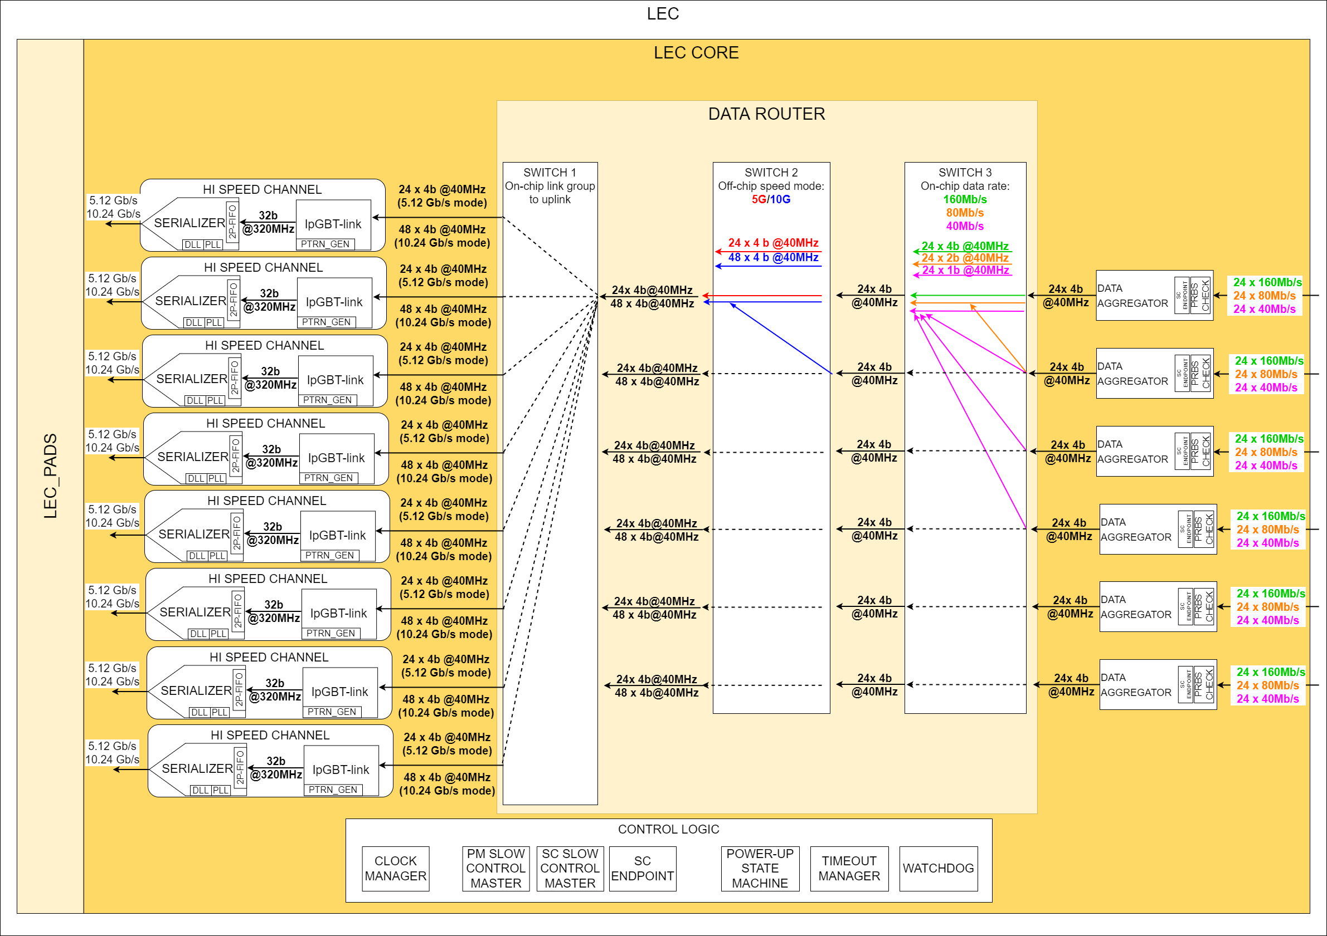
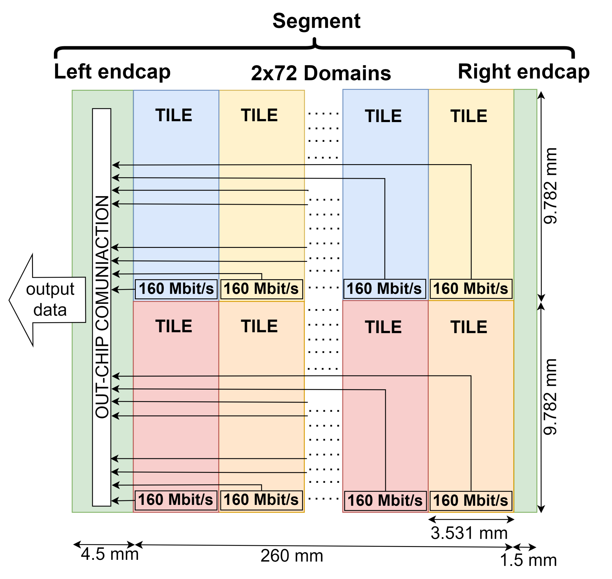
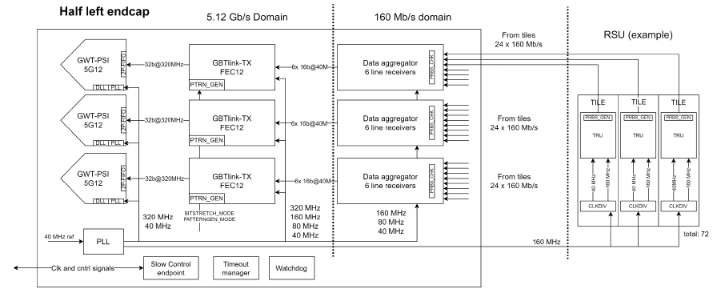
Data Flow – From Tiles to Left Endcap
160 Mbps x 144 = 23.04 Gbps (ITS3 expected: 15.55 Gbps)

Slide 11
LEC Data Aggregator Block

Slide 12
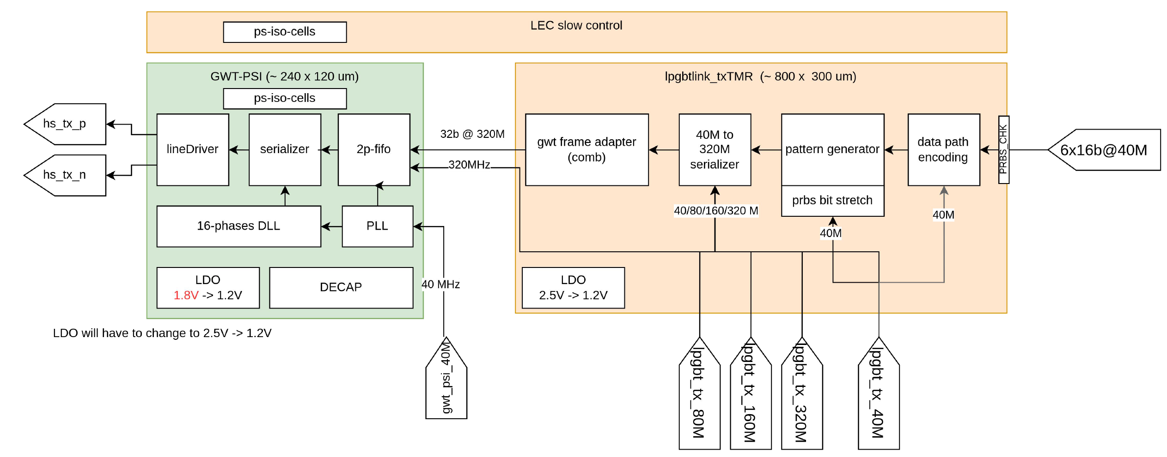
LEC High Speed Block Diagram

Slide 13
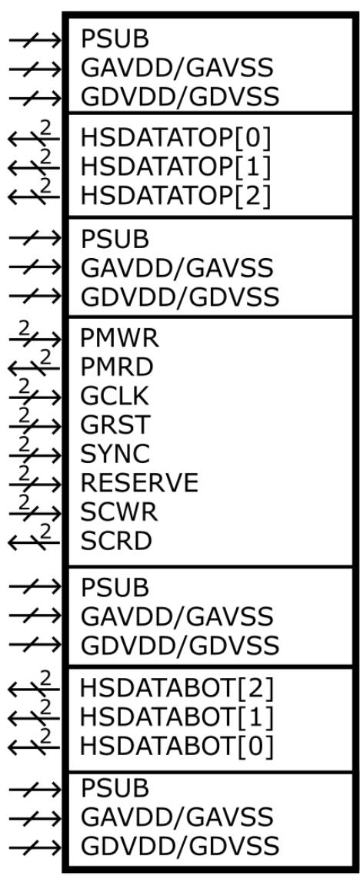
Supplies and I/Os
Supplies
I/Os
Supplies
Supplies
I/Os
Supplies
Supplies
I/Os
Supplies
All I/Os are differential
6x 5.12 Gb/s data outputs
1x clock at 160 MHz (possibly 320 MHz?)
2x slow control at 5 Mbps
(slow controls via lpGBT: 1 clk, 4 elink down, 2 elink up, 1 spare)
Global analog and digital supplies per segment
On-chip supply segmentation and control
Reverse biasing of substrate (PSUB)
down
up
Slow control
down
down
down
down
down
up

Slide 14
MOSS Slow Controls Top Level

Slide 15
MOSS Slow Controls Summary
  Asynchronous, two-wire, point-to-point serial communication protocol
  Optimized for area and on-chip routing
  Composed of two layers
    Physical layer
      CERN Low Power Signalling (CLPS) compliant differential input and output
      Manchester encoding to achieve DC balance
      5 MBd baudrate (2.5 Mbps bit rate, revised in MOSAIX to 5, maybe 10 Mbps)
      MSB first transmission
    Transaction layer
      Parametrized packet structure
      Fixed transaction width and format for both input and output
      Supports write (WR) and read (RD) transactions
      Writes are posted to achieve high throughput (i.e. no response to a write transaction)
      Reads cannot be pipelined (i.e. Sender must wait for a read response after a read request before initiating another transaction)
      Supports broadcast write operations at Repeated Sensor Unit (RSU) and Half-RSU (HRSU) granularities
  Two independent and isolated slow control interfaces
    PM bus and SC bus

Slide 16
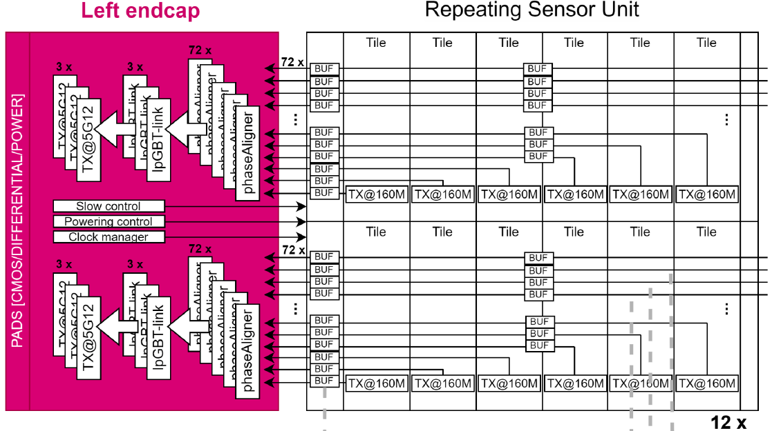
ePIC SVT: “Large Area Sensor” (LAS)
LAS
Inner Barrel (Layers 0,1,2) will reuse ITS3-like sensors as is
  Layer 0: 4 sensors in r-phi, 3 segments of 12 RSU
  Layer 1: 4 sensors in r-phi, 4 segments of 12 RSU
  Layer 2: 8 sensors in r-phi, 5 segments of 12 RSU
EIC variant for the Outer Barrel ( Layers 3,4) and Endcap Disks
  “Large Area Sensor” (LAS)
  Will be stitched, but not to wafer scale
  Likely 1 Segment of 5 or 6 RSU (no need for right endcap)
  Hope is to multiplex Domain data lines to 1 High-Speed output
  More conventional carbon composite mechanical support with integrated cooling
1x
1x
36x
36x
MUX
36x
36x
X
5/6x
Supplies
I/Os
No Supplies

Slide 17
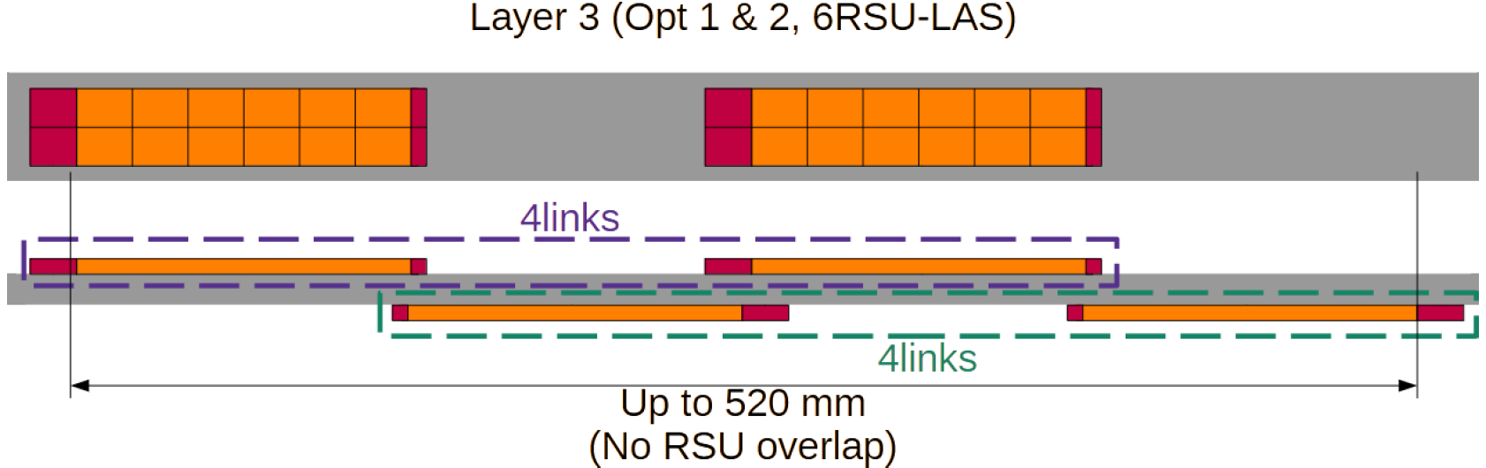
OB Stave Layout (J. Glover)

Slide 18
Disk Concept

Slide 19
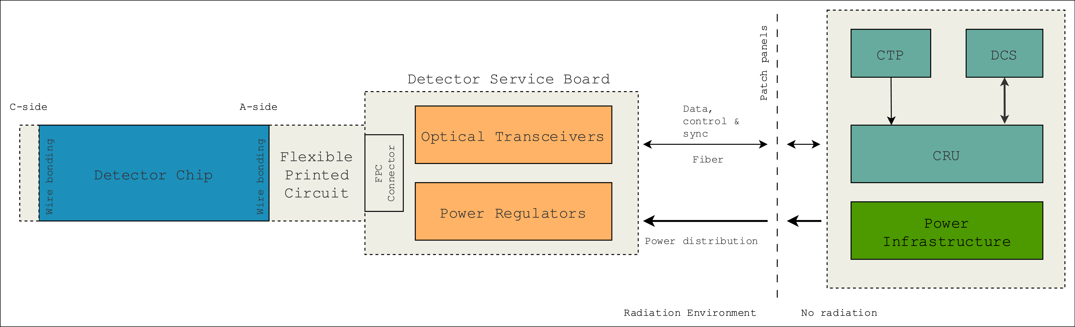
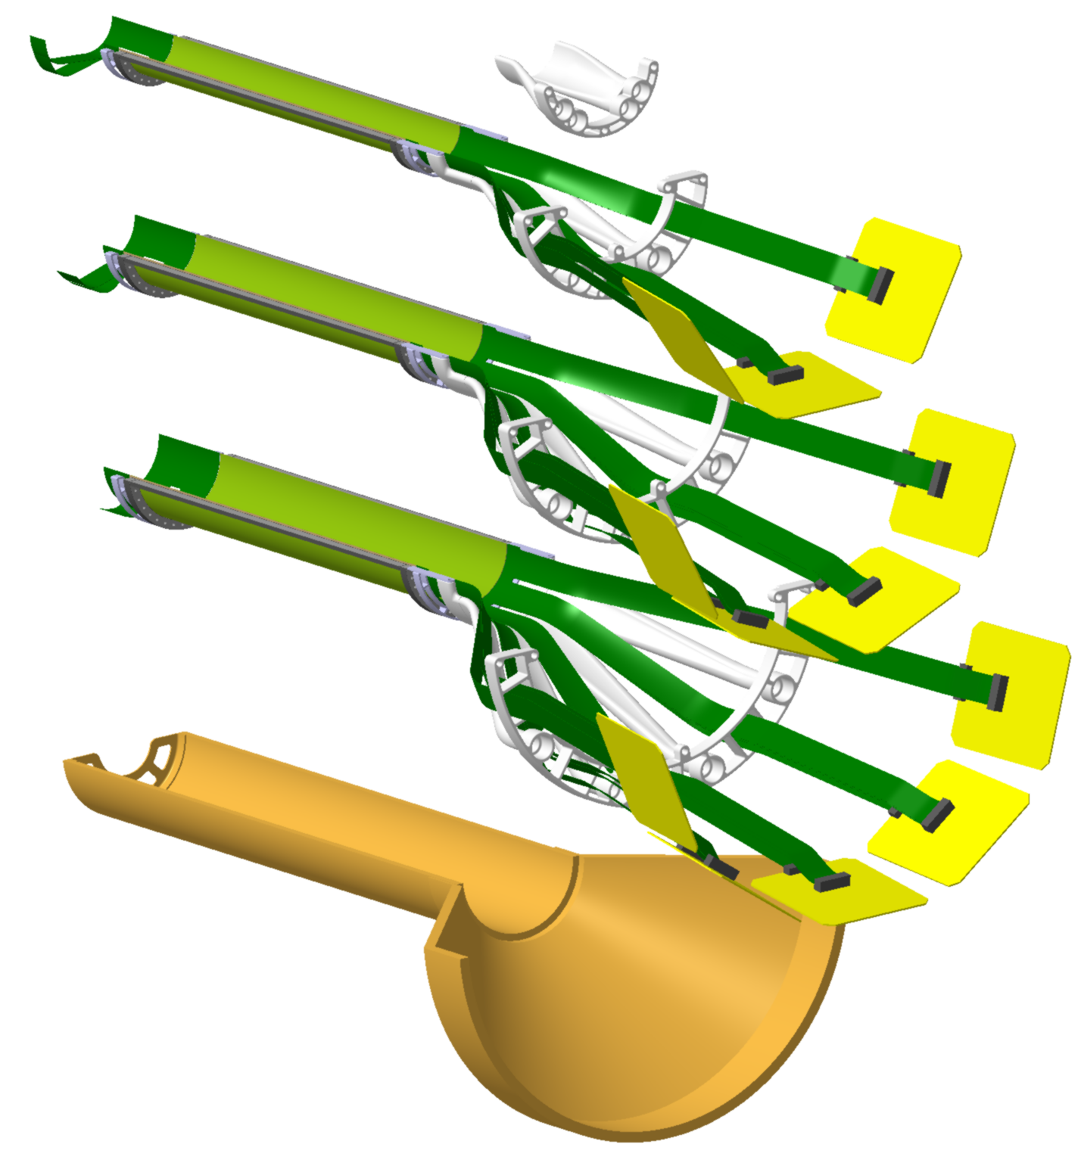
Off Detector Electronics – Simplified Overview
< 50 cm long
GTU
FELIX

Slide 20
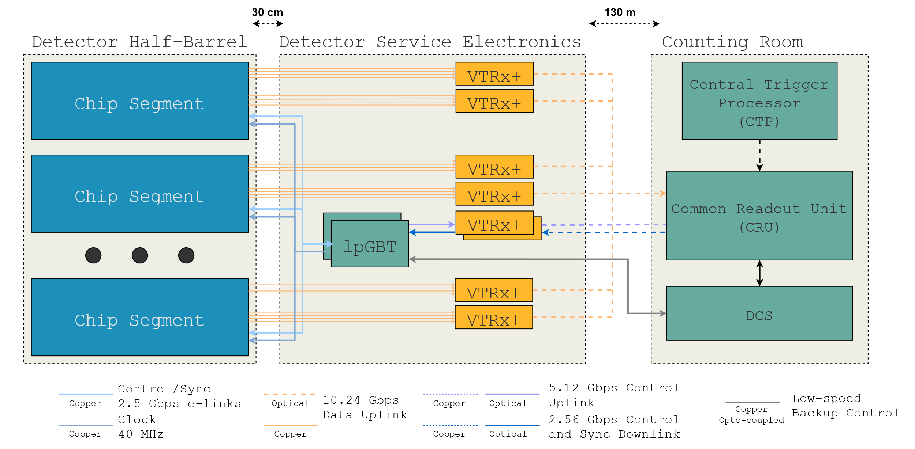
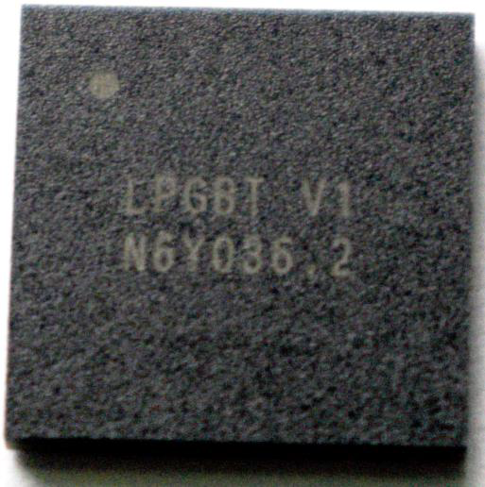
Detector Electronics – Data & Control

Slide 21
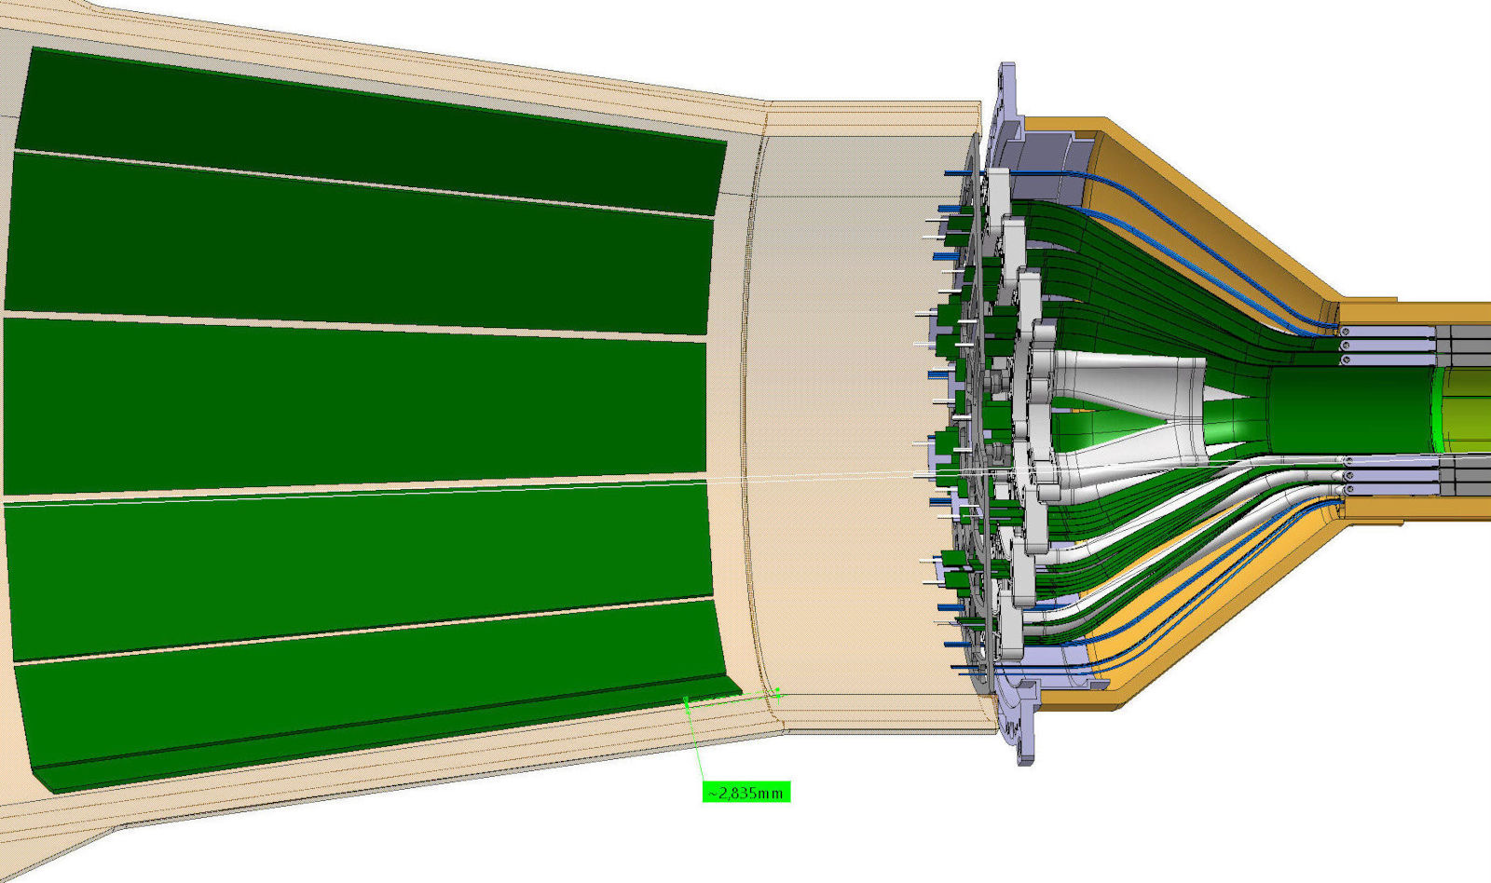
Integration of Readout
~15cm
~25cm
Main PCB
55x300mm²
Small PCB with VTRx+

Slide 22
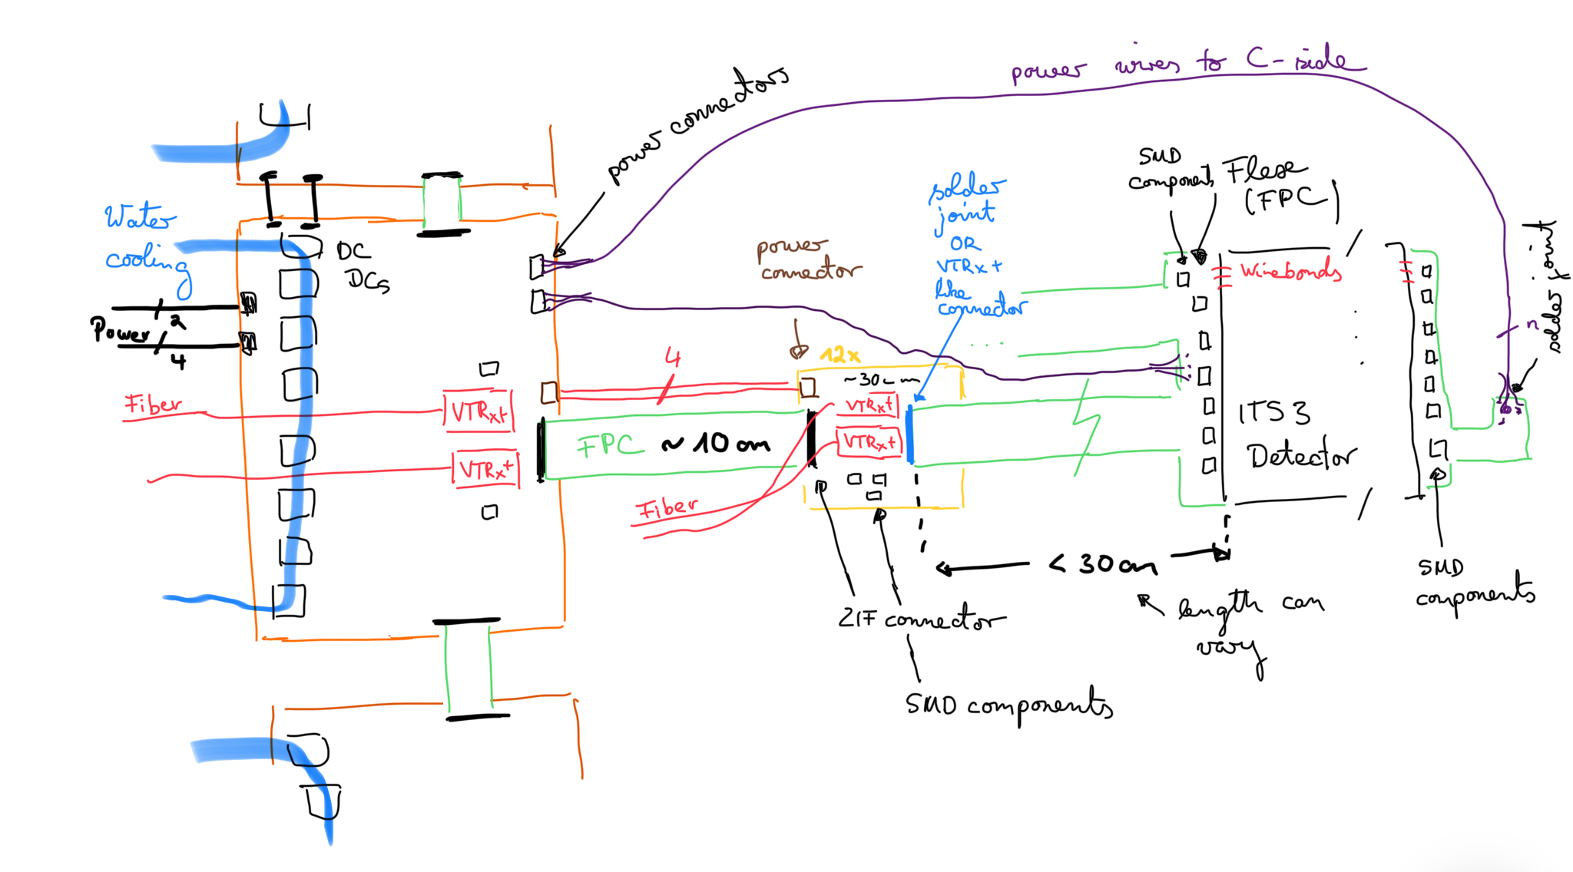
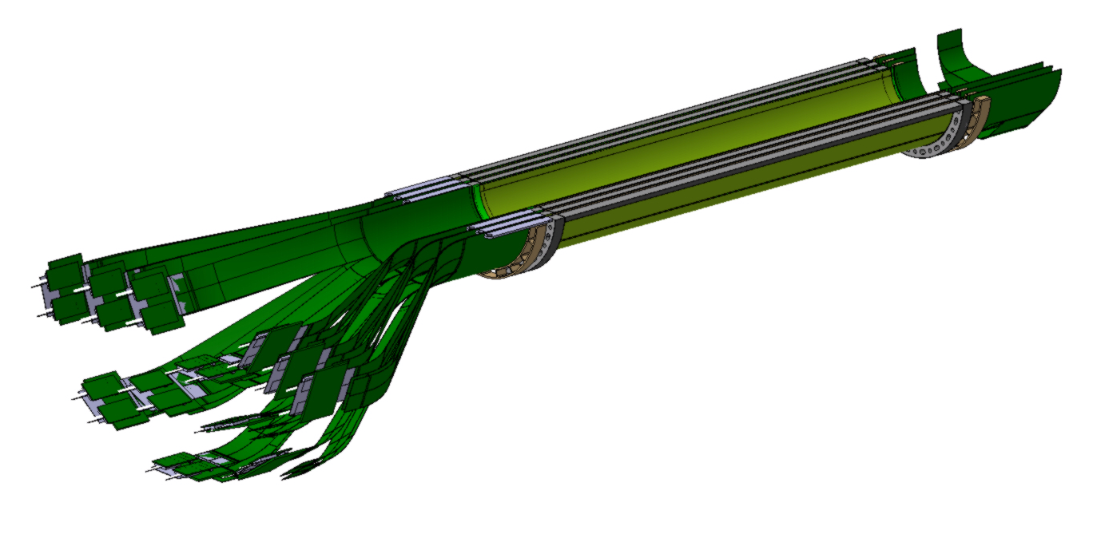
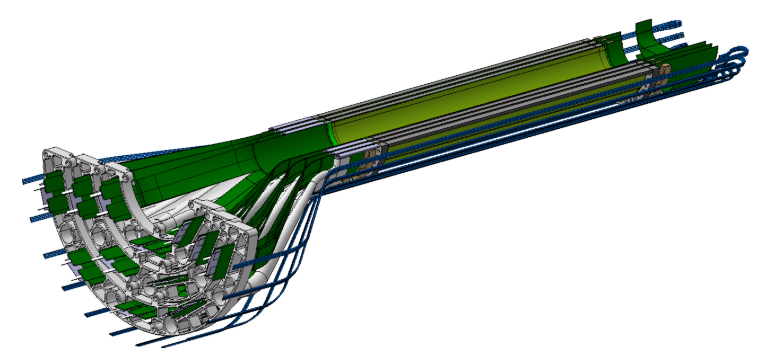
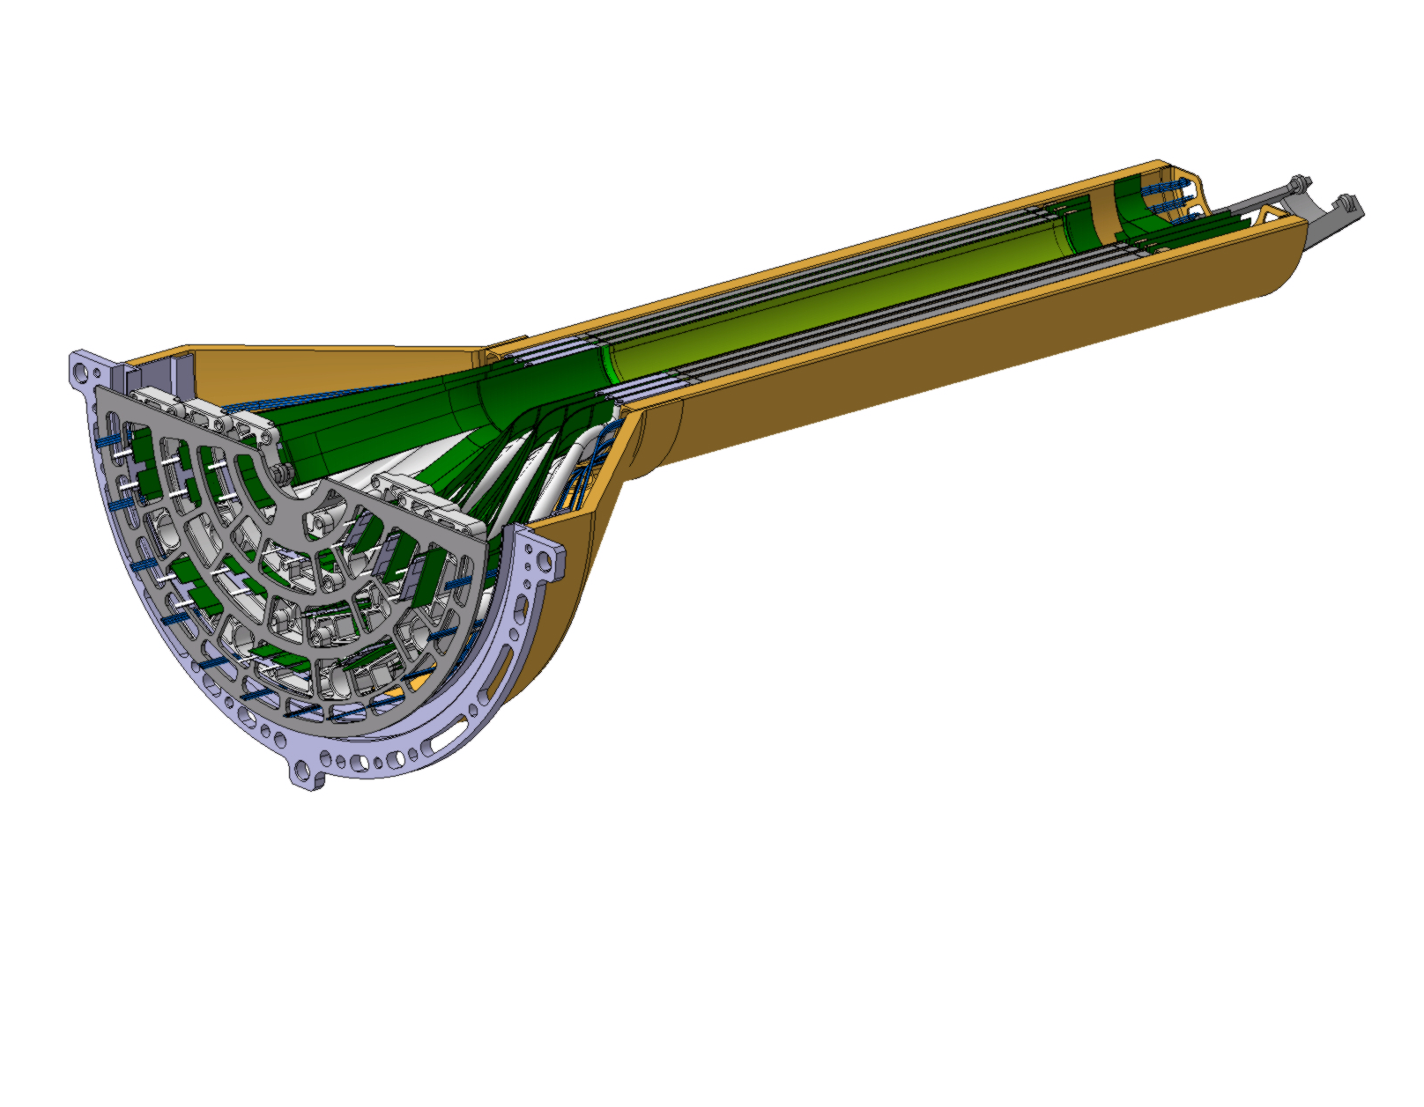
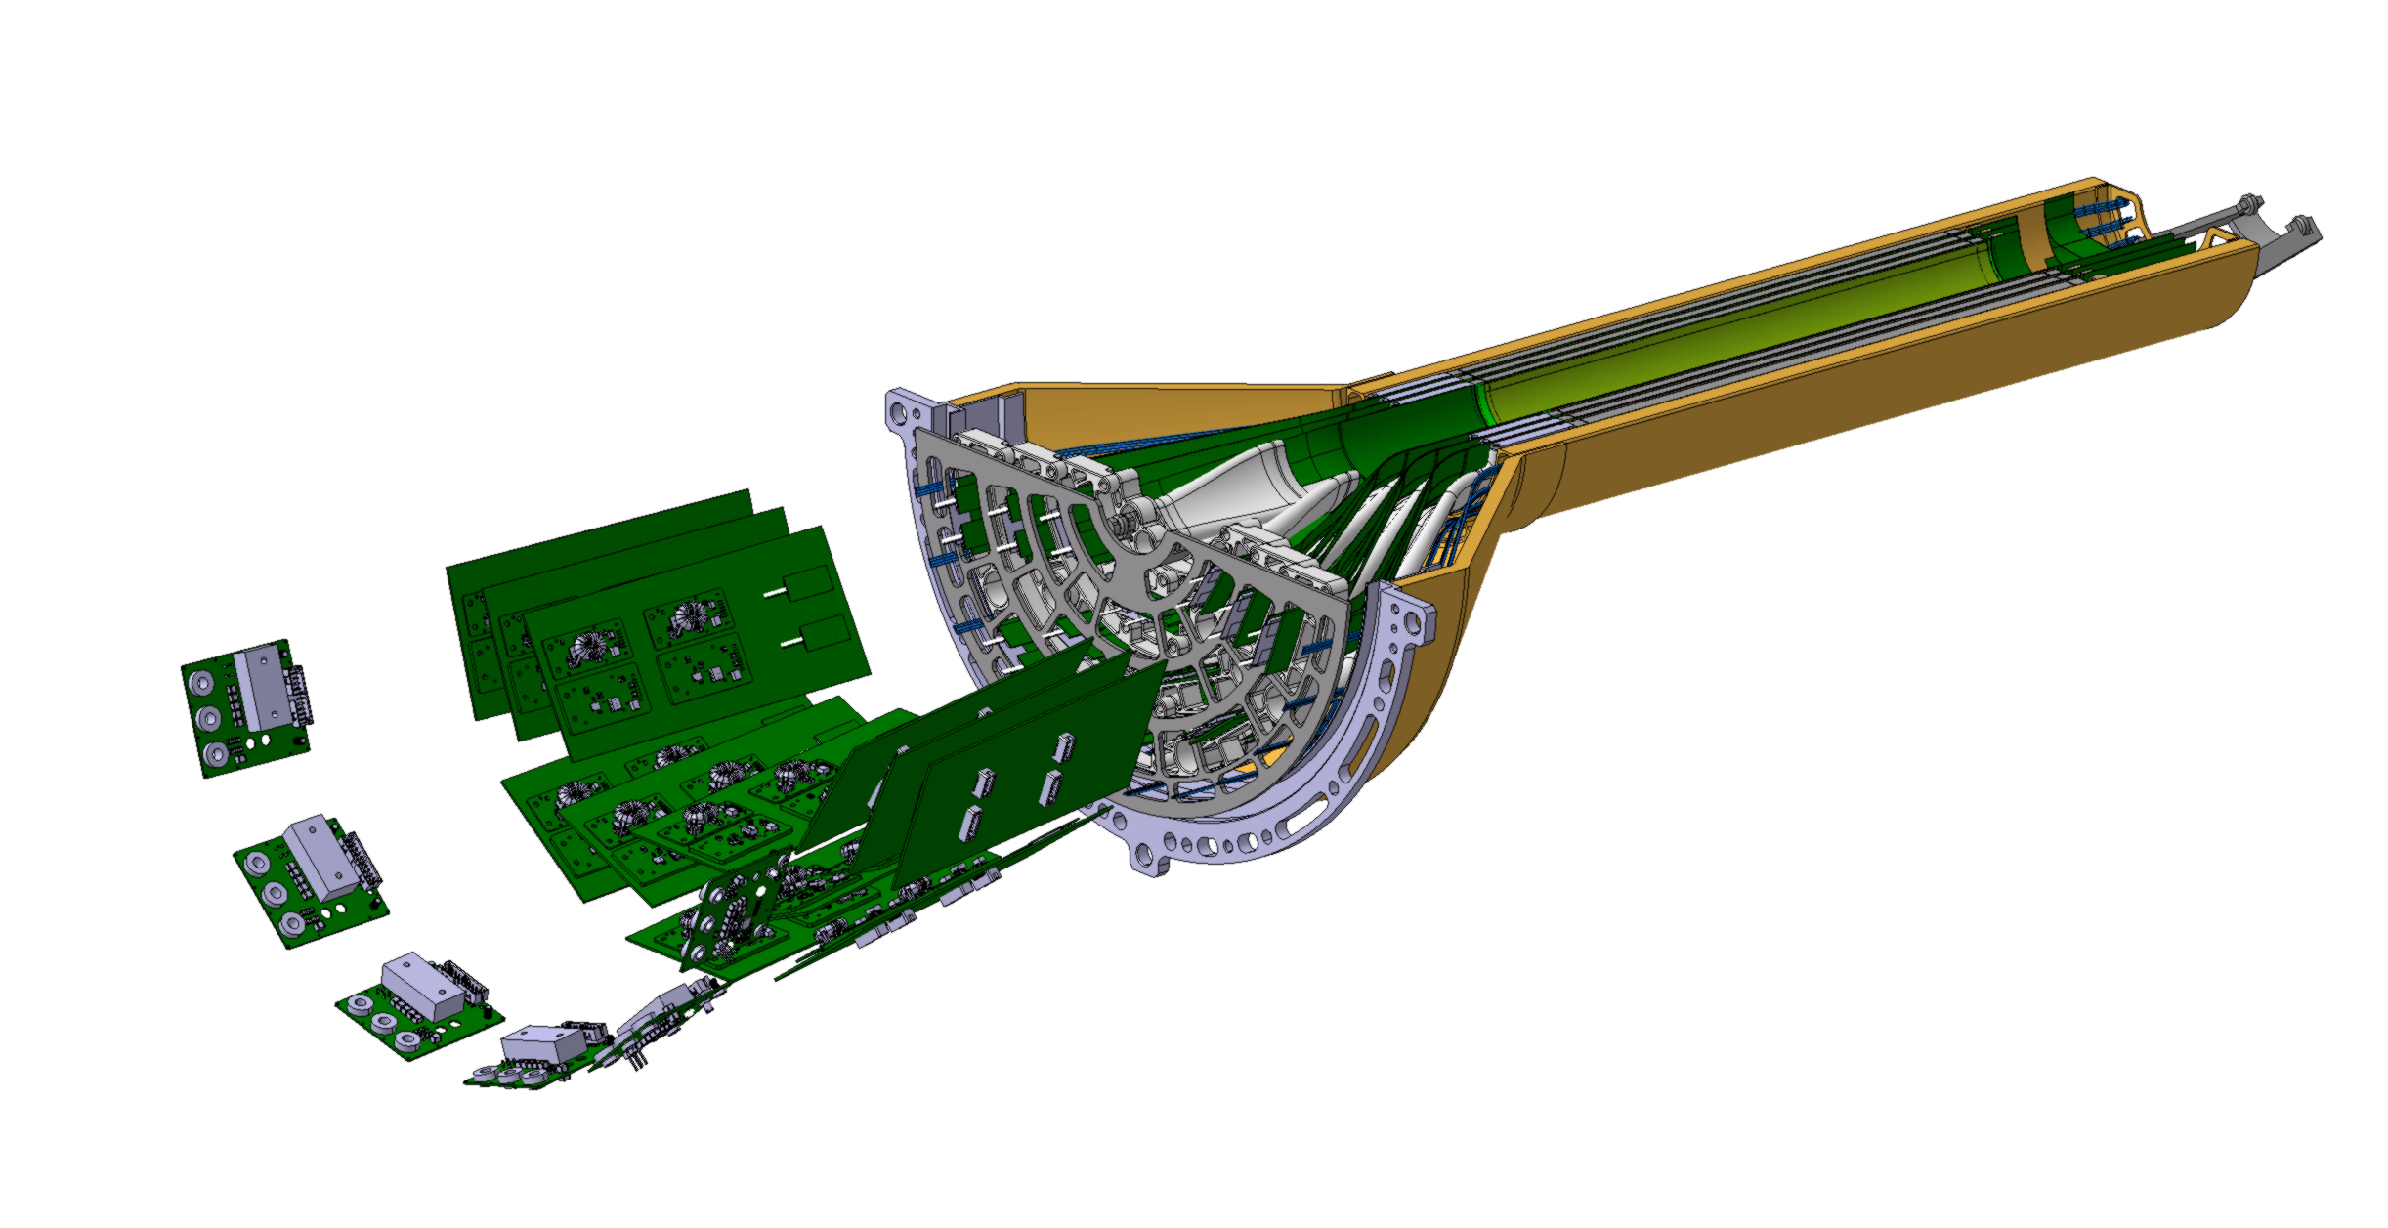
Layout updates: Front end electronics layout being evaluated (Preliminary)
Design and position of the boards depend on available volume limited by the FoCAL acceptance cone.
Design developed in collaboration with WP6
@Collaboration with WP6
~250 mm
PP3
https://codimd.web.cern.ch/s/_y0lXEEQq
PP3
See Felix, Ola presentation
small PCB, one per sub-module
This board will host the two VTRx+ modules
VTRx+ to be placed as close as possible to sensor edge
  + ZIF connector for the flex to the control board
  +power connectors for power coming from the control board.
  The VTRx+ module can be plugged after the layer assembly.
  The approximate dimensions are 30 mm x 30 mm.
~150 mm
Control Board
Contains all the remaining electronics
It is divided in several segments avoiding acceptance cone
Different layout under study
In terms of components the control PCB will host two VTRx+ modules, many SMD components (passive + active) as well as the DC-DC converters.
*VTRx+ (Versatile TransReceiver)= Optical Link Module for Data Transmission
@G.Ledey

Slide 23
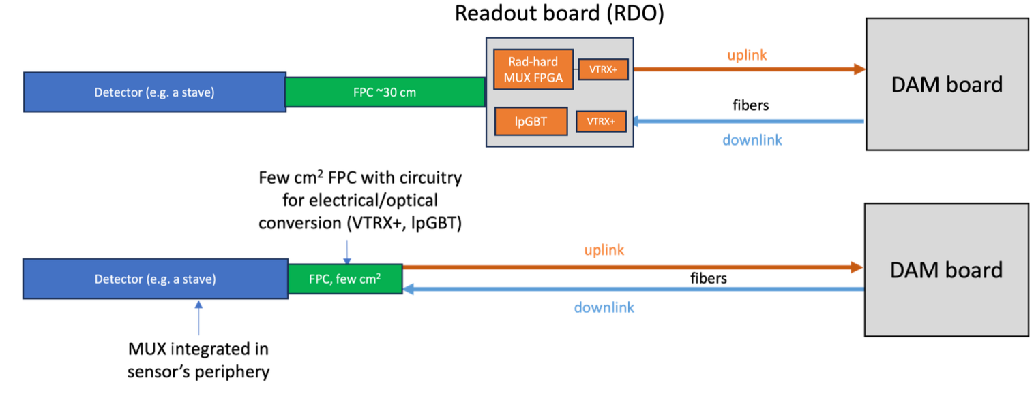
SVT Readout (inspired by ITS3 Readout)

Slide 24
SVT Slow control Ideas
~8
X3
Stave
Demux
IF
Clk
FPGA
or lpGBT
Ctrl
Fiber

Slide 25
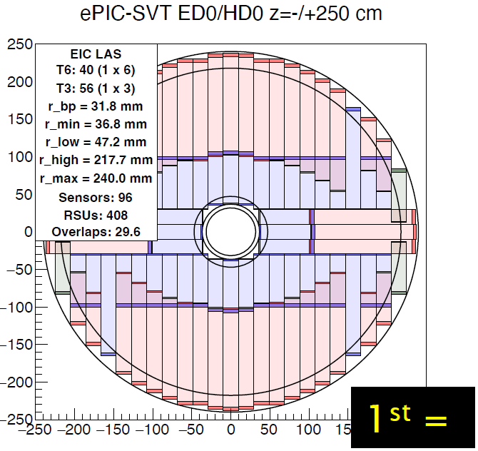
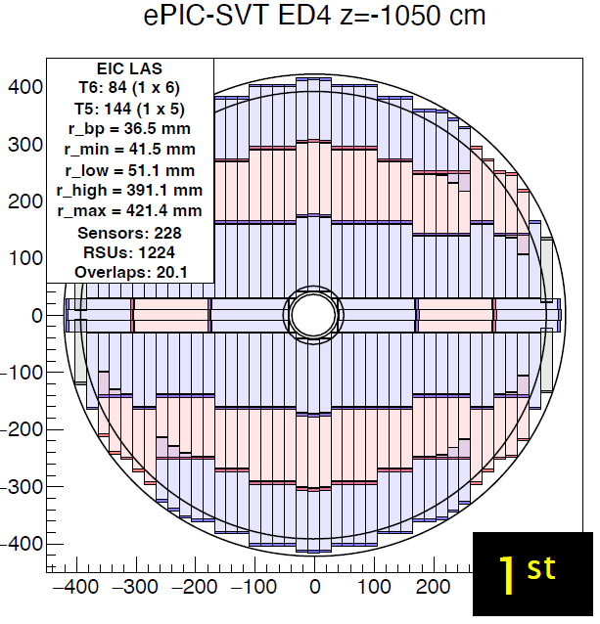
Disk Staves
52 stave
86 stave
88 stave
88 stave
88 stave
88 stave
88 stave
88 stave

Slide 26
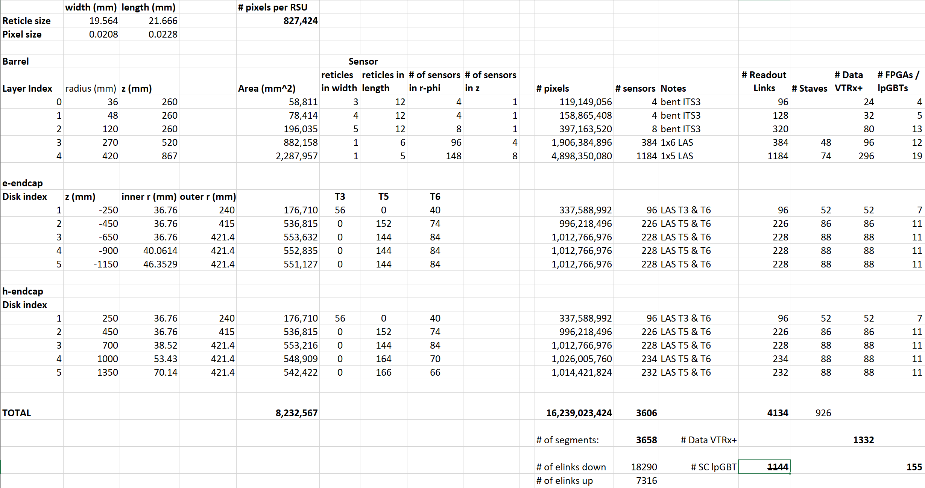
SVT by the Numbers

Slide 27
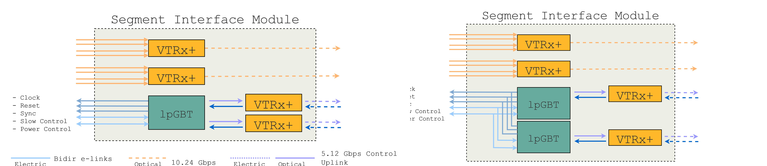
Open Issues
Chip Control Redundancy, (similar to data path redundancy), e.g.:
Location of VTRx+ and Control Board (SC, power) for both Barrel and Discs
Data Aggregation before FELIX: 4134 readout links need 87 FELIXs, but total data rate only ~29 Gbps. Each link can carry 7.68 Gbps (10.24 Gbps, lpGBT, FEC12)
Noise Rate? TDR specifies 0.1 pixel⁻¹s⁻¹, i.e. 1.6 Gpixel per sec.
Alternatives to lpGBT: PolarFire multiplexing, Samtec optical FireFly (at least in Discs, where radiation load is not so high)

Slide 28
Extra Slides

Slide 29
