Slide 1
SVT IB design & R&D activities
Domenico Elia for the INFN groups
other institutes interested in the project: LBNL, MIT etc.

Slide 2
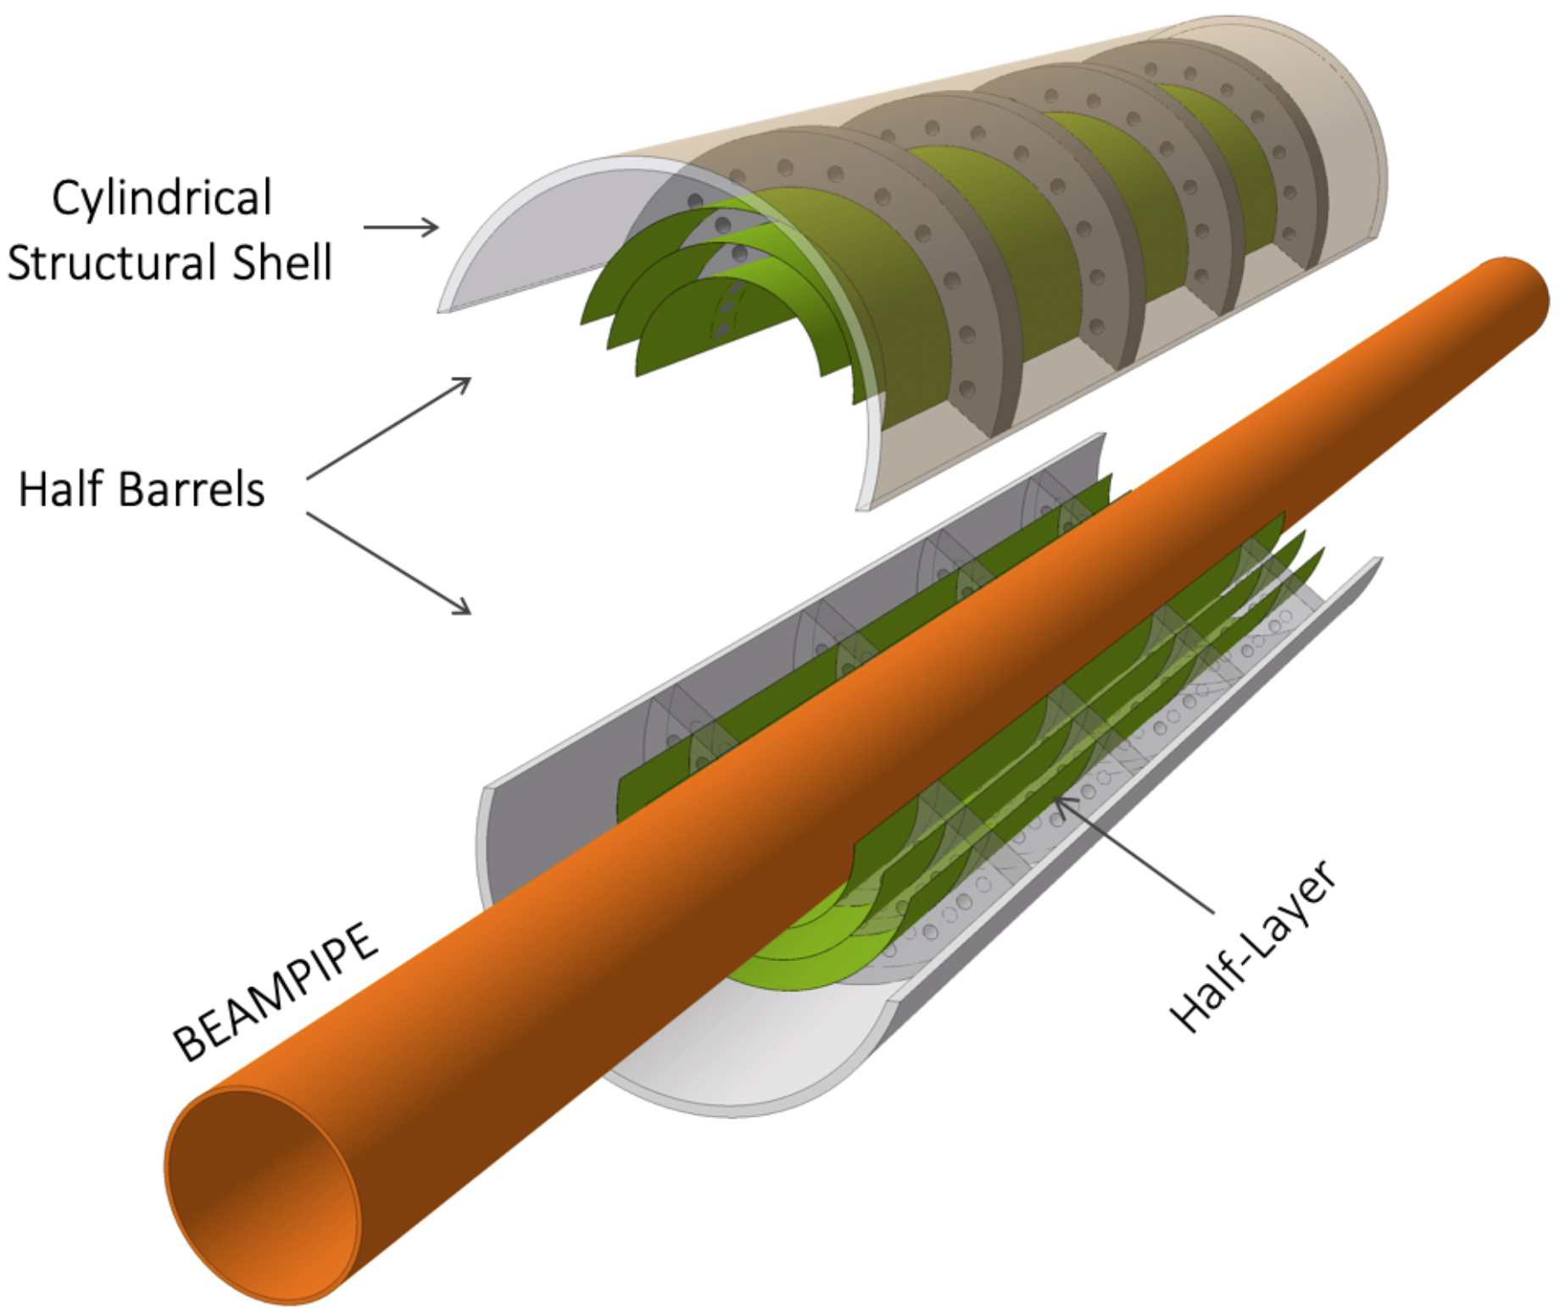
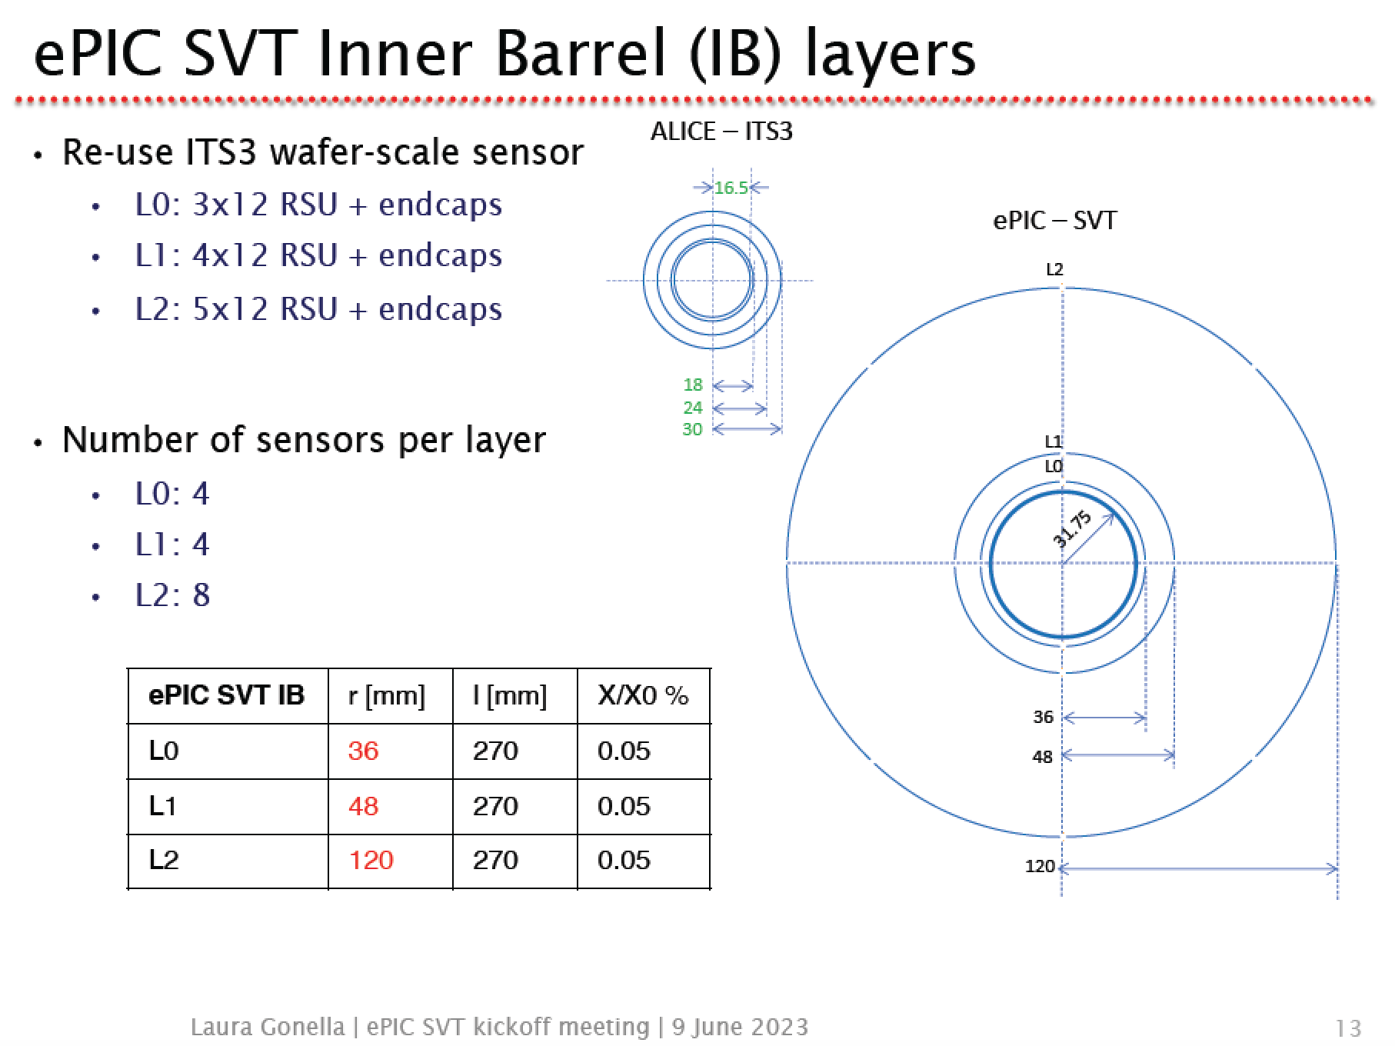
ePIC SVT IB layout and concept
Use the ITS3 wafer-scale sensor
Adapt ITS3 detector concept to the (larger) EIC radii → mechanics, services and cooling of ePIC SVT inner barrel layers need specific development

Slide 3
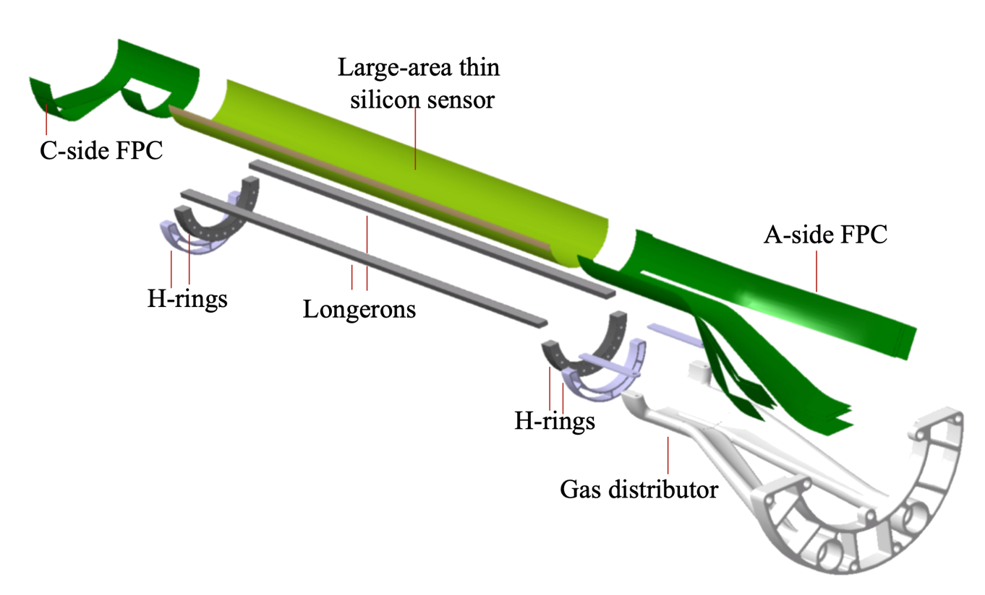
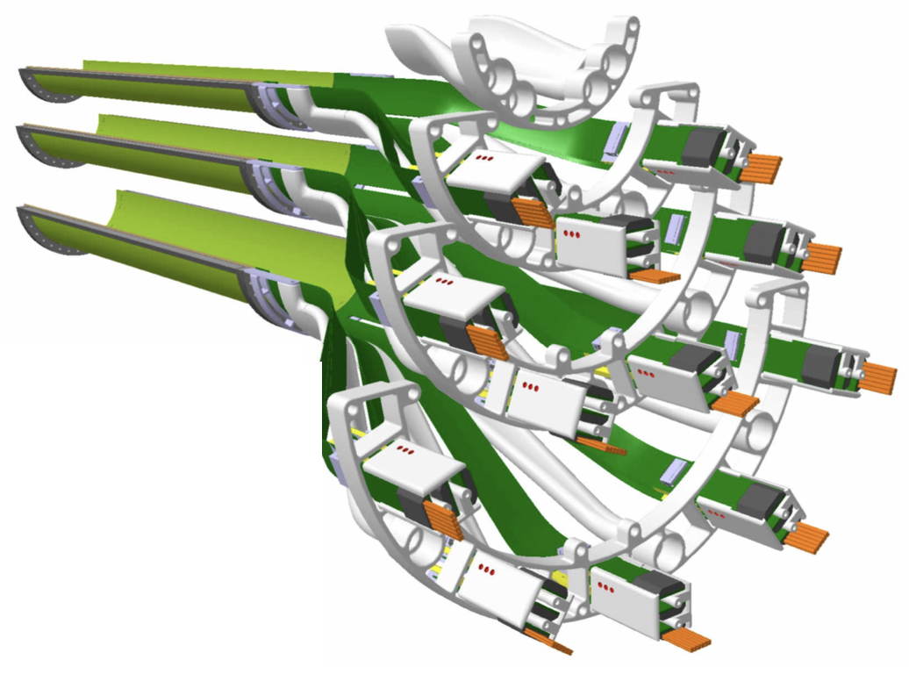
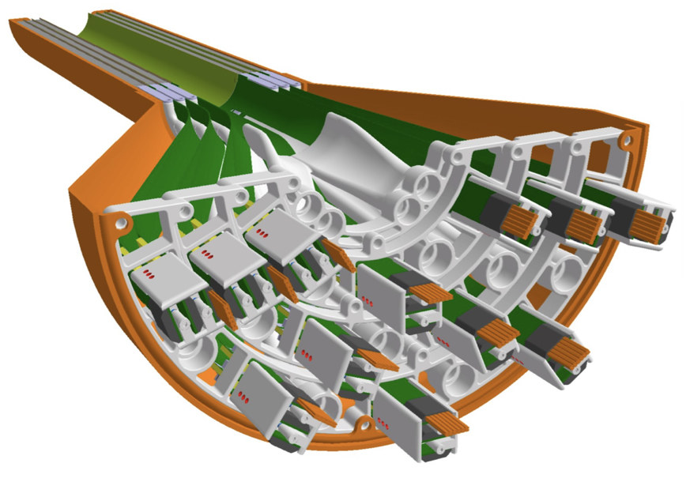
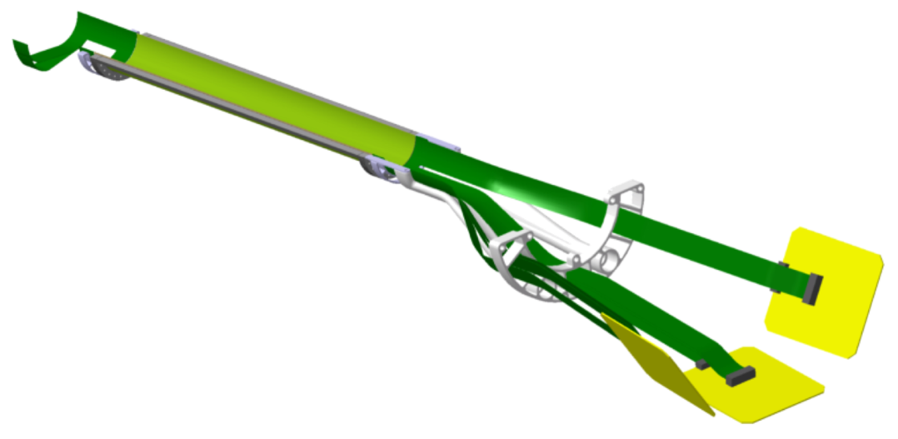
ALICE ITS3 design
Half-layer is the basic building block
Three half-layers assembled in a half-barrel
ITS3 key ingredients:
Wafer-scale chips (up to ~27x10 cm, ≤ 50 μm thick)
Chips bent in cylindrical shape at target radii
Ultra-light carbon foam structures
Air cooling

Slide 4
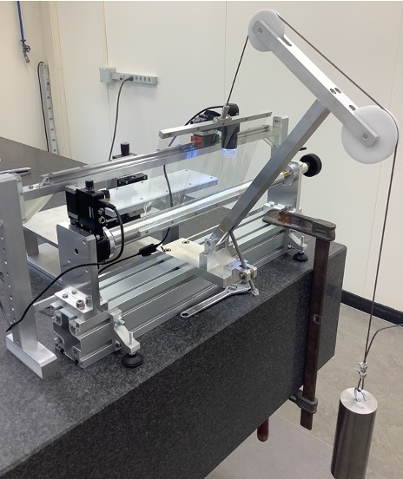
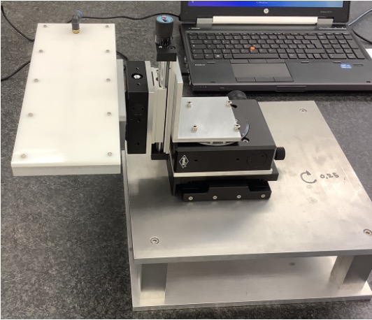
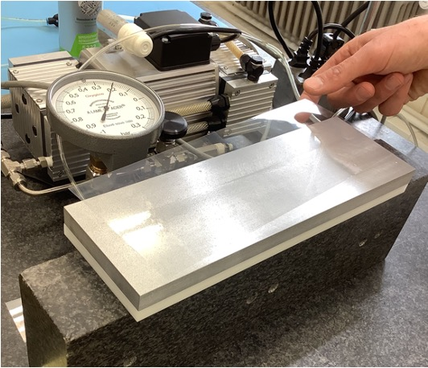
R&D activity for ALICE ITS3
Large-dimension silicon sensor bending procedure
Bending-bonding tool
Handling vacuum tools

Slide 5
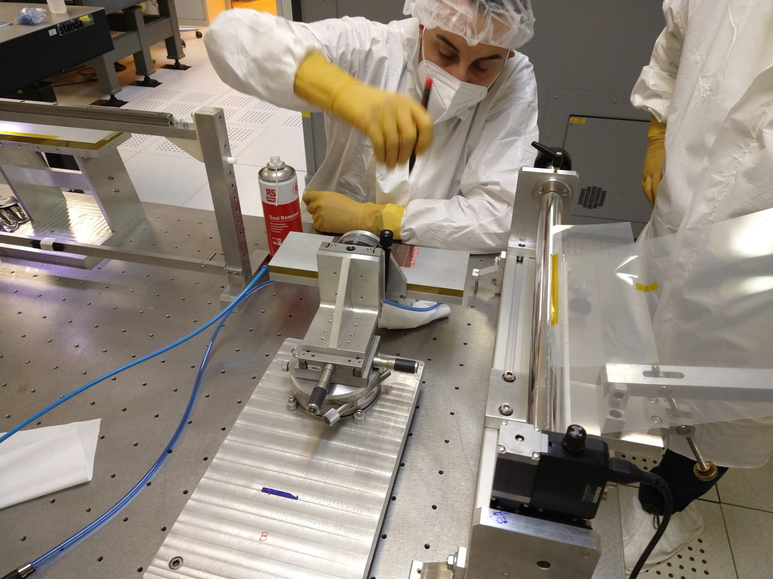
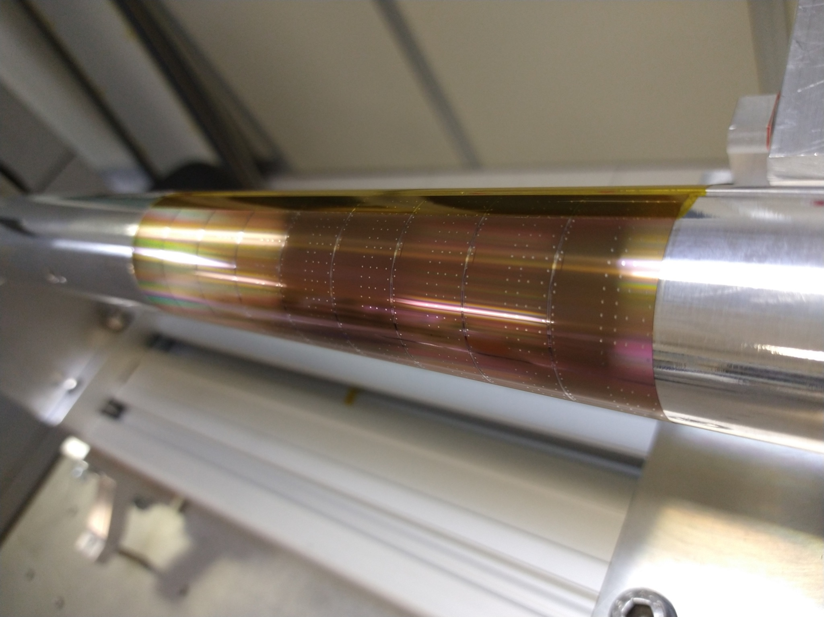
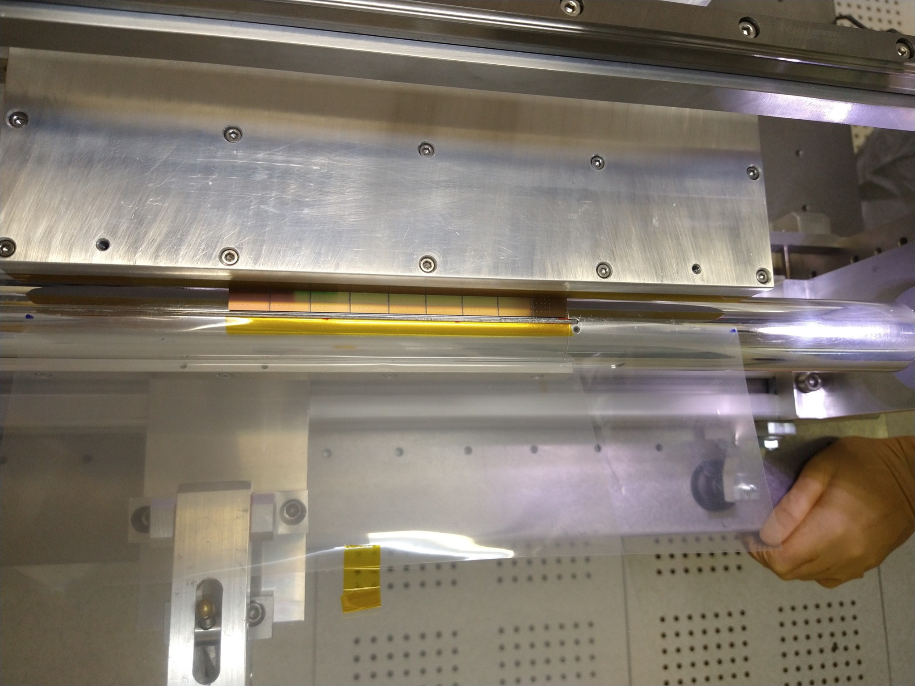
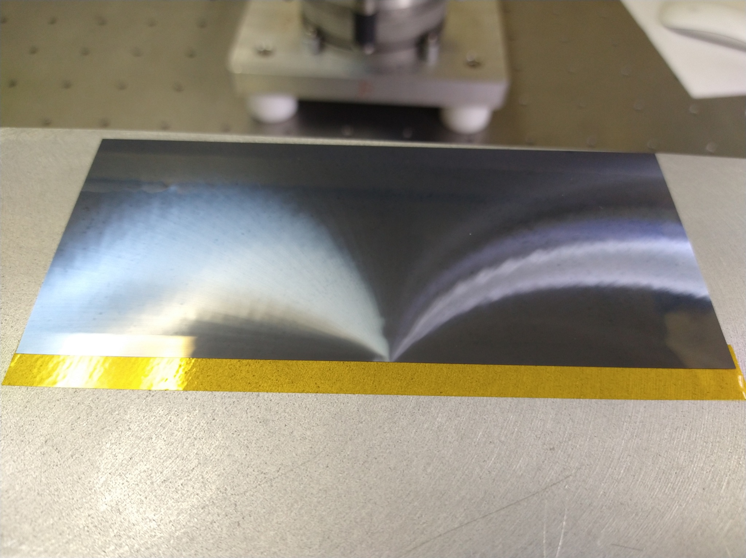
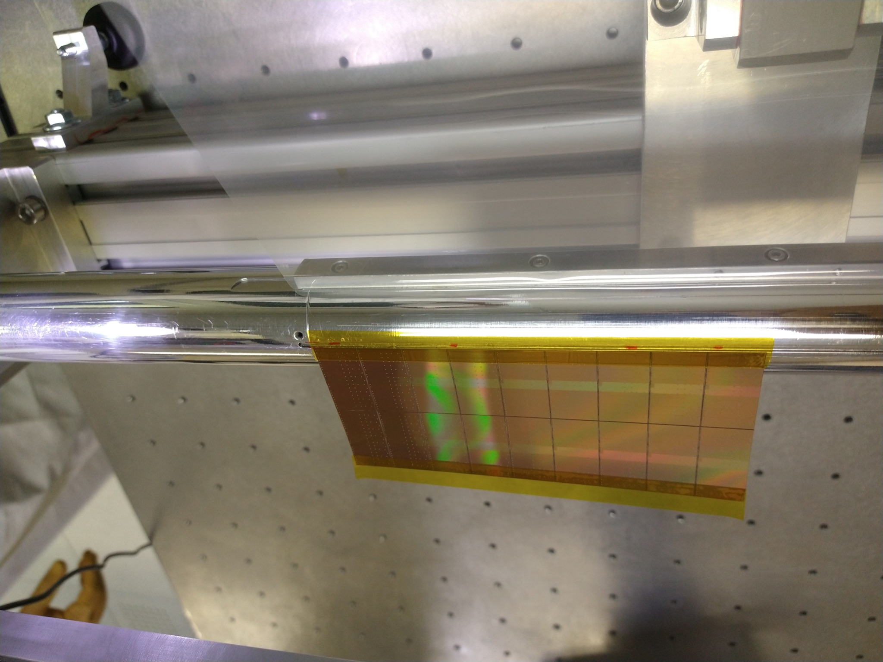
R&D activity for ALICE ITS3
1.
Large-dimension silicon sensor bending procedure
Procedure blocks:
kapton tape positioning on the mandrel
kapton tape positioning on the sensor
alignment of the sensor to the mandrel and attaching to the kapton tape
bending of the chip
4.
3.
2.

Slide 6
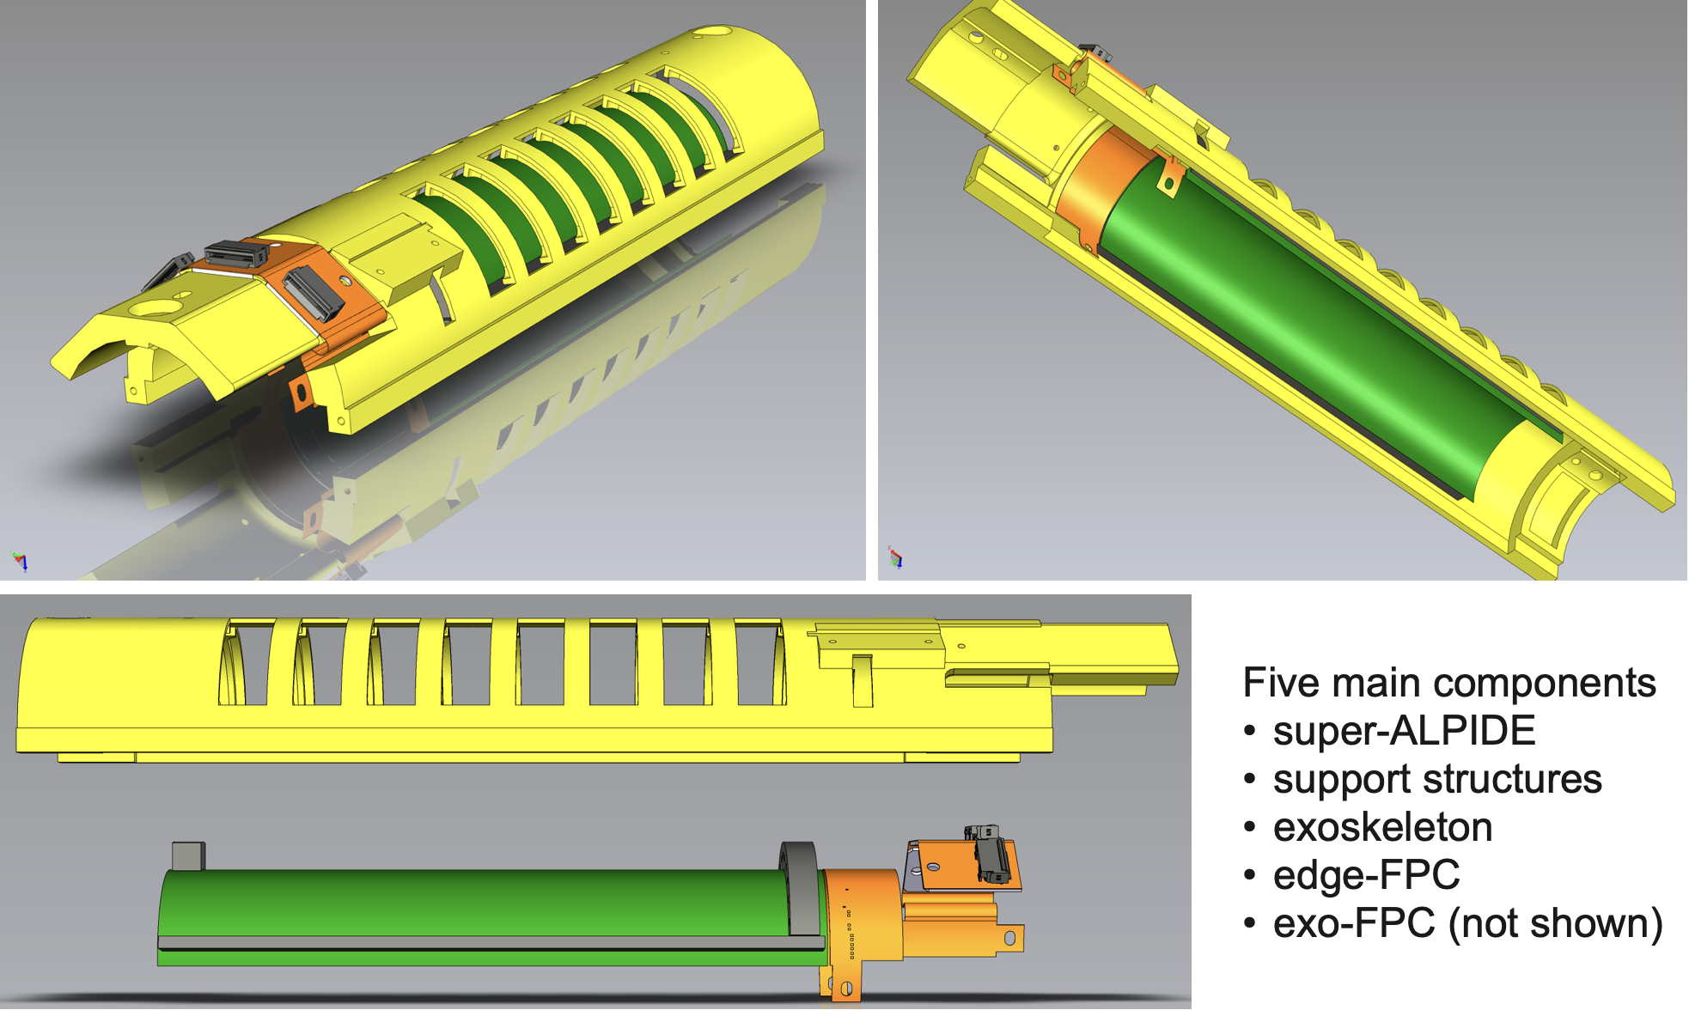
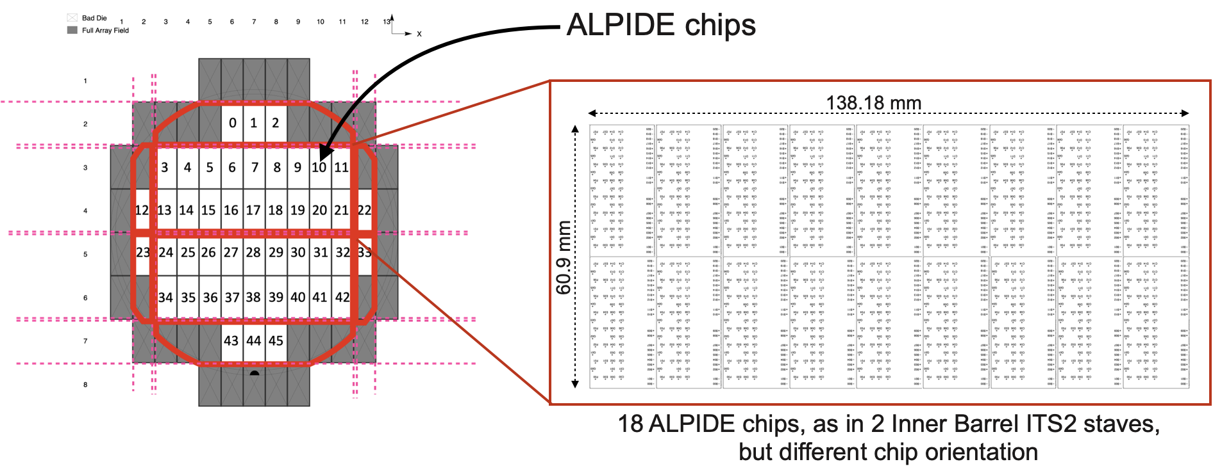
R&D activity for ALICE ITS3
Super-ALPIDE project
Proof of concept for large-dimension bent silicon sensor detector:
while waiting for large-dimension ITS3 sensors
learn how to handle large-dimension chips
explore wire-bonding interconnection to flex (for data/control/powering) and encapsulation
explore edge-flex solutions towards the final detector

Slide 7
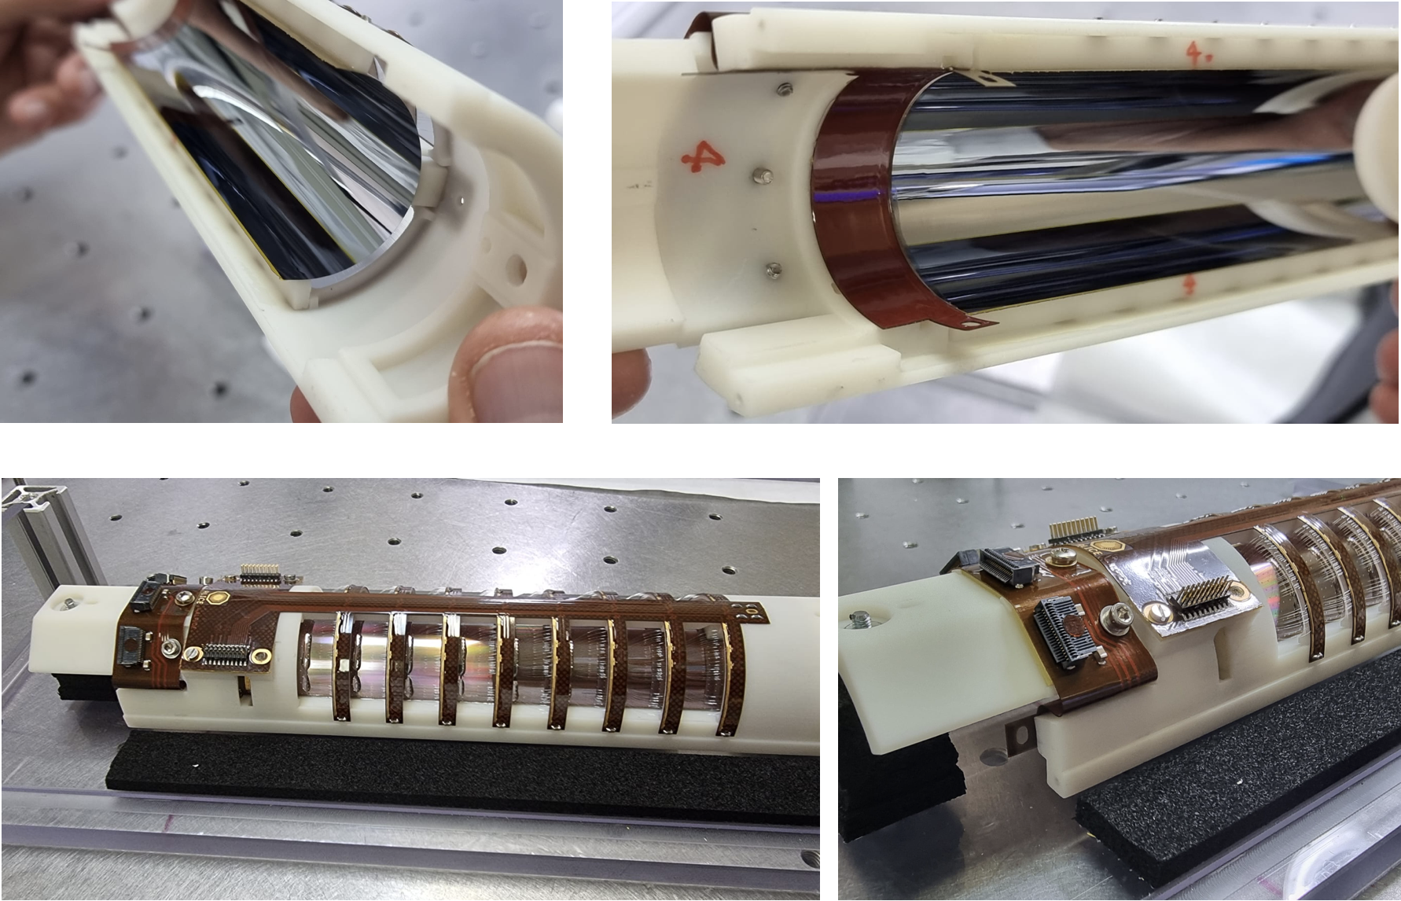
R&D activity for ALICE ITS3
Super-ALPIDE project
Proof of concept for large-dimension bent silicon sensor detector:
while waiting for large-dimension ITS3 sensors
learn how to handle large-dimension chips
explore wire-bonding interconnection to flex (for data/control/powering) and encapsulation
explore edge-flex solutions towards the final detector
Status and plans:
Two assemblies using blank silicon chips
Assembly using working sensors requires new mandrel → beginning of 2024

Slide 8
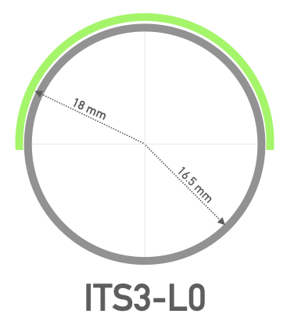
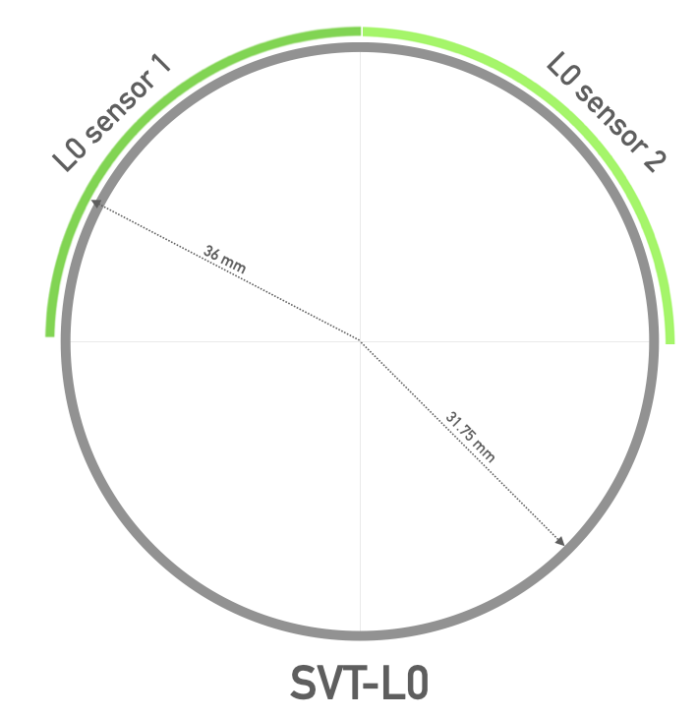
From ITS3 to ePIC SVT IB
Plan to develop bending procedure for SVT L0 (L1)
Main differences & challenges wrt ITS3:
x2 larger radius (18 → 36 mm)*
need to bend 2 sensors for each half-layer
      * will increase to ~19/~38 mm with ITS3 ER2/3 sensors
Possible strategies:
embedding (2 sensors): try to exploit “embedding” the two sensors in kapton foils and bend them as a single object → half-layer
independent bending: bend each of the two sensors separately and glue them on independent support structures → quarter of layer

Slide 9
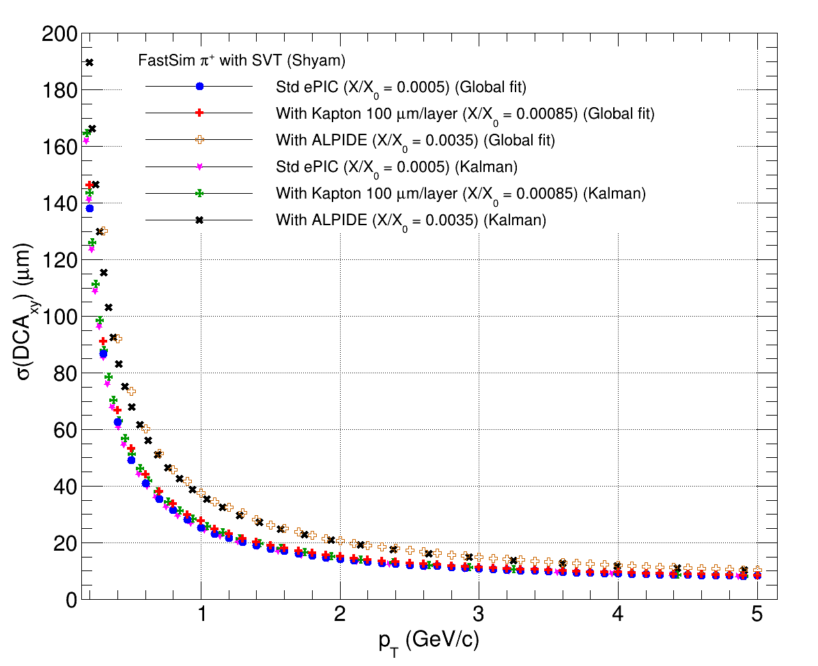
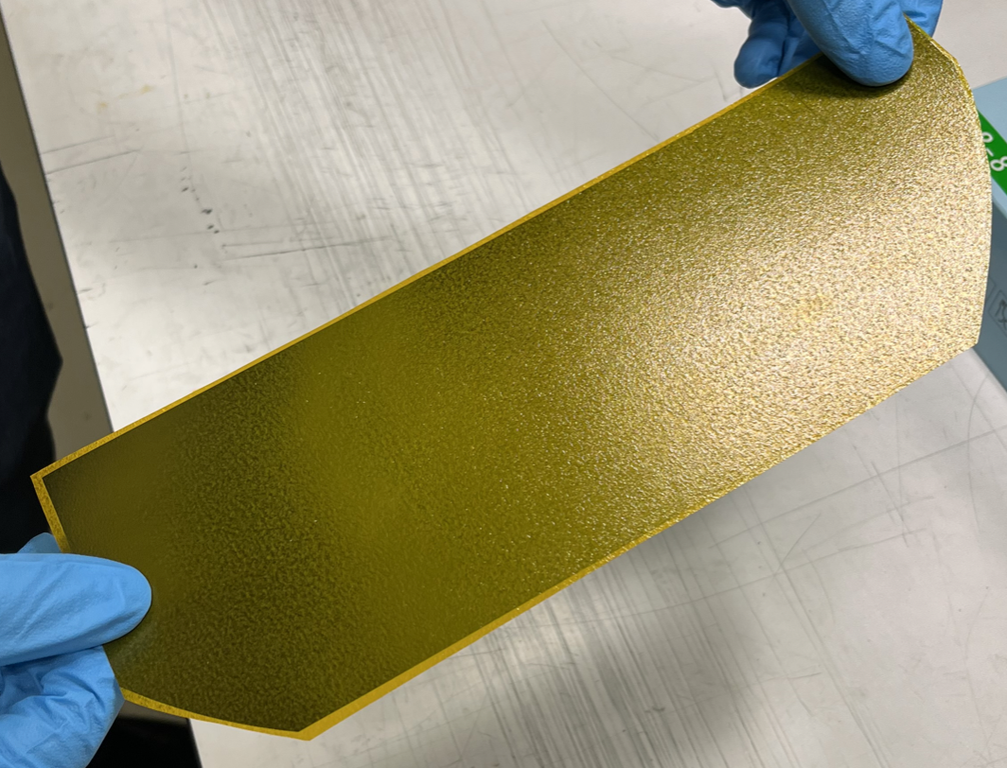
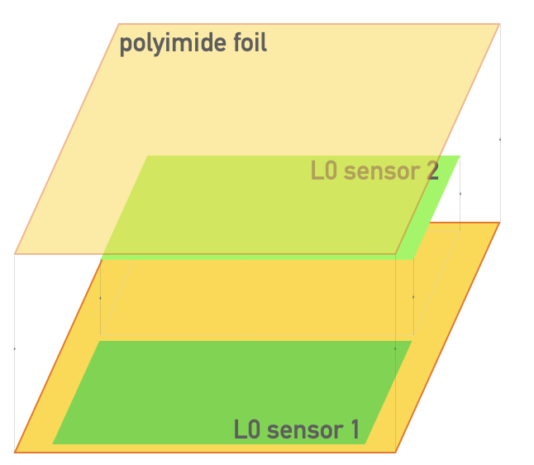
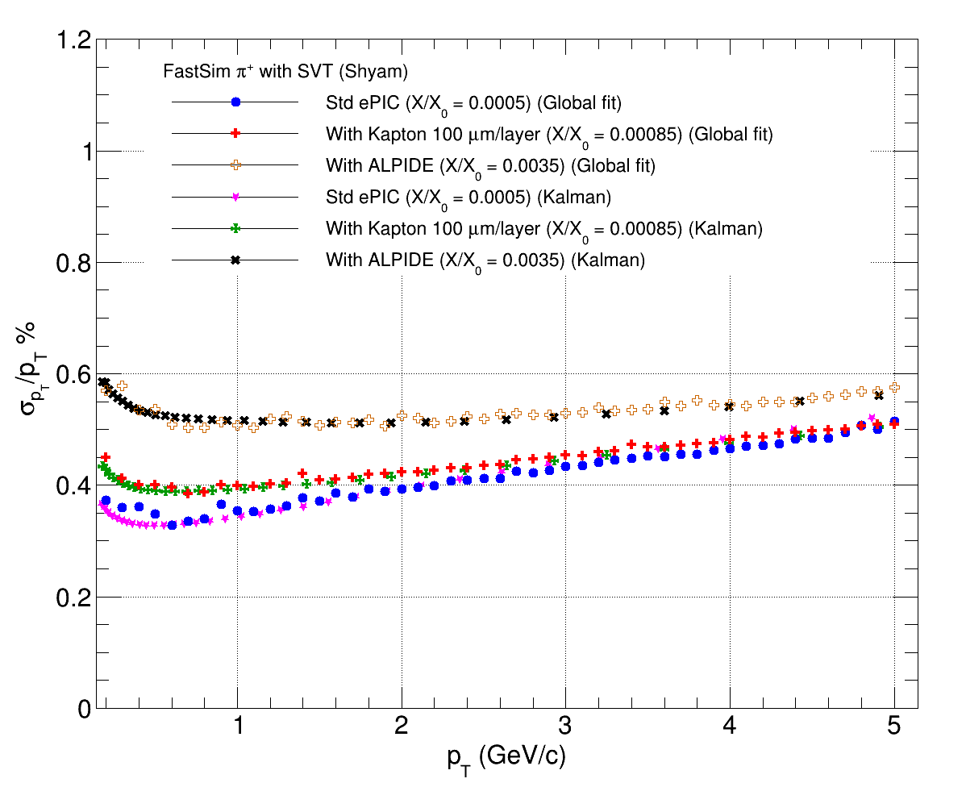
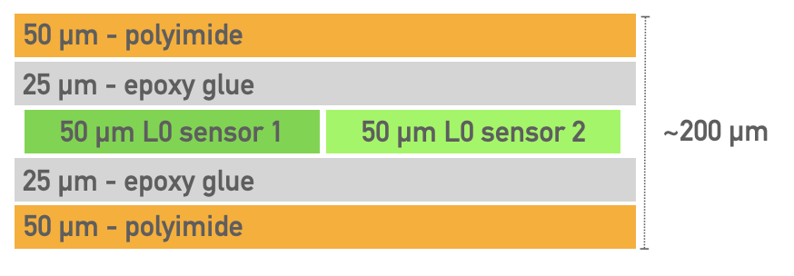
From ITS3 to ePIC SVT IB
Plan to develop bending procedure for SVT L0 (L1)
1. Embedding strategy:
maximizes overlap with ITS3 bending procedure
Limited effect of the additional material budget due to kapton foils (S. Kumar et al.)
The MAPS foil, S. Beolè et al.
(https://doi.org/10.1016/j.nima.2022.167673)
ALPIDE
ALPIDE
65 nm MAPS w/ and w/o kapton

Slide 10
From ITS3 to ePIC SVT IB
Plan to develop bending procedure for SVT L0 (L1)
1. Embedding strategy:
maximizes overlap with ITS3 bending procedure
What needs to be checked:
embedding as a way to held mechanically together the two sensors so to avoid bending them individually (stability, positioning/precision issues etc)
it would require leaving uncovered the periphery region of each sensor (i.e. at least the top foil should be smaller) to allow wire-bonding
alternatively, if a complete kapton-embedded silicon technology would show to be required/preferable, significant dedicated R&D would be needed
      → activity within generic R&D funding
    (ORNL, LBNL, INFN-TS involved)
The MAPS foil, S. Beolè et al.
(https://doi.org/10.1016/j.nima.2022.167673)

Slide 11
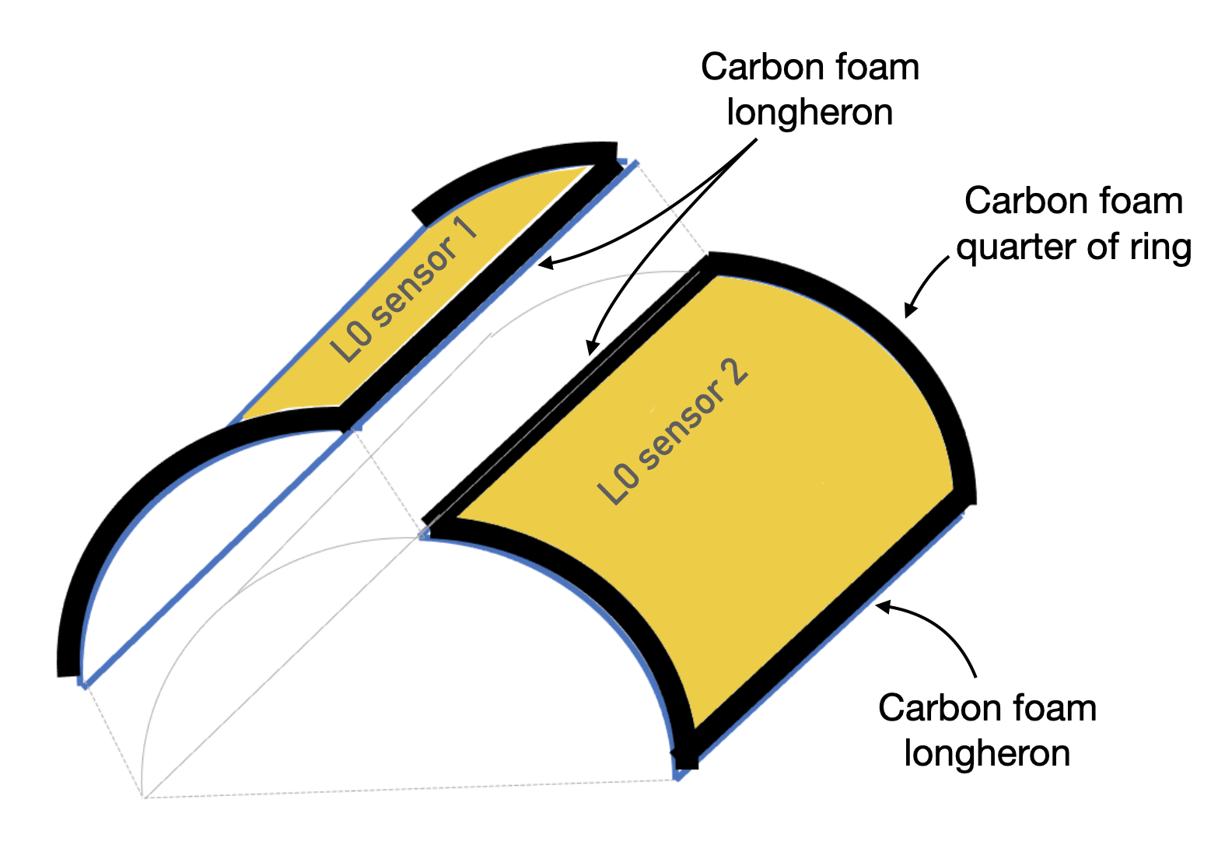
From ITS3 to ePIC SVT IB
Plan to develop bending procedure for SVT L0 (L1)
2. Independent bending strategy:
avoids complications connected to embedding
introduces further steps and potential issues on positioning procedure and mechanical stability of the bent sensors

Slide 12
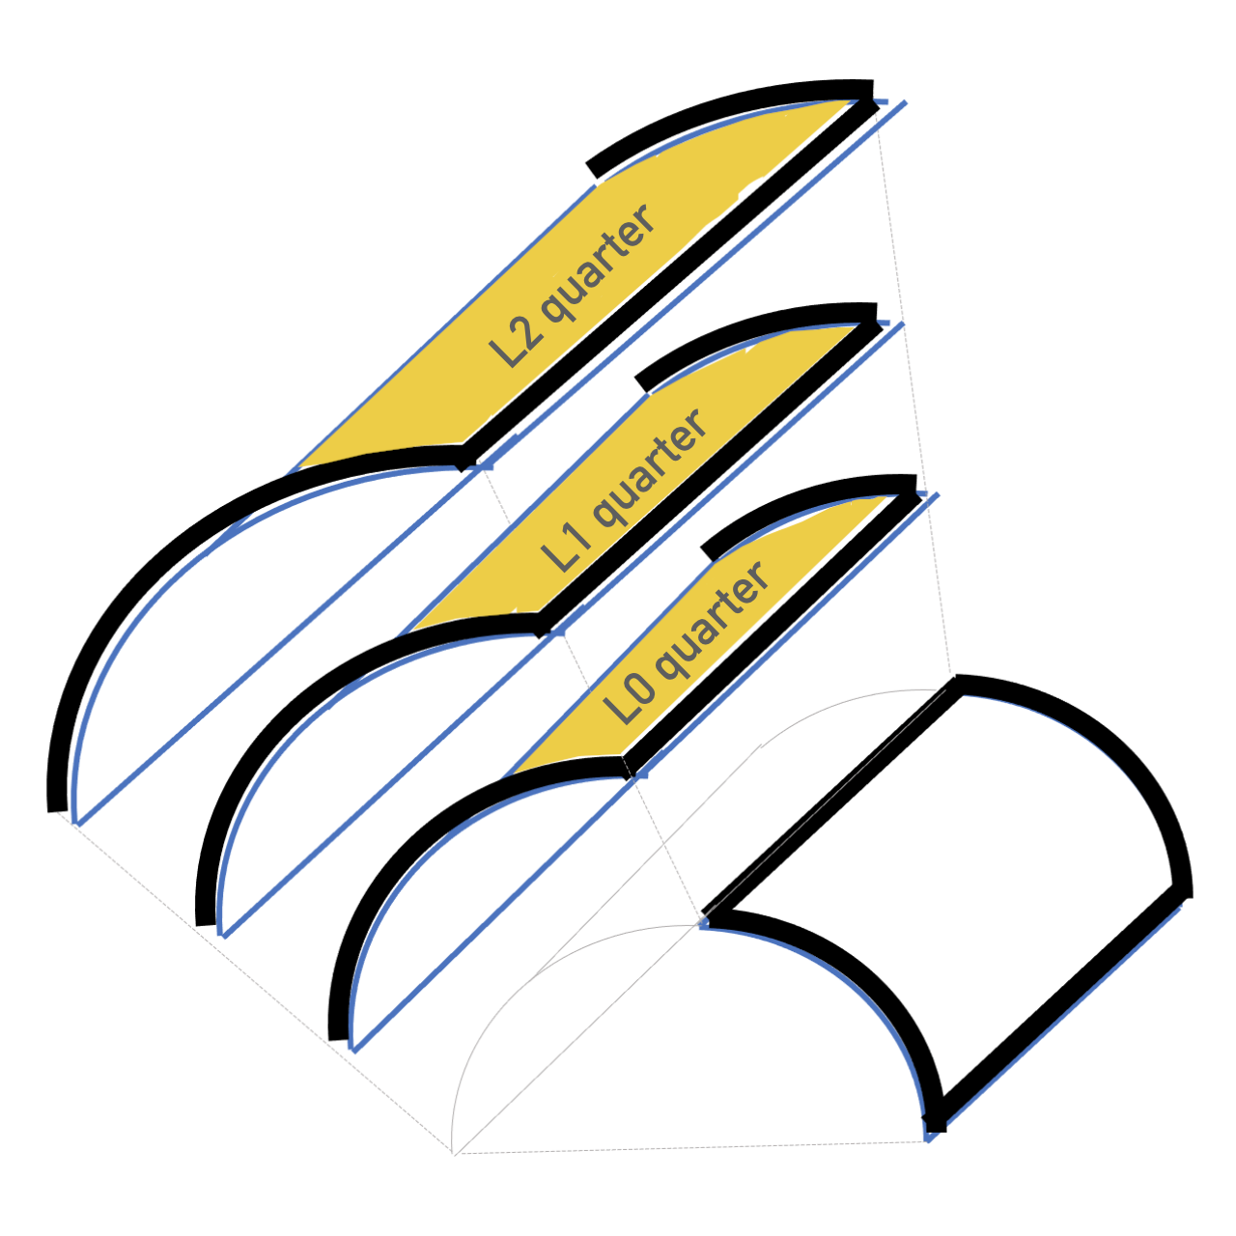
From ITS3 to ePIC SVT IB
Plan to develop bending procedure for SVT L0 (L1)
2. Independent bending strategy:
avoids complications connected to embedding
introduces further steps and potential issues on positioning procedure and mechanical stability of the bent sensors
implies that the full detector (L0+L1+L2) would be built in mechanically independent quarters to be precisely positioned together in the subsequent final assembly*
*This basically follows the same strategy used by ITS3 for bending the single sensors (kept on the mandrel by adhesive tape) and assemblying the detector (glueing from outermost to innermost) → the assemby of SVT IB will proceed in quarters of layers and not (as for ITS3) in half-layers

Slide 13
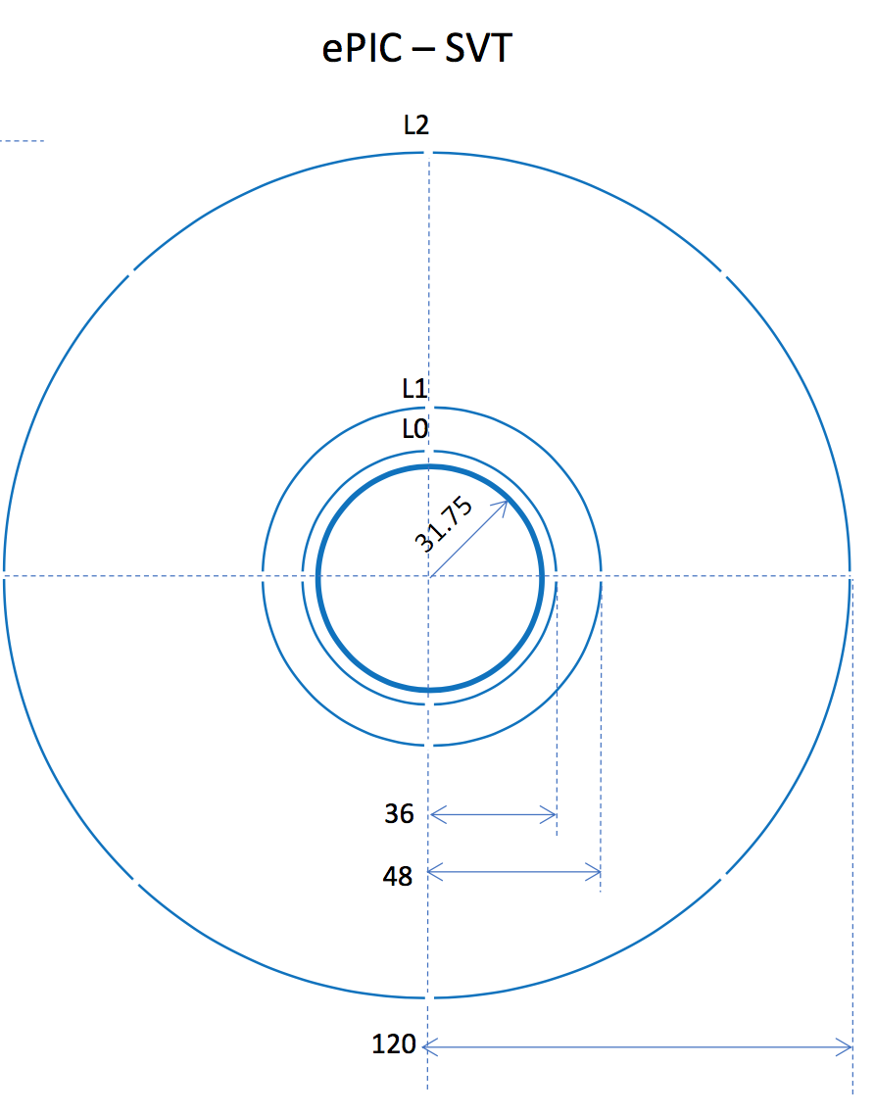
From ITS3 to ePIC SVT IB
Different approach needed for L2 wrt L0/L1
L2 sensor 2
L2 sensor 3
Bending procedure:
4 sensors for each half-layer
embedding all 4 or just 2 sensors, as well as independent (single sensor) bending, to be evaluated in connection with the next point
L2 specific issues and required development:
L2 radius quite large (~120 mm) and far away from L1 (~70 mm, compared to L1-L0 ~6 mm)
need to define mechanical connection to L1
also aspects connected to cooling (in a much larger volume) will be completely different wrt L0/L1 (and to ITS3) and will require dedicated solutions
L2 sensor 1
L2 sensor 4
L2 sensors: 5 x 12 RSU + endcaps
(L0: 3 x 12 RSU, L1: 4 x 12 RSU)

Slide 14
Towards TDR planning
List of items for SVT IB in the ePIC TDR:
Detector requirements and challenges
Detector layer components
Mechanics and cooling: design, material and production process
Detector assembly (“half-layer” and “half-barrel”)
Interconnections (linked to the FPC design)
Global support structures, services and installation
Specific tasks within WP4 where additional effort is needed:
Mechanics and cooling: design, material and production process
Detector assembly

Slide 15
First thoughts on SVT OB stave concept
James Glover, Adam Huddart, Adam Lowe, Georg Viehhauser, Stephanie Yang

Slide 16
General idea
Disclaimer: Nothing of this concept has been verified or optimized in any way
  Will talk about the issues later
  Dimensions are only indicative and need to be fine-tuned, but they are reasonably representative and internally consistent
Follow the ITS3 concept
  Bent sensor supports itself
  Only reinforced around perimeter
    LEC has highest power density and foam there is good thermal conductor (K9)
    Foam on edges (longerons) and REC are structural (3% foam)
  Over most of the area silicon is in direct contact with air flow
Try to make each element fulfil more than one functions (active, mechanical, thermal, electrical, gas flow, etc.)

Slide 17
Concept
Sensor assembly
Core of stave is made of array of foam blocks
Twin sensor
Sensor geometry used (approximate 5RSUs)
Glued with Kapton strip and some runny, hard-curing glue (TBD)
Purpose of vertical strip later
Thickness and curvature arbitrary
More on optimization later
Crossribs are K9
Central spar 3% RVC
  Could be thinned to hourglass shape
  Alternatively, carbon fibre I-beam
Edges are 3% RVC
  Alternatively, 3% Al, if we want to run the power bus through this
          In that case the Al would be in shorter sections for serial powering

Slide 18
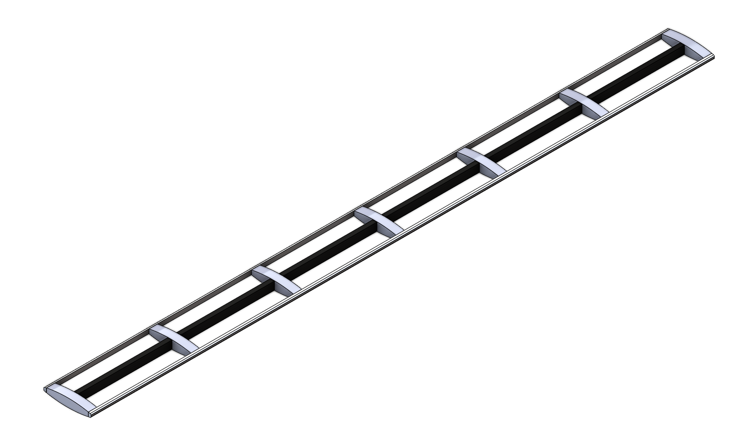
L4 stave foam skeleton
Sensors alternating on both sides, allow for
  Overlaps
  Space for connections (interposers)
LEC areas (+ ancillary chips) are backed by K9 foam ribs
  These would also mechanically support bond areas
Central spar will support joint between twin sensors and maintain curvature of sensors
Edge blocks a through-going for structure, to possibly contain liquid cooling pipe, or possibly power bus

Slide 19
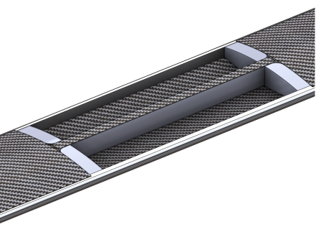
L4 stave CF covers
Surface between sensors covered with CF skin
Probably beneficial to have central, through-going strip
  This could be reinforced by additional layers
Material, lay-up and thickness needs to be optimized
  We will start with UD K13C2U (45 gsm, 65μm per layer) as in ATLAS, but we have access to thinner material
  Thinner material would give us the possibility to use several layers with different orientation
Ideally, we would like to co-cure the skins with the foam skeleton
  Either use upper and lower mould that support the on the other side
  Or use inflatable bags
Material will be cut to shape before cure
After co-cure/bonding this structure should be self-supporting
Preliminary CAD model
Probably skin will cover rib under REC

Slide 20
L4 stave side covers
The sides of the stave need to be covered
This could be a simple Kapton C-channel
But even better, this could be the FPC, with doglegs folding over
  This will lead to interplay between FPC width and stave thickness
  The ancillary chips should be on the dogleg and placed inline with the sensors
    In this way they can share the backing with K9 foam for heat removal
Could also be part of the CF-foam skeleton co-cure (saves glue)

Slide 21
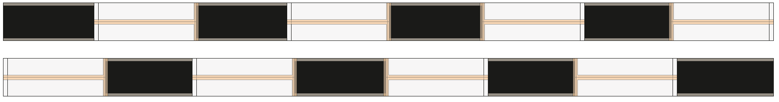
L4 sensor mounting
Sensors are placed over empty gaps
  Suspect that we will use a concave vacuum jig
    Sensors will first mounted on matching convex jig and then transferred
  Glued around perimeter with some runny (for wicking action), hard-curing glue
    Under the LEC we will need some epoxy loaded for thermal conductivity
Sealing at the REC done with Kapton strip
  This also will make a good mechanical bond
Need more thinking on LEC
  Need to understand where the bond pads are, and how far from the edge and whether similar strip (possibly smaller) is possible…
Sensors will need to be electrically insulated from foam and carbon fibre

Slide 22
L4 cylinder
Will investigate options for annular linking
Might be beneficial to couple staves with some damping material (soft foam) to dampen air-flow induced vibrations

Slide 23
Air flow cooling
For L3 stave (four 6-RSU LAS per length, 2 side-by-side): 20 W
  Without ancillaries (shunt-LDO, etc.)
  Requires 1.5 l/s
    Isobaric volumetric heat capacity of air (Sea level, dry, 0 °C) c_{P,v} = 0.001297 J/Kcm³ (from Wikipedia) and ΔT = 10 °C
    Assuming the core has cross-section 40×5 mm², and is 540 mm long, that’s about 0.1 l, so we need 15 volume exchanges per s or a flow velocity of 7.5 m/s
For L4 assume 40 W per stave
  Requires 3 l/s, and thus 15 m/s
Compared to ITS3 power for L4 is about 4× (excl. ancillaries)
Flow velocity can be decreased if stave becomes thicker
Suspect that K9 ribs will equalize temperatures and mix flow
  But this will need to be verified with CFD and prototypes
It might be beneficial to use a counter-current air flow (to equalize temperatures)
  In that case we need a central barrier (could be a carbon fibre spar, instead of foam backbone)

Slide 24
Issues and questions
Dimensions
  In particular thickness
    FPC, stiffness and air flow requirements will push for larger thickness, material (also overlaps) for lower
Sealing of air channel
  In particular at the LEC
Can we wire-bond on curved surface?
  Suspect that this should be possible, because ITS3 does require this, too…
Can we wire-bond on a backing of K9?
If we want to pursue the power bus through edge foam then electrical isolation is going to be interesting
  Maybe anodizing is a solution, but then how do we maintain capability to connect
  Not clear what length Al foam is available (might need 3 sections, how to electrically connect…)
How much will the structure wiggle when the sensors start to produce heat (due to differential CTE and non-uniform temperature)
If air cooling is insufficient we could introduce cooling pipes in either the central backbone or the edge blocks
What vibrations will the air flow introduce? What stiffness is required to keep stability at acceptable level?
And probably many more… Inputs welcome

Slide 25
Next steps
Immediate main activities
  Further detailing of model
    In particular integration with FPC
  Design of tooling and development of production procedures
  FEA of mechanical performance
    This has started already, but too early to show
    Benchmark is going to be the 1st mode frequency
  CFD of air flow and FEA of thermal performance
  Get started on integration and global OB structures
    This will include air flow distribution
Plan to build prototypes by early summer
  We have secured first funding pots, so will be able to start procuring materials for this

Slide 26
Disks
Nikki Apadula, Ernst Sichtermann and the LBNL engineering team

Slide 27
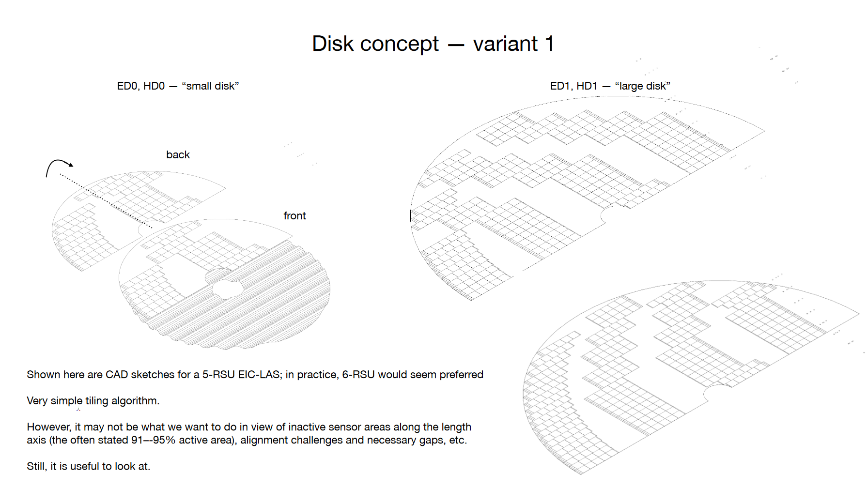

Slide 28
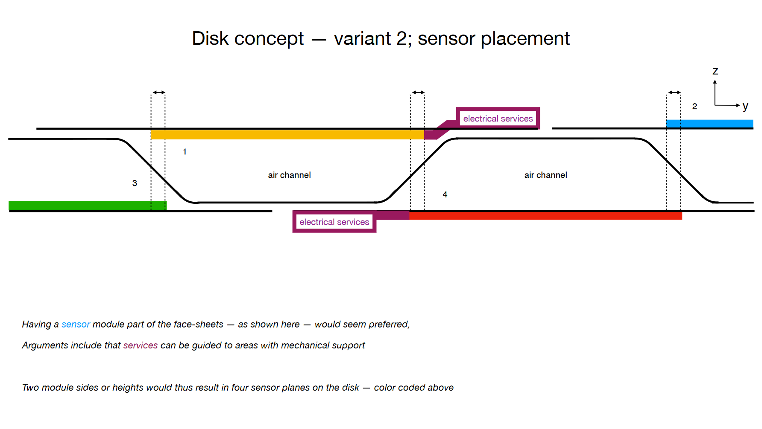
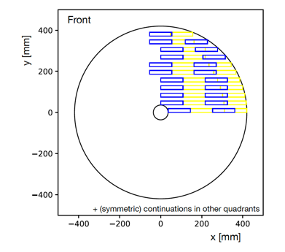
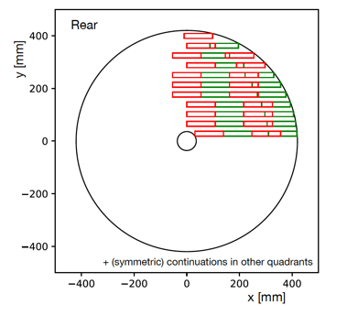

Slide 29
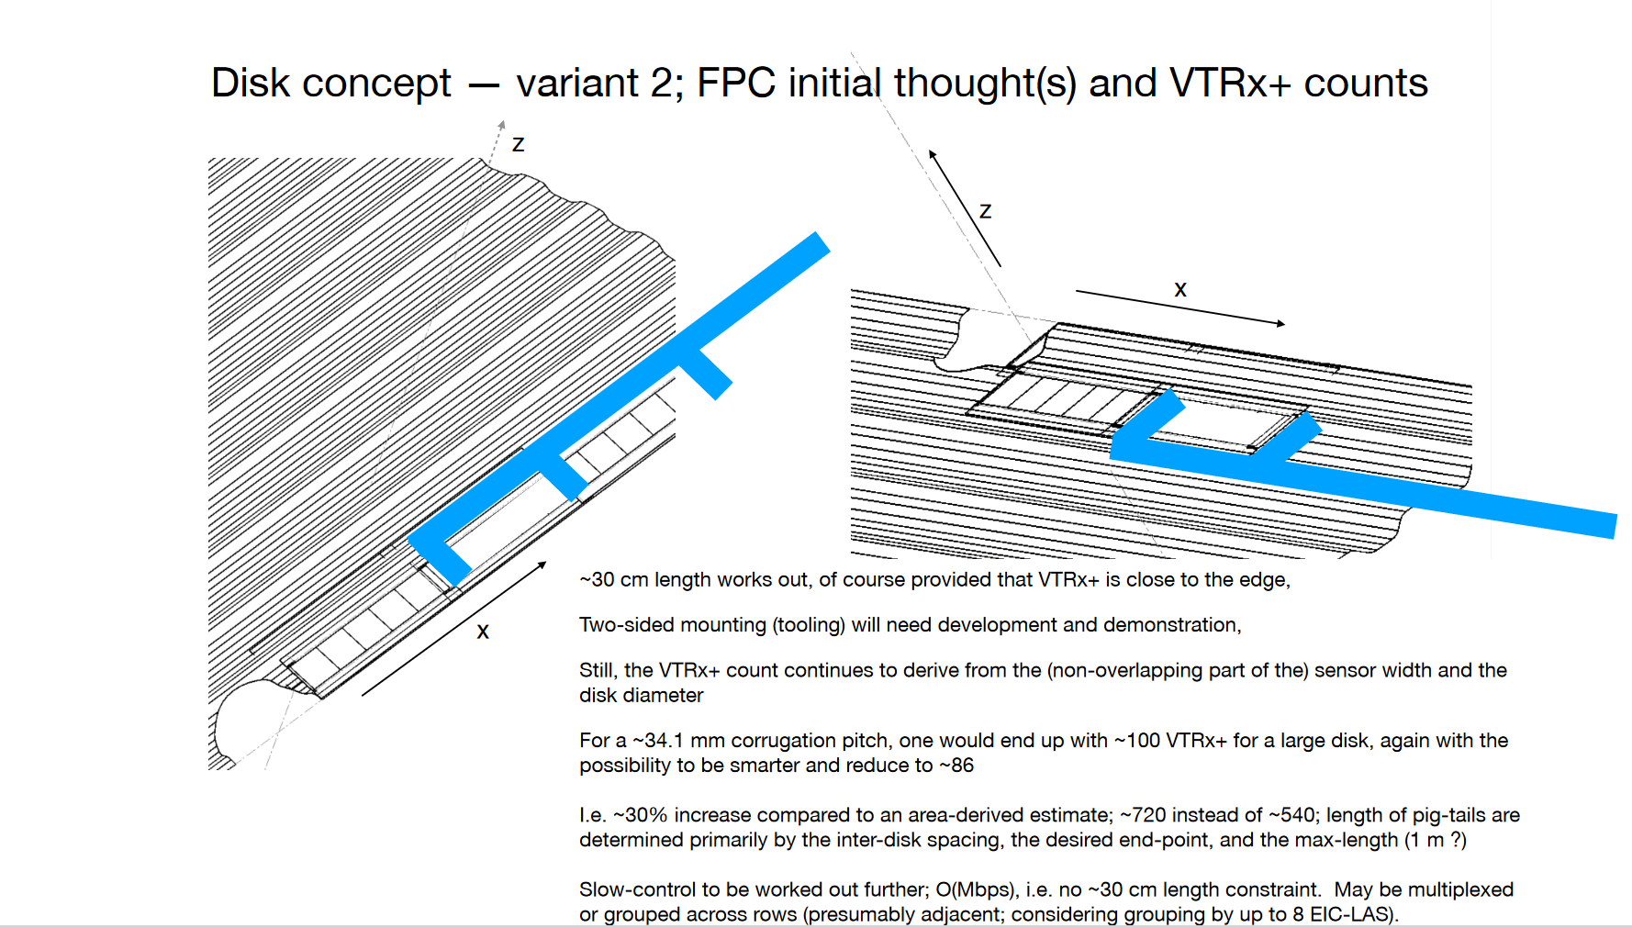

Slide 30
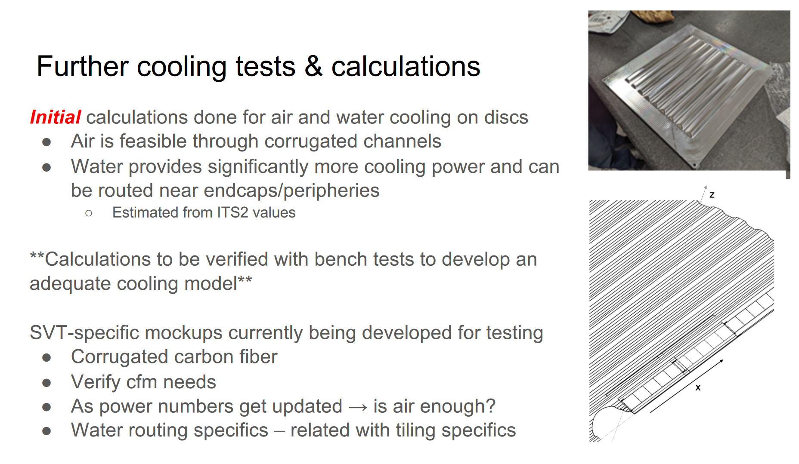

Slide 31
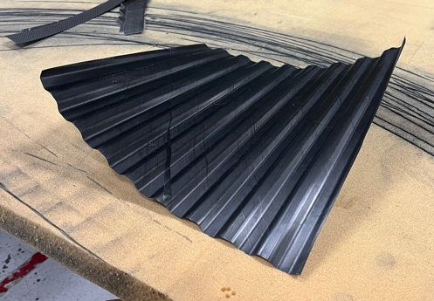
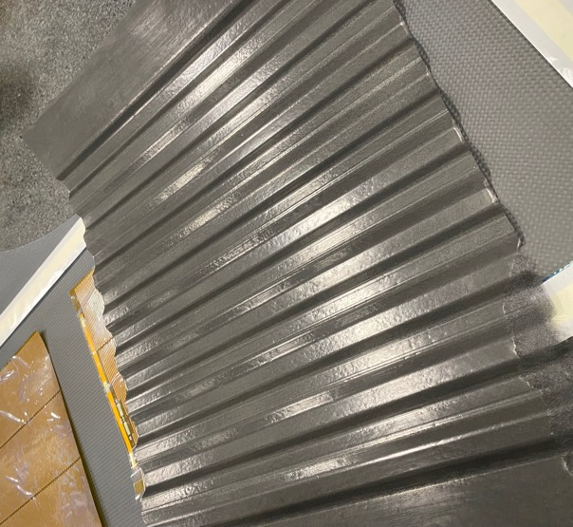
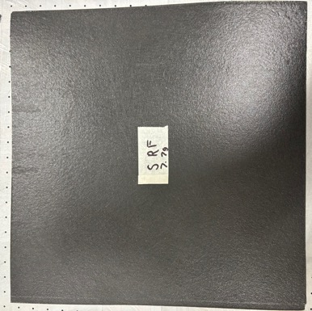
Towards a corrugated test piece
Many iterations over the past few months
45 gsm uni-directional (-45, 0, 45) → twisted
34 gsm veil with varied resin layers
  Opted for 2 layers of veil + 5 layers resin
Ongoing: wet layup with epoxy resin

Slide 32
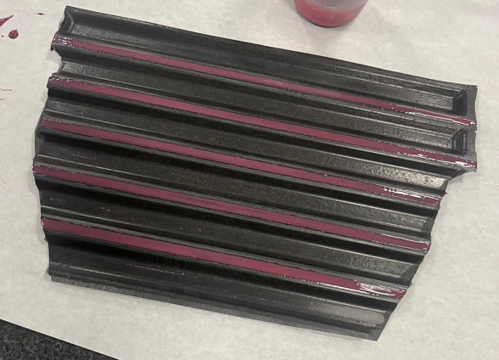
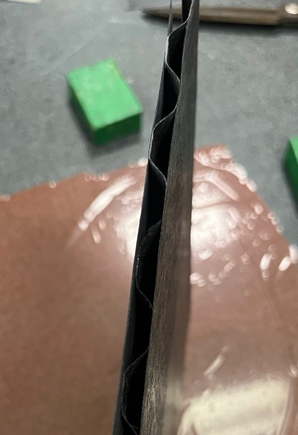
Corrugated prototype test pieces
Each piece → 2 layers 34 gsm veil + 5 layers resin
Face sheets glued with 9309 adhesive in 5 mm strips
Final size of prototype test piece = 22.4 cm x 20.2 cm
Final weight of prototype test piece = 22.5 g
Density = 497 gsm → ~ 0.12% X/X0
Silicon ~0.05% X/X0, adhesive 0.01-0.02% X/X0
First Prototype

Slide 33
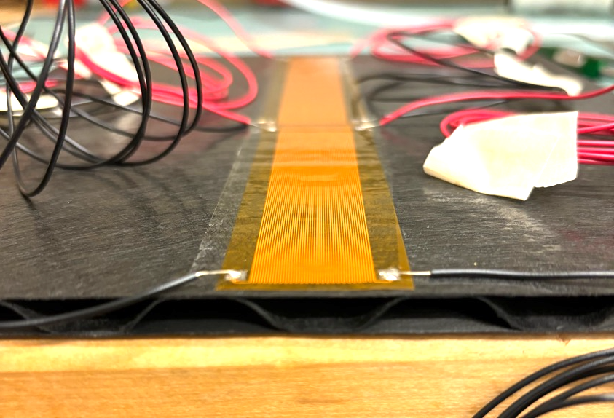
Corrugated carbon fiber thermal tests
Two heaters with separate power zones for LEC (~1W/cm²) & matrix (~40 mW/cm²)
Using 3M 467MP double-sided tape, 60μm thick (used to glue silicon for STAR HFT PXL)
First step: Put a tube in corrugated channel and blow air through

Slide 34
Towards a disc design – not exhaustive
Corrugation
Refining the prototypes → different layups, different glues, different gluing techniques, etc.
Mechanical stress test & FEA
Making a face sheet out of module sized pieces → what does this do to the structural integrity? The cooling?
Finalize pitch and thickness of the corrugation → direct implications on the sensor overlap and acceptance
Global mechanics
Models/design on connection to global support
Services
Work with WP3 on FPC design → how it runs along the face sheet, how they come off the end of the disc
Cooling → modeling a “duct” system inside the corrugation. Think about foam/water as necessary. How affected are the discs by bake-out?

Slide 35
Overlapping activities

Slide 36
Thermo-mechanical dummy sensors
We all will need to build prototypes with sensors that behave mechanically and thermally (power load) realistically
By using the same design we can also make results comparable
ITS3 (Corrado’s group) has such dummy sensors, and used them in their half-barrel ITS3 prototype
  50 μm Si, laminated to Kapton/Cu for heater
  I think these have been supplied by Rui de Oliveira (CERN)
  I have started to make enquiries whether we can get similar devices
    With modifications of geometry to reflect latest sensor designs
Plan is to procure
  For IB: enough for one half barrel (2 off L0, 2 off L1 and 4 off L2 + spares)
  For disks: 20 off LAS with 5 RSU
  For L4: enough for one stave + spares - 20 off LAS with 5 RSU
  For L3: enough for one stave + spares - 12 off LAS with 6 RSU
On timescale of 2 to 3 months

Slide 37
Prototypes for TDR
IB: Protoype half a barrel, although not necessarily together
  L0 & L1 to study assembly (double-sensor geometry) and heating equivalent to beampipe bake-out
  L2 & carbon fibre cylinder to study assembly and cooling
OB: Prototype a L4 stave
  Study assembly, mechanical and thermal performance using air cooling
Disks: Prototype a suitable section
  Study assembly and thermal performance using air cooling
I think the aim should be that these prototypes will be built during the summer

