Slide 1
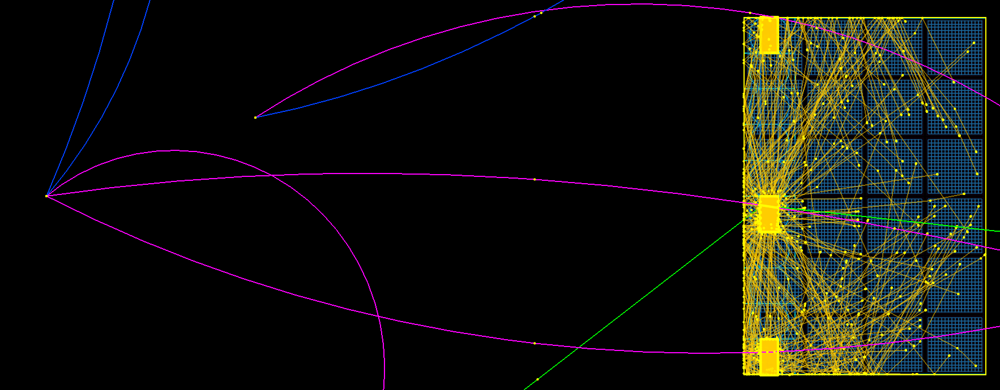
hpDIRC performance with particle backgrounds
outline:
- clean PID with an hpDIRC
- PID performance underneath pythia8 events
- PID performance with additional primaries hitting same bars
w.j. llope
1/XX/2024

Slide 2
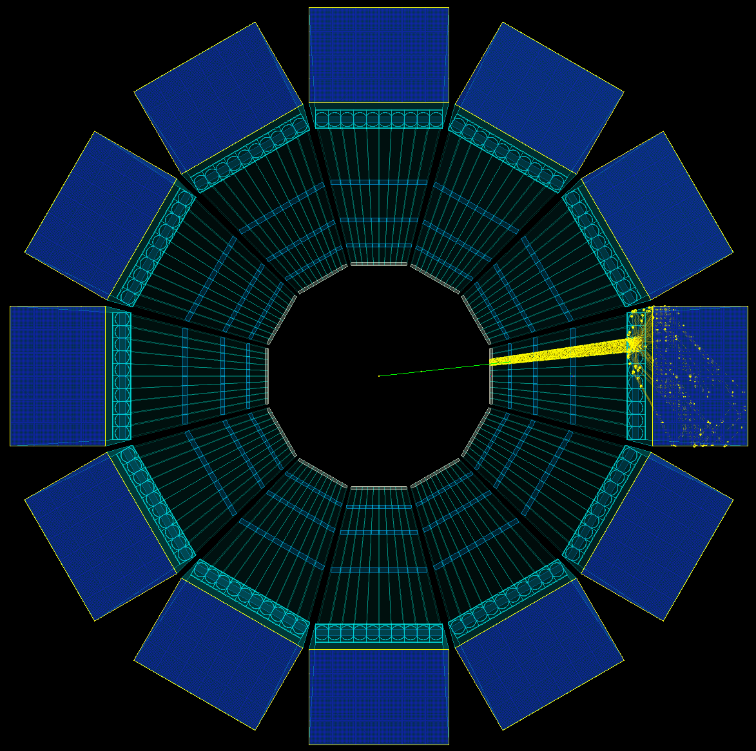
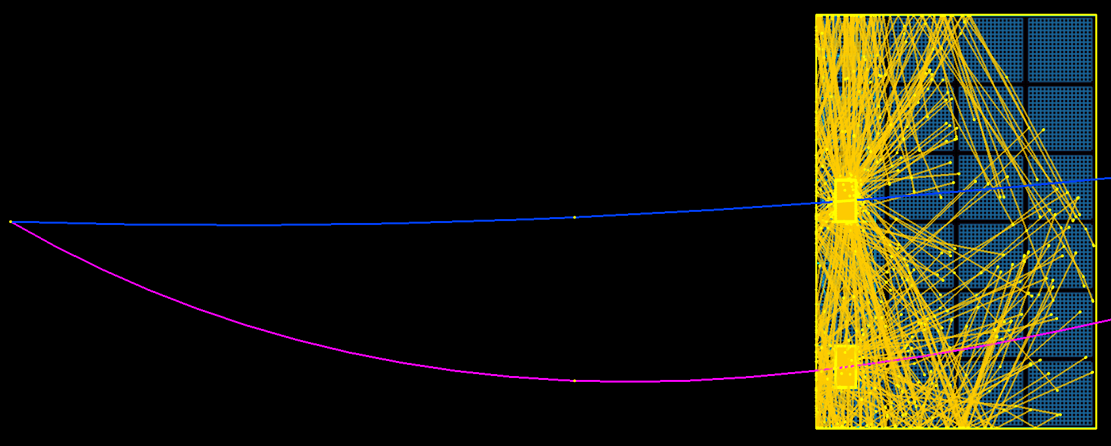
hpDIRC simulation geometry
Rinner = 700mm
12 boxes, 10 bars per box
bar dimensions 35x17x4200mm
10 3-layer lenses
4x6 MCPs, 16x16 pixels (3x3mm)
eicdirc: R. Dzhygadlo
PMT time resn: 0.1 ns
time cut const: 0.2 ns
tracking resn: 0.5 mrad
bar 9
8
7
6
5
4
3
2
1
0
“POI”
another track causing confusion
(from pythia event,
or at a controlled relative position/momentum)

Slide 3
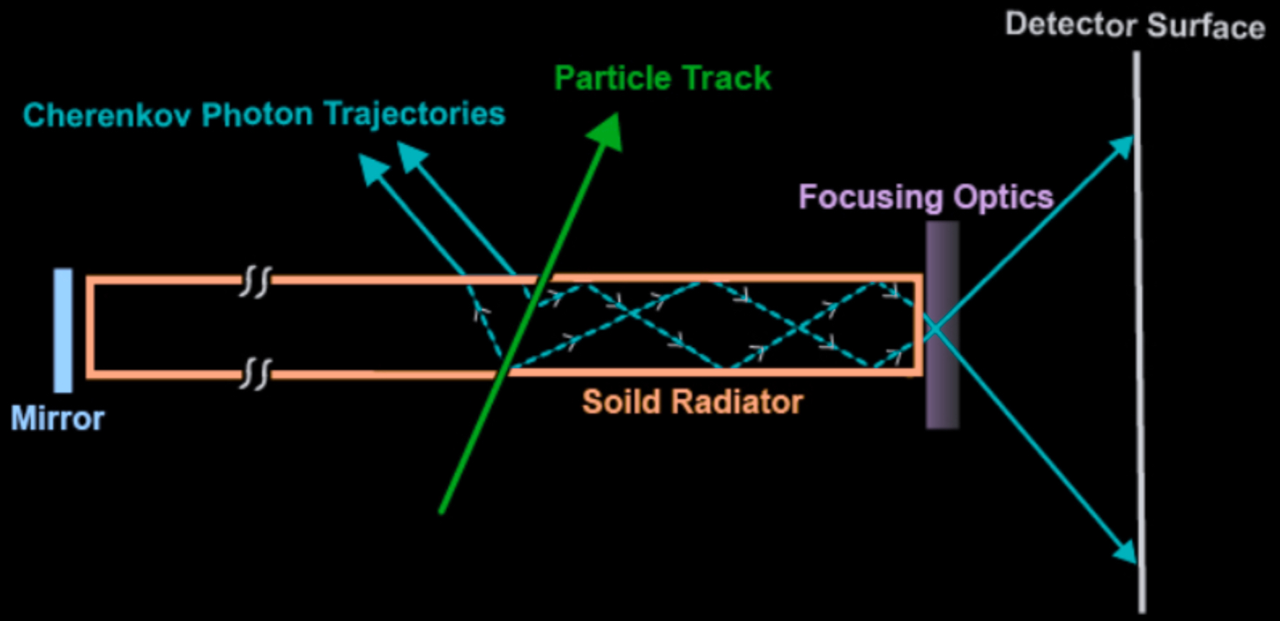
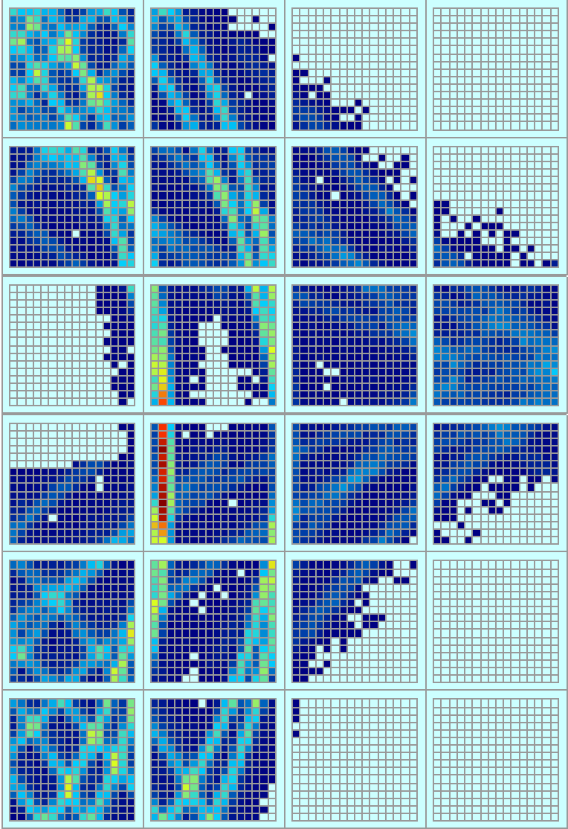
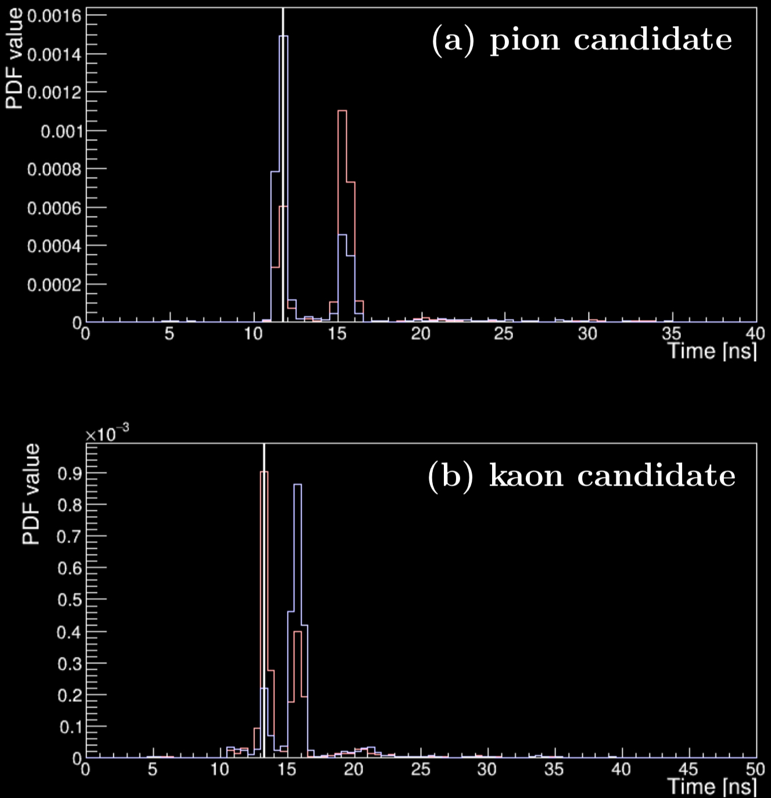
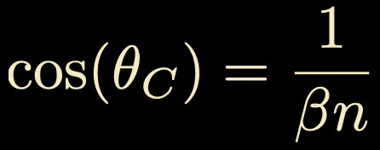
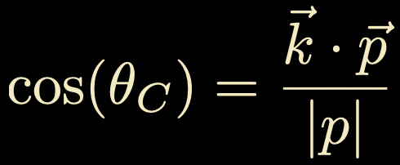
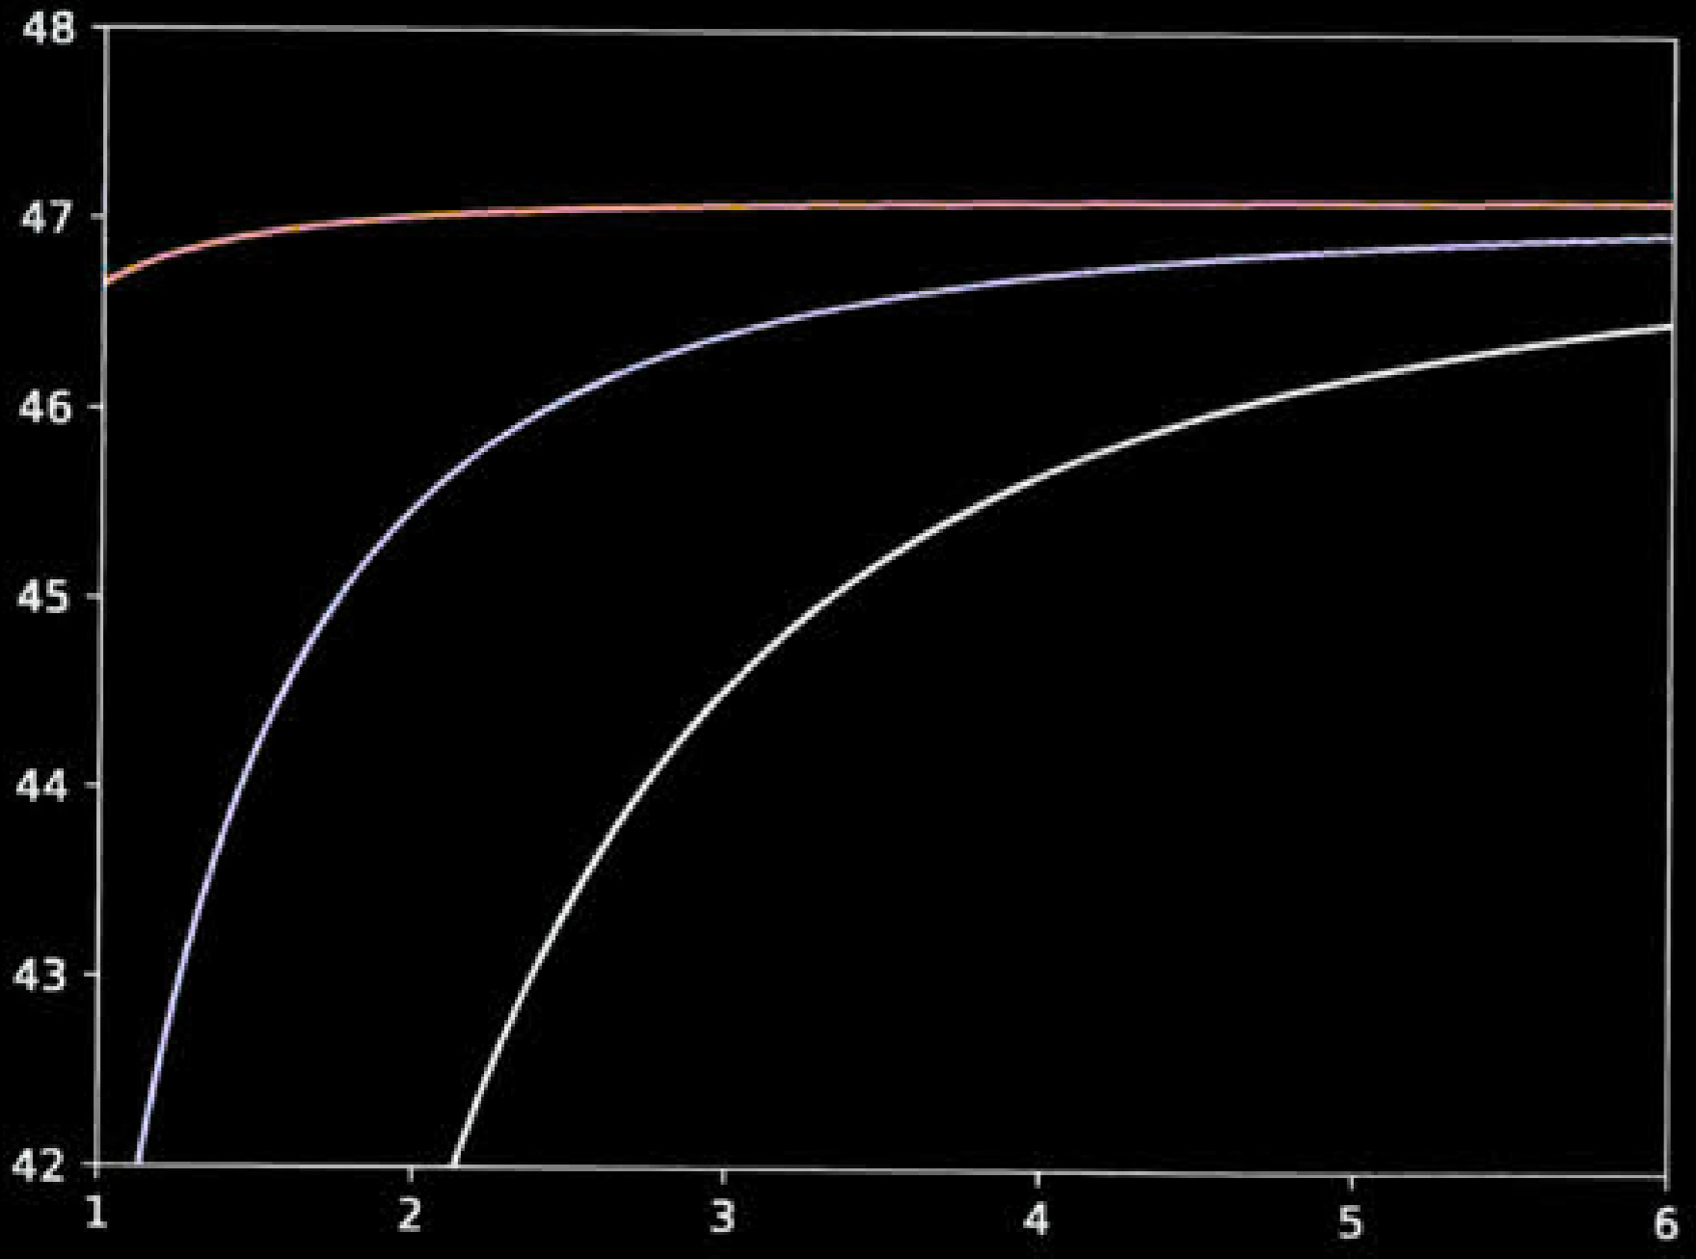
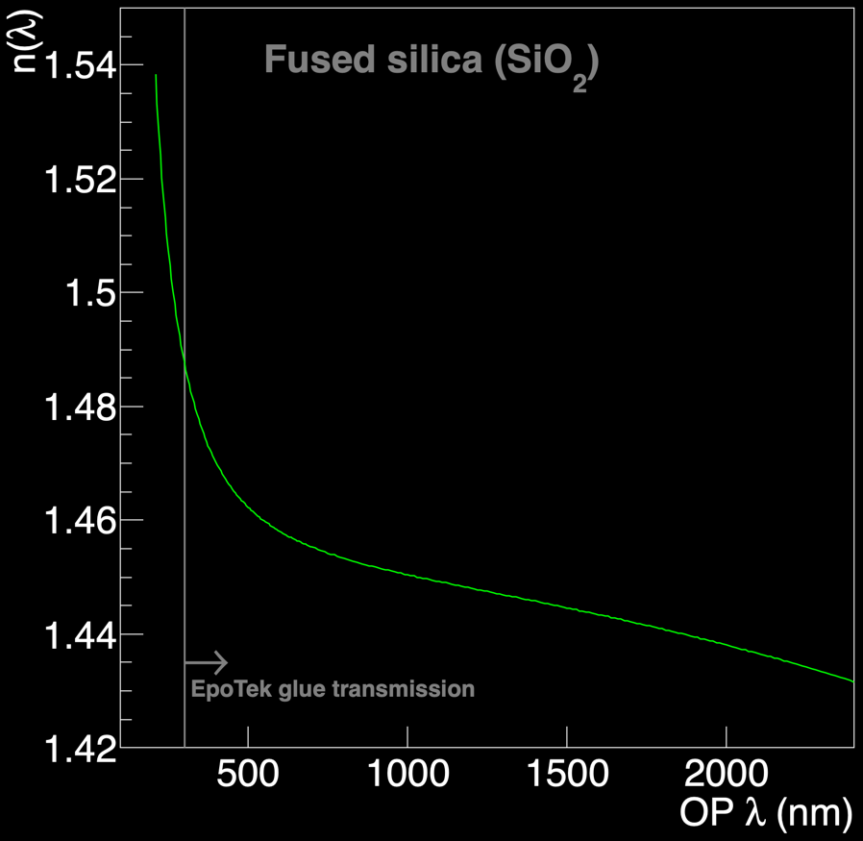
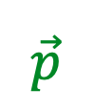

PID using the DIRC technique
Optical photons have different colors,
which travel at different speeds in bars.
Time Imaging uses this info! (hit time)
bar
$$\vec{p}$$
$$\vec{k}$$
θ_{C} (deg)
π
K
p
Ε (GeV)
Form library of PDFs of arrival times of OPs at pixels.
Calculate LL over all lit pixels.
chromaticity limits resolution
of direct measurements of θ_{C}

Slide 4
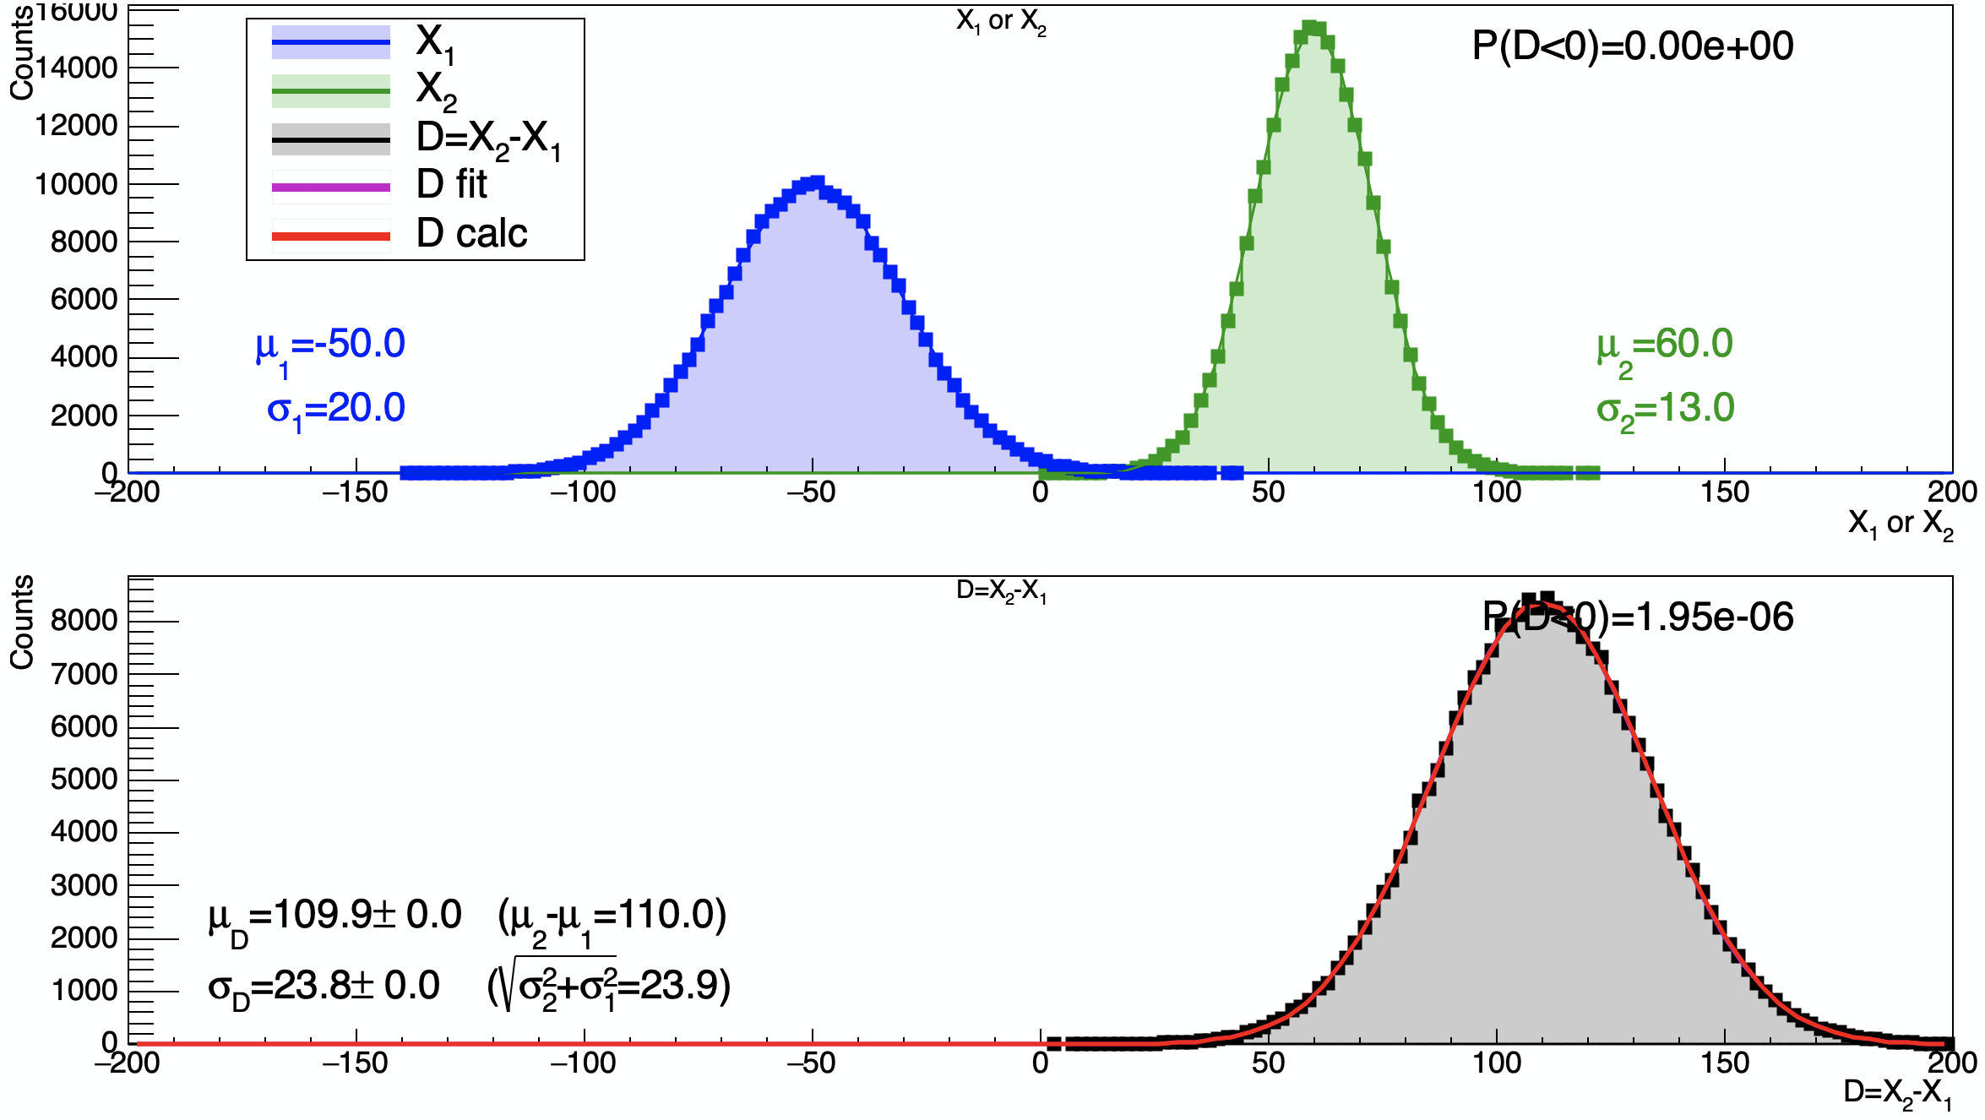
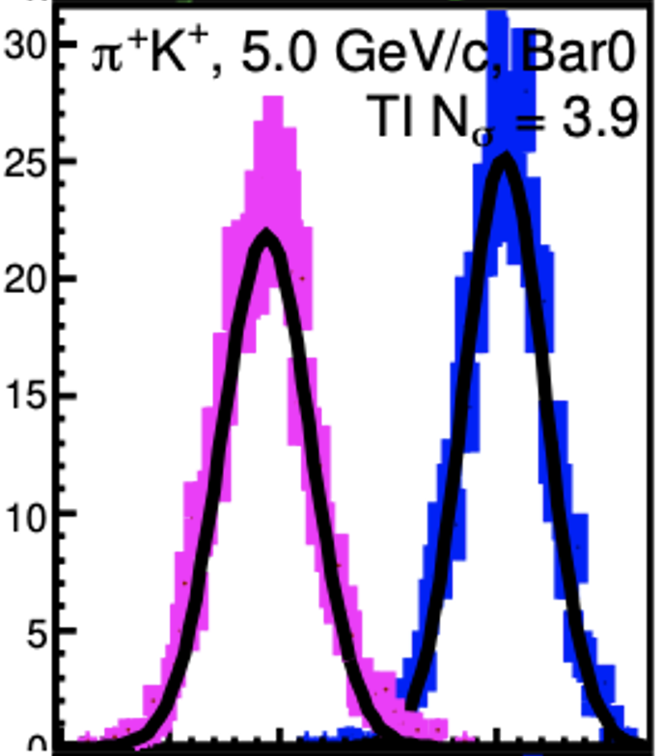
Nσ calculation
if RV X₁ is Gaussian:
and RV X₂ is Gaussian:
then their difference:
is a Gaussian RV with pdf:
“Separation power” (eicdirc)
quadrature sum vs arithmetic average in denominator...

Slide 5
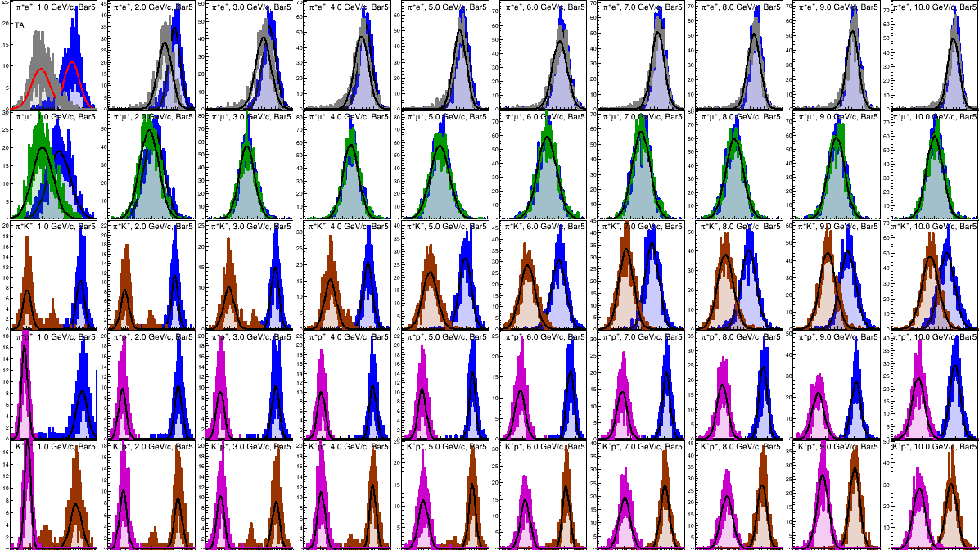
θ=30
Bar5
1GeV 2 3 4 5 6 7 8 9 10
counts versus log-likelihood

Slide 6
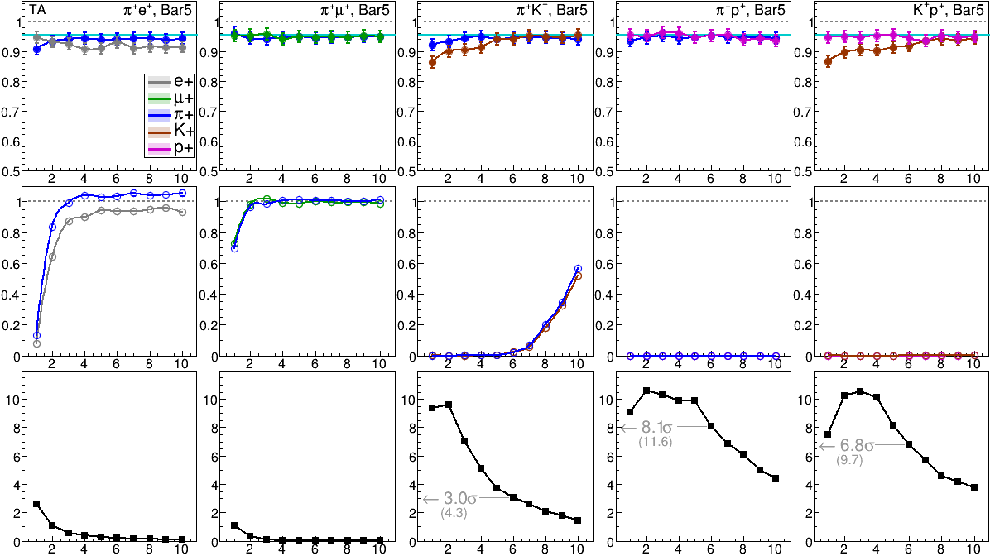

Single particle PID (no backgrounds), Bar5
CLEAN
efficiency
background
performance
($Nsep)$
momentum (GeV)

Slide 7
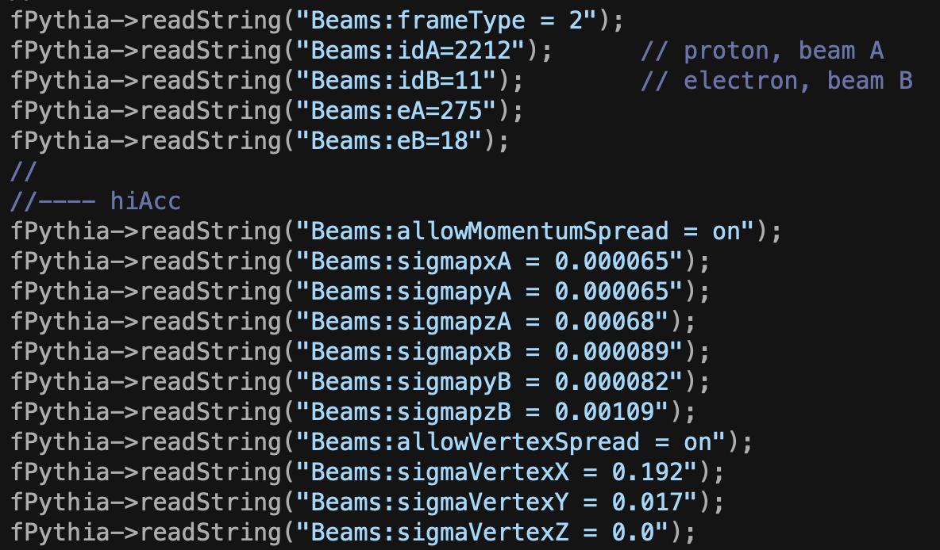
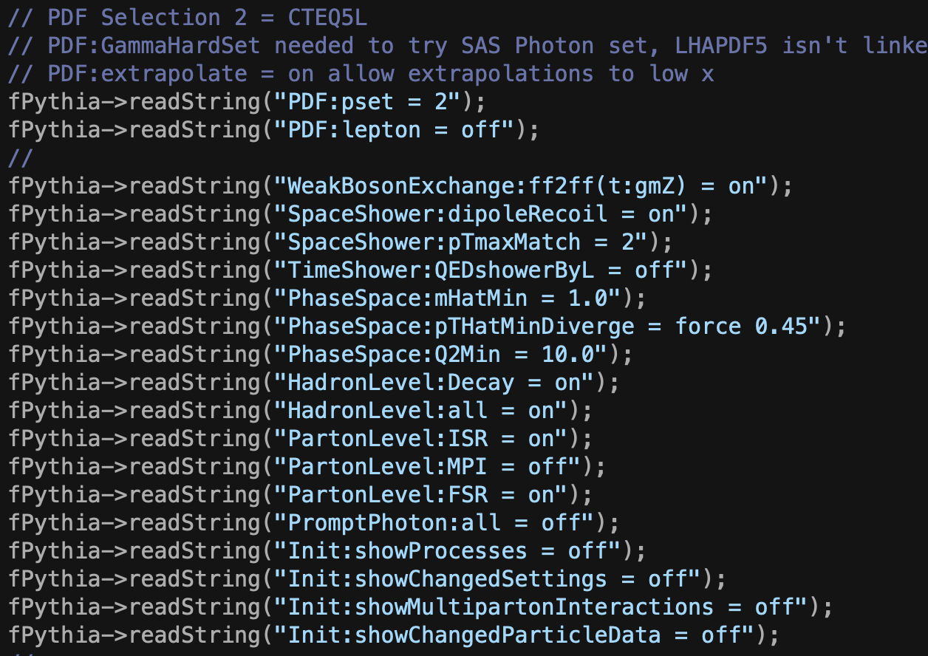

Pythia 8.309: e+p, 18x275 GeV
Beam incidence angles/divergence and
pythia physics flags taken from github
github:eic/SimuBeamEffects (thanks Brian Page!)
- pythia does the decays (Λ, K_{0S}, etc)
- FS particles added to G4 event at the
pythia production points
(V0 daughters properly added to G4 - next page)
- zerobias vs ”minbias” event trigger
- all DIRC studies done with trigger:
$≥$1 charged particle
with |η|<1.6 && ptot>0.25 GeV/c
- Each G4 event has
a single POI(species,ptot,theta,targetbar)
  plus one triggered pythia8 event

Slide 8
pythia does the decays, G4 knows where they are, and daughters light up bars...

Slide 9
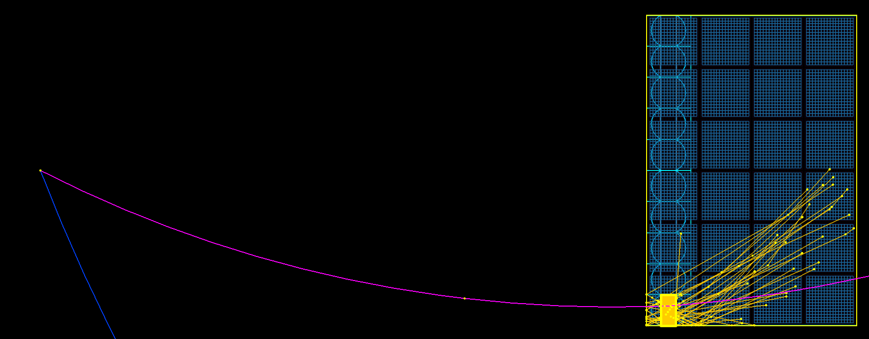
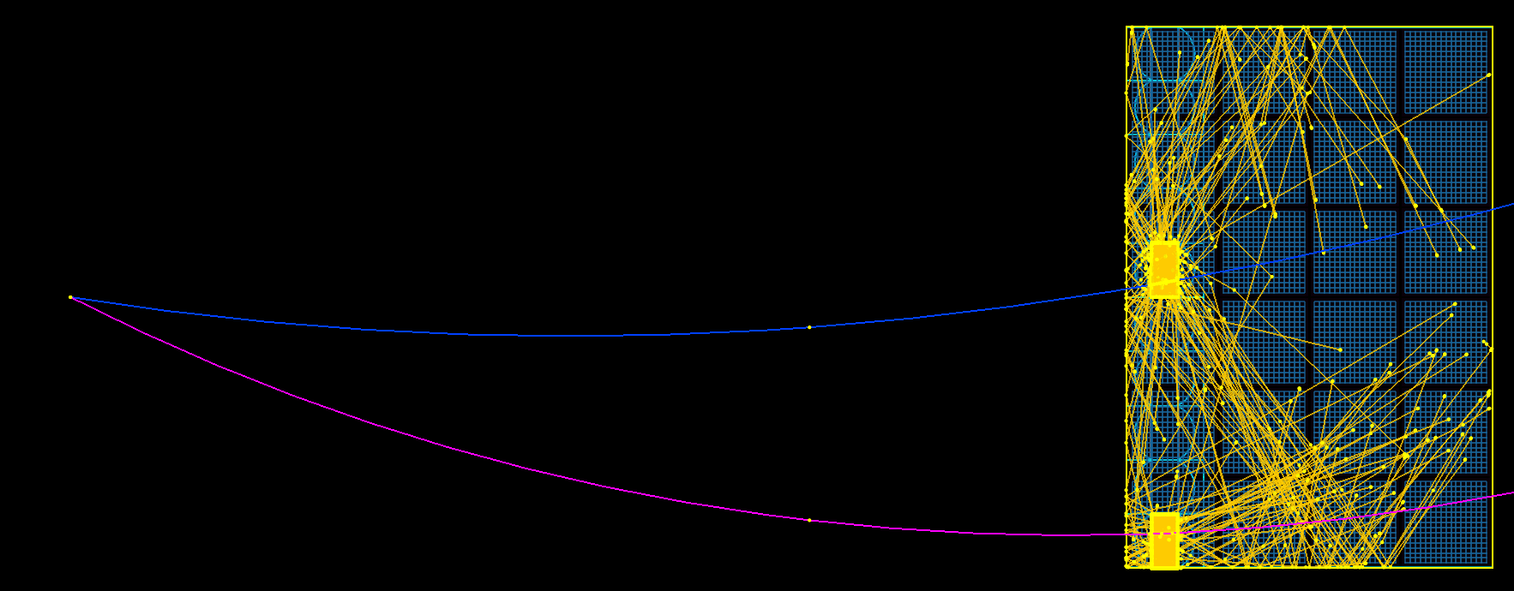
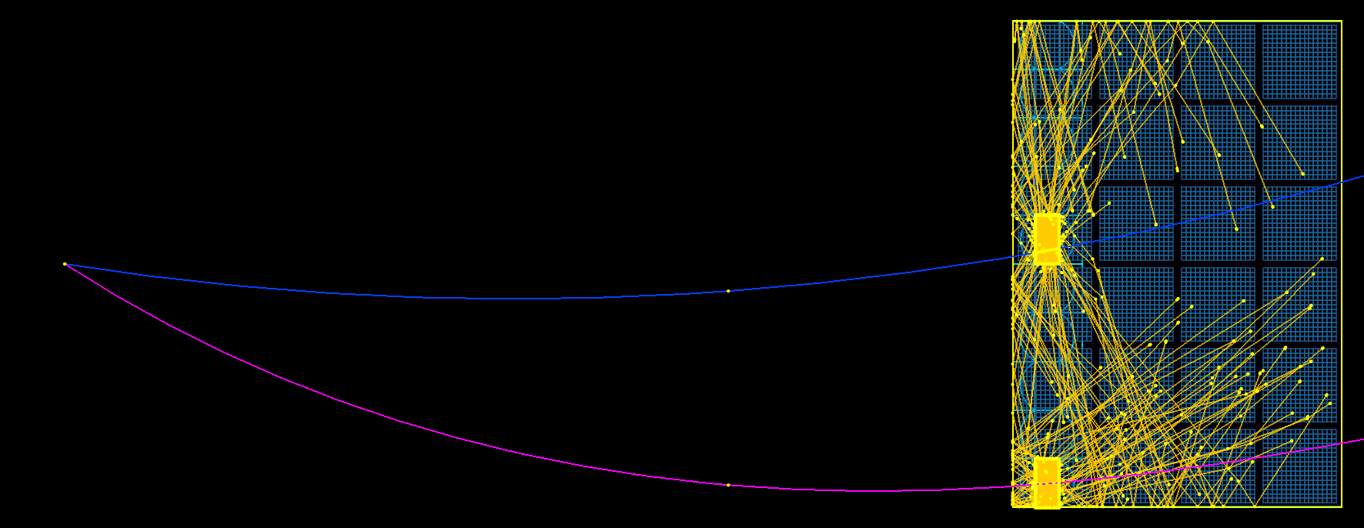
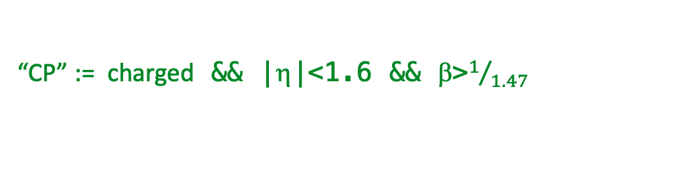
these examples all have the primary POI @ Bar=0
Adding pythia8 to the G4 event:
Pythia
All triggered events
No rotations
Same, but with a rotation:
Find sector with highest-pT particle
Rotate event to put that sector at φ=0deg
Same, but with a different rotation:
Find sector w/ most Cerenkov’ing Particles (CP)
Rotate event to put that sector at φ=0deg
Pythia RotSect
Pythia RotNCP
“CP” := charged && |η|<1.6 && β>$1/{1.47}$

Slide 10
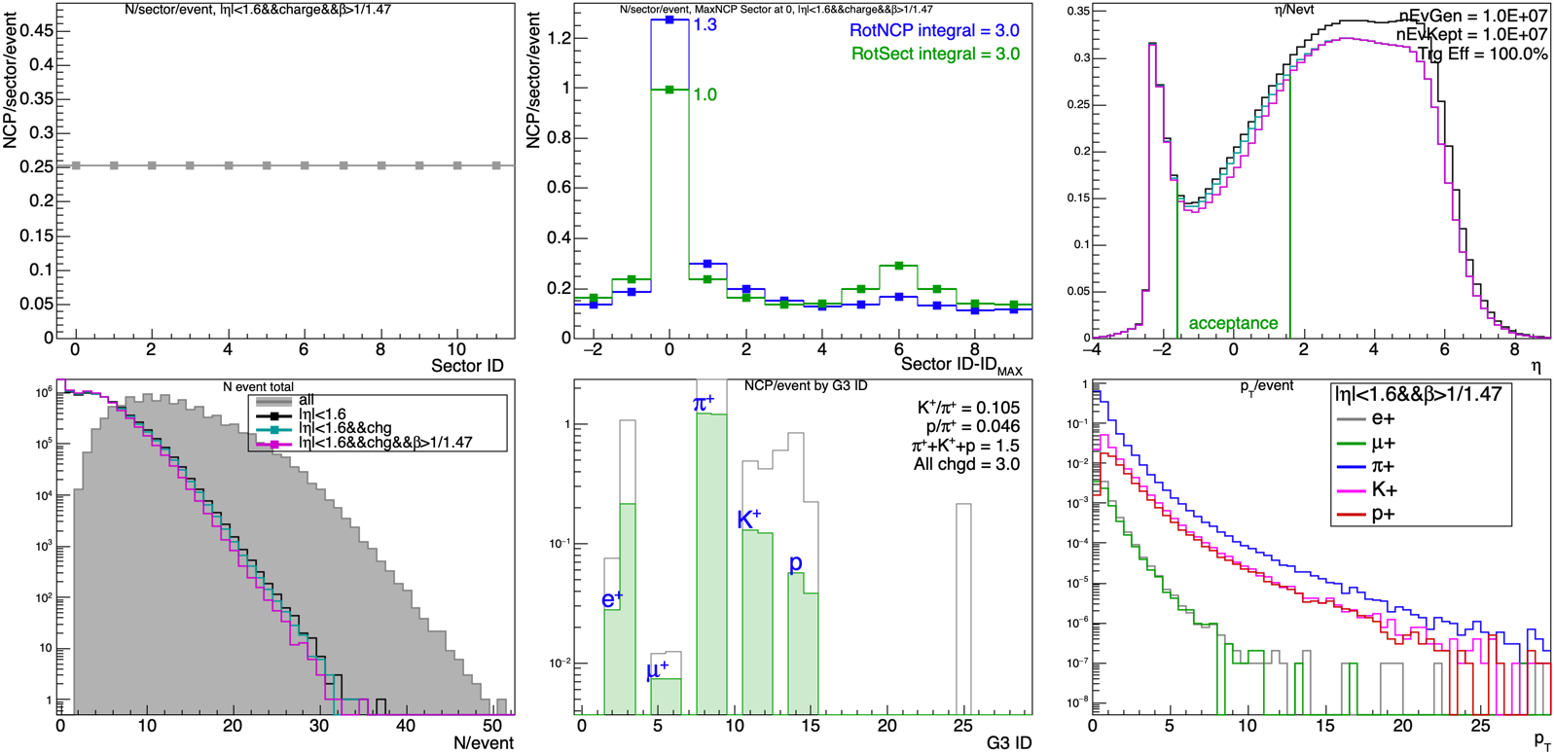
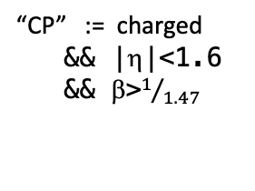
pythia, Zero Bias, 10M events
“CP” := charged
&& |η|<1.6
&& β>$1/{1.47}$

Slide 11
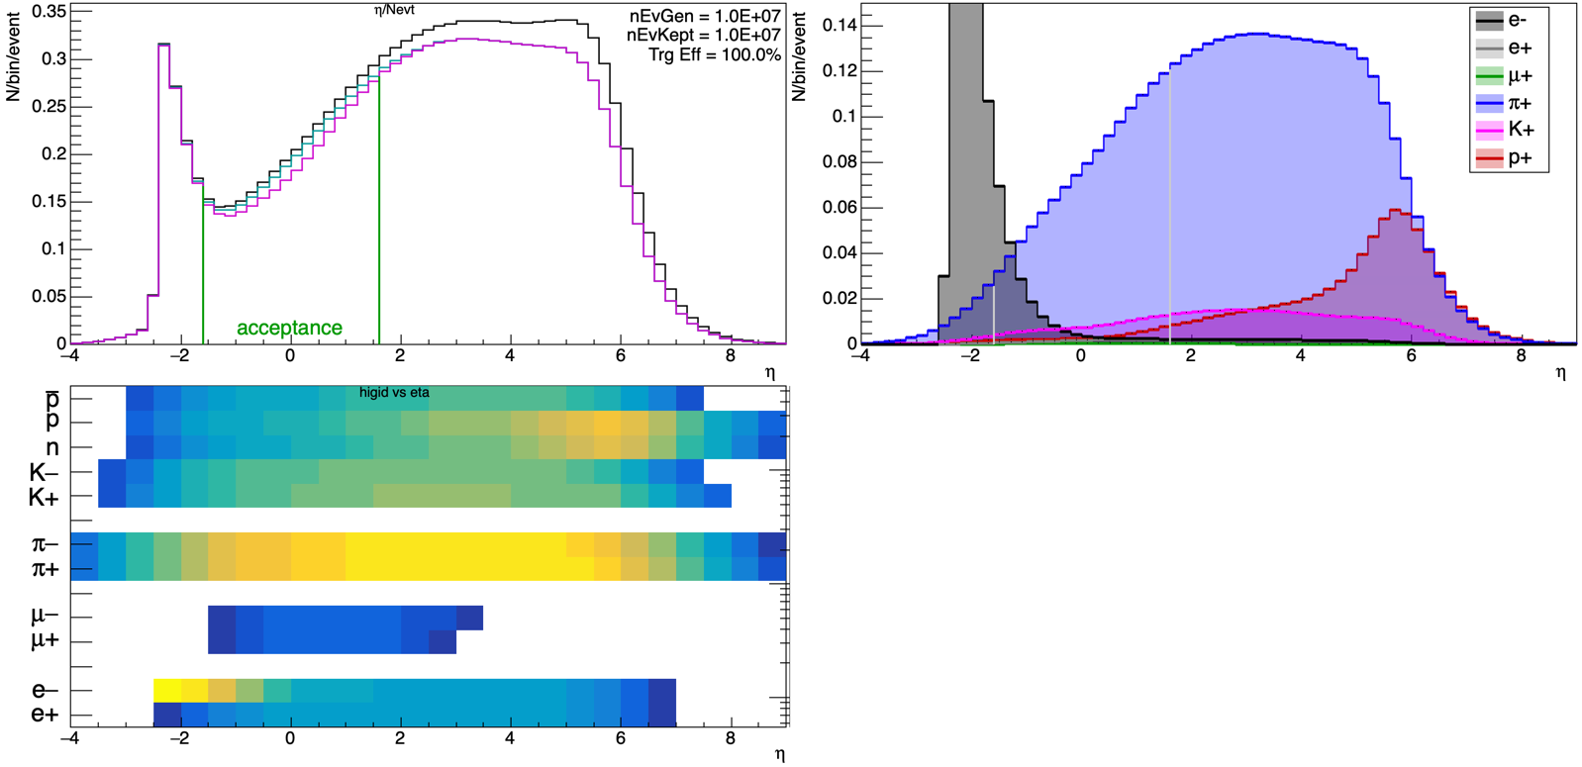
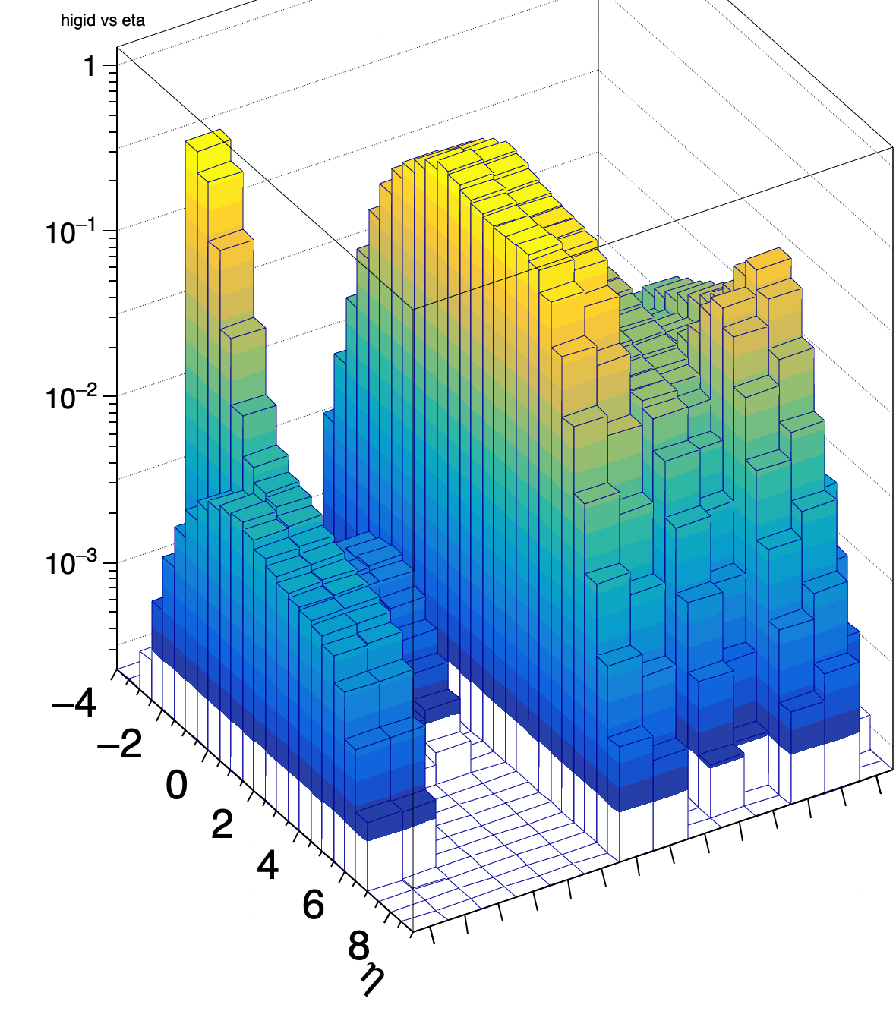

pythia, Zero Bias, 10M events
e-
π
B
K
µ$±$ (π decays?)

Slide 12
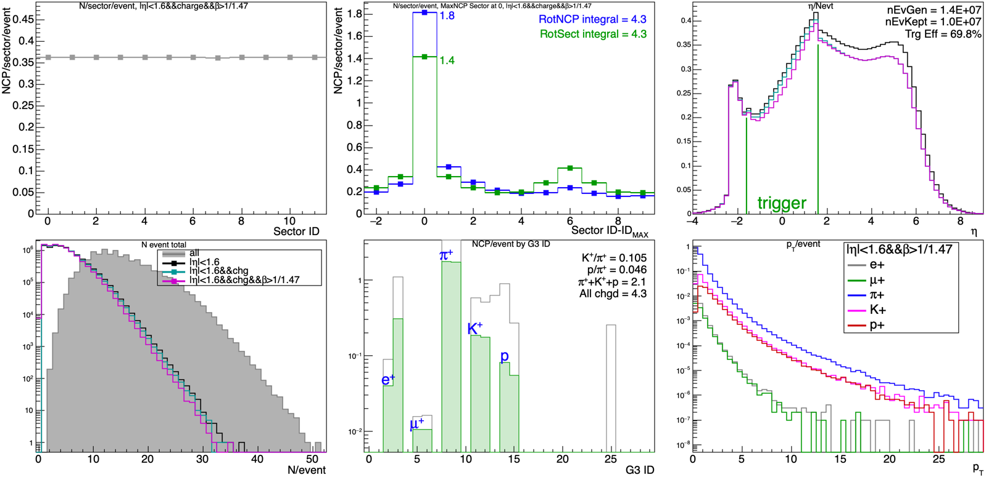
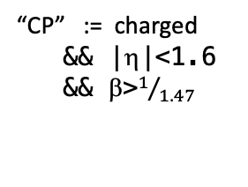
pythia, Minimum Bias, 10M events ($≥$1 charged track with p>0.25GeV/c & |η|<1.6)
“CP” := charged
&& |η|<1.6
&& β>$1/{1.47}$

Slide 13
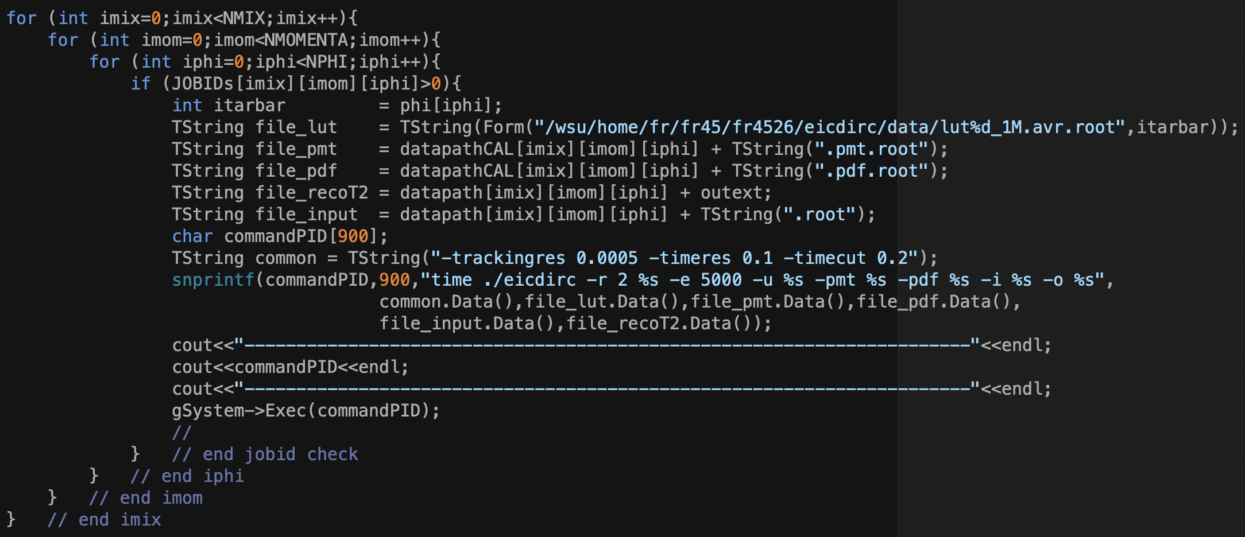

Scripts and macros developed to process entire directories of simulations:
loop over all subdirectories (mix, momentum, targetbar) and,
regenerate the corrections rootfiles, or
regenerate final PID results with different calibrations files.
per-pmt and TI PDF calibrations for given pythia simulation taken from the clean (background-free) simulations of the same particle mix, momentum, & target bar
Event Activity, instrumented sector:
A: clean <NCP> ~ 0.0
B: Pythia <NCP> ~ 0.36
C: Py + RotSect <NCP> ~ 1.4
D: Py + RotNCP <NCP> ~ 1.8
$→$look at PID Nσ vs EA

Slide 14
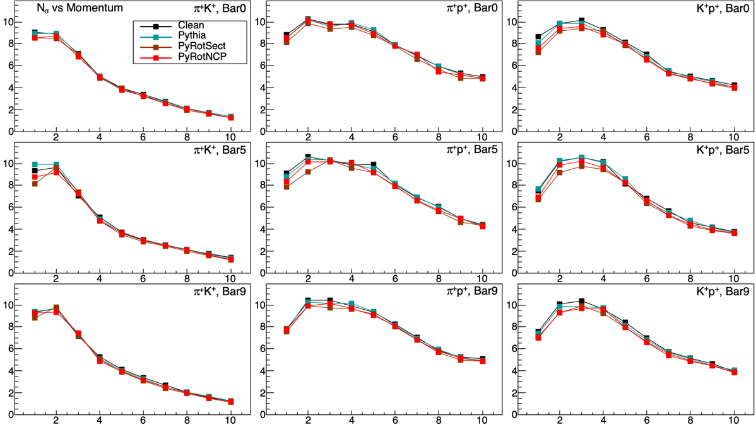
Nσ vs momentum
momentum (GeV)

Slide 15
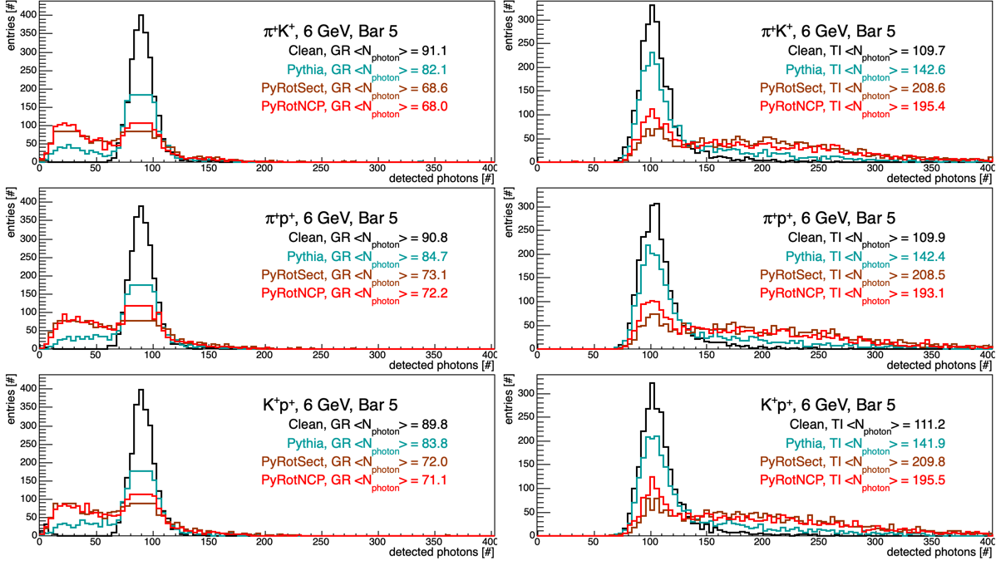
Number of detected photons

Slide 16
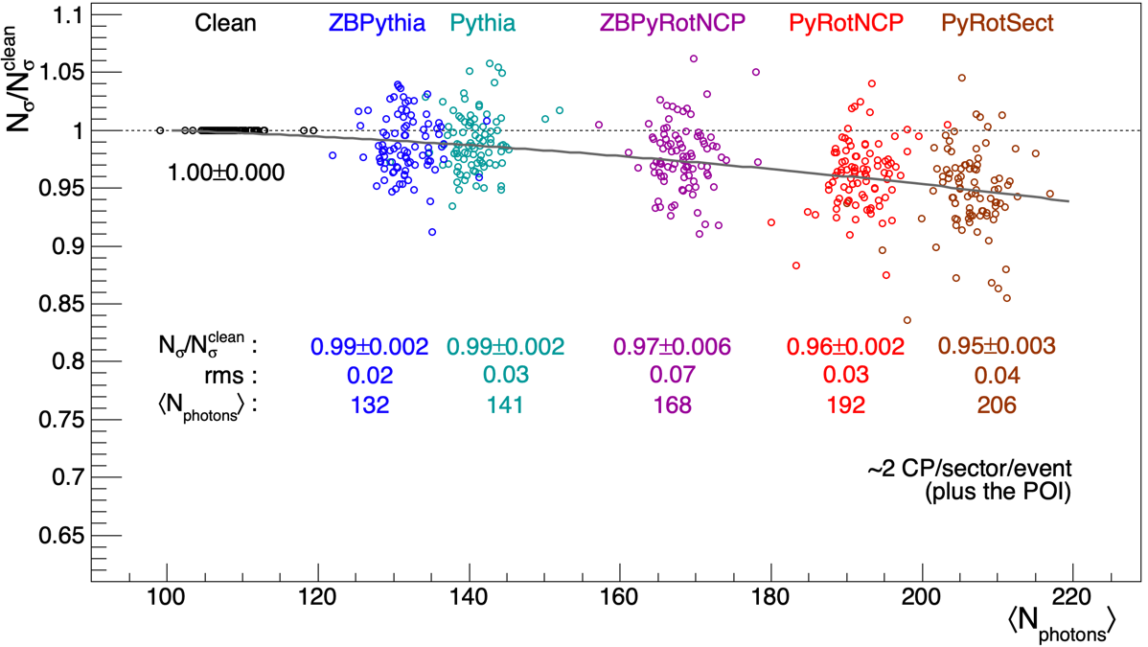
plot together all
- mixes (3-5)
- momenta (10)
- target bars (3)
π⁺e⁺, π⁺µ⁺, π⁺K⁺, π⁺p, K⁺p
1, 2, ..., 10 GeV
0, 5, 9

Slide 17

Pythia Summary
• Pythia8 events added to eicdirc “mix” simulations to study PID backgrounds.
• e-p collisions, 18x275GeV, default hpDIRC geometry, MARCO 1.7T
• Pythia events in these simulations
<NCP/event> ~ 3 zerobias CP:= [ chg && |η|<1.6 && β>$1/{1.47} ]$
<NCP/sector/event> ~ 0.25 zerobias
<NCP/event> ~ 4.3 minbias minbias trigger:= $≥1$ track w/ [ chg && |η|<1.6 && ptot>0.25 ]
<NCP/sector/event> ~ 0.36 minbias
<NCP/sector/event> ~ 1.4 minbias, sector with highest-p_{T} track in each event (highest total activity)
<NCP/sector/event> ~ 1.8 minbias, sector with larget NCP in each event (high total activity)
π/K (|η|<1.6) ~ 10 minbias
π/p (|η|<1.6) ~ 20 minbias
• New approach to set the phi in the Gun so the POI swims to the center of a specified bar.
• Modifications to eicdirc (pythia, workflow, histograms). Significant scripting developed.
• Simulations with BG use “clean” calibrations for same particles, momentum, and target bar.
• Aside: studying the degradation to the PID this way is somewhat unfair.
These pythia charged particles causing PID backgrounds will be tracked in the experiment!
We’d have additional information on these “BG” tracks that is not being used here.
• Consider this what happens if there are up to ~2 untracked CP/sector/evt.
• Degradation to dirc PID quantified by studying Nσ vs <NCP/sector/evt>, & <Nphotons> detected
• TI Nσ decreases by ~5% when there is ~2 (untracked) CP/sector/event besides the POI

Slide 18
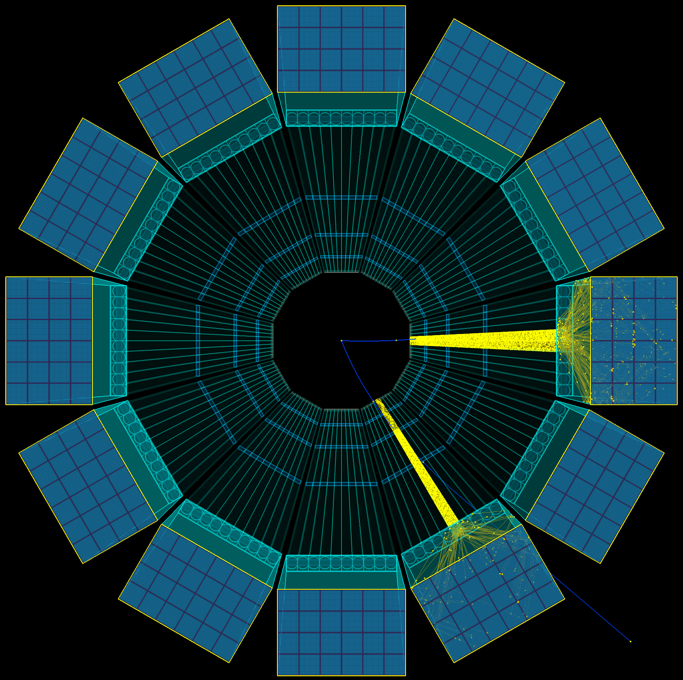
Pythia events put “additional” CP on bars.
We’ve ignored that these particles were tracked.
PID degrades by ~5% in the hottest sector/event.
True, but not very specific, nor useful.
To get more direct information,
control the BG
do single particle PID as before (“POI”)
p_{POI} = 6 GeV/c
theta = 30, 90, 150 deg
”middle” bar in box (bar 5)
but now throw another particle from the PV
such that it hits the same bar as the POI.
study how the PID performance depends on the
relative momentum, Δp, and pseudorapidity, Δη,
between the POI and this ”shadow” particle

Slide 19
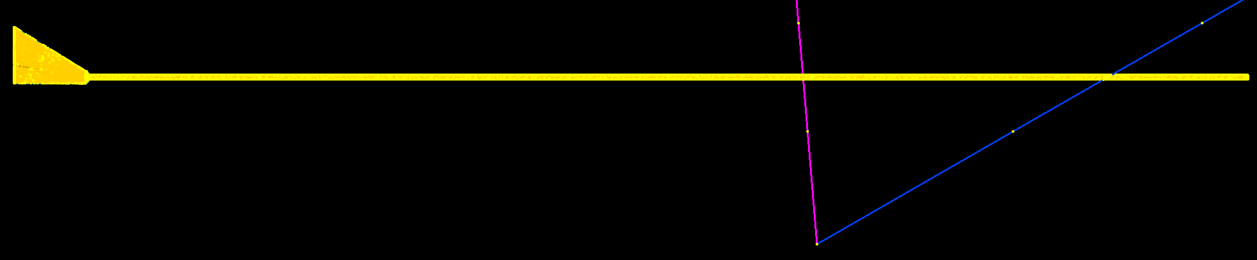
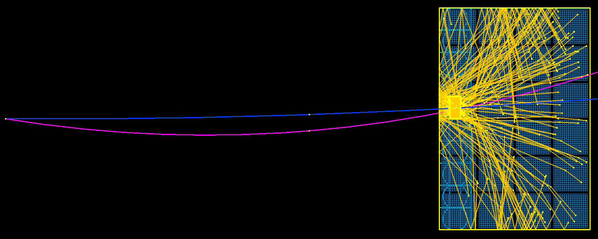

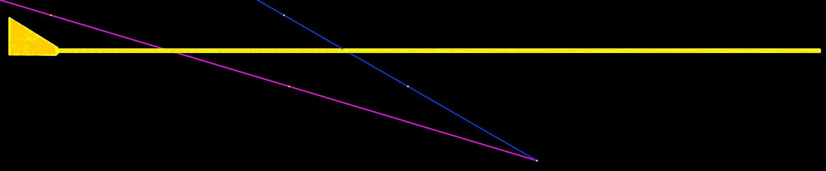
“eta scan”:
- throw a “shadow” particle onto the same bar as the PID POI
- this particle has controlled momentum and pseudorapidity (i.e. it’s “tracked”!)
30◦, 6 GeV/c
-1.4<dη<0.3
yz view
xy view
90◦, 6 GeV/c
-1.0<dη<1.0
150◦, 6 GeV/c
-0.6<dη<1.4

Slide 20
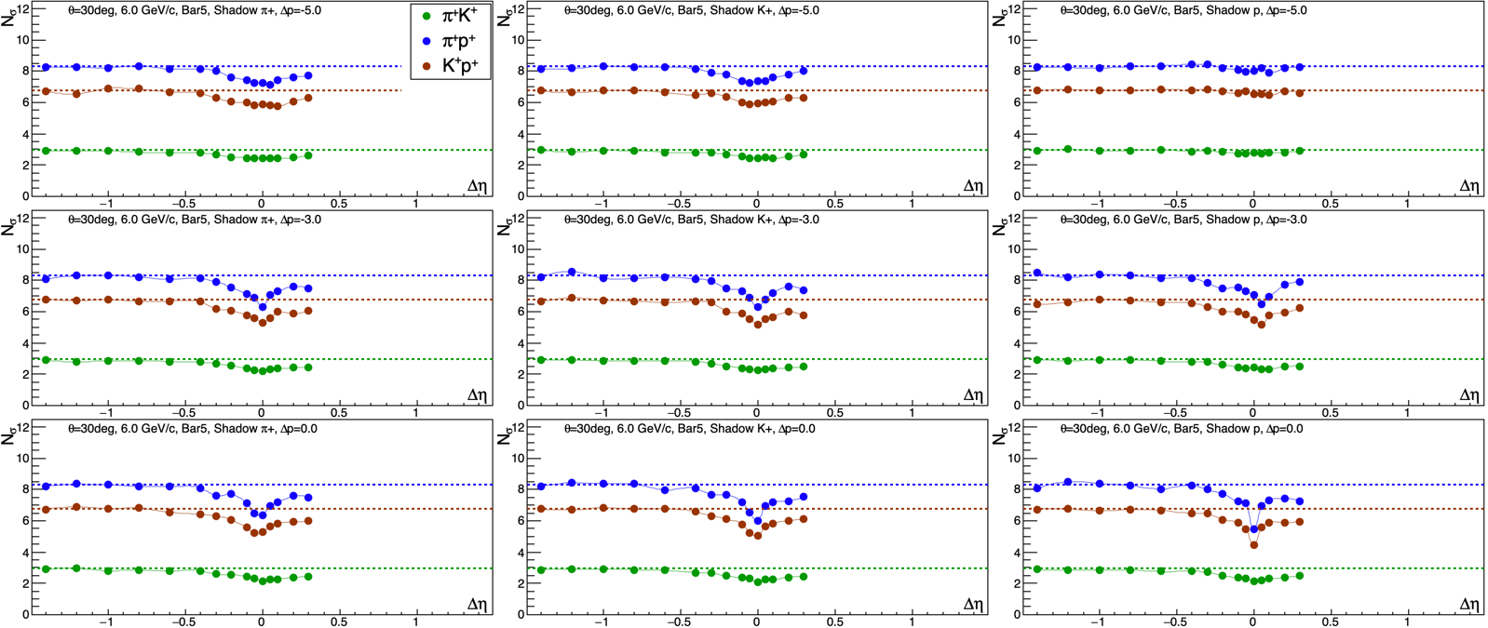
POI: 30◦, 6 GeV/c
Shadow:
dp=-5,-3,0
-1.4<dη<0.3
shadow: π+ K+ p
Nσ
p_{POI}=6 GeV
p_{SHA}=1 GeV
p_{POI}=6 GeV
p_{SHA}=3 GeV
p_{POI}=6 GeV
p_{SHA}=6 GeV
Δη
dashed lines are Nσ for clean PID (no background particles) := Nσ^{CLEAN}

Slide 21
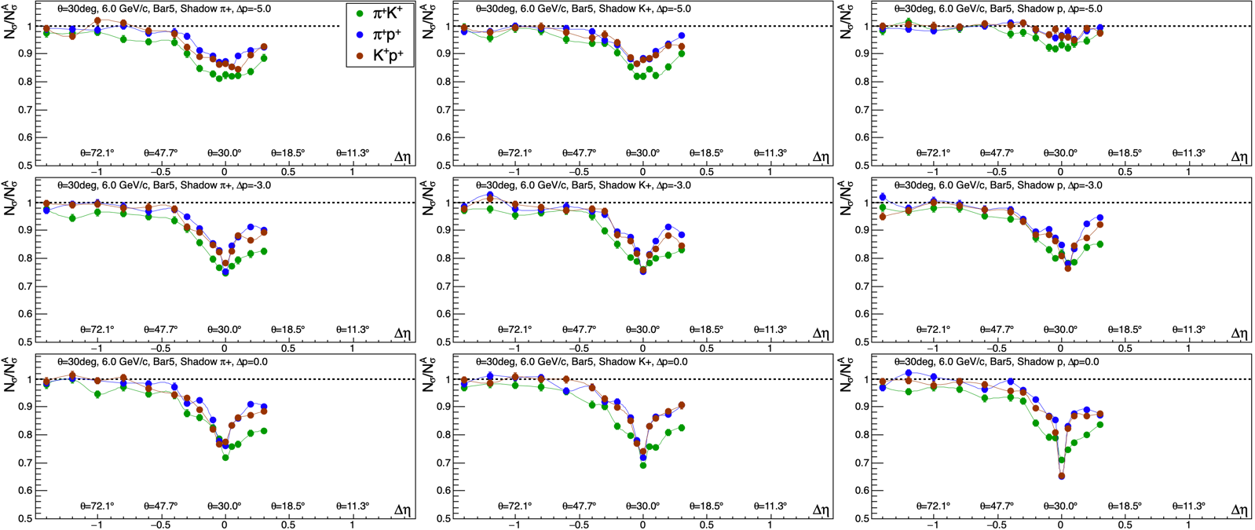
POI: 30◦, 6 GeV/c
Shadow:
dp=-5,-3,0
-1.4<dη<0.3
“PID degradation”
shadow: π+ K+ p
p_{POI}=6 GeV
p_{SHA}=1 GeV
Nσ/Ν_{σ}^{CLEAN}
p_{POI}=6 GeV
p_{SHA}=3 GeV
p_{POI}=6 GeV
p_{SHA}=6 GeV
Δη
normalize every Nσ value by that w/ clean PID

Slide 22
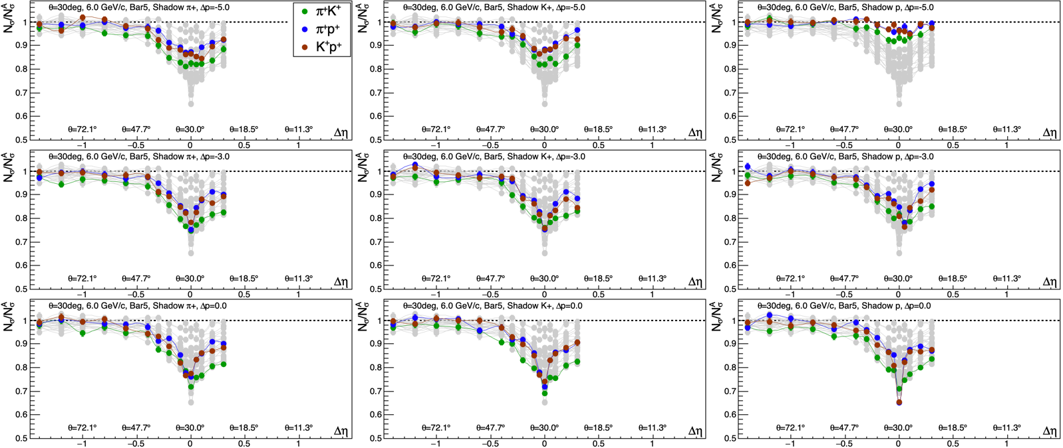
POI: 30◦, 6 GeV/c
Shadow:
dp=-5,-3,0
-1.4<dη<0.3
shadow: π+ K+ p
p_{POI}=6 GeV
p_{SHA}=1 GeV
Nσ/Ν_{σ}^{CLEAN}
p_{POI}=6 GeV
p_{SHA}=3 GeV
p_{POI}=6 GeV
p_{SHA}=6 GeV
Δη
(draw in gray all points in every frame)

Slide 23
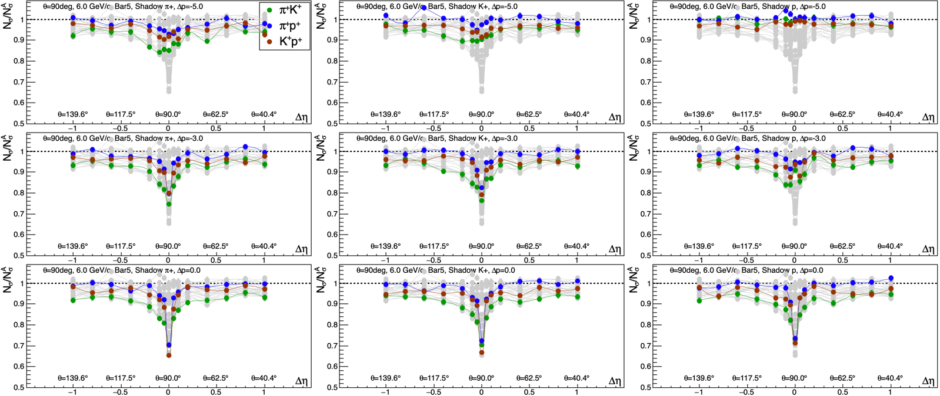
POI: 90◦, 6 GeV/c
Shadow:
dp=-5,-3,0
-1.0<dη<1.0
shadow: π+ K+ p
p_{POI}=6 GeV
p_{SHA}=1 GeV
Nσ/Ν_{σ}^{CLEAN}
p_{POI}=6 GeV
p_{SHA}=3 GeV
p_{POI}=6 GeV
p_{SHA}=6 GeV
Δη

Slide 24
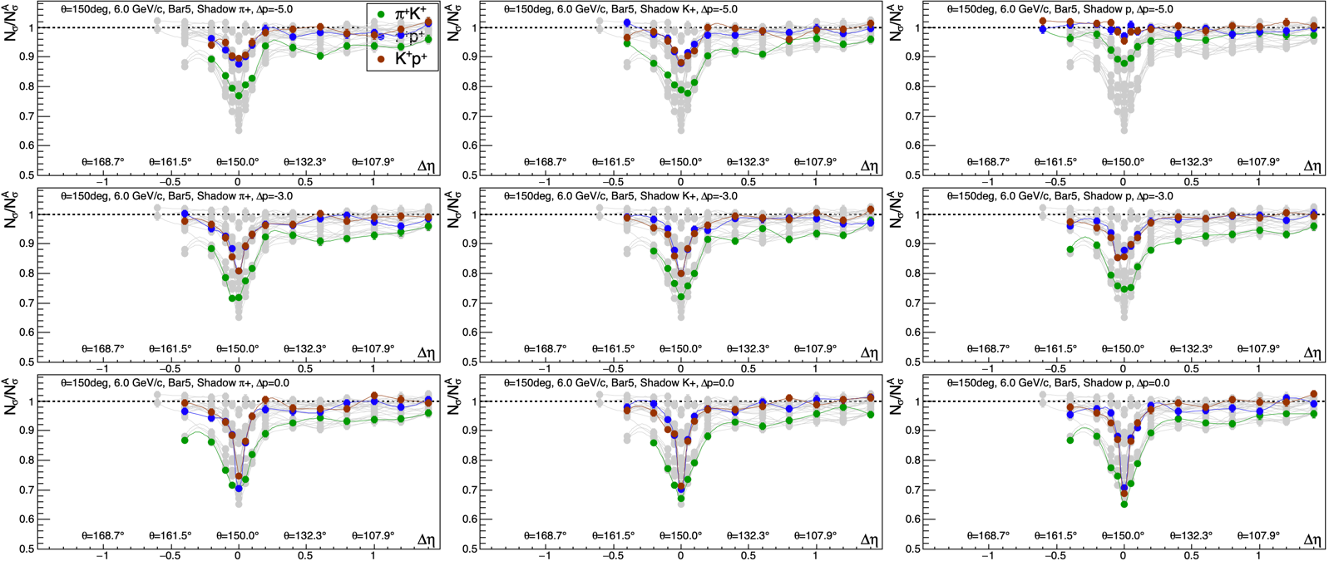
POI: 150◦, 6 GeV/c
Shadow:
dp=-5,-3,0
-0.4<dη<1.4
shadow: π+ K+ p
p_{POI}=6 GeV
p_{SHA}=1 GeV
Nσ/Ν_{σ}^{CLEAN}
p_{POI}=6 GeV
p_{SHA}=3 GeV
p_{POI}=6 GeV
p_{SHA}=6 GeV
Δη

Slide 25
hpDIRC PID performance near 6 GeV/c with a 2nd particle hitting same bar:
PID “unaffected” by 2nd hit if |Δη|>~0.3 or 2nd hit has low momentum
Worst degradation (2nd hit Δη=0 and dp=0) of N_{σ} is 70%
Now, two particles hitting same bar and at same η, but vary relative momentum
POI: p_{POI}= 6 GeV, theta=30deg, Bar 5
Shad: 1<p_{SHA}<11 GeV, theta=30deg, Bar 5

Slide 26
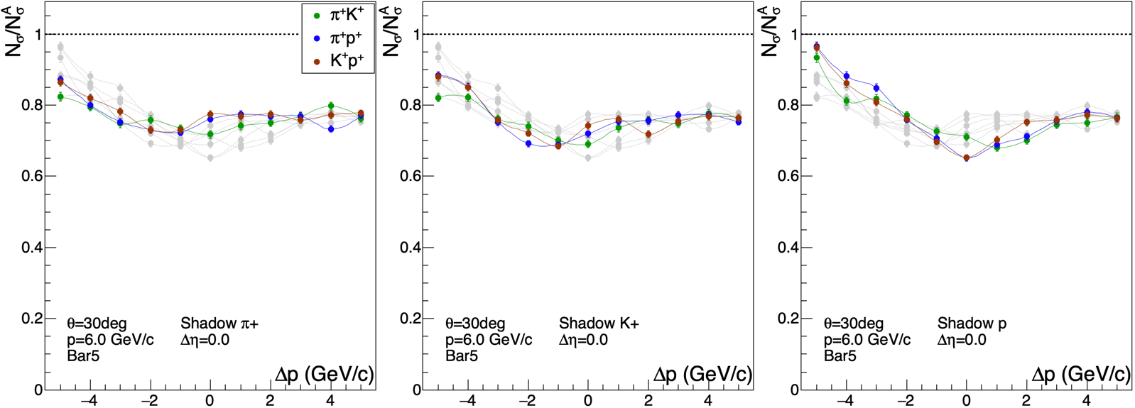
two particles hitting the same bar at the same η, vary momentum of shadow particle
POI: p_{POI}= 6 GeV, theta=30deg, Bar 5
Shad: 1<p_{SHA}<11 GeV, theta=30deg, Bar 5
p_{POI}=6 GeV
p_{SHA}=1 GeV
p_{POI}=6 GeV
p_{SHA}=6 GeV
p_{POI}= 6 GeV
p_{SHA}=11 GeV

Slide 27
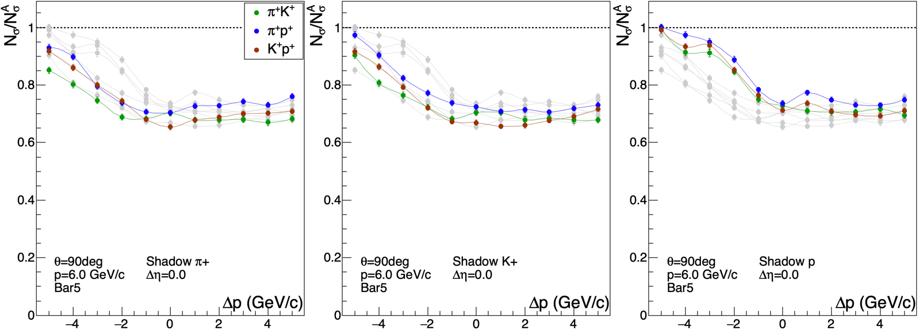
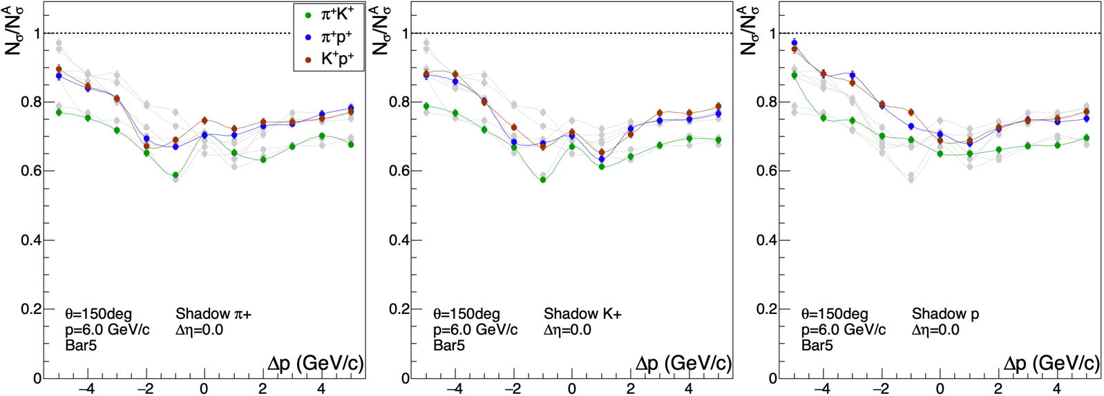
POI:
p_{POI}= 6 GeV
Shadow:
1<p_{SHA}<11 GeV
theta=90deg, Bar 5
theta=150deg, Bar 5

Slide 28
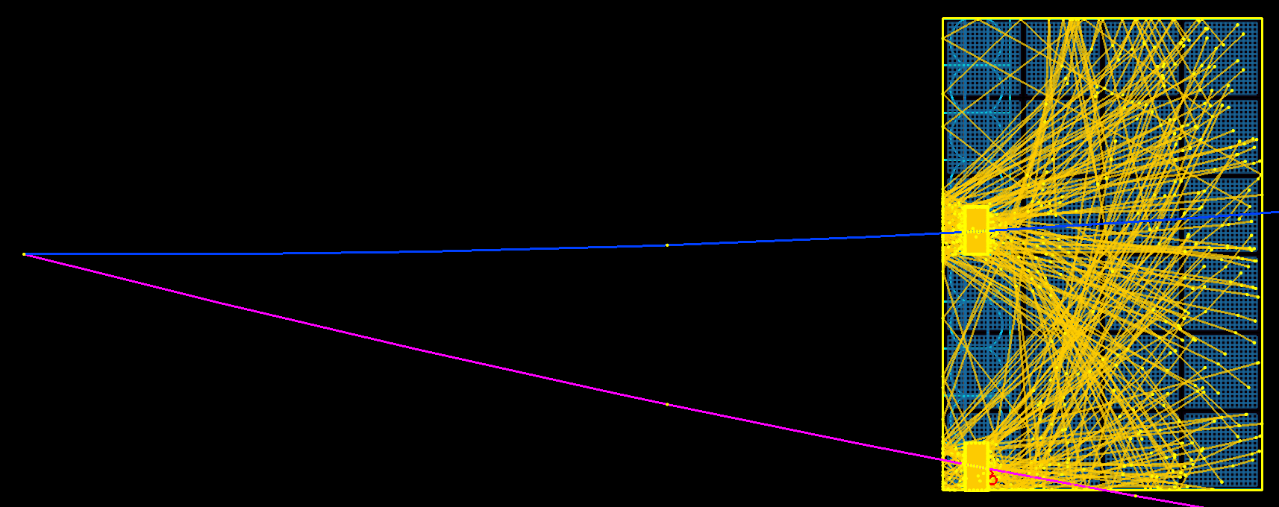
hpDIRC PID performance near 6 GeV/c with a 2nd particle hitting exact same spot:
70% degradation of N_{σ} remains 70% for p_{SHA}>6 GeV/c
If shadow particle has low momentum, PID recovers.
Now, two particles (POI and shadow) hitting different bars in the same box
and they have the same η and p
(Δη=0 and dp=0)
POI: p_{POI}=6 GeV, theta=30 deg, Bar 5
Shad: p_{SHA}=6 GeV, theta=30 deg, 0<=Bar<=9

Slide 29
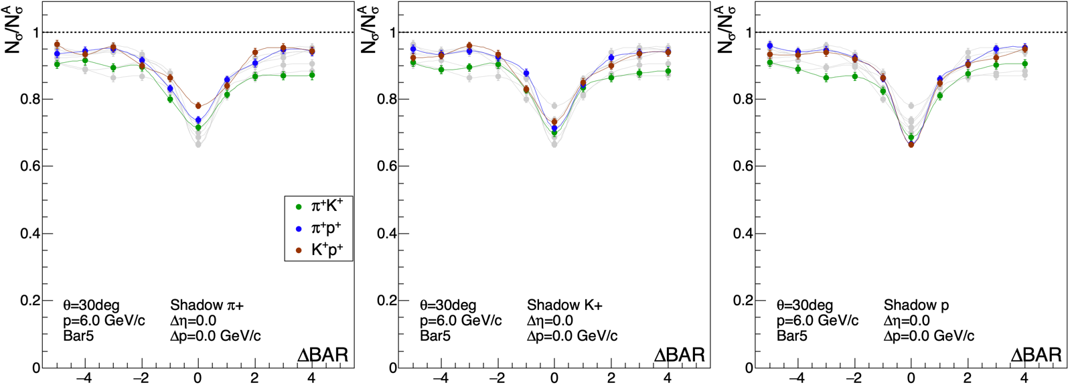
two particles hitting two bars in the same box w/ the tracks at same p and η
POI: p_{POI}=6 GeV, theta=30deg, Bar 5
Shad: p_{SHA}=6 GeV, theta=30deg, 0<Bar<9
POI Bar = 5
Shadow Bar = 0
5
5
5
9

Slide 30
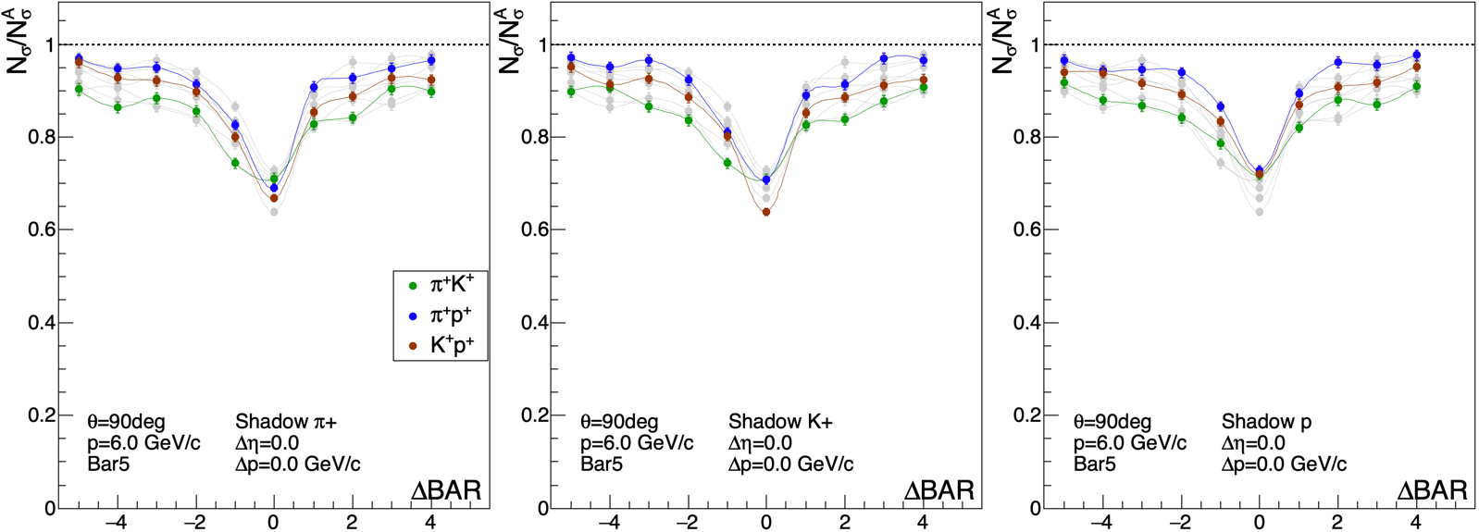
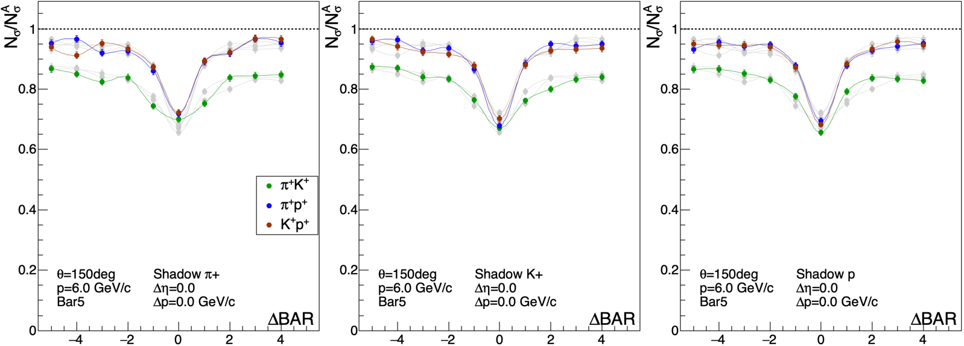
p_{POI}=6 GeV
POI: Bar 5
Shadow: 0<=Bar<=9
Δp=0
Δη=0
theta=90deg
theta=150deg

Slide 31
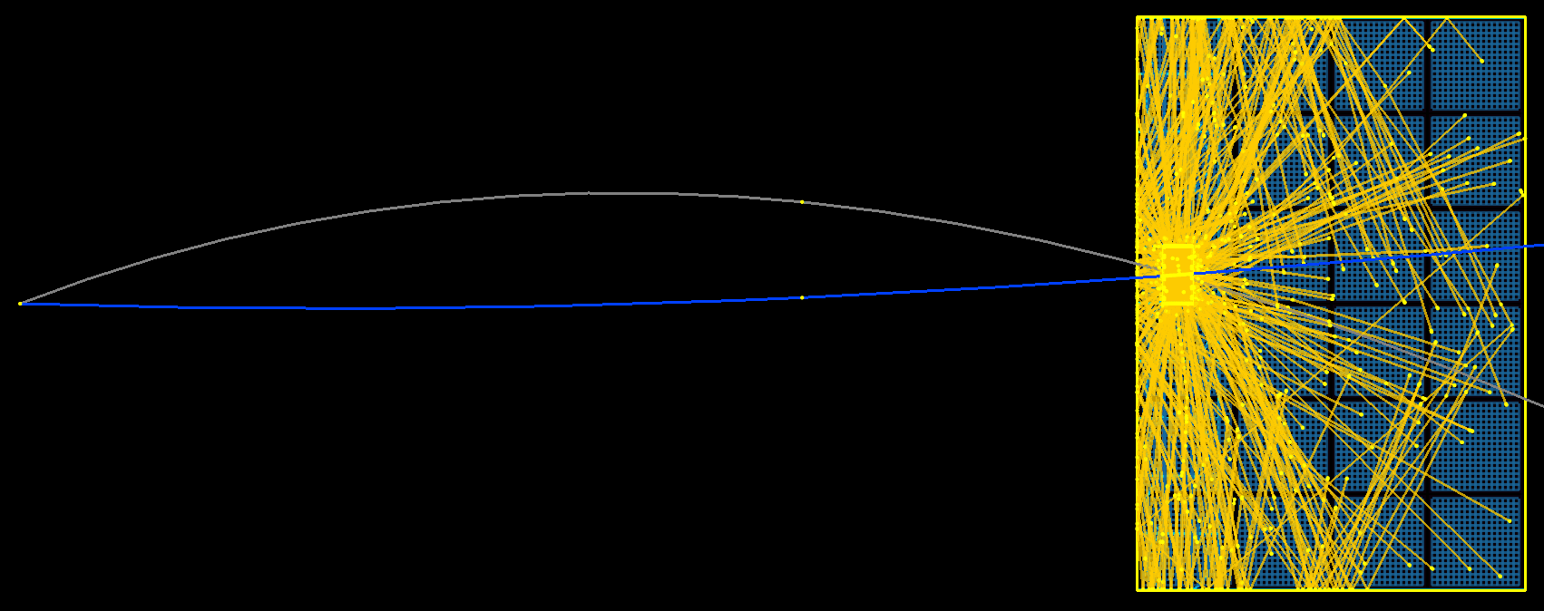
Now, two particles hitting the same bar, but
POI is positively charged (as before)
and
Shadow is negatively charged
POI: p_{POI}=6 GeV, theta=30 deg, Bar 5, positive
Shad: p_{SHA}=6 GeV, theta=30 deg, Bar 5, negative
dp=-5,-3,0 & -1.4<dη<0.3

Slide 32

POI: 30◦, 6 GeV/c
Negative Shadow:
dp=-5,-3,0
-1.4<dη<0.3
shadow: π- K- pbar
p_{POI}=6 GeV
p_{SHA}=1 GeV
Nσ/Ν_{σ}^{CLEAN}
p_{POI}=6 GeV
p_{SHA}=3 GeV
p_{POI}=6 GeV
p_{SHA}=6 GeV
Δη

Slide 33
Summary
Pythia8 events, as an untracked background to DIRC single-particle PID:
- PID performance (Nσ) unaffected on average.
- “hottest” sector in each event has ~2 CP hitting same bar box
PID performance (Nσ) degrades by ~5% in these boxes
More direct information on the PID degradation: throw “shadow” primary tracks.
These hit the same bar (or box), putting “extra” OPs on pixels, degrading Nσ
So far, I’ve concentrated on the performance for
6 GeV/c π/K/p in Bar 5 at θ = 30, 90, 150 deg.
- PID performance (Nσ) is, at worst, 70% of the value for clean PID.
This 70% is for two tracks hitting same bar with same p and η.
- If two tracks hit the same bar with |Dη|>~0.3, or if the 2nd particle has
low momentum, then the PID performance is essentially unaffected.
- Two tracks hitting different bars (with same p and η) also studied.
DIRCs appear to be remarkably robust detectors!
Any interest in a dircPID fast simulator?

Slide 34

b a c k u p

Slide 35



Determine the equation of a circle
given two points on the circle and the circle’s radius
pos
(x₁,y₁): Primary vertex
(x₂,y₂): center of target bar
@ mid-depth
$$\hat{y}$$
(x₄,y₄)
two solutions, corresponding to
the two charge signs
Circle R from p_{T} and B:
DIRC bar
$$\hat{x}$$
primary
vertex
φ
pos primary:
phi = -atan2(x₄,y₄)
neg primary:
phi = -atan2(x₃,y₃)
eicdirc:
DIRC BARINNERR=70cm
This calculation assumes a pure solenoid
but MARCO radial fields grow with |η|...
Scale B_{EFF} from 1.75 to 1.6 vs |η| to compensate
neg

Slide 36





simulation command line: ./eicdirc -p 1.0 -theta 30 -phi [990+Bar] ...
then the code calculates the φ value to throw the primary POI: (this works for |η|<1.6)
e+, 1.0GeV/c, Bar 9
proton, 10.0 GeV/c, Bar 5
e+, 1.0 GeV/c, Bar 5
proton, 1.0 GeV/c, Bar 0
e+, 1.0 GeV/c, Bar 0
e+, 10.0 GeV/c, Bar 0

Slide 37

Results from eicdirc code
wDirc mother volume shadowed edge bars in neighboring boxes (fixed)
fRadius = 700. (to front face of “middle bar”, Rinner)
Nboxes = 12, NBars = 10
efficiency
~93.55%
Momentum (GeV/c)

Slide 38

geometry
SECTORY
BARPLANEY
(“y is φ”)
y
SECTORDPHI/2 = π/NBOXES
BARPLANEWIDTH
z⦿
x
BARINNERR
SECTORGAP
BARWIDTH=35.
BARGAP=0.15
BARDEPTH=17.
BARINNERR=BARCENTERR-BARDEPTH/2.
10 bars

Slide 39

angle ratio
circumference ratio
B2a simulation
1M µ+, 10 GeV/c

Slide 40
µ+, p = 10 GeV/c
BARWIDTH = 35. mm
BARGAP = 0.15 mm
SECTORDPHI/2 (deg)
BARPLANEY (mm)
PLANEDPHI/2 (deg)
BARINNERR (mm)
SECTORGAP (mm)
EFFICIENCY
NBOX
NBAR
total
12 9 744.7 158.1 80.1 15.0 12.0 0.799
12 10 744.7 175.7 46.1 15.0 13.3 0.885
11 744.7 193.2 12.2 15.0 14.5 0.970
16 6 754.6 105.4 87.7 11.3 7.9 0.707
16 7 754.6 122.9 53.3 11.3 9.3 0.823
16 8 754.6 140.5 18.8 11.3 10.5 0.938
18 5 757.3 87.8 90.1 10.0 6.6 0.661
18 6 757.3 105.4 55.5 10.0 7.9 0.792
7 757.3 122.9 20.8 10.0 9.2 0.922
24 3 761.8 52.6 94.5 7.5 4.0 0.527
24 4 761.8 70.2 59.6 7.5 5.3 0.702
24 5 761.8 87.8 24.8 7.5 6.6 0.877
~5.7in
~12in
~14.7in
~23.4in
yellow rows: same parameters as the columns in Jochen’s table

