Slide 1
Jet Benchmark Status
Particle Flow and Jets & HF Workfest Session
ePIC Collaboration Meeting
January 11, 2024

Slide 2
Benchmark Status
While official benchmark effort is ramping up, I have generated my own set of plots
Create plots for each campaign (23.09.1, 23.10.0, 23.11.0) for min Bias when available, minQ2=10, and minQ2=100
Also created a special instance of ReconstructedChargedParticleJet using real seeded tracks for minQ2=100
Look at generated and reconstructed kinematics, reco/gen matching efficiencies, resolutions, and duplicate tracks for charged and full jets
Next steps:
Complete plots for December campaign
Gather all plots into a coherent presentation (until automation is in place)
Start adding QA and duplicate removal to tracks
Need to begin producing _physics_ benchmarks
Have identified a number of necessary plots from YR and proposals
People are beginning to work on these

Slide 3
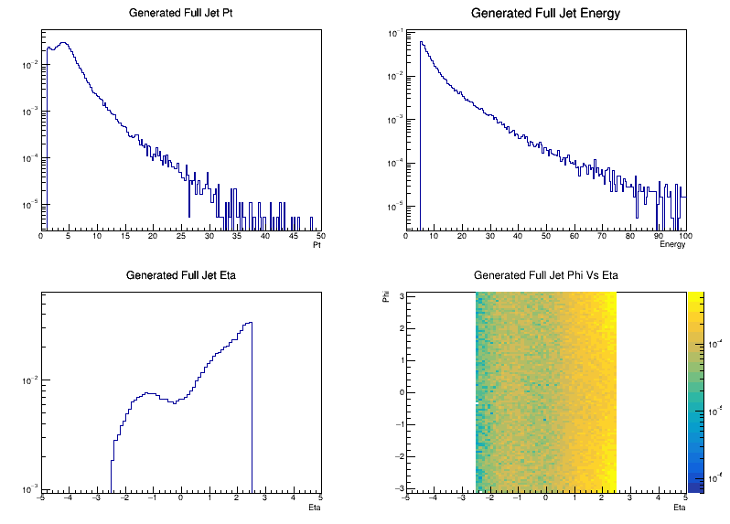
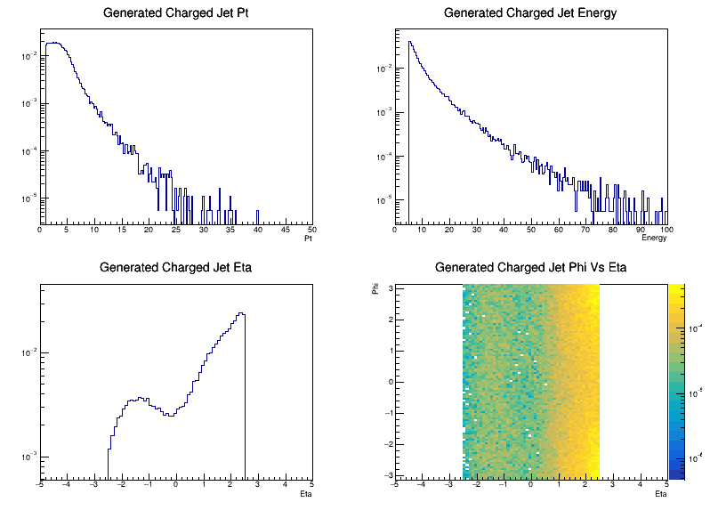
Generated Jet Kinematics
Full Jets (23.11.0 minQ2 = 10)
Charged Jets (23.11.0 minQ2 = 10)

Slide 4
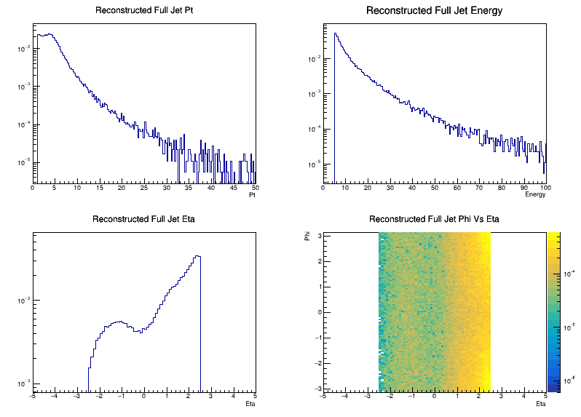
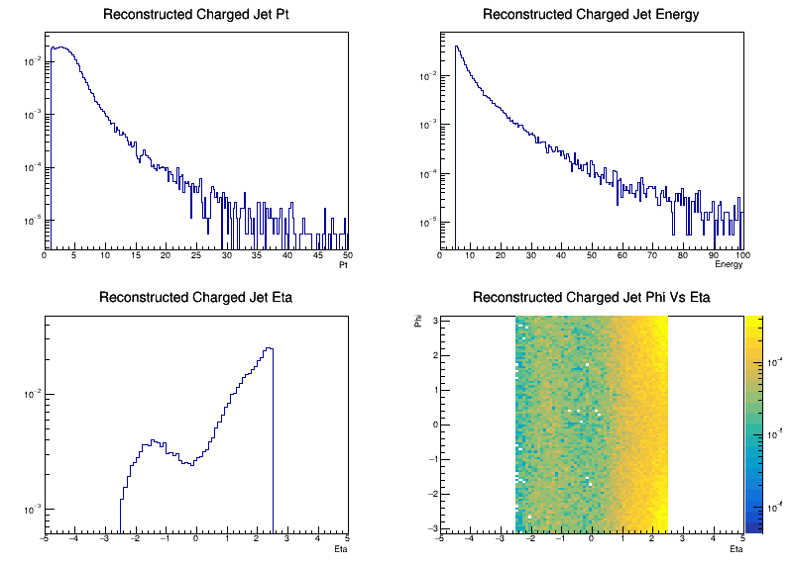
Reconstructed Jet Kinematics
Full Jets (23.11.0 minQ2 = 10)
Charged Jets (23.11.0 minQ2 = 10)

Slide 5
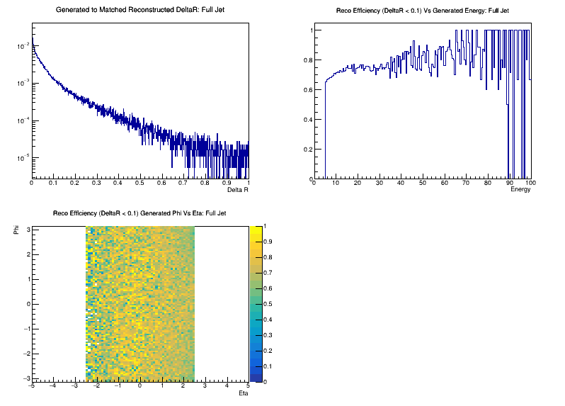
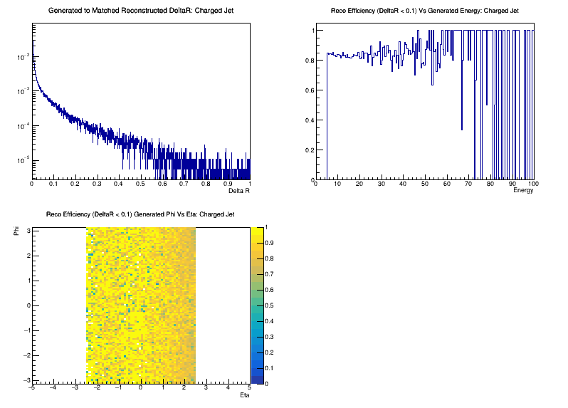
Gen / Reco Matching Efficiency
Full Jets (23.11.0 minQ2 = 10)
Charged Jets (23.11.0 minQ2 = 10)

Slide 6
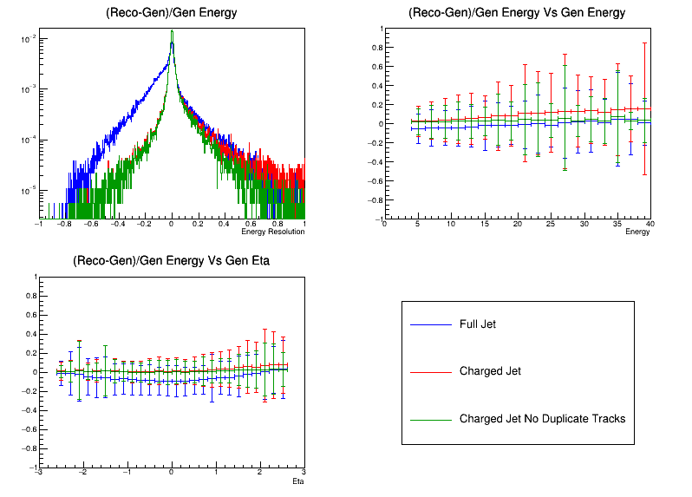
Jet Resolution Summary
(23.11.0 minQ2 = 10)

Slide 7
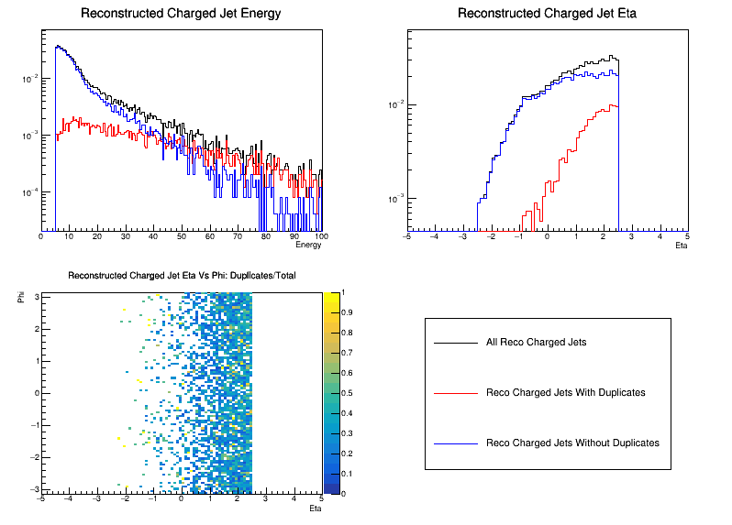
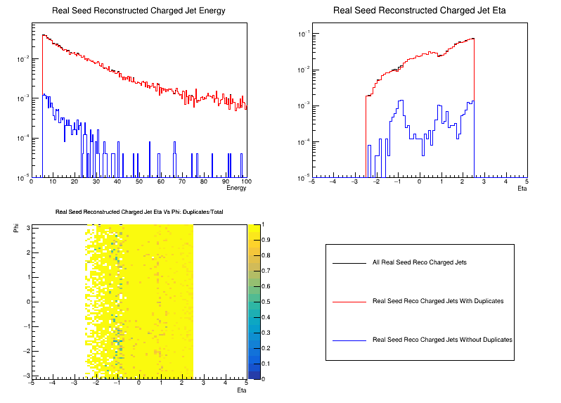
Jet Duplicate Track Summary
(23.11.0 minQ2 = 100 Truth Seed)
(23.11.0 minQ2 = 100 Real Seed)

