Slide 1
Admixed Background Effects on Tracking Reconstruction
By Benjamen Sterwerf

Slide 2
Overview
Analysis Pipeline
Observable Distributions (eta, phi, pt)
Analysis Plots (ACTs Locb, admixed compared to pure signal)

Slide 3
Tracking Reconstruction Effects of Backgrounds
Uses the HEPMC Admixing Code found at: https://github.com/eic/HEPMC_Merger/tree/koljadev
Using DIS for the signal event
10x100 GeV^2
Min Q^2=10
Three Main Background Types included in the study:
Synchrotron Radiation, Hadron Beam Gas, and Electron Beam Gas
All Files obtained from:
https://dtn01.sdcc.bnl.gov:9001/buckets
Signal File(s)
Merger Code
GEANT/EICRECON
Analysis
Background Files

Slide 4
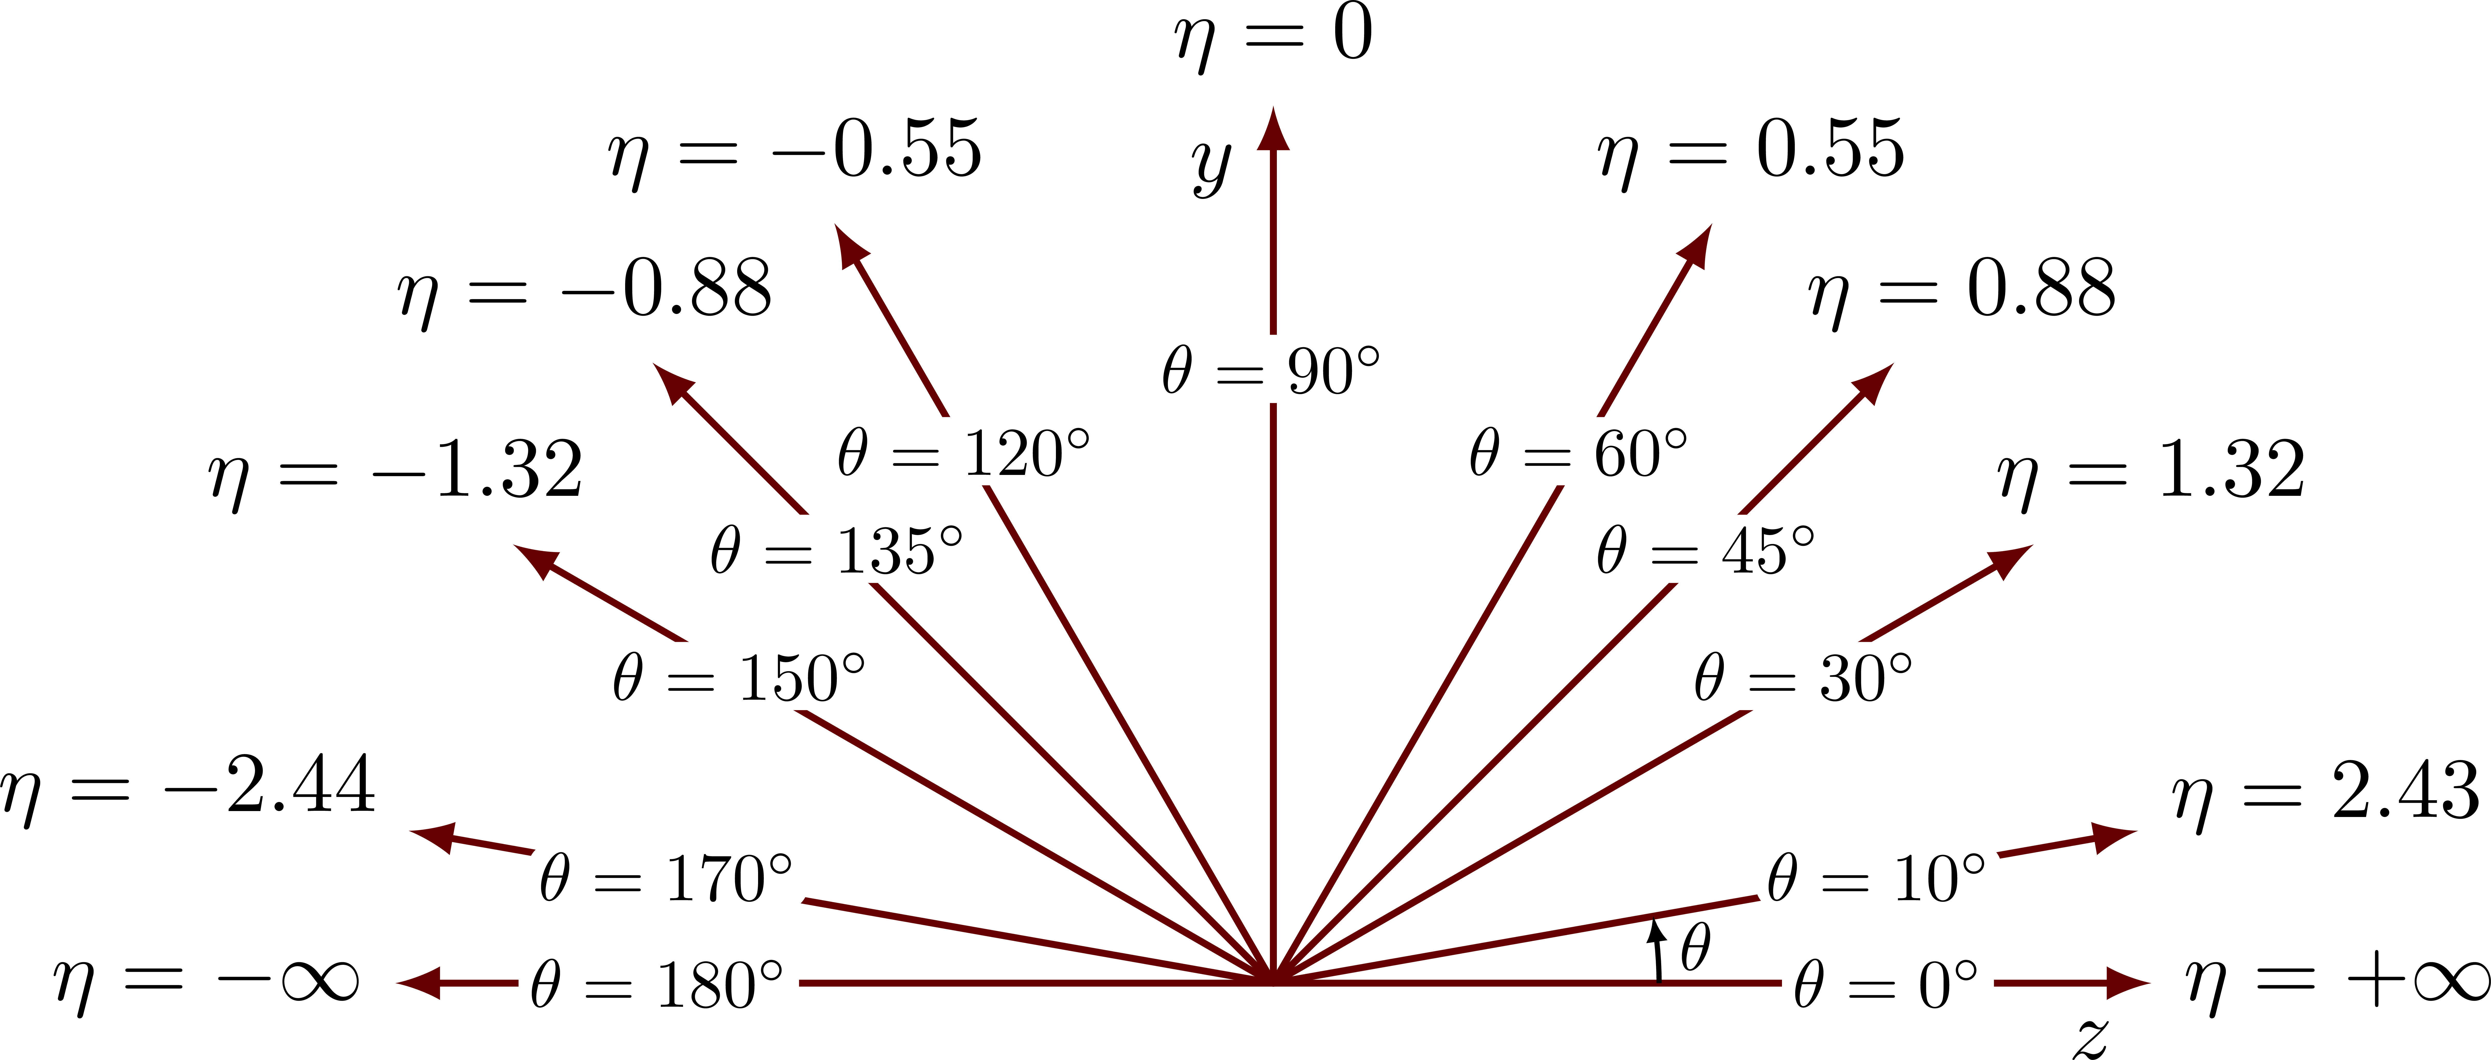
Cuts Applied and Geometry Used
Pt Cut=150 MeV
Rudimentary Multiple Track Filtering:
Parameters to reject duplicates:
PDG=/=0 (Flag that the particle was not matched)
Eta Difference between two candidates >0.002
Phi Difference between two candidates >2 mrad
pT Difference between potential duplicates of >10% of the matched pT
(pT2-pT1)/pT1 *100%
Charge =/= 0 (Only Charged Particles)
η$=\operatorname{arctanh}\left(\frac{p_{L}}{\left|p\right|}\right)$
$$φ=arctan2(\frac{p_{x}}{p_{y}})$$
$$p_{T}=\sqrt{{\left|p_{x}\right|}^{2}+{\left|p_{y}\right|}^{2}}$$
Hadron
Electron

Slide 5
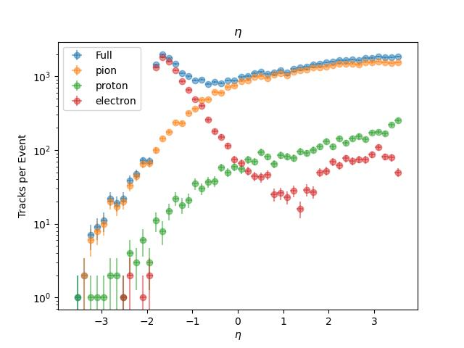
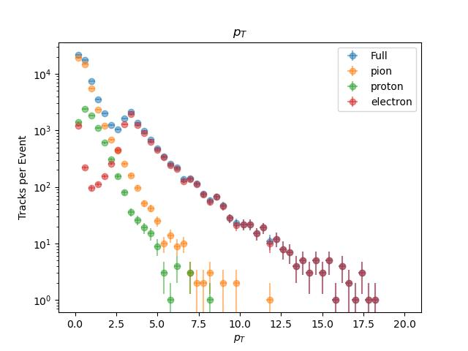
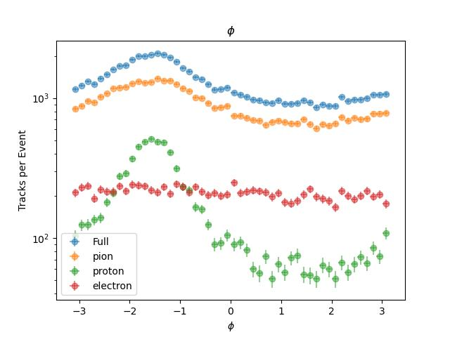
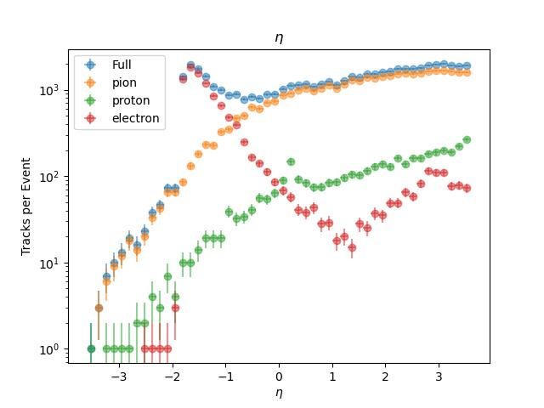
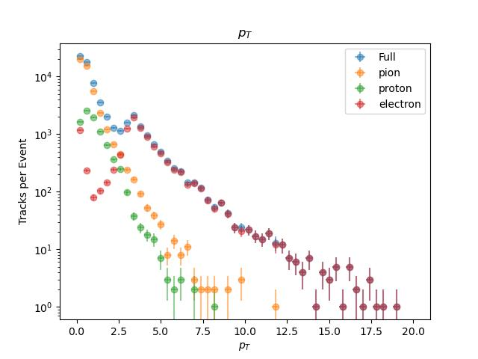
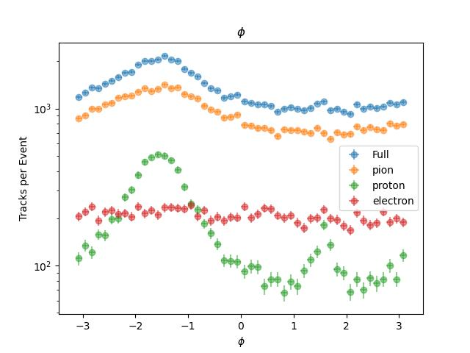
Observables (eta, pT, phi)
Pure Signal
Pure Signal
Pure Signal
Hadron Gas Admixed
Hadron Gas Admixed
Hadron Gas Admixed

Slide 6
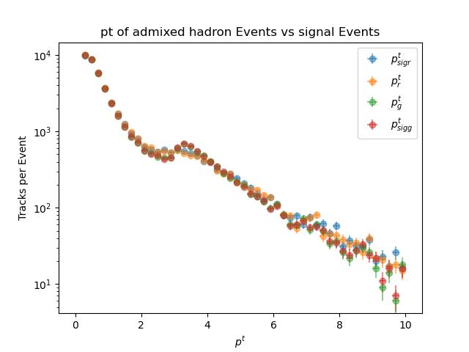
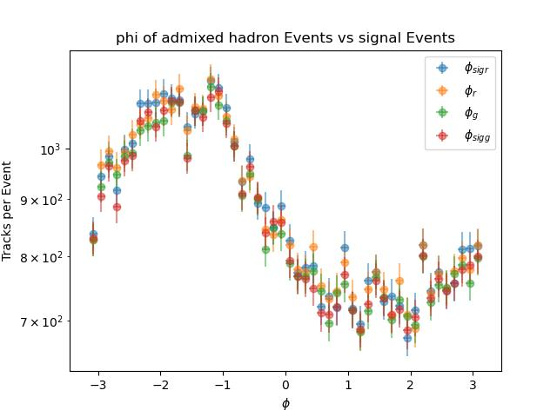
Admixed Hadron Gas and DIS Signal vs Pure DIS Signal
Blue=Signal Reconstructed Particles
Yellow=Admixed Reconstructed Particles
Green=Matched Admixed MC Particles
Red=Matched Signal MC Particles
Hadron
Electron

Slide 7
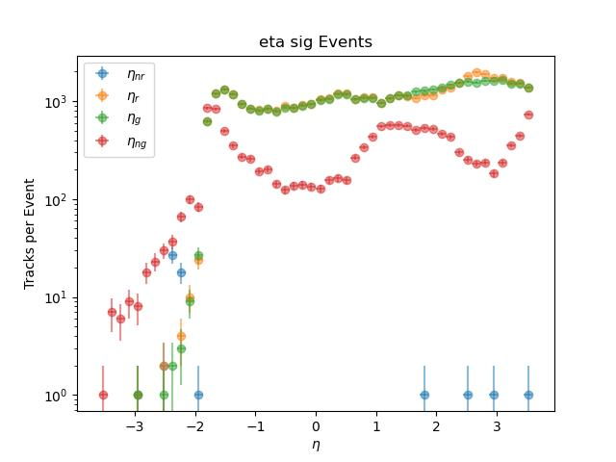
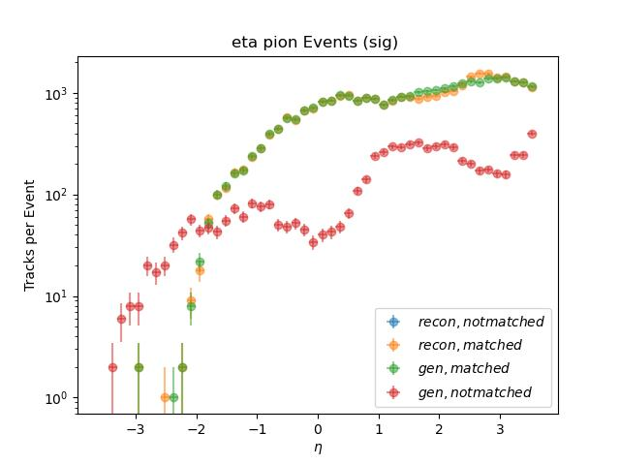
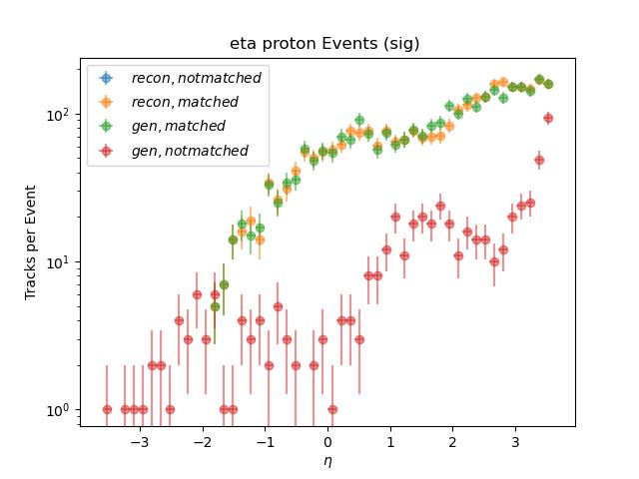
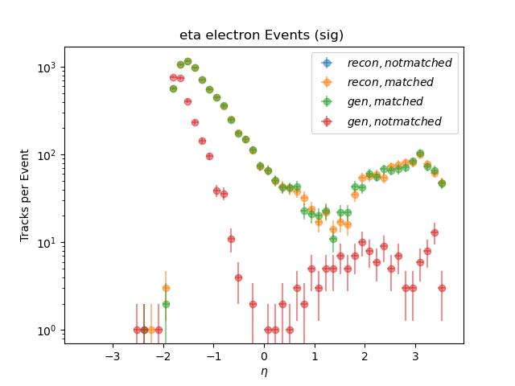
Sig eta events
Breakdown By Particle Type
Sig eta events Pions
We see that the majority of not reconstructed MC particles are pions except in low eta regime where there is a strong electron peak
Blue=Reconstructed Particles that do not get matched
Yellow=Reconstructed Particles that get matched
Green=MC Particles that get Reconstructed
Red=MC Particles that do not get Reconstructed
Sig eta events Protons
Sig eta events Electrons

Slide 8
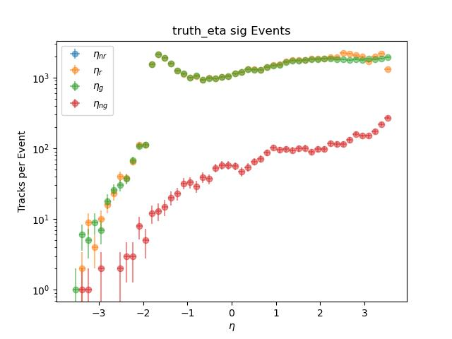
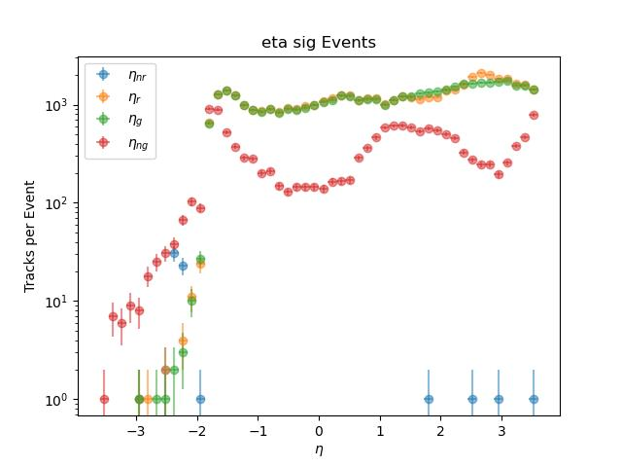
Truth vs Realistic Seeding
From the particle breakdown, we can see that the main difference between the two is the number of non-reconstructed electrons in the negative eta direction and the non-reconstructed pions at higher eta.

Slide 9
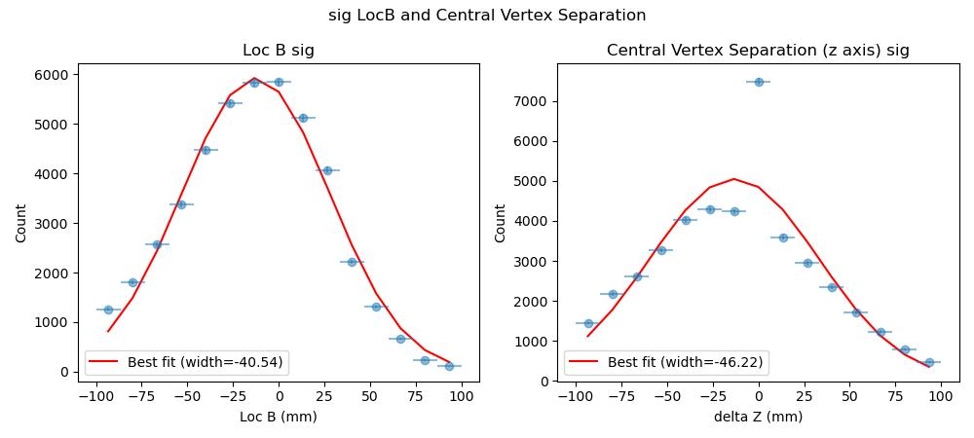
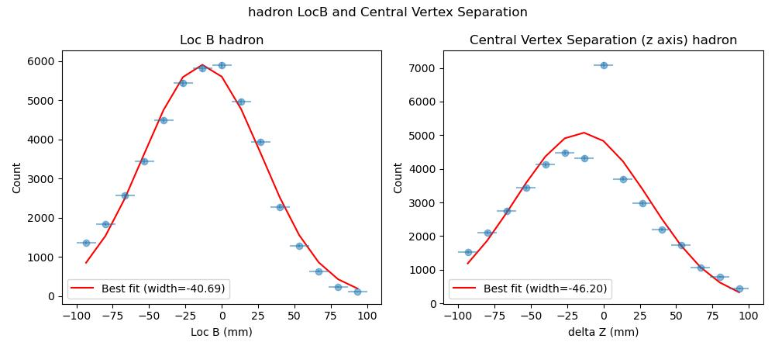
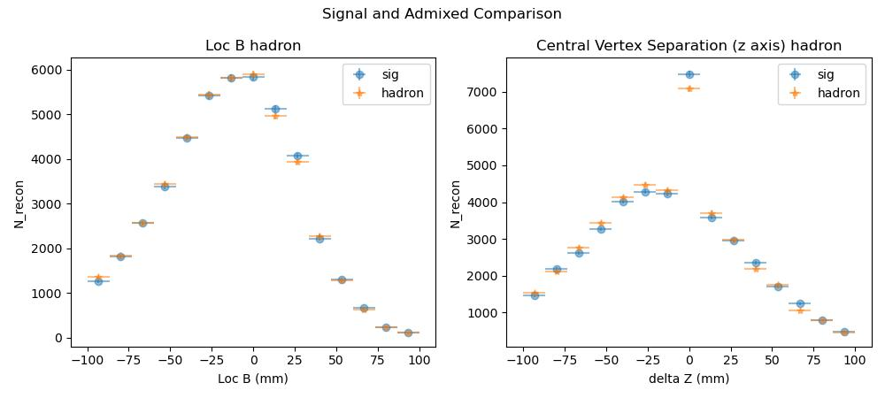
ACTs Location B
Z coordinates of the reconstructed central vertex
Delta Z= Loc B Reconstructed - Simulation Central Vertex

Slide 10
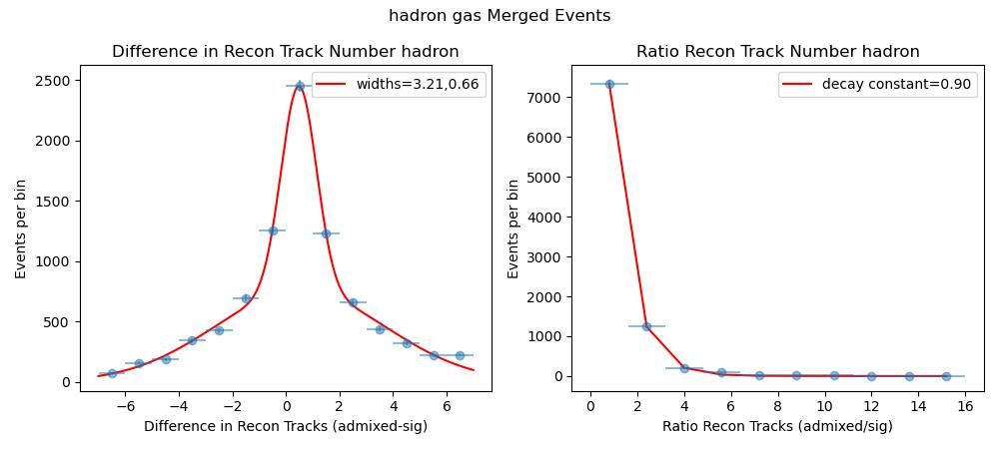
Track Reconstruction Comparison Between Signal And Backgrounds
After Applying the Rudimentary Multiple Track Filtering we see that adding backgrounds occasionally changes the number of reconstructed tracks.
Fitted with a double Gaussian (left), exponential (right)

Slide 11
Next Steps
Currently running 100000 event files for all the different admixed background types (Hadron Gas, Electron Gas, Synchrotron Radiation, and All Admixed)

Slide 12
Backup Slides

Slide 13
New Background Merger (HEPMC File Level)
Signal + Background = Combo Event
p2 bp2 p2
/ / /
P1----v1----p3 p5 + bp1-----bv1---bp3 = central axis----p1-----v1-----p3 p5
\ / \ \ \ /
p4----v2-----p6 bp4 \ p4----------v2 -----p6
\ \ \
p7 \ p7 bp2
\ /
bp1---------------------------------------- bv1-----bp3
\
bp4

Slide 14
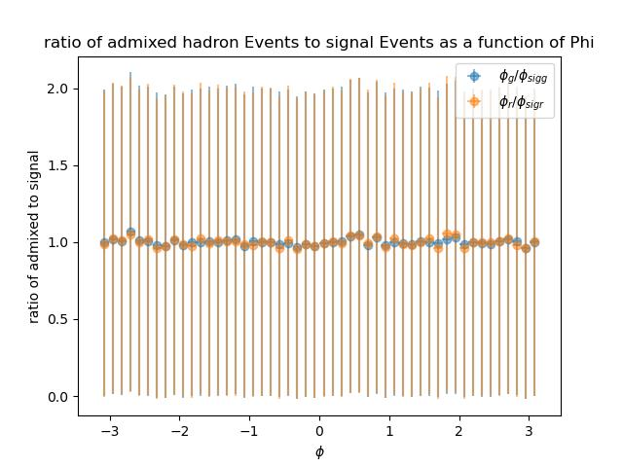
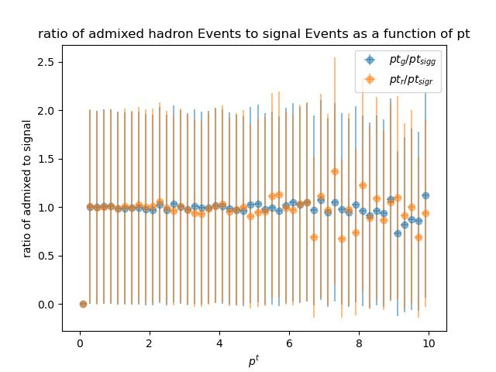
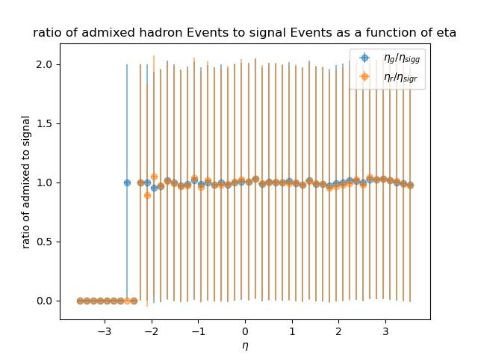
Admixed Hadron Gas and DIS Signal vs Pure DIS Signal
Blue=Matched Admixed MCParticles/Matched Signal MCParticles
Yellow= Admixed Reconstructed/Signal Reconstructed

Slide 15
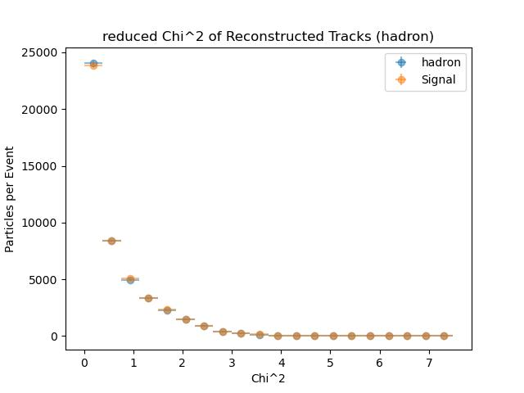
Reduced Chi-squared

Slide 16
Reduced Chi-square Cut Analysis
Signal Efficiency calculated by:
Nr/(Ng+Nng)
The efficiency is still low due to the large amount of non- reconstructed generator particles
Additionally, just a placeholder until the chi2 calculations for EICRECON are sorted out.

Slide 17
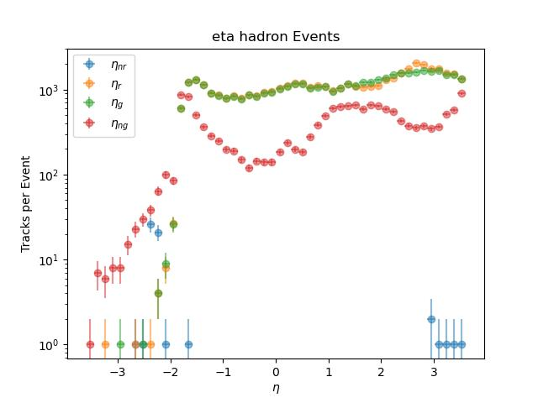
Eta Distributions
Red=MCParticles that do not get Reconstructed
Yellow=Reconstructed Particles that get matched
Green=MCParticles that get Reconstructed
Blue=Reconstructed Particles that do not get matched

Slide 18
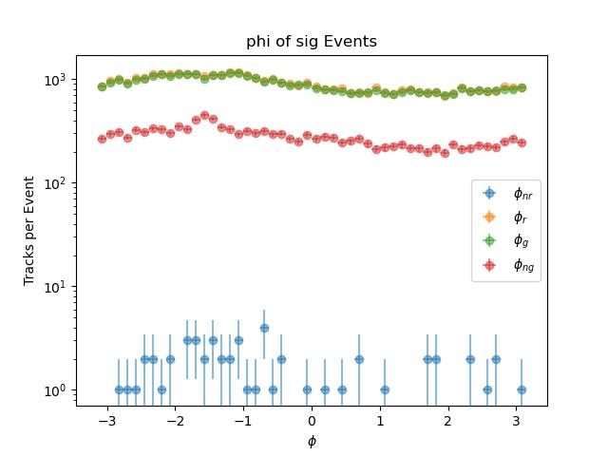
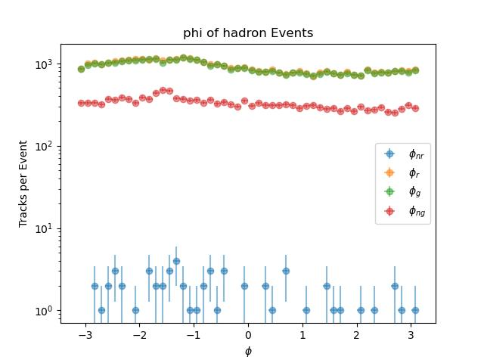
Phi Distributions
Red=MCParticles that do not get Reconstructed
Yellow=Reconstructed Particles that get matched
Green=MCParticles that get Reconstructed
Blue=Reconstructed Particles that do not get matched

Slide 19
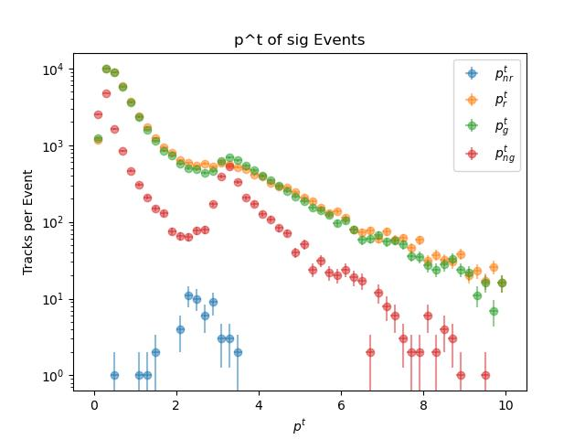
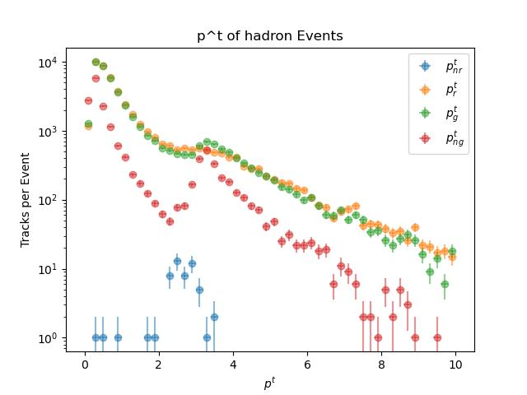
Pt Distributions
Red=MCParticles that do not get Reconstructed
Yellow=Reconstructed Particles that get matched
Green=MCParticles that get Reconstructed
Blue=Reconstructed Particles that do not get matched

Slide 20
Potential issue found while running code
Strange Disparities between the number of events processed by the EICRECON
Signal Events 9500/10000
Hadron 9100/10000
Determined to be the EICRECON Code because the GEANT files have the required 10000 events which then disappear following the EICRECON
Working around the issue by carefully matching the events

