Slide 1
Collider-Accelerator Department Machine Advisory Committee
Wolfram Fischer Deputy Associate Laboratory Director for Accelerators, NPP Chair, C-AD
C-AD Machine Advisory Committee
19 December 2023
Notes:
15 min => 10 slides

Slide 2
Committee Members (4-year terms)
Andrei Seryi, JLab (2023) – Chair (remote)
Richard Scrivens, CERN (2023)
Andreas Lehrach, RWTH Aachen (2025)
Uli Wienands, ANL (2025)
Sasha Valishev, Fermilab (2025) – new Chair
Yoichi Sato, J-PARC/KEK (2026)

Slide 3
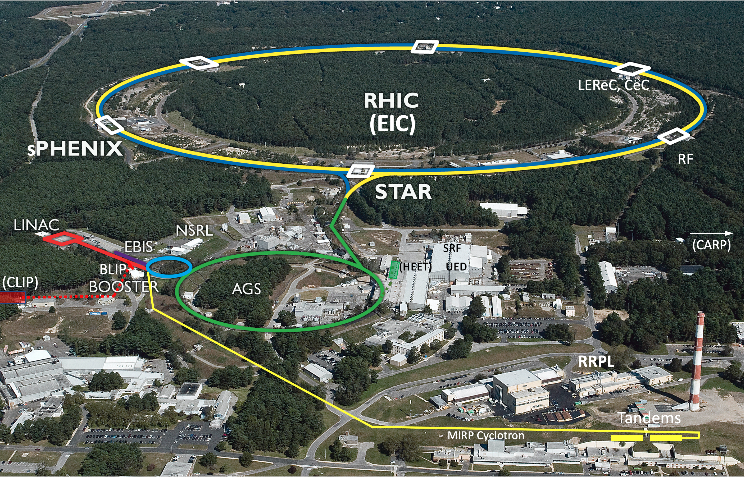
Collider-Accelerator Department facilities
Uniquely flexible and only hadron collider in US for exploration of QCD phase diagram and proton spin
Injectors also used for application programs: - Linac/BLIP for isotope production - Booster/NSRL for space radiation studies
- Tandem for industrial/academic users
R&D for future facilities and application sources, cooling, pol. beams, …

Slide 4
Collider-Accelerator Department
Mission: Design, develop, commission and operate state-of-the-art accelerators to carry out accelerator-based experiments in an environmentally responsible and safe manner. Perform accelerator R&D towards the next generation of accelerator facilities and accelerator applications in support of national needs.
FY2023: 409 head, 411 FTE (324 RHIC NP)
Significant legacy infrastructure issues (AGS started operation in 1960) are being addressed through continuous renovation and replacement of obsolete equipment.

Slide 5
C-AD themes
RHIC repair and completion of RHIC science mission
Run-24: p+p at 100 GeV beam energy
Run-25: Au+Au at 100/nucleon GeV beam energy
Transition to EIC
Support for growing Isotope Program, and NSRL
Electronics test facility proposal HEET
R&D

Slide 6
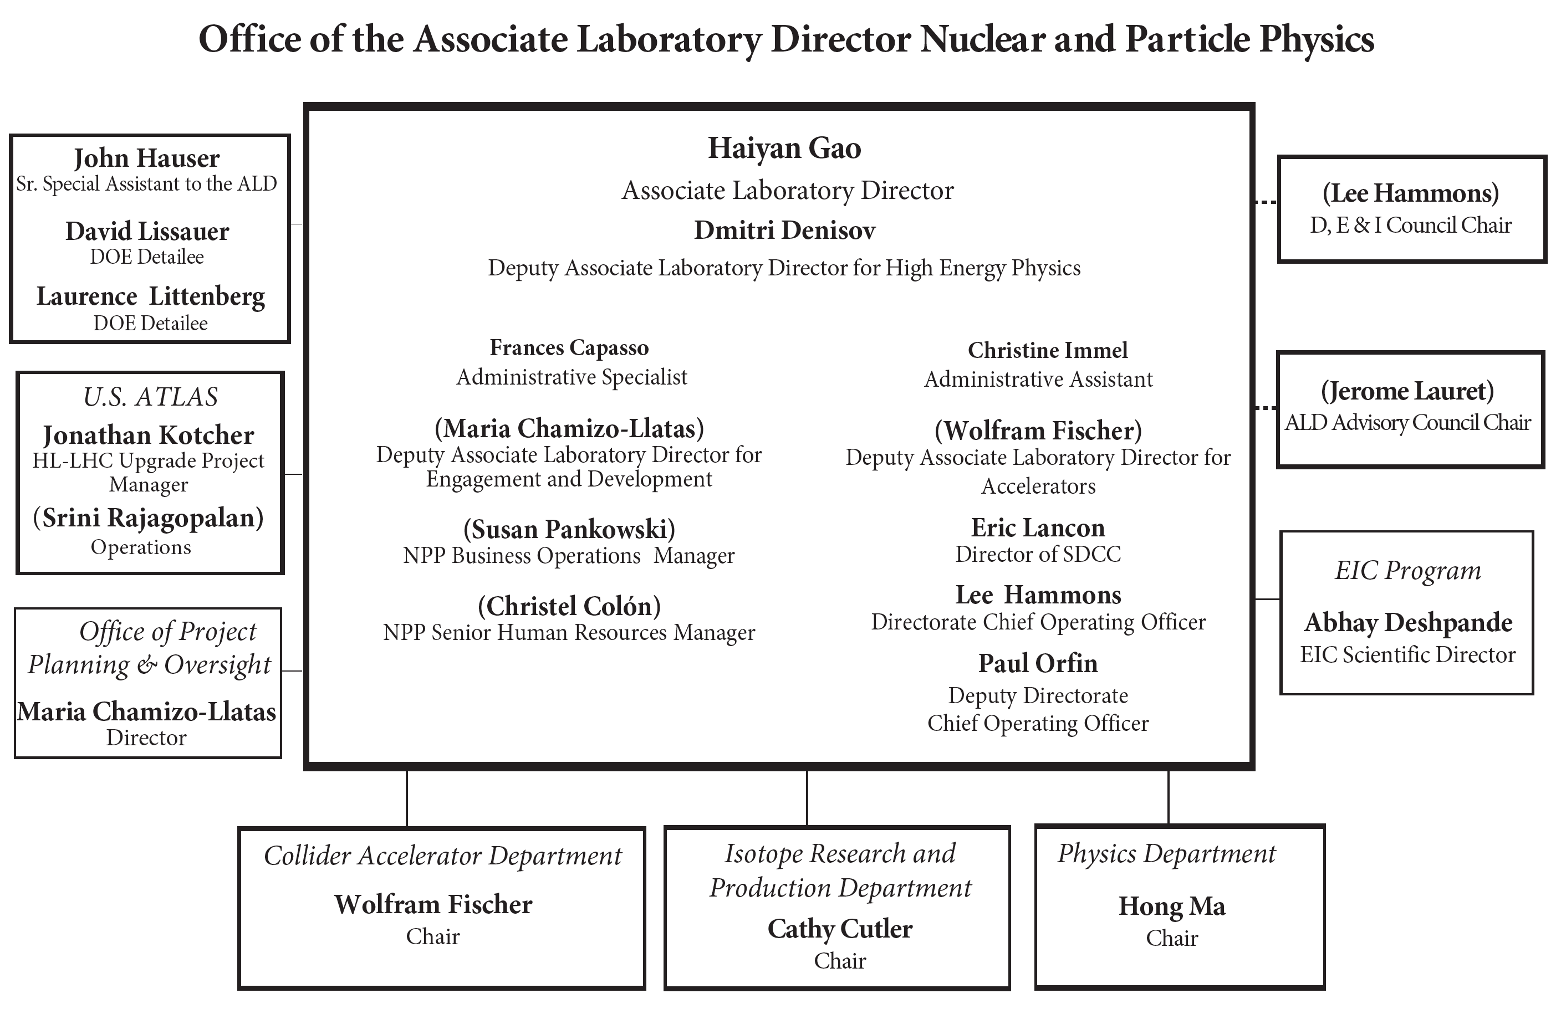
Isotope Research and Production Department
Medical Isotope Research and Production (MIRP) was part of C-AD since 2010
Became Department on 1 Oct 2023
Fastest growing program in DOE Office of Science
New DOE Accelerator Safety Order (420.2D)
target processing under accelerator order must move to nuclear order
Little change of actual accelerator work:
Irradiation of targets at BLIP with H- beam from Linac
Engineering and other support for IP Department
LIUP2 – proposal for existing Linac intensity upgrade (short-term)
CLIP – proposal for new Linac(s) for isotope production (medium-term)

Slide 7
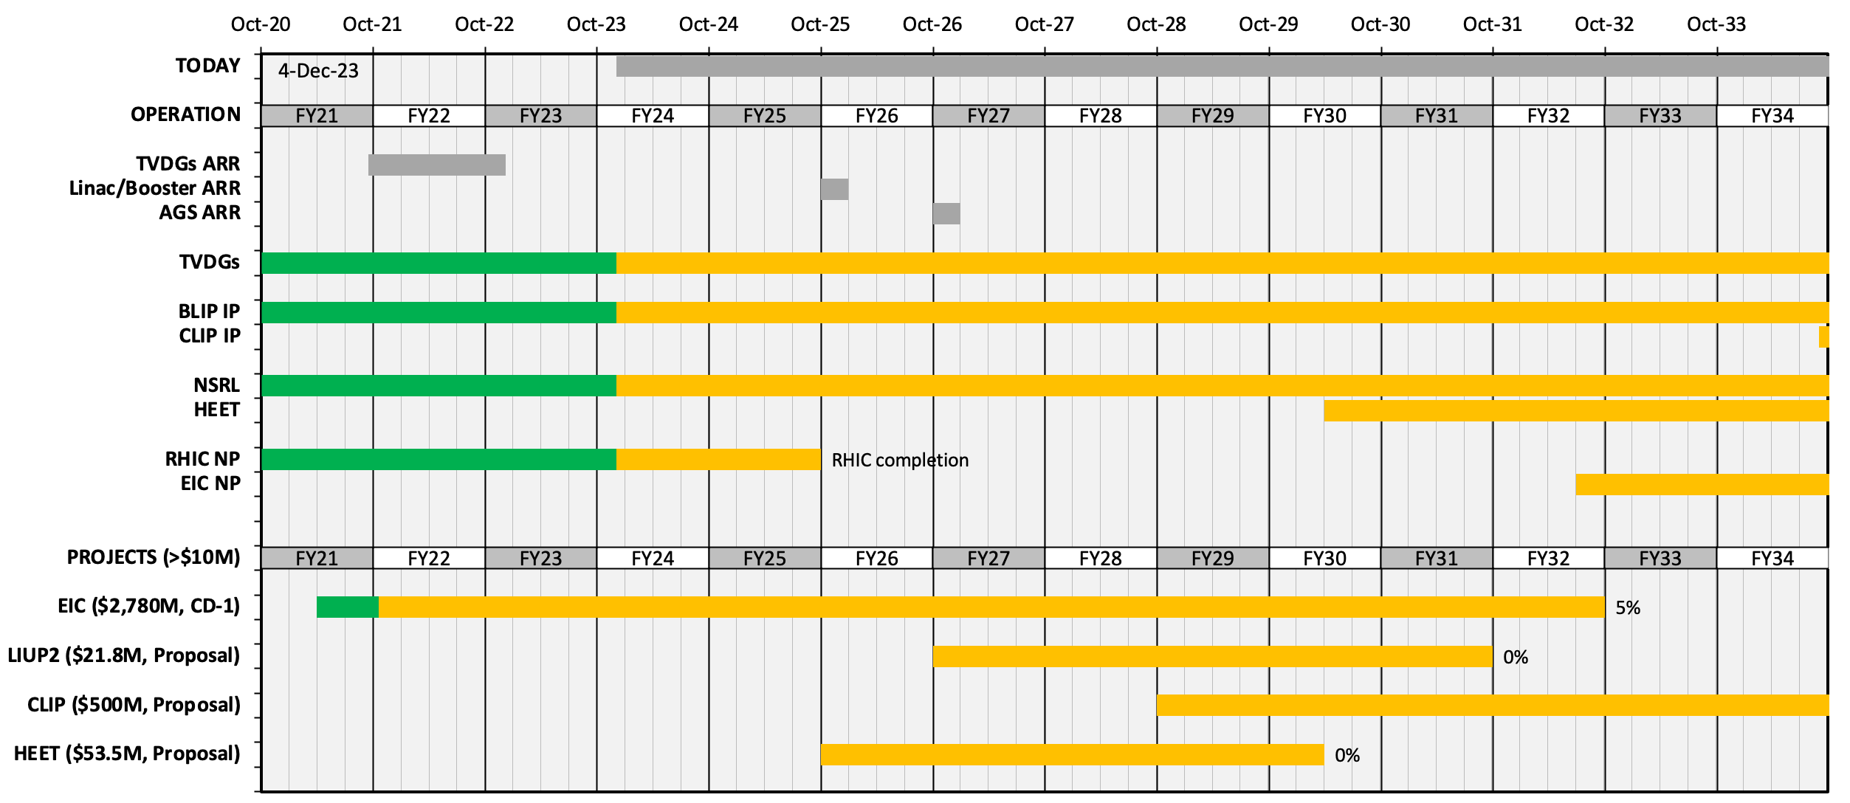
C-AD decadal timeline

Slide 8
Accelerator Safety, Readiness Reviews
Major effort for department
All legacy accelerators must undergo Accelerator Readiness Reviews
ARR Tandem Nov 2022 – done
ARR AP Hot Cell (IP) Dec 2022 – done
USI sPHENIX sc magnet (IRR w/ external) Mar 2023 – done
ASE Change for RHIC (ODH) Feb 2024
ARR IP Cyclotron (IP) Feb 2024 (IRR 18-20 Dec 2023)
ARR ATF (in ATRO, assisting) Nov 2024
ARR Linac+Booster Nov 2025
ARR AGS Sep 2026
… then need to get ready for EIC ARRs

Slide 9
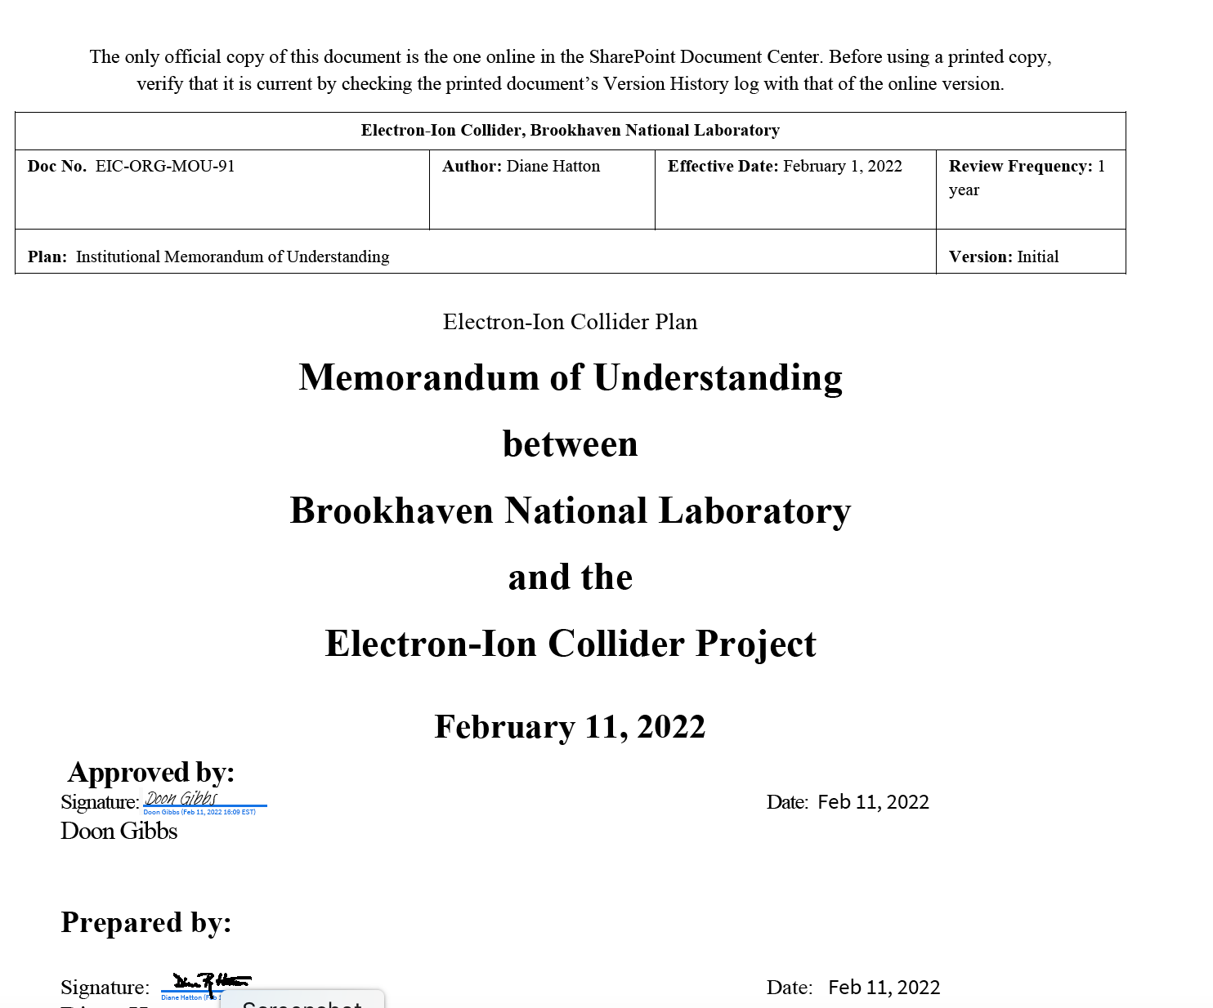
C-AD and EIC
EIC Project has staff at BNL and JLab EIC Directorate at BNL separate from NPP
C-AD staff use for EIC in 3 forms:
Staff transfer
Matrixed staff with individual or group MOUs (>20%, ~70 people)
FY2021 – 17 FTE in C-AD on EIC
FY2022 – 15 FTE in C-AD on EIC
FY2023 – 26 FTE in C-AD on EIC
also have reversed MOU
EIC scope execution in C-AD with C-AD staff
C-AD MAC does not review EIC project topics

Slide 10
Recommendations from MAC-19

Slide 11
Recommendations from MAC-19
R1 (RHIC Performance): Michiko Minty in MAC-20 presentation
Plan in advance with facilities services to be ready for running with high energies in hot summer months.
Look for alternative funding resources to complete cryo upgrade.
R2 (Operation with sPHENIX): Kiel Hock in MAC-20 presentation
Clarify the consequences of a quench protection diode failure.
R3 (EBIS Status and Commissioning Plan): Haixin Huang, here
For the next MAC review, the preparation schedule for polarized 3He for EIC should be presented.
R4 (CeC Status and Plan for 2023): Vladimir Litvinenko and Alexei Fedotov, here
● Develop a prioritized list of CeC accelerator upgrades and work on their implementation to demonstrate machine performance in accordance with the updated requirements.
● Based on the 2022-23 results, prepare an updated plan for studies in 2024-25 compatible with the RHIC program and present at the 2023 MAC.
R5 (CeC Simulation with Realistic Distribution): Alexei Fedotov, here
Develop and carry out a realistic plan for generating quantitative predictions for the CeC experiments from the simulations.
R6 (Polarization Increase in AGS with Skew Quads): Vincent Schoefer in MAC-20 presentation
Include measurement of driving terms for coupling in the optimization process of skew quadrupole settings.

Slide 12
Recommendations from MAC-19
R7 (He-3 Polarization Preservation in Injectors): Kiel Hock in MAC-20 presentation
Consider testing the beam dynamics of this scheme with unpolarized He-3 beams.
R8 (ML R&D in C-AD Overview): Georg Hoffstaetter in MAC-20 presentation
● Consider prioritizing by estimating the resource costs (including beam testing time), benefit and risk of each item presented, and selecting several of the best to develop first. This would allow teams to concentrate and develop the most promising items more quickly.
● We suggest one of the goals to be implementation in the control system of a process robust enough to be able to run independently for extended times without the need for intervention. Necessary interventions should be logged to allow identification of shortcomings.
R9: (ML for Luminosity Maximization): Xiaofeng Guo in MAC-20 presentation
Develop a plan and assess the resources needed to carry out the plan. The plan needs to have well-defined and achievable goals and include defined measures and actions to protect the machine and the detector. The protection measures need to be agreed upon with sPHENIX management.
R10 (LEReC Concept for EIC pre-cooler): Alexei Fedotov, here
Analyze the effect of the field of SHC quads on the angular spread of the precooler electron beam, including the possible remaining nonzero field of the quads, when they ramp down, and also the impact of their field on the magnetization of the neighboring mu-metal shield. Consider if an experimental magnetic measurement test may need to be performed.

Slide 13
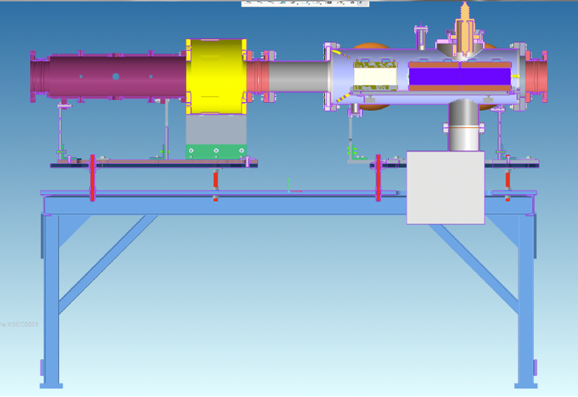
R3 (EBIS Status and Commissioning Plan): Haixin Huang, here For the next MAC review, the preparation schedule for polarized 3He for EIC should be presented.
Schemes of Polarized He³ in Injectors
Intrinsic resonances in the Booster are overcome by AC dipole.
Imperfection resonances in the Booster are overcome by harmonic orbit correction.
Betatron tunes in the AGS are put into spin tune gap generated by two partial snakes. Both intrinsic and imperfection resonances are avoided.
AGS spin tune gap and vertical spin component
Mechanical drawing of Booster AC dipole

Slide 14
R3 (EBIS Status and Commissioning Plan): Haixin Huang, here For the next MAC review, the preparation schedule for polarized 3He for EIC should be presented.
Commissioning Plan of He³ in Injectors
Unpolarized He³ was not available in 2023 for beam test in injectors.
Unpolarized He³ will be available in run 24 for RHIC He³ polarimetry test.
Setup AGS with both betatron tunes inside the spin tune gap (>8.95) along the energy ramp.
Polarized He³ will be available in early 2025.
Test polarized He³ beam with Booster AC dipole at AGS injection. Measure polarization as function of AC dipole amplitude.
Set up AGS with both betatron tune into spin tune gap generated by two partial snakes. Measure polarization with this setup. Measure polarization on the energy ramp.

Slide 15
R4 (CeC Status and Plan for 2023): Vladimir Litvinenko and Alexei Fedotov, here
● Develop a prioritized list of CeC accelerator upgrades and work on their implementation to
CeC accelerator prioritizes demonstration of stable laser operation with laser pulse jitter less then 1%
Installation and commissioning of new (symmetric) 500 MHz bunching cavity
Establishing stable and repeatable parameters of electron beam
● Based on the 2022-23 results, prepare an updated plan for studies in 2024-25 compatible with the RHIC program and present at the 2023 MAC.
Since CeC no longer has dedicated portion of RHIC operation, scheduling is possible only for portion of the CeC program which does not require ion beam. Operation with ion beam could be possible as a portion of time allocated for RHIC APEX program.
Key point in the plan:
In parallel with RHIC operations:
Optimize laser pulse shape necessary to expand uniform portion of electron bunches
Reduce laser pulse energy jitter to below 1% RMS
Demonstrate longitudinal uniform beam with desirable beam quality with new laser profile.
Tune the CeC accelerator to design values of beam paramours: 50 A peak current; 2E-4 slice energy spread; 1.5 mm mrad normalized emittance (or better)
Restore high gain in the Plasma-Cascade Amplifier in pulse e-beam mode
In APEX deducted time – proceed as far as time allows with
Restore RHIC setting with ion beam at 26.5 GeV/u in Yellow ring
Establish CW e-beam in the common section
Establish overlap of electron and ion beam and match their relativistic factors
Restore high gain in the Plasma-Cascade Amplifier with CW e-beam
Attempt to demonstrate longitudinal cooling.

Slide 16
R5 (CeC Simulation with Realistic Distribution): Alexei Fedotov, here Develop and carry out a realistic plan for generating quantitative predictions for the CeC experiments from the simulations.
Detailed simulations were developed which take into account that ions experience different kicks at difference slices of electron beam. These simulations provide requirements on electron beam parameters and quantitative predictions for the CeC experiment. We are currently optimizing the electron accelerator and the cooling section magnets so that the followings can be achieved for the electron bunch:
Peak-to-peak variation of the instantaneous current stay below 10% over a duration of 15 ps;
The quality of the electrons with the 15 ps duration should be sufficient to generate cooling energy kick with amplitude of 1.5e-9 at the center of the bunch;
The transverse RMS size of the cooling force should not be smaller than the RMS size of the ion.
e- beam part: Continue searching in parameter space for injector design to generate temporally uniform beam with low emittances. Study various effects’ (space charge, compression – potential linearizers (higher order cavities, vacuum chamber) impact on slice emittance and optimize the machine set up. Benchmark the simulation results with the experiment measurements.
Ion tracking part: Since the electron bunch is more than two orders of magnitude shorter than the ion bunch and the cooling is more efficient for ions with small synchrotron amplitude than those with large synchrotron amplitude, the RMS bunch length is not a good quantity to observe cooling. We plan to use the amplitude of the longitudinal charge distribution of the ion bunch as measured from the wall current monitor as the observables for monitoring cooling effects quantitatively. Specifically, we will follow the following procedures for observing cooling:
inject 6 ion bunches with similar intensities.
overlap one of the 6 ion bunches with the cooling electron bunch and use the other 5 bunches as reference bunches.
measure the ion bunch longitudinal profile using the wall current monitor and remove the statistical noise by averaging all traces collected over a period much shorter that the expected cooling time (~1 hour).
calculate the amplitudes of the ion bunch profiles for the cooled bunch and the reference bunch. The ratio of the amplitudes from the cooled bunch and that from the reference bunch will serve as the quantity to be compared with the ion tracking simulation.

Slide 17
R10 (LEReC Concept for EIC pre-cooler): Alexei Fedotov, here Analyze the effect of the field of SHC quads on the angular spread of the precooler electron beam, including the possible remaining nonzero field of the quads, when they ramp down, and also the impact of their field on the magnetization of the neighboring mu-metal shield. Consider if an experimental magnetic measurement test may need to be performed.
Precooler is now part of the EIC project. This concern is very important and will be addressed both by finding appropriate design and by performing magnetic measurements of chosen configuration.
Analysis of magnetic fields from SHC quads in the cooling sections in the presence of mu-metal shielding started. Present thinking is to have Panofsky-type SHC quadrupoles without iron which should satisfy requirement on remnant magnetic fields for the Precooler cooling sections.

Slide 18
MAC-20

Slide 19
MAC-20 Charge
The Collider-Accelerator Department (C-AD) is preparing for two more years of running with the new sPHENIX and the upgraded STAR detectors. The most recent RHIC Run-23 was ended on 1 August 2023, 6 weeks early, because of a helium leak in a valve box and subsequent damage to a superconducting DX magnet. After completion of the RHIC program the C-AD will maintain the hadron accelerator complex in a ready state while transitioning the majority of the staff to the Electron Ion Collider (EIC) Project.
During this year’s MAC we request the committee’s review and advice on (i) the operation with sPHENIX and STAR, (ii) the plan to maintain the hadron injectors for EIC, and (iii) the presented R&D initiatives.
For item (i) and (ii), please address the following charge questions:
Are the technical goals realistic and is the progress appropriate to meet the stated goals?
Are there any technical issues that were missed and/or need additional attention by the team?
For item (iii), please also address the following charge questions:
Is the accelerator R&D effort well executed and future work well planned?
Any other comments on the C-AD accelerator operation and R&D are welcome.
It is requested that a concise report responsive to this charge be forwarded to the C-AD Chair, Wolfram Fischer, by 5 January 2024.

