Slide 1
RHIC Performance and Repair Status
Michiko Minty
Associate Chair for Accelerators and Applications
Accelerator Division Head, C-AD
C-AD MAC-20
19 December 2023

Slide 2
Outline
RHIC Performance
RHIC Run 2023 timeline and achievements
RHIC accelerator availability
Operational challenges
APEX (Accelerator Physics Experiments) during Run 2023
RHIC Repair Status
Event on 1 August 2023
Causal analysis and external “RHIC Recovery” review
Repair status
Completing the RHIC physics science mission and APEX (FY24 and FY25)
Summary
M. Minty C-AD MAC-20 (19-21 Dec 2023)

Slide 3
RHIC Performance

Slide 4
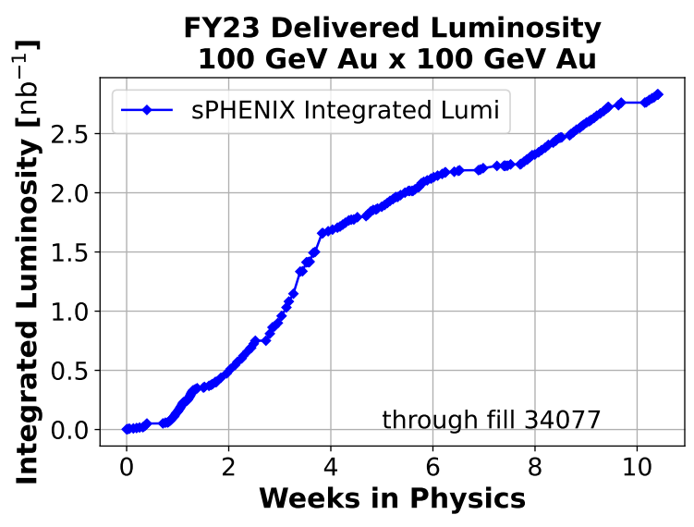
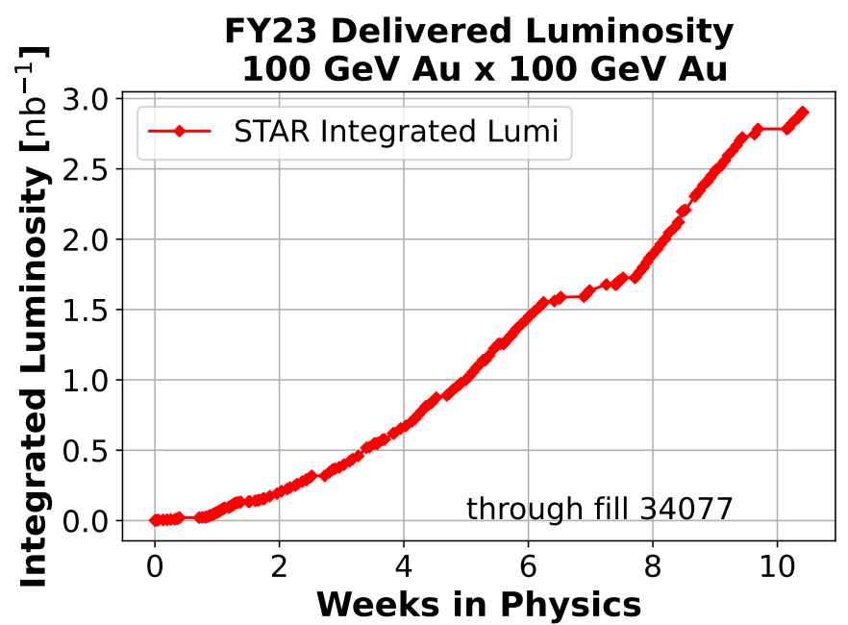
Run Coordinator: Travis Shrey
RHIC Run-23 timeline and achievements
Timeline for sPHENIX commissioning with Au+Au (100 GeV/beam)
  sPHENIX MIE PD-4 project approval 12 Dec 2022
  RHIC 4K cooldown 5 May 2023
  First beam injection 8 May 2023 (Blue), 10 May 2023 (Yellow)
  sPHENIX approval to operate 18 May 2023
  sPHENIX commissioning with beam 18 May 2023
  STAR physics “declared” 20 May 2023
  APEX and maintenance alternating weeks starting 24 May 2023
  Blue Ring 1004B valve box failure 1 August 2023
  End of RHIC Run 2023 4 August 2023
Achievements
  Provided wide variety of RHIC beam conditions (number of bunches, bunch intensities, up to 2 mrad crossing angles), met sPHENIX commissioning requirements per sPHENIX schedule.
  Provided collisions also for STAR with 1 mrad crossing angle and luminosity-leveling; ~30% of minimum-bias goal (Run23+25) collected.
preliminary
preliminary
4
M. Minty C-AD MAC-20 (19-21 Dec 2023)

Slide 5
RHIC accelerator availability
p↑+p↑
Au+Au
100 GeV
courtesy Chris Naylor
255 GeV
74.4% 2023
85.8% 10-year average
RHIC Availability [%]
Time [Fiscal Year]
Availability = beam time / scheduled beam time
(denominator excludes scheduled maintenance)
Availability goals: 82.5% < FY20,
85% FY21-FY22
82.5% FY23
RHIC Run 2023: 74.4%
Average over last 10 years: 85.8%
M. Minty C-AD MAC-20 (19-21 Dec 2023)

Slide 6
Primary challenge for Run 2023: operation during summer months
From DOE 2022 RHIC Science & Technology Review:
Concerns
Heat
  Many support buildings not equipped to operate with sustained high temperatures
  Many unique AC systems
Humidity
  Reduced cooling tower efficiency, increased load on AC equipment
  Condensation issues
Power
  More frequent power dips and/or outages (storm related), possible brown-outs
Air Conditioning
  Aging equipment, some obsolete controls and parts
Not achieved, RHIC main magnet power supply building
    Maintenance
      ensure existing systems are operable at full capacity
      verify existing AC spares inventory (9 portable units, 6 portable high-volume fans)
Mitigation
  AC ductwork modifications
  New procurements
    spare AC systems for RHIC alcoves (5)
    portable AC units for RHIC service buildings (6) for power supply quench detection racks
M. Minty C-AD MAC-20 (19-21 Dec 2023)

Slide 7
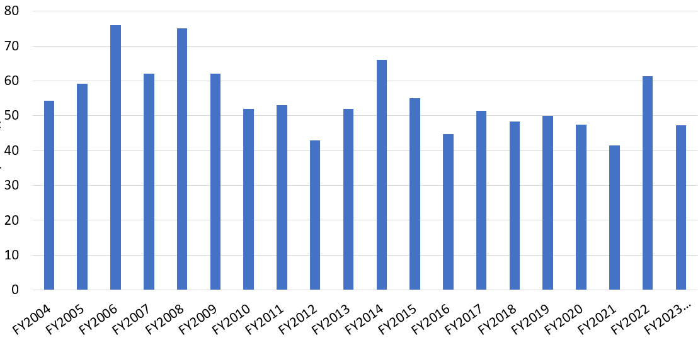
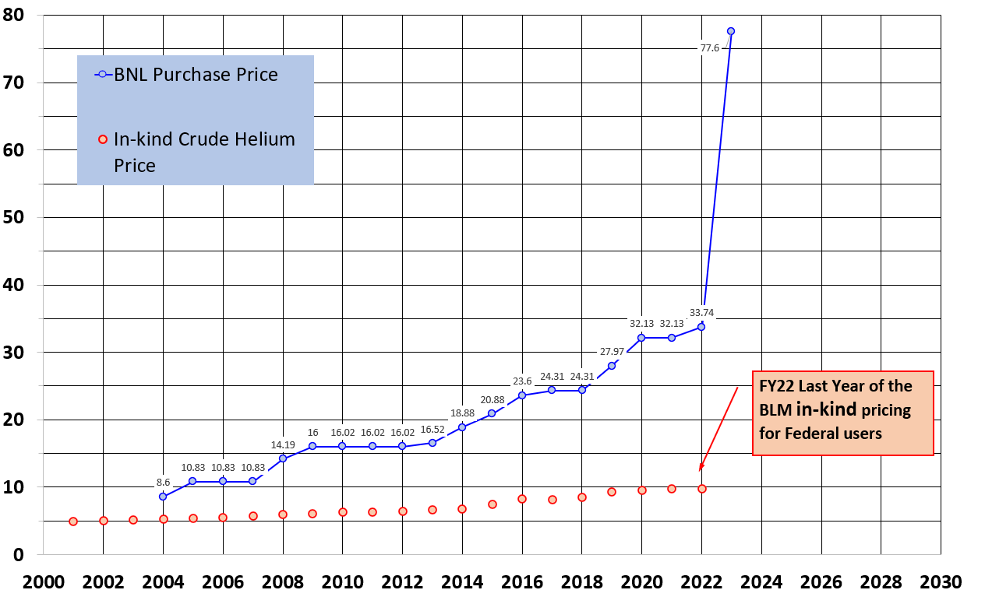
Supply chain and inflation: Helium and Electrical Costs
Electrical costs
  no fixed price contract, price volatility
    FY21: $41.4/MWh
    FY22: $61.4/MWh
    FY23: $47.3/MWh actual
    (had planned for $70.0/MWh)
    FY24: planning for $82.4/MWh
Electricity Rates
$57/MWh
$55.1 average
Cost of LHe
FY23: no more “in-kind” pricing from Bureau of Land Management (BLM) Reserves due to 2013 Act eliminating Federal Helium Reserves
Helium Pricing Trends
$77.6
  FY21: $32.1/LHe gallon
  FY22: ~$33.7/LHe gallon
  FY23: $77.6/LHe gallon
  (had planned for $50/LHe gallon)
  FY24: planning for $77.6/LHe gallon
M. Minty C-AD MAC-20 (19-21 Dec 2023)

Slide 8
Supply chain and inflation
Other impacts of supply chain on RHIC Operations during RHIC Run-23:
highest impact: air conditioning in RHIC main magnet power supply building
unit #1 (25-ton) – OK
unit #2 (25-ton) – OK
unit #3 (2 25-ton stages) – 1 stage down, other stage awaiting parts (>6 months)
unit #4 (2 25-ton stages) – late arrival of parts, unsuccessful attempts at repair
implemented multiple (3 10-ton) movable AC units during run
Other impacts
  air conditioning units on rooftop for sPHENIX delayed by 5 months (installed during run)
  air conditioning for LEReC and CeC-X laser trailer resulted in 1 missed APEX opportunity
  delayed delivery (6 months) of new AGS skew quadrupole power supply (no AGS beam tests for P+P in Run 2023)
  delayed delivery (~ 6 months) of integrated circuits and isolation amplifiers) for machine protection enhancement
  delayed delivery (~ 6 months) of CEC-X cooling section power supplies (although in time for Run 2023)
other groups report no effect on RHIC operations owing to healthy spares inventories and/or work-arounds
good news: most groups (except laser group) report delivery times trending towards those pre-COVID
Impacts of inflation on RHIC operations
EBIS: (30-50)% for parts (diode pack, drift tube and smaller supplies, due to increased material costs)
LINAC RF: DC blocking capacitor (350% increase since 2018)
5 kW amplifiers (160% increase since 2020)
good news: most groups report costs reducing to pre-COVID levels
M. Minty C-AD MAC-20 (19-21 Dec 2023)

Slide 9
APEX (Accelerator Physics Experiments) during Run 2023

Slide 10
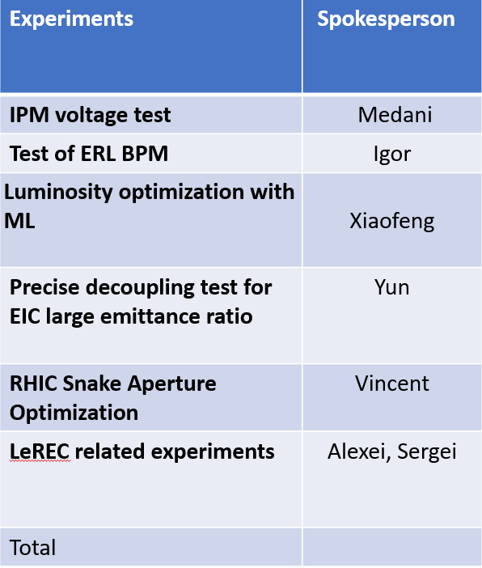
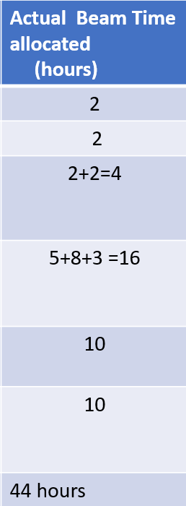
Recent APEX Overview
APEX Beam Time (hours)
focus: experiments to inform EIC design
focus: experiments to inform EIC design, beam cooling studies
focus: beam cooling studies
(Low Energy Au runs, COVID)
APEX experiments during Run 2023
Low Energy Au runs
Four experimental periods:
24 May, 14 June, 28 June, 26 July
M. Minty C-AD MAC-20 (19-21 Dec 2023)

Slide 11
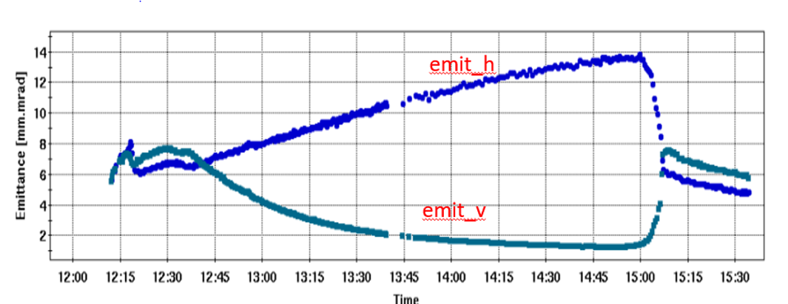
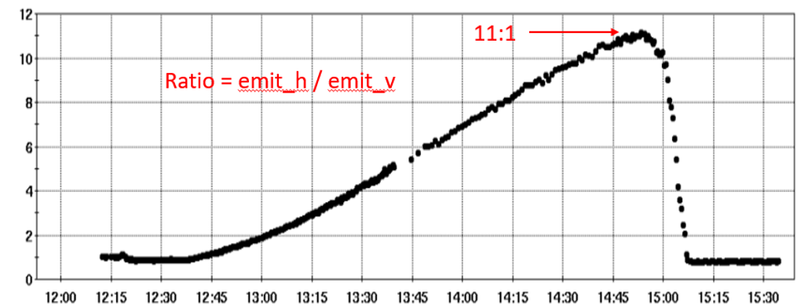
APEX - Precision Decoupling for Large Emittance Ratio
EIC luminosity is enhanced by large beam size ratio at the interaction point.
While flat electron beams are naturally produced by synchrotron radiation, the use of the flat hadron beam in storage rings is unusual.
Very good correction and control of betatron coupling is required to produce large hadron emittance ratio.
The experiment in RHIC intended to demonstrate feasibility of creating the flat hadron beam and the adequacy of present decoupling system for this task.
horizontal
Emittance [μm]
vertical
Emittance Ratio
Ratio
Time [hr:min]
Result: goal of > 10:1 emittance ratio demonstrated.
M. Minty C-AD MAC-20 (19-21 Dec 2023)

Slide 12
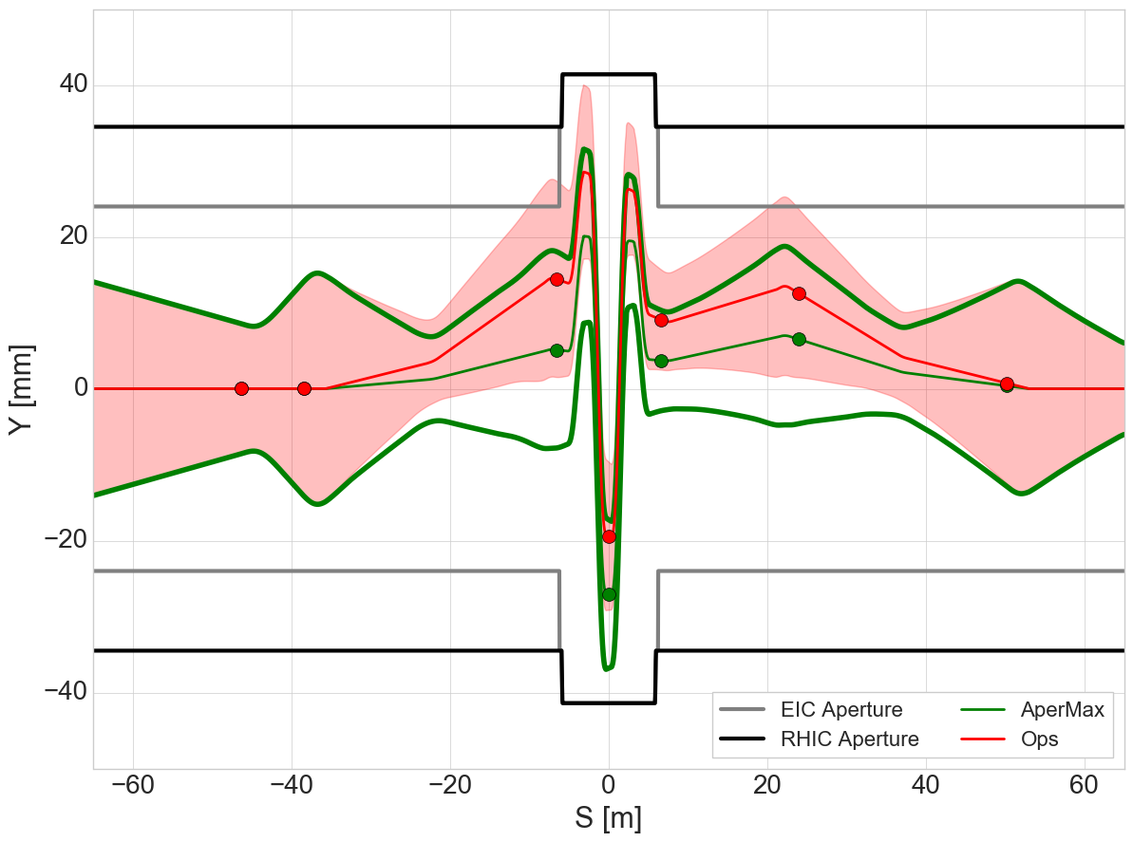
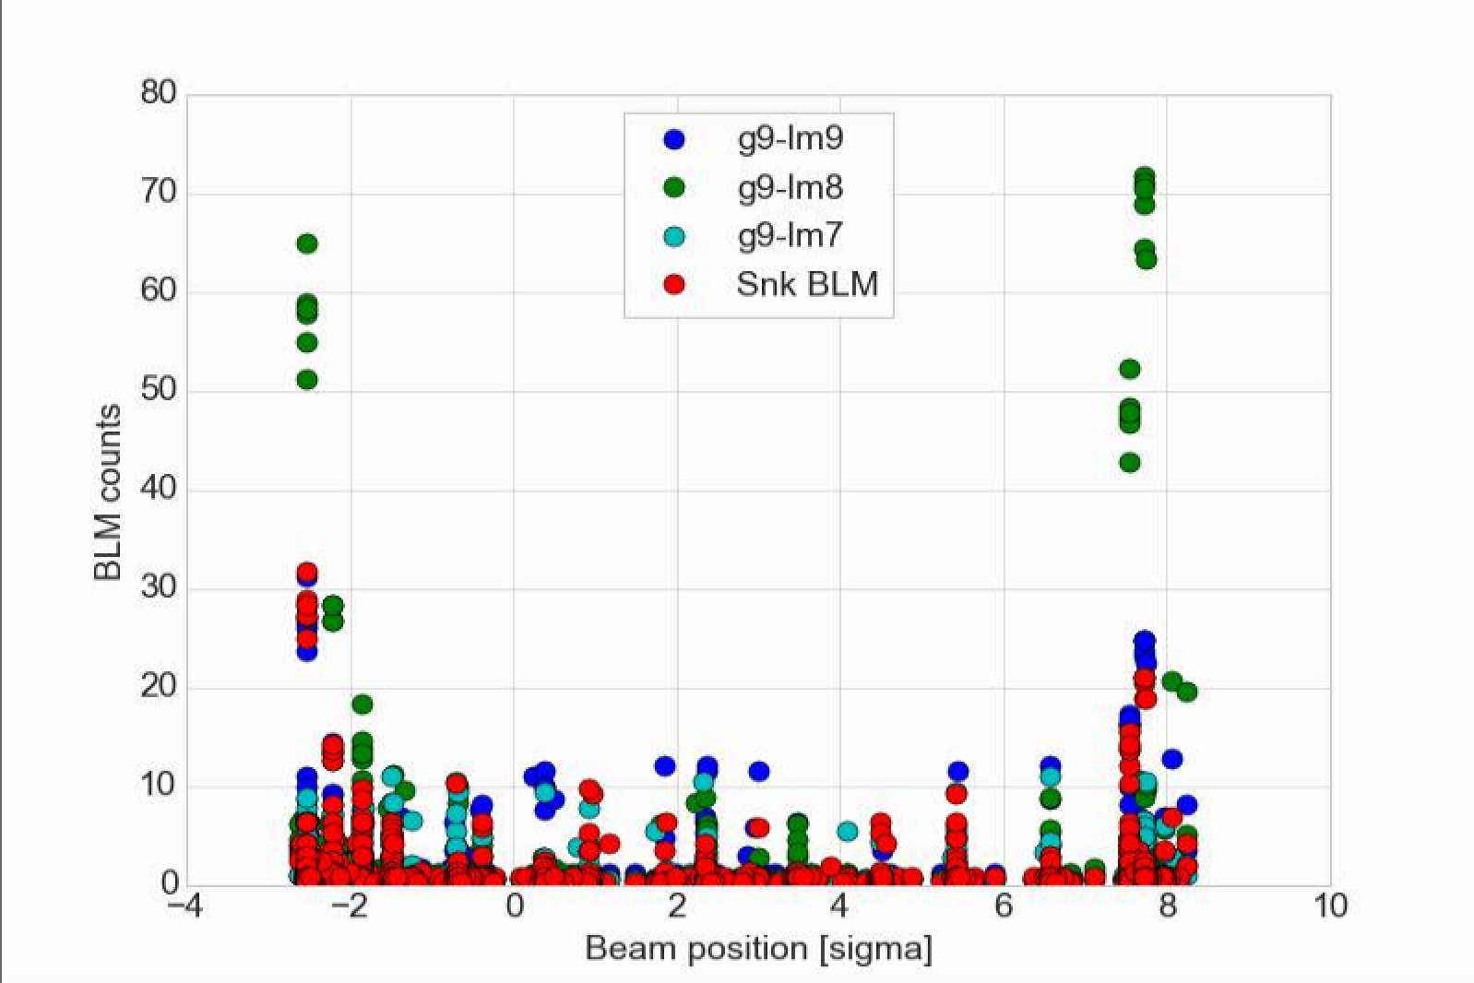
APEX - RHIC Snake Aperture Optimization
Proposed EIC beam screen design restricts aperture in the arcs. New aperture would impinge on present RHIC beam envelope near snake locations (red envelopes). New trajectory established (green envelope) and scanned.
Model: predicts ~9σ, with limiting aperture in snake body.
Experiment shows +/- 5σ of centroid motion before beam edge at +/- 5-6σ contacts aperture. Shows ~10σ clearance between beam centroid on central trajectory and aperture with loss signal consistent with primary scraping in snake body.
Vertical trajectory in snake
g9-lm7
snk-blm
g9-lm8
g9-lm9
Loss signals during scan
+/- 6𝞂 beam envelopes
2.5 um norm rms emit.
Centroid moveable +/- 5σ before scraping of beam edge
RED = Operational trajectory
GREEN = Proposed trajectory
Result: Trajectory exists with sufficient aperture to inject beam in EIC without modifying the screen design near the snake. Assumes local EIC optics approximate RHIC optics.
M. Minty C-AD MAC-20 (19-21 Dec 2023)

Slide 13
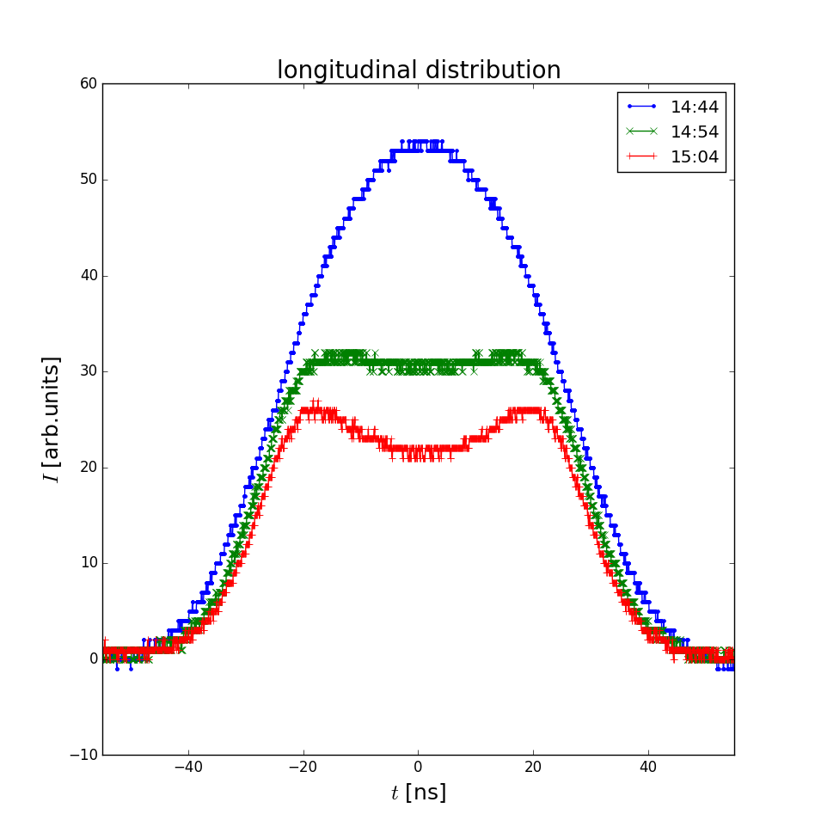
APEX - Advanced Beam Cooling
While both LEReC and CeC established electron beam operations, no beam cooling experiments took place in Run 2023.
LEReC – advances in accelerator science
Analyzed data from APEX 2022 and published (details in backup slides):
Experimental demonstration of circular attractor at relativistic energy using LEReC
S. Seletskiy, A. Fedotov, D. Kayran, “Experimental studies of circular attractors in the first rf-based electron cooler”, PRAB 26, 024401 (2023).
Demonstrated influence of circular attractor on CeC
S. Seletskiy, A. Fedotov, D. Kayran, “Circular attractors as heating mechanism in coherent electron cooling” PRAB 25, 054403 (2022).
Measured ion bunch evolution in the presence of a circular attractor
Electron beams re-established in 2023 reproducing design beam parameters.
APEX for LEReC this year (10 hours) was devoted to establishing 3.85 GeV beam (with 100 GeV initial conditions).
M. Minty C-AD MAC-20 (19-21 Dec 2023)

Slide 14
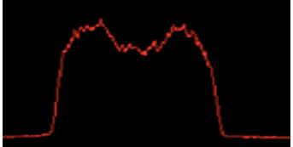
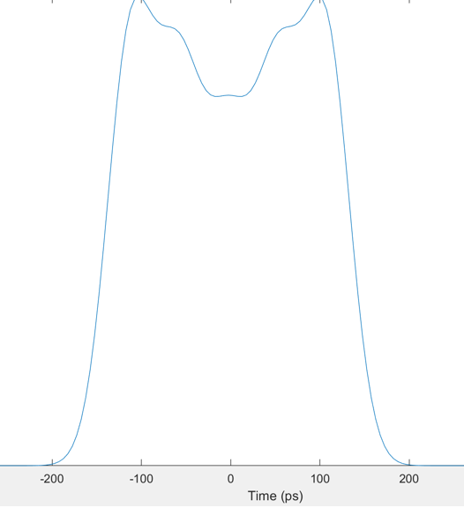
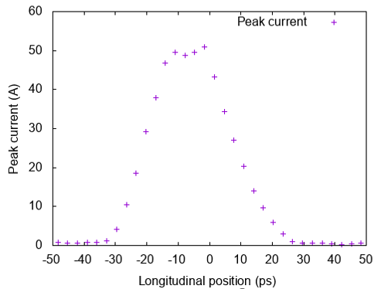
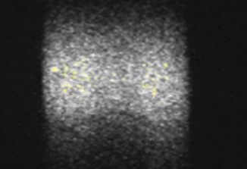
APEX - Advanced Beam Cooling
CeC – advances in accelerator technology
Updated cooling simulation require the electron beam in cooling section to have uniform current distribution (<10% peak-to-peak variation) as well as good quality over 15 ps duration
Beam dynamics simulations show that the uniform distribution can be achieved using a new (non-Gaussian) distribution of the laser pulse profile.
The laser system was upgraded to produce five overlapping Gaussian laser pulses (using five interferometers). Efforts underway to ensure same laser profile at laser gun table.
simulation: electron current distribution (in ps)
proposed laser pulse shape
streak camera measurement
(laser trailer)
-200 -100 0 100 200
at gun
in cooling region
Manufacturing process has started for new 500 MHz bunching cavity.
New transfer system for photocathodes successfully tested.
M. Minty C-AD MAC-20 (19-21 Dec 2023)

Slide 15
RHIC repair status

Slide 16
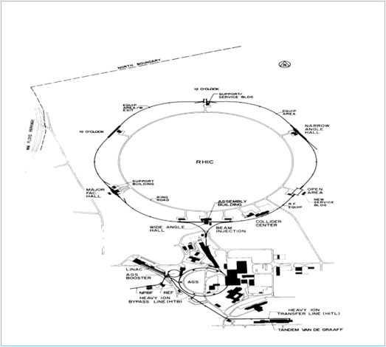
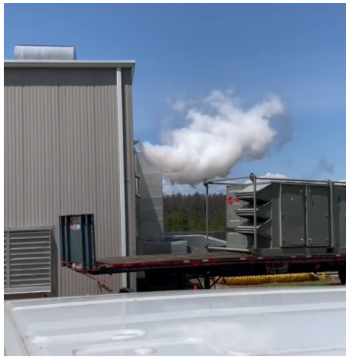
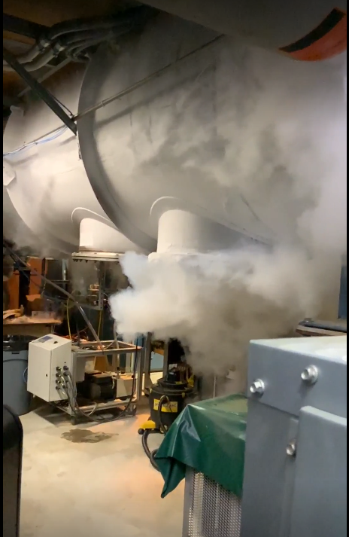
Event on 1 Aug 2023
On 1 Aug 2023 the Blue Ring Quench Interlock (QLI) System commanded the RHIC energy extraction system to dissipate the stored energy in the Blue Ring. Due to uncertainties in the sequence of events and estimated time for recovery, RHIC Run 2023 was terminated six weeks early (on 4 Aug 2023).
The DOE Office of Science has approved carryover of these six weeks into RHIC Run 2024.
The unexpected release of Helium in Building 1004B through the valve box access port necessitates a USI (Unreviewed Safety Incident) requiring a change to the RHIC ASE.
Helium venting at Bldg. 1004B
1004B Valve Box
M. Minty C-AD MAC-20 (19-21 Dec 2023)

Slide 17
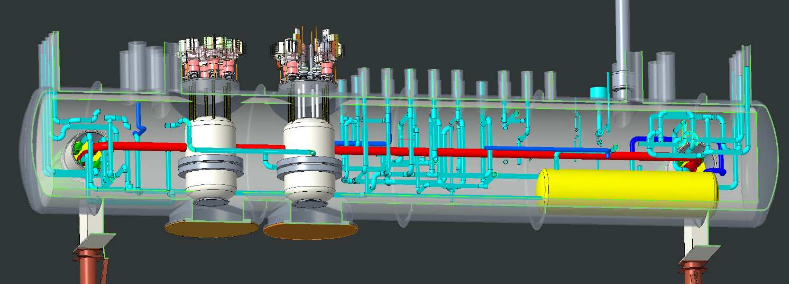
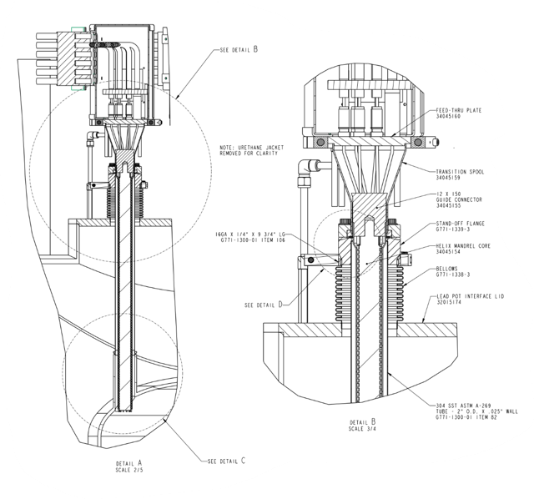
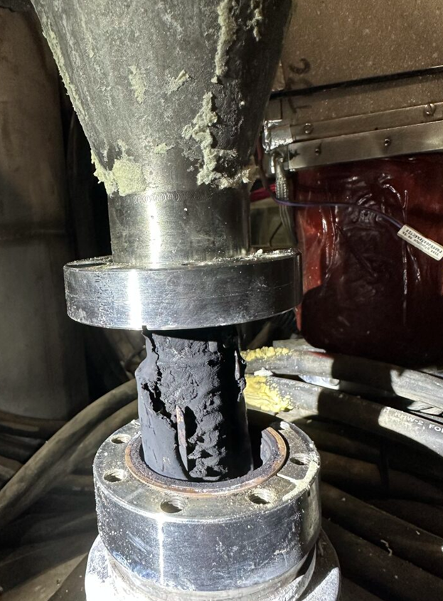
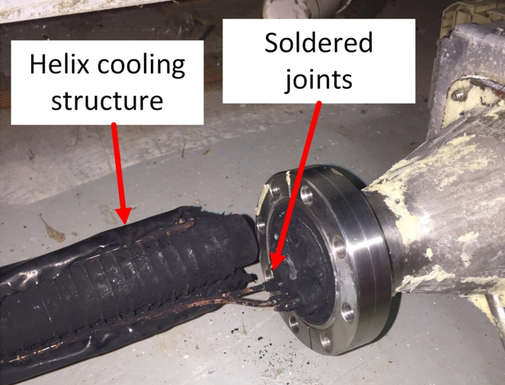
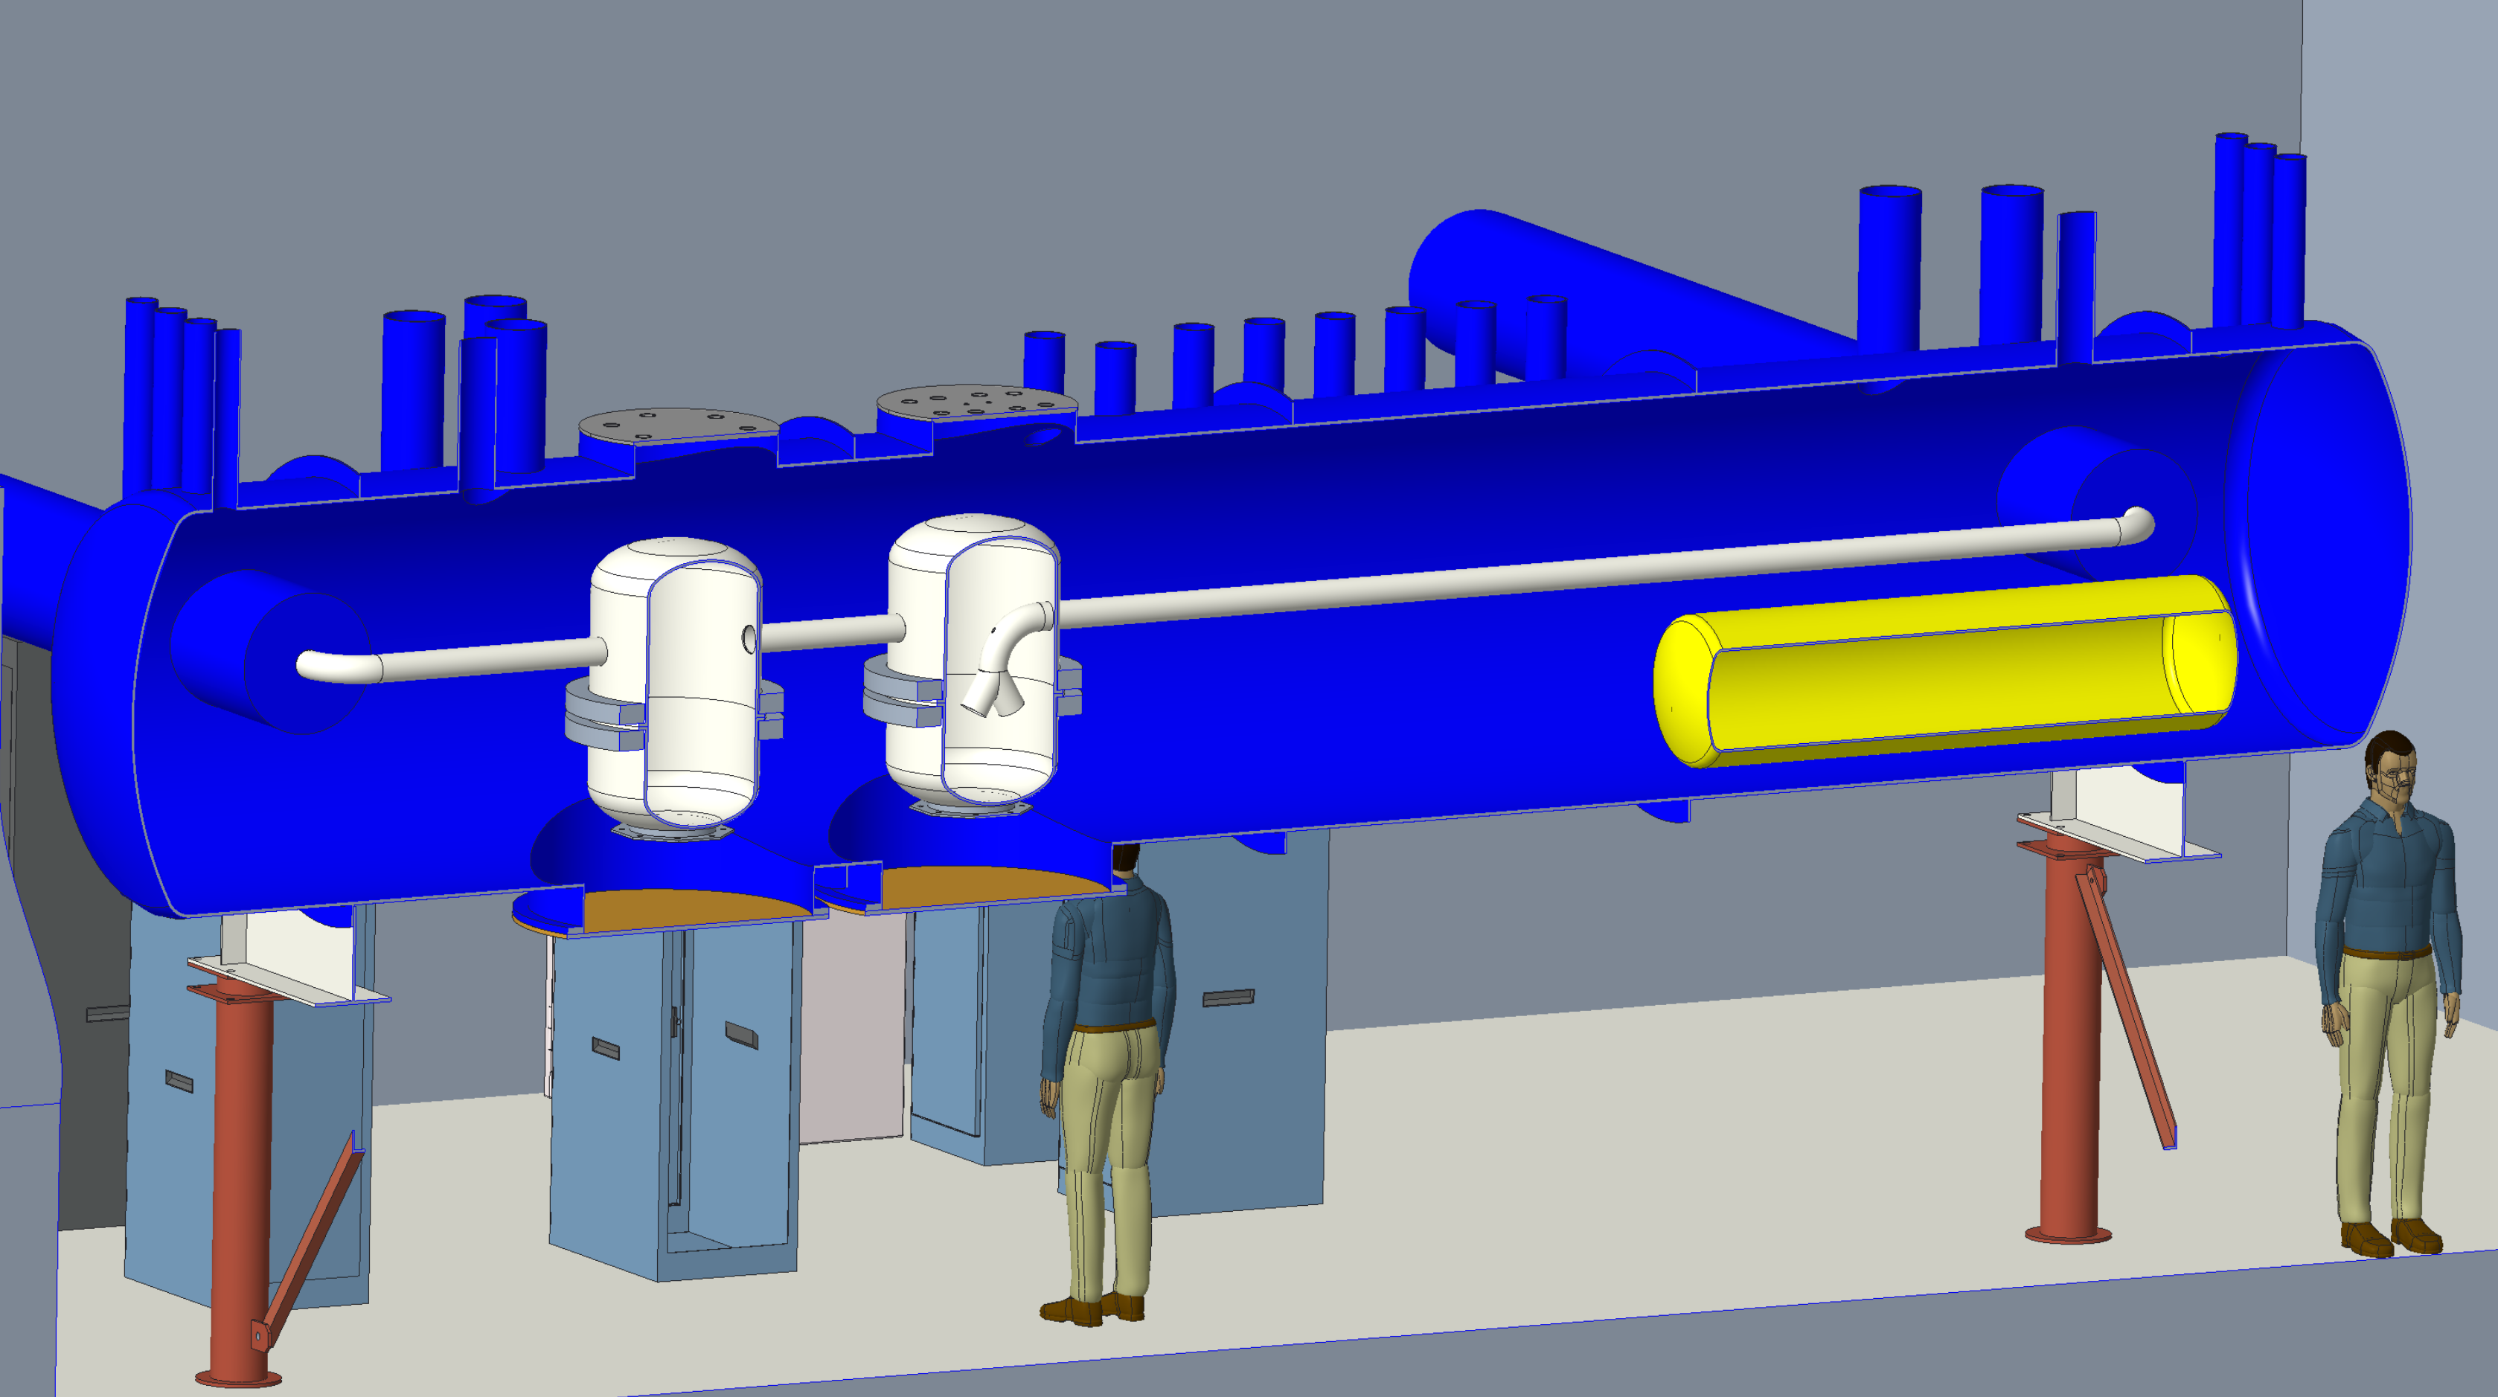
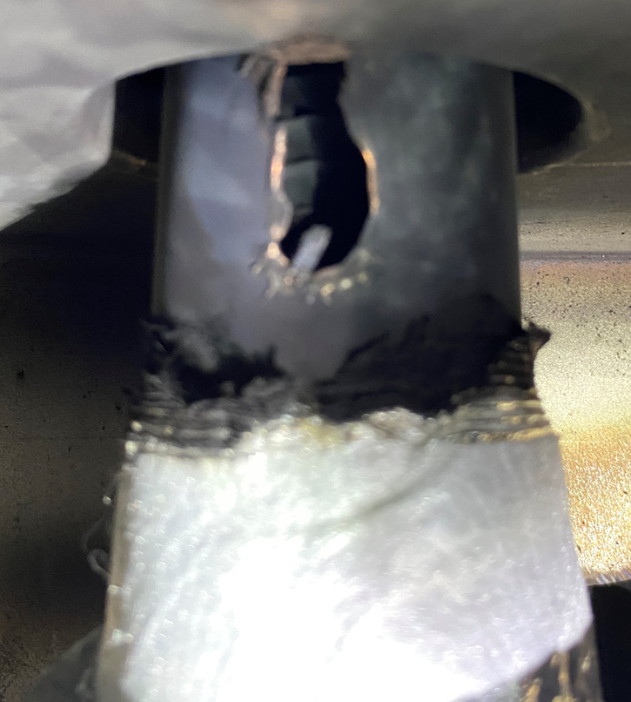
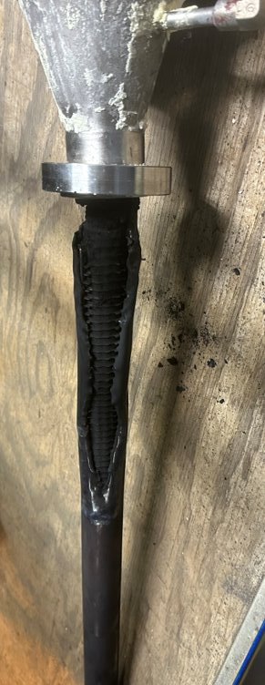
Valve Box in Building 1004B
Feedthrough in lead pot
Feedthrough in situ
Feedthrough in lab
1004B Blue Valve Box CAD model
Lead pot “BA”
M-line pipe
Lead pot “A”
Feedthrough pipe
.025” wall feedthrough tube and bellows were ruptured by current lead arc failure
1004B Blue Valve Box CAD model
M. Minty C-AD MAC-20 (19-21 Dec 2023)

Slide 18
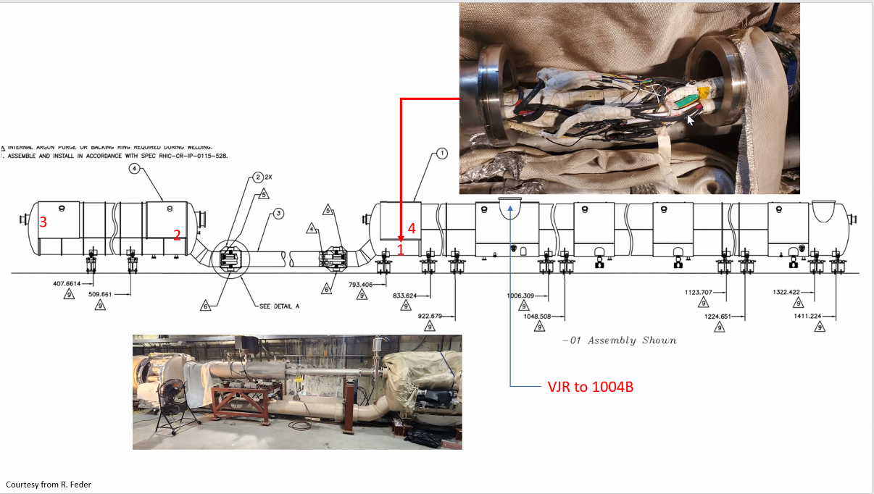
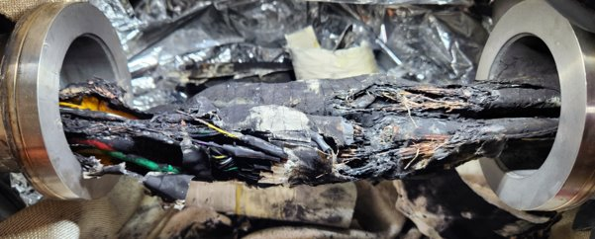
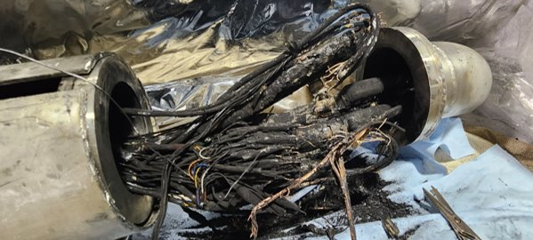
DX Magnet Splice Cans
Splice can #1 (no trouble found)
Splice can #3
Splice can #2
DX magnet
10000000000
Location of electrical connections to 1004B valve box
DX magnet
Inside the RHIC tunnel
M. Minty C-AD MAC-20 (19-21 Dec 2023)

Slide 19
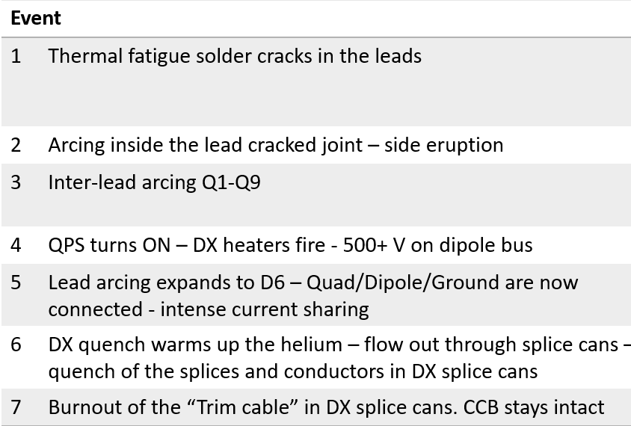
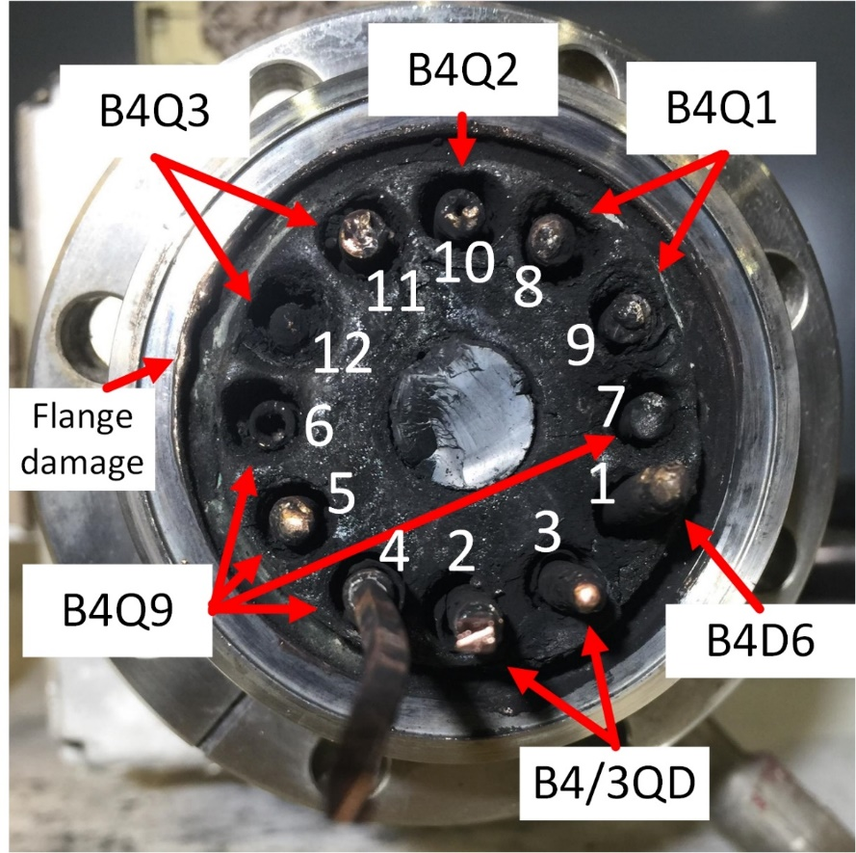
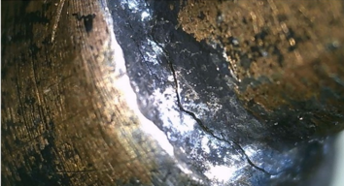
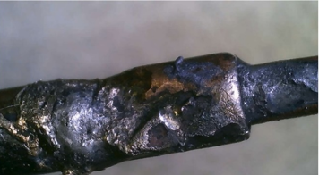
Causal analysis and “RHIC Recovery Review”
External review (28 Nov 2023)
Marc Ross, chair (SLAC), Philippe Lebrun (CERN), Yuenian Huang (FNAL), Renuka Rajput-Ghoshai (JLAB),
George Ganetis (BNL), George Mahler (BNL)
current lead feedthrough
current lead
Review committee which concurred with causal analysis and planned repairs, recommended more analysis of splice can failures.
M. Minty C-AD MAC-20 (19-21 Dec 2023)

Slide 20
RHIC recovery
We understand what happened
Broad BNL effort to repair RHIC and return to operations
  1004B valve box mechanical repairs
  Spare 12X150 current lead preparation and valve box electrical work
  DX magnet and magnet bus repairs, mechanical and electrical work
  DX magnet preparation and testing
  ASE and USI documents and supporting ODH calculations
  RHIC 4K cooldown by 4 Mar 2024
Milestone tests to verify repair
  A. M-line pressure test by 1/15/24
  B. DX magnet and super-conducting bus cold testing starting in early March 2024
Continuing to assess how to prevent recurrences and mitigate for EIC operations
  A. 12X150 current lead
    Fabricating additional units based on current design
    Developing improved design for EIC operations
  B. Implementing improved current lead cooling-flow control
M. Minty C-AD MAC-20 (19-21 Dec 2023)

Slide 21
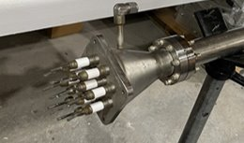
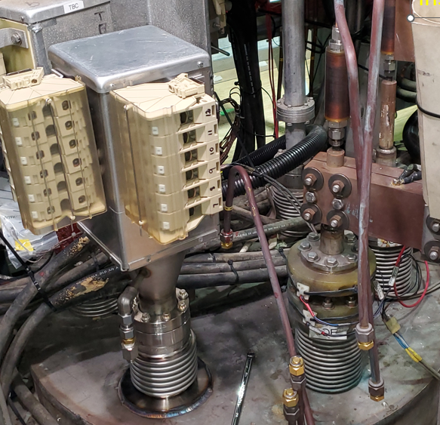
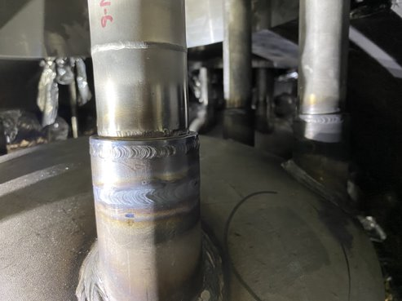
Repair status – 1004B valve box
Feedthrough pressure and electrical tests completed
Feedthrough, new feedthrough tube and bellows installed
Next steps: feedthrough electrical testing
close lead pots (weld)
M-line pressure test (includes closure of all splice cans)
Pumpdown valve box
Modifications to cryo cooling control (for faster regulation and to avoid ‘overcooling’ to reduce thermal stresses
M. Minty C-AD MAC-20 (19-21 Dec 2023)

Slide 22
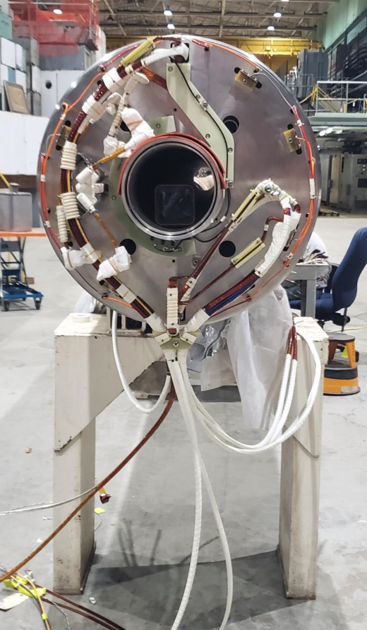
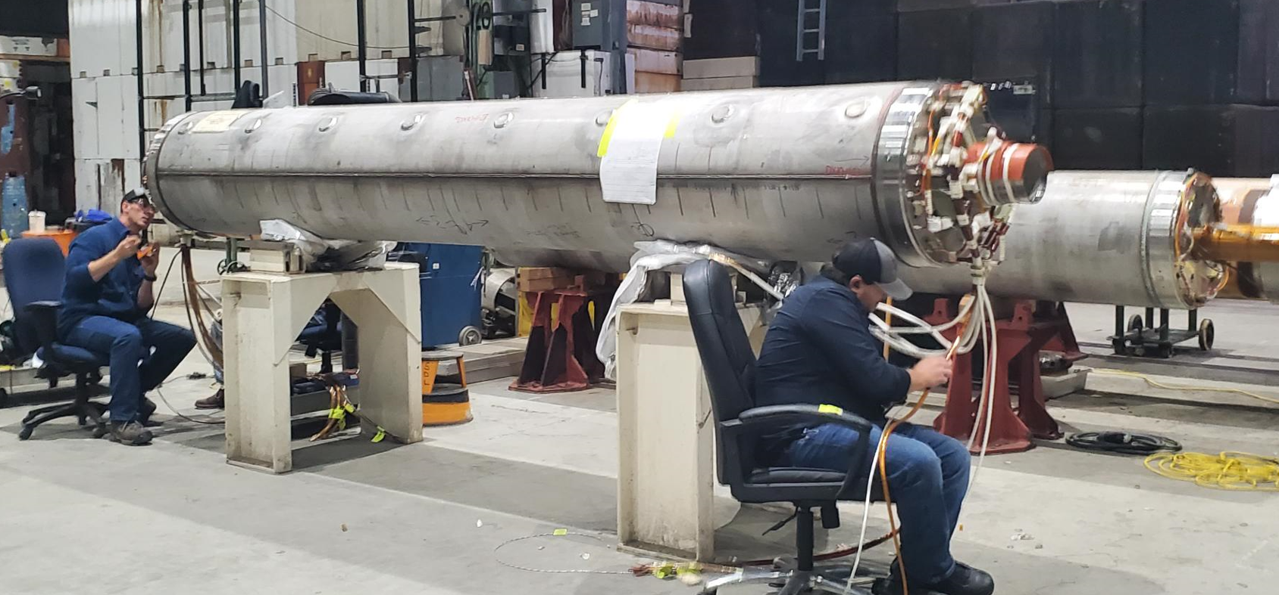
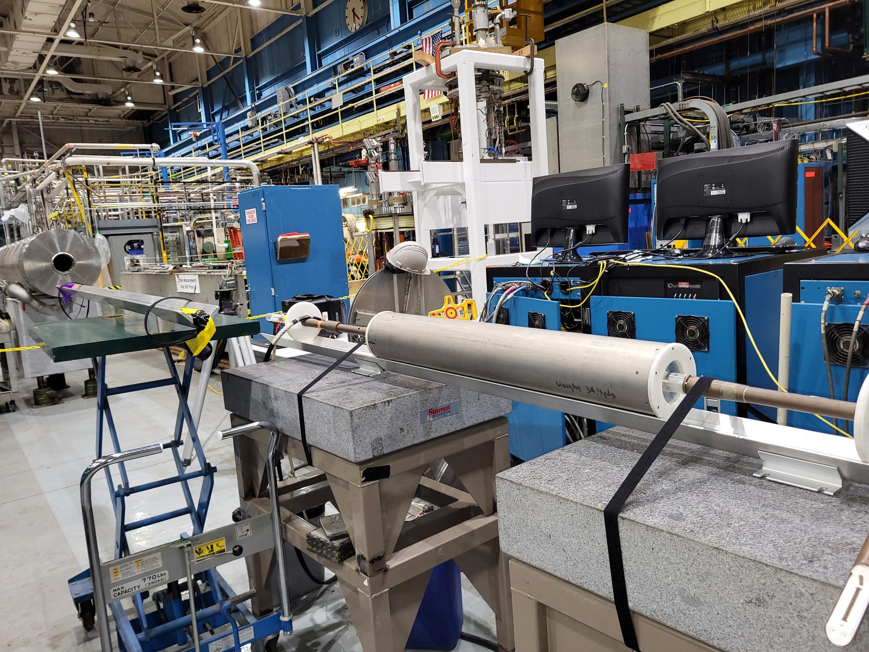
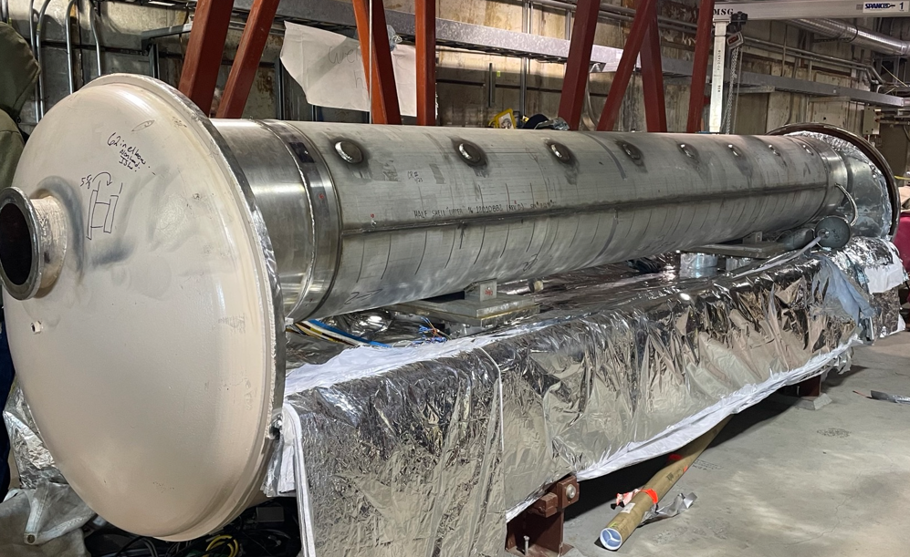
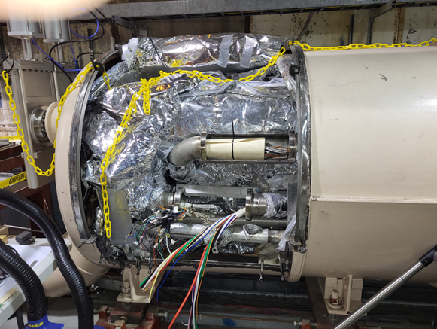
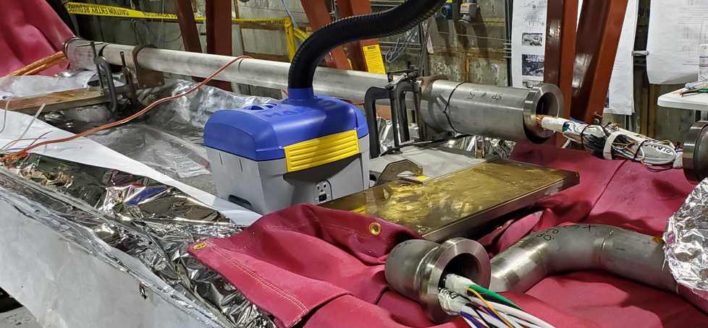
Repair status – DX magnet and electrical splices
Electrical wiring of spare DX magnet completed
Magnetic fields measured
DX magnet re-installed
Electrical wiring: 3 “splice cans” (SC) completed, 2 prepared to accept DX magnet
SC #1
SC #2
SC #4
SC #5
SC #3
Next steps: electrical testing
close all splice cans
M-line pressure test
M. Minty C-AD MAC-20 (19-21 Dec 2023)

Slide 23
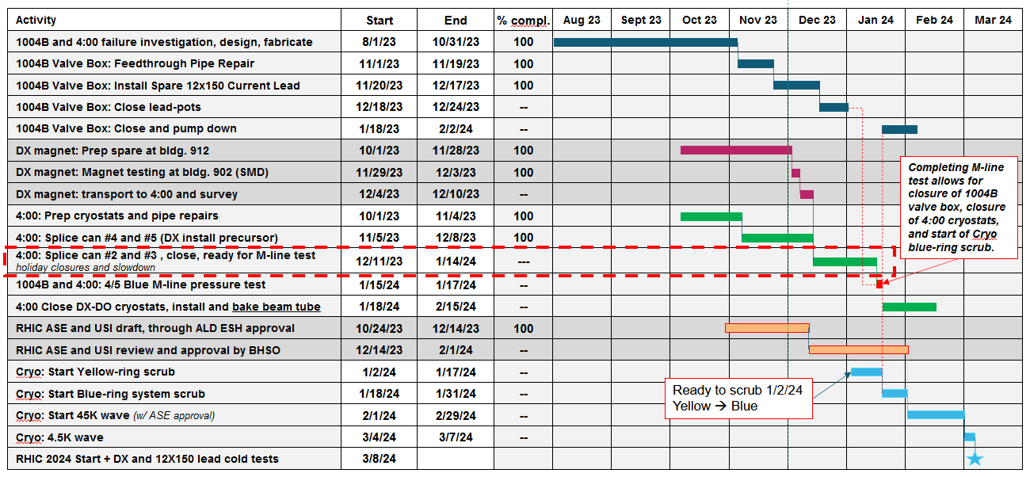
RHIC recovery schedule
4K wave start no earlier than 4 Mar 2024
45K wave requires approval of USIs (make existing ODH systems credited controls) and corresponding update of RHIC ASE
today
M. Minty C-AD MAC-20 (19-21 Dec 2023)

Slide 24
Completing the RHIC physics science mission (FY24 and FY25)

Slide 25
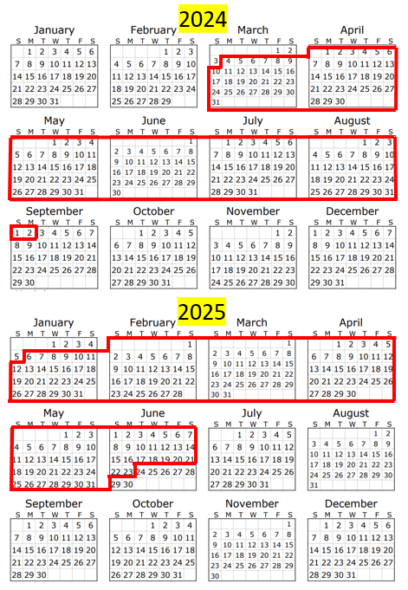
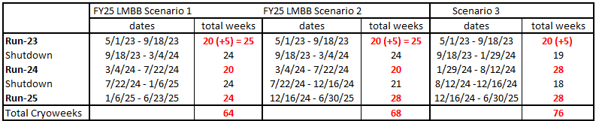
Completing the RHIC physics science mission (FY24 and FY25)
Run-24 assumes 20 cryo-weeks (p↑ + p↑) in scenario 1 and a 6-week carryover (Au + Au).
Prior to Run-25, a 24-week shutdown is assumed to accommodate possible future requirements of the sPHENIX experiment and maintenance needed for Run-25. Removal of equipment not needed for RHIC operations in Run-25 will also take place in preparation for the EIC.
Run-25 assumes 24 cryo-weeks (Au + Au) in scenario 1.
DOE Site Visit, Nov 2022 (includes more optimistic operating scenarios):
Notes
operating budgets for Run-24 and Run-25 still TBD
scenarios 2 and 3 could enable p↑ + Au

Slide 26
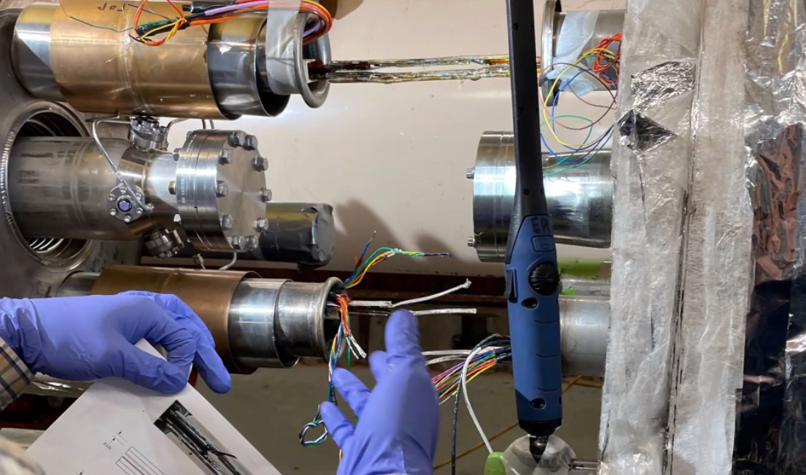
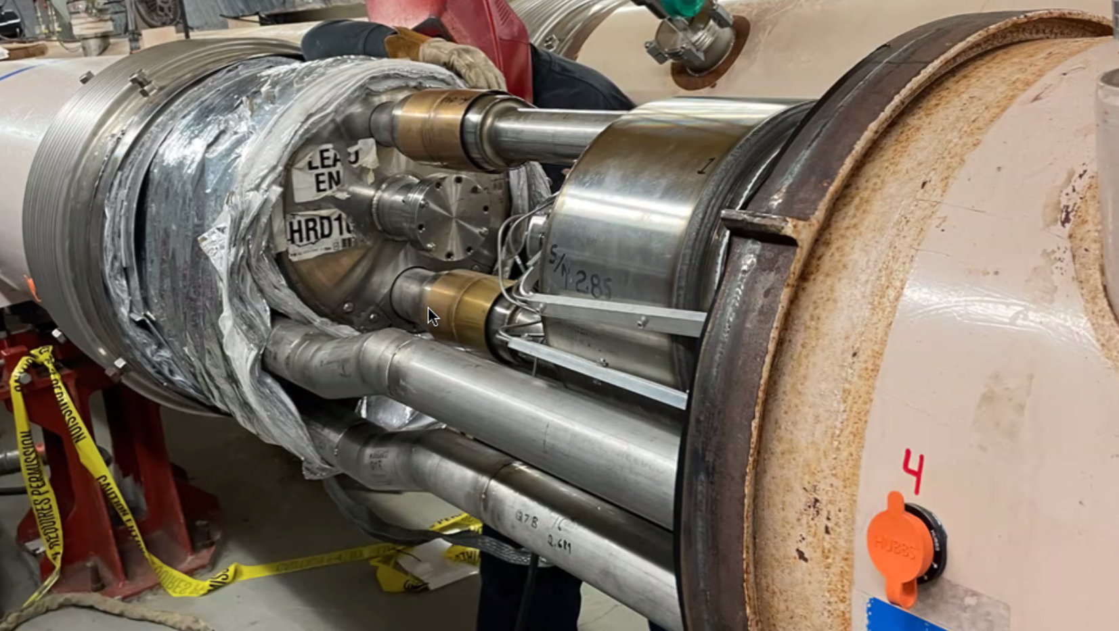
Siberian Snake
The Siberian Snake, needed for polarized proton operation in Run-24, was damaged during Run-22. Amazingly, Run-22 was completed with high polarization.
The Siberian Snake magnet repaired at the Magnet division.
Work on superconducting electrical connections
Utility lines completed and welded (10 o’clock side)
The Siberian Snake magnet has been re-installed for RHIC Run-24.
M. Minty C-AD MAC-20 (19-21 Dec 2023)

Slide 27
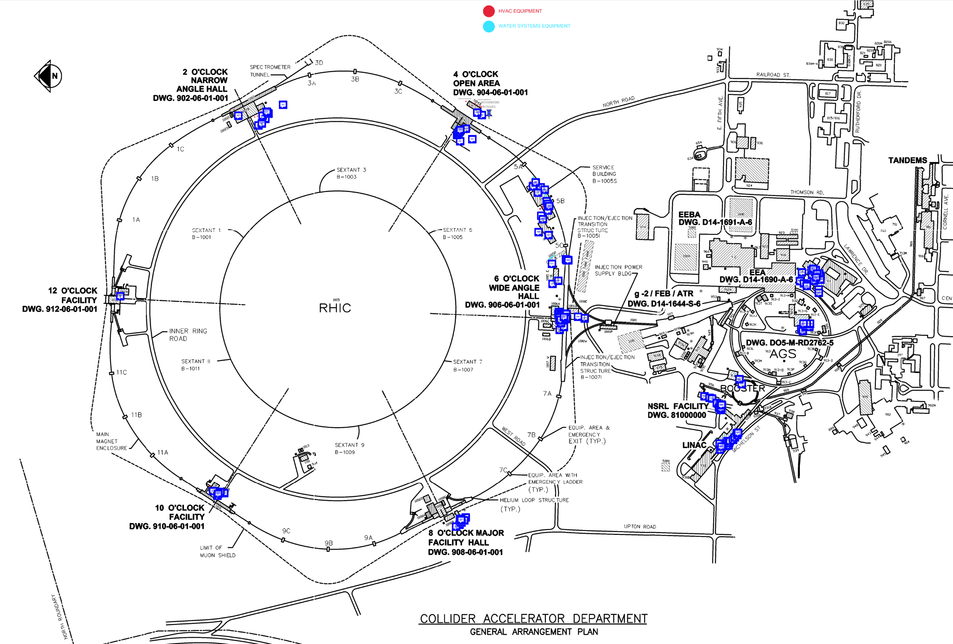
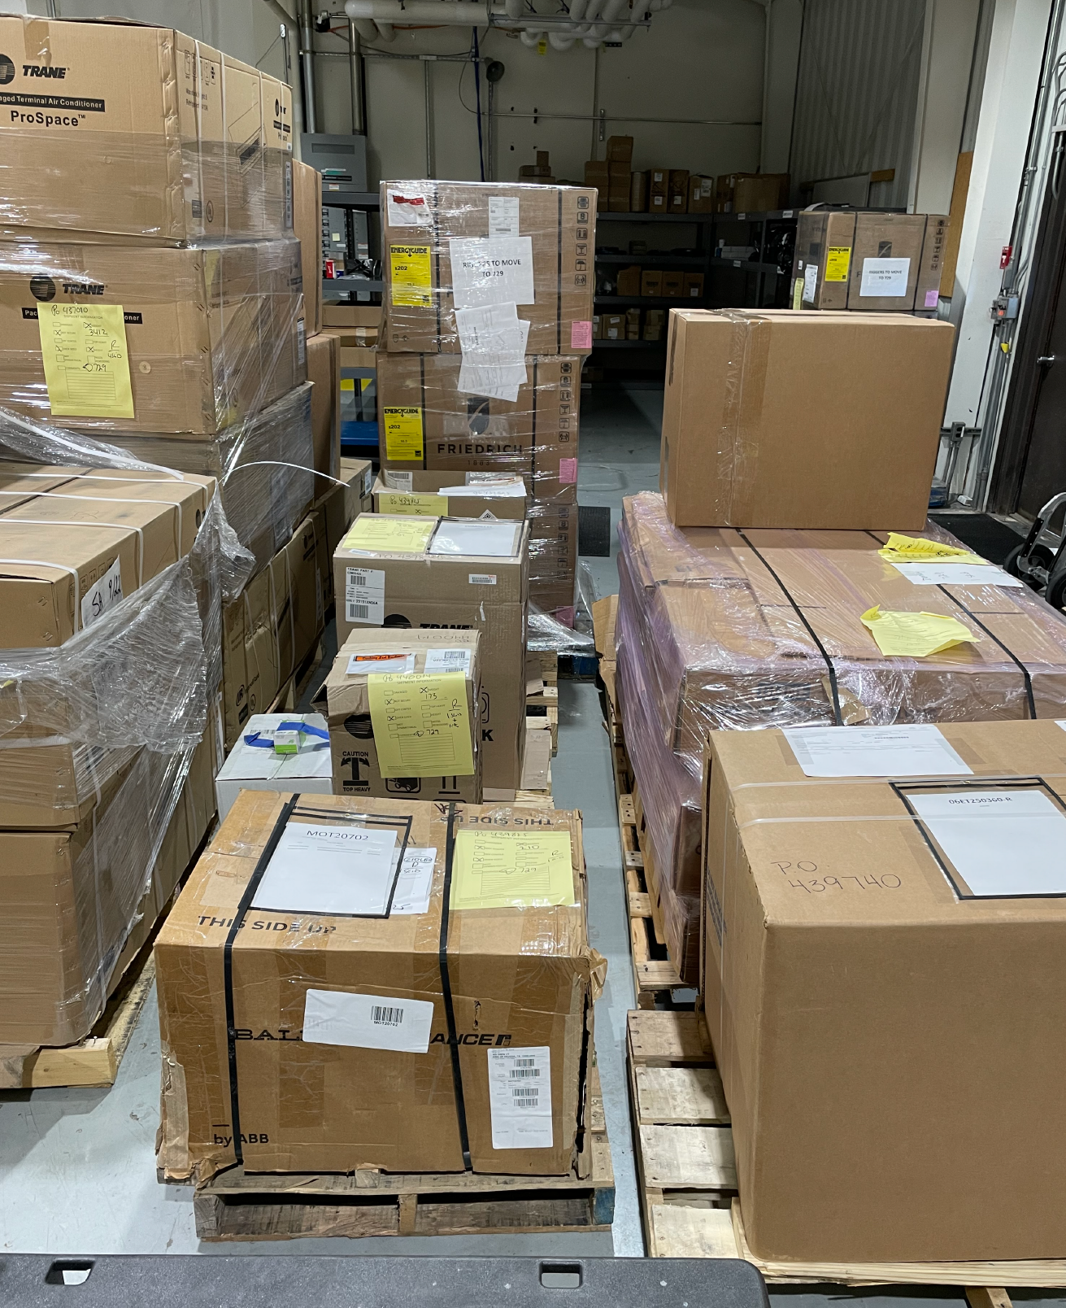
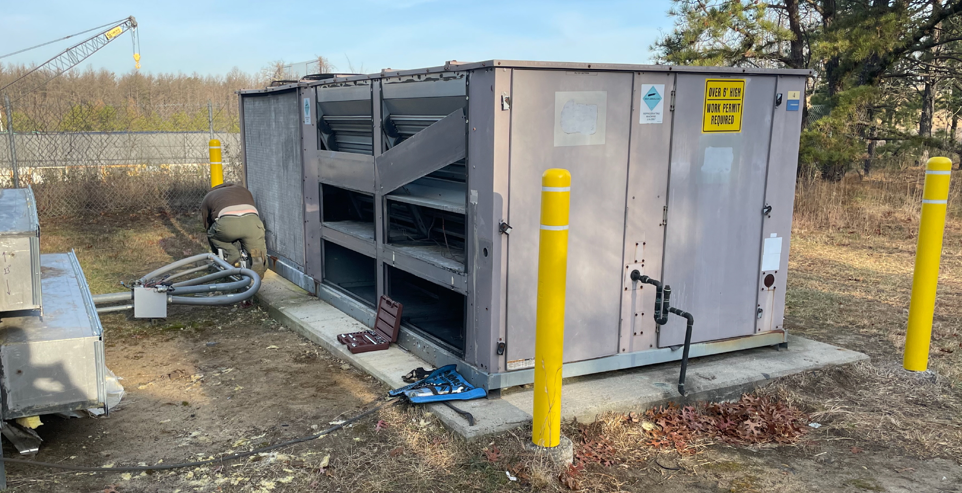
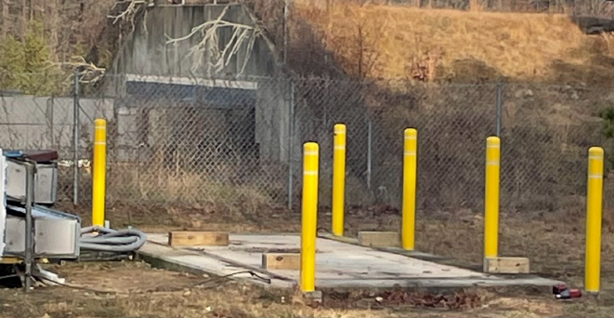

RHIC operations through hot summer months
  Dedicate weekend and holiday AC Mechanic support from F&O
  Service contracts through AC unit manufacturers
  Tracking preventative maintenance of critical AC systems prior to RHIC run
  Cleaning of critical water systems heat exchanges to optimize performance
  Connect heat generating equipment to exhaust heat to the outside
  Replace failed 1004B AC unit and purchase a spare
  Purchase spare portable AC units for Service Buildings and additional spare portable AC units (air cooled and water cooled) for deployment as needed
  Purchase of spare Split AC units for RHIC Alcoves
  Purchase spare parts for (54) critical AC systems
  Provide for standby spare large capacity monthly rental AC systems with generator power in the event of failure to major AC Systems
Site map of location of (54) critical AC Units
Removal of existing 1004B AC unit in preparation of new unit arrival
Portable spare AC unit inventory
Spare parts inventory
M. Minty C-AD MAC-20 (19-21 Dec 2023)

Slide 28
Completing Accelerator Physics Experiments (FY24 and FY25)
APEX proposals are reviewed and ranked by the APEX Steering Committee
Criteria (Number/Letter):
0 - has immediate benefit for improved accelerator performance
1 - impacts near-term (e.g. planned future modes of) accelerator performance
2 - advances accelerator science
A (high priority), B (recommended), C (allowable if time permits), D (declined)
Through long-term agreement, 2 shifts of APEX experiments are performed every other week.
As of December 2023, beam time requests through the end of RHIC operations amount to ~36 shifts, which can be accommodated with the long-term agreement (however more EIC-related proposals are anticipated as emphasized by the recent EIC CD3A review).
Proposed APEX experiments are dominated by EIC-related developments
  Bunched-beam electron cooling
  Coherent electron cooling
  Polarization (for protons and He3)
M. Minty C-AD MAC-20 (19-21 Dec 2023)

Slide 29
Summary

Slide 30
Summary
RHIC performance in Run 2023
  wide variety of RHIC beam conditions successfully provided for sPHENIX commissioning and for physics at STAR
  accelerator availability was low (74.4%), impacted by operation during the summer; 10-year average is 85.8%
  electricity rates lower than planned, however cost of liquid helium increased more than expected (factor 2)
  RHIC run 2023 terminated early (1 Aug 2023) due to short in valve box (Blue Ring main dipole circuit)
Accelerator Physics Experiments (APEX) during Run 2023
  successful completion of experiments informing EIC design
  no cooling experiments performed
RHIC Repair Status
  causal analysis of 1 Aug 2023 event completed
  external “RHIC Recovery” review committee (28 Nov 2023) concurred
  repairs progressing well and on schedule for completion by early March 2024
  RHIC Run 2024 start date contingent on authorization by the Brookhaven Site Office and readiness of sPHENIX
Completing the RHIC science mission (2024 – 2025)
  planning is based on scenario 1 of last DOE budget briefing meeting
  Run-24: 20 cryo-weeks for p↑ + p↑ and a 6-week carryover for sPHENIX with Au + Au
  Run-25: 24 cryo-weeks with Au+Au
  many APEX experiments are planned supporting both EIC and accelerator science

