Slide 1
Homework Questions
HW1
Present simulation curves illustrating the answer to R5 from previous MAC
Alexei Fedotov
20 December 2023

Slide 2
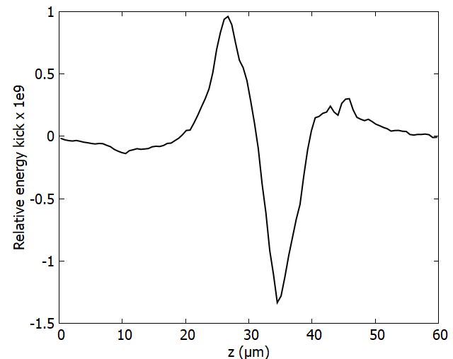
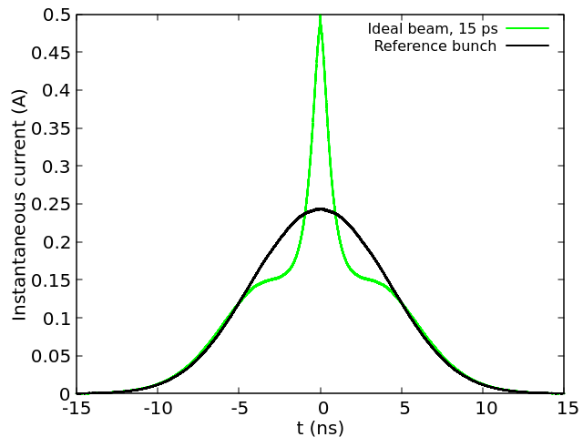
What has been done in the past...
2
Amplified energy kick on an ion
In the past, approach for predicting the cooling performance was the following:
Find a set of peak current, emittance and energy spread of the electrons (via 3D SPACE simulation) required to achieve the desired results for cooling (Modulation signal, PCA gain, cooling force)
Peak current: 50A
Norm. emit.: 1.5 μm
RMS energy spread: 2e-4
Find the proper settings for the electron accelerator (via beam dynamic simulations, IMPACT-T) so that the desired parameters can be achieved (or succeed) over a sufficient range (10ps~15ps) around the bunch center.
Ion bunch profile after 40 minutes of cooling with 15 ps of effective cooling range
Applying the same cooling force from step 1 to all ions within the 15ps range where the electron beam parameters are equal to or better than the required parameters

Slide 3
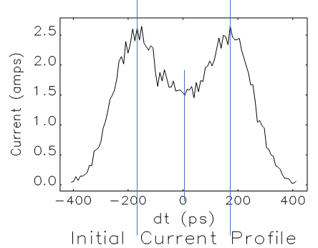
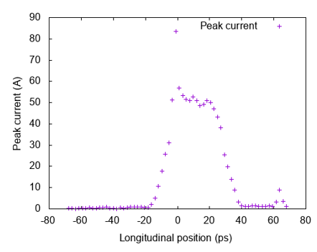
Electron beam distribution
3
Courtesy to Y. Jing and J. Ma
Current profile out of the Gun
Current profile at the cooling section
~50% variation in the ~13ps range
Presently, work is underway to produce more uniform longitudinal profile of electron beam in the cooling section, with required electron beam parameters.

Slide 4
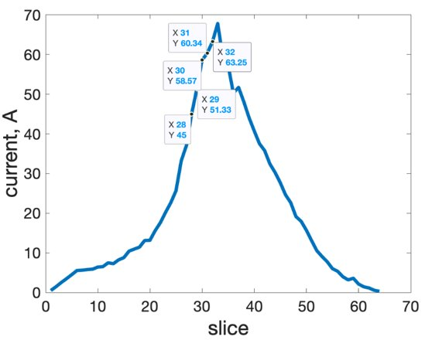
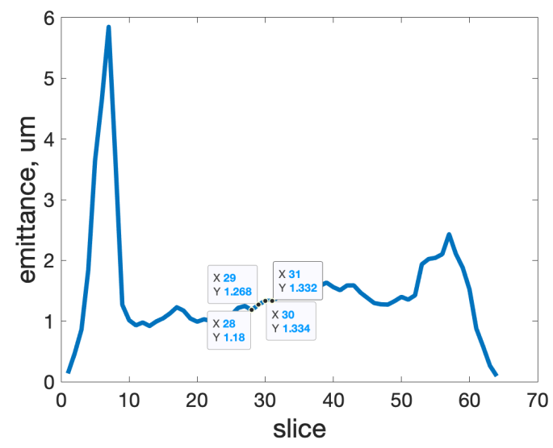
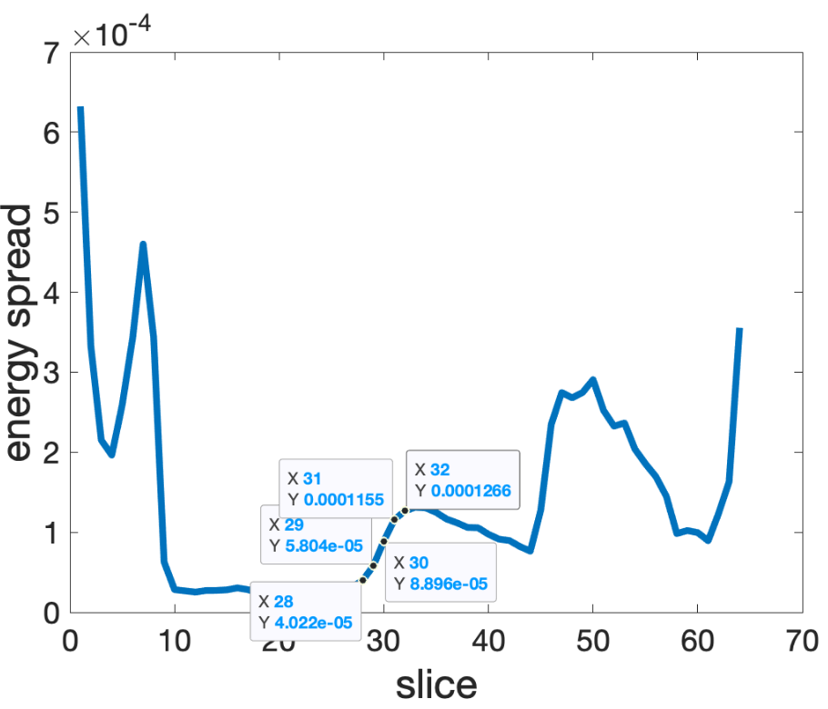
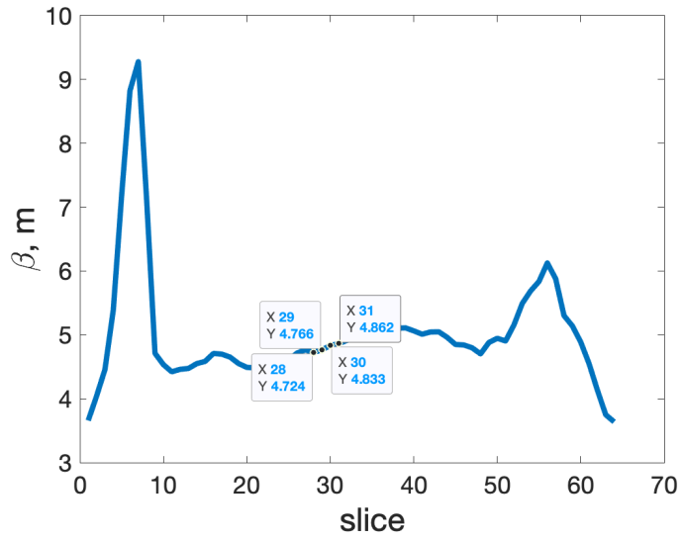
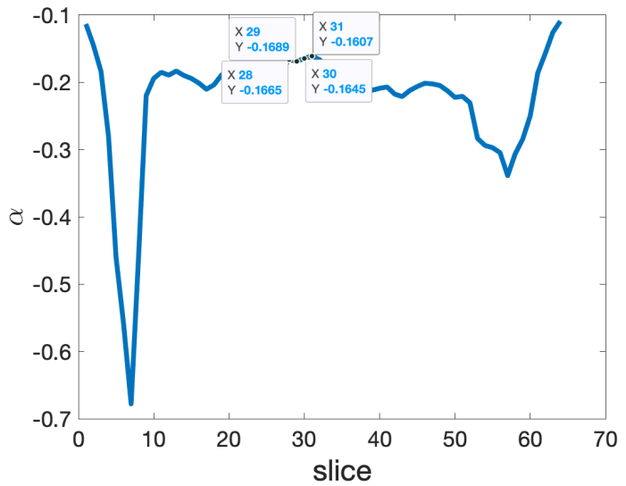
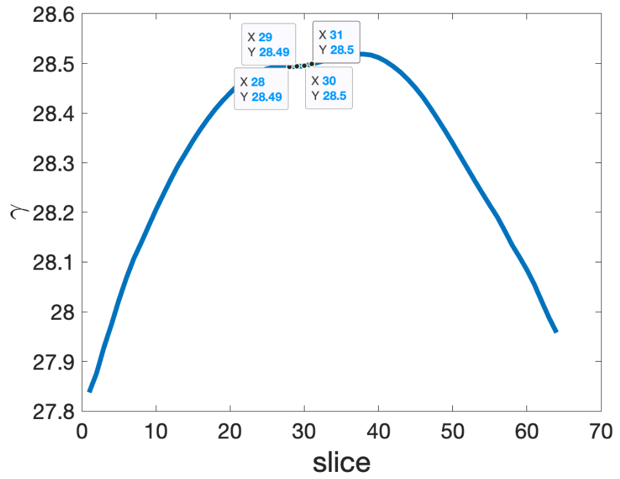
Dependance of the cooling force on the longitudinal position of the ion:
Variation of the electrons' parameters
Courtesy to Y. Jing and J. Ma
~35% variation in the ~10ps range
~10% variation in the ~10ps range
~a factor of 3 variation in the ~10ps range
~3% variation in the ~10ps range
~5% variation in the ~10ps range
~0.035% variation in the ~10ps range

Slide 5
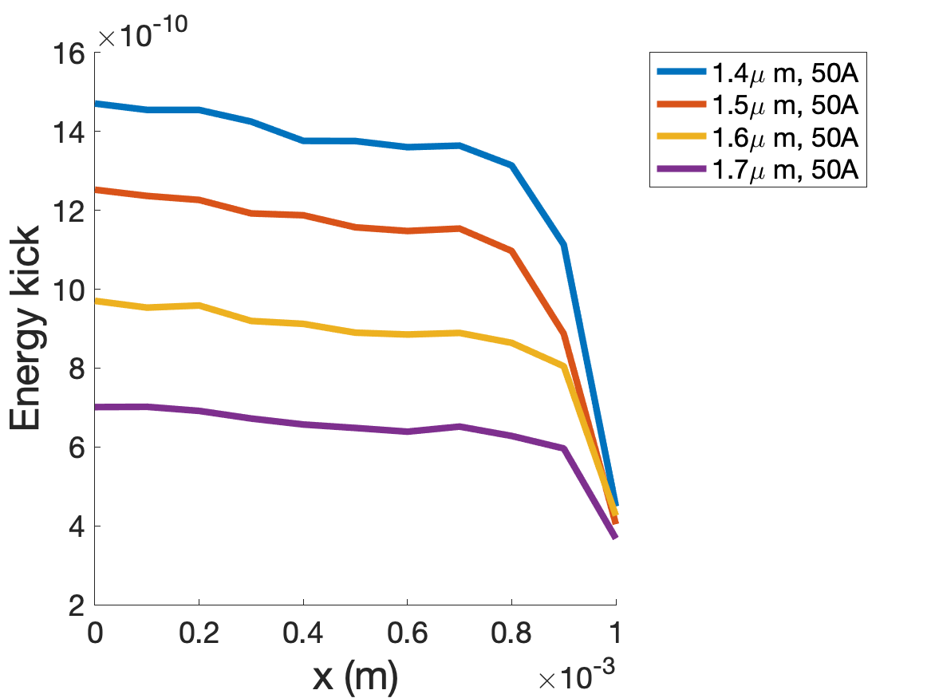
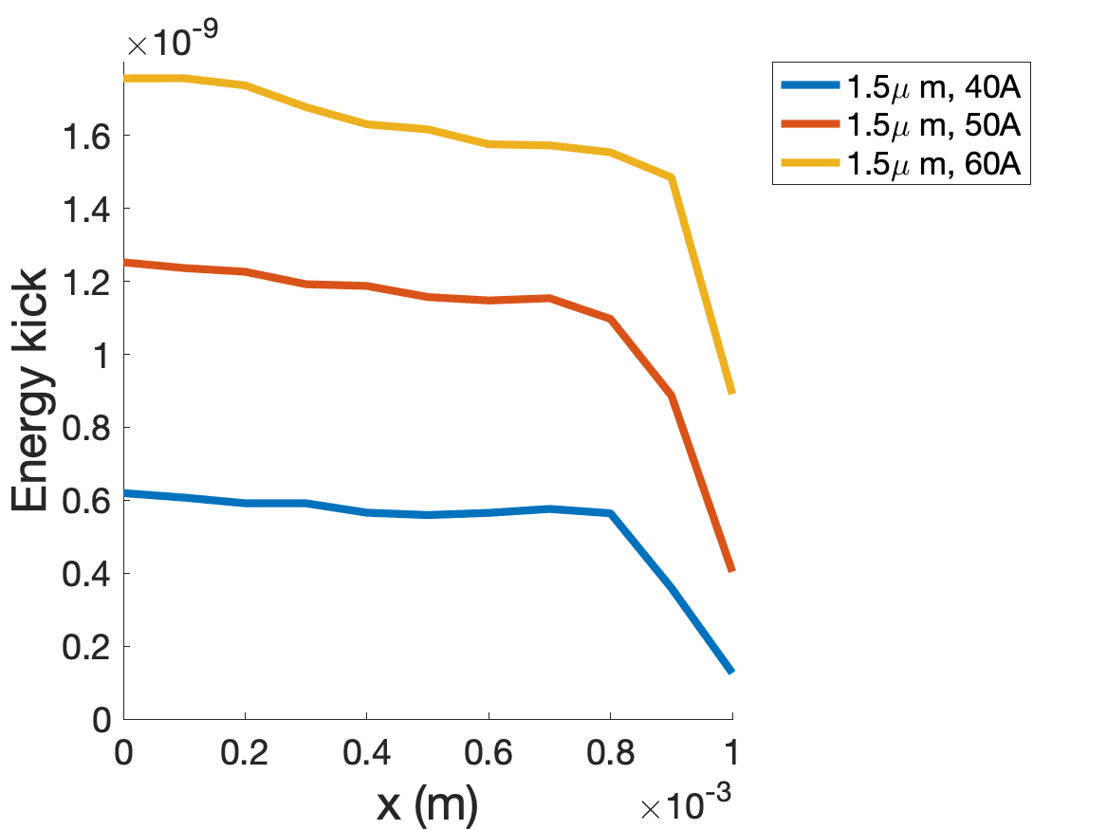
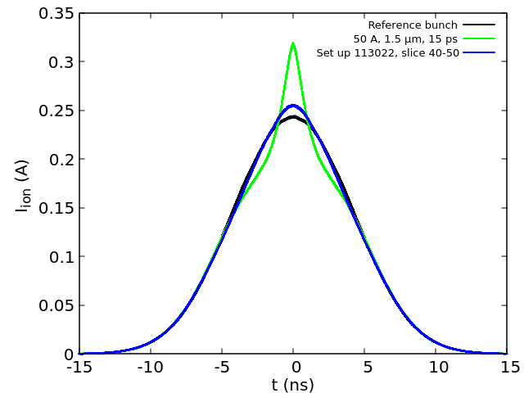
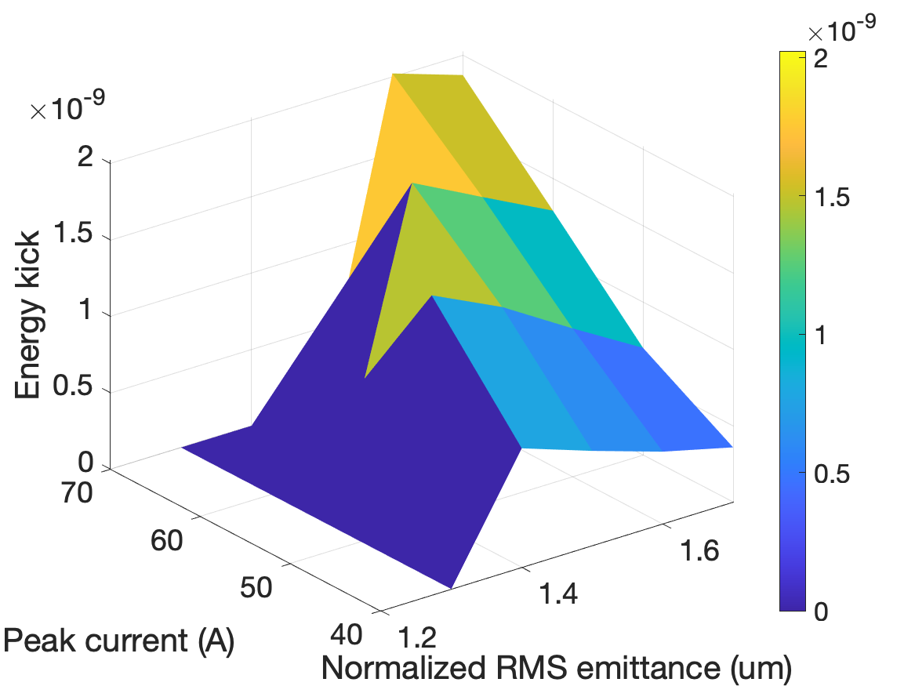
Energy kicks and cooling performance
5
Courtesy of J. Ma and G. Wang
3D map of required electron beam parameters, under construction:
Simulated cooling performance, for baseline with energy kick 1.2e-9 within 15ps.
The goal is to establish setup close to the green curve (new ideal case).

Slide 6
Required electron beam quality
6
Required parameters for the electron beam in CeC X
I_{peak} (t₀) | 50 Amp | δE_{amp,cool}(r=0)/E | >1.5e-9
Peak-to-Peak Variation of I(t) for duration of 15 ps | 10 % | δE_{amp,cool}(r=σ_{x,y})/E | >0.75e-9
Slice norm. emittance (RMS) | <1.5 μm.rad | Relative energy jitter (RMS) | <2e-4
Slice energy spread (RMS) | <2e-4 | Slice to slice variation of α, β and ε within 15 ps around bunch center (peak-to-peak) | <10 %
σ_{x,y} at modulator/kicker | > σ_{ion,x}, σ_{ion,y} | Correlated energy chirp | <2e-4
The quality of the electrons within 15 ps duration should be sufficient to generate cooling energy kick with amplitude of 1.2e-9 at the center of the bunch. Presently, work is underway to produce such electron beam in the cooling section.
The transverse RMS size of the cooling force should not be smaller than the RMS size of the ion.

Slide 7
Homework Questions
HW2
Describe ideas for use of AGS for beam studies or other developments when RHIC will be transitioning to EIC, and roughly estimate the needed resources and impacts
Haixin Huang
20 December 2023

Slide 8
Describe ideas for use of AGS for beam studies or other developments when RHIC will be transitioning to EIC, and roughly estimate the needed resources and impacts.
Polarized ³He development. This is to fulfil EIC needs. It is in the EIC baseline design, although it won’t be needed on day 1. The estimate is that we need to run AGS for 3-4 weeks/year for 3-4 years to get the required polarization and intensity.
If needed, polarized proton development for high intensity (such as bunch merge) or higher polarization (skew quads) can continue in this period.
EIC hadron ring requires different transition crossing scheme to avoid excessive beam loss. The new ideas will be tested in RHIC during APEX. If not finished, it is possible to carry out beam test for some candidate scheme in the AGS. 1-2 weeks beam time. This will improve EIC HSR ramping efficiency.
Polarized jet target for AGS. An absolute polarization value at AGS extraction is important to distinguish any residual polarization loss in the AGS and EIC HSR ring. Price tag is about 2 million. It is still in early proposal stage. If it become reality, beam time is needed for its commissioning and polarization measurement.

Slide 9
Homework Questions
HW3 and HW4
Remind us what highest intensity was demonstrated at RHIC (protons)
Has luminosity leveling for optimization of sPHENIX physics been investigated?
Kiel Hock
20 December 2023

Slide 10
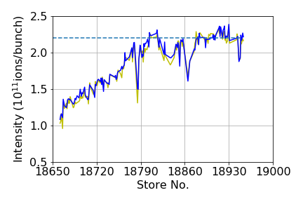
HW3: Highest Demonstrated Intensity at RHIC
The highest intensity demonstrated at RHIC for polarized protons was 2.38x10¹¹protons/bunch
This was during Run15 with 100 GeV Protons.
Initial ramp up of intensity shown over the first several weeks.
Average end of run intensity 2.2x10¹¹ protons/bunch.
Maximum intensities for Run17 and Run22 (255 GeV Protons) was 2.18x10¹¹ and 2.24x10¹¹ protons/bunch.

Slide 11
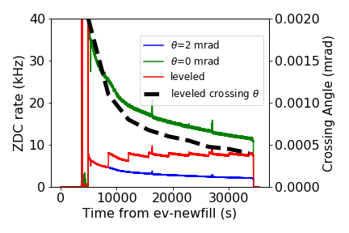
HW4: Luminosity Leveling for sPHENIX
Luminosity leveling for sPHENIX was considered
Initial leveling used the crossing angle and considered the full luminous region which is incorrect as it would saturate the TPC and provide additional unusable collisions for the detector.

Slide 12
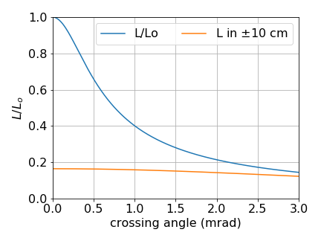
HW4: Luminosity Leveling for sPHENIX II
Ramping the crossing angle down in a single step in the store would lead to an instantaneous increase of approximately 20% within the +-10 cm vertex.
This however would likely saturate the TPC as the number of collisions outside of the vertex would increase from ~33% to ~80%.

Slide 13
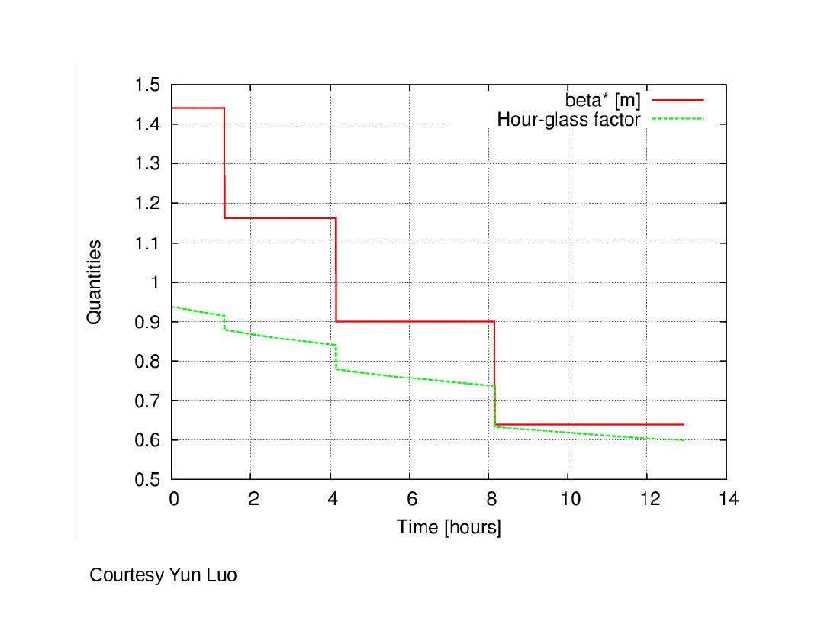
HW4: Luminosity Leveling for sPHENIX III
Ramping down the beta* throughout the store was done in Run22 to level the luminosity at STAR (shown on right for 255 GeV protons)
This is the intended method for Run24 with a ramp to squeeze the beta* at increments throughout the store.
Ramping the DX and triplets continuously has not been investigated.

Slide 14
Homework Questions
HW5
Please describe the overall strategy for polarized He-3 together with a timeline including decision points and milestones of when and what needs to be tested with beam
Haixin Huang
20 December 2023

Slide 15
Please describe the overall strategy for polarized He-3 together with a timeline including decision points and milestones of when and what needs to be tested with beam
Stronger partial snake would provide wider spin tune gap to push both betartron tune into the spin tune gap. But stronger partial snake would also cause large optical distortion near injection which affect the admittance. Due to the reduced admittance at |Gγ| = 7.5, excessive beam loss will necessitate additional bunch merges compared to the |Gγ| = 10.5 case. To support |Gγ| = 10.5 injection, the Booster Main Magnet PS and AGS injection kicker need upgrades.
Roughly we would need 3 years for the upgrade and 2 years for the commissioning. We need to decide and locate fund for the upgrade by 2027.
2024 with unpolarized ³He test: setup AGS with both betatron tunes inside the spin tune gap (>8.95) along the energy ramp.
Polarized He³ test for booster(~2025): AGS injection polarization measurement to check Booster polarization preservation scheme (AC dipole for intrinsic resonance and harmonic orbit correction for imperfection resonance). No partial snake is needed.
Polarized He³ test for AGS(~2026 and later): Start with | Gγ| = 7.5. Find out the minimum snake strength needed for polarization preservation. Check the intensity achievable at injection with this strength. Decide if higher injection energy is necessary.

