Slide 1
ML for Beam Polarization Increase Accepted ML / AI Proposal to DOE-NP FOA
Georg Hoffstaetter de Torquat
Collider-Accelerator Department, BNL and Cornell University
Georg.Hoffstaetter@cornell.edu
CAD MAC December 20, 2023

Slide 2
DE-FOA-0002875 : ARTIFICIAL INTELLIGENCE AND MACHINE LEARNING FOR AUTONOMOUS OPTIMIZATION AND CONTROL OF ACCELERATORS AND DETECTORS
Title: Higher RHIC polarization by Physics-informed Bayesian Learning
Budget: $1.5M, duration 2 years, start 09/01/2023 to BNL, Cornell, JLAB, SLAC, RPI
Funding through DOE-NP DE SC-0024287, contr.# 2023-BNL-AD060-FUND
Funding officer Manouchehr Farkhondeh
Requested topics:
Efficiently extract critical and strategic information from large complex data sets
Address the challenges of autonomous control and experimentation
Efficiency of operation of accelerators and scientific instruments
AI for data reduction of large experimental data

Slide 3
Desired result: higher proton polarization
What high-impact operational challenge can be addressed by MI/AI? ➔ Polarized protons.
From the source to high energy RHIC experiments, 20% polarization is lost.
Polarized luminosity for longitudinal collisions scales with P⁴, i.e., a factor of 2 reduction!
The proton polarization chain depends on a hose of delicate accelerator settings form Linac to the Booster, the AGS, and the RHIC ramp.
Even 5% more polarization would be a significant achievement.

Slide 4
Outline
Objective of proposed work: higher proton polarization in RHIC and the EIC.
Polarized-proton acceleration chain.
Potential avenues toward higher proton polarization.
Emittance reduction
More accurate timing of timed elements
Reduction of resonance driving terms
Started Activities
Gaussian Process (GP) Bayesian Optimization (BO) and physics informed learning.
When is ML/AI better for accelerator operations than other feedbacks and optimizers?

Slide 5
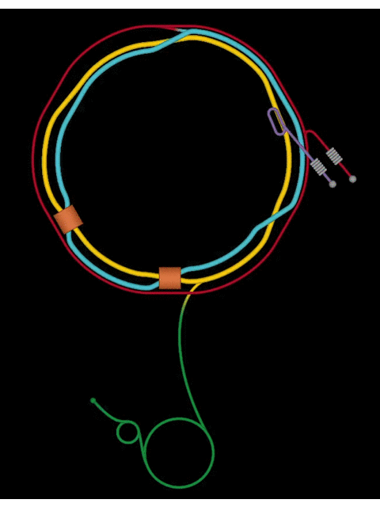
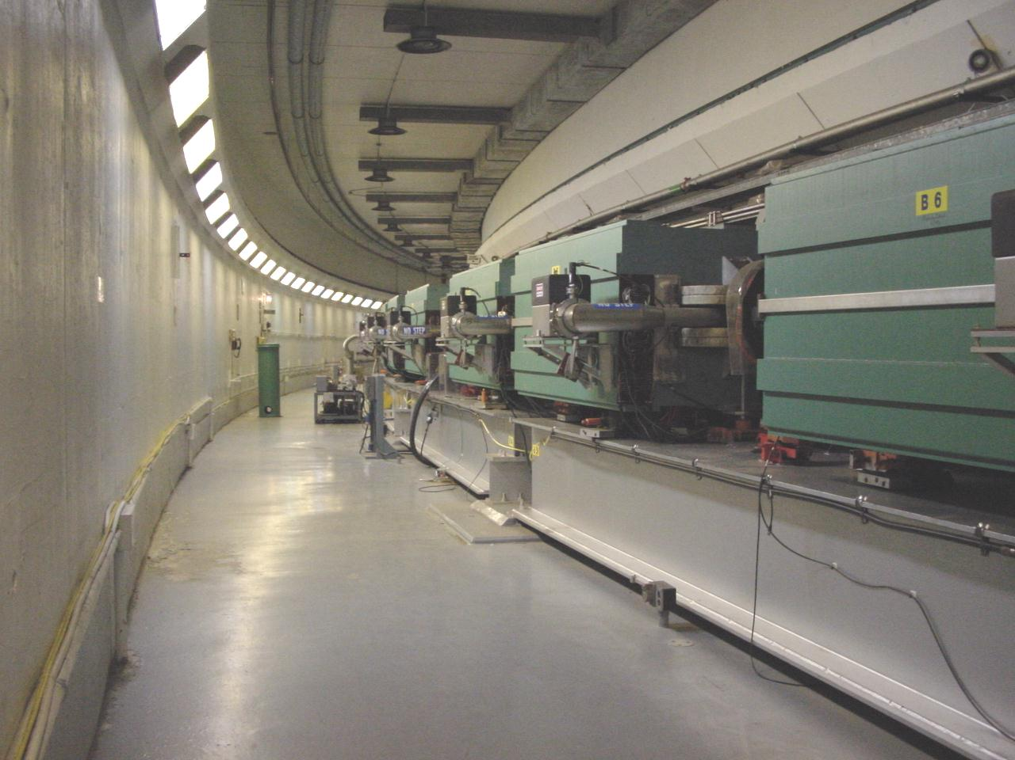
The polarized proton accelerator chain
Injector Compound
Partial snakes

Slide 6
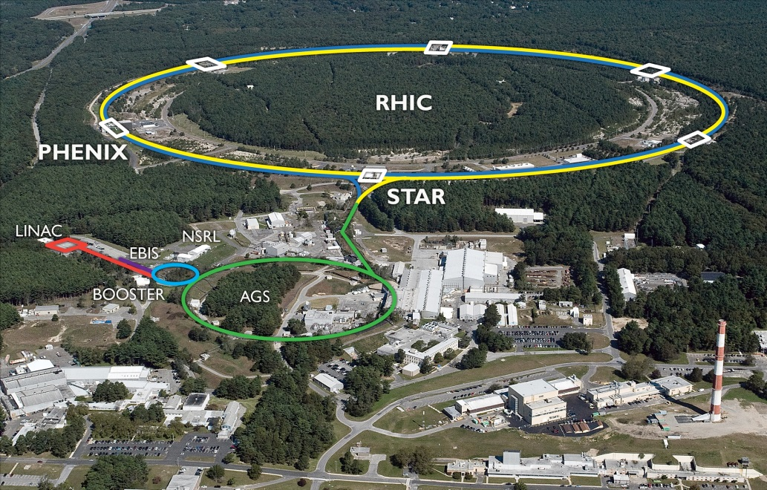
Polarization at RHIC
 | Max Energy [GeV] | Pol. At Max Energy [%] | Polarimeter
Source+Linac | 1.1 | 82-84
Booster | 2.5 | ~80-84
AGS | 23.8 | 67-70 | p-Carbon
RHIC | 255 | 55-60 | Jet, full store avg*
Tandem van de Graaff
Loss in polarization along the chain
Polarimetry available at:
Source
End of Linac (200 MeV)
AGS extraction
RHIC injection energy
RHIC flattop
No Booster polarimeter
 | Relative Ramp Polarization Loss (Run 17, full run avg)
AGS | 17 %
RHIC | 8 %

Slide 7
Topics that can improve polarization
(1) Emittance reduction
(2) More accurate timing of tune jumps
(3) Reduction of resonance driving terms

Slide 8
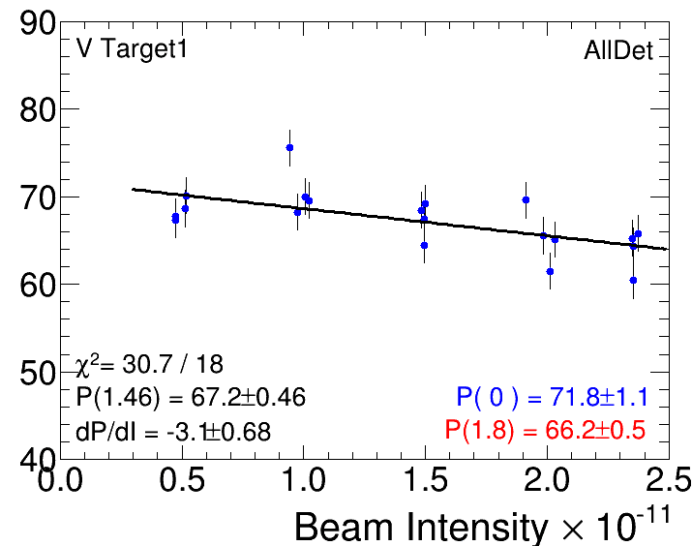
Improve Polarization at RHIC
Figure-of-merits (FOM) for the project (“experimental outputs”): emittance, beam intensity, polarization
Trade-offs in optimizing FOMs:
Emittance $↓$ Beam intensity $↑$ Polarization $↑$
Trade-offs between controls:
Beam intensity $↑$ $→$ Emittance $↑$
Emittance $↑$ $→$ Polarization $↓$
Main areas to optimize:
Booster injection / capture
AGS bunch splitting / merging scheme
AGS spin resonance compensation
AGS Polarization vs. Beam Intensity

Slide 9
Emittance reduction ➔ less depolarization
Optimized Linac to Booster transfer
Optimized Booster to AGS transfer
Optics and orbit correction in Booster and AGS
Beam-based alignment & calibration from orbit response in Booster and AGS.
Bunch splitting in the Booster for space charge reduction and bunch re-coalescing at AGS top energy.

Slide 10
Linac to Booster transfer
Parameters to vary:
Transfer line steers
Main Booster dipol90e field
Booster beta wave (stop-band quadrupoles) for tune toward ½ and minimum on the foil
Last two linac phases
Injection bump elements and their time profile
Scraper amplitudes
Observables to optimize:
Transfer efficiency linac ➔ Booster early ramp (2% absolute)
Emittance from multi wires of the AGS transfer line (5% relative)

Slide 11
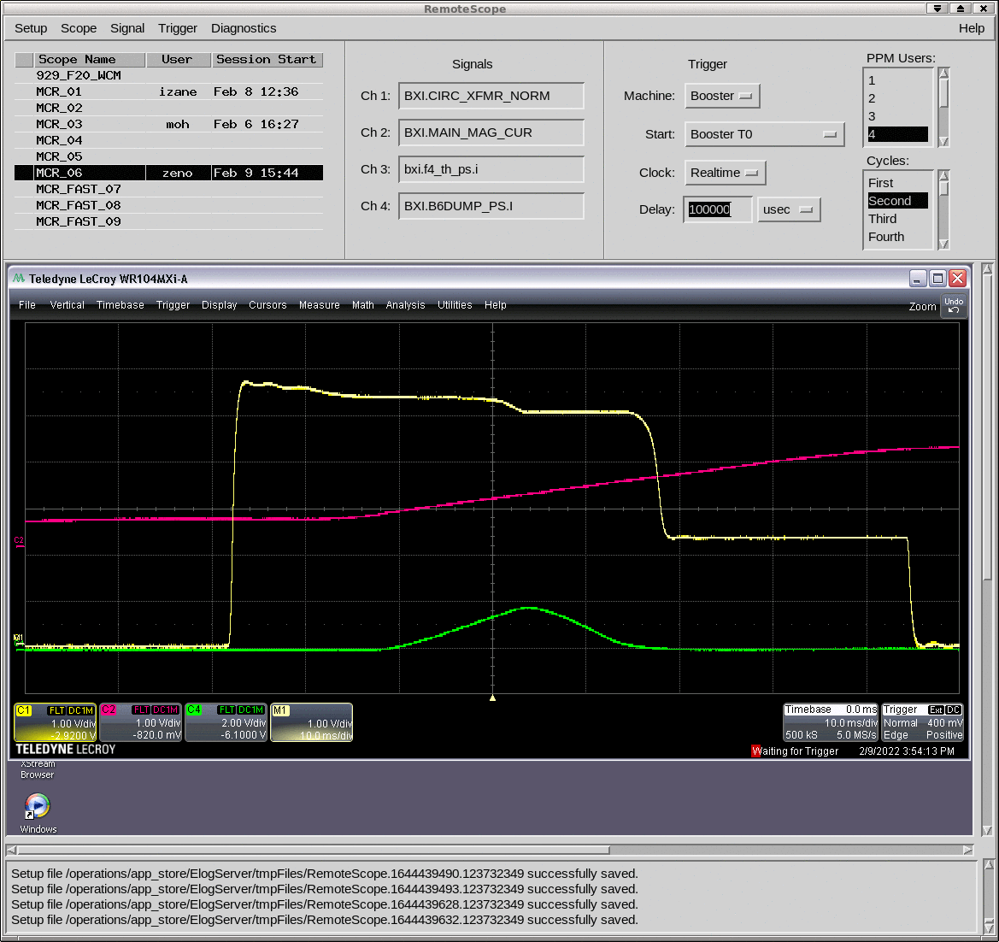
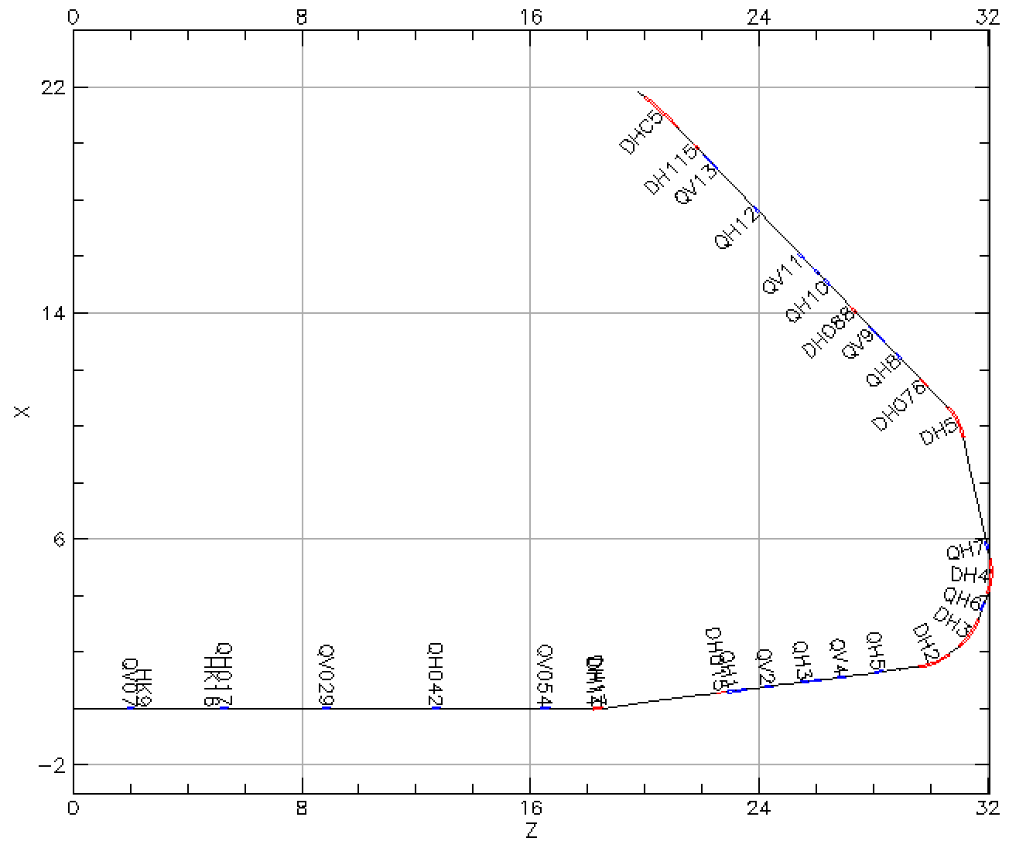
Ongoing project (a): Booter injection/capture
Intensity
Main mag
scrape
Booster injection/early acceleration process sets maximum beam brightness for rest of acceleration though RHIC
Linac pulse of 300 us, H⁻ beam ~6-9x10¹¹ protons, strip through a carbon foil. Intentional horizontal and vertical scraping reduce emittance (and intensity) to RHIC requirements ~2.5x10¹¹ protons
Goal: minimize beam loss at scraper
Controls: Linac to Booster (LtB) transfer line optics, beam size on ionization foil
Method: Bayesian Optimization
Progress: Setup injection model incl. foil, create OpenAI Gym function for optimization training.
To Booster
$126°$
bend
From Linac

Slide 12
Ongoing project (b): AGS injection
Parameters to vary:
Transfer line steerers
Main AGS dipole field, RF phase, injection bumps, tunes.
Horizontal orbit in the snakes and their optics and orbit correction.
Observables to optimize:
Transfer efficiency Booster ➔ AGS early ramp (2% absolute)
Emittance from two IPMs (10% relative)
Progress
Setup detailed injection and AGS model, including symplectic snake tracking

Slide 13
Ongoing project (c): Booster model calibration
$$model$$
$$\left(I_{quad},I_{corr},θ\right) ⟸===⟹ \left(X_{BPM}^{(I_{quad}^{\left(1\right)},{ I}_{corr}^{\left(1\right)})},{ X}_{BPM}^{(I_{quad}^{\left(2\right)},{ I}_{corr}^{\left(2\right)})},⋯\right)$$
Control: power supply currents of quadrupoles and correctors
Parameter $θ$: parameters that affect the orbit but not in our control $→$ (magnet misalignments, magnet transfer functions, etc.)
Output: orbit at the BPMs with certain current configuration
Invert from measured BPM data to simulation model parameters, update model for digital twin.
Progress: Detailed Booster model, compared to survey data and BPM readings. Write system parameter search as OpenAI gym function for ML optimization.
$$X_{BPM}=m\left(I_{quad},I_{corr};θ\right)+ε, ε\sim N(0,σ)$$
$I_{quad}^{∗},I_{corr}^{∗}=argmax F(m\left(I_{quad},I_{corr};θ\right)$)

Slide 14
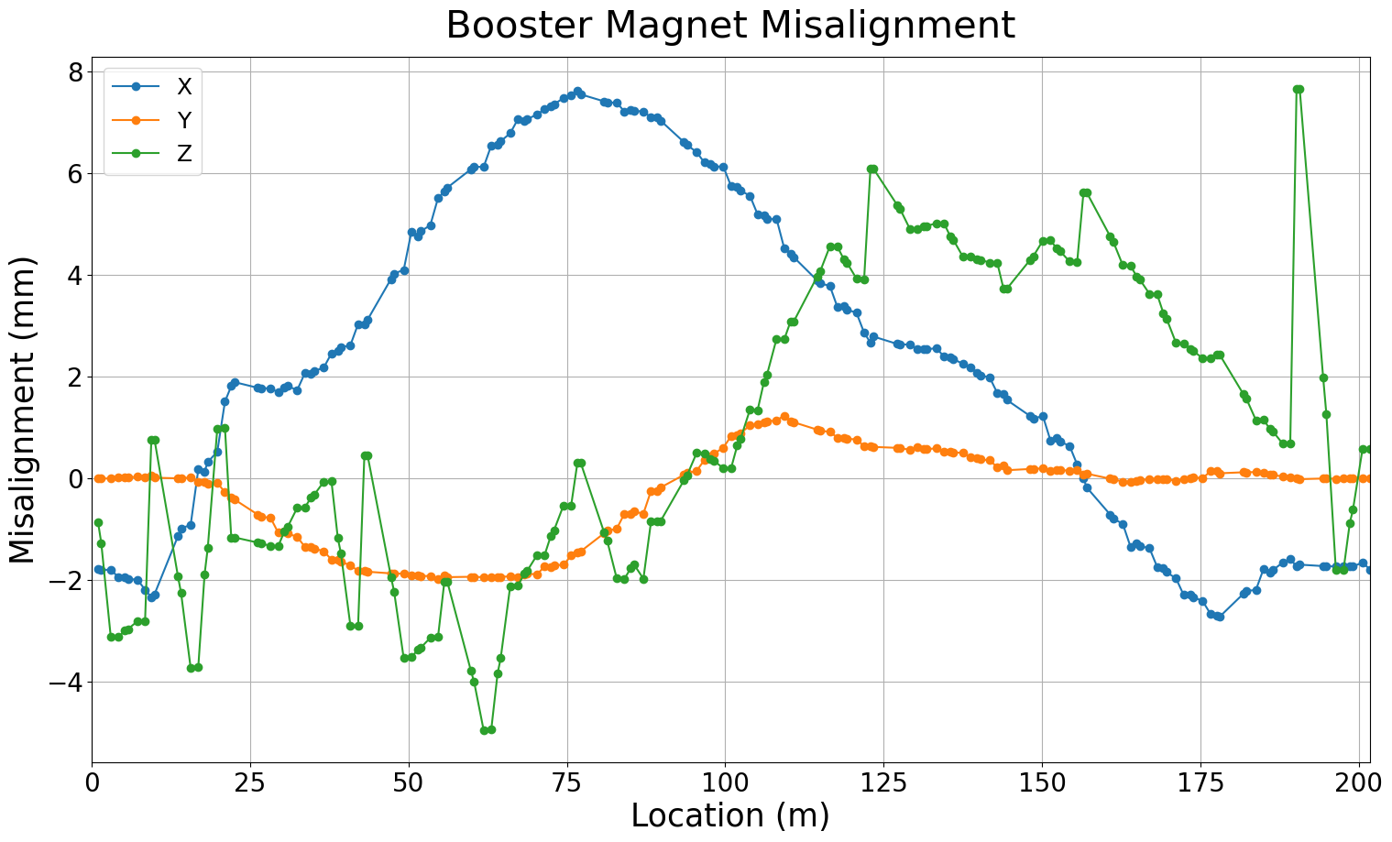
Booster magnet misalignment
Magnet location in real machine from 2015 and 2022 survey data for quadrupoles and dipoles
Trouble with making physics simulation with misalignment agree with measured orbit data
Challenge: How well can we determine the alignment by orbit-response evaluation?

Slide 15
Where do we put AI/ML?
ORM will give us
BPM and Corrector Anomalies (Trust Analysis)
Gradient errors for given conditions
Beta-deviations from model
Dispersion measurements give us
BPM Consistency check for given dp/p (BPM Anomalies)
Coupling through longitudinal motion (very slow, typically)
Tune measurements
Betatron tune and coupling = destructive measurement in Booster/AGS
Tune, Chrom, coupling, emittance, dp/p from RHIC Schottky
Chromaticity measurements – need to change energy and measure tune
Orbit Measurements – parasitic = most are time averaged, some turn by turn
Linear model + small nonlinearities with NN model

Slide 16
Ongoing project (d): AGS model calibration
Parameters to vary:
Corrector coils (24 per Booster plane)
Corrector coils (48 per AGS plane)
Observables to optimize:
BPM readings (24 x&y in the Booster) (100um accuracy)
BPM readings (72 x&y in the AGS) (100um for 2mm size at 25GeV)
Progress:
Detailed model of AGS incl. differentiable snakes, symplectic tracking, orbit and optics compensation of snakes for all energies.

Slide 17
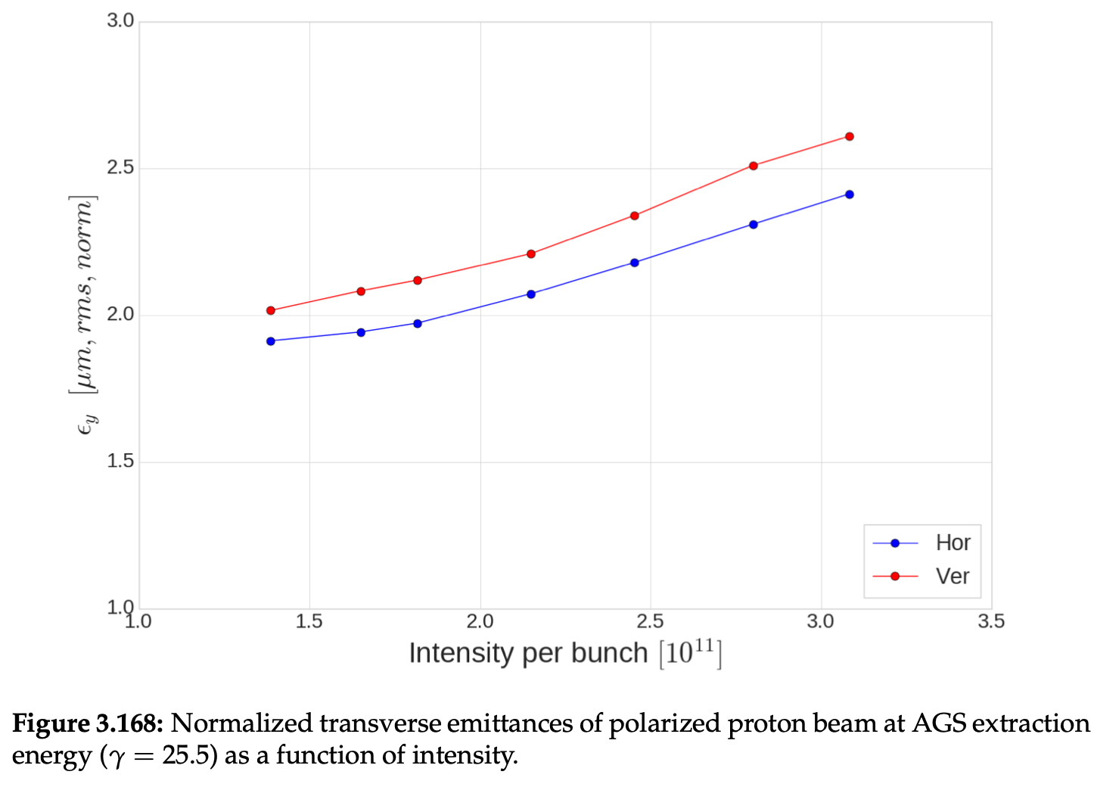
Space-charge emittance increase
➔ Splitting bunches before AGS acceleration can reduce the emittance.

Slide 18
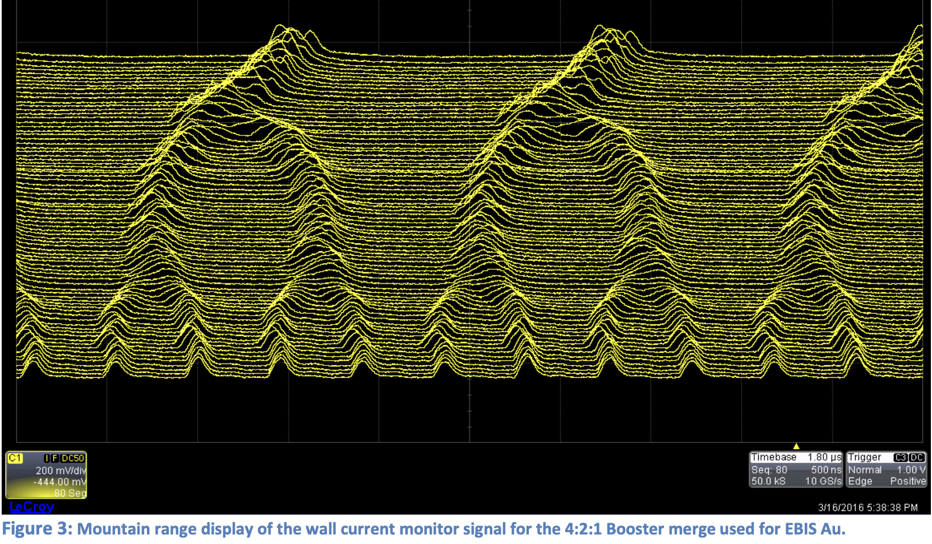
Ongoing project (e): Bunch splitting / coalescing
➔ Splitting bunches before AGS acceleration can reduce the emittance.
Progress: Setup Bmad model of bunch merging to find adiabatic parameters without emittance increase.

Slide 19
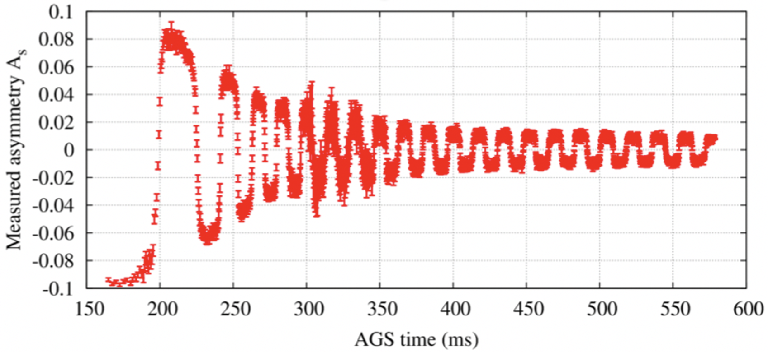
Future project (f): Timing of tune jumps
The G-gamma meter and accurate energy vs. time
Measure the energy by orbit + revolution frequency measurement
Measure of energy by field + revolution frequency measurement
Measure energy by spin flip at every integer spin tune
Combined optimization
better timing
➔ higher polarization

Slide 20
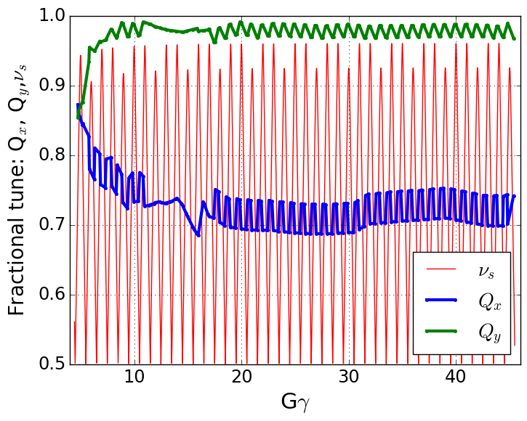
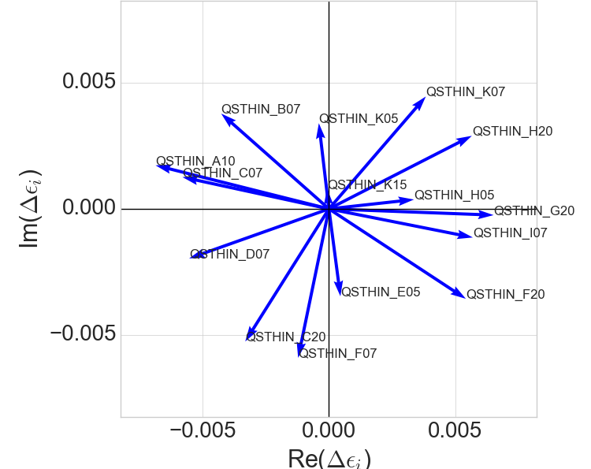
Ongoing project (g): AGS resonance compensation
Betatron and spin tunes during AGS ramp
Spin tune gap
Partial snakes in the AGS keep the spin tune away from the integer (>0.96), avoiding vertical resonances
Horizontal resonances remain, currently ‘jumped’ by moving the horizontal tune through the resonance
Each resonance is weak (~0.1% polarization loss)
But there are many of them (82)
Proposal to use 15 pulsed skew quadrupoles to eliminate residual resonances (as described by Vincent Schoefer)
Goal: minimize resonance strengths by timed skew quads
Method: Reinforcement Learning / Bayesian Optimization
Progress: detailed Bmad model incl. differentiable snake model, symplectic tracking, orbit and optics correction, and various methods of resonance strength evaluation.
Tune jump
Spin resonance terms from skew quads in AGS
G$γ$ = 43.72

Slide 21
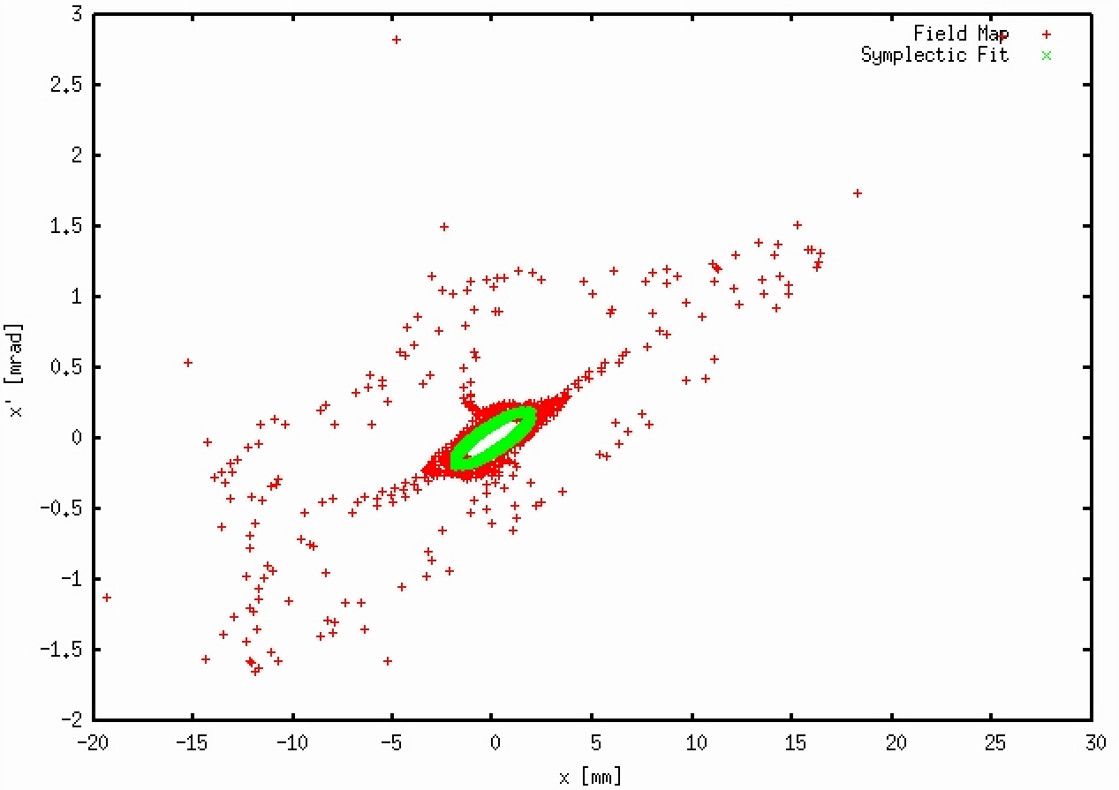
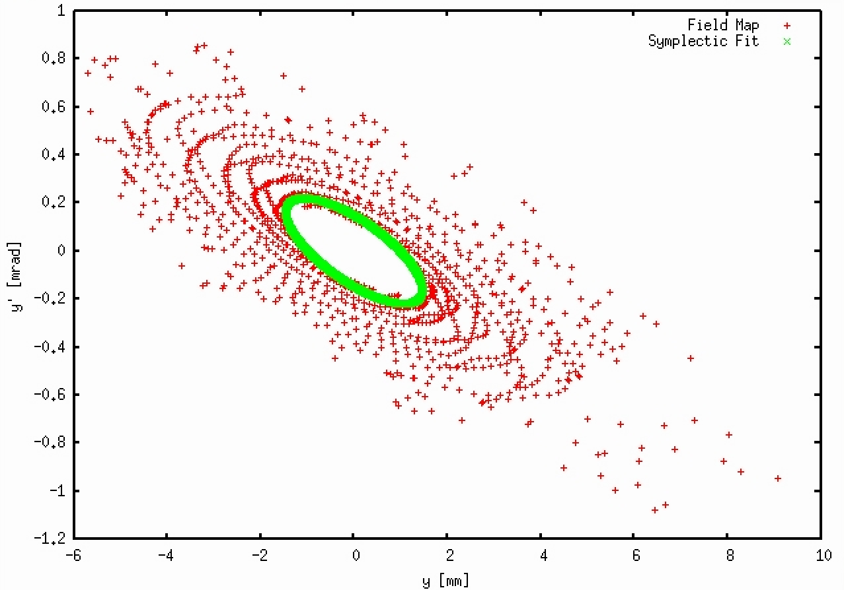
For ongoing project (g): Importance of snake modeling
Horizontal Phase Space
Vertical Phase Space
Tracking with fied maps of snakes
Symplectic tracking with differentialbe
snake model
Note: All 10,000 turns of symplectic tracking were used in the green curve

Slide 22
For ongoing project (g): AGS snake modeling
I used a series expansion of solutions to Maxwell’s equations such that each term is an exact solution.
This allows me to truncate the expansion at any order and still precisely satisfy Maxwell’s equations.
The following is an example of 1 term in such a series solution:
By fitting the field data to 300 such terms, I recover an expression that exactly solves Maxwell’s equations (i.e. satisfies symplecticity for any particle trajectory) and agrees with the simulated data with an RMS deviation of 0.02 T in the relevant region. Max field is 2T.
With a differentiable model, TPSA (DA) techniques become available, e.g. normal forms

Slide 23
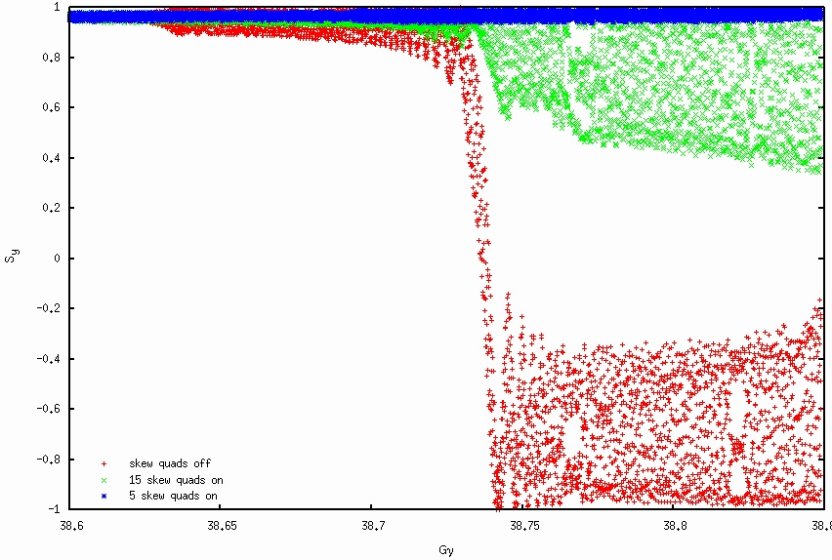
Tracking through a single horizontal spin resonance with very large emittance to visualize depolarization. This is not the real case since each resonance is much weaker and causes less than 0.1% depolarization:
For ongoing project (g): AGS polarization tracking
15 skew quads
5 skew quads
0 skew quads

Slide 24
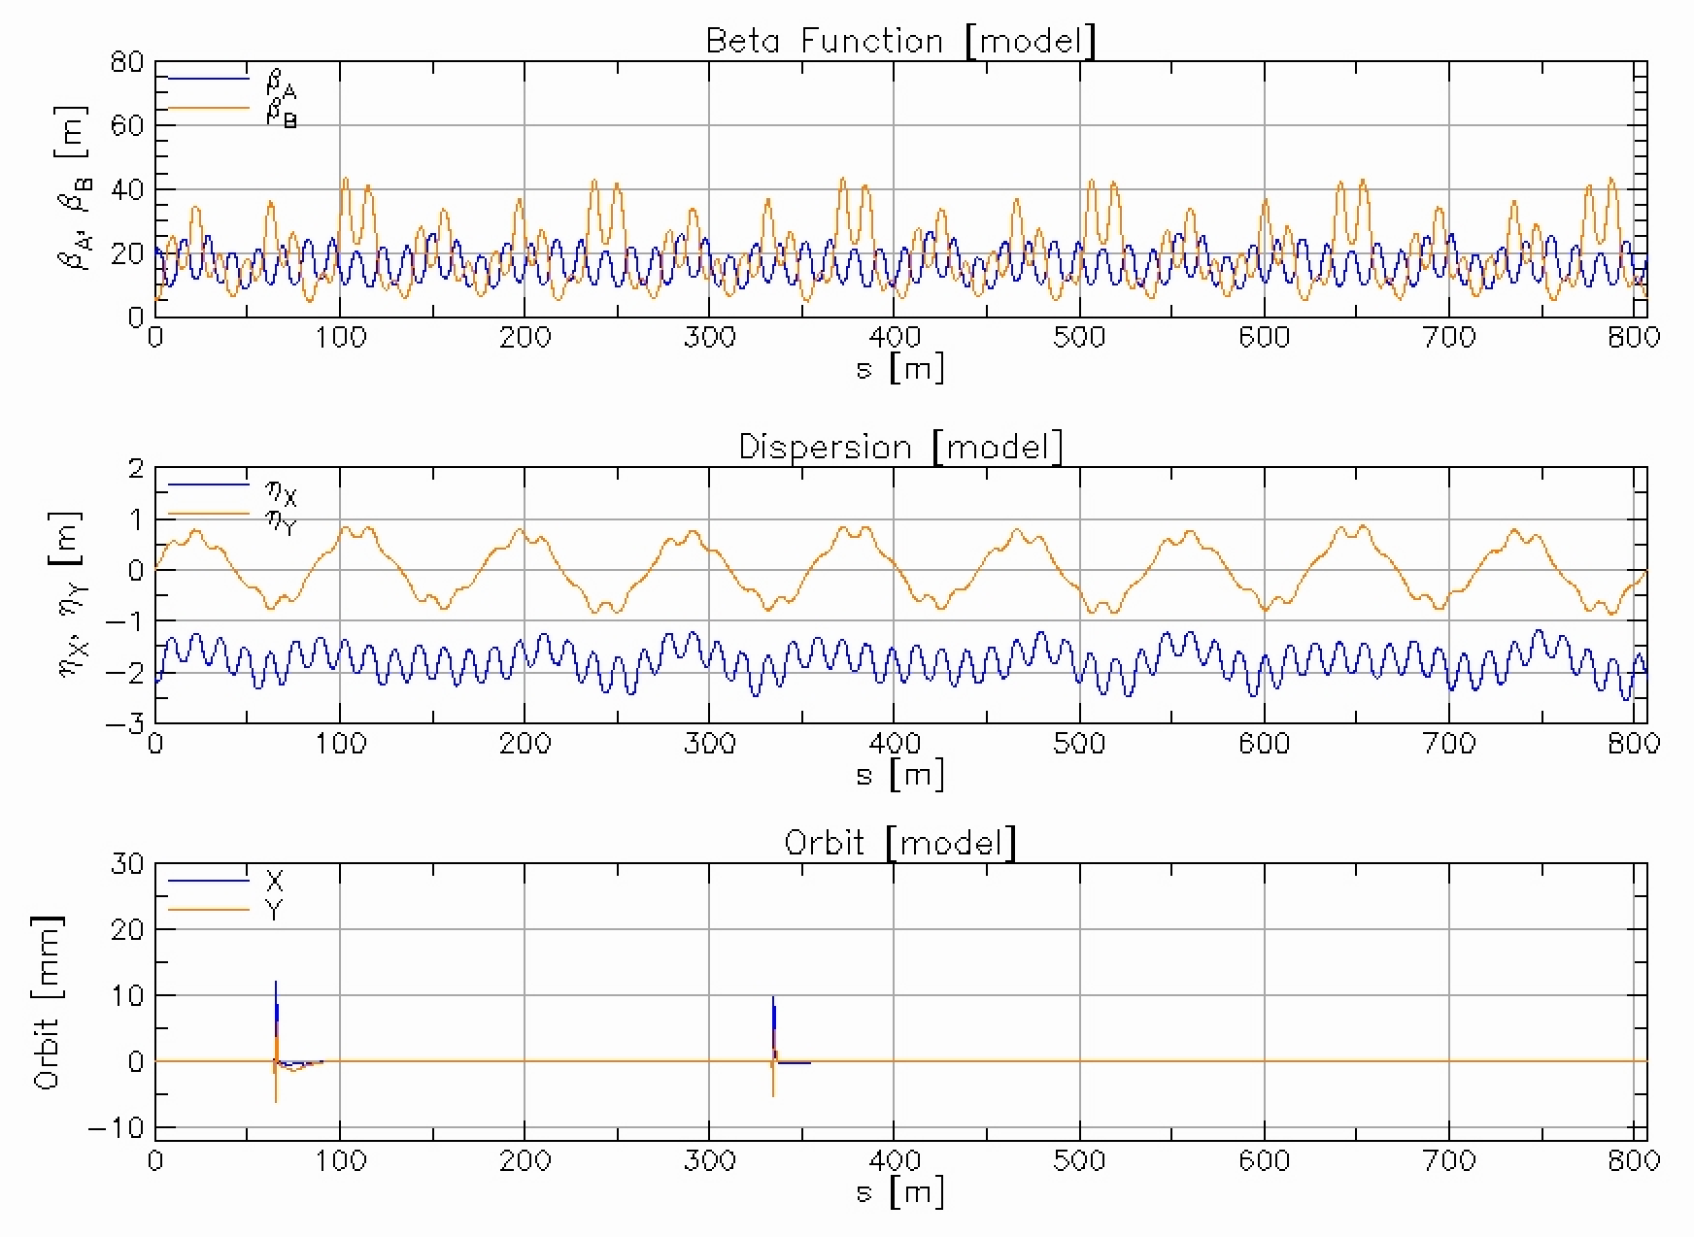
In the following, we track through a few resonances with realistic transverse emittance before transition energy (at Gγ~15). The transverse emittance blows up due to vertical dispersion and optics errors after Gγ~13, decreasing polarization. In response to yesterday’s question, no problem has yet been observed at 1/3 spin tune.
For ongoing project (g): Need of optics correction
8 GeV
Symplectic Fit
50m
1 m

Slide 25
Activities
Kickoff Collaboration meeting @ Cornell, August 25, 2023 – successful in person
Weekly meetings Mondays 3:30pm of all collaborators
Interface with weekly meeting Wednesdays 11am on digital twins from Linac to AGS
Semi-weekly ML/AI software meeting Friday’s on beam & ML computer standards
Teams have formed for projects
Booster injection, (b) AGS injection
(c) Booster model calibration, (d) AGS model calibration
(e) Bunch splitting/coalescing, (f) Timing
(g) Resonance minimization.
(h) Combined and verified evaluation of existing emittance measurements (Radiasoft)

Slide 26
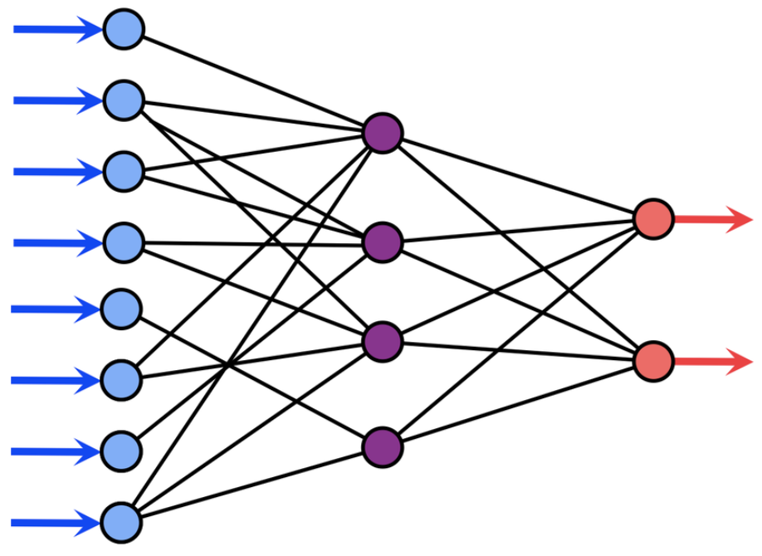
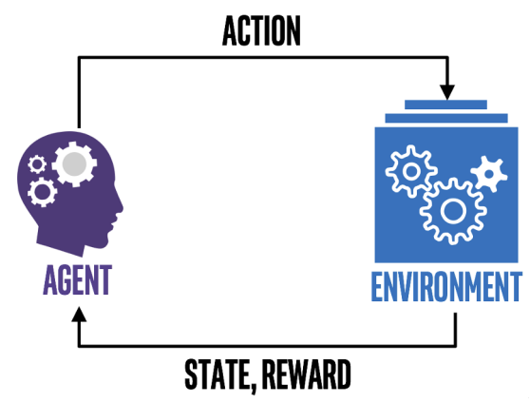
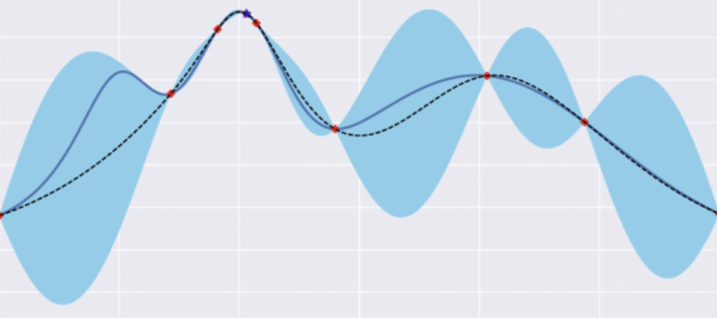
Future: Digital twin and Optimal control
Digital Twin
Control parameters + Environmental factors
Evaluation / Analytic Metric (e.g., agreement with real measurements)
Find best settings for desired machine state
AI/ML Methods (RL, BO, etc.)

Slide 27
Dominant Participants
Kevin Brown, Bhawin Dhital, Yuan Gao, Levente Hajdu, Kiel Hock, Natalie Isenberg, Chuyu Liu, Linh Nguyen, Vincent Schoefer, Nathan Urban, Keith Zeno
Eiad Hamwi, Georg Hoffstaetter de Torquat, David Sagan
Weining Dai, Bohong Huang, Thomas Robertazzi
Yinan Wang
Auralee Edelen
Malachi Schram
Radiasoft: Nathan Cook, Jon Edelen, Chris Hall

Slide 28
Summary
A proposal to DOE-NP has been accepted for the enhancement of proton polarization using ML/AI. Goal: 5%.
Several accelerator optimizations can impact polarization.
These topics are of the type suitable for Bayesian Optimization
Excellent team has formed, items being addressed:
Emittance reduction (orbit, optics, bunch splitting)
More accurate timing of quadrupole jumps (G-gamma meter)
Reduction of resonance driving terms (Horizontal spin matching with skew quads)
Accelerator studies in the next run will be aimed to improve emittances and polarization toward the run-end already.

Slide 29
Publications
ML/AI efforts at BNL/CAD
B. Huang, C. González-Zacarías, S. Sosa Güitrón, A. Aslam, S. G. Biedron, K. Brown, T. Bolin, Artificial Intelligence-Assisted Design and Virtual Diagnostic for the Initial Condition of a Storage-Ring-Based Quantum Information System, IEEE Access, Volume 10, 2022, pp.14350-14358
Y. Gao, W. Lin, K. A. Brown, X. Gu, G. H. Hoffstaetter, J. Morris, and S. Seletskiy, Bayesian optimization experiment for trajectory alignment at the low energy RHIC electron cooling system, Phys. Rev. Accel. Beams 25, 014601 – Published 7 January 2022
Y. Gao, J. Chen, T. Robertazzi, and K. A. Brown, Reinforcement learning based schemes to manage client activities in large distributed control systems, Phys. Rev. Accel. Beams 22, 014601 – Published 2 January 2019
W. Lin, M. A. Sampson, Y.C. Jing, K. Shih, G. H. Hoffstaetter, J. A. Crittenden, Simulation Studies and Machine Learning Applications at the Coherent Electron Cooling Experiment at RHIC, IPAC2022, Bangkok, Thailand
Y. Gao, K. A. Brown, X. Gu, J. Morris, S. Seletskiy, W. Lin, G. H. Hoffstaetter, J. A. Crittenden, Experiment Of Bayesian Optimization For Trajectory Alignment At Low Energy RHIC Electron Cooler, IPAC2022, Bangkok, Thailand
Y. Gao, K. A. Brown, P. Dyer, S. Seletskiy, H. Zhao, Applying Machine Learning to Optimization of Cooling Rate at Low Energy RHIC Electron Cooler, IPAC2021, Campinas, SP, Brazil
Polarized proton beams at BNL
K. Zeno, An overview of Booster and AGS Polarized Proton Operations during Run 17, BNL-114742-2017-TECH (10/2017)
K. Zeno, Run 16 Tandem gold performance in the injectors and possible improvement with AGS type 6:3:1 bunch merge in the Booster, C-A/AP/576, (10/2016)
V. H. Ranjbar, Approximations for crossing two nearby spin resonances, Phys. Rev. ST-AB 18, 014001 (2015)
Y. Dutheil, L. Ahrens, H. Huang, F. Méot, A. Poblaguev, V. Schoefer, K. Yip, Energy Calibration and Tune Jumps Efficiency in the PP APS, in Proc. PAC2014, Dresden/Germany (2014)
V. H. Ranjbar, M. Bai, H. Huang, A. Marusic, M. Minty, V. Ptitsyn, Experimental Effects of Orbit on Polarization Loss in RHIC, Proc. IPAC2012, New Orleans/LA (2012)
V. Schoefer, L. Ahrens, K.A. Brown, J.W. Glenn, H. Huang, Optics Error Measurements in the AGS for Polarized Proton Operation, Proc. PAC2011, New York/NY (2011)
V. Schoefer, Using betatron coupling to suppress horizontal intrinsic spin resonances driven by partial snakes, Phys. Rev. AB 24, 031001 (2021)
V. Schoefer, AGS Horizontal Resonance Compensation Overview, Presentation at BNL (2022)

Slide 30
Thank you and Questions?

Slide 31
Backup slides

Slide 32
Started Activities
(a) Emittance reduction by linac 2 booster optimization:
Adjust the model to hardware and alignment data for the L2B line
Simulate scraping of beam in the Booster, including ionization foil with Bmad
Write Bmad function that produces loss rate vs. last two L2B correctors and bring to OpenAI Gym format.
Apply established ML codes to this function.
(b) Emittance reduction by B2A transfer:
Adjust the Bmad model to hardware and alignment data for the B2A line
Simulate Booster phase space transfer through this line and compare to measured harp profiles

Slide 33
Started Activities
(c) Emittance reduction by booster optimization
Compare Bmad to established Zgoubi results and compare to BPM/alignment measurements
Establish booster-orbit response to corrector changes and produce function that gets minimized by optimizing system parameters, e.g. element alignments, bring into OpenAI gym format.
Apply established ML codes to this function.
(d) Emittance reduction by re-bucketing
Adapt Bmad bunch-merging code for the EIC’s RCS to the Booster (bunch splitting) and AGS (bunch merging)
Compare Bmad to established Python re-bucketing code for Booster and AGS
Write a function that characterizes bunch splitting/merging efficiency from RF parameters for ML/AI optimization.

Slide 34
Started Activities
(f) Improved timing by combining 3 gamma meter measurements
(g) Depolarization reduction by Skew-quad resonance minimization in the AGS:
i) Detailed Bmad model of the AGS at all energies overcoming:
Non-symplecticity of tracking through field maps of snakes
Introduce differentiable models of snake fields and match these to their field maps
Compensate the closed orbit, optics, coupling, and dispersion (esp. vertical) for these maps at all energies
ii) Compute resonance strength of the Bmad model and compare to established results
1) Compare resonance strength to previous measurements
2) Define optimized skew-quad compensation schemes at all 82 resonances, minimizing vertical dispersion, coupling, optics errors, and speed of skew-quad changes
(h) Combined and verified evaluation of existing emittance measurement techniques (through Radiasoft)
Technique discussed, Team is formed

Slide 35
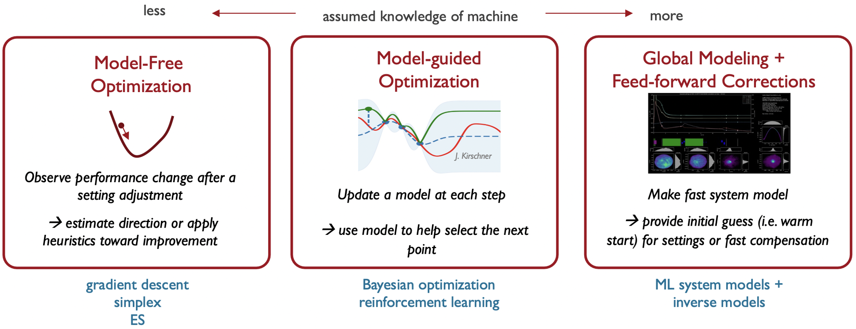
Optimizers for different applications
Courtesy Auralee Edelen

Slide 36
Characteristics of involved optimizations
Optimal parameter settings are hard to find, and the optimum is difficult to maintain.
The data to optimize on has significant uncertainties.
Models of the accelerator exist.
A history of much data is available and can be stored.
Is this type of problem suitable for Machine Learning?
Why would ML be better suited than other optimizers and feedbacks?

Slide 37
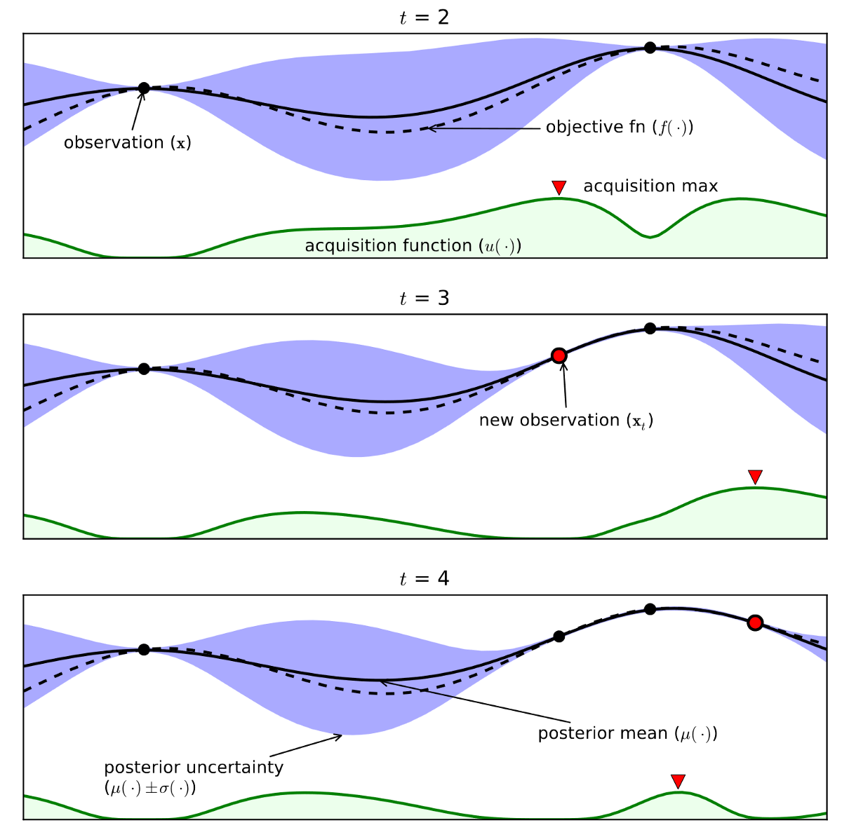
Acquisition Function
[2]
Guide how input space should be explored during optimization
Combine predicted mean and variance from Gaussian Process model
Probability Improvement (PI)
Expected Improvement (EI)
Upper Confidence Bound (UCB)
$$UCB\left(x\right)=μ\left(x\right)+κσ(x)$$

Slide 38
Advantages of Bayesian Optimization

Slide 39
Why is Bayesian Optimization suitable?
1. The data to optimize on has significant uncertainties
No derivatives have to be computed.
2. Models of the accelerator exist
the expected functional form can be included in the function search (Physics-informed learning)
3. A history of much data is available and can be stored
➔ All past data are included to model the function to be optimized.

