Slide 1
Machine Learning applications for luminosity maximization
Xiaofeng Gu
Collaborators:
MSU: Yue Hao, Will Fung
LBNL: Ji Qiang, Sherry Li, Yi-Kai Kan
BNL: Xiaofeng Gu, Robert-Demolaize, Takeshi Kanesue
MAC Review

Slide 2
Outline:
Motivation
GPTune and APEX
GPTune and EBIS
Summary

Slide 3
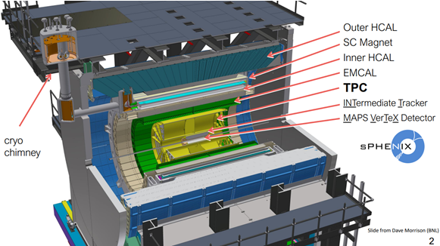
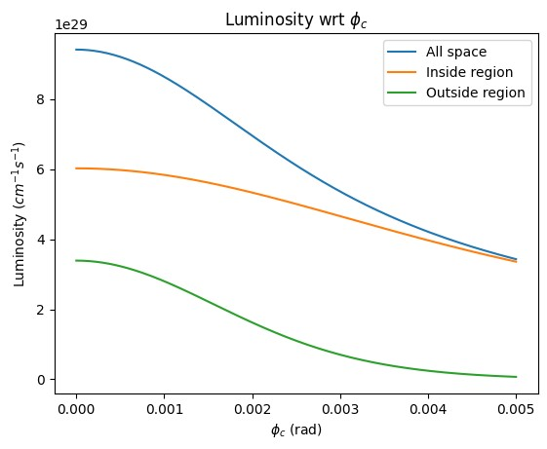
sPHENIX luminosity Optimization
$$L=\frac{N_{1}N_{2}fH}{2π\sqrt{σ_{x1}^{2}+σ_{x2}^{2}}\sqrt{σ_{y2}^{2}+σ_{y2}^{2}}}$$
sPHENIX:
max. VTX (+/-10 cm)
min. unwanted signal
Crossing angle (2mrad)
Global Parameters:
Orbit (Dipole)
Tune (Quadrupole),
Chromaticity (Sextuple)
Octupole
Local (IR8) Parameters:
Beta*
S* (more sensitive than head on)
Transverse offset
Other Parameters:
RF Voltage
Collimator Position
Many variables;
Maximize the useful signal within VTX while minimize the unwanted signal outside of VTX
Machine learning could be a good tool for a fast, multi-objects tunning.
GPTune will be used.
Maximize
minimize

Slide 4
Outline:
Motivation
GPTune and APEX
GPTune and EBIS
Summary

Slide 5
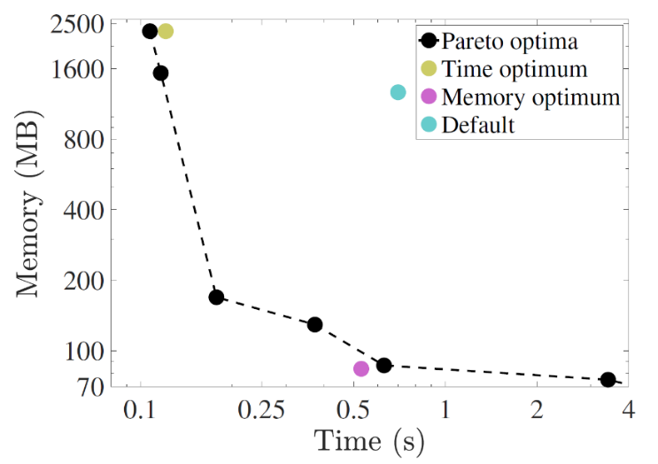
Bayesian optimization at LBNL GPTune
Several features of GPTune (BLNL) are very useful, including:
relies on dynamic process management for running applications with varying core counts and GPUs
can incorporate coarse performance models to improve the surrogate model
allows multi-objective tuning such as tuning a hybrid of computation, memory and communication
allows multi-fidelity tuning to better utilize the limited resource budget
supports checkpoints and reuse of historical performance database.
https://github.com/mkturkcan/GPTune
https://nimrodteam.org/meetings/team_mtg_5_21/nimrod_meeting_YangLiu.pdf

Slide 6
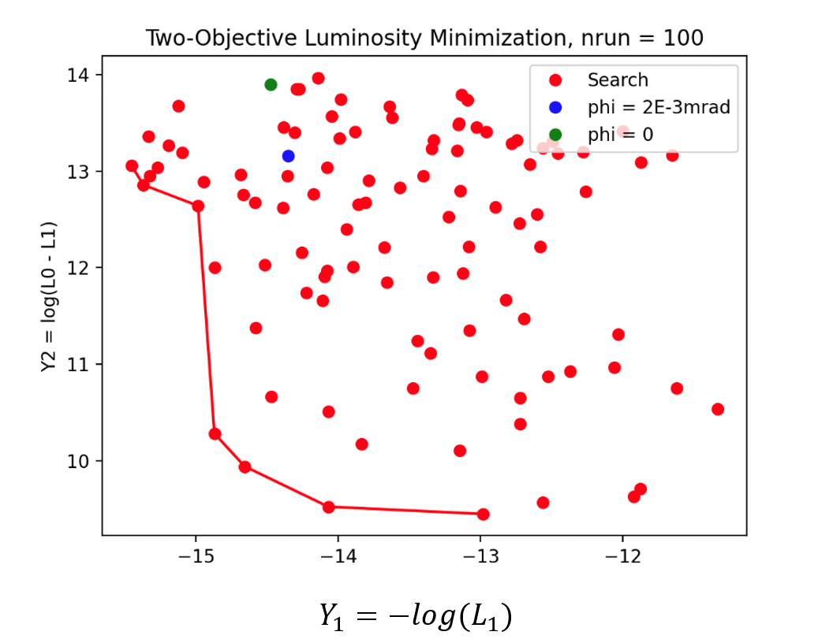
GPTune Optimization with the Analytical Luminosity
Maximize
Unwanted Lumi
minimize
Unwanted
Vertex signal (±10cm)

Slide 7
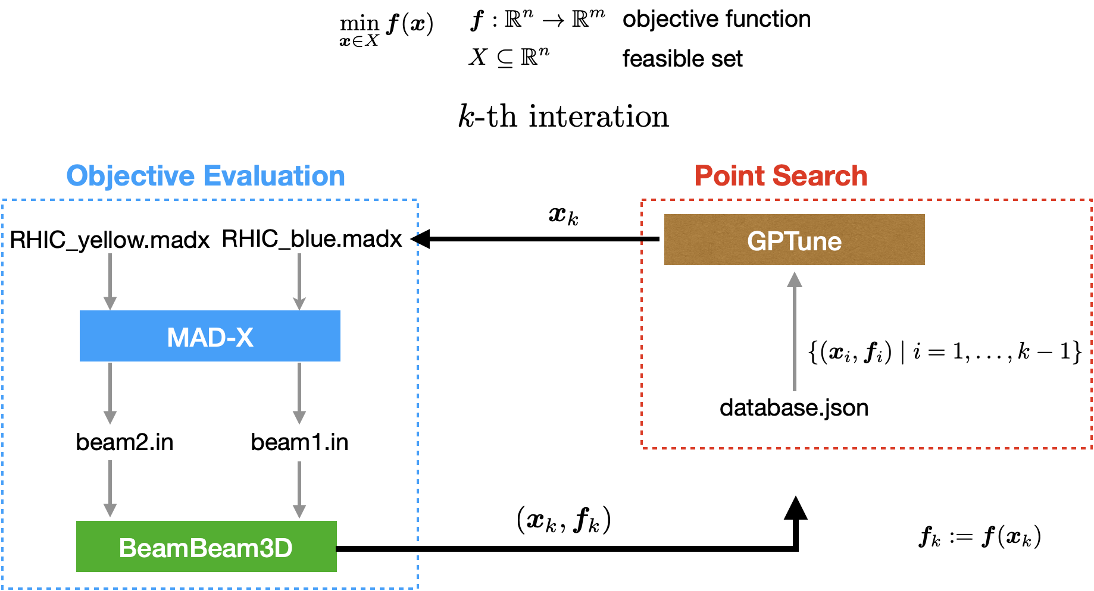
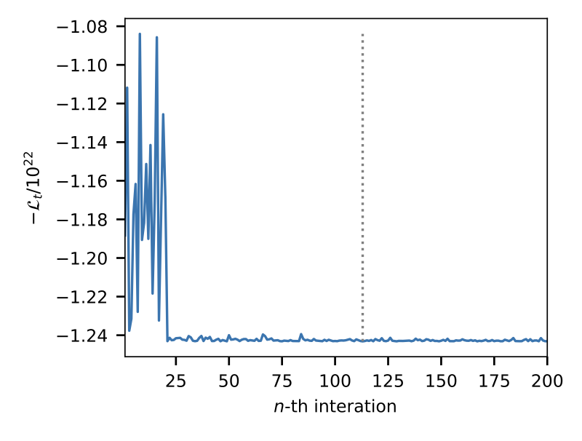
GPTune Optimization with Simulated Luminosity
The optimization of the lattice setting with respect to the luminosity is performed for the head-on collision of two Au-Au beams in the Relativistic Heavy Ion Collider (RHIC). The parameters of the lattice setting with only two variables $ΔS_{x}$ and $ΔS_{y}$.
The value of the objective function converges when more optimization steps are executed. This implies the value of the objective function is minimized and hence the total luminosity $L_{t}$is maximized.

Slide 8
APEX for Luminosity Optimization
1. S* and beta* changing scripts: Tested (next slide)
change the target s*, beta* within ‘deltas.dat’ file;
run ‘madx job.madx_Au16-e0::store’ command, will get ‘IP8knob.dat’ file;
run ‘CreateSend.IP8’ command, will get ‘SendTrim.IP8’ file;
run ‘SendTrim.IP8’ command.
Machine
parameters
Luminosity Measurement
Optimization method
VTX
signal
2. Vertex Signal: contacted with sPHINEX people:
Did it with PHENIX before
Send the vertex data several ways.
S*
GPTune
3. GPTune: Tested (next several slides)
Installed and tested
Did some optimizations EBIS and got some good results.

Slide 9
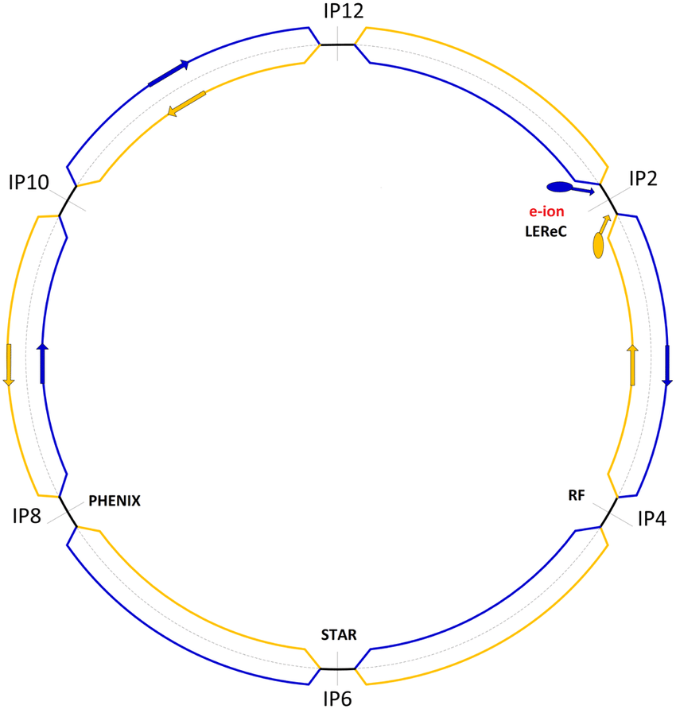
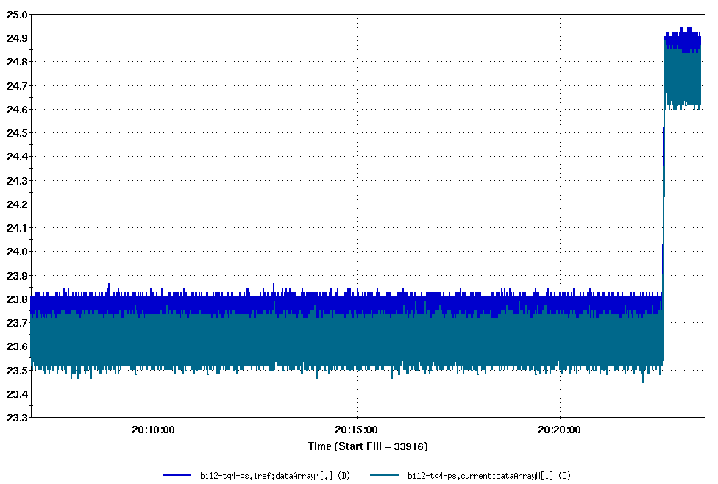
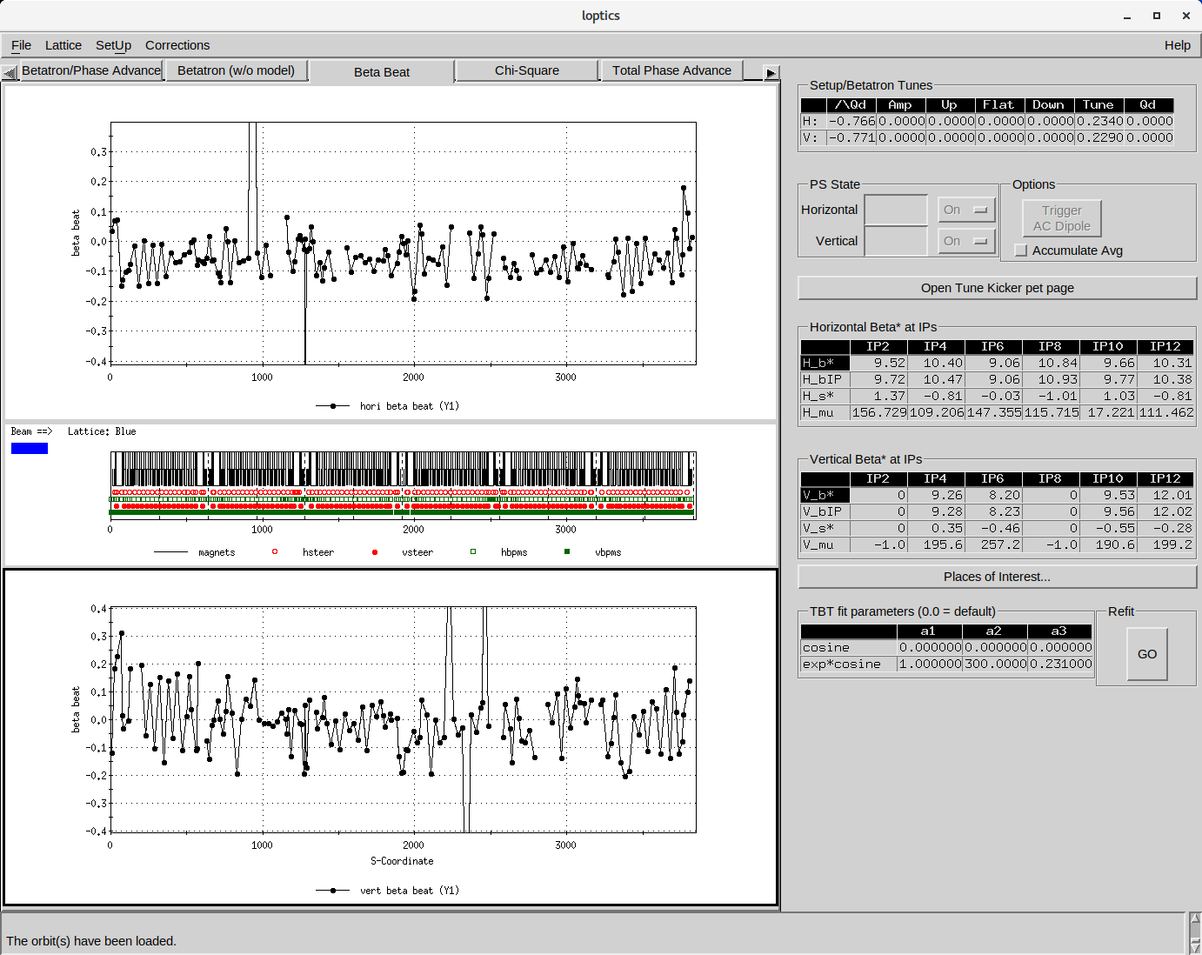
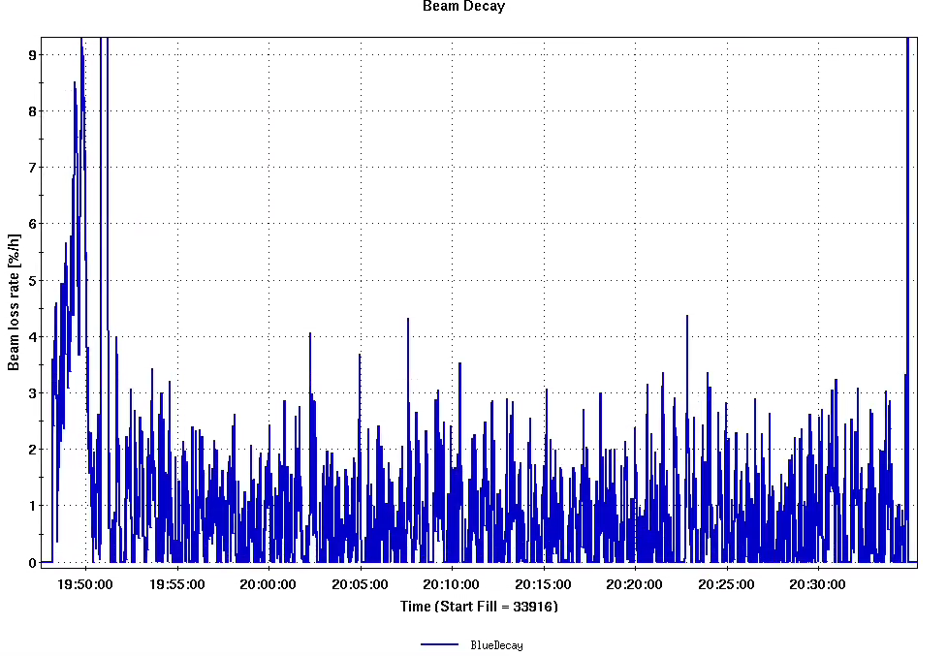
Script Test at IR12
IR12 PS Current
PS Current
Successfully test the s* script at store (IR12).
No additional significant beam loss during +/- 0.5 m s* change.
Will explore a large safety range next time at IR12 without separation bump.
s* measurement
Beam Loss During Test

Slide 10
Outline:
Motivation
GPTune and APEX
GPTune and EBIS
Summary

Slide 11
GPTune Test: EBIS Intensity Optimization
LION
fc96
1
2
RFQ
LINAC
3
4
5
6
7
8
EBIS
Buncher1
xf14
Buncher2
Buncher3
LION
EBIS Injection Line (fc96)
EBIS
EBIS Extraction line (xf14)
RFQ
MEBT
Linac
HEBT
 |  | Injection [xf14] | Extraction [fc96]
1 | IonLens20-40kV | ✓ | ✓
2 | DeflPlatBias | ✓ | ✓
3 | 16PoleX | ✓ | ✓
4 | 16PoleY | ✓ | ✓
5 | Gridded_Lens | ✓ | ✓
6 | Horiz_Bend_Defl | ✓ | ✓
7 | Inter_Vert_Defl | ✓ | ✓
8 | Inter_Vert_Defl_Lower | ✓ | ✓
9 | Horiz_Sphere_Bend | ✓ | ×
10 | RFQ_Horiz_Bend | × | ✓
11 | LEBT_Solenoid | × | ✓
 | Total Variables | 9 | 10

Slide 12
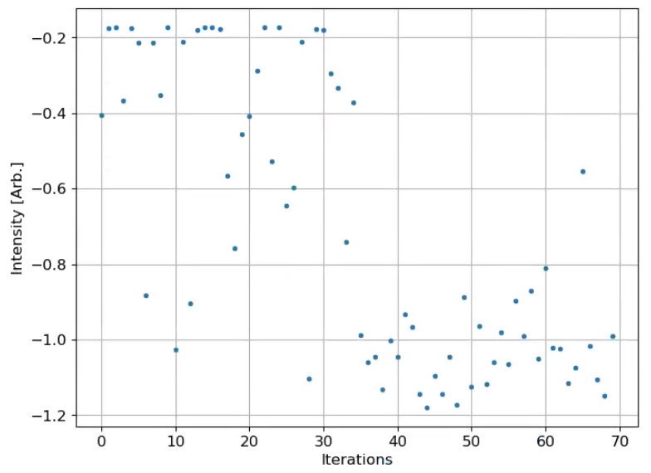
GPTune: EBIS Injection Line (9 parameters)
GPTune: minimize the signal to get a maximum output.
script was running from 12:33 to 13:36 (~63 min)
1 pulse / super-cycle [6.6 s]; it takes 2 super-cycles for the powers settle down; 4 super-cycles for measurement.
fc96 measurement was used for injection optimization
9 control parameters after 70 iterations
GPTune Signal

Slide 13
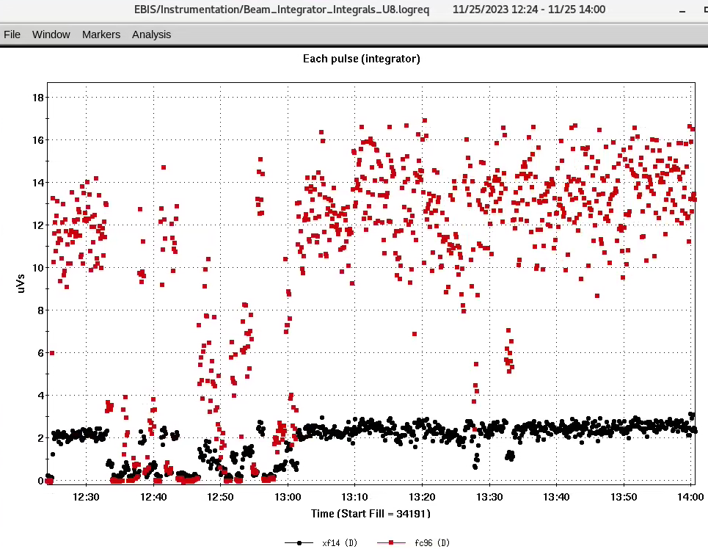
GPTune: EBIS Injection Line (9 parameters)
~14.0
~22% improvement after optimization
fc96 Intensity
11.5

Slide 14
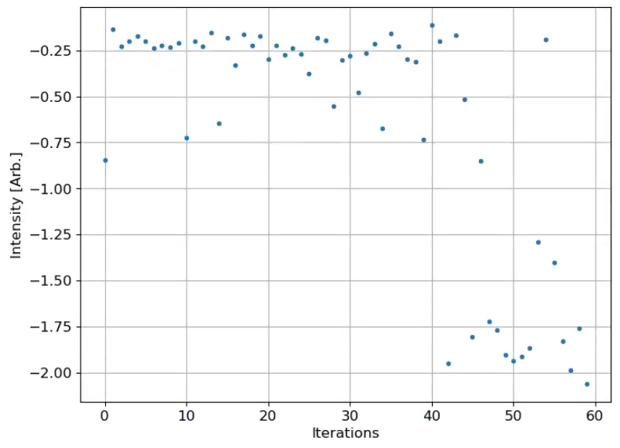
GPTune: EBIS Extraction Line (10 parameters)
script was running from 10:18 to 11:15 (~57 min)
2 pulses / super-cycle [6.6 s].
xf14 measurement was used for extraction optimization.
10 control parameters after 60 iterations
GPTune Signal

Slide 15
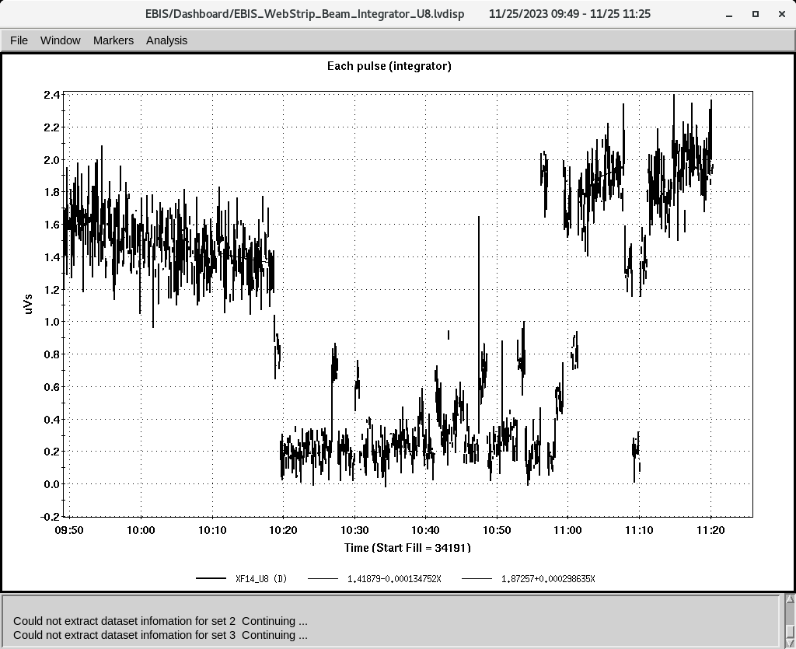
GPTune: EBIS Extraction Line (10 parameters)
~2.0
~43% improvement after optimization
Xf14 Intensity
1.4

Slide 16
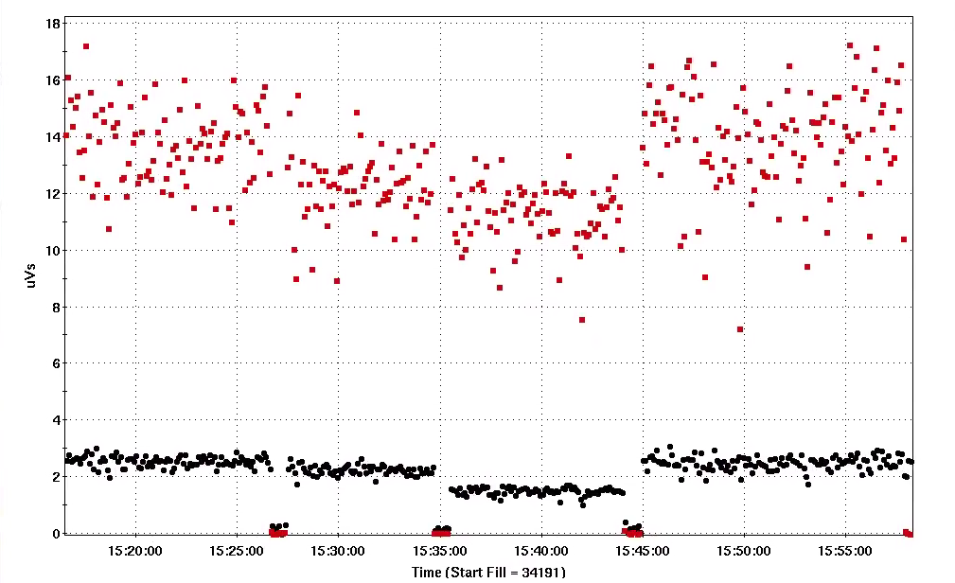
GPTune: EBIS Intensity Gain (11/25/2023)
13.67±1.40
12.16±1.23
13.89±1.76
11.22±1.05
GPTune works with std ±10% (pp ±15% ) noisy signals!
Possible more gain with fc96 instead of xf14 for the extraction line?
fc96 Intensity
Inj+Ext.
Ext.
Original.
Inj+Ext.
2.53±0.20
2.23±0.17
2.49±0.24
1.48±0.13
Intensity detector | Original | Ext. optimized with xf14 | Gain | + Inj. Optimized with FC96 | Total Gain | Total Gain
xf14 (uVs) | 1.48 | 2.23 | 42~50% | 2.53/2.49 |  | 68~71%
fc96 (uVs) | 11.22 | 12.61 | 8.4% | 13.67/13.89 |  | 22-24%
?

Slide 17
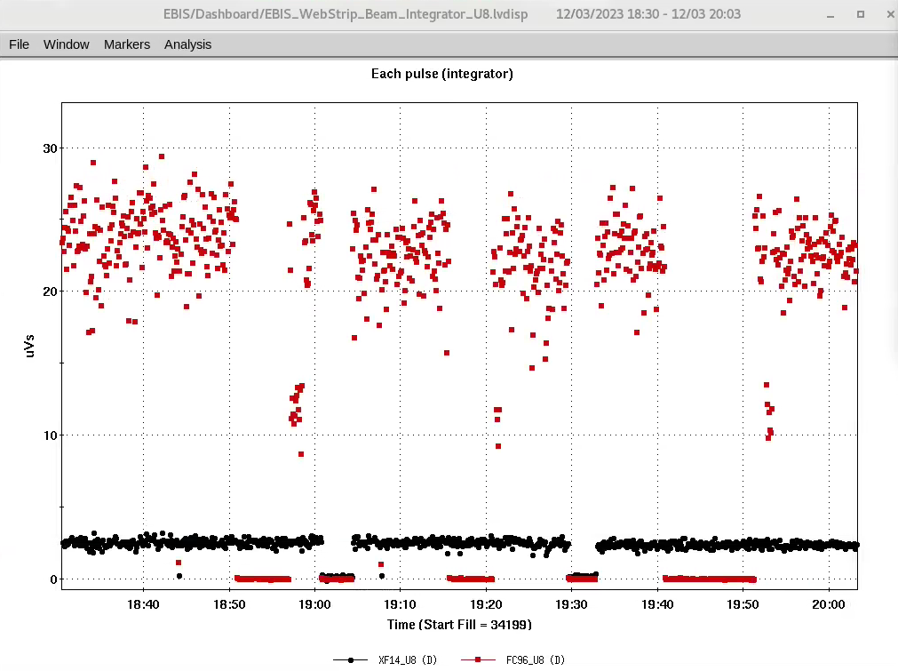
GPTune: EBIS Injection + Extraction (19 parameters)
12/03/2023:
Change 19 parameters simultaneously
Fc96 was used.
Original: 22 [uVs]
80-iterations: 23 [uVs]
90-iterations: 23.56 [uVs] (7%)
1.07×1.22 ~ 1.30 ?
90 iterations
Original
80 iterations
fc96 Intensity

Slide 18
Outline:
Motivation
GPTune and APEX
GPTune and EBIS
Summary

Slide 19
Summary
GPTune has been demonstrated as a powerful tool for optimization. It was used for EBIS intensity optimization and got 22~30% intensity improvement at xf14 CT (70% with fc96 CT) , with ±10% std noisy signals and 19 variables. GPTune is planned to be used for other beam lines in RHIC complex.
The luminosity optimization plan has been developed: testing scripts, variable limits and beam loss at IR12 (injection and store), then at IR8 (store).
Scripts for Luminosity optimization have been tested at IR12. No significant beam loss during the test. Maybe more time to explore the variable limits.
The experience of luminosity optimization with a cross angle is very useful for EIC.

Slide 20
About the last year’s recommendations
Recommendations: Develop a plan and assess the resources needed to carry out the plan. The plan needs to have well-defined and achievable goals.
Partially Done: Scripts for Luminosity optimization are tested at IR12 at injection and store; will do it at IR8 this run.
Recommendations: and include defined measures and actions to protect the machine and the detector.
Done: No significant loss during the test. Will explore the limit range again.
Recommendations: The protection measures need to be agreed upon with sPHENIX management.
Partially Done: Have contacted with them about the vertx signals; will communicate with them for APEX.

Slide 21
Acknowledgement
R. Guillaume
T. Kanesue
M. Okamura
J. Morris

