Slide 1
High-Field Combined Function Permanent Magnet
Stephen Brooks
December 20th, 2023

Slide 2
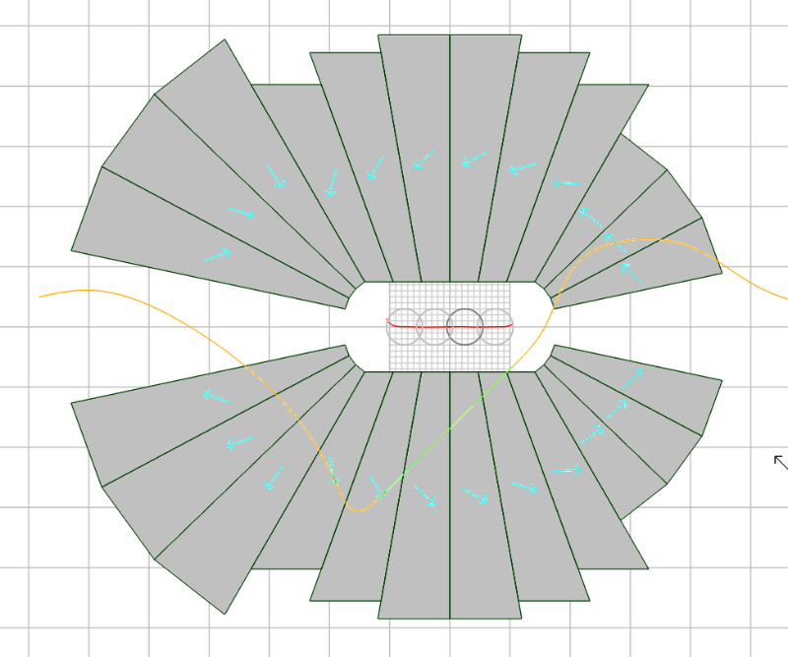
Magnet Design
Open midplane design with >1.5T in good field region, 10⁻³ field accuracy, relevant for CEBAF upgrade
Bought 24 permanent magnet wedges from AllStar Magnets
  Material grade N42EH, B_{r}=1.30T
  45mm length
B(0) = -0.9512T, 55.54T/m
±10.5mm good field region
  B_{max,gfr} = -1.536T
±7.5mm vertical aperture
6mm total minimum gap
10cm
cm grid

Slide 3
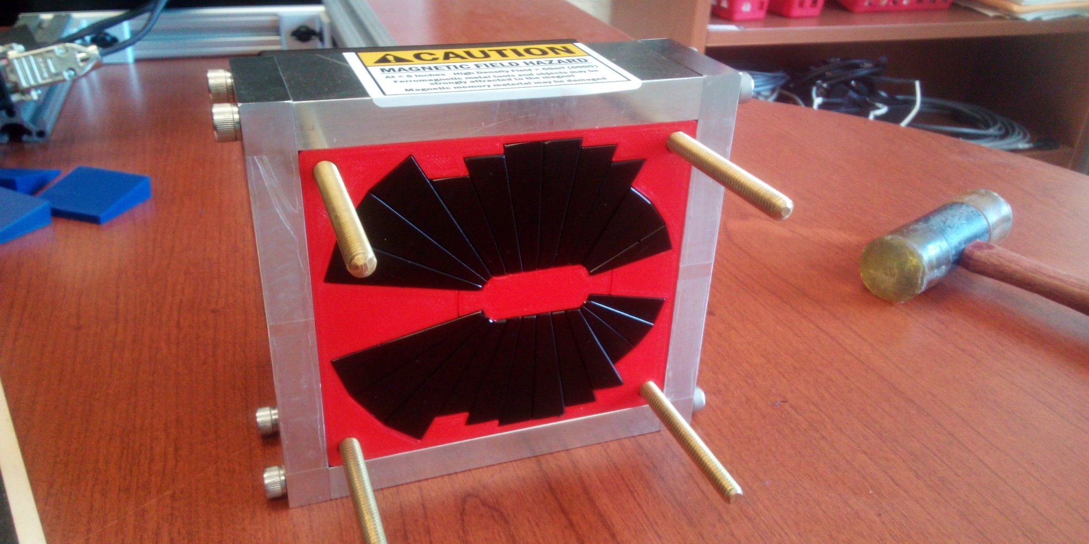
Assembled Magnet
Outer ½” thick aluminium frame for strength

Slide 4
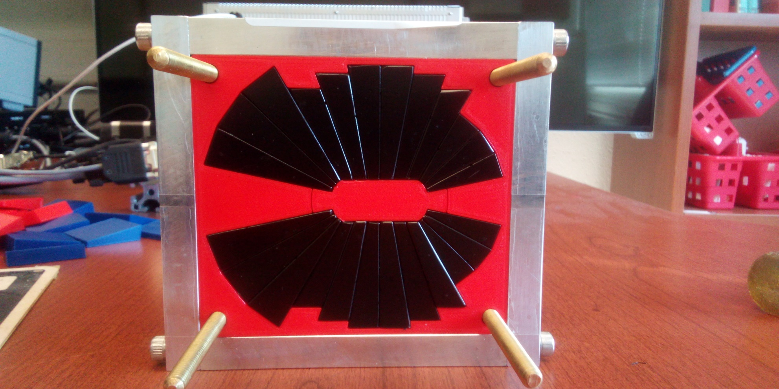
Assembled Magnet
Outer ½” thick aluminium frame for strength

Slide 5
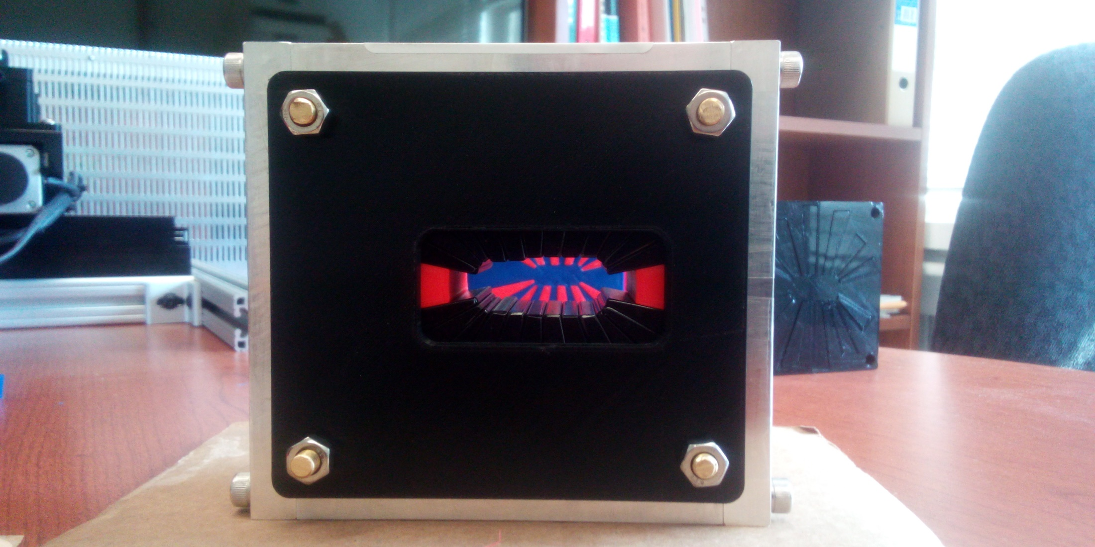
Endcaps for Safety (no shims here)

Slide 6
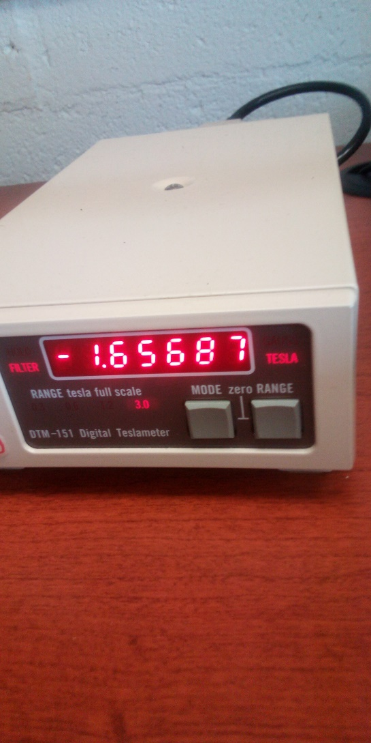
High fields exist in aperture

Slide 7
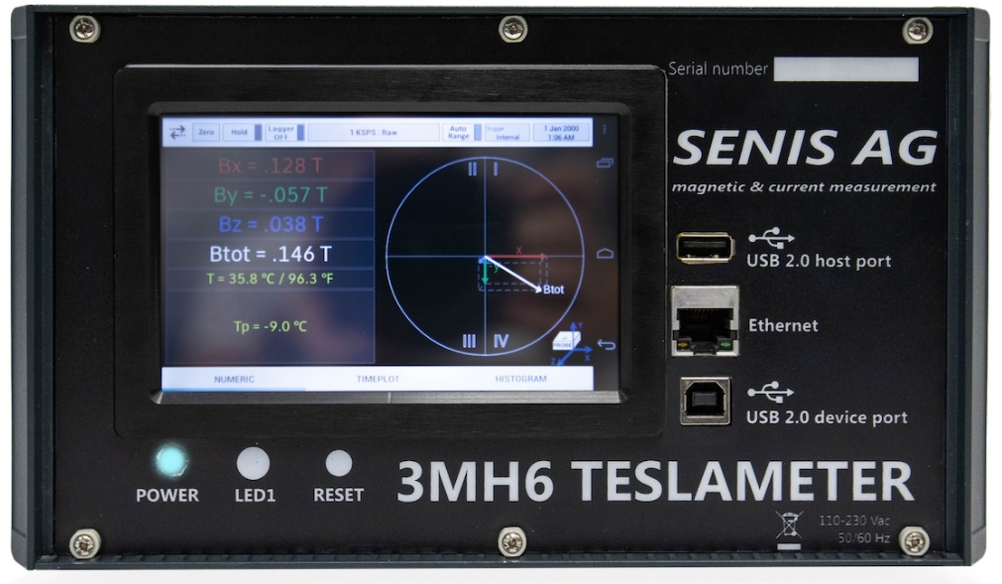
Fieldmap Measurement
Used Senis 3MH6 teslameter with 3-axis Hall probe
  Accurate to ±0.01%
Two (horizontal X,Z) linear movement stages
  Few microns
±10.5mm × 200mm
  0.5mm, 2.5mm steps
8 repeated scans

Slide 8
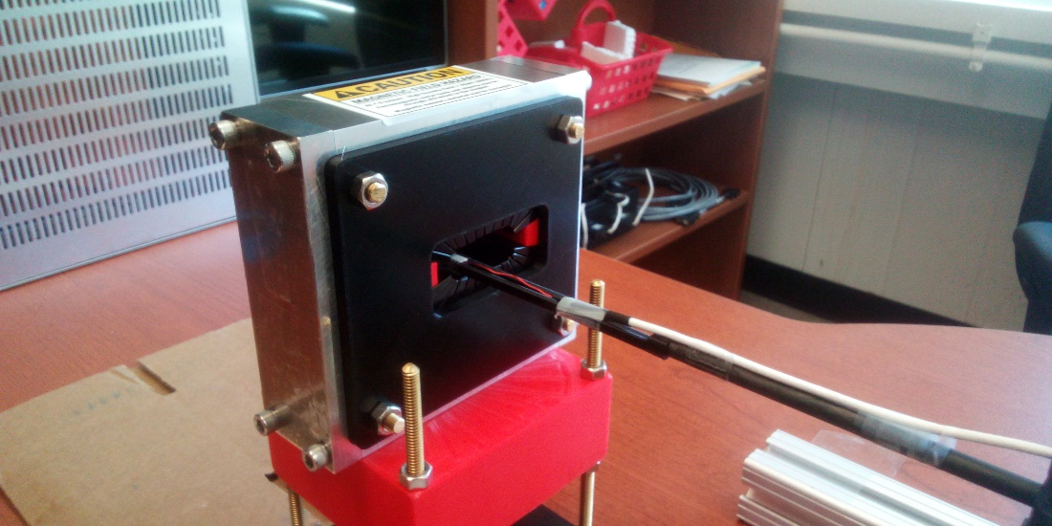
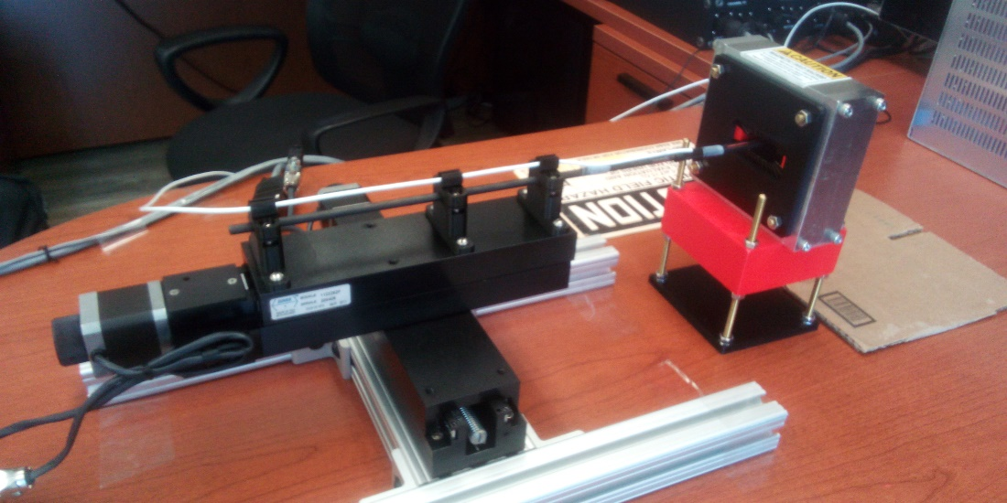
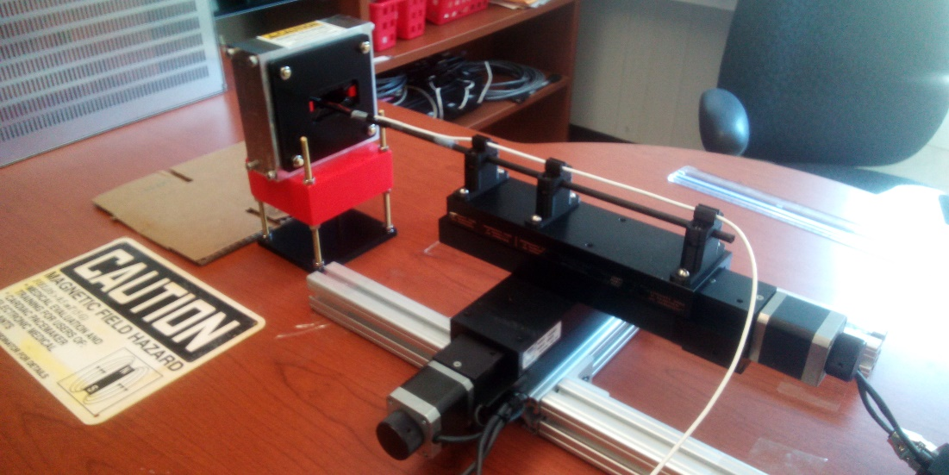
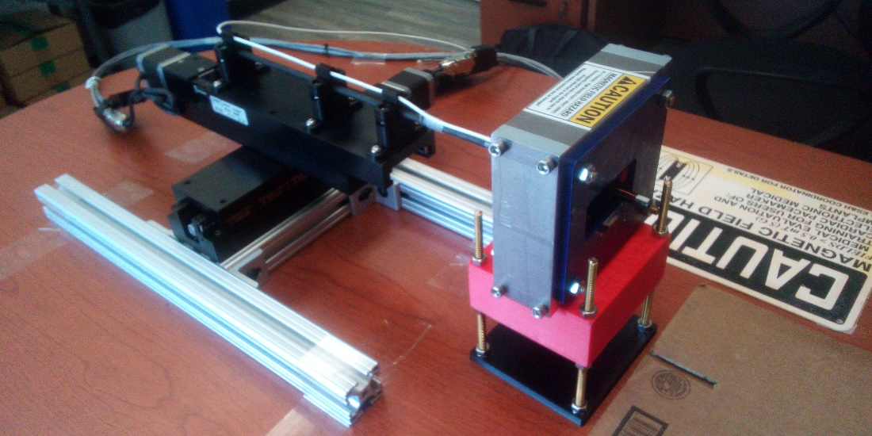
Fieldmap Measurement

Slide 9

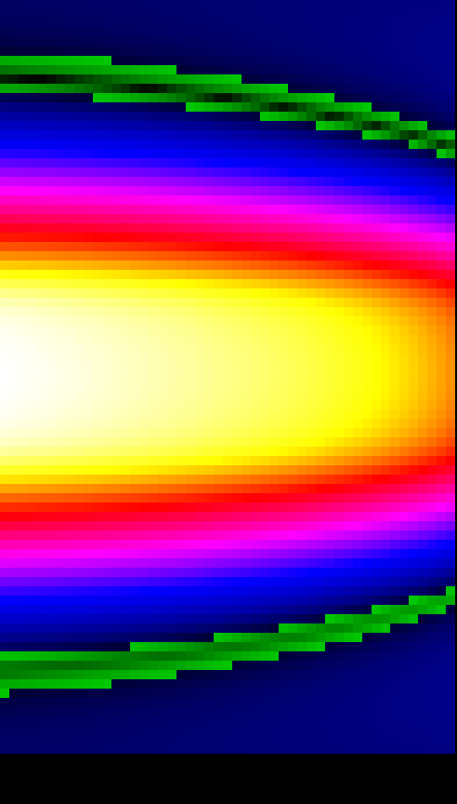
Graphical Fieldmap Plot
Left: linear colour scale
Right: log colour map,
field inversion (flux return) far from magnet is visible
Z
X

Slide 10
Magnet Field Mapping Run Sequence
Run 1: bare magnet but bad wedge alignment
Run 2: added brass shims between wedges (better alignment)
Run 3: added 26× 35mil Ø iron tuning rods but got X-axis direction definition wrong!
Run 4: tried first tuning iteration again with corrected X axis
Run 5: verify first tuning iteration with different rod holder but field changed
Run 6: investigate bare magnet without tuning rods again, field had changed, wedge alignment worse perhaps
Run 7: tuning rods first iteration based on run 6
Run 8: 2nd tuning iteration from run 6
Run 9: 3rd tuning iteration from run 6
Three consecutive field tuning iterations

Slide 11
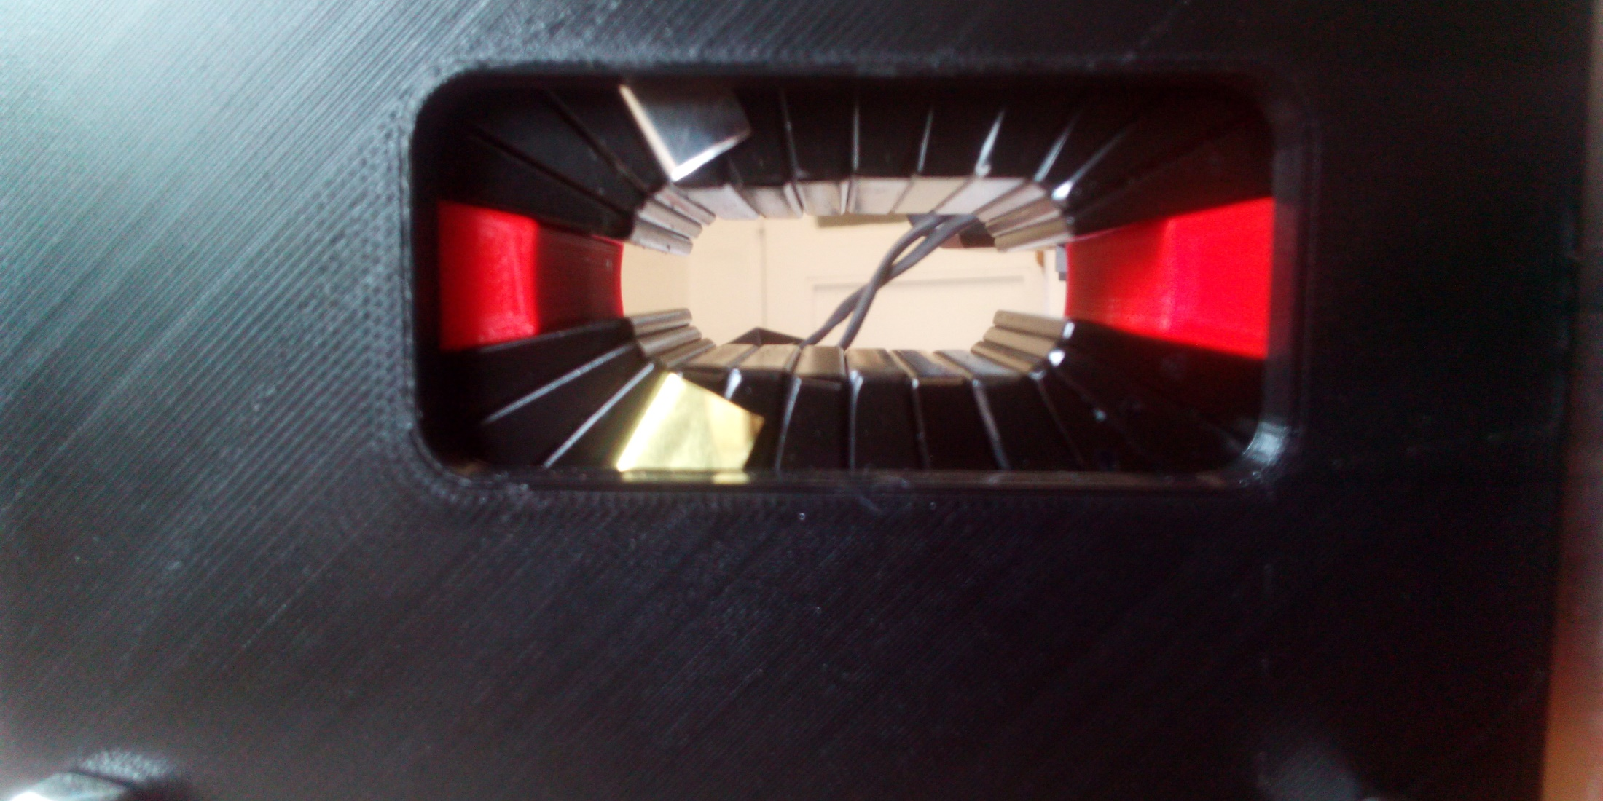
Aperture after Brass Shims (Run 2)

Slide 12
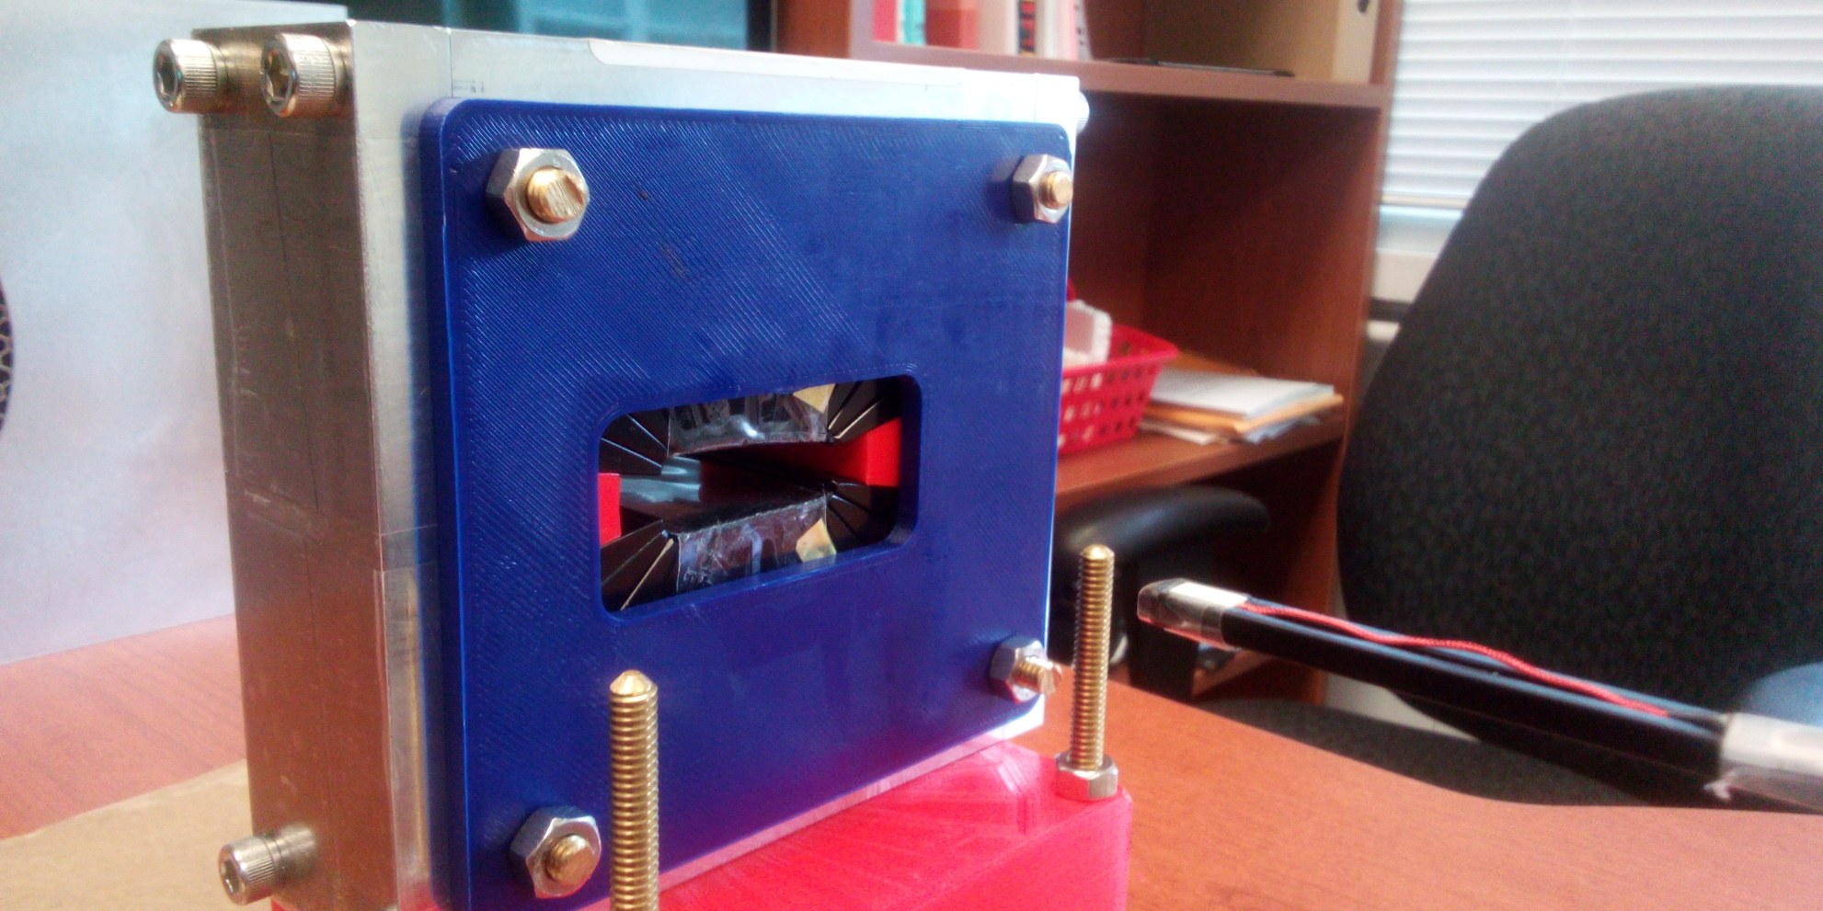
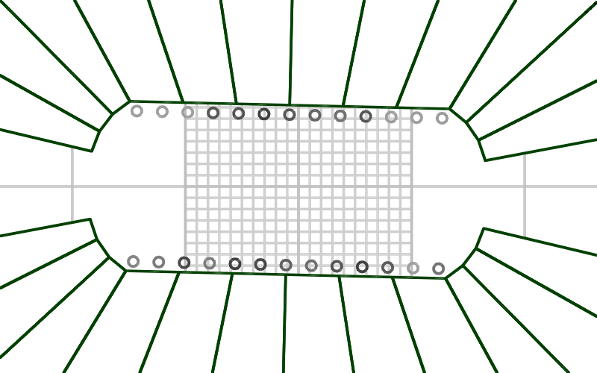
Magnet with Iron Tuning Rods

Slide 13
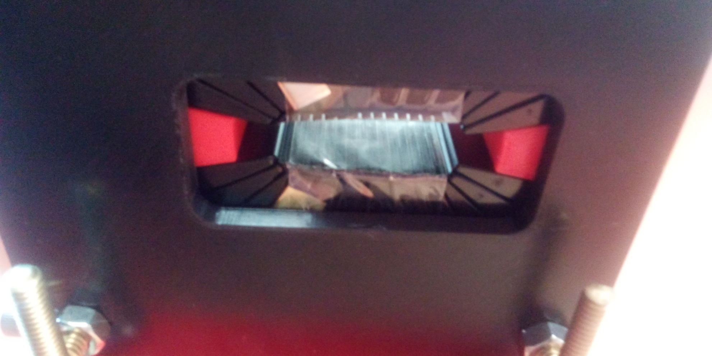
Magnet with Iron Tuning Rods

Slide 14
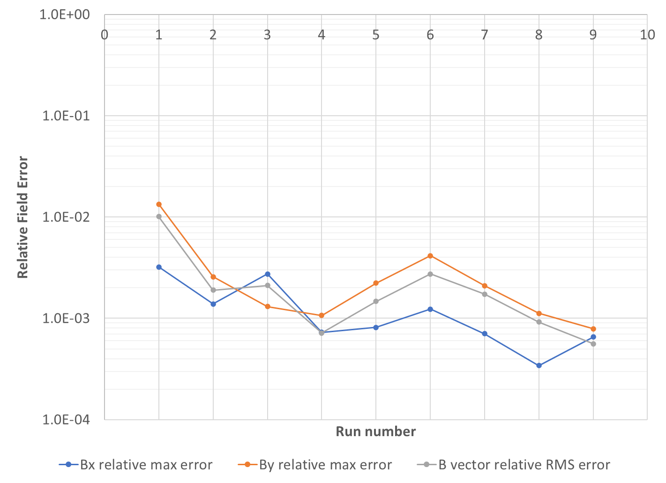
Maximum Field Error History
Original
Iter 1, verify, block slip?
Iter 1, rev. X axis
No tuning rods
Brass shims
Iter 1, correct X axis
Iter 1
Iter 2
Iter 3

Slide 15
Integrated Fields (Run 9)
Note: integrated fields are divided by magnet nominal length of 45mm to give Telsa
Field Error (T)
Good field region ±10.5mm
X (m)
Main Field (T)
RHS
RHS

Slide 16
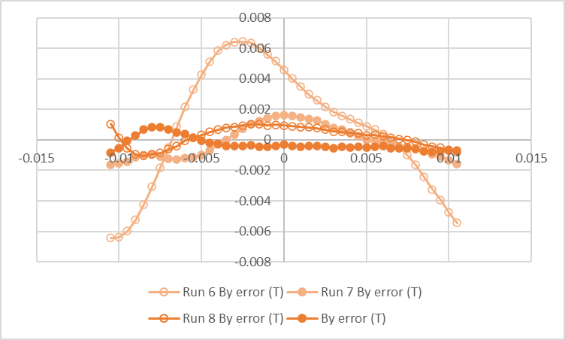
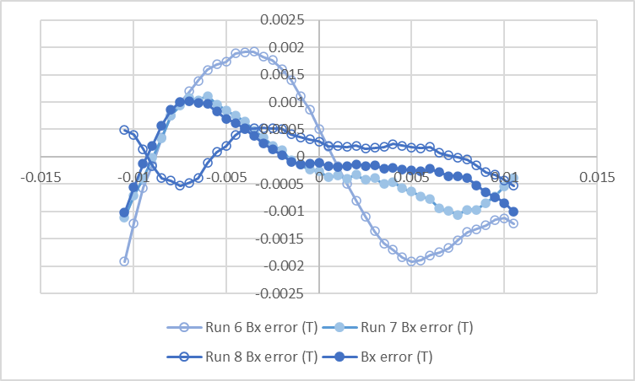
Integrated Field Error History
Gradual improvement over iterations 0-3 (runs 6-9)
Short magnets often require more iterations because of end field effects
B_{y} Field Error (T)
B_{x} Field Error (T)
8mT
2.5mT
X (m)
X (m)

Slide 17
Conclusion and Future Work
A short section of magnet similar to CEBAF upgrade FFA has been tuned to <10⁻³ accuracy
  No glue/epoxy was used (might reuse wedges), so some issues with blocks staying in place
  A technique with epoxy was also attempted (in backup slides)
Temperature variation and material thermal coefficient appears to be the main source of measurement error now
  Thermal coefficient is approximately 1.1×10⁻³/K
  Temperature-controlled enclosure is a future option

Slide 18
Tooling for Assembling a Permanent Magnet

Slide 19
Tooling Design
Full mould
all pieces and central plug, printed double wall thickness for strength
“Spider”
Channels for half the pieces
Can be flipped over to get other half
Corner holes for ¼”-20 threaded rods throughout, provide loose alignment, constraint

Slide 20
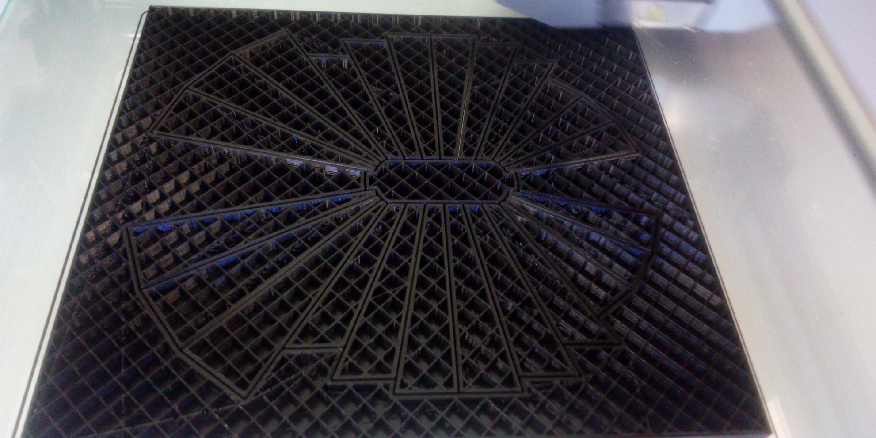
Can 3D print all parts in place
0.3mm spacing between pieces minimum possible with our printers

Slide 21
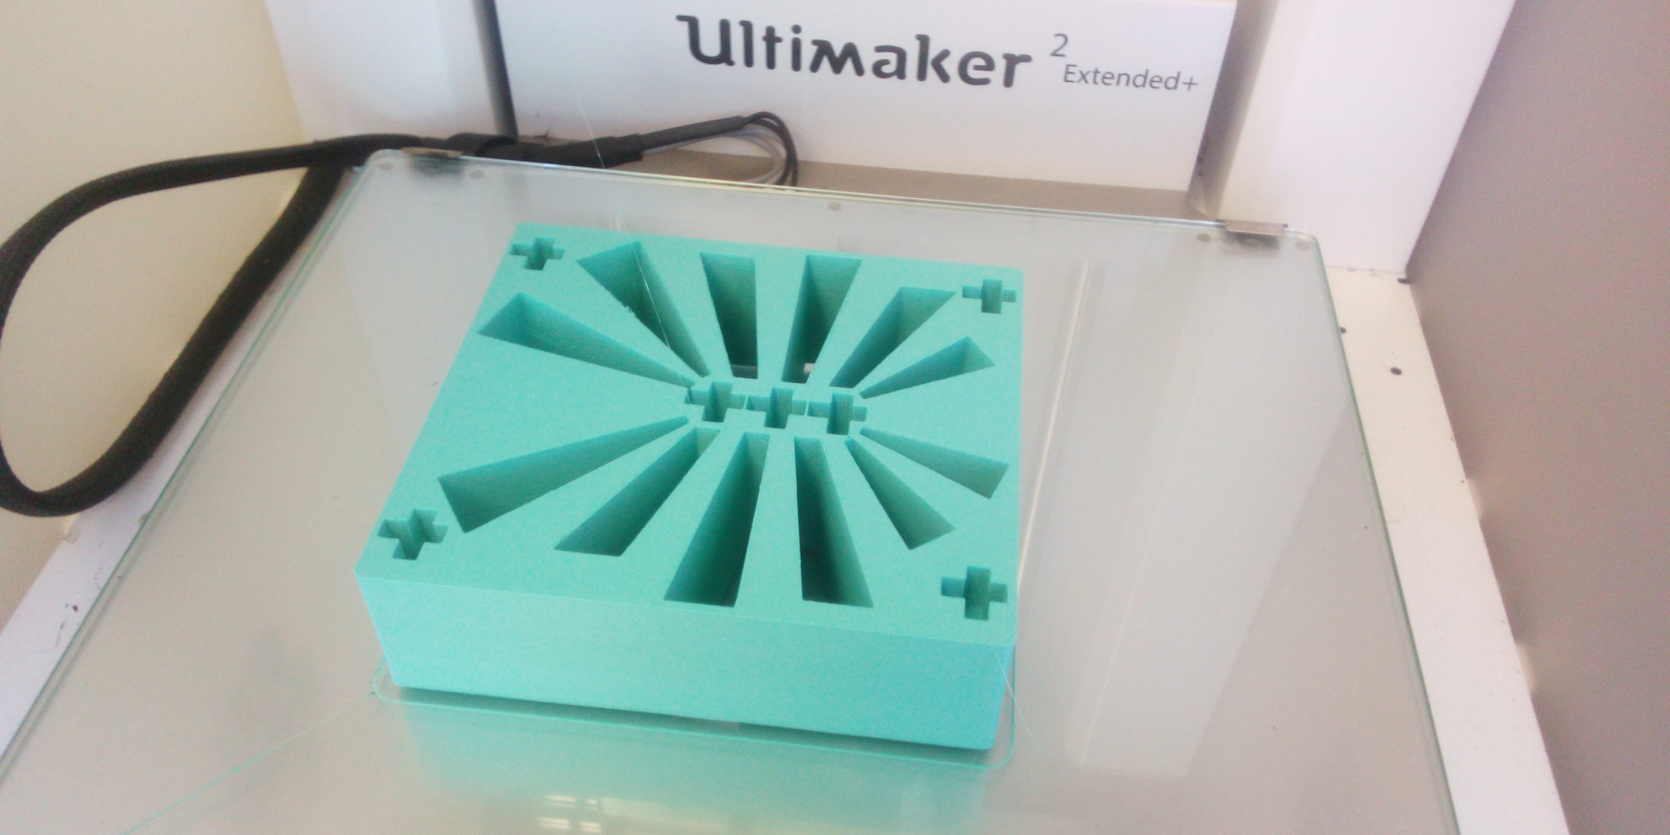
Point field measurement tool for Hall probe, also a “spider”
Single-axis Hall probe inserted in X and Y directions in cross-shaped holes, depth is controlled the centre of magnet length
Used this to confirm field of all 24 wedges at 7 locations → rough magnetisation vector measurement

Slide 22
Assembly Sandwich

Slide 23

Assembly Process
1.
2.
3.
4.
5.

Slide 24
Assembly Process Notes
Insert one half of the blocks and then flip the spiders over and insert the other half
Make sure each block is pushed all the way in because they can repel longitudinally
  Actually a mixture of attraction and repulsion
The later blocks will be tighter fit but it was OK with the 0.3mm gaps (0.15mm larger mould)
  Small gaps between some magnets were visible after central plug removed (0.1-0.2mm), inserted brass shims

Slide 25
Permanent Magnet Assembly With Epoxy

Slide 26
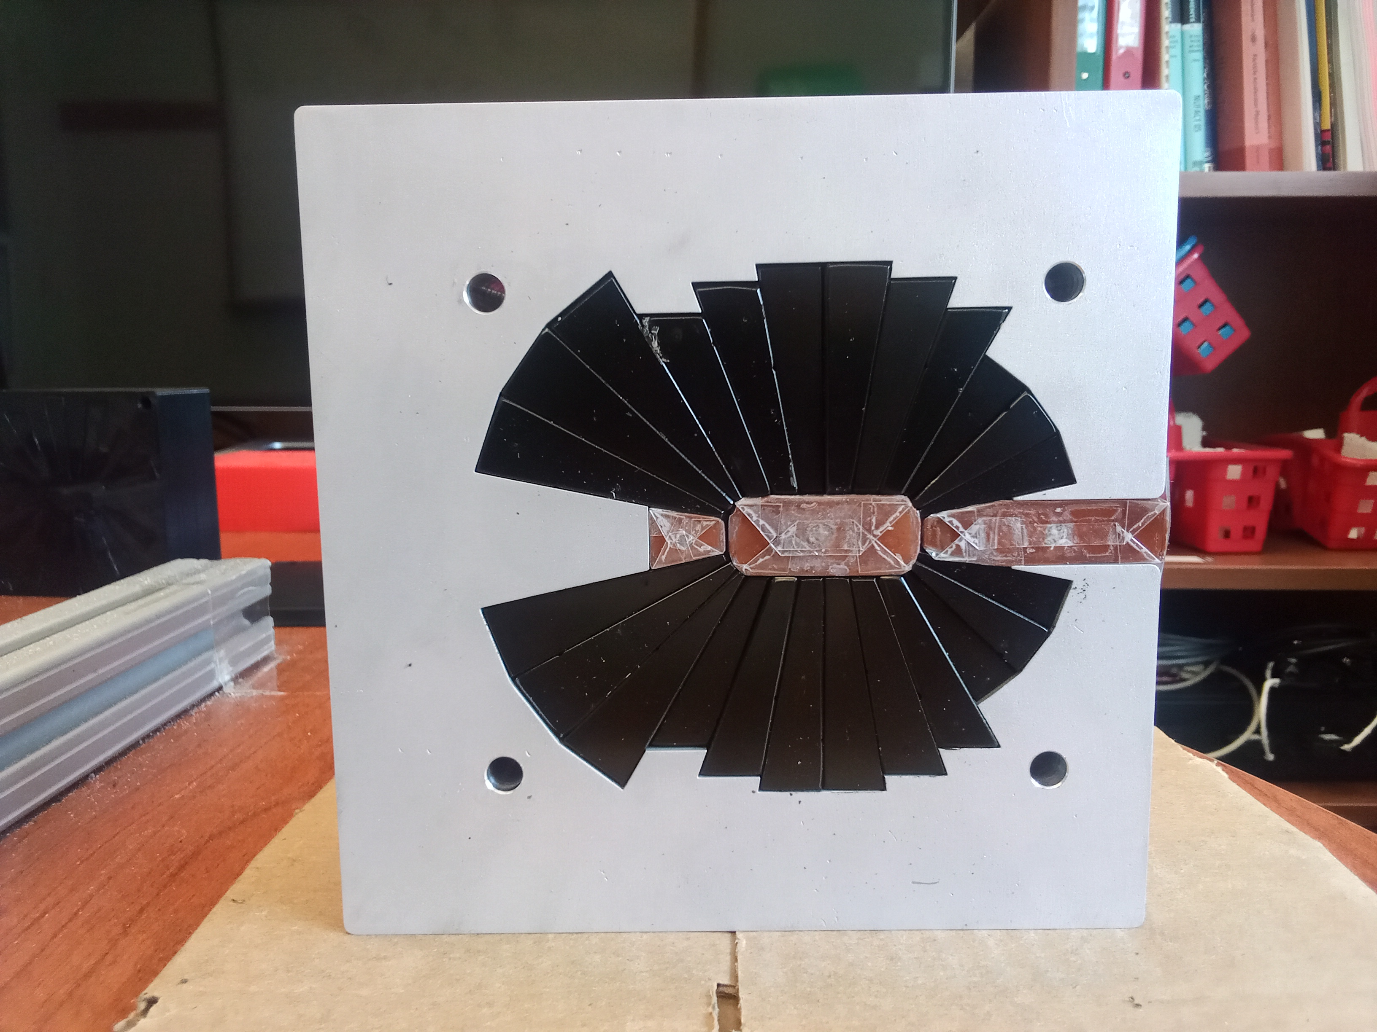
Double Tape-Wrapped Spacers
Spacer must not be glued in place!

Slide 27
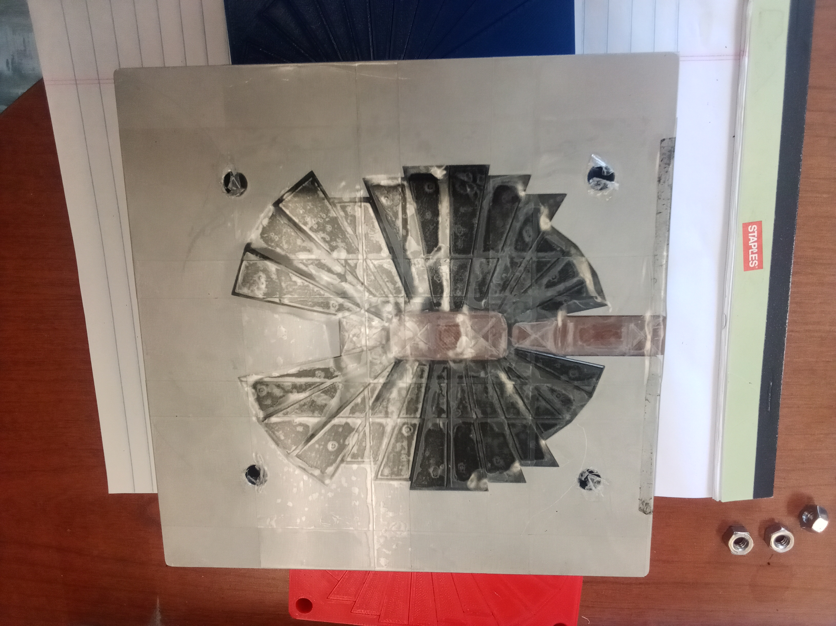
Tape-Wrapped Base
Epoxy should not leak out of base
Spacer must not be glued in place!

Slide 28
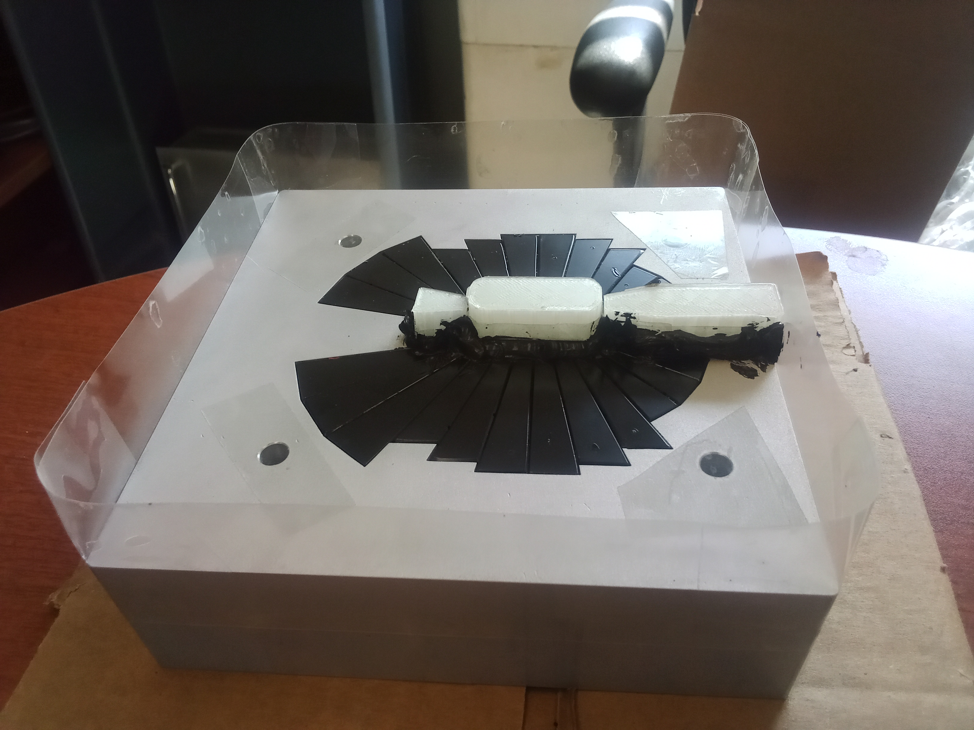
Side Tape and Epoxy “Bucket”
RTV sealant used around seams, plus extended spacers

Slide 29
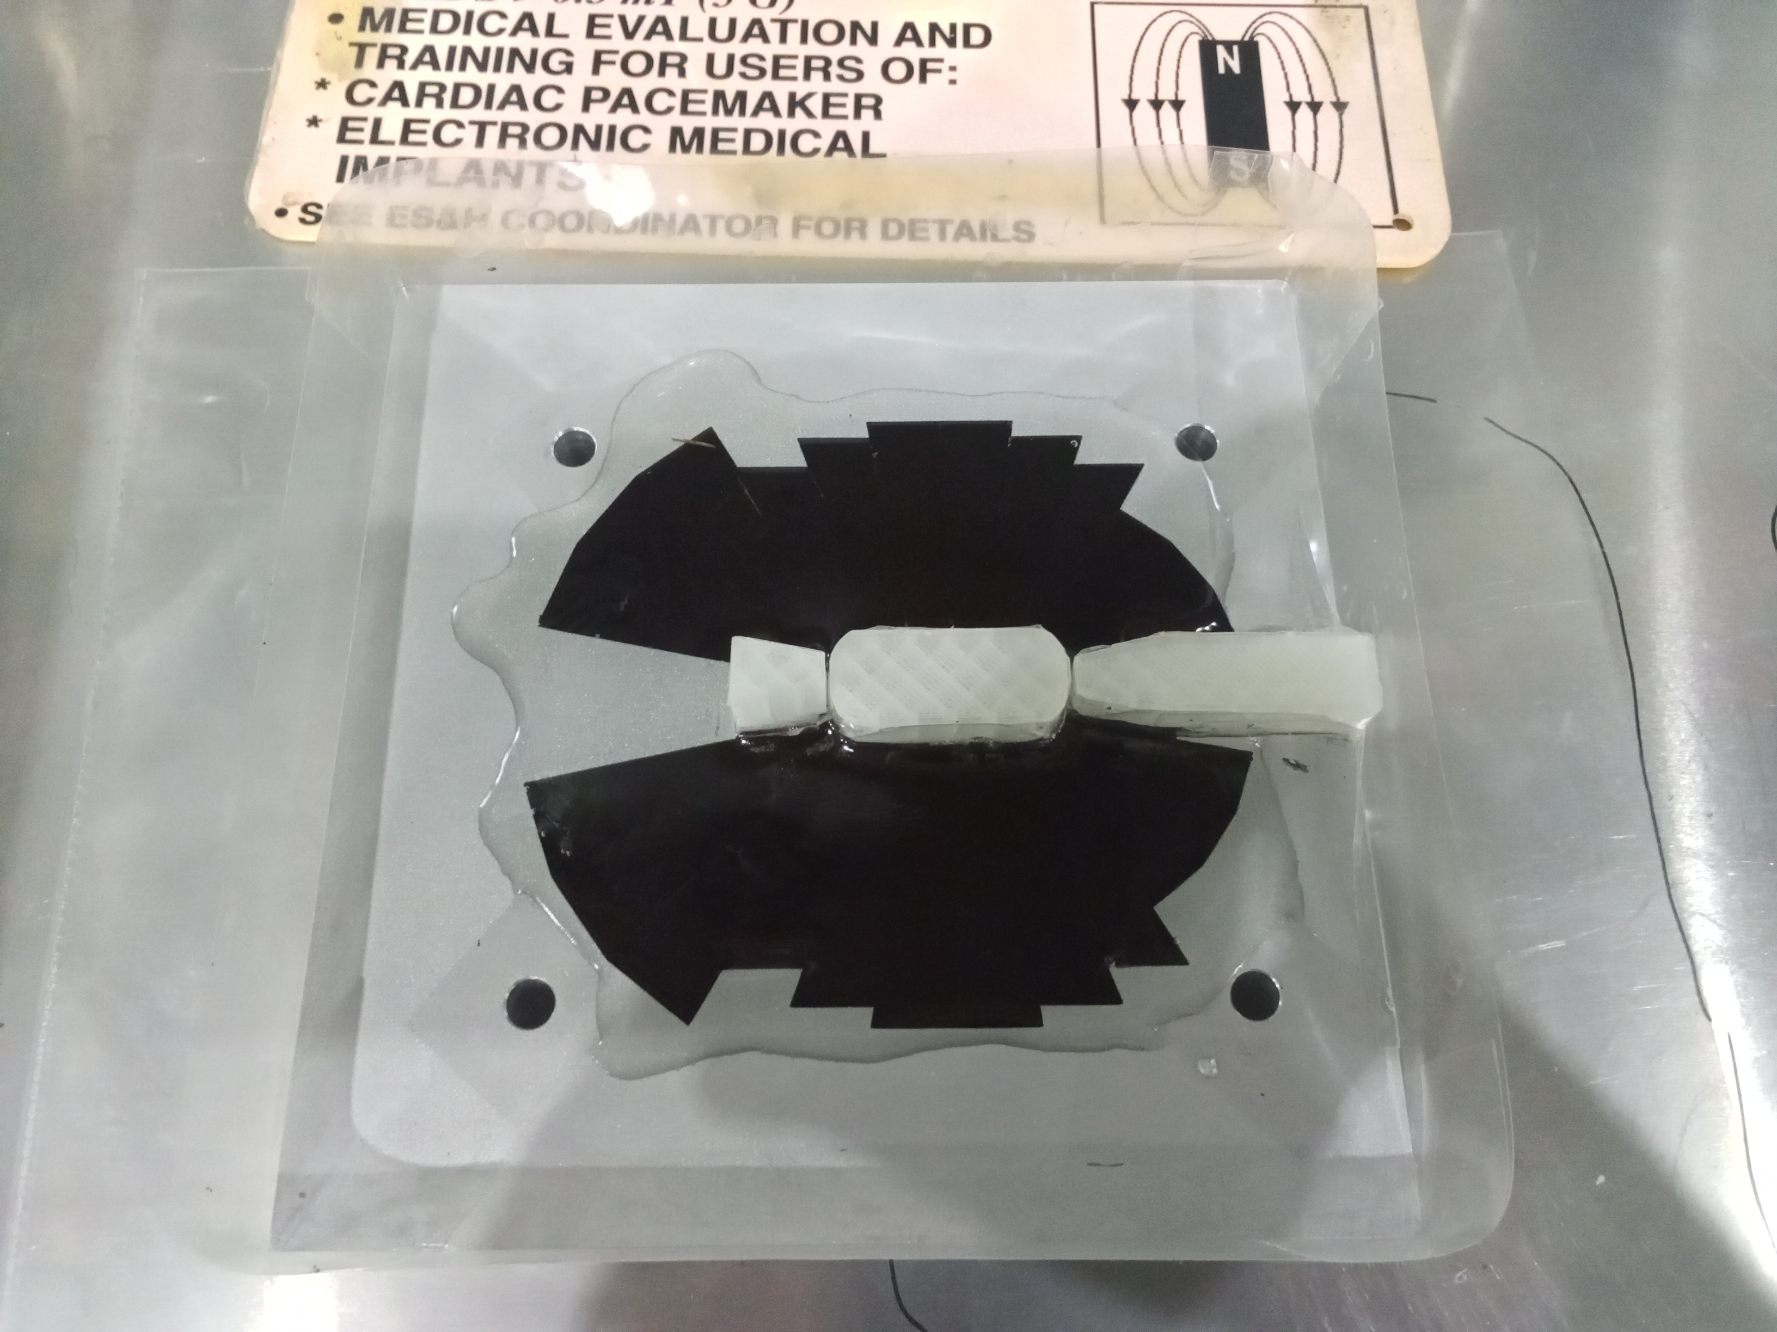
Epoxy Pour in Vacuum Chamber

Slide 30
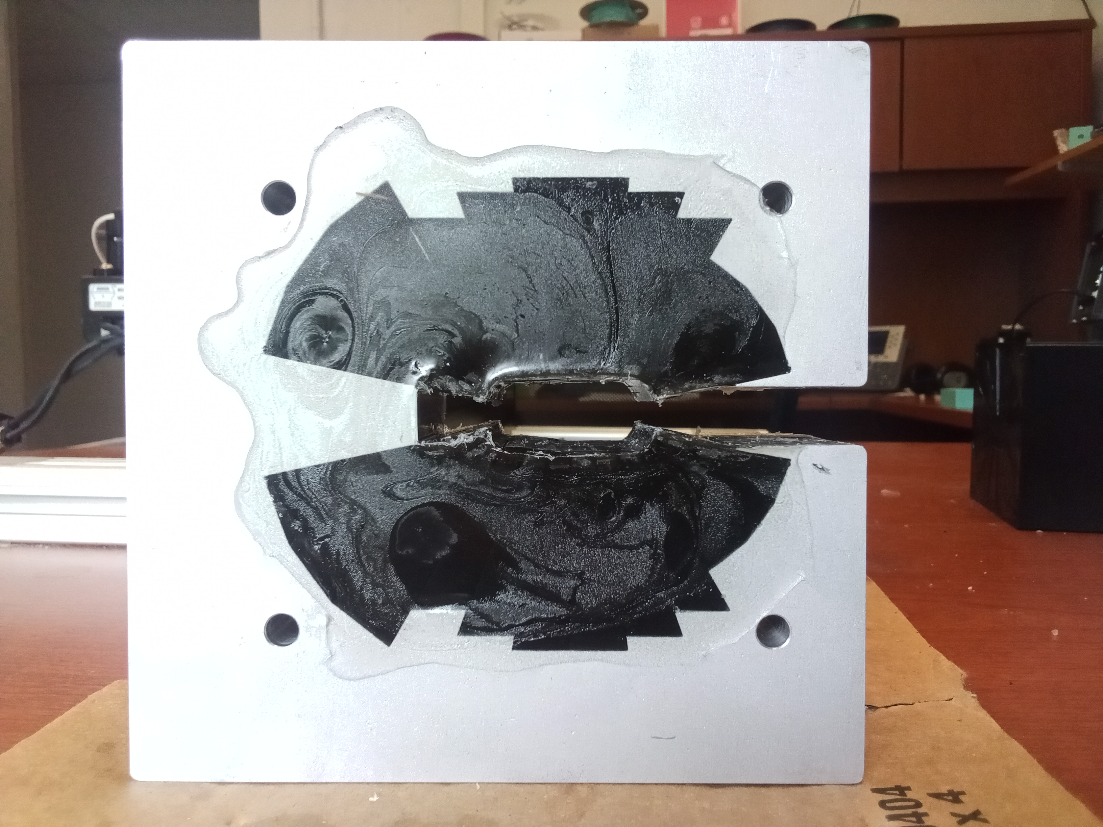
Solid Epoxy after Spacers Removed

