Slide 1
Ring cooler feasibility study for EIC
Sergei Seletskiy
For CAD Cooling Studies group in collaboration with G. H. Hoffstaetter and J. Unger (Cornell University)
C-AD Machine Advisory Committee Meeting (MAC-20)
December 19-21, 2023

Slide 2
Outline
Introduction
Electron cooling at high energy
Idea of the Ring Electron Cooler (REC)
Optimization of electron beam parameters
Design features of the REC
Challenges
Ongoing work
Summary

Slide 3
References
S. Seletskiy, A. Fedotov, Useful formulas for non-magnetized electron cooling, BNL-222963-2022-TECH (2022).
M. Blaskiewicz, Dispersion and electron cooling, BNL-210932-2019-TECH, (2019).
S. Seletskiy, Redistribution of cooling rates for electron bunch with nonuniform density, BNL-223860-2023-TECH (2023).
S. Seletskiy, A.V. Fedotov, D. Kayran, J. Kewisch, Proton-electron focusing in EIC Ring Electron Cooler, WEPA78, NAPAC2022, Albuquerque, NM, USA (2022).
S. Seletskiy, S. Nagaitsev, Focusing effect of proton bunch with Gaussian longitudinal distribution on electrons in EIC Ring Cooler, BNL-224133-2023-TECH (2023).
H. Zhao, J. Kewisch, M. Blaskiewicz, A. Fedotov, Ring-based electron cooler for high energy beam cooling, Phys. Rev. Accel. Beams 24, 043501 (2021).
S. Nagaitsev, Intrabeam scattering formulas for fast numerical evaluation, Phys.Rev. STAccel.Beams 8, 064403 (2005).
H. Zhao and M. Blaskiewicz, Electron heating by ions in cooling rings, doi.org/10.18429/JACoW-NAPAC2019-TUPLM24, (2019).
J. Kewisch et al., WE4P24, Proc. FLS2023, Luzern, Switzerland, (2023)
A. Piwinski, Beam losses and lifetime
S. Nagaitsev et al., Phys. Rev. Lett. 96, 044801 (2006).

Slide 4
EIC requirements for cooling
To achieve design operational parameters EIC requires both cooling at both the injection and the top energy
A pre-cooler, which is an RF-based (bunched) electron cooler, will work at injection energy ($γ=25.4$) and will provide the target emittances of $ε_{nx}=3.3 μm, ε_{ny}=0.3 μm$ of the proton bunches
The goal of the top energy cooler is to preserve the required emittances by counteracting the IBS
The Ring Electron Cooler is an RF-based electron cooler utilizing an electron storage ring
The REC is currently a back-up option for the high energy cooler (the baseline option is based on a Coherent Electron Cooling)

Slide 5
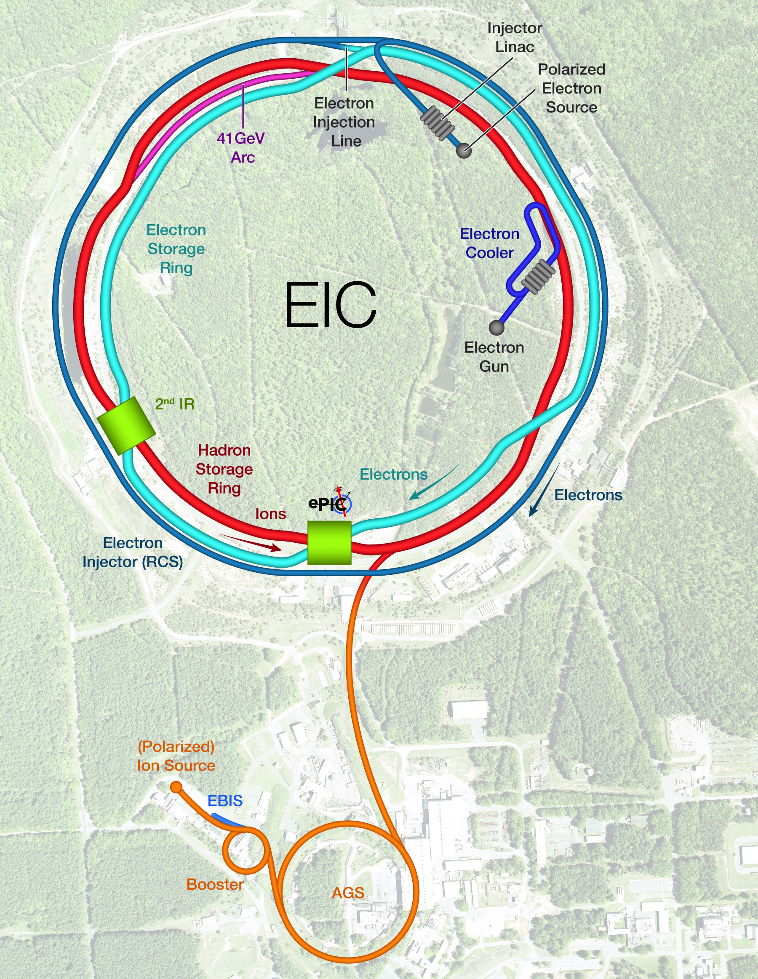
Coolers’ location
Both the pre-cooler and the top energy cooler are located at a 2 o’clock hall.
They must share the same section of the Hadron Storage Ring (HSR)
About 180 m of the HSR are available for the cooling section

Slide 6
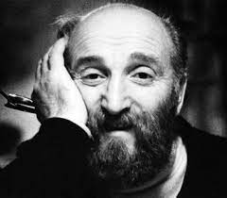
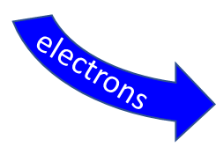
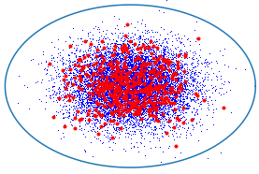
Electron Cooling
In electron cooling a bunch of hadrons co-travels with electrons (with matched $γ$) in a straight section of a hadron storage ring
“Hot” hadron and “cold” electron gases exchange heat, which leads to reduction of the phase space volume occupied by hadrons
Electron cooling was first demonstrated in 1974
Gersh Budker
EC
hadron storage ring
Cooling Section
electrons
hadrons
hadrons
$$m_{e}≪m_{h}$$
$$T_{e}≪T_{h}$$

Slide 7
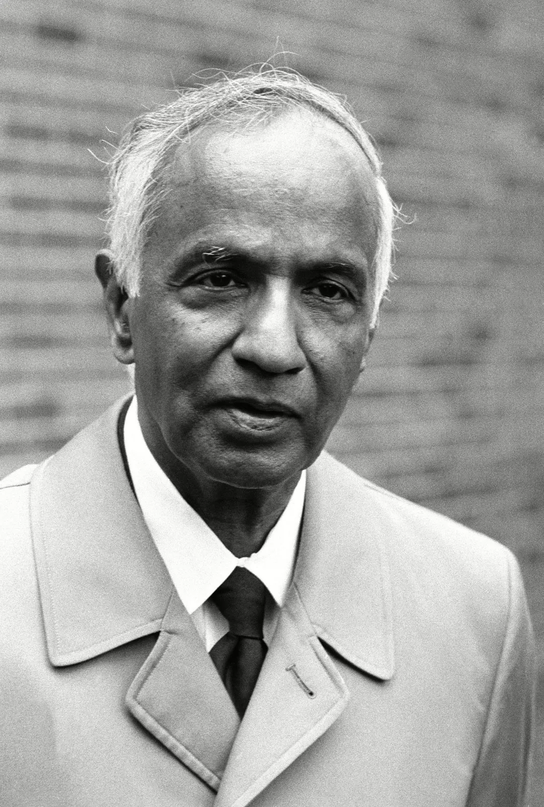
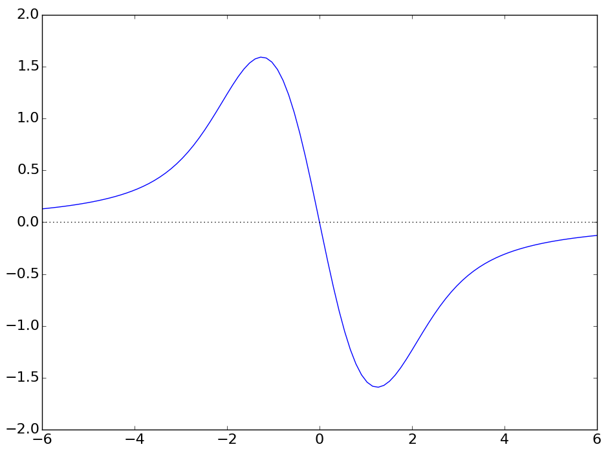
Dynamical friction
A massive object (a star or an ion) moving through a cloud of lighter bodies (space dust or electrons) experiences Dynamical Friction - a pull from the cloud that slows down the object.
If the force acting between bodies in the system follows the $F∝1/r^{2}$ law, then the dynamical friction force is given by:
Subrahmanyan Chandrasekhar
$$\vec{F}=\frac{4πn_{e}{e^{4}Z}^{2}}{m_{e}}⋅∫Λ_{c}\frac{\vec{v_{i}}−\vec{v_{e}}}{{\left|\vec{v_{i}}−\vec{v_{e}}\right|}^{3}}f_{ve}d^{3}v_{e}$$
Friction Force ($F$) [arb. units]
Each time an ion passes the cooling section (CS) it experiences a friction force which reduces its velocity deviation from an average bunch velocity
hadron velocity relative to electrons’ velocity spread ($v_{i}/Δv_{e}$)

Slide 8
Cooling rate
Cooling rate for ions with “small relative amplitudes” $v_{i\left(x,y,z\right)}/σ_{ve(x,y,z)}$ [1]:
$$λ_{x,y}=\frac{r_{e}^{2}m_{e}cZ^{2}Λ_{c}}{πA_{i}m_{p}}⋅\frac{1}{γ^{2}}⋅\frac{N_{e}}{ε_{xn}ε_{yn}{σ_{z}σ}_{δ}}⋅\frac{L_{CS}}{C_{r}}Φ\left(\frac{σ_{δ}}{{γσ}_{θ}}\right)$$
$$λ_{z}=\frac{2r_{e}^{2}m_{e}cZ^{2}Λ_{c}}{πA_{i}m_{p}}⋅\frac{1}{γ^{2}}⋅\frac{N_{e}}{ε_{xn}ε_{yn}{σ_{z}σ}_{δ}}⋅\frac{L_{CS}}{C_{r}}\left(1−Φ\left(\frac{σ_{δ}}{{γσ}_{θ}}\right)\right)$$
Cooling rate is getting reduces with energy as $1/γ^{2}$, this reduction can be compensated by a longer cooling section and a higher phase space density of electrons

Slide 9
Non-relativistic vs relativistic coolers
Non-relativistic coolers ($γ≈1$) use:
Electrostatically accelerated DC electron beam
Beam magnetization – both a cathode and a cooling section are immersed into a solenoidal field
The first relativistic cooler ($γ=$9.4) [11] also utilized a magnetized DC e-beam
For much higher energies, a different approach might be more feasible from technical point of view:
RF-accelerated (bunched) electrons
Electron beam is not magnetized
A non-magnetized, RF-based electron cooler (LEReC) was built and successfully operated at RHIC. It was used at $γ=4.1 \& 4.9$ to cool colliding gold ions, and provided a factor of two luminosity increase during RHIC-II low energy run.

Slide 10
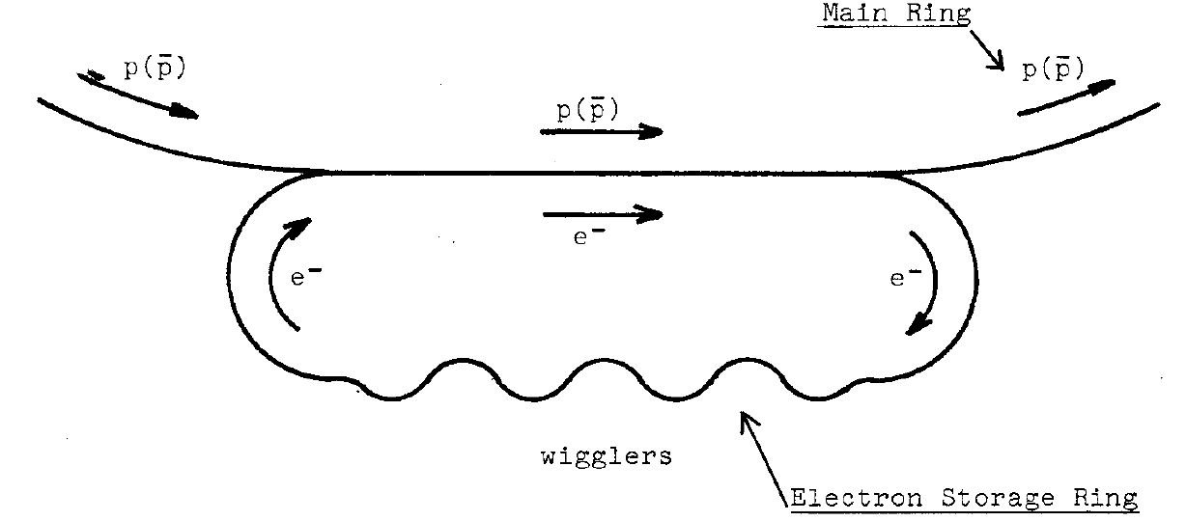
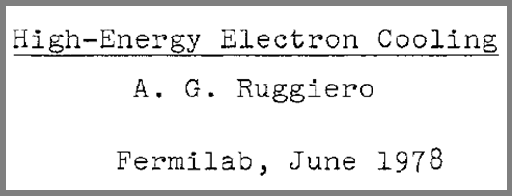
Concept of Ring Electron Cooler
Keeping electrons in the electron storage ring for many turns helps to relax requirements to an average current in an injector
As stored electrons are cooling hadrons, the hadrons are heating-up the electron bunches. The electrons’ emittance will also be increased due to the IBS and other collective effects
Electrons’ emittance is kept constant with a help from damping wigglers
A natural (although not exclusive) approach to the Ring Electron Cooler is the RF-based, non-magnetized cooling
The focus of our studies is a bunched, non-magnetized cooler based on an electron storage ring, where the e-bunches themselves are cooled by radiation damping in dedicated wigglers.
The idea of the ring-based electron cooler is neither new nor exotic:
C. Rubbia, LBL-7574, 1978
A. Ruggiero, FN-311 1503, 1978
D. Cline et al., PAC’79, 1979
S.Y. Lee et al., 1997
R. Brinkmann et al., 1998
A. Burov et al., 2000
V. Lebedev et al 2021 JINST 16 T01003

Slide 11
Requirements to REC performance and limiting factors
REC must counteract the IBS-driven emittance growth of the proton bunches at 275 GeV (${τ_{cool(x,z)}=τ}_{IBS(x,z)}=2, 3$ hours)
We would like to increase the cooling by increasing the phase space density of the e-bunch:
$$λ_{cool}∝\frac{N_{e}}{ε_{enx}ε_{eny}{σ_{ze}σ}_{δe}}$$
Yet, there are numerous effects limiting the achievable cooling rate:
Electrons’ space charge: $Δν_{e}∝\frac{N_{e}}{ε_{e} σ_{ze}}$
Proton-electron space charge focusing: $Δν_{pe}∝\frac{N_{i}}{σ_{zi}σ_{i\left(x,y\right)}^{2}}β_{eCS}$
The achievable equilibrium e-bunch parameters are defined by:
p-e beam-beam scattering: $λ_{BBSz}∝\frac{N_{i}}{σ_{zi}σ_{i\left(x,y\right)}^{2}}⋅\frac{1}{σ_{δi}σ_{θi}^{2}}⋅\frac{1}{σ_{δe}^{3}σ_{θe}^{2}}$
e-bunch IBS: $λ_{IBSz}∝\frac{N_{e}}{σ_{ze}σ_{e\left(x,y\right)}^{2}}⋅\frac{1}{σ_{δe}^{2}σ_{θe}}$
Radiation damping: $λ_{damp}∝B_{wigg}^{2}L_{wigg}$

Slide 12
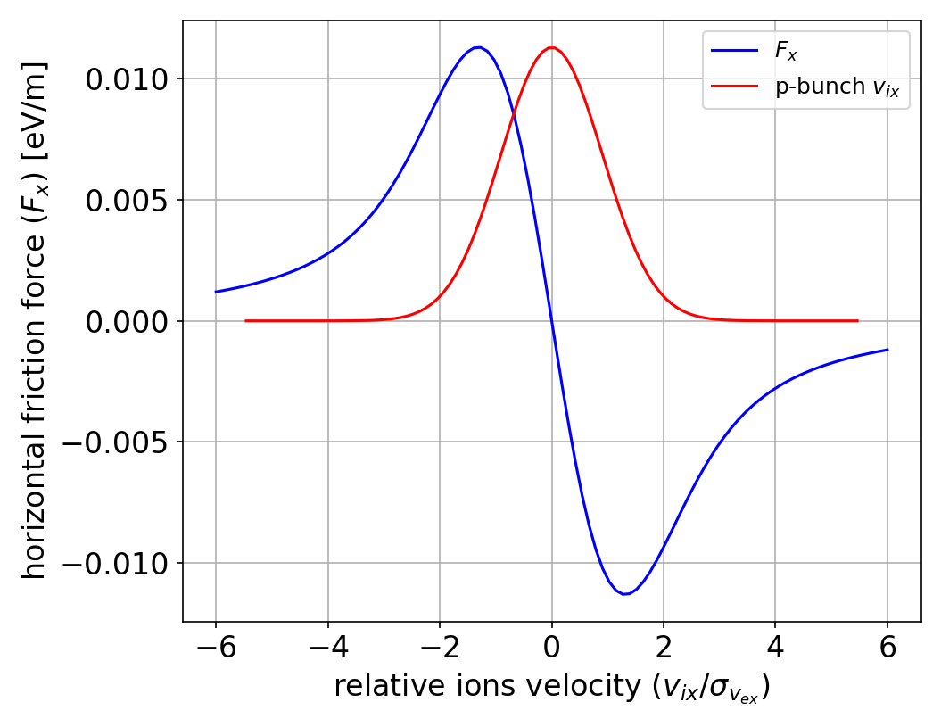
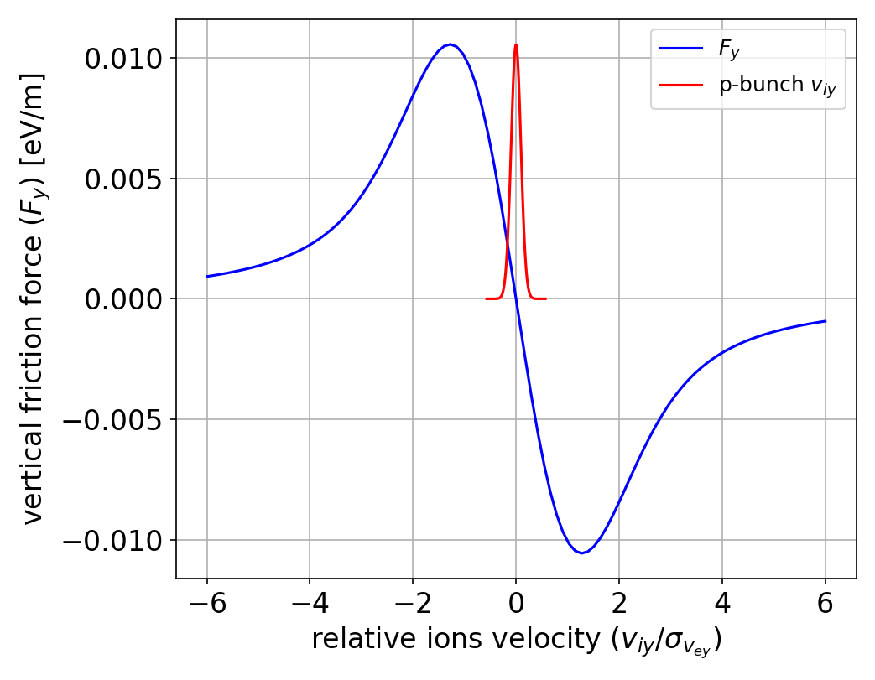
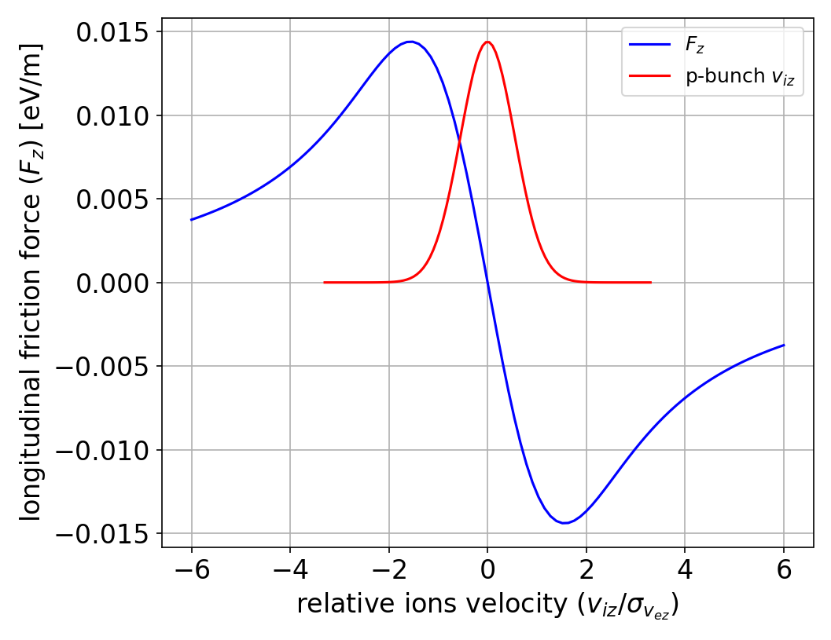
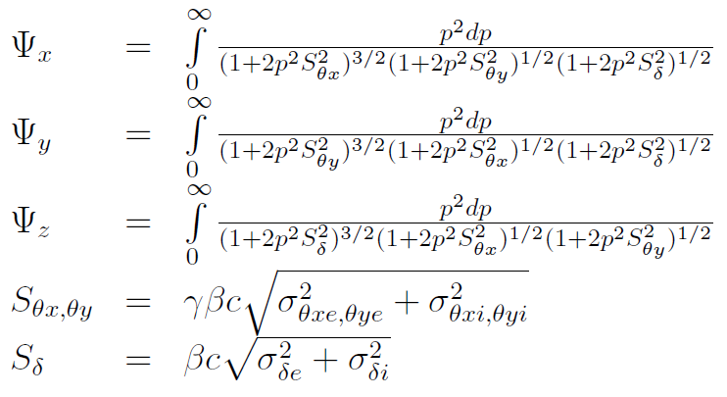
Fully integrated cooling rates
While “small amplitude” formulas give good cooling times: $τ_{x}=50$ min and $τ_{z}=40$ min, the total cooling rate must be obtained by integrating the friction force over 6D distributions of both beams:
If both beams have Maxwell-Boltzmann velocity distributions, then integration over velocities can be reduced to 1D integrals
When both beams have 3D Gaussian density distribution:
When e-bunch has a flat-top longitudinal distribution:

Slide 13
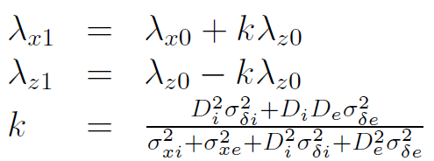
Redistribution of cooling rates
To redistribute cooling between longitudinal and horizontal directions one needs:
Dependence of a longitudinal cooling force on a horizontal coordinate
Horizontal ion dispersion in the cooling section (dependence of ions’ longitudinal velocity on their horizontal coordinate)
The redistributed rates [2,3] can be calculated from:
where $λ_{x0}$ and $λ_{z0}$are given by formulas from the previous slide with the following substitutions:

Slide 14
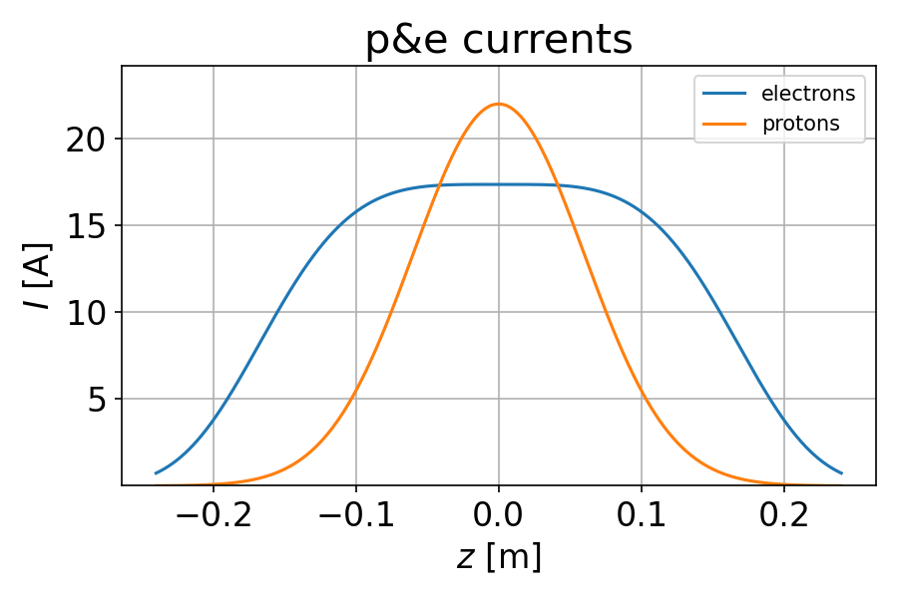
Longitudinal distribution of e-bunch
One can increase cooling by increasing e-bunch’s charge while reducing its emittances:
On the other hand, space charge tune shift can be estimated as:
$$λ∝\frac{N_{e}}{ε_{x,y}^{2}ε_{z}}⋅\frac{L_{CS}}{C_{ring}}$$
For a fixed $Δν_{e}$, one gets a higher cooling rate for the same $N_{e}$ with a flat top bunch if one makes its FWHM $L_{ze}>\sqrt{2π}σ_{ze}$
Optimization of the cooling rate leads us to employing a double-RF system producing $L_{ze}≈5σ_{zp}−6σ_{zp}$

Slide 15
Proton-electron focusing
A focusing of e-bunch by a space charge of co-traveling protons, limits a transverse size of the electron bunch in the cooling section relative to the proton bunch size
To determine a tolerable $Δν_{pe}$, we performed tracking studies [4] which included a realistic focusing from a proton bunch with Gaussian transverse distribution
An additional effect of the p-e focusing results from a non-uniformity of the longitudinal distribution of a proton bunch
Different slices of an e-bunch see different focusing from protons
This unavoidable focusing mismatch can cause an “emittance dilution” [5]
Our studies showed that the p-e focusing effects are tolerable if the characteristic condition $Δν_{pe}<0.07$ is satisfied, where

Slide 16
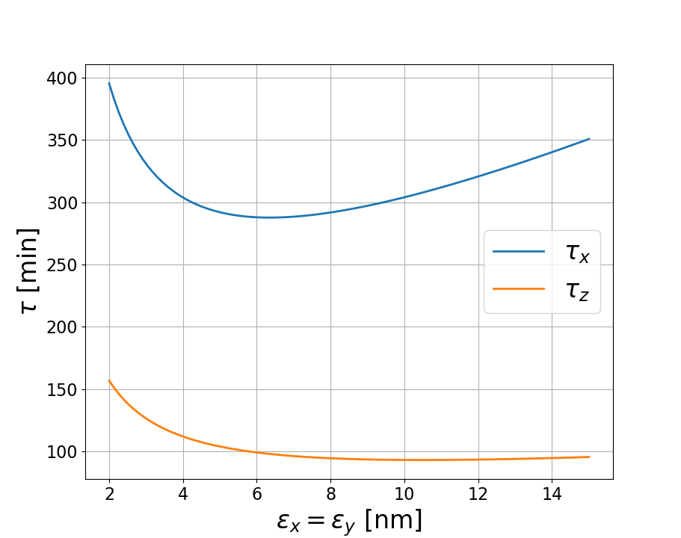
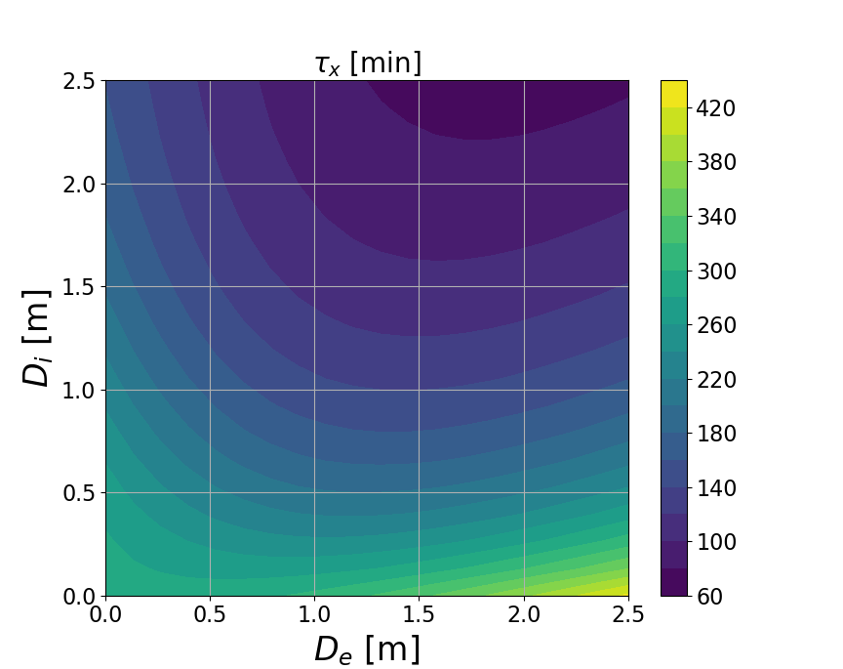
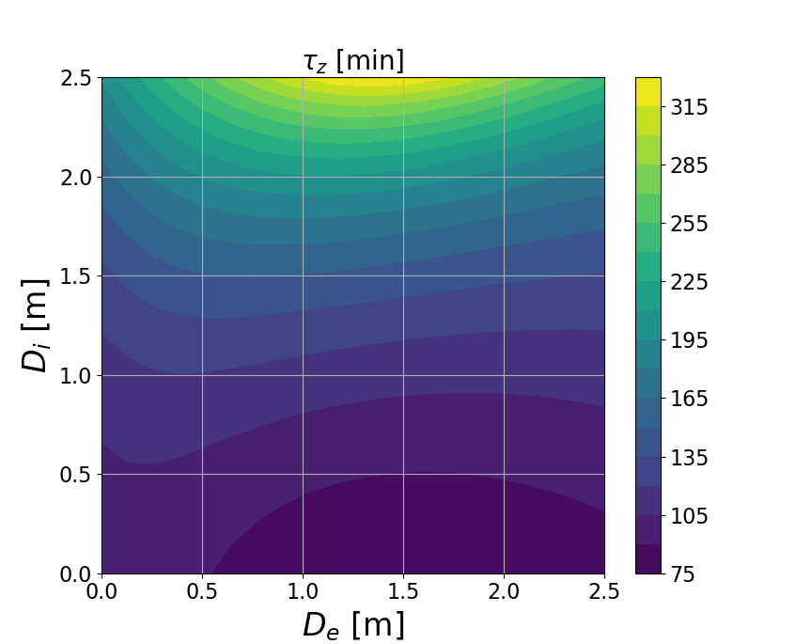
Optimal e-bunch parameters
We keep a constant $Δν_{e}=0.2$ (making $N_{e}$ a function of $ε$), we keep $β_{e}, β_{i}$ in the CS such that $Δν_{pe}<0.07$, and we assume $σ_{δe}={10}^{−3}$, then:
Optimal $ε=6$ nm
Good $z−x$ redistribution at $D_{ex}=1.2$ m and $D_{ix}=1.6$ m
Nominal protons parameters:
$ε_{x,y}=11., 1.$ nm
$$N_{p}=6.9⋅{10}^{10}$$
$$σ_{δp}=6⋅{10}^{−4}$$
$σ_{zp}=6$ cm
Optimal electrons parameters:
$ε_{x,y}=6$ nm
$$N_{e}=1.3⋅{10}^{11}$$
$τ_{x}=1.9$ hrs
$τ_{z}=2.5$ hrs
($τ_{y}=3.4$ hrs)
$$σ_{δe}={10}^{−3}$$
$L_{ze}=36$ cm
$D_{ex}=1.2$ m
$D_{ix}=1.6$ m

Slide 17
Equilibrium e-bunch parameters
Electrons equilibrium parameters are defined by a balance of the IBS rate, beam-beam scattering (BBS) rate, quantum excitation (small effect), and a rate of radiation damping:
$$\frac{dε}{dt}=\left(−λ_{damp}+λ_{IBS}+λ_{BBS}\right)ε+C_{q}$$
$$C_{q}=λ_{damp }ε_{nat}$$
To determine the equilibrium parameters for any lattice we perform a turn-by-turn tracking [6]
Damping rate and quantum excitation depend on the ring lattice only:
$$λ_{damp}∝B_{wigg}^{2}L_{wigg}$$
IBS and BBS depend on beam parameters dynamically
For the IBS the code uses fast algorithm for IBS calculation in the absence of x-y coupling [7]
$$λ_{IBSz}∝\frac{N_{e}}{σ_{ze}σ_{e\left(x,y\right)}^{2}}⋅\frac{1}{σ_{δe}^{2}σ_{θe}}⋅f_{IBS}(σ_{δe}{,σ}_{θe})$$
For the BBS the model for electrons’ heating due to collisions with hadrons was developed [8]:
$$λ_{BBSz}∝\frac{N_{i}}{σ_{zi}σ_{i\left(x,y\right)}^{2}}⋅\frac{1}{σ_{δi}σ_{θi}^{2}}⋅\frac{1}{σ_{δe}^{3}σ_{θe}^{2}}⋅f_{BBS}(σ_{δe}{,σ}_{θe},σ_{δi}{,σ}_{θi})$$

Slide 18
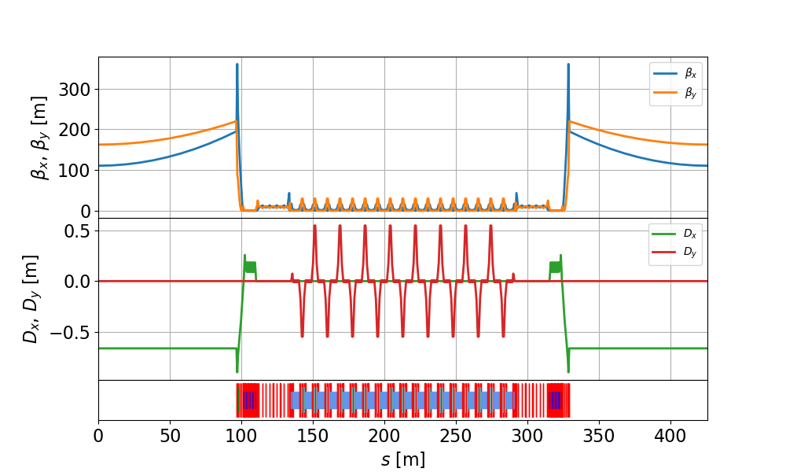
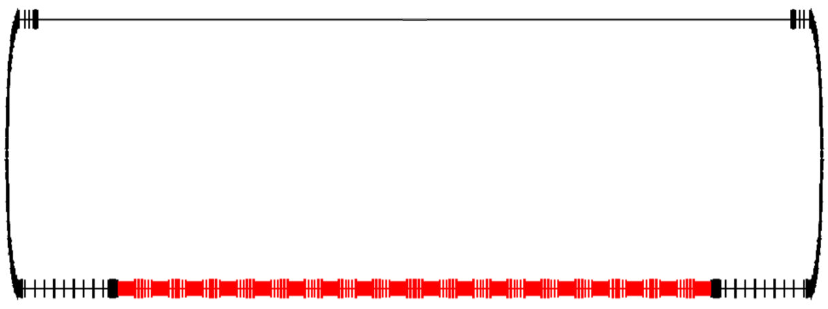
Ring Electron Cooler lattice
Cooling section
180 m
We developed a lattice with eighteen 3.8 m long wigglers, the wiggler field is $B_{wigg}=2.4$ T
In this lattice we have in the CS $D_{ex}=0.66$ m, and we set $D_{ix}=1.35$ m
Wigglers’ section
We obtained the following equilibrium e-bunch parameters, and respective heating and damping rates:
$$N_{e}=1.9⋅{10}^{11}$$
$L_{ze}=34$ cm
$ε_{e(x,y)}=6$, 13 nm
$$σ_{δe}={1.3⋅10}^{−3}$$
This lattice provides the required cooling times:
$$λ_{damp(x,y,z)}=29, 29, 57 [\sec^{−1}]$$
$$λ_{BBS(x,y,z)}=1, 0, 5 \left[\sec^{−1}\right]$$
$$λ_{IBS(x,y,z)}=28, 29, 50 [\sec^{−1}]$$
$τ_{x}=2$ hrs
$τ_{z}=3$ hrs
($τ_{y}=6$ hrs)

Slide 19
Optical features of REC wigglers (I)
We are working in an unusual range of parameters – a large wiggler field $B_{0}≈2.4 [T]$ and a relatively small beam energy $Bρ≈0.5 [T⋅m]$
Therefore, in our case $b≡\frac{B_{0}}{Bρ}≈4.8 \left[\frac{1}{m}\right]$ is not small, unlike for the usual wigglers, where $b≪1$
Let’s consider a conventional analytic wiggler field representation (from [R.P. Walker, DOI: 10.5170/CERN-1995-006.807], for example):
$$\begin{matrix}B_{x}=\frac{k_{x}}{k_{y}}B_{0}\sinh\left(k_{x}x\right)\sinh\left(k_{y}y\right)\sin\left(kz\right) \\ B_{y}=B_{0}\cosh\left(k_{x}x\right)\cosh\left(k_{y}y\right)\sin\left(kz\right) \\ B_{z}=\frac{k}{k_{y}}B_{0}\cosh\left(k_{x}x\right)\sinh\left(k_{y}y\right)\cos{(kz)} \\ k_{x}^{2}+k_{y}^{2}=k^{2}; k=\frac{2π}{λ}≈31.4 \left[\frac{1}{m}\right]\end{matrix}$$
$x$ is a direction of wiggling, $y$ is a direction orthogonal to the wiggling plane, $z$is a direction along the wiggler’s axis

Slide 20
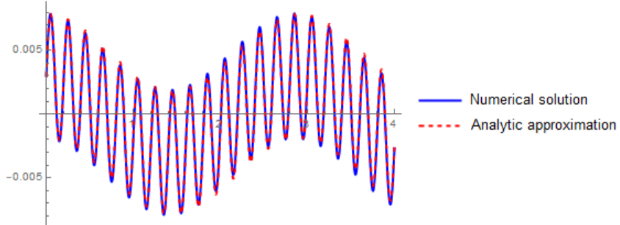
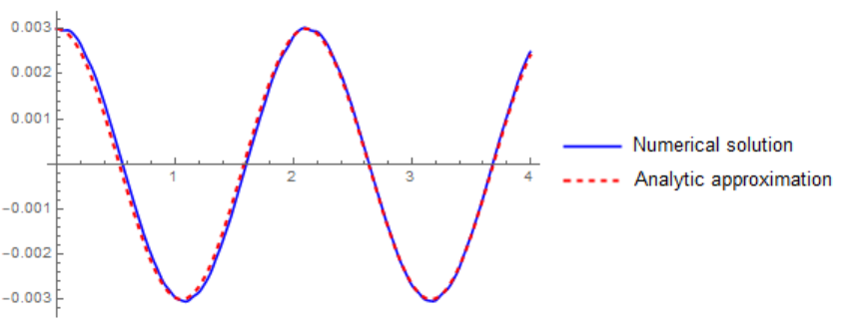
Optical features of REC wigglers (II)
Equations of motion:
$$x^{′′}=−\frac{B_{y}}{Bρ}+y^{′}\frac{B_{z}}{Bρ}; y^{′′}=\frac{B_{x}}{Bρ}−x^{′}\frac{B_{z}}{Bρ}$$
Approximate analytic solution:
$$x=\frac{b}{k^{2}}\sin\left(kz\right)+x_{0}\cos\left(\frac{bk_{x}}{\sqrt{2}k}z\right)+\left(x_{0}^{′}−\frac{b}{k}\right)\frac{\sqrt{2}k}{bk_{x}}\sin\left(\frac{bk_{x}}{\sqrt{2}k}z\right)$$
$$y=y_{0}\cos\left(\frac{bk_{y}}{\sqrt{2}k}z\right)+y_{0}^{′}\frac{\sqrt{2}k}{bk_{y}}\sin\left(\frac{bk_{y}}{\sqrt{2}k}z\right)$$
$$k_{x}=15 m^{−1}$$
$$k_{x}=15 m^{−1}$$
$$x [m]$$
$$y [m]$$
$$z [m]$$
$$z [m]$$
Our wigglers work as a thick lens in both $x\&y$ directions (there can be several full oscillations over the length of a wiggler)

Slide 21
Optical features of REC wigglers (III)
Transport matrices:
$$M_{x}\left(z\right)=\left(\begin{matrix}\cos\left(\frac{bk_{x}}{\sqrt{2}k}z\right) & \frac{\sqrt{2}k}{bk_{x}}\sin\left(\frac{bk_{x}}{\sqrt{2}k}z\right) \\ −\frac{bk_{x}}{\sqrt{2}k}\sin\left(\frac{bk_{x}}{\sqrt{2}k}z\right) & \cos\left(\frac{bk_{x}}{\sqrt{2}k}z\right)\end{matrix}\right); M_{y}\left(z\right)=\left(\begin{matrix}\cos\left(\frac{b\sqrt{k^{2}−k_{x}^{2}}}{\sqrt{2}k}z\right) & \frac{\sqrt{2}k}{b\sqrt{k^{2}−k_{x}^{2}}}\sin\left(\frac{b\sqrt{k^{2}−k_{x}^{2}}}{\sqrt{2}k}z\right) \\ −\frac{b\sqrt{k^{2}−k_{x}^{2}}}{\sqrt{2}k}\sin\left(\frac{b\sqrt{k^{2}−k_{x}^{2}}}{\sqrt{2}k}z\right) & \cos\left(\frac{b\sqrt{k^{2}−k_{x}^{2}}}{\sqrt{2}k}z\right)\end{matrix}\right)$$
This gives the expected focusing for small $b$: $\left\langle K_{x}\right\rangle =\frac{B_{0}^{2}}{2{\left(Bρ\right)}^{2}}\frac{k_{x}^{2}}{k^{2}}, \left\langle K_{y}\right\rangle =\frac{B_{0}^{2}}{2{\left(Bρ\right)}^{2}}\left(1−\frac{k_{x}^{2}}{k^{2}}\right)$
Chromaticity is easy to calculate for the matched conditions $\left(β_{x}=\frac{\sqrt{2}k}{bk_{x}}; β_{y}=\frac{\sqrt{2}k}{b\sqrt{k^{2}−k_{x}^{2}}}\right)$:
$$\frac{∂Q_{x}}{∂δ}=−\frac{1}{2π}\frac{B_{0}N_{p}λ}{\sqrt{2}Bρ}\frac{k_{x}}{k}; \frac{∂Q_{y}}{∂δ}=−\frac{1}{2π}\frac{B_{0}N_{p}λ}{\sqrt{2}Bρ}\frac{\sqrt{k^{2}−k_{x}^{2}}}{k}$$
Obtained analytic expressions were cross-checked by Bmad and GPT tracking
For example, in the current lattice we want $β_{x}=30 cm$. This sets $k_{x}=30.7 m^{−1}$ and $β_{y}=1.4 m$, $\frac{∂Q_{x}}{∂δ}=−2.1, \frac{∂Q_{y}}{∂δ}=−0.5$

Slide 22
Importance of proper wiggler focusing
We started with a different wiggler field – a “s-bend wiggler”:
$$B_{x}=B_{0}\cos\left(k_{q}x\right)\sinh\left(k_{q}y\right)$$
$$B_{y}=B_{0}\cosh\left(ky\right)\sin\left(kz\right)+B_{0}\sin\left(k_{q}x\right)\cosh{(k_{q}y)}$$
$$B_{z}=B_{0}\sinh\left(ky\right)\cos{(kz)}$$
For a thick lens case, such a wiggler produces a huge chromaticity in the direction orthogonal to the wiggling plane when $k_{q}→\frac{B_{0}}{2Bρ}$:
$$\frac{∂Q_{y}}{∂δ}=−\frac{NλB_{0}}{2π\sqrt{2}Bρ}\frac{1−k_{q}Bρ/B_{0}}{\sqrt{1−2k_{q}Bρ/B_{0}}}$$
Since the required focusing in the wiggling plane set our $k_{q}≈2.3 m^{−1}$, the chromaticity in a non-wiggling plane from a single wiggler became ~ -11, resulting in an extra chromaticity of ~ -200
Switching to a more conventional “wiggler with gradient” restored our momentum and dynamic aperture
Also, we found an element with a close to zero focusing and an arbitrary large chromaticity – this might be interesting

Slide 23
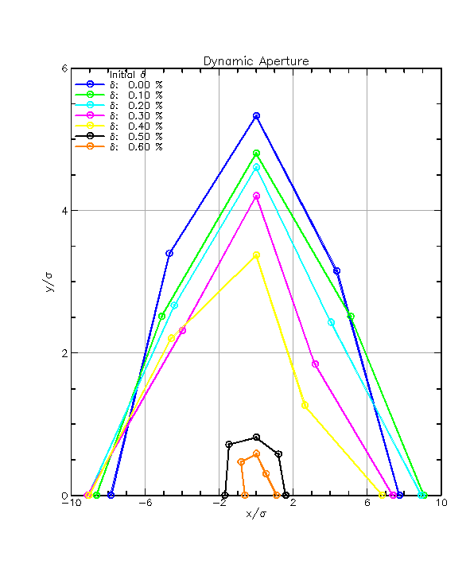
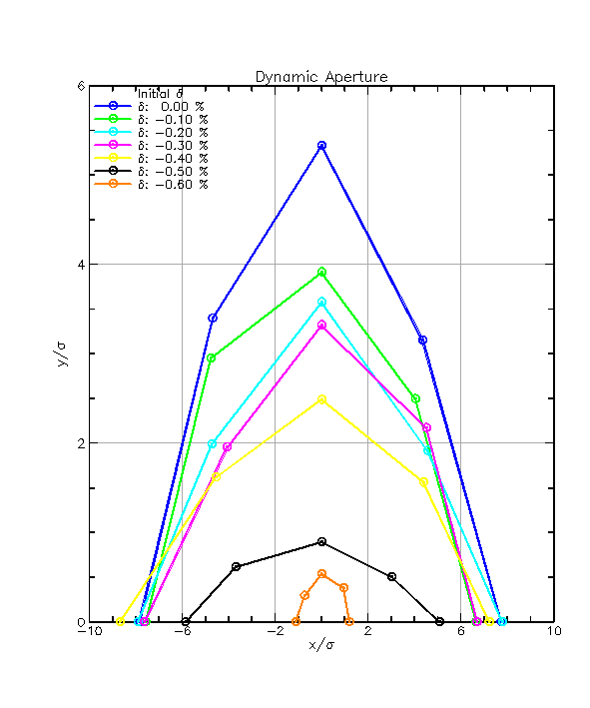
Dynamic and momentum aperture
For the obtained damping rates, with aperture of $4.5σ_{x,y,z}$ the lifetimes are $T_{XYlife}≈40 sec, T_{Zlife}≈20 sec$ [10]
Dynamic aperture $a_{x}=8σ_{x}, a_{y}=5.5σ_{y}$ and momentum aperture of $a_{z}=4.6σ_{z}$ were obtained for the current lattice with compensating only the first order chromaticity
DA/MA optimization is in progress.
Courtesy of J. Unger
positive $δ$-offset
negative $δ$-offset

Slide 24
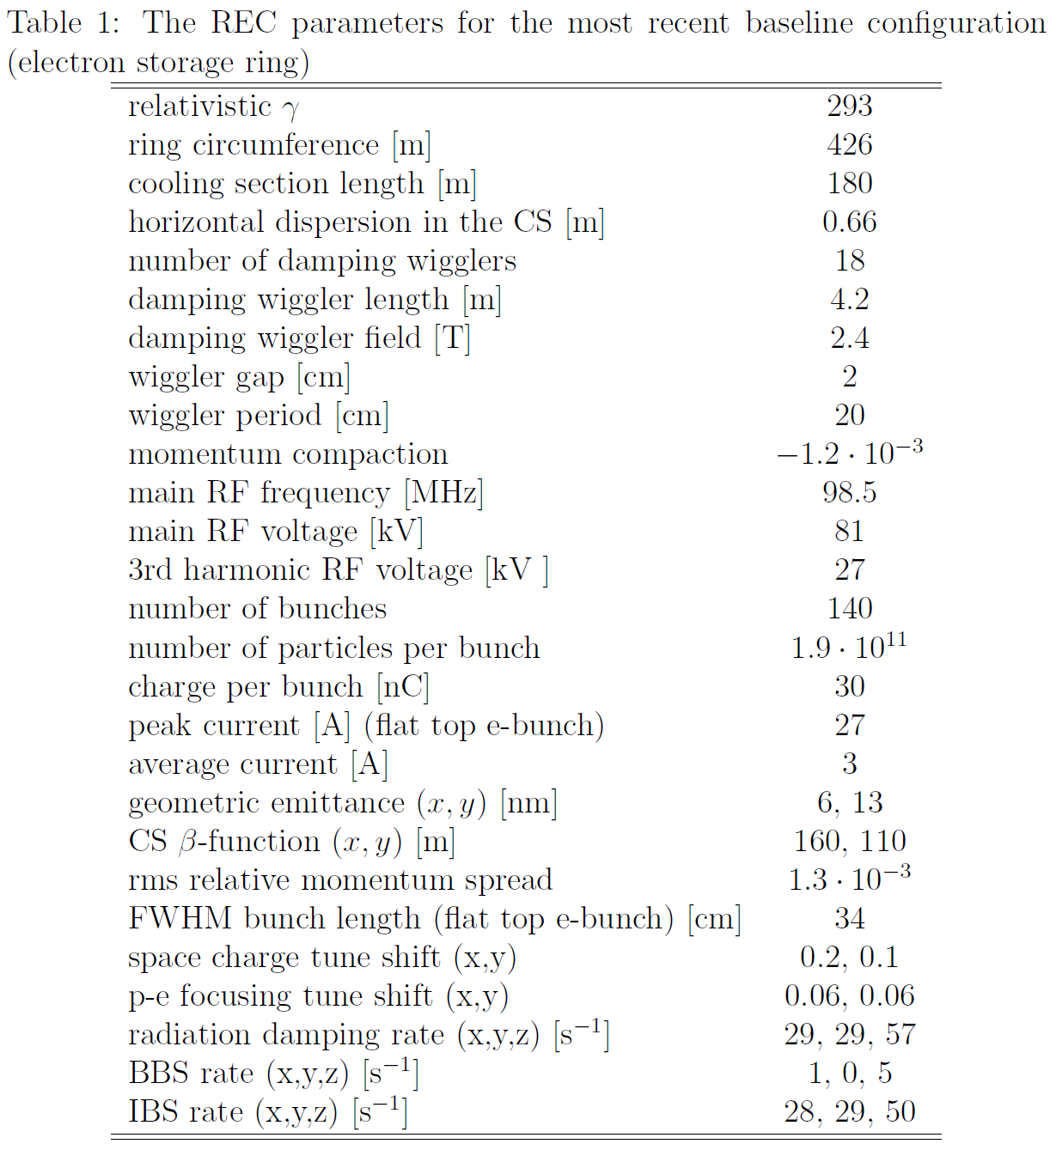
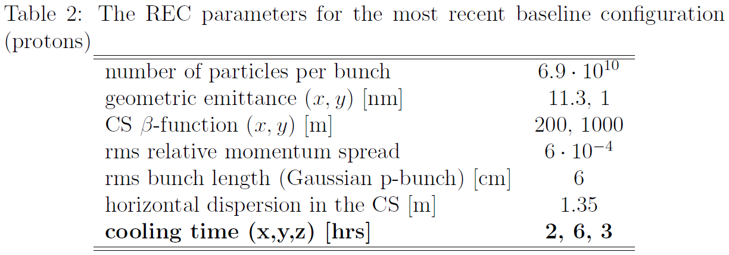
Parameters

Slide 25
Challenges
Design of electron ring lattice which provides good dynamic and momentum aperture requires proper treatment of wiggler magnets for our regime of parameters with careful optimization.
Collective effects in a high-current electron ring require careful study. CSR impedance in wigglers was found significant. Several mitigation options were considered but full consideration of impedances and collective effects is needed.
Accurate estimate of electron beam lifetime due to various effects, including vacuum lifetime, is required.
Use of non-magnetized cooling approach which requires small electron beam emittances have space charge constraint in the ring. Reasonable set of parameters was found.
Design of high-field wigglers for our choice of parameters requires careful optimization.

Slide 26
Ongoing work and plans
Dynamic and momentum aperture:
Design a realistic wiggler/generate respective field map
Find lattice with good DA/MA for realistic wigglers (including nonlinear effects)
Crosscheck DA/MA calculations between several codes (Bmad, Elegant)
Collective Effects:
Optimize e-beam parameters/lattice to minimize adverse collective effects
Optimize wigglers’ design to mitigate a possible CSR-driven instability
100 GeV proton cooling:
Extending linac-based cooler to higher energy (possible addition of several recirculations)

Slide 27
Summary
REC is a bunched electron cooler based on an electron storage ring approach
It relies on a well-established cooling technique
REC requires an involved storage ring – high current, low energy ring employing high-field damping wigglers
To get a design with the required e-beam we are performing a multi-parametric optimization taking into account self space charge, hadron-electron focusing, IBS, BBS and radiation damping
We developed a ring lattice with proper treatment of “high field low energy” wigglers and an acceptable dynamic and momentum apertures
We are currently working on further optimization leading to self-consistent simulations of beam dynamics in the ring

Slide 28
Backup slides

Slide 29
Total cooling rate
“Small amplitude” formulas give good cooling times: $τ_{x}=50$ min and $τ_{z}=40$ min
Total cooling rate is obtained by integrating the friction force over 6D distributions of both beams:
If both beams have Maxwell-Boltzmann velocity distributions, then integration over velocities can be reduced to 1D integrals:
When both beams have 3D Gaussian density distribution:
If e-bunch have a flat-top longitudinal distribution, approximated by:
then:

Slide 30
Space charge tune shift
One can increase cooling by increasing e-bunch’s charge while reducing its emittances:
On the other hand, space charge tune shift can be estimated as:
Depending on e-bunch longitudinal density distribution
$$λ∝\frac{N_{e}}{ε_{x,y}^{2}ε_{z}}⋅\frac{L_{CS}}{C_{ring}}$$
Gaussian:
Flat top:
For a fixed $Δν_{e}$, one gets a higher cooling rate for the same $N_{e}$ with a flat top bunch if one makes $L_{ze}>\sqrt{2π}σ_{ze}$

Slide 31
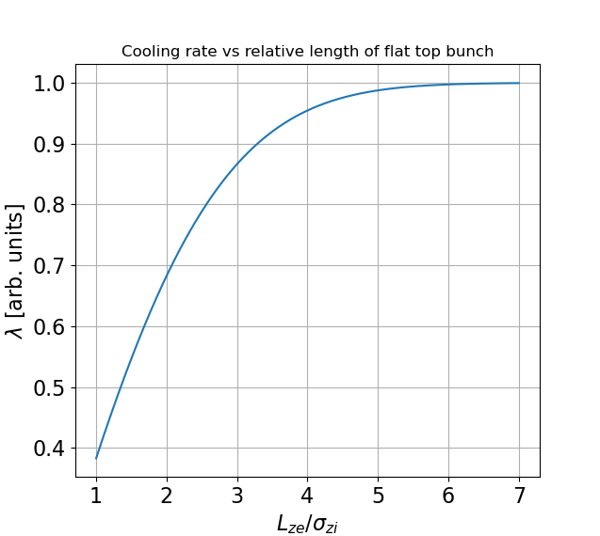
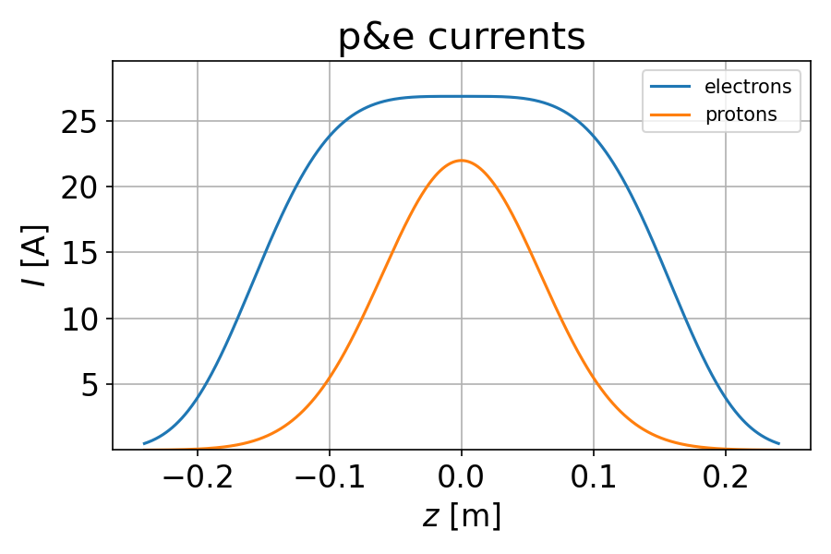
Optimal longitudinal distribution
For a flat top (employing double-RF system) e-bunch, for a given $Δν_{e}$, the cooling rate dependence on bunch length becomes:
$$λ∝\operatorname{erf}\left(\frac{L_{ze}}{2\sqrt{2}σ_{zi}}\right)$$

Slide 32
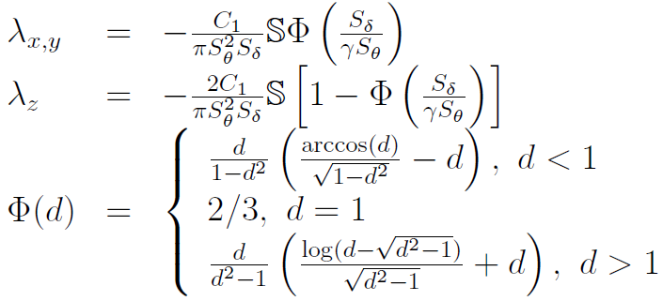
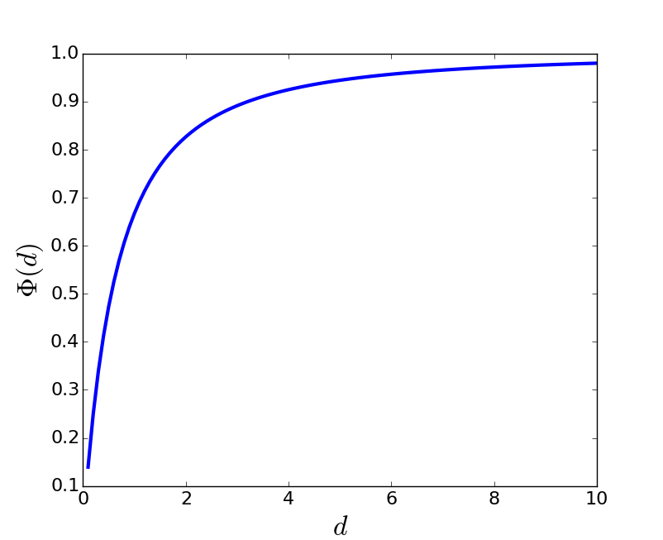
Total cooling rate (special case)

Slide 33
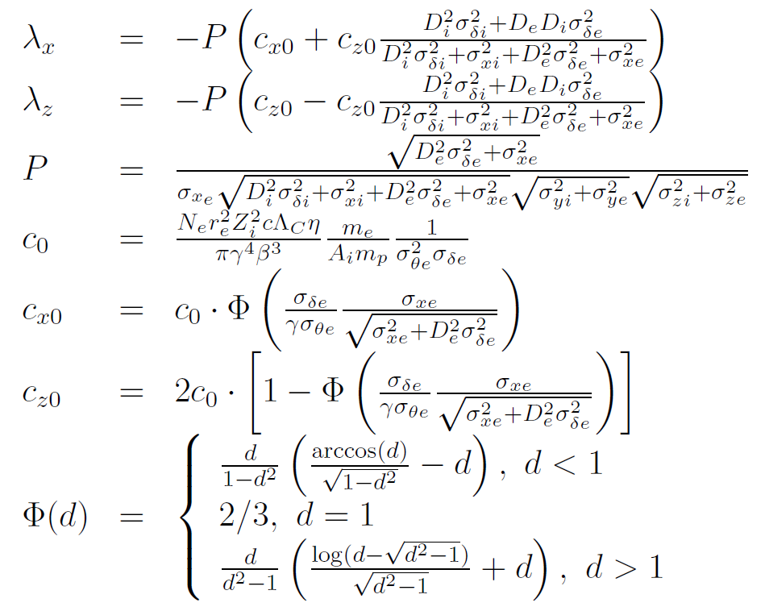
Redistribution (special case)

Slide 34
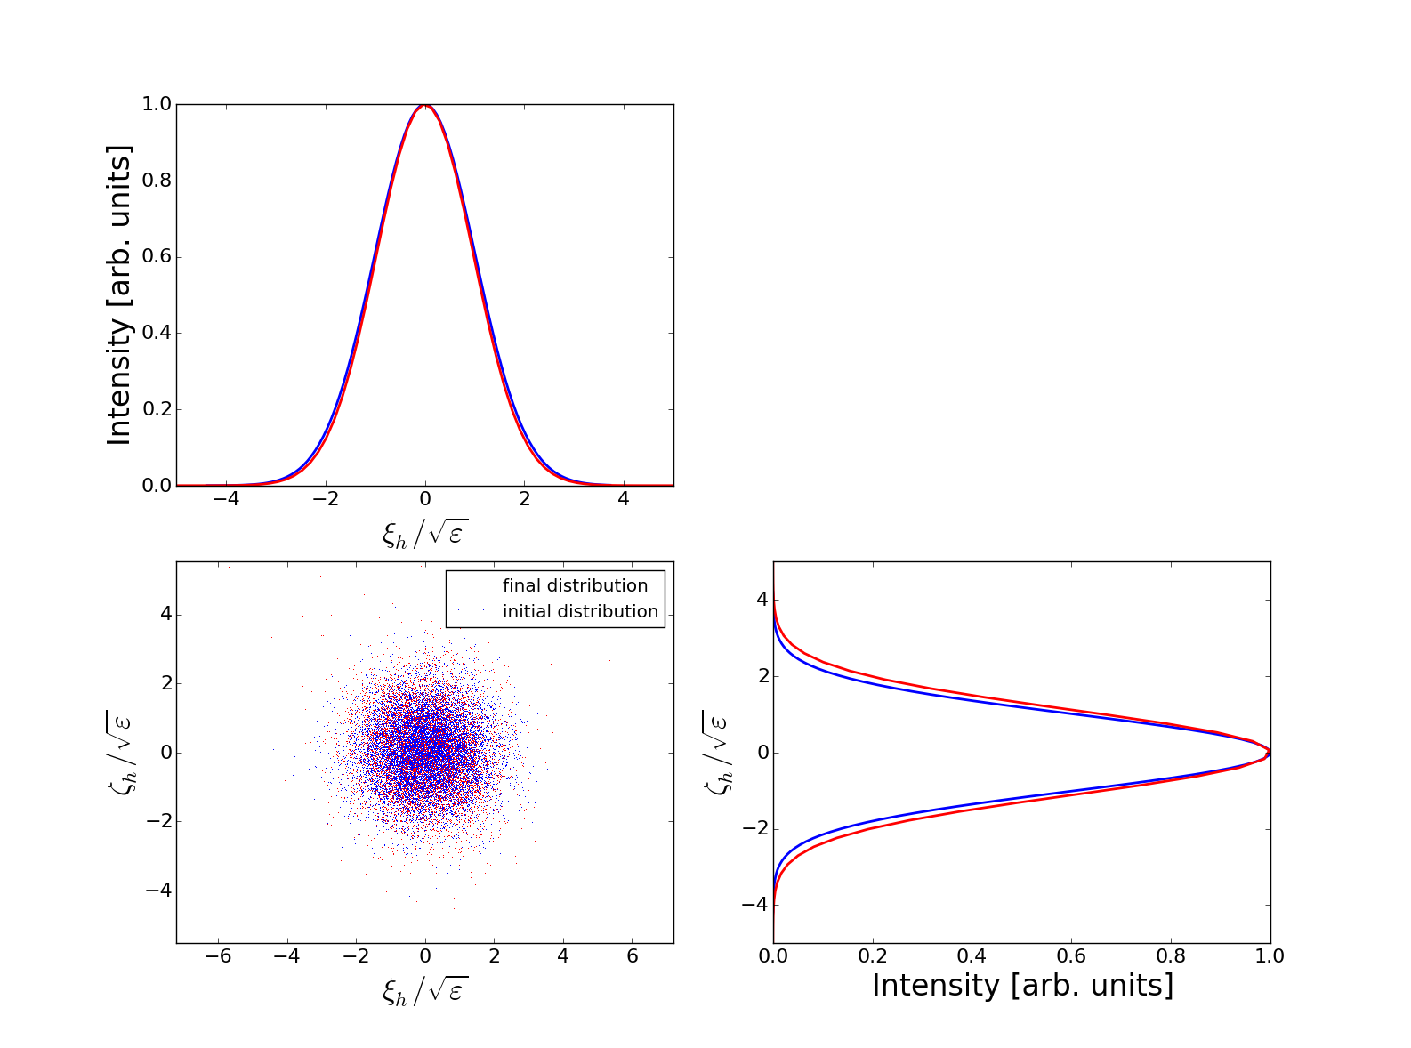
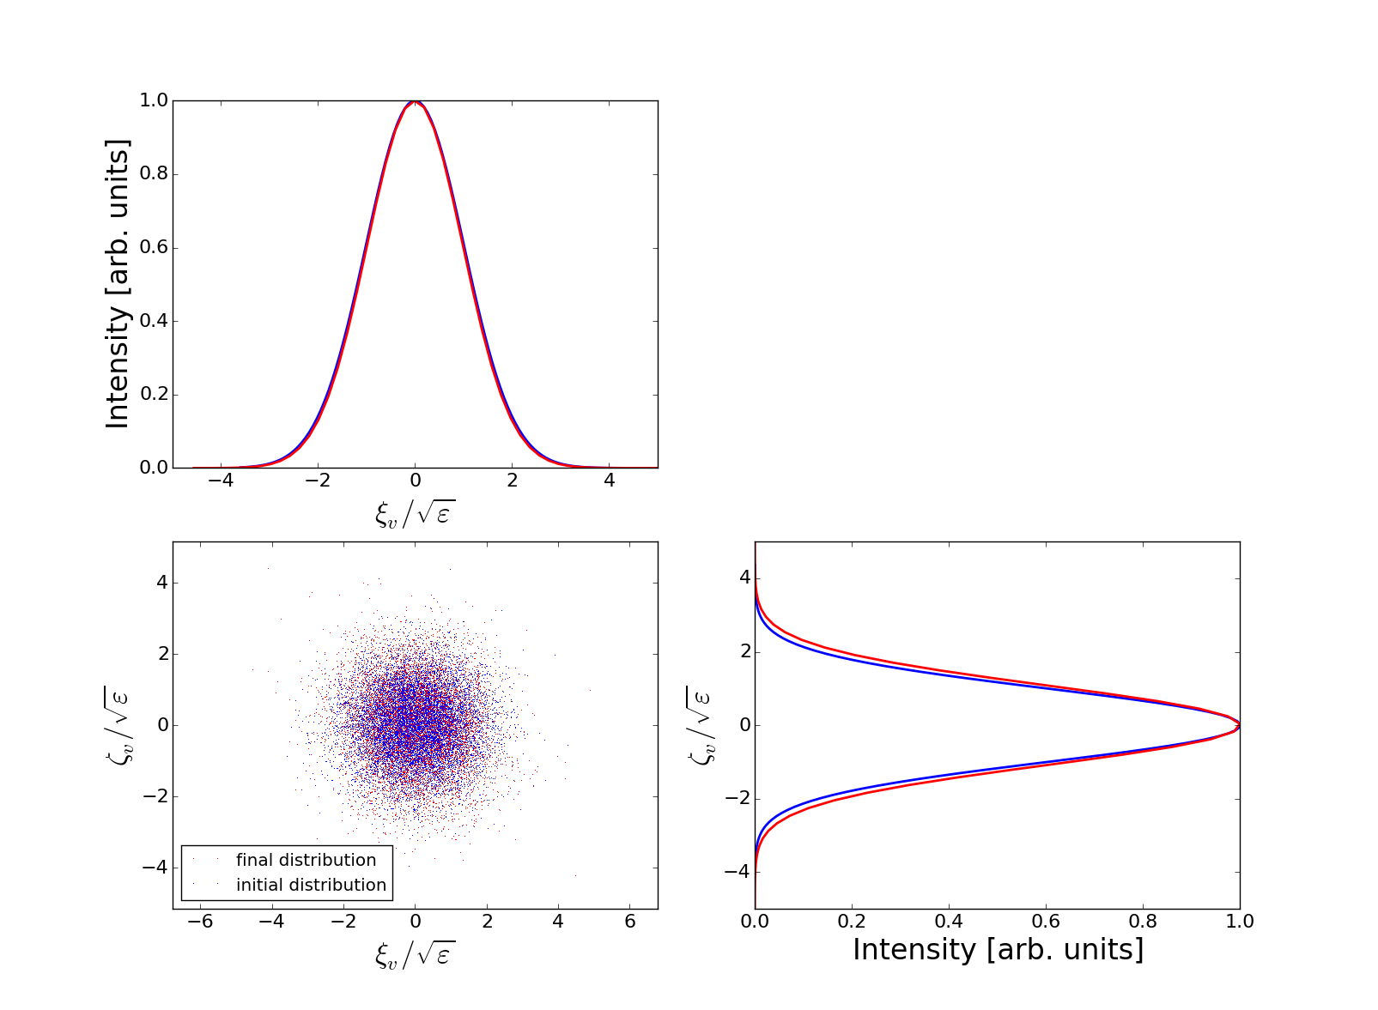
Proton-electron focusing (I)
A focusing of e-bunch by a space charge of co-traveling protons, limits a tolerable transverse size of the electron bunch in the cooling section relative to the proton bunch size
To determine a tolerable $Δν_{pe}$, we performed tracking studies which included a realistic focusing from a proton bunch with Gaussian transverse distribution [S. Seletskiy, A.V. Fedotov, D. Kayran, J. Kewisch, WEPA78, NAPAC2022, Albuquerque, NM, USA (2022)]
10k particles are tracked for 5k, 10k, and 20k turns
No emittance growth or particles’ loss is observed for $Δν_{pe}≤0.07$

Slide 35
Proton-electron focusing (II)
An additional effect of the p-e focusing results from a non-uniformity of the longitudinal distribution of a proton bunch.
Different slices of an e-bunch see different focusing from protons.
This unavoidable focusing mismatch can cause an “emittance dilution”. The diluted equilibrium projected emittance can be estimated as:
For
and $Δν_{pe}<0.07$, $\left\langle δε/ε\right\rangle <0.015$
S. Seletskiy, S. Nagaitsev, BNL-224133-2023-TECH (2023)

Slide 36
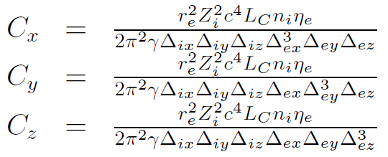
BBS rate

Slide 37
Same focusing, different energy dependence
$$y^{′′}=\frac{B_{x}}{Bρ}−x^{′}\frac{B_{z}}{Bρ}$$
$$x=\frac{b}{k^{2}}\sin\left(kz\right)$$
$$x^{′}=\frac{b}{k}\cos\left(kz\right)$$
$y−e$quation of motion:
Beam’s $x−$trajectory:
Fields:
$$b=\frac{B_{0}}{Bρ}=\frac{1}{R}$$
$$\begin{matrix}B_{x}=\frac{k_{x}}{k_{y}}B_{0}\sinh\left(k_{x}x\right)\sinh\left(k_{y}y\right)\sin\left(kz\right)≈B_{0}k_{x}^{2}xy\sin\left(kz\right) \\ B_{y}=B_{0}\cosh\left(k_{x}x\right)\cosh\left(k_{y}y\right)\sin\left(kz\right) \\ B_{z}=\frac{k}{k_{y}}B_{0}\cosh\left(k_{x}x\right)\sinh\left(k_{y}y\right)\cos{(kz)}≈B_{0}ky\cos{(kz)} \\ k_{x}^{2}+k_{y}^{2}=k^{2}\end{matrix}$$
$$B_{x}=B_{0}\cos\left(k_{q}x\right)\sinh\left(k_{q}y\right)≈B_{0}k_{q}y$$
$$B_{y}=B_{0}\cosh\left(ky\right)\sin\left(kz\right)+B_{0}\sin\left(k_{q}x\right)\cosh{(k_{q}y)}$$
$$B_{z}=B_{0}\sinh\left(ky\right)\cos{(kz)}≈B_{0}ky\cos\left(kz\right)$$
Wiggler focusing ($x^{′}B_{z}−$term):
$$\frac{x^{′}B_{z}}{Bρ}≈b^{2}y\cos^{2}\left(kz\right)→\frac{b^{2}}{2}y$$
Quadrupole (de)focusing ($B_{x}−$term):
$$\frac{B_{x}}{Bρ}≈bk_{x}^{2}x\sin\left(kz\right)y=b^{2}\frac{k_{x}^{2}}{k^{2}}\sin^{2}\left(kz\right)y→\frac{b^{2}}{2}\frac{k_{x}^{2}}{k^{2}}y$$
$$\frac{B_{x}}{Bρ}≈bk_{q}y$$
$$\frac{B_{z}x′}{Bρ}=B_{0}ky\cos\left(kz\right)\frac{1}{Bρ}\frac{B_{0}}{Bρk}cos\left(kz\right)=$$
$$\frac{B_{0}^{2}}{{\left(Bρ\right)}^{2}}y\cos^{2}{(kz)}$$
$$\frac{B_{x}}{Bρ}=\frac{k_{q}B_{0}}{Bρ}y$$
$$Bρ≡\frac{p}{q}; \frac{B_{0}}{Bρ}=\frac{{qB}_{0}}{p_{0}(1+δ)}$$
$$\frac{qB_{0}}{2p_{0}{\left(1+δ\right)}^{2}}−\frac{k_{q}}{ (1+δ)}$$

Slide 38
Comparison of wiggler’s fields
$$x=\frac{b}{k^{2}}\sin\left(kz\right)+x_{0}\cos\left(\frac{b}{\sqrt{2}}\sqrt{\frac{2k_{q}}{b}}z\right)$$
$$y=y_{0}\cos\left(\frac{b}{\sqrt{2}}\sqrt{1−\frac{2k_{q}}{b}}z\right)+y_{0}^{′}\frac{\sqrt{2}}{b\sqrt{1−\frac{2k_{q}}{b}}}\sin\left(\frac{b}{\sqrt{2}}\sqrt{1−\frac{2k_{q}}{b}}z\right)$$
$$\begin{matrix}x=\frac{b}{k^{2}}\sin\left(kz\right)+x_{0}\cos\left(\frac{b}{\sqrt{2}}\frac{k_{x}}{k}z\right) \\ y=y_{0}\cos\left(\frac{b}{\sqrt{2}}\sqrt{1−\frac{k_{x}^{2}}{k^{2}}}z\right)+y_{0}^{′}\frac{\sqrt{2}}{b\sqrt{1−\frac{k_{x}^{2}}{k^{2}}}}\sin\left(\frac{b}{\sqrt{2}}\sqrt{1−\frac{k_{x}^{2}}{k^{2}}}z\right)\end{matrix}$$
(25), (26)
(19)
$$\frac{∂Q_{y}}{∂δ}=−\frac{1}{2π}\frac{B_{0}N_{p}λ}{\sqrt{2}Bρ}\frac{\sqrt{k^{2}−k_{x}^{2}}}{k}$$
$$\frac{∂Q_{y}}{∂δ}=−\frac{NλB_{0}}{2π\sqrt{2}Bρ}\frac{1−k_{q}Bρ/B_{0}}{\sqrt{1−2k_{q}Bρ/B_{0}}}$$
(20)
(27)
$$k_{x}=\sqrt{\frac{2k_{q}}{b}}k$$
If we want to get the same $x−$ focusing with the good field, then we choose:
Let’s have $k_{q}=2.3 m^{−1}$: $k_{x}=30.7 m^{−1}$
This provides matched $β_{x}=30 cm; β_{y}=1.4 m$
For a vertical chromaticity per wiggler we get: $\frac{ ∂Q_{y}}{∂δ}=−0.5$

Slide 39
Injection in Ring Cooler, concept
Courtesy of Erdong Wang
For 2021 lattice and parameters, Tousheck lifetime was 55 sec (to be recalculated for
new lattice and parameters). This would require 420 nC every 5 sec.

Slide 40
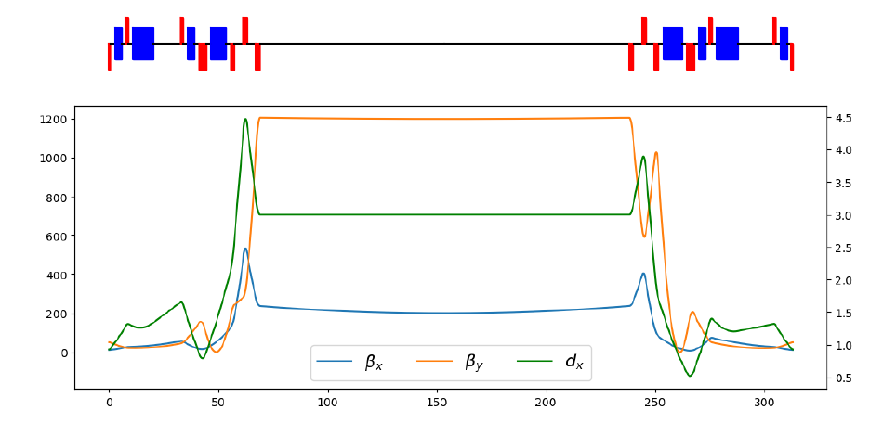
Ring cooler hadron beam optics
Details in Derong Xu talk.
Ring cooler requirements of long cooling section with proper hadron beam beta functions
and dispersion can be achieved.
As Ring Cooler provides long cooling section, integration with Precooler becomes simple
as Precooler also requires long cooling section. As a result, when integrated with Ring cooler
Precooler design could be simplified with performance significantly improved.

Slide 41
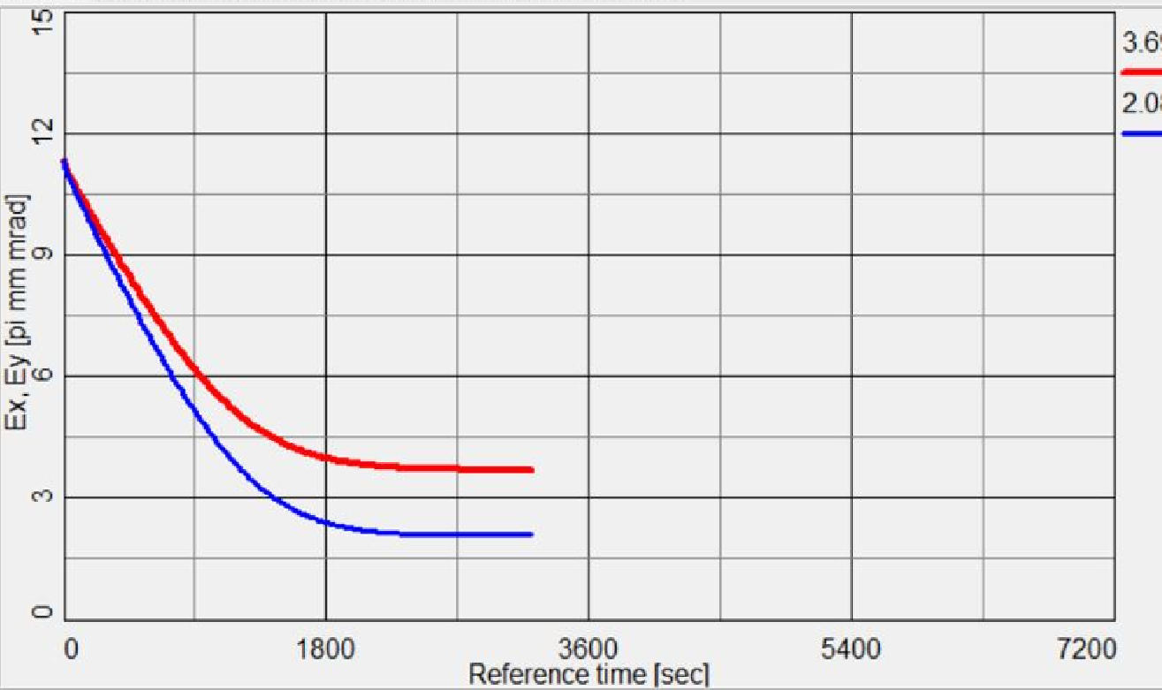
Integration of Precooler with Ring Cooler
Precooling of protons beam
emittances at 24 GeV, assumes
effective cooling section length of
120m, electron current of 100mA, and
electron angles of 20urad.
Integration with high-energy cooling
based on Ring cooler concept, allows
to use longer cooling section which
allows to reduce required current
for Precooler and achieve better cooling performance.
Cooling of protons emittances
at 24GeV, using Precooler.
As Ring cooler does not requires many focusing elements for electron beam cooling section,
compared to SHC-CeC, it offers simpler technical solution to provide shielding from remnant
Magnetic fields and achieve required angular spread for Precooling.

