Slide 1
Homework Questions HW1 Present vector of deltas for the found optima in EBIS ML tuning. Explain the components of noise in the EBIS beam intensity measurements
Xiaofeng Gu
21 December 2023

Slide 2
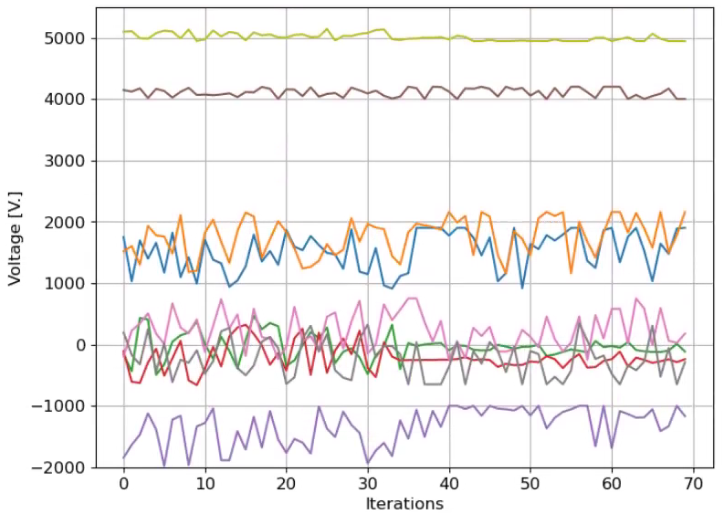
Vector of deltas for the found optima
Before [V] | 1400 | 1660 | -14 | -174 | -1500 | 4100 | 250 | -150 | 5044
After [V] | 1451 | 2160 | -98 | -243 | -1161 | 4200 | 135 | -312 | 4944
After - Before | 51 | 500 | -84 | -69 | 339 | 100 | -115 | -162 | -100
Delta | 0.036429 | 0.301205 | 6 | 0.396552 | -0.226 | 0.02439 | -0.46 | 1.08 | -0.01983

Slide 3
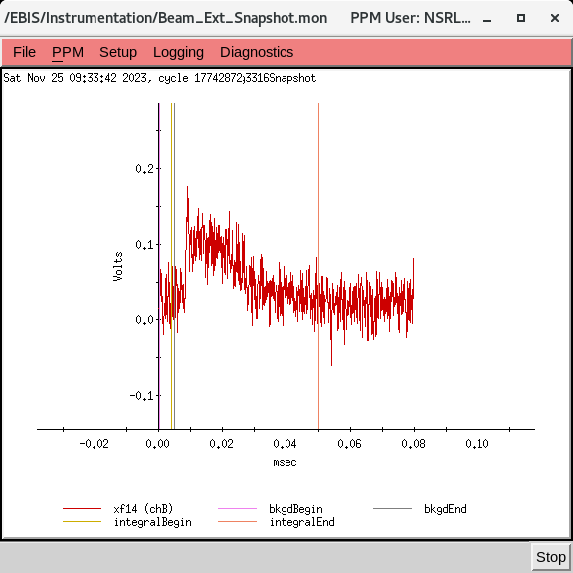
The components of noise in the intensity measurements
Xf14 or fc96 beam intensity signals are the integral of this waveform signal.
Variation in the EBIS beam intensity measurements came from the fluctuation of beam itself.
Noise when there was no beam was small compared to the fluctuation of the EBIS beam.
One source of the beam fluctuation was from EBIS itself. Si beam from EBIS was operated with satisfactory condition for NSRL, but not fully optimized for the best stability. This fluctuation was out of control of GPTune script.
The other source of the beam fluctuation was from beams hitting on electrostatic devices with not optimal settings set by GPTune script.
Courtesy Takeshi

Slide 4
Homework Questions HW2 Present the list of machine studies foreseen and expected outcomes, and how much time is needed for these studies; also describe if/how the activities are connected with APEX process, as well as what resources are needed from BNL
G. Hoffstaetter, K. Brown, V. Schoefer
20 December 2023

Slide 5
Present the list of machine studies foreseen and expected outcomes, and how much time is needed for these studies; also describe if/how the activities are connected with APEX process, as well as what resources are needed from BNL
Interpreted to mean dedicated measurements to inform algorithm development. Tests of the actual control codes probably proceeds for a few hours (2 hr/day, ~1 shift) a week every week for the course of the run as they become ready “parasitic” to operations.
Project list:
Booster injection/capture optimization
Experiments:
parameter scans of individual knobs (steerers,optics etc) as necessary to validate preliminary models and verify adequate sensitivity of measured outcomes for training (estimate ~4-5 shifts per stage of optimization model upgrades. Maybe 3-4 stages (e.g. Just transfer line steering →transfer line steering + optics→ line steering +optics + Booster ring parameters). Final stage experiments are testing/running optimizations in operation, likely requires more time. Stages distributed over weeks to allow offline development
Outcomes
parametric curves of objective vs knob value, selection of viable knobs and objectives (e.g. do we need separate optimization of intensity and emittance or can we combine into a single ‘brightness’ objective? Is the relative precision of a single multiwire sufficient (and over what range?))
AGS injection: Similar to Booster injection
Booster model calibration, misalignment study (orbit,quad response)
Experiments
Initial debugging of acquisition scripts (largely done already in 1-2 shifts total). A few more likely for improvements. Data acquisition takes many hours, can be done during idle injector time, 4+ shifts per week likely available (5000 cycles of data available per shift).
Outcomes: functional tools for acquisition. Adequate data set for inference
AGS model calibration: similar to Booster model calibration

Slide 6
Bunch split/merge
Experiments:
Parameter scans to validate training simulations and establish reasonable tuning ranges for inputs (2-3 shifts)
Outcomes:
Validated models and good control parameter sets
BNL investment:
Goal is to correct for long term drifts and optimize (approximately) continuously. This requires a dedicated scope for continuous specialized WCM data acquisition. Requires dedicated scope and Controls group support (both already allocated)
Gɣ measurement, resonance timing determination
This is a measurement calibration with a large historical data set available. No dedicated accelerator time necessary. Changes do not actively impact beam conditions.
Resonance compensation (skew quad optimization)
Experiments: Sensitivity studies to determine what kinds of knobs show sufficient impact on polarization to be optimized in available time (~6-8 shifts). (Includes ML directed efforts, does not include commissioning of system which is of order ~6-8 weeks of continuous development)
Outcomes: scannable parameters of sufficient impact to be optimized via polarization measurements.
Approximate sum is ~25-35 shifts of dedicated measurements
Would be roughly 1-2 shifts/wk over one 20 week RHIC run, project spans 2 runs

Slide 7
BNL Investment (outside of main team)
Operations staff to establish new/particular machine configurations (1-2 people for a up to a shift intermittently over weeks)
Controls support to develop logging and control tools
K. Brown is Controls Head and BNL Co-PI
Longitudinal split/merge requires a dedicated scope for continuous, specialized WCM data acquisition. Requires hardware and Controls group support (already allocated). Goal is to correct for long term drifts and optimize ~continuously.
APEX Process
Injector studies are generally not allocated time as part of the formal APEX approval process since they are often done non-disruptively to RHIC operation (i.e. do not consume cryo hours). We’ve encouraged people involved in this project to submit APEX proposals since it can help clarify ideas is a good venue to publicize/get feedback about the efforts.
Injector studies are generally discussed, coordinated with other efforts, and reported on at weekly operational meetings (injector meeting, “time” meeting), and daily RHIC meeting when necessary.

Slide 8
Homework Questions HW3 Please clarify what is the target for QE for photocathode
Mengjia Gaowei
21 December 2023

Slide 9
Target for QE for photocathode
The EIC R&D plan puts the requirement for EIC HC electron source: minimum quantum efficiency requirement is 3%, with an ultimate goal >8% at start of gun operation.

Slide 10
Homework Questions HW4 Present thoughts on integration of thin permanent magnet FFA slices into long magnets, taking into account error corrections. And also discuss practical integration with vacuum chamber.
Stephen Brooks
21 December 2023

Slide 11
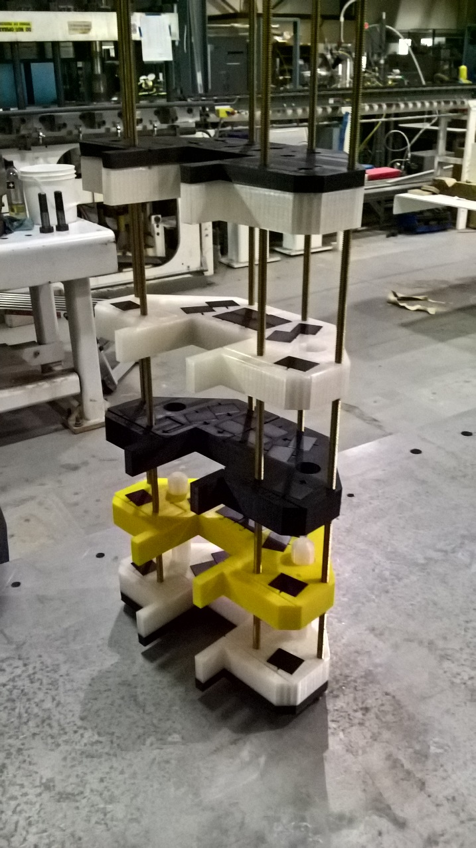
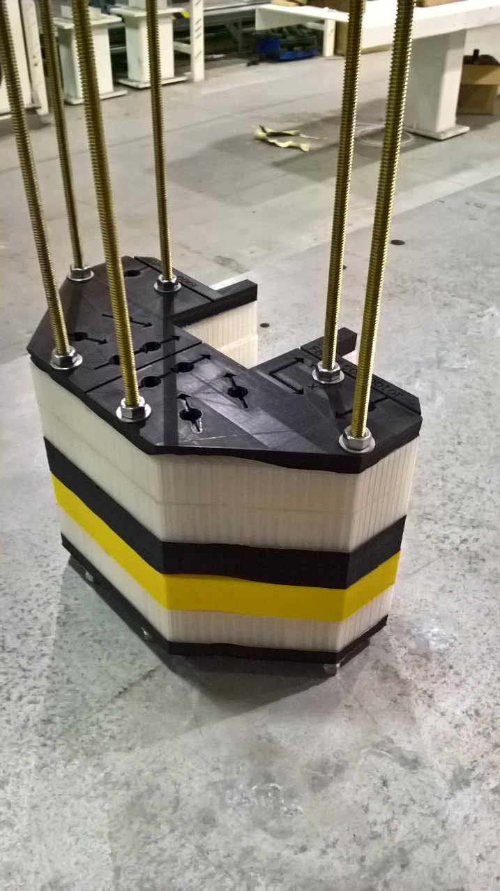
Making a Long Magnet from Slices
Previous example: made a 5-slice magnet with an exponential field profile, 5×10⁻⁴ relative integrated field error.

Slide 12
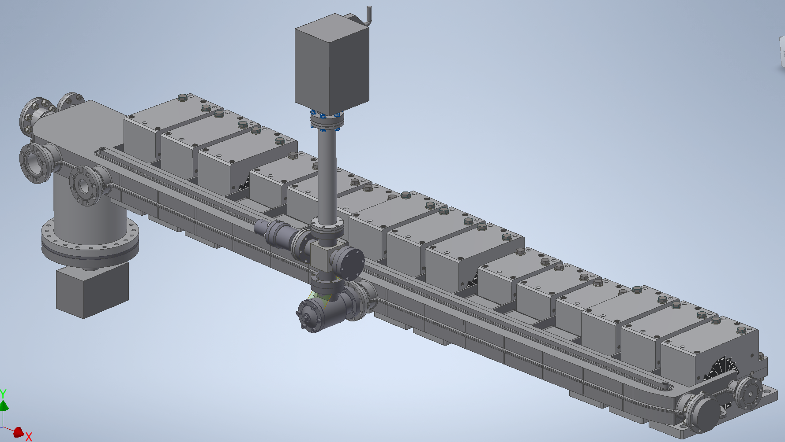
Integration with Vacuum Chamber
This is what the NSLS-II Upgrade team are doing.
Chamber
Defocusing Magnets
Focusing Magnets
Absorber
Down Stream Pump
Gauge Tree
Reinforcement Ribs
Up Stream Pump

Slide 13
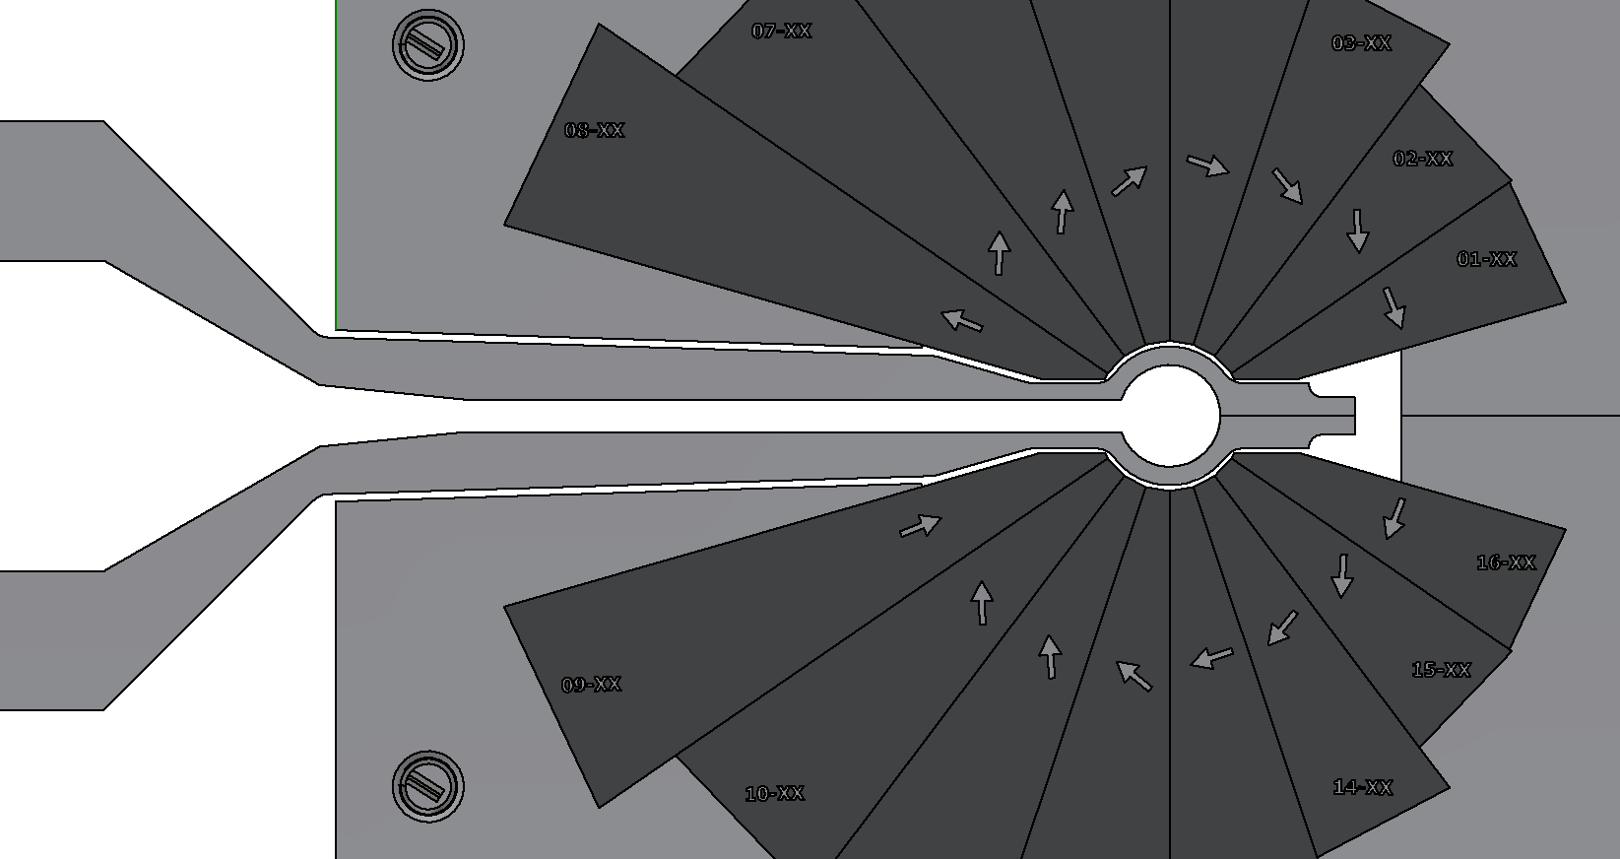
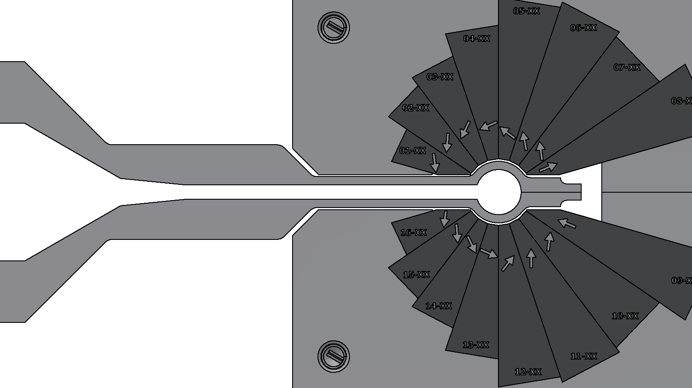
Vacuum Chamber Cross-Section
NSLS-II Upgrade (130T/m magnets, 16mm diameter apertures).
Has SR ante-chamber. CEBAF 20GeV upgrade would look similar.
TYPICAL 0.5mm CLEARANCE
DEFOCUS
FOCUS

Slide 14
Homework Questions HW5 Describe vacuum requirements for the ring electron cooler, or the process and timeline to determine this and other relevant requirements
Alexei Fedotov, Sergei Seletskiy
21 December 2023

Slide 15
REC: Gas scattering lifetime
Residual gas collisions lead to particle loss, N_{b}(t)~N_{b}(0)Exp(-t/τ)
Elastic scattering
Beam lost on transverse apertures, A_{x,y} are geometric acceptances, $a_{x, y}$ are half-apertures
Bremsstrahlung (loss due to momentum acceptance)
$$\frac{1}{τ_{scat}}=\frac{4r_{e}^{2}Z^{2}πnc}{2γ^{2}}\left[\left\langle β_{x}\right\rangle {\left(\frac{β_{x}}{{a_{x}}^{2}}\right)}_{max}+\left\langle β_{y}\right\rangle {\left(\frac{β_{y}}{{a_{y}}^{2}}\right)}_{max}\right]$$
1/A_{x}
1/A_{y}
Important for the cooler due to low energy, large β-functions, and relatively small apertures

Slide 16
REC: Relevant parameters
β-functions in wigglers: 25 m in the wiggling plane and ~1 m in the non-wiggling plane
Wiggler gap sets the acceptance in the non-wiggling plane
Average beta functions ~100 m
Physical apertures:
Wigglers (or collimators) will likely set these
We take full wiggler gap of 2 cm
Results for P=1 nTorr of CO
Elastic scattering lifetime: ~15 min
Bremsstrahlung lifetime: ~50 hours

Slide 17
REC: The role of dynamic aperture
Electrons do not care whether they are lost on physical or dynamic aperture
Relevant aperture determined by some combination of beam dynamics and physical aperture limits, sometimes called the “dynamic acceptance”
Detailed dynamics acceptance calculations are possible
Very crude estimate is as follows
Beam sizes in the wiggler, incl. energy spread ~ 1 mm rms, so
6 σ_{x} = 5.9 mm
6 σ_{y} = 5.7 mm
The wiggler gap is no longer the limiting aperture, 25 m β-function in the wiggling plane defines the acceptance,
A_{x}= A_{y}≈(6 mm)^2/25 m= 1.4 micron
=> Elastic scattering lifetime: ~12 sec

Slide 18
HW5, REC: Vacuum lifetime summary
Preliminary analysis of gas-scattering lifetime indicates that this effect is important for the ring cooler
Elastic scattering lifetime is of concern due to low energy, small wiggler gaps, and large beta-functions
For 1 nT CO and assuming a 2 cm full wiggler gap defines the acceptance, the gas scattering lifetime is estimated at 15 min
If the acceptance is instead dominated by the dynamic aperture (<6σ in both planes), then the previous estimate shortens to ~12 sec
Presently, vacuum requirement is <1e-9 (to be finalized after lattice design is finished)
Presently, lattice optimization is being done to improve both DA and momentum aperture.
Touschek losses would need to be recalculated (previously was 60 sec). This will be done once we improve momentum aperture.

