Slide 1
Comanage-Registry Status and Uses
Robert Hancock
7 Sep 2023

Slide 2
What is CoManage-Registry
Platform for aggregating identities from different institutions
Can also keep track of administrative structures via Collaborative Units, Groups, and Departments
Acts a single point of authorization for federated services
Acts as a central listing for available federated services
Adds customized authn/authz error handling without modifying service itself. Expedites solutions
Integrated with CILogon token issuer
<number>

Slide 3
Aggregating Identities
Many different institutions have Identity Providers(IDP) that authenticate against their own local user stores.
These institutions can be part of federations such as Edugain/InCommon whose members can outsource authentication to each other.
Registry creates a single COperson record for each real person that is enrolled.
Each IDP login that a person links to Registry becomes an “Organizational Identity” and is linked to their COperson identity.
<number>

Slide 4
Administrative Units
The primary administrative group is the Collaborative Unit (COU)
Its main purpose is to allow for delegation of person management operations
Holding a role in a COU, be it simply member, or editor, is used an an input for authorization decisions. These roles can be arbitrarily defined.
These COUs are auto populated when they have a analogue in SDCC account groups.
Requires linking SDCC account to COPerson. For those that have multiple SDCC accounts, you will only see the COUs associated with those you have linked to Registry so far.
Each experiment can select enrolled person(s) to have administrative capability over a COU. These people can manually add are remove people from their experiment’s COU and any child COUs.
<number>

Slide 5
Administrative Units cont.
Regular groups – any CO member can create a group. It can be open or closed(invite only). The can be linked to email lists or used for authorization purposes.
Departments - they are intended to store representations of objects (just like CO People), in this case organizational structure within the CO. CO Departments can attach to either a CO or a COU, and can be used to store a number of attributes about the department, including telephone numbers, email addresses, URLs, identifiers, and the sets of people associated with specific responsibilities within the department.
<number>

Slide 6
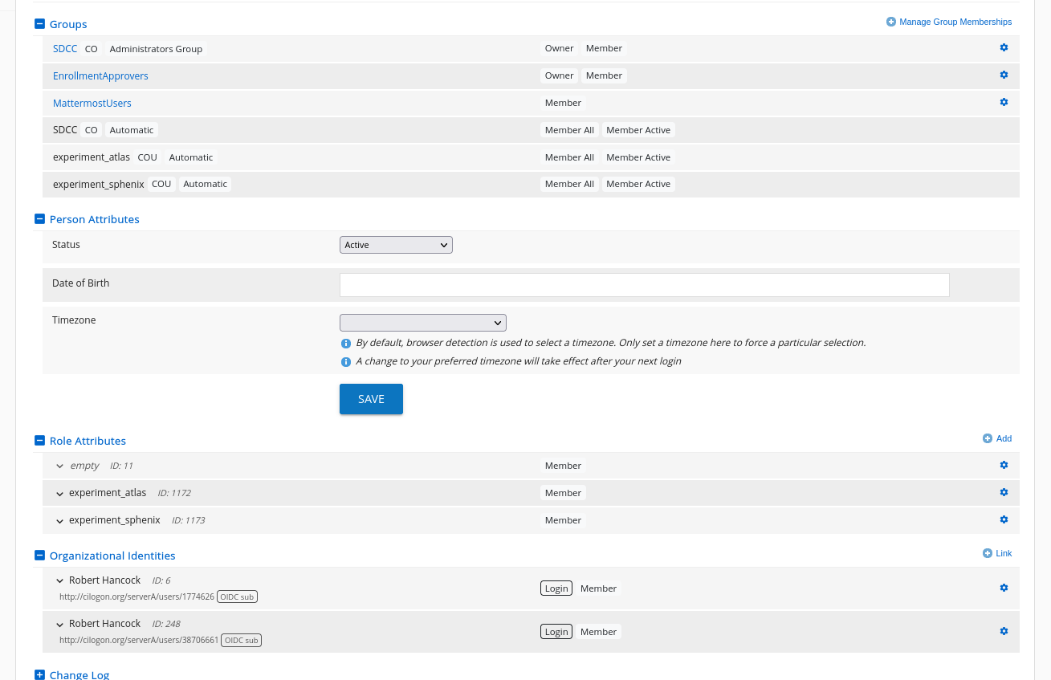
Aggregating Identities
<number>

Slide 7
Single Point Authorization
Federated Services at SDCC accept tokens for authentication and authorization.
These tokens are generated by CILogon token issuer according to security policies
These security policies reference information in COperson and organizational Identities.
Ex 1: You are a member of the MattermostUsers group
You can login to mattermost service and you will map to the mattermostid stored in Registry COPerson
Ex 2: You are a member of Sphenix COU. You are allowed to authenticate against Sphenix Invenio.
<number>

Slide 8
Listing federated services
The “Services” tab in COManage Registry UI lists icons for each service that is configured for authn/authz via Registry.
This allows easy knowledge of what federated services are available to a user.
Some services are available to all members of the CO
Other services are only available to members of certain COUs.
The available service list/links present accordingly.
<number>

Slide 9
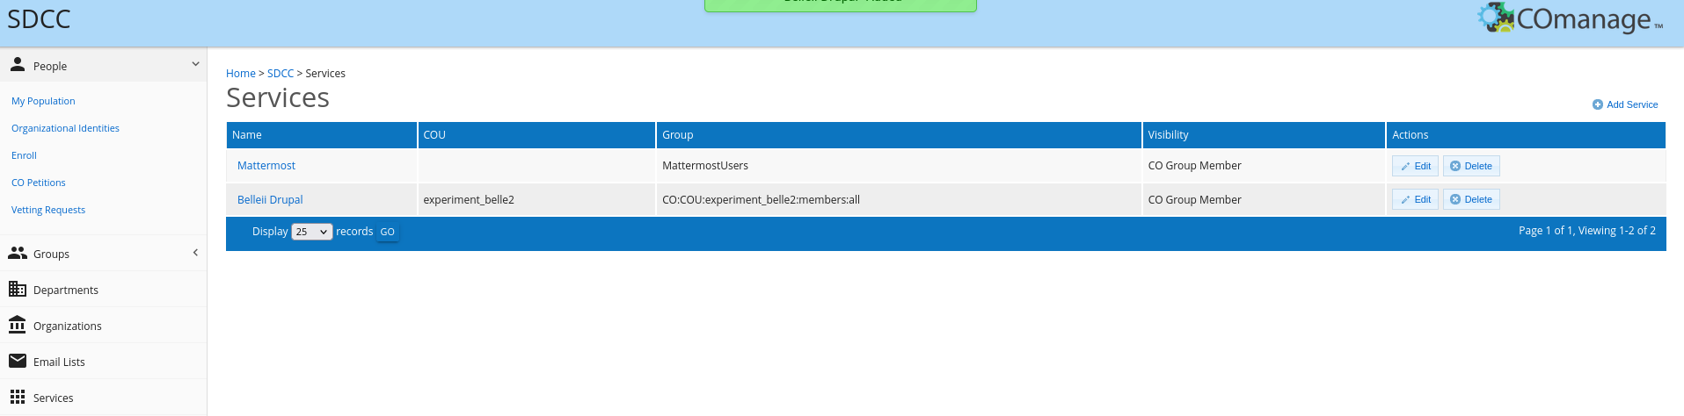
Listing federated services - diagram
<number>

Slide 10
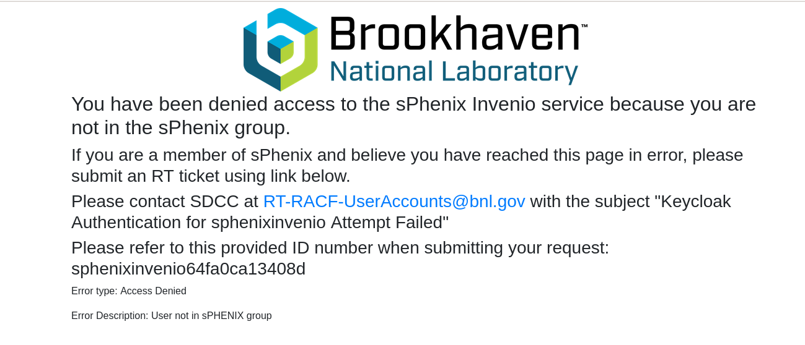
Customized authentication/authorization error handling.
<number>

Slide 11
The End
Questions on what we covered?
<number>

