Slide 1
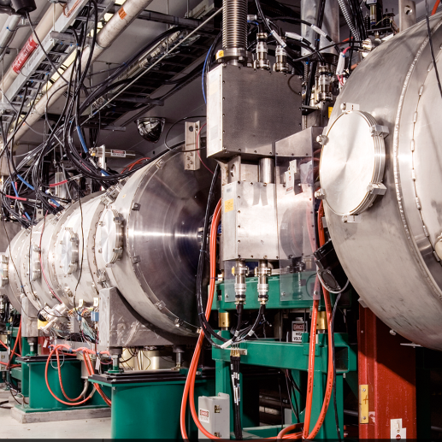
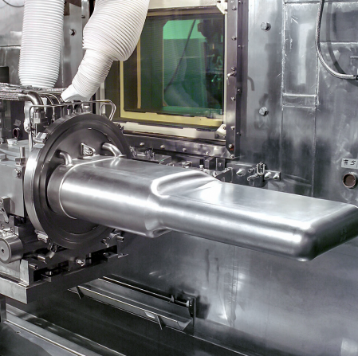
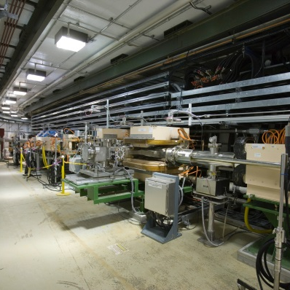

ePIC
Forward Hadronic Calorimeter
LFHCal Mechanical Design
Final Design Review
Eliott Fountain
September 25, 2023

Slide 2
Mechanical Design Scope:
Produce the LFHCAL Mechanical Design including:
Detailed CAD Models. (SolidWorks)
Structural Analysis of Detector Components to ensure stability and compliance.
Ensure sufficient use of materials for magnet quench flux return.
Formal CAD Drawing Package for fabrication.
Preliminary testing with single detector assembly for design verification / refinement.
Assembly Procedure Documents for sensor integration and final assembly.
Produce any specific tooling for the assembly process.

Slide 3
Review Charges
Are the LFHCAL technical performance requirements complete, documented, and understood?
Are the plans for achieving detector performance and construction sufficiently developed and documented for the present phase of the project? Specifically, are they commensurate with the initiation of the LFHCAL absorber and casing steel procurement (also hereafter referred to as the procurement)?
Do the present LFHCAL design and the resulting absorber and casing steel specifications meet the abovementioned performance requirements with a low risk of cost increases, schedule delays, and technical problems?
Are the fabrication and assembly plans for the LFHCAL consistent with the overall project and detector schedule and appropriately developed to initiate the procurement?
Are the plans for LFHCAL integration in the EIC detector appropriately developed to initiate the procurement? In particular, is the design consistent with a requirement that LFHCAL iron components should serve as part of the EIC detector solenoid flux return?
Have the December 2022 EIC Calorimetry Review recommendations been adequately addressed to initiate the procurement?
Have ES&H and QA considerations been adequately incorporated in the procurement planning? (This includes a quality assurance plan for receipt of material, in particular verification of the required permeability of the steel components.)
Is the procurement approach sound and the procurement schedule credible?

Slide 4
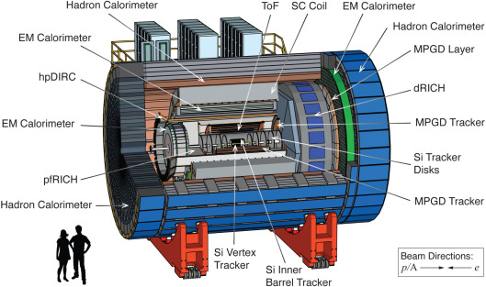
FHCAL Location / Overview
PLACE HOLDER FOR MOST UP-TO-DATE RENDERING

Slide 5
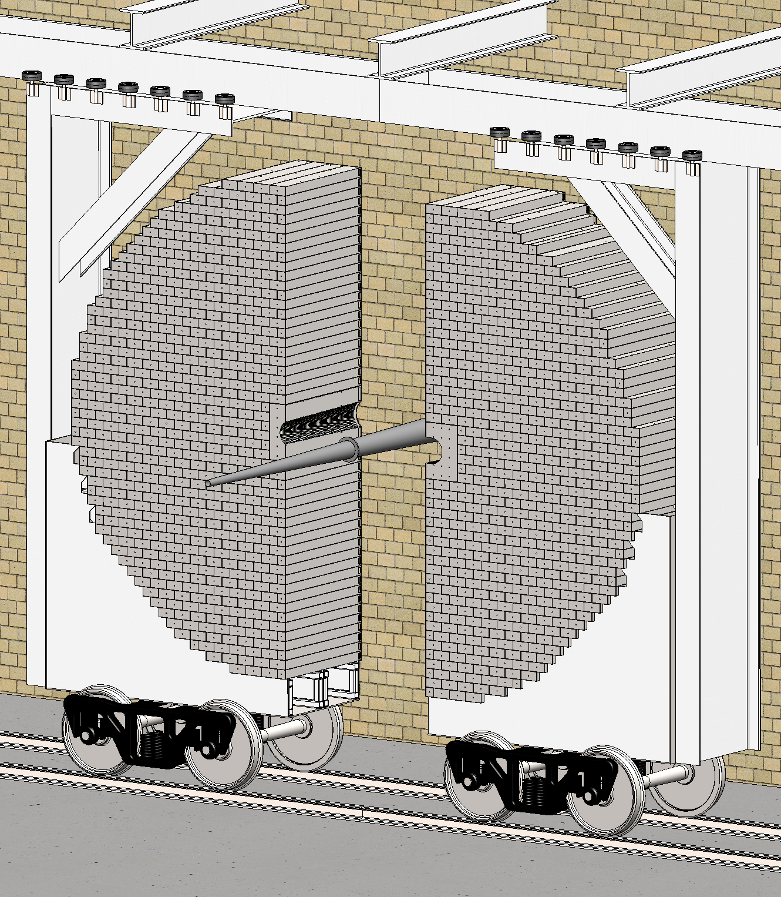
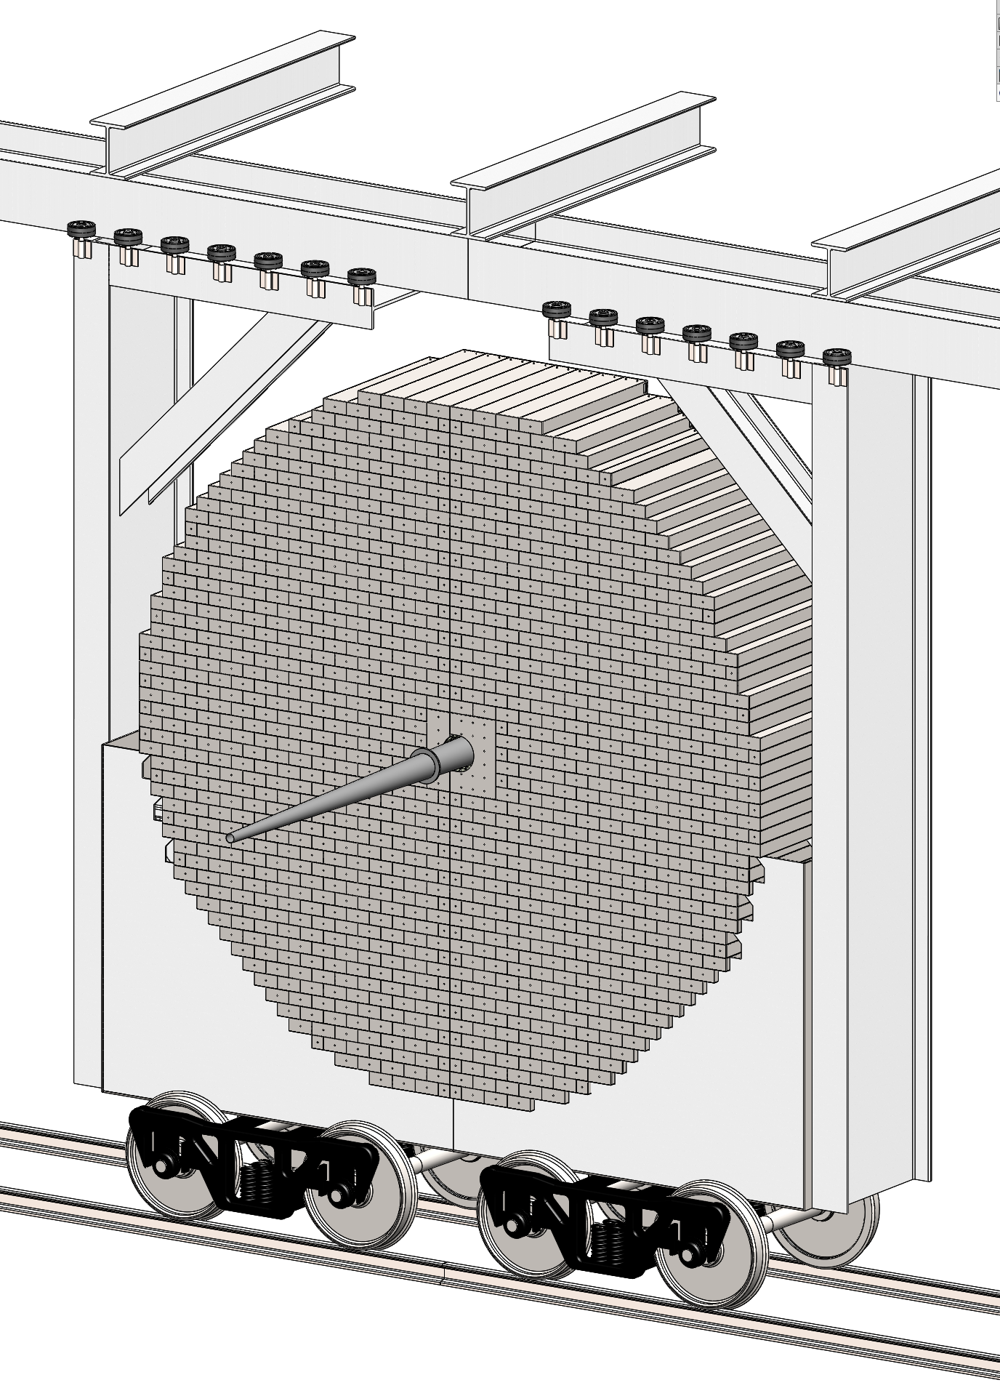
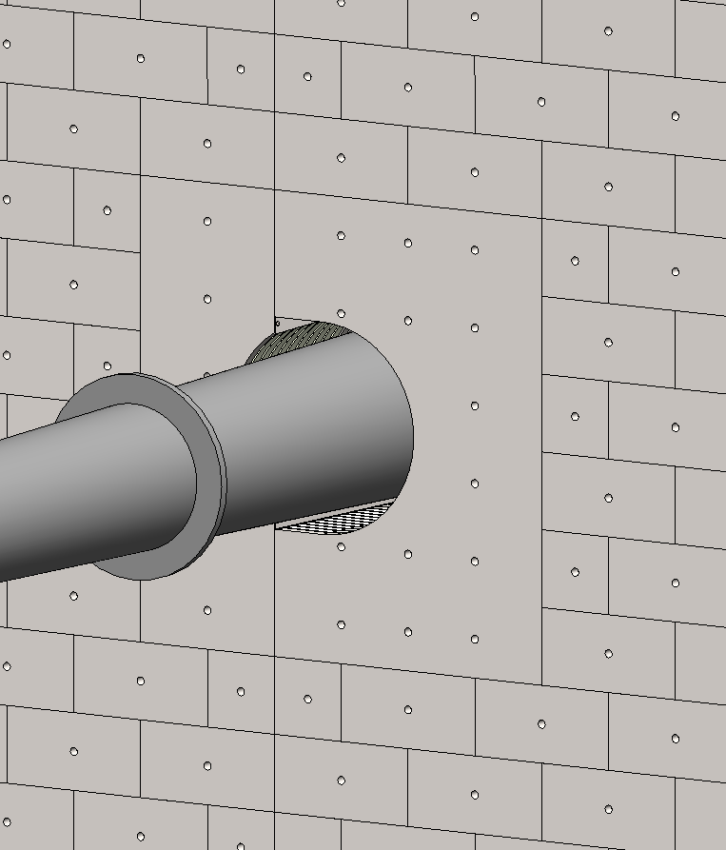
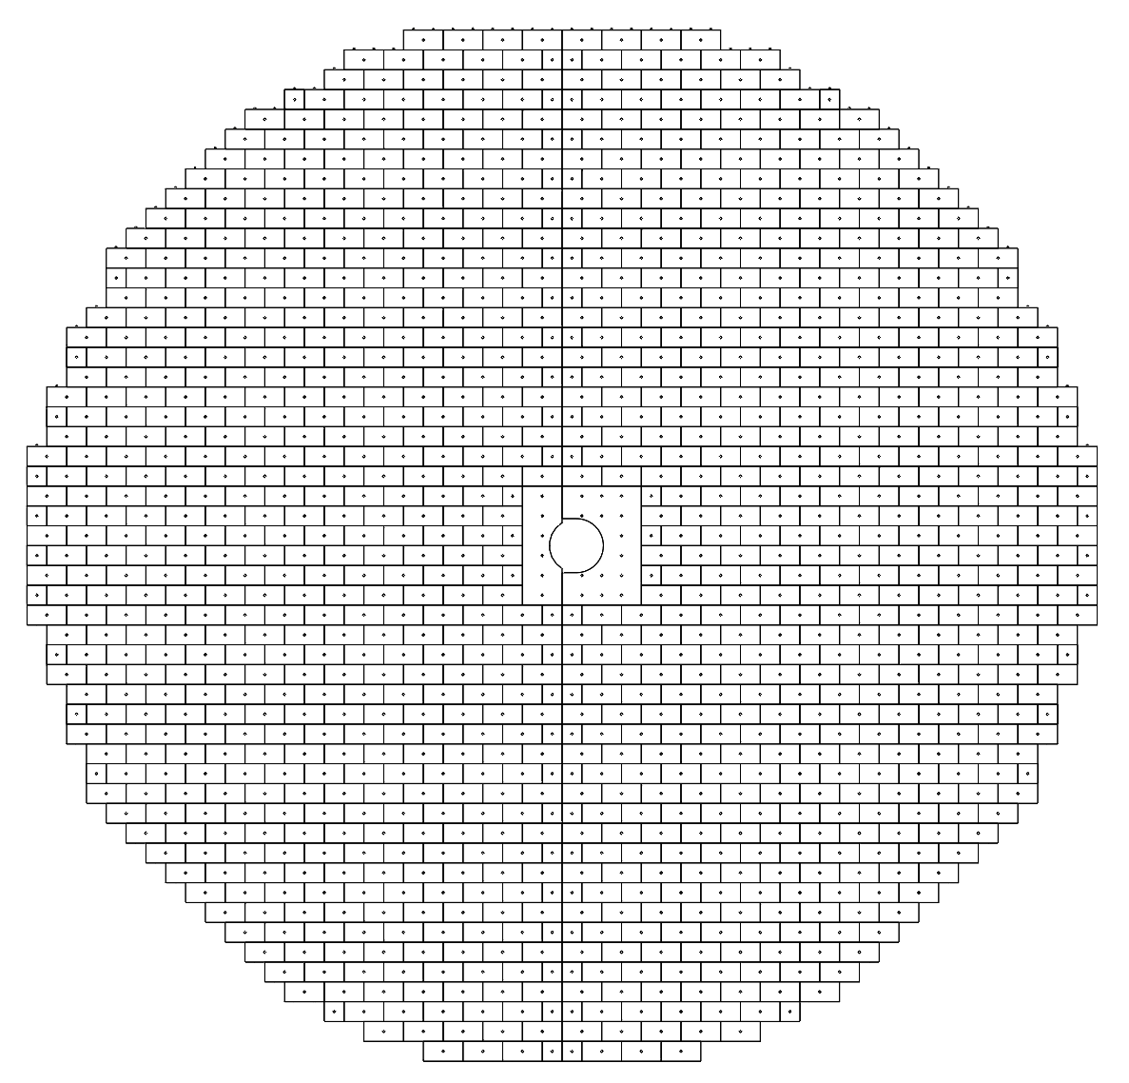
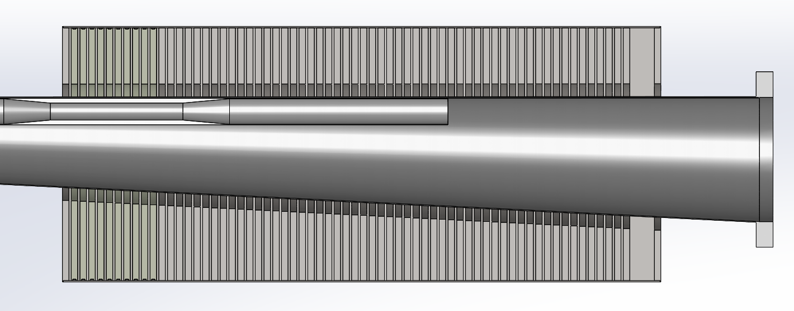
Top Level FHCAL Structure
Charge: 5
Detector Features / Highlights:
Ø 5.2 meters, 1.4 meters thick.
Contains 163,000 kg of Steel & 22,300 kg of Tungsten.
1,050x 8M Towers, 76x 4M Towers.
2x unique “Insert” Towers for beampipe passage.
65x Scintillator assembly layers
≈ 580,000x Scintillator Tiles, 50x50 mm with individual readouts.
3cm annular clearance around beampipe
Conceptual support structure

Slide 6
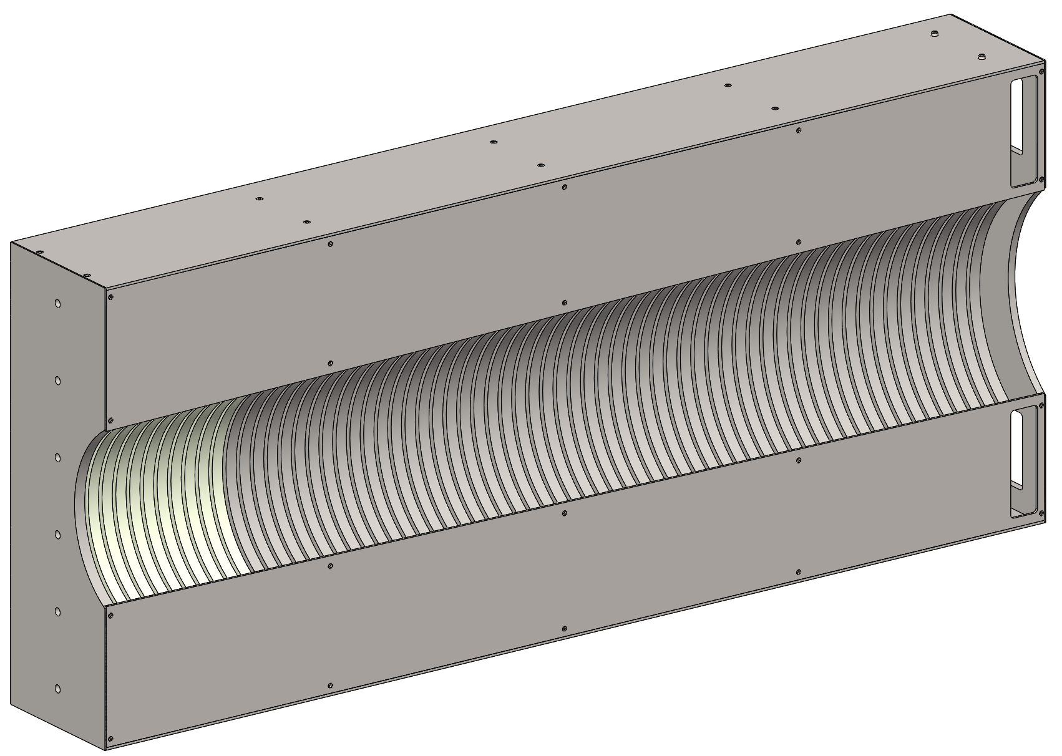
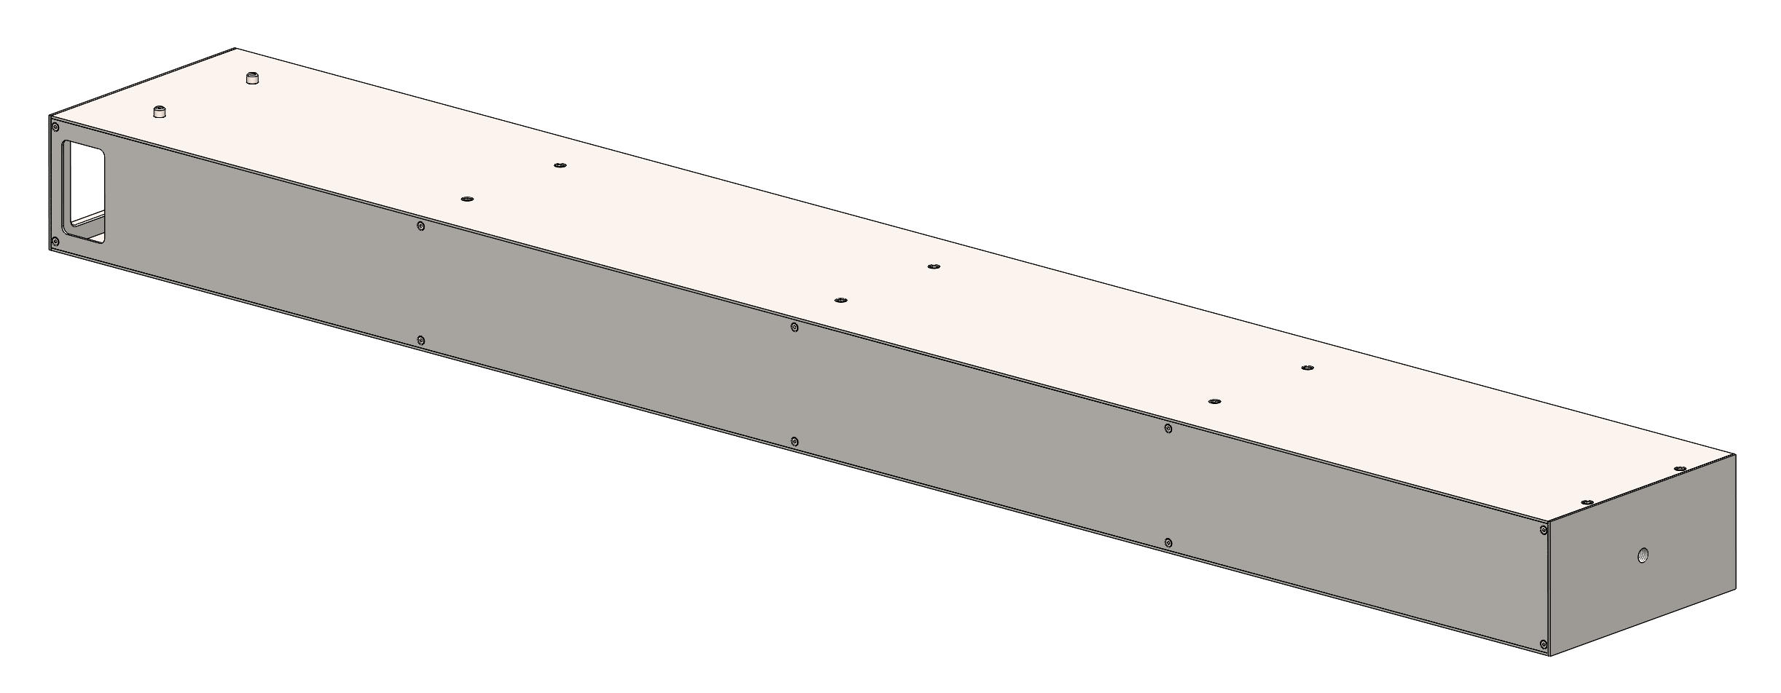
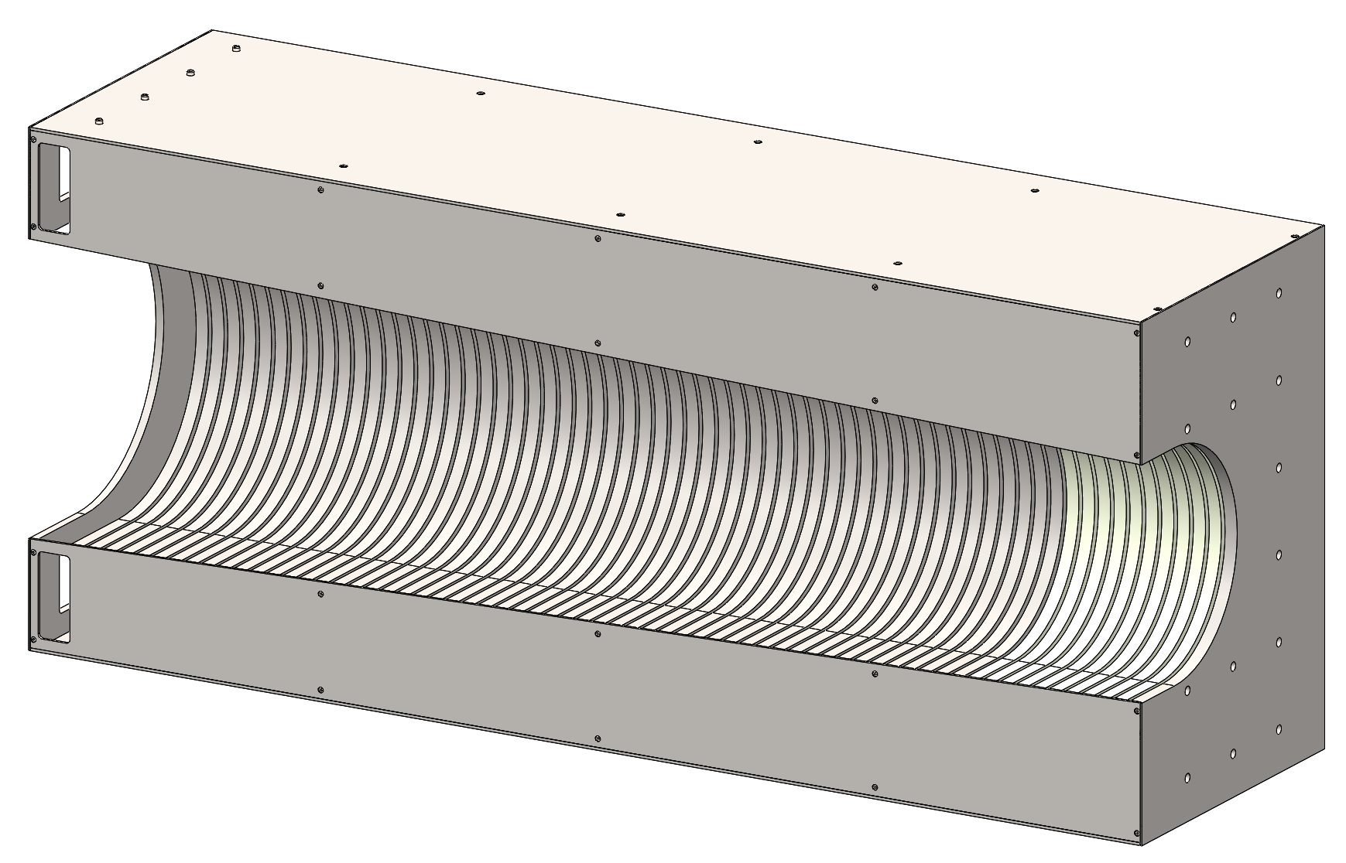
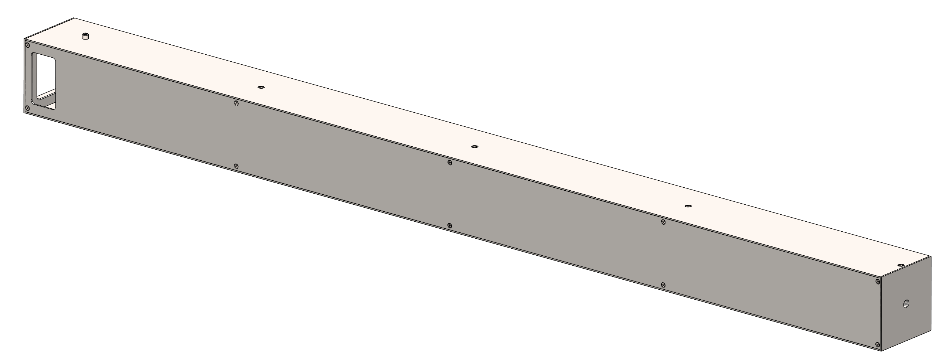
Unique Detector Geometries
Charge: 3
Left Insert Assembly
- Dimensions: 60 x 20 x 140 cm
- Quantity: 1
- Mass: ≈ 1,040 kg
8M Tower Assembly
- Dimensions: 10 x 20 x 140 cm
- Quantity: 1050
- Mass: ≈ 170 kg
4M Tower Assembly
- Dimensions: 10 x 10 x 140 cm
- Quantity: 76
- Mass: ≈ 85 kg
Right Insert Assembly
- Dimensions: 60 x 40 x 140 cm
- Quantity: 1
- Mass: ≈ 1,700 kg

Slide 7
Common Materials and Methods
Charge: 3
Materials:
1045 Carbon Steel for all structural steel components.
W 6Ni-4Cu Tungsten for all applicable components.
Grade 12.9 or equivalent Alloy Steel for all fasteners / hardware.
Steel Tower Weldments to be Electroless Nickel plated for corrosion prevention.
Hoisting / Assembly Structures to be 6061-T6 Aluminum or equivalent w/ Grade 12.9 hardware and approved hoisting lift points.
Design:
Minimize unique parts, maximize standard material thicknesses / sizes where possible.
Utilize commercially available materials and hardware where possible.
Incorporate features to allow the final assembly of scintillator tiles into the tower weldments and connections to the instrumentation.
Incorporate features on tower assemblies to ensure ease of assembly / alignment.
Ensure the structural integrity of each tower, as well as the integrity of the entire detector array.
Allow for and define the method(s) for achieving fine alignment of the detector assembly.
Fabrication:
Create a formal, detailed drawing package for all parts and assemblies suitable for fabricators foreign and domestic.
Utilize industry standard forms of fabrication, including fastening, welding, plating, and assembly.
Incorporate features / fixtures / methods to promote consistent tower geometry and fabrication processes.
Allow for open dialogue between fabricator and engineering to promote economical and effective manufacturing processes to be identified.
Create robust design specifications document to ensure finished products are manufactured to a high level of quality and consistency and will function as designed.

Slide 8
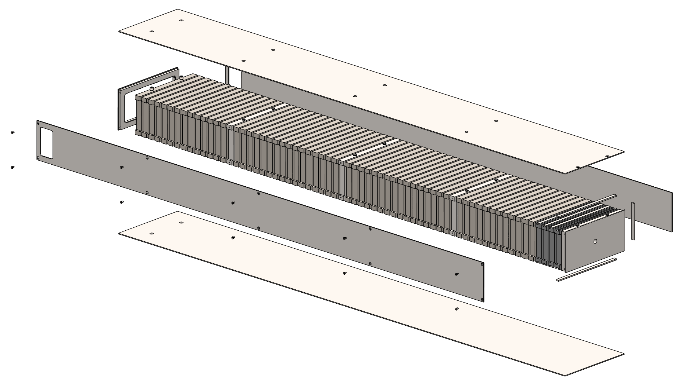
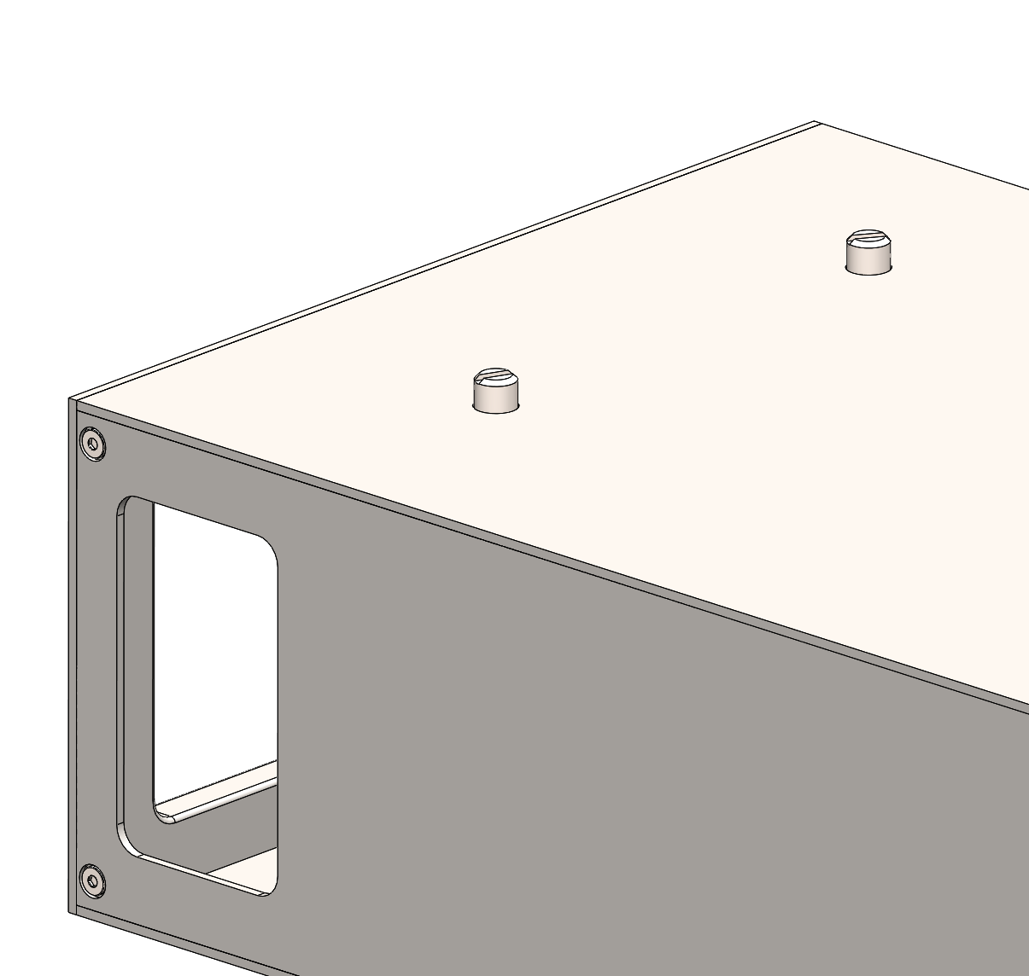
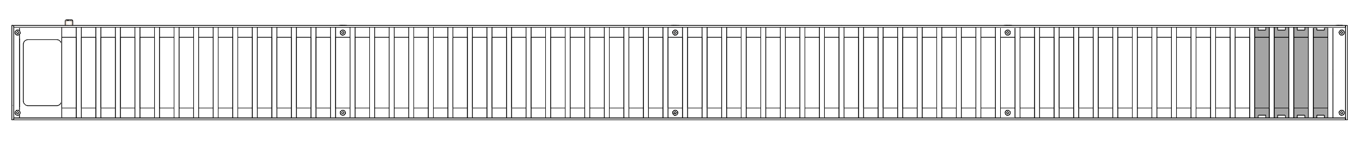
8M Tower Design
Charge: 3
8M Tower Assembly
65x Scintillator Layers; 1st Steel, 2nd – 5th Tungsten, 6th – 65th Steel.
Tungsten Absorber plates constrained with steel “keys” (3x) welded to tower structure.
Electron-Beam (or equivalent) welding of all steel components for a monolithic structure.
Top, bottom, and side panels made from 14 GA sheet metal.
M8 tapped holes for hoisting.
M8 dowel pins threaded into last plate mate with 8.5 mm holes on bottom side for assembly / alignment.
M12 tapped hole in front plate.
Removable side panel for scintillator assembly, maintenance.
Generous windows at rear for PCB access.
Steel Plates
Tungsten Plate “Keys”
Removable Side Plate
Alignment Pins
Expanded View
Front Plate
Tungsten Plates
Front View with side panel removed

Slide 9
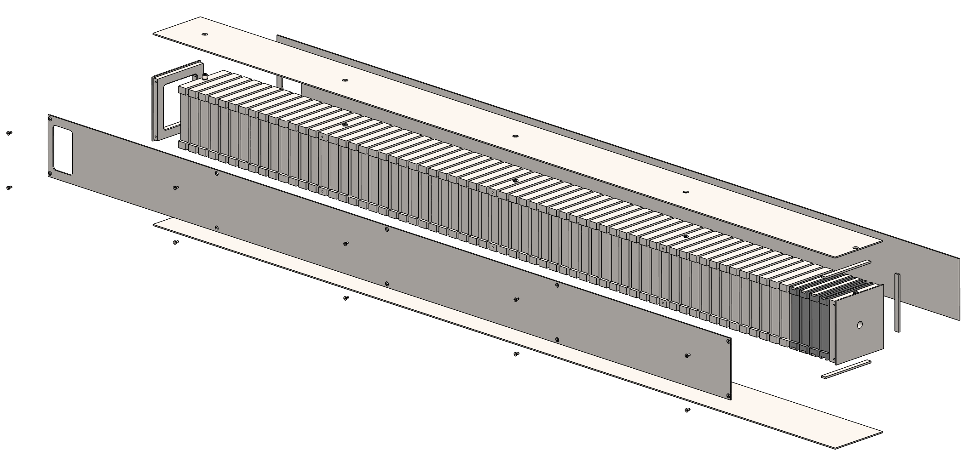
4M Tower Design
Charge: 3
8M Tower Assembly
65x Scintillator Layers; 1st Steel, 2nd – 5th Tungsten, 6th – 65th Steel.
Tungsten Absorber plates constrained with steel “keys” (3x) welded to tower structure.
Electron-Beam (or equivalent) welding of all steel components for a monolithic structure.
Top, bottom, and side panels made from 14 GA sheet metal.
M8 tapped holes for hoisting.
M8 dowel pin threaded into last plate mates with 8.5 mm hole on bottom side for assembly / alignment.
M12 tapped hole in front plate.
Removable side panel for scintillator assembly, maintenance.
Generous windows at rear for PCB access.
Steel Plates
Tungsten Plate “Keys”
Removable Side Plate
Expanded View
Front Plate
Tungsten Plates
Front View with side panel removed

Slide 10
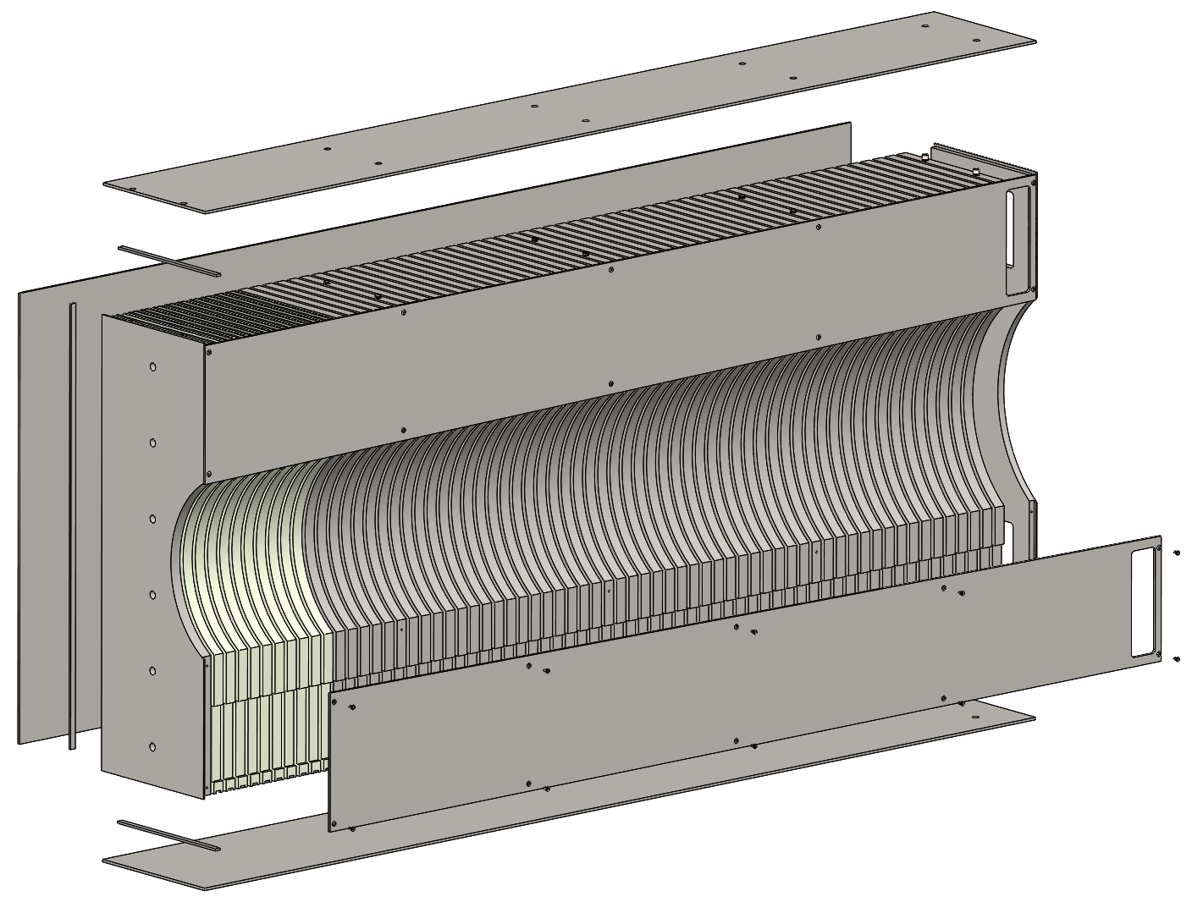
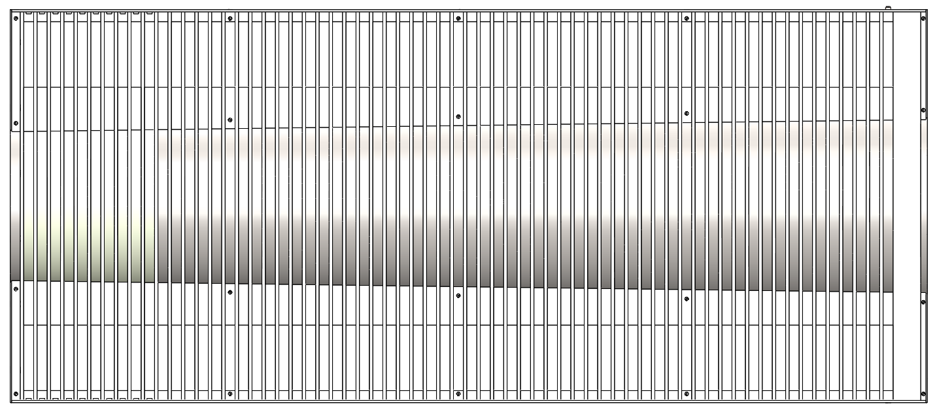
Insert Assembly Design (Left Side)
Charge: 3
65x Scintillator Layers; 1st Steel, 2nd – 11th Tungsten, 12th – 65th Steel.
Continuously expanding circular cut for constant beampipe clearance.
Tungsten Absorber plates constrained with steel “keys” (3x) welded to tower structure.
Electron-Beam (or equivalent) welding of all steel components for a monolithic structure.
Top, bottom, and side panels made from 10 GA sheet metal.
M8 tapped holes for hoisting.
M8 dowel pins threaded into last plate mate with 8.5 mm holes on bottom side for assembly / alignment.
M12 tapped holes in front plate.
Removable side panels for scintillator assembly, maintenance.
Generous windows at rear for PCB access.
Expanded View
Tungsten Plate “Keys”
Steel Plates
Removable Side Plate
Tungsten Plates
Removable Side Plate
Front Plate
Front View with side panels removed
Left Insert Assembly

Slide 11
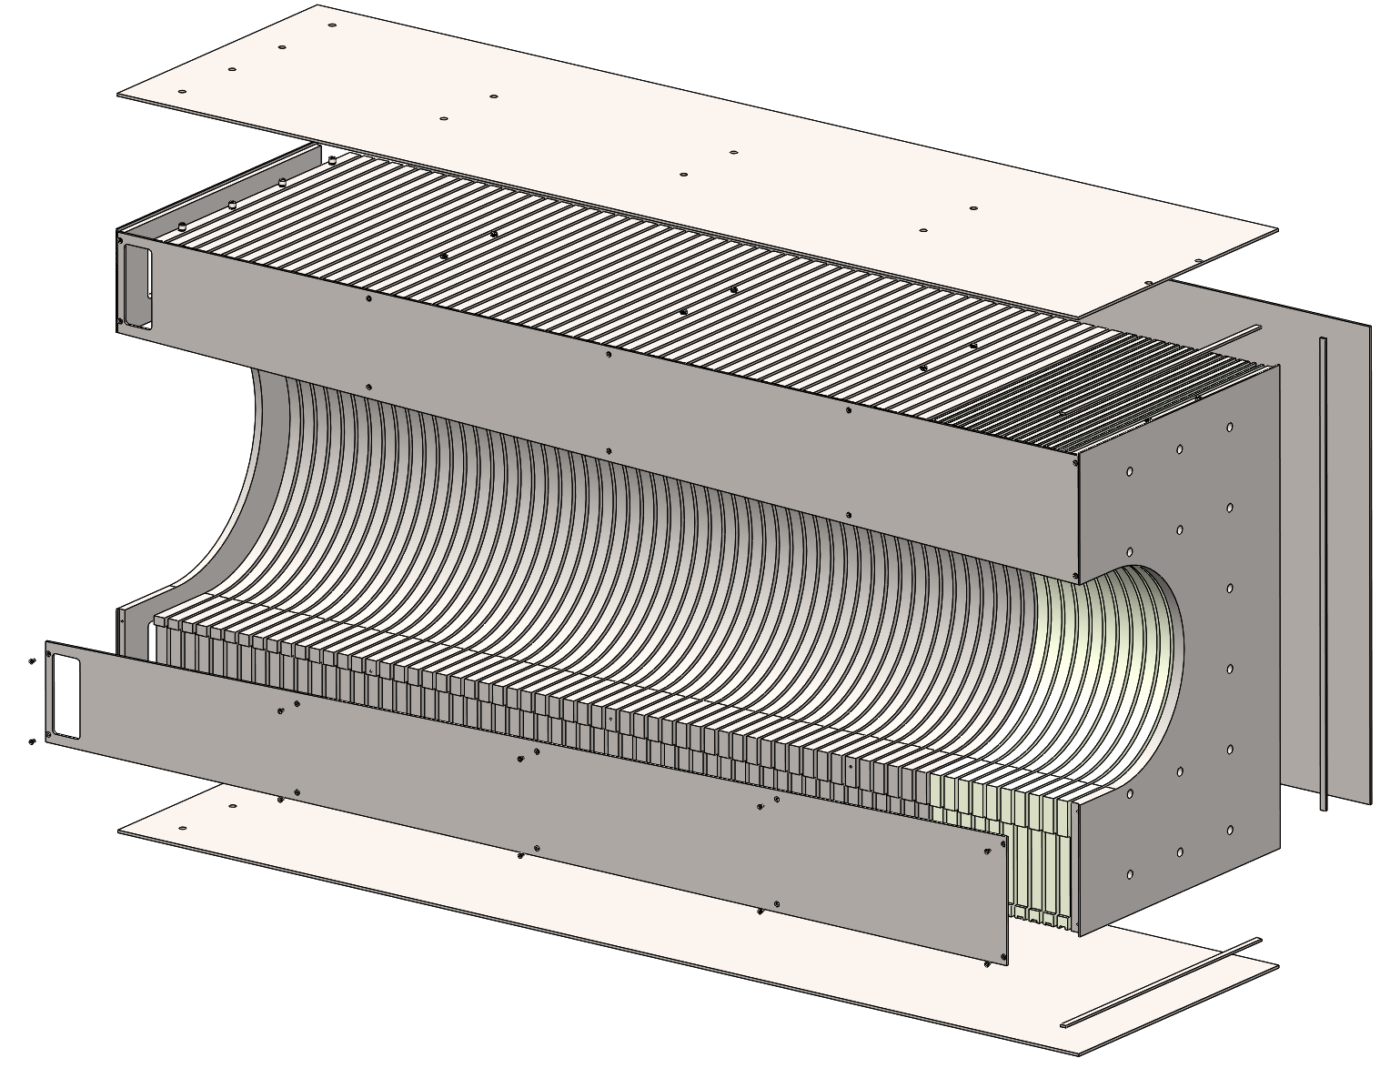
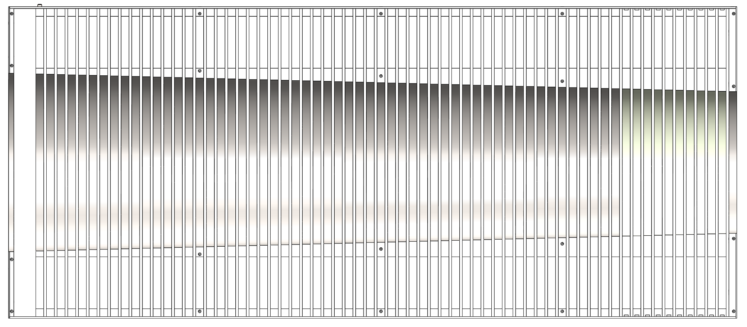
Insert Assembly Design (Right Side)
Charge: 3
65x Scintillator Layers; 1st Steel, 2nd – 11th Tungsten, 12th – 65th Steel.
Continuously expanding circular cut for constant beampipe clearance.
Tungsten Absorber plates constrained with steel “keys” (3x) welded to tower structure.
Electron-Beam (or equivalent) welding of all steel components for a monolithic structure.
Top, bottom, and side panels made from 10 GA sheet metal.
M8 tapped holes for hoisting.
M8 dowel pins threaded into last plate mate with 8.5 mm holes on bottom side for assembly / alignment.
M12 tapped holes in front plate.
Removable side panels for scintillator assembly, maintenance.
Generous windows at rear for PCB access.
Expanded View
Tungsten Plate “Keys”
Steel Plates
Removable Side Plate
Removable Side Plate
Front Plate
Tungsten Plates
Front View with side panels removed
Right Insert Assembly

Slide 12
Overall Design Remarks
Charge: 3
Designs of all towers and internal components utilize flat profiles with as little complexity as possible to allow for tight tolerances to be held during manufacturing and also to ease geometric testing for acceptance criteria.
Electron-beam welding is currently identified as the process of choice for welding the steel absorber plates and tungsten keys to the sheet metal panels to from the tower weldments. This form of welding produces very little heat soak in to the material, resulting in little to no warping of the components from their original shape.
The final assembled shape is that of either a rectangle (8M) or square (4M) profile, and lends itself to be placed in a special jig for dimensional evaluation / straightening. For the upper and lower surfaces, if manufacturing anomalies do occur, an industry standard “fly cutter” milling attachment can achieve a flatness tolerance of 0.05 – 0.1 mm, well within our acceptable tolerance.
1045 Carbon Steel has high magnetic permeability, making it suitable for the magnetic quench material, and is also relatively cheap, easy to machine, and abundant in industry. This material is accepting of electroless Nickel plating for corrosion prevention.
Along with a properly designed support structure, the 8 mm pins to the rear of the detectors along with the M12 threaded hole in the front plate of each detector allow for proper and repeatable alignment of the units when assembling on the detector stack. Note that the shear strength of a single 8 mm dowel pin is ≈ 45 kN.

Slide 13
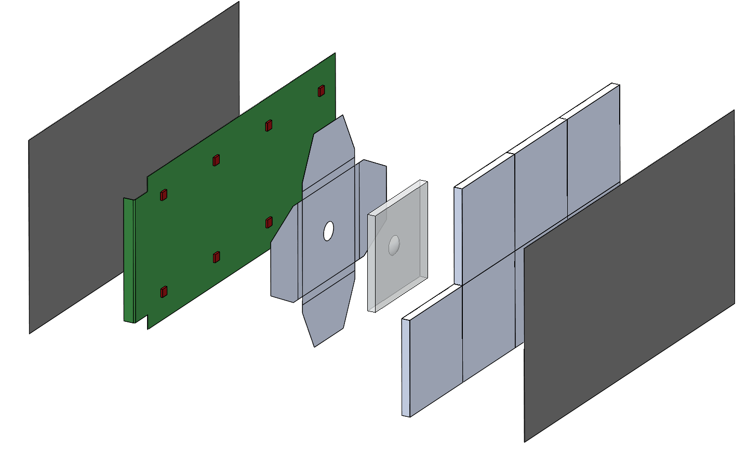
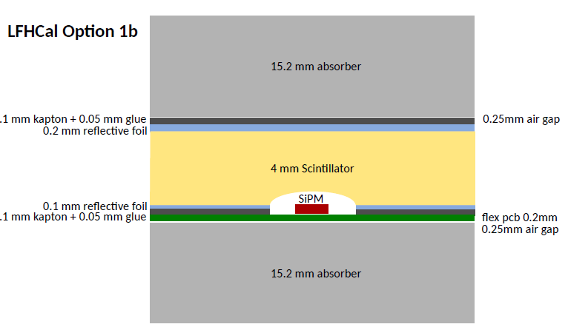
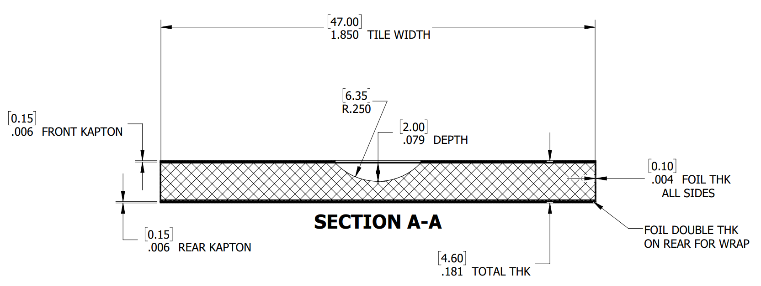
Common Scintillator Assembly Features (8M shown)
Charge: 3
Material / Manufacturing: TBD
FNAL injection molded tile
EJ-212 machined tile
Dimensions:
Raw Tile: 47x47x4 mm
Wrapped tile: 47.2x47.2x4.6 mm (not including SiPM board thickness)
Dimple Geometry: TBD, various dimple geometries are being analyzed for performance before final selection.
Scintillator tile geometry for the insert assemblies is still TBD between square and hexagonal profiles, based on performance and feasibility.
SiPM PCB connects to the common flex PCB running along the tower to the rear of the assembly.
The flex PCB then connects to the readout board at the rear of the Tower.
Wrapped Tiles
Unwrapped Tile
Kapton Sheet
Kapton Sheet
SiPM PCB
3M Reflective Foil

Slide 14
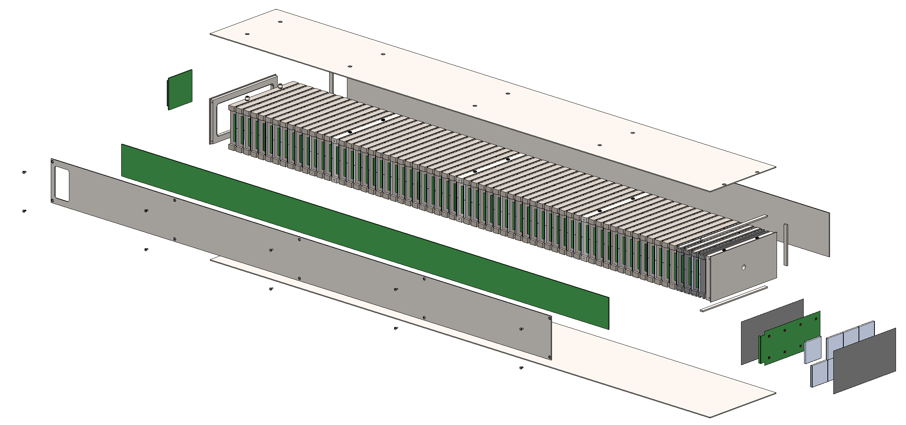
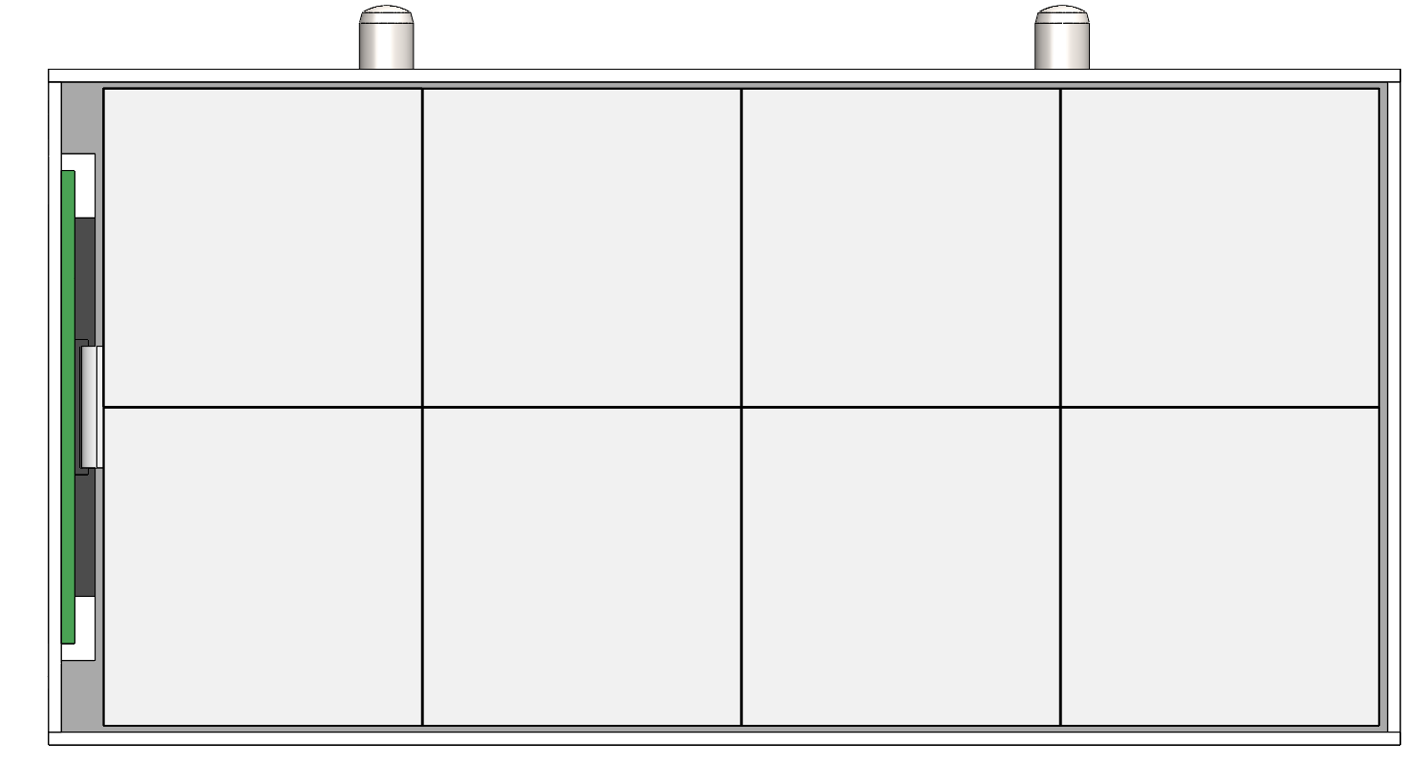
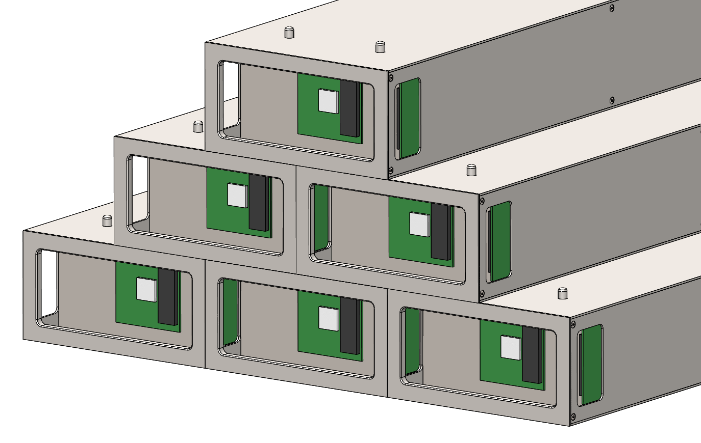
Assembly Methods (8M Tower / Scintillator Envelopes)
Charge: 4
Scintillator Envelope:
Tiles are wrapped in 3M Foil.
SiPM Boards attached to wrapped tiles.
Kapton sheet attached to front and back of envelope assembly.
Assembling Tower:
Side panel is removed from tower (10x screws).
Each Scintillator Envelope is slid into the slot between absorber plates (65x).
The side flex PCB is connected to each of the SiPM board connectors.
The flex PCB is connected to the readout board at the rear of the tower.
The side panel is re-attached.
At this point, the Tower assembly is ready for function testing & final assembly.
Flex PCB
Flex PCB Connections
Scintillator Envelope
Readout Boards

Slide 15
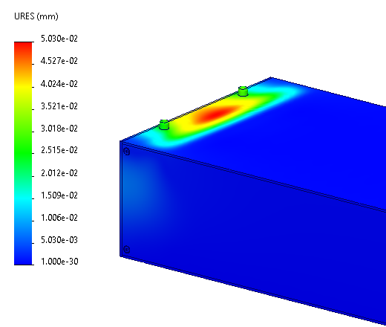
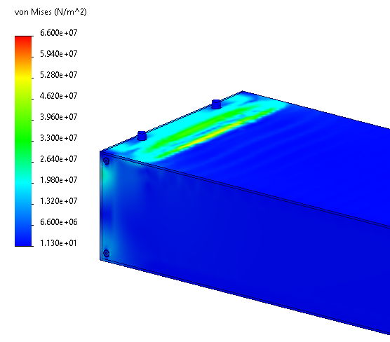
Bearing Load Analysis (8M Tower)
Charge: 3
Identified Tower for analysis: 8M Tower with highest vertical loading identified in image below, on bottom row.
Analysis Setup:
Applied Load: 10,200 kg (51x 8M Tower Assemblies)
Fixtures: Bottom Face is held Fixed, Load is applied evenly distributed on top face.
Analysis Results:
Max Deflection: 0.05 mm. At rear of Tower, window area.
Max Stress: 66.0 MPa / 350 MPa.

Slide 16
Bearing Load Analysis (4M Tower)
Charge: 3
Identified Tower for analysis: 4M Tower with highest vertical loading identified in image below, on bottom row.
Analysis Setup:
Applied Load: 5,100 kg (51x 4M Tower Assemblies)
Fixtures: Bottom Face is held Fixed, Load is applied evenly distributed on top face.
Analysis Results:
Max Deflection: 0.05 mm. At rear of Tower, window area.
Max Stress: 66.0 MPa / 350 MPa.
IN
PROGRESS

Slide 17
Bearing Load Analysis (Left Insert)
Charge: 3
Analysis Setup:
Applied Load: 4,600 kg (23x 8M Tower Assemblies)
Fixtures: Bottom Face is held Fixed, Load is applied evenly distributed on top face.
Analysis Results:
Max Deflection: 0.04 mm. At rear of Insert, window area.
Max Stress: 33.0 MPa / 350 MPa.
IN
PROGRESS

Slide 18
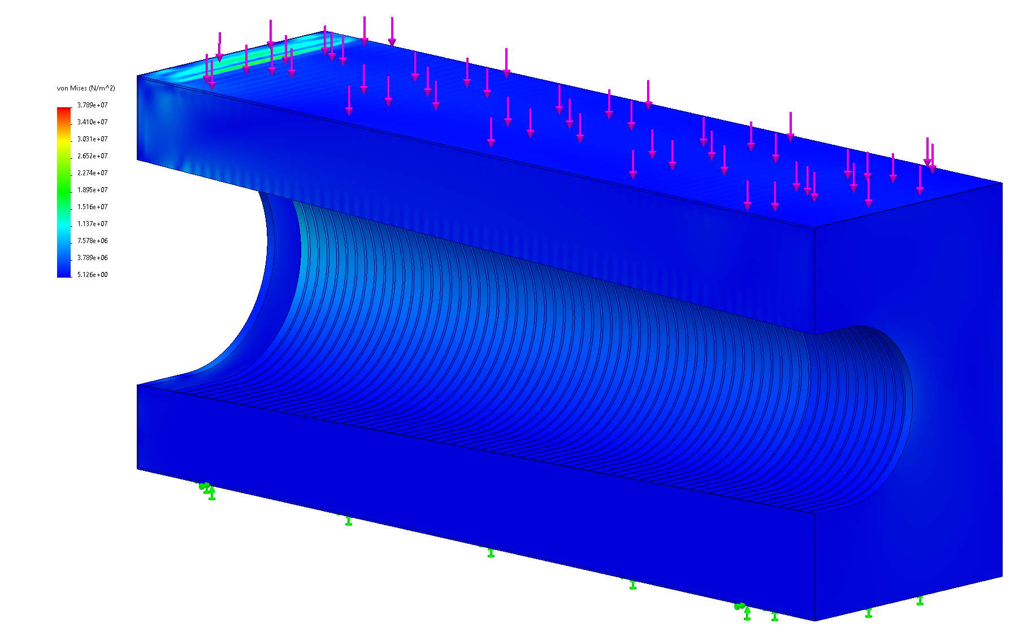
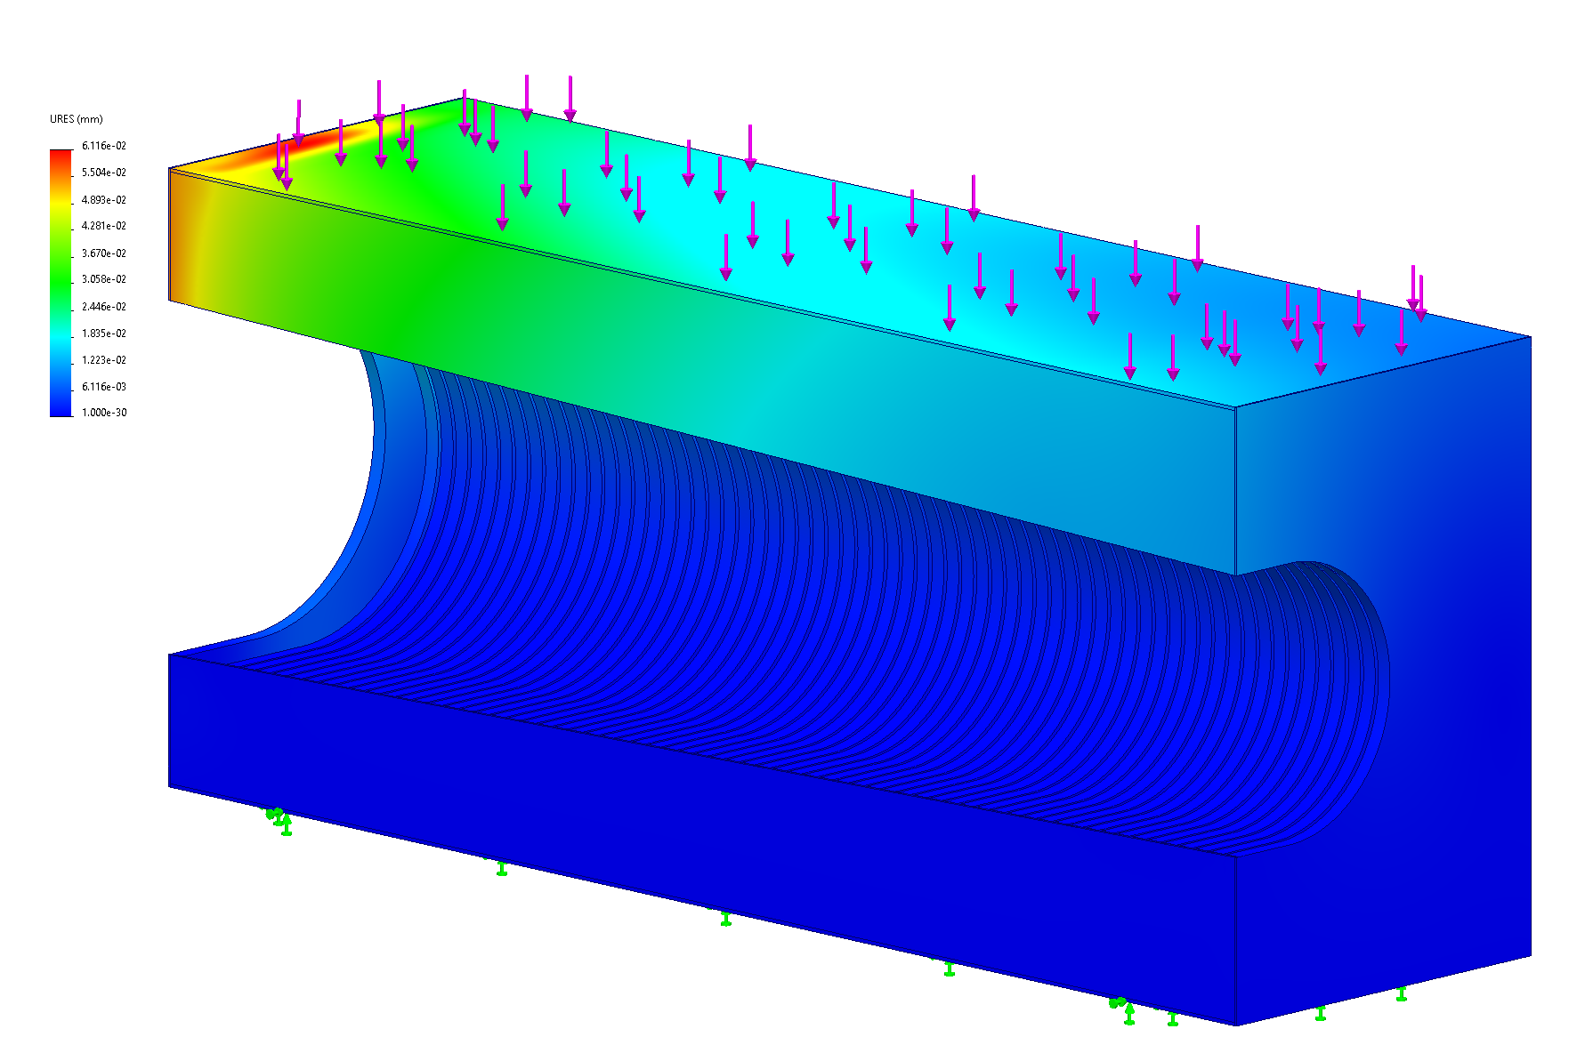
Bearing Load Analysis (Right Insert)
Charge: 3
Analysis Setup:
Applied Load: 9,200 kg (2x rows 23x 8M Tower Assemblies)
Fixtures: Bottom Face is held Fixed, Load is applied evenly distributed on top face.
Analysis Results:
Max Deflection: 0.06 mm. At rear of Insert, window area.
Max Stress: 38.0 MPa / 350 MPa.

Slide 19
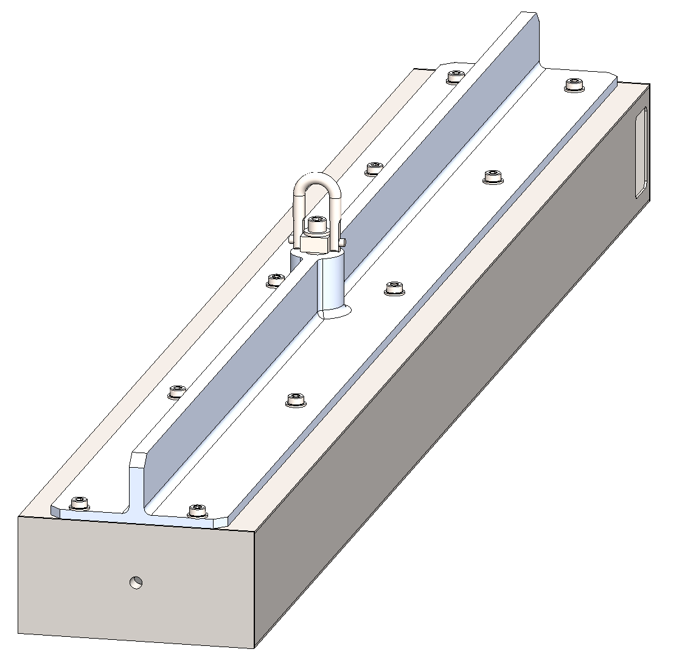
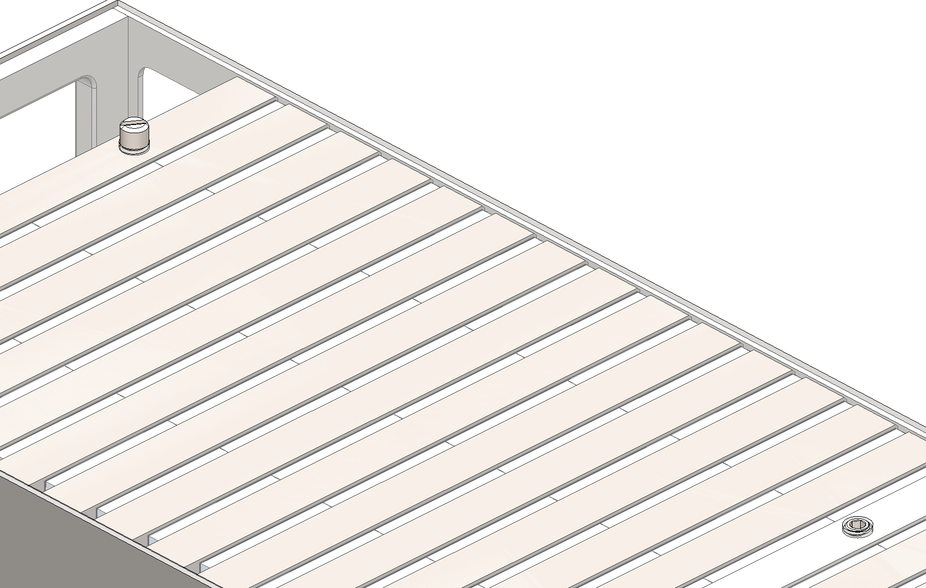
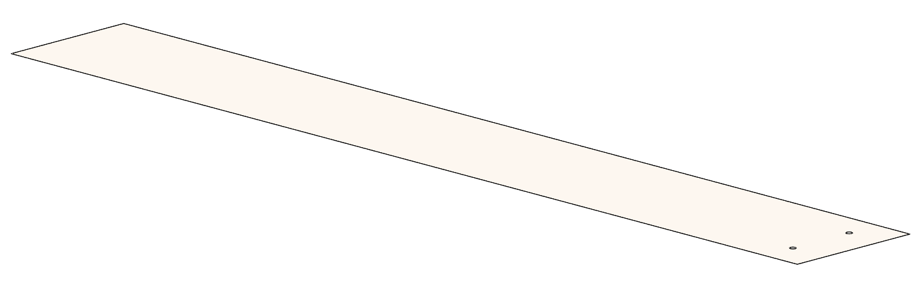
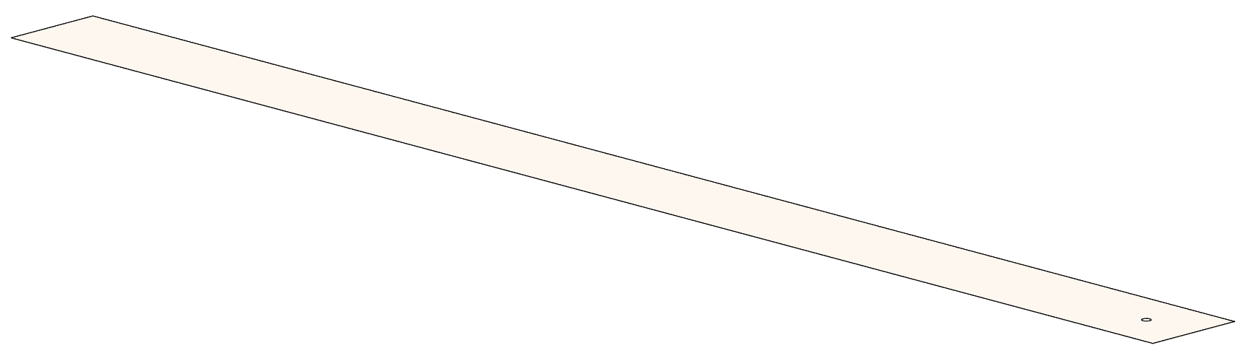
Assembly Methods (Detector Stack)
Charge: 4
Strongback lifting fixture attaches to Tower Assemblies using the M8 threaded holes on the top face. (10x for 8M Towers and Insert Assemblies / 5x for 4M Towers)
Threaded holes are tapped directly into the front plate, and 4x absorber plates.
Tapped absorber plates are the same ones tapped for side cover screws to reduce unique parts.
Hoist ring is positioned directly above center of mass of the Tower assembly (optimization / adjustment needed for proper positioning).
Ensures structural integrity of the tower assemblies, and eases the assembly process.
Simple design for multiple units to be constructed and utilized if desired.
At least 3 unique variations of the strongback will be necessary based on top plate geometry and assembled weight. 4M Tower, 8M Tower, and Insert variations.
Once Tower is positioned on the stack, the strongback is removed and alignment pins are installed in the rear 2x holes and set screws are installed in the remaining 8x holes.
Sheet metal shims of various thicknesses / widths allow for fine adjustments of the stack during the final assembly process.
Strongback attached to 8M Tower
Alignment Pins / Set Screws
Top plate transparent for visualization
Full and half width .005” thick shims

Slide 20
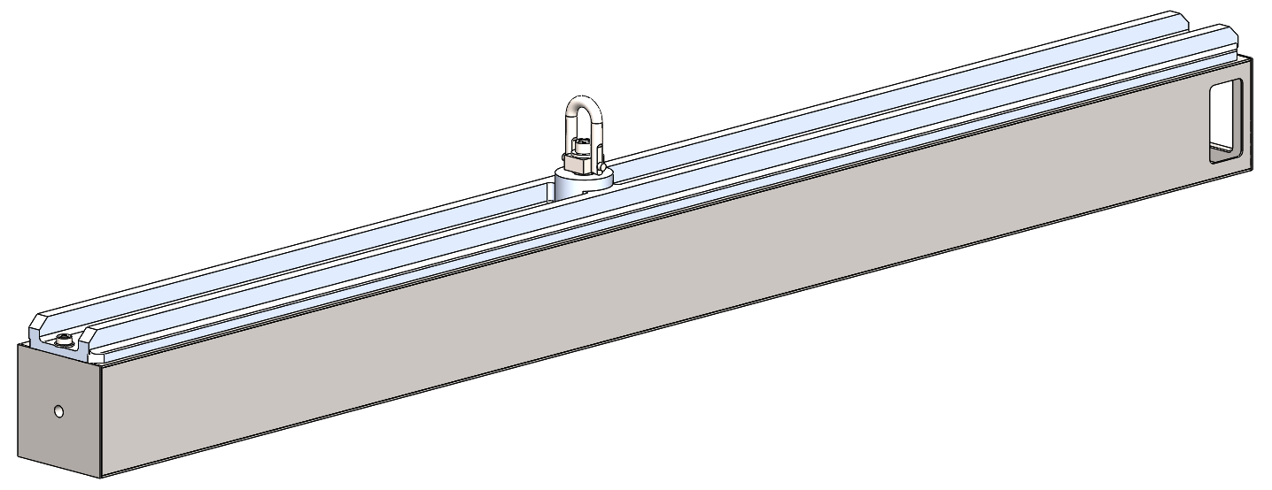
4M Tower Strongback Lifting Analysis
Charge: 4
Items for Analysis: 4M Tower under normal lift. (Tower + Strongback)
Analysis Setup:
Applied Load: Gravity (weight from assigned material density) + Estimated weight of internal components (scintillator envelopes).
Fixtures: Threaded region of strongback for hoist ring will be held fixed.
Analysis Results:
Max Deflection: 0.04 mm.
Max Stress: 33.0 MPa / 350 MPa.
IN
PROGRESS

Slide 21
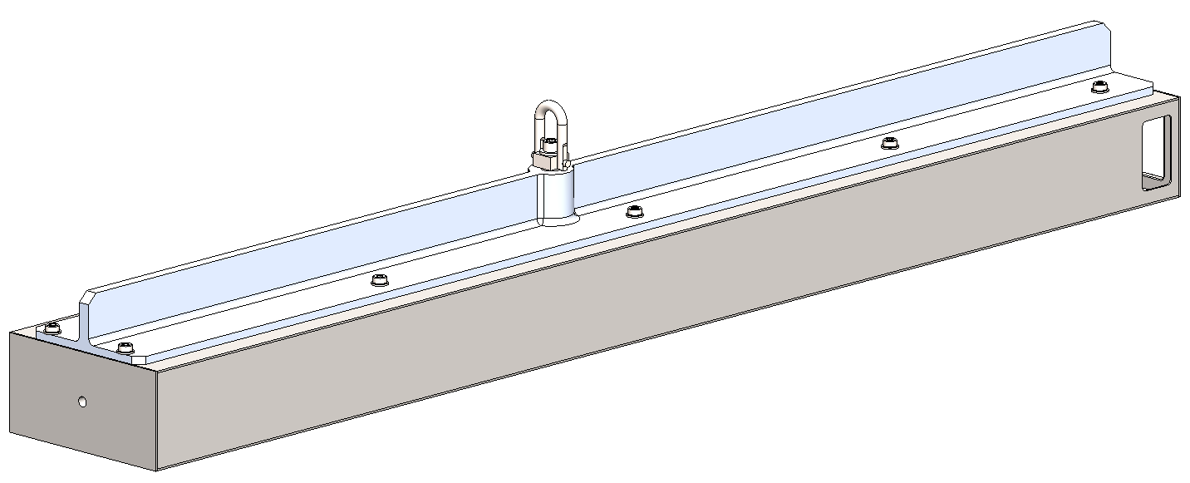
8M Tower Strongback Lifting Analysis
Charge: 4
Items for Analysis: 8M Tower under normal lift. (Tower + Strongback)
Analysis Setup:
Applied Load: Gravity (weight from assigned material density) + Estimated weight of internal components (scintillator envelopes).
Fixtures: Threaded region of strongback for hoist ring will be held fixed.
Analysis Results:
Max Deflection: 0.04 mm.
Max Stress: 33.0 MPa / 350 MPa.
IN
PROGRESS

Slide 22
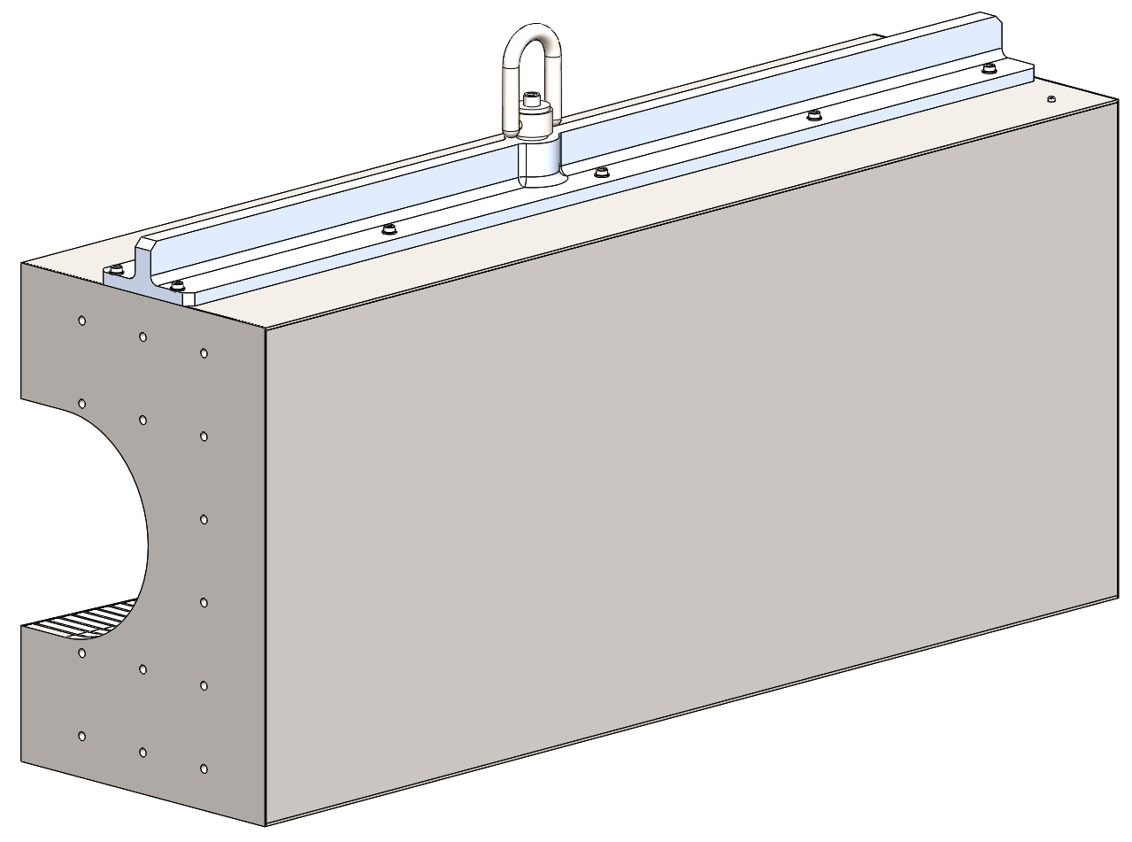
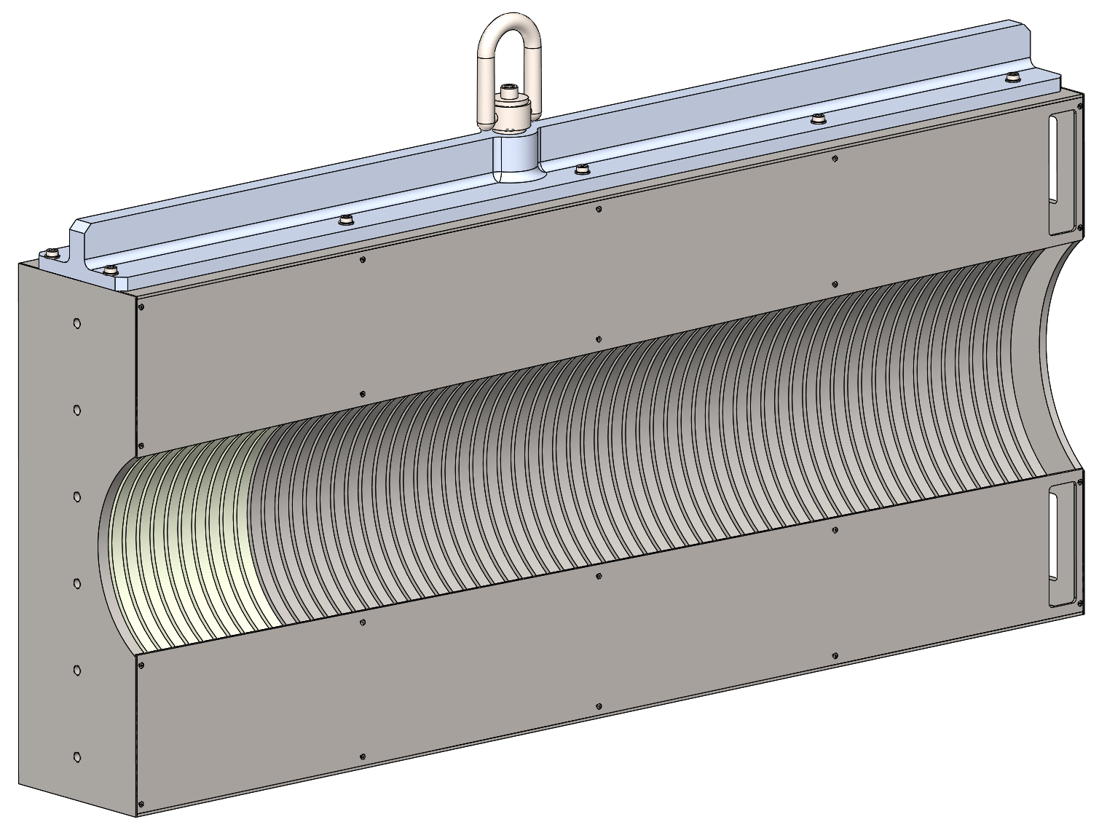
Left / Right Insert Strongback Lifting Analysis
Charge: 4
Items for Analysis: Left / Right Inserts under normal lift. (Insert + Strongback)
Analysis Setup:
Applied Load: Gravity (weight from assigned material density) + Estimated weight of internal components (scintillator envelopes).
Fixtures: Threaded region of strongback for hoist ring will be held fixed.
Analysis Results:
Max Deflection: 0.04 mm.
Max Stress: 33.0 MPa / 350 MPa.
IN
PROGRESS

Slide 23
In Summary
Design of the LFHCal has reached a mature state and is ready for final detail polish, finalized drawings, and call for fabrication quotations.
1045 Carbon Steel has high magnetic permeability, making it suitable for the magnetic quench material, and is also relatively cheap, easy to machine, and abundant in industry.
Design meets the criteria to accommodate high fidelity measurements based on the quantity and size of the scintillator tile assemblies as well as the compact flex PCBs and connectors allow for maximum cross-sectional area of each layer to be occupied by scintillator tile material, maximizing the effective monitored area / volume.
Structural Analyses of the worst-case configurations of the Tower assemblies conclude the tower designs are robust and do not indicate a point of failure based on normal loading.
Further analysis of the hoisting strongbacks and lifting configurations conclude that the proposed lifting and assembly process is sufficient to protect the tower assemblies from damage during normal lifting operations, promote ease of assembly of the detector stack, and allow for safe handling of the assemblies by personnel.
Overall, we believe the LFHCal Design and proposed fabrication and assembly procedures are robust, and mature enough to move into finalization of design, and toward procurement of long lead components.

Slide 24
Final Tasks before Procurement Readiness
Finalize and Review Drawing Package and Assembly Plan.
Create Design Specification document for fabrication standards / testing procedures, acceptance criteria, and shipment instructions.
Procure, assemble, and test a single 8M Tower Assembly. Make revisions to design as necessary.
Perform any necessary structural analyses based on final magnet quench forces / seismic code requirements for the detector assembly. (Support structure engineers??)

Slide 25
Thank you for your attention!
Questions / Comments / Discussion

Slide 26
To Do Morning 9/19
Slide 9: 4M expanded View and alignment pin view.
Slide 10, 11: Expanded views and alignment pin views.
Slide 18: Picture of sheet metal shim

