Slide 1
Radio Astronomy Instrumentation
Paul O’Connor
EDIT school
Oct. 13, 2023

Slide 2
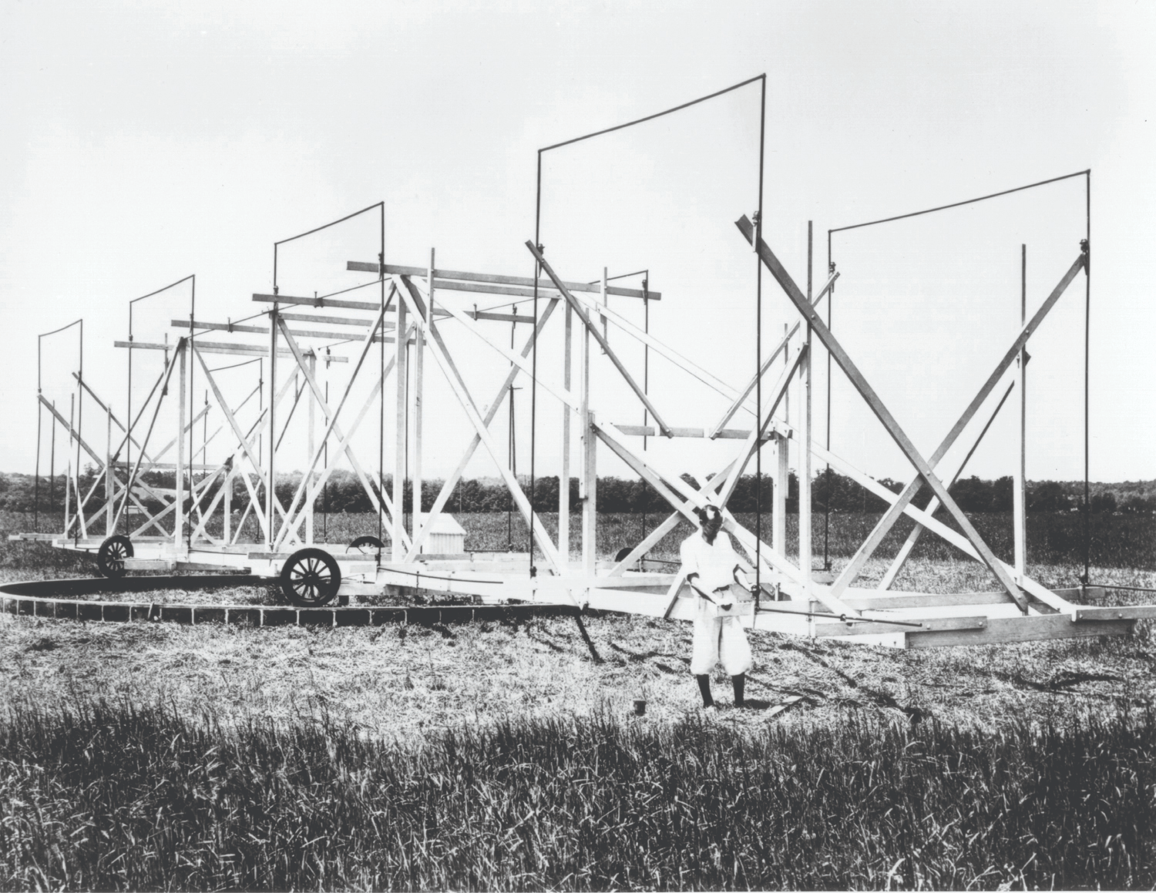
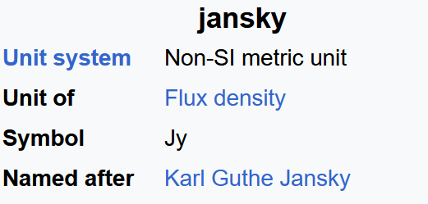
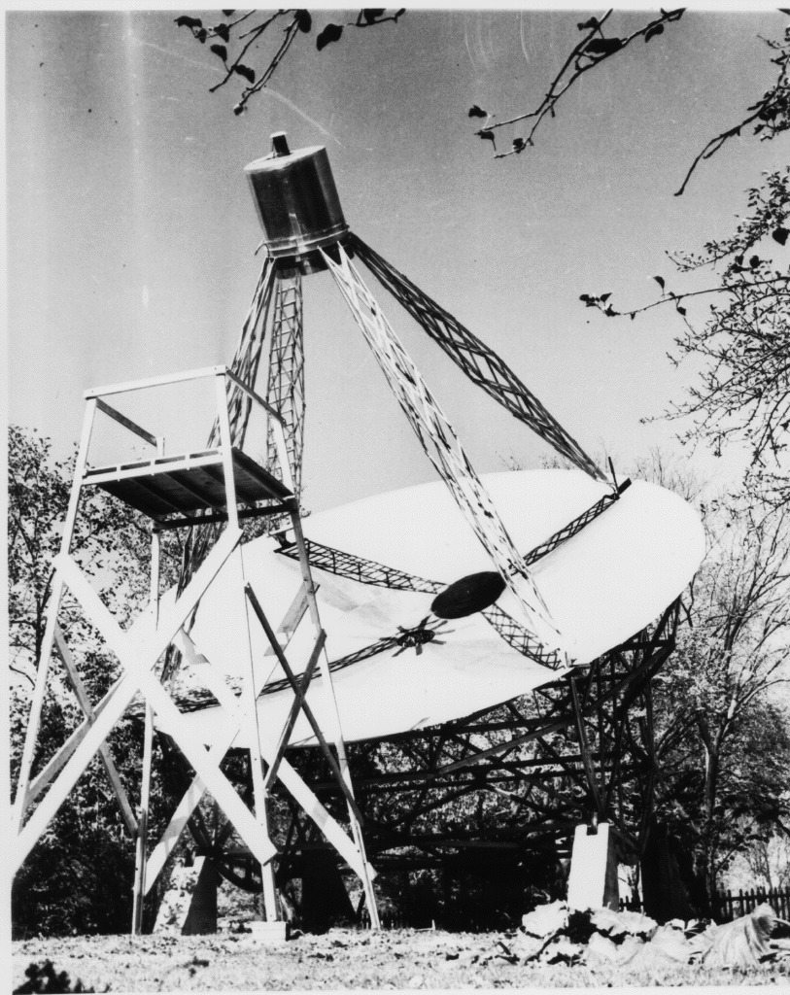
Historical Overview (1/2)
Jansky 1932
First observation of radio waves from space
Reber 1937
First parabolic dish antenna
K. Jansky, "Electrical disturbances apparently of extraterrestrial origin." Proceedings of the Institute of Radio Engineers 21.10 (1933): 1387-1398
G. Reber, "Cosmic Static," in Proceedings of the IRE, vol. 28, no. 2, pp. 68-70, Feb. 1940, doi: 10.1109/JRPROC.1940.228921.
Notes:
Jansky:
Bell Labs, investing. noise interference w/transatlantic shortwave voice comm.
20.53 MHz rotatable dipole
identified extra-solar source from 23h56m sidereal period
identified location as Sag A*
got MS from UW then left Astro
Reber: 9.6m parabolic, receiver at focus. Elevation axis
Worked for Bell Labs. Sky map at 160MHz. Low frequency studies from Tasmania.
discovered frequency dependence of MW spectrum, opposite to expectation from a hot blackbody
“World’s only radio astronomer” from 1937-47

Slide 3
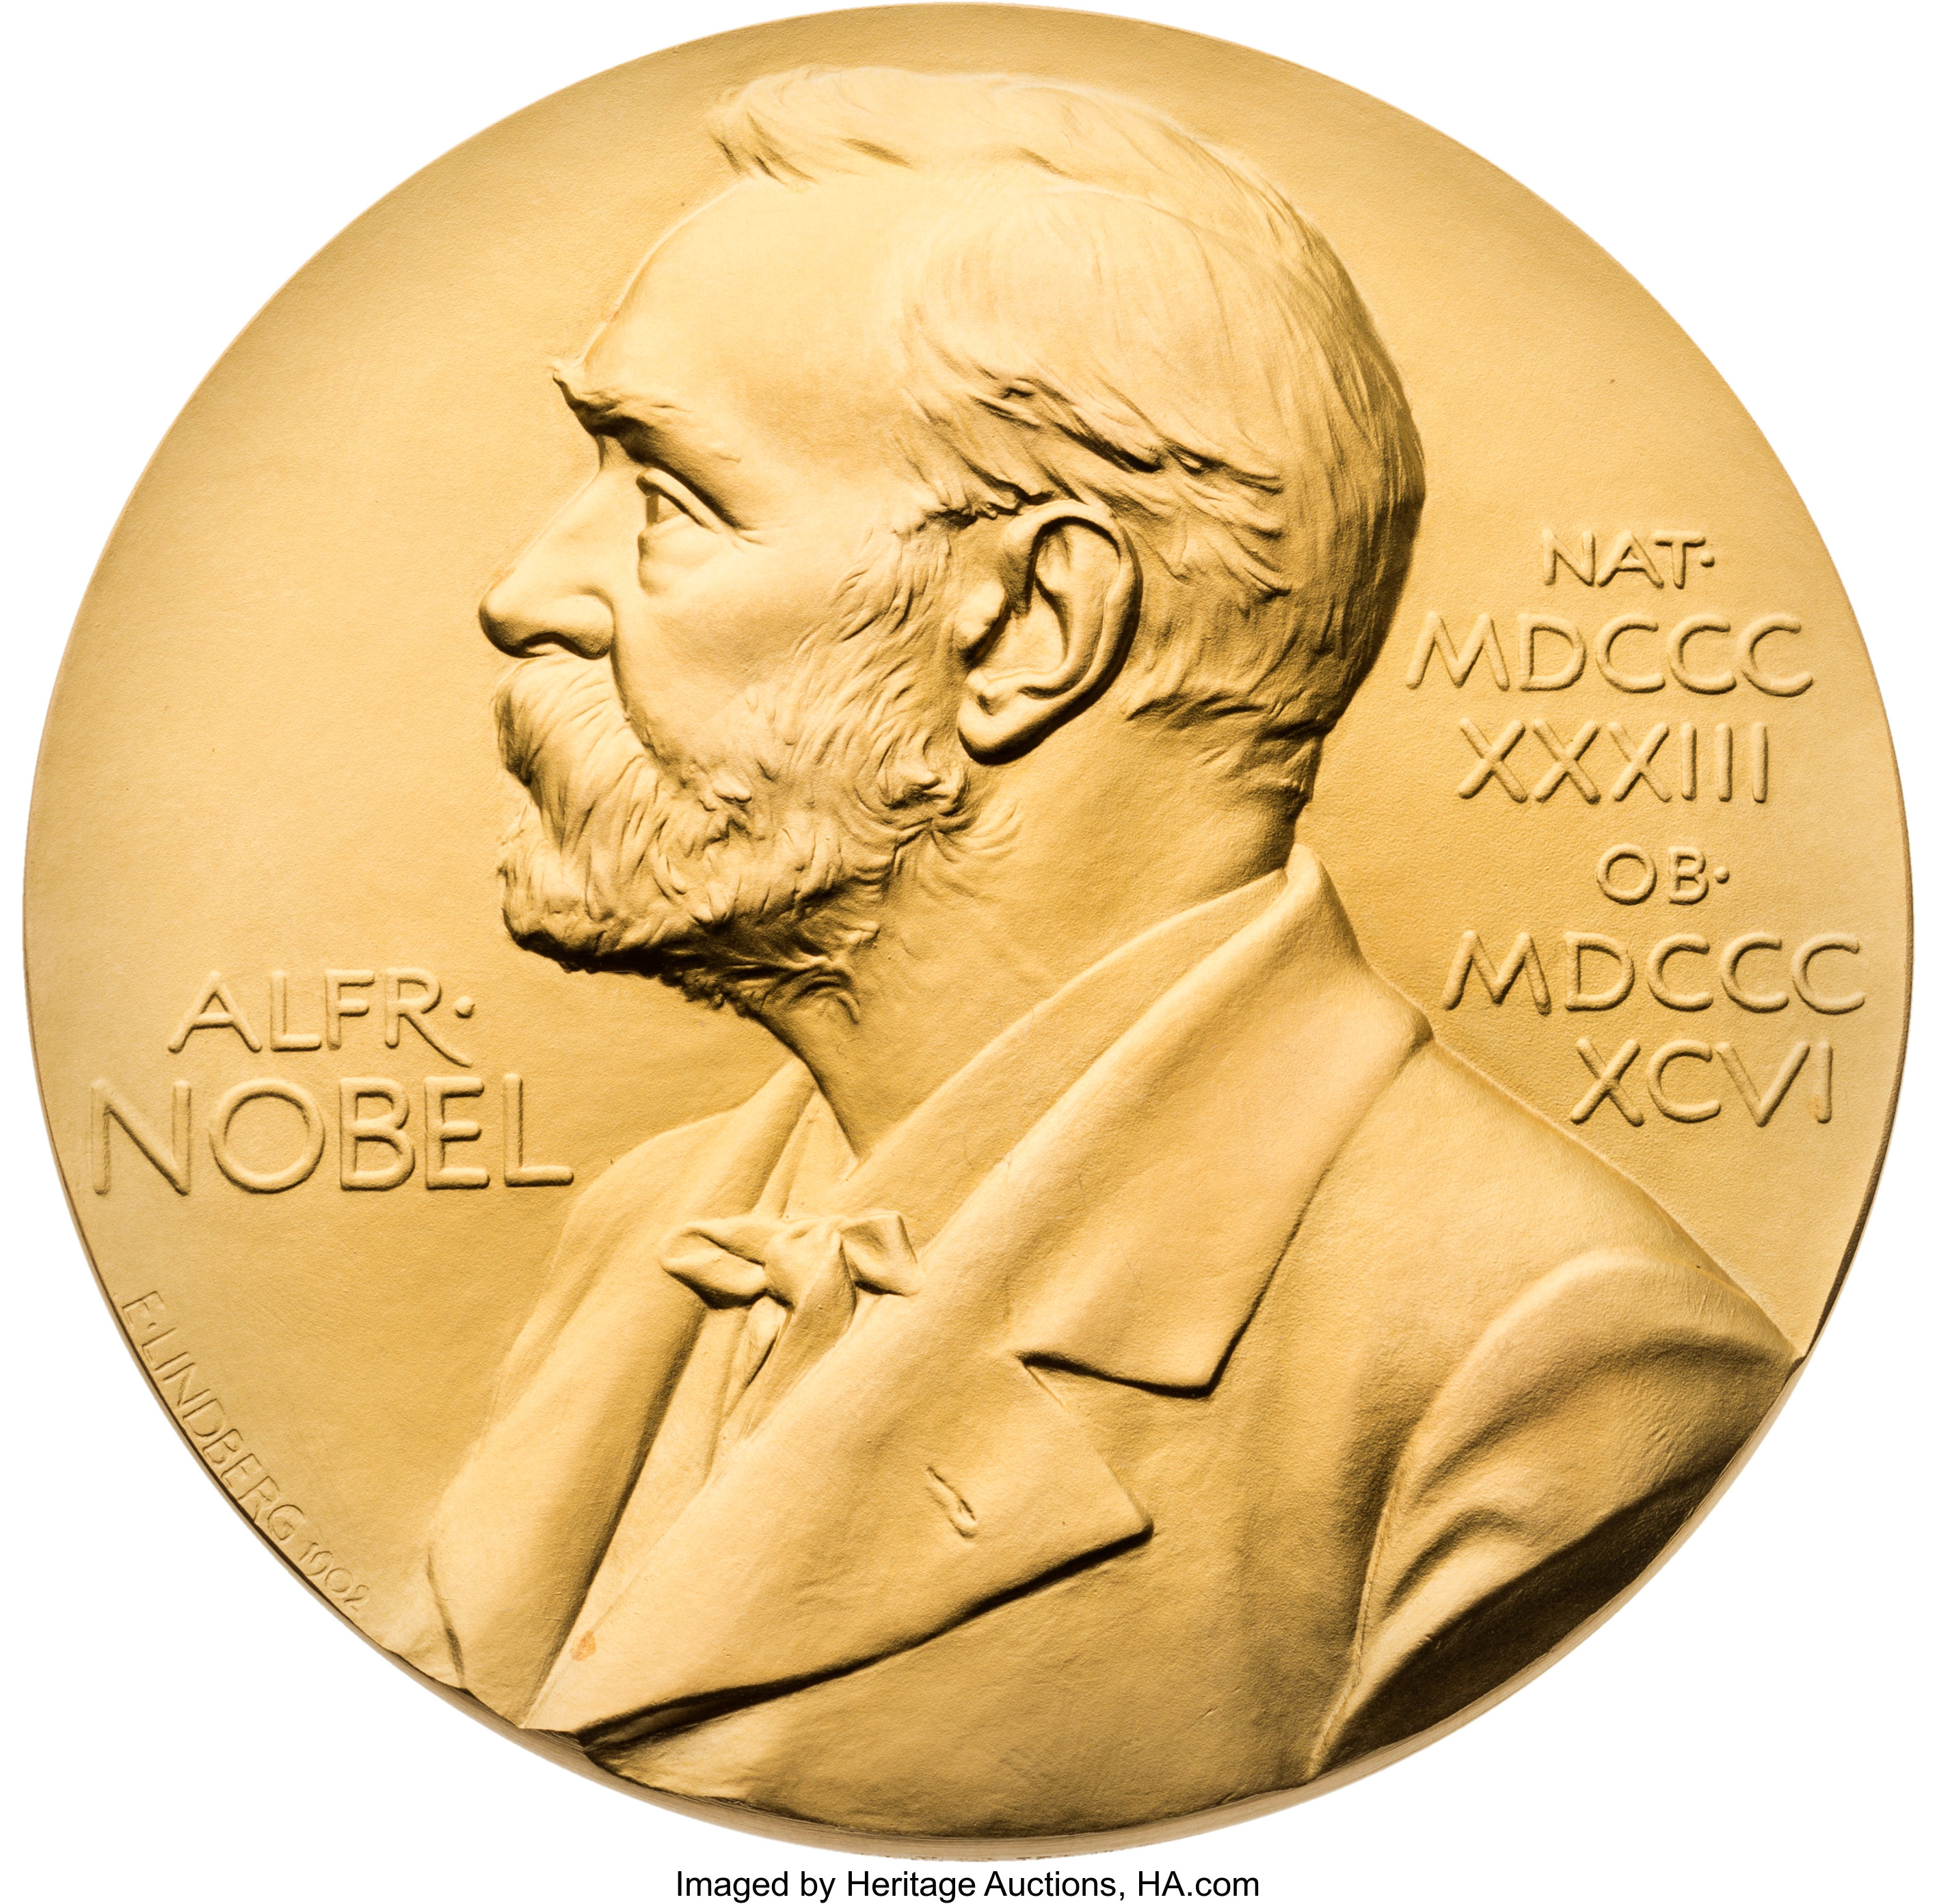
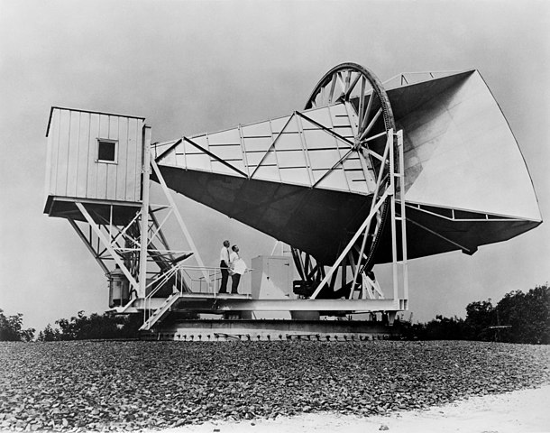
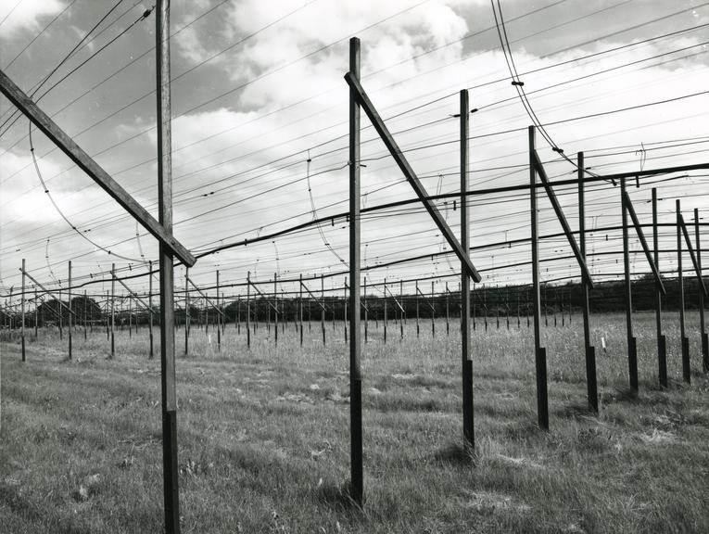
Historical Overview (2/2)
Penzias and Wilson 1963
Cosmic microwave background
Bell and Hewish 1967
Pulsars
Penzias, Arno A., and Robert W. Wilson. "A measurement of excess antenna temperature at 4080 MHz." A Source Book in Astronomy and Astrophysics, 1900–1975. Harvard University Press, 1979. 873-876.
HEWISH, A., BELL, S., PILKINGTON, J. et al. Observation of a Rapidly Pulsating Radio Source. Nature 217, 709–713 (1968). https://doi.org/10.1038/217709a0
Notes:
6.1x6.1m Hogg horn-reflector, elevation wheel and turntable azimuth. One of 2 ground stations originally built for Project ECHO; wideband (no resonant structures), ultra sensitive (Lhe-cooled RX, unobscured aperture)
Found 100X expected noise at 4GHz, independent of pointing direction. Fortuitous connection w/Princeton
Bekk.Hewish 2000-element dipole array constructed to search for quasars by their bursty emission signature, nu=880MHz

Slide 4
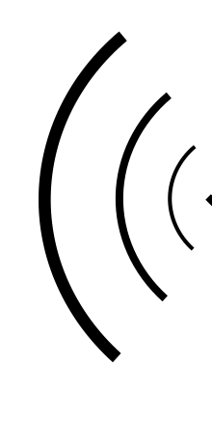
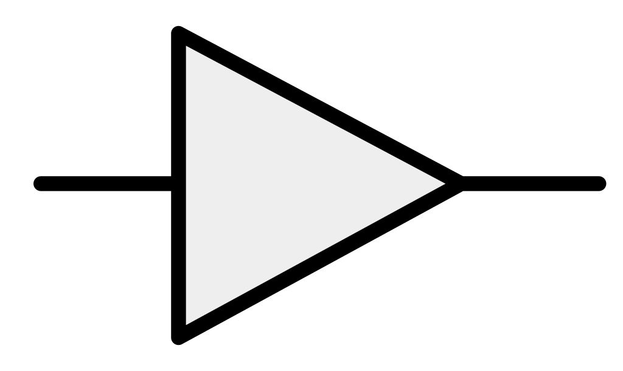
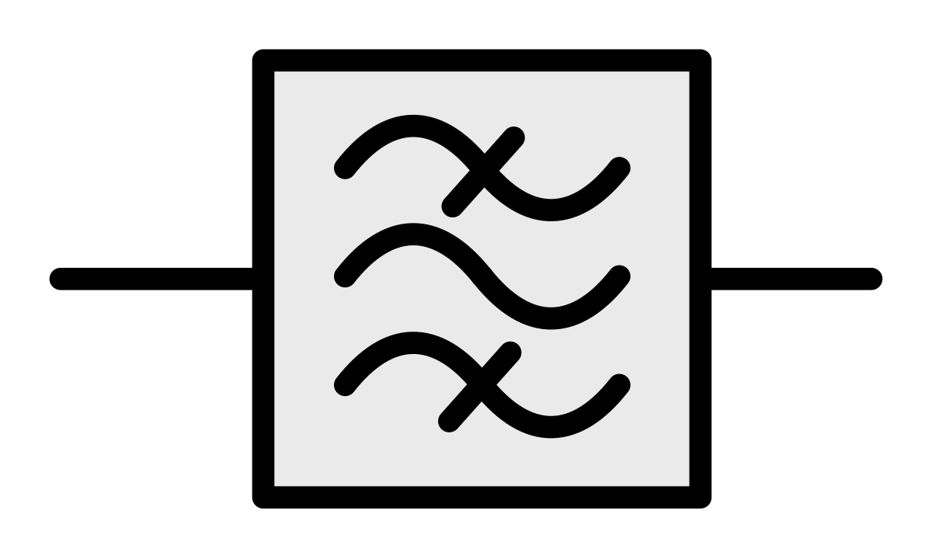
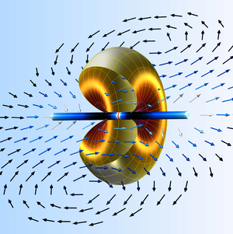
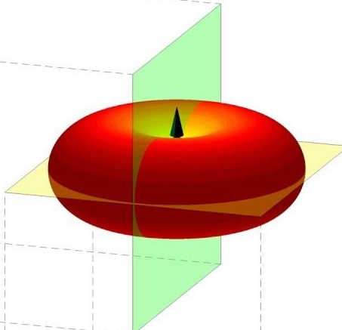


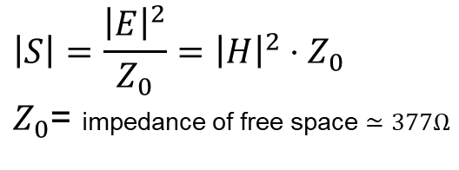


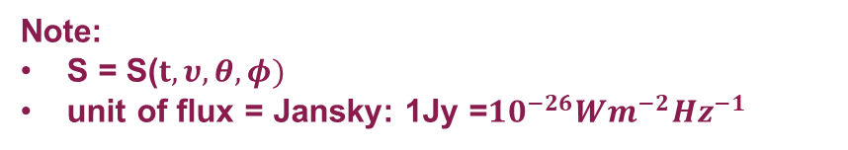

Detecting radio waves
antenna
Elementary antennas
low-noise amp
filter
receiver
dipole
$${\vec{E}}$$
Quantity to be measured is Flux (S)
V
$$\vec{S}=\vec{E} ×\vec{H}$$
In the far field, a wave propagating in free space has
$$\left|S\right|=\frac{{\left|E\right|}^{2}}{Z_{0}}={\left|H\right|}^{2}⋅Z_{0}$$
$Z_{0}$= impedance of free space $≃377Ω$
loop
$${\vec{H}}$$
Note:
S = S($t, υ,θ,φ)$
unit of flux = Jansky: 1Jy =${10}^{−26}Wm^{−2}{Hz}^{−1}$
$$T_{ant}≡\frac{P_{ν}}{k_{B}}$$
by analogy with Johnson noise produced by a resistor at temperature T_{ant}
Notes:
General case: we want to detect radio wave emission from astrophysical objects that are incident (as plane waves) on our antenna
by measuring E-field intensity we can infer flux (just div by Z0)
Flux is a function of frequency, sky coordinates, and time. Often we also want to know its polarization state
The Antenna’s function is to transduce the EM wave in free space into bound conductors in the metallic elements of the antenna
The resulting currents may be used drive voltage-domain electronics or simply to heat a bolometer
simplest antennas (dipole and loop) have resonant behavior when their dimensions are equal to sub-multiples of the EM wavelength
Therefore they are not well suited for broad frequency bands. Techniques exist to broaden their bands and alter the spatial patterns to be more or less directional
Often the antenna is preceded by focusing optics (dish, horn, mirror, lens) to increase the flux density at the antenna probe.

Slide 5
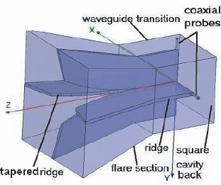
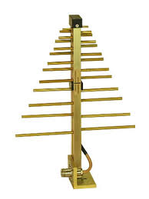
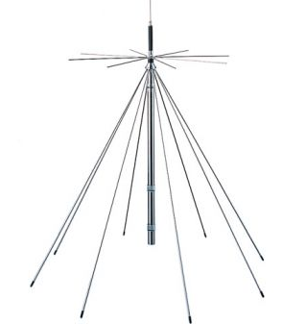
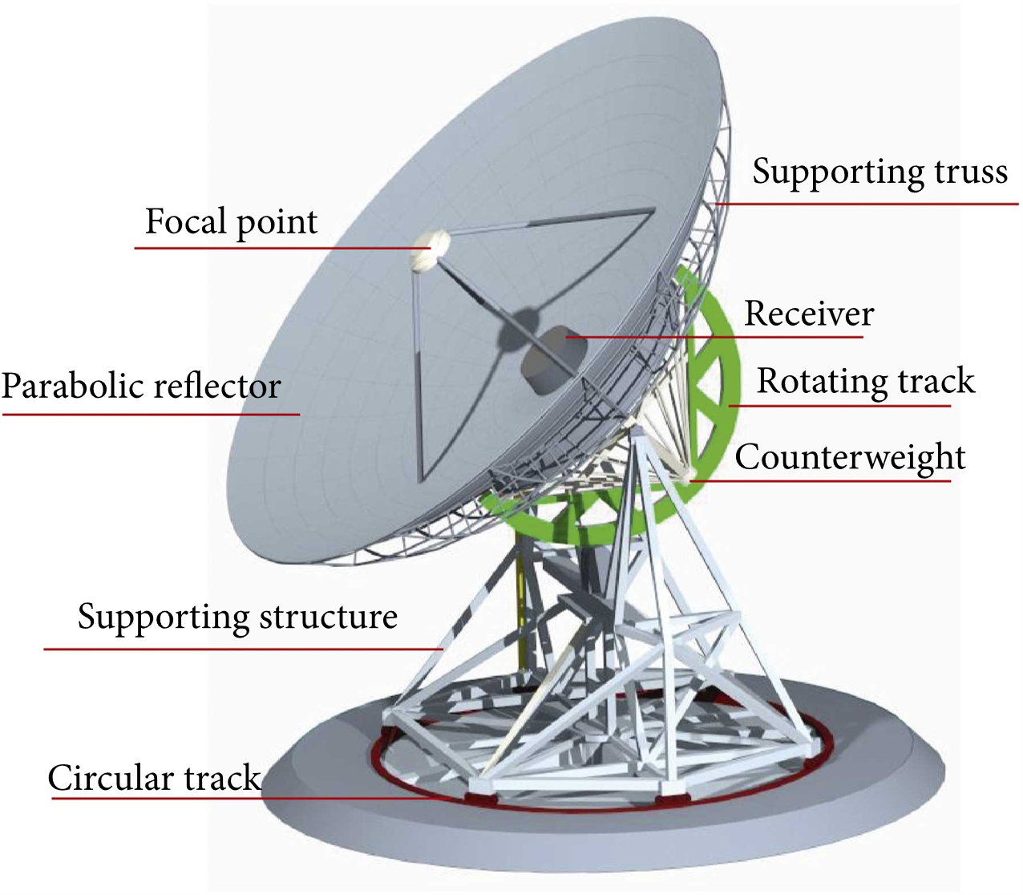
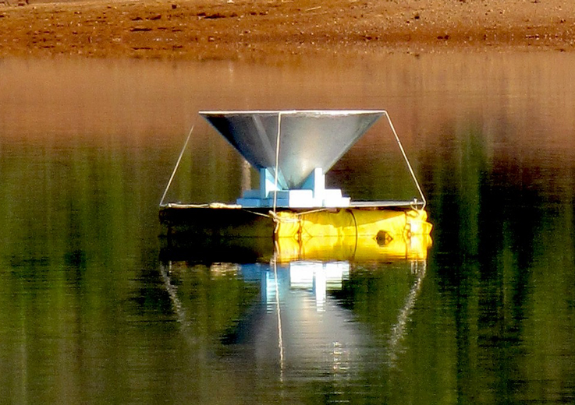
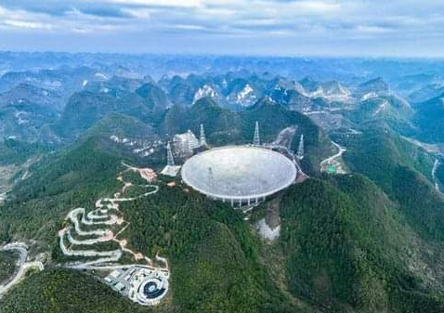
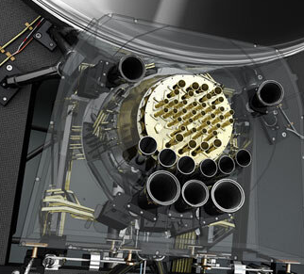
Moder radio astronomy antennas
Log-periodic dipole
discone
dish
ridged waveguide
Planck HFI
SARAS-3
FAST

Slide 6
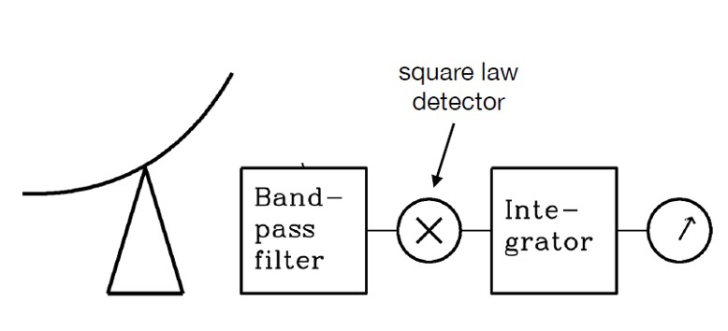
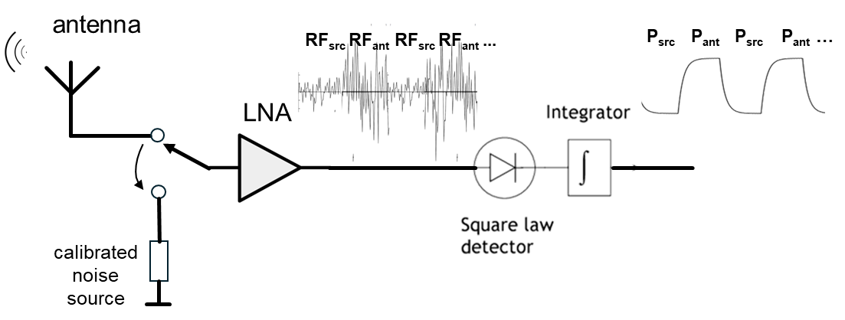
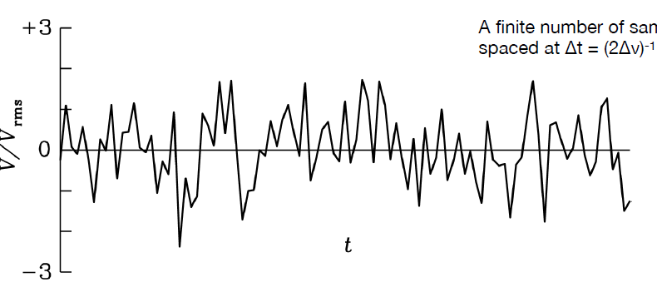
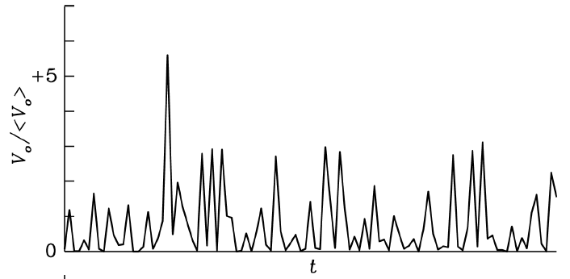
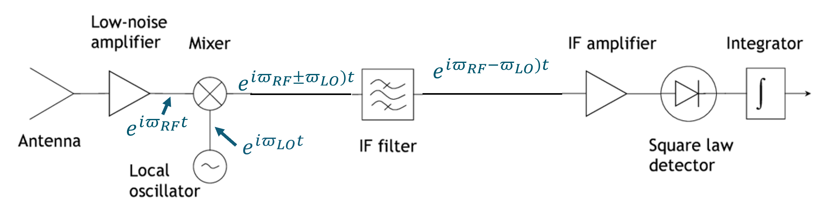



Simplest receiver: Total Power Radiometer
(e.g. diode at low signal level)
Dicke-switched Receiver
A
B
C
V(A)
Heterodyne (downconversion) Receiver
Frequency translation
TPR
V(B)
V(C)
$V_{A}\left(t\right)=A∙cos⁡(πt)$ (zero mean)
$${V_{B}=V}_{A}^{2}\left(t\right)=A^{2}(1+\sin^{2}\left(πt\right))$$
$$V_{C}=A^{2}=V_{rms}^{2}∝Power$$
TUNABLE
Notes:
With a stable noise source we eliminate gain fluctuations which would otherwise be indistinguishable from the signal

Slide 7
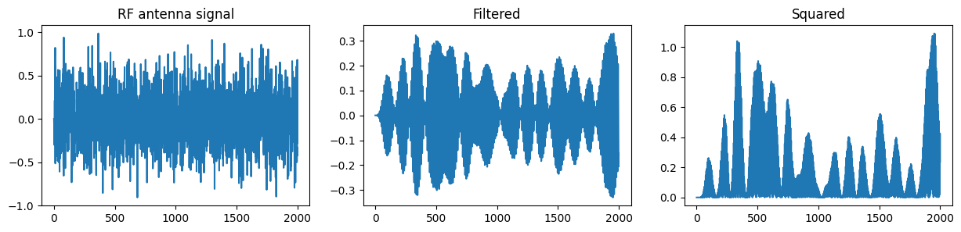
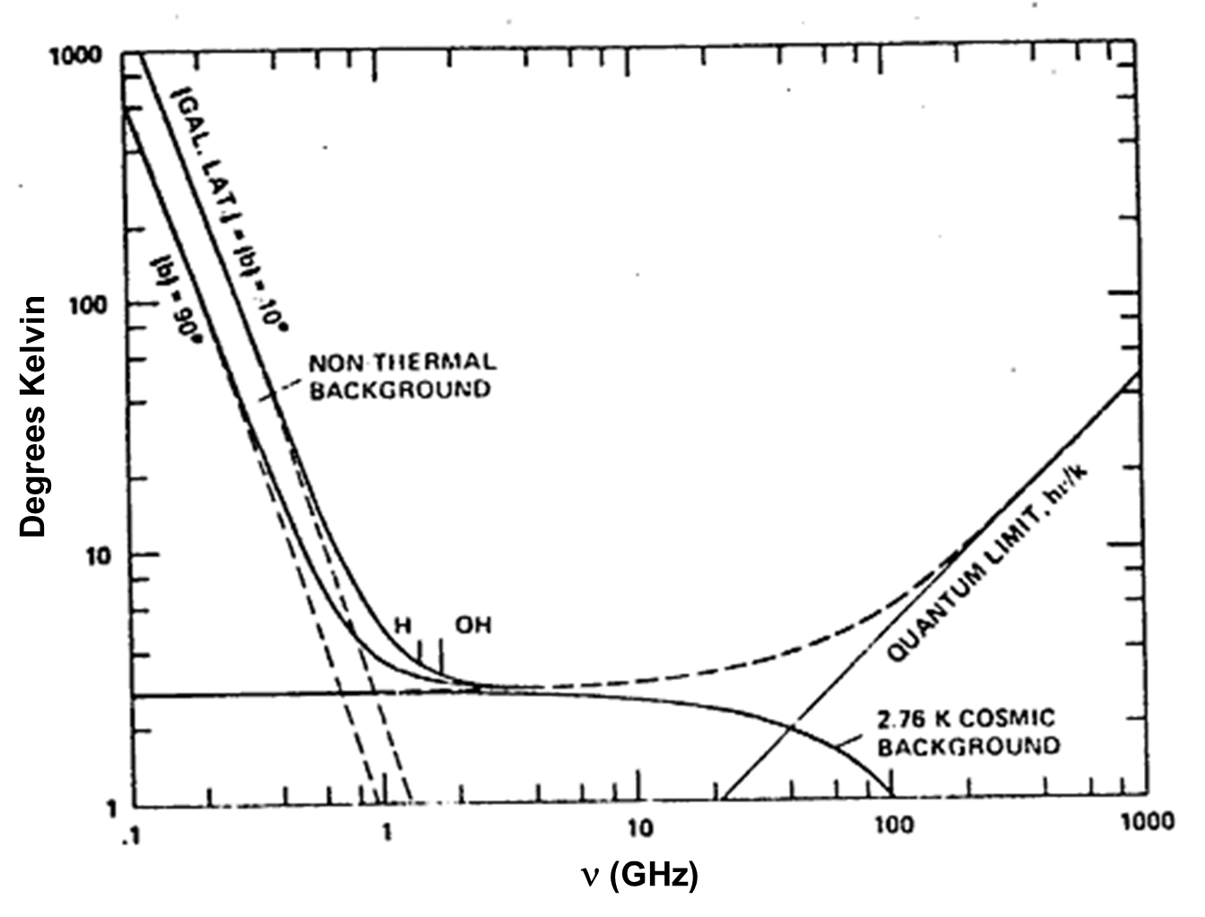
Signals and noise in receivers
The signal itself has a noiselike waveform
  radio astronomy targets emit incoherent radiation
Objects in the field of view of the antenna other than the target
  thermal emission from ground and antenna structures
  celestial sources in our Galaxy
  extragalactic sources
  satellites in Earth orbit
Noise from the receiver front end electronics
  LNA equivalent input noise or noise figure
  losses in cables, couplers, mixers etc.
Manmade and meteorological RFI
Average radio sky, 0.1 GHz – 1 THz
21cm

Slide 8
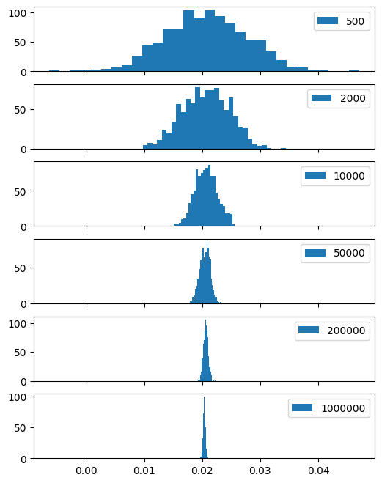
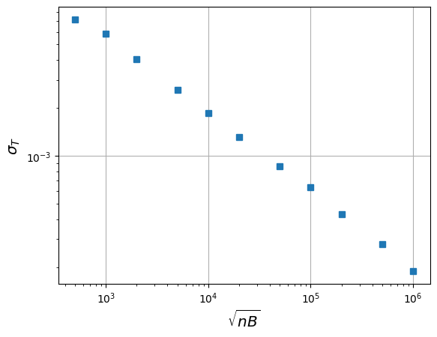
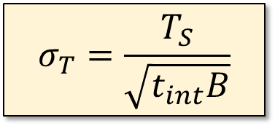
Radiometer equation
The signal itself has a noiselike waveform
Consider the following experimental setup using a total power radiometer:
The antenna signal is filtered, squared, and averaged to provide a measure of the power over a band of frequencies with bandwidth B.
Output of the TPR is sampled at Nyquist rate, f_{Nyq} = 2B.
In a time t_{int} we will have made n = 2*t_{int}*B measurements.
By the central limit theorem, if the noise is stationary and the underlying distribution is 100% random then the uncertainty in the measurement will decrease as n^{-1/2}
$$σ_{T}=\frac{T_{S}}{\sqrt{t_{int}B}}$$

Slide 9








Spectrometers
Total power radiometer does not provide information about the frequency content of the incoming radiation
antenna
RF amp
filterbank
Analog filterbank:
  RF signal split into N_{ch} bandpass filters before measurement
ν₁
TPR
ν₂
TPR
ν₃
TPR
ν₄
TPR
ν₅
TPR
Heterodyne system:
  RF signal translated into fixed IF frequency by N_{ch} local oscillators before measurement
$$×$$
TPR
$$×$$
TPR
$$×$$
TPR
$$×$$
TPR
LO₁
$$\sim$$
LO₂
$$\sim$$
LO₃
$$\sim$$
LO₄
$$\sim$$
Notes:
Parallel structure illustrated (only LNA is shared)
Can also time-share a single TPR with round-robin
Heterodyne can scan the measurement band by using single, tunable LO translating different sections of the RF into same IF; one IF filter and TPR

Slide 10
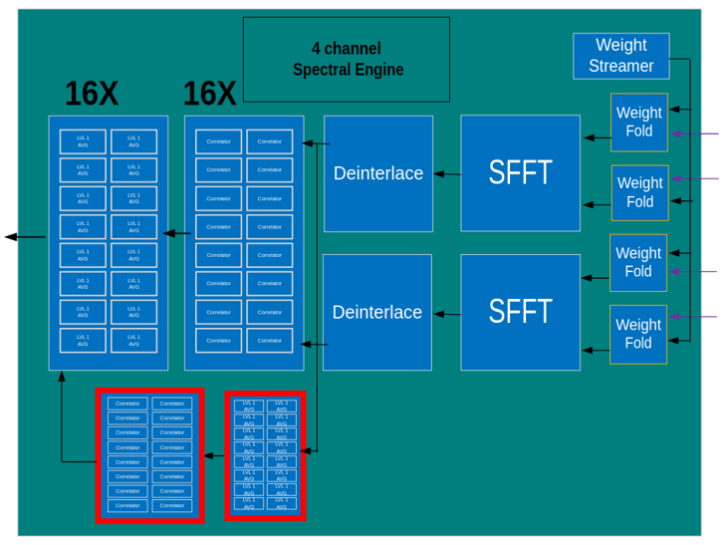
4-input, all-digital spectrometer
4X spectrometer with all auto- and cross-correlations
2048, 25 kHz channels per input
“Firmware Defined Radio
CH0
CH1
ADC Data
14b, 102.4Msps
CH2
CH3
E. Raguzin, J. Fried, A. Slosar
LuSEE-Night project
Notes:
Teaser for LuSEE-Night talk

Slide 11

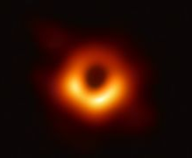
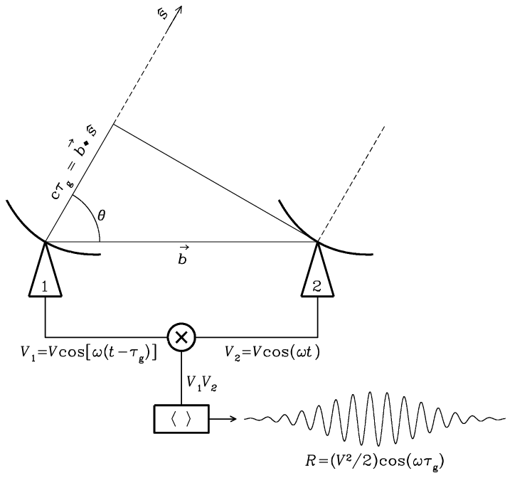
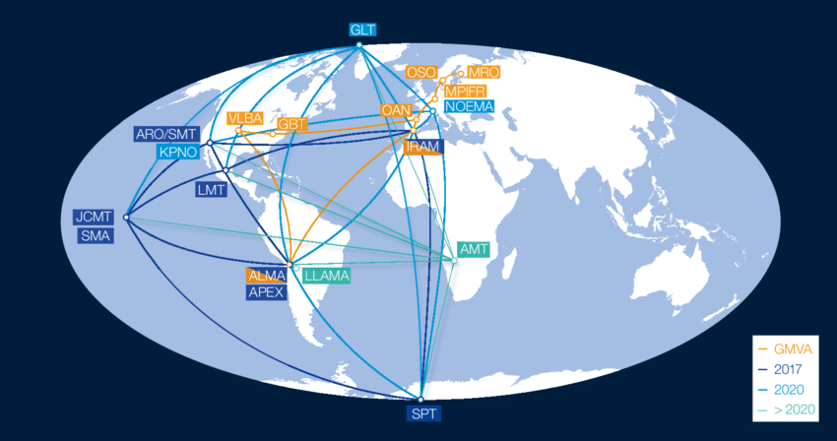
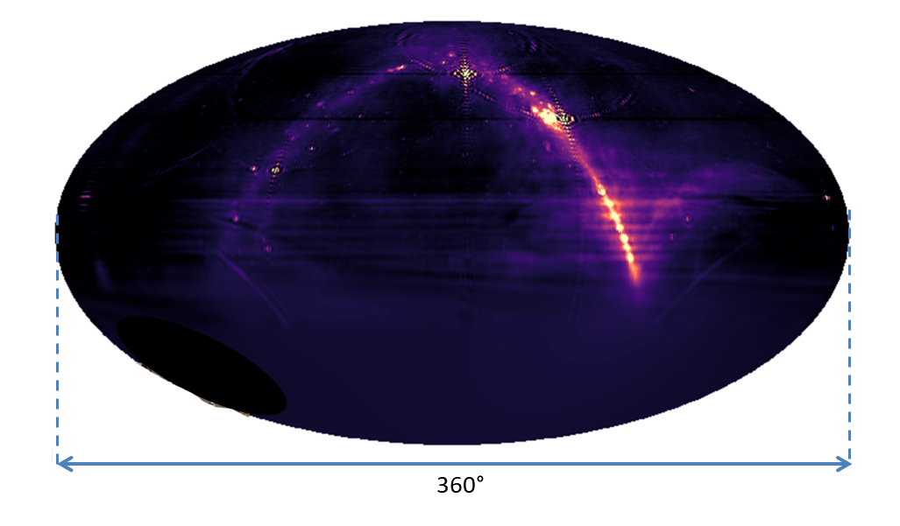
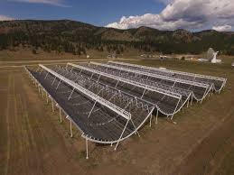
Instrument design: radio interferometer
One baseline (N_{dish} = 2)
black hole M87
Large b, small λ
Large D, small N
λ
D
50 μarcsec
Event Horizon Telescope
b
Small b, large λ
Small D, large N
NRAO
Interference fringes based on path length difference between 2 stations
Collecting area πD²N_{dish}/4
Angular resolution λ/b
Angular field of view λ/D
CHIME
Notes:
Resolution EHT/CHIME = 1e8

Slide 12
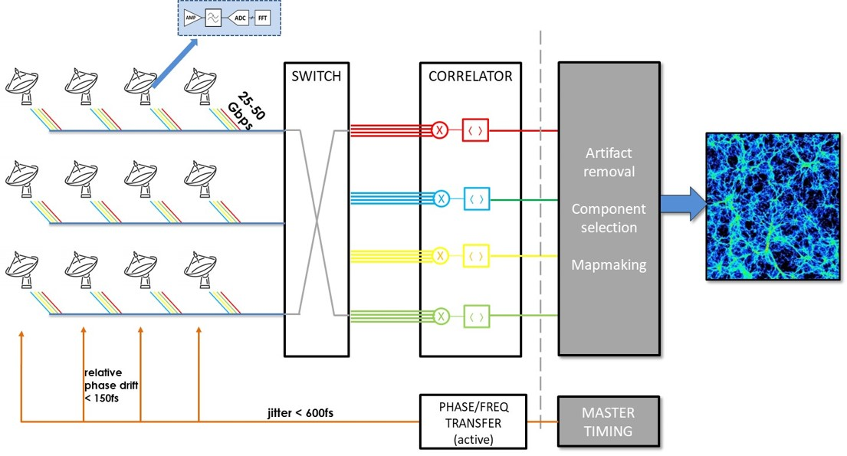
Signal processing for large array

Slide 13
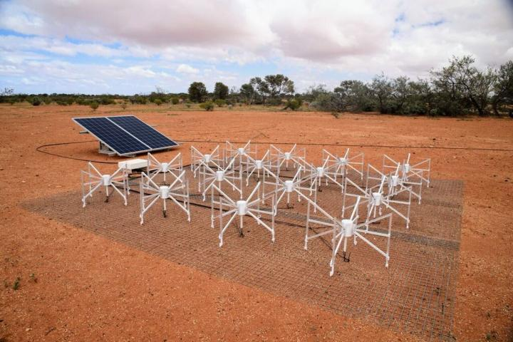
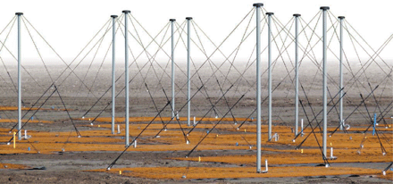
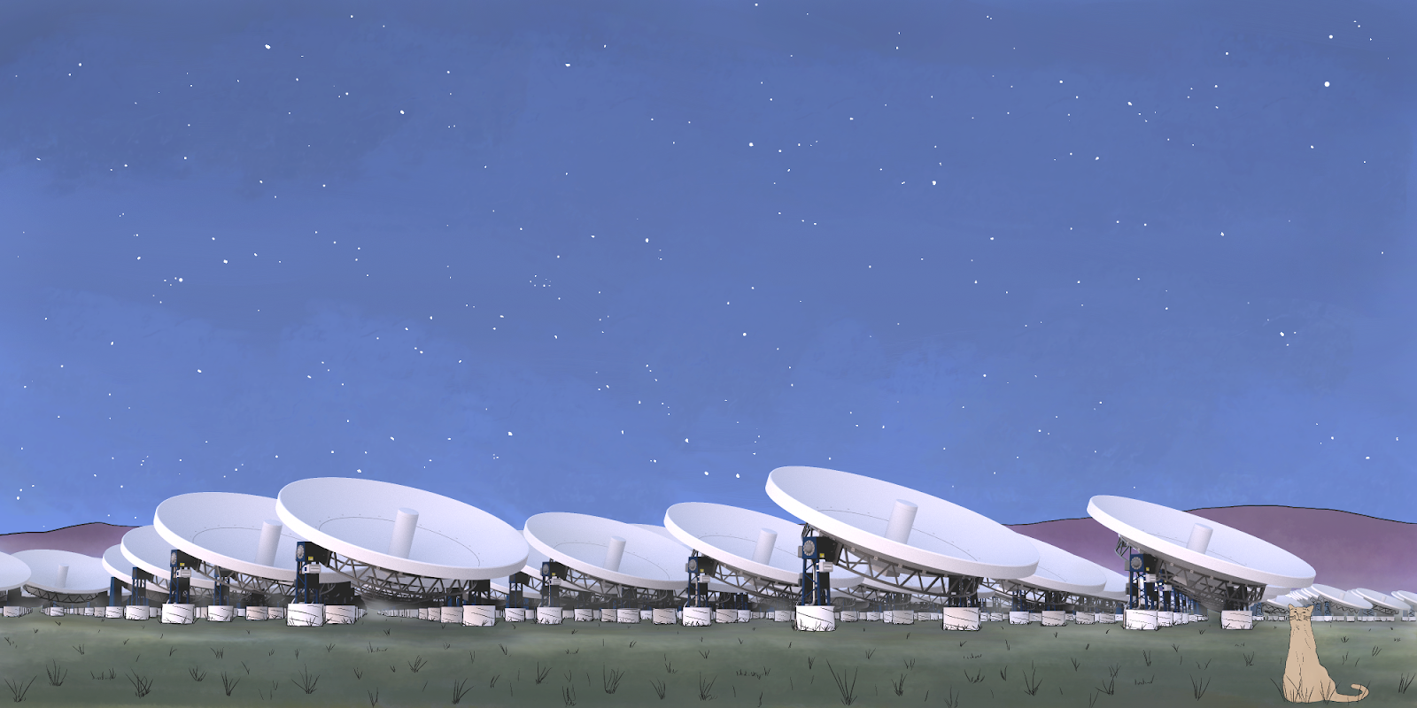
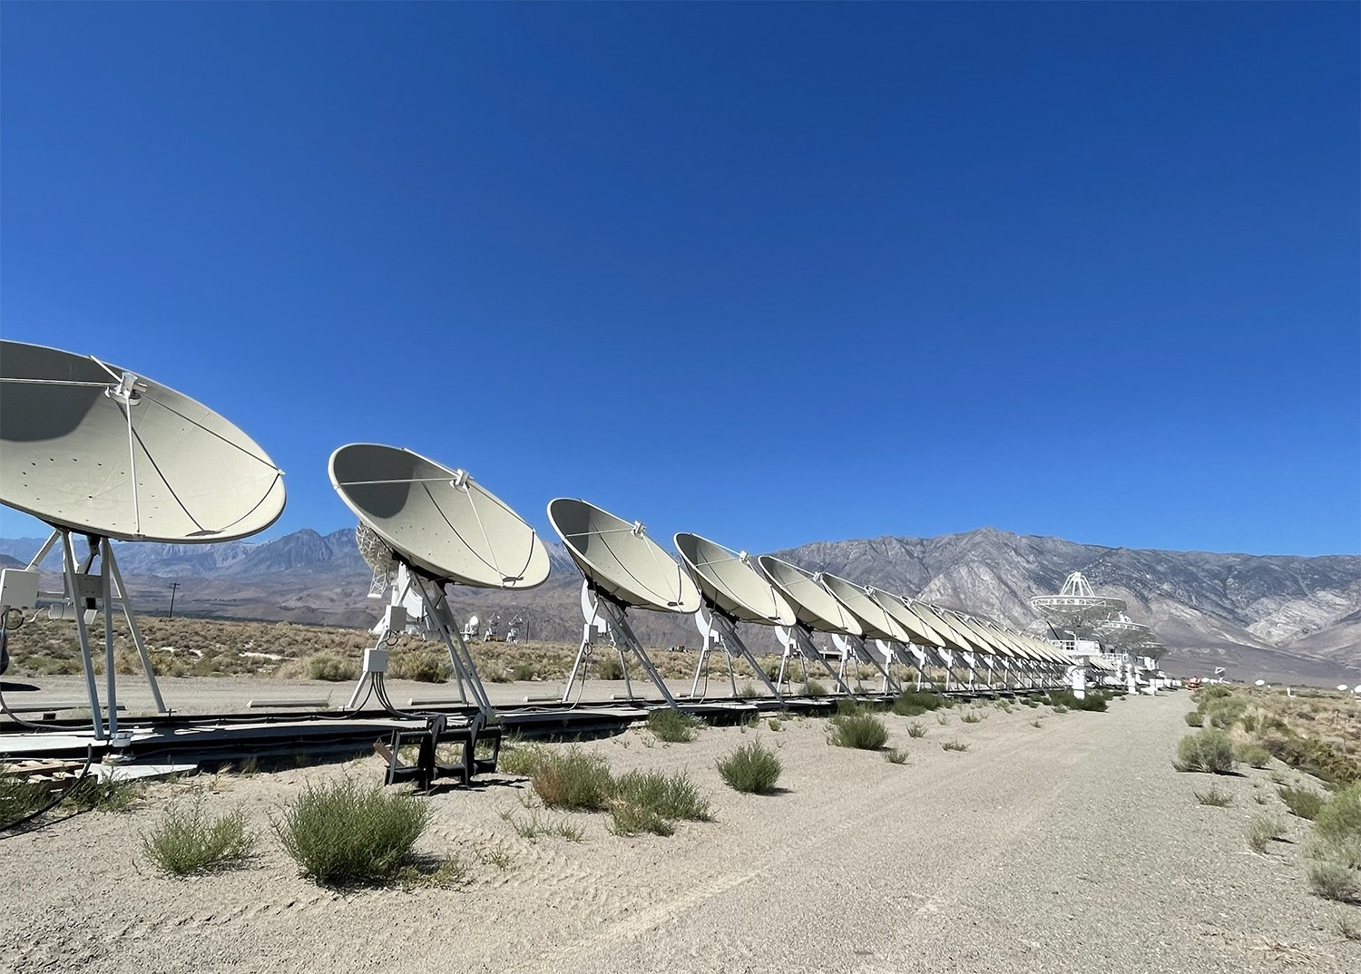
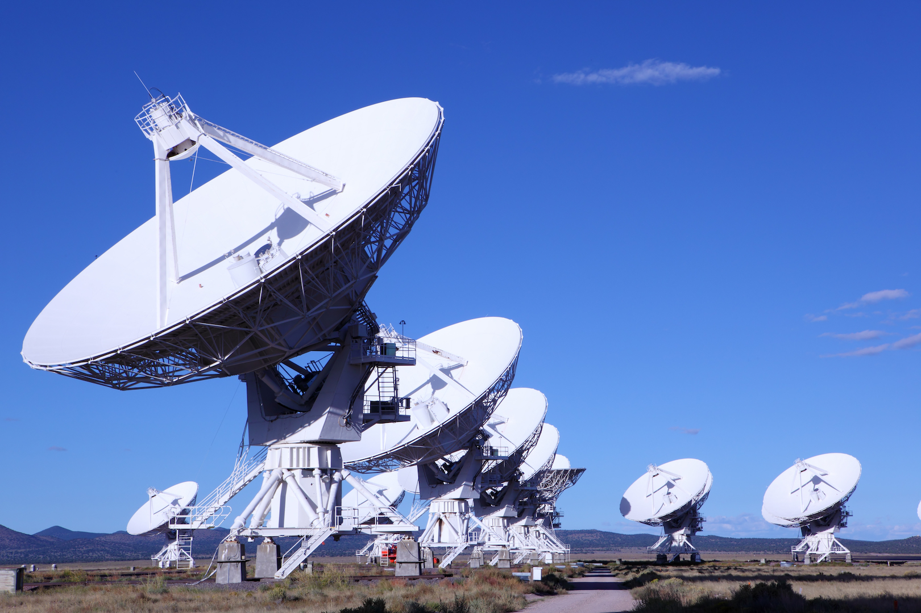
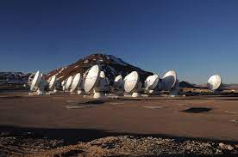
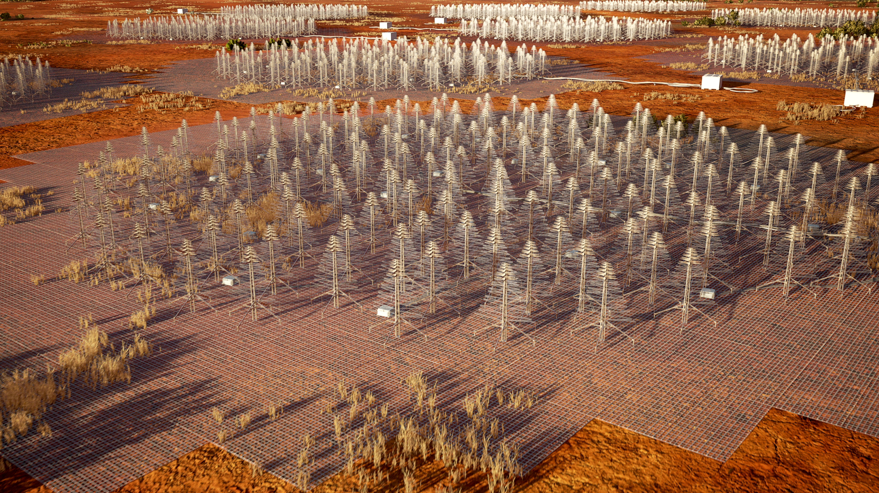
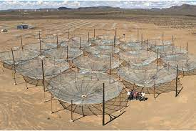

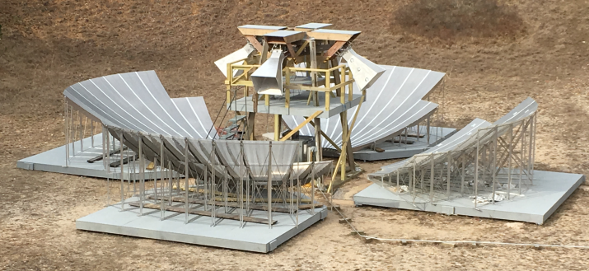
Interferometer gallery

Slide 14
RF probes for cosmology research
Concordance model ΛCDM
Cosmic Microwave Background
21cm hydrogen line
  intensity mapping
  low-frequency global spectrum
Notes:
Other HEP RF applications include radio detection of UHECRs and neutrinos, also axion dark matter search

Slide 15
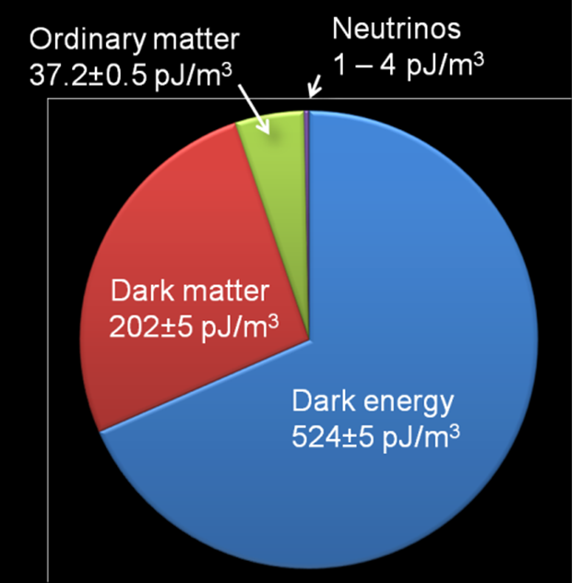
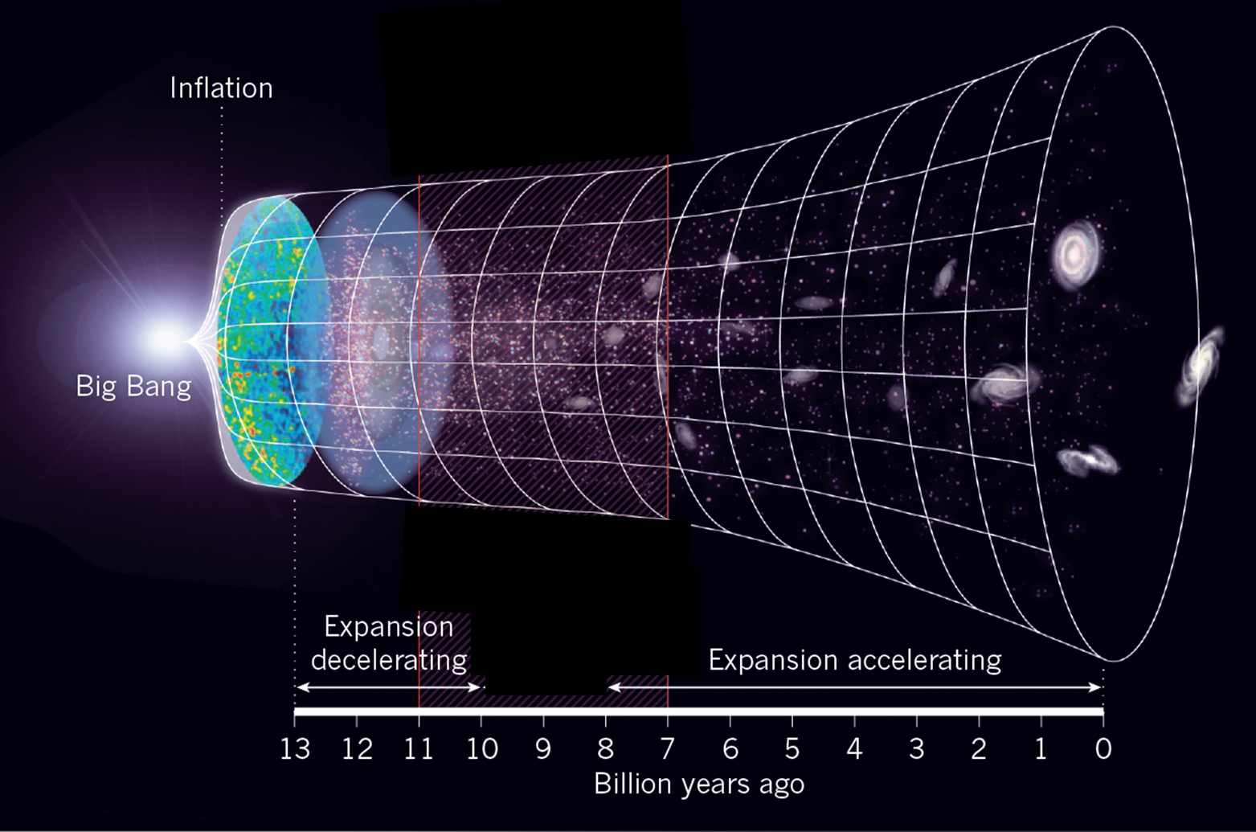
Cosmology concordance model
Matter-energy inventory
Expansion history
scale factor
scale factor
??
??
??
time (billion years ago)
cosmology concordance model
Perlmutter, Reiss, Schmidt 1998
Recession speed first decreased, then began to increase (acceleration)
“ΛCDM”

Slide 16
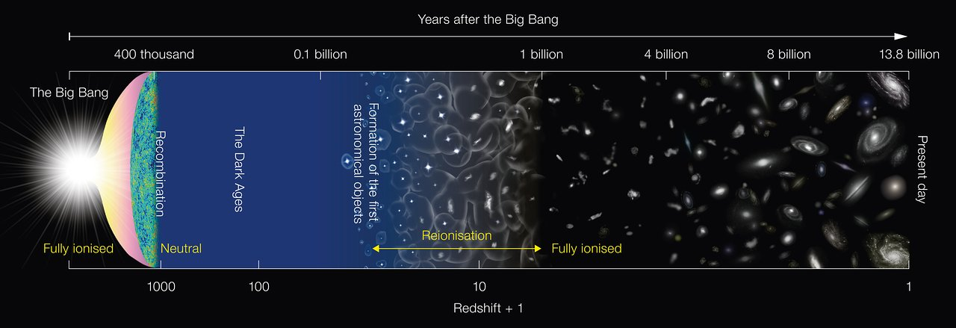
Cosmic timeline
CMB
21cm global spectrum
21cm intensity mapping
Notes:
Next I will explain how we use RF probes to observe these 3 epochs, and what each of them tell us about the ?? areas

Slide 17








Measuring distances and lookback times
distance
6 × 10²¹ miles
light travel time
(at 671 million mph)
unmeasurable
1 billion years
recession velocity
recession velocity
48 million mph ➔
redshift
7.5% redder
(z = 0.075)

Slide 18
Cosmic Microwave Background
Notes:
Other HEP RF applications include radio detection of UHECRs and neutrinos, also axion dark matter search

Slide 19




Observing the CMB
CMB blackbody spectrum
About 300,000 years after the Big Bang (z ~1100), the universe had cooled enough to enable the blackbody radiation to propagate freely for the first time.
Spatial anisotropies in the CMB encode important cosmological properties.
CMB spatial anisotropy
Opacity of Earth’s atmosphere
Notes:
CMB is spectrally broad but information of interest is in its spatial structure over wide range of angular l
Measures: age and curvature of the universe, fraction of DE/DM, DE equation of state,…

Slide 20

3 generations of space-based CMB observatories

Slide 21





CMB detectors
Next-generation observatories will use ~10⁵s of superconducting transition-edge bolometers as polarization-sensitive total power receivers.

Slide 22
Techniques of 21cm cosmology
Intensity Mapping
  growth of large-scale structure in the modern universe
  dark energy probe to redshift z > 3
21cm global spectrum
  fundamental processes during the cosmic dark ages (20 < z < 150)
  BSM physics by studying thermal history of the universe
Notes:
Other HEP RF applications include radio detection of UHECRs and neutrinos, also axion dark matter search

Slide 23







Origin and ubiquity of the 21cm line
Spin-flip transition of neutral hydrogen
Nearby galaxy M31 imaged in 21cm
21cm and optical surveys detect similar structure to z ~ 0.07
Highest redshift detection (z = 0.376)
Fernandez
2016
Haynes et al. 2011
Red: SDSS optical
Blue: ALFALFA 21cm
Grey: optical
Purple: 21cm
1s level hyperfine splitting
emission
absorption
Spectral line at 21cm rest-frame wavelength is sharp and isolated
→ Once detected, provides precise redshift
ν_{21cm} = 1, 420, 405, 751.768 ± 0.001 Hz

Slide 24

Origin and ubiquity of the 21cm line
Spin-flip transition of neutral hydrogen
Nearby galaxy imaged in 21cm
21cm and optical surveys detect similar structure to z ~ 0.07
Highest redshift detection (z = 0.376)
Fernandez
2016
Haynes et al. 2011
Red: SDSS optical
Blue: ALFALFA 21cm
Grey: optical
Purple: 21cm
1s level hyperfine splitting
emission
absorption
Spectral line at 21cm rest-frame wavelength is sharp and isolated
→ Once detected, provides precise redshift
ν_{21cm} = 1, 420, 405, 751.768 ± 0.001 Hz

Slide 25








Intensity mapping: tomographic reconstruction of the density field
θ_{x}
Δθ~ 0.2°
redshift (time)
θ_{y}
Δf ~ 1MHz
power spectrum of fluctuations,
measure of standard ruler feature imprinted at recombination
redshift
(line-of-sight distance)
Scale of interest for cosmology
coarse map (like CMB),
but in 3D
Redshift range of most interest: z ~ 1 (emergence of Dark Energy)
CHIME (Canada)
HIRAX (S. Africa)
PAON-4 (France)
TIANLAI (China)
Notes:
EMISSION of 21cm from neutral H in galaxies is the probe
Spatial anisotropies and their evolution over cosmic time

Slide 26



Slide 27





BMX Antenna and Front-end Electronics
Off-axis configuration of single dish + receiver
Parent paraboloid
EM Sim of illumination pattern on dish
(fixed)
Front end electronics
Calibrated noise diode

Slide 28









Telescope layout
Reflector array and baselines
Location on BNL campus
$$\vec{b_{14}}$$
$$\vec{b_{12}}$$
$$\vec{b_{24}}$$
$$\vec{b_{13}}$$
$$\vec{b_{34}}$$
$$\vec{b_{23}}$$

Slide 29


BMX field of view on the sky
Horizon coordinates
FOV unwrapped superimposed with radio source map

Slide 30




Calibrators
 | DIODE | UAV | GNSS | MW | CygA
For: | gain(ν) | beam(ν) | beam | beam, frequency | beam, array layout
Range | 0 | 170 m | 2e7 m | 5e20 m | 6e24 m
Heading angle | - | Any | ~NE, ~SW | W | W
Angular rate | - | 1 – 1.1 ◦/s | 0.006 - 0.01 ◦/s | 0.0032 ◦/s (sidereal) | 0.0032 ◦/s (sidereal)
Passes/day | - | up to 10 | 20 – 30 | 1 | 1
Power | 3K | 200,000K adj. | 20,000K max. | 1 -- 40K | 5 K @ 1.42GHz
Polarization | No | Yes | No | No | No

Slide 31













Transit of CygA observed by BMX
$${\vec{b}}_{12}$$
$${\vec{b}}_{23}$$
$$\vec{b_{14}}$$
$$\vec{b_{12}}$$
$${\vec{b}}_{13}$$
$${\vec{b}}_{24}$$
$$\vec{b_{13}}$$
$$\vec{b_{24}}$$
$$\vec{b_{34}}$$
$$\vec{b_{23}}$$
$${\vec{b}}_{14}$$
$${\vec{b}}_{34}$$
data
fit
envelope

Slide 32


21cm Dark Ages global spectrum
During the Dark Ages the universe contained only CMB photons, cold atomic hydrogen, and dark matter
Spin temperature of the gas evolves due to heating/cooling, altering the brightness of the 21cm line
Standard model predicts features stemming from H-H, H-$γ$, and H-DM interactions during the Dark Ages
21cm spectrometer ~ “spin calorimeter”, opening a previously unexplored cosmic epoch, sensitive to BSM physics
21 cm brightness temperature
n₁
_{F=1}
_{F=0}
n₀
n₁/n₀ = 3 exp(−hν_{21cm}/k_{b}Ts)
DA trough
Spin temperature Ts
describes relative occupation of levels
Pritchard et al. (2013)
Want a spectrometer that can observe here
Nearly impossible from Earth

Slide 33

The Moon’s far side is the ideal location for radio astronomy
https://www.timeanddate.com/astronomy/moon/far-side.html

Slide 34



Radio interference from Earth is blocked
29.5 days
Bassett et al. Adv. Space Res. 2020
The farside is always shielded from Earth
  and from the Sun during lunar night

Slide 35








LuSEE-Night: 21cm global spectrum pathfinder
orbiting relay satellite
LuSEE-Night Payload
orbiting calibrator
mission operations center
POWER
THERMAL
Operations:
  Lander shuts down on first sunset
  Night: observe on battery power
  Day: charge battery, move antennas, and transmit stored data via relay sat
Lander (Firefly Aerospace)

Slide 36
Instrument requirements and constraints
Signal chain
Efficient, well-calibrated antenna
Analog signal chain:
  input noise power < sky (few nV/√Hz)
  3dB bandwidth 0.1-50MHz
  Dynamic range 10⁵
  High EMI immunity
  6th-order antialiasing filter
  ADC driver
Digital spectral engine, correlator, and averager
Communications module to relay satellite
Power system
Storage battery to provide operating power through the lunar night (14 Earth-days)
Photovoltaic array to recharge battery during daylight
Fully synchronous to limit EMI
Power distribution and protection
Thermal management
Maintain instrument electronics within their safe operating range
Mission constraints:
  Power (night) 15W
  Power (day) 100W
  Mass (total) 128kg
  Mass (battery) 36kg
  Data to Earth 6GB/lunation
Surface Environment:
  Day/night cycle 29 Earth days
  Temperature -180 to +110C
  dT/dt 5C/hr
  Vacuum 2x10⁻¹² torr
  Radiation ~250X terrestrial
~2.5X LEO
Programmatic:
  27-month schedule (concept to flight hardware delivered)
  limited budget flexibility
  5-institution team
  4 critical suppliers

Slide 37

Instrument block diagram

Slide 38



Mechanical design
Main Electronics Crate (MEC): modular design using Parker Solar Probe as the basis
Metallic “slice” frames form electrical ground and thermal path
Integrated Electronics Assembly (IEA) = MEC + battery + satcom radio + thermal interface plate + mounting supports + cable harnesses
Designed to meet space requirements (vibration, outgassing, etc.)
Inner Electronics Assembly
BATTERY
Instrument
pre-deployment
Main Electronics Crate
PV
RADIATOR

Slide 39



LuSEE-Night electronics
Preamp
Spectrometer
Power Distribution Board

Slide 40





We get there on commercial spacecraft
SSTL Lunar Pathfinder
SpaceX Falcon 9
SpaceX Falcon 9
LuSEE-Night
BG Lander
Payload bay
BG Transport
Firefly Blue Ghost Lander
Firefly Aerospace

Slide 41
Summary
Cosmology with RF probes opens up unexplored epochs in cosmic time:
  z ~ 1100 (CMB)
  150 < z < 20 (global 21cm spectrum)
  6 < z < 0.2 (intensity mapping)
Tools of the trade are evolving rapidly
  Enormous industrial R&D effort aimed at burgeoning wireless communications and radar applications
Other HEP programs utilizing RF probes:
  Neutrino detection in huge volumes of seawater/ice/lunar regolity
  Axion dark matter search (haloscope)
  Quantum sensors and quantum information technology

Slide 42
End of Presentation
Subtitle

Slide 44
Backup Material
Subtitle

Slide 45





Transit of CygA observed by BMX
Science Observable
“Constraining the unexplored period between reionization and the dark ages with observations of the global 21 cm signal”, J. Pritchard and A. Loeb 2010
Dark Ages spectrum is a cosmic calorimeter
Measures something adding or taking energy from hydrogen fluid
Constrains physics like dark matter-baryon scattering, millicharged dark matter, dark matter annihilation, axions, neutrino decay, charge sequestration, quark nuggets, dark photons, interacting dark energy
Cold hydrogen gas sometimes absorbs, sometimes emits a 21cm photon depending on spin temperature

Slide 46


UAV calibrations
Vehicle: commercial DJI hexacopter. Flight time ~25 minutes per battery change.
Transmitter: switched, broadband noise source + biconic antenna (polarized). Variable attenuator to set power level.
Position determination: differential GPS, ~1cm accuracy.
Timebase: GPS
Flight plan: ascend to far field (~170m), fly raster pattern over telescope. Drone “yaw” orientation sets polarization direction either aligned with or perpendicular to direction of travel. While flying legs of the raster, typical speed 2 - 4m/s.
Thanks to Yale team of L. Newburgh for use of DJI
Flight patterns
Repeat rasters in N-S, E-W heading, each polarization, each power level
Higher transmit power and larger extent used to probe sidebands

Slide 47




UAV calibrations
We measure the angular response of the 4 dishes…
…vs frequency
Location of the beam centers
Beam widths
First Airy disc null for 3.95m aperture at 1500MHz
Measured data includes full frequency range and both polarizations per dish.
Analysis by G. Troiani

Slide 48




GNSS satellites: constellations, passes over BMX
orbits
Predicted tracks over BMX
Angular rates by constellation
Angular rates and headings

Slide 49



GNSS passes over BMX on 1/3/2020
BEI
Assigned transmit bands
Observed (blue); predicted times (red)
GAL
GPS
GPS
GPS
GAL
GAL
BEI
13 satellites observed in 4 constellations over 24 hours
GAL
GPS
GPS
BEI
GAL

Slide 50







Fitted beam parameters
Tracks (red triangle = fit)
beam parameter | mean | st. dev.
θ_{x0} | 0.3639 | 0.1229
θ_{y0} | -1.5392 | 0.1863
σ_{x} | 1.5953 | 0.1568
σ_{y} | 1.7222 | 0.1030
 | deg | deg
pointing direction
beam width
statistics (mean subtracted)
σ_{y}
σ_{x}
θ_{y0}
θ_{x0}
degrees (mean=0)

Slide 51



Observations in the HF band are challenging
 Earth’s ionosphere
● Galactic foreground
Reflects HF radiation
Emission from energetic electrons interacting with magnetic fields
 Human-generated interference
Cell phones, pagers, air traffic radar, marine radio, radar, AM broadcast,…

Slide 52
Print-friendly Title Slide
Presenter(s)
Date

Slide 53
Slide Header
Body Text
  Bullet Tier 1
    Bullet Tier 2

Slide 54
Blank Slide (No Logo)

Slide 55
Cosmic Frontier Applications
Subtitle

