Slide 1
EDIT School: Quantum Dots and their applications to QIST
Dr Joanna M Zajac
20/10/23

Slide 2
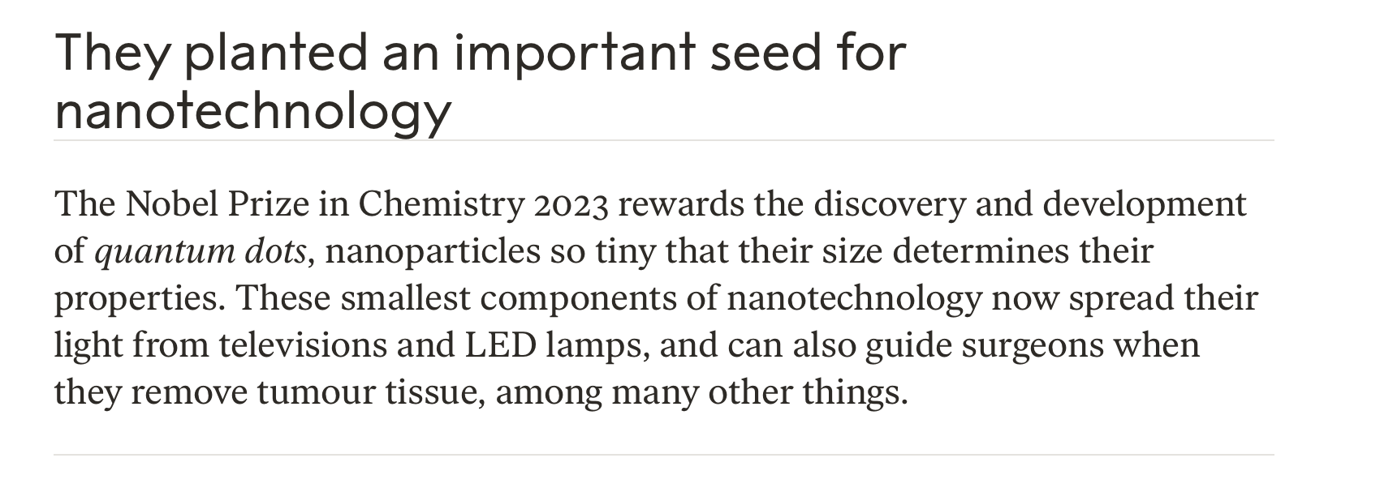
Quantum Dots: Nobel Price in Chemistry 2023 ^{and beyond}

Slide 3
Quantum materials and nanotechnology
Going from ultra-big towards ultra-small, macroscopic objects are covered by the properties of classical mechanics while microscopic ones by quantum mechanics
Transition usually takes place when the size of the object is around the size of the electron wave-function
When we can engineer material on a nanometer scale, we are able to engineer their quantum properties; boundary of condensed matter physics and quantum physics
Sun 1e9 meter
Human
1 meter
Quantum Dot
1e-9 meter
Sense of the scale

Slide 4
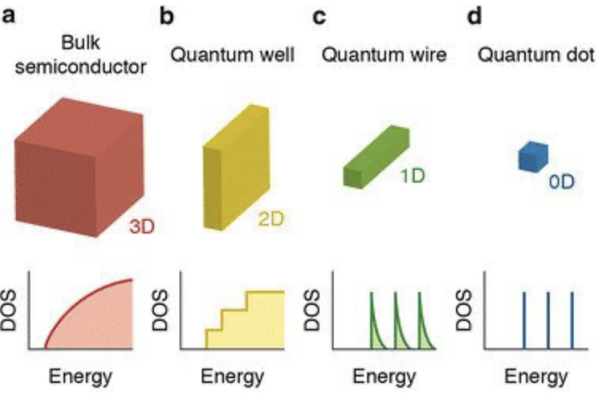
What are Quantum Dots?
Made of semiconducting materials
Properties explained by the particle in the box picture
Electron is trapped in the box, here potential energy box, that causes quantization of its energy
Energy takes only well-defined values!
$E=\frac{ℏ^{2}π^{2}}{2ml^{2}}n^{2}$ where is n is
principial quantum number, l is confinement size
Boxes can be 3-, 2-, 1- or 0-dim as described by density of states DOS
Density of states

Slide 5
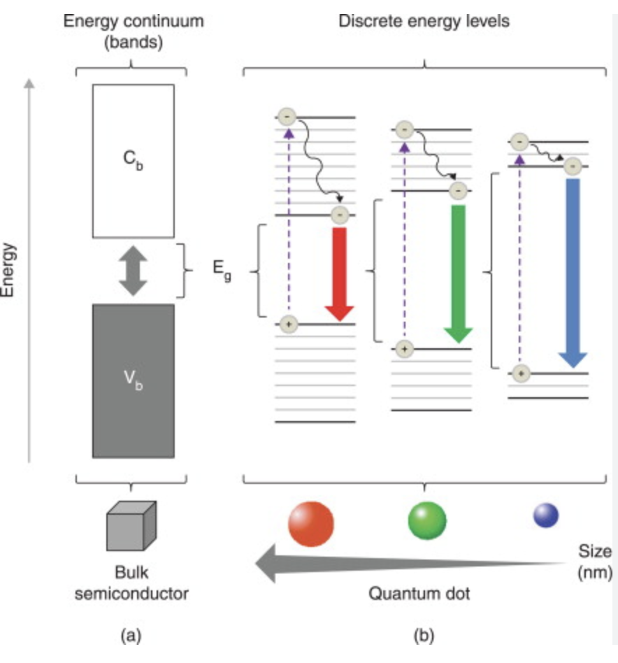
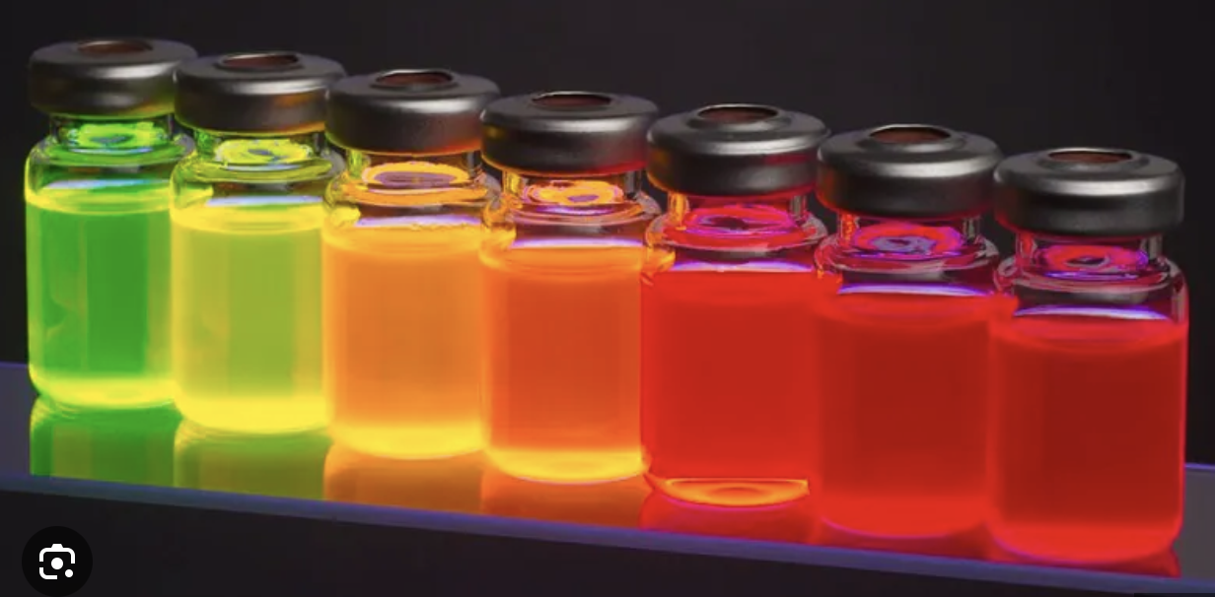
What are Quantum Dots properties?
When QDs are illuminated, electrons will get promoted from valence to conduction band
It is reversible process and after some time electron will relax into its ground state
Bigger the box, or QDs, longer the wavelengths
Band-gap vs color
Different colors of QDs

Slide 6
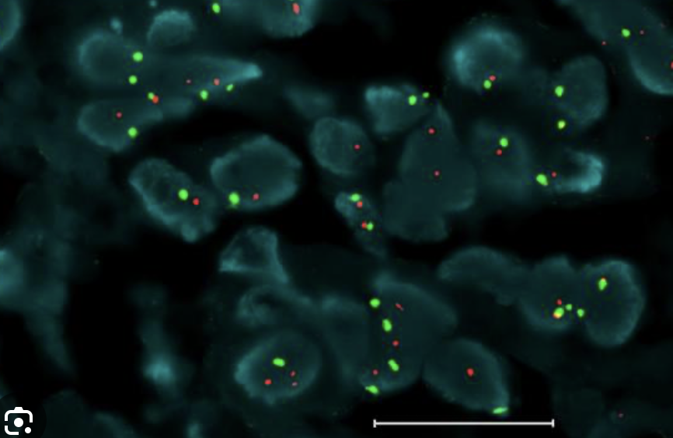
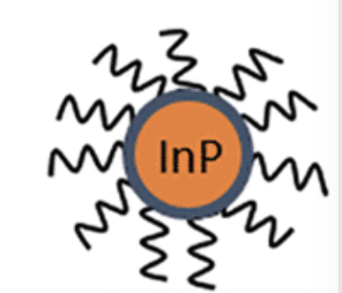
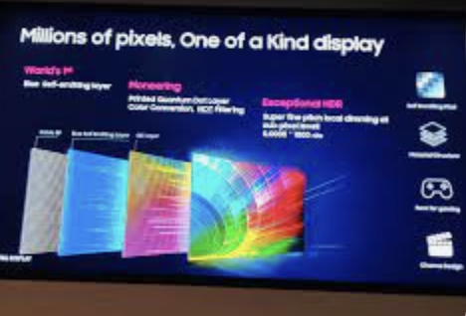
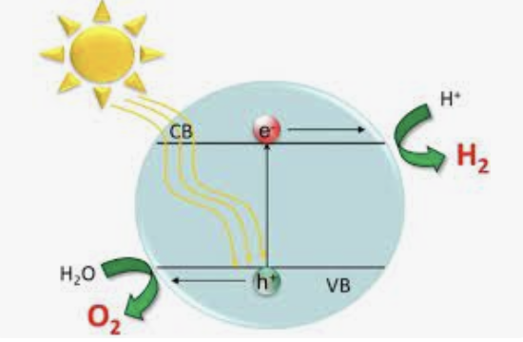
QDs applications
Biology and medicine
Sensing
Markers
Therapy
Optoelectronic devices
Light-emitting-diodes LEDs
Lasers
Displays
Photodetectors
Photovoltaics, i.e. solar cells
Photocatalysts
Fundamental science
Quantum Information Science and Technology QIST

Slide 7
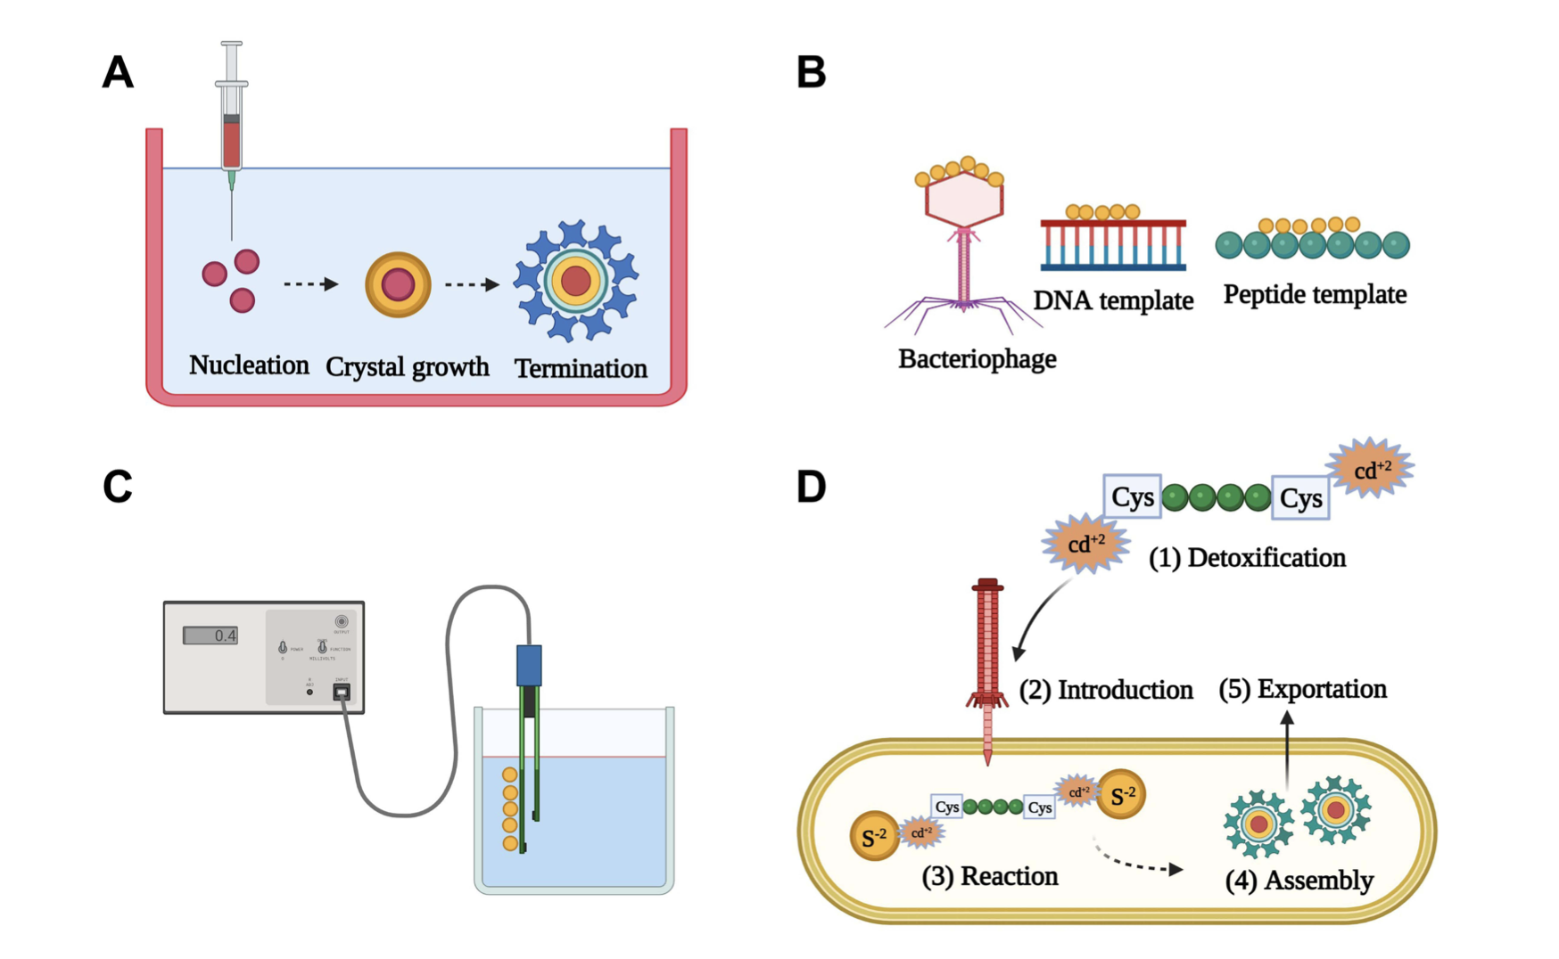
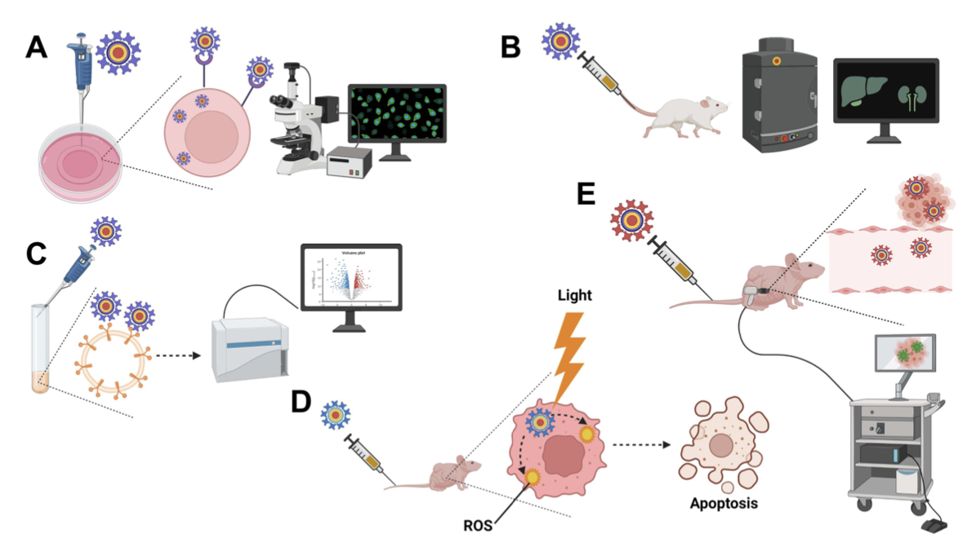
QDs applications: Biology and Medicine
Methods to prepare QDs A) colloidal synthesis, B) Bio-template
synthesis, C) electrochemical assembly, D) bio-gentic synthesis
Methods to prepare QDs A) Intracellular imaging, B) In-vivo imaging, C) Fluorescence activated cell sorting, D) photodynamic therapy, E) Traceable drug delivery
Notes:
Figure 3 Some biomedical applications of QDs. (A) Intracellular imaging. QDs decorated with specific targeting moieties are used as fluorescent labels for intracellular visualization by fluorescence microscopy or confocal laser scanning microscopy (CLSM). (B) In vivo imaging. Following administration, QDs modified with tissue-specific targeting moieties can be used for visualization of certain organs in question using in vivo imaging systems (IVIS). (C) Fluorescence-activated cell sorting (FACS). QDs decorated with cell-specific ligands can be used as fluorescent probes for cell sorting during flow cytometry. Thanks to numerous advantages, QDs have a better capacity in polychromatic cell sorting compared to conventional organic dyes. (D) Photodynamic therapy (PDT). Following irradiation, QDs can act as photosensitizers or energy donors to other photosensitizers to generate reactive oxygen species (ROS) in situ leading to apoptotic cell death during cancer treatment. (E) Traceable drug delivery vehicles. QDs can be used as drug carriers to various tissues with high extravasation and tissue penetration capabilities thanks to their ultra-fine particle sizes. Owing to their quantum properties, QDs accumulation in the target tissues can be easily tracked. Created by BioRender.com.

Slide 8
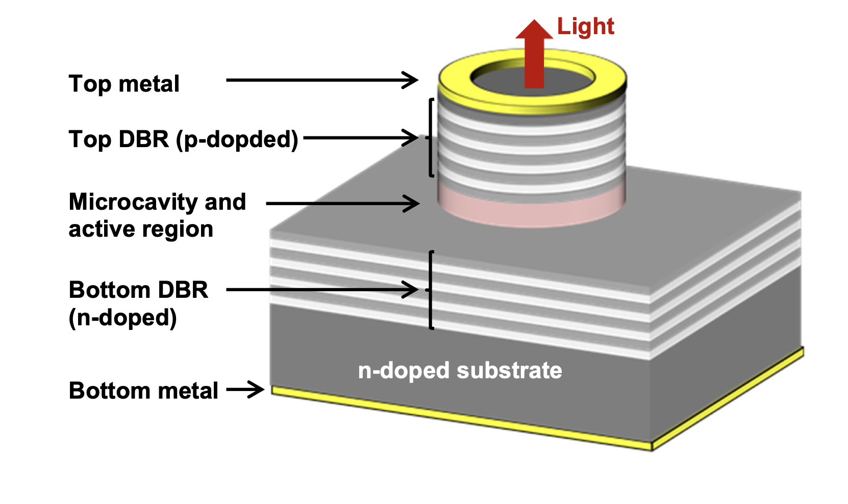
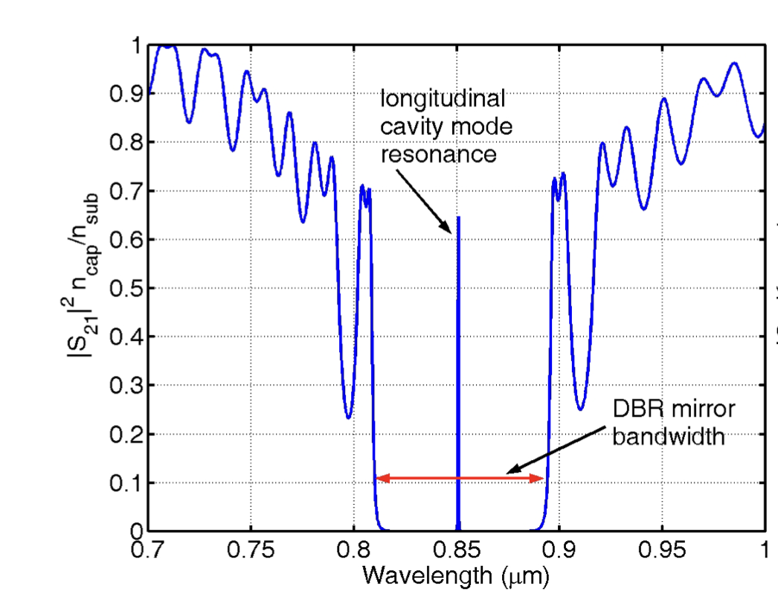
QDs applications: QDs lasers
Cross-section of example VECSELs
structure
Cross-section of example VECSELs structure

Slide 9
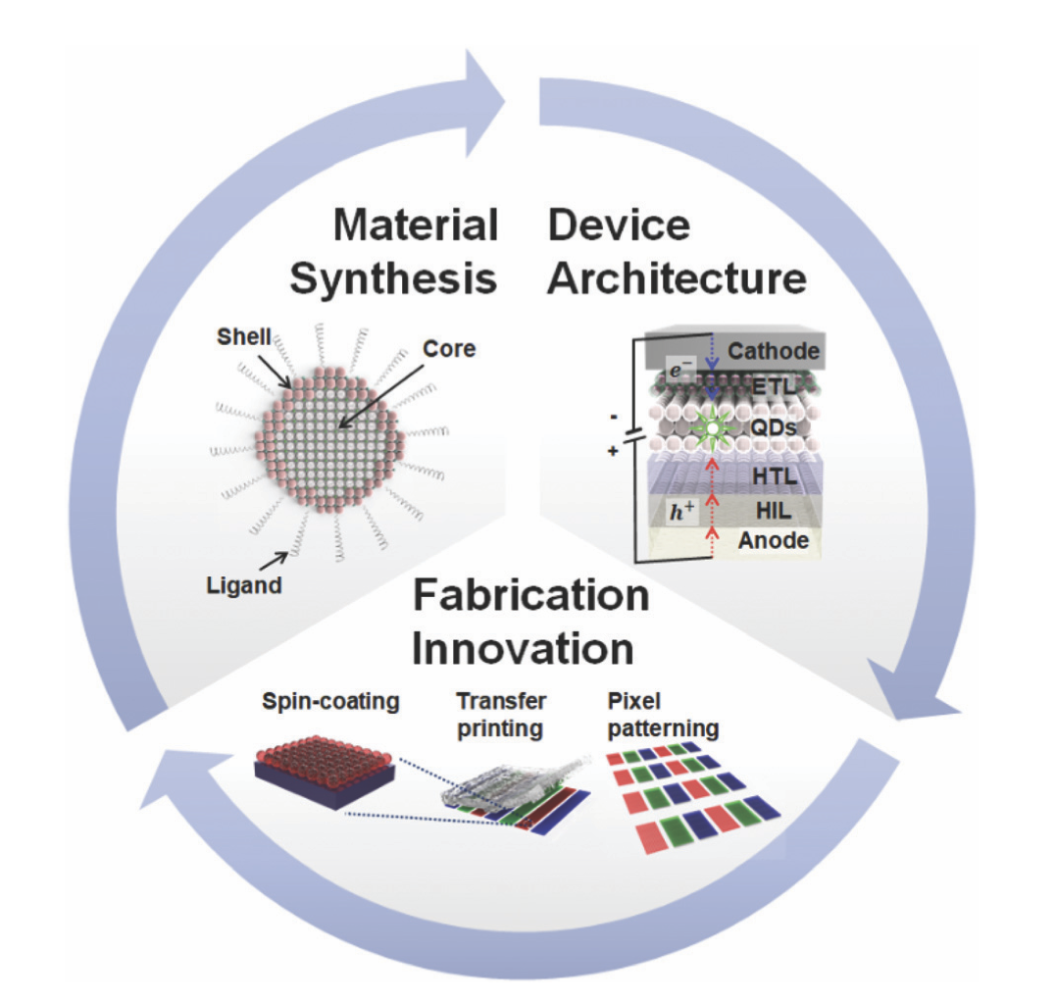
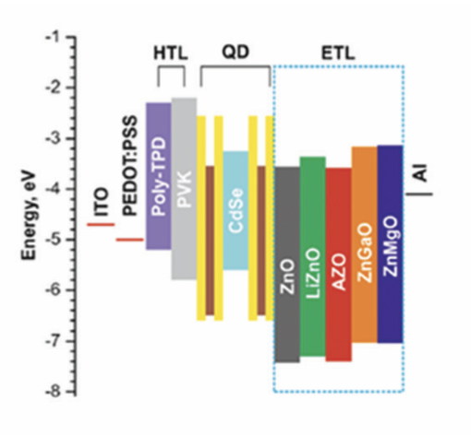
QDs applications: QDs LEDs
Typical structure of the QD-LED device
And energy band diagram of the typical structure of QD-LED devices having different ZnO layers. HTL-hole transport layer and ETL-electron transport layer, EML –emissive layer
Classification of the development categories for the QDs-LEDs
Notes:
https://pubs.rsc.org/en/content/articlepdf/2021/nh/d0nh00556h
Fig. 4 (a) Typical structure and (b) an inverted structure of QD-LED device architecture. (c) Device architecture of tandem structure of QD-LEDs.
(d) Energy band diagram of the typical structure of QD-LED devices having different ZnO layers. Copyright 2020, Nature Publishing Group. (e) Energy band diagram of the typical device structure with an insulating layer using PMMA. Copyright 2014, Nature Publishing Group. (f) Energy band diagram of inverted structure of QD-LEDs. Copyright 2019 IOP Publishing. (g) Schematic device structure of tandem QD-LED and the EQE characteristics of red, green, and blue QD-LEDs. Copyright 2014, the American Chemical Society.

Slide 10
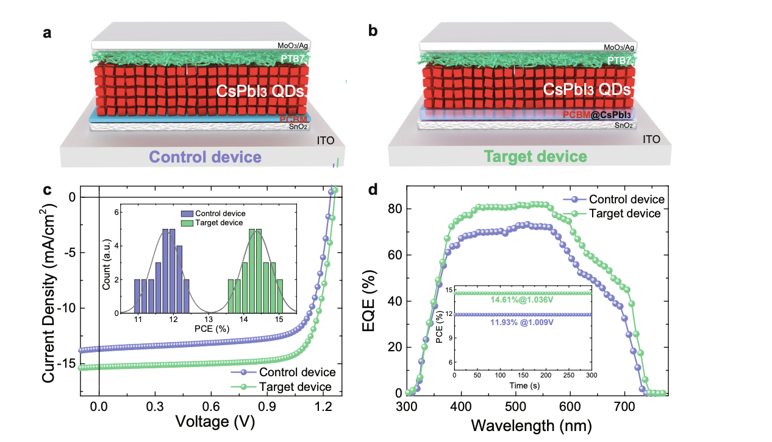
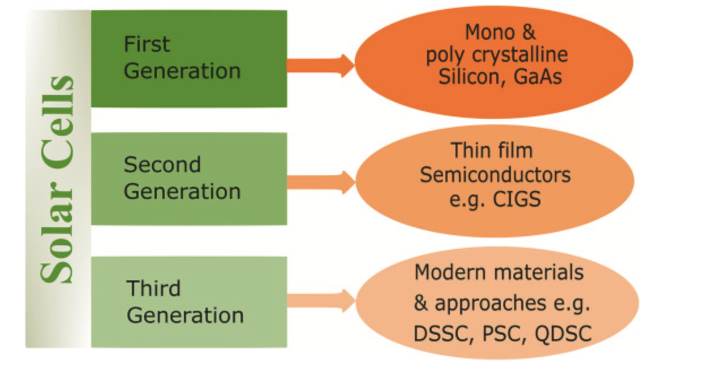
QDs applications: Photovoltaics
Photovoltaic performance of solar cell; a, b Schematic diagram of the control device and target device. c J–V curves measured under AM 1.5 G solar irradiation at 100 mW/cm2 (inset: PCE distribution of control and target devices). d EQE curves of control and target devices (inset: stabilized power output of control and target devices).
Generation of solar cells
QDs promise to boost efficiencies to 60% limit
Notes:
NATURE COMMUNICATIONS | https://doi.org/10.1038/s41467-020-20749-1
PCE POWER Conversion efficiency
EQE external quantum efficiency

Slide 11
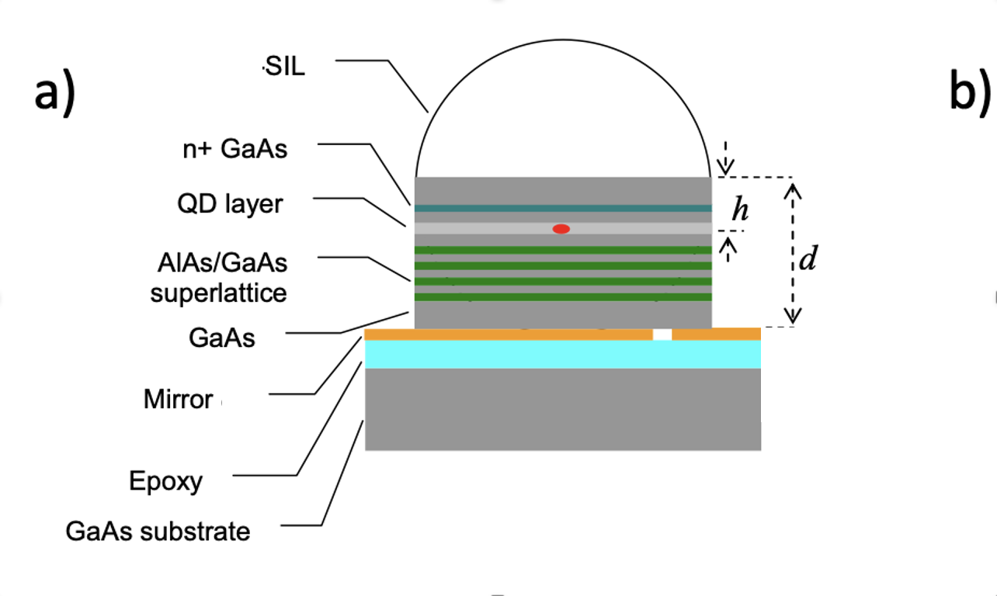
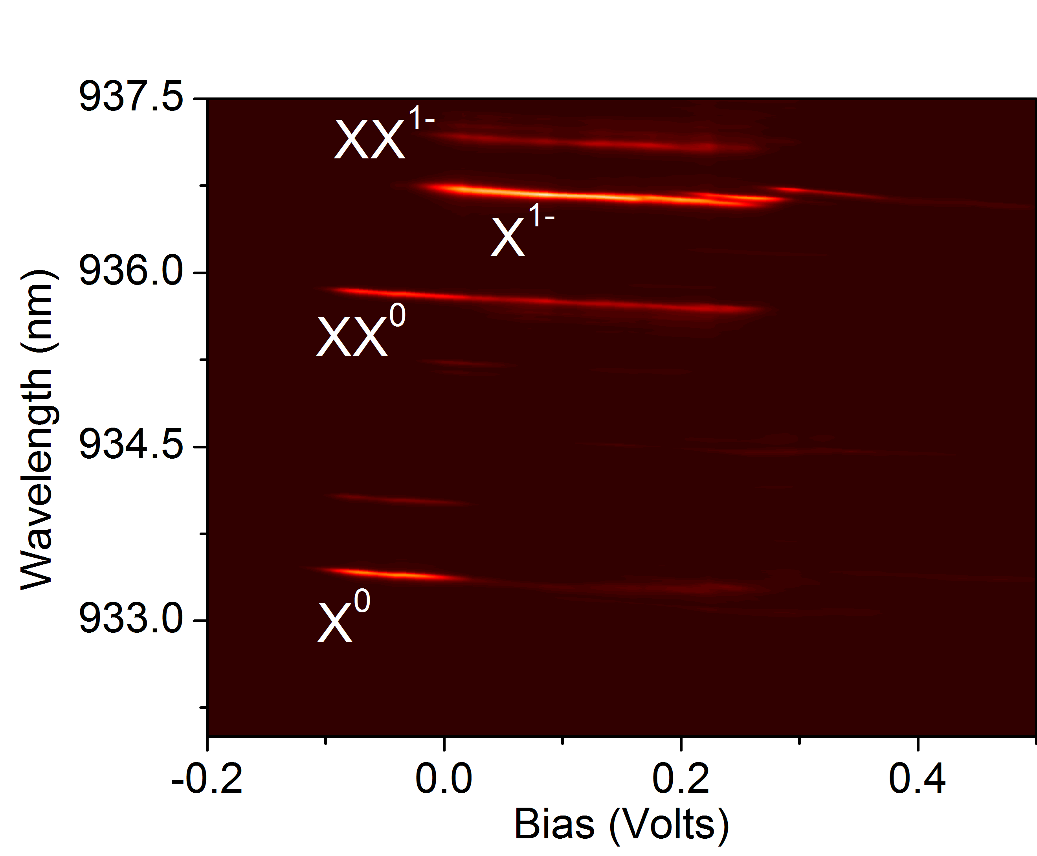
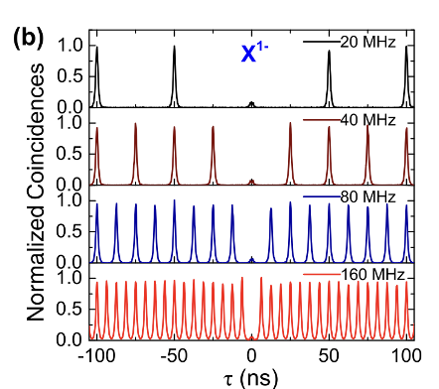
Our work at BNL: QDs non-classical light sources advantages
Single photon is fundamental carrier of quantum information
Using QDs allows us to obtain photons with
Desirable temporal and spectral properties
Deterministic and versatile
QDs diode for deterministic charge control
QDs photoluminescence
Deterministic emission and modulation

Slide 12
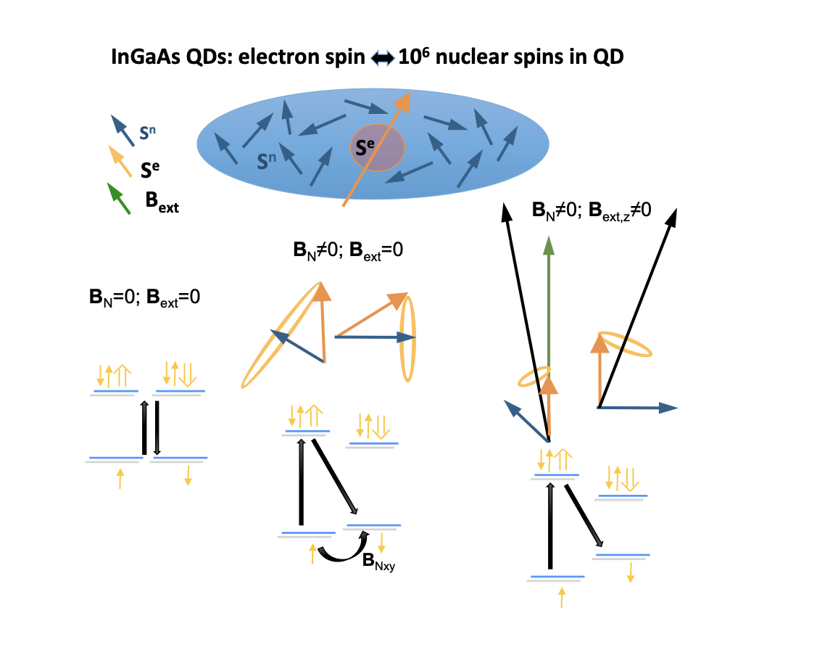
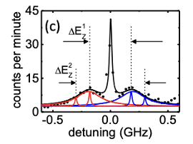
Our work at BNL: QDs non-classical light sources challenges
QDs are part of solid-state matrix
There is a lot going on; i.e. interactions with lattice through thermal effects and magnetic and electric fields
This will have impact emission properties of single photons
Spin-spin interaction
Overhauser field

Slide 13
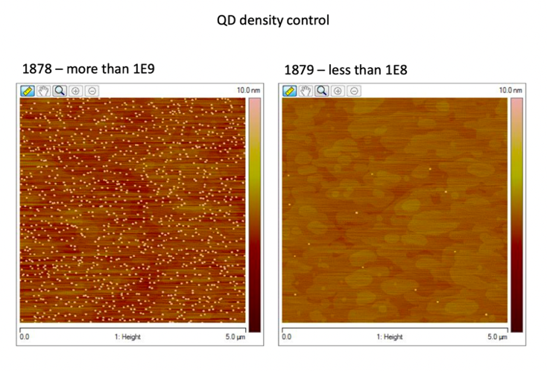
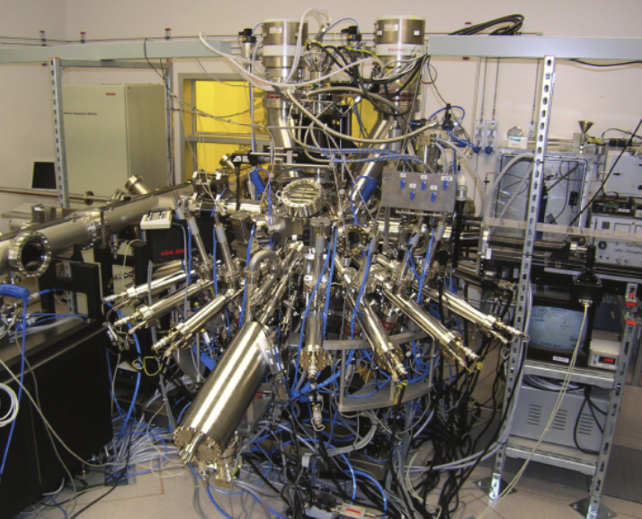
Our work at BNL: QDs non-classical light sources manufacturing
Epitaxial QDs
Grown atom-by-atom using molecular beam epitaxy MBE. Well controlled process resulting in exceptional properties of QDs
Growth thermodynamics triggers formation of QDs
2.5 µm
AFM picture of QDs
MBE reactor
SEM picture of QDs

Slide 14
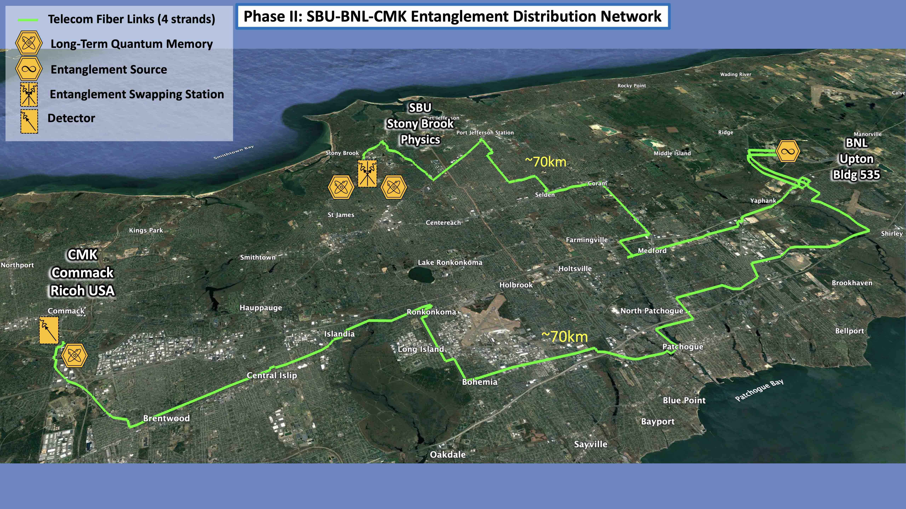
Our work at BNL: QDs non-classical light sources QN applications
Fundamental building blocks of quantum networks
photon sources
memories
protocols to interconnect them
With these buildings blocks, we can construct quantum networks that are capable of plethora of fascinating applications
quantum communication, computing, fundamental science, sensing,…
3-node metro-Quantum Network realization

Slide 15
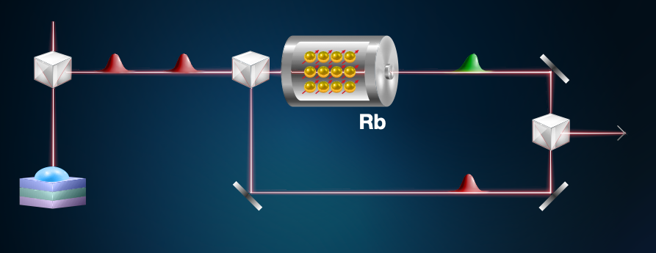
Our work at BNL: QDs for heterogenous quantum interconnects
Use the advantages of heterogenous systems
Quantum dots for generation of quantum information
Alkali vapors for storage
Rb memories work at RT. They ensure storage time of of around 20 µsec and fidelity of around 5%
After storage, we investigate how properties of these photons had been altered and which protocols needs to be used to make this process controllable and efficient
Quantum information storage and revival in hybrid system

Slide 16
Thanks for your attention We have openings for PhD/PostDocs – reach out! jzajac@bnl.gov
Questions?

