Slide 1

Analysis Coordinators’ Communications
Analysis Coordination Meeting
Sep 15th, 2023
Rosi Reed – Lehigh University
Salvatore Fazio – Unical

Slide 2
After some Holiday break… time to come back stronger!
  Keeping the community engaged is key. Guidelines:
    Schedule your PWG meeting timely and consistently (at least biweekly!)
    If no meeting is required by the agenda → explicitly cancel the meeting
    Never let months pass without a meeting!
Four reconstruction tasks being reorganized with efficiency in mind:
  Regular technical updates related to these tasks will be presented in the S&C meetings only
  Initiate joint meetings between Analysis and S&C -> once a month on Wednesday 12:00pm ET
    this will replace the standard S&C meeting -> no additional meetings required :)
    Focus: interplay of physics analysis and S&C, with regular reports on both the progress on reconstruction tasks and the status of physics benchmarks
TDR is coming, let’s get ready! Need to showcase detector performance
  STEP 1 - start with reproducing key results from ECCE+ATHENA+CORE
    useful also for talks at conferences etc.
    We shall build up on those for future studies and required documents
  Some examples in next slides
  We can collect them on our wiki, for easy access

Slide 3
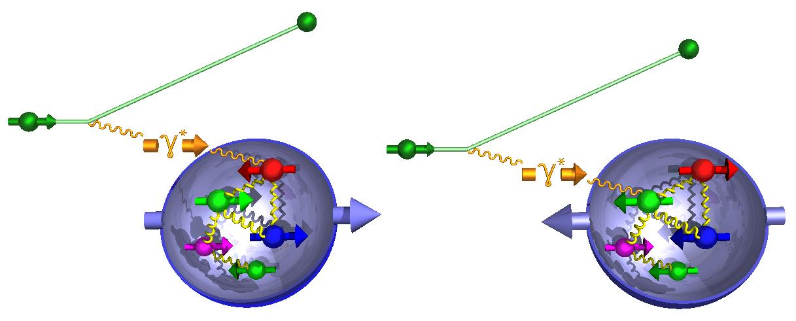

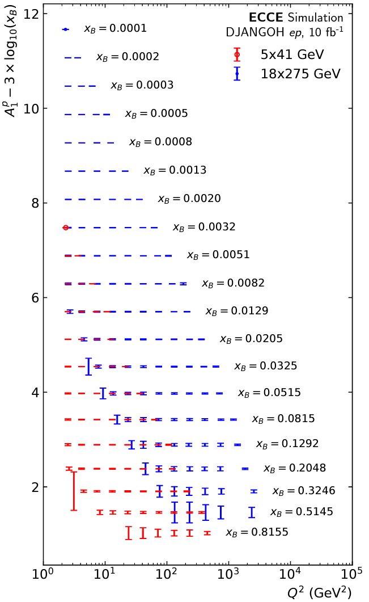

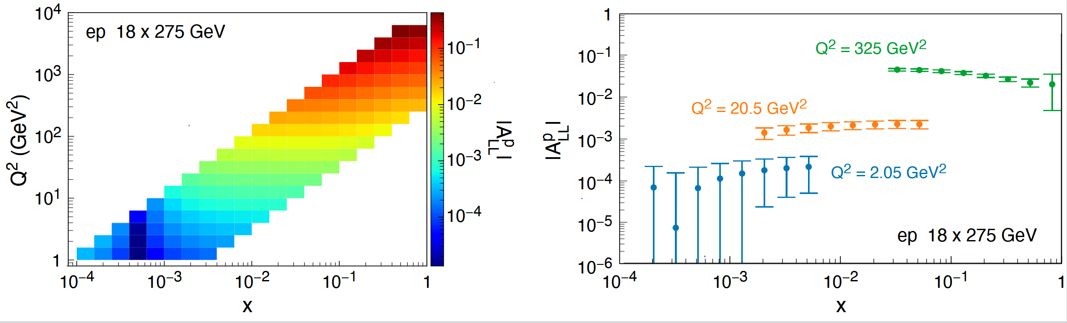
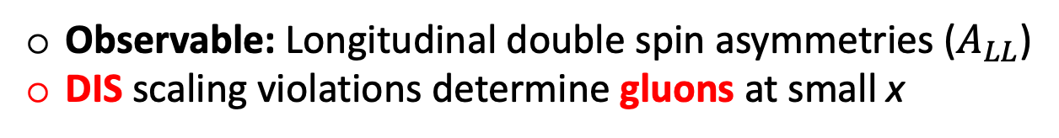
Proton’s helicity structure
Observable: Longitudinal double spin asymmetries ($A_{LL}$)
DIS scaling violations determine gluons at small x
Δg(x,Q²)=g (x,Q²)-g (x,Q²)
Key:
Acceptance
electron id
Inclusive double spin asymmetry A₁(x)
g₁ scaling violation
- Double spin asymm. in NC DIS
10 fb⁻¹
world data
till EIC

Slide 4
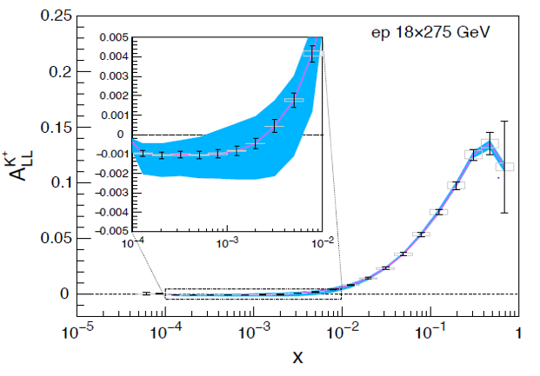
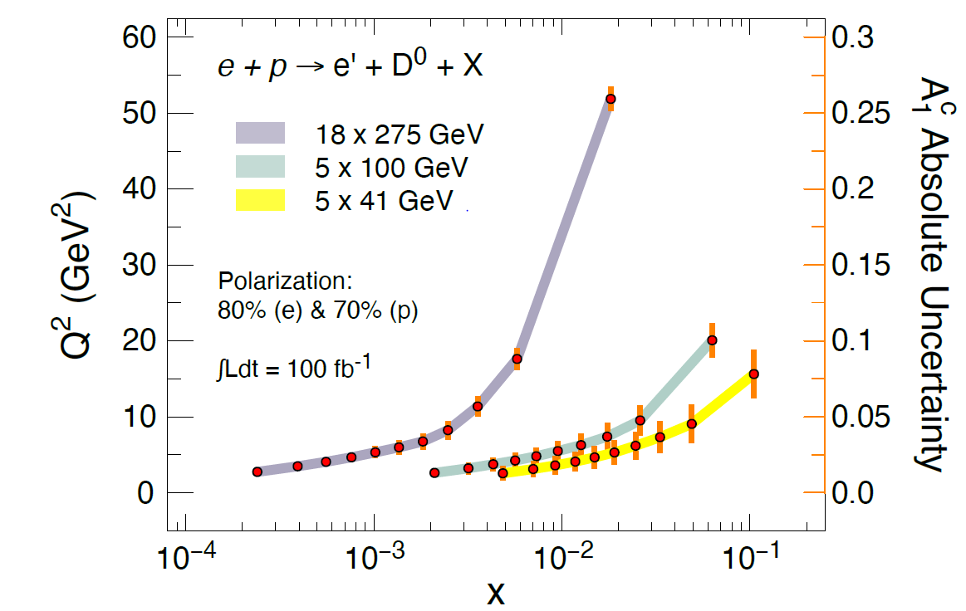
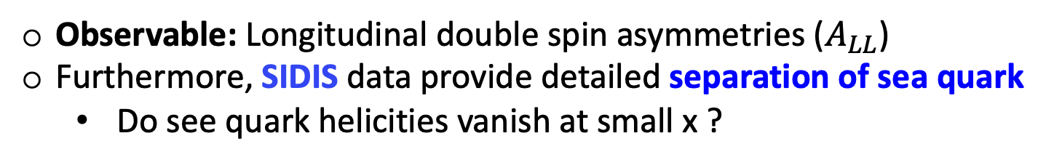
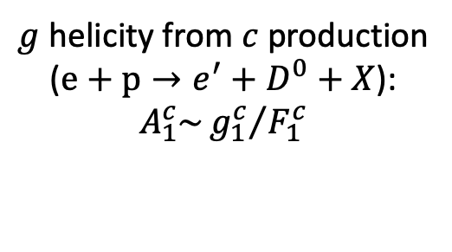
Proton’s helicity structure from SIDIS
Observable: Longitudinal double spin asymmetries ($A_{LL}$)
Furthermore, SIDIS data provide detailed separation of sea quark
  Do see quark helicities vanish at small x ?
Key:
PID (barrel, forward
Vertexing for charm tagging
Charged kaons
Charm production
$g$ helicity from $c$ production
($e+p→e^{′}+D^{0}+X$):
$$A_{1}^{c}\sim {g_{1}^{c}}/{F_{1}^{c}}$$
Theory bands from:
DSSV PDF & DSS FFs
15.5 fb⁻¹

Slide 5
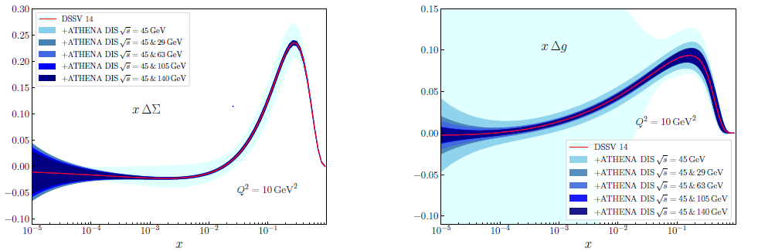

The spin sum rule
q spin
ΔΣ
g spin
Δg
New global fit by
JAM/DSSV collaboration
1/2 -
Quarks
-
Gluons
=
orb. angular momentum

Slide 6
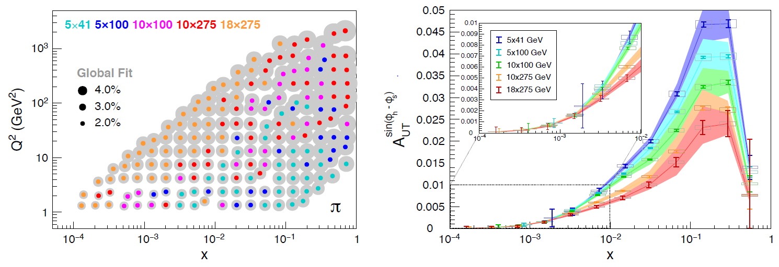
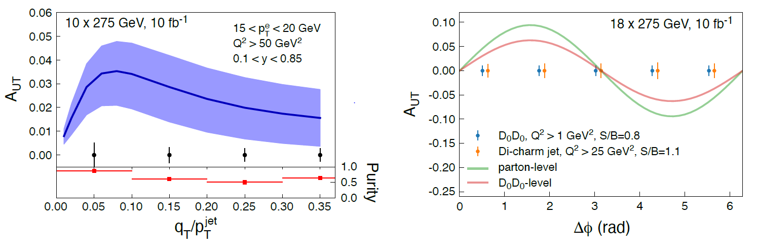
Momentum tomography – SIDIS, Heavy Flavor, Jets
Unpolarized cross section uncertainties
Projected Sievers asymmetries
Heavy flavor
Sensitivity for Sivers in di-charm
Jets:
excellent proxies for partons
probe quark TMDs without convolution with FF
di-jets can probe gluon Sivers
Key:
Azimuthal acceptance
PID
Acceptance
Vertexing (heavy flavor)
Quality of tracking
HCal (for jets)

Slide 7
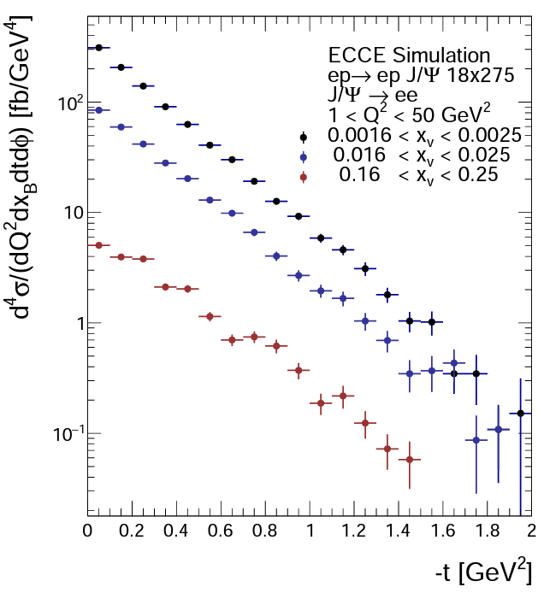
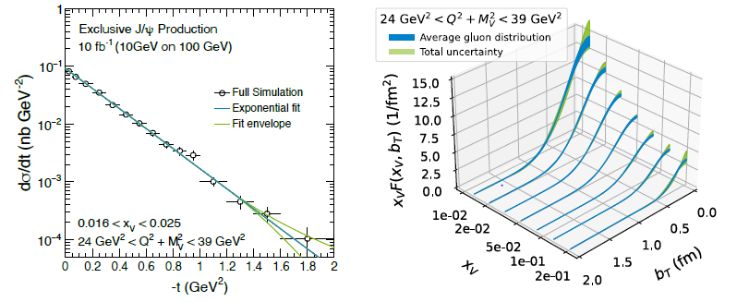
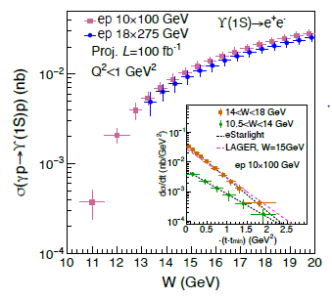
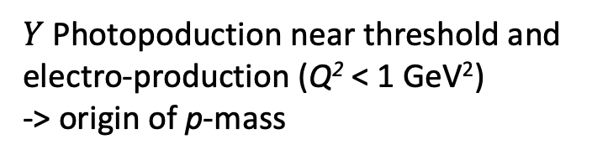
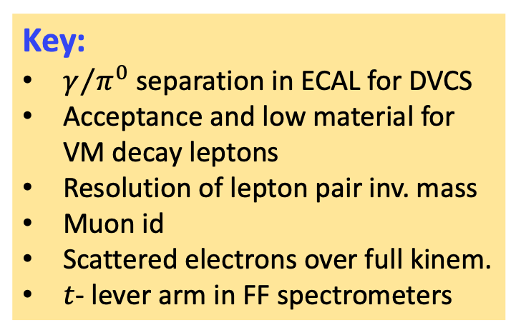

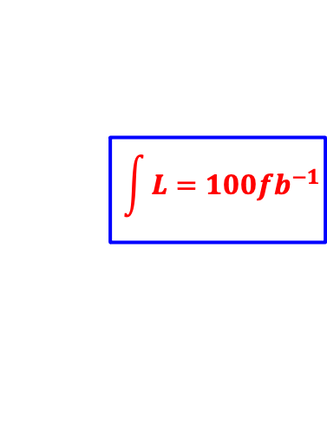
VMs in ep
$$\vec{e}+\vec{p}→e+p+\vec{V}$$
Key:
$γ/{π^{0}}$ separation in ECAL for DVCS
Acceptance and low material for VM decay leptons
Resolution of lepton pair inv. mass
Muon id
Scattered electrons over full kinem.
$t$- lever arm in FF spectrometers
$$\int{L=100{fb}^{−1}}$$
$Y$ Photopoduction near threshold and electro-production (Q² < 1 GeV²)
-> origin of p-mass

Slide 8
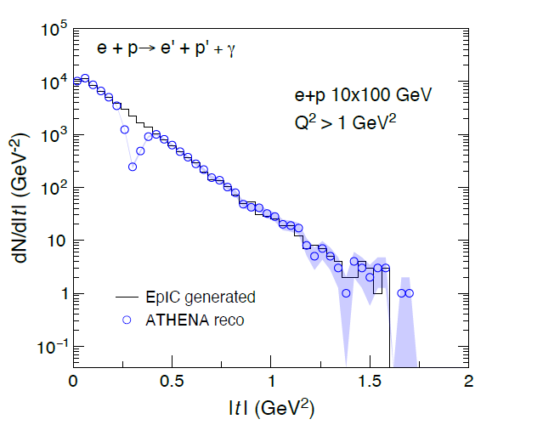
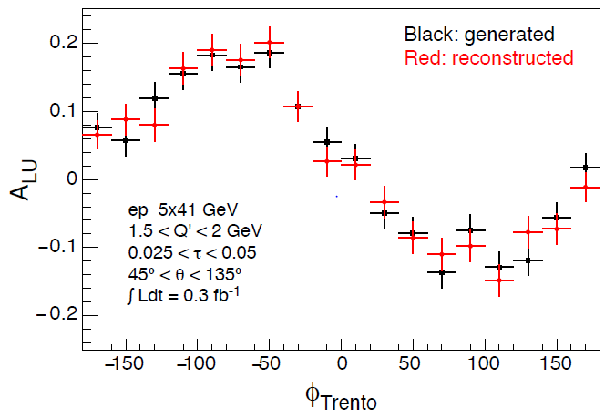
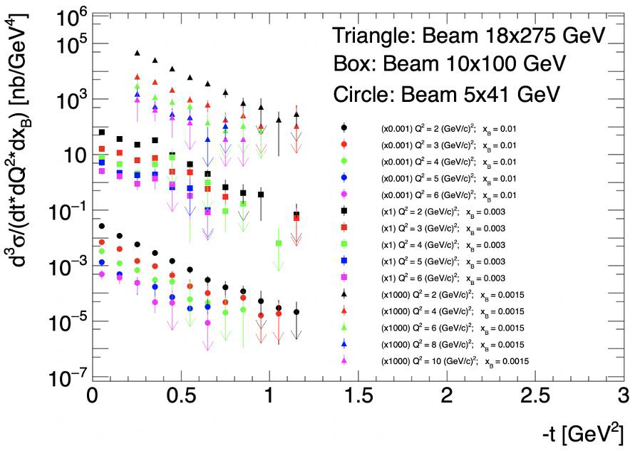
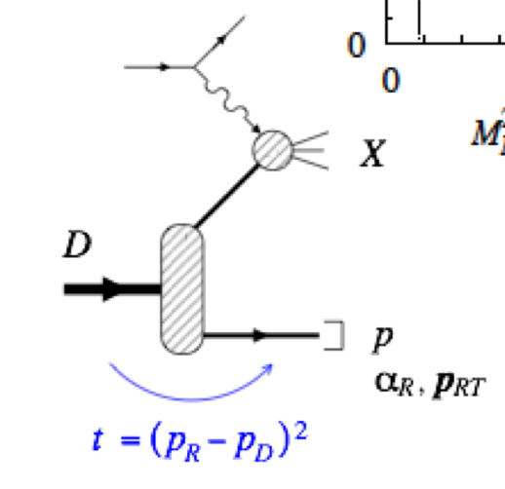
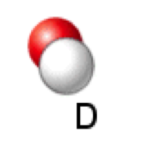
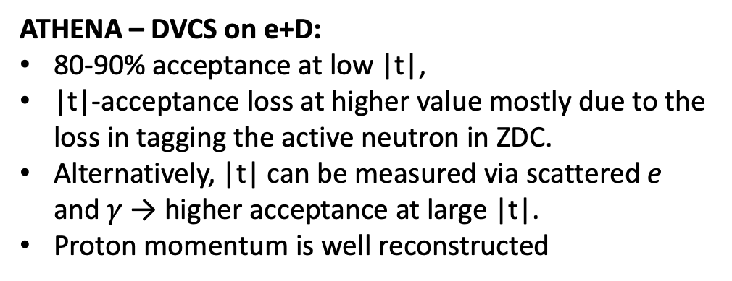
DVCS & TCS in ep
TCS
Study of neutrons with light nuclei
ATHENA – DVCS on e+D:
80-90% acceptance at low |t|,
|t|-acceptance loss at higher value mostly due to the loss in tagging the active neutron in ZDC.
Alternatively, |t| can be measured via scattered e and $γ$ → higher acceptance at large |t|.
Proton momentum is well reconstructed
𝛾

Slide 9
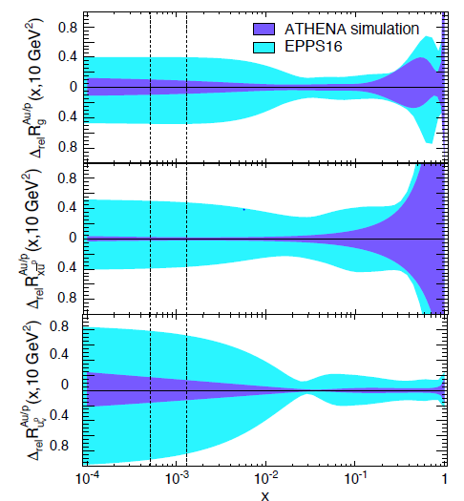
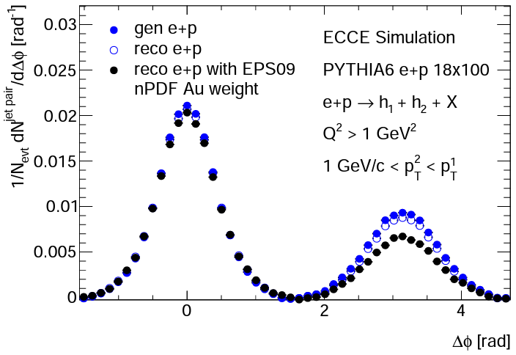



Collinear nuclear PDFs
Saturation via Di-hadron correlations
nPDFs: Au/p
$$g$$
$$\overline{u}$$
xFitter framework
Key:
Quality detection at mid rapidity
Reconstruction of dijets sensitive to saturation effects
$$u_{V}$$
Key:
Fine resolution in y over a large phase space
Minimum x for p fit
Minimum x for A fit

