Slide 1
BNL Sensor Production Status and Plan
https://indico.bnl.gov/event/20575/
Gabriele Giacomini
September 26th 2023
eRD112/LGAD Consortium Meeting

Slide 2
EICROC, new mask, old implant
1 x 50, 30, 20 um thick substrates :
- 30um done, diced
- 20 and 50 um done
Wafer # | Thick (um) | VBD (V)
3054 | 50 | 400 V
3081 | 20 | 170 V
3105 | 30 | 200V
EICROC bump-bond compatible
2cm x 0.5cm
High VBD as the furnace tripped.
Used to test:
- termination at the edge
- new mask
- new contacts
- new passivation
0.5cm x 0.5cm
0.2cm x 0.2cm
Compatible with EICROC

Slide 3
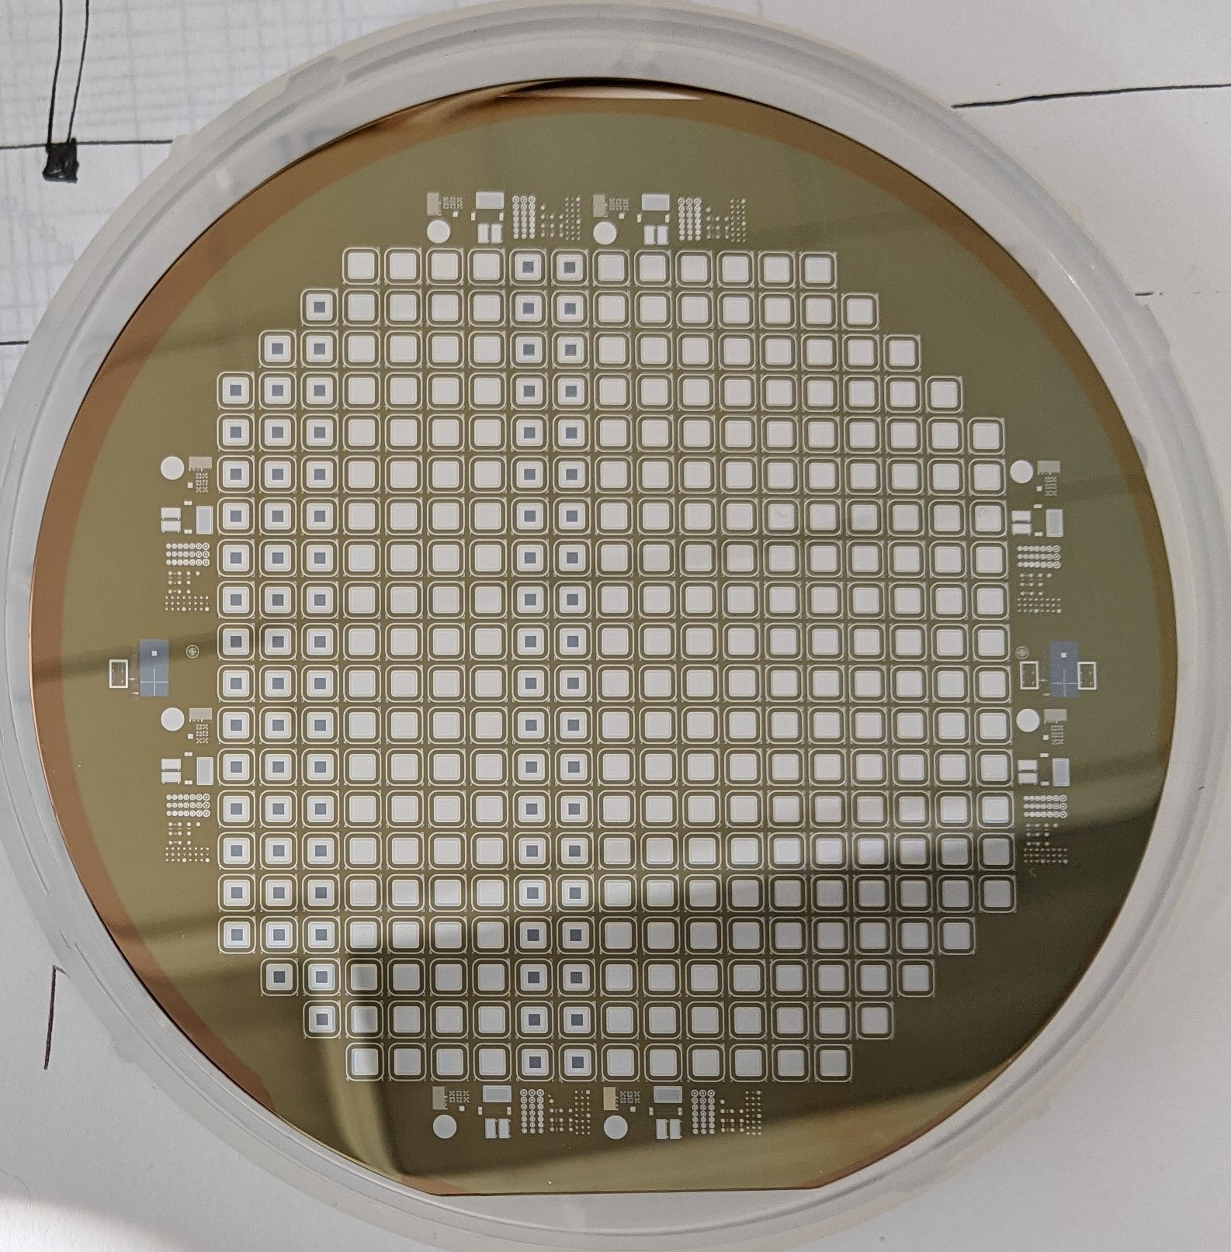
Next: LGAD & AC-LGAD with higher gain
With present technology, max gain = 60 for mips
To have more gain, we need higher UNIFORM implantation energy (380keV → 1Mev)
Test on small DC LGAD devices:
Single channel LGADs (1.3 mm x1.3mm)
TCAD simulations with UCSC, decided to go with one wafer first
30 um LGAD done (#3106), but VBD was high , ~ 250V
GRs still can sustain that high voltage.
Wafer need passivation opening (this week, RIE is back)
For the other two wafers, 20 and 50 um, increase of the gain dose.
To be shipped when the PO is approved ($$)
AC-LGAD with deep gain layer will follow the same strategy.
TCAD with UCSC
One wafer will go (waiting to go with the two DCLGADs)
VBD will be measured
Other two will follow, with adjusted gain dose.
All wafers with new technology (new contacts, termination, passivation)

