Slide 1
eRD110 DAQ
Gabor NAGY and Miklos CZELLER
2023-09-21

Slide 2
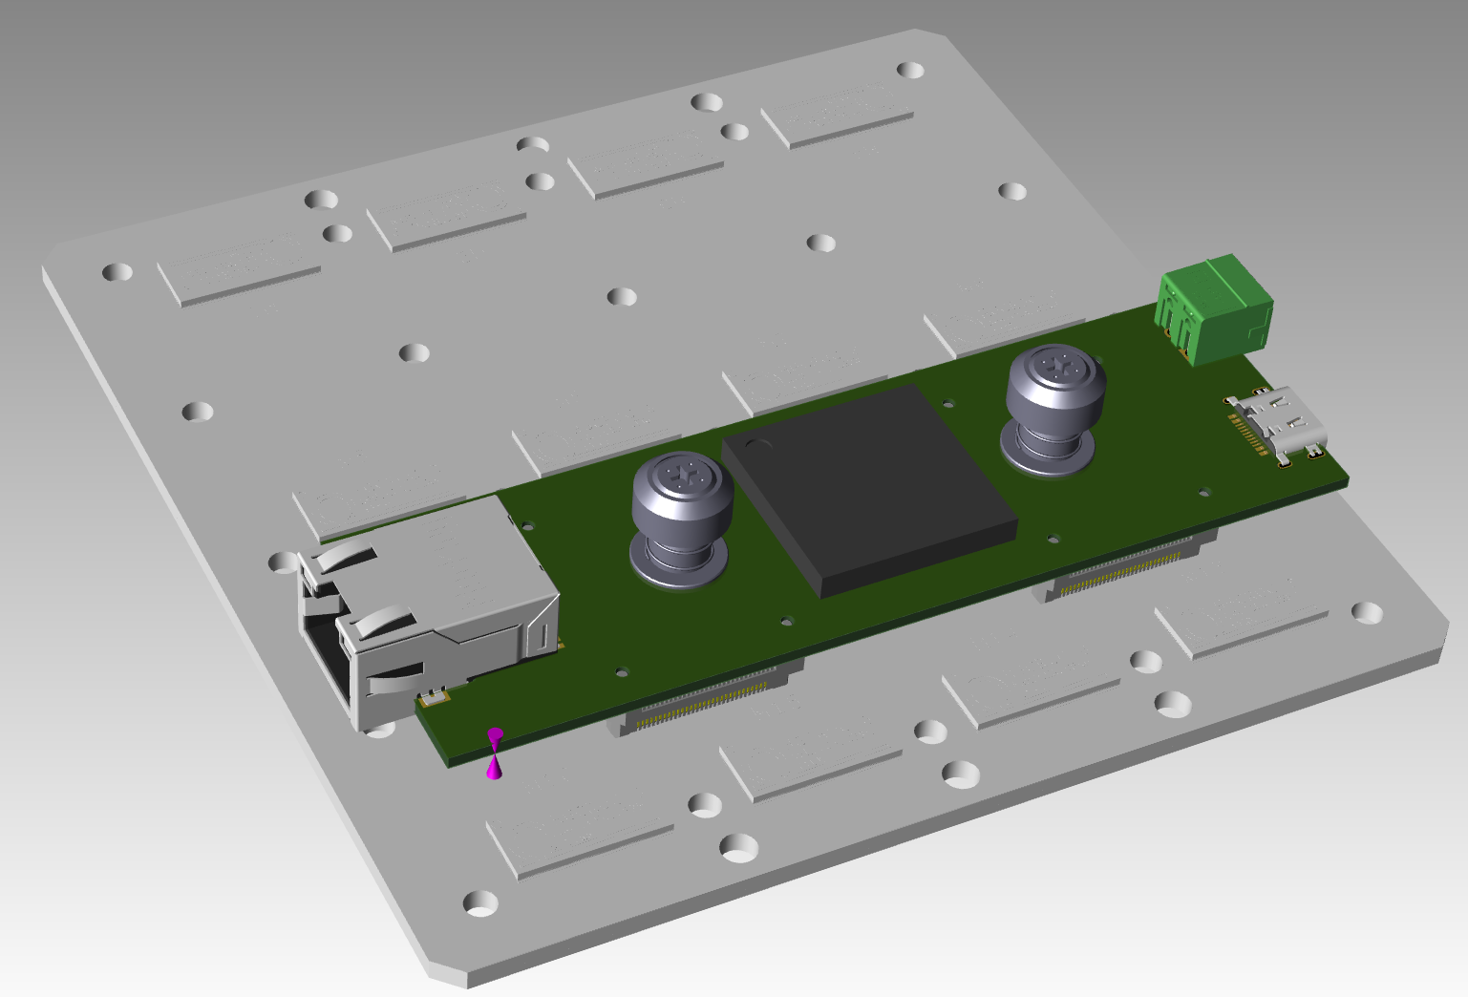
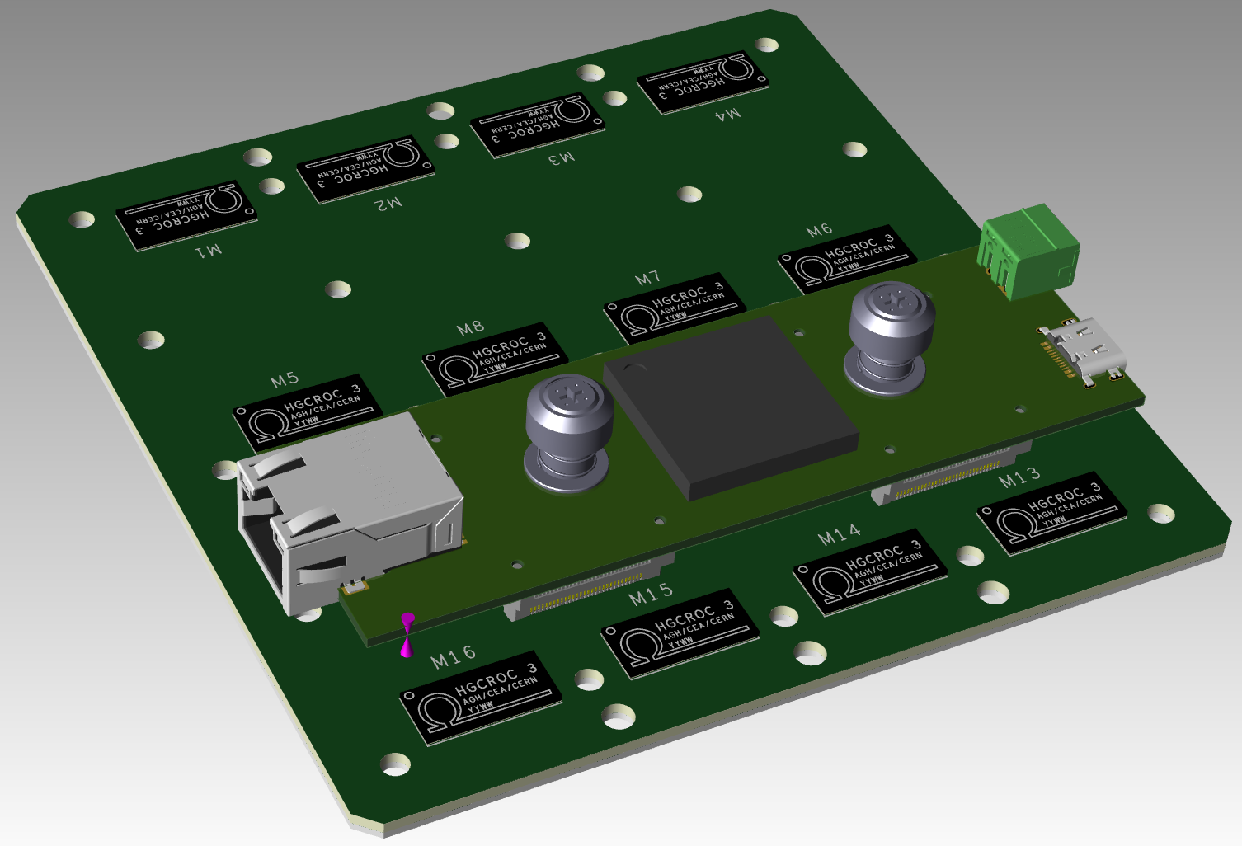
Version2 concept

Slide 3
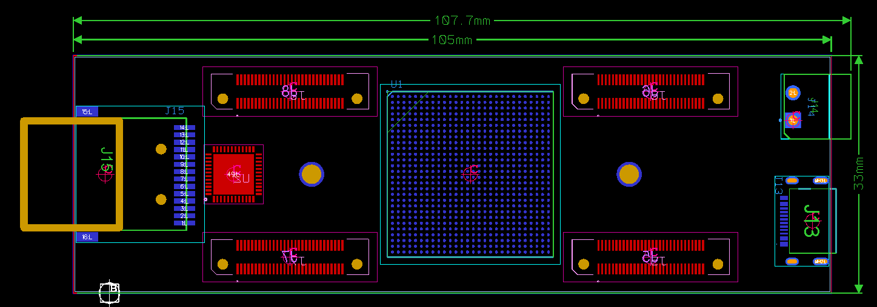
Readout board size

Slide 4
Alexander’s comments
slide 1: I thought we wanted to place the ASICs further away towards the edge of the FPGA board footprint (and move Samtec connectors closer to each other, as you also indicate in the subsequent slides)
slide 2: it is unlikely, but can happen that -0.50- ERF(M)5 connectors do not provide enough clearance to accommodate the screws / nuts which attach ASIC PCB to the sensor. -0.70- may be a better choice, but let me ask Alexey Lyashenko from Incom give you the screws (nuts) specs, as we see them now
slide 2: what is a problem with Jumbo frames? We routinely use such a configuration for the gas detector readout (DREAM by Saclay, UDP), and I guess eventually in the test beam there will be a single gigabit switch shared by DREAM FEEs and your HGCROC implementation cards, with Jumbo frame support, and perhaps a 10G uplink to the host PC
slide 5: 100mm x 42mm sounds great to me, but it is not clear how LV is distributed. Do I get it right that ASICs receive power via Samtec connectors, and we end up with a pair of LV cables per sensor (one per FPGA board)?
slide 6: I recall ERF5 only has 5mm and 7mm height options. Are the other ones non-standard? IN this case we should certainly avoid them, because of the limited supply and long lead times
slide 6: I think we should be able to machine these heat sinks to a shape we need, but still have them as a single piece, to simplify integration. Daniel can correct me, but I think that by using gap pads we are not really too much sensitive to a possible few hundred um FPGA and ASIC top surface "height" mismatch, to provide a good thermal contact to both of them

Slide 5
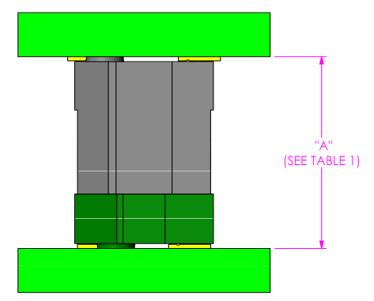
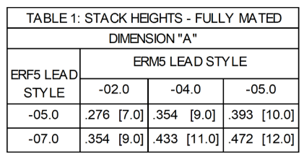

ERF5 MATED VIEWS
https://suddendocs.samtec.com/prints/erx5%20mated%20document-mkt.pdf

