Slide 1
Report from the EIC Advisory Board
Stuart Henderson
Director, Jefferson Lab

Slide 2
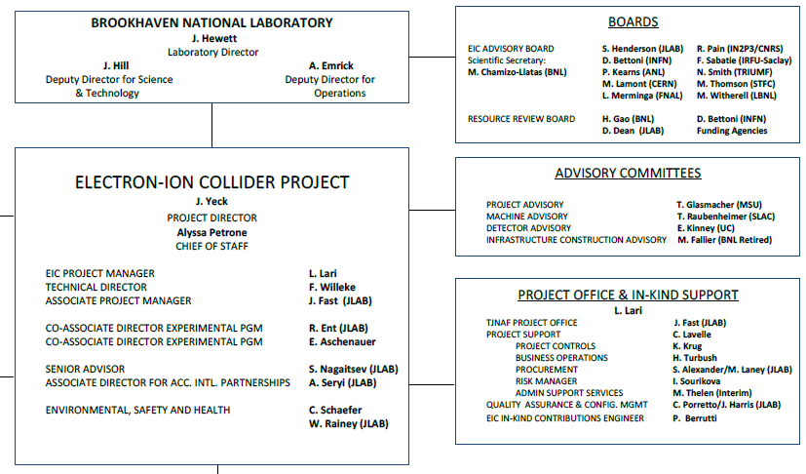
EIC Boards and Advisory Committees
DOE, BNL, and JLab envision an EIC facility that is “fully international in character.”
EIC Advisory Board provides oversight and advice on the construction of the facility, focusing on the accelerator (BNL, TJNAF, LBNL, ANL, FNAL, TRIUMF, IN2P3, CEA, STFC, INFN, CERN).
EIC RRB to provide oversight of the experiments

Slide 3
EIC Advisory Board Members
Stuart Henderson, Director, TJNAF (Chair)
Diego Bettoni, Vice President of INFN
Marcella Grasso, Deputy Scientific Director, IN2P3
Paul Kearns, Director of ANL
Mike Lamont, Director of Accelerators & Technology-CERN
Lia Merminga, Director of Fermilab
Reynald Pain, Director of IN2P3/CNRS
Franck Sabatié, Director of IRFU-Saclay
Nigel Smith, Director of TRIUMF
Mark Thomson, Executive Chair, STFC, UK Research & Innovation
Mike Witherell, Director of LBNL
Scientific Secretary: Maria Chamizo-Llatas, EIC In-Kind Manager/Deputy ALD, BNL
EIC Advisory Board reports to JoAnne Hewitt, Director of BNL

Slide 4
Origin of the EIC Advisory Board
The notion of an advisory board comes from best practices for management of large projects, particularly those involving multiple laboratories in partnership
Started in 2021 with two members to ensure good two-lab coordination; has expanded in membership as more partners join the EIC Project
To realize the “fully international” character of the EIC facility, we felt it important to incorporate all partners into the EIC Advisory Board
All are stakeholders, with vested interest in the success of the Project
Want to instill a relationship of shared success and shared ownership in that success
EIC Project benefits from the extensive experience
Members are at the level of lab directors and funding agency leaders who are empowered to make decisions and direct resources

Slide 5
EIC Advisory Board Charter (Excerpt; approved June 29, 2023)
Purpose
The purpose of the Electron Ion Collider Advisory Board (EAB) is to provide guidance and advice to the BNL Director on the design and construction of the EIC accelerator facility and on the efforts to establish partnerships, international and domestic, with institutions collaborating on the facility. The EAB provides a forum for high-level planning, communication, coordination, and resolution of issues affecting the EIC facility, appropriate at the level of the Laboratory Directors. The EAB will consider issues affecting the scope and/or resource allocations at BNL and the participant institutions.
The EAB Charter will be reviewed as the EIC moves from construction into operations, and as the needs of the program evolve.
Membership
Membership includes Laboratory Directors (or senior leadership) of institutions participating in the design and construction of the EIC accelerator facility. Board members may also include leaders of institutions with common accelerator Science and Technology interests. EAB members may delegate participation for a given meeting.
The BNL Laboratory Director will appoint the members of the EAB, and the EAB chair.
The EIC Project Director will be an ex-officio member of the EAB.
Chair
The EAB Chair, supported by the scientific secretary, shall convene meetings, set meeting agendas, and determine objectives for the EAB. The Chair shall report to the BNL Laboratory Director on the activities and recommendations of the EAB and keep the EIC Resources Review Board informed of significant issues and developments.

Slide 6
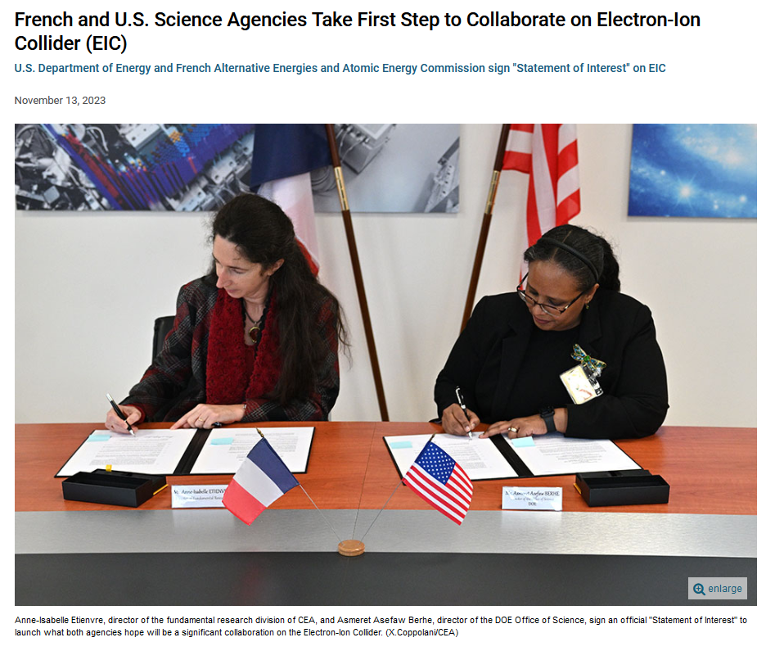
Recent Activities
CEA-DOE Signing Statement of Interest on EIC
EIC Advisory Board Meeting June 29, 2023
Update on EIC project progress and outlook
Review, approval of EIC Advisory Board Charter
Roundtable updates from partners on EIC accelerator collaborations
Actions:
Explore establishment of an EIC Accelerator Collaboration
Define high-level risks/milestones appropriate for Advisory Board visibility
Complete scope definition with partners
EIC Advisory Board Meeting November 6, 2023
Update on EIC project, Director’s Review and preparation for DOE CD-3A Review
Roundtable updates from partners on EIC accelerator collaborations
Discussion of the EIC Accelerator Collaboration and International Agreements
Actions:
JLAB: EIC/IN2P3 to identify the scope for accelerator collaboration before the end of 2023.
BNL/JLab: Provide an update on accelerator collaboration activities.
EIC Project Provide an update on DOE IPR results, CD-3A approval, and DOE project funding plans.
All: Finalize the matrix of the anticipated contributions of partners to the accelerator

Slide 7
EIC Accelerator Collaboration
The EIC design, construction, and future upgrades have many exciting scientific and technical challenges, creating opportunities for a worldwide accelerator collaboration to become part of this exciting endeavor
EIC accelerator collaboration, with formal organizational structure, being launched now, will help in realization of these opportunities
Emerged from the 2020 and 2021 EIC accelerator workshops, which attracted hundreds of participants from more than 20 countries, as well as numerous technical meetings with national and international institutions
The EIC Accelerator Collaboration co-chairs
Prof. Carsten Welsch (Univ. of Liverpool, UK) and Prof. Andrei Seryi (JLAB and Old Dominion University)
The EIC Accelerator Collaboration will benefit the EIC project, collaborating partners, and the wider community of accelerator experts. The EIC Accelerator Collaboration will also enhance the developments of the evolution, upgrades, and the ultimate performance of the EIC facility
The collaboration kick-off meeting will be held as a satellite meeting at the IPAC2024 conference in May 2024 in Nashville, TN, USA
We invite and look forward to your engagement in this exciting opportunity of the EIC Accelerator Collaboration

Slide 8
Status of accelerator scope discussions
This table does not imply any commitment. It reflects discussions with international partners
Country/Institution Funding Agency | Scope | Lead Lab
CERN | FCC-EIC areas for collaboration
Canada | SRF / Cryomodules | JLAB-TRIUMF
France - IN2P3 ¹⁾ | SRF / Cryomodules | JLAB-IJCLAB
France – CEA ¹⁾ | Superconducting magnets spin rotators | BNL-CEA/Irfu
Italy ²⁾ | Vacuum coating measurements | BNL-INFN/LNF
United Kingdom ³⁾ | SRF / Cryomodules | JLAB-UK
¹⁾ France-IN2P3-CEA plan joint request to Ministry
³⁾ UK-EIC proposal in the last phase of review by UKRI
²⁾ Covered with INFN funds
Notes:
SC=office of Science

Slide 9
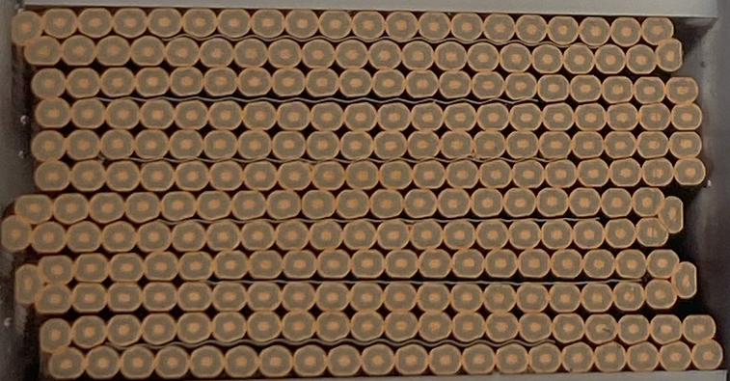
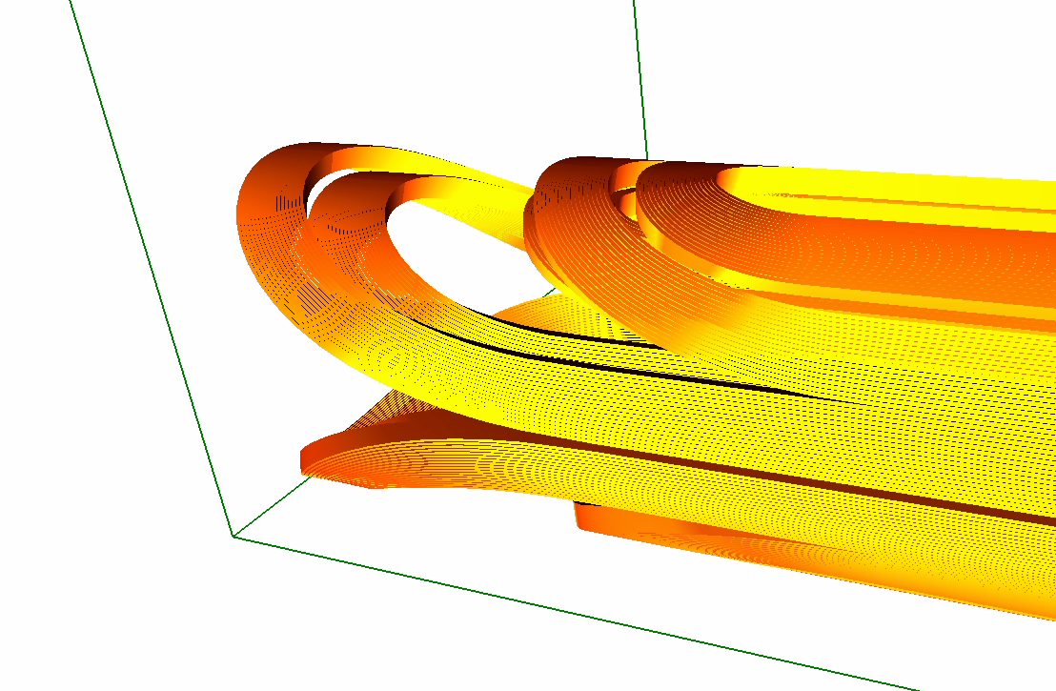
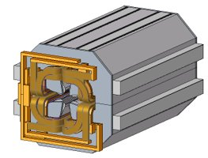
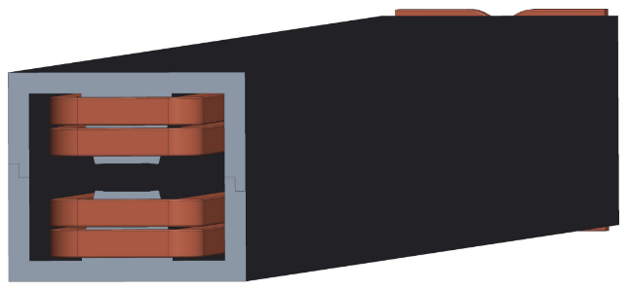
Partnerships with DOE Labs & other Domestic Partners
SLAC: - Beam Dynamics and IR and crab cavity design ongoing
LBNL: - Beam dynamics Simulations, ongoing
- s.c. cable production MOU in preparation
- design of superconducting “matching” magnets ongoing
ANL: - Design of RCS Quadrupole magnets ongoing
- APS quadrupoles and Sextupoles ongoing
- Beam dynamics ongoing
FERMILAB: - Beam dynamics (e-Polarization) ongoing
- Design of RCS dipole magnets ongoing
- S.C. IR magnet quench Protection ongoing
- Collaboration on design and manufacturing
of collared s.c. IR magnets under discussion
ORNL: -Beam dynamics ongoing
Cornell - Beam dynamics and accelerator design ongoing
MSU - Beam dynamics ongoing
ODU - Ga-As cathodes, Crab Cavity Design ongoing
CalPoly - Beam dynamics ongoing
Stony Brook - R&D support ongoing

Slide 10
Outlook
We appreciate the significant interest and engagement from international community and international funding agencies and laboratories
Considerable progress on defining potential accelerator-related contributions from partners and defining roles (both domestic and international)
Its focus will inevitably evolve from initial focus on partnership formation, toward execution and delivery
EIC Advisory Board is a valuable group to help ensure open communication and a forum to develop relationships, strengthen engagement and learn from members
Next meeting following this RRB meeting in early summer, prior to EIC User’s Meeting

