Slide 1

Detector Advisory Committee Report:
Report on the DAC to the EIC Resources Review Board
Overview of DAC
Report on 2023 Activities
Edward Kinney, DAC Chair

Slide 2
Detector Advisory Committee (DAC)
Formed in Fall 2020 to advise Laboratory and Project Management on issues related to the EIC detector design, EIC Users Group activities and associated R&D efforts
Composed of 12 members, bringing technical expertise on Calorimetry, Tracking, Particle Identification, Readout Electronics, Data Acquisition, Detector Infrastructure, and EIC science.
Meets once or twice a year to review project progress and evaluate R&D proposals and reports.
After first two years, 1/3 of original members have rotated off and were replaced. In the future, we will continue with staggered 3 year terms.

Slide 3
2023 DAC Members
Detector Advisory Committee 2023
Name | Institition | Expertise
Edward Kinney | Boulder CO | EIC Science, general
Ken Wyllie | CERN | ASICs/electronics
Petra Merkel | FNAL | R&D, Integration
Antonis Papanestis | Rutherford Appleton Laboratory | Particle Identification
Peter Krizan | U Ljubljana | Particle Identification
Ana Amelia Machado | University of Campinas, Brazil | Particle Identification, Sensors
Heidi Schellman | Oregon State | Computing
Brigitte Vachon | McGill | Electronics
Stefano Miscetti | INFN Frascati | Calorimetry
Etiennette Auffray | CERN | Calorimetry
Andrew White | U. Texas Arlington | Tracking
Chi Yang | SDU China | Tracking
1/3 of DAC members to rotate off this spring.

Slide 4
Past Meetings/Tasks of DAC
September 28-29, 2020. Bring the DAC up to speed and prepare them for upcoming charges, e.g., related to input on assessment of the call for Expressions of Interest (EoI).
December 18, 2020. Update DAC on the EIC Project and Yellow Report status, the EoI assessment, international engagement, and planning for call for detector proposals.
March 24-26, 2021. Transition from the generic EIC detector R&D to the Project detector R&D.
December 2021 – January 2022. Evaluation of detector technologies, cost and schedule as input to the Detector Proposal Advisory Panel.
October 19-21, 2022. Review the ongoing project detector R&D. Advise for the FY23 detector R&D.

Slide 5
DAC Activities in 2023
August 28,31: Review the ongoing project detector R&D. Advise for the FY24 detector R&D.
August 29-30: Comprehensive Review of EPIC Detector in preparation for upcoming DOE CD-3a and future CD-2 reviews

Slide 6
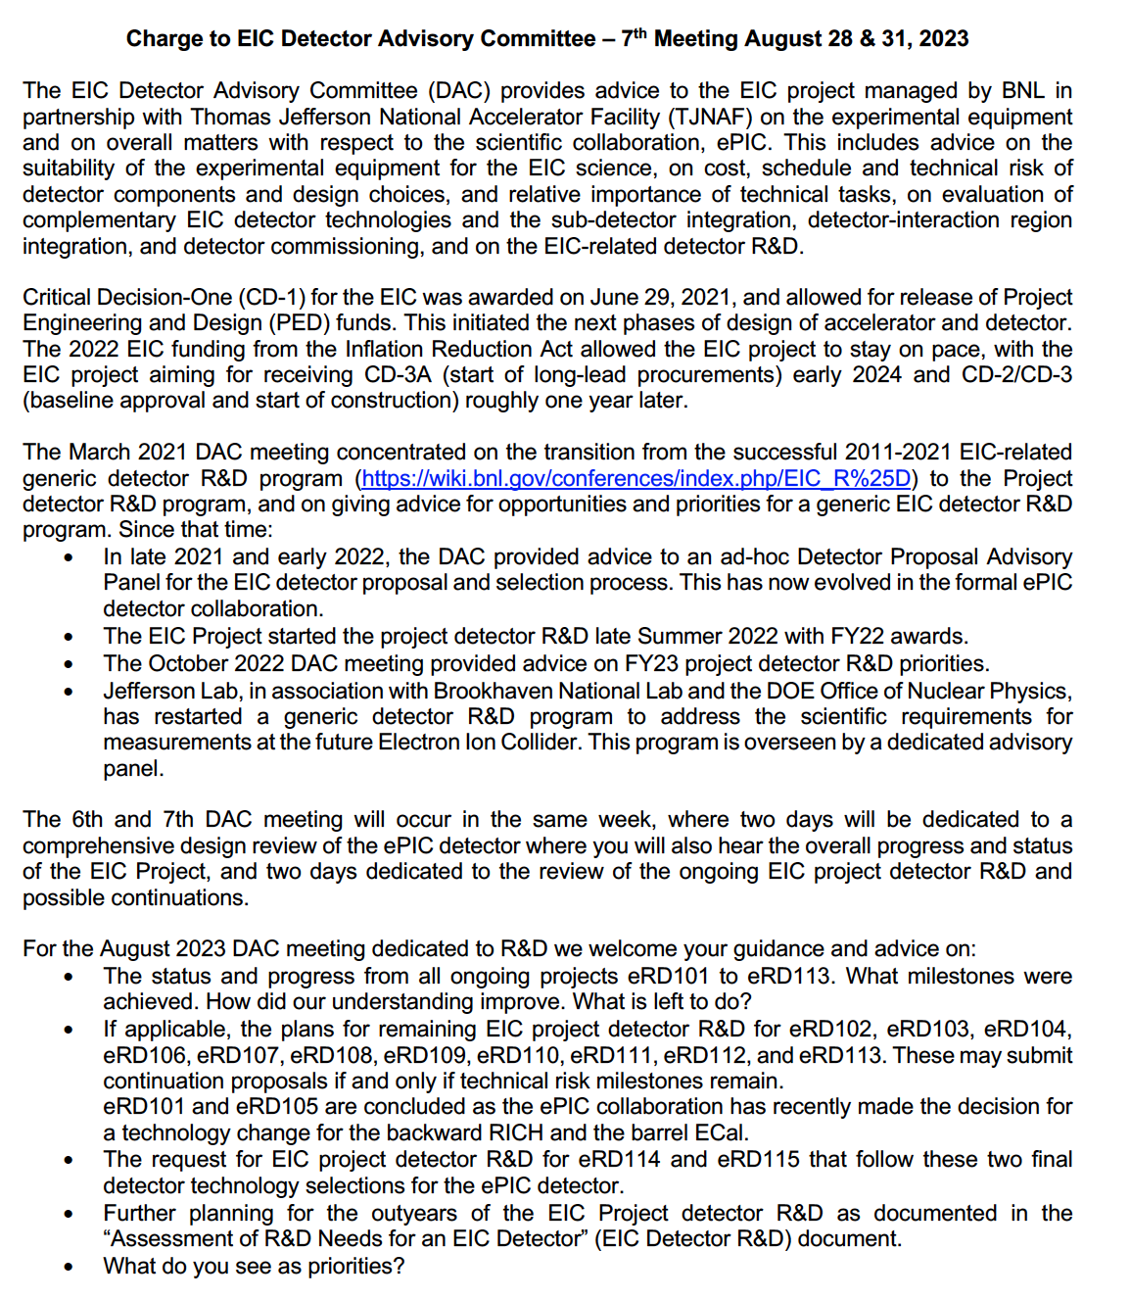
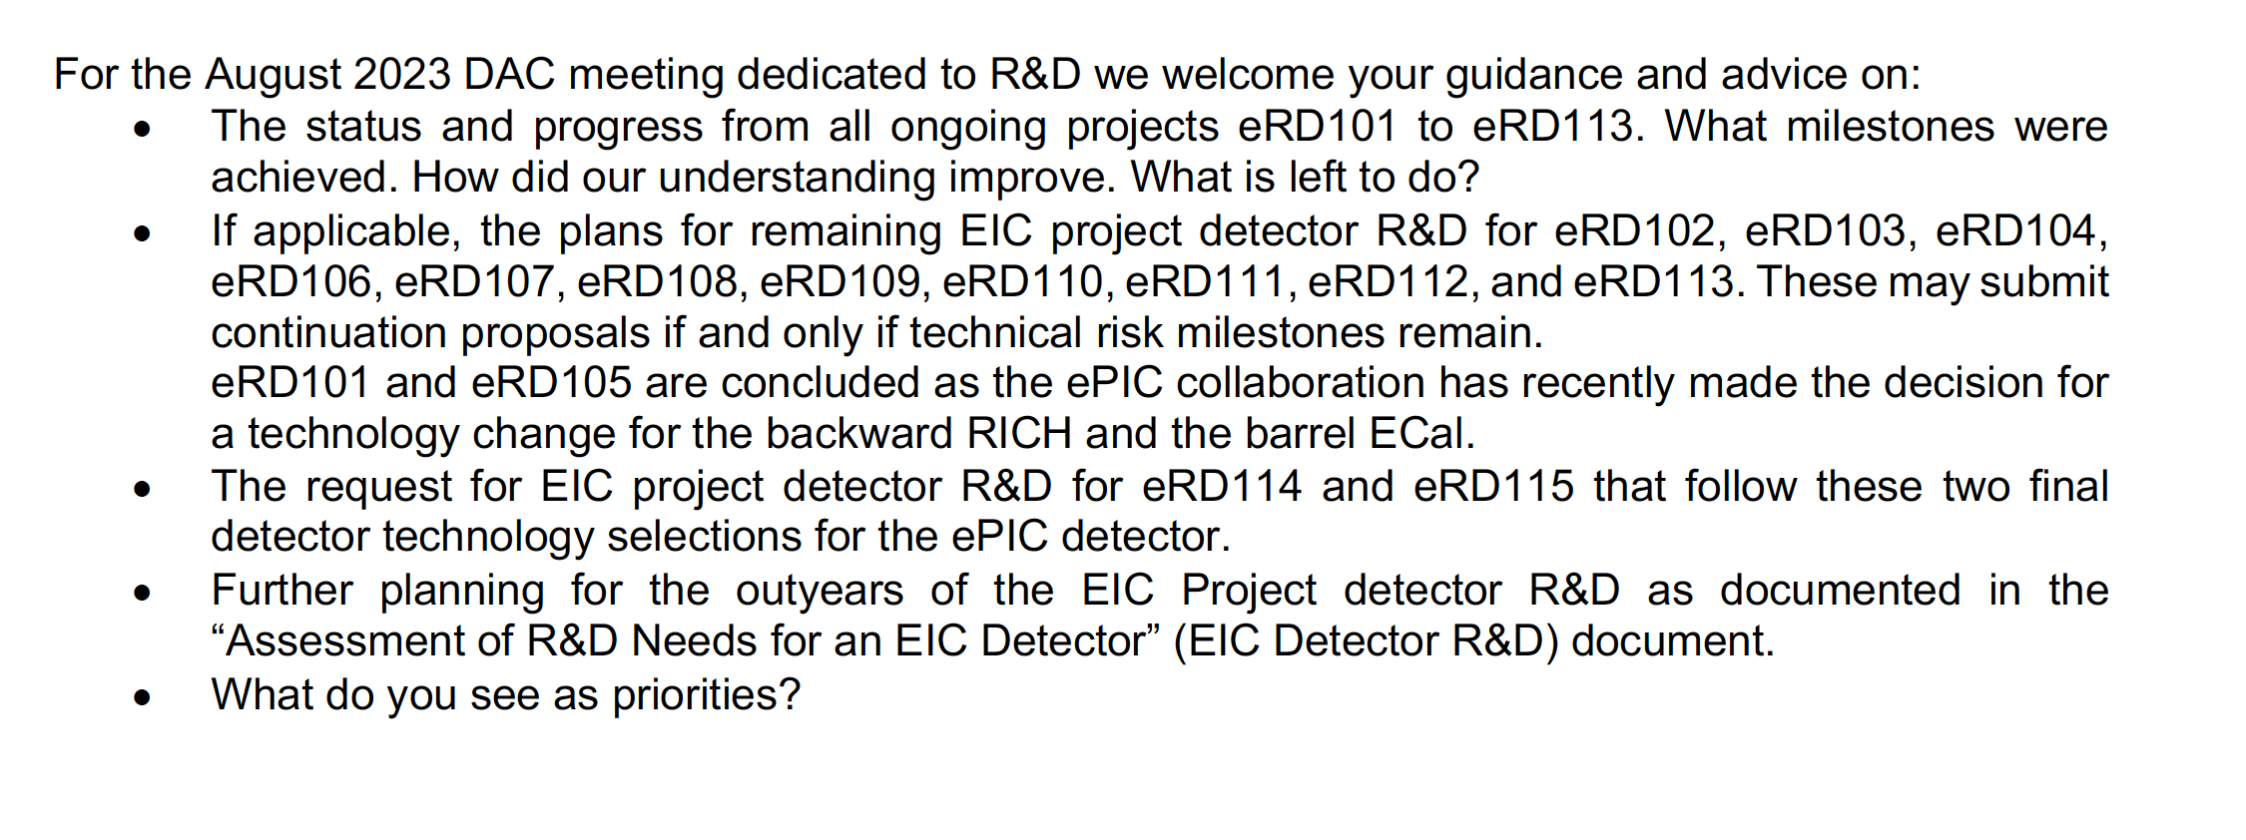
DAC Charge for Project R&D Review

Slide 7
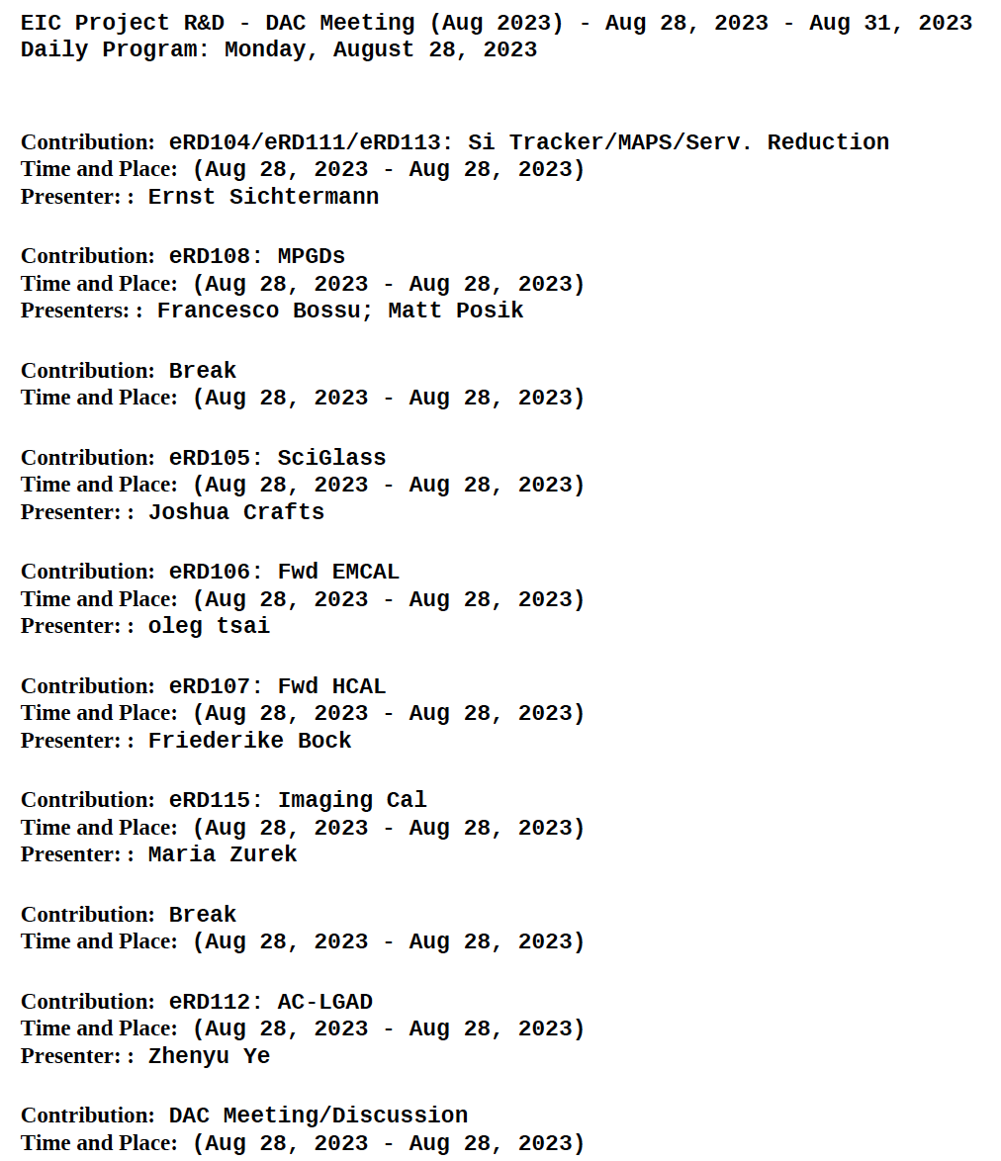
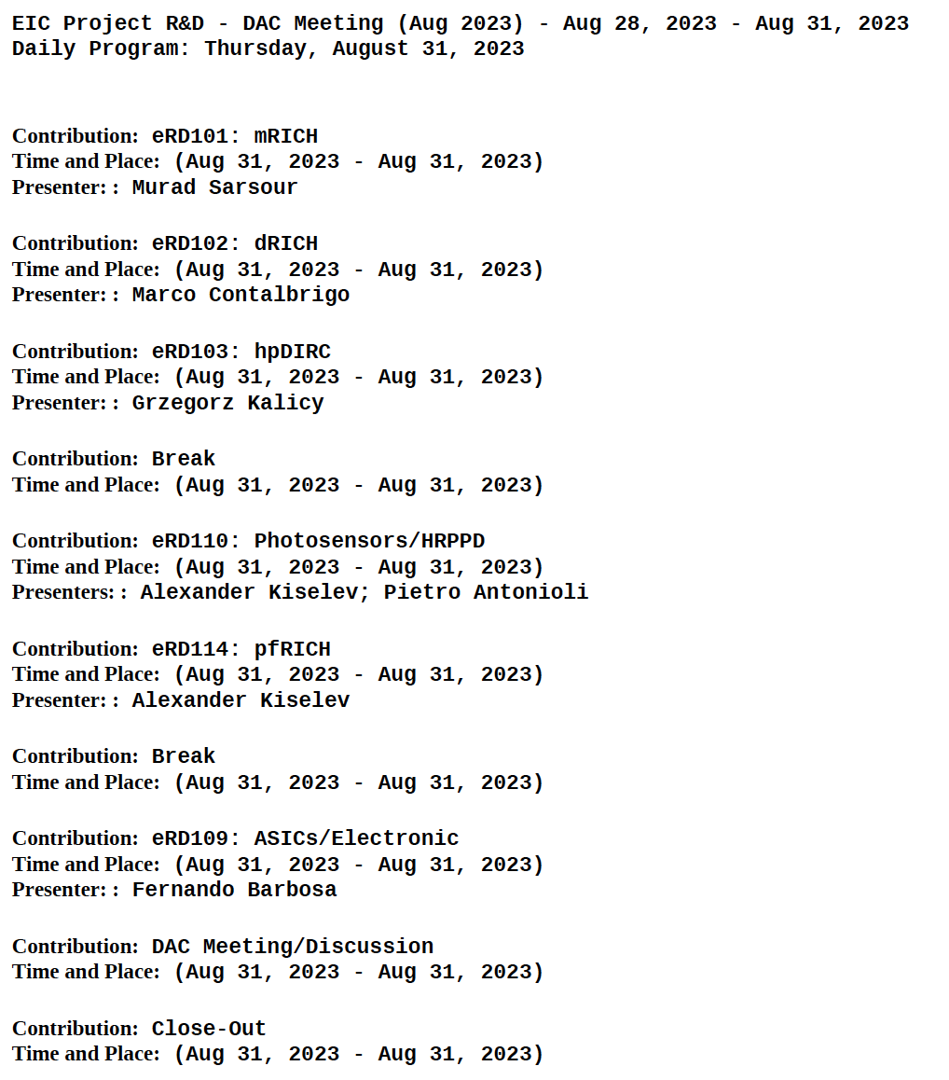
Agenda: Project R&D Review

Slide 8
Highlights from Project R&D Review - 1
Overall, projects made good progress, some groups delayed by test beam shutdown during FNAL safety review.
Two new efforts related to technology changes by EPIC: Proximity Focusing RICH and Imaging Barrel EM Calorimeter, also some changes to Forward Hadron Calorimeter design; these have a very short time to complete their studies.
Silicon tracker projects now better integrated with ALICE ITS3 R&D effort, reduction of services using serial power under study to understand feasibility, sensor development continues. Recommend that this group advance as quickly as possible to finalize the collaboration agreement with ALICE and integrate designers in the team at CERN.

Slide 9
Highlights from Project R&D Review - 2
Barrel and end-cap micro pattern gas detectors still need significant effort to establish a final design.
ASIC development ongoing and likely to extend past CD-2, advise push all detector groups to use planned readout electronics at the earliest possible stage.
Wide use of SiPM requires specification very soon for CD-3a. In some systems (e.g., Dual Radiator RICH), significant infrastructure required for cooling and heating (annealing) services.
Foundry and supply chain issues remain significant issues.
Encourage groups to maintain expertise and manpower as they transition to the final detector design, assembly, installation and commissioning.

Slide 10
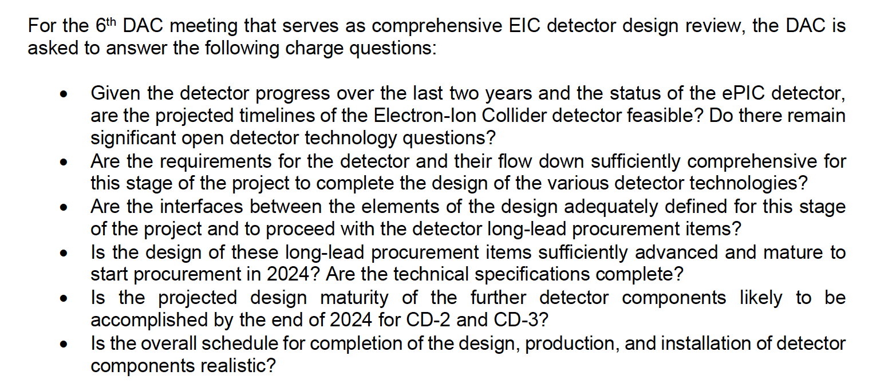
DAC Charge for Comprehensive Review

Slide 11
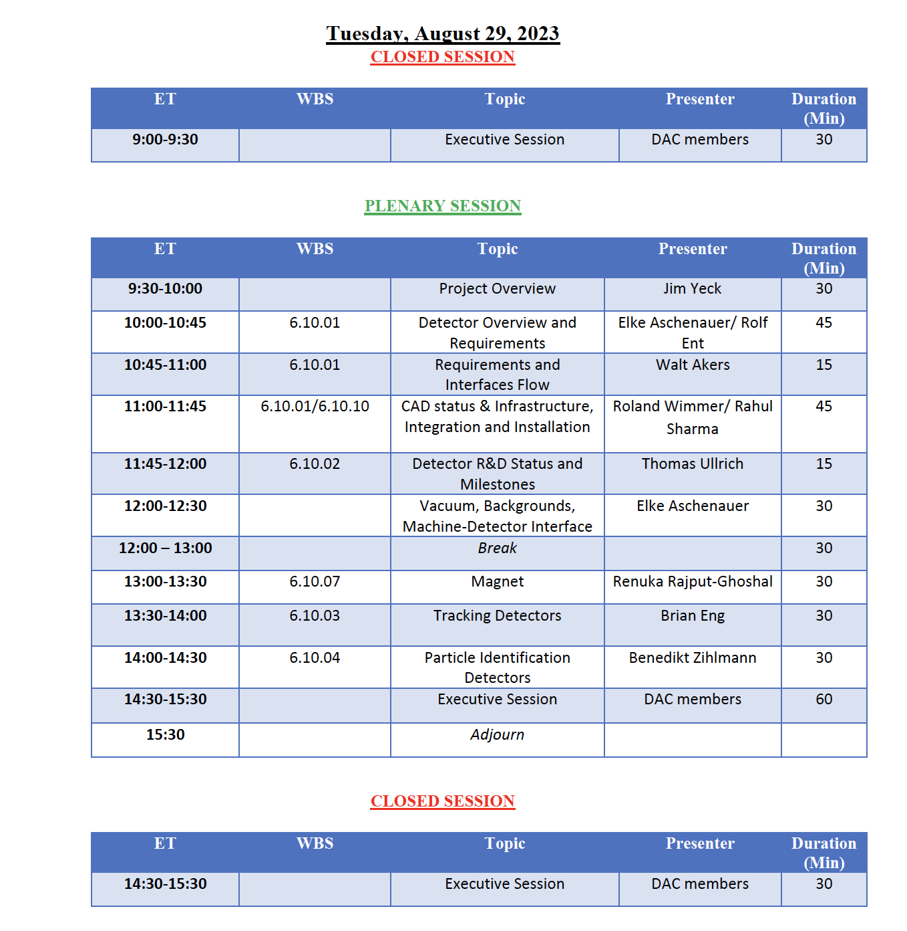
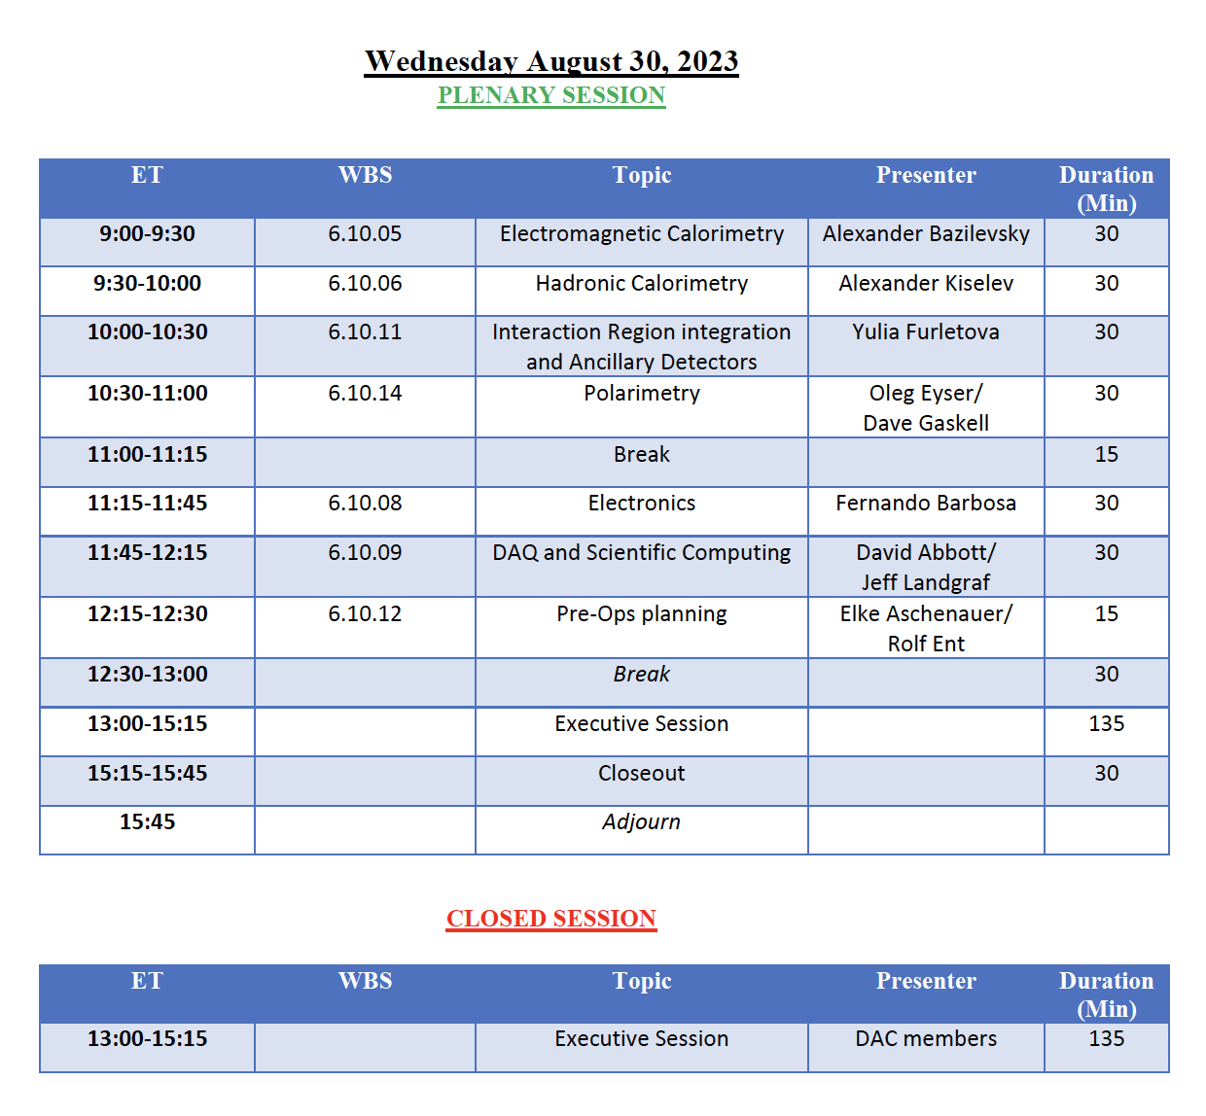
Agenda: Comprehensive Review

Slide 12
Summary from Comprehensive Review
Charge 1: Given the detector progress over the last two years and the status of the ePIC detector, are the projected timelines of the Electron-Ion Collider detector feasible? Do there remain significant open detector technology questions?
Timelines are aggressive but appear feasible. Magnet and Silicon Vertex Tracker have significant risk. Magnet as it drives detector assembly, and Silicon as it is a large external dependency.
All central detector technologies have been chosen and appear appropriate, however, not all are at the same stage of design and some still require R&D.
Charge 2: Are the requirements for the detector and their flow down sufficiently
comprehensive for this stage of the project to complete the design of the various detector technologies?
Implemented formal system engineering approach seems critical to successful comprehensive integration and understanding of flowdown of detectors.
Committee recommended continued study of background effects on detector performance and requirements as well as an overall survey/alignment plan.

Slide 13
Charge 3: Are the interfaces between the elements of the design adequately defined for this stage of the project and to proceed with the detector long-lead procurement items?
The identified long-lead items were the superconducting solenoid magnet, a large number of SiPMs for use in the PID/CAL detectors, the PbWO₄ crystals for the electron endcap calorimeter, the scintillating fibers for the calorimeters, and the absorber for the forward HCAL/insert.
The demonstrated systems engineering approach gave confidence that the interfaces are sufficiently well defined that the long-lead items can be procured with small risk to the project.
Charge 4: Are the requirements for the detector and their flow down sufficiently
comprehensive for this stage of the project to complete the design of the various detector technologies?
The magnet, HCAL, PbWO₄ and scintillating fiber specifications are clear and the design appears quite mature and nearly completed.
Some concerns that SiPM background effects needing close attention and more information on Astropix procurement requested.

Slide 14
Charge 5: Is the projected design maturity of the further detector components likely to be accomplished by the end of 2024 for CD-2 and CD-3?
Overall maturity of the design and integration is good, but some systems still have R&D cycles to accomplish in roughly a year(!)
Silicon Vertex tracker is tied with ALICE ITS3 development, and 𝛍RWELL foils are produced only at CERN so R&D/design is less controllable.
Overall concern with changing availability of silicon foundries and suppliers.
Charge 6: Is the overall schedule for completion of the design, production, and installation of detector components realistic?
The overall schedule is aggressive but achievable as presently estimated.
Contingency plans in case of delay of magnet and silicon vertex tracker should be developed.

Slide 15
General Comments and Recommendations from Comprehensive Review
Congratulations to all involved in the EIC project on the rapid development of a nearly complete design for the EIC detector. This was extremely impressive to the committee, especially in the organization of the many different project components and tasks. This inspired confidence in the successful completion of this incredibly complex facility.
Enormous progress has been made in developing a coherent design for detector to carry out EIC research goals, with minimal open technology choices at present.
The committee recommends continued study of the detector readout and DAQ strategy. In particular, significant resources will be necessary to support all aspects of the R&D, production and commissioning, throughout the period between CD2/3 and CD4. The committee applauds the adoption of common solutions, but their development and support must be properly resourced to guarantee the success of this approach.
ASIC development has historically been on the critical path in many projects, often due to a lack of personnel resources. We encourage the EIC community to carefully monitor the progress of the various ASIC projects and ensure these are properly resourced.

Slide 16
Summary and Outlook
The EPIC collaboration, BNL and Jlab project personnel continue to make excellent progress on the design and development of the Electron-Ion Collider.
DAC plans for next year: Pre-CD 2 review of the ePIC detector and in-kind engagement, and the next phase of Project Detector R&D.
New DAC members will join in spring 2024.

