Slide 1
EIC Project Status
Jim Yeck
EIC Project Director
Luisella Lari
EIC Project Manager
EIC 2nd Resource Review Board Meeting
December 7-8, 2023

Slide 2
Outline
Requirement and Performance Parameters
Summary Schedule and Funding Plan
Project Organization and Management
DOE IPR CD-3A/Status Review Results
In-Kind Agreement Types
Responses to April 2024 RRB Actions
Summary

Slide 3
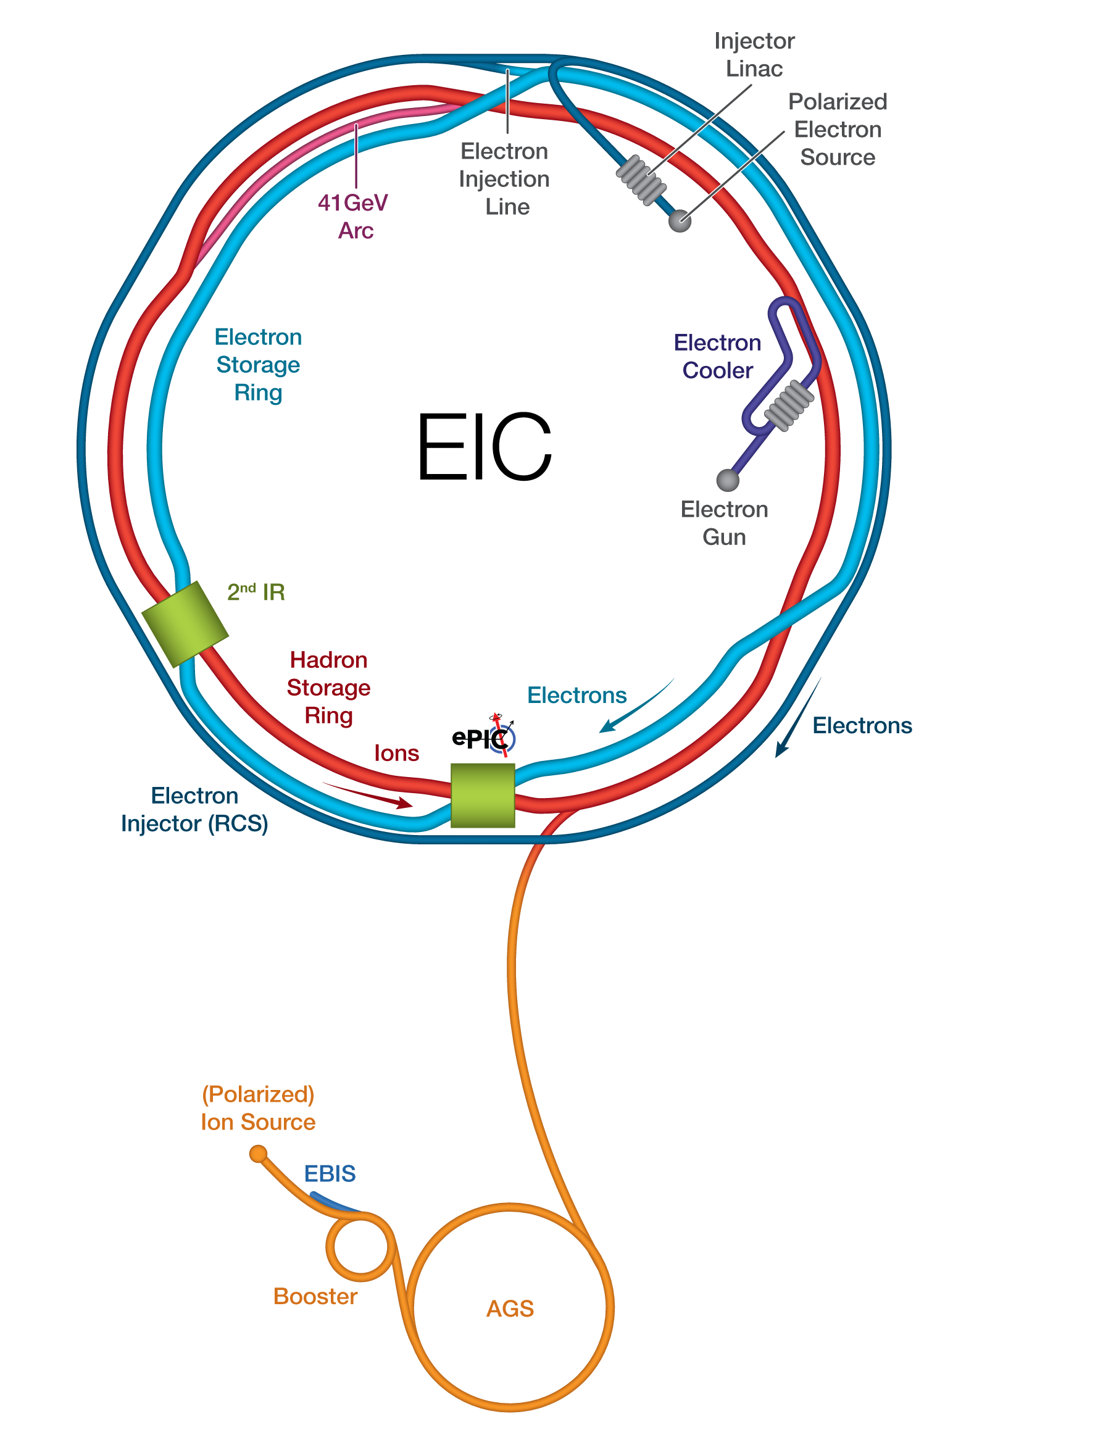



Electron- Ion Collider Decades of Discovery Potential
Polarized electrons colliding with polarized protons, polarized light ions, and heavy ions will allow us to study sea-quarks and gluons to understand:
mass and spin of the proton.
spatial and momentum distribution of low-x partons
possible gluon saturation
modifications of parton distribution functions when a nucleon is embedded in a nucleus
hadron formation

Slide 4

2023 NSAC Long Range Plan Presentation
RECOMMENDATIONS 2 and 3
Next, we reaffirm the exceptionally high priority of the following two investments in new capabilities for nuclear physics. The Electron–Ion Collider (EIC), to be built in the United States, will elucidate the origin of visible matter in the universe and significantly advance accelerator technology as the first new particle collider to be constructed since the LHC. Neutrino less double beta decay experiments have the potential to dramatically change our understanding of the physical laws governing the universe.
We recommend the expeditious completion of the EIC as the highest priority for facility construction.

Slide 5



EIC Requirements
Facility Performance Goals
High Luminosity: L= 10³³ – 10³⁴cm⁻²sec⁻¹, 10 – 100 fb⁻¹/year
Highly Polarized Beams: 70%
Large Center of Mass Energy Range: E_{cm} = 20 – 140 GeV
Large Ion Species Range: protons – Uranium
Large Detector Acceptance and Good Background Conditions
Accommodate a Second Interaction Region (IR)
Conceptual design scope and expected performance meet or exceed the Nuclear Science Advisory Committee (NSAC) Long Range Plan (2015 & 2023) and the EIC White Paper requirements endorsed by the National Academy of Sciences (2018).

Slide 6
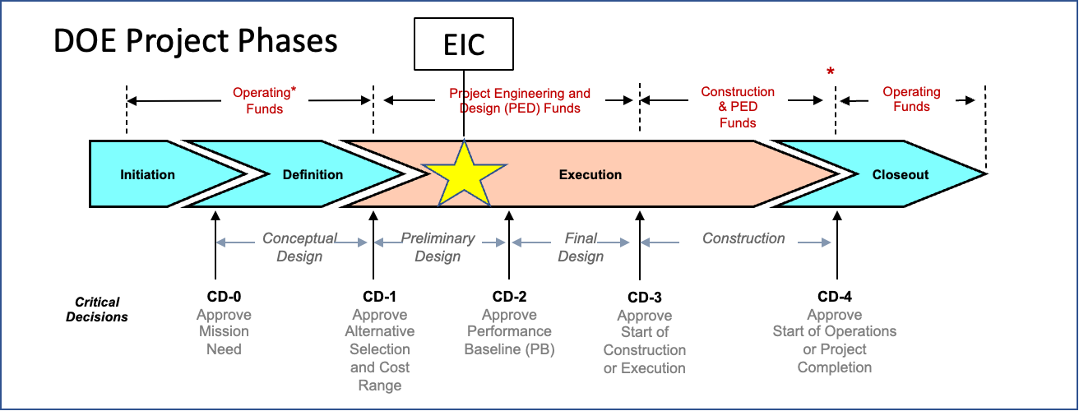
EIC Project Critical Decisions and Plans
CD-0, Mission Need Approved | December 2019
DOE Site Selection Announced | January 2020
CD-1, Alternative Selection and Cost Range, Approved | June 2021
CD-3A, Long Lead Procurement Approval (Review 11/24) | January 2024
CD-3B, Long Lead Procurement Approval | October 2024
CD-2/3, Performance Baseline/Construction Start | April 2025

Slide 7
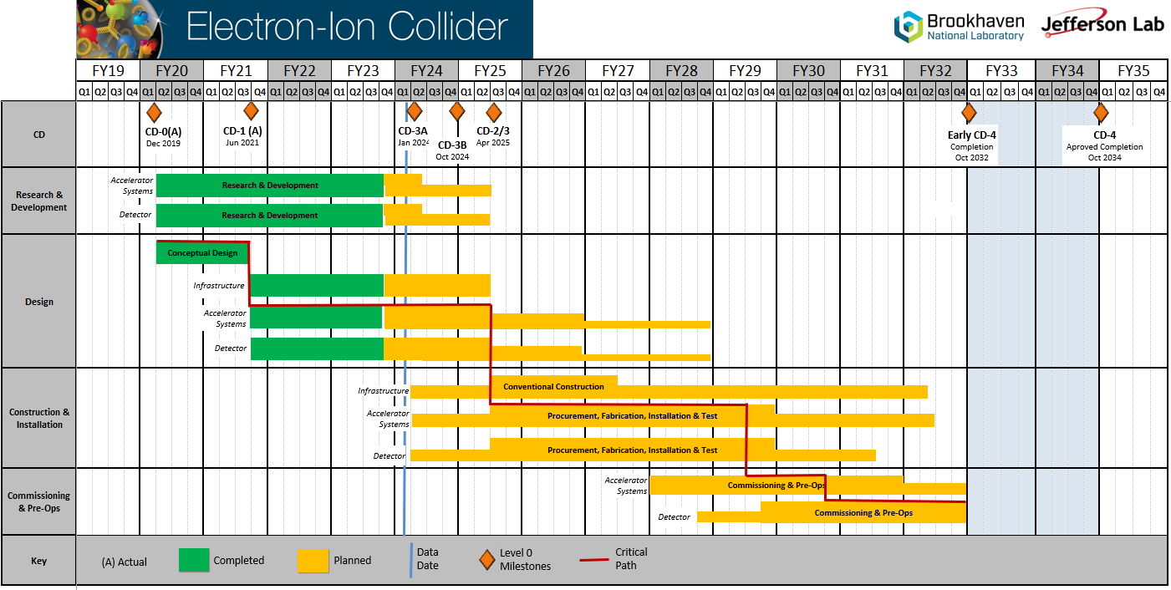
Summary Schedule
Conclusion of RHIC
Operations

Slide 8
Reference Plan for DOE Funding
Transition to Operations
Total EIC funding commitments through FY2024 are expected to be $492.5M: 1) DOE funding through FY2023, including $138M of IRA funding = $294M; 2) FY2024 President’s Budget Request = $98.5M; and, 3) Pending NYS commitment = $100M.
Significant RHIC operations funding is reprioritized to EIC construction starting in FY2025 and is anticipated to reach ~$150M/year. FY2025 funding is TBD and it will also depend on RHIC run plans.

Slide 9
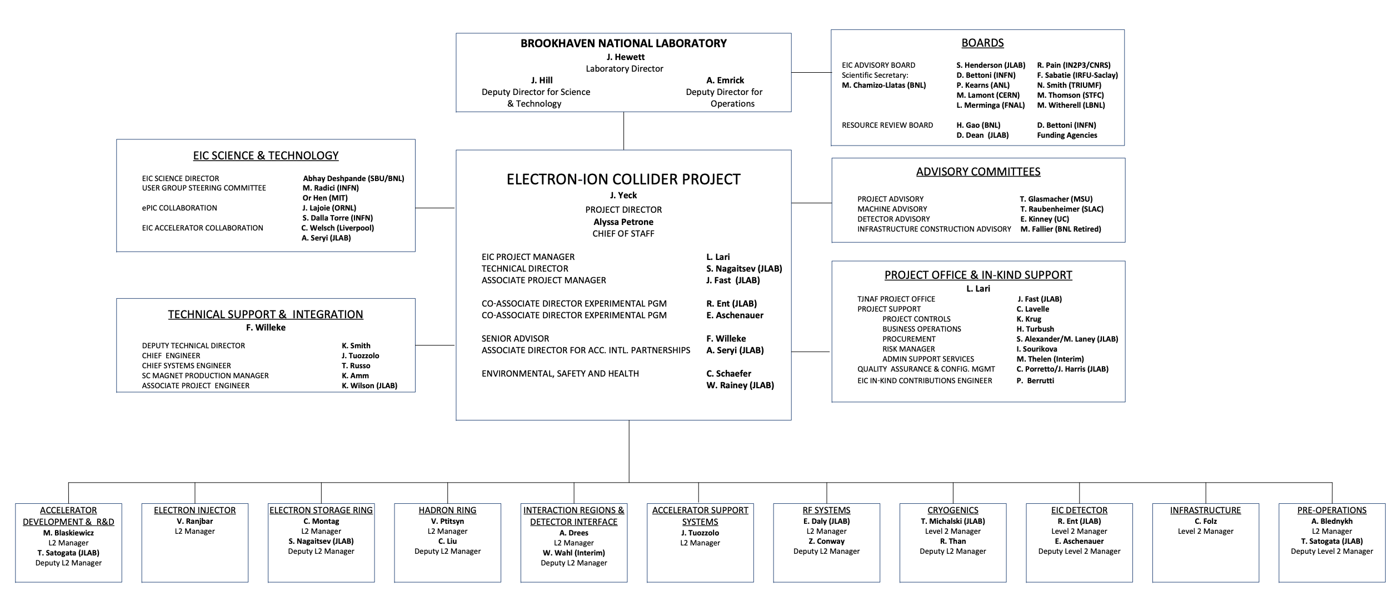
Project Organization – Level 1
BNL/JLab Partnership
Science & Collaboration Advice and Input
International Governance
Technical and Project Support

Slide 10
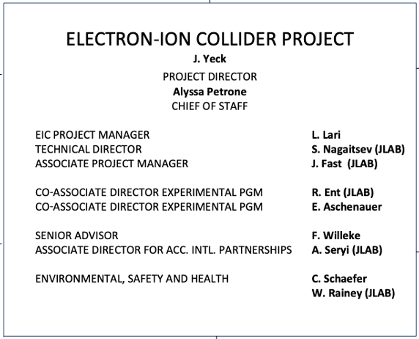
Project Organization – Integrated BNL/JLAB
Integrated BNL/JLab organization established in 2020.
Continues to evolve and strengthen with the support of the host labs.
An effective framework for developing execution strategies and identifying and resolving issues.
Executive Management Team meetings include additional participants.
New Technical Director effective in charge after the Nov-2023 CD-3A review.

Slide 11
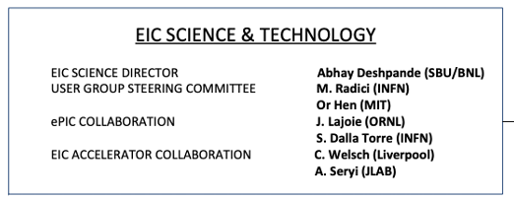
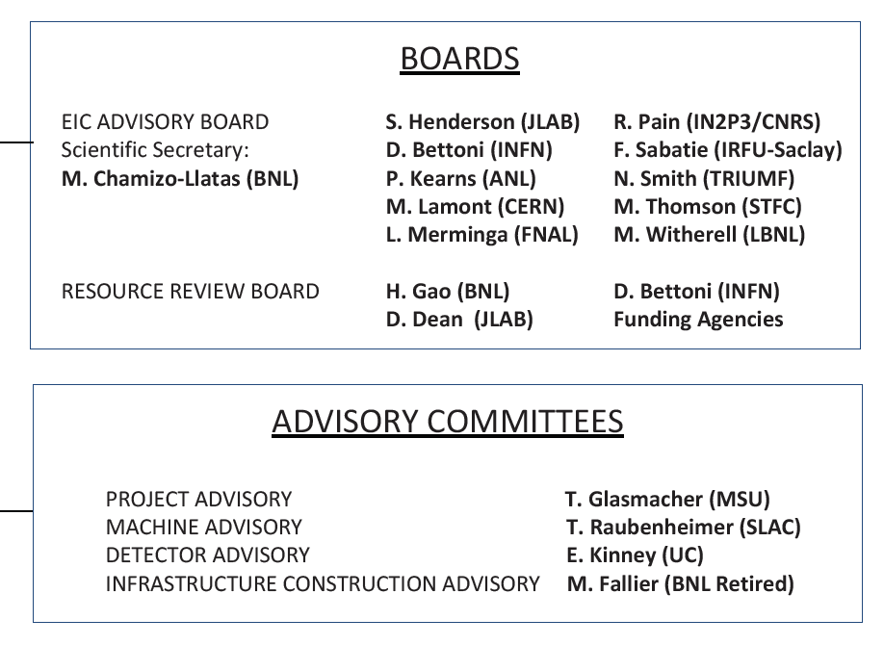
Project Organization – Governance & Support
Strong connections to the S&T communities.
DOE, BNL, and JLab envision an EIC facility that is “fully international in character.”
The International Advisory Board provides oversight and advice on the construction of the facility, focusing on the accelerator.
International Resource Review Board provides oversight of experiments.
International Advisory Committees provide advice on the Project, Infrastructure, Machine, and Detector.

Slide 12
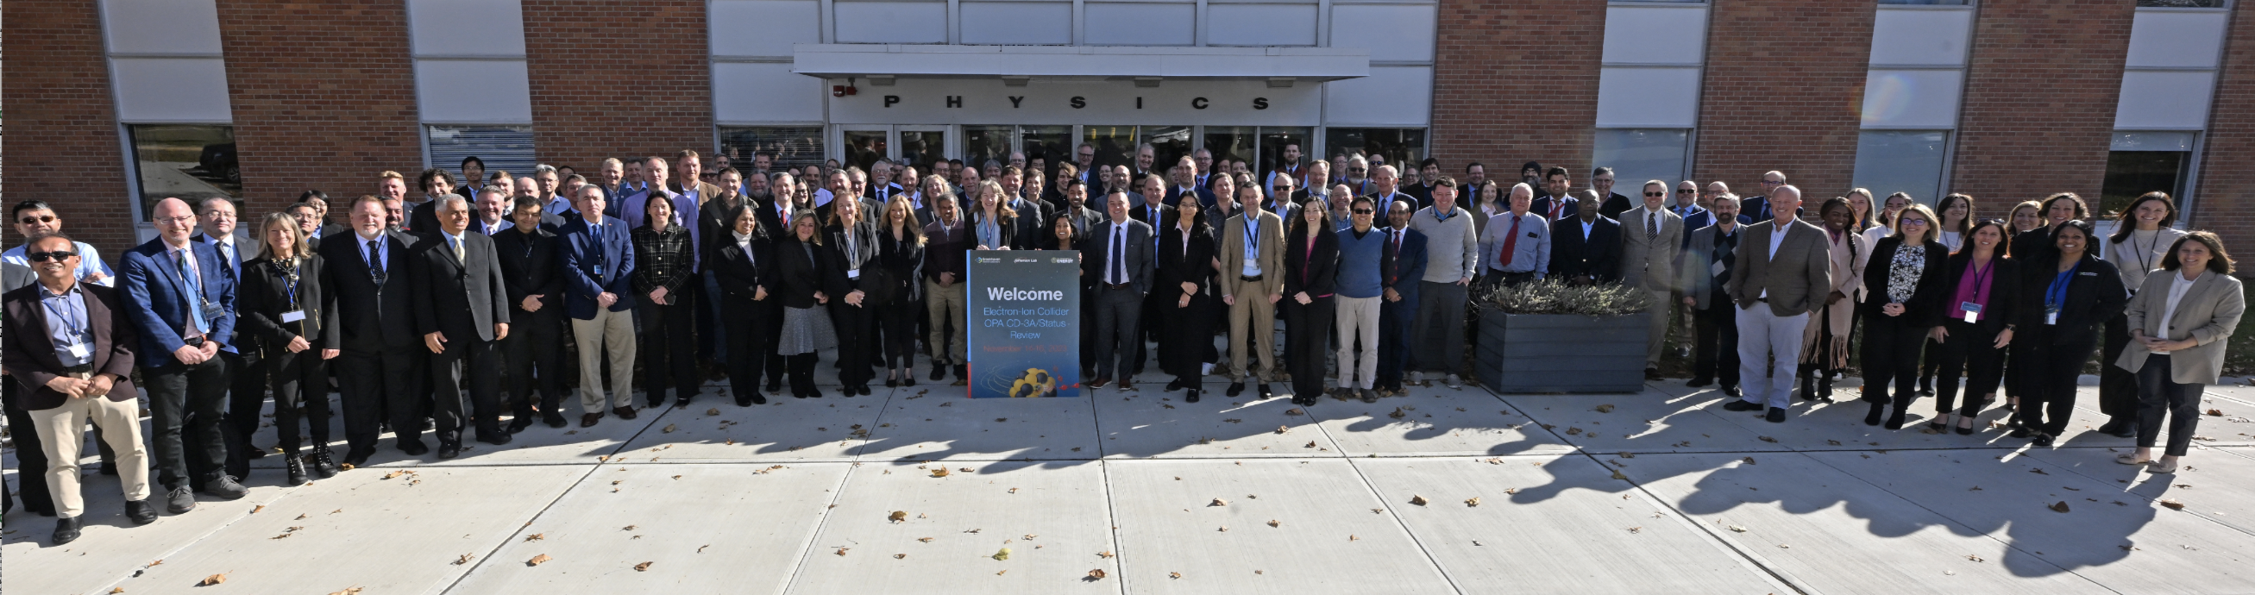
DOE CD-3A/Status Independent Project Review
Date: November 14-16
Location: BNL
Overall Conclusion
Proceed to CD-3A
With the numerous critical variables to be resolved by CD-2/3 such as funding uncertainty, advancing technical design maturity, planning the end of RHIC science program, identifying off-project DOE scope, and securing commitments for non-DOE contributions, the IPT should consider alternative tailoring strategies should the current plan become untenable.
Even with the challenges ahead, the Committee is confident the project is in position to successfully resolve the critical issues.

Slide 13
In-Kind Agreement Types
Government to Government
Science & Technology (S&T) Agreement
binding (contractual)
not-binding
Agency to Agency
Implementing Agreement
DOE led/ signed
Project Annex
Statement of Interest
US Lab led/ signed
iCRADA
Project Planning Documents (PPDs)
In order to baseline the EIC Project (CD-2) it is requested that appropriate binding and not-binding agreements are signed, in particular if significant/critical item are provided as IKC.

Slide 14
Laboratory Agreements for IKC
For delivery of In-kind critical hardware:
An iCRADA required
Bi-lateral Project Planning Documents are required.
For labor and/or not critical equipment
A MoU-kind document detailing the terms for collaboration could be developed.
General considerations:
International agreements take time and need DOE revisions → prioritize documents.
Favor bi-lateral agreements to simplify iterations.
iCRADA template approved by DOE/GC to be used for bi-lateral agreements.
PPDs requires approval process DOE/GC.
Equivalence of documents US/Europe:
US iCRADA → European MoU
US PPD → similar to European MoU (except not binding)
US MoU → European Expression of Interest

Slide 15
Responses to April 2023 RRB Actions @ Project Level
#2-Jim Yeck, EIC Project Director, will provide a “PoP” needed for the detector and accelerator
Response: Direction and templates are provided for the lab level agreements required for baseline the EIC Project.

Slide 16
Summary
EIC is a unique, high-energy, high-luminosity, polarized beam collider that will be one of the most challenging and exciting accelerator complexes ever built -- only new collider in the next decades.
The project team successfully complete the OPA CD-3A the Long Lead Procurement review in Nov-2023 and continues to prepare for CD-2/3 in 2025.
Strong support for EIC in the scientific community and increasing International engagement
Partners participating in preparing the EIC governance model and supporting a facility that is international in character.
IKC goals remain 30% of the Detector; 5% of the Accelerator.
Next EIC Advisory Board is planning for January/February 2024.
Next EIC RRB Meeting is planning for May 2024.

