Slide 1
Experimental Program Overview
E.C. Aschenauer (BNL)
R. Ent (JLab)
Co-Associate Directors for the Experimental Program
EIC RRB Meeting
December 7th & 8th, 2023

Slide 2
Detector Overview - Outline
EIC detector scope
Details on Schedules
Peer Review Summary
CD-3A and Long-Lead Procurement Overview
How we work and integrate the ePIC collaboration
Change Control Process and Records of Decision
In-Kind/International Engagement
Outlook to CD-2

Slide 3
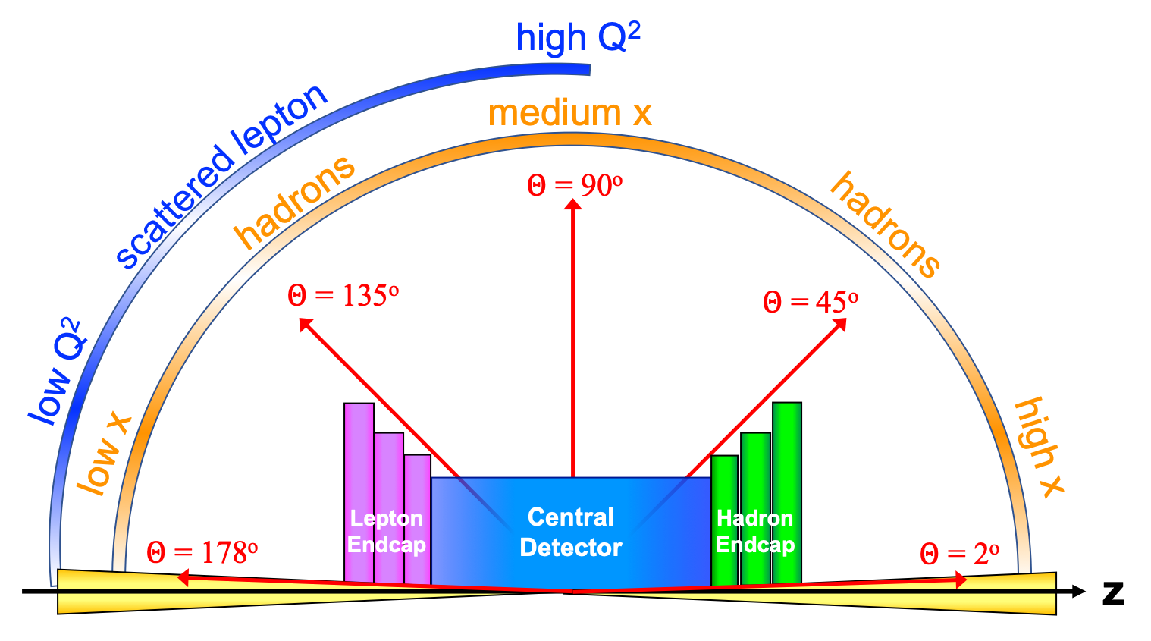
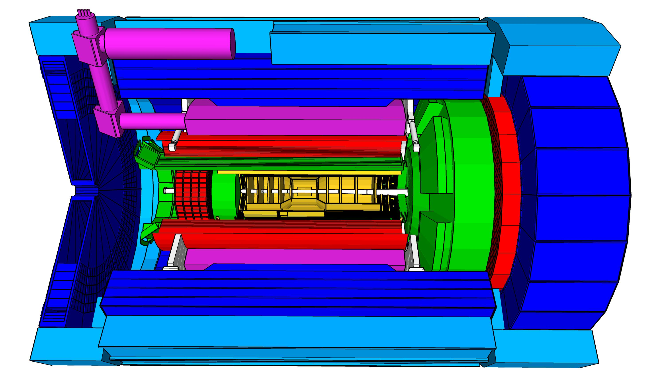
Experimental Equipment Scope
High Luminosity: L= 10³³ – 10³⁴cm⁻²sec⁻¹,
10 – 100 fb⁻¹/year
Highly Polarized Beams: 70%
→ requires high precision electron and hadron polarimetry
Large Center of Mass Energy Range:
E_{cm} = 29 – 140 GeV
→ Large Detector Acceptance
Asymmetric beam energies
→ require an asymmetric detector Barrel
with electron and hadron endcap → 9.5 m
→ equal coverage (-4 < η < 4) Tracking, particle dentification,
electromagnetic and hadronic calorimetry
High precision low mass tracking
good e/h separation critical for scattered electron identification
separate e, π, K, p on track level
Science program required momentum resolution
→ requires a large bore 2T magnet
(1.7 T magnet operation point, stretch goal 2T)
that has same geometry as the BaBAR magnet.
Imaging science program → Large Ion Species Range:
protons to Uranium
→ requires specialized detectors integrated in the Interaction Region over 80 m
Streaming readout electronics model
→ highest scientific flexibility
very compact Detector → Integration is key
Good Background Conditions
25 Subsystems incl. Polarimetry
local hadron polarimeter
hadronic calorimeters
Time.of.Flight,
DIRC,
RICH detectors
MPGD trackers
Solenoidal Magnet
MAPS tracker
e/m calorimeters
Luminosity
Monitor
low Q² electron-tagger
off-Momentum
taggers
Roman
Pots
Zero-Degree
Calorimeter
p: 41 GeV, 100 to 275 GeV
p/A beam
e beam
e: 5 GeV to 18 GeV
lepton and hadron polarimeters not shown

Slide 4
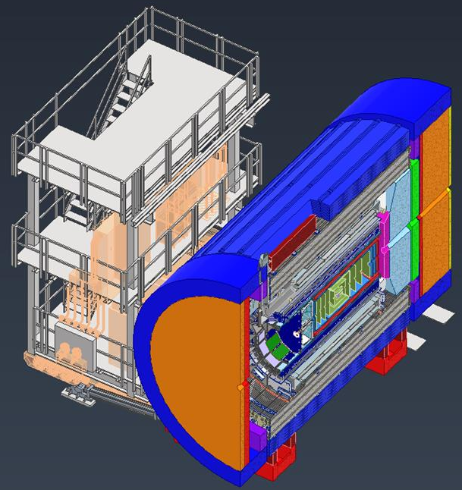

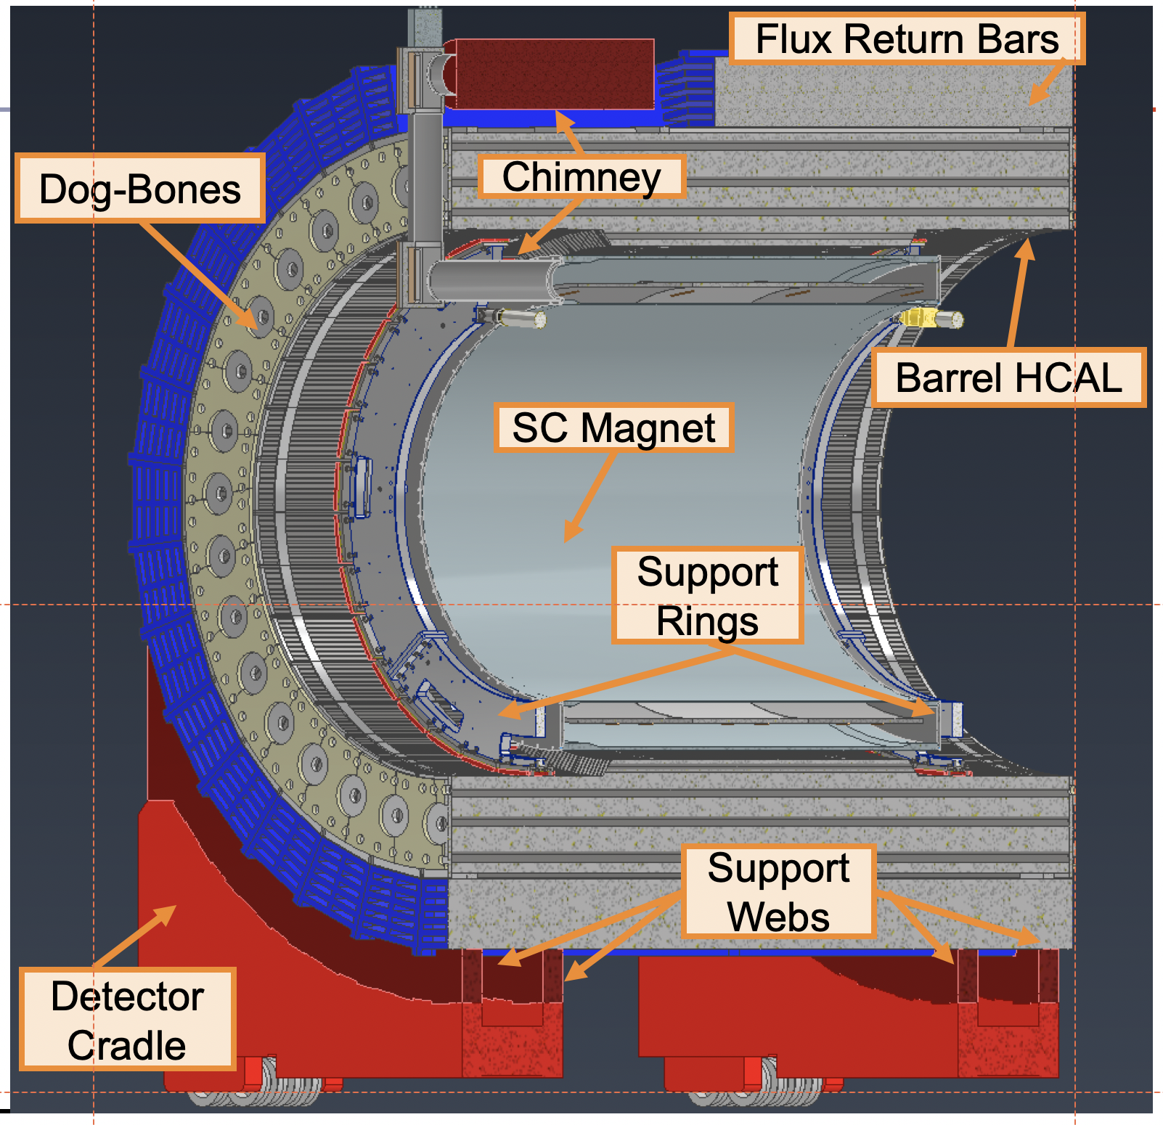
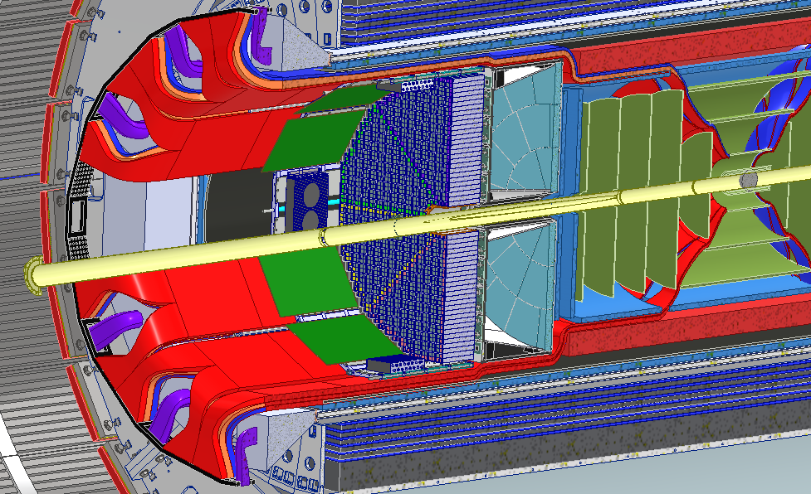
What is new/special for ePIC
Vertex detector → Identify primary and secondary vertices,
Low material budget: 0.05% X/X₀ per layer;
High spatial resolution: 10 mm pitch CMOS Monolithic Active Pixel Sensor
Central tracker → Measure charged track momenta
MAPS – tracking layers in combination with micro pattern gas detectors
MPGD: m-RWell or MicroMegas
electron and hadron endcap tracker → Measure charged track momenta
MAPS – disks in combination with micro pattern gas detectors
Particle Identification → pion, kaon, proton separation on track level
RICH detectors (modular and dual radiator RICH, DIRC)
Time-of-Flight high resolution timing detectors (LAPPS, LGAD) 10 – 30 ps
novel photon sensors for RICHs: LAPPD & SiPMs
Electromagnetic calorimeter → Measure photons (E, angle), identify electrons
Backward: PbWO₄ Crystals with SiPM readout,
Forward: W/SciFi Spacal, Barrel: Pb/SciFi+imaging part using MAPS
Hadron calorimeter → Measure charged hadrons, neutrons and K_{L}⁰
Forward: achieve ~50%/√E + 10% for low E hadrons (<E> ~ 20 GeV)
Steel/Sc & W/Sc sandwich with longitudinal segmentation & SiPM readout
Barrel & Backward: Steel/Sc sandwich & SiPM readout
DAQ & Readout Electronics: trigger-less / streaming DAQ
Integrate AI into DAQ → cognizant Detector
Very forward and backward detectors → scattered particles under very small angles
Silicon tracking layers hadron beam vacuum and along lepton beam
Zero – degree high resolution electromagnetic and hadronic calorimeter
Luminosity Monitor: Pair-Spectrometer and high rate zero-degree calorimeter to detect Bethe Heitler process
Polarimetry
Lepton: integrated transverse and longitudinal Compton polarimeter
Hadron: absolute and relative hadron polarimetry in the CNI region
world’s first
at
Radius/Distance from IP
world’s first
at
world’s first
at
world’s first
at

Slide 5
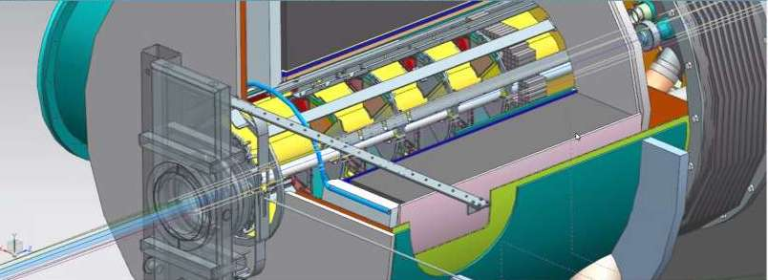
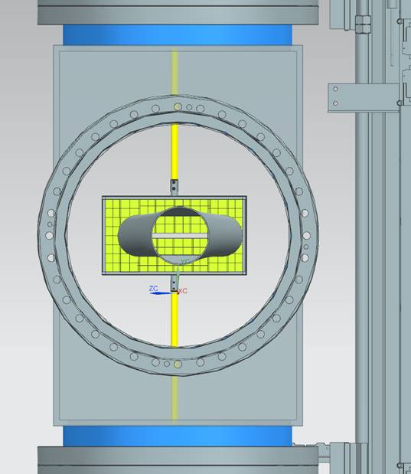
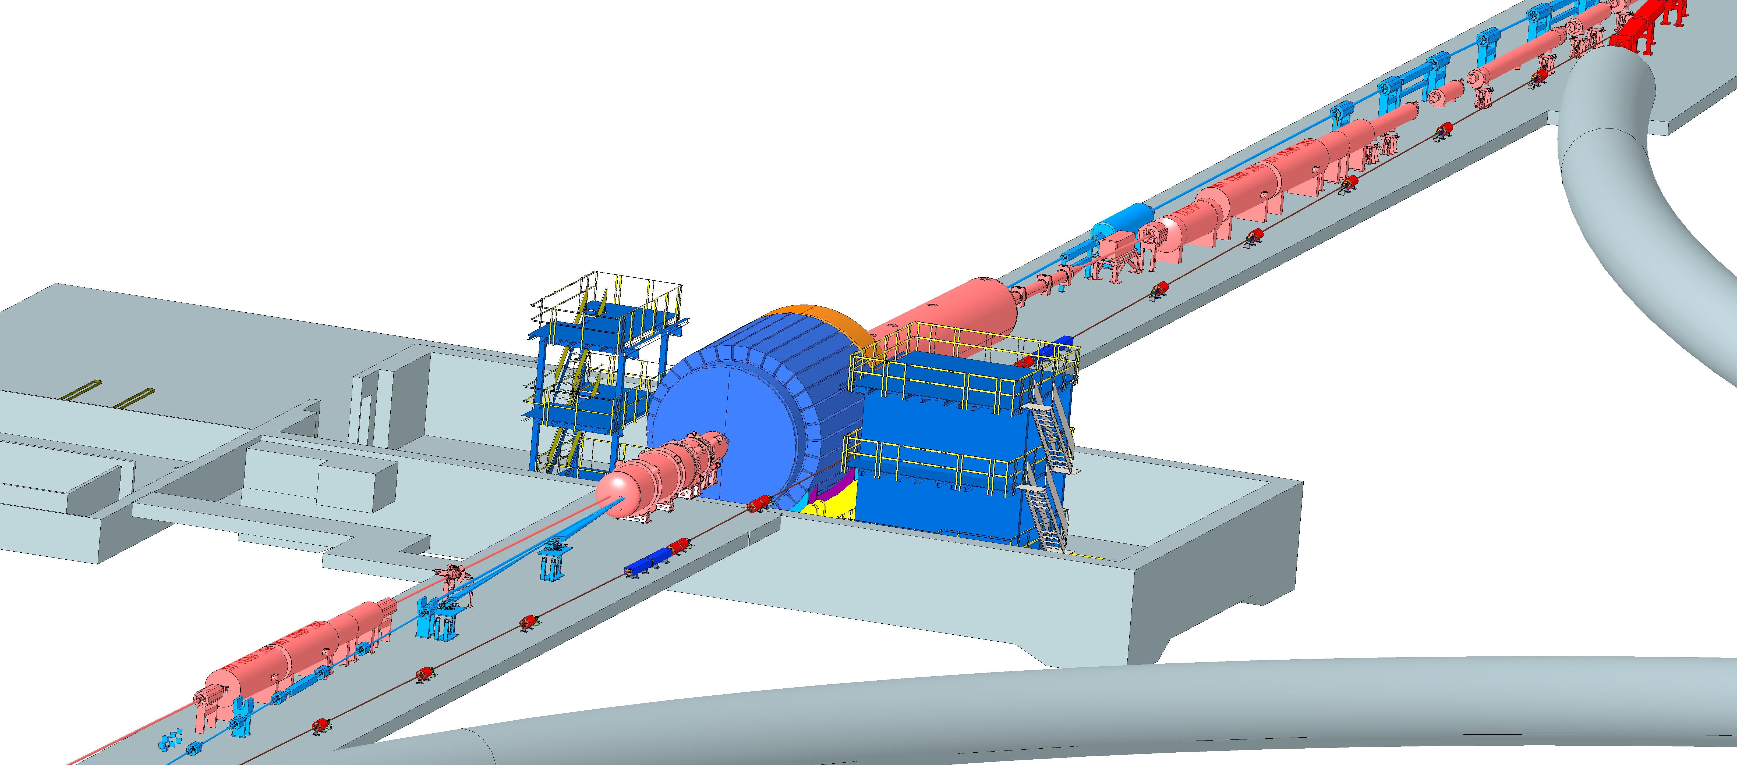
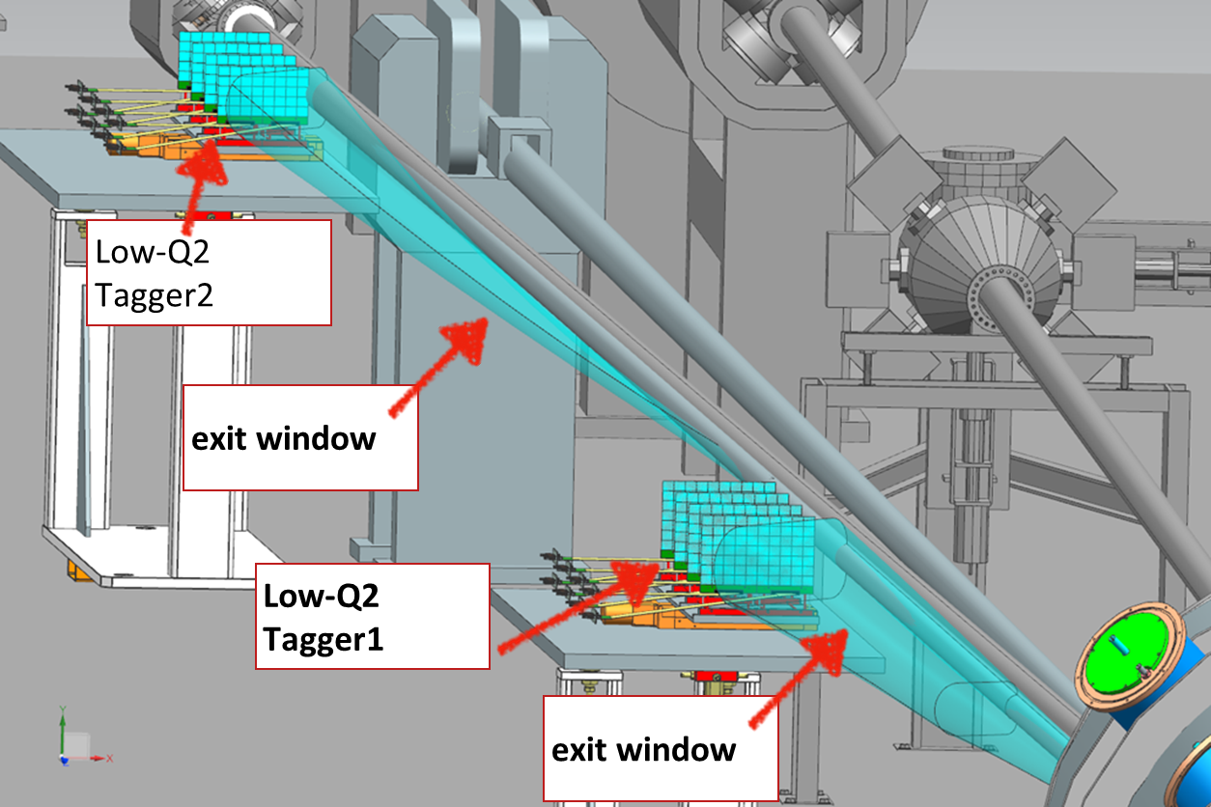
Interaction Region Layout
Central Detector
ESR Forward side
Roman Pots
Detectors in B0 magnet
Forward Side
SC Magnet Cryostat
HSR Injection Line
Central Detector
Rear Side
SC Magnet Cryostat
electrons
HSR Forward Side
HSR: Hadron Storage Ring
ESR: Electron Storage Ring
RCS: Rapid Cycling Synchrotron
SC: Superconducting
HSR
Rear Side
Hadrons
RCS
With Detector Bypass
Low-Q2 Detectors
ESR Rear side
every cm counts… → integration and communication with accelerator team is crucial

Slide 6
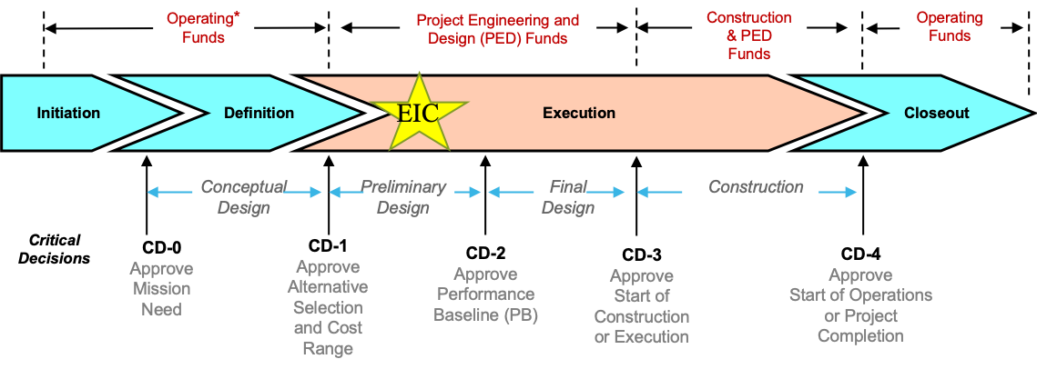
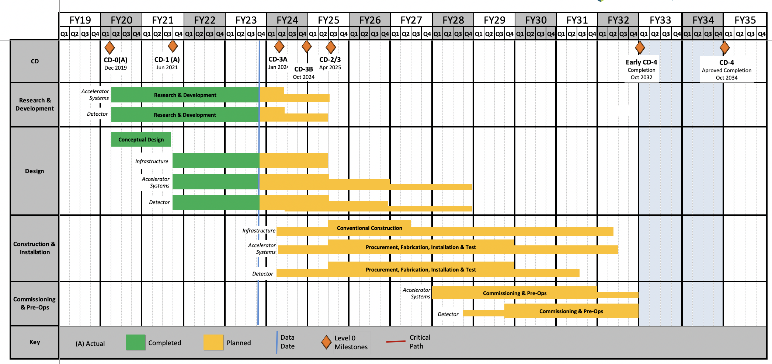
EIC Schedule
EIC Critical Decision Plan
CD-0/Site Selection December 2019 ✓
CD-1 June 2021 ✓
CD-3A January 2024
CD-3B October 2024
CD-2/3 April 2025
early CD-4 October 2032
CD-4 October 2034
CD-3A:
Define Baseline:
technologies, Scope, Cost & Schedule
Long Lead Procurement (LLP) items
Design Maturity: ~90%
Plan is tracked through EVMS & Change control process
Start of construction for LLPs
Construction Phase
Conclusion of
RHIC Operation
Science Phase
The thinner bars indicate that R&D and design
can continue at a small level beyond CD-2 and CD-3
6

Slide 7
High Level Installation Schedule
Oct 2028
Jan 2029
Milestone
PO_0305_0900
Apr. 2031
CD-3
04/2025
April 2029
Dec 2029
early CD-4
10/2032
CD-4
10/2034
June 2030
Oct 2030
Jan 2031
Construction
Pre-OPS
IR-6 ready
for installation
Detector Assembled and Ready for Cosmic Data Taking
Early start of
Operations
&
Science
Start of
Operations
&
Science
lower half
barrel Hcal
installed
Solenoid
delivered
Endcap HCals
completed
Solenoid
Field mapping
done in beam position
Hadron Endcap
Detectors
installed
Trackers, dRICH
ECal
done in Assembly Hall
Barrel Ecal
ready
for installation
Barrel Hcal
& Solenoid
installed
followed by low
power test
Lepton Endcap
Detectors
installed
Trackers, bRICH
ECal
Barrel Detectors
installed
ECal, DIRC,
ToF, Trackers
Take Away:
Solenoid and Barrel HCal need to be ready by Jan 2029
all other subdetectors need to be ready between 06/29 to 06/30 depending on their location in the detector
7

Slide 8
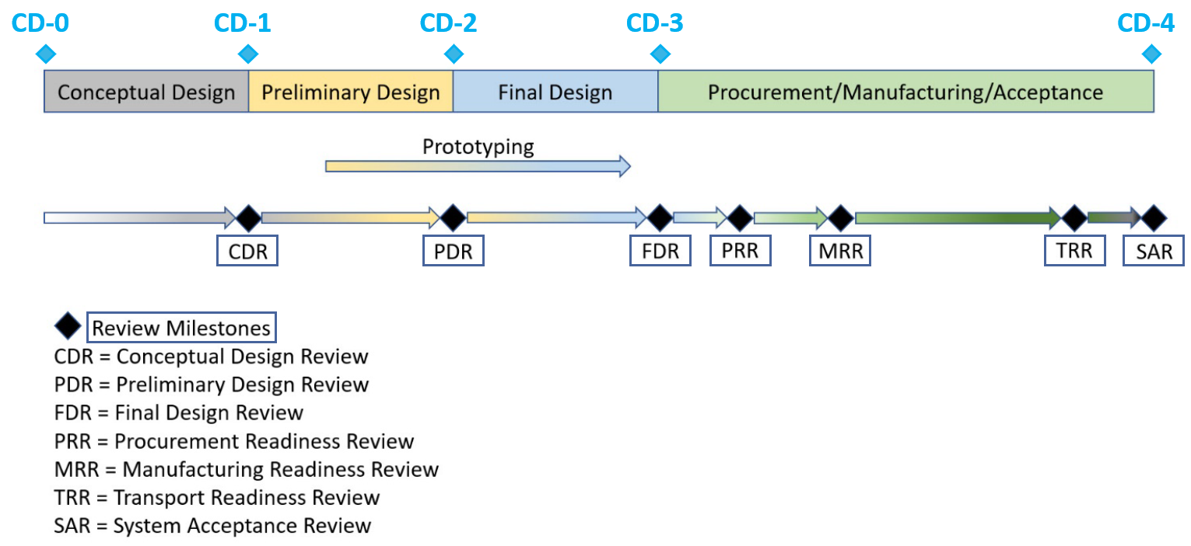
Design Review Progress
Preliminary Design Reviews:
Magnet (6.10.07) – 30% design, Feb. 23, 2022
IR Integration and Ancillary Detectors (6.10.11) – April 27, 2022
Electronics/Computing Subsystems (6.10.08 & 6.10.09) – August 29-30, 2022
Magnet (6.10.07) – 60% design, October 18-19, 2022
Calorimetry (6.10.05 & 6.10.06) – December 6-8, 2022
Polarimetry (6.10.14) – January 17-18, 2023
Particle Identification Detectors (6.10.04) – July 5-6, 2023
Final Design Reviews:
PbWO4 Crystals (6.10.05) – July 14, 2023
Scintillating Fibers (6.10.05) – September 13, 2023
Silicon Photomultipliers (6.10.06, 6.10.05, 6.10.04) – September 14, 2023
Forward Hadron Calorimeter Steel and Tungsten (6.10.06) – September 25, 2023
Magnet (6.10.07) – October 5-6, 2023
Scientific computing & associated infrastructure is a dependency for the EIC
EIC Detector Software Infrastructure Review, in collaboration with host labs (https://indico.bnl.gov/event/16676/) – August 22-23, 2022
ePIC Computing & Software review by host labs (https://indico.bnl.gov/event/20481/) – October 19-20, 2023
Project detector R&D (6.10.02) is annually reviewed by the DAC
2023 August 29 + 30: Details: https://indico.bnl.gov/event/20113/

Slide 9
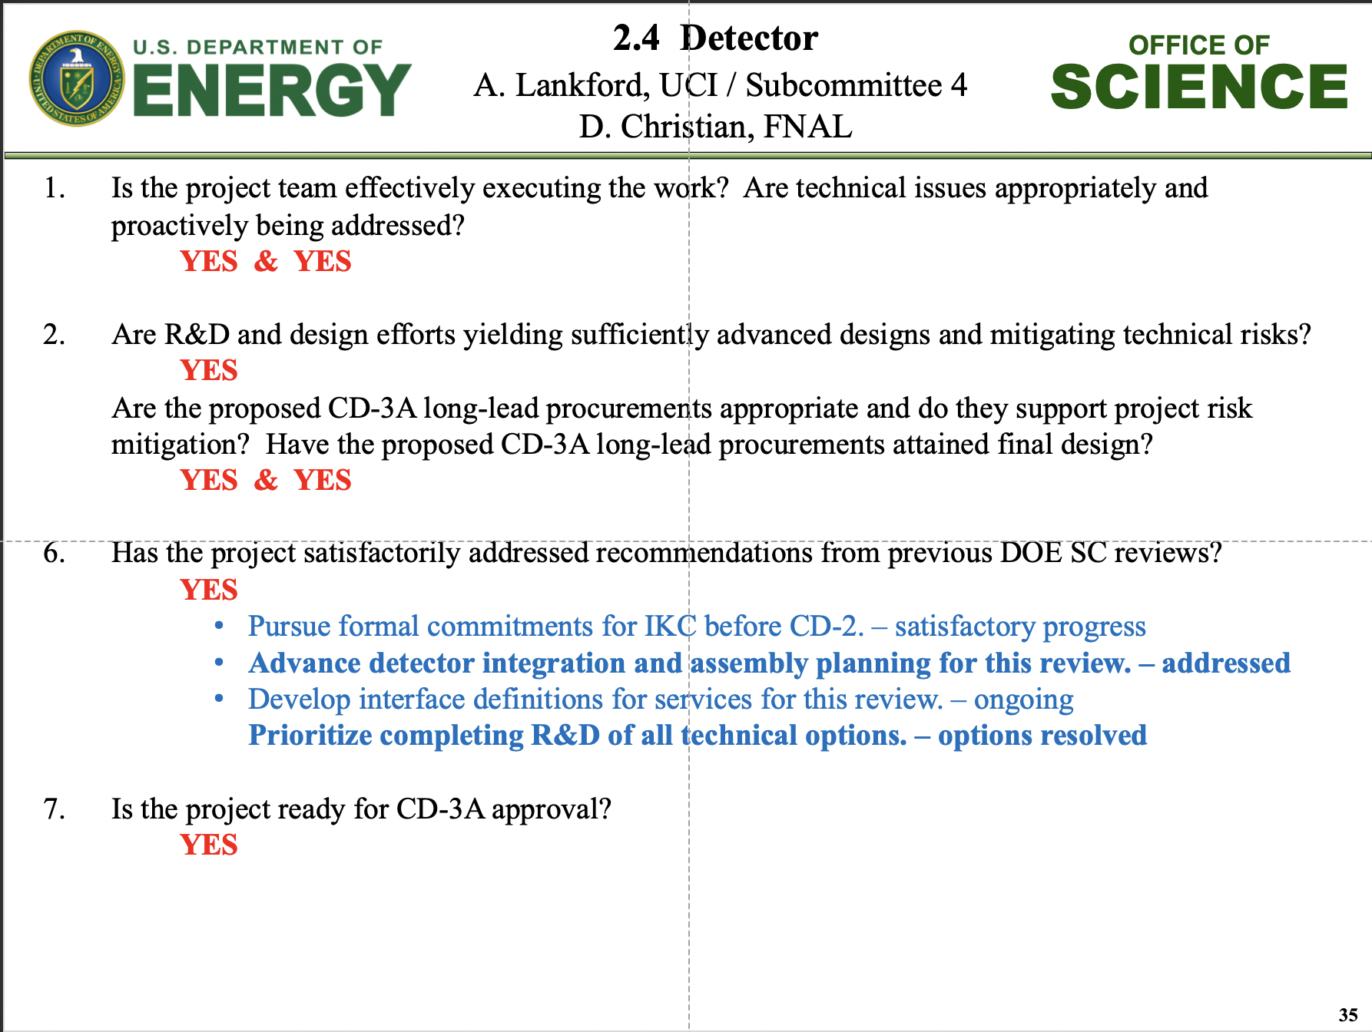
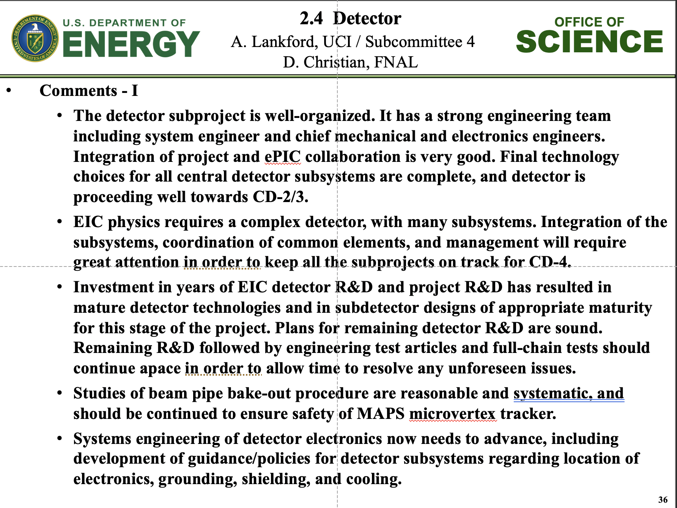
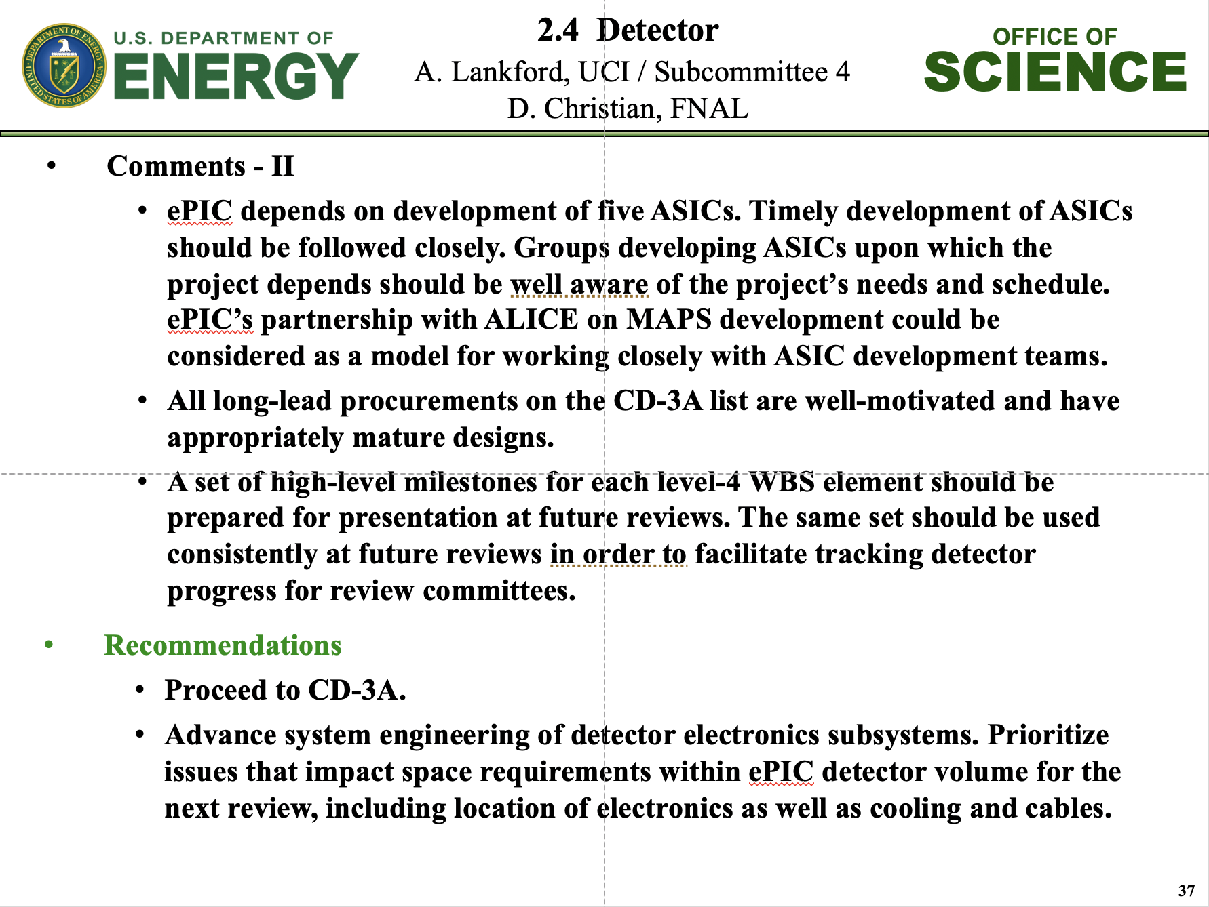
Design Review Progress
Global Project Reviews:
DOE CD-3A Design Review by DAC August 29 + 30, 2023
DOE CD-3A Director’s Review October 10-12, 2023
Integrated Design Review reports of DAC, MAC, Infrastructure Committee, Focus on CD-3A Long Lead Procurement Items
DOE CD-3A Independent Project Review November 14-16, 2023

Slide 10
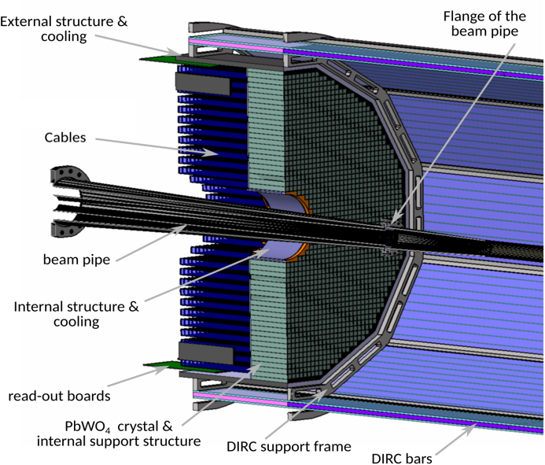
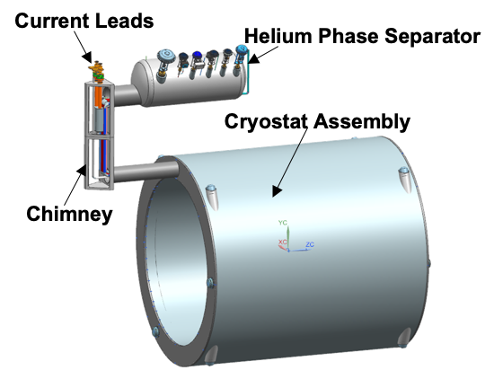
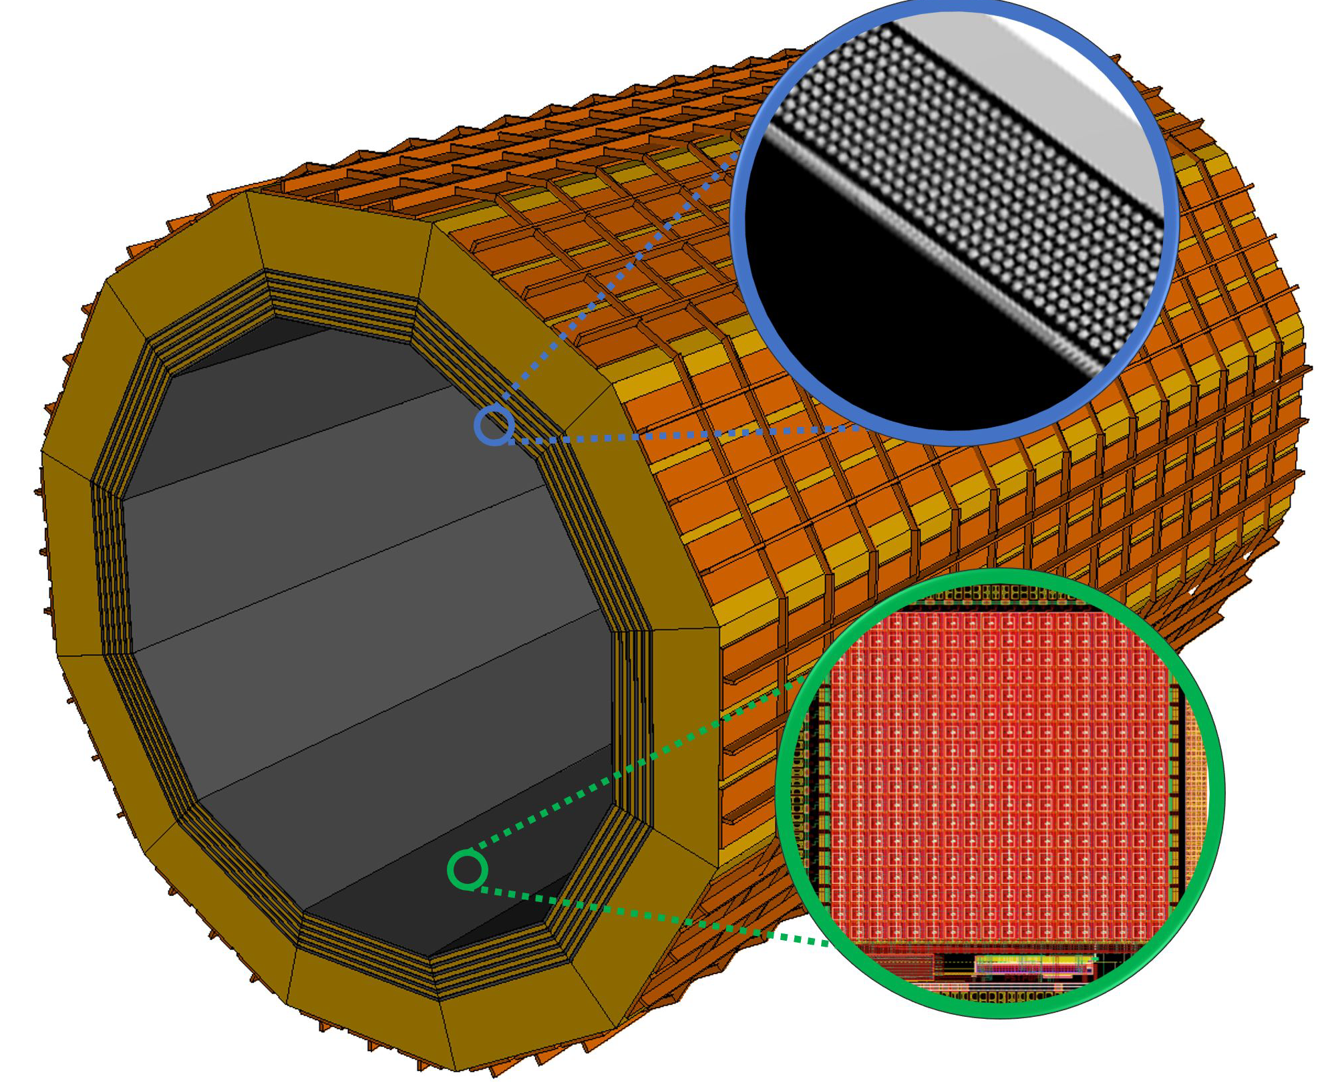
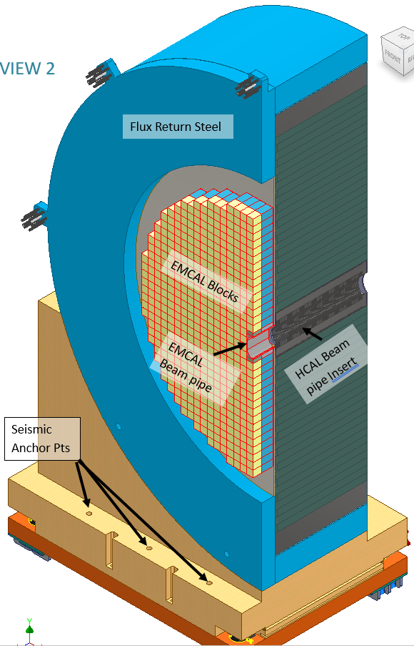
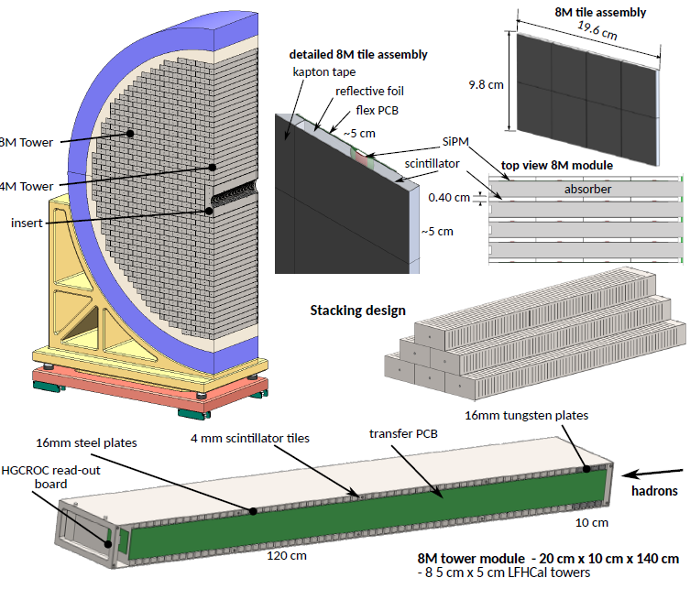
CD-3A Scope Overview for Detector Systems
Detector Systems CD-3A Scope
WBS 6.10.05: Lead Tungstate Crystals for the Detector Backward EM Calorimeter
CD-3A scope is first two years of procurements (1500 pieces)
WBS 6.10.05: Scintillating Fibers for the Detector Barrel and Forward EM Calorimeters
CD-3A scope is 1875 km first of four phases
WBS 6.10.06: Silicon Photomultipliers for the Detector Foward Hadronic Calorimeter
CD-3A scope is one phase (320K SiPMs) out of two for the forward Hadron Calorimeter
WBS 6.10.06: Steel and Tungsten Plates for the Detector Forward Hadronic Calorimeter
CD-3A scope is first of two phases (~50%)
WBS 6.10.07: Detector Solenoid Magnet Design and Fabrication and Conductor
CD-3A scope is for the conductor and the full magnet construction.
Designs driving CD-3A Detector Systems scope are stable – final design reviews are completed for all LLP scope. Review committees concurred there is minimal risk of change that could impact CD-3A LLPs following contract award.
CD-3A Detector System scope justifications are based on:
Reduction of cost and technical risk
Limited world-wide vendors
Production times and capability and/or labor-intensive manufacturing tasks
Evade competition by other projects around the world
SciFi

Slide 11
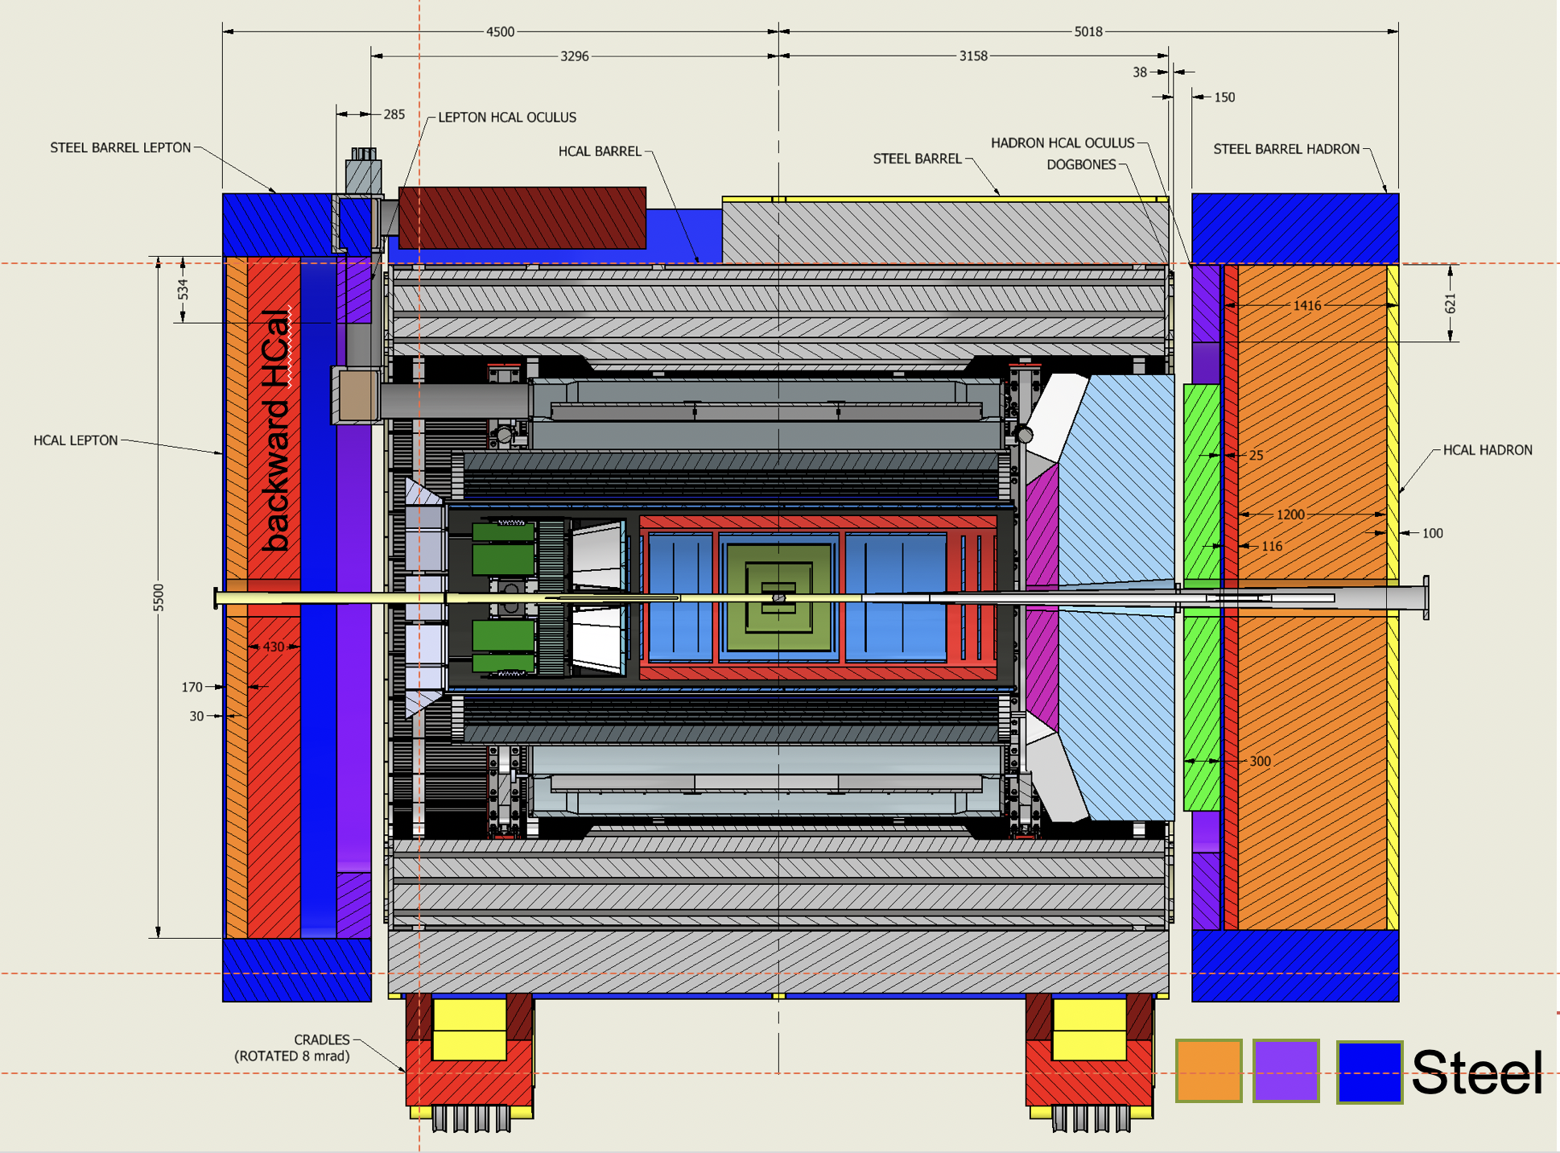
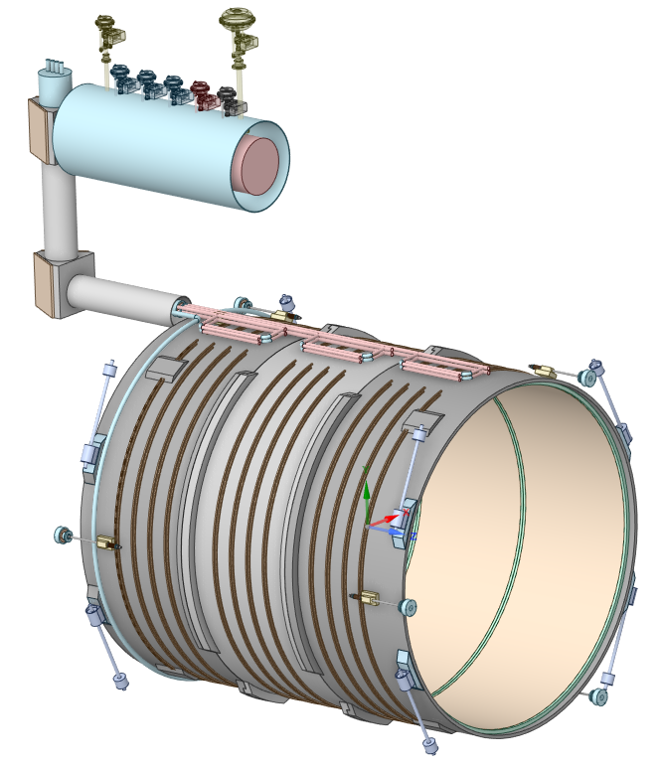
MARCO Magnet Design Details
B₀ | 1.5 T | 1.7 T | 2.0 T | Units
Current | 2942 | 3335 | 3924 | A
T_{op} | 4.7 | 4.7 | 4.7 | K
B_{peak} | 2.00 | 2.27 | 2.67 | T
Temp. margin | 3.06 | 2.82 | 2.45 | K
Load line margin | 59.6 | 54.2 | 46.1 | %
I / Ic(T,B_{peak}) | 17.9 | 22.1 | 29.3 | %
Order of conductor samples put in place based on these specifications !
Working on sample conductor qualification
Discussed with test facilities around the world
Already have estimated cost from at least one test facility
Conductor is similar to the conductor used for 11.7 T MRI magnet at CEA, Saclay
Robust and safe operating parameters
Coil is divided in 3 modules with 6 layers each. This is done mainly to accommodate possible conductor length.
Flux return steel layout fully defined to minimize forces and fringe fields (~10G)
Dimensions in mm
Mechanical
2D and 3D mechanical analysis done on the overall magnet assembly, coils, mandrel and tie-rods.
All the stresses, displacement are well within the acceptable limits.
Cryogenic
Redundant cooling system is used to ensure that thermosiphon works properly
How we work:
Collaboration of Jefferson Lab, CEA Saclay and Brookhaven National Lab, the review committee also concluded:
The collaboration between CEA-Saclay, JLab and BNL has continued to make excellent progress and the review committee strongly supports extending this collaboration into the procurement, fabrication and commissioning phases
30% Design done as in-kind contribution by CEA Saclay in collaboration with Jefferson Lab Magnet Group
BNL provides subject matter expert information on infrastructure and integration
60% and 90% design done as contract with CEA Saclay augmented with Jefferson Lab work and further in-kind contributions of CEA Saclay
Expectation is that vendor contract may follow similar pattern for vendor oversight.
Further discussions are ongoing on international engagement on magnet construction phase

Slide 12
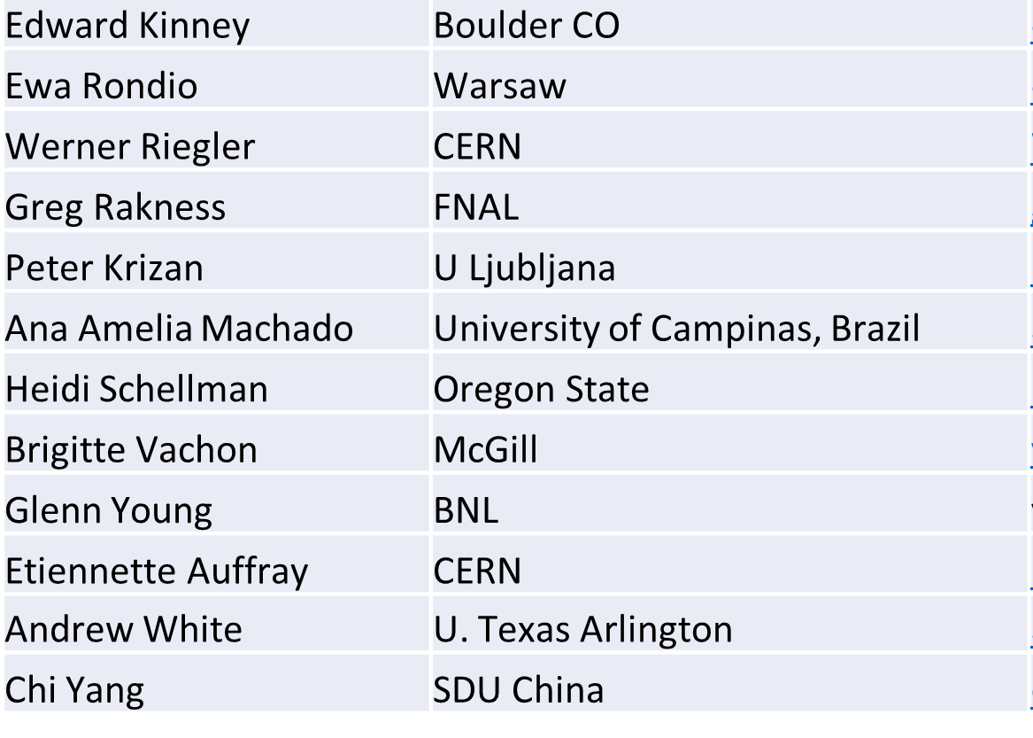
Detector Advisory Committee
We assembled the DAC in 2020
Per the charter, 1/3 of the committee was replaced early 2023
Meetings to date:
September 28-29, 2020. Bring the DAC up to speed and prepare them for upcoming charges, e.g., related to input on assessment of the call for Expressions of Interest (EoI).
December 18, 2020. Update DAC on the EIC Project and Yellow Report status, the EoI assessment, international engagement, and planning for call for detector proposals.
March 24-26, 2021. Transition from the generic EIC detector R&D to the Project detector R&D.
Dec. 2021 – Jan. 2022. Evaluation of detector technologies, cost and schedule as input to the Detector Proposal Advisory Panel.
October 19-21, 2022. Review the ongoing project detector R&D. Advise for the FY23 detector R&D.
August 28-31, 2023: Review next phase of Project Detector R&D and status of ePIC design
Edward Kinney (Chair) | Boulder CO
Ken Wyllie | CERN
Petra Merkel | FNAL
Antonis Papanestis | Rutherford Appleton Laboratory
Peter Krizan | U Ljubljana
Ana Amelia Machado | University of Campinas, Brazil
Heidi Schellman | Oregon State
Brigitte Vachon | McGill
Stefano Miscetti | INFN Frascati
Etiennette Auffray | CERN
Andrew White | U. Texas Arlington
Chi Yang | SDU China

Slide 13
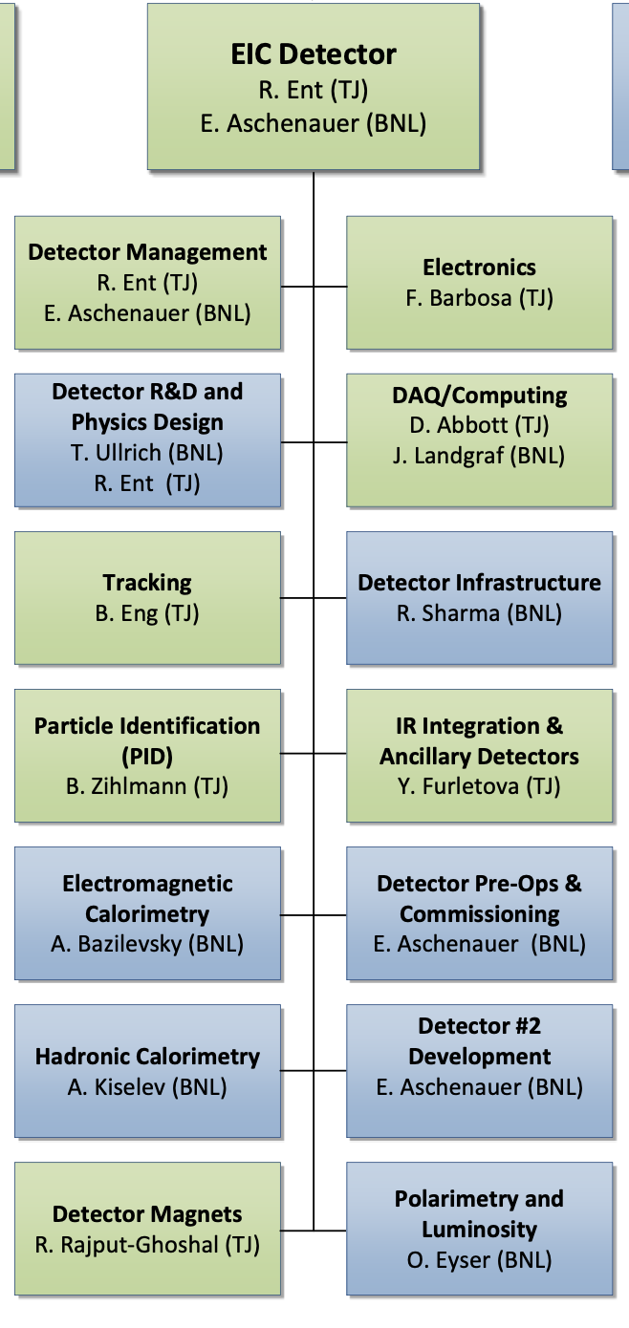
WBS 6.10 EIC Detector & 6.10.01 Management
How We Work:
The highest-level detector management consists of:
Elke & Rolf L2 Leads
Walt Akers 6.10 Systems Engineer
Fernando Barbosa Chief Electrical Engineer
Rahul Sharma Chief Mechanical Engineer
Do not use this CAM responsibility organization as Black and White, we work together as a scientific collaboration and use expertise from each lab as it fits independent of high-level responsibility
We include user efforts where it makes sense, and lean to more
We have
Weekly meetings with ePIC spokesperson and deputy
Weekly meetings with the mechanical engineering team
Biweekly meetings with the electrical engineering team
Weekly meetings with the Detector Control Account Managers
As needed meetings with various detector subsystems
Walt, Fernando and Rahul have also separate meetings, for Walt with the Systems Engineering Group, for Rahul with also various non-BNL/non-Jlab engineers/designers, etc.
We report at the biweekly ePIC meetings and many other meetings on general detector progress or requested topics
Blue/Green show nominal BNL/JLAB responsibility

Slide 14

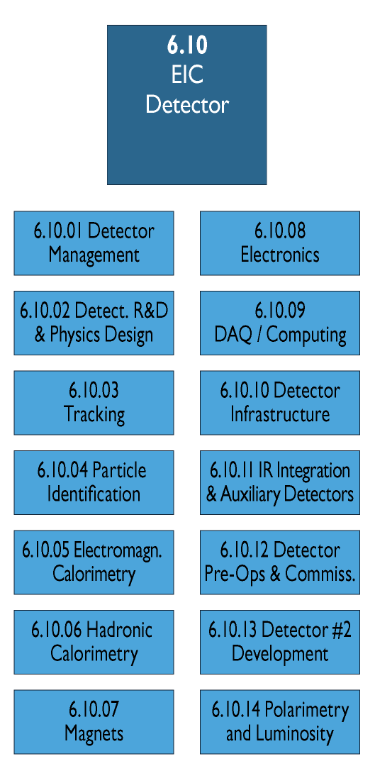
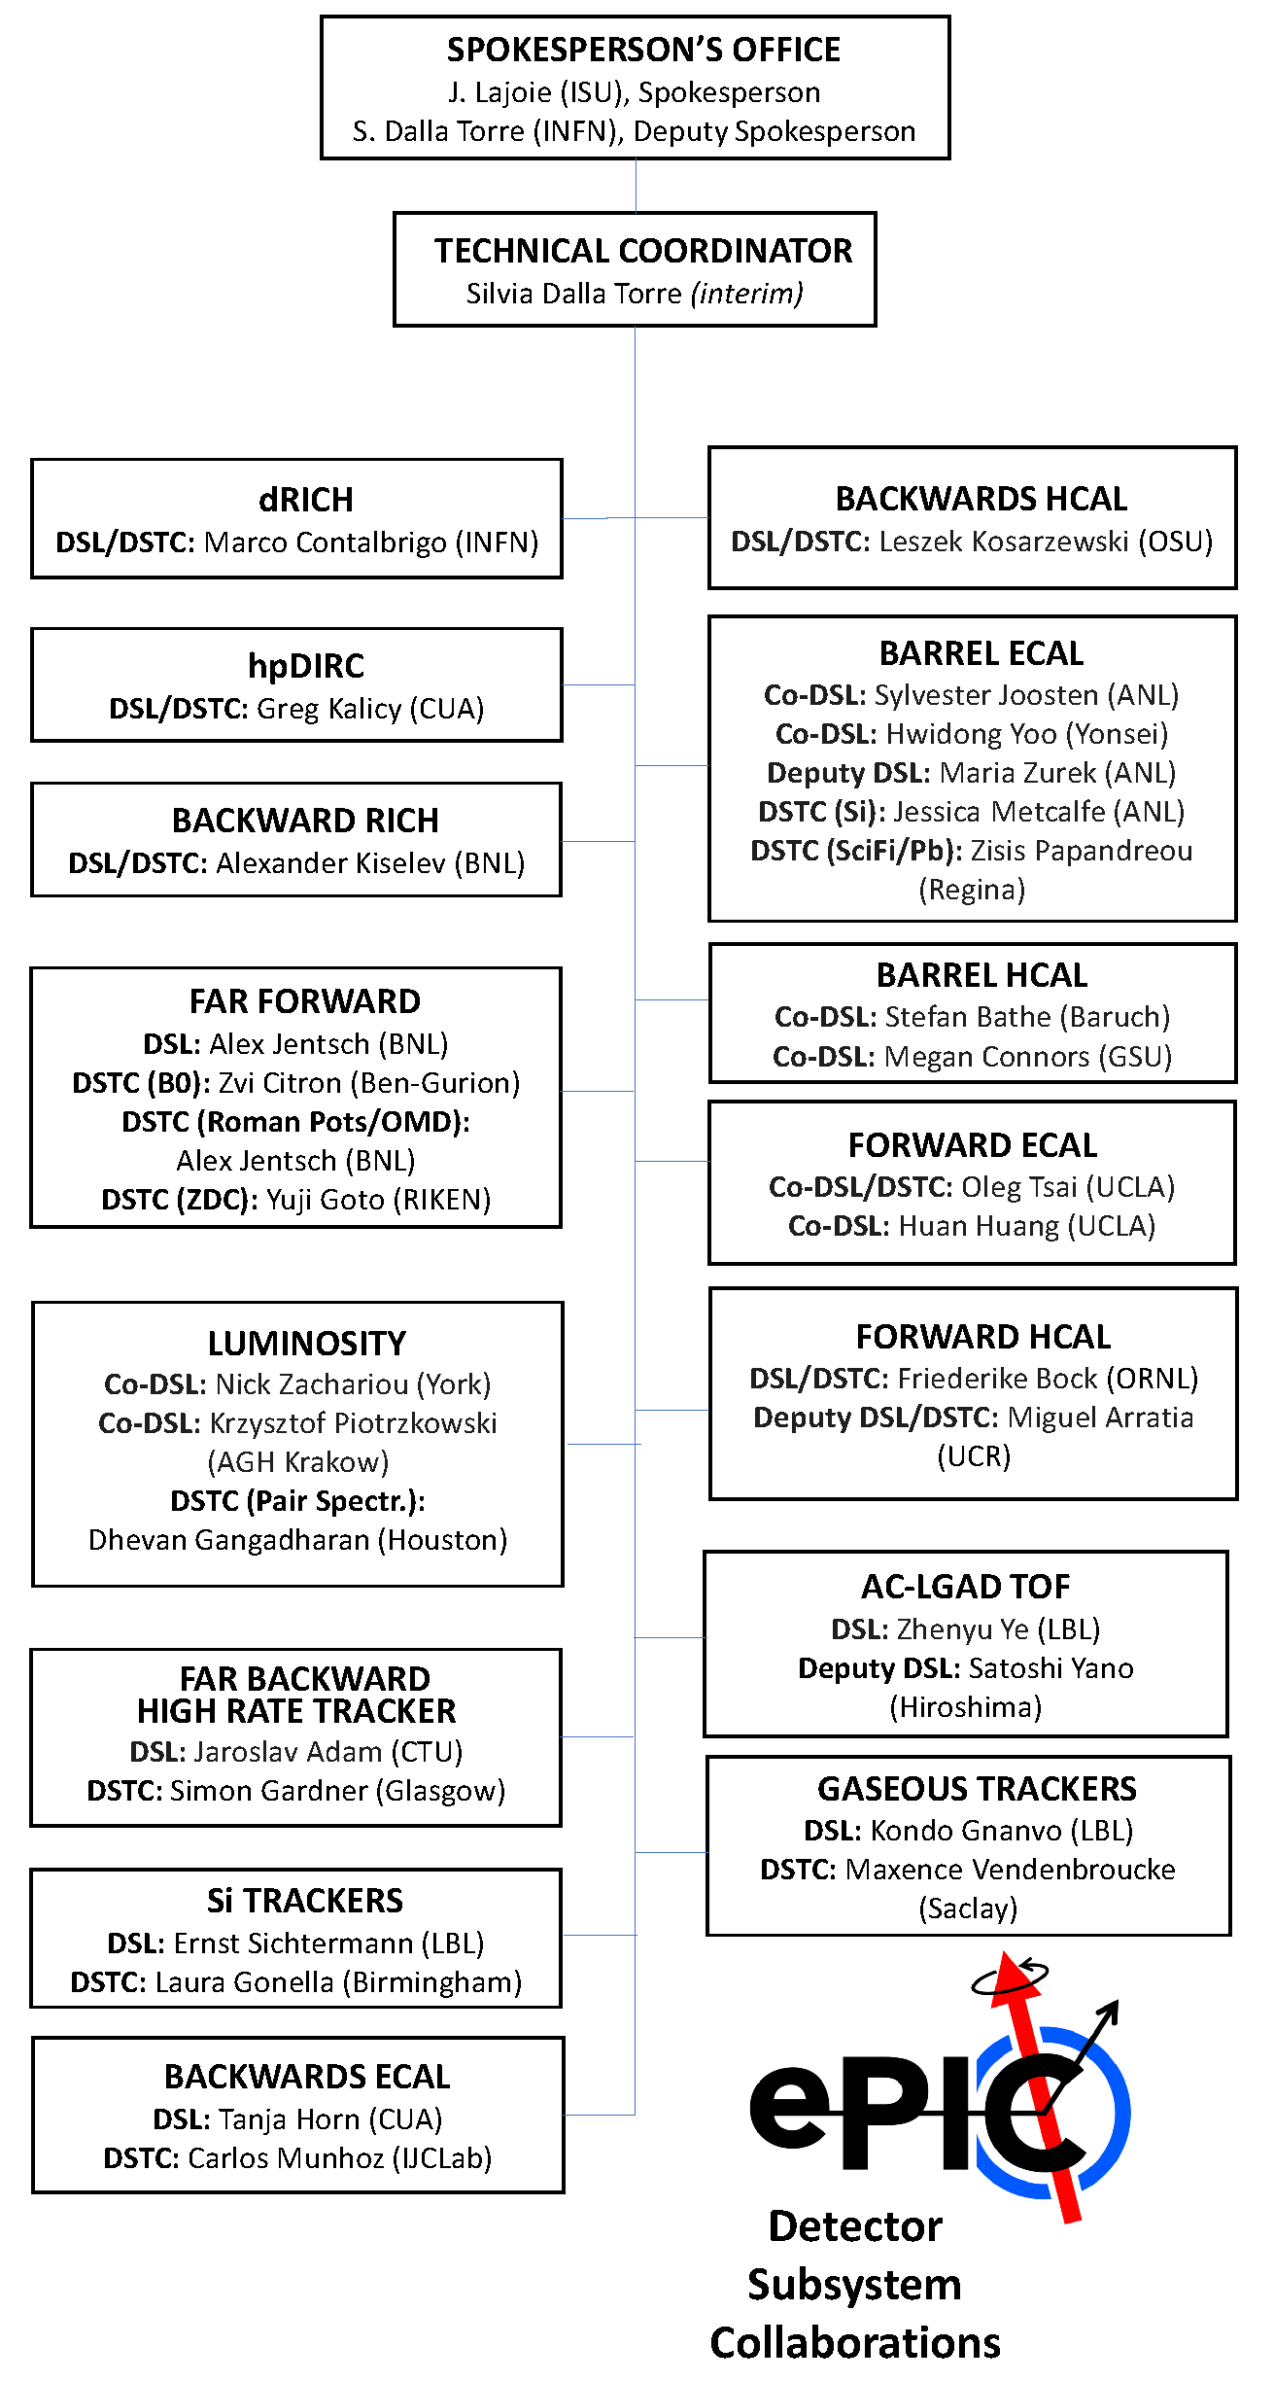
Integrating collaboration in Project WBS
DSL:
Detector Subsystem Leader
DSTC:
Detector Subsystem Technical
Coordinator
Detector
Subsystem
Work Packages
need to be
integrated in WBS

Slide 15
Integrating collaboration in Project WBS
6.10.04 Particle
Identification
Level-3
L3 CAM from Project
6.10.04.01 Backward RICH
Level-4
6.10.04.02
DIRC
Level-4
6.10.04.03 dRICH
Level-4
6.10.04.04 Time-of-Flight
Level-4
L4 - Management
CAM from Project
+
DSTC from
Aerogel
Level-5
6.10.04.04.01
bToF
Level-5
6.10.04.04.02
fToF
Level-5
Photosensors
Level-5
Vessel
Level-5
Work package leads
from
Mirrors
Level-5
Services
Level-5
This is a bit trickier as we have
to think how to roll up at L5 as
the collaboration suggested to
add a common system at L5
Readout
Level-5

Slide 16
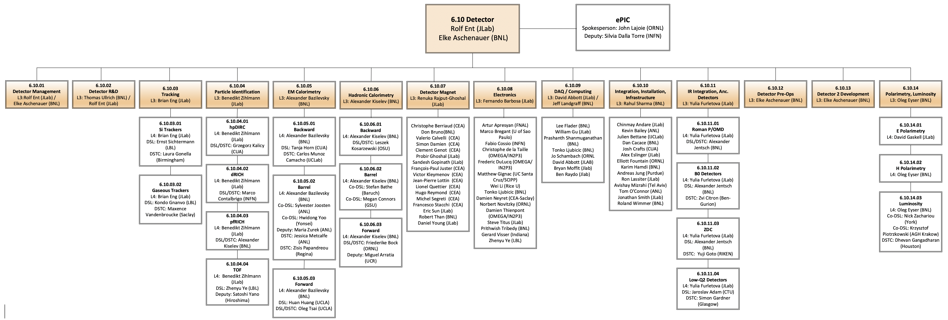
Integrating collaboration in Project WBS
Workpages are implemented on Level-5 and lower.

Slide 17
Detector Technical Change Control Board (TCCB)
Copied process as has been used for the accelerator as it works well
Five-step change control process
The detector collaboration initiates a possible change in baseline scope
The collaboration technical board or equivalent ensures the change is consistent
with the NAS science requirements and initiates the change request
→ prepare input for the TCCB
detailed changes in cost, schedule and risk → implement in P6
science and technical justification for the change ← input from ePIC
The detector TCCB collects wide input, discusses, and gives advise
The Project Technical Director gives approval
The EIC Management Team needs to approve the formal baseline change control, but in obeyance of the various thresholds in the Project Execution Plan.
TCCB composition:
Qiong Wu (chair)
Person with detector experience to take notes and help Qiong
Elke Aschenauer and Rolf Ent
detector lead mechanical engineer (Rahul Sharma, 6.10.10 CAM)
detector lead electronics engineer (Fernando Barbosa, 6.10.08 CAM)
two members of the ePIC collaboration (Silvia Dalla Torre, Technical Coordinator)
three accelerator L2 leads or alternate: HSR, ESR and IR to ensure overlap
relevant L3 CAM of the WBS the change is requested for
add subject matter experts as needed (for example Charlie Folz for infrastructure).
Always included in TCCB process: Technical Director

Slide 18
Recent ePIC Detector Changes
Up to now, we have not needed to invoke the full detector technical change process as after deliberations with the EIC Management Team the changes were accepted through a Record of Decision.
Three changes were made:
Adopt a new magnet with 1.7 T design goal and 2 T stretch goal (Initiated Summer 2022)
This required +5M$ but was a must for the tracking requirements
The existing BaBar/sPHENIX magnet could only reach 1.15T – engineering risk assessment also captured as Technical Note.
Change from a modular to a proximity-focusing RICH in the backward region (Initiated Spring 2023)
No change in cost, schedule or risk
Change from a Sci-glass based to an imaging EM calorimeter in barrel region (Initiated Spring 2023)
Costs absorbed in EIC scope cost changes list (and reduced to before)
Changes are fully integrated in P6 for all systems affected (for example, for the barrel EM calorimeter change this could impact the 6.10.05 EM calorimetry, the 6.10.08 electronics, the 6.10.09 DAQ/computing (was nil), and the 6.10.10 Infrastructure (was in the end small)).
18

Slide 19
High-Level Summary for In-Kind
Slides that indicate country interest provided by the primary scientists of each country to us to ensure foreign agencies and DOE have similar information:
https://www.dropbox.com/sh/qfkl5q8lf717b34/AACl0o7IxsTPRbP8RjY0qGcSa?dl=0
We summarize interest of non-DOE funded groups at high level in a table.
From the start of the EIC Project (CD-0), the DOE assumption was that there would be in-kind contributions to the detector of order $100M (corresponding to ~30% of the detector cost).
Present In-Kind Status:
Large In-Kind Component of EIC Project Detector R&D
Excellent progress on PED – designs moving rapidly with help of many friends
We defined three categories in P6, confirmed (includes reuse and ~$5M PED contribution), likely (still needs formal in-kind agreement) and possible (subject of recent proposals to agencies)
$60+M of in-kind scope seems secured (confirmed, likely) and $80M seems within near-term reach (includes possible).
The 30% (~$100M) in-kind EIC detector scope remains within reach. E.g., we have recent increased interest from Korea and Taiwan. We continue to work to further develop international EIC detector engagement.

Slide 20



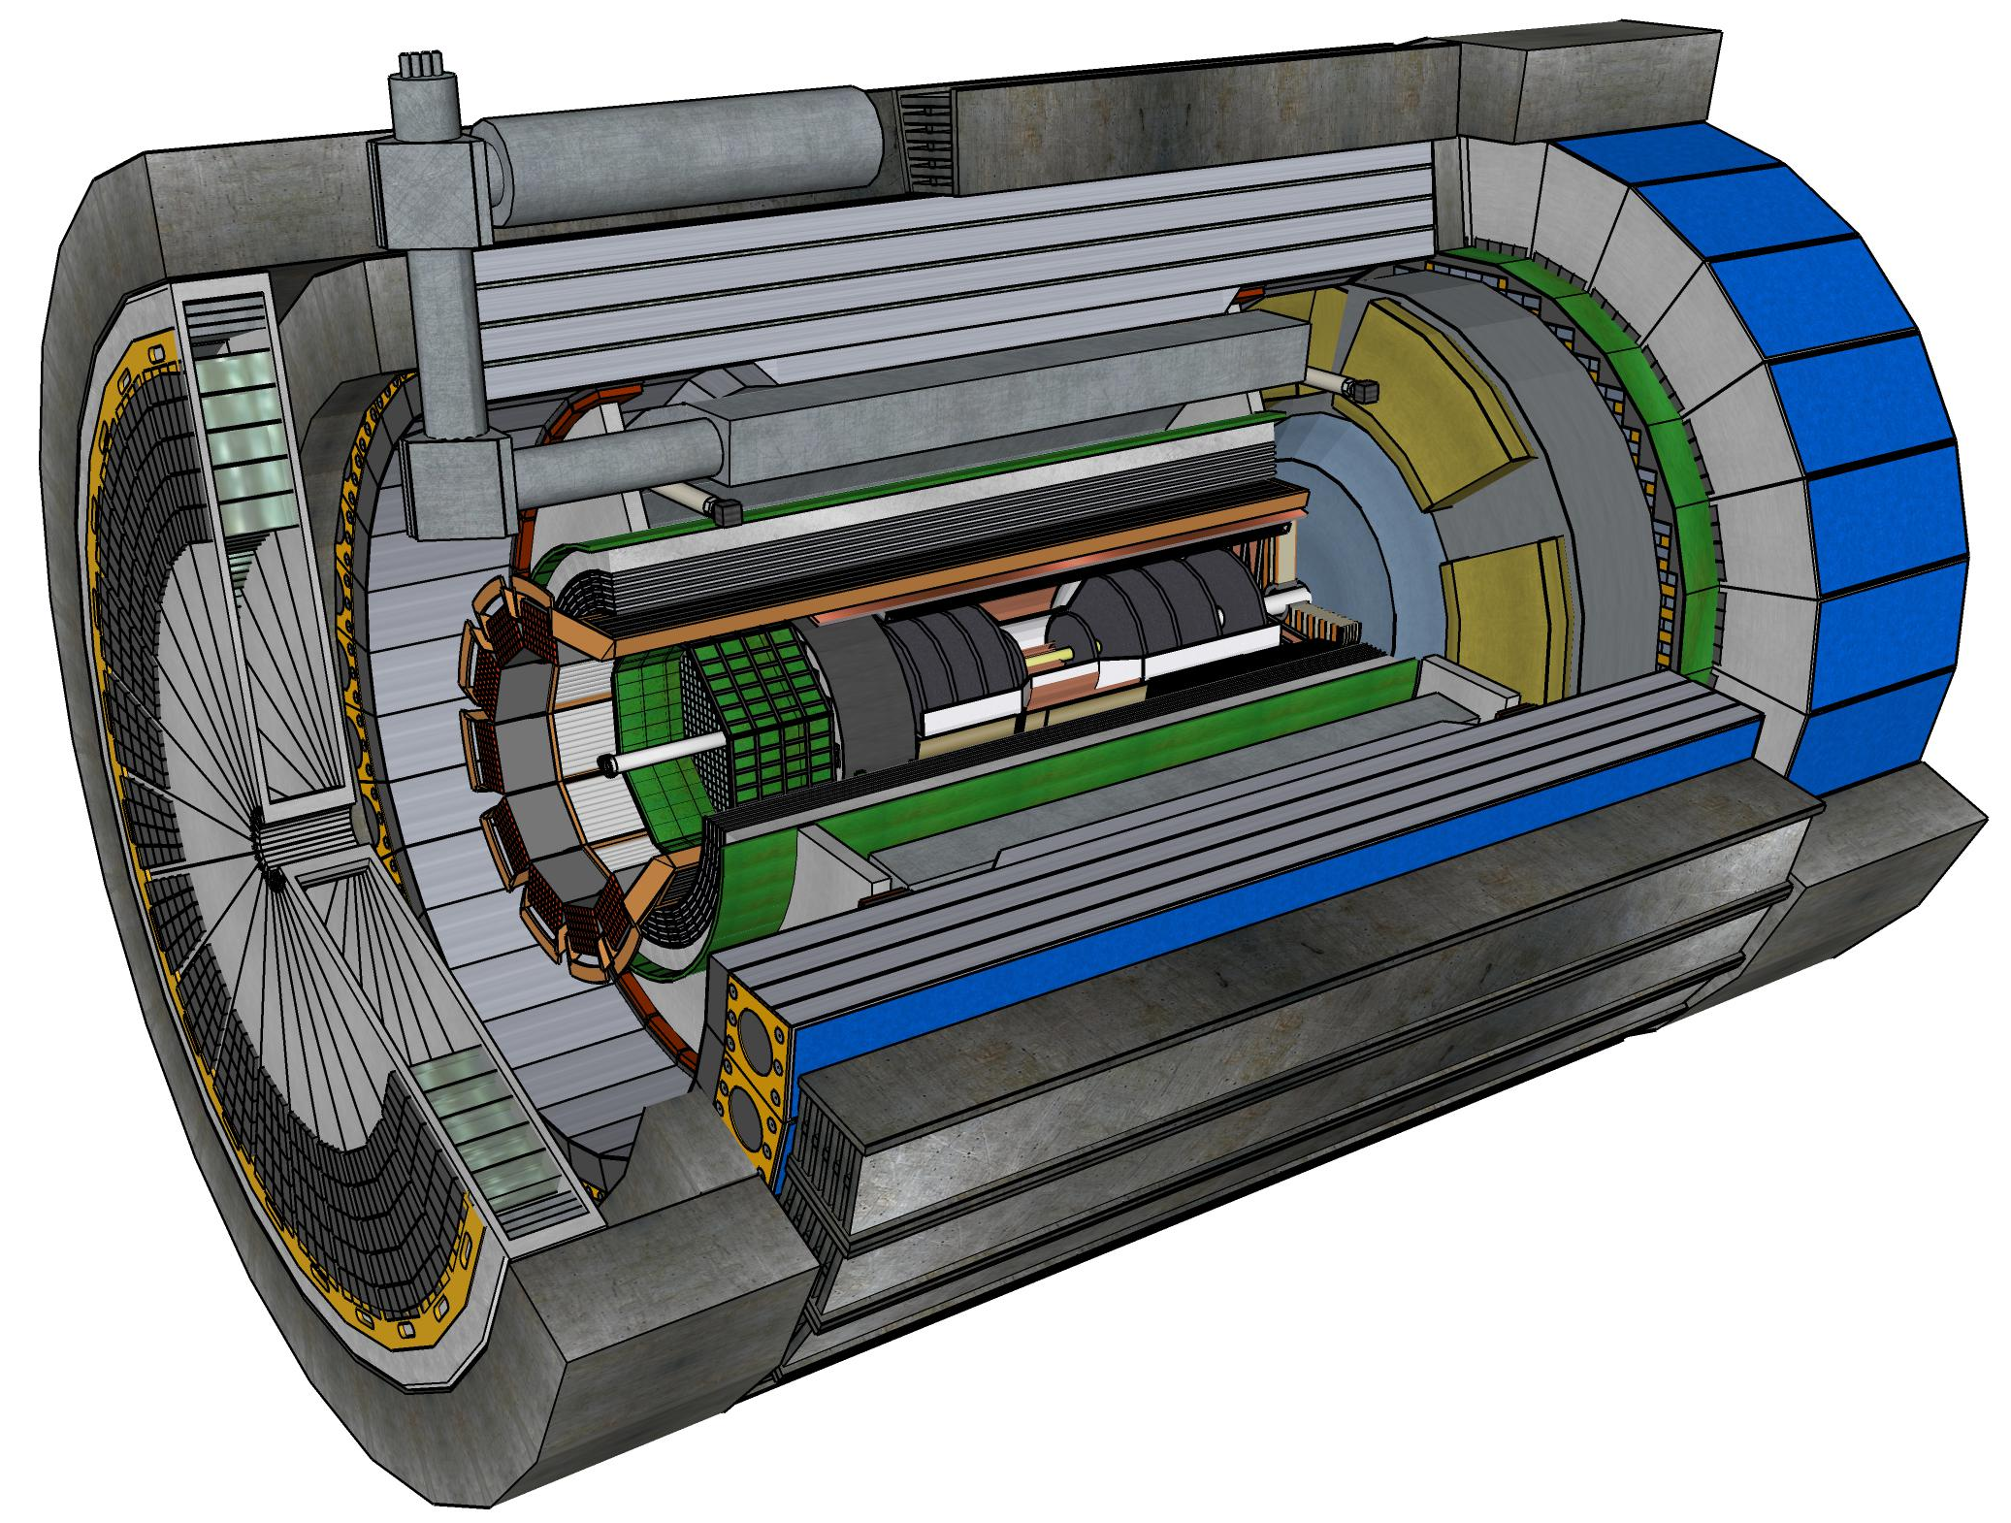










Central Detector Non-DOE Interest & In-Kind
Superconducting
Solenoid
Dual-radiator
RICH
Forward Electromagnetic
Calorimeter
Barrel
Electromagnetic
Calorimeter
Tracking
Detectors
Backward
Electromagnetic
Calorimeter
Time-of-Flight
Backward Hadronic
Calorimeter
Data-Acquisition
Electronics

Slide 21
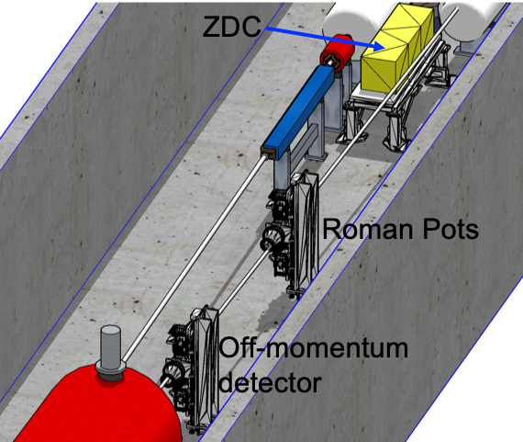
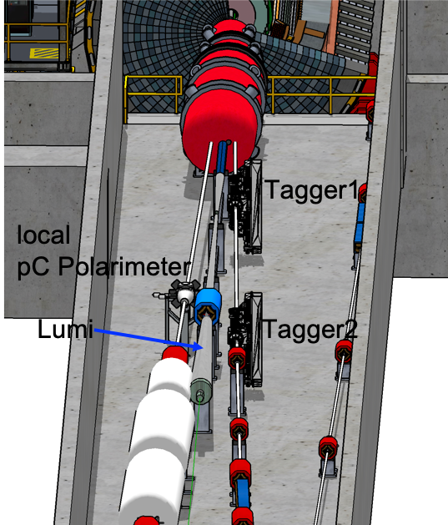


Far-Forward/Far-Backward Detectors Non-DOE Interest & In-Kind
Detectors along the hadron and electron beam-lines
B0-Tracker & Electromagnetic Calorimeter

Slide 22
Detector Non-DOE Interest & In-Kind
Entity | Interest and Important Facts
NSF | NSF-MSRI pre-proposal submitted by 10 US universities – aims at full scope of backward EM calorimetry (eECal). Armenia, Czech, France/IN2P3 as unfunded contributors. Invited to submit proposal. Final internal NSF review is ongoing.
CERN | MAPS sensor design developed by CERN/ITS-3 Group providing synergy with ALICE. Synergy of gaseous-based Cherenkov detectors and photon-sensors with ALICE & LHCb. Synergy of Forward AC-LGAD design with CMS endcap timing layer.
Armenia | Contributions, mainly labor to eECal and many EM calorimetry and particle id detectors component tests.
Canada | EIC included in 2022 Canadian Subatomic Physics Long-Range Plan; Interested in Compton Polarimetry, Barrel Electromagnetic Calorimetry and Software
China | Interested in Forward EM Calorimeter – working on NSF-China proposal.
Czech | Working with funding agency; Interested in eECal (PbWO4 crystals and glass) and Silicon
France/IRFU | Interested in MPGD/racking, electronics. Provided in-kind contributions to SC magnet design and interested to continue labor oversight during magnet construction.
France/IN2P3 | International contribution to backward EM calorimetry (including in-kind design) and to readout electronics (two ASICs for AC-LGAD detectors and Calorimetry). IRFU & IN2P3 discussing together for higher-level contributions.
India | Consortium is working with Funding agency; Interested in detector software (non-project scientific contribution), contributions to DAQ/slow controls. Investigating further hardware contributions (including possible links with Si groups and plants).
Italy/INFN | Aims at major scope of forward particle identification detector (dRICH), at (part of) the Si/MAPS tracker scope, and at photo-sensor contributions as well as contributions to the μRwell. tracker. Further investigating possible interest in EIC detector magnet scope.
Israel | B0 Detectors (Si tracking and PbWO4)
Japan | Interested in a US-Japan agreement; Aims at full scope of Zero-Degree Calorimeter in collaboration with Taiwan/Korea. Pursuit of full scope of barrel AC-LGAD detector as EIC-Asia consortium. Contribution to DAQ/streaming.
Korea | Aims at major scope for fiber-based barrel EM calorimeter, Also work packages for barrel AC-LGAD and Si-based hadronic calorimetry for ZDC.as part of EIC-Asia consortium (includes also Japan,Taiwan), Collaboration on Si tracking detector.
Poland | Actively working with ministry/funding agency; Interested in detectors along the beam line (luminosity detector, Roman Pots)
Taiwan | Pursuit of full scope of barrel AC-LGAD as part of EIC-Asia consortium. LYSO-based EM calorimeter for ZDC, Also optical readout/fiber. Possible later interest in PCBs. Computing.
UK | STFC seed funding for UK detector R&D (3M£). Interest in Si/MAPS tracker, polarimetry and detectors along the beams (Low-Q2/TimePix). Follow-up STFC/UKRI request for 5-7 years submitted early 2023 (includes accelerator part).

Slide 23
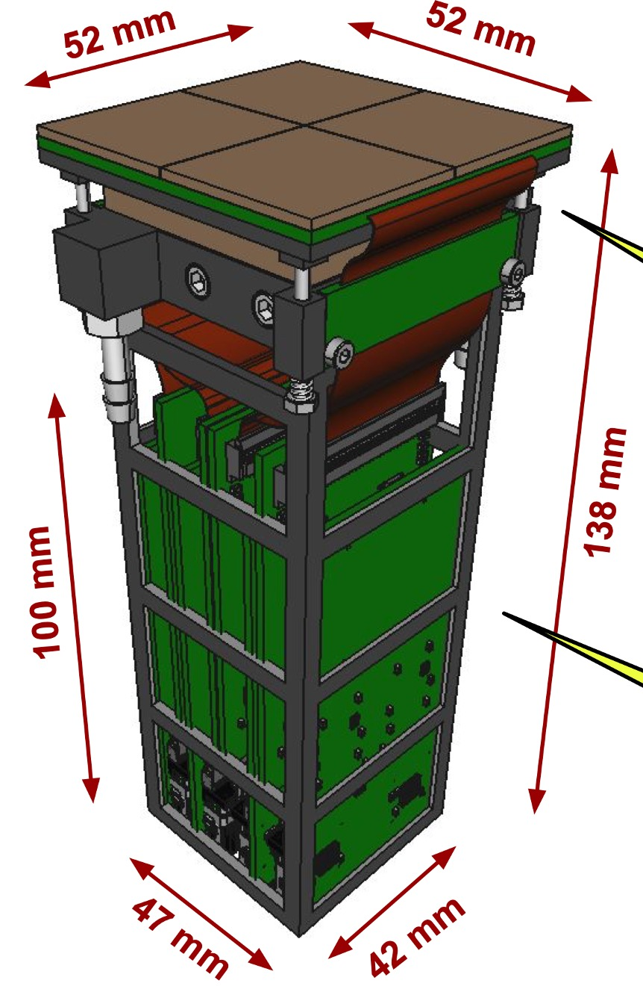
In-Kind and EIC Detector Progress
Large in-kind component of ongoing project detector R&D.
in-kind contributions from Italy/INFN, France/IRFU, France/IN2P3, UK/STFC, etc.
similar many contributions from US universities
and benefitting from synergies with CERN (ITS3/MAPS, PID, Photo-sensors, etc.)
Excellent progress on PED – designs moving rapidly with help of many friends. This constitutes a ~$5M in-kind non-DOE PED contribution.
silicon and gaseous-based trackers (UK & Italy, France, …)
particle identification detectors (Italy, Taiwan, …)
EM calorimetry (Armenia, Canada, Czech, France, Korea, …)
Magnet (France)
Far-Forward/Far-Backward Detectors (Czech, France, Israel, Japan, Poland, UK, …)
dRICH photo sensor module
Backward EM Calorimeter
Barrel Micromegas tracker
TimePix detail of Low-Q2 tracker

Slide 24
1st Wave of Milestones for Detector IKC
Agency | Milestone | Target Date
Italy-INFN | Outcome on detector solenoid funding (CD-3A scope) | December 2023
US-NSF | Outcome on MSRI funding (CD-3A scope) | January 2024
UK | UKRI outcome on funding proposal | January 2024
Italy-INFN | JLab iCRADA draft on magnet | February 2024
Italy-INFN | BNL iCRADA draft on magnet | March 2024
Italy-INFN | iCRADAs on magnet signed | May 2024
France-IN2P3 | PPD draft | May 2024
France-CEA | PPD draft | June 2024
UK | PPD draft | August 2024
Italy-INFN | JLab iCRADA signed (excluding magnet scope) | August 2024
Italy-INFN | PPD draft / excluding magnet scope | August 2024
France-IN2P3 | JLab iCRADA and BNL iCRADA signed (draft in Jun/Jul) | September 2024
France-CEA | JLab iCRADA signed (draft in Jun/Jul) | September 2024
UK | JLab iCRADA signed (draft in Jun/Jul) | September 2024
 | CD-2/CD-3 Director’s Review / All PPDs signed | November 2024
 | CD-2/3 OPA review | January 2025
 | CD-2/3 ESAAB | April 2025
There will be amble opportunity
to make in-kind contributions
after CD-2 as fits best with
your funding agency cycle.
To achieve these timelines, it
will be critical to have a dedicated
team from the in-kind partner and
the project team working in sync to
get the documents done
and signed.
Would appreciate to get contact
persons defined asap after this
RRB.

Slide 25
Path Forward to CD-2
We will start the process of writing a TDR beginning of 2024
Working model will be similar as we used to create the CDR, Elke/Rolf with engagement of ePIC leadership, and a mix of the project CAMs, ePIC WG and DSC representatives.
Completion of Non-Si R&D (MAPS/ITS3, ASICs, and AC-LGAD to continue)
Quantify (time, cost, performance) and document, before CD2, mitigation plans for the possibility that some R&D components will not meet expectations
Tracking layout with branching points defined and documented
Continue work on design maturity for all (non-CD-3A) systems.
Continue work on integration aspects, e.g., service needs of various detectors, cable routing, electronic rack layouts, survey & alignment planning, monitoring systems, controls needs.
Collect interfaces beyond CD-3A scope, and document towards ICDs
PDRs of Tracking, Far-Forward/Far-Backward, Electronics/DAQ, Particle Identification
FDR of Calorimetry
Simulations with Full Materials, Background and Reconstruction
Draft Technical Design Report
Formalize in-kind agreements in form of high-level agreements and project planning documents, as appropriate
On track for baselining (CD-2) in early 2025.

Slide 26
Summary
EIC detector scope and layout fully defined since July 2023
Design fulfills all high level constrains
Long lead procurements are well defined
EIC Project provides critical information to collaboration
Beam backgrounds and radiation at IR
Material budgets due to services & support structures
Successful CD-3A review now moving forward to CD-2/3
Defining installation schedule and commissioning plans
ePIC collaboration and EIC Project work hand in hand to realize the experimental program
26

Slide 27


Slide 28
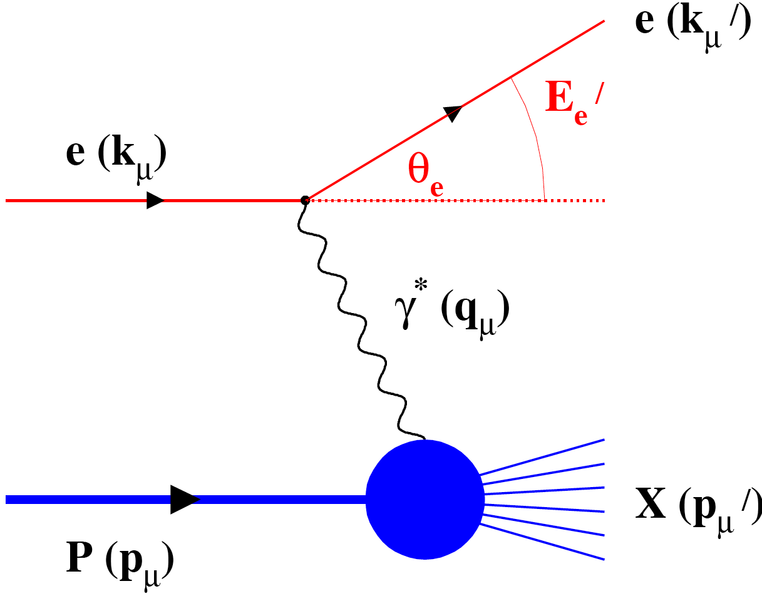
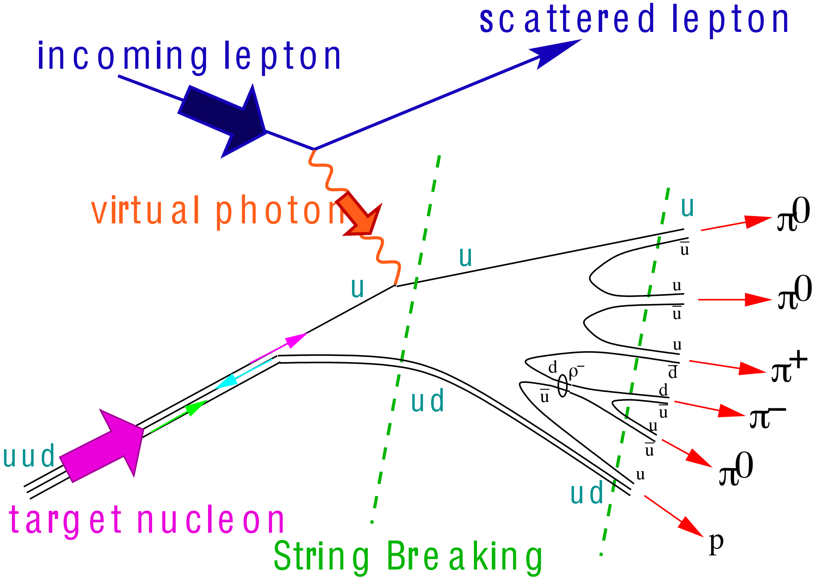
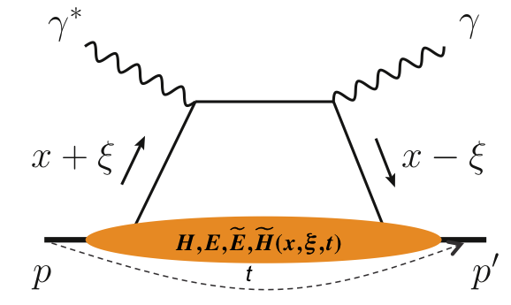
What Is Needed Experimentally?
experimental measurements categories to address EIC physics:
Parton Distributions in nucleons and nuclei
Spin and
Flavor structure of nucleons and nuclei
Tomography Transverse Momentum Dist.
QCD at Extreme Parton Densities - Saturation
Tomography
Spatial Imaging
inclusive DIS
semi-inclusive DIS
exclusive processes
measure scattered lepton
multi-dimensional binning: x, Q²
reach to lowest x, Q² impacts
Interaction Region design
measure scattered lepton
and hadrons in coincidence
multi-dimensional binning:
x, Q², z, p_{T}, Q
particle identification over entire region is critical
measure all particles in event
multi-dimensional binning:
x, Q², t, Q
proton p_{t}: 0.2 - 1.3 GeV
cannot be detected in main detector
strong impact on Interaction Region design
∫Ldt:
1 fb⁻¹
10 fb⁻¹
10 - 100 fb⁻¹
machine & detector requirements
28

Slide 29
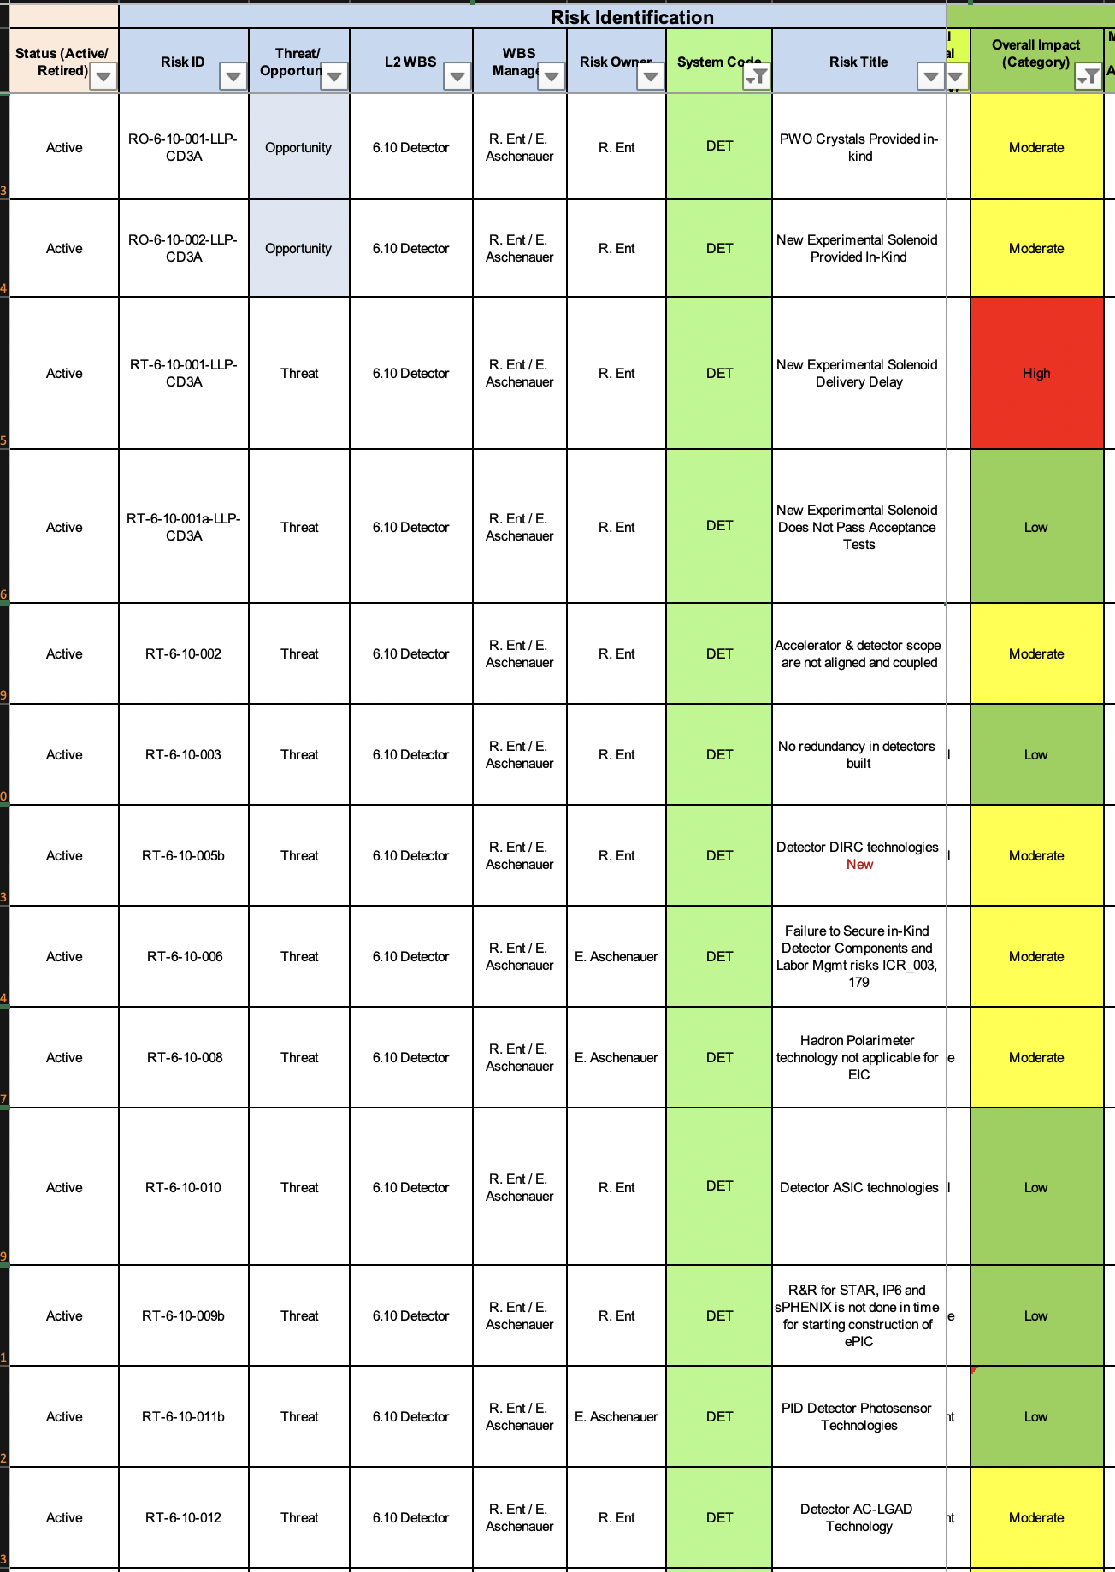
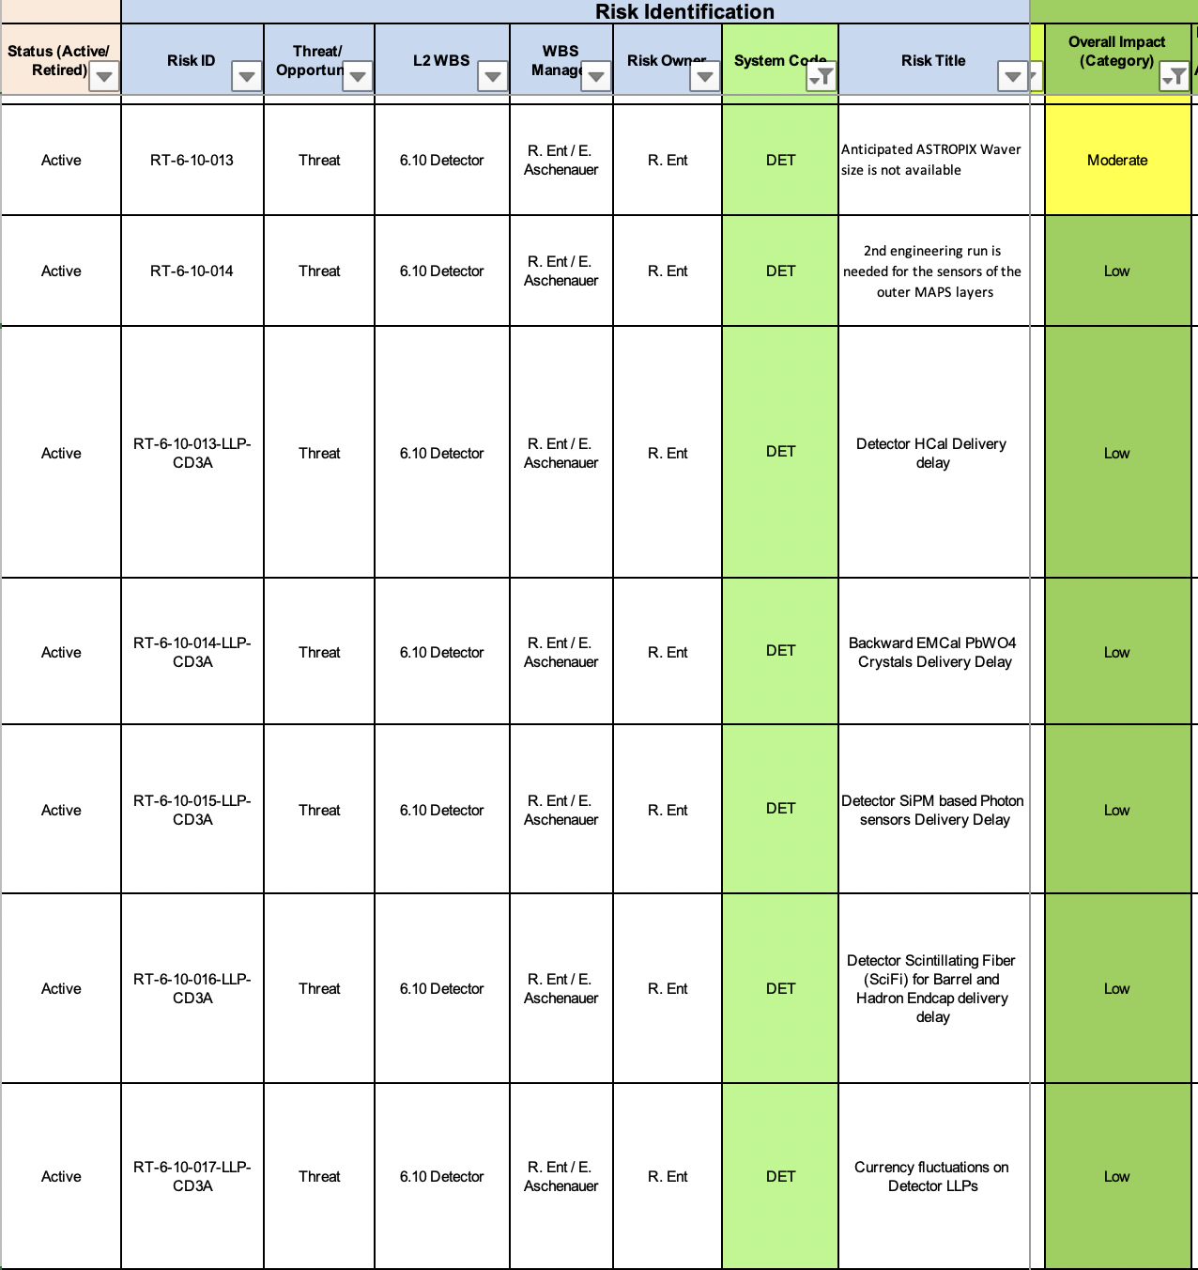
Experimental Program Active Risks

Slide 30
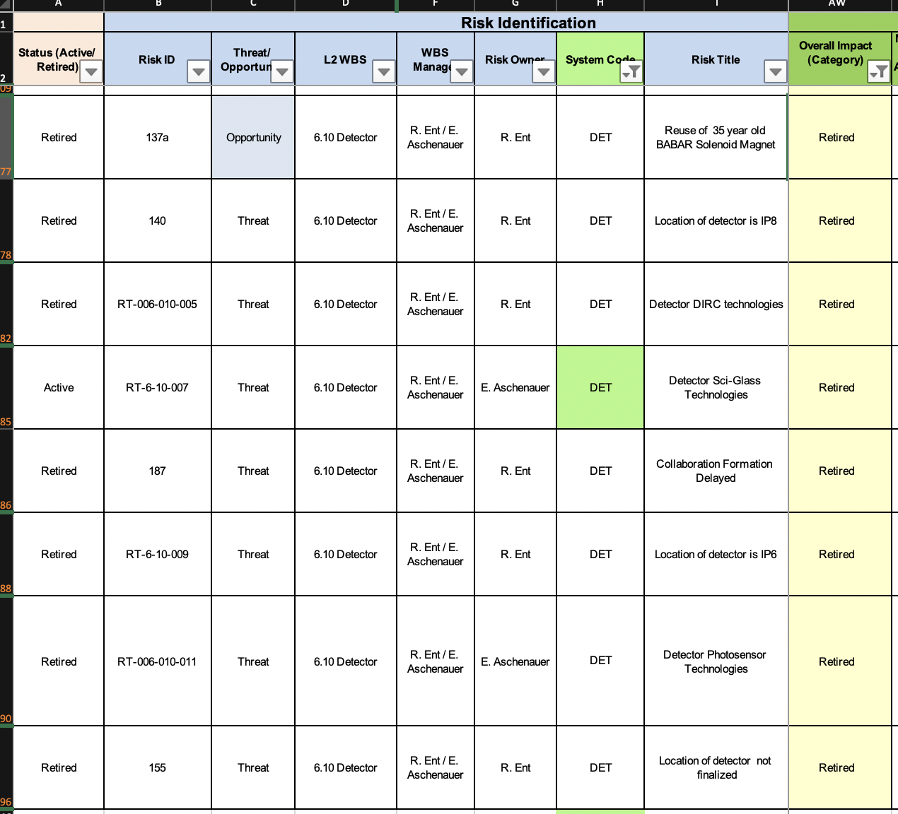
Experimental Program Retired Risks

Slide 31
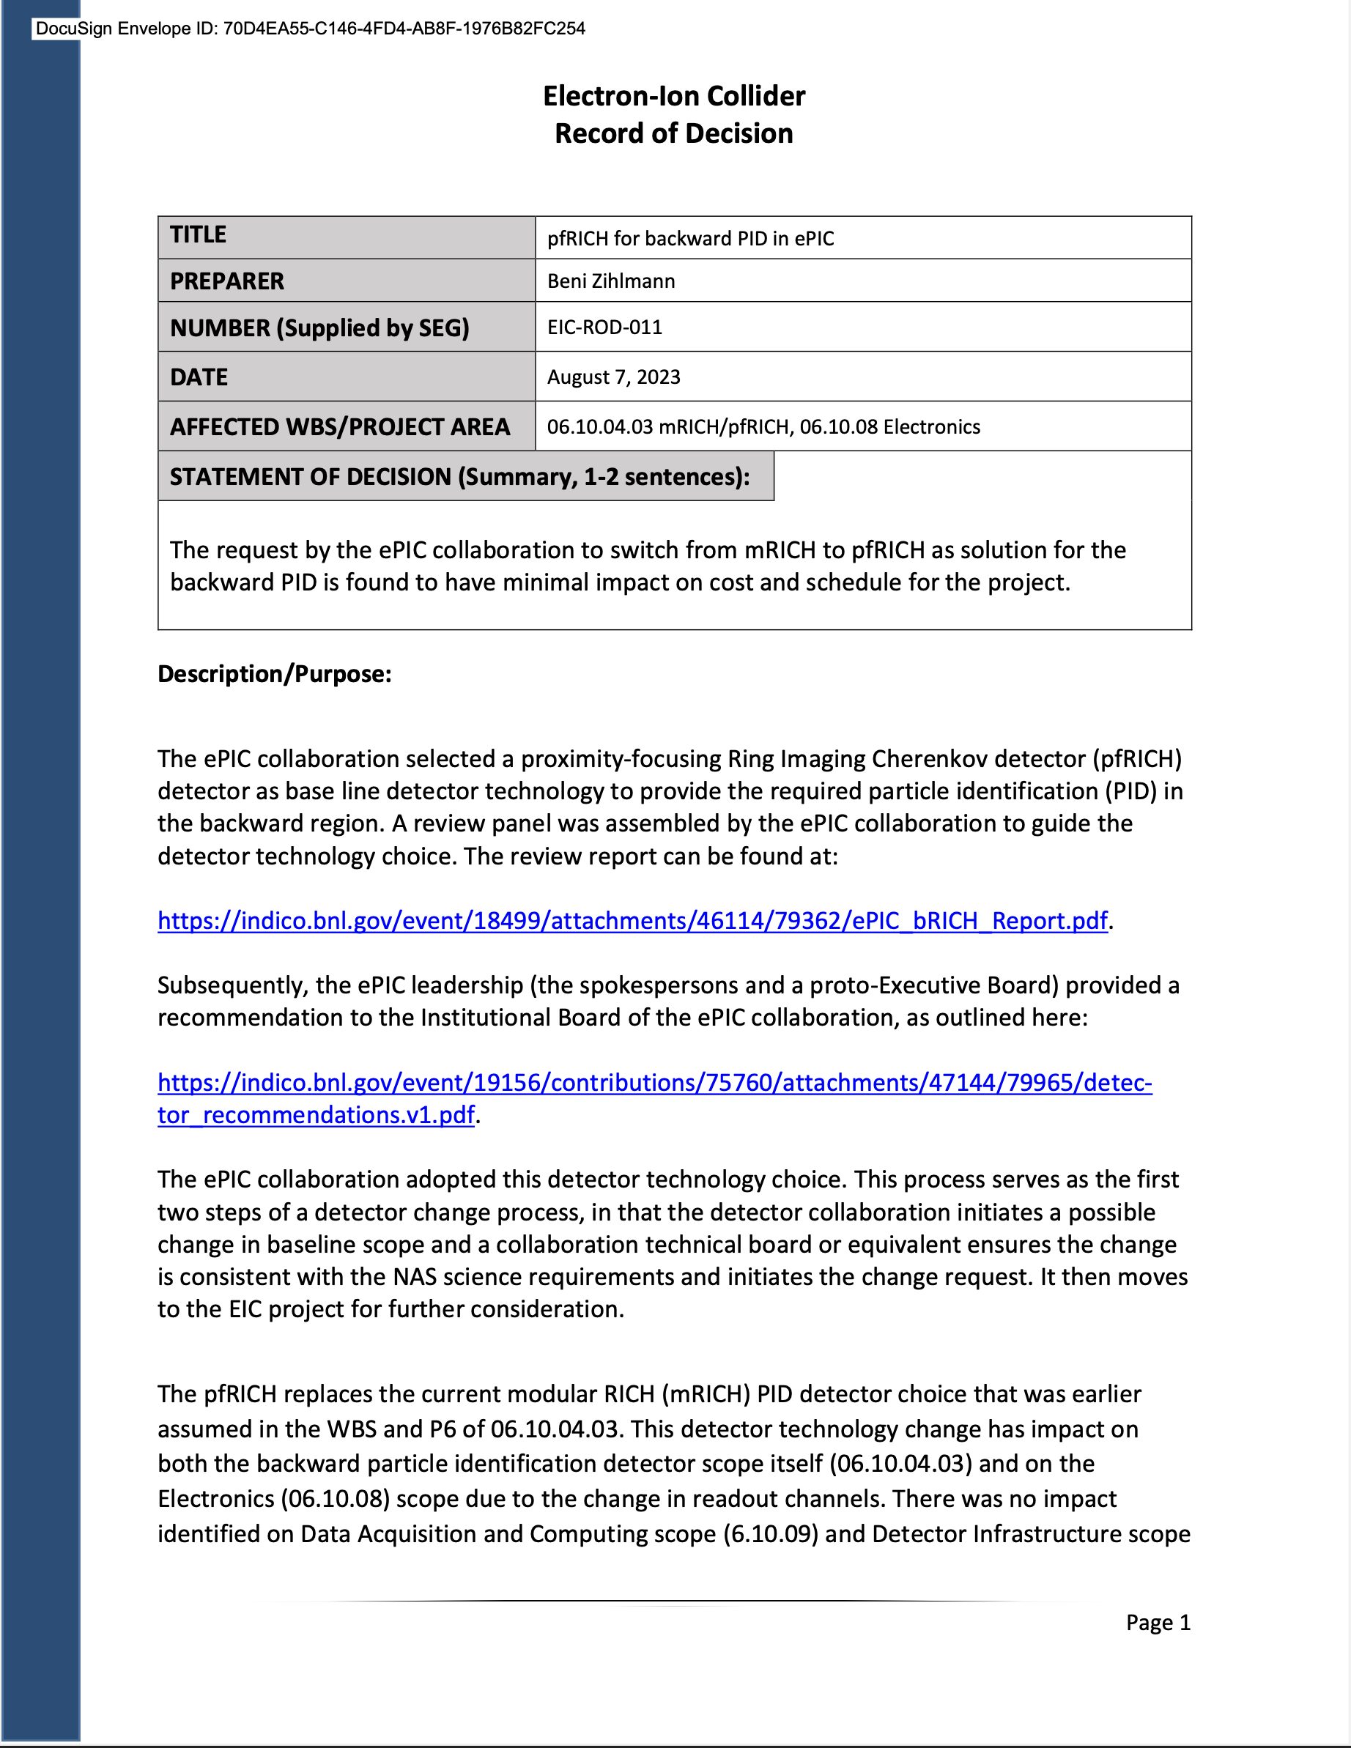
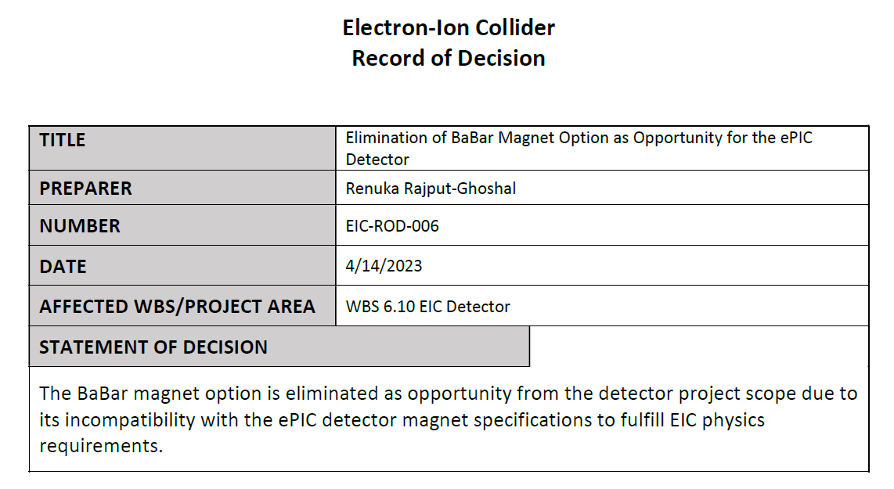
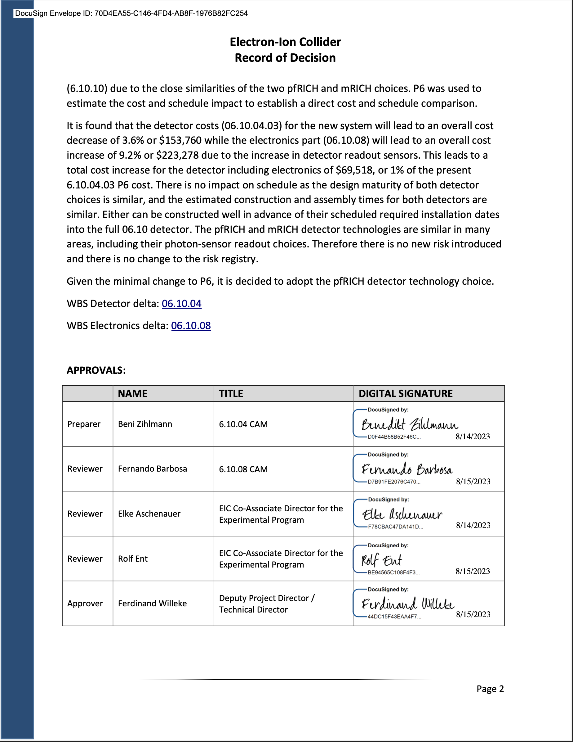
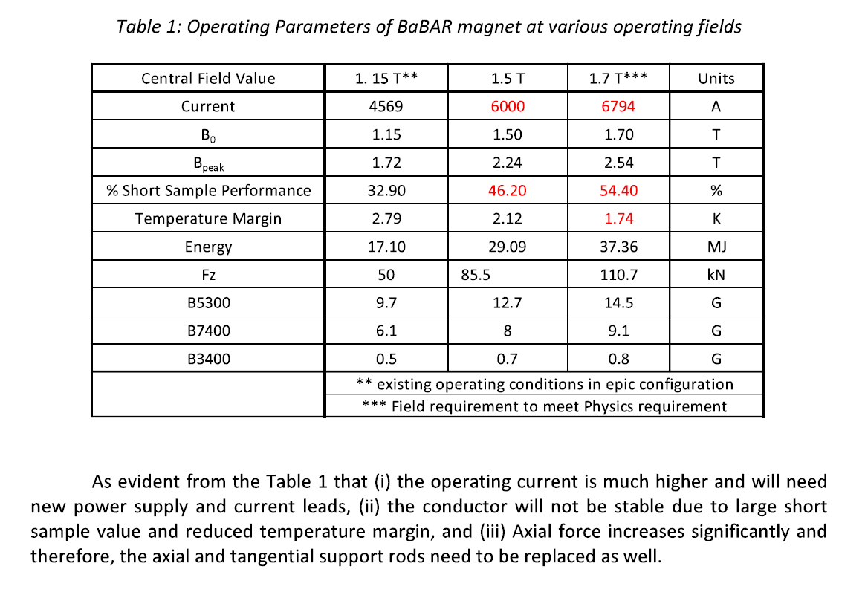
Detector Record of Decisions - Examples
Adopt pfRICH
Rule out reuse of BaBar magnet
31

Slide 32
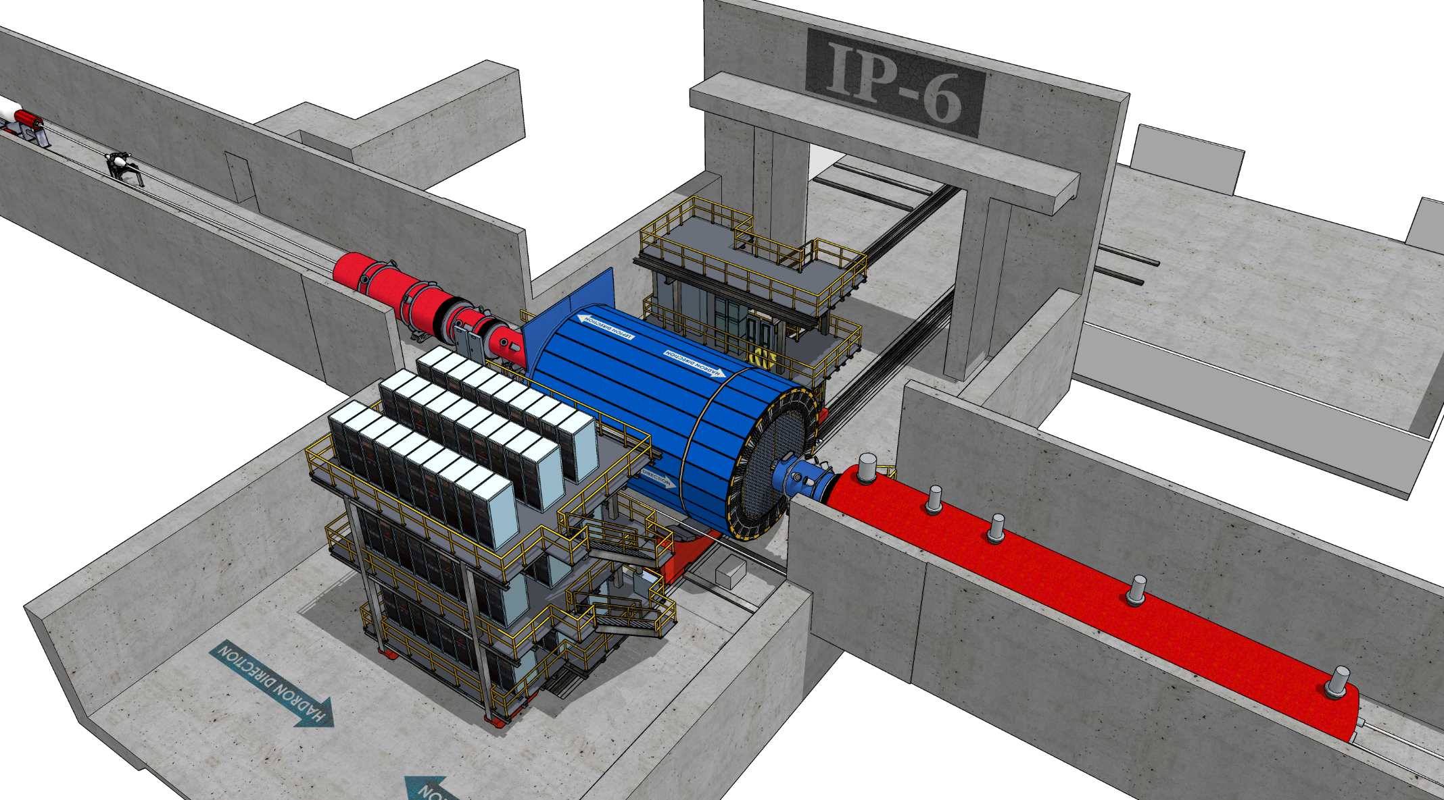
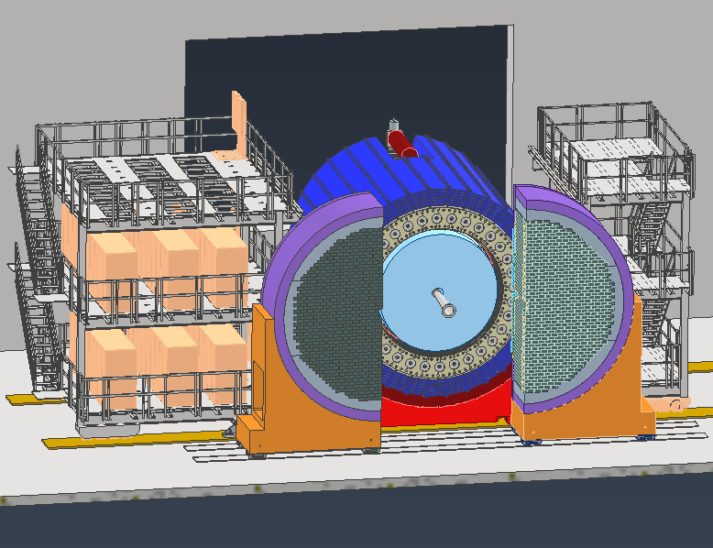
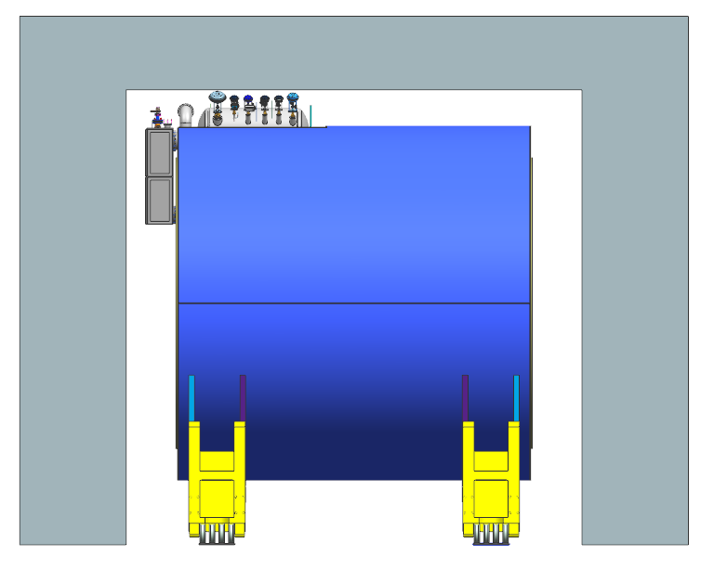
IR-Integration Constrains
Space Constrains:
Detector: -4.5 m – IP – +5m not negotiable
Detector aligned with electron beam
→ 8 mrad rotation
<50 cm space to 1st IR-magnets occupied by vacuum pumps, valves, …..
IP moved 81 cm towards ring inside compared to RHIC; y: 432 cm above floor
RCS to IP: radial distance 335.2 cm at a height of 372 cm above floor
Maximum outer radius ~ 3.2 m
limited installation possible in Collider Hall
endcap hadron calorimeters need to be split transverse to beam pipe for access to barrel part of detector
RCS vacuum needs to be broken
9.5 m long detector does not fit through the door
Door-Size: 823 cm x 823 cm
endcaps need to remain in collider hall, if central detector rolls in assembly hall
Electrons
Hadrons
RCS
3 cm
Doorway at IP6
64 cm
35 cm
89 cm

Slide 33
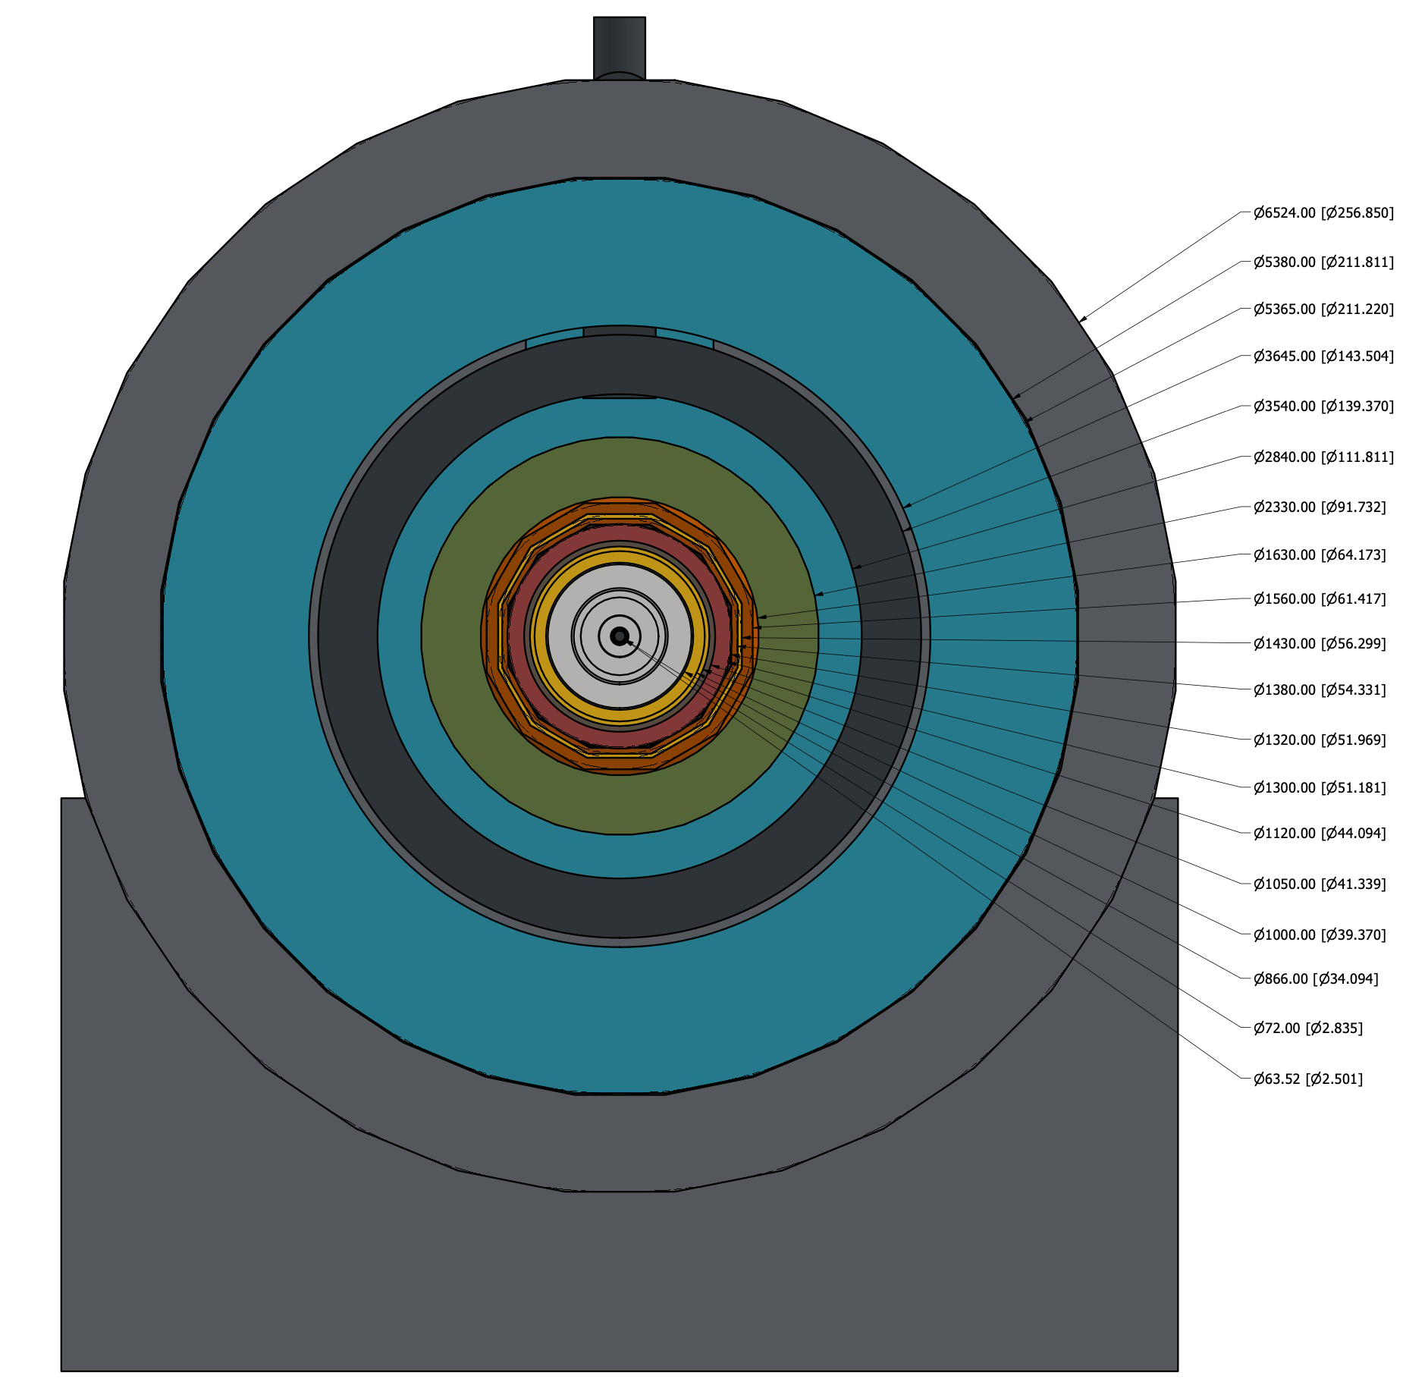
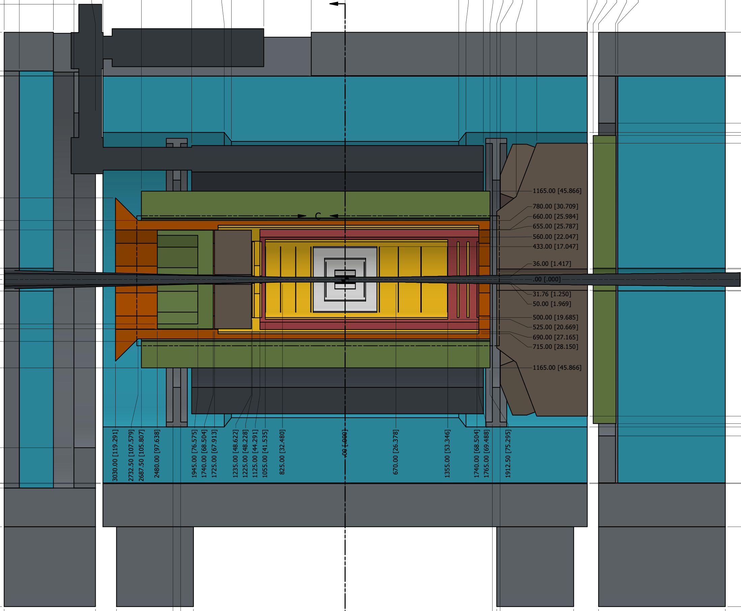
Beam Pipe Bake-Out
Charge Question 1
Remember: limited installation and maintenance possible in Collider Hall due to space constrains
Will have to break vacuum each time we roll into the assembly hall for maintenance
will have separation valves around the detector
no pumping over 9.5 m
will vent under nitrogen and keep beam pipe rolling
with detector under nitrogen
will need to bake-out beam pipe integrated in central detector
Considerations for central beam pipe bake-out
1st MAPS μvertex tracker sits at 36 mm radius, so 5 mm from the beam pipe
MAPS sensor cannot go higher as 30ºC
rules out std. bake-out methods and NEC
pumping
want to cool with air to keep material budget
as low as possible
Investigate baking out the central beam pipe
with hot gas at > 100ºC to break water bonds
rolling to
assembly hall

Slide 34
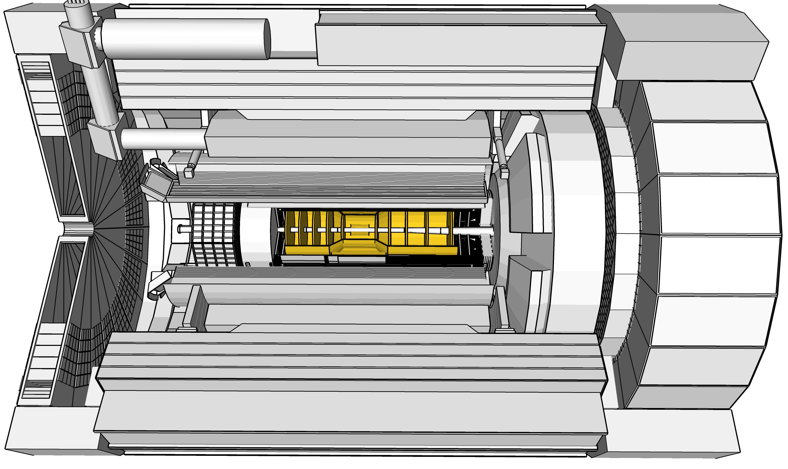
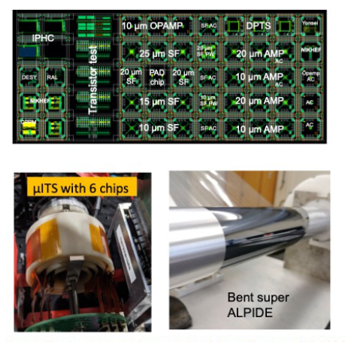
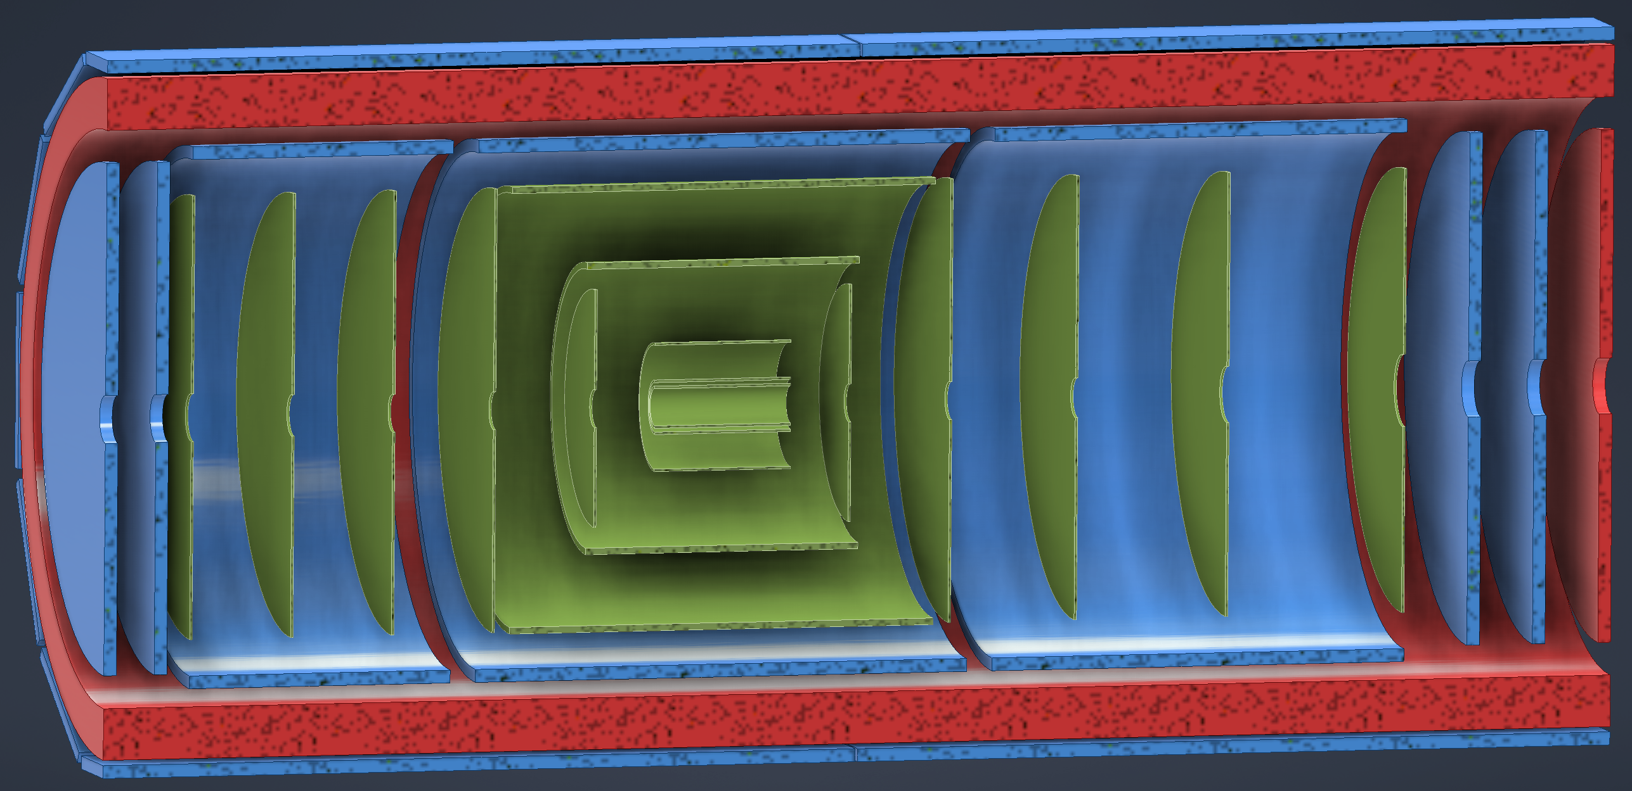
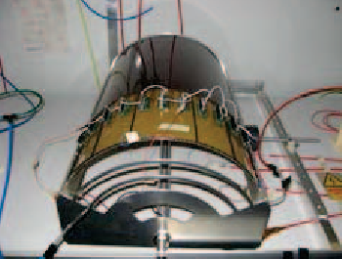
ePIC Tracking Detectors
Charge Question 3
Monolithic Active Pixel Silicon Tracker:
1 single technology: 65-nm MAPS
small pixels (~18 μm) and power
consumption (<20 mW/cm²)
low material budget
(0.05% to 0.55% X/X₀ / layer)
based on ALICE ITS3 development
MAPS Vertex layers
MAPS Barrel, forward and backward disks
Multi Pattern Gas Detectors:
additional space points at large radii
Cylindrical microMEGAS
→ Additional space point for pattern recognition / redundancy
→ Ongoing geometry optimization
μRWELL planar layer just before hpDIRC
→ Impact point and direction for the ring seeding of hpDIRC
→ Additional space point for pattern recognition / redundancy
Two MPGD disks each beyond Si disks in forward and backward direction
→ To provide sufficient hits under large backgrounds to
compensate for large Si time integration frame
MAPS Barrel + Disks
MPGD Barrels + Disks
AC-LGAD based ToF
→ more details in Brian Eng’s talk

Slide 35





ePIC Calorimetry
Charge Question 2,3
→ more details in A. Bazilevsky’s & A. Kiselev’s talk
Backwards HCal
Steel/Sc Sandwich
tail catcher
Barrel HCAL (re-used from sPHENIX)
Forward ECal
High granularity Tungsten-Powder/SciFi matrix
SiPMs as photonsensors
ForwardHCAL
Longitudinally separated Steel/Sc & Tungsten/Sc sandwich
with SiPMs embedded in Scintillator
Backward Ecal
High-precision, PbWO4
SiPMs as photonsensor
Long Lead
Procurement
Items
Pb/SciFi
Barrel ECal: Pb/SciFi with a
hybrid imaging part (using 6 layers of ASTROPIX)

Slide 36






ePIC Particle Identification Detectors
Charge Question 3
Backward RICH:
Aerogel Cherenkov Det.
e, π, K, p separation
→ π/K 3σ sep. at 10 GeV/c
Photon-sensor:
LAPPDs to include TOF
hpDIRC (High Performance DIRC)
Quartz bar radiator → Reuse of BaBAR DIRC bars
light detection with MCP-PMTs
Fully focused
p/K 3σ sep. at 6 GeV/c
dual Radiator RICH
Aerogel
z: 4cm radius: 110 cm
air gap
0.3 mm acrylic filter
Single volume proximity focusing aerogel RICH with long proximity gap (~30 cm)
Spherical Mirrors
6 Azimuthal Sectors
C₂F₆ Gas Volume
120 cm length
radius: 185 cm
Tapered bore radius
Al vessel
Sensors tiled on spheres
→ SiPMs as Photonsensors
π/K 3σ sep. at 50 GeV/c
ToF AC-LGAD (Low Gain Avalanche Detector)
20-35 psec
Accurate space point for tracking
forward disk and central barrel
R&D and PED by International consortium HEP & NP
→ more details in Beni Zihlmann’s talk

Slide 37

Final Layout of Flux Return and HCals
Stray Field Requirement: < 10G @ z= -5.3m @ z=7.4 m and @R=3.4m
Flux return layout finalized, documented and integrated in the HCal designs
backward HCal
Steel

Slide 38



How Maintenance is done
In Beam Position:
can only reach limited subsystems
lepton side:
HCal, endcap & barrel ECal, DIRC
hadron side:
endcap HCal and ECal
investigate dRICH can be removed →
access to inner detectors
all equipment on experimental platforms
In Assembly Hall:
to reach all subsystems need to take
ePIC apart piece by piece in the opposite order as it got assembled

Slide 39

Beam Background / Radiation at IR
Charge Question 1
The HERA and KEK experience show that having backgrounds well understood, is crucial for the EIC collider and detector performance
There are several background/radiation sources :
primary collisions
Electron Beam
background due to de-excitation of beam if bunches are replaced
synchrotron radiation
electron beam gas events due to Bethe Heitler process e_{Beam} + H²_{restgas} → e’ + γ + H²_{restgas}
Proton Beam
Low beam lifetime during injection and ramping
beam gas event: hadron beam interacts with restgas
Note:
all simulations presented use blue curve:
10000 Ah correspond to 5 month @ 10³⁴ cm²s⁻¹
→ beam pipe bake-out critical to keep a good vacuum
different to HERA and KEK the length of beam pipe the both beam share, is thanks to the crossing angle minimized
GEANT4

Slide 40


Synchrotron Radiation Results
Rates in different subdetectors:
Effect of gold coating on SR
→ Example μvertex MAPS layers
Need to repeat synchrotron radiation studies due to recent lattice change
→ anticipate also a change in the rear side

Slide 41



DIS and Beam Gas Background Rates
Hadron Beam Gas
protons: 275 GeV
vacuum after 10000 Ah
Electron Beam Gas
10 GeV
vacuum after 10000 Ah

Slide 42

Radiation at IR
Primary collisions contribute a substantial fraction of the ionizing radiation and low energy neutron fluence in the experimental hall
Simulations use Pythia-6 well tuned to HERMES, COMPASS and HERA
rates: “min-bias” DIS data → Q²> 10⁻⁹ GeV²
Validation: Yuri Fisyak et al. NIM A 756 (2014) 68-72, arXiv:1310.2495
Study dependence on physics-list in GEANT-4 → especially for low energy neutrons

Slide 43



Proton and Neutron Radiation

Slide 44


Information sharing with collaboration
Design:
generate subdetector envelopes
geometry database for users and GEANT simulations: https://eic.jlab.org/Geometry/
provide stp-files of support structures and services to be converted to GEANT geometries
General Information:
Requirements and Interfaces: https://eic.jlab.org/Requirements/
Wiki-page: https://wiki.bnl.gov/EPIC/index.php?title=Project_Information
ePIC Public Sharepoint to collect information from subsystems, i.e. services and readout chain
→ more details in Rahul Sharma’s talk
Readout Chain Information

Slide 45
Pre-Ops Plan of Experimental Equipment
Big Picture:
Two commissioning periods
First detector commissioning in assembly hall with cosmic
During this time, the different accelerators will be commissioned
Commissioning the detector with beam
Notes:
all subcomponents will be tested before installation not part of Pre-Ops
during collider commissioning without detector, we will have the beam-pipe around the IP instrumented to understand backgrounds and other beam related parameters
during commissioning of the RCS, ESR and HSR, this includes a first look to polarization and collisions at low luminosity
during this time, the experiment will be assembly hall and taking cosmic
BUT the electron (RCS & ESR), hadron polarimeters and luminosity monitor need to be fully operational to aid the collider commissioning
exact timelines still need to be worked out in cooperation with the accelerator group.
45

