Slide 1
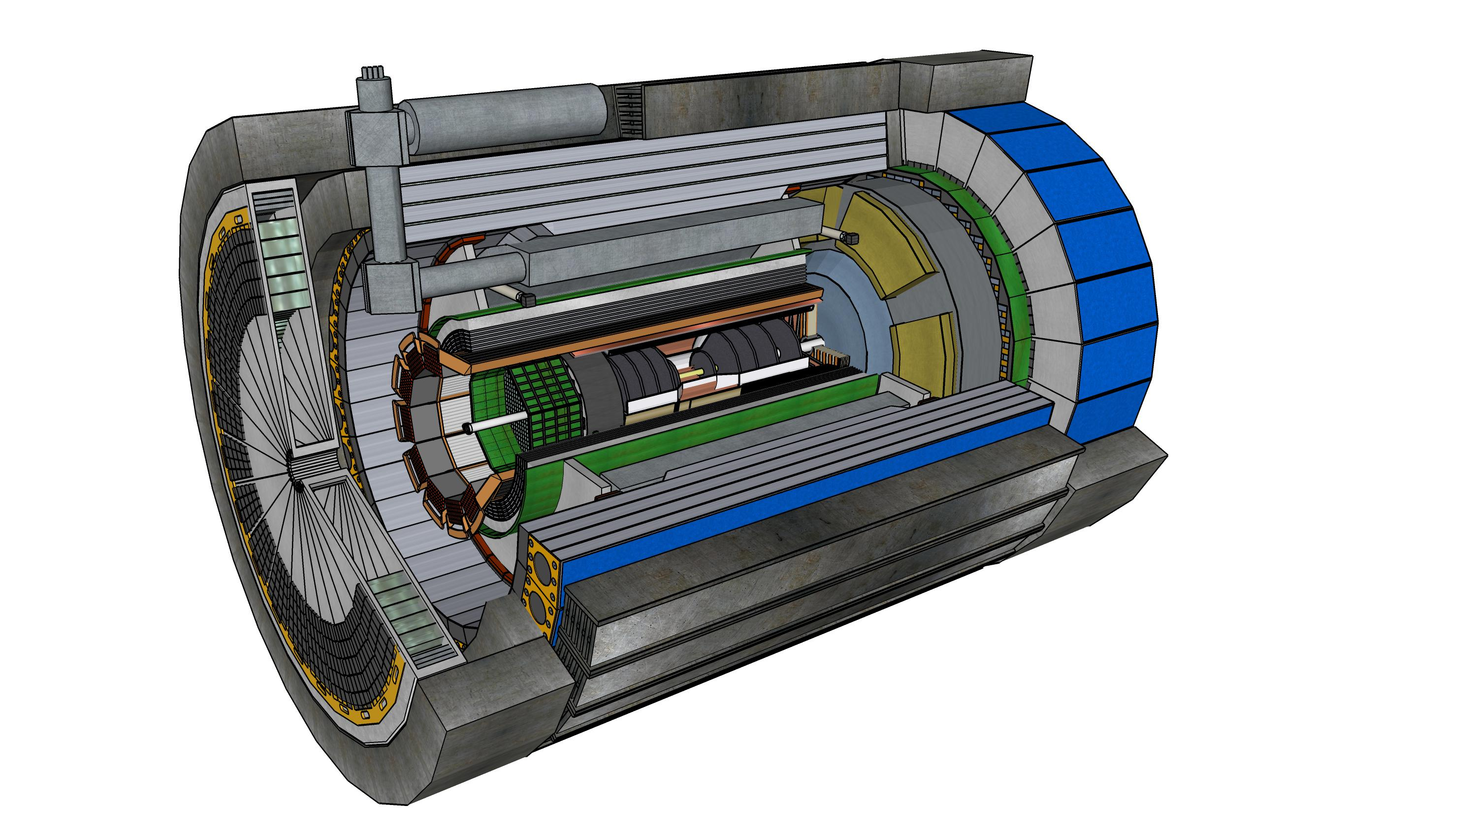



Report from the ePIC Collaboration Spokesperson
John Lajoie
Oak Ridge National Laboratory

Slide 2
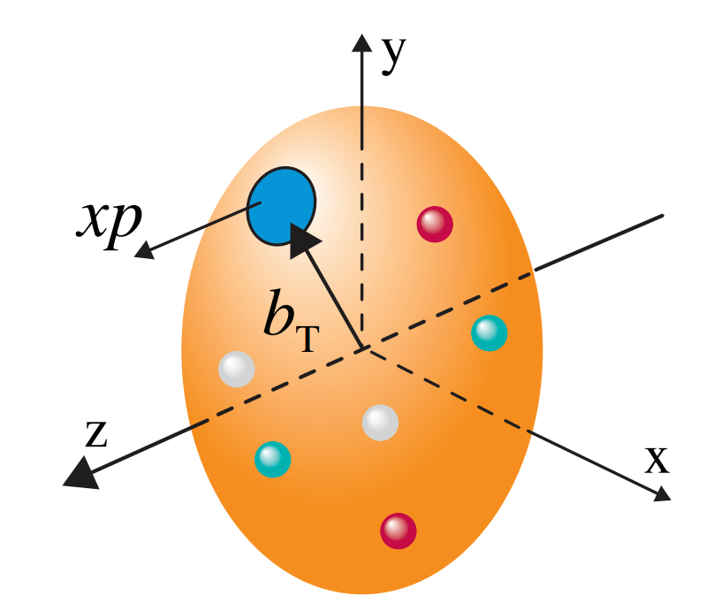
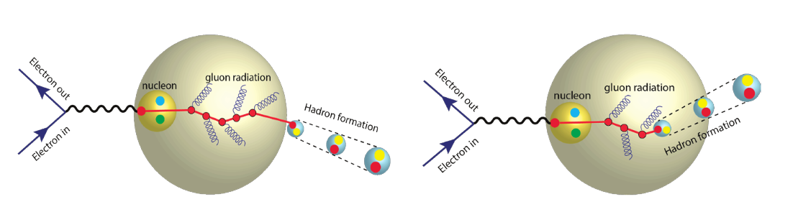
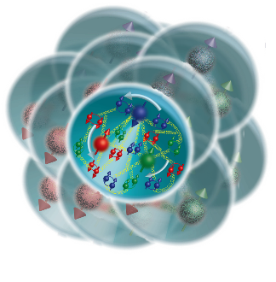
The Collaboration Pursues the Science
How do the nucleon properties like mass and spin emerge from quarks and their interactions?
How are the sea quarks and gluons distributed in space and momentum inside the nucleon? How is spin dynamically generated?
s
What is the mechanism through which quark-gluon interactions give rise to nuclear binding?
Is there a saturation point for the density of gluons in nuclei at high energies, and does this lead to the formation of gluonic matter with universal properties across all nuclei, including the proton?
In what manner do color-charged quarks and gluons, along with colorless jets, interact with the nuclear medium? And how do the confined hadronic states emerge from these quarks and gluons?
What impact does a high-density nuclear environment have on the interactions, correlations, and behaviors of quarks and gluons?
2

Slide 3
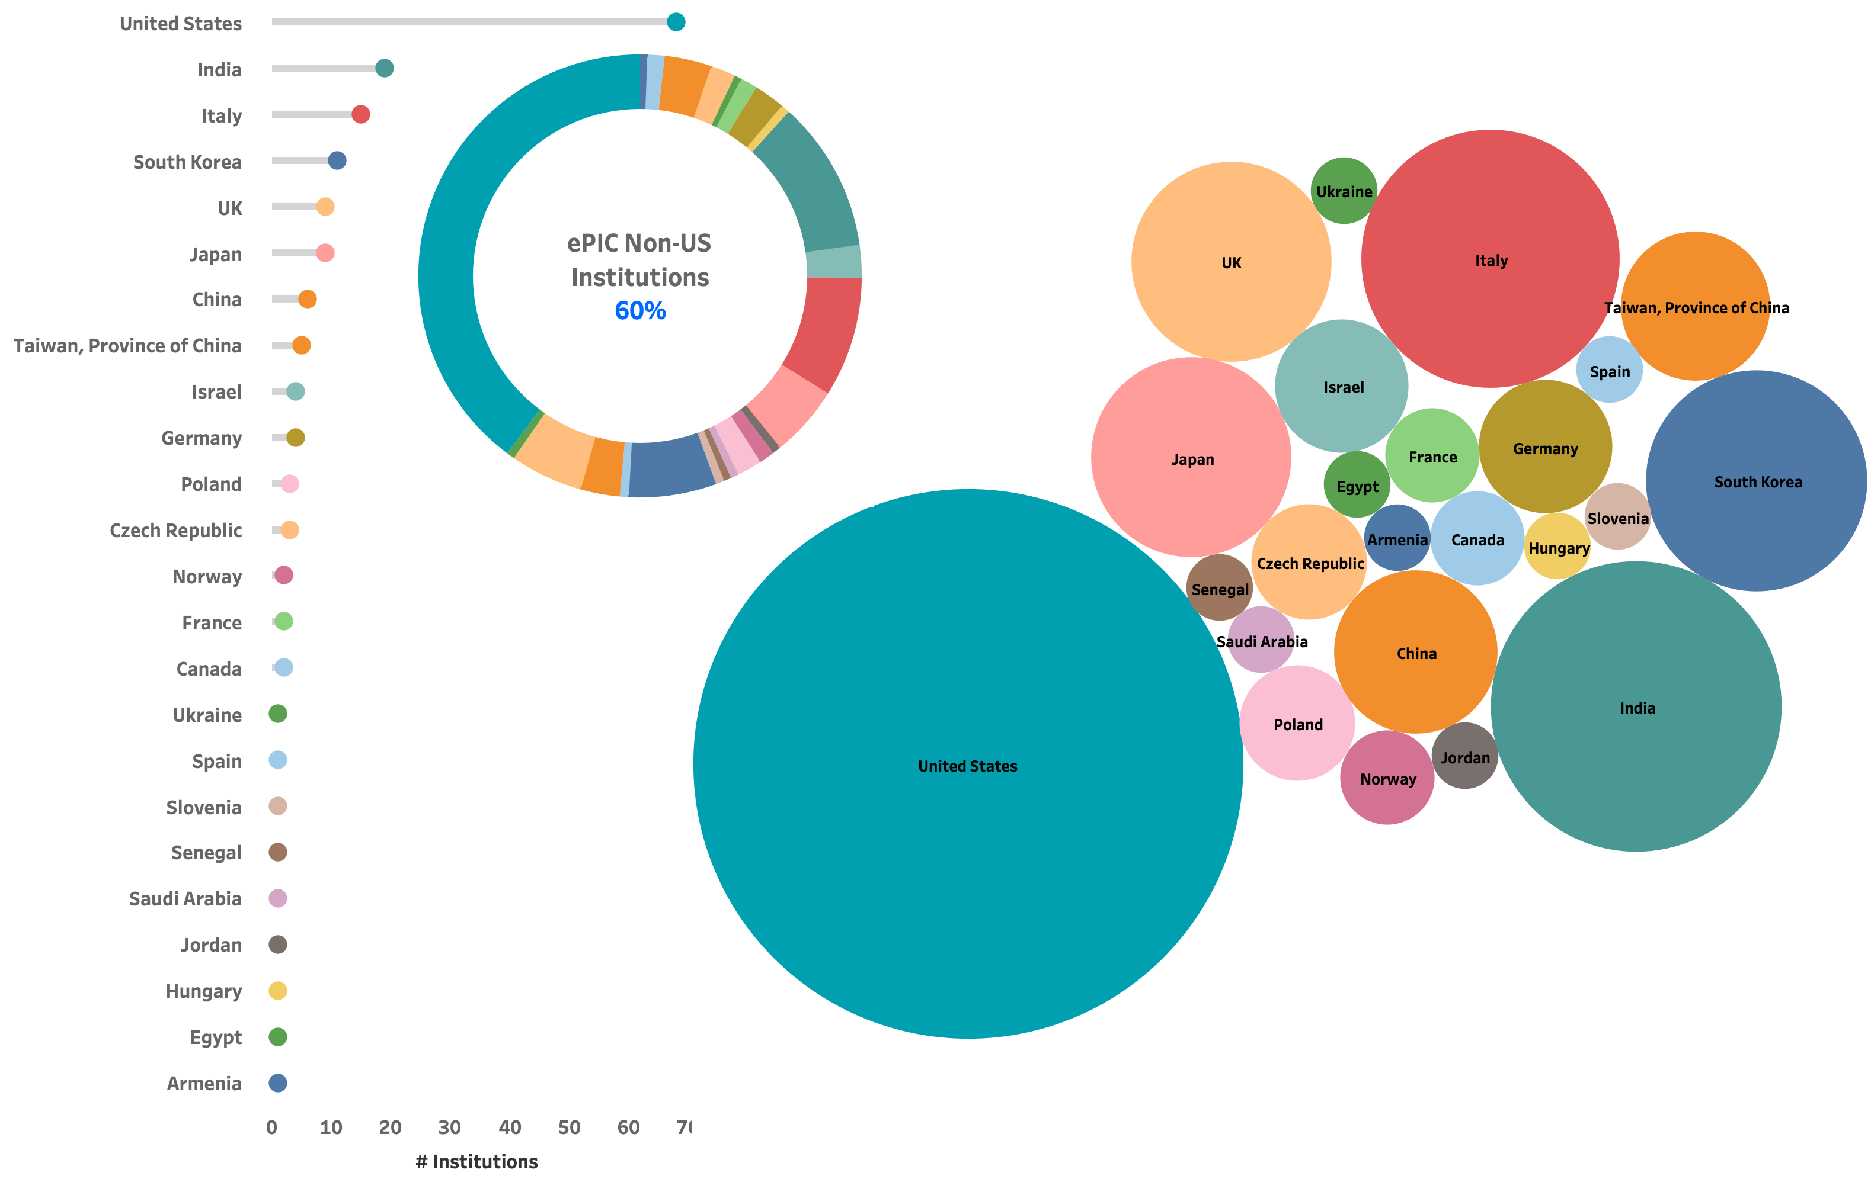








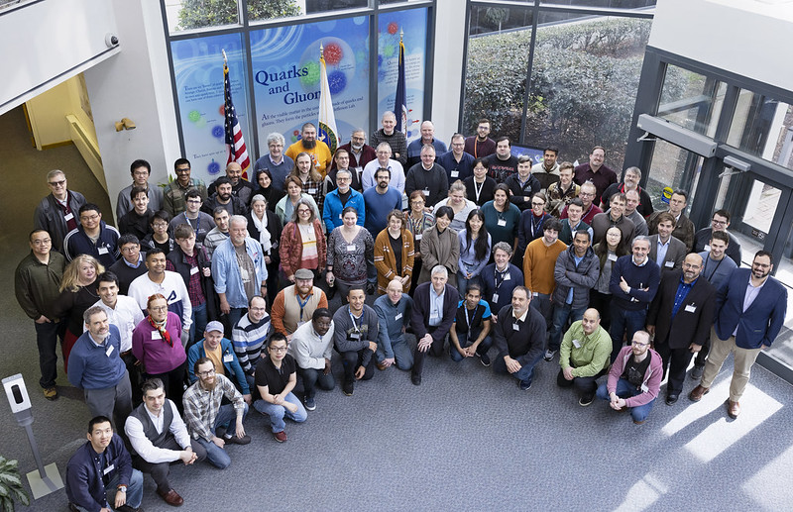




The ePIC Collaboration
173 (Dec. 2023)
160 institutions (April 2023)
24 countries
A truly global pursuit for the first experiment at the EIC!
Gangneung-Wonju National University
Hanyang University
Karlsruhe (ADL)
Nara Women’s University
NASA Goddard
Oklahoma State
Sungkyunkwan University
The Ohio State
University of Debrecen
University of Liverpool
University of Seoul
University of Tokyo (CNS)
Yonsei University
Notes:
24 countries total

Slide 4
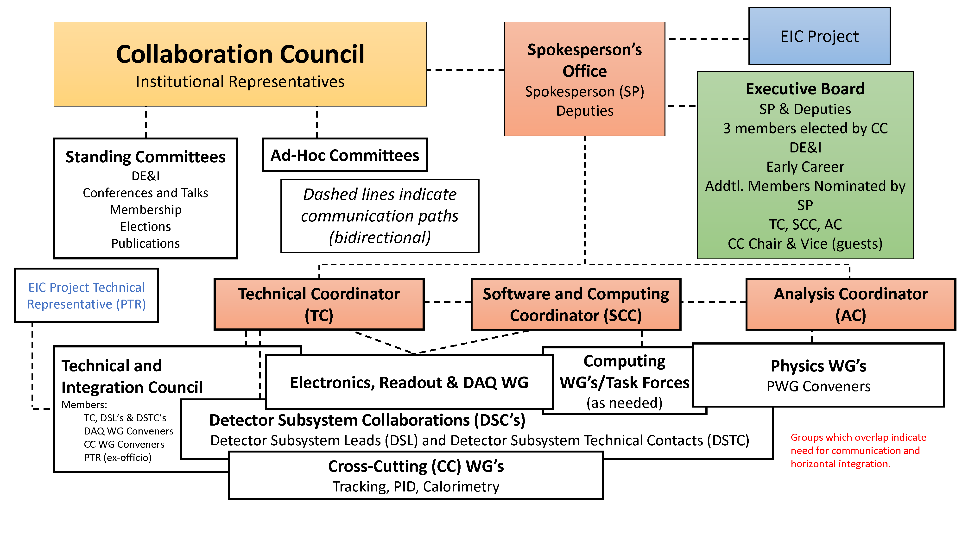
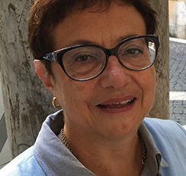

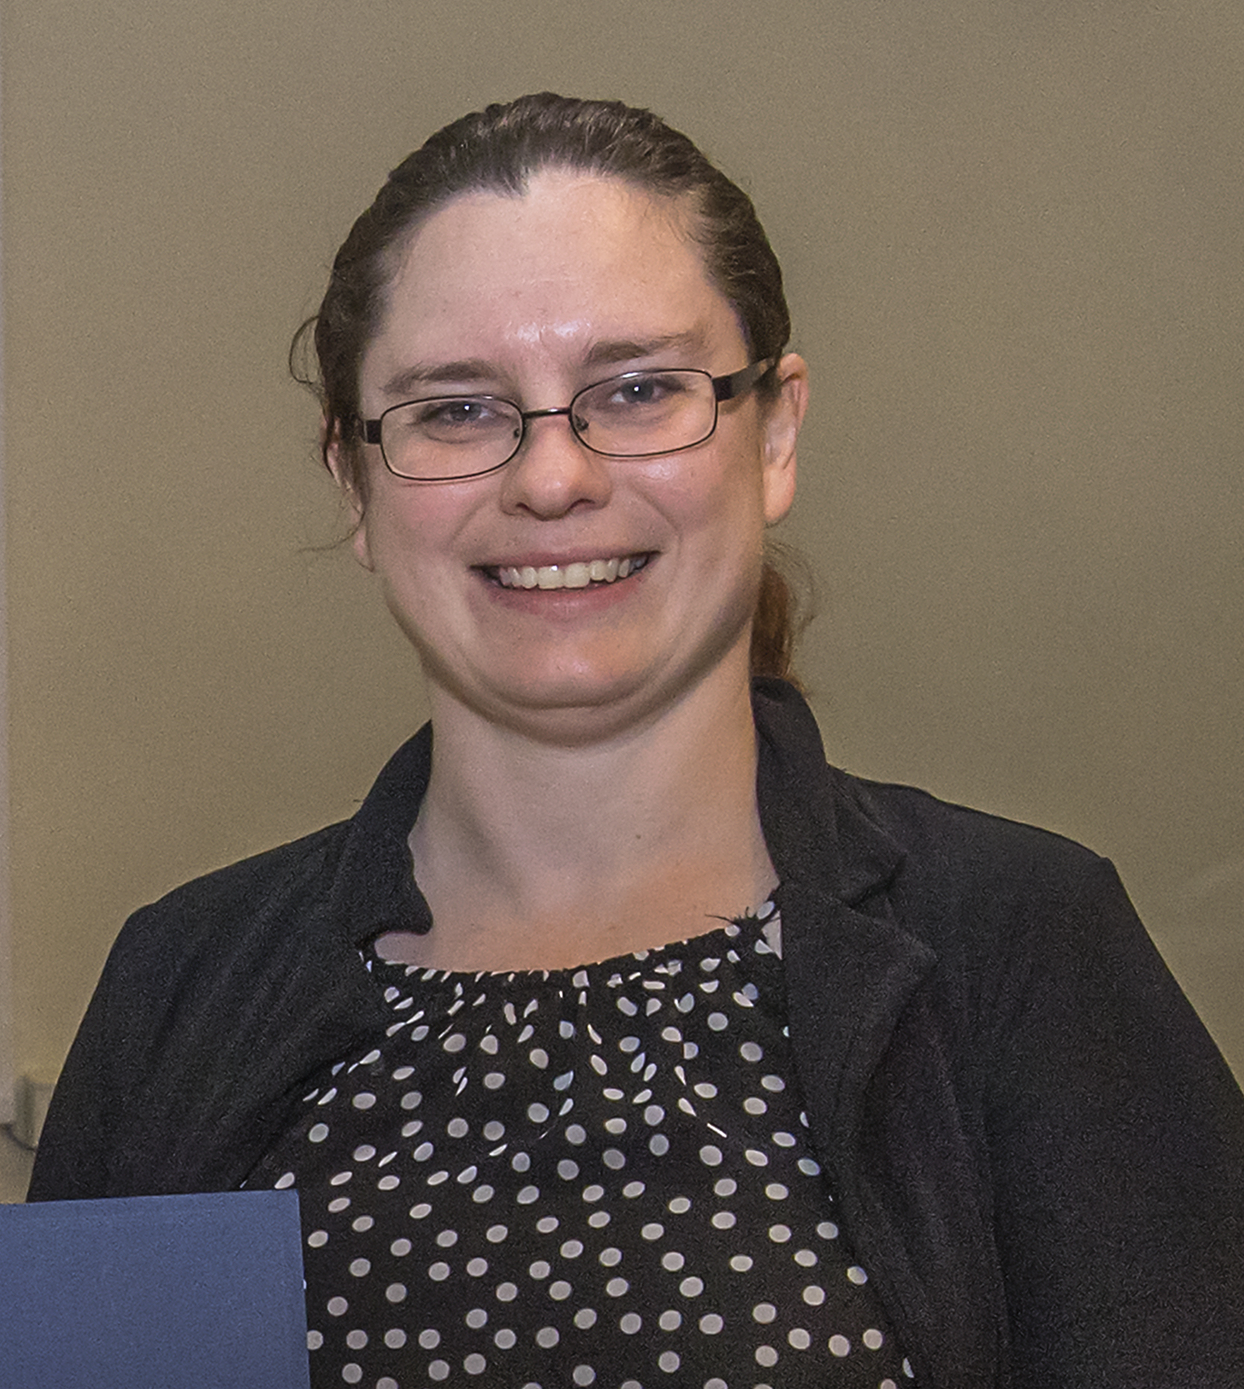
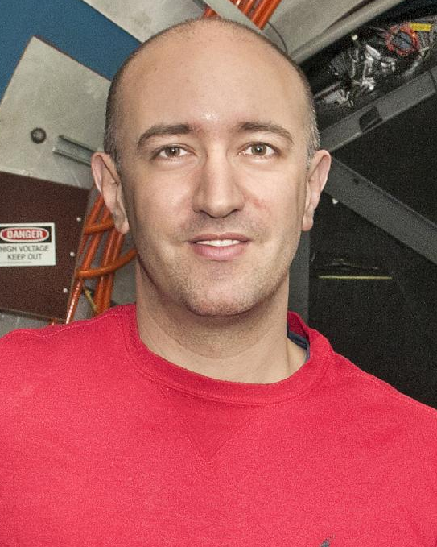
ePIC Collaboration Structure
Technical Coordinator (Acting)
• Silvia Dalla Torre (INFN)
Deputy TC’s: Prakhar Garg (Yale) Oskar Hartbrich (ORNL) Matt Posik (Temple)
SCC Coordinator
• Markus Diefenthaler (JLab)
• Wouter Deconinck
(U. of Manitoba, Deputy SCC for Operations)
• Sylvester Joosten
(ANL, Deputy SCC for Development)
• Torre Wenaus
(BNL, Deputy SCC for Infrastructure)
Analysis Co-Coordinators
• Rosi Reed (Lehigh Univ.)
• Salvatore Fazio (Univ. Calabria)

Slide 5
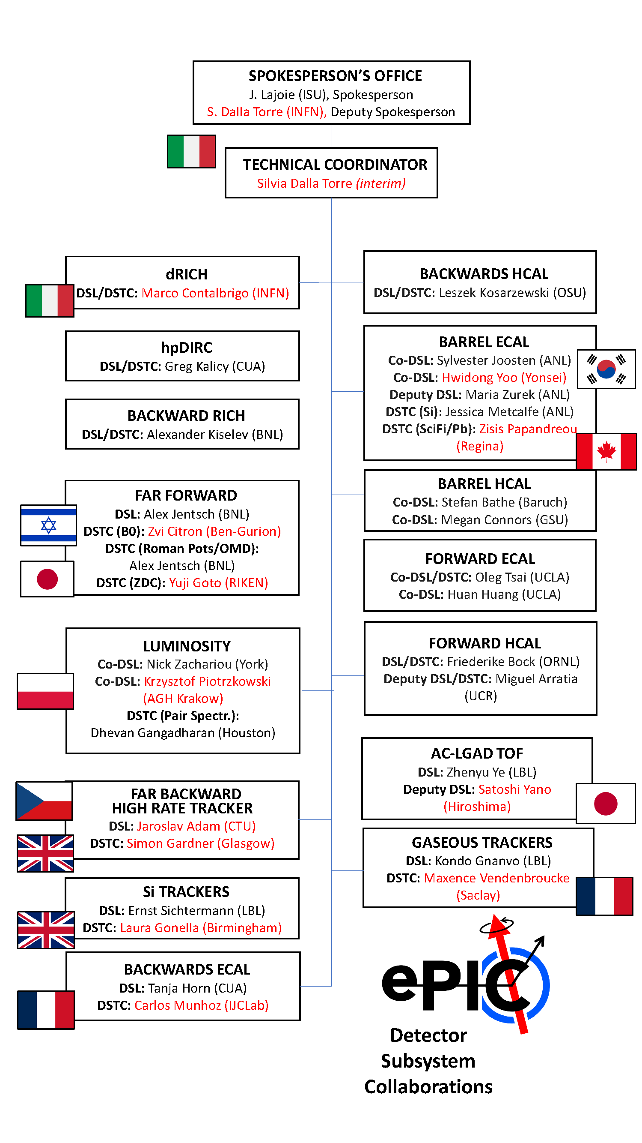
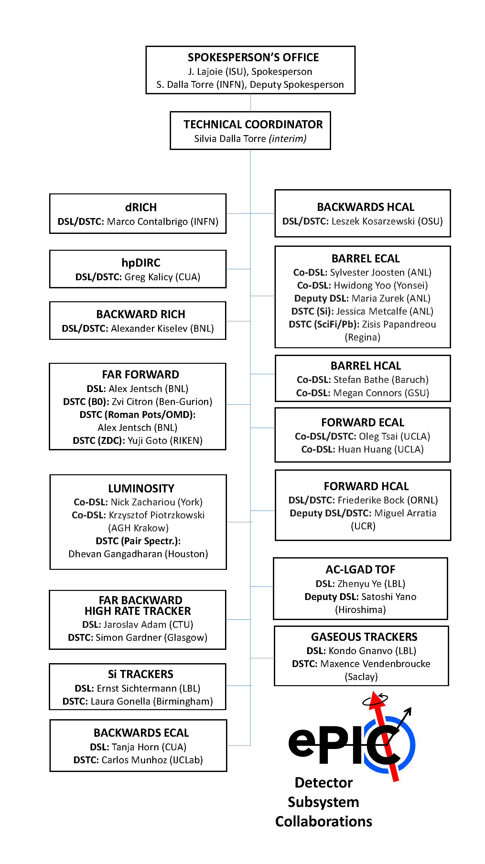
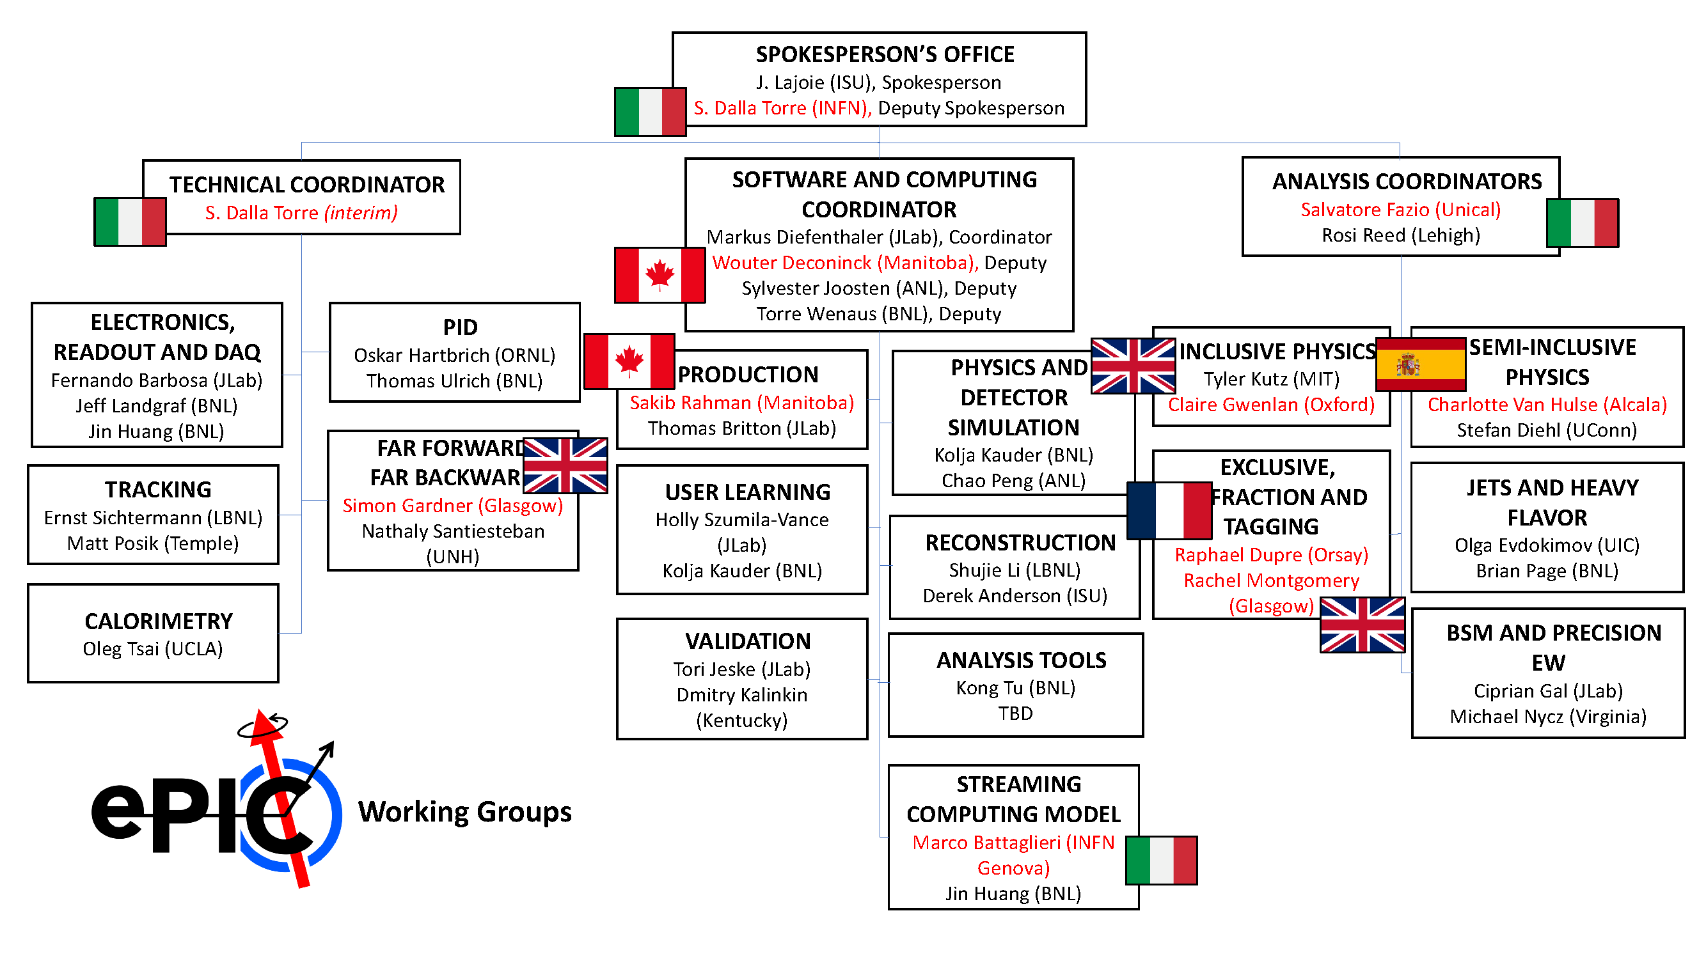
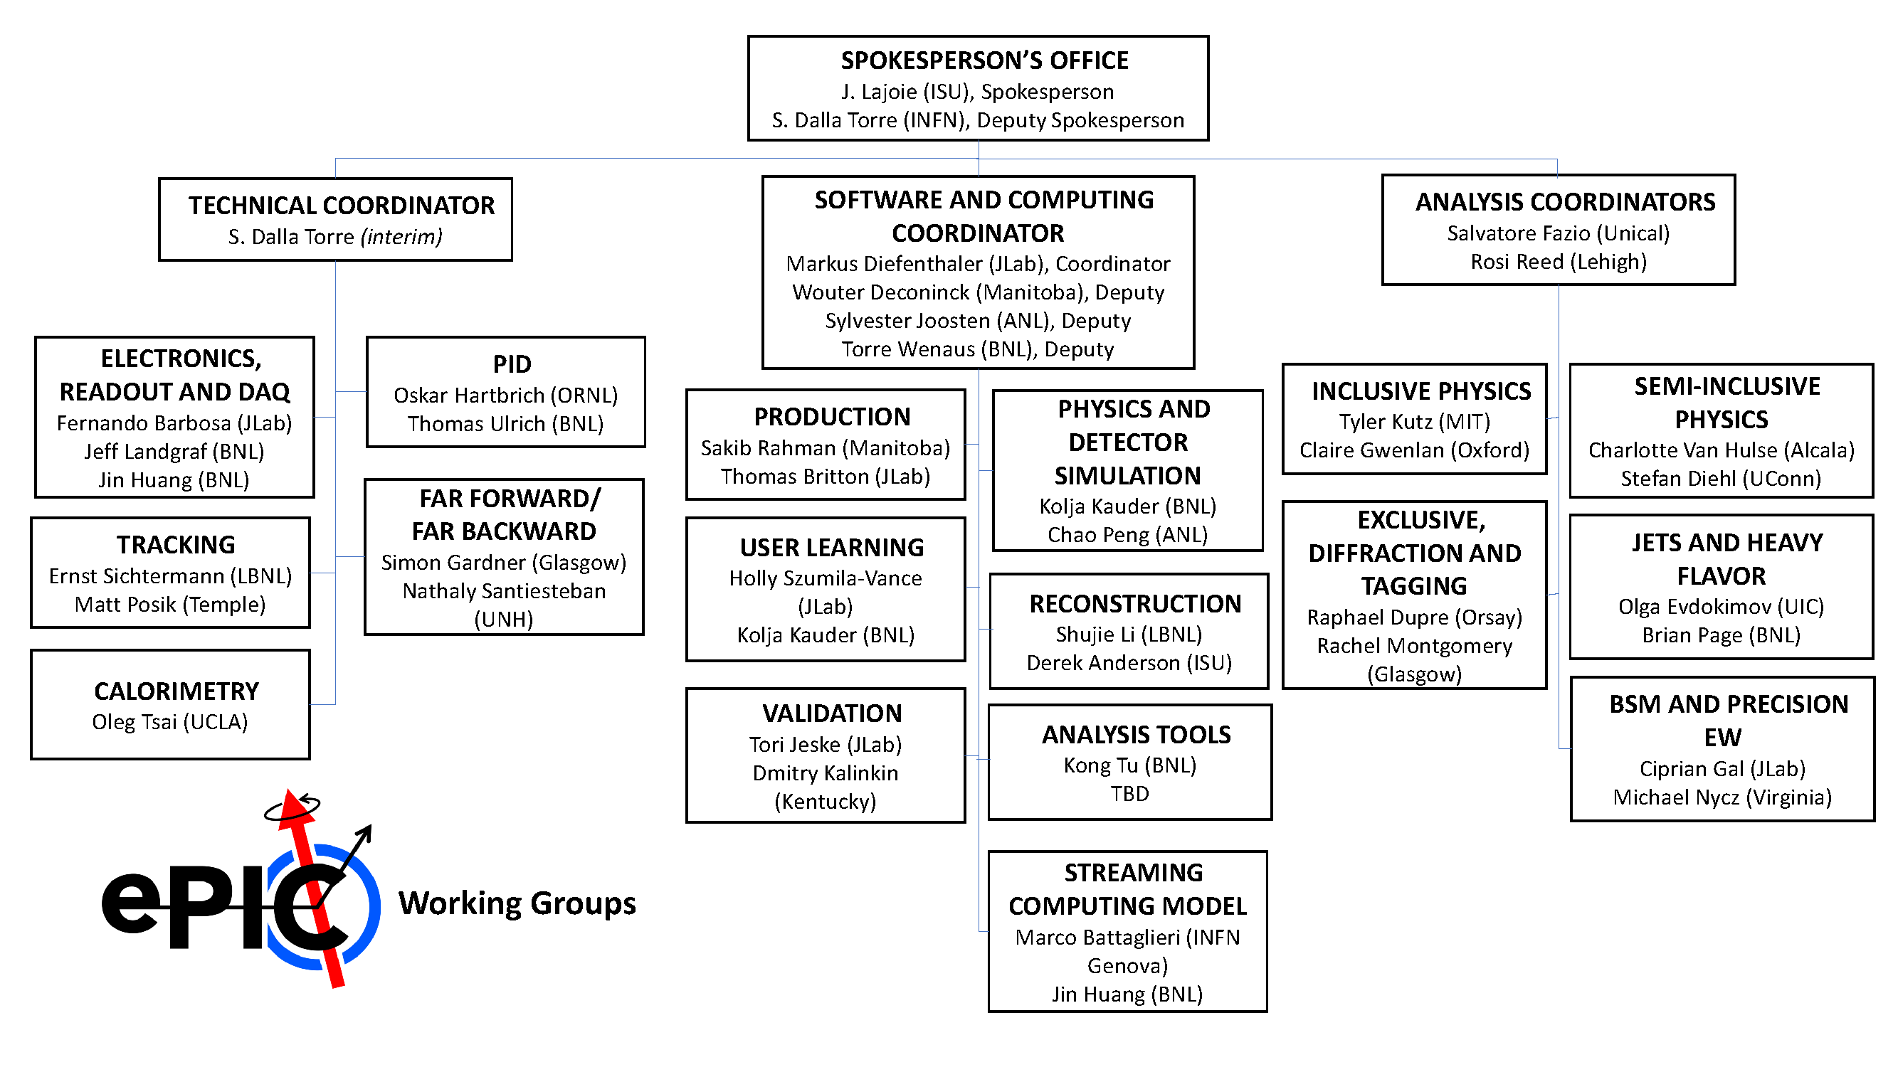
ePIC Collaboration Structure

Slide 6





Newly Formed ePIC Committees
Committee Chair/Vice-Chair elected by Collaboration Council.
Chair/Vice-Chair propose committee membership, endorsed by CC vote.
Collaboration Council
Institutional Representatives
Elections Committee:
Chair: John Arrington (LBL)
Helen Caines (Yale), Or Hen (MIT),
Domenico Elia (INFN)
Standing Committees
DE&I
Conferences and Talks
Membership
Elections
Publications
Ad-Hoc Committees
Membership Committee:
Chair: Peter Steinberg (BNL)
Vice-Chair: Pietro Anontioli (INFN-Bologna)
Friederike Bock (ORNL), Helen Caines (Yale), Doug Higinbotham (JLab), Bedhangas Moharty (NISER), Silvia Niccolai (IJCLAB), Marzia Rosati (ISU)
Conferences and Talks:
Chair: Maria Zurek (ANL)
Vice-Chair: Brain Page (BNL)
Barbara Jacak (Berkeley), Daniel Brandenburg (OSU), Dmitry Kalinkin (Kentucky), Nick Zachariou (York), Xuan Li (LANL), Nicola Rubini (Bologna), Wouter Deconinck (Manitoba)
DE&I Committee:
Chair: Megan Connors (GSU)
Vice-Chair: Christine Nattrass (UTK)
committee formation underway
Publications Committee:
Chair: Rene Bellwied (U. Houston)
Vice –Chair: Annalisa Mastroserio (INFN Bari)
committee formation underway

Slide 7

ePIC Executive Board
Spokesperson’s Office
Spokesperson (SP)
Deputies
Executive Board
SP & Deputies
3 members elected by CC
DE&I
Early Career
Addtl. Members Nominated by SP
TC, SCC, AC
CC Chair & Vice (guests)
The EB provides input to the Spokespersons on physics policy, instrumentation choices, and candidate suggestions for leadership positions. In addition to the 3 at-large members who will be elected by the Collaboration Council (CC), two members will be selected by the early-career group and the DEI committee. The Spokespersons can appoint additional members after endorsement by the CC. It is expected that top level activity coordinators will be members of the EB.
"From the perspective of the Spokesperson, it is essential to have an advisory body that represents the breadth of the collaboration that can be consulted on a regular basis. The real benefit comes when facing major decisions or crises – the Executive Board guarantees that the Spokesperson will receive recommendations and advice that enables a consideration of all perspectives within the collaboration. An Executive Board can help support the Spokesperson’s office by endorsing decisions after careful consideration, or more importantly, forcing the Spokesperson’s office to adequately consider aspects that might not have been part of their original considerations.
From the perspective of the Collaboration, it creates a body where the membership is known and deliberately balanced by the CC process and the SP nominations. The Collaboration knows who is on the Executive Board and advising the Spokesperson’s Office on key decisions, which provides transparency. Of course, major decisions (like technology selections) will go before the CC for endorsement, but whatever is brought before the CC must be well considered and worked out beforehand. The Executive Board is key to that process.”
At-large members:
Barbara Jacak (Berkeley), Taku Gunji (Tokyo),
Paul Newman (U. of Birmingham)
DEI member: Megan Connors (GSU)
Early Career member: Fernando Flor (Yale U.)
Top level coordinators: Markus Diefenthaler (JLab), Salvatore Fazio (Calabria), Rosi Reed (Lehigh U.), TC (vacant)
CC chair and vice-chair (non-voting): Ernst Sichtermann (LBNL), Bernd Surrow (Temple U.)
First EB Meeting Nov. 17th, planning to meet ~monthly

Slide 8








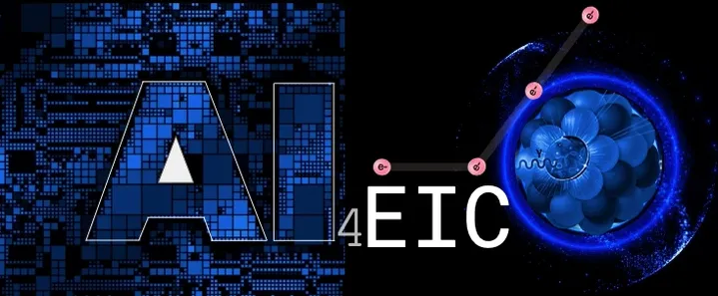


ePIC Conference Presentations
A selection of ePIC presentations at conferences in the past year:
10TH WORKSHOP OF THE APS TOPICAL GROUP ON HADRONIC PHYSICS
SESAPS 2023: invited talk
HP 2023: invited talk
Three invited talks
GHP 2023: invited talk
2nd workshop on advancing the understanding of non-perturbative QCD using energy flow
Forward Physics and QCD at the LHC and the EIC - 798 WE-Heraeus Seminar
DIS 2023: two invited talk, five contributed
invited talk
Spin 2023: two invited talks
Keynote, plenary and five contributed
invited talk
One invited, two contributed
invited talk
Multiple contributed, posters
Six contributed talks
AI4EIC: four talks
EPIPHANY 2023: two invited talks

Slide 9
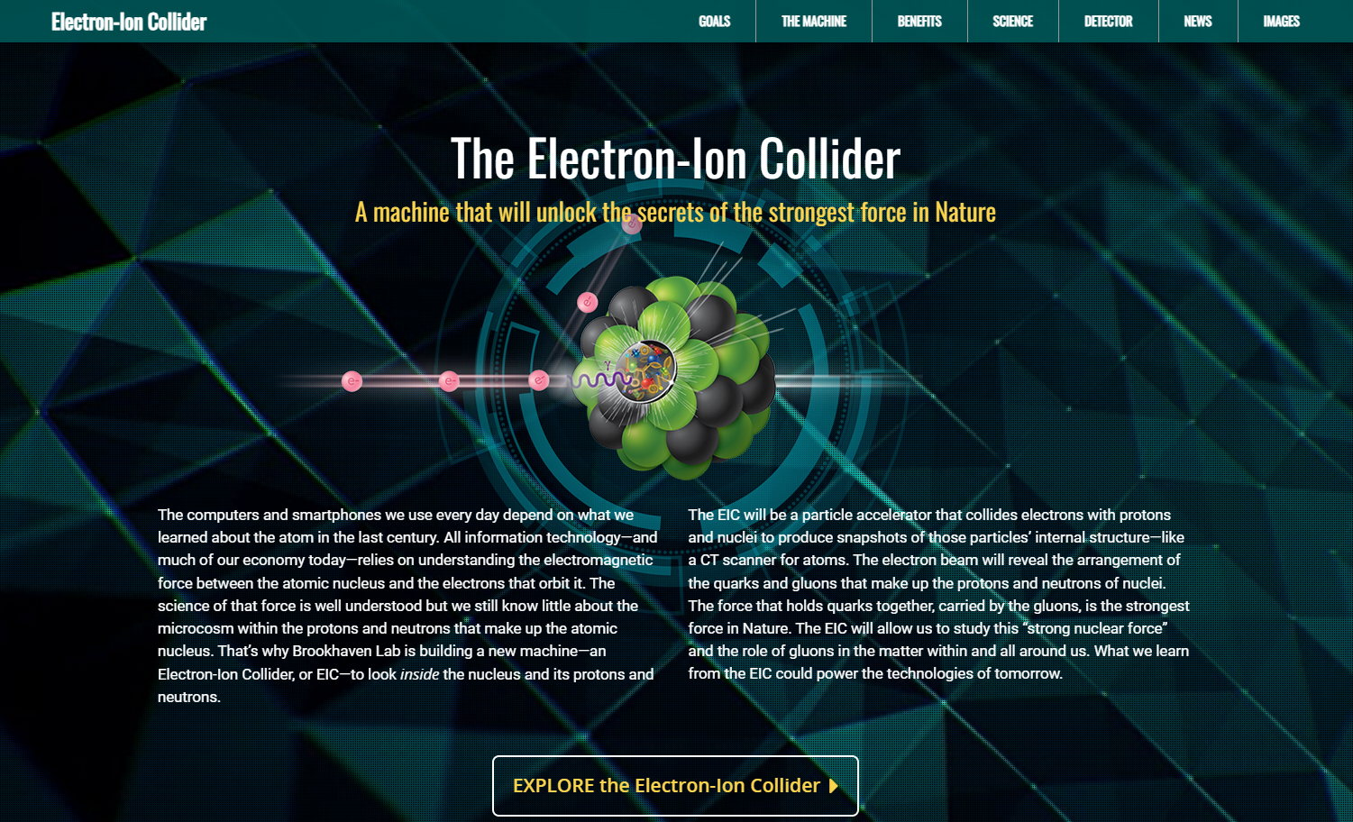
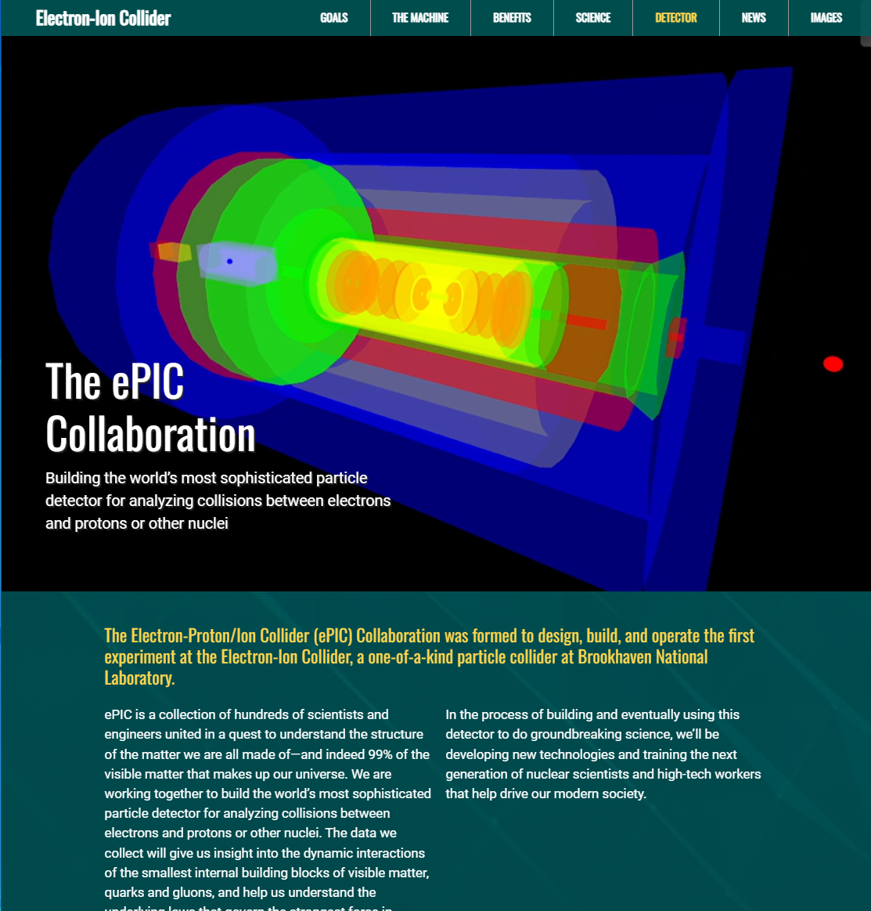
ePIC Collaboration Web Presence
Integrated into the main EIC website through the top navigation. Page contains contact information and link to the ePIC Wiki.
Gary Schroeder, Karen McNulty Walsch, Thomas Ullrich, JGL
Animations courtesy of UC Riverside group.
Continuing to update and improve.
https://www.bnl.gov/eic/epic.php

Slide 10
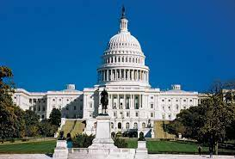
Streaming Computing Model Review
Review held Oct 19-20th, SURA HQ in Washington D.C.
Called by David Dean and Haiyan Gao
At this stage, approximately ten years prior to data collection, is there a comprehensive and cost-effective long-term plan for the software and computing of the experiment?
Are the plans for integrating international partners' contributions adequate at this stage of the project?
Are the plans for software and computing integrated with the HEP/NP community developments, especially given data taking in ten years?
Are the resources for software and computing sufficient to deliver the detector conceptional and technical design reports?
Are the ECSJI plans to integrate into the software and computing plans of the experiment sufficient?
EIC Computing and Software Advisory Committee (ECSAC)
Mohammad Al-Turany (GSI)
David Brown (LBNL)
Simone Campana (CERN)
Pere Mato (CERN)
Christoph Pauss (MIT)
Heidi Schellman (UOregon)
Frank Wuerthwein (UCSD)

Slide 11

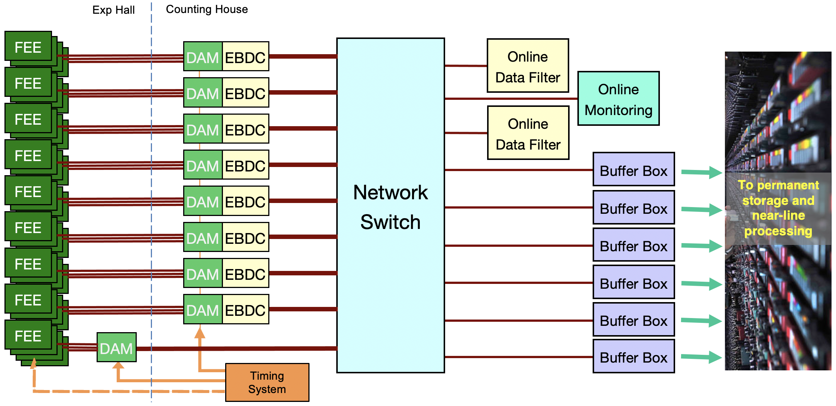
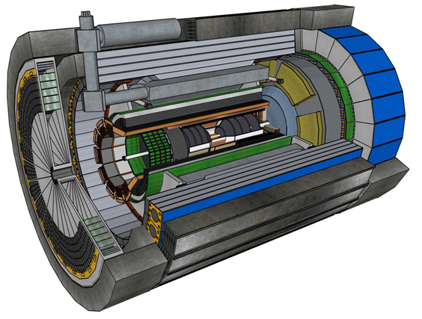
ePIC Streaming DAQ
Bunch Crossing ~ 10.2 ns/98.5 MHz
Interaction Rate ~ 2 μs/500 kHz
Low occupancy
RDO
More on this in the talk from Markus…
No External trigger
All collision data digitized but aggressively zero suppressed at FEB
Low / zero deadtime
Event selection can be based upon full data from all detectors (in real time, or later)
Collision data flow is independent and unidirectional-> no global latency requirements
Avoiding hardware trigger avoids complex custom hardware and firmware
Data volume is reduced as much as possible at each stage ensuring that biases are controlled
RDO
RDO
RDO
ePIC DETECTOR
RDO
The Streaming Computing Model review is the first major review for the ePIC collaboration.
RDO
RDO
BW O(100Gbps)
RDO
RDO
GTU/Distributed clock
(jitter ~5ps)

Slide 12


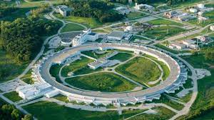
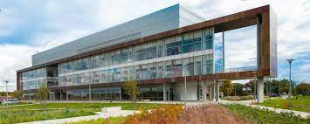
Jan 2024 ePIC Collaboration Meeting
Jan 9-13th, 2024 @ ANL
Three days of parallel workfests followed by two days of plenary sessions:
https://indico.bnl.gov/event/20473/
Strongly encouraging participation, especially by early-career scientists
Student support available
Updates and status reports
Discussion of ePIC strategy for 2024

Slide 13
TDR Strategy and Publications
In 2024 the ePIC collaboration will produce:
An ePIC Detector Design paper:
Derived and expanded from the Experimental Systems TDR chapter
An ePIC Physics Performance paper:
Derived and expanded from the Physics Goals and Requirements TDR chapter
Both to be published in a scientific journal (such as NIMA, JINST, or PRC)
These publications will serve as a focus in developing the ePIC Membership and Publication policies.
In 2024 the ePIC collaboration will produce:
The ePIC contributions to the EIC TDR
The EIC TDR is the top priority
Chapters on Physics Goals and Requirements and Experimental Systems
Not just the document, but the simulations and detector R&D that form the basis
Requires close cooperation between the collaboration and the project!
This strategy will be a focus of discussion and be refined at the Jan 2024 collaboration meeting.
More on this in Silvia’s talk…
process design phase
structuring the
effort
finalizing EIC TDR
Preparing papers for
publication
writing
(TDR/notes)
Mid Jan.24
End Sep.24
End Dec.24
Mid Mar.24
End July 24

Slide 14
Broadening Engagement in ePIC
Engagement is a primary focus for ePIC leadership:
ePIC as a collaboration must be a welcoming environment for people to pursue their science
Emphasis on opportunities for professional development (Deputies, WG conveners)
Structure collaboration meetings to enable new members, foster connections and collaboration
Articulate clear plans and goals to the collaboration (TDR strategy)
Fostering a collaboration culture where contributions are recognized through opportunities
ePIC advocates for resources for research groups (lab and university)
Communicate to funding agencies the need to support efforts in ePIC/EIC
ePIC actively works to engage new collaborators
Added thirteen new institutions in the past year

Slide 15
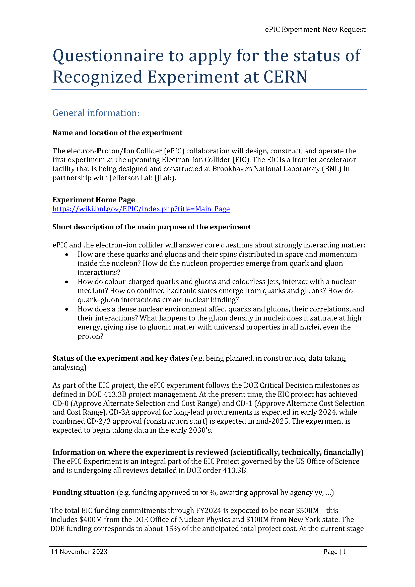
CERN Recognized Experiment
ePIC Application for CERN Recognized Experiment:
ePIC leadership has submitted an application to become a CERN Recognized Experiment
Strong synergies between CERN and EIC
Important for access to CERN resources (test beams, …)
Increase visibility in the European community

Slide 16
Take-Away Messages
The ePIC Collaboration is strong, active and growing!
Thirteen new member institutions bring new strengths
International participation is key to the success of ePIC!
International collaborators play key roles in collaboration leadership
Collaboration committees are formed and starting to work
A comprehensive strategy to tackle the challenges of 2024 is being developed
ePIC leadership is focused on improving engagement
The ePIC detector is maturing into a detailed technical design tuned to pursue the EIC science program
More on this in Silvia’s report
The Streaming Computing Model is evolving
More on this in Markus’ talk

Slide 17


Slide 18
ePIC Meetings in 2024
ePIC Collaboration Meeting (ANL)
Jan 9-13, 2024
3rd EIC-Asia Meeting (Taiwan)
Jan 29-31, 2024
ePIC Software and Computing Meeting (CERN)
April 22nd-26th, 2024
Joint EICUG/ePIC Collaboration Meeting (Lehigh)
July 22-28, 2024
4th EIC-Asia Meeting (China)
Aug. 12-16th, 2024

Slide 19
Jan 2024 ePIC Meeting Workfests
Workshop Title | Organizers
Barrel ECAL DSC | Maria Zurek, Sylvester Joosten
SVT DSC | Laura Gonella, Ernst Sichtermann
Tracking | Ernst Sichtermann, Matt Posik
Jets & HF (Particle Flow) | Brian Page, Olga Evdokimov, Derek Anderson
Jets & HF (Vertex) | Brian Page, Olga Evdokimov, Shujie Li, Barak Schmookler
Streaming Computing Model / Electronics & DAQ | Fernando Barbosa, Jin Huang, Jeff Landgraf, Marco Battaglieri, Markus Diefenthaler
FFWD, FBKWD & Exclusive, Diffractive and Tagging, eA | Raphael Dupre, Rachel Montgomery, Alex Jentsch, Kong Tu, Simon Gardner, Nathaly Santiesteban, Dhevan Gangadharan, Nick Zachariou
Backgrounds | Kolja Kauder, Elke-Caroline Aschenauer, Shujie Li, Barak Schmookler
AC-LGAD DSC | Alessandro Tricoli, Alex Jentcsh, Wei Li, Zhenyu Ye
Common PID | Thomas Ullrich, Oskar Hartbrich
Software & Sim TDR Readiness | Markus Diefenthaler, Sylvester Joosten, Wouter Deconinck, Torre Wenaus

Slide 20
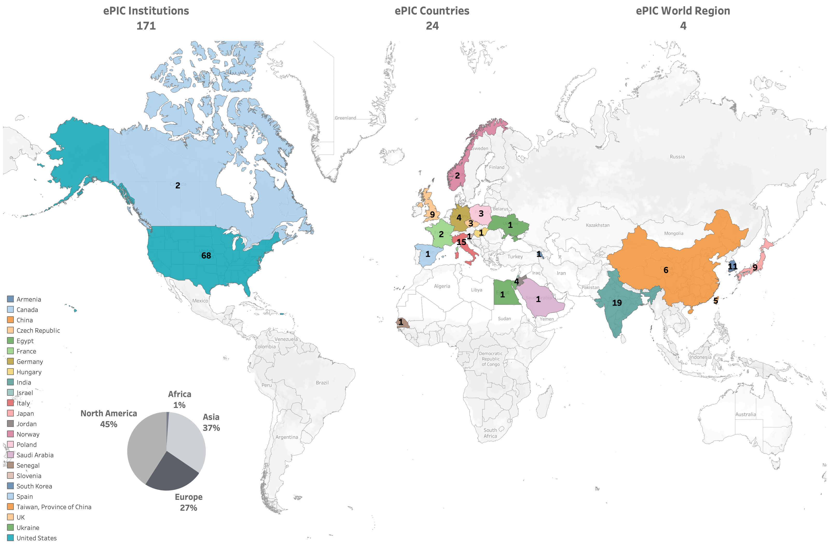
International
173

Slide 21
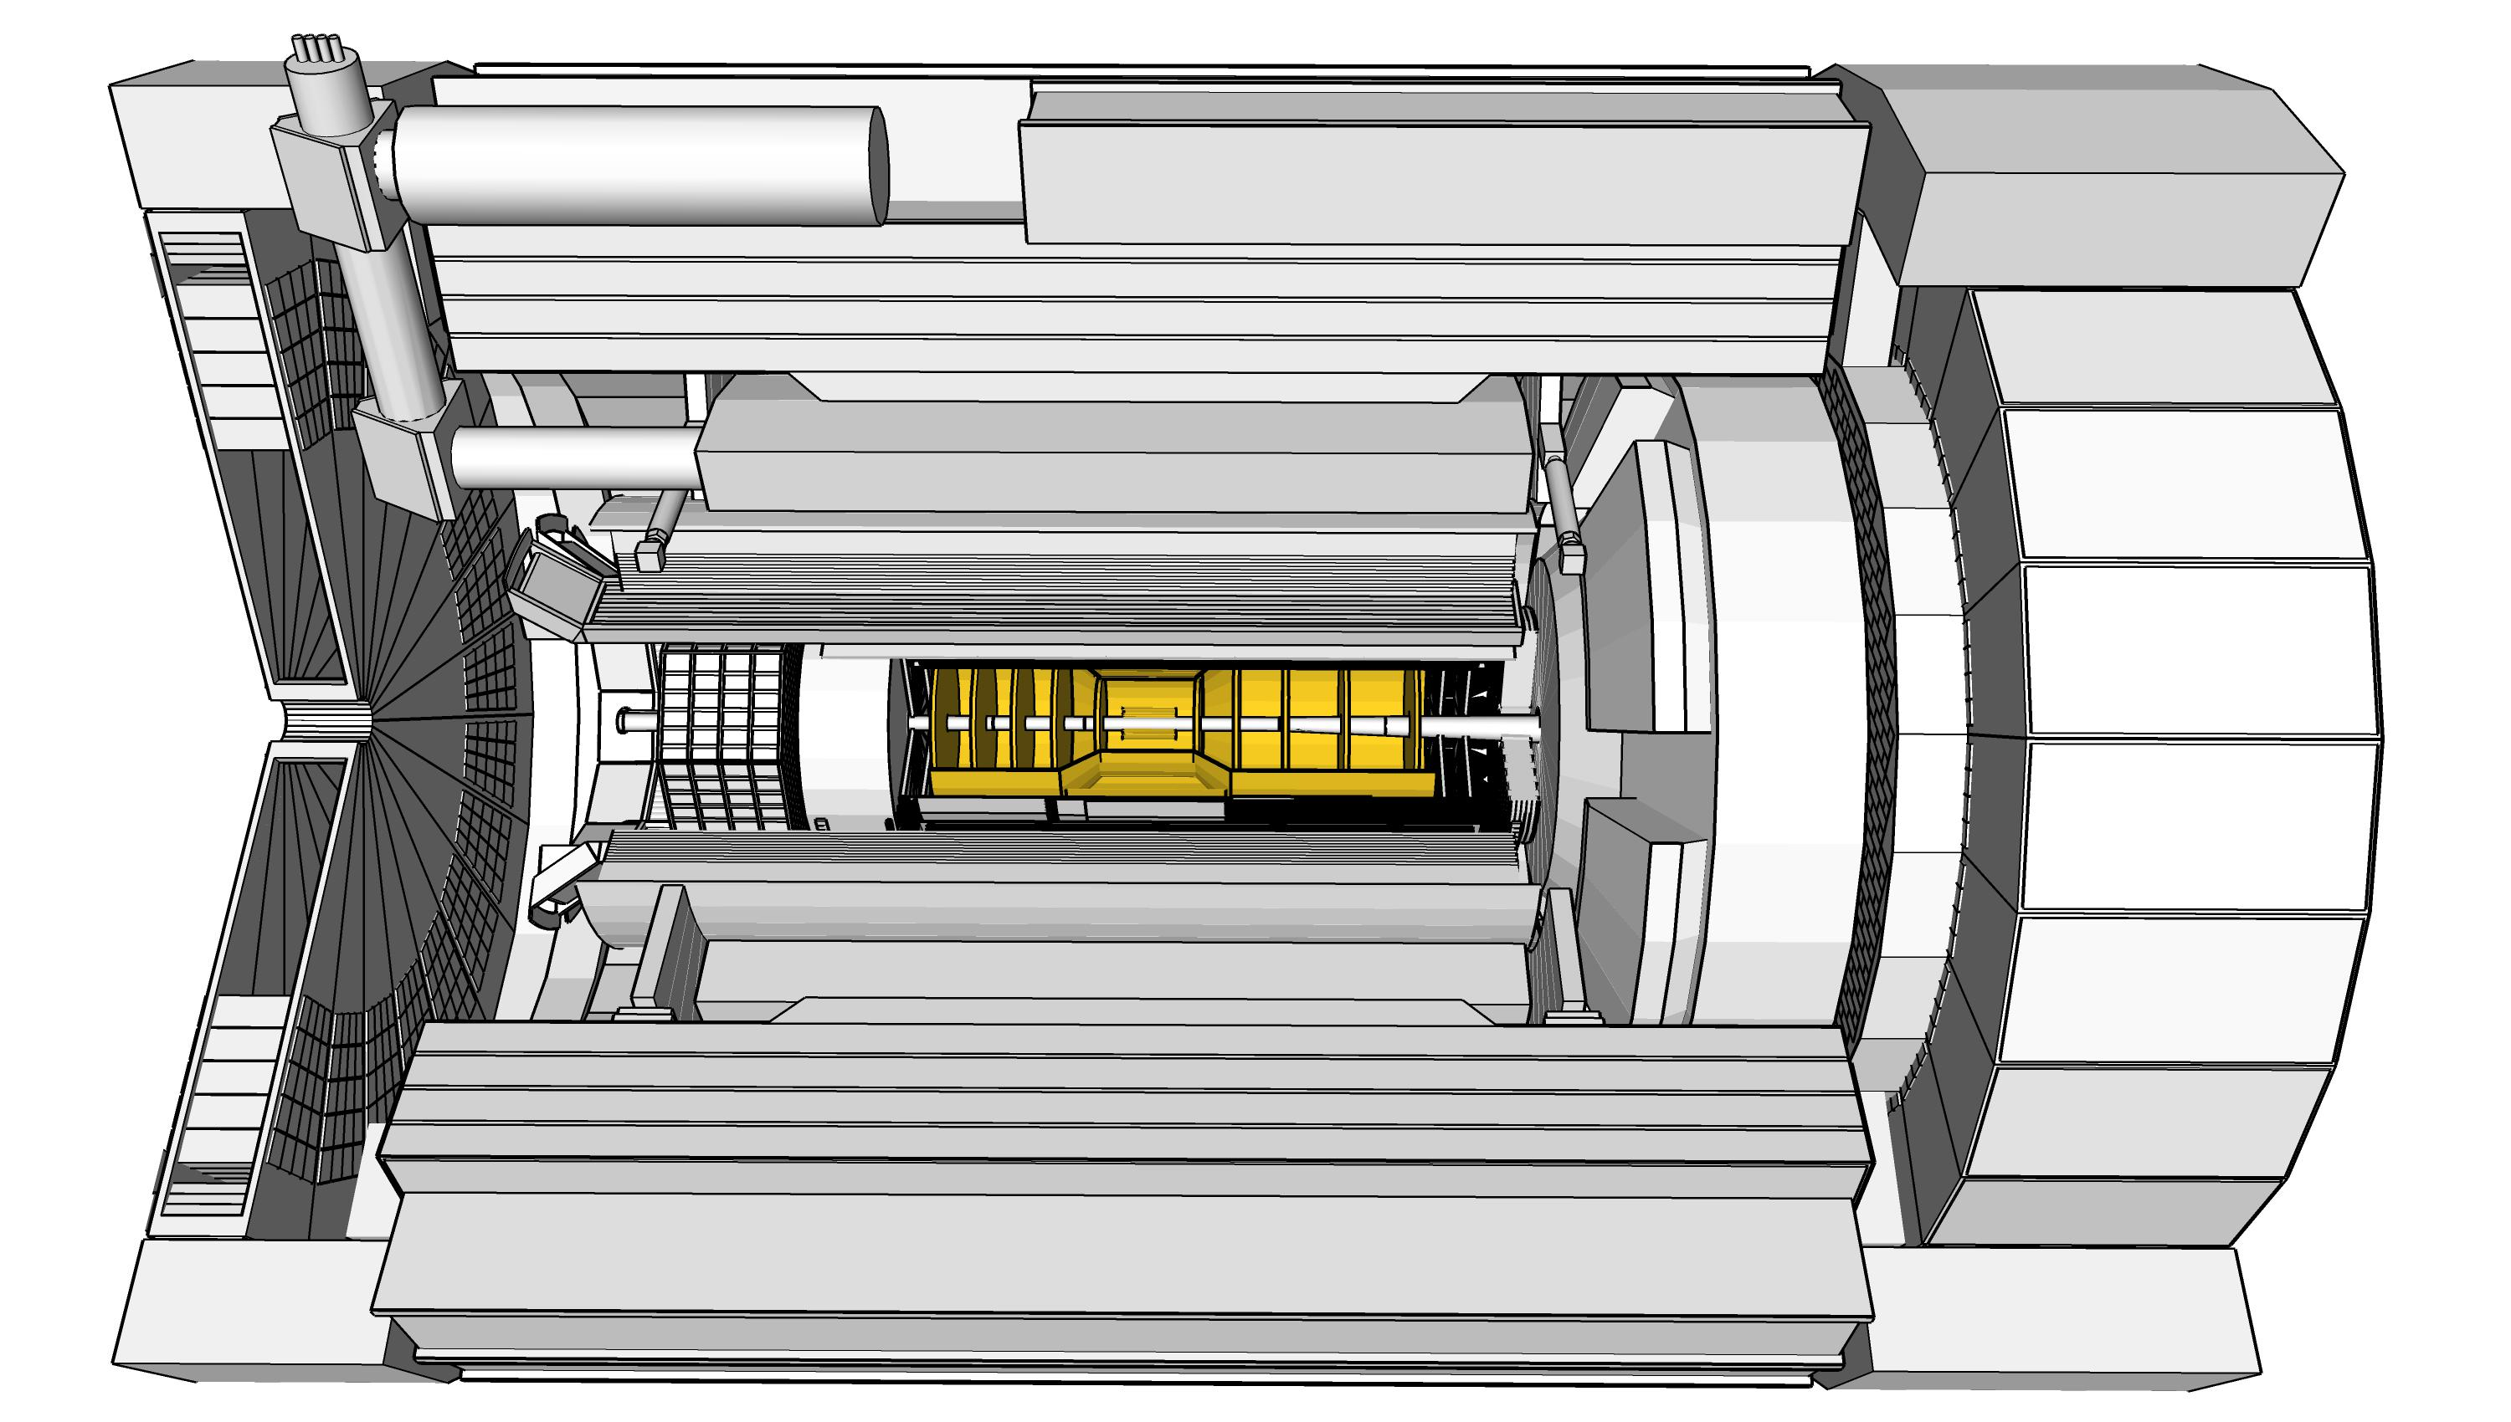
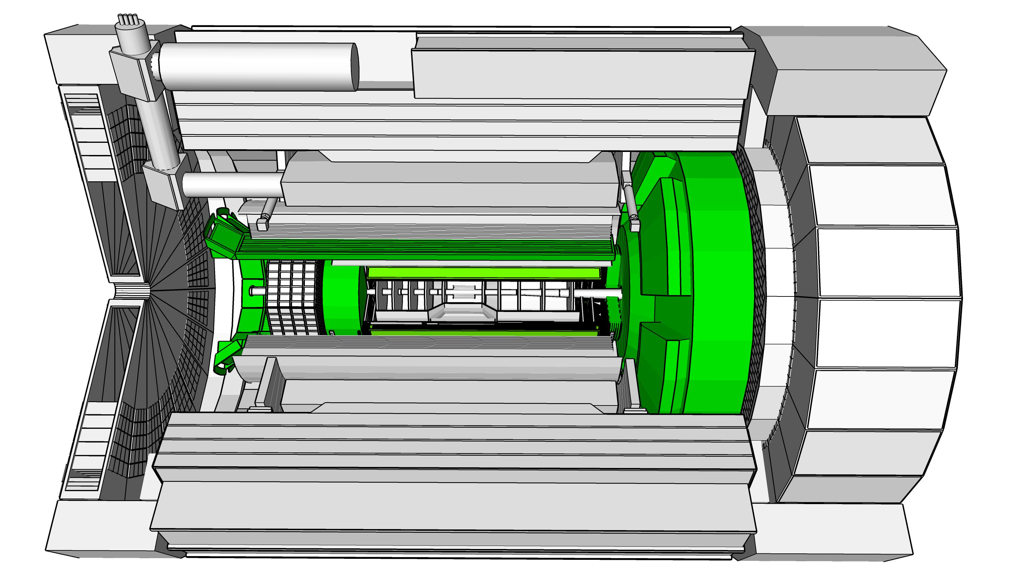
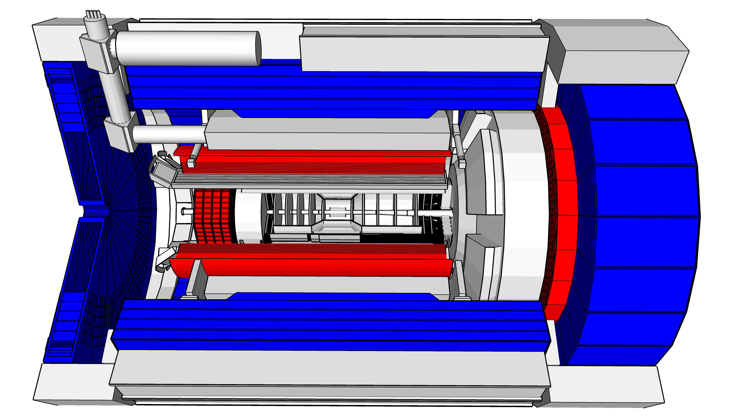
ePIC Detector Design
3.5m
η=0
5.0m
3.2m
Tracking:
New 1.7T solenoid
Si MAPS Tracker
MPGDs (μRWELL/μMegas)
PID:
hpDIRC
pfRICH
dRICH
AC-LGAD (~30ps TOF)
Calorimetry:
Imaging Barrel EMCal
PbWO4 EMCal in backward direction
Finely segmented EMCal +HCal in forward direction
Outer HCal (sPHENIX re-use)
Backwards HCal (tail-catcher)
5.34m
hadrons
electrons

Slide 22
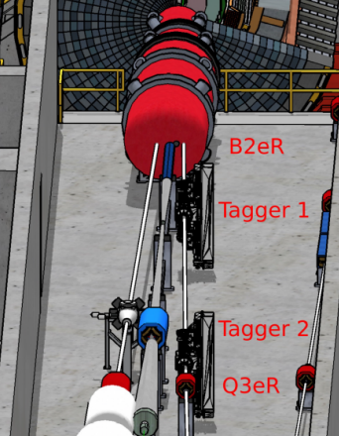
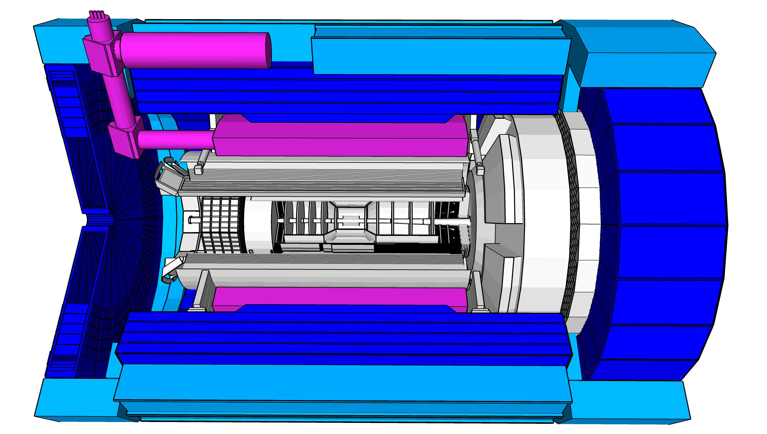
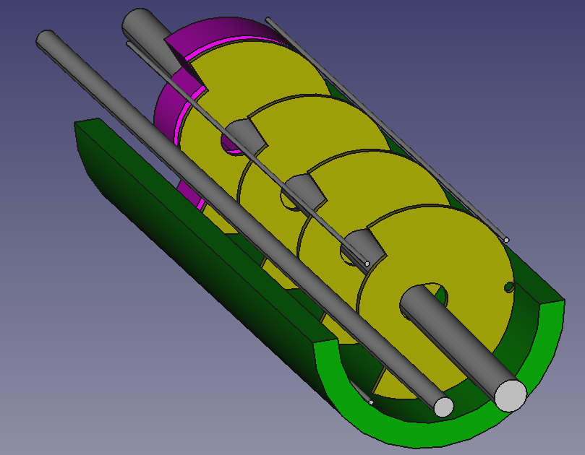
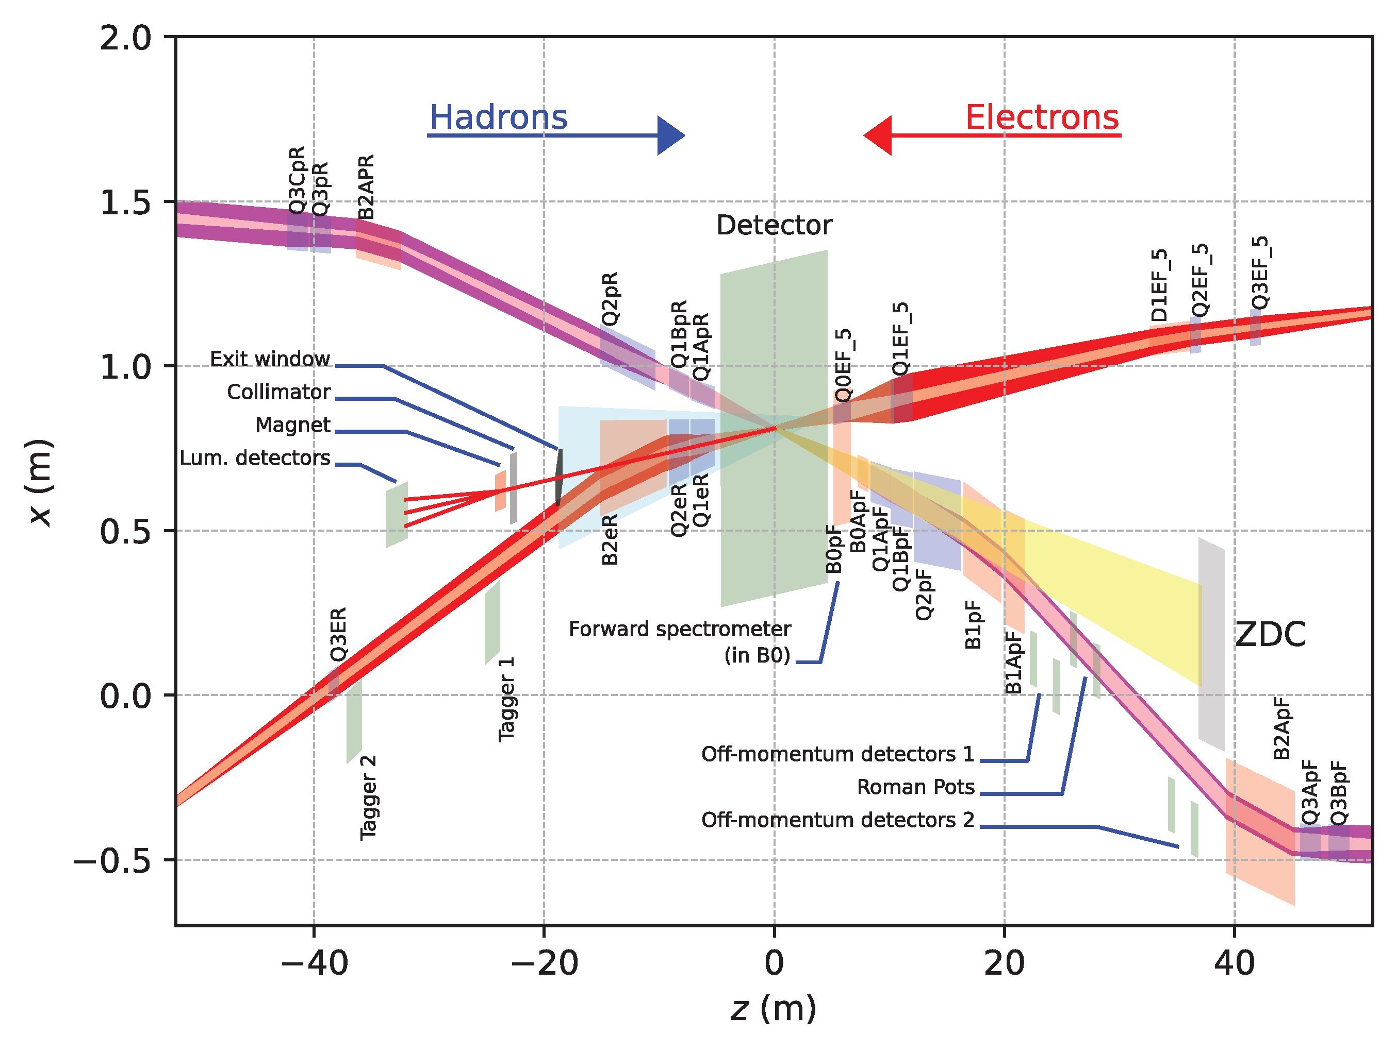
Far-Forward and Far-Backward Detectors
8.5m
PbW04 EMCAL
Si Tracking
Far-Backward Detectors
Luminosity monitor
Low-Q² Tagging Detectors
Far-Forward Detectors
B0 Tracking and Photon Detection
Roman Pots and Off-Momentum Detectors
Zero-Degree Calorimeter

Slide 23
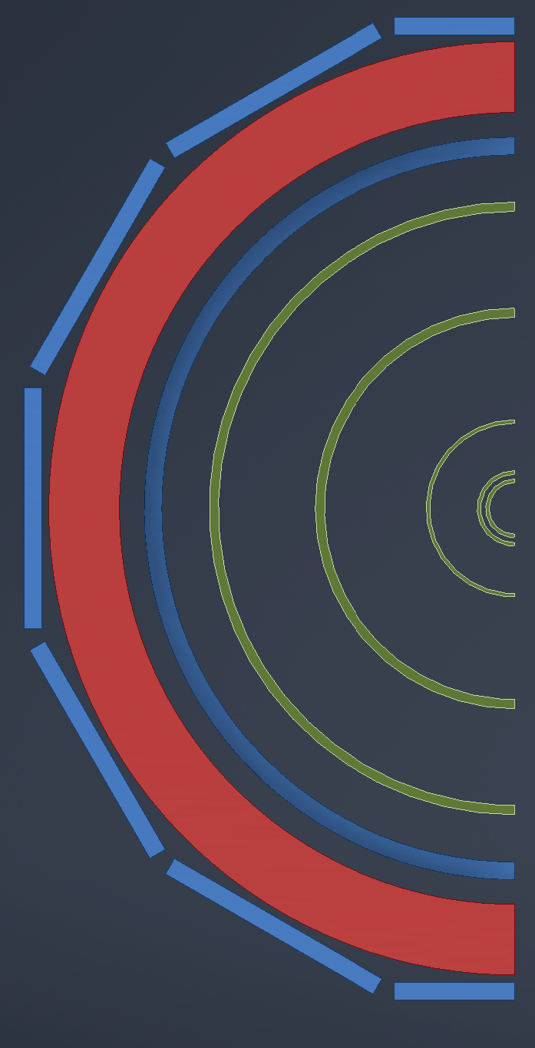

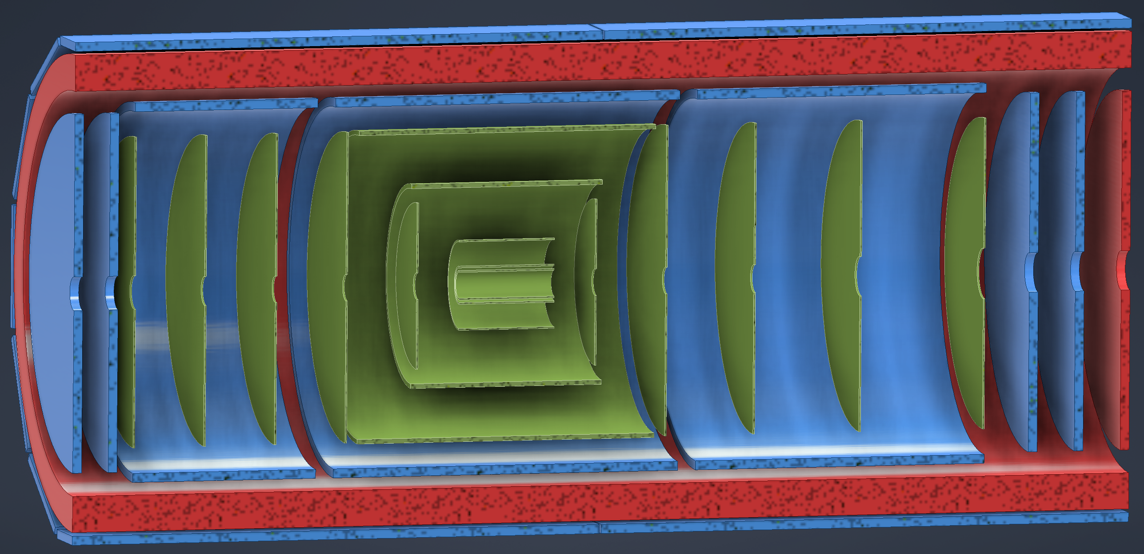
ePIC Tracking Detectors
MAPS Tracker:
Small pixels (20 μm), low power consumption (<20 mW/cm²) and material budget (0.05% to 0.55% X/X₀) per layer
Based on ALICE ITS3 development
Vertex layers optimized for beam pipe bakeout and ITS-3 sensor size
Barrel layers based on EIC LAS development
Forward and backwards disks
MPGD Layers:
Provide timing and pattern recognition redundancy
Cylindrical μMEGAs
Planar μRWell’s before hpDIRC
Impact point and direction for ring seeding
AC-LGAD TOF and AstroPix (BECAL)
Additional space point for pattern recognition / redundancy
world’s first
at
world’s first
at
MAPS Barrel + Disks
MPGD Barrels + Disks
AC-LGAD based ToF

Slide 24
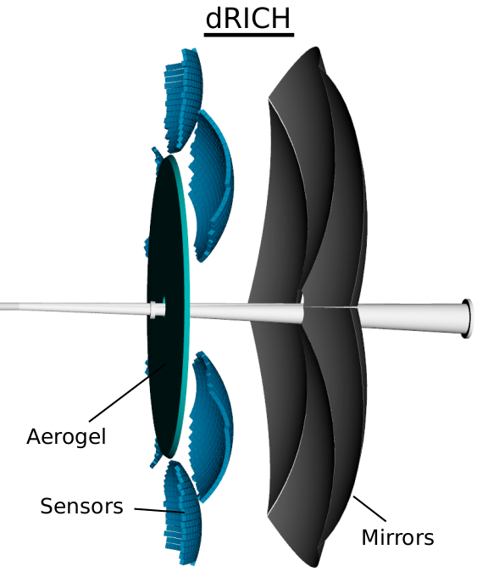
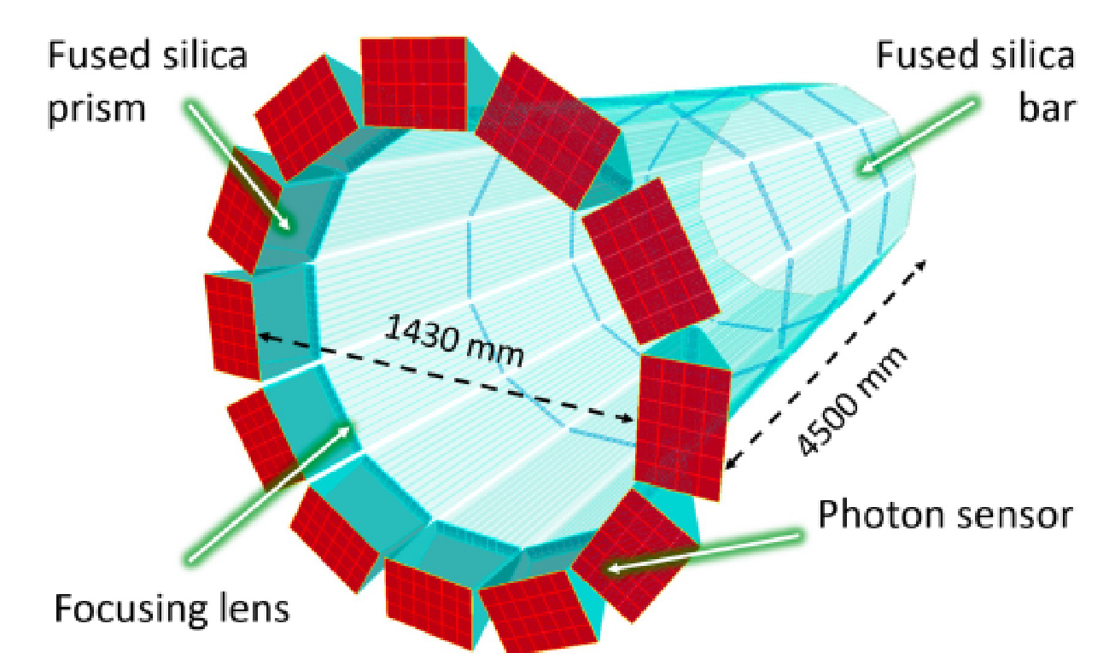
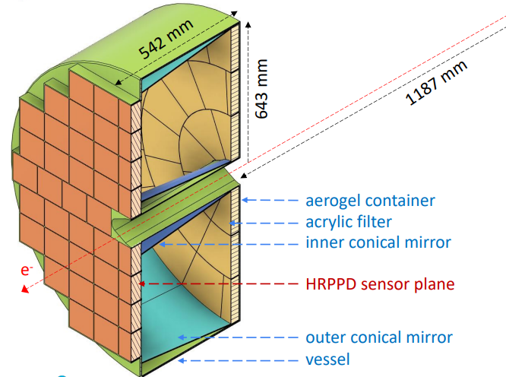
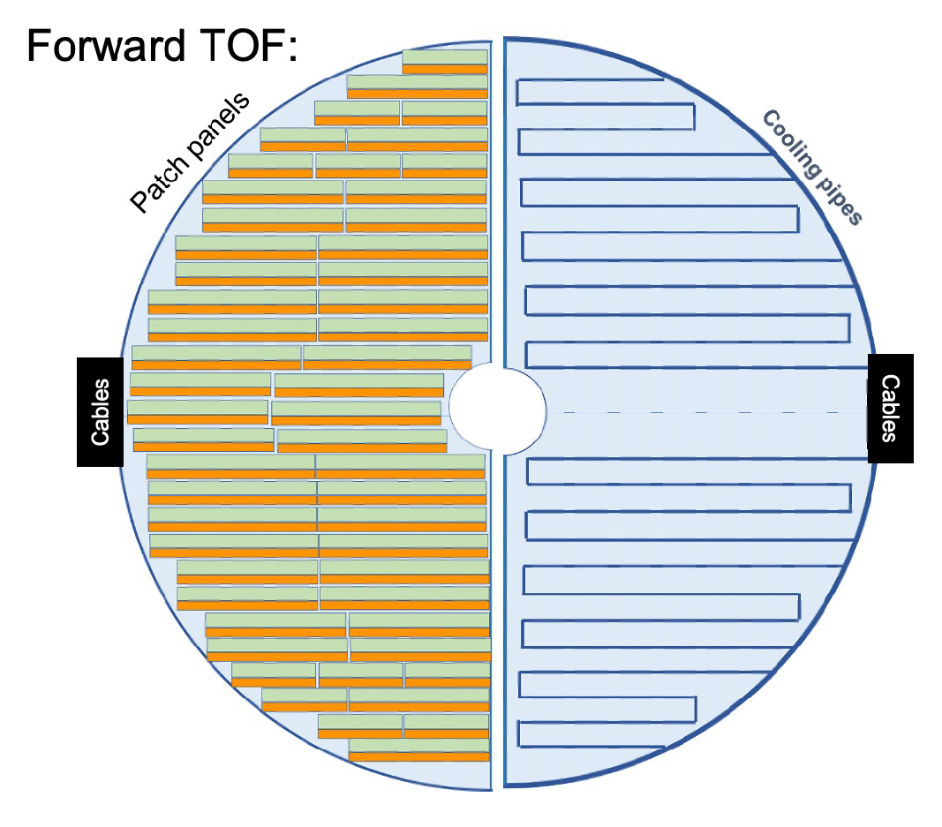
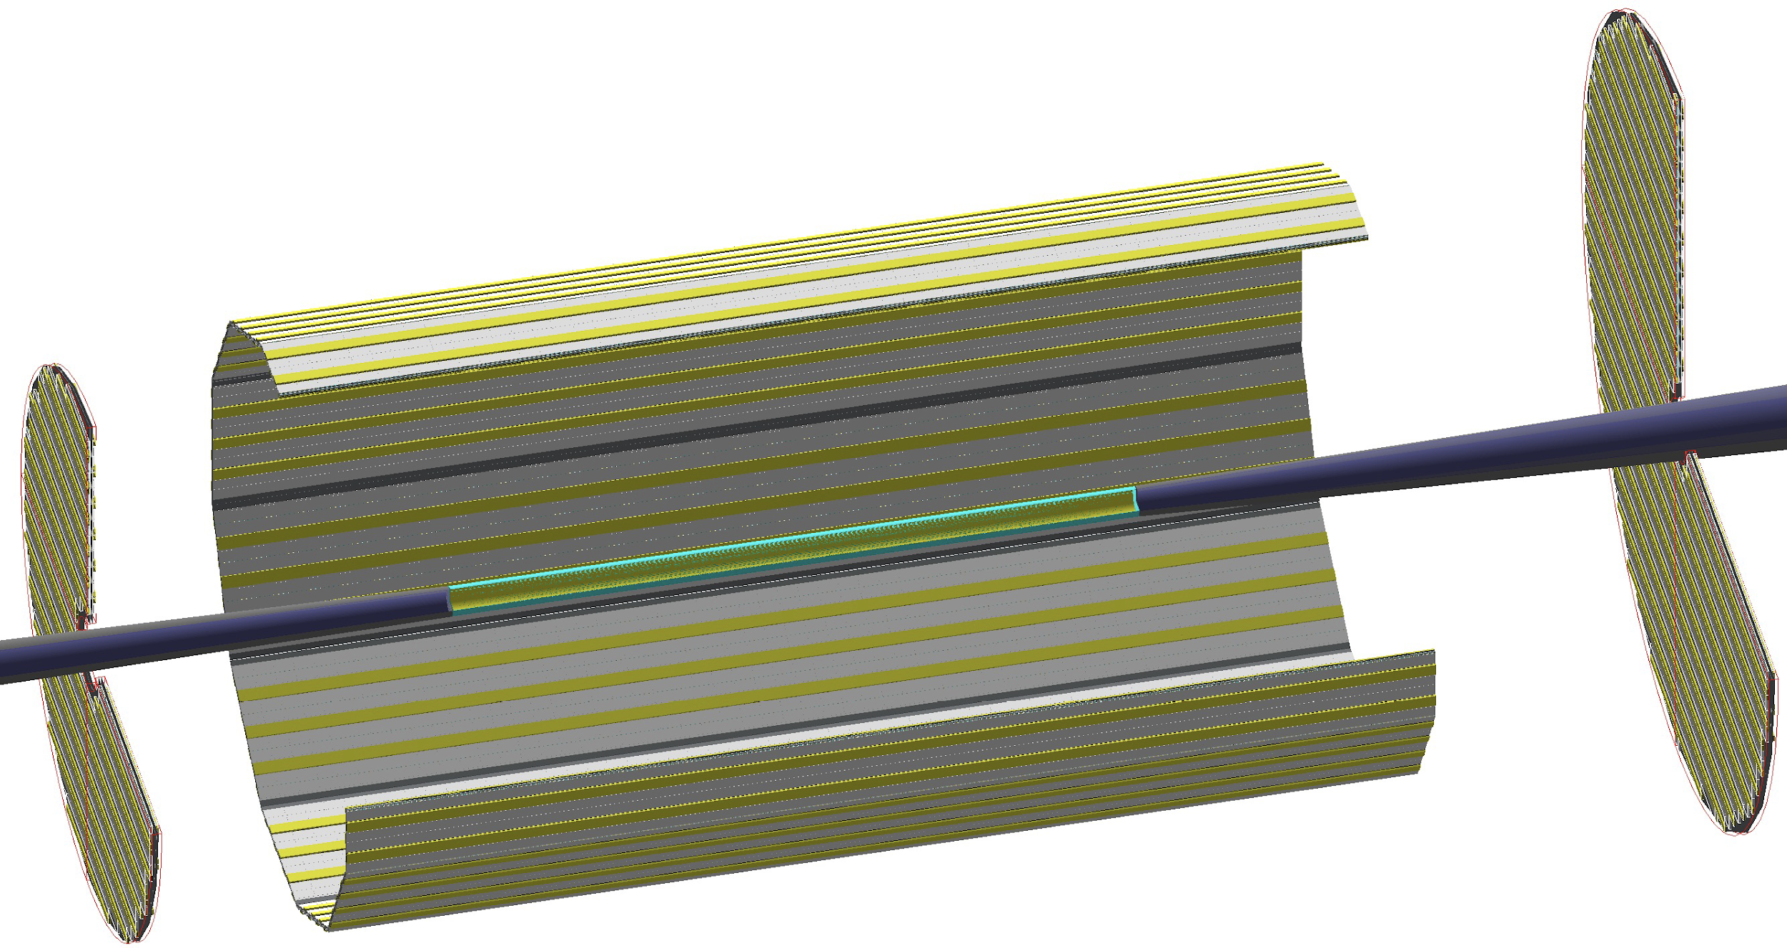
Particle ID
Dual-Radiator RICH(dRICH)
High-Performance DIRC
Quartz bar radiator (BaBAR bars)
light detection with MCP-PMTs
Fully focused
π/K 3σ separation at 6 GeV/c
Proximity Focused (pfRICH)
Long proximity gap (~40 cm)
Sensor: HRPPDs
up to 9 GeV/c 3σ π/K sep.
world’s first
at
C₂F₆ Gas Volume and Aerogel
Sensors tiled on spheres (SiPMs)
π/K 3σ sep. at 50 GeV/c
AC-LGAD TOF (~30ps)
world’s first
at
world’s first
at
hadrons
electrons
Accurate space point for tracking
forward disk and central barrel

Slide 25
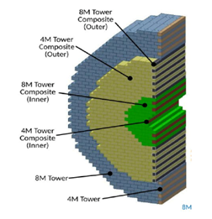
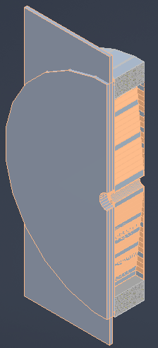
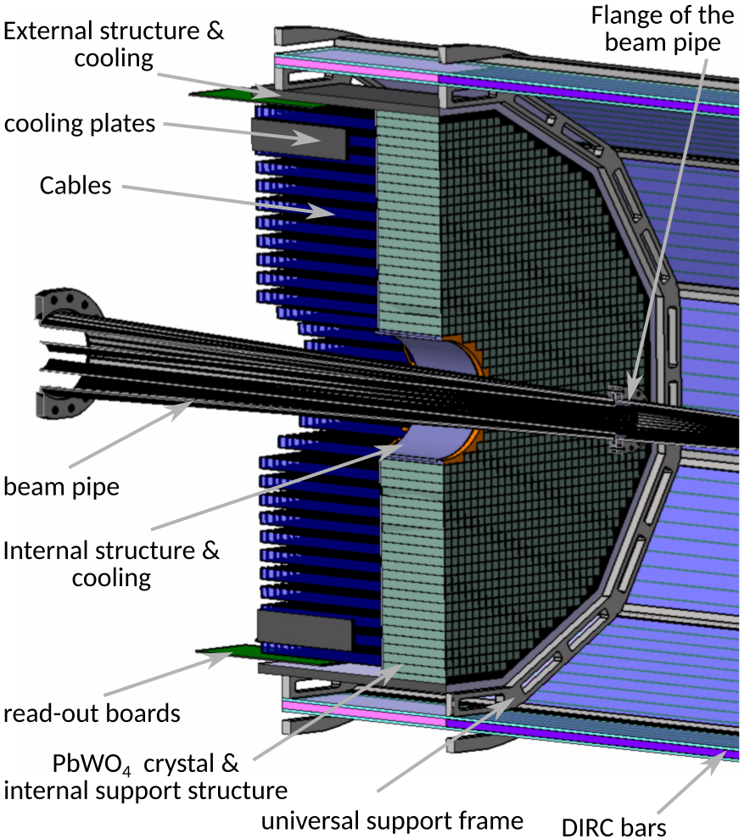
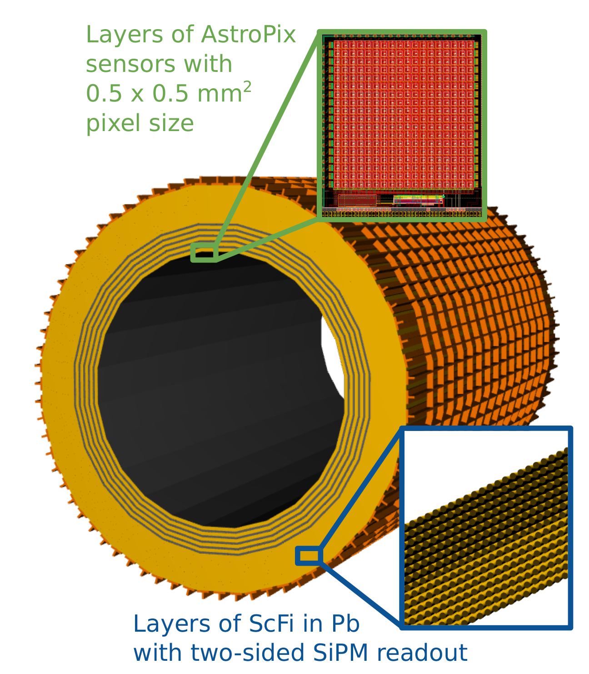
Calorimetry
hadrons
electrons
Backwards HCal
Steel/Sc Sandwich
tail catcher
world’s first
at
High granularity W/SciFi EMCal
Longitudinally separated HCAL with high-η insert
world’s first
at
Backwards EMCal
PbW04 crystals, SiPM photosensor
Barrel HCAL (sPHENIX re-use)
world’s first
at

Slide 26
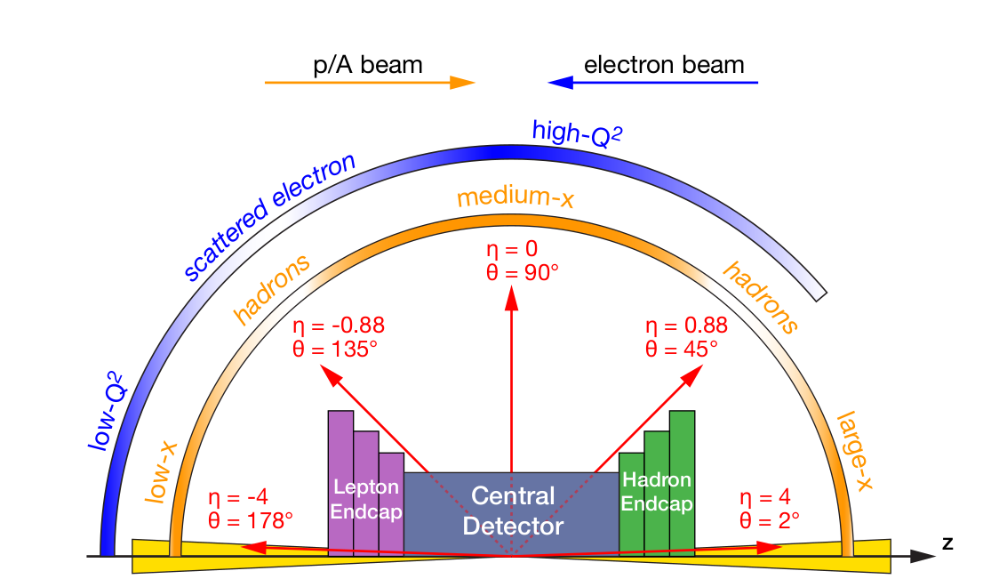
EIC Detector Requirements
Vertex detector → Identify primary and secondary vertices,
Low material budget: 0.05% X/X₀ per layer
High spatial resolution: 20 μm pitch CMOS Monolithic Active Pixel Sensor
Central and Endcap tracker → High precision low mass tracking
MAPS – tracking layers in combination with micro pattern gas detectors
Particle Identification → High performance single track PID for π, K, p separation
RICH detectors (RICH, DIRC)
Time-of-Flight high resolution timing detectors (HRPPDs, LGAD)
Novel photon sensors: MCP-PMT / HRPPD
Electromagnetic calorimetry → Measure photons (E, angle), identify electrons
PbWO₄ Crystals (backward), W/ScFi (forward)
Barrel Imaging Calorimeter (Si + Pb/ScFi)
Hadron calorimetry → Measure charged hadrons, neutrons and K_{L}⁰
Achieve ~70%/√E + 10% for low E hadrons (~ 20 GeV)
Fe/Sc sandwich with longitudinal segmentation
Very forward and backward detectors → Large acceptance for diffraction, tagging, neutrons from nuclear breakup
Silicon tracking layers in lepton and hadron beam vacuum
Zero-degree high resolution electromagnetic and hadronic calorimeters
DAQ & Readout Electronics → trigger-less / streaming DAQ, Integrate AI into DAQ
Radius/Distance from IP

Slide 27





Detector Design Process Timeline
Detector and machine design parameters driven by physics objectives
2012
2015
2018
2020
2023
Call for proposals issued jointly by BNL and JLab in March 2021 (Due Dec 2021)
ATHENA, CORE and ECCE proposals submitted
DPAP review Dec 2021 – Jan 2022, closeout March 2022
ECCE proposal chosen as basis for first EIC detector reference design
Spring/Summer 2022 – ATHENA and ECCE form joint leadership team
Joint WG’s formed and consolidation process undertaken
Coordination with EIC project on development of technical design
Collaboration formation process started July 2022
Charter ratified & elected ePIC Leadership Team February 2023
EIC/ePIC endorsed as highest priority for new facility construction in 2023 LRP.
Working towards TDR and CD-3A (review Nov. 2023) and CD-2/3 (2025)

Slide 28
Streaming Model Review Recommendations
All charge questions answered in the affirmative:
Q1 (… comprehensive and cost-effective long-term plan …):
We recommend that ECSJI verify the readiness of simulation and reconstruction for the TDR by May 2024.
We recommend that ePIC document a first computing needs assessment by the next ECSAC review, in roughly one year.
Q3 (… integrated with the HEP/NP community developments …):
We recommend that the ePIC collaboration starts, by the time of next year’s ECSAC review, an evolving list of software dependencies that includes: the packages, who the primary supporters are, and what the ePIC collaboration contributes to them.
Link to full closeout slides: https://indico.bnl.gov/event/20960/contributions/82384/attachments/50617/86563/Review%20-Closeout.pdf

Slide 29
ePIC Technical Coordination
We have encountered a number of difficulties in finding a permanent Technical Coordinator for ePIC:
Our community is already heavily committed
Can’t just shift the TC problem to somewhere else within ePIC!
Groups have existing responsibilities, not just on ePIC but at JLab, RHIC, LHC, etc.
Experienced people from outside ePIC are committed and unavailable
There are also issues associated with the nature of the position:
It is not funded – asking for 80% of an experienced technical person is asking for a very substantial commitment
This is a collaboration position and not directly connected to the EIC Project or the Host Labs - there is a lot of concern about the scope of the responsibilities
Technical Coordinator
Requirements:
Technical competence
Experience with DOE construction projects
Able to spend >80% of time on ePIC

