Slide 1


Host labs’ computing support and partner expectations
Eric Lancon
elancon@bnl.gov
Amber Boehnlein
amber@jlab.org

Slide 2
The Partnership
Brookhaven National Laboratory (BNL) and Thomas Jefferson National Accelerator Facility (JLab), as Electron-Ion Collider host labs, have created a joint structure, the EIC Computing and Software Joint Institute (ECSJI), incorporating parts of BNL and JLab facilities to support the EIC computing and software needs and activities.
ECSJI will leverage complementary expertise at the two labs and provide needed visibility to the respective lab management and stakeholders. The advantages of such a structure also include increased reliability and availability of resources for the ePIC collaboration and other future collaboration.
The success of the EIC, an international scientific endeavor, will benefit from contributions from international partners towards its computing effort.
To facilitate efficient coordination, the Institute will administer the EIC International Computing Organization (EICO), which will include all the contributors to the EIC computing effort.

Slide 3
The Scope
The Institute will provide for EIC computing and software matters:
A single entity to interface with the EIC project, the ePIC collaboration, theoreticians, and future collaborators.
Execution of host lab responsibilities.
Maintenance of service level agreements and statements of work outlining the host labs’ contribution to the ePIC collaboration concerning computing resources, services, and personnel assigned to work on ePIC computing and software deliverables.
A coordinating body for interacting with international partners, providing computing resources as in-kind contributions, including:
Assessing resources.
Managing the agreements with the sites delivering resources (including service levels).
Facilitating and assessing the delivery against the agreements.

Slide 4
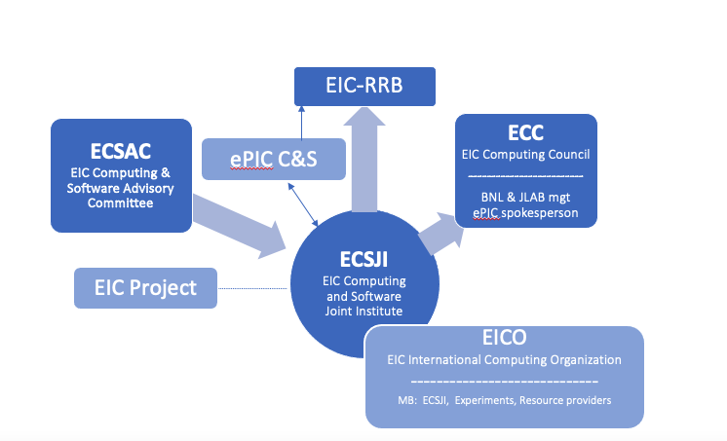
Organization & Governance
The Institute aims to provide efficient support to the EIC while acknowledging organizational differences at the two labs.
The proposed governance model ensures that EIC experiments, accelerator simulations, and theoreticians are well supported in matters of computing and software, the Institute’s performance is monitored, and reporting is clearly defined.
The proposed governance structure is composed of two central bodies, designed to facilitate communication, coordination, escalation of issues, and conflict resolution.

Slide 5
Responsibilities: Host Labs
Oversight for ePIC software and computing designs and execution to provide assurance functions for the host labs and DOE.
Provisioning and operating standard infrastructure solutions consistent with supported lab infrastructures and community best practices.
Support for the EIC International Computing Organization (EICO).
Interface for local resources and policies at the respective labs.
Ongoing computing operations in support of the accelerator and detector design and construction.
Operational support functions for:
Experimental data curation and analysis preservation.
First-pass processing.
Data analysis.
Support of collaboration(s) and users.
Accelerator and detector simulations and theoretical calculations.

Slide 6
Institute Management
Composition: Management will comprise two co-directors, each nominated by one lab. The co-directors are currently Eric Lancon (BNL) and Amber Boehnlein (JLab).
Reporting: The Institute’s management will report jointly to host lab management.
Duties and accountability:
The management will be responsible for organizing the Institute to deliver on the previously defined responsibilities.
The management will maintain a multi-year operation plan for the host labs, providing matrixed staff members to support activities.
Institute management will provide a yearly report to the host labs’ management.
Regular meetings are organized with
ePIC management and computing coordinator
EIC co-directors of the experimental program

Slide 7
EIC Computing Council
ECC EIC Computing Council
-------------------------
BNL & JLAB mgt ePIC spokesperson
The ECC is chaired in alternation by the Associate Laboratory Director for Nuclear and Particle Physics of BNL and the Deputy Director for Science of JLab. It comprises the ALDs/ADs and deputies involved in the EIC science program and Institute management. The ePIC collaboration spokesperson or deputy is an ex officio member.
Responsibility: Review the ECSJI strategic direction and support leadership in managing effective interfaces of the ECSJI to the EIC project and ePIC collaboration.
Authority: Approve the ECSJI strategic direction, leadership changes, annual budgets, resource allocations, and performance milestones.
Additional proposed responsibilities:
Oversee the development and implementation of EIC Computing and Software and review future computing needs.
Oversee synergies between the host Labs in EIC scientific computing area and provide institutional strategic direction.
Resolve high-level issues between stakeholders.
Meet at least twice a year and hear reports from Institute management.

Slide 8
EIC Computing and Software Advisory Committee
ECSAC EIC Computing & Software Advisory Committee
The ECSAC is chartered to propose advice, guidance, and counsel on the strategy and objectives of the Institute and of the EIC International Computing Organization.
The committee reports to the ECSJI management. The ECSAC chair and committee members include external managers and experts in the field appointed by Institute management in consultation with host lab management. It will meet at least twice a year.
Proposed responsibilities:
Review the strategy and objectives of the Institute to support EIC Computing and Software.
Evaluate the adequacy of the infrastructure and resources to meet the computing requirements of the ePIC collaboration.
Evaluate proposed technical solutions and their implementation.
Identify opportunities to increase effectiveness and efficiency.
Provide recommendations on technical and organizational matters.
If conflicting requirements affect operation, planning, or budget, the ECSAC will be asked to provide recommendations.

Slide 9
EIC Computing and Software Advisory Committee
Current members:
Mohammad Al-Turany (GSI) David Brown (LBNL)
Simone Campana (CERN) Pere Mato (CERN)
Christoph Pauss (MIT)
Heidi Schellman (U Oregon) Frank Wuerthwein (UCSD)
A review was held on 10/19-20 in preparation for this EIC-RRB session

Slide 10
EIC International Computing Organization
EICO
EIC International Computing Organization
-----------------------------
MB: ECSJI, Experiments, Resource providers
The EICO is led by the Institute’s co-directors and administered by the ECSJI. It exists to provide computing resources and infrastructure to the ePIC collaboration and potentially other EIC computing needs.
As the EICO becomes established, its structure will be formally documented in an EICO charter. The EICO is managed by a board that includes representatives from ePIC and international partners. The board will meet at least quarterly and hear regular reports from the ePIC experiment.
Proposed responsibilities:
Document and maintain agreements with international contributors to EIC computing.
Collect requirements from the ePIC collaboration.
Produce accounting reports of EIC computing.
Accounting report to the EIC Resource Review Board (EIC-RRB), detailing service delivery with respect to agreements.
Supervise service level agreements.
Propose ECSAC members.

Slide 11

EICO next steps
ECSJI and ePIC management will collaborate to define 'external partners' for inclusion in the upcoming EICO charter. The charter will cover key aspects such as
standards for service quality,
specific functionality criteria,
contribution size determination (FTE/authors scaling?)
a formalized procedure for external partner inclusion and validation.
The EIC is already using the Open Science Grid (OSG) and anticipating the inclusion of significant external partners from WLCG-affiliated institutions.
We expect to integrate and leverage software, tools, and services developed by the WLCG community into EIC computing operations
Over the next year, the ECSJI plans to apply for observer status to the WLCG

Slide 12
Computing resources for the EIC in the US
Presently, support and resources for the EIC at BNL and JLAB are offered opportunistically.
Limited local funding is available at both Labs for storage and software development.
BNL and JLAB partnered on the long-term planning of the Nuclear Science Advisory Committee (NSAC), underscoring the significant rise in computing requirements anticipated prior to the turn-on of the EIC in the coming years.
NSAC provides guidance and recommendations to the U.S. Department of Energy (DOE) and the National Science Foundation (NSF) regarding priorities and planning for nuclear physics research
Limited funding specifically allocated to EIC computing is expected to commence in FY25.

Slide 13
Early contacts with international partners
Early contacts have been established with representatives from Canada, Italy, and the UK
Canada: Wouter Deconinck
Italy: Pietro Antonioli, Andrea Bressan, Domenico Elia
UK: Peter Jones, David Britton (GridPP)
These nations have expressed interest in participating in the ePIC computing initiative.
Discussions covered the following points:
Organization of funding for Nuclear Physics (NP) computing at the national level.
Structure of computing for the EIC and for ePIC within each respective country.
Existing support and commitment for EIC computing.
Schedule and the specified level of contribution for formalizing contributions to EIC computing through agreements.
Follow-up discussions will be organized (aligned with EIC-RRB cadence), and every country is cordially invited to participate.

Slide 14

Canadian infrastructure available for the EIC
Wouter Deconinck
Digital Research Alliance of Canada: National computing resources supporting both HPC and HTC workflows
Operated through regional consortia
EIC Canada's computing contribution is operated by staff from Prairies, one of the five regional organizations
Annual resource allocation competitions (with fast-track continuance option), Peer review process of access
EIC Canada has held active allocation for 4 years
~50 core-years/year, 100 TB during proposal and initial ePIC development phase
Supported majority of ATHENA simulations until Open Science Grid (5k-10k core-years)
Primary use for EIC Canada researchers and for international contribution proof of concepts

Slide 15
Future? - Canadian infrastructure available for the EIC
Wouter Deconinck
Canada aims for approximately 10% of the U.S. contribution to EIC computing.
In the future, it was mentioned, that EIC Canada could have the opportunity to make a contribution through dedicated infrastructure.
Precedent exists in ATLAS Canadian Tier-1 located at Simon Fraser University (SFU).
SFU leads a consortium of Canadian institutions, including TRIUMF, operating the Tier-1 Data Centre, which receives funding from the Canada Foundation for Innovation (CFI).
For EIC Canada to expand with dedicated “Tier-1”-like resources, a formal proposal is anticipated after the completion of detector subsystem construction (also requested of CFI).

Slide 16

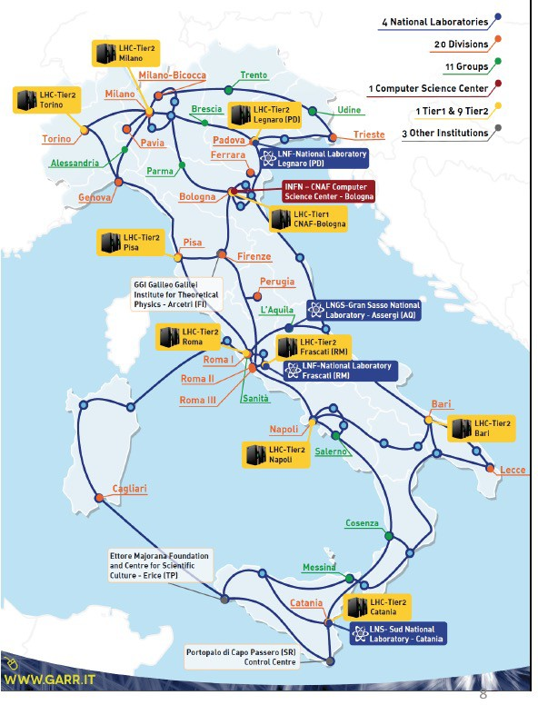
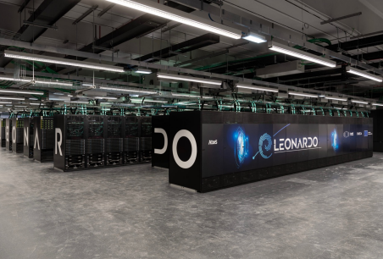
Italian infrastructure available for the EIC
Andrea Bressan
INFN operates its own Grid and Cloud services:
Nine medium-sized centers
One large national center at CNAF (Bologna) collocated with LEONARDO (pre-exascale supercomputer)
Successfully contributing to the WLCG for two decades and will support the LHC in the High Luminosity area
A major national initiative has recently been approved: ICSC
National Research Centre for High-Performance Computing, Big Data, and Quantum Computing
The EIC could benefit from this global infrastructure
Modest resources are available for EIC until detector construction is completed
Italian EIC community has been yearly applying (and getting approved) for a share at CNAF since 2020
Aiming at contributing at the level of ~10% to EIC computing effort

Slide 17



UK infrastructure available for the EIC
Peter Jones
Science and Technology Facilities Council (STFC)
Part of UK Research and Innovation (UKRI)
Supports research in Nuclear Physics, Particle Physics and Astronomy
IRIS project set up in 2018 to improve federation of STFC digital infrastructure
Infrastructure partners include GridPP (High Throughput Computing) and DiRAC (High Performance Computing), amongst others
GridPP supports HTC needs of nuclear and particle physics, in particular the UK’s contribution to the WLCG but also non-LHC experiments
www.ukri.org/councils/stfc/
www.iris.ac.uk
www.gridpp.ac.uk

Slide 18
UK contribution to the EIC
Peter Jones
10% of GridPP resources are available to non-LHC experiments – EIC can request a share for development
The resource is allocated through IRIS
Future planning assumes EIC will apply for funding for its own allocation potentially starting in FY28/29, to be implemented by GridPP (e.g., as an extension of the Tier-1 site at RAL)
Exploiting synergies with WLCG data management is highly desirable
Aiming to provide a fair share percentage of EIC computing resources (TBD)
GridPP federates the Rutherford Appleton Laboratory (RAL) Tier-1 site and 16 Tier-2 sites

Slide 19
Proposed computing agreements timeline
2024
Identify possible international contributors
2027+
Finalize agreements legal content
Start agreements signing process
2029+
agreements are signed
International contributions included in eventual EIC Full dress rehearsals
Work on agreements legal content, Identify signing authorities in various countries
Year-0
Data Taking
ePIC to develop a comprehensive quantitative computing model
Establish accounting mechanism for contributions to EIC computing
Work on the EICO Charter
2025 -2026
Resource planning for the short and long-term
Refinement of ePIC computing model and requirements

Slide 20
THANK YOU

Slide 21
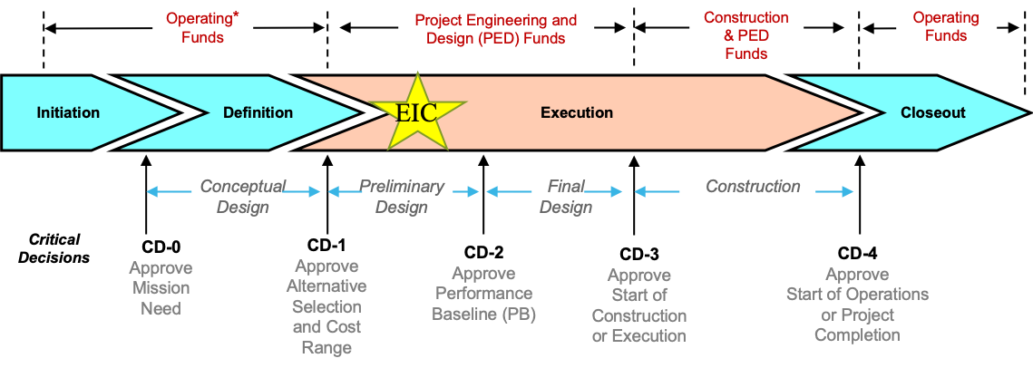
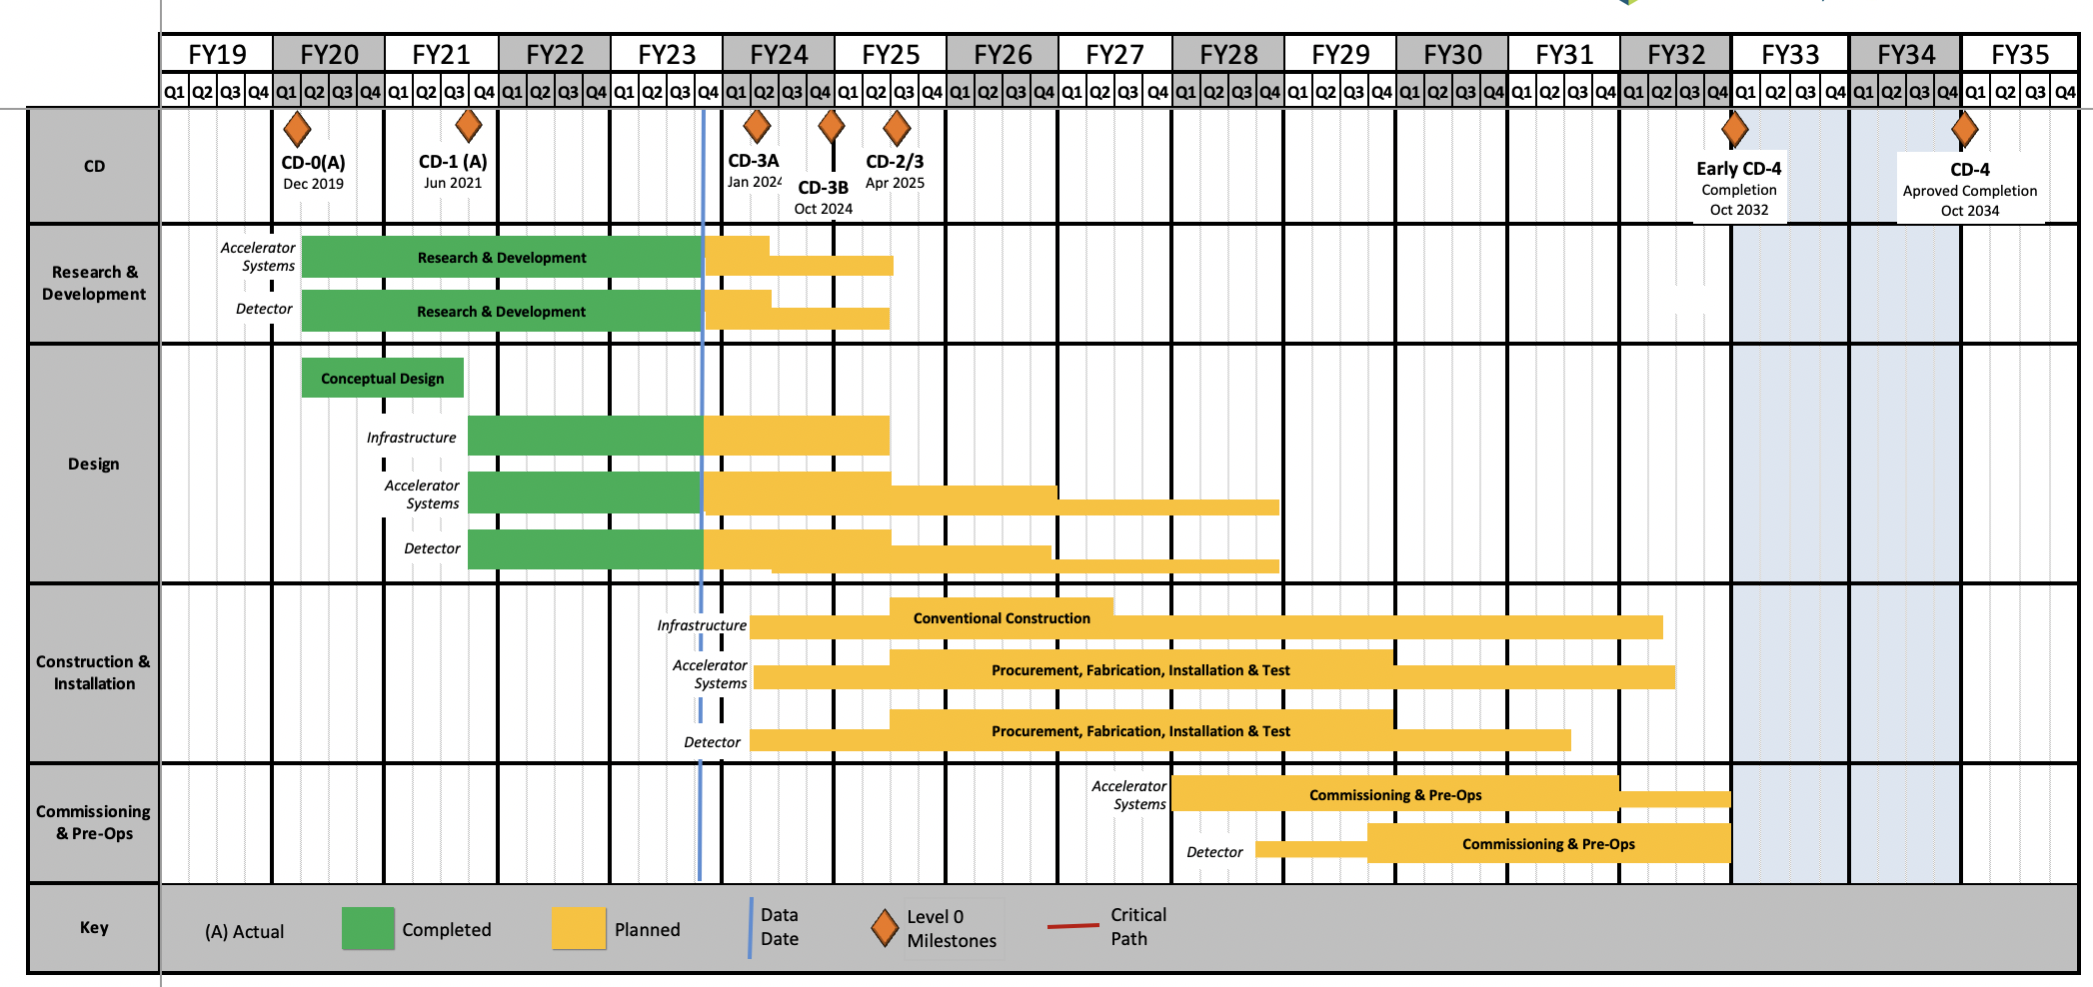
EIC Schedule
EIC Critical Decision Plan
CD-0/Site Selection December 2019 ✓
CD-1 June 2021 ✓
CD-3A January 2024
CD-3B October 2024
CD-2/3 April 2025
early CD-4 October 2032
CD-4 October 2034
CD-3A:
Define Baseline:
technologies, Scope, Cost & Schedule
Long Lead Procurement (LLP) items
Design Maturity: ~90%
Plan is tracked through EVMS & Change control process
Start of construction for LLPs
Construction Phase
Conclusion of
RHIC Operation
Science Phase
The thinner bars indicate that R&D and design
can continue at a small level beyond CD-2 and CD-3
Courtesy
E.C. Aschenauer (BNL)
R. Ent (JLab)
21

