Slide 1
EIC (IKC) Path to CD-2 (/CD-3)
Luisella Lari
EIC Project Manager
Sr. Scientist
EIC 2nd Resource Review Board Meeting
December 7-8, 2023

Slide 2
Outline
EIC Summary Schedule
EIC IKC CD-2 expectations
First wave of Milestones for Accelerator
First wave of Milestones for Detector
Summary

Slide 3
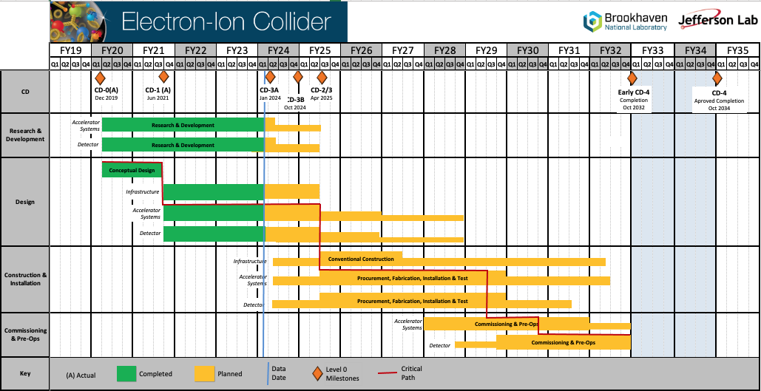
Summary Schedule
CD-2 in April 2025 leaves one year to prepare baseline documentation.

Slide 4
EIC IKC CD-2 expectations
Validate IKC EIC goals.
IKC goals are currently: 5% of the accelerator and 30% of the detector scope.
2. Sign binding (contractual) agreements.
3. Develop & sign IKC PPDs, where necessary, to align the IKC deliveries to the project scope expectation and schedule.

Slide 5
EIC IKC CD-2 Expectations
Government to Government
Science & Technology (S&T) Agreement
binding (contractual)
not-binding
Agency to Agency
Implementing Agreement
DOE led/ signed
Project Annex
Statement of Interest
US Lab led/ signed
iCRADA
Project Planning Documents (PPDs)
DOE agreements do not contain EIC Project IKC scope details.
Project Planning Documents (PPDs) contain IKC scope details.
PPDs are not required for all IKC. EIC will have ~ 5-10.
Laboratory (BNL or JLab) iCRADA binding agreements are suggested for IKC items requiring a PPD.

Slide 6
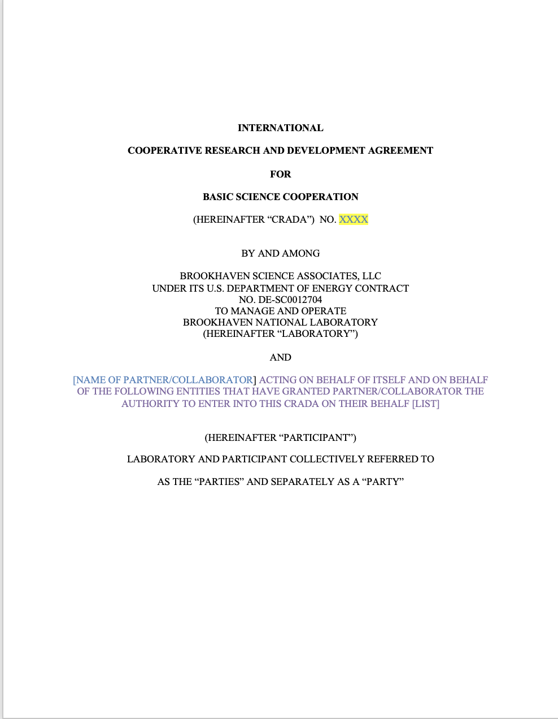
Why iCRADA?
iCRADA = international Cooperative Research And Development Agreement.
iCRADA is needed to carry out the cooperative activities set forth in the Annex.
iCRADA first 8 pages can not be modified by the Parties i.e. the first 8 pages are not negotiable (Please note that the first 8 pages might look familiar too many of you.)
iCRADA Annex need to be develop with each EIC Partner with a preference to maintain separate the Detector and Accelerator scope.
iCRADA Annex contains a high level description of the EIC specific IKC scope from a EIC Partner.
iCRADA Annex contains an estimation of the IKC work “up to/do not exceed” US $ calculated as the IKC work will be performed by DOE $.
Template posted on the RRB indico page

Slide 7
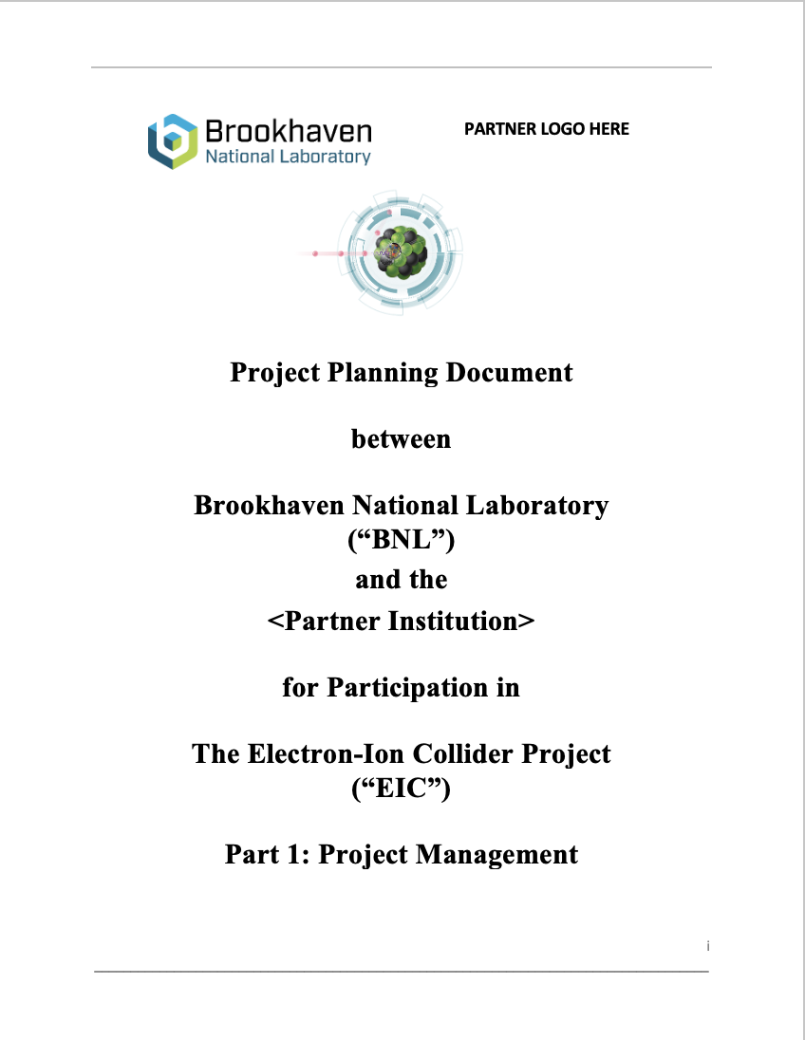
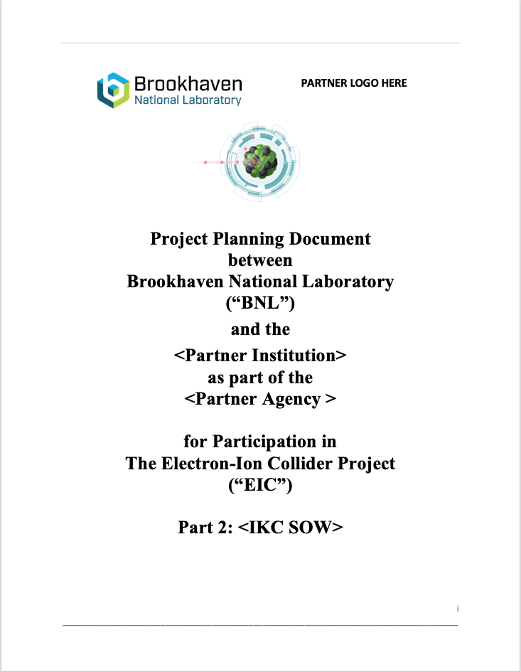
When are PPDs needed?
The EIC Project requests PPDs for the following cases:
Technical complex items;
Critical technical items;
High-risk items;
High-cost items;
Templates posted on the RRB indico page
PPDs are needed to align step by step the IKC scope/expectation to the project requirements.

Slide 8
PPDs Overview
PPDs are used to establish and manage the EIC Project baseline and construction.
The EIC Project will pursue PPDs, when needed, with International Partners, in coordination with Host Labs (BNL and JLab) and DOE (Site Offices and Headquarters)
PPD – Part 1: describes EIC Project Management Principles applicable to the Partner IKC.
PPD – Part 2: describes IKC Deliverables, including the scope of work, schedule milestones, description of supporting documentation and activities required to enable EIC to meet DOE O 413.3b requirements abide by BNL & TJNAF policies and procedures, and conform to the principals established in the EIC Systems Engineering Management Plan.
PPDs will be updated, as necessary, to maintain consistency with the legally binding agreements.

Slide 9
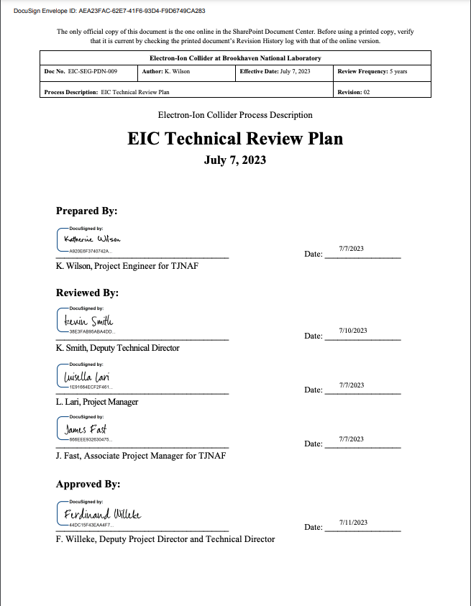
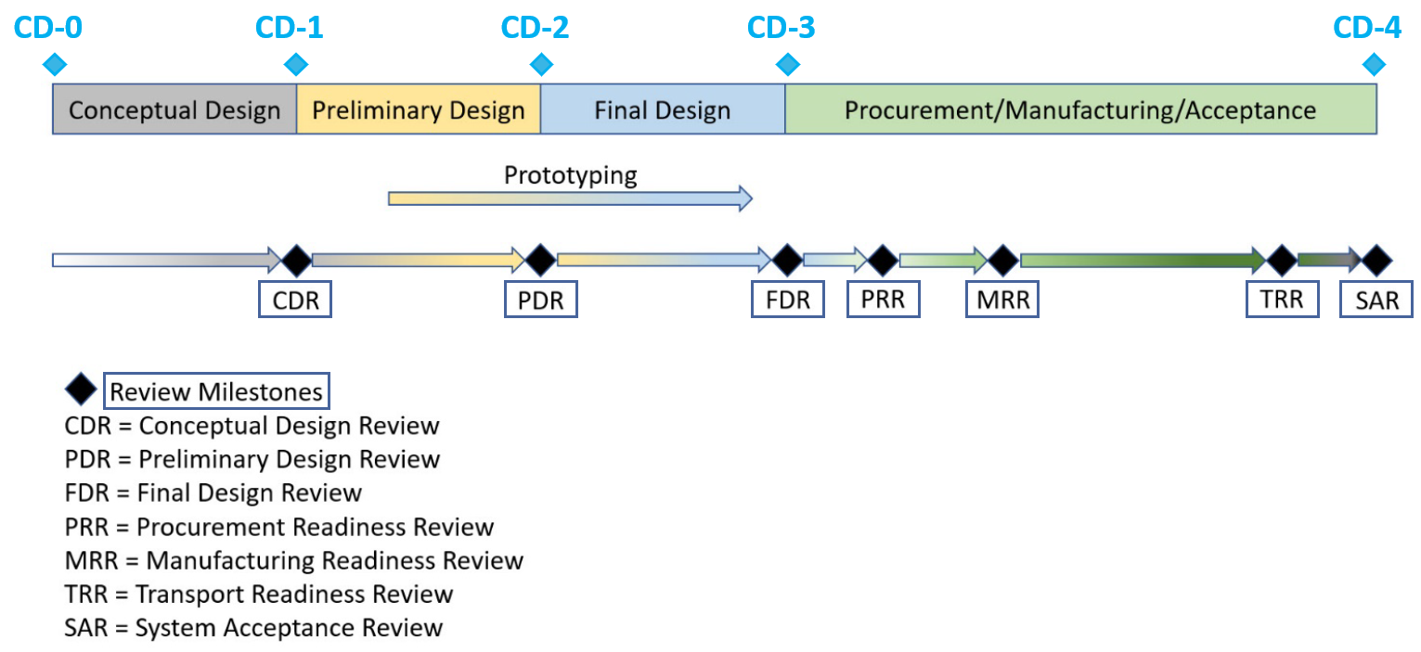
PPDs Reference the EIC Technical Review Plan
This document defines the Technical Review Plan (TRP) that the EIC Project will use for systems, subsystems, and components under development at BNL and JLab, as well as at domestic and international partners including In-Kind Contributors (IKC).
Doc posted on the RRB indico page

Slide 10
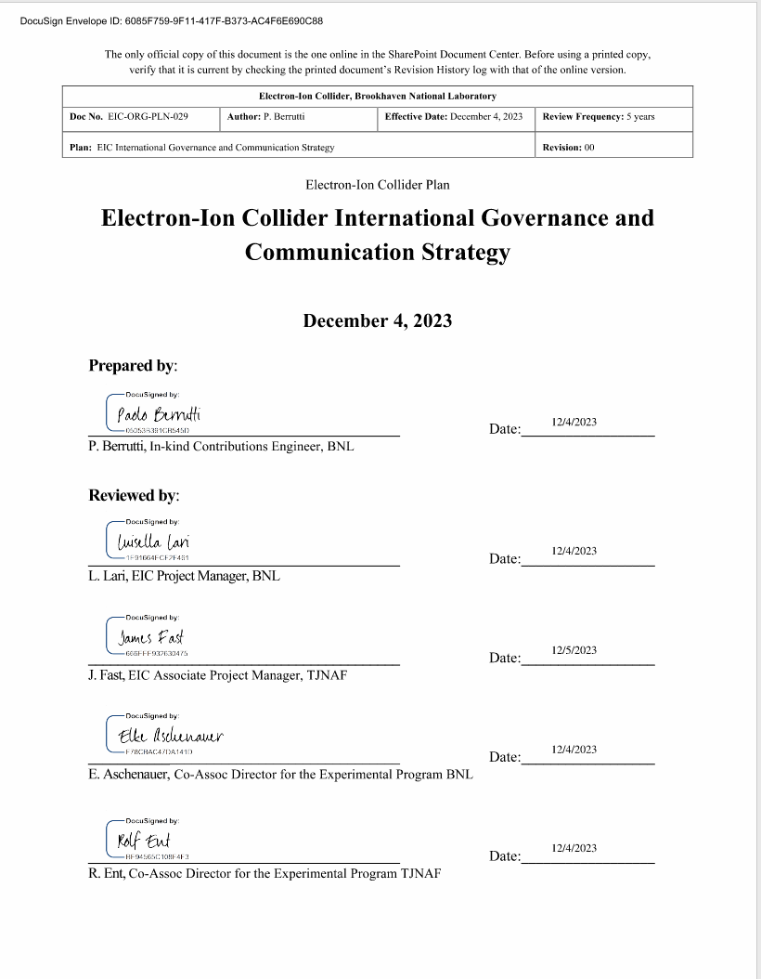
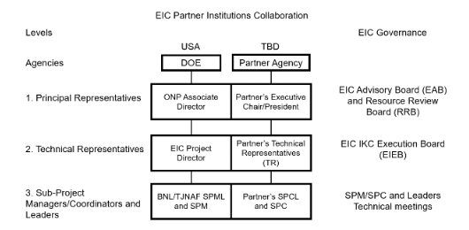
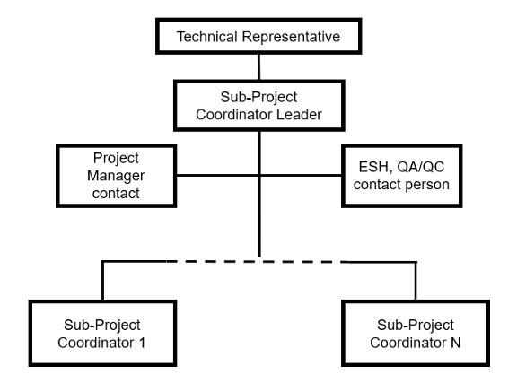
PPDs Reference the EIC IKC Governance Doc
The Partner’s Technical Representative is assumed to develop a org chart with POCs in PM &ESH&Q areas.
Doc posted on the RRB indico page

Slide 11
1st Wave of Milestones for Accelerator IKC
Agency | Milestone | Target Date
France – IN2P3 | Proposed scope accelerator | End December 2023
UK | UKRI outcome on funding proposal | January 2024
France – CEA/IN2P3 | Joint Proposal submitted to French Ministry | February 2024
Canada – TRIUMF | JLab iCRADA draft | February 2024
Canada – TRIUMF | BNL iCRADA draft | March 2024
Canada – TRIUMF | iCRADAs signed | May 2024
Canada – TRIUMF | PPD draft | June 2024
France – CEA | BNL iCRADA draft | June/July 2024
UK | Jlab iCRADA draft | June/July 2024
France – CEA | PPD draft | August 2024
UK | PPD draft | August 2024
France-CEA | BNL iCRADA signed | August 2024
UK | JLab iCRADA signed | August 2024
 | CD-2/CD-3 Director’s Review / All PPDs signed | November 2024
 | CD-2/3 OPA review | January 2025
 | CD-2/3 ESAAB | April 2025

Slide 12
1st Wave of Milestones for Detector IKC
Agency | Milestone | Target Date
Italy-INFN | Outcome on detector solenoid funding (CD-3A scope) | December 2023
US-NSF | Outcome on MSRI funding (CD-3A scope) | January 2024
UK | UKRI outcome on funding proposal | January 2024
Italy-INFN | JLab iCRADA draft on magnet | February 2024
Italy-INFN | BNL iCRADA draft on magnet | March 2024
Italy-INFN | iCRADAs on magnet signed | May 2024
France-IN2P3 | PPD draft | May 2024
France-CEA | PPD draft | June 2024
UK | PPD draft | August 2024
Italy-INFN | JLab iCRADA signed (excluding magnet scope) | August 2024
Italy-INFN | PPD draft / excluding magnet scope | August 2024
France-IN2P3 | JLab iCRADA and BNL iCRADA signed (draft in Jun/Jul) | September 2024
France-CEA | JLab iCRADA signed (draft in Jun/Jul) | September 2024
UK | JLab iCRADA signed (draft in Jun/Jul) | September 2024
 | CD-2/CD-3 Director’s Review / All PPDs signed | November 2024
 | CD-2/3 OPA review | January 2025
 | CD-2/3 ESAAB | April 2025

Slide 13
IKC Not Addressed in iCRADA / PPDs
At the time of the DOE CD-2/3 Review, currently planned for early 2025, scope without identified IKC partners will be assumed as DOE scope, and pursued as opportunities.
IKC are expected to be identified and agreed upon at all stages of the EIC project, e.g., detector upgrades, accelerator installation and commissioning, and the timing of approval cycles in different countries (for example in the detector area, we would like to mention in this categories Countries with which we are already working such as Canada, Japan, Korea, Taiwan, etc, Taiwan, etc).

Slide 14
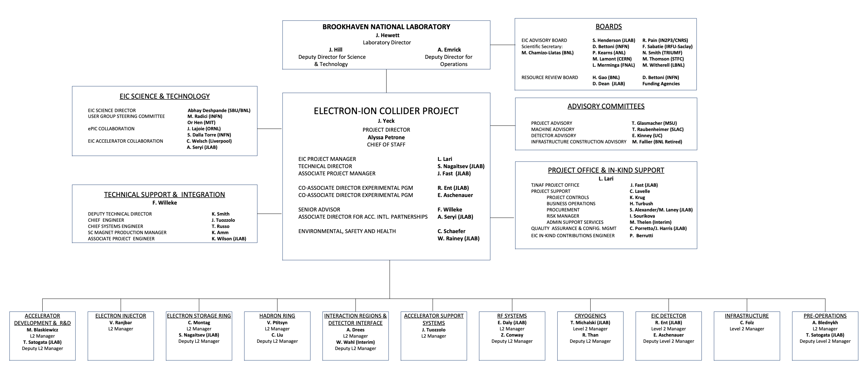
IKC EIC support
The Project & In-kind Support Office is set up to provide support to EIC Partners to develop the Lab level documentations.

Slide 15

Summary
The EIC Project baseline (CD-2) needs to properly document the IKC scope, particularly in areas with complex deliveries:
iCRADA legally-binding agreements are proposed to be prepared and signed.
PPDs not legally binding documents are proposed to be prepared and signed.
iCRADA and PPDs templates are provided on the RRB indico web-page.
Please provide feedback as soon as possible on iCRADA template.
PPDs are used to partner and properly manage the IKC scope & acceptance.
DOE and the EIC Project are organized to support IKC Partners at each level
In the case of complex delivery, an ad-hoc structure needs to be put in place on both sides to properly manage the IKC until acceptance.

