Slide 1
sPhenix Ground Fault Studies
May 4, 2016
Carl Schultheiss

Slide 2
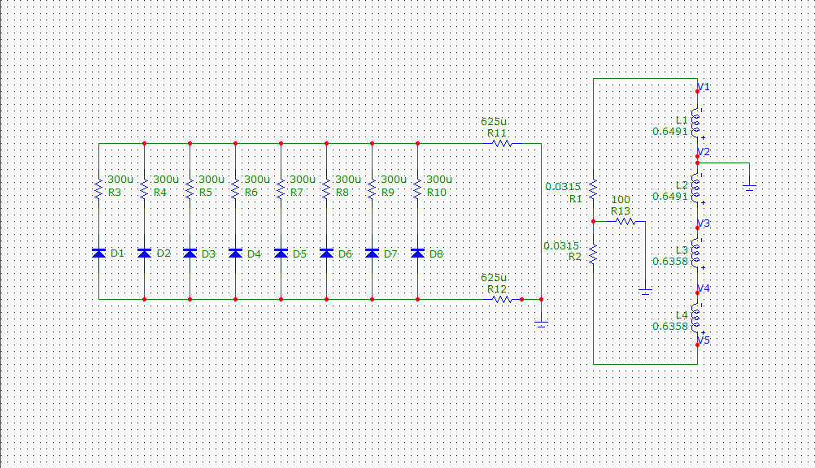
Circuit Simulation

Slide 3
Simulation Conditions
Initial current in the magnet is 4600 Amps.
Cable resistance was neglected.
Each magnet coil was divided in half to simulate a coil failing to ground. Includes 1% difference between inner and outer coil’s inductances.
Symmetrical circuit means faults at V4 look similar to faults at V2; but with a shifted ground. Faults at V5 look similar to V1, and a fault at V3 looks like no fault.
Results shown for V1 and V2 faults.

Slide 4
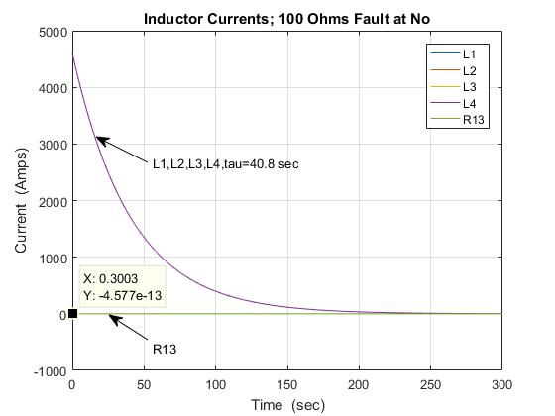
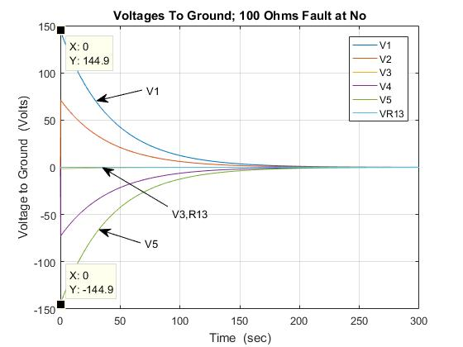
R=100 Ohm; No Ground Fault

Slide 5
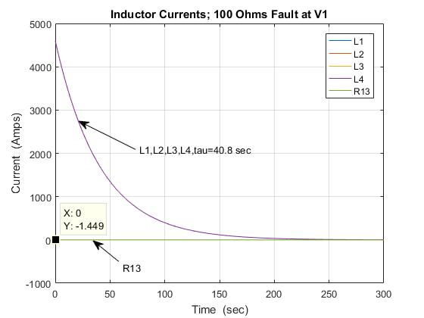
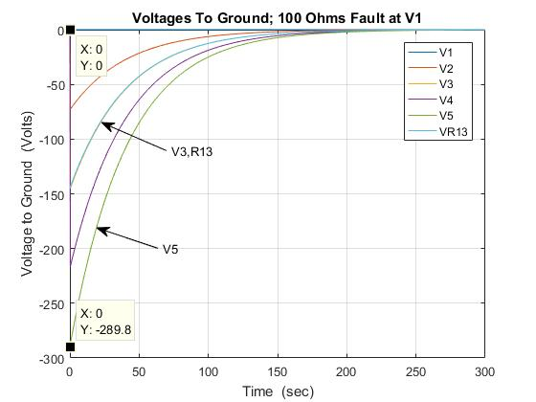
R=100 Ohm; V1 Ground Fault

Slide 6
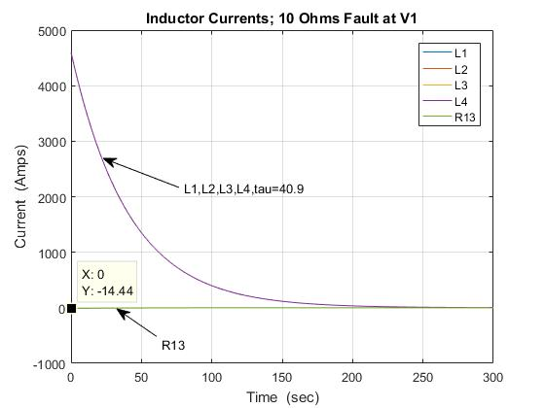
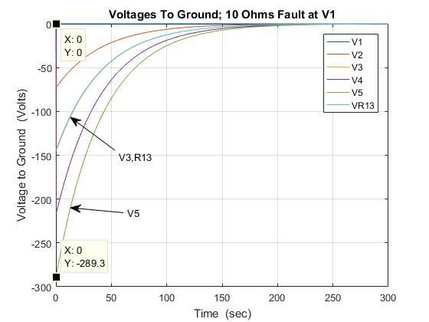
R=10 Ohm; V1 Ground Fault

Slide 7
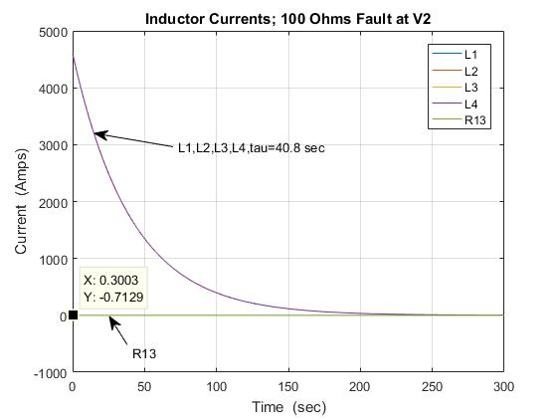
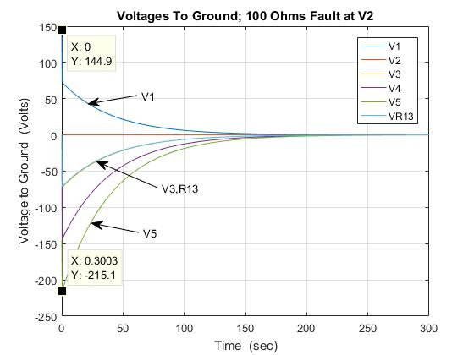
R=100 Ohm; V2 Ground Fault

Slide 8
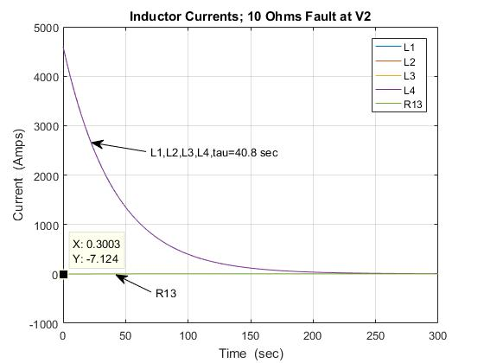
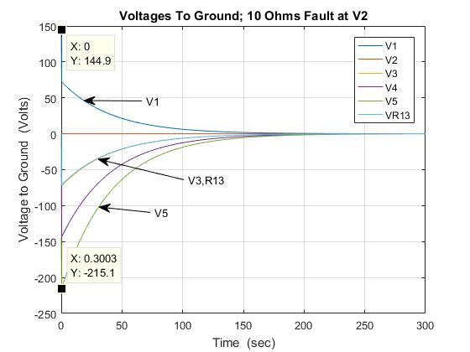
R10 Ohm; V2 Ground Fault

Slide 9
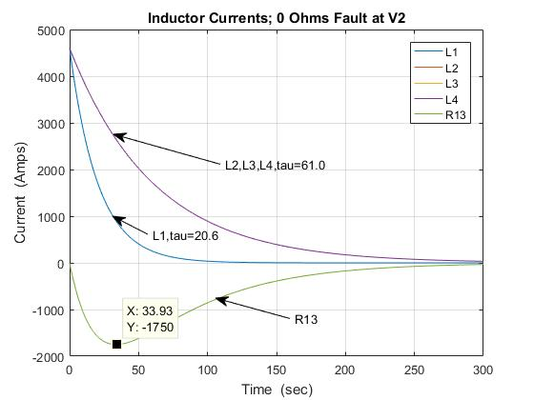
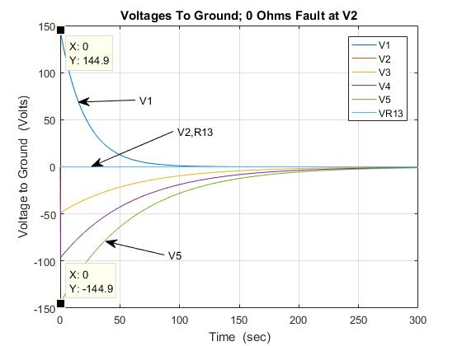
R=0 Ohms; V2 Ground Fault

Slide 10
Observations
 | L1 Tau (sec.) | L2, L3, L4 Tau (sec.) | R13 Current (Amps) | R13 Voltage (Volts) | V1 Voltage (Volts) | V5 Voltage (Volts) | Voltage Across Magnet (Volts)
100 Ohm Resistor No Ground Fault | 40.8 | 40.8 | 0 | 0 | 144.9 | -144.9 | 289.8
100 Ohm Resistor V1 Ground Fault | 40.8 | 40.8 | -1.449 | -144.9 | 0 | -289.8 | 289.8
10 Ohm Resistor V1 Ground Fault | 40.9 | 40.9 | -14.44 | -144.4 | 0 | -289.3 | 289.3
100 Ohm Resistor V2 Ground Fault | 40.8 | 40.8 | -0.713 | -71.29 | 74.3 | -219.8 | 294.1
10 Ohm Resistor V2 Ground Fault | 40.8 | 40.8 | -7.153 | -71.24 | 75.3 | -218.6 | 293.9
0 Ohm Resistor V2 Ground Fault | 20.6 | 61 | -1750 | 0 | 144.9 | -144.9 | 289.8
10 Ohm Resistor V2 10 Ohm Ground Fault | 40.8 | 40.8 | -3.565 | -35.65 | 110.6 | --183.4 | 294.0
100 Ohm Resistor V2 10 Ohm Ground Fault | 40.8 | 40.8 | -0.6486 | -64.86 | 80.88 | --213.2 | 294.1

Slide 11
Conclusions
Some resistance in the ground leg of the center-tapped energy dump resistor is necessary.
  With No resistance a ground fault at V2 results in 1750 Amps in the center-tap and uneven currents in the magnet coils.
There is little difference in the voltages to ground with resistances of 10 Ohms to 100 Ohms in the center tap.
  With a 10 Ohm ground fault the difference is
  208.6 - 179.9 = 28.7 Volts more for a 100 Ohm center- tap resistor.
Keep the center-tap as SLAC had it.

