Slide 1
Data QA for INTT
Maya Shimomura

Slide 2
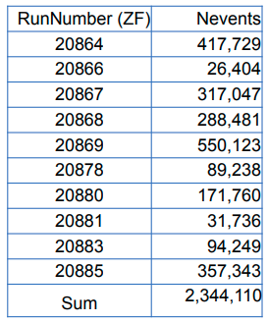
Number of runs: 10
20869 Cheng-Wei recommend

Slide 3
To do
Run dependence of
zvertex (INTT)
Number of clusters
Number of hits
Event dependence of
INTT standalone
Number of clusters
Number of hits
INTT and MBD
BCO_full1-BCO1
zvertex(INTT) – zvertex(MBD)
For v2 analysis
Average of Q vectors (Qx, Qy)
Notes:
RunNumber (ZF) Nevents
20864 417,729
20866 26,404
20867 317,047
20868 288,481
20869 550,123
20878 89,238
20880 171,760
20881 31,736
20883 94,249
20885 357,343
Sum 2,344,110

Slide 4
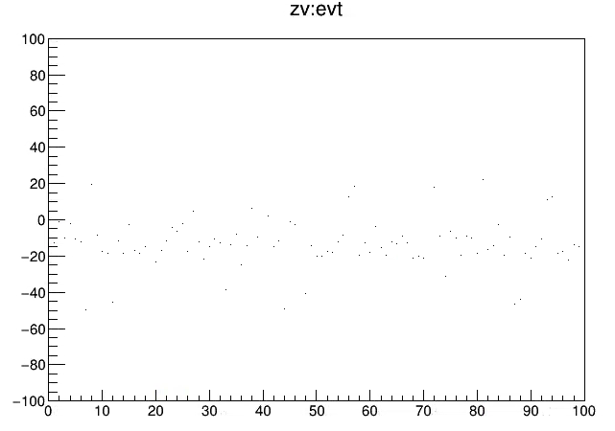
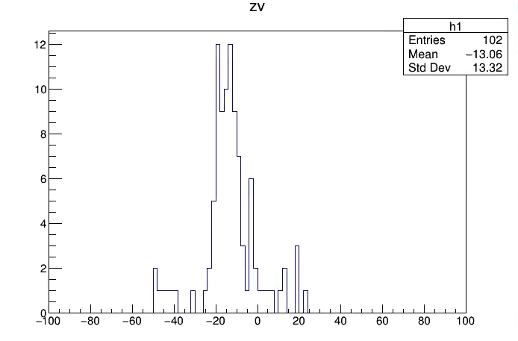
Z-vertex(INTT) vs. event number
Z-vertex (n = 100)
Z-vertex [cm]
Z vertex [cm]
Using INTT z-vertex reconstruction macros in github.
Event number
So far, good, keep going.

Slide 5
Summary
Data QA started. Listed the items, could be added.
Z-vertex is reconstructed and checking its event number dependence.
More is coming.

