Slide 1

EIC next 10+ years to start of operations
Abhay Deshpande
October 16, 2023
Discussion in the CFNS Fellows Gathering @ Stony Brook
These are my personal thoughts, not “the opinion” of the EIC Project (though they should be ;-))

Slide 2
From now until first physics collisions
EIC Project (1 machine + 1 detector) timeline & criticality of its success
Some thoughts on EIC early operations & planning
  How would the EIC Operations evolve? – Historical precedent and experience
Is “theory” ready to meet EIC data?
Ultimate Success of EIC ➔ A second detector
  Expansion of EIC Science Scope for ePIC & science scope for Detector 2

Slide 3
Item 1:
EIC project and its timeline

Slide 4
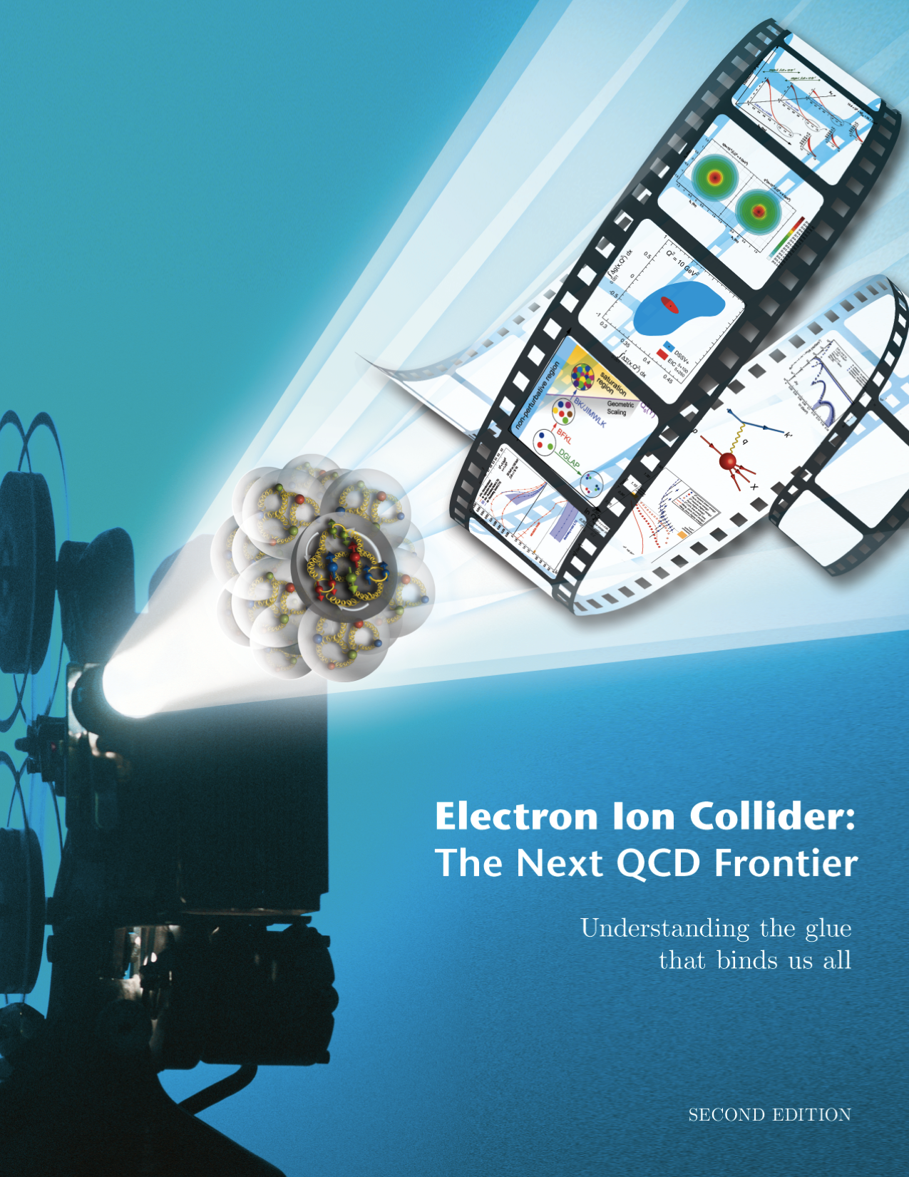
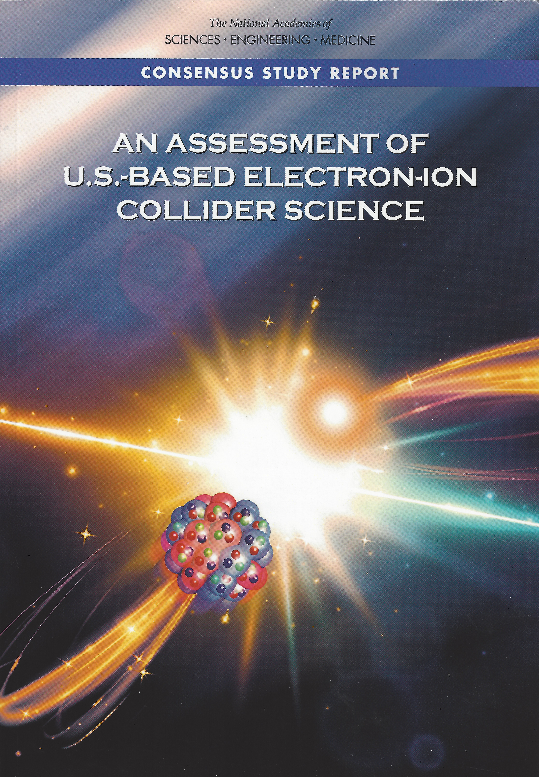

National Academy of Science, Engineering and Medicine
Assessment July 2018
Physics of EIC
Emergence of Spin
Emergence of Mass
Physics of high-density gluon fields
Machine Design Parameters:
High luminosity: up to 10³³-10³⁴ cm⁻²sec⁻¹
  a factor ~100-1000 times HERA
Broad range in center-of-mass energy: ~20-140 GeV
Polarized beams e-, p, and light ion beams with flexible spin patterns/orientation
Broad range in hadron species: protons…. Uranium
Up to two detectors well-integrated detector(s) into the machine lattice
EIC science:
compelling, fundamental
and timely

Slide 5

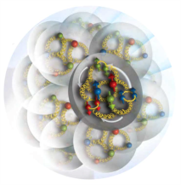
EIC Physics at-a-Glance
Eur. Phys. J. A 52 (2016) 9, 268 arXiv:1212.1701 (nucl-ex)
How are the sea quarks and gluons, and their spins, distributed in space and momentum inside the nucleon? How do the nucleon properties (mass & spin) emerge from their interactions?
How do color-charged quarks and gluons, and colorless jets, interact with a nuclear medium? How do the confined hadronic states emerge from these quarks and gluons? How do the quark-gluon interactions create nuclear binding?
How does a dense nuclear environment affect the quark- and gluon- distributions? What happens to the gluon density in nuclei? Does it saturate at high energy, giving rise to a gluonic matter with universal properties in all nuclei, even the proton?
gluon
emission
gluon recombination
?
=

Slide 6
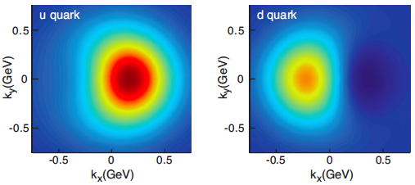
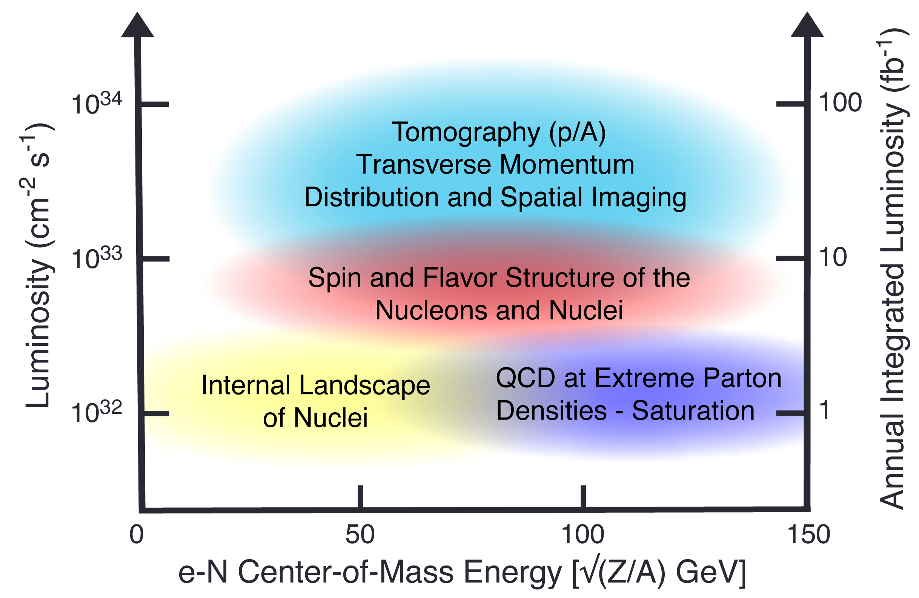
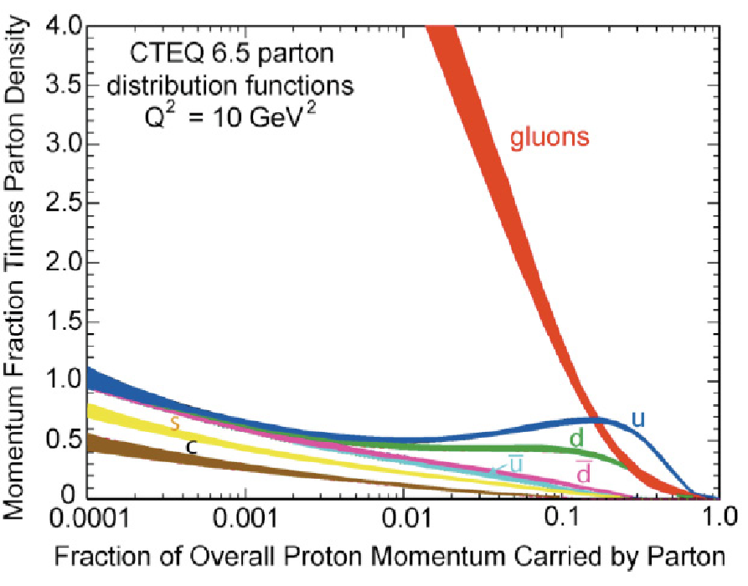
EIC science highlights
Mass &
?

Slide 7
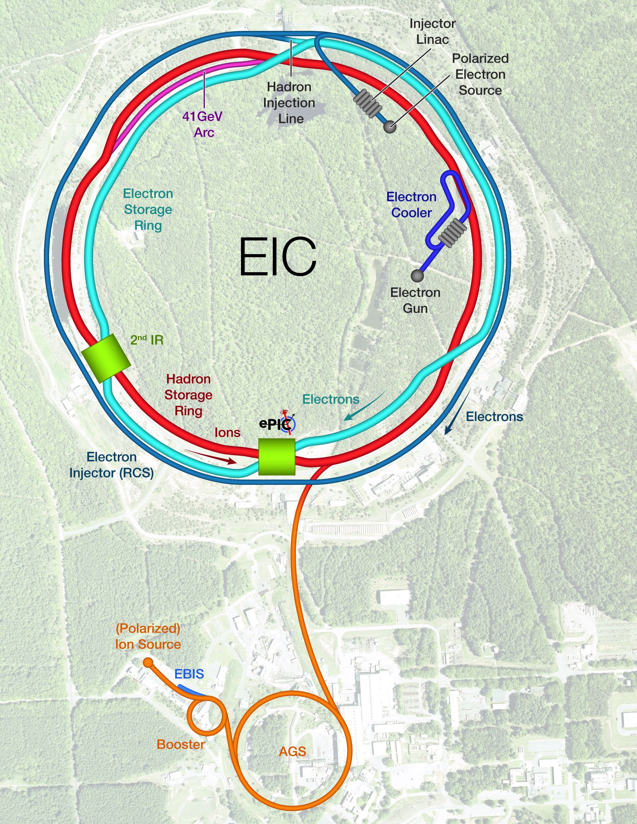
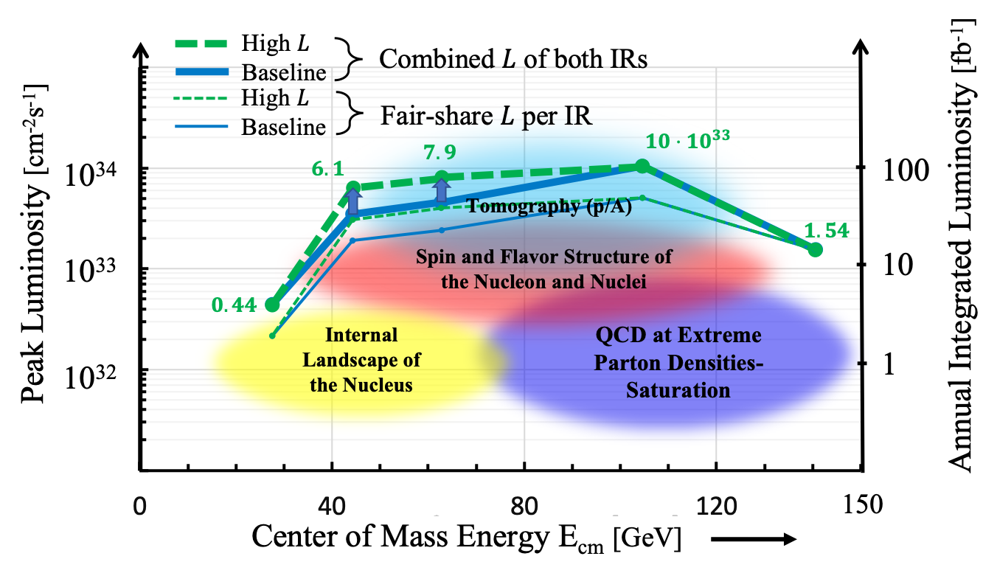
EIC Accelerator Design
Center of Mass Energies: | 20GeV - 140GeV
Luminosity: | 10³³ ⁻ 10³⁴ cm⁻²s⁻¹ / 10-100fb⁻¹ / year
Highly Polarized Beams: | 70%
Large Ion Species Range: | p to U
Number of Interaction Regions: | Up to 2!

Slide 8

Jim Yeck

Slide 9
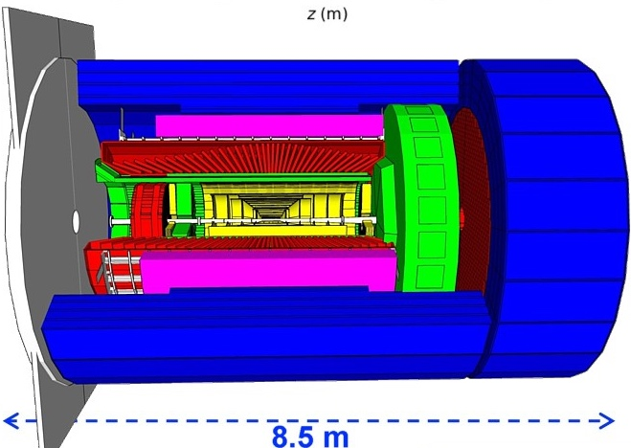
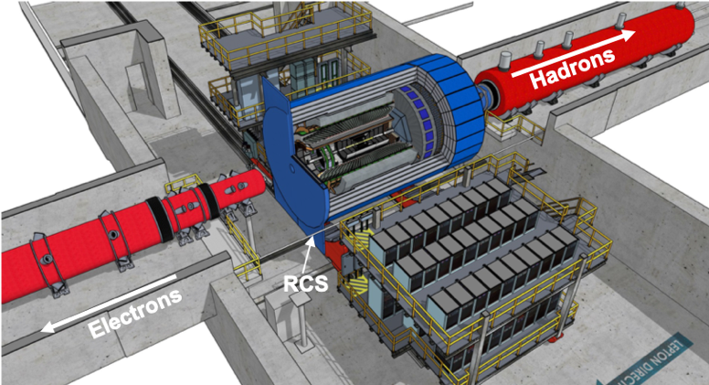
EIC Management team working with the EICUG to realize EPIC
hadronic calorimeters
solenoid coils
ToF, DIRC,
RICH detectors
e/m calorimeters
MPG & MAPS trackers
Detector requirements:
Large rapidity (-4 < η < 4) coverage; and far beyond
  Large acceptance for diffraction, tagging, neutrons from nuclear breakup: critical for physics program
  → Integration into IR from the beginning critical
  Many ancillary detector along the beam lines:
  low-Q² tagger, Roman Pots, Zero-Degree
  Calorimeter, ….
High precision low mass tracking
  small (μ-vertex Silicon) and large radius (gas-based) tracking
Electromagnetic and Hadronic Calorimetry
  equal coverage of tracking and EM-calorimetry
High performance PID to separate e, π, K, p on track level
  good e/h separation critical for scattered electron ID
Maximum scientific flexibility
  Streaming DAQ → integrating AI/ML
Excellent control of systematics
  luminosity monitor, electron & hadron Polarimetry

Slide 10
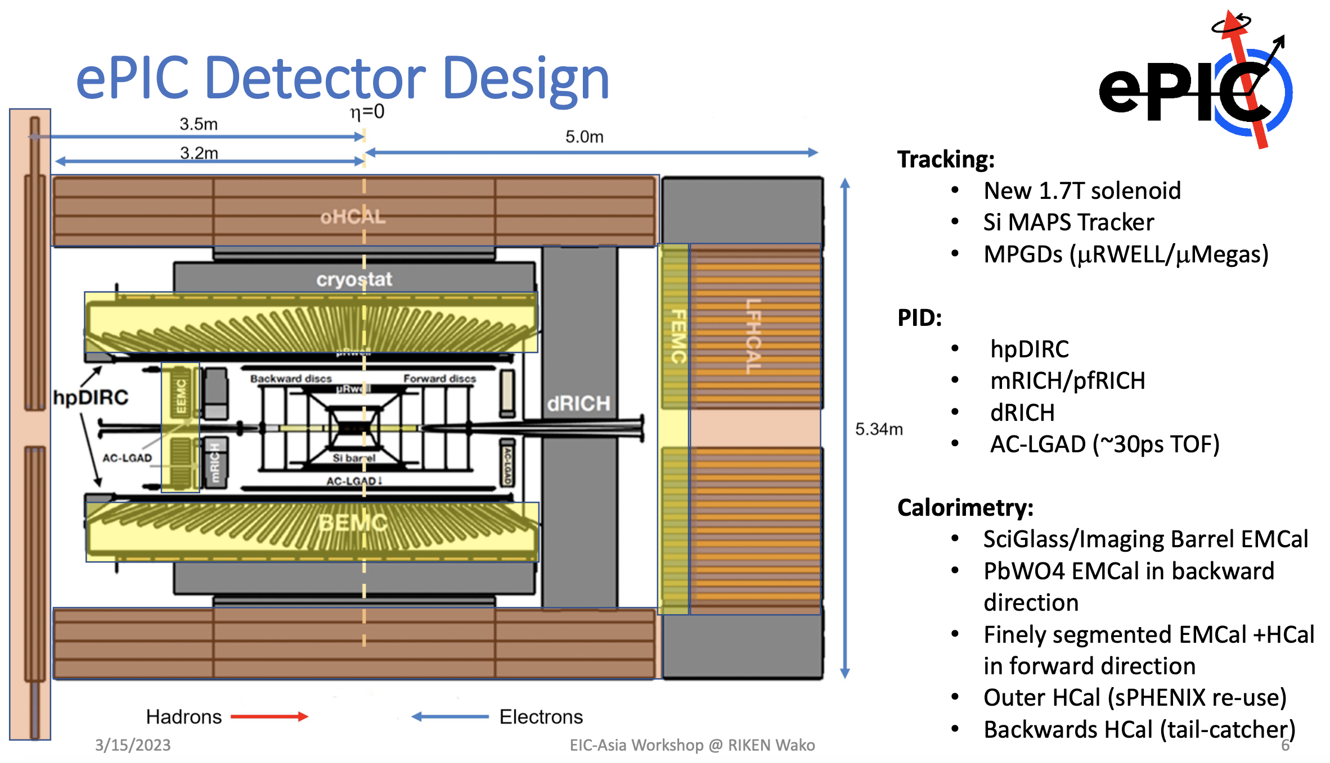

Slide 11

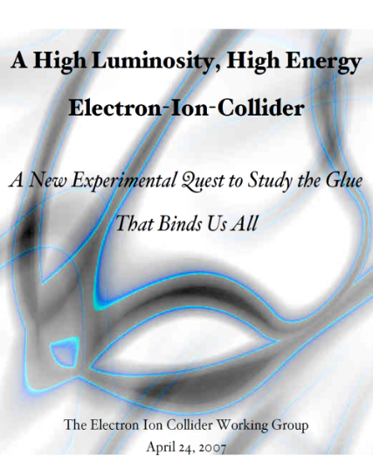



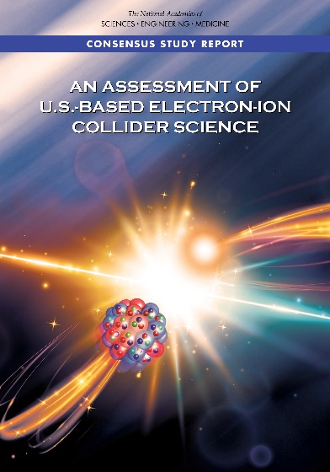
The Scientific Foundation for an EIC was Built Over Two Decades
2002
2007
Electron-Ion Collider..absolutely central to the nuclear science program of the next decade.
2009
2010
The science questions that an EIC will answer are central to completing an understanding of atoms as well as being integral to the agenda of nuclear physics today.”
“a high-energy high-luminosity polarized EIC [is] the highest priority for new facility construction following the completion of FRIB.”
Gluons and the Quark Sea at High Energies
2012
2013
2023
Major Nuclear Physics Facilities for the Next Decade
2015
2018
“…essential accelerator and detector R&D [for EIC] should be given very high priority
in the short term.”
2021
“We recommend the allocation of resources …to lay the foundation for a polarized Electron-Ion Collider…”
NSAC
“..a new dedicated facility will be essential for answering some of the most central questions.”
March 14, 2013
“The quantitative study of matter in this new regime [where abundant gluons dominate] requires a new experimental facility: an Electron Ion Collider..”
Build
expeditiously
arXiv:2103.05419
Science Requirements and Detector Concepts for the EIC – Drives the requirements of EIC detectors

Slide 12
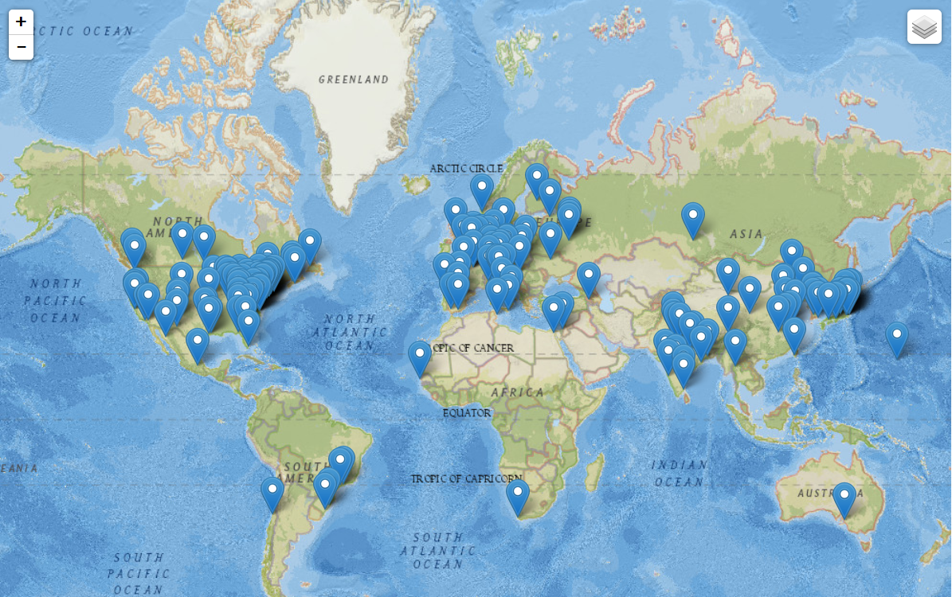
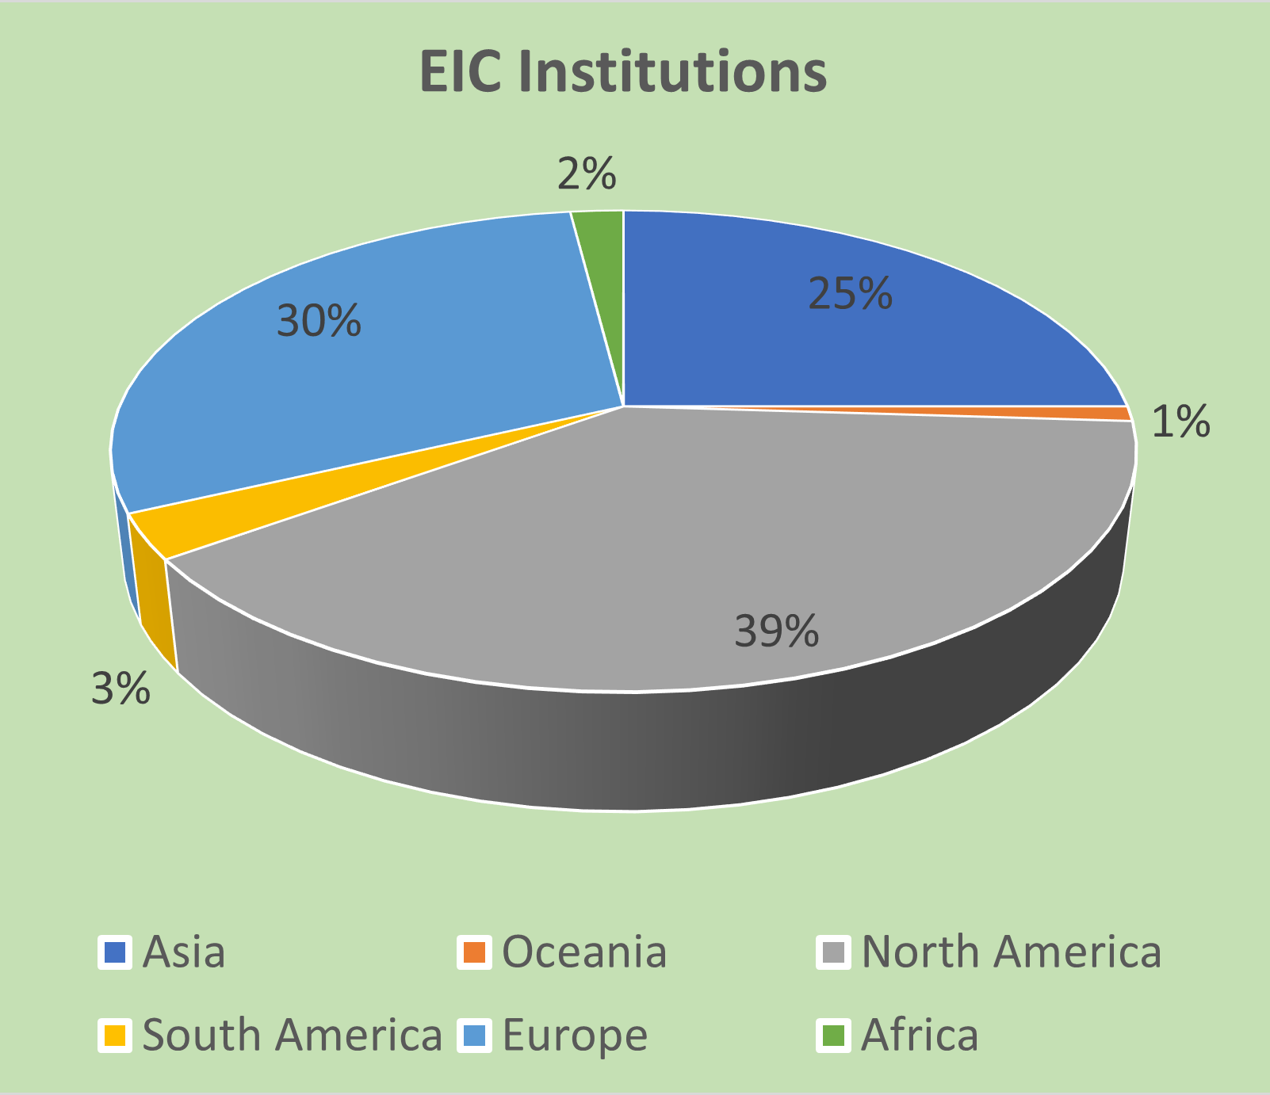
Worldwide Interest in EIC
The EIC User Group: https://eicug.github.io/
Map of institution’s locations
Formed 2016 –
1417 collaborators,
37 countries,
285 institutions
as of October 02, 2023.
Strong International Participation.
Annual EICUG meeting
2016 UC Berkeley, CA
2016 Argonne, IL
2017 Trieste, Italy
2018 CUA, Washington, DC
2019 Paris, France
2020 FIU, Miami, FL
2021 VUU, VA & UCR, CA
2022 Stony Brook U, NY
2023 Warsaw, Poland
2024 Lehigh U, PA

Slide 13
Physics @ the US EIC beyond the EIC’s core science
Of HEP/LHC-HI interest to Snowmass 2021 (EF 05, 06, and 07 and possibly also EF 04)
New Studies with proton or neutron target:
Impact of precision measurements of unpolarized PDFs at high x/Q², on LHC-Upgrade results(?)
Precision calculation of α_{S} : higher order pQCD calculations, twist 3
Heavy quark and quarkonia (c, b quarks) studies with 100-1000 times lumi of HERA and with polarization
Polarized light nuclei in the EIC
Physics with nucleons and nuclear targets:
Quark Exotica: 4,5,6 quark systems…? Much interest after recent LHCb led results.
Physic of and with jets with EIC as a precision QCD machine:
  Jets as probe of nuclear matter & Internal structure of jets : novel new observables, energy variability
  Entanglement, entropy, connections to fragmentation, hadronization and confinement
Precision electroweak and BSM physics:
Electroweak physics & searches beyond the SM: Parity, charge symmetry, lepton flavor violation
LHC-EIC Synergies & complementarity
Study of universality: e-p/A vs. p-A, d-A, A-A at RHIC and LHC

Slide 14
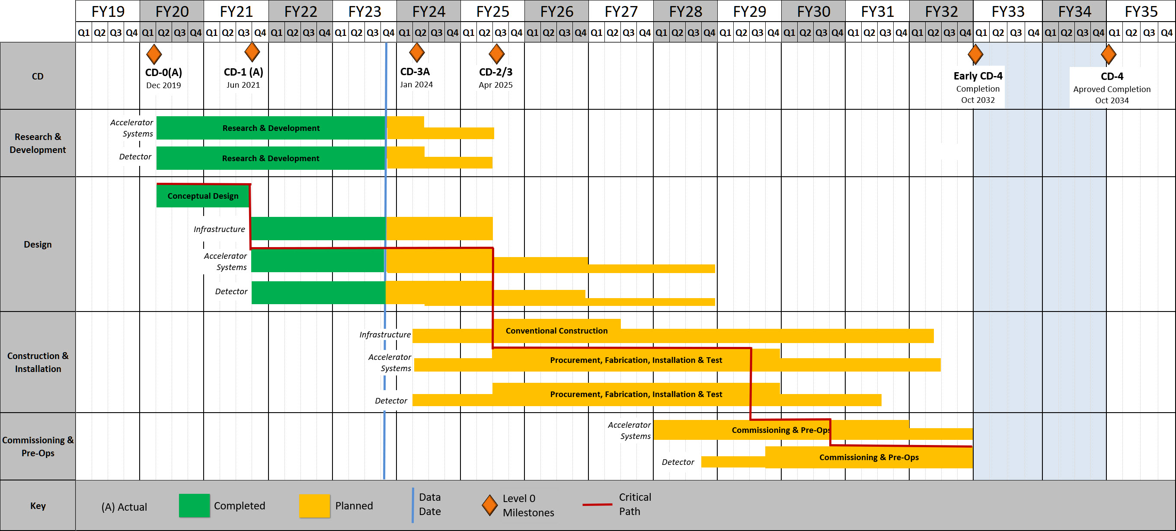
Timeline:
Operating* Funds
Project Engineering and Design (PED) Funds
Construction & PED
Funds
Operating Funds
Initiation
Definition
Execution
Closeout
    EIC Critical Decision Plan
    CD-0/Site Selection December 2019 ✓
    CD-1 June 2021 ✓
    CD-3A January 2024
    CD-2/3 April 2025
    CD-4A October 2032
    CD-4 October 2034
EIC
Conceptual Design
Preliminary Design
Final Design
Construction
Critical
Decisions
CD-0
Approve Mission Need
CD-1
Approve Alternative Selection
and Cost
Range
CD-2
Approve Performance Baseline (PB)
CD-3
Approve Start of Construction or Execution
CD-4
Approve
Start of Operations or Project Completion
CD-3A: (review mid-November)
Define Baseline:
technologies, Scope, Cost & Schedule
Long Lead Procurement (LLP) items
Design Maturity: ~90%
Plan is tracked through EVMS
& Change control process
Start of construction for LLPs
Construction Phase
Conclusion of
RHIC Operation
Science Phase

Slide 15
Project Schedule
Conclusion of
RHIC Operations
06/2025
Review
14-16 Nov
CD-2
01/2025
early
CD-4A
04/2031
early CD-4
CD-4A
04/2032
CD-0
12/2019
CD-1
06/2021
CD-3A
01/2024
CD-3
04/2025
will
combine
CD-2 & CD-3
CD-4
04/2034
Conceptual
Design
Preliminary
Design
Final
Design
Construction
Transition into
Operations
Start of
Operations
&
Science
Final Design LLPs
Approve final design
for all subdetectors
Design Maturity: ~90%
Need full TDR
January 2023:
start change control
process for detector
April 2023:
train EVMS process
    EIC Critical Decision Plan
    CD-0/Site Selection December 2019 ✓
    CD-1 June 2021 ✓
    CD-3a January 2024
    CD-2 January 2025
    CD-3 April 2025
    CD-4a early finish April 2031
    CD-4a April 2032
    CD-4 early finish April 2032
    CD-4 April 2034
Define Baseline:
Subdetector technologies,
Scope, Cost & Schedule
Long Lead Procurement items
Design Maturity: ~90%
Plan is tracked through EVMS
& Change control process
Need TDR for LLPs
Aschenauer & Ent

Slide 16
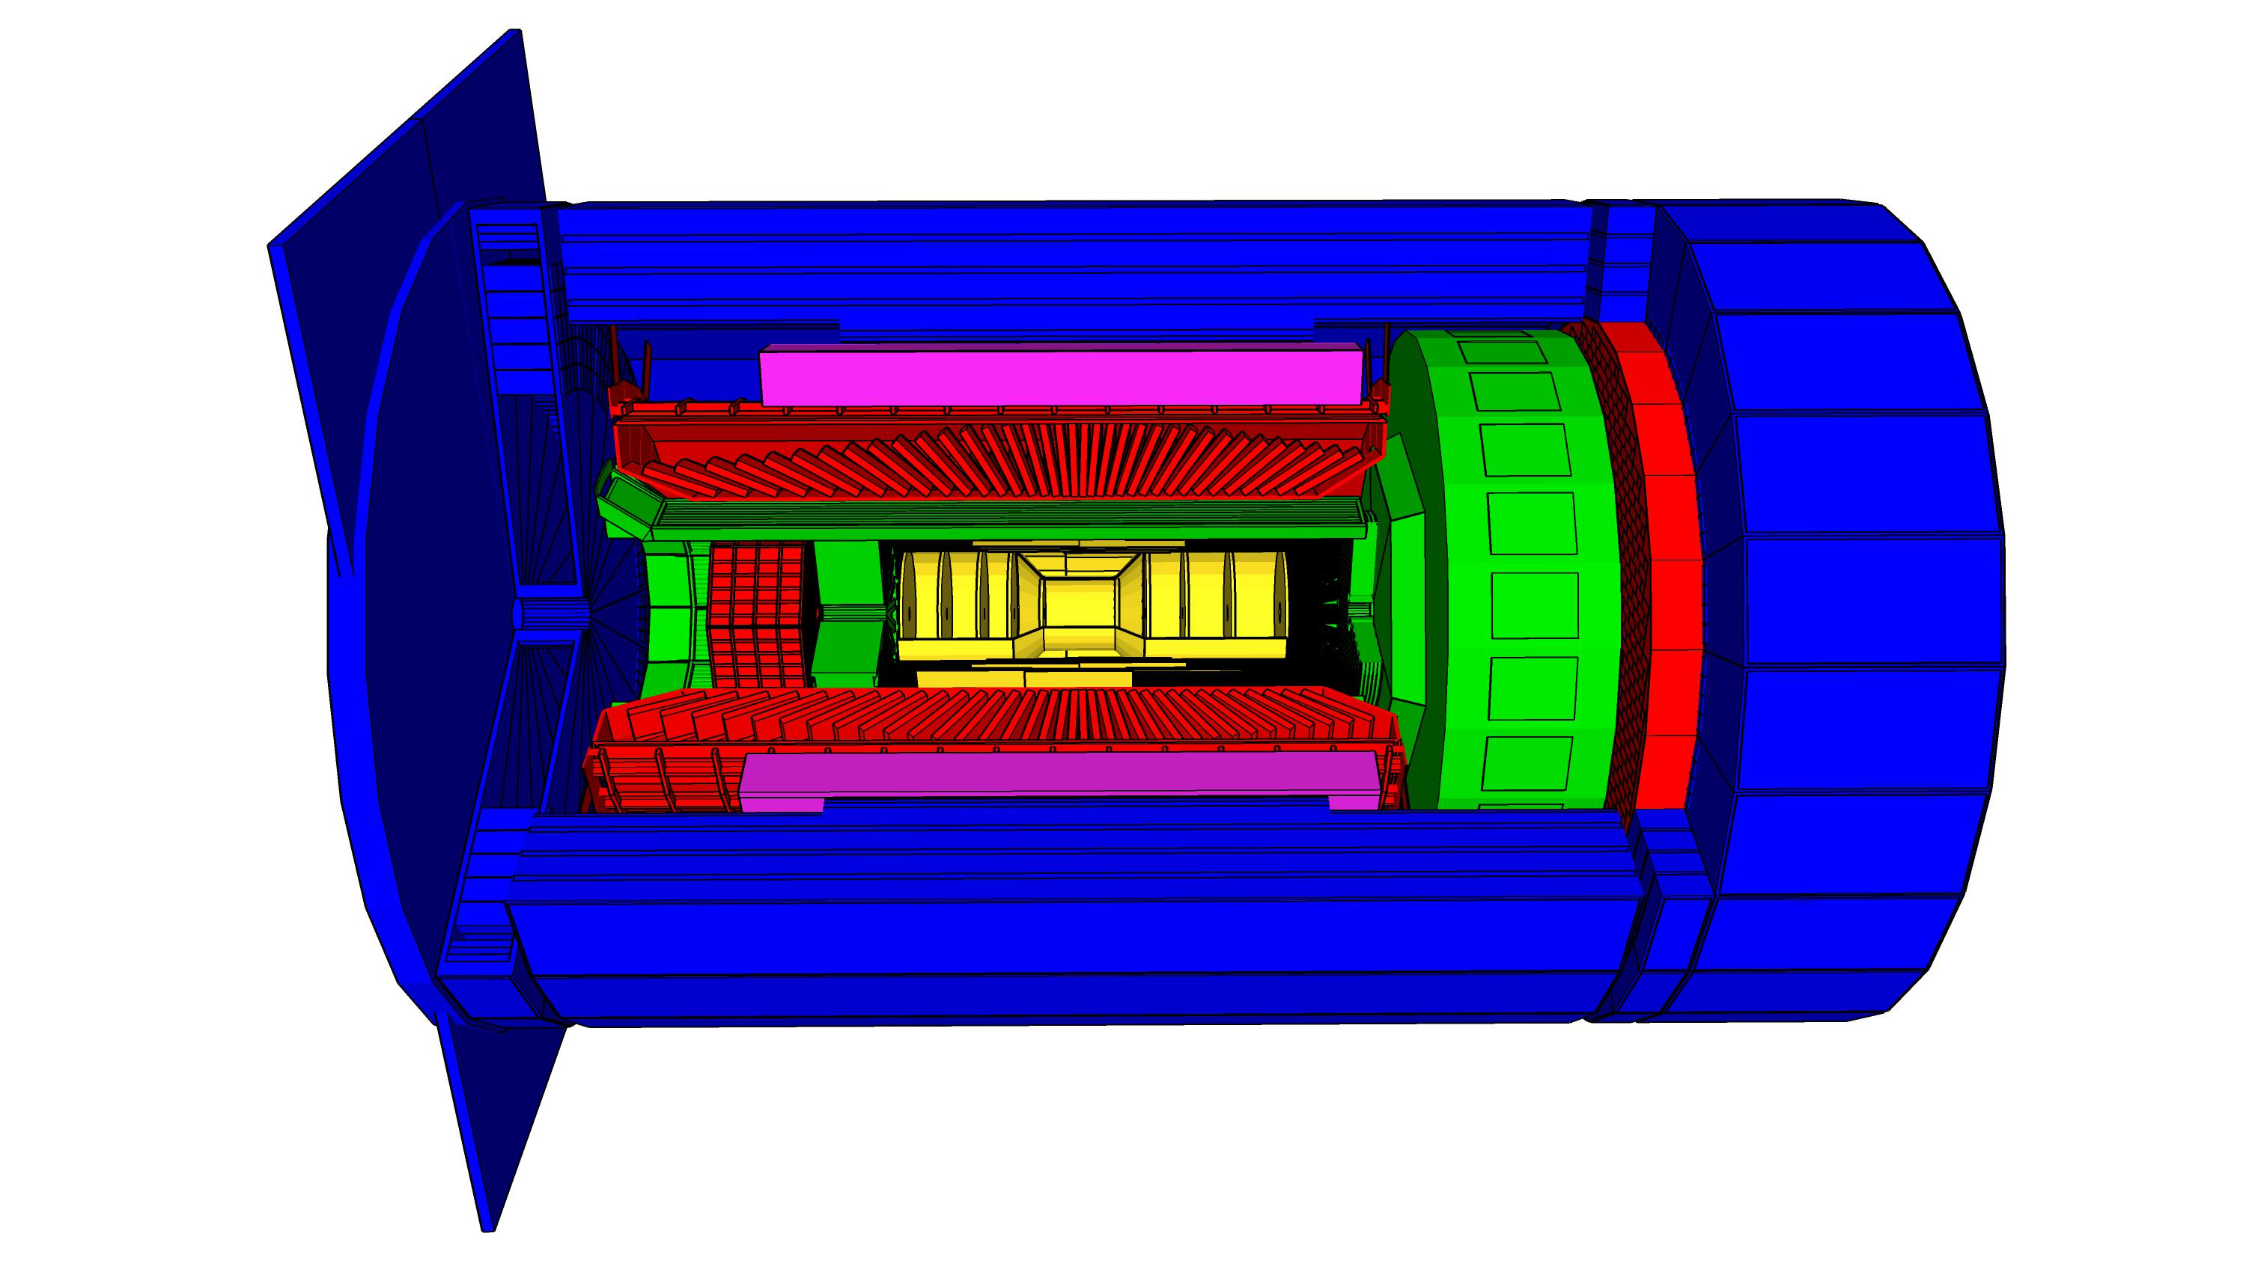
High Level Installation Schedule
Oct 2028
Jan 2029
early
CD-4A
04/2031
early CD-4
CD-4A
04/2032
CD-3
04/2025
April 2029
Dec 2029
CD-4
04/2034
June 2030
Oct 2030
Jan 2031
Construction
IR-6 ready
for installation
Transition into
Operations
Start of
Operations
&
Science
lower half
barrel Hcal
installed
Solenoid
delivered
Endcap HCals
completed
Solenoid
Field mapping
done in beam position
Hadron Endcap
Detectors
installed
Trackers, dRICH
ECal
done in IP-6 Assembly Hall
Barrel Ecal
ready
for installation
Barrel Hcal
& Solenoid
installed
followed by low
power test
Lepton Endcap
Detectors
installed
Trackers, bRICH
ECal
Barrel Detectors
installed
ECal, DIRC,
ToF, Trackers
Tight Timeline:
Solenoid and Barrel HCal need to be ready by Jan 2029
all other subdetectors need to be ready between 06/29 to 06/30 depending on their location in the detector
Aschenauer & Ent

Slide 17
Item 2:
Transition to operation:
Operations planning
Start with lowest possible luminosity to build confidence in the machine in order to avoid accidental damage to the detector components and the machine itself. As we go forward and we get some explicit guidance on luminosity rise from EIC/CAD – we should be able to make more concrete proposals for early running – energy, species and physics goals/outcomes.

Slide 18
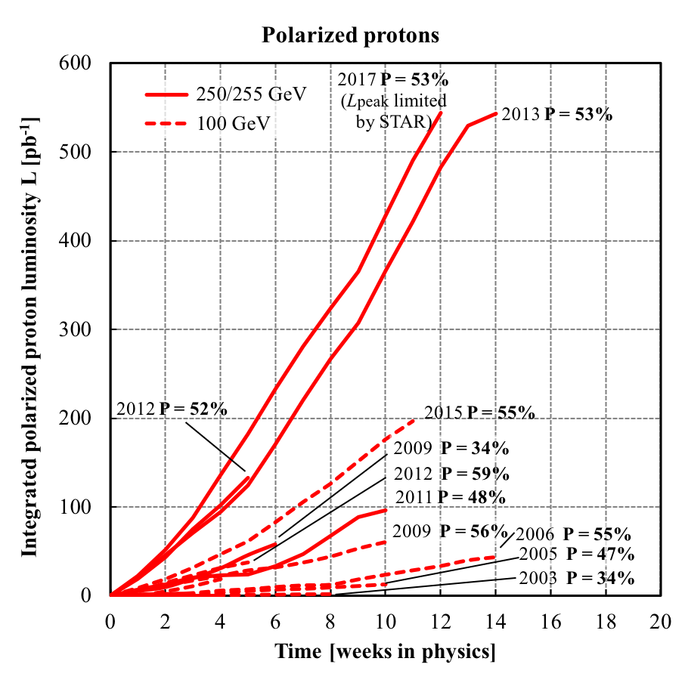
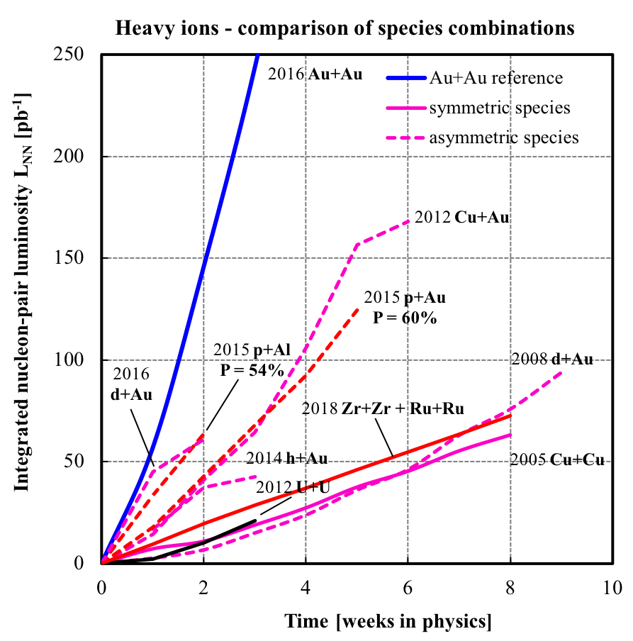
@RHIC Polarized protons harder than nuclei
Notes:
What was the landscape of spin physics just before RHIC Spin?

Slide 19
Historical Precedence:
HERA Experience:
HERA highest luminosity ~ 5 x 10³¹ cm⁻²sec⁻¹
HERA & RHIC lessons:
Start of the machine slow and deliberate
Development of polarization (both beams along with luminosity) will take time but early investments pay-off

Slide 20
Preliminary thoughts & estimates
Time on this slide starts at CD4
We should (hope to) see ~1 x 10³²cm⁻²sec⁻¹ in the 1st year (already twice the maximum reached at HERA), and reach ~10³³ in ~2-3 years, and 10³⁴ in ~5+ years at 10 x 250 GeV polarized proton operation.
18 GeV e beam will be experimented with before CD4 if RF is ready but not for “physics operation” until about 3-5 years into the program.
I expect polarization of electron and proton would be harder to achieve compared to e-A luminosity.
We would like to show fast physics results ➔
e-A physics 10 x 100 GeV beams at the beginning with highest luminosity possible
run at least two nuclei in the first two years
ample time would be given to develop polarization and luminosity for e-p

Slide 21
Start EIC physics program hence could be:
Begin with electron-Nucleus/Ion Physics:
Intermediate/high energy operations with different nuclei leading to:
Search for saturation from inclusive to sem-inclusive ➔ F₂^{A}, disappearance of jet
Interactions in color with nuclear matter: with multiple nuclear sized targets; study of jet production and its interaction with nuclear matter, study jet internal structure, hadronization
With luminosity increase: exclusive diffraction in e-A to establish saturation
Comparison runs of e-p should be expected at moderate luminosity (not for polarization) but we should be ready to utilize what we get for inclusive & start semi-inclusive spin physics
Allow ample time for luminosity and polarization development. In RHIC era, significant time of p-p was given to R&D. This philosophy gave high returns later in the program.

Slide 22
Operational thoughts further….
10³³ luminosity ➔ 20 fb⁻¹/year including 70% accelerator & detector efficiency
White paper and Yellow Report hence assumed those luminosities and hardly any measurement showed more luminosity in e-p-equivalent would be needed.
It is hence my guess that physics with polarized beams will start happening after the 2nd year with.
Transverse spin measurements needing only proton beam polarization should be easier to achieve than double longitudinal spin measurements with high e-polarization

Slide 23
Item 3:
Is theory ready for EIC to start?
Greatly benefitted from Daniel deFlorian’s recent talk at DIS2023 and also input from Werner Vogelsang and a recent White Paper submitted to the NSAC Long Range Planning process:
“A Case for an EIC Theory Alliance: Theoretical Challenges of the EIC”, R. Abir et al. arXiv: 2305.14572v1
Based on: CFNS/Stony Brook & CFNS/MIT Workshops in 2022:
1) Precision QCD for e-p at the EIC and 2)Theory for EIC in the Next Decade

Slide 24
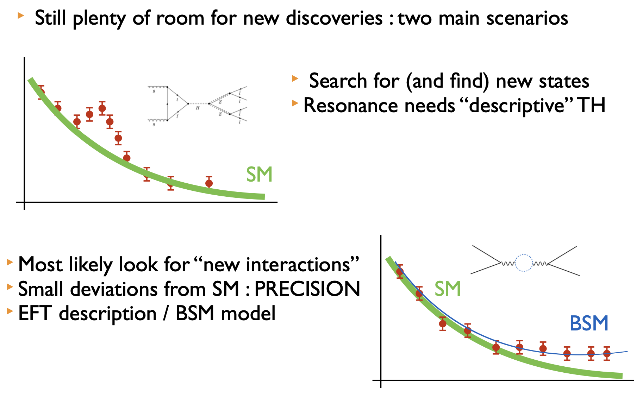
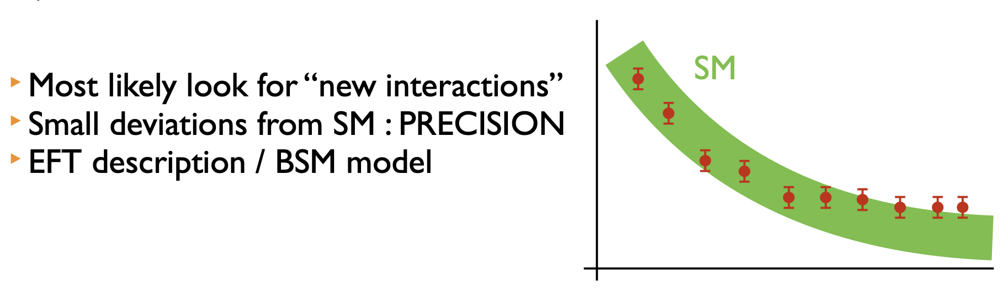
Anticipated precision at the LHC drove higher precision calculations in theory
Fig. from de Florian
Theory uncertainties HAD to be reduced

Slide 25
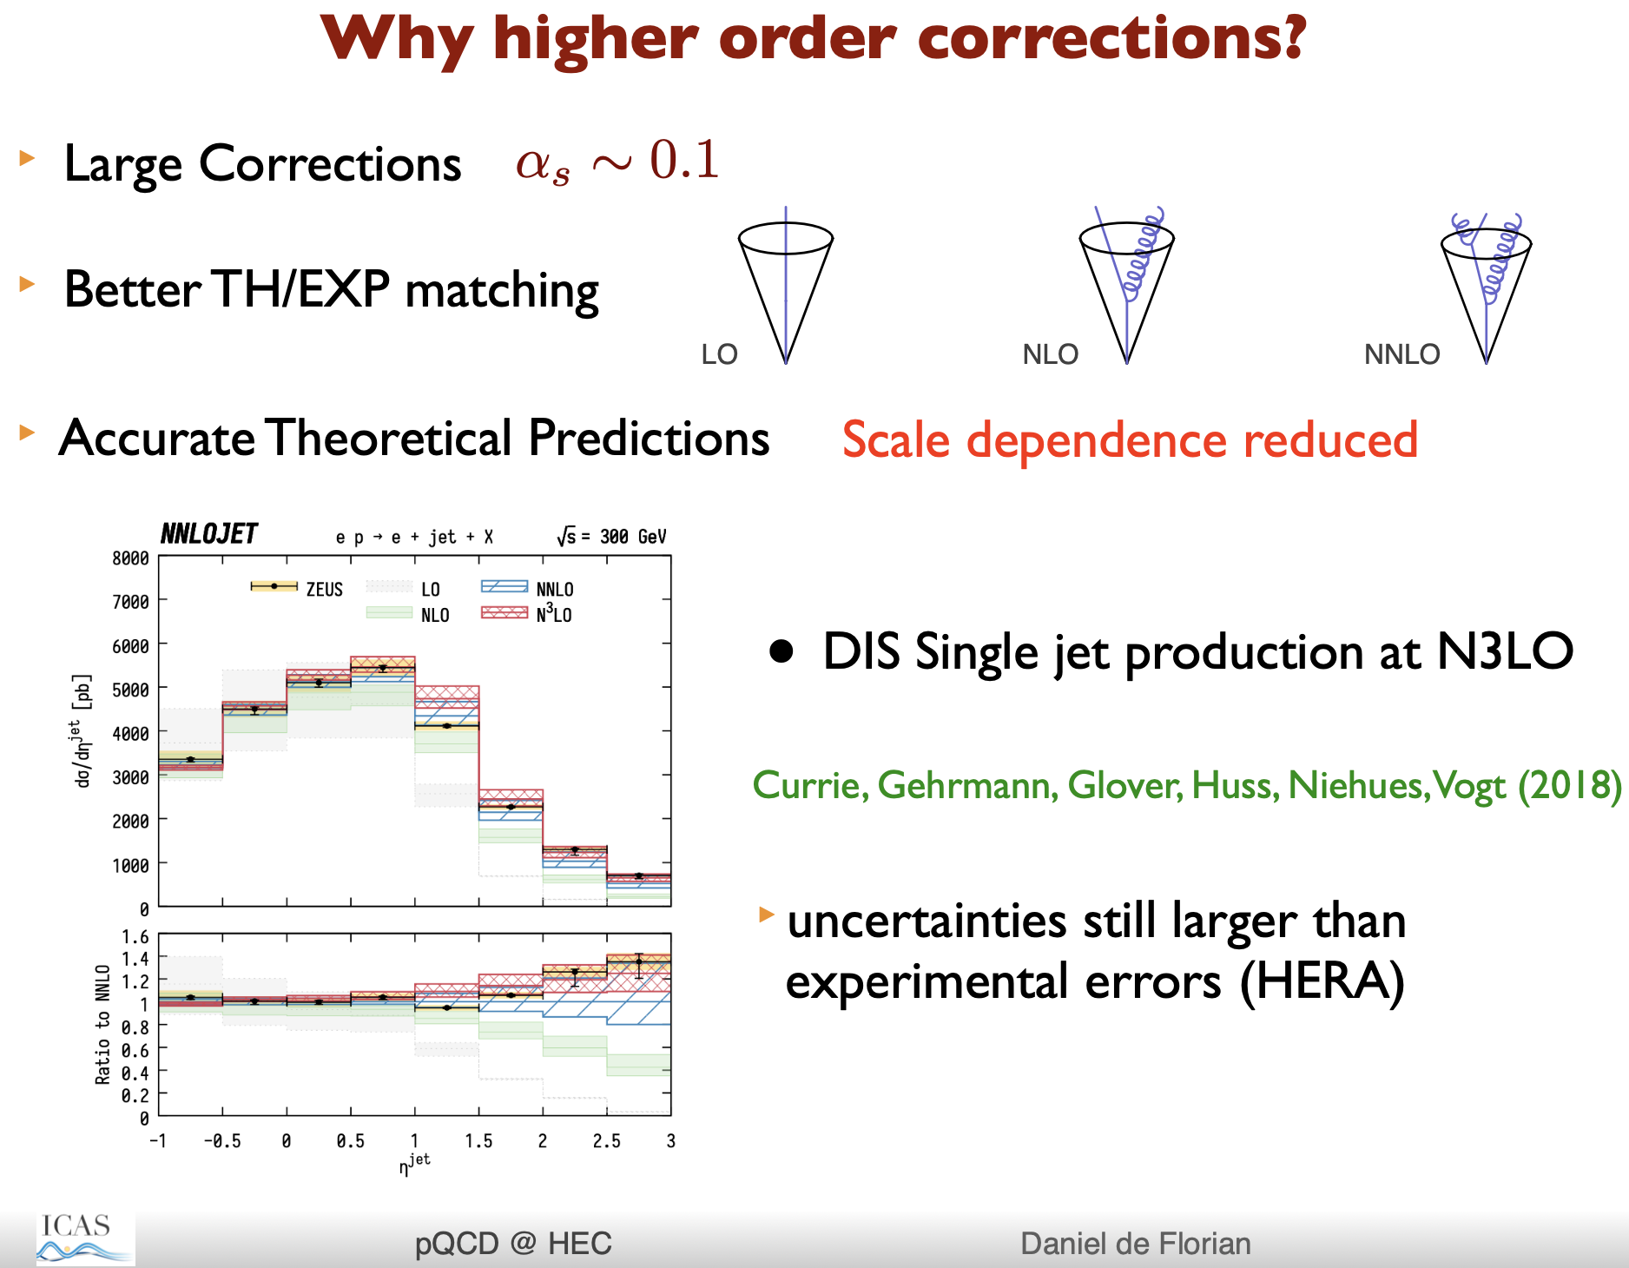
Recall, EIC luminosity will be at
least 100 (if not 1000) times larger than HERA
Clearly theory precisions needs to be visited immediately.

Slide 26
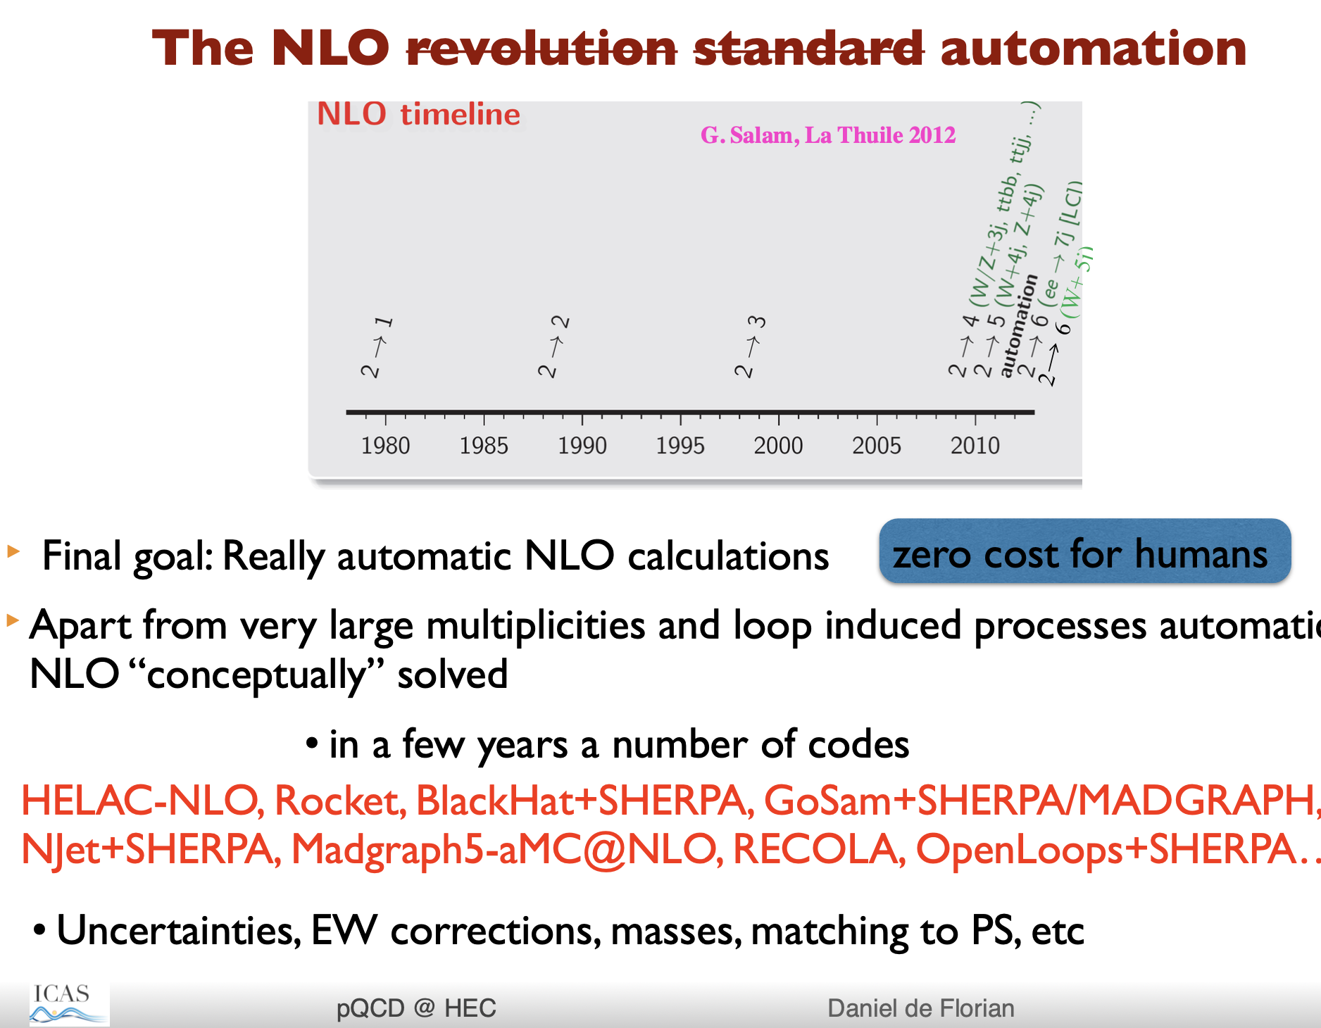
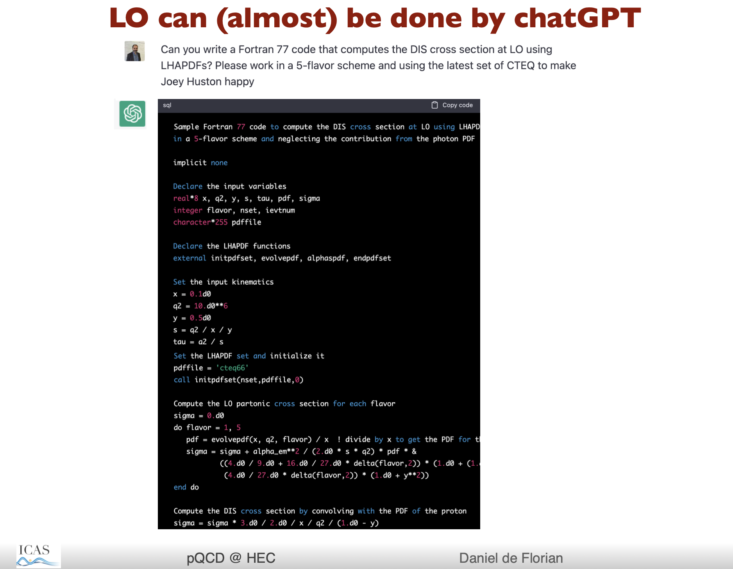
Automation at NLO already used and demonstrated.
Modern version: with ChatGPT LO tested(?) (Joke!)

Slide 27
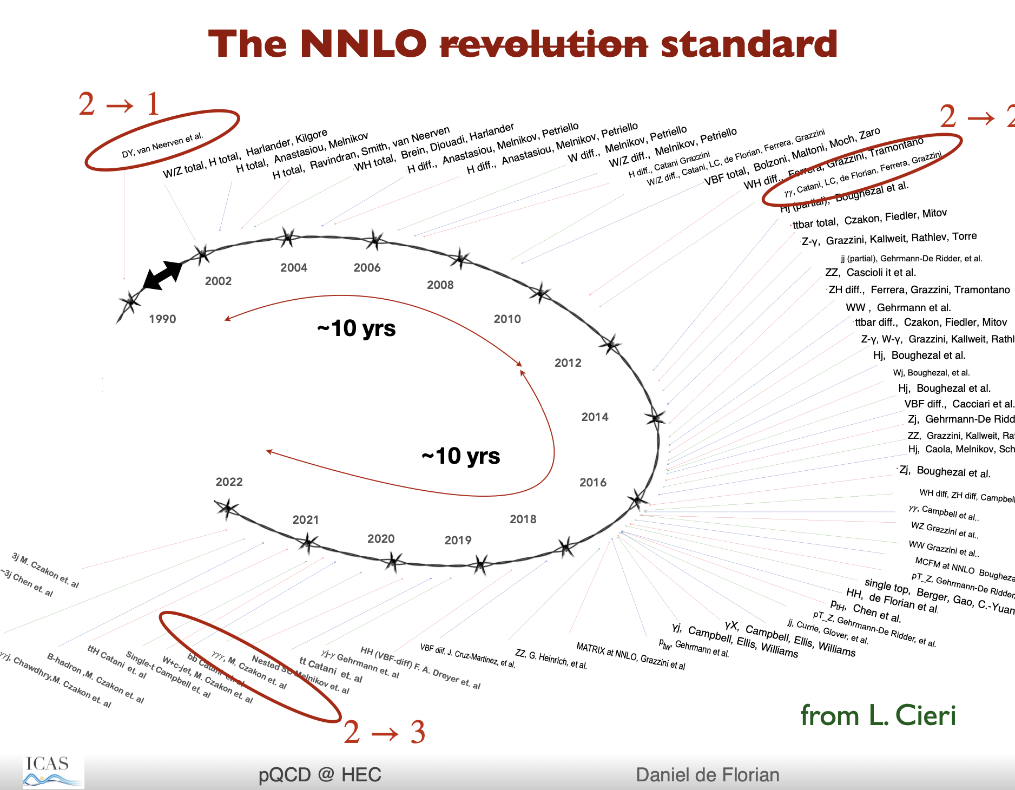
New Standard at LHC is NNLO
But it took 20 years from 1990’s to 2020’s for all processes to be calculate & tested

Slide 28
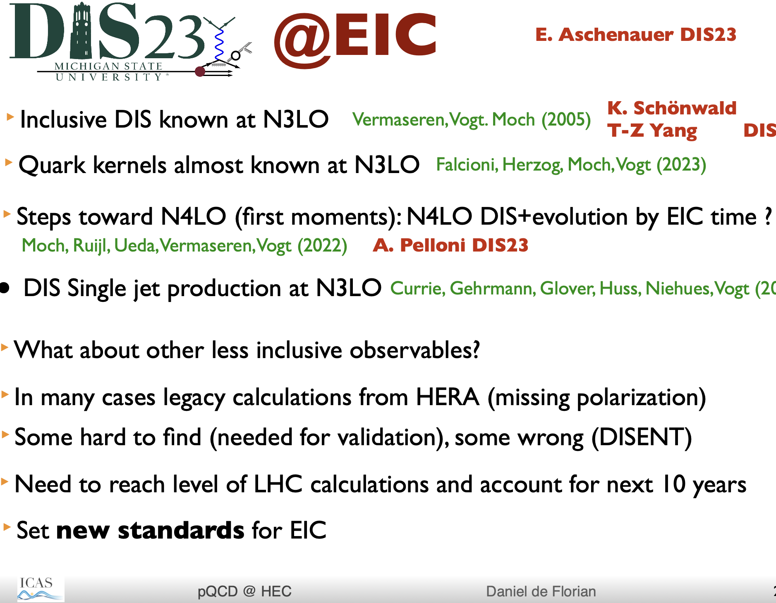
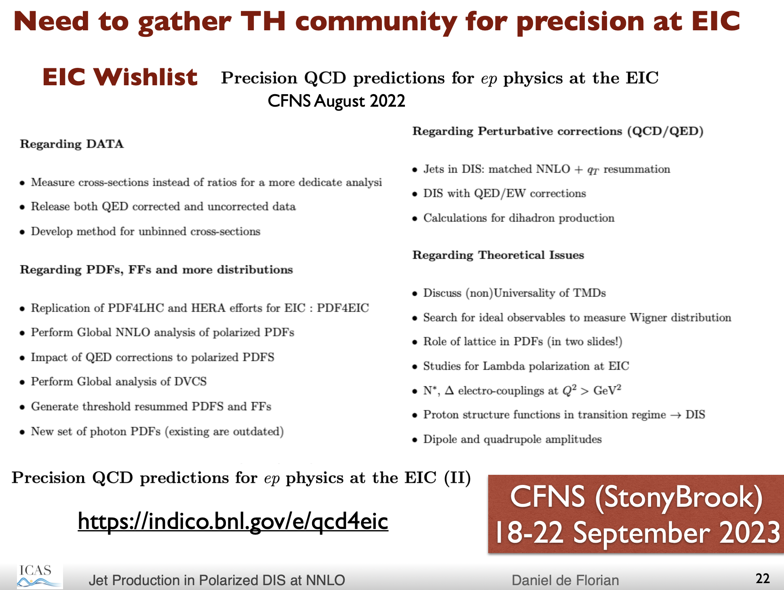

Slide 29
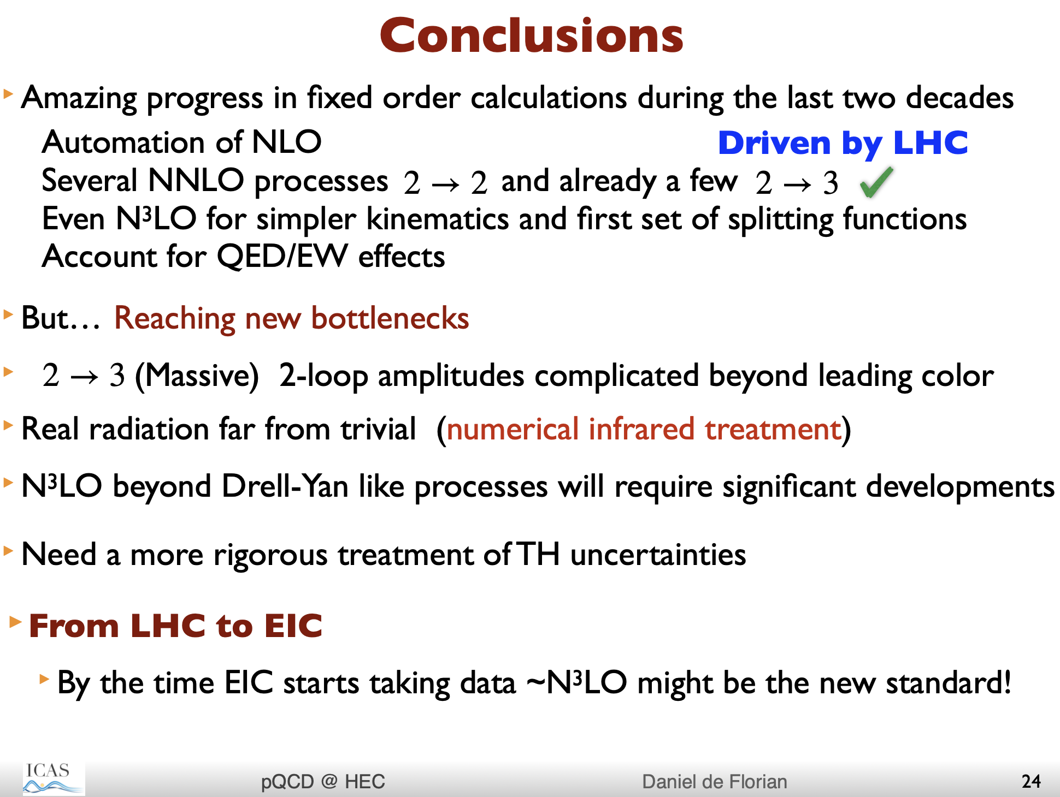
An enormous thrust in precision calculations in Theory including already emerging precision in Lattice QCD is needed in the next ~10 years before or around the same time the EIC data will become available

Slide 30
While EIC project (machine and 1st detector) have to succeed….
I think we have everything we need to sow the seeds for a 2nd detector

Slide 31
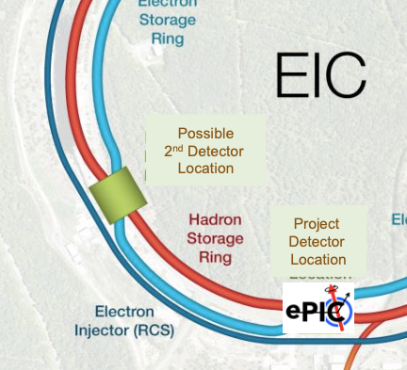
The 2nd detector
NSAC documents talk about possibly ~4 detectors
NAS Report: planning for up to 2 well-integrated detectors
EICUG desires 2 Detectors
EIC Project has 1 Machine, 1 IR and ~1 Detector
  without negating the possibility of the 2nd IR/Detector

Slide 32
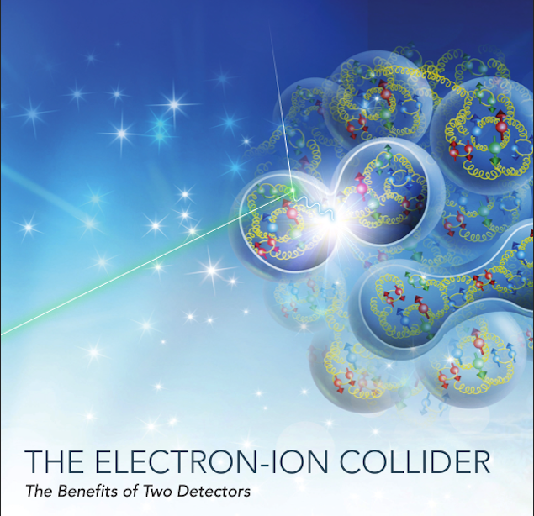
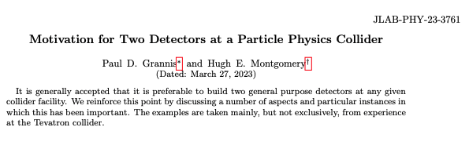
Two documents: with overlapping arguments
arXiv: 2303.08228v2 March 24, 20234
Case for two detectors being made from Nuclear and Particle Physics
Ent and Milner et al for the EICUG SC

Slide 33
History: Discoveries established with more than one detectors in Nuclear Science
Discovery of gluon : TASSO, JADE, Mark J, and PLUTO @ DESY
H1 and ZEUS at Rise of F₂ and hence the gluon dominance at low-x
BRAHMS, PHOBOS, PHENIX and STAR Discovery and establishing the existence of Quark Gluon Plasma
Measurements at DESY and JLab eventually led to “parton imaging”
EMC/CERN discovered and then SMC/CERN and EXXX/SLAC established nucleon spin crisis (low-x) & EMC discovered and then NMC/CERN & E865/FNAL established nuclear effects on nucleon PDFs (also low-x)

Slide 34
Two detectors (independent cross checks) builds trust in novel discoveries and prevents historical mistakes
Building Trust
Quark Gluon Plasma: RHIC Experiments
Discovery of Top Quark D0/CDF
Discovery of Higgs Boson: ATLAS and CMS
Gravitational Waves: LIGO and VIRGO
Neutrino oscillations
Mistakes or misinterpretations:
Cold fusion
17 KeV neutrinos in Tritium
Superluminal neutrinos
Leptoquarks
Pentaquarks from 2000’s

Slide 35
Vision for the 2nd detector: C²C
Complementary (IR, detector technologies & design)
  Continue to explore complementary ready and not-yet-ready technologies
  Generic detector R&D program – Run through Jlab
Complementary (physics)
  A significant list of physics topics exists (some-exclusive to 2nd IR, some-overlapping): drill down and see which of those can develop into strong pillars of science for the 2nd detector.
  New physics developing around the world: we need to monitor constantly
Complementary (people)
  New non-US/outside groups who may bring new interests & funding in future
  New US groups – other than those with significant responsibilities in ePIC

Slide 36
Focus first on Physics beyond the EIC’s core (CD0) science
(there will be others: some overlapping, some exclusive due to different IR design)
Potential Physics topics beyond Core EPIC detector’s mandate exist
Physics with nucleons and nuclear targets:
Quark Exotica: 4,5,6 quark systems…? Much interest after recent LHCb led results.
Nuclear Fragments from light and heavy nuclei : e-A – Connecting to low energy nuclear physics (exotic nuclei), studying the shapes of nuclei and their nternal substructure; entanglement, entropy, fragmentation, hadronization and such phenomena
New Studies with proton or neutron target: (mostly overlapping?)
Impact of precision measurements of unpolarized PDFs at high x/Q², on LHC-Upgrade results(?)
Precision calculation of α_{S} : higher order pQCD calculations, twist 3
Heavy quark and quarkonia (c, b quarks) studies with 1000 times lumi of HERA (and polarization)
Precision electroweak and BSM physics:
Electroweak physics & searches beyond the SM: Parity, charge symmetry, lepton flavor violation
LHC-EIC Synergies & complementarity: (muon detectors were of particular interest)

Slide 37
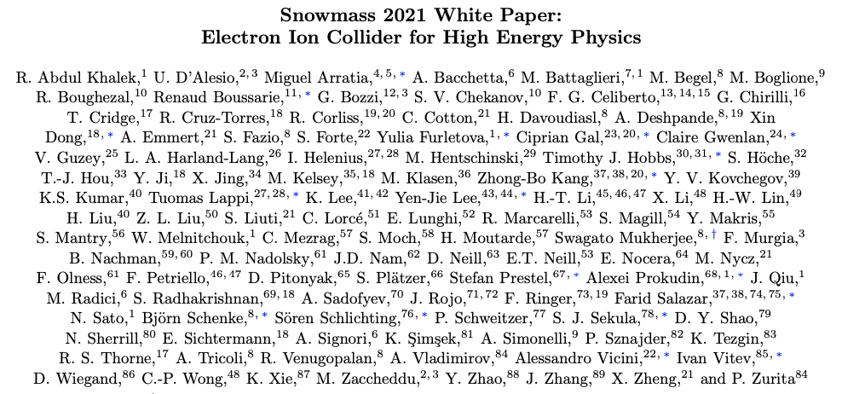
EIC Science from the perspective of High Energy Physicists
arXiv:2203.13199v1 [hep-ph] 24 March 2022

Slide 38
EIC’s versatility, resolving power and intensity (luminosity) open new windows of opportunity to address some of the crucial and fundamental scientific questions in particle physics. The paper summarizes the EIC physics from the perspective of the HEP community participating in Snowmass 2021
Beyond the Standard Model Physics at the EIC
Tomography (1,3,5 d PDFs) of Hadrons and Nuclei at the EIC
Jets at EIC
Heavy Flavors at EIC
Small-x Physics at the EIC
High luminosity wide CM range
Polarized e, p, and ion beams
All nuclei

Slide 39
Detector technologies EIC & LHC:
Potential for overlap and collaboration: Many EIC collaborators already part of RD51 (and family) at CERN & vice-versa.
MAPS μVertex for primary/secondary vtx: barrel & end-caps (ALICE ITS3)
Micro Pattern Gas Detectors: large rapidity, spatial resolution ~100 μm
Electromagnetic Calorimetry for kinematic reconstruction, precise energy measurements e, γ; e/π & π⁰/γ separation. Various technologies at various locations:
  W/SciFi w/o PMT, PbWO4, SiGlass; AstroPix & Pb/SciFi
  High resolution Crystal Cal for e-endcap
  Barrel EMCal 6 layers AstroPix and Pb/SciFi
Particle Identification – extremely important for most EIC physics
  K/pi separation over a wide range 1-20 GeV/c
  Hadron ID: hpDIRC in Barrel, forward EndCap: duel RICH, backward Endcap: modular RICH or pF RICH, also TOF for short lever arm : LGAD, LAPPD
Streaming Readout

Slide 40
Complementary detectors : 1 + 1 > 2
More than one detectors with different acceptances, optimizations and technologies: Redundancy, cross-calibration and independent validation of important results
Complementary acceptance -- confirming or refuting discoveries – studying from different “point of views”
Complementary Technologies – multiple examples of systematic uncertainties improvement due to different Particle ID, Calorimetry, Tracking, magnetic field strengths and orientations.
  H1/ZEUS, PHENIX/STAR, CDF/D0 and ATLAS/CMS vs. LHCb
  Very important because most measurements at the EIC expected to be systematics limited
Impact of different perspectives that different collaborators bring to the same problem.
  Complementary analyses strategies build confidence in conclusions
Complementary Science would add a very significant weight to to the argument for the 2nd detector

Slide 41
Path forward 2nd Detector:
Focused workshops and detector studies on new physics topics:
Look at complementary detector technologies (to ePIC) and attract groups that are experts in them to the EICUG
Focused discussions on new physics topics (not just listed in this talk but also beyond) to try to make a unique case complementary to ePIC/EIC White Paper
Build community – new groups/faces/resources needed to contribute and become part of new detector effort
Resources:
  Generic detector R&D – supported by DOE administered from JLab
  Center for Frontiers in Nuclear Science @ Stony Brook (& EIC – Theory Institute at BNL) and the EIC² at JLab

Slide 42
Summary
EIC Project (1 machine + 1 detector) timeline & criticality of its success
  Consolidate the collaboration, science and detector : Its success is paramount
Some thoughts on EIC early operations & planning
  – Historical precedent and early operational experience: inclusive – to – exclusive,
  e-A to polarized e-p/A
Is “theory” ready to meet EIC data? NO
Ultimate Success of EIC ➔ Physics with a second detector : (Complementarity)³ – physics, detector and people.

Slide 43
Message to CFNS Fellows:
You can be leaders in all of this!
EIC project’s path is well understood. Its success is paramount. Your input and leadership will be paramount in EIC’s success and EIC assure a great career for all of you!
Tremendous developments in THOERY are needed in the next 10 years for EIC’s success
2nd detector is essential for completing the Vision of EIC
  C³ : Complementary physics, technology and people
  Series of workshops, outreach and critical evaluation
I look forward to discussions and ideas….

Slide 44
Thank you

Slide 45

Complementarity for 1st-IR & 2nd-IR
Opportunity for complementary detector designs for different IRs exists!
1st IR (IP-6) ePIC
2nd IR (IP-8)
Geometry:
ring inside to outside
ring outside to inside
tunnel and assembly hall
are larger
Tunnel: ⦰ 7m +/- 140m
tunnel and assembly hall are smaller
Tunnel: ⦰ 6.3m to 60m then 5.3m
Crossing Angle:
25 mrad
35 mrad
secondary focus
different blind spots
different forward detectors and acceptances
different acceptance of central detector
Luminosity:
More luminosity at lower E_{CM} ?
Optimize Doublet focusing FDD vs. FDF
→ impact of far forward p_{T} acceptance
Experiment:
1.7 Tesla or 3 (?) Tesla
different subdetector technologies
ECA & RE

Slide 46
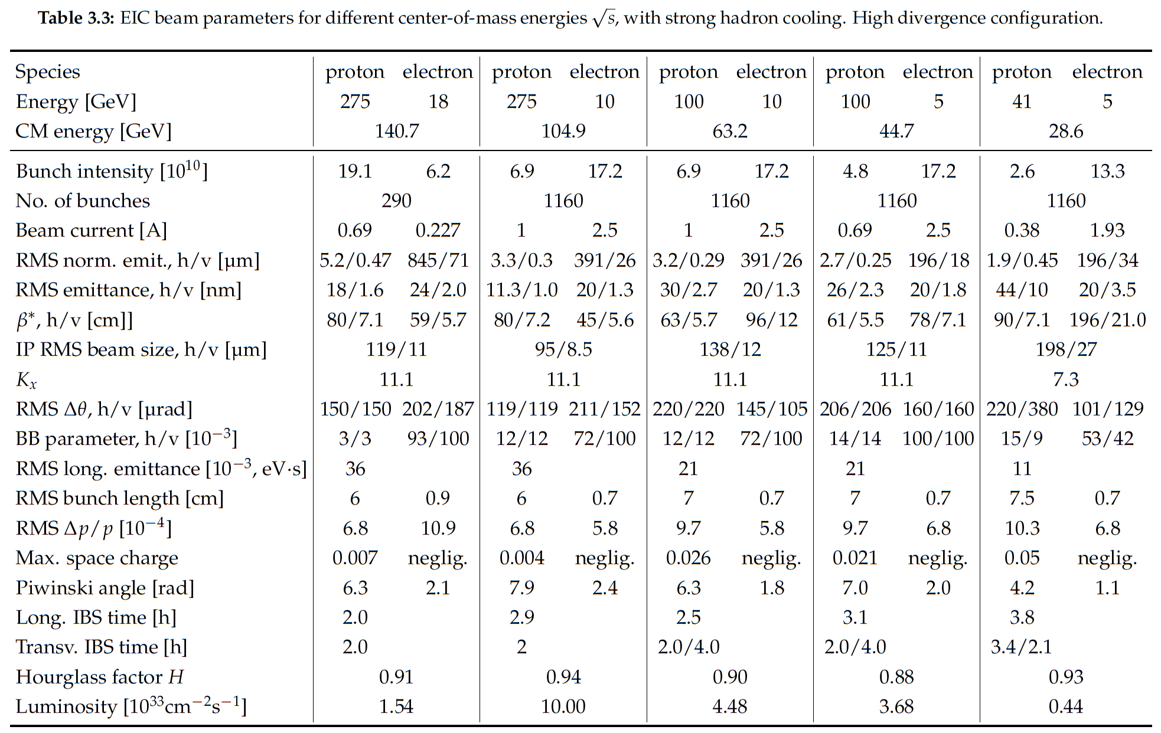
EIC Design Parameters
Notes:
LHC design 0.58A p (HL up to 1A), beam-beam parameter 3.4e-4 (3-5—3 HL-LHC)

Slide 47
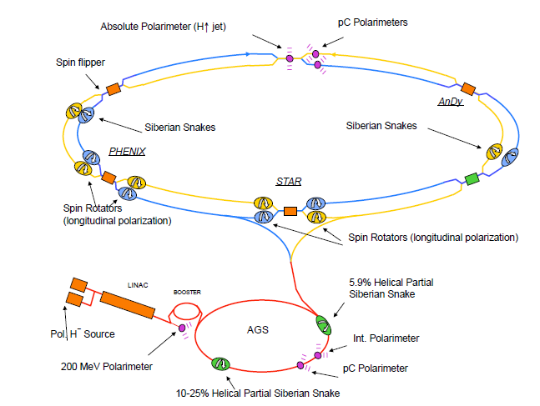
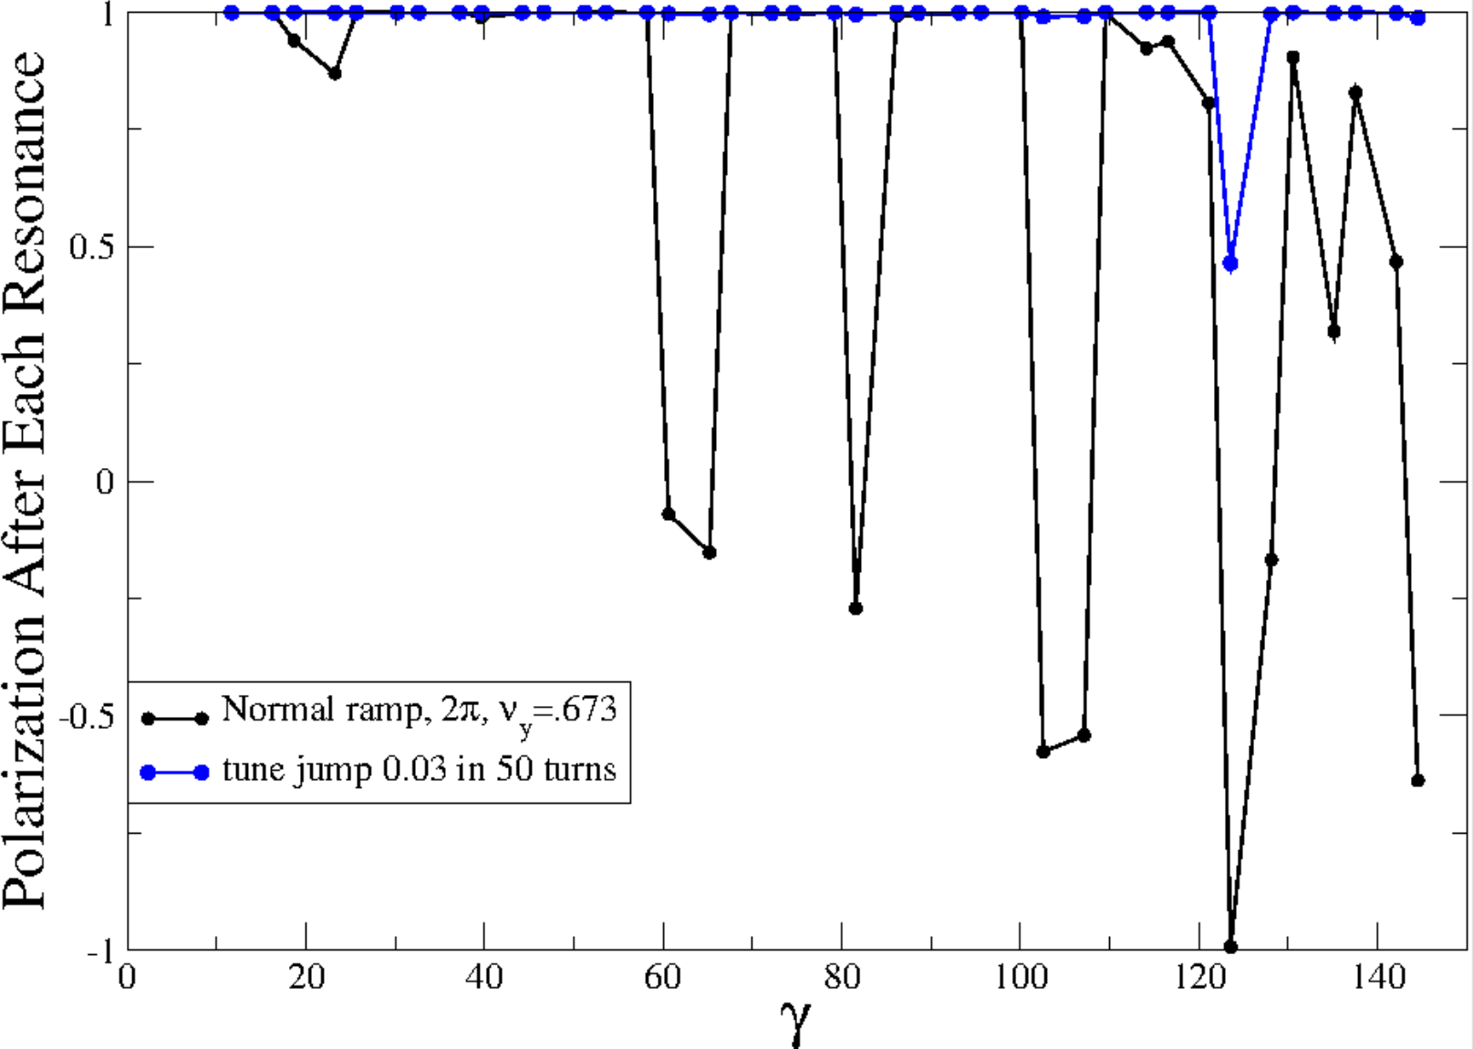
eRHIC Hadron Polarization
Measured RHIC Results:
Proton Source Polarization 83 %
Polarization at extraction from AGS 70%
Polarization at RHIC collision energy 60%
Planned near term improvements:
AGS: Stronger snake, skew quadrupoles, increased injection energy
➔expect 80% at extraction of AGS
RHIC: Add 2 snakes to 4 existing no/reduce polarization loss
expect 80% in Polarization in RHIC and EIC
Expected simulations results benchmarked against RHIC operations
³He in eRHIC with six snakes
Achieved 85% polarization in 3He ion source
Polarization preserved with 6 snakes for up to twice the design emittance
Deuterons in eRHIC:
Requires tune jumps in the AGS, then
benchmarked simulation show 100% Spin transparency
No polarization loss expected in the EIC hadron ring

Slide 48
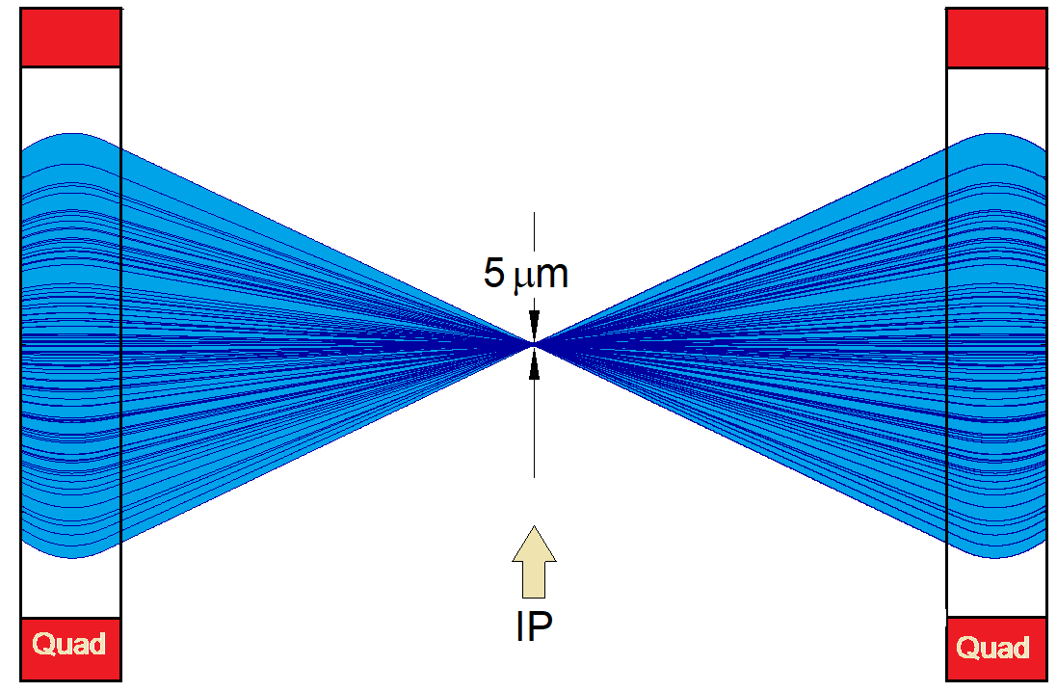
EIC achieves high luminosity L = 10³⁴ cm⁻²s⁻¹
Large bunch charges N_{e} ≤ 1.7·10¹¹, N_{p} ≤ 0.69·10¹¹
Many bunches, n_{b}=1160
  crossing angle collision geometry
  large total beam currents
  limited by installed RF power of 10 MW
Small beam size at collision point achieved by
  small emittance, requiring either:
- strong hadron cooling to prevent emittance growth
or frequent hadron injection
  and strong focusing at interaction point (small β_{y})
  flat beams σ_{x}/σ_{y} ≈ 10
Strong, but previously demonstrated beam-beam interactions
Δν_{p} = 0.01 demonstrated in RHIC
Δν_{e} = 0.1 demonstrated in HERA, B-factories
Strong focusing β_{y} =5 cm

