Slide 1

Overview of GridPix projects
  1st CFNS Postdoc Meet
  Stony Brook University, October 16 - 20, 2023
  E. Shulga

Slide 2
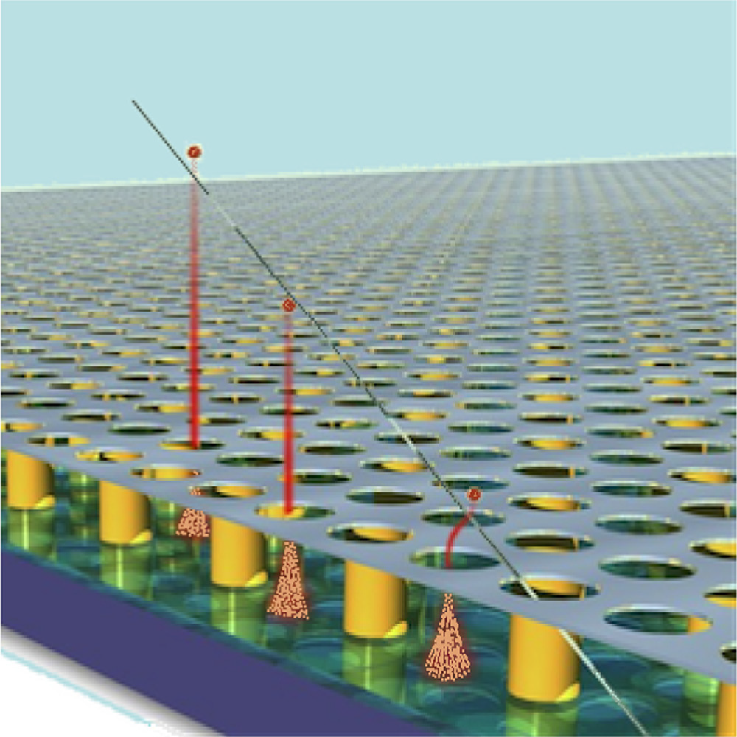
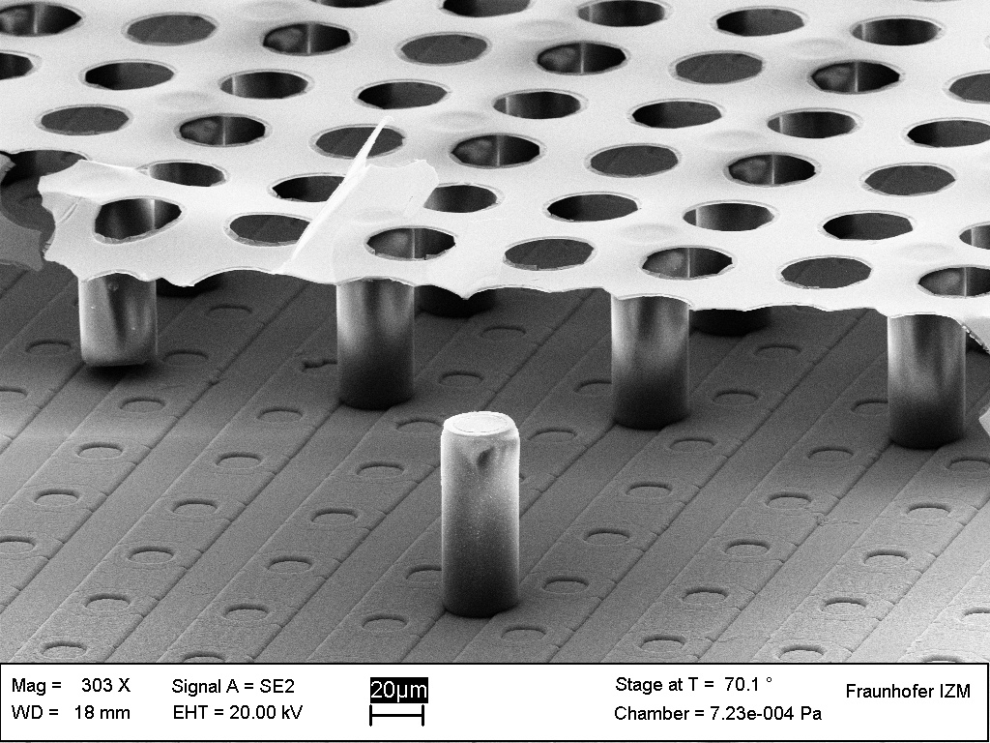
GridPix
GridPix is a miniature Time Projection Chamber (TPC) with a two-dimensional readout plane.
It consists of a gas amplification region on top of a signal-readout chip, a Timepix (CERN).
It records the arrival time and the position of electrons.
The amplification region consists of a grid supported by ~50 μm tall spacers.
Amplification field is large ~60 kV/cm to create electron induced avalanches.
50 μm
A. Boldyrev & others Tracking performance of GasPixel detectors in test beam studies. NIMA 807: 47 - 55. 2016
W. Koppert & others GridPix detectors: Production and beam test results. NIMA 732: 245 - 249. 2013

Slide 3
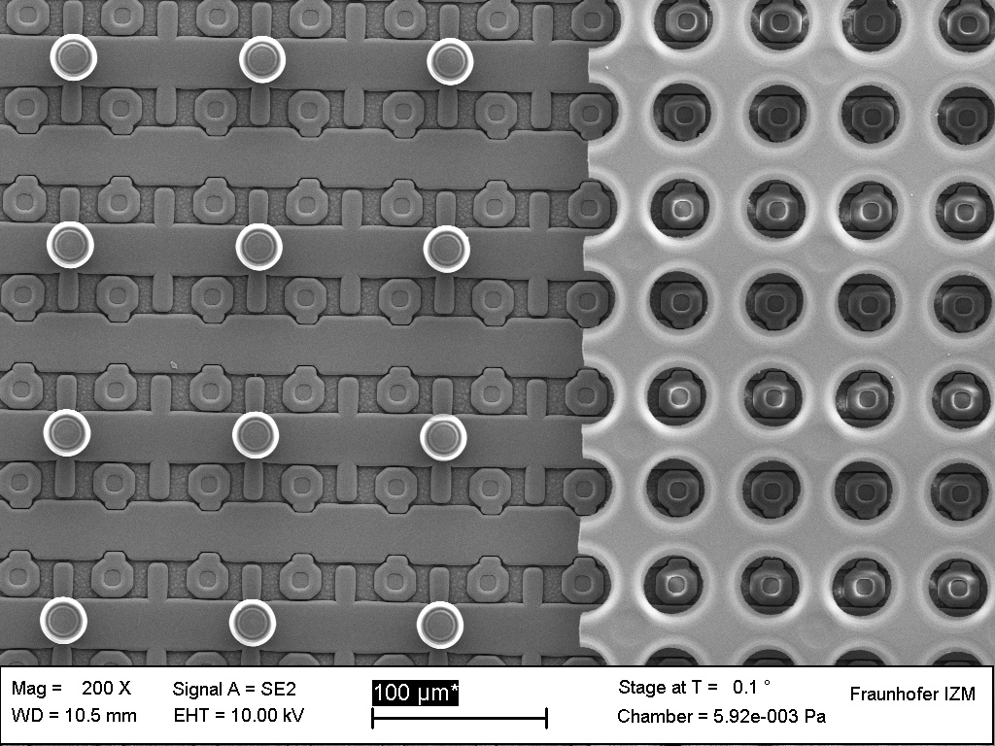
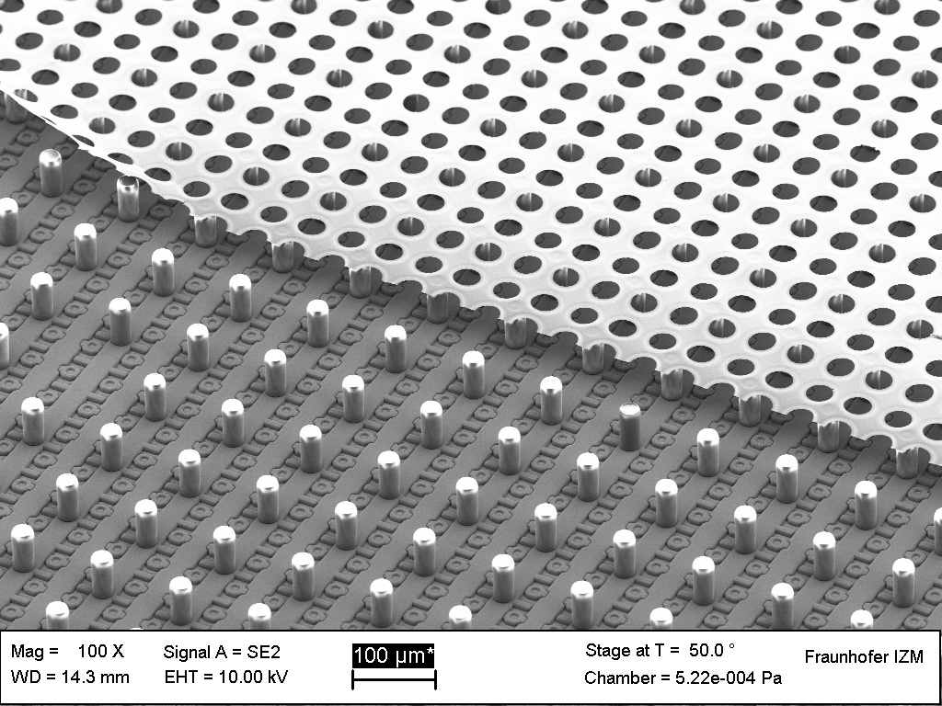
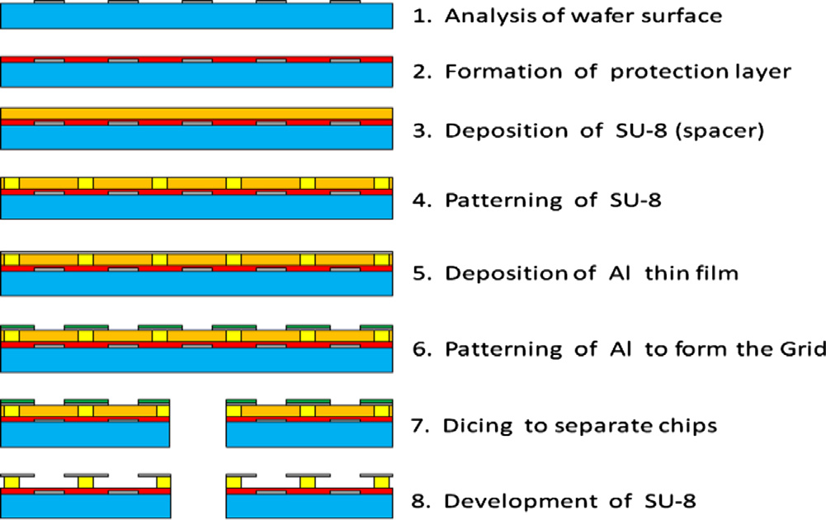
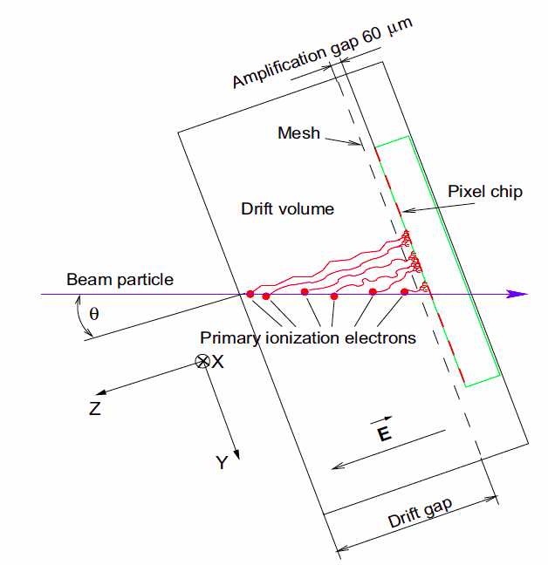
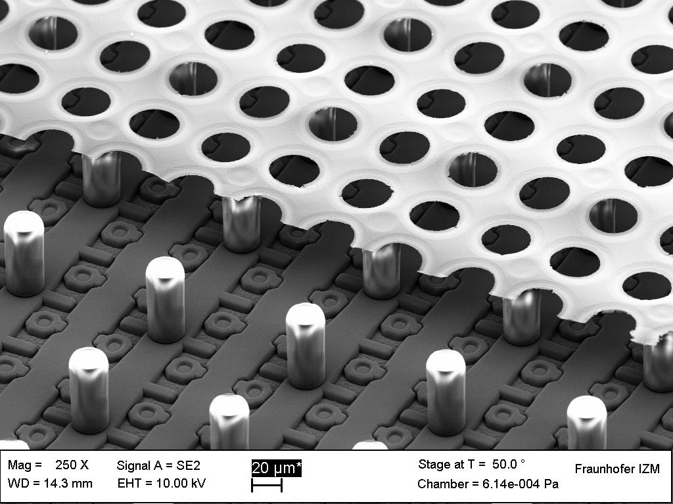
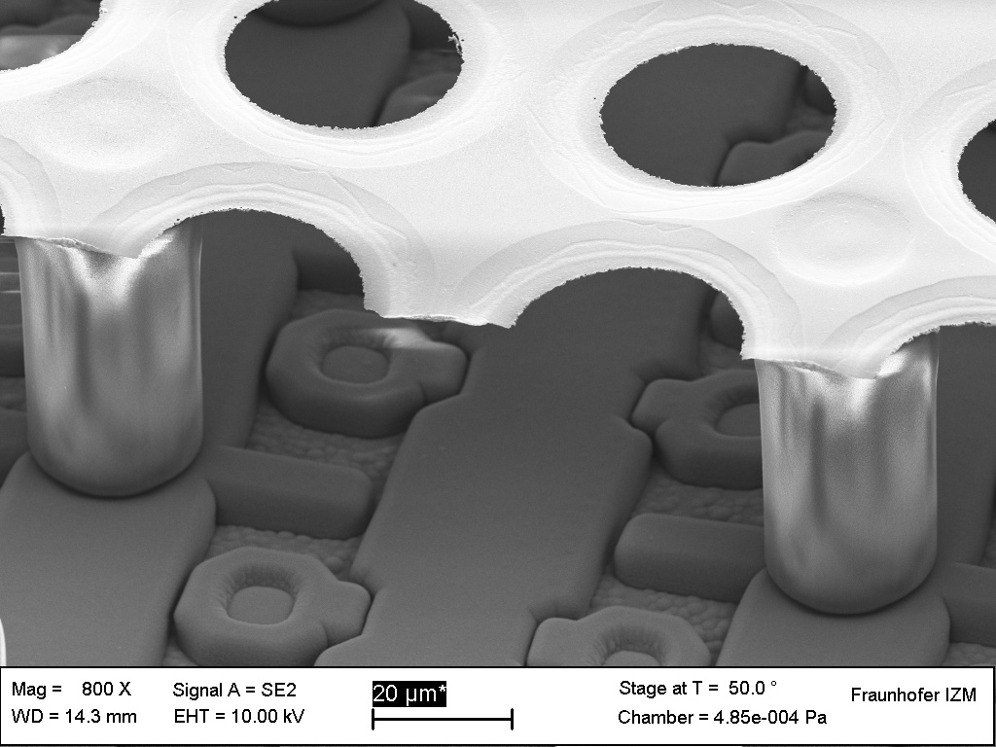
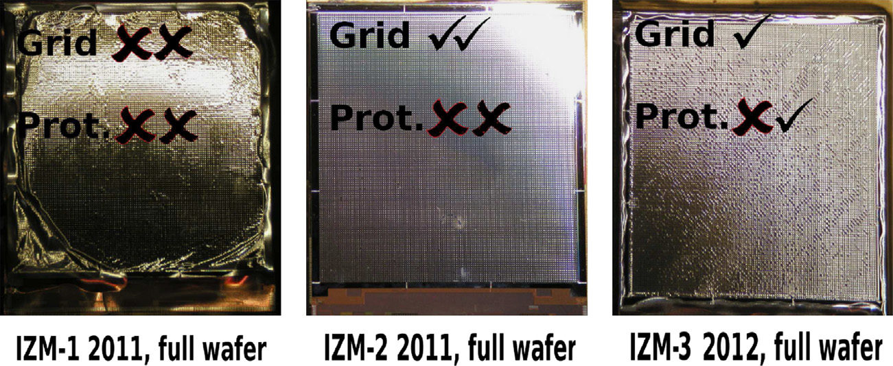
GridPix
Concept is simple, production is a complicated process
Has been developing and improving over the last decade
Coupled with Timepix3 readout:
Number of pixels: 256 × 256 pixels
Pixel pitch: 55 × 55 μm.
ENC: ~ 60 e-
Charge (ToT) and time (ToA) available per hit
Timing resolution: 1.56 ns for duration of ~410 μs
Zero suppression on chip (sparse readout)
Multi-hit capable (pixels sens. after t_{ToT}+475 ns)
Super-pixels store hits for some time
Output rate up to 5.12 Gbps
Power pulsing possible (800 ns for start up)

Slide 4
TPC with GridPix readout for EIC
  P. Garg, T. Hemmick, E. Shulga

Slide 5
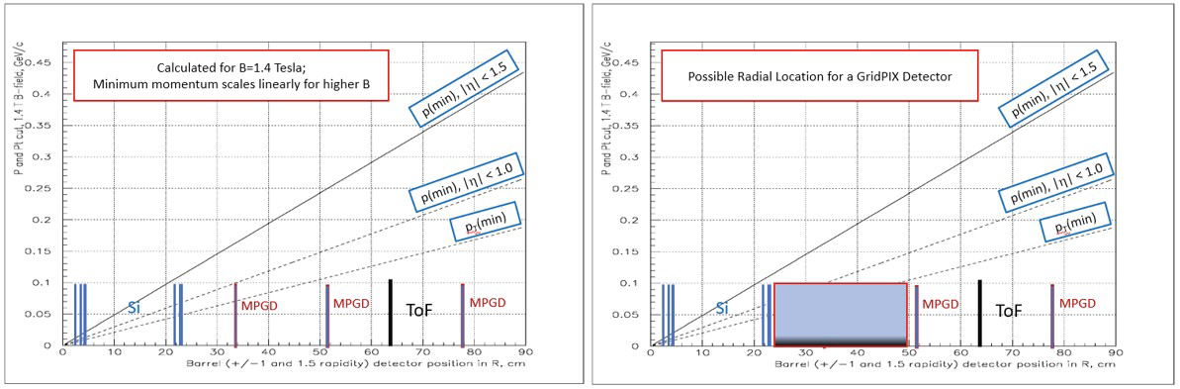
GridPix TPC for EIC 2nd detector
Low momentum particles will form tight spirals in a high magnetic field. As a result, there exists a linearly rising ”minimum” transverse momentum required for particles to reach a detector plane at any given radius. PID thereby acquires a minimum momentum due simply to the geometric placement of the first PID layer.

Slide 6
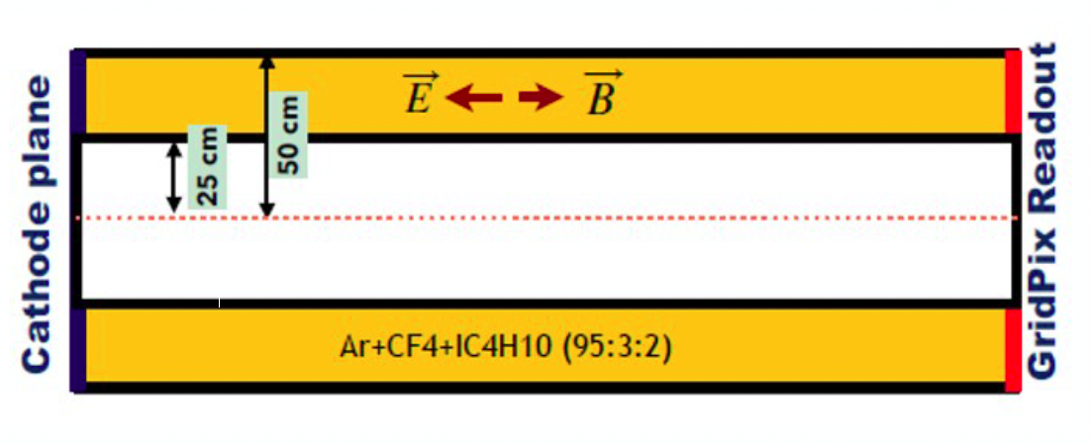
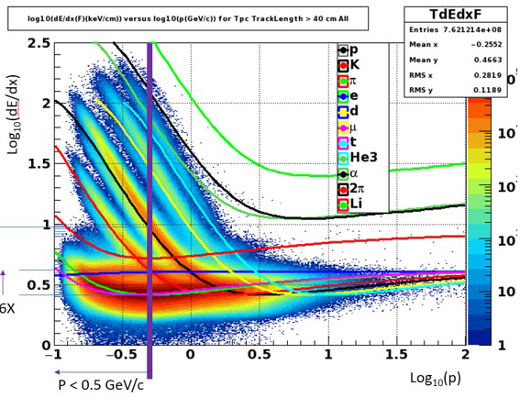
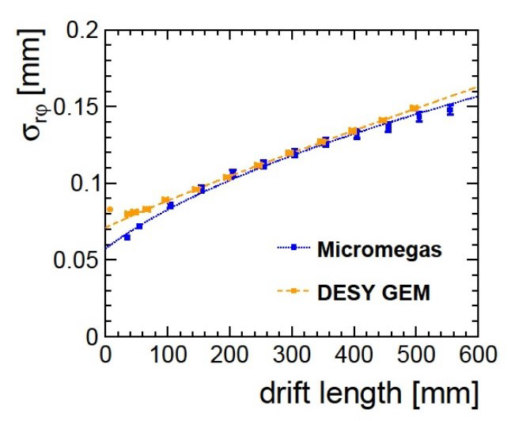
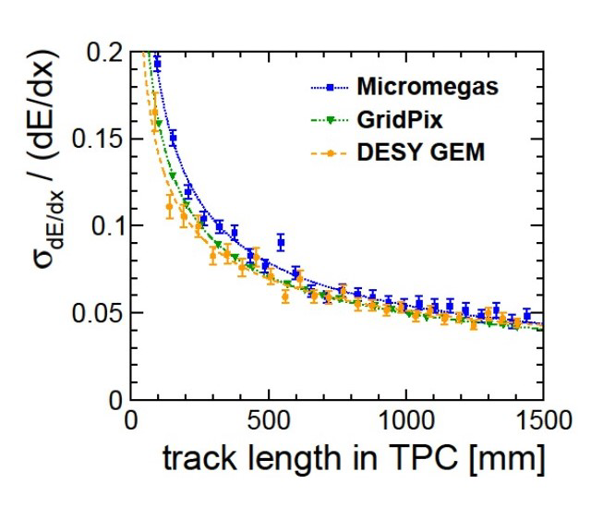

GridPix TPC for EIC 2nd detector
Benefits of GridPix readout:
Lower occupancy → better track finding
Identification/removal of δ-rays/kinks
Improved dE/dx→ primary e- counting
$$B=1T$$

Slide 7
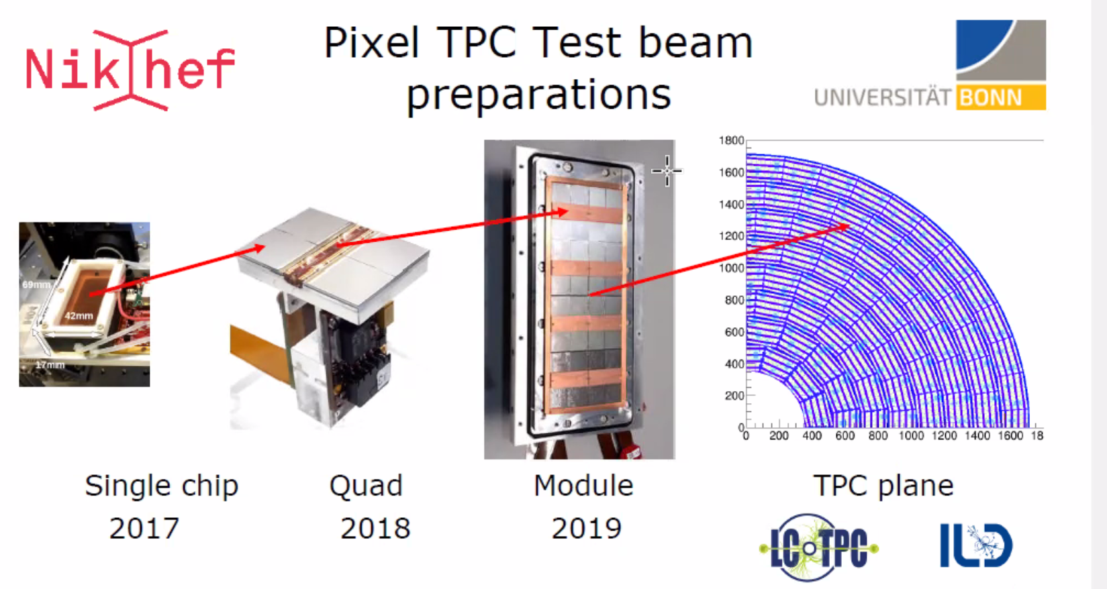
LCTPC R&D

Slide 8
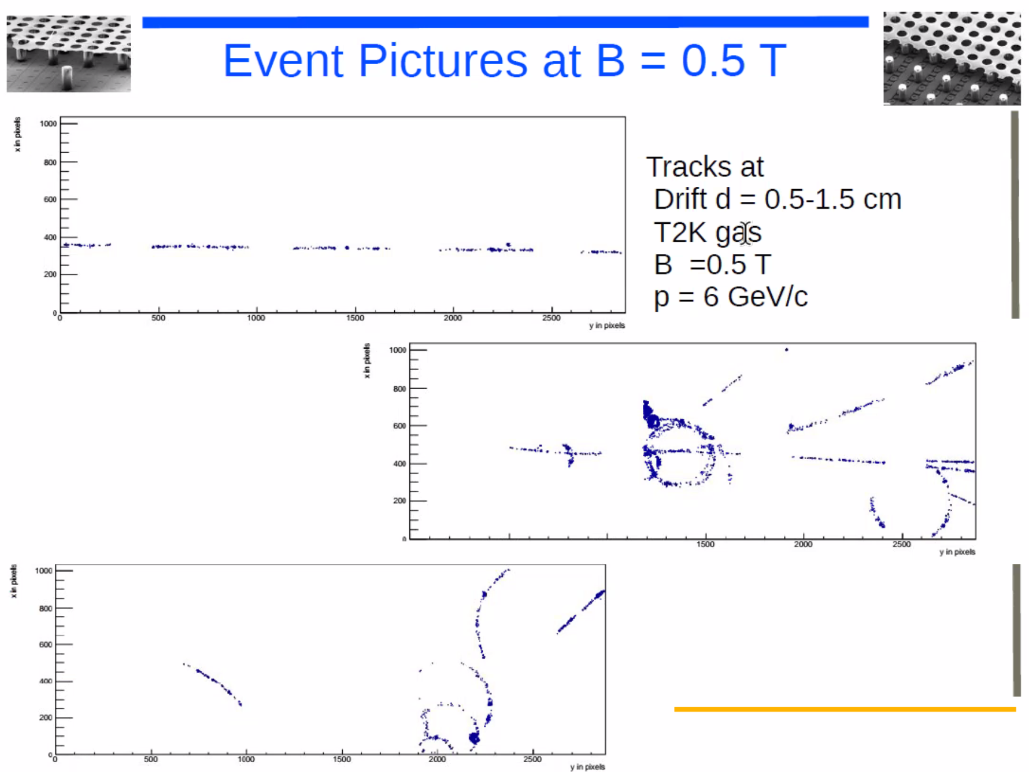


GridPix
Segmentation: $\frac{25 cm}{55μm}=4500$
70% active area ⇒ 3150 “rows”
2400 primaries in 25 cm for a MIP
Thousands of hits per track
Extremely robust patterns
Identification/removal of δ-rays/kinks
$$2.75cm$$
Gas T2K (Ar/CF₄/iC₄H₁₀ 95:3:2)
B = 0.5 T
Drift d = 0.5-1.5 cm
P = 6 GeV/c

Slide 9
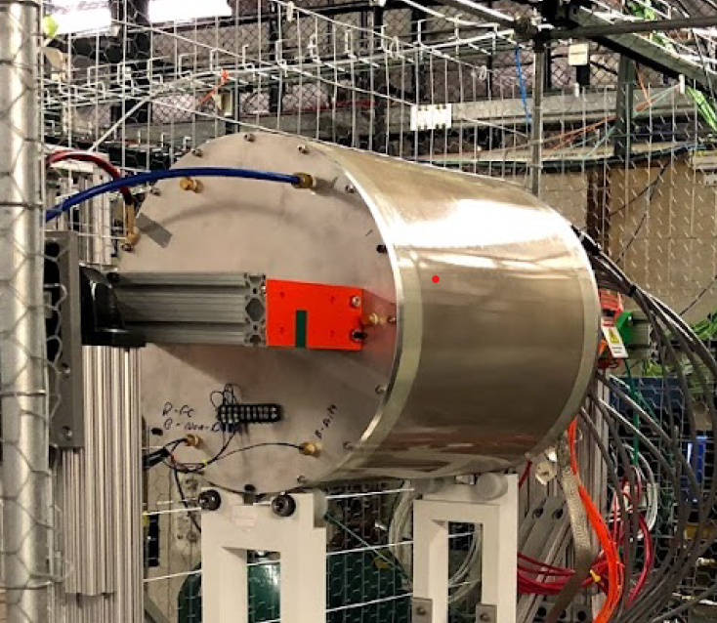
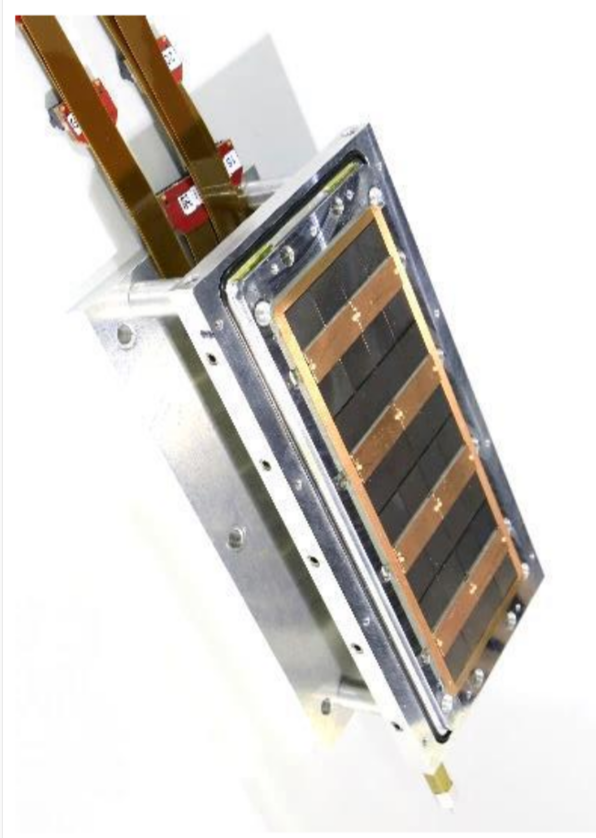
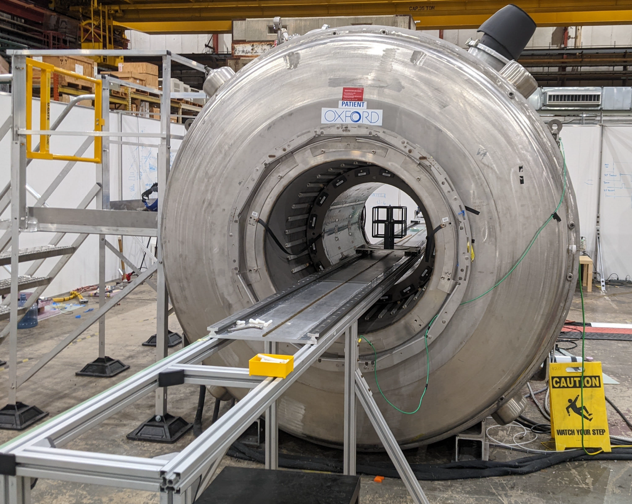
Initial R&D Plan
Fermilab Test Beam
  Mixed beam at low energies
  Identified by beam line Cherenkov
Cosmic Rays at Argonne
  0-4 Tesla Field available.
  Limits diffusion, maintains “clusters”
sPHENIX TPC Prototype Field Cage
Ability to study PID & clusters
Nikhef
32-chip Module
Argonne Magnet Facility

Slide 10
Bi-polar grid studies with
  E. Shulga

Slide 11
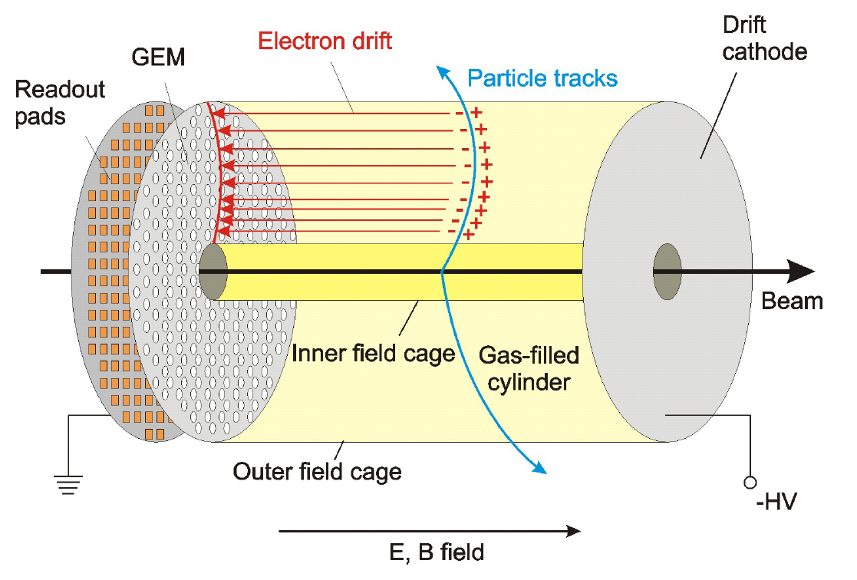
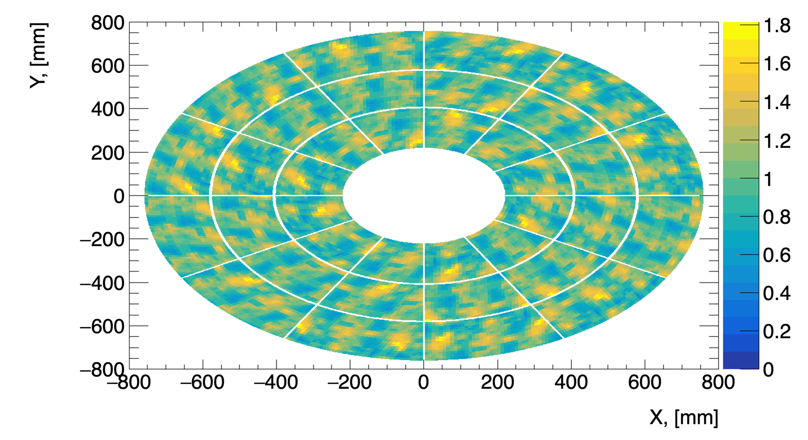
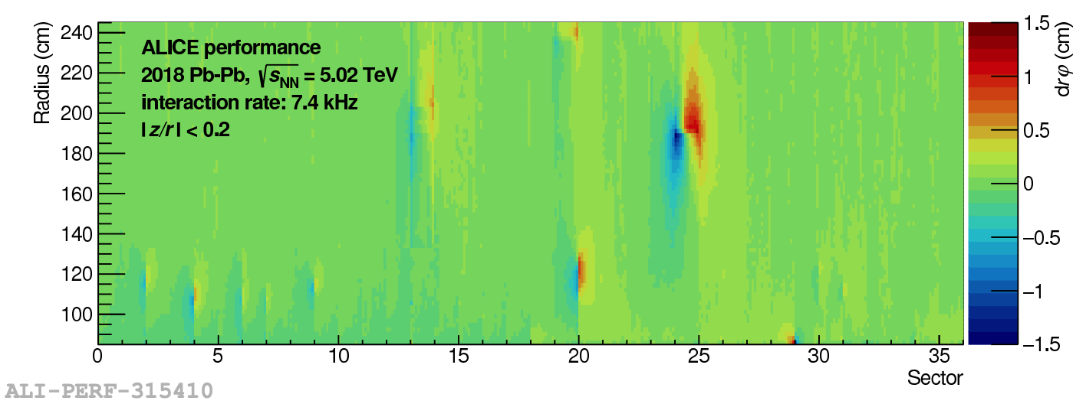
Space charge effects
Space charge (SC) is formed in the TPC
Electric fields are distorted due to SC
Tracking performance is affected
95 % of SC is Ion Backflow (IBF)
Minimization of IBF is our goal
ALICE Pb-Pb 𝞅 distortion measurements

Slide 12
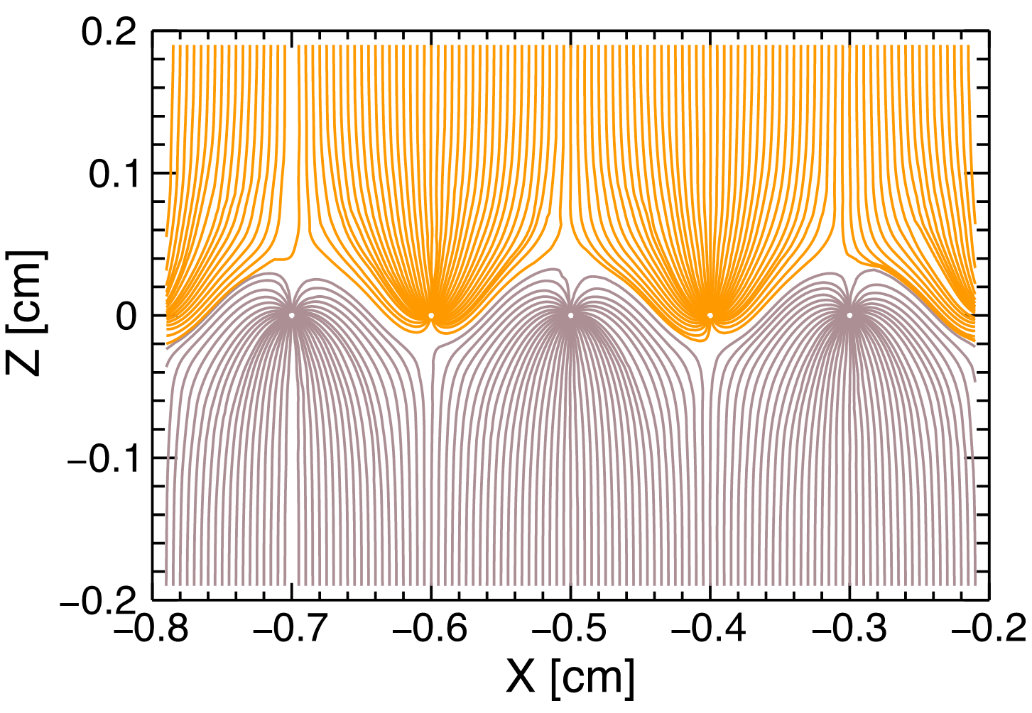
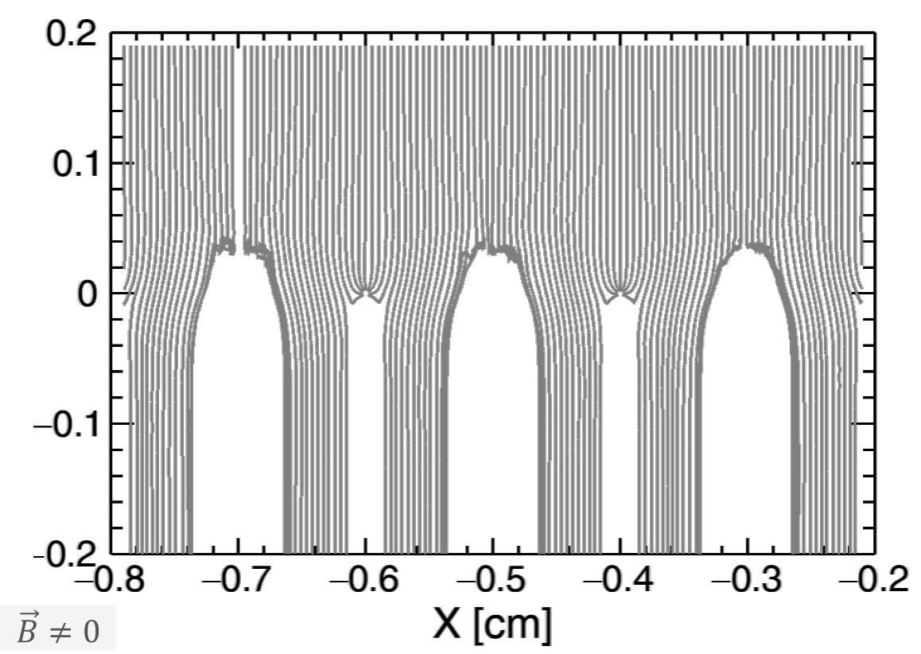


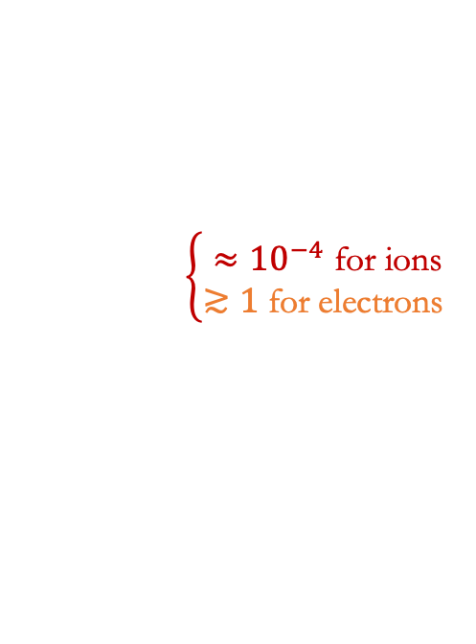

Gating grid: static mode
Gating grid can be optimized to collect ions and be transparent to electrons:
GARFIELD++ simulations
$$\vec{B}>0$$
$$\vec{B}=0$$
$$V=\frac{μ}{1+ω^{2}τ^{2}}\left(E+\frac{E×B}{\left|B\right|}ωτ+\frac{\left(EB\right)B}{B^{2}}ω^{2}τ^{2}\right)$$
with
µ = mobility,
$ω=\frac{eB}{mc}$ (cyclotron frequency),
$τ=τ\left(E\right)$ (mean collision time),
$B=\left[0,0,B_{z}\right]$.
$B_{z}$>1 T is required (sPHENIX and future experiments)
$$\left\{\begin{aligned}≈{10}^{−4} \text{for} \text{ions} \\ ≳1 \text{for} \text{electrons} \end{aligned}\right.$$

Slide 13
Ion Blocking by the Passive Bipolar Grid
Results show that IBF can be suppressed down to 0 with a cost of 45% of primary electrons @ B≥1.2 T
Comparison to simulations have been performed, better measured gases provide better results, improvement could be obtained in the future
Beam test @ the Argon National Laboratory did not show resolution worsening at high magnetic fields
Garfield++ simulations have shown good results for Ar/CH4
arXiv:2007.13616
IEEE:9279256

Slide 14
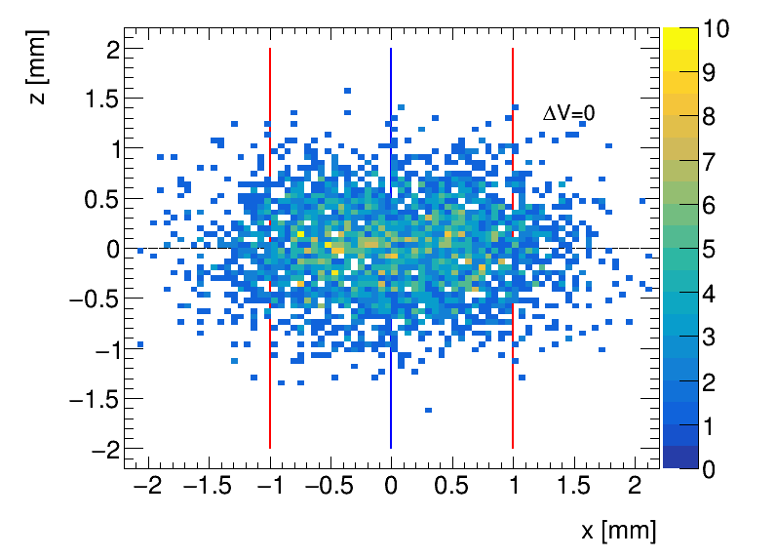
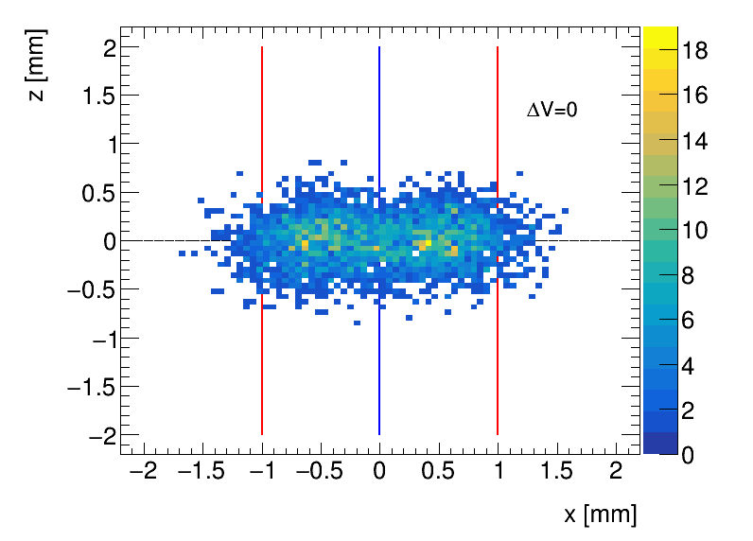
BPG effect on the drift of electrons
My Garfield++ Simulations Ar/CH₄ (90:10): 55 µm binning
B=0
B=1.2 T
Linear bias corresponding to Lorentz angle
Designed a setup with GridPix detector (from Bonn group) to measure the bias

Slide 15
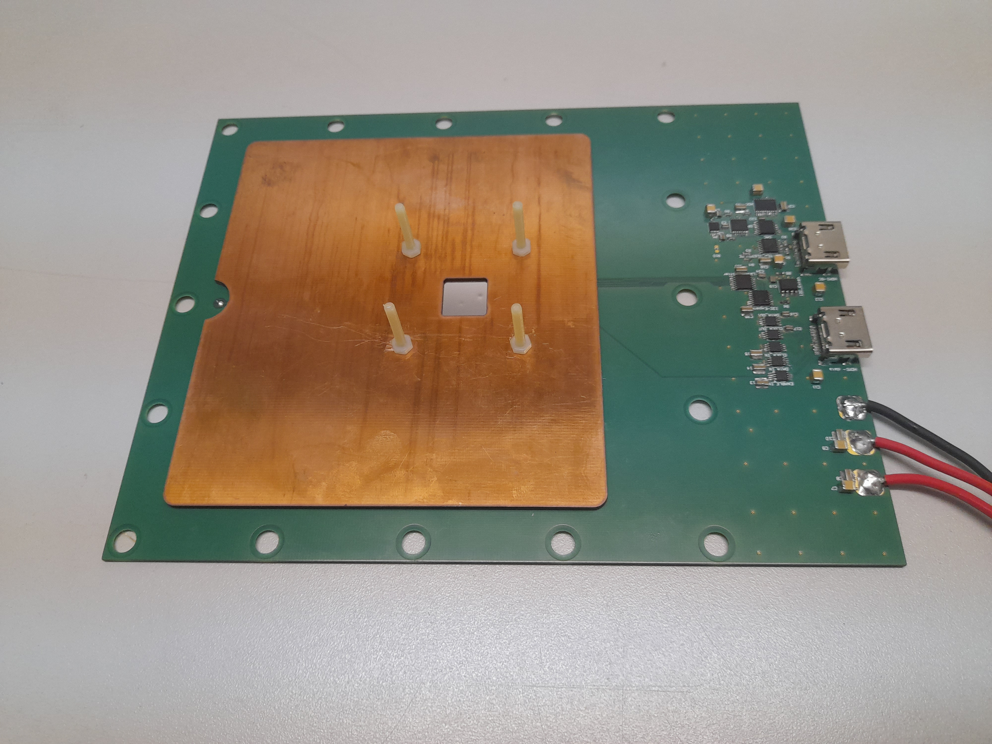
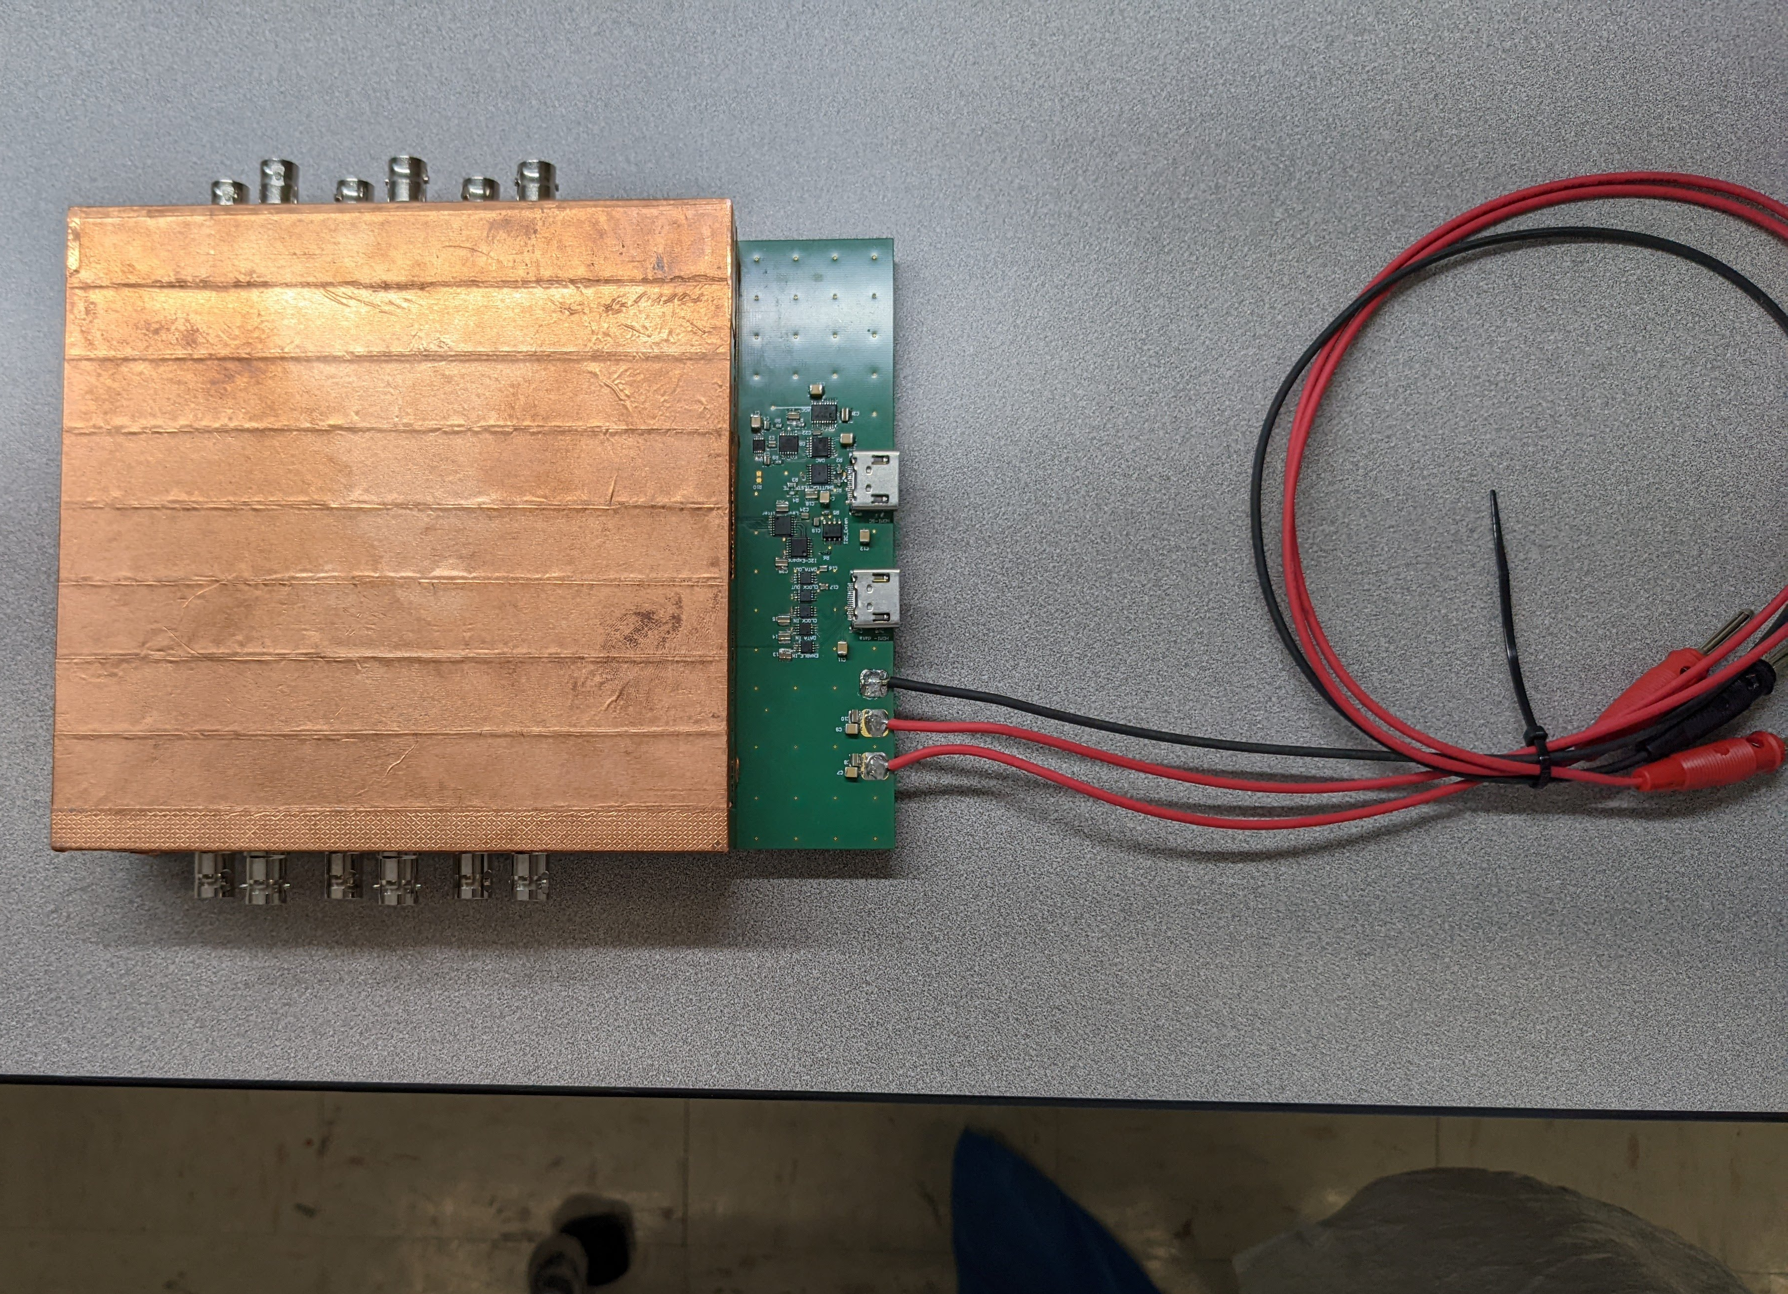
BPG effect on the drift of electrons
Setup is at SBU (designed by Me and J. Kaminsky produced @ Weizmann & Bonn)
Setting up DAQ system (SRS)
Plan to perform measurements in the magnet @ ANL or BNL

Slide 16
TimePix for large pads
  J. Driebeek, K. Dehmelt

Slide 17
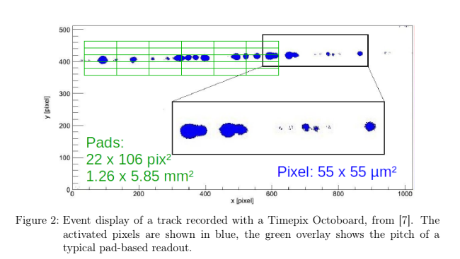
Timepix with Large Pads
Current MPGDs have pad sizes of mm²
  Constrained by existing readout ASICs
Pixel ASICs such as the Timepix have pads on the order of 10s of μm²
The resolution of pixel ASICs is more than necessary for some measurements resulting in unnecessary heat and material
Our goal is to demonstrate the use of a pixel ASIC as the front-end readout of charge sensitive pads in a GEM module with a resolution in between current pads and pixels

Slide 18
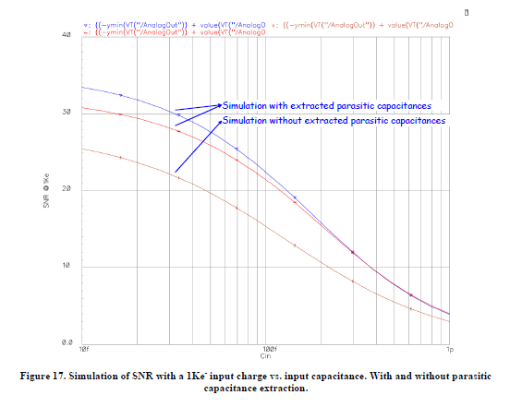
Timepix with Large Pads
Front end ASICs are designed with a certain detector capacitance in mind
Higher capacitance leads to worse SNR
We want to physically recreate the measurement shown in this simulation
We will explore the effects of larger charges and higher capacitance
If SNR depends on capacitance independently from signal size, can large GEM gain overcome SNR?
These results will inform the design of a prototype

Slide 19
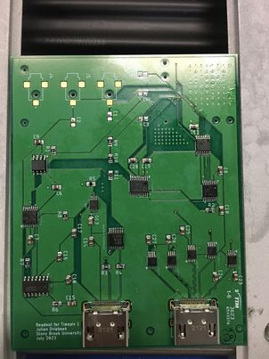
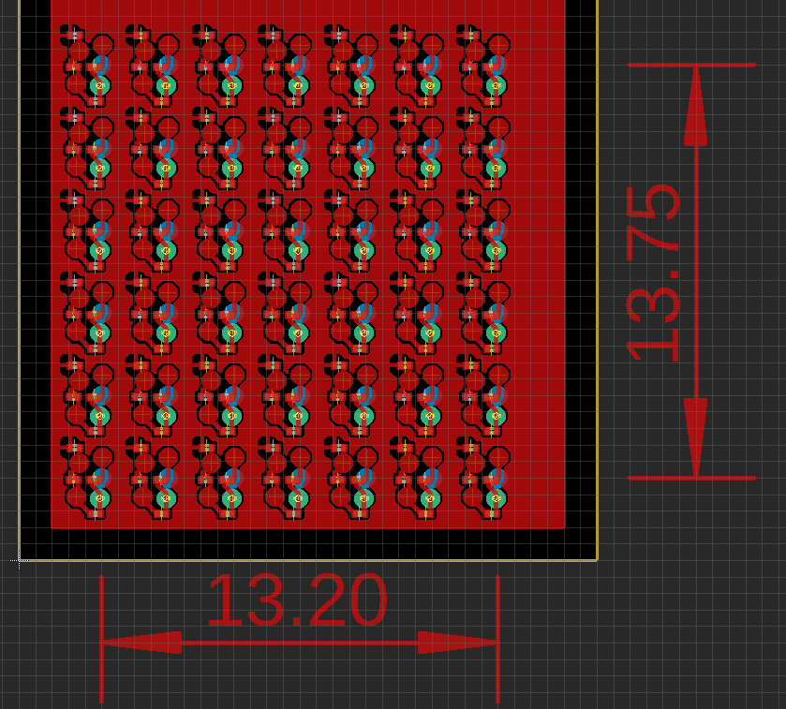
Timepix with Large Pads
PCB for connecting 42 Capacitors to Timepix
Readout PCB for Timepix

Slide 20
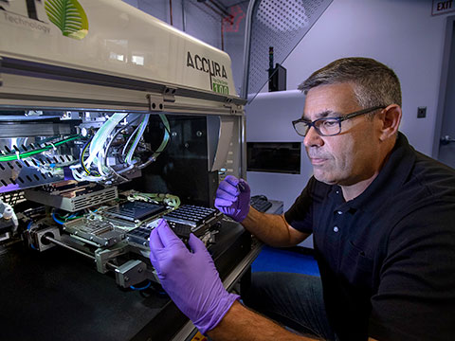
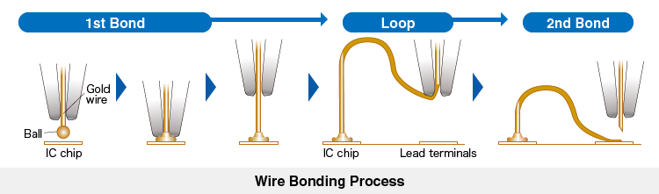
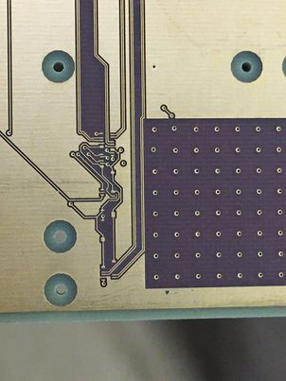
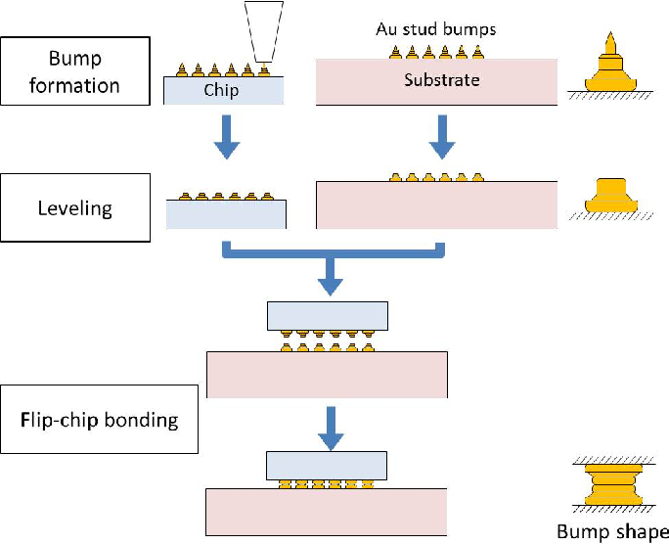
Timepix with Large Pads
Interconnects
Timepix will be wirebonded to readout PCB
Pad Plane will be gold stud bump bonded to the Timepix
Wire and bump bonding is being worked on with BNL Instrumentation Division’s High Density Interconnects Lab

Slide 21

Conclusions
Tree projects are currently ongoing @ SBU related to GridPix
All of them could converge in a GridPix TPC for EIC 2nd detector
$$\vec{B}>0$$
Improved dE/dx→ primary e- counting
IBF suppression
Larger pads → less electronics → lower costs

Slide 22
Backup

Slide 23
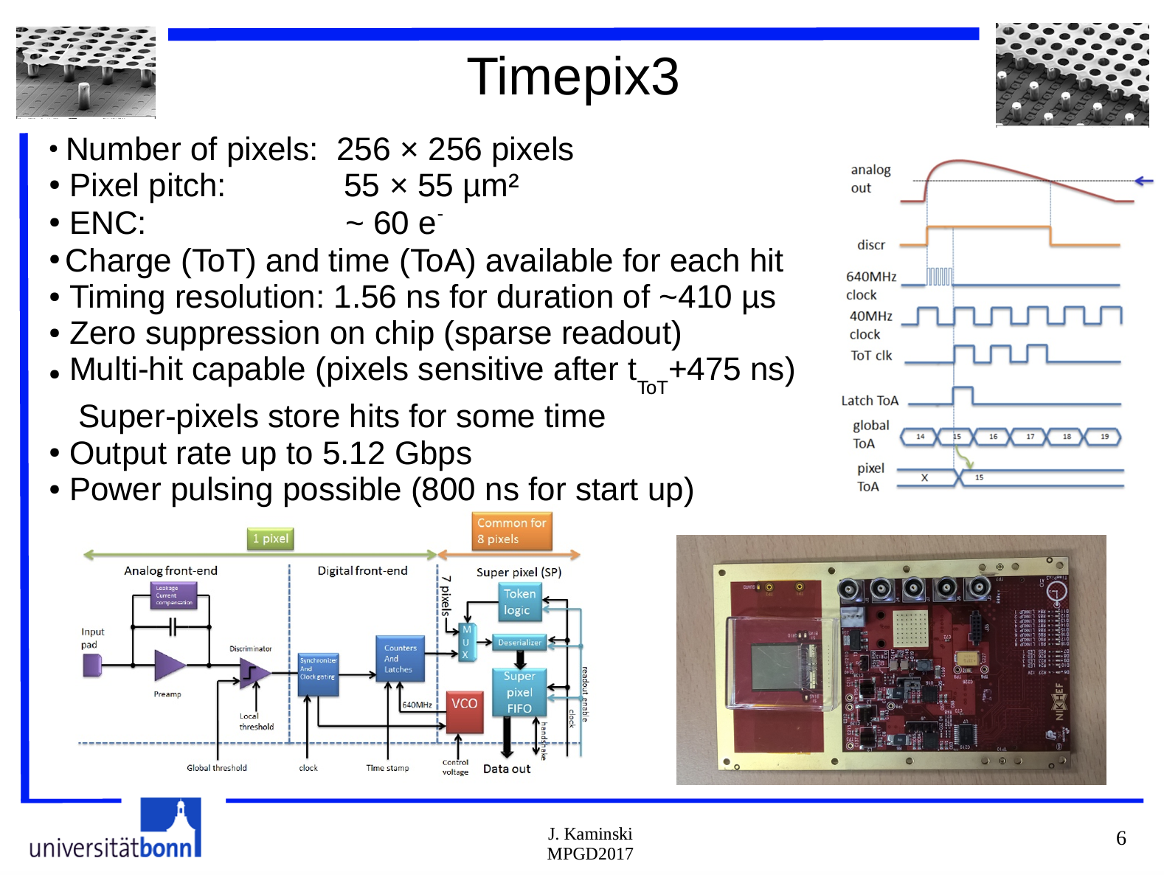

Slide 24
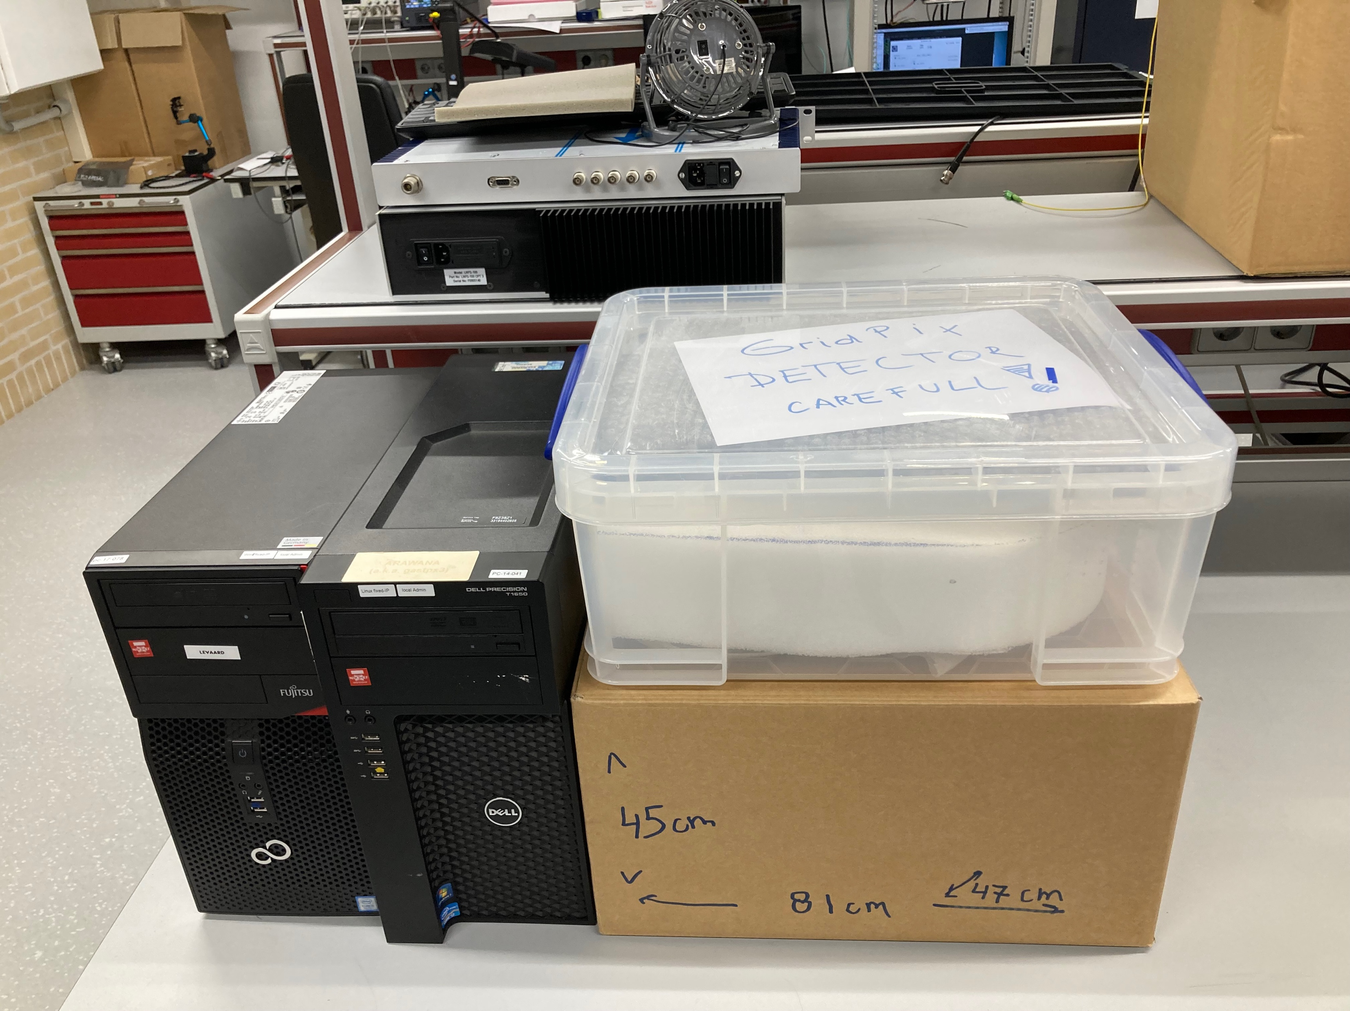
8-QUAD module with field cage
Nikhef will send to Stony Brook a 32-chip module & COMPLETE DAQ.
Timing is in the hands of the lawyers:
  SBU & J-Lab
    Show me the money!
  SBU & Nikhef
    Loan agreement, shipping payment, insurance, …

