Slide 1
Inaugural CFNS Postdoc Meeting 2023
CFNS, Stony Brook University, October 16-20, 2023
Quantum entanglement
at RHIC and EIC
Dmitri Kharzeev
1

Slide 2
Based on ongoing work with CFNS/CNT postdocs and students!

Slide 3
Outline
Introduction: QCD, QIS and EIC
Entanglement and baryon structure
The puzzle of the parton model
3. Maximally entangled state at small x
4. Experimental tests
5. Outlook

Slide 4
QCD, QIS and EIC
What have we learned about QCD in fifty years of its existence?
It does not make sense to talk about individual quarks and gluons –
they rapidly become dressed by interactions and become part of
a complex field configuration.
This can be seen in all existing approaches to QCD:
in pQCD, collinear and infrared logs signal the emission of
large number of soft gluons
in models with confinement (strong coupling expansion, …)
strings describe multi-gluon field configurations
Non-perturbative semiclassical solutions (instantons, calorons,…)
describe gluon field configurations with non-trivial topology
QCD sum rules introduce interactions with gluon and quark
condensates in the vacuum
4

Slide 5
QCD, QIS and EIC
How should we then think about (individual) quark and gluon distributions?
‘‘...we never experiment with just one electron or atom or (small) molecule. In thought experiments, we sometimes assume that we do; this invariably entails ridiculous consequences ... .’’
Erwin Schrödinger, 1952
If this is true for electrons, it has to be extremely important
for quarks and gluons!
5

Slide 6
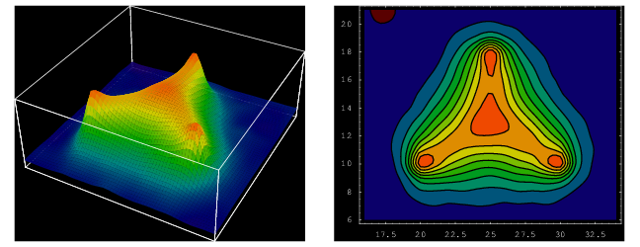
Consider for example the proton: a pure state
(eigenstate of the QCD Hamiltonian), with zero entropy
and extremely strong correlations among the quarks
H. Suganuma, H. Ichie, T. Takahashi 2004
These correlations are so strong that the quarks
do not even exist as individual particles! (``confinement”)

Slide 7
The lattice results show the presence of a “baryon junction” inside proton – a purely gluonic field configuration that represents entanglement among the quarks and carries baryon number (!)
H. Suganuma, H. Ichie, T. Takahashi 2004
It has been predicted to exist on the basis of local gauge
invariance of the baryon wave function (Rossi, Veneziano 1974).
It was also argued to dramatically affect the transport of baryon number
in high energy processes (DK, 1996).

Slide 8
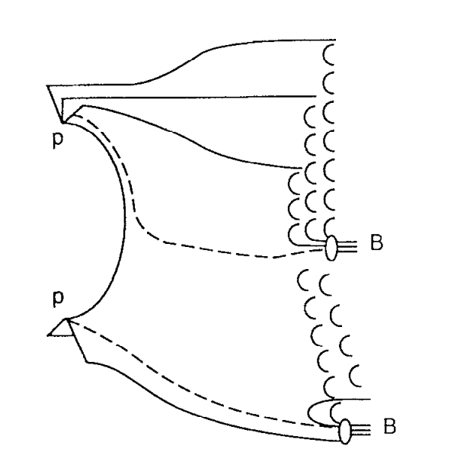
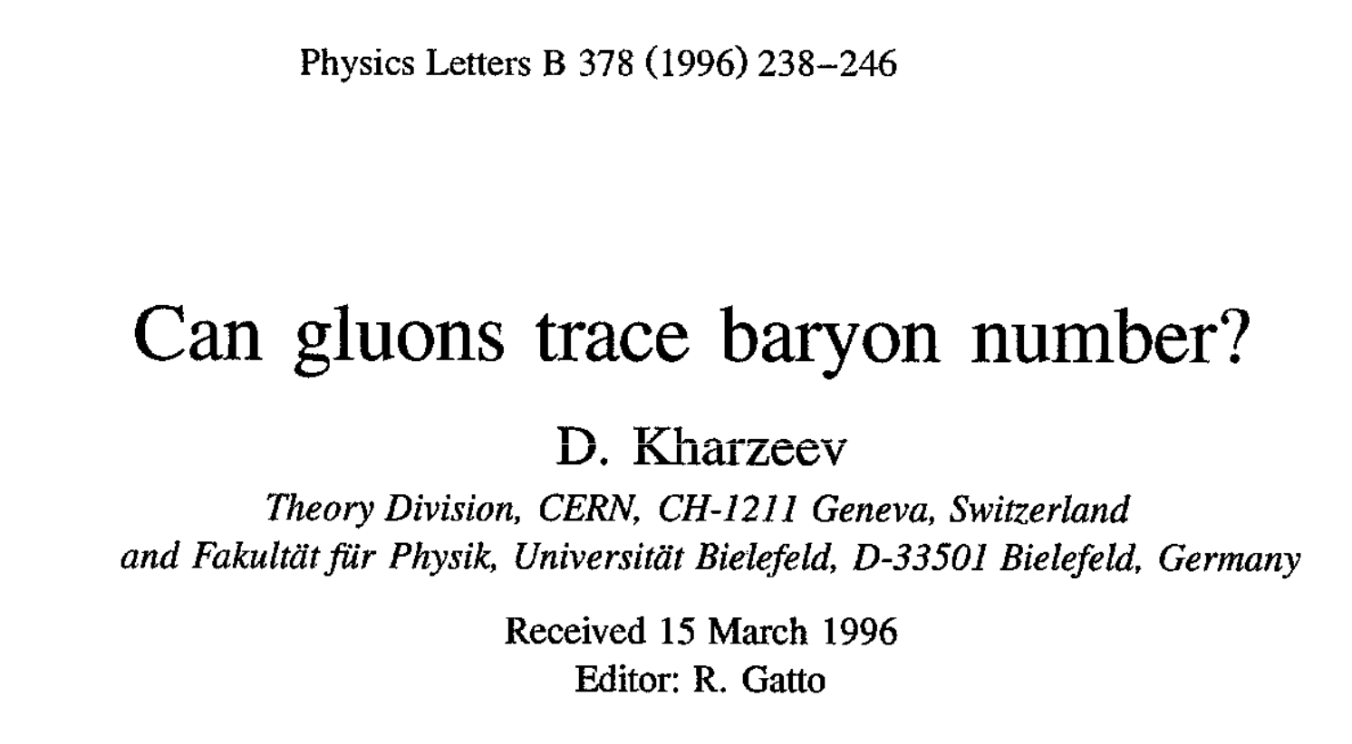

Slide 9
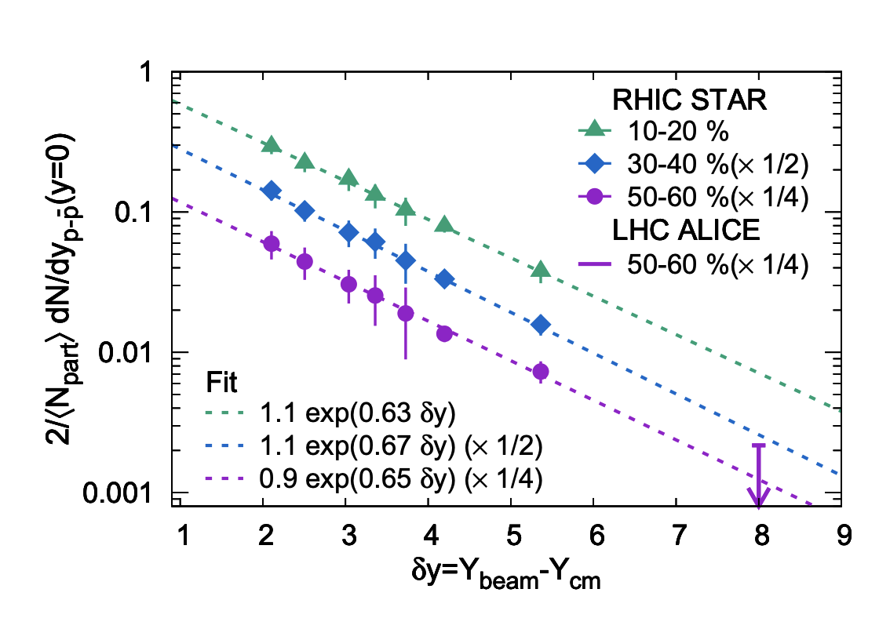

Slide 11
Study this at EIC – work in progress with David Frenklakh, Adrien Florio
and Bill Li

Slide 12
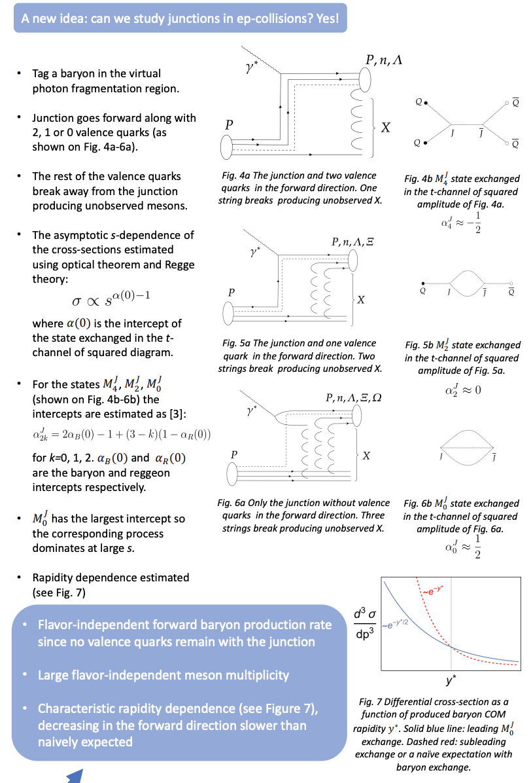

Slide 13
QCD, QIS and EIC
How to describe partons in the presence of strong correlations?
In classical physics, a proper way of dealing with an interacting system
of a large number of particles is statistical physics [entropy].
In field theory at strong coupling (describing a system of a large number
of interacting particles), a proper approach is quantum statistics
[entanglement entropy].
13

Slide 14
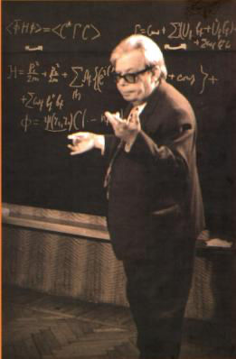
QCD, QIS and EIC
What is a way out?
In classical physics, a proper way of dealing with an interacting system
of a large number of particles is statistical physics [entropy].
In field theory at strong coupling (describing a system of a large number
of interacting particles), a proper approach is quantum statistics
[entanglement entropy].
A side historical remark: I graduated from
the “Division for Quantum Field Theory and Quantum Statistics”
at Moscow State University
[it has been renamed since then]
N.N.Bogolyubov
1909-1992
14

Slide 15
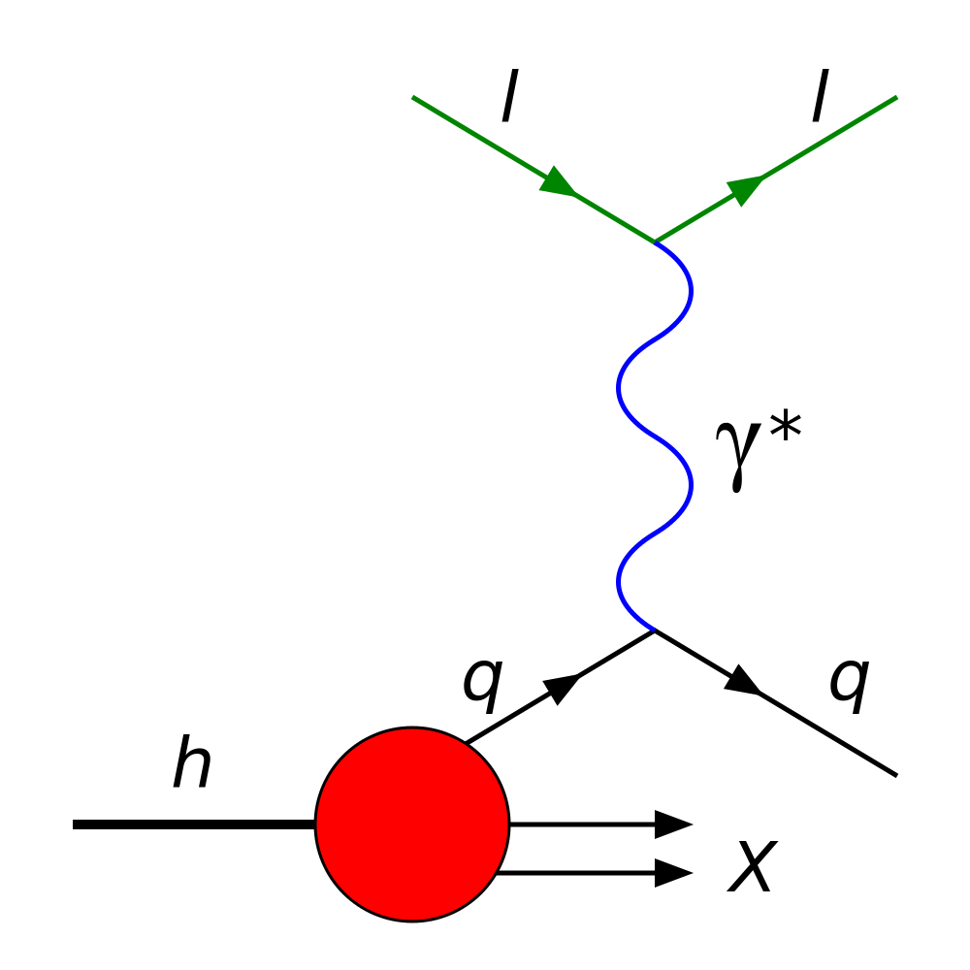
The parton model: 50 years of success
R. Feynman
J. Bjorken
V. Gribov
In fifty years that have ensued after the birth of
the parton model, it has become an indispensable building block
of high energy physics – so we have to understand it
15

Slide 16
The puzzle of the parton model
In parton model, the proton is pictured as a collection of point-like quasi-free partons that are frozen in
the infinite momentum frame due to Lorentz dilation.
The DIS cross section is given by the incoherent sum of cross sections of scattering off individual partons.
How to reconcile this with quantum mechanics?
16

Slide 17
The puzzle of the parton model
In quantum mechanics, the proton is a pure state with
zero entropy. Yet, a collection of free partons does
possess entropy… Boosting to the infinite momentum
frame does not help, as a Lorentz boost cannot
transform a pure state into a mixed one.
The crucial importance of entropy in (2+1)D systems:
BKT phase transition (Nobel prize 2016)
17

Slide 18
The quantum mechanics of partons and entanglement
Our proposal: the key to solving this apparent paradox
is entanglement.
DIS probes only a part of the proton’s wave function
(region A). We sum over unobserved region B;
in quantum mechanics, this corresponds to accessing
the density matrix of a mixed state
with a non-zero entanglement entropy
DK, E. Levin, arXiv:1702.03489; PRD
A
B
18

Slide 19
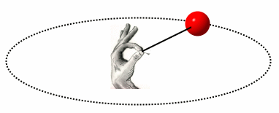
The quantum mechanics of partons and entanglement
Another (more general?) argument:
DIS takes an instant snapshot of the proton’s wave function. This snapshot cannot measure the phase
of the wave function.
Classical analogy:
Instant snapshot can
measure the amplitude ρ,
but not the angular
velocity ω !
DK, Phil. Trans. Royal Soc (2022); arXiv:2108.08792
ρ
19

Slide 20
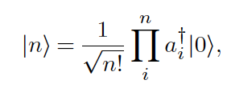
The quantum mechanics of partons and entanglement
A simple quantum mechanical model (proton rest frame):
DK, Phil. Trans. Royal Soc (2022); arXiv:2108.08792
Expand the proton’s w.f.
in oscillator Fock states:
The density matrix:
depends on time:
But this time dependence cannot be measured by a light front –
it crosses the hadron too fast, at time
20

Slide 21
Decoherence in high energy interactions
DK, Phil. Trans. Royal Soc (2022)
Therefore, the observed density matrix is a trace over an unobserved phase:
U(1) Haar measure
“Haar scrambling” = decoherence
Y.Sekino, L.Susskind ‘08
After “Haar scrambling”,
the density matrix
becomes diagonal
in parton basis
(Schmidt basis) –
Probabilistic parton
model!
This is a density matrix of a mixed state,
with non-zero entanglement entropy!
21

Slide 22
The quantum mechanics of partons and entanglement
DK, Phil. Trans. Royal Soc (2022); arXiv:2108.08792
The parton model density matrix:
is mixed, with purity
entanglement entropy
Parton model expressions
for expectation values
of operators:
22

Slide 23
The quantum mechanics of partons and entanglement on the light cone
The density matrix on the light cone:
Haar scrambling: on the light cone,
but t, z and x⁺ = z + t cannot be independently
determined:
23

Slide 24
The entanglement entropy from QCD evolution
Space-time picture
in the proton’s rest frame:
The evolution equation:
24

Slide 25
The entanglement entropy from QCD evolution
Solve by using the generating function method
(A.H. Mueller ‘94; E. Levin, M. Lublinsky ‘04):
Solution:
The resulting von Neumann entropy is
DK, E. Levin, arXiv:1702.03489; PRD
25

Slide 26
The entanglement entropy from QCD evolution
At large , the entropy becomes
This “asymptotic”
regime starts rather
early, at
26
DK, E. Levin, arXiv:1702.03489; PRD

Slide 27
The entanglement entropy from QCD evolution
At large (x ~ 10⁻³) the relation between
the entanglement entropy and the structure function
becomes very simple:
27
DK, E. Levin, arXiv:1702.03489; PRD 95 (2017)

Slide 28
The entanglement entropy from QCD evolution
What is the physics behind this relation?
It signals that all partonic states have about
equal probabilities – in this case
the entanglement entropy is maximal, and
the proton is a maximally entangled state
(a new look at the parton saturation and CGC?)
DK, E. Levin, arXiv:1702.03489; PRD 95 (2017)
28

Slide 29
Maximally entangled states
Consider the entanglement entropy
for the case of N states with equal probabilities
Then
This looks like the Boltzmann formula!

Slide 30
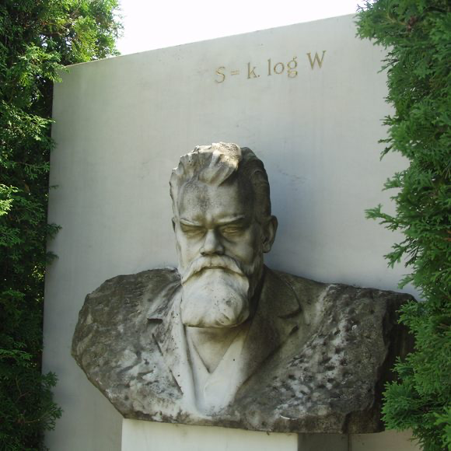

Slide 31
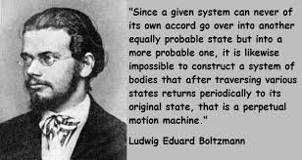
L. Boltzmann:
the system is driven to the most probable state with the largest entropy

Slide 32
Why does the entanglement entropy of a maximally entangled quantum state have the same form as a classical entropy of an equilibrated system?
Perhaps, what we perceive as ``classical equilibrium” is a maximally entangled quantum state in which some information has been scrambled?
Why does the entanglement entropy of a maximally entangled quantum state have the same form as a classical entropy of an equilibrated system?
Perhaps, what we perceive as ``classical equilibrium” is a maximally entangled quantum state in which some information has been scrambled?

Slide 33
Maximally entangled state at small x
In the maximally entangled regime at small x, it appears that
the behavior of the gluon structure function becomes universal;
[it is determined by the central charge of the corresponding CFT,
and not by its anomalous dimension]
Analogy to statistical mechanics:
in thermal equilibrium (maximal entropy), the equation of state
is determined by temperature (1/x)
and
the effective number of degrees of freedom (central charge).
[DK, Levin ‘17; Hao, DK, Korepin, ‘19; Zhang, Hao, DK, Korepin, ‘22]

Slide 34
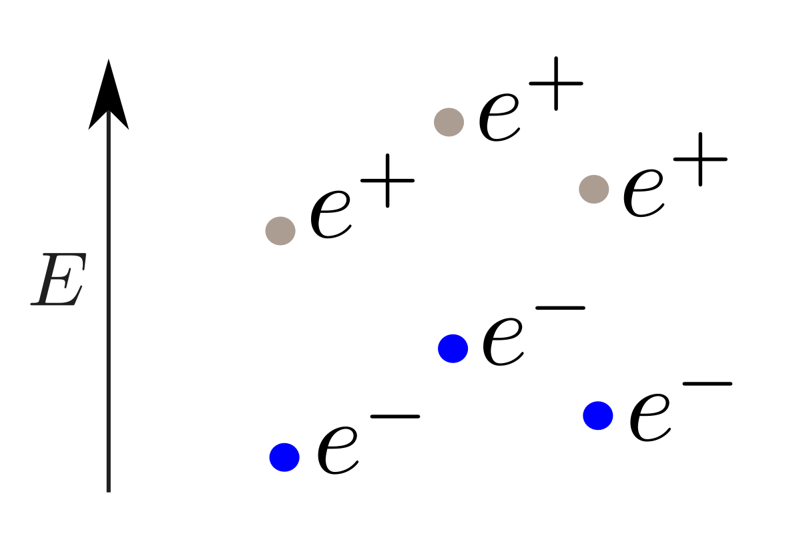
From entanglement entropy to statistical entropy: a simple example
A. Florio, DK,
PRD (2021)
Study of real-time evolution of entanglement between
the left- and right-movers in Schwinger pair production by
electric pulses
Gibbs entropy
entanglement
Entanglement entropy

Slide 35
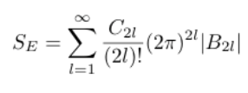
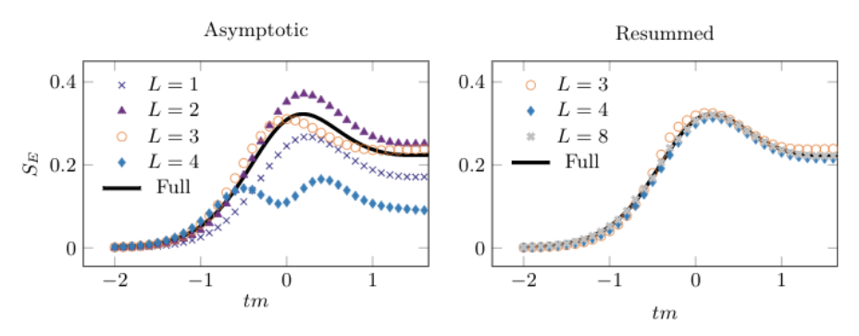
Real-time dynamics: from entanglement entropy to Boltzmann entropy
Entanglement entropy can be reconstructed from
the moments of multiplicity distribution:
A. Florio, DK,
PRD (2021)
Derived first for shot noise in Quantum Point Contacts:
I. Klich, L. Levitov, PRL (2009)
Bernoulli numbers
An efficient way to resum this series is found, using Pade-Borel methods:
The effect of radiation
on quantum entanglement:
S. Grieninger, DK,
I.Zahed,
arXiv:2305.07121;
and to appear

Slide 36
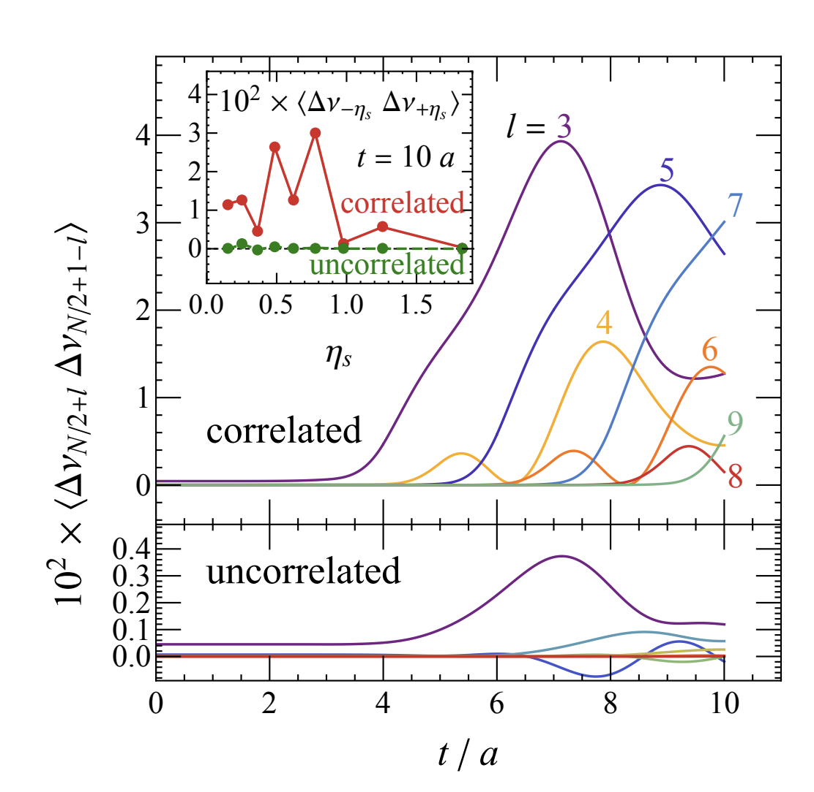
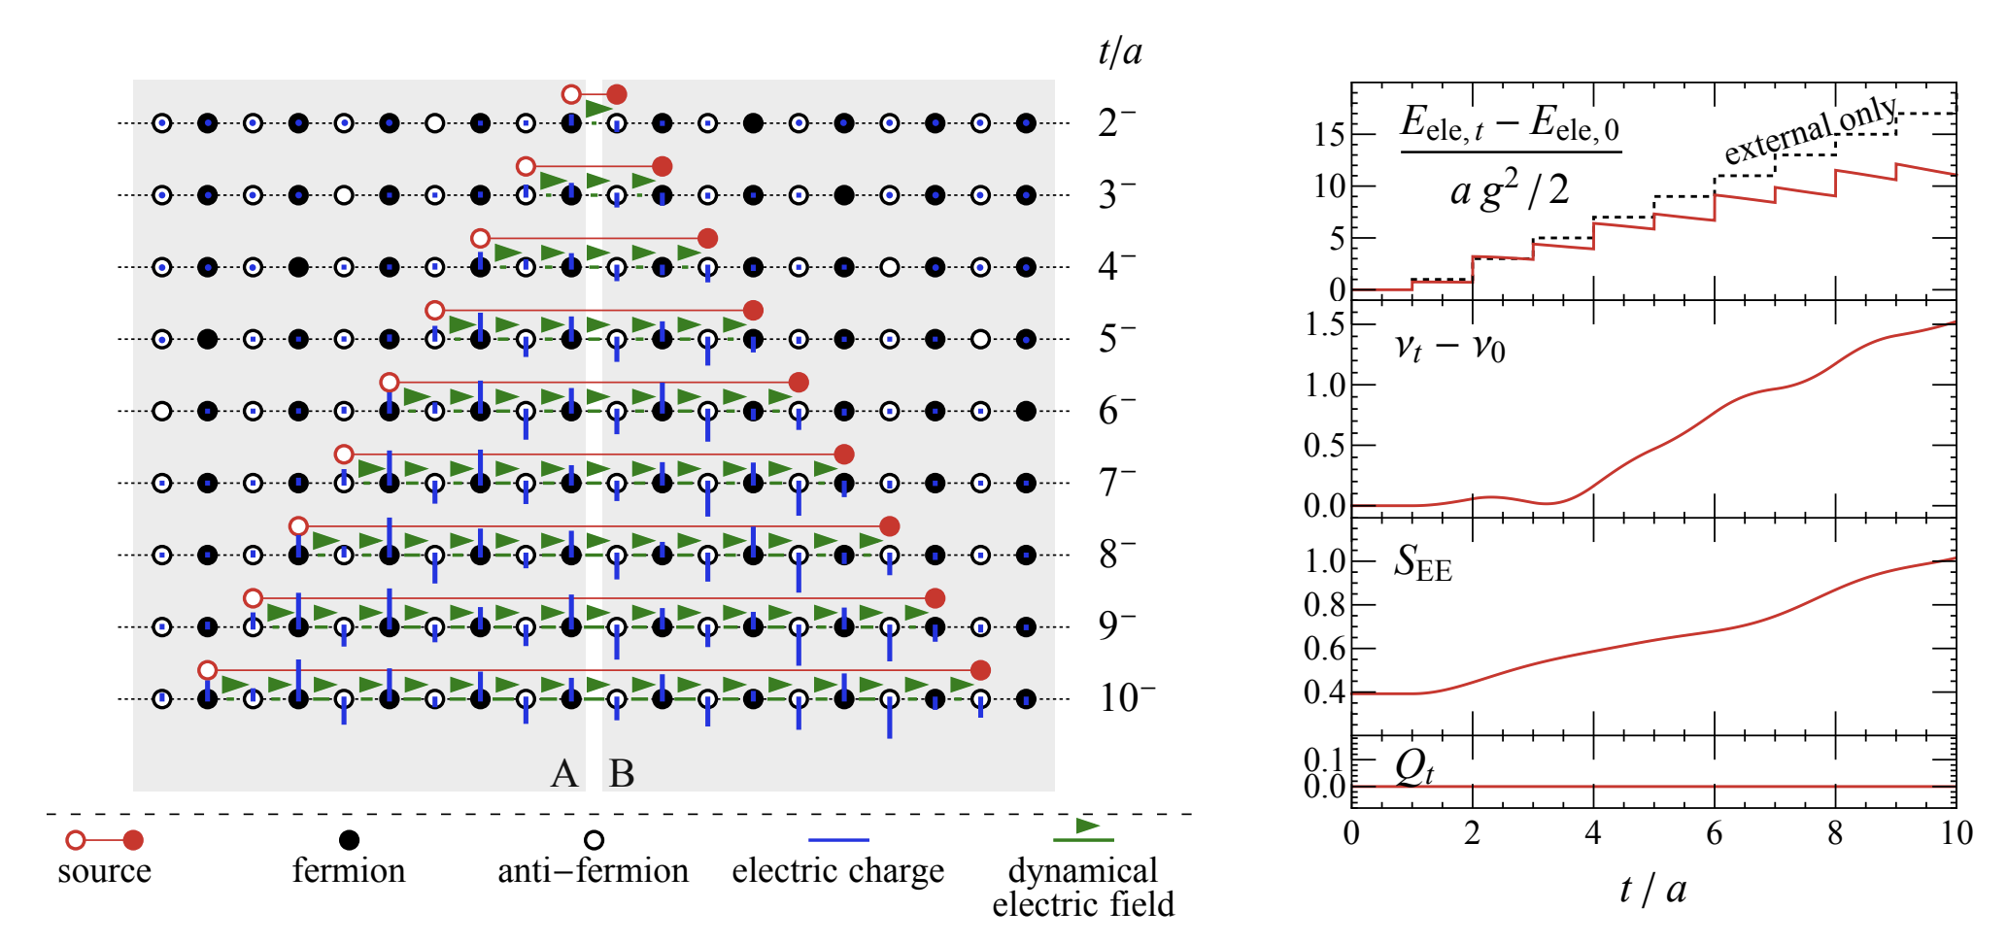
Real-time dynamics: from entanglement entropy to Boltzmann entropy
Entanglement in jet production:
PRL 131 (2023) 021902

Slide 37
Experimental tests
What is the relation between the parton and hadron multiplicity distributions?
Let us assume they are the same
(“EbyE parton-hadron duality”); then the hadron
multiplicity distribution should be given by
Consider moments
37

Slide 38
Fluctuations in hadron multiplicity
The moments can be easily computed by
using the generating function
We get
38

Slide 39
Fluctuations in hadron multiplicity
Numerically, for at |η|<0.5, E_{cm}=7 TeV
we get:
theory exp (CMS) theory, high energy limit
C₂ = 1.83
C₃ = 5.0
C₄ = 18.2
C₅ = 83
C₂ = 2.0+-0.05
C₃ = 5.9+-0.6
C₄ = 21+-2
C₅ = 90+-19
C₂ = 2.0
C₃ = 6.0
C₄ = 24.0
C₅ = 120
It appears that the multiplicity distributions of final state hadrons
are very similar to the parton multiplicity distributions –
this suggests that the entropy is close to the entanglement entropy
39

Slide 40
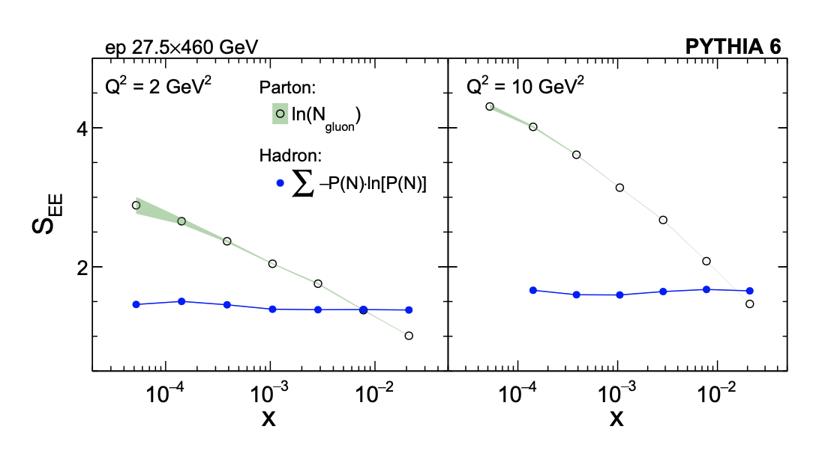
Test of the entanglement at the LHC
MC generator PYTHIA:
is not satisfied at small x (no entanglement)
K. Tu, DK, T. Ullrich,
arXiv:1904.11974;
PRL (2020)
40

Slide 41
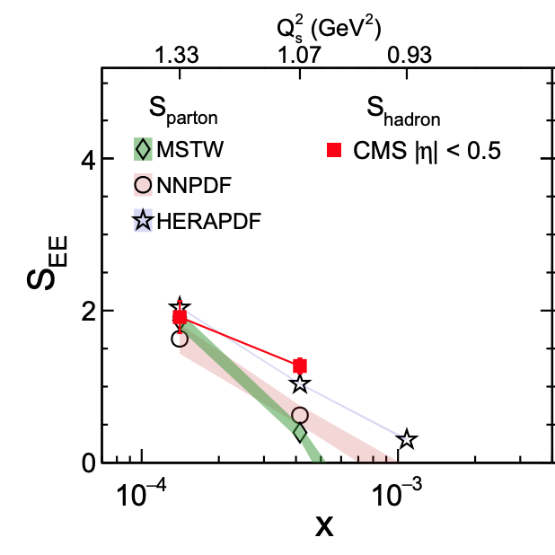
Test of the entanglement at the LHC
LHC data:
is satisfied at small x (entanglement?!)
arXiv:1904.11974
K. Tu, DK, T. Ullrich,
arXiv:1904.11974;
PRL (2020)
41

Slide 42
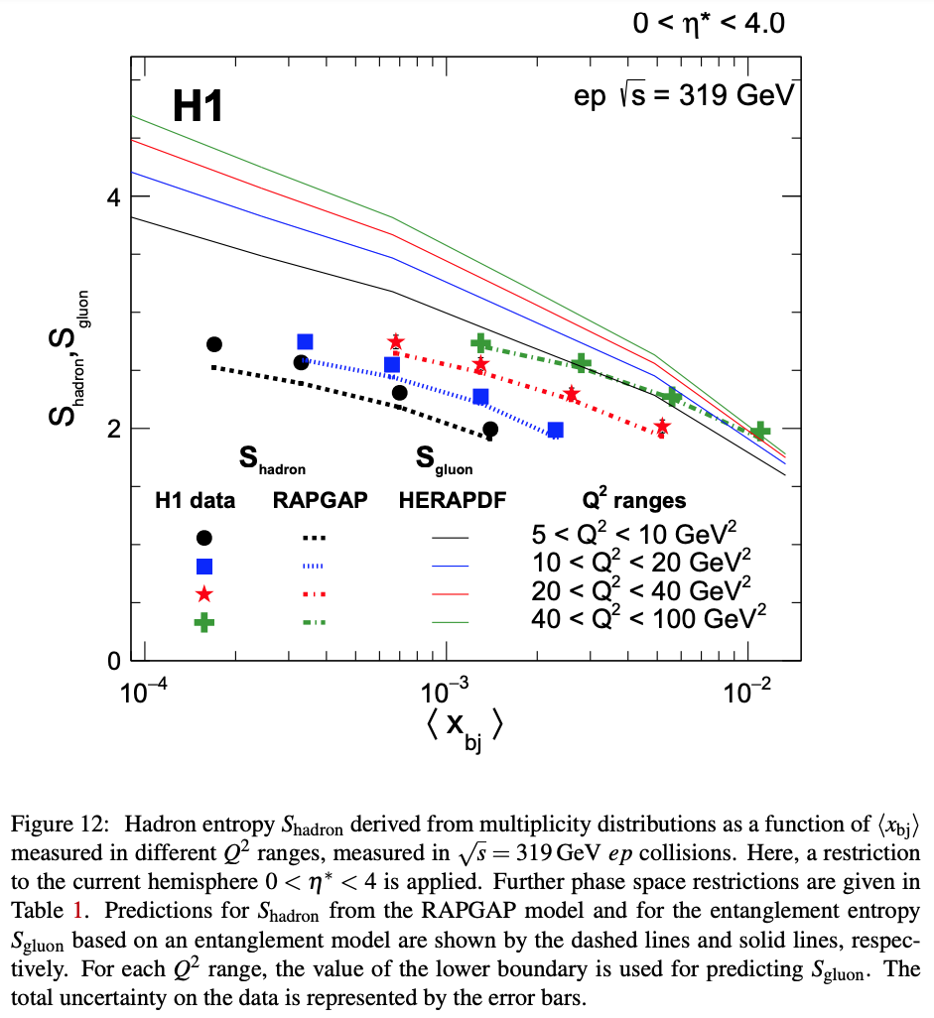
Test of the entanglement in DIS
H1 Coll.,
arXiv:2011.01812;
EPJC81(2021)3, 212
H1 Coll. test of
using DIS data (current fragmentation region)
Poor agreement is found!
Failure of the entanglement-
based picture?
42

Slide 43
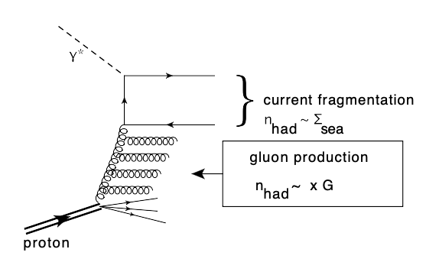
Test of the entanglement in DIS
It appears that in H1 kinematics
(current fragmentation region),
the assumptions used to derive the formula
do not apply:
The quark structure function is not proportional to the gluon one,
so need to use the quark distribution explicitly
Multiplicity N is not large, so need to take into account
1/N corrections
DK, E. Levin,
arXiv:2102.09773, PRD
43

Slide 44
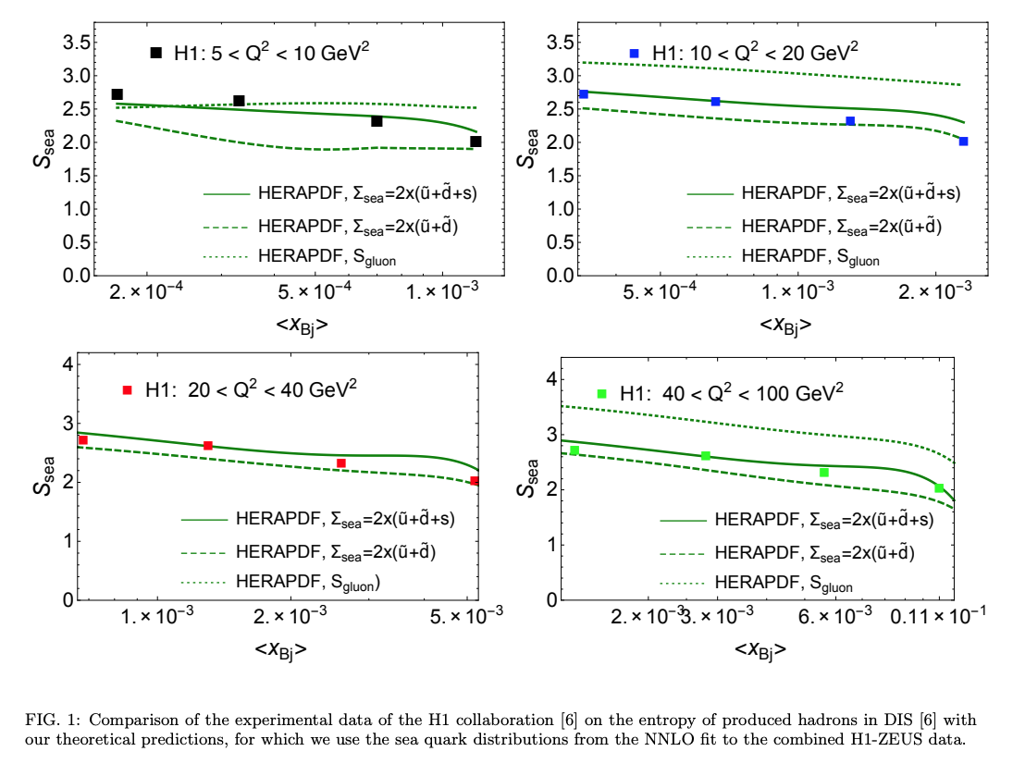
Test of the entanglement in DIS
The result: good agreement with H1 data
DK, E. Levin,
arXiv:2102.09773; PRD
44

Slide 45
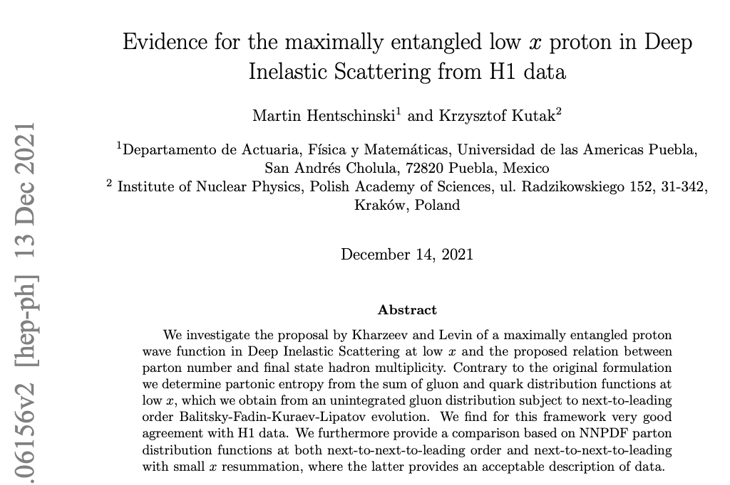

Slide 46
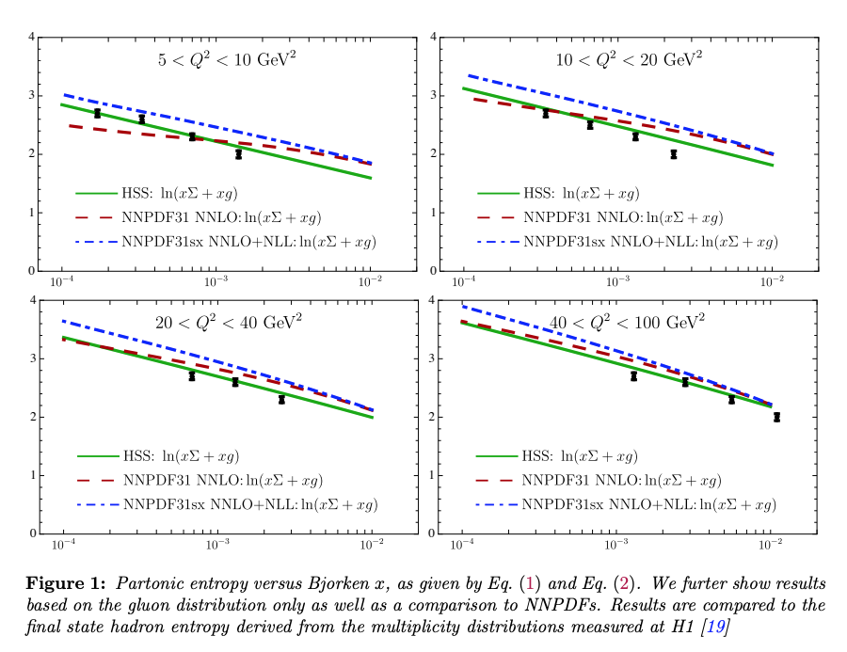

Slide 47
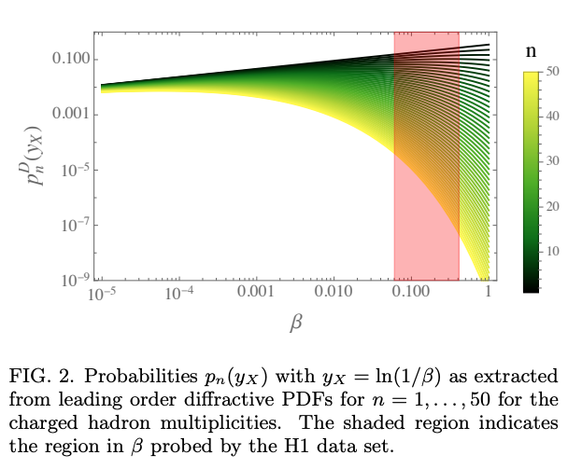
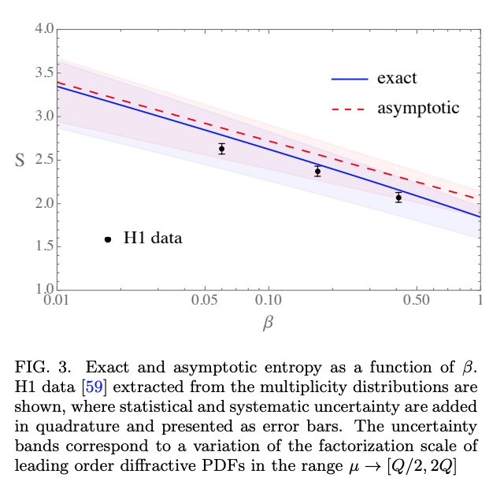
The onset of maximal entanglement in diffractive DIS
M. Hentschinski, DK, K. Kutak, Z. Tu, arXiv:2305.03069
Main idea: requirement of rapidity gap Δy “delays” the evolution
inside the proton by Δy,
so we can study the onset of maximal entanglement
See e.g. A.D.Le, A.H.Mueller, S. Munier,
PRD 104 (2021) 034026

Slide 48
Summary
Entanglement entropy (EE) provides a viable solution to the apparent contradiction between the parton model and quantum mechanics.
Indications from experiment that the link between EE and parton distributions is real, and proton at small x is a maximally entangled state.
Further tests at RHIC and EIC, requirements for
detector design (target fragmentation region, …)
3. Entanglement may provide a mechanism for
thermalization in high-energy collisions. Need for
further study of real-time dynamics.
48

Slide 49
Based on:
DK, E. Levin, Phys Rev D 95 (2017) 114008 + PRD 104 (2021) 3
DK, Phil. Trans. Royal Soc A 380 (2021) 5
M. Hentschinski, DK, K. Kutak, Z. Tu, arXiv:2305.03069
K. Hao, DK, V. Korepin, Int J Mod Phys A34 (2019) 1950197
K. Zhang, K. Hao, DK, V. Korepin, Phys Rev D 105 (2022) 1
Entanglement in DIS: Maximally entangled state
Entanglement and integrability in DIS

Slide 50
Based on:
DK, Y. Kikuchi, Phys. Rev. Res. 2 (2020) 2, 023342
A. Florio, DK, Phys Rev D 104 (2021) 5, 056021
D. Frenklakh, A. Florio, DK, Phys Rev D 106 (2022) 056021
A. Florio, D. Frenklakh, K. Ikeda, DK, V. Korepin, S. Shi, K. Yu, arXiv:2301.11991
K. Ikeda, DK, R. Meyer, S. Shi, arXiv:2305.00996
K. Ikeda, DK, S. Shi, arXiv:2305.05685
S. Grieninger, DK, I. Zahed, to appear
S. Grieninger, K. Ikeda, DK, to appear
Entanglement in real time processes + quantum simulations

Slide 51
Based on:
O.K. Baker, DK, Phys Rev D 98 (2018) 054007
Z. Tu, DK, T. Ullrich, Phys Rev Lett 124 (2020) 6, 062001
Entanglement in high energy hadron collisions

Slide 52
Related work on entanglement in DIS:
Maximally entangled state at small x, link to black holes:
G. Dvali, R. Venugopalan, Phys Rev D 105 (2022) 5, 056026
Y. Liu, M. Nowak, I. Zahed, Phys.Rev.D 105 (2022) 11, 114028; …
Maximally entangled state at small x:
M. Hentschinski, K. Kutak, Eur.Phys.J.C 82 (2022) 2, 111; ….
Momentum space entanglement and RG evolution:
Kovner, M. Lublinsky Phys Rev D 92 (2015) 3, 034016;
A. Kovner, M. Lublinsky, M. Serino, Phys Lett B 792 (2019) 4;
N. Armesto, F. Dominguez, A. Kovner, M. Lublinsky, V. Skokov, JHEP 05(2019) 025; ….

