Slide 1
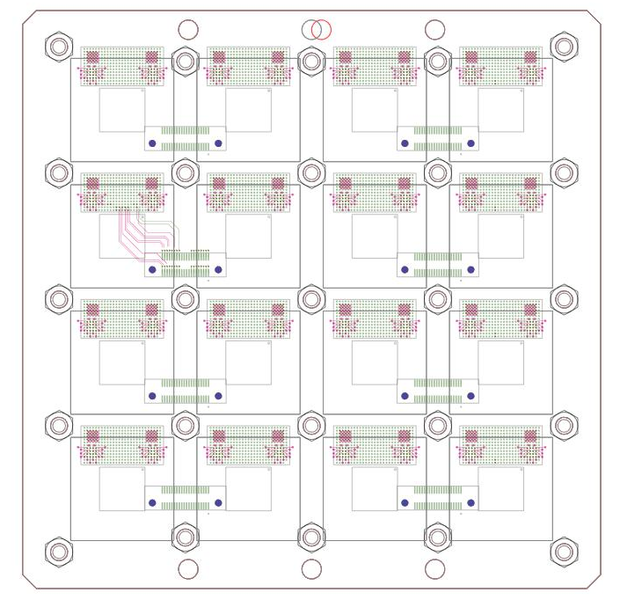
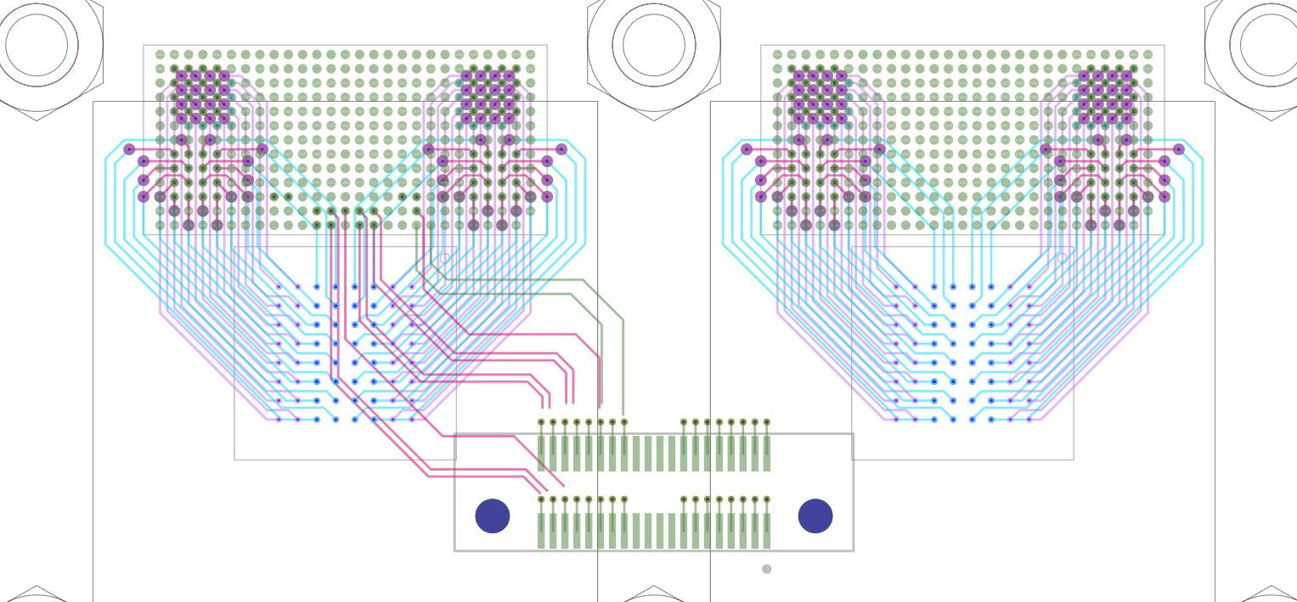
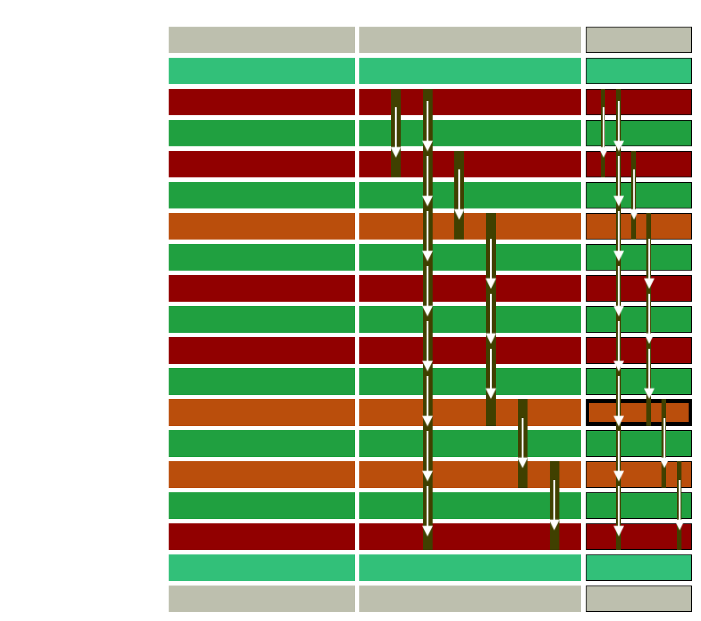
ERM5-020-050-L-DV-K-TR
8 Layers
(maybe 10)
PCB HDI
µvia:
C1-C2
C2-C3
C3-C6
C6-C7
C7-C8
Pth via
C1-C8
FRONT END BOARD 16 x BGA Hgcroc HD 350 0.6mm

Slide 2
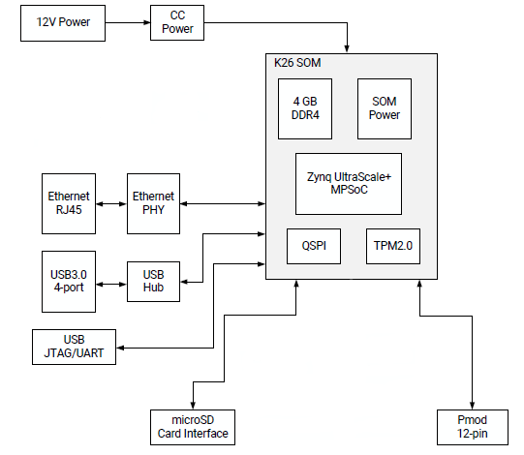
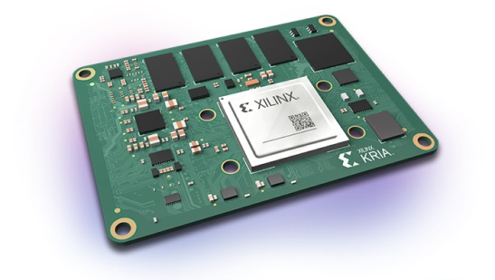
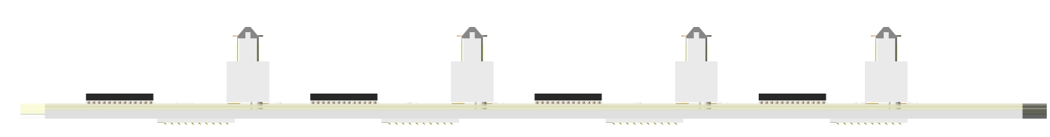
Carrier Board for Kria SOM
I2C - CLK320 – FCMD – Soft/Hard Rstb - DAQ
ERM5-020-050-L-DV-K-TR
FRONT END BOARD 16 x BGA Hgcroc HD 350 0.6mm

Slide 3
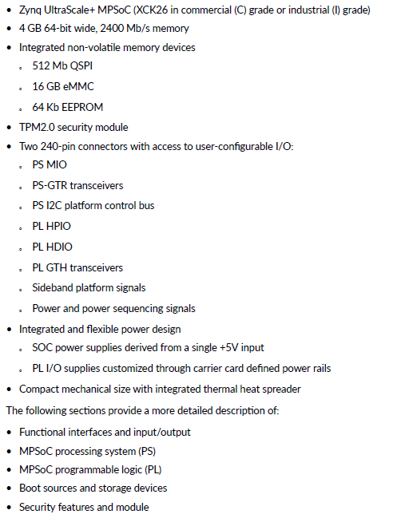
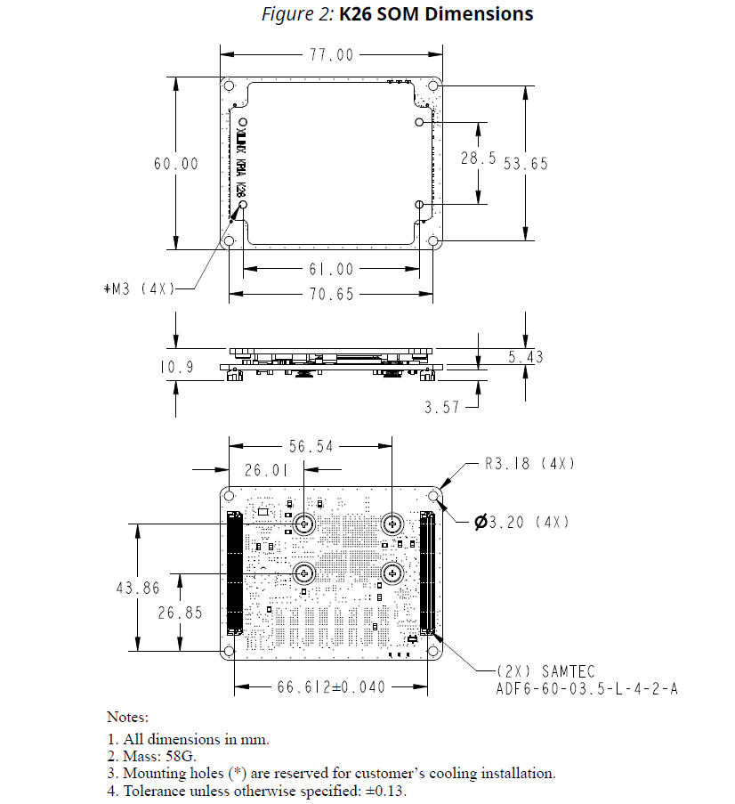
Unit Price :
400$/€

Slide 4
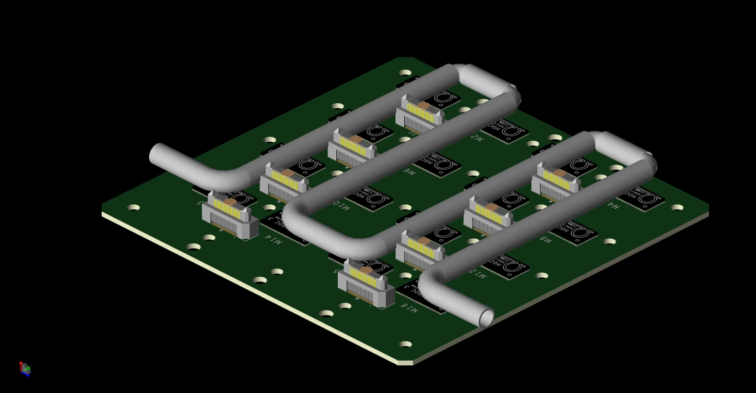
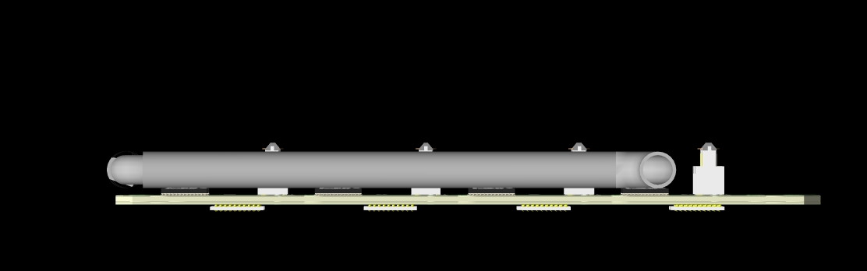
COOLING PIPE ?
Try with pipes 5mm diam, preferred 2-3mm

