Slide 1
Planning for Early Physics Phases
E.C. Aschenauer (BNL), R. Ent (JLab)
Co-Associate Directors for the Experimental Program
Summer 2024 Joint EICUG/ ePIC Collaboration Meeting
July 23rd – 27th, 2024

Slide 2

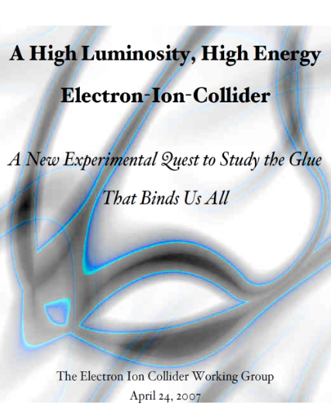




The Scientific Foundation for an EIC was Built Over Two Decades
2002
“a high-energy high-luminosity polarized EIC [is] the highest priority for new facility construction following the completion of FRIB.”
2007
The science questions that an EIC will answer are central to completing an understanding of atoms as well as being integral to the agenda of nuclear physics today.”
2009
2010
Gluons and the Quark Sea at High Energies
2012
2013
  High Level Requirements to Accelerator stable since the 2010 INT Program
2015
Science Requirements and Detector Concepts for the EIC – Drives the requirements of EIC detectors
Major Nuclear Physics Facilities for the Next Decade
2018
2021
“…essential accelerator and detector R&D [for EIC] should be given very high priority
in the short term.”
NSAC
2023
We recommend the expeditious completion of the EIC as the highest priority for facility construction.
“We recommend the allocation of resources …to lay the foundation for a polarized Electron-Ion Collider…”
“..a new dedicated facility will be essential for answering some of the most central questions.”
March 14, 2013
“The quantitative study of matter in this new regime [where abundant gluons dominate] requires a new experimental facility: an Electron Ion Collider..”
Electron-Ion Collider..absolutely central to the nuclear science program of the next decade.
arXiv:2103.05419

Slide 3


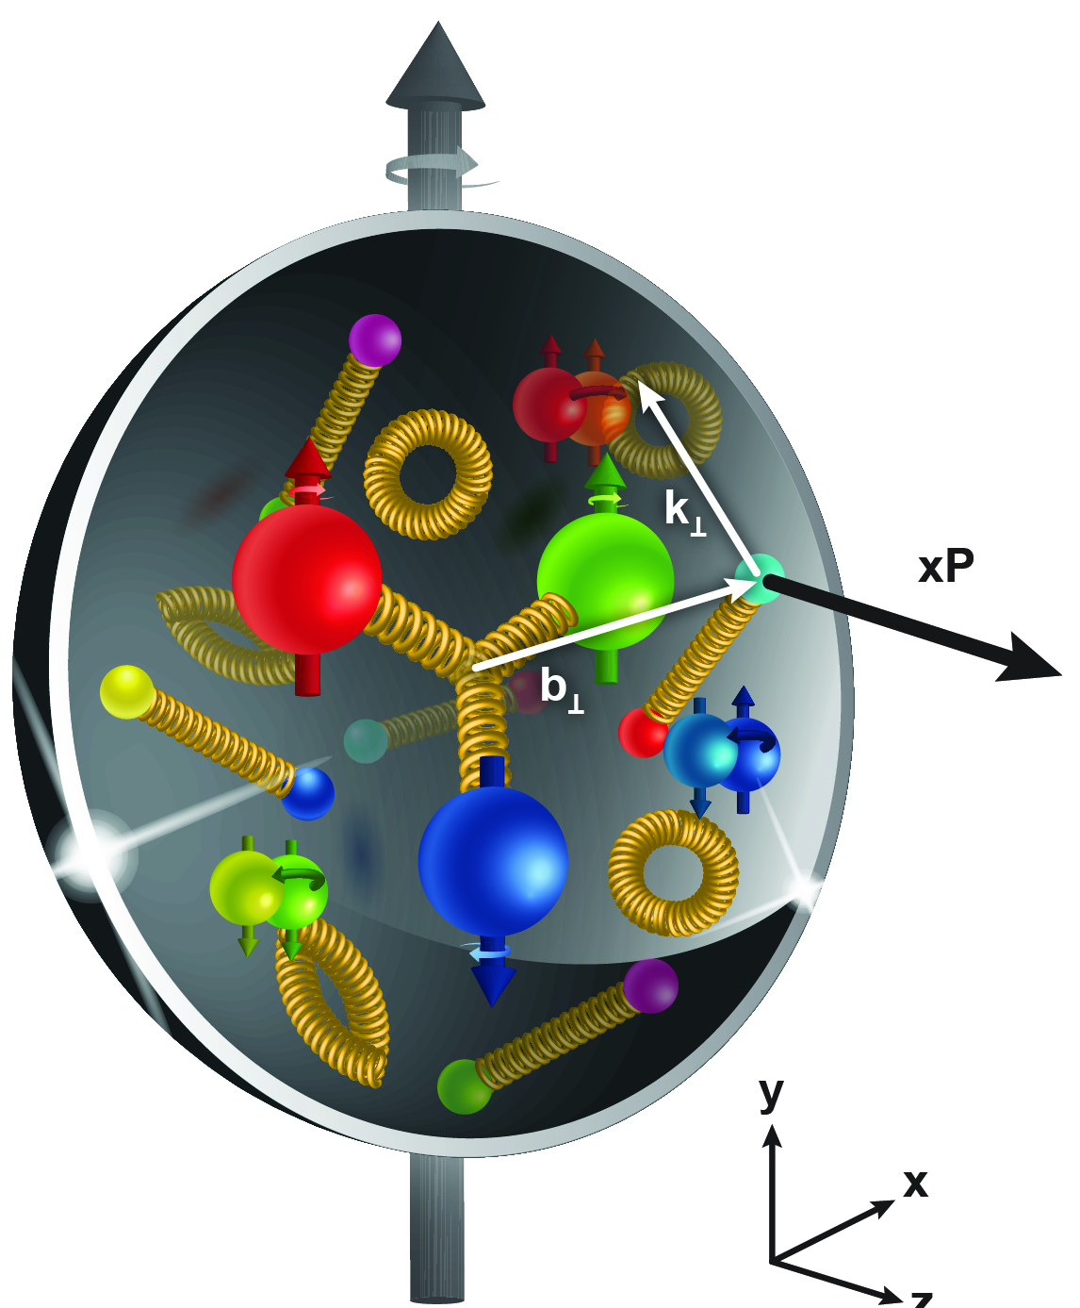
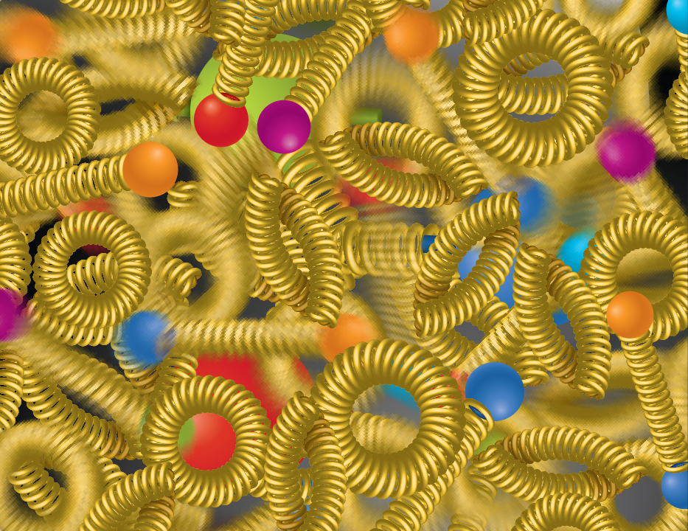
EIC NSAC/NAS Science Pillars
SPIN is one of the fundamental properties of matter.
All elementary particles, but the Higgs carry spin.
Spin cannot be explained by a static picture of the proton
It is the interplay between the intrinsic properties and interactions of quarks and gluons
The EIC will unravel the different contribution from the quarks, gluons and orbital angular momentum.
Does the mass of visible matter emerge from quark-gluon interactions?
Atom: Binding/Mass =
0.00000001
Nucleus: Binding/Mass =
0.01
Proton: Binding/Mass =
100
For the proton the EIC will determine an important term contributing to the proton mass, the so-called “QCD trace anomaly
How are the quarks and gluon distributed in space and momentum inside the nucleon & nuclei?
How do the nucleon properties emerge from them and their interactions?
How can we understand their dynamical origin in QCD?
What is the relation to Confinement
Is the structure of a free and bound nucleon the same?
How do quarks and gluons, interact with a nuclear medium?
How do the confined hadronic states emerge from these quarks and gluons?
How do the quark-gluon interactions create nuclear binding?
How many gluons can fit in a proton?
How does a dense nuclear environment affect the quarks and gluons, their correlations, and their interactions?
What happens to the gluon density in nuclei? Does it saturate at high energy?
?
gluon
splitting
=
gluon
recombination

Slide 4
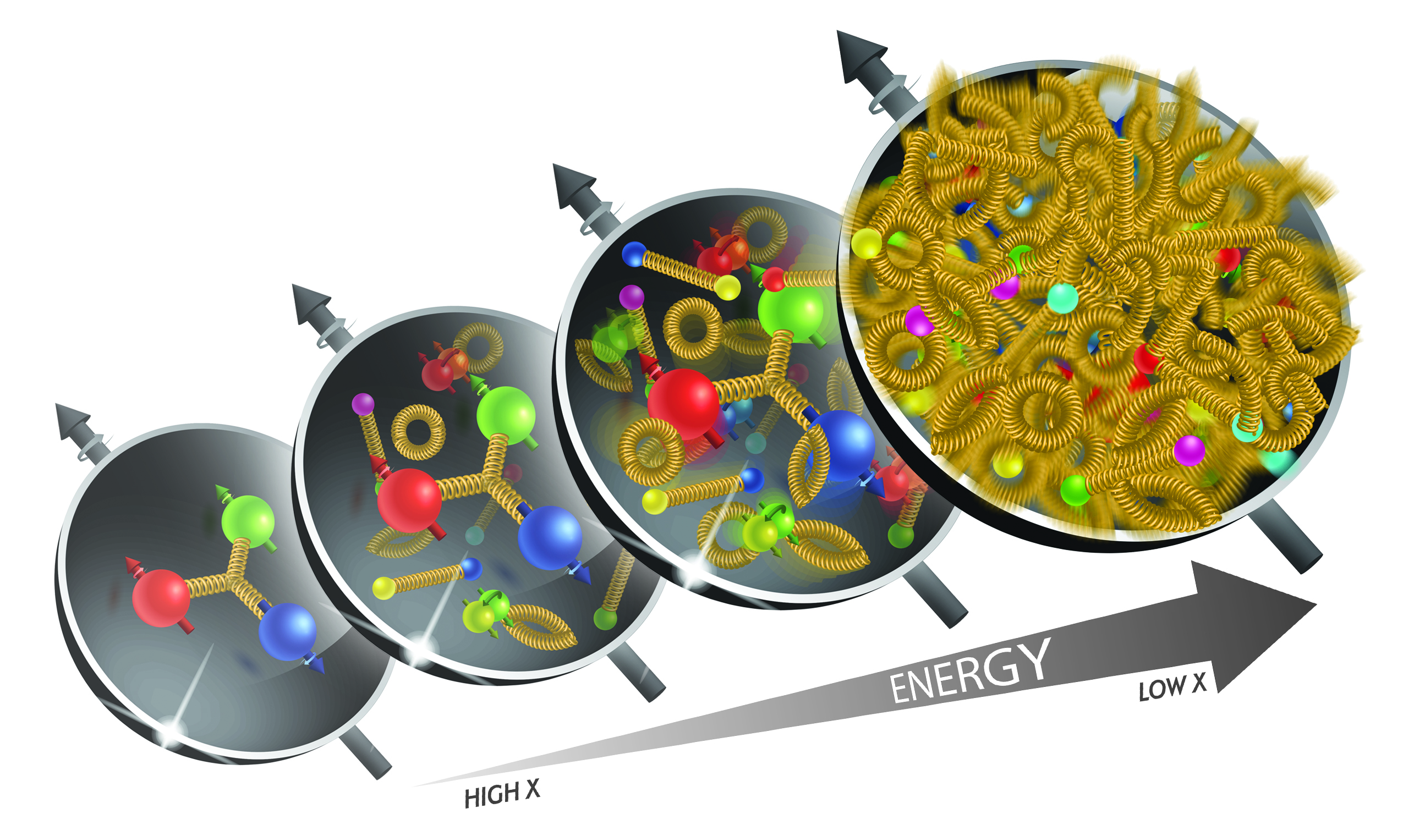
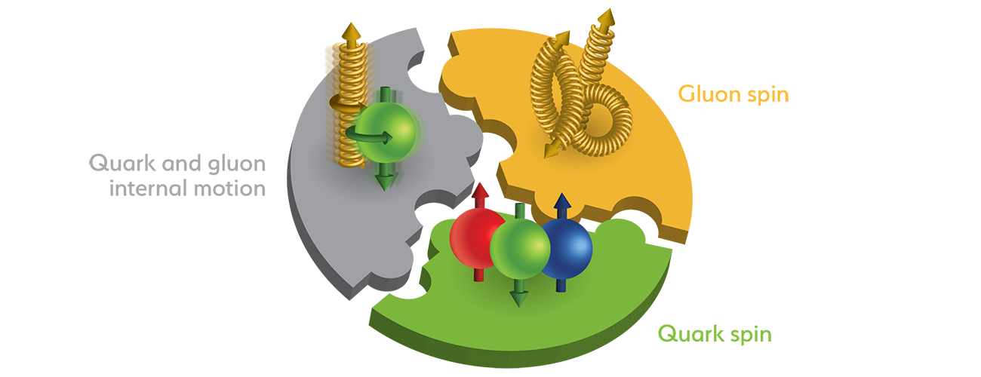
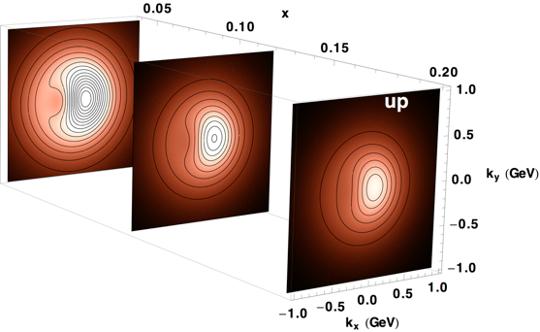
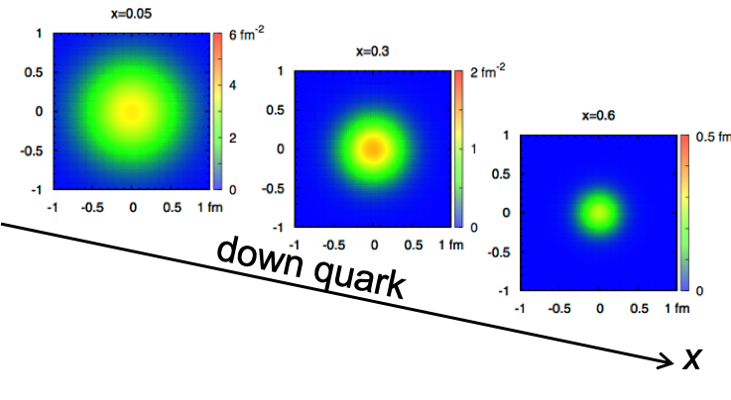
Ultimate Accelerator Performance for NAS Science
wide center-of-mass energy √s: ~20 – 140 GeV :
map the out nucleon and nuclei structure from high to low x
polarized electron and hadron (p, He-3) beams:
access to spin structure of nucleons and nuclei
Spin vehicle to access the spatial and momentum structure of the nucleon in 3d
Full specification of initial and final states to probe q-g structure of NN and NNN interaction in light nuclei
nuclear beams: d to Pb
accessing the highest gluon densities → saturation
quark and gluon interact with a nuclear medium
high luminosity 10³³-10³⁴ cm⁻²s⁻¹ :
mapping the spatial and momentum structure of nucleons and nuclei in 3d
access to rare probes, i.e. Ws
large acceptance (0.2 – 1.3 GeV) through forward focusing IR magnets
spatial imaging of nucleons and nuclei
gluon emission
gluon recombination
?
=

Slide 5
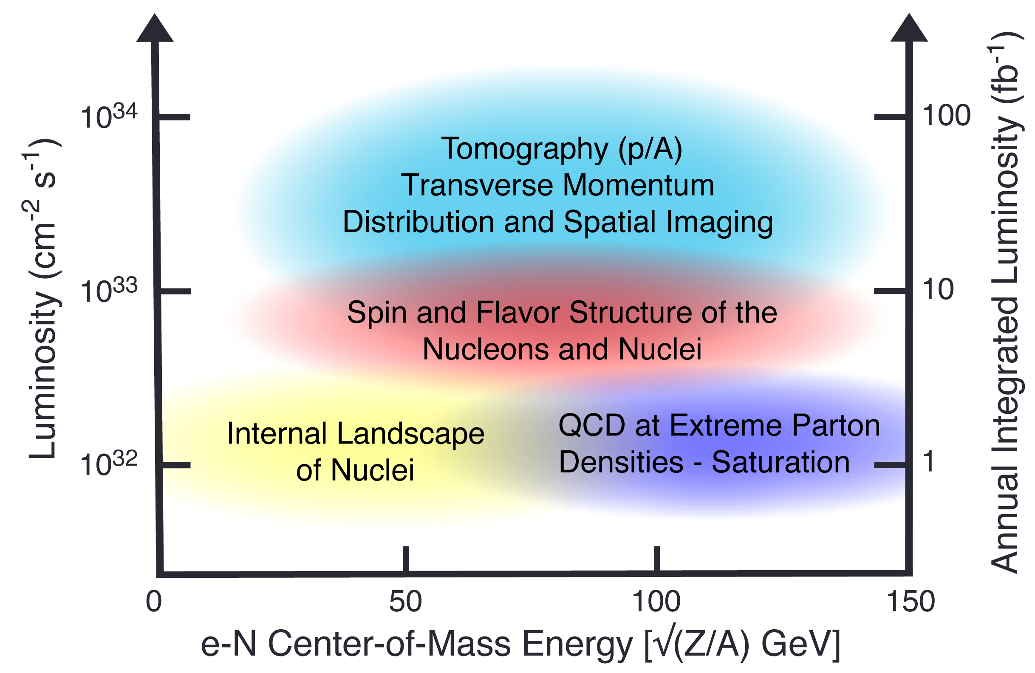
EIC Science Reach
Spin
Mass
3D Imaging
Quarks, Gluons & Nuclei
Dense gluon systems

Slide 6
Accelerator at Day One and Ultimate
RCS:
7nC / bunch add bunch merging RF cavities, update Power Supplies (PS),
5 – 10 GeV polarized e- add harmonic kickers to reach 28 nC / bunch and 18 GeV electrons
ESR:
7nC / bunch
5 – 10 GeV polarized e- add more RF cavities to reach 28 nC / bunch and 18 GeV electrons
HSR:
100 – 250 GeV polarized p update PS to reach 275 GeV protons and 110 GeV/u nuclei
100 GeV/u nuclear beams add 41 GeV bypass to get full HSR beam energy capabilities
pre-cooling at injection add strong hadron cooling to achieve ultimate beam parameters
and integrated luminosity
Proposal for the Day-One Physics and the initial years of science is driven by
  Start of the promised NSAC/NAS science program
  Alignment with expected order of commissioning the collider and ramp up of performance that comes with gain of operational experience
  Having access to new physics results early to get high impact publications, i.e. PRLs, ……

Slide 7
Initial thoughts on the EIC Commissioning Strategy
Use the same beams as for Year-1 ‘First Science’
Prefer ~130 GeV/u, which corresponds to a ‘centered’ hadron beam (path length difference ΔR ~ 0, this is achieved for a beam where Z ~ 0.5A).
Do not want to exceed the present RHIC maximum dipole fields (corresponds to 250 GeV protons or 833 T-m)
  At present, the limit is due to the DX magnets (combining dipoles at the IRs). These will be removed for EIC and the main dipoles are capable of 275 GeV proton field.
Unpolarized Electrons
Since the electron revolution frequency is fixed, the hadron orbit must be adjusted with energy to keep the collisions synchronized.
→ Our proposal for Year-1 ‘First Science’ would be to
run Ruthenium or Copper ions. Both already used
in RHIC.
3He
p
Zr
d
Au,
p
U
Ru
Cu

Slide 8
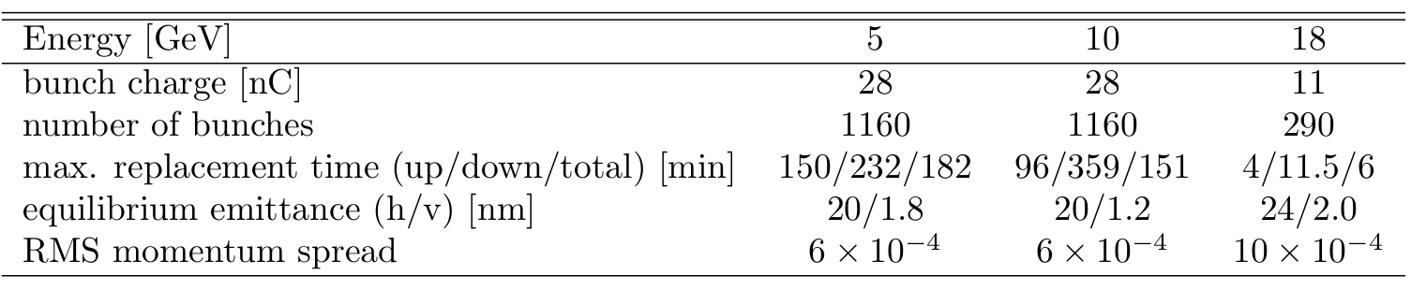
Initial thoughts on the EIC Commissioning Strategy
Advantage of 5 and 10 GeV?
we want polarization as early as possible, depolarization time due to the Sokolov-Ternov effect is small
max allowable replacement time for 10 GeV 360 mins (85% → 70%) for the preferred polarization state and 96 mins for opposite direction
→ proposal run only the preferred spin state per fill
  Consequence: need to flip the ESR spin rotators between fills to keep systematics small → possible; optics does not depend on spin rotator polarity and in the shadow of filling the HSR we change spin rotator polarity in ESR
Maximum replacement times (= max. allowable storage times in ESR) are based on 85% injected polarization and 70% time averaged polarization

Slide 9
Proposal for EIC Science Program in the First Years
Year - 1
Start with Phase 1 EIC
New capability
Commission electron polarization in parallel
Run:
10 GeV electrons on 115 GeV/u heavy ion beams (Ru or Cu)
Physics:
gives world-wide new data on nPDFs and a first look on saturation

Slide 10
Proposal for EIC Science Program in the First Years
Year - 1
Year - 2
Start with Phase 1 EIC
New Capability:
Commission electron polarization in parallel
Run:
10 GeV electrons on 115 GeV/u heavy ion beams (Ru or Cu) Physics:
gives world-wide new data on nPDFs and a first look on saturation
Start with Phase 1 EIC
Commission electron polarization in parallel
New Capability:
Commission hadron polarization in parallel
Run:
10 GeV electrons on 130 GeV/u deuterium
Physics:
gives world-wide new data → critical baseline for nPDFs and saturation
free vs. bound proton structure
Run:
Last weeks 10 GeV electrons and 130 GeV polarized protons
Physics:
first look to 3d imaging of the proton

Slide 11
Proposal for EIC Science Program in the First Years
Year - 1
Year - 2
Year - 3
Start with Phase 1 EIC
New Capability:
Commission electron polarization in parallel
Run:
10 GeV electrons on 115 GeV/u heavy ion beams (Ru or Cu) Physics:
gives world-wide new data on nPDFs and a first look on saturation
Start with Phase 1 EIC
Commission electron polarization in parallel
New Capability:
Commission hadron polarization in parallel
Run:
10 GeV electrons on 130 GeV/u Deuterium
Physics:
gives world-wide new data → critical baseline for nPDFs and saturation
free vs. bound proton structure
Run:
Last weeks 10 GeV electrons and 130 GeV polarized protons
Physics:
first look to 3d imaging of the proton
Start with Phase 1 EIC
Commission electron polarization in parallel
Commission hadron polarization in parallel
New Capability:
Commission running with hadron spin rotators
Run:
10 GeV electrons on 130 GeV transverse polarized protons
Physics:
3d imaging of the proton / mass of the nucleon
Run:
Last weeks switch to longitudinal proton polarization
Physics:
first look helicity structure of the proton – unravel quark, gluon and orbital angular contributions

Slide 12
Proposal for EIC Science Program in the First Years
Year - 1
Year - 2
Year - 3
Year - 4
Start with Phase 1 EIC
New Capability:
Commission electron polarization in parallel
Run:
10 GeV electrons and 115 GeV/u heavy ion beams (Ru or Cu)
Physics:
gives world-wide new data on nPDFs and a first look on saturation
Start with Phase 1 EIC
Commission electron polarization in parallel
New Capability:
Commission hadron polarization in parallel
Run:
10 GeV electrons and 130 GeV/u Deuterium
Physics:
gives world-wide new data → critical baseline for nPDFs and saturation
free vs. bound proton structure
Run:
Last weeks 10 GeV electrons and 100 GeV polarized protons
Physics:
first look to 3d imaging of the proton
Start with Phase 1 EIC
Commission electron polarization in parallel
Commission hadron polarization in parallel
New Capability:
Commission running with hadron spin rotators
Run:
10 GeV electrons and 130 GeV transverse polarized protons
Physics:
3d imaging of the proton / mass of the nucleon
Run:
Last weeks switch to longitudinal proton polarization
Physics:
first look helicity structure of the proton – unravel quark, gluon and orbital angular contributions
Start with Phase 1 EIC
Commission electron polarization in parallel
Commission hadron polarization in parallel
Commission running with hadron spin rotators
New Capability:
Commission hadron accelerator to operate with not centered orbits
Run:
10 GeV electrons and 250 GeV transverse and longitudinal polarized protons
Physics:
3d imaging of the proton at low x
helicity structure of the proton – unravel quark, gluon and orbital angular contributions

Slide 13
Proposal for EIC Science Program in the First Years
Year - 1
Year - 2
Year - 3
Year - 4
Year - 5
Start with Phase 1 EIC
New Capability:
Commission electron polarization in parallel
Run:
10 GeV electrons and 115 GeV/u heavy ion beams (Ru or Cu)
Physics:
gives world-wide new data on nPDFs and a first look on saturation
Start with Phase 1 EIC
Commission electron polarization in parallel
New Capability:
Commission hadron polarization in parallel
Run:
10 GeV electrons and 130 GeV/u Deuterium
Physics:
gives world-wide new data → critical baseline for nPDFs and saturation
free vs. bound proton structure
Run:
Last weeks 10 GeV electrons and 100 GeV polarized protons
Physics:
first look to 3d imaging of the proton
Start with Phase 1 EIC
Commission electron polarization in parallel
Commission hadron polarization in parallel
New Capability:
Commission running with hadron spin rotators
Run:
10 GeV electrons and 130 GeV transverse polarized protons
Physics:
3d imaging of the proton / mass of the nucleon
Run:
Last weeks switch to longitudinal proton polarization
Physics:
first look helicity structure of the proton – unravel quark, gluon and orbital angular contributions
Start with Phase 1 EIC
Commission electron polarization in parallel
Commission hadron polarization in parallel
Commission running with hadron spin rotators
New Capability:
Commission hadron accelerator to operate with not centered orbits
Run:
10 GeV electrons and 250 GeV transverse and longitudinal polarized protons
Physics:
3d imaging of the proton at low x
helicity structure of the proton – unravel quark, gluon and orbital angular contributions
Start with Phase 1 EIC
Commission electron polarization in parallel
Commission hadron polarization in parallel
Commission running with hadron spin rotators
Commission hadron accelerator to operate with not centered orbits
Run:
10 GeV electrons and 166 GeV transverse and longitudinal polarized He-3
Physics:
3d imaging of the nucleons → flavor separation
helicity structure of the nucleon– unravel helicities for different quark flavors
first look to nuclear binding

Slide 14
Proposal for EIC Science Program in the First Years
Year - 1
Year - 2
Year - 3
Year - 4
Year - 5
Start with Phase 1 EIC
New Capability:
Commission electron polarization in parallel
Run:
10 GeV electrons on 115 GeV/u heavy ion beams (Ru or Cu) Physics:
gives world-wide new data on nPDFs and a first look on saturation
Start with Phase 1 EIC
Commission electron polarization in parallel
New Capability:
Commission hadron polarization in parallel
Run:
10 GeV electrons on 130 GeV/u Deuterium
Physics:
gives world-wide new data → critical baseline for nPDFs and saturation
free vs. bound proton structure
Run:
Last weeks 10 GeV electrons and 130 GeV polarized protons
Physics:
first look to 3d imaging of the proton
Start with Phase 1 EIC
Commission electron polarization in parallel
Commission hadron polarization in parallel
New Capability:
Commission running with hadron spin rotators
Run:
10 GeV electrons on 130 GeV transverse polarized protons
Physics:
3d imaging of the proton / mass of the nucleon
Run:
Last weeks switch to longitudinal proton polarization
Physics:
first look helicity structure of the proton – unravel quark, gluon and orbital angular contributions
Start with Phase 1 EIC
Commission electron polarization in parallel
Commission hadron polarization in parallel
Commission running with hadron spin rotators
New Capability:
Commission hadron accelerator to operate with not centered orbits
Run:
10 GeV electrons on 250 GeV transverse and longitudinal polarized protons
Physics:
3d imaging of the proton
at low x
helicity structure of the proton – unravel quark, gluon and orbital angular contributions
Start with Phase 1 EIC
Commission electron polarization in parallel
Commission hadron polarization in parallel
Commission running with hadron spin rotators
Commission hadron accelerator to operate with not centered orbits
Run:
10 GeV electrons on 166 GeV transverse and longitudinal polarized He-3
Physics:
3d imaging of the nucleons → flavor separation
helicity structure of the nucleon– unravel helicities for different quark flavors
first look to nuclear binding
Time to install additional ESR RF and HSR PS to
reach design Current and max. Energies

Slide 15
Proposal for EIC Science Program in the First Years
Year - 5
Year - 6
Year - 7
Start with Phase 1 EIC
Commission electron polarization in parallel
Commission hadron polarization in parallel
Commission running with hadron spin rotators
Commission hadron accelerator to operate with not centered orbits
Run:
10 GeV electrons on 166 GeV transverse and longitudinal polarized He-3
Physics:
3d imaging of the nucleons → flavor separation
helicity structure of the nucleon– unravel helicities for different quark flavors
first look to nuclear binding
Start with Phase 1 EIC
Commission electron polarization in parallel
Commission hadron polarization in parallel
Commission running with hadron spin rotators
Commission hadron accelerator to operate with not centered orbits
New Capability:
Commission ESR & HSR at max. energy and beam currents
Run:
18 GeV polarized electrons on 110 GeV/u Au (Pb) beams
Physics:
ultimate x-Q² reach for saturation physics
Start with Phase 1 EIC
Commission electron polarization in parallel
Commission hadron polarization in parallel
Commission running with hadron spin rotators
Commission hadron accelerator to operate with not centered orbits
Commission ESR & HSR at max. energy and beam currents
New Capability:
Operate HSR with 41 GeV bypass
Run:
5 GeV polarized electrons on 41 GeV transverse polarized proton beams
Physics:
first look to moderate-x 3d imaging and Kaon structure/ mass

Slide 16
We need to think about phasing
Any potential Phasing of Detector Components must be compatible with the EIC science program.
alignment with the ramp up of the accelerator should be considered.
are there subsystem which would benefit from a delay in construction time?
we need to be careful that funding or in-kind contributions are not negatively impacted by any potential phasing.
This is a difficult balancing act:
  It is our duty to consider phasing.
  It is critical to maintain a path to the envisioned ePIC detector and to keep the full ePIC collaboration involved and engaged.

Slide 17


Slide 18


Slide 19
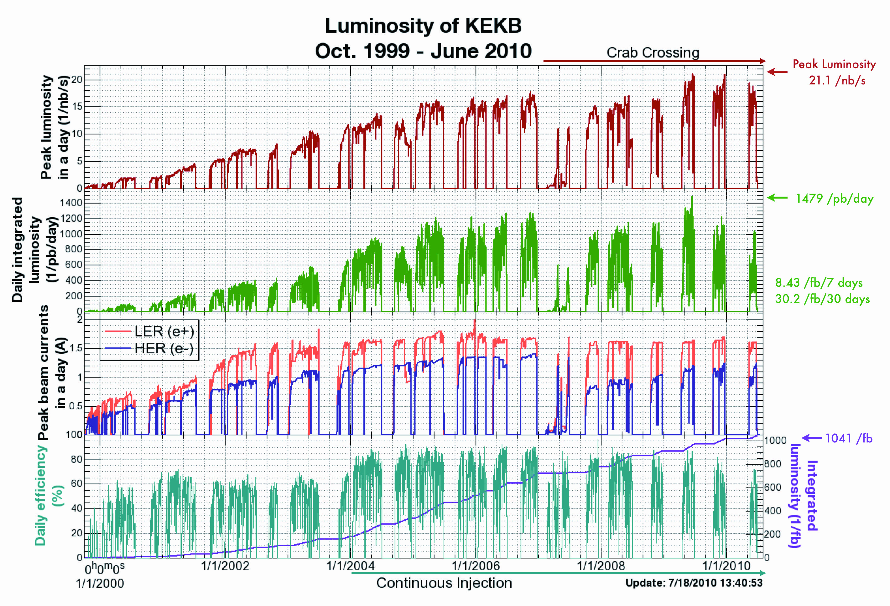
Real experience ramping up a high current collider

Slide 20
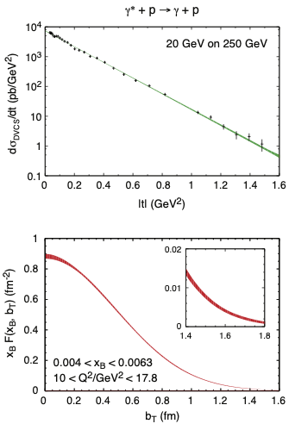
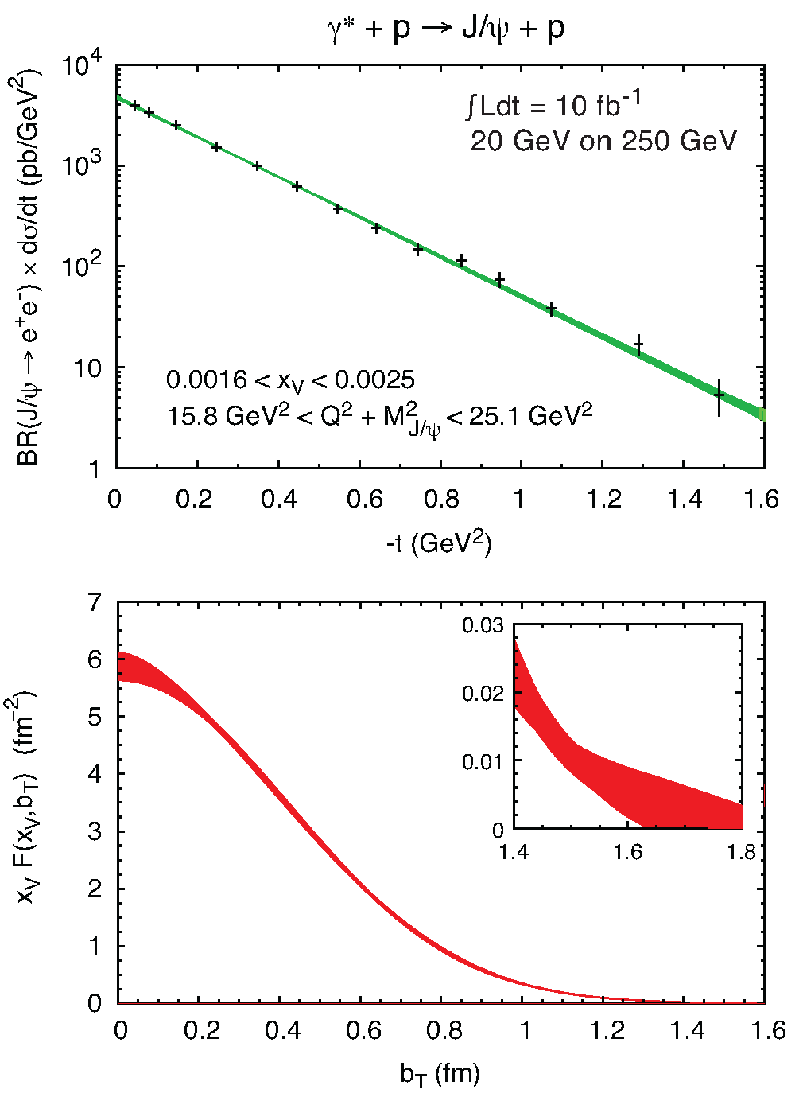
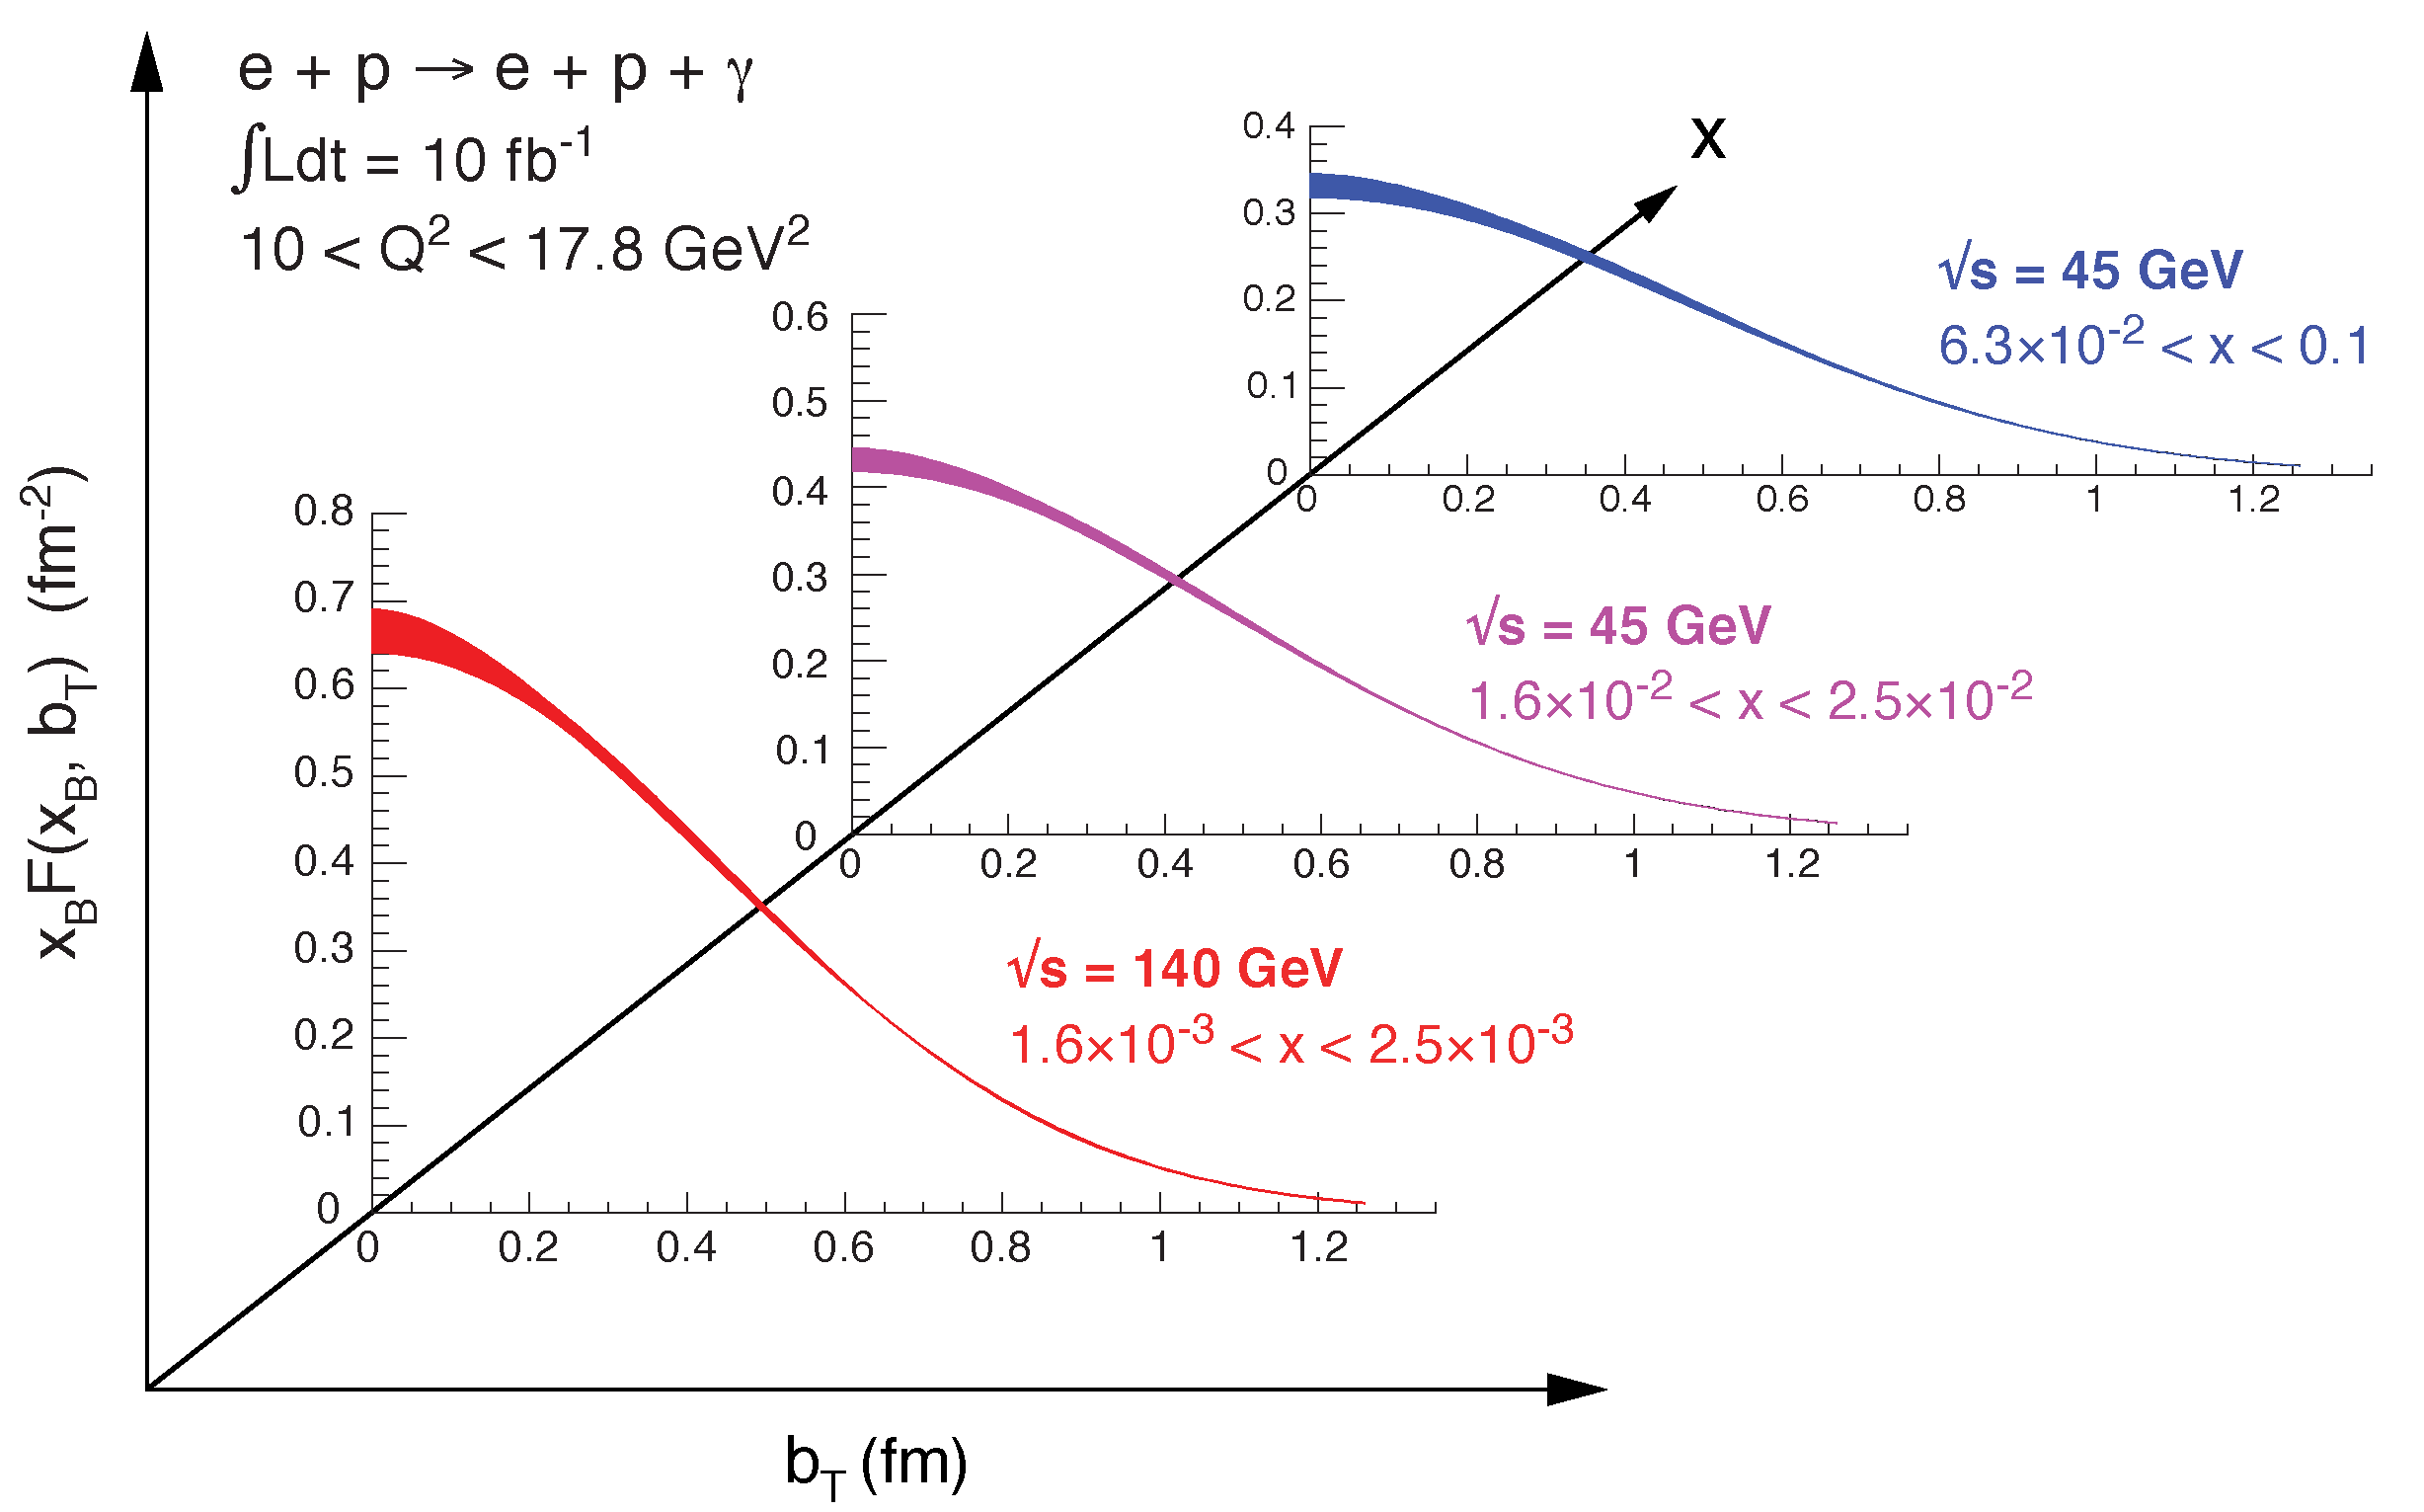
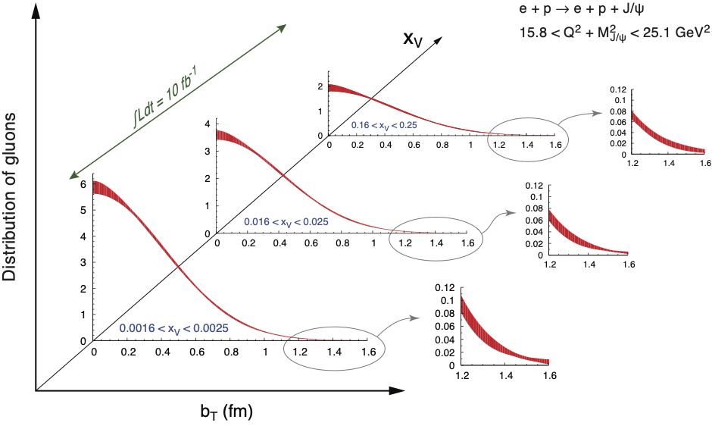

Spatial Imaging
High precision
imaging at EIC
at low and high x
Golden channels:
e’
e
γ_{L}*
γ, J/ψ
(Q²)
x+ξ
~
x-ξ
~
p
H, H, E, E (x,ξ,t)
p’
p_{T}²
DVCS
J/ψ
pion cloud
effects seen
at high b_{T}

Slide 21
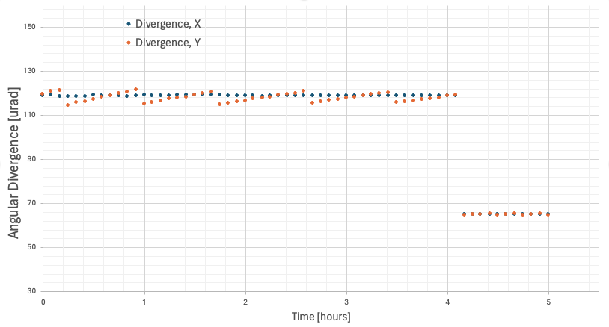
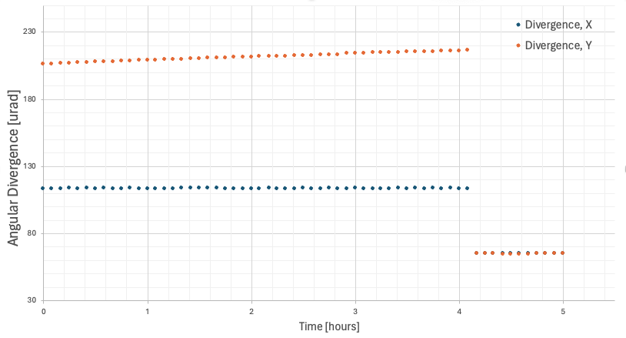
Science Impact from phasing Luminosity and SHC
Study for 2 scenarios
phasing SHC, having a precooler and the max beam-currents as planned
phasing SHC, having a precooler and lepton current reduced to 7nC/bunch
use an idea from HERMES and STAR to change running condition through the fill → have HD and LD in one fill
or run 4 fills in HD configuration and 1 fill in LD configuration
Case-1
Case-2
HD: pT > 330 MeV/c – 40 fb-1 for “normal year” (1e7 seconds)
HA: pT > 180 MeV/c – 1.2 fb-1 for “normal year” (1e7 seconds)
HD: pT > 550 MeV/c – 12.6 fb-1 for “normal year” (1e7 seconds)
HA: pT > 180 MeV/c – 0.35 fb-1 for “normal year” (1e7 seconds)
All luminosities calculated with a 10⁷ second/year runtime assumption (6 months at 60% machine efficiency).

Slide 22
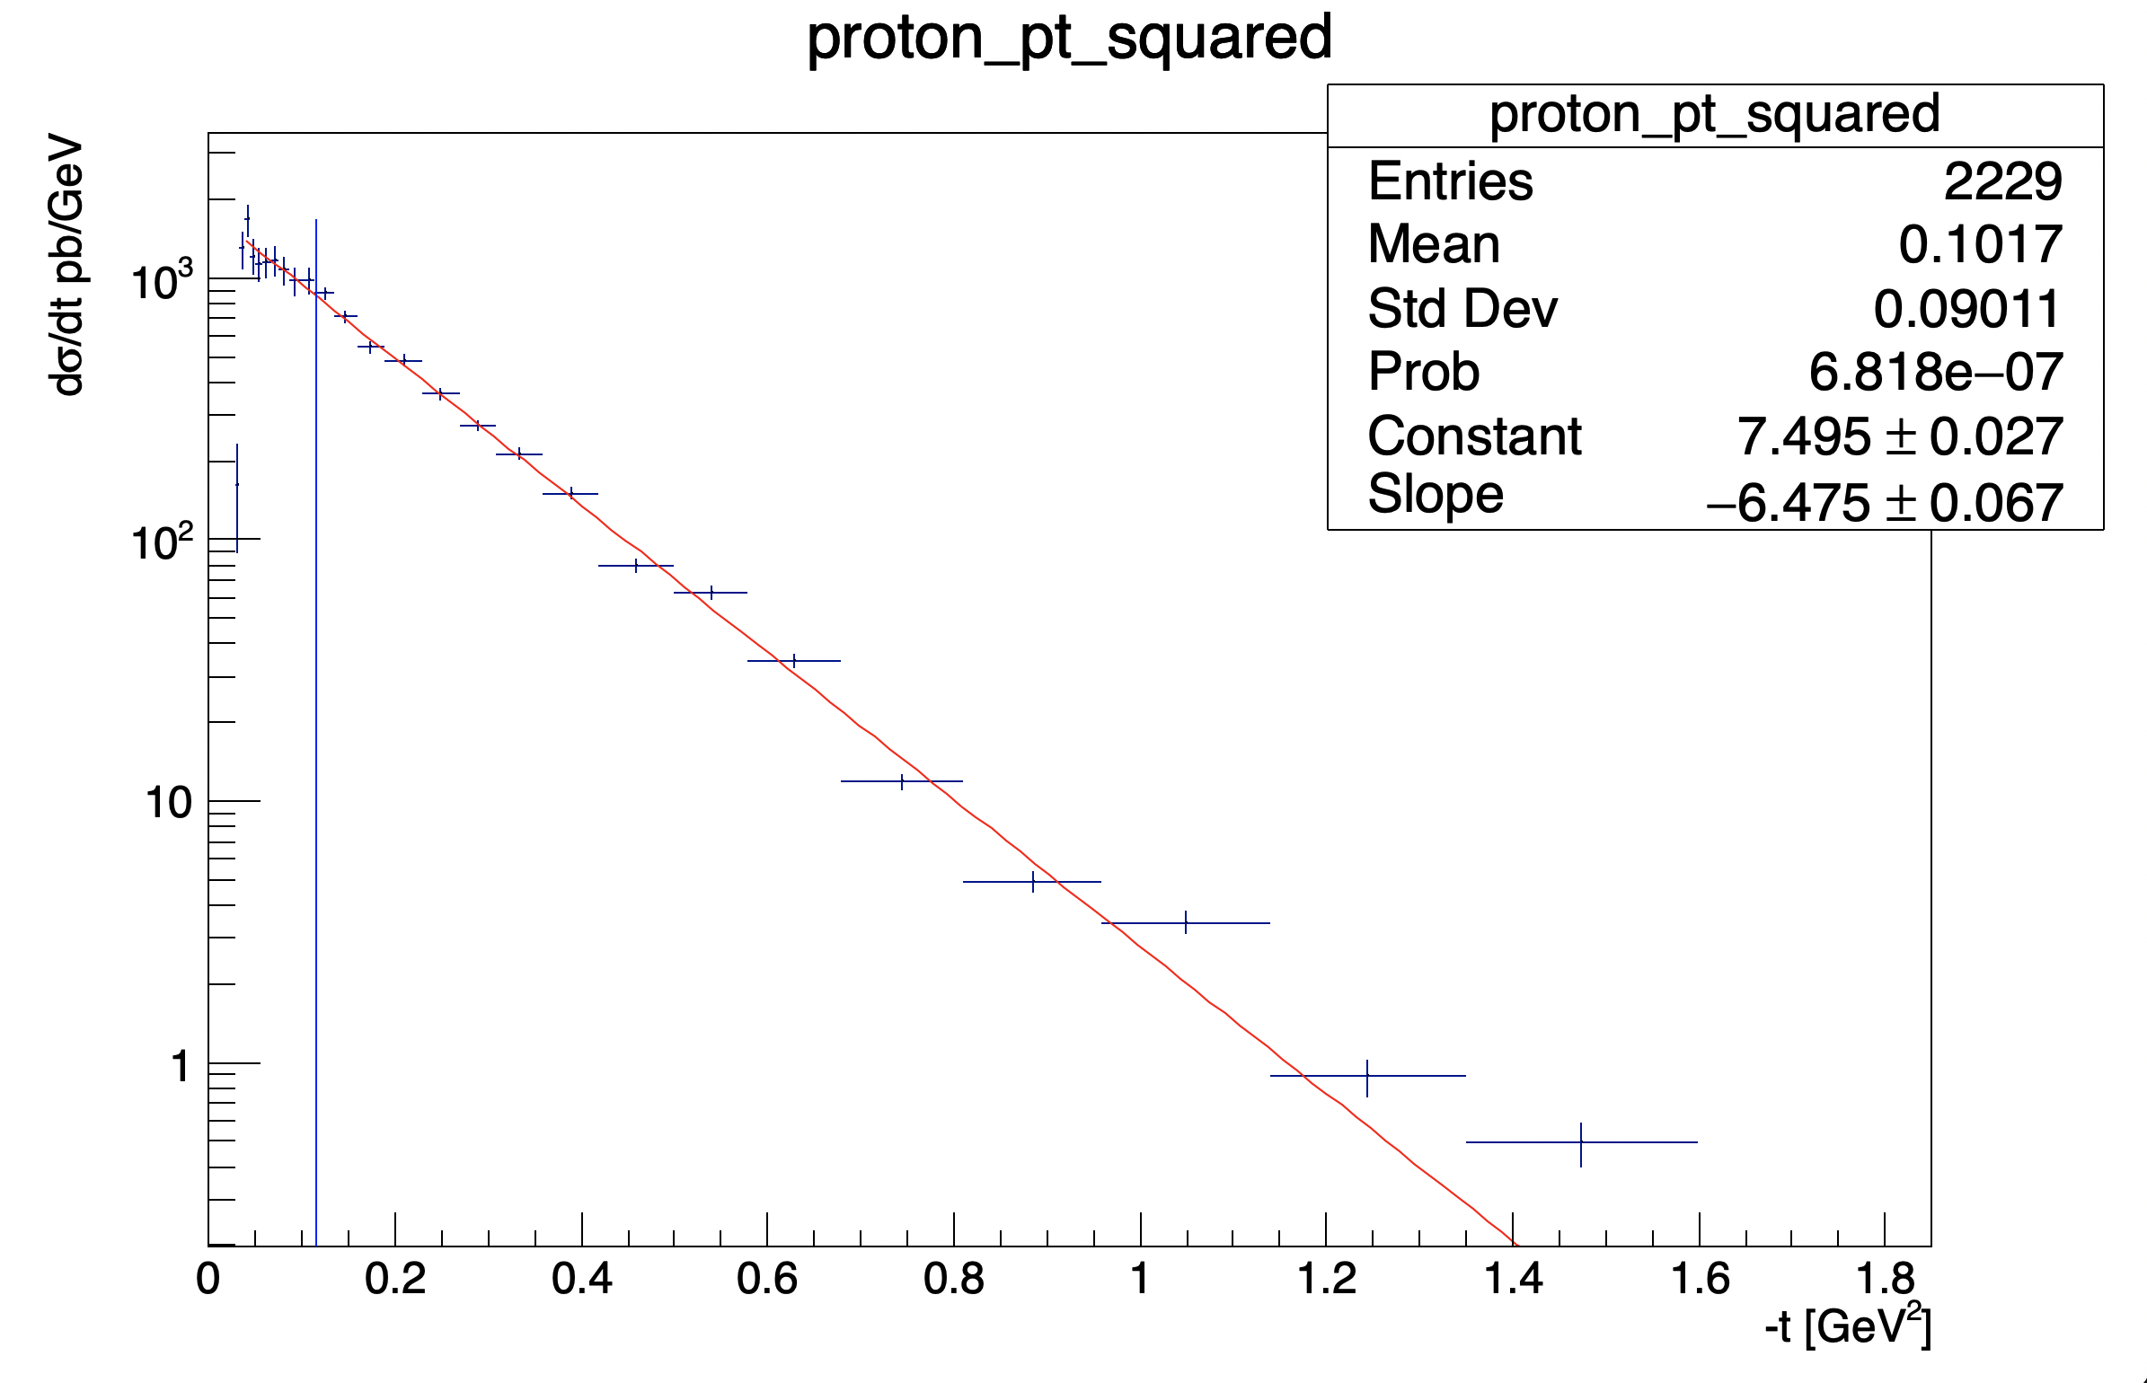
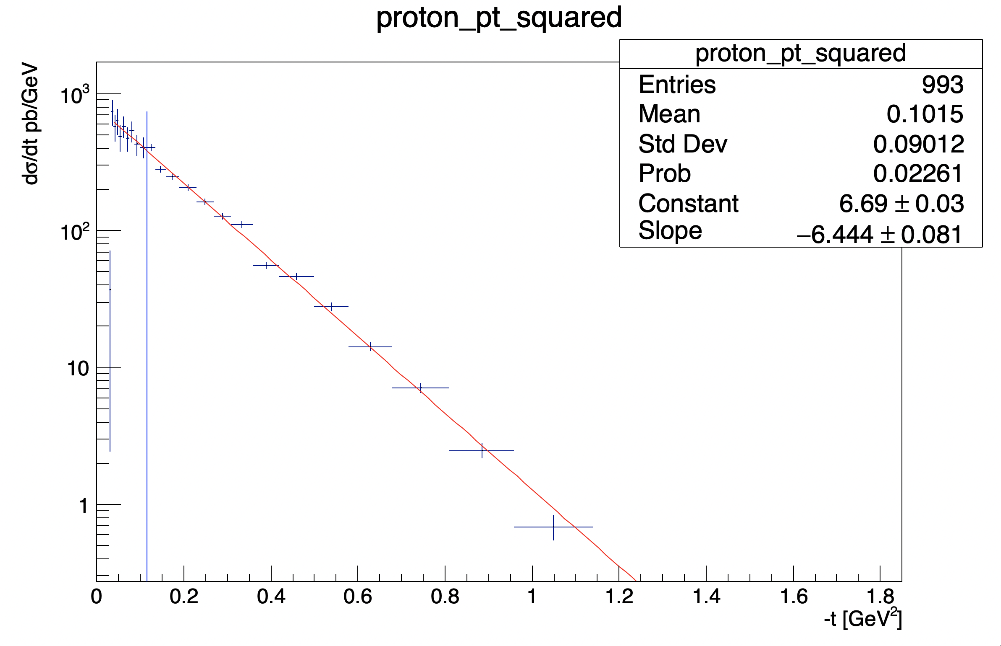
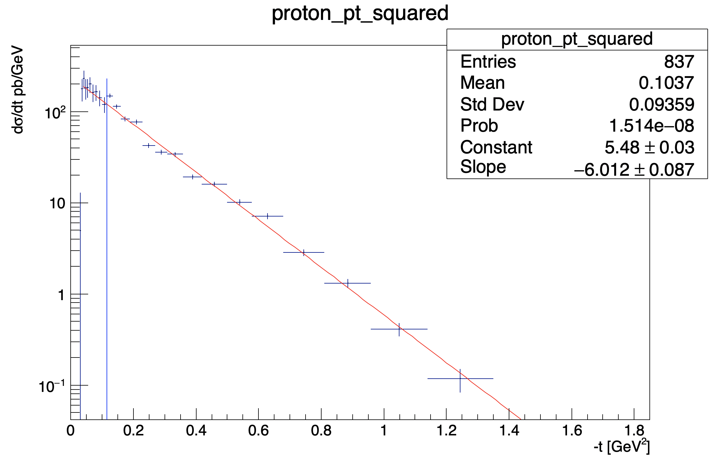
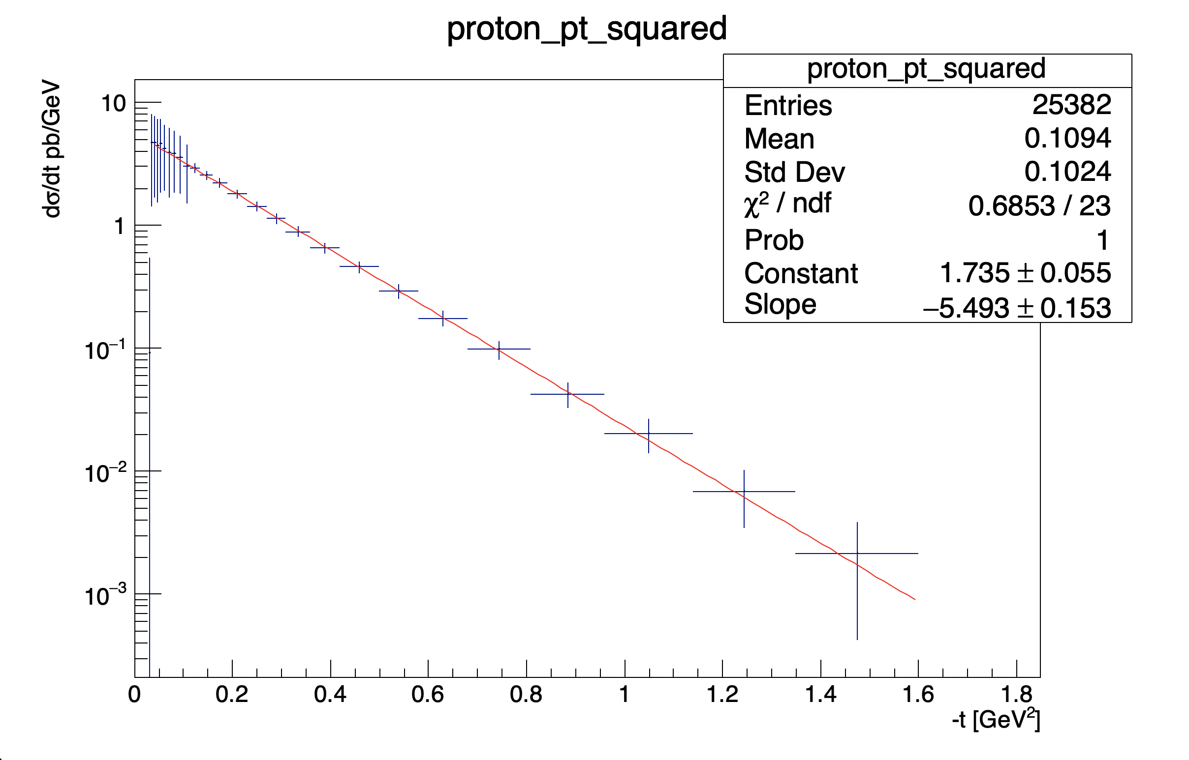
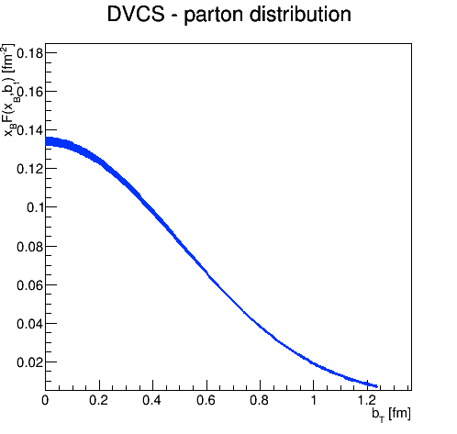
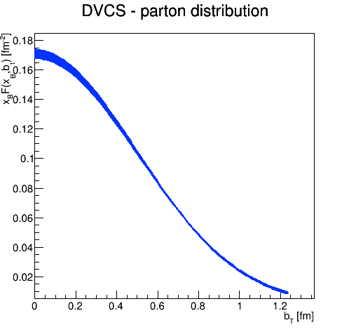
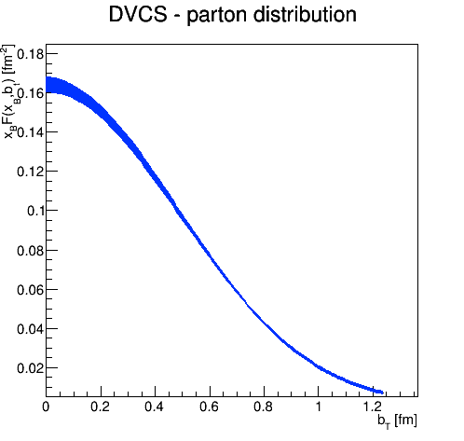
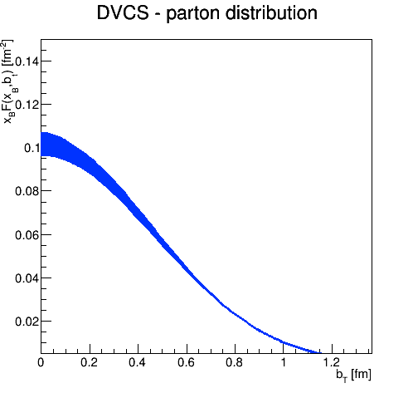
Science Impact from phasing Luminosity and SHC – Case-1
1.78 < Q2 < 2.47
0.00398 < x < 0.00514
2.47 < Q2 < 3.16
0.00398 < x < 0.00515
2.47 < Q2 < 3.16
0.01 < x < 0.0129
10.00 < Q2 < 13.89
0.01 < x < 0.0129
Minimum acceptance:
pT > 0.18 GeV/c
Minimum acceptance:
pT > 0.18 GeV/c
Minimum acceptance:
pT > 0.18 GeV/c
Minimum acceptance:
pT > 0.18 GeV/c

Slide 23
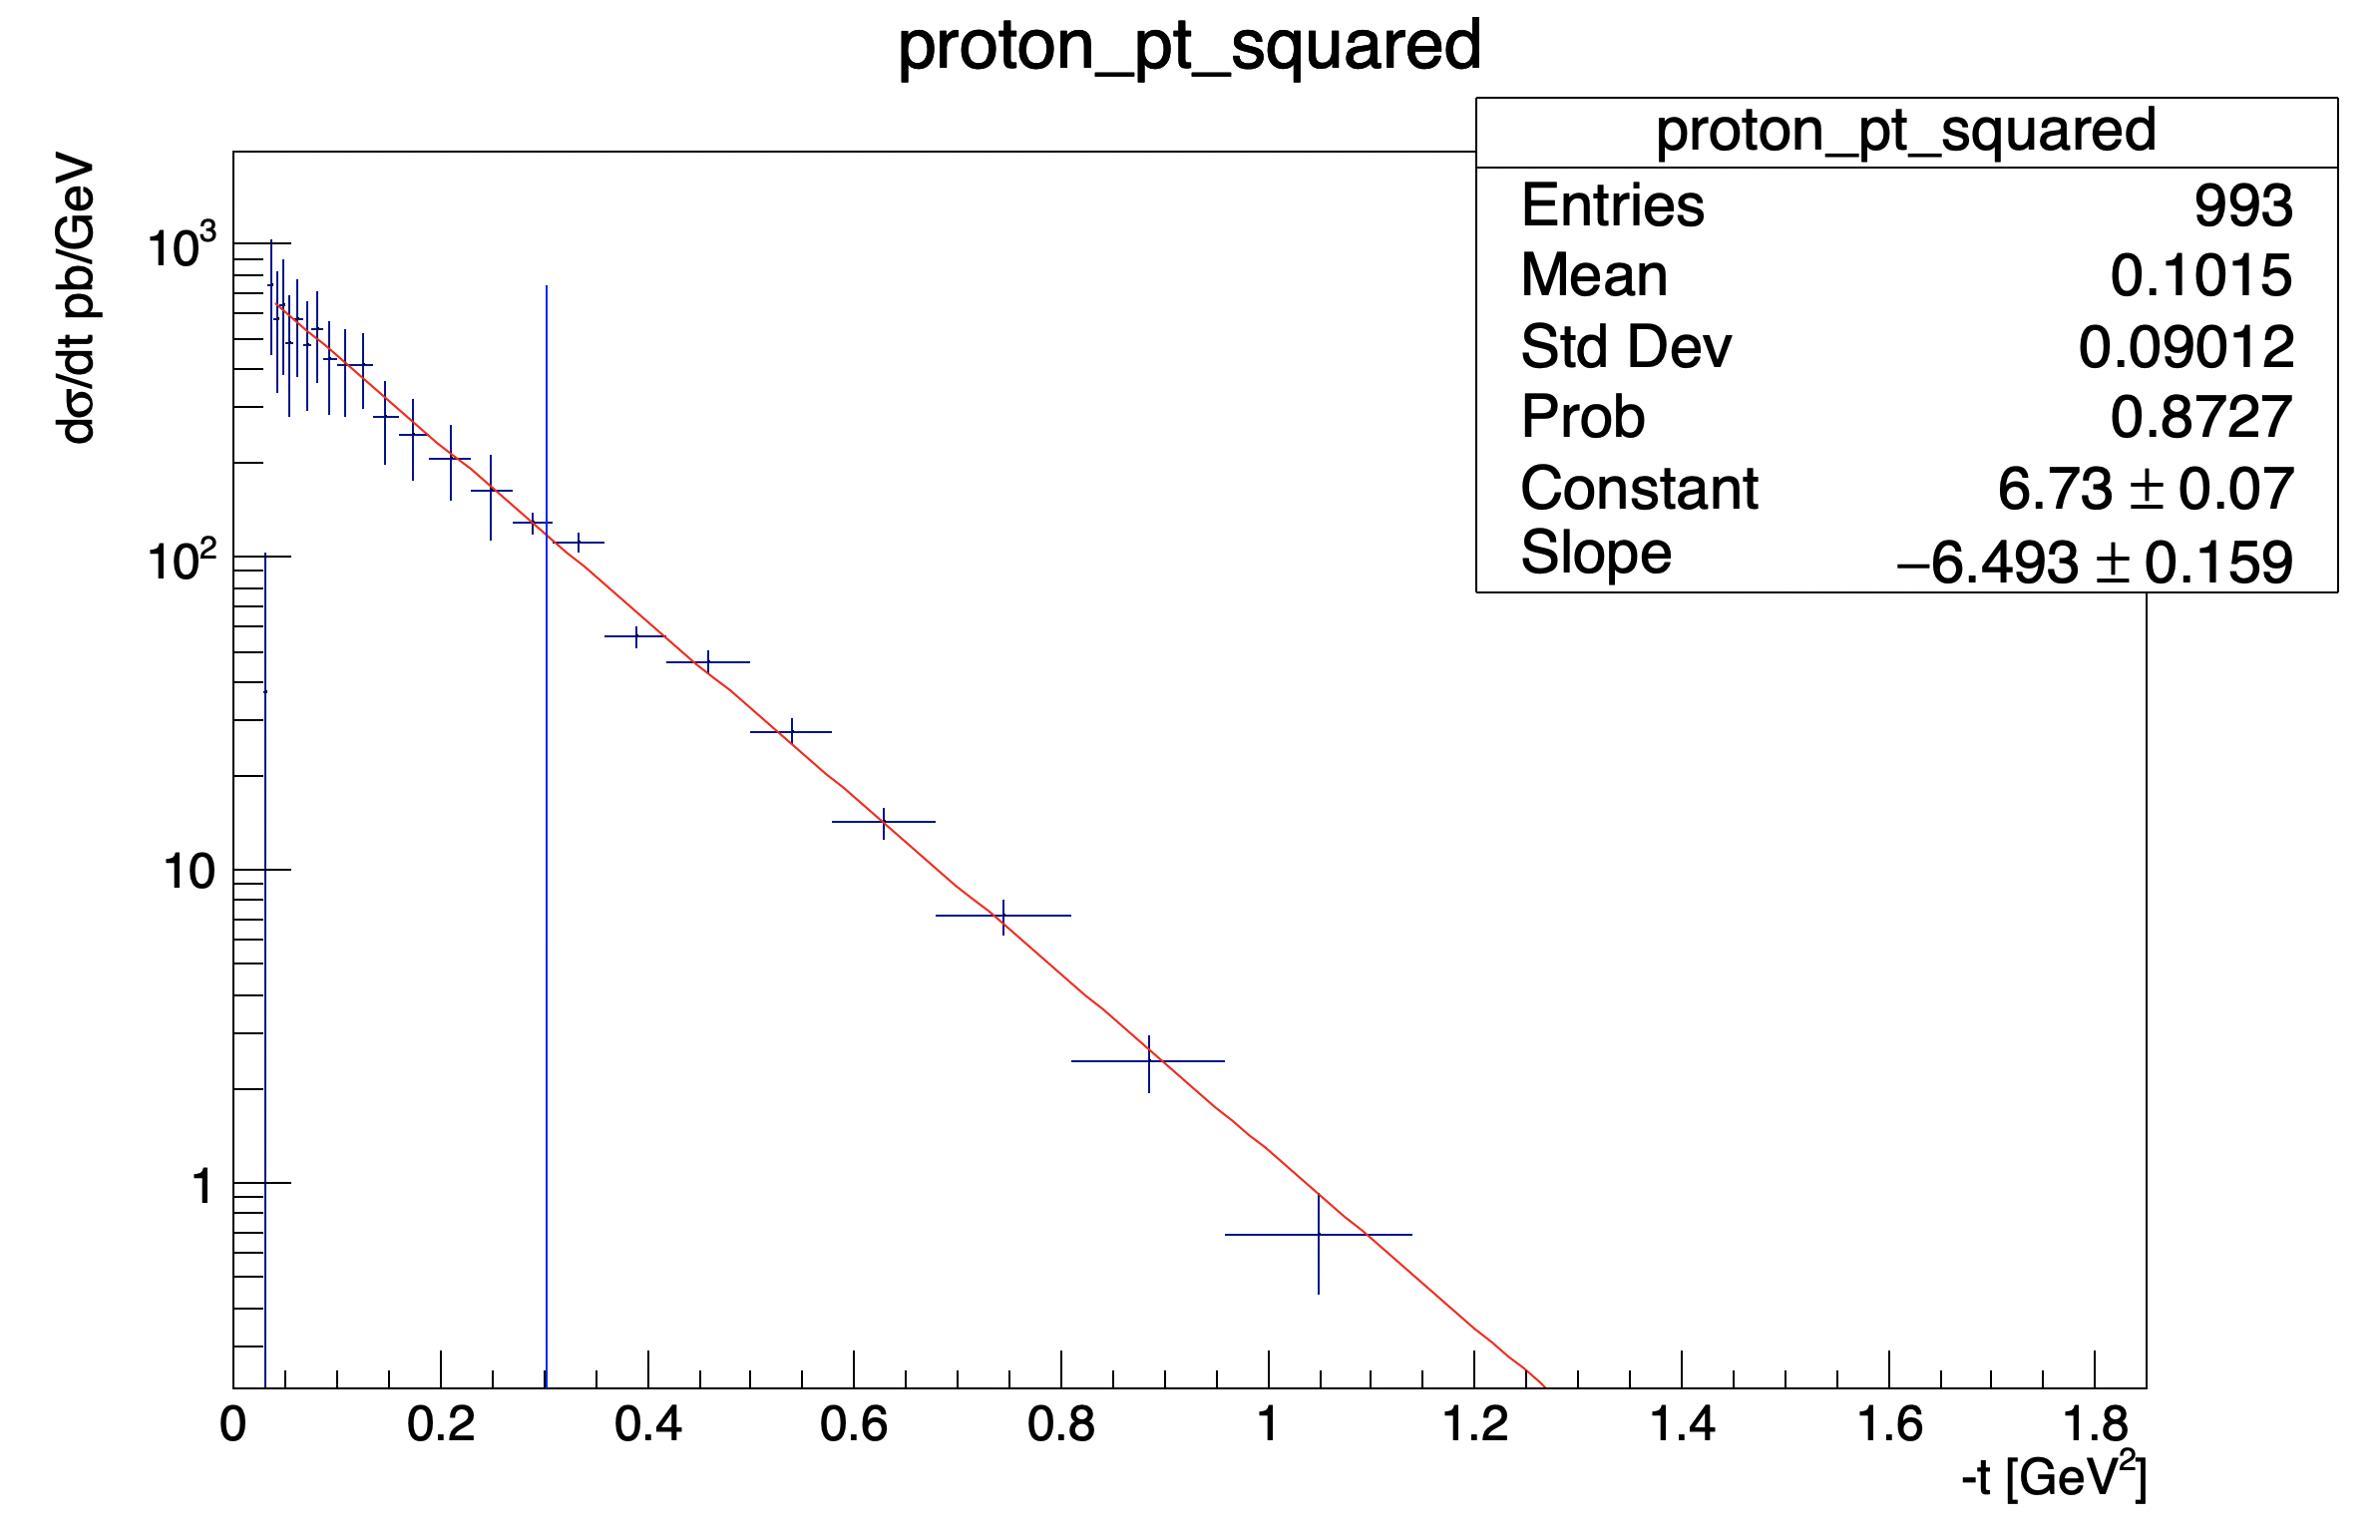
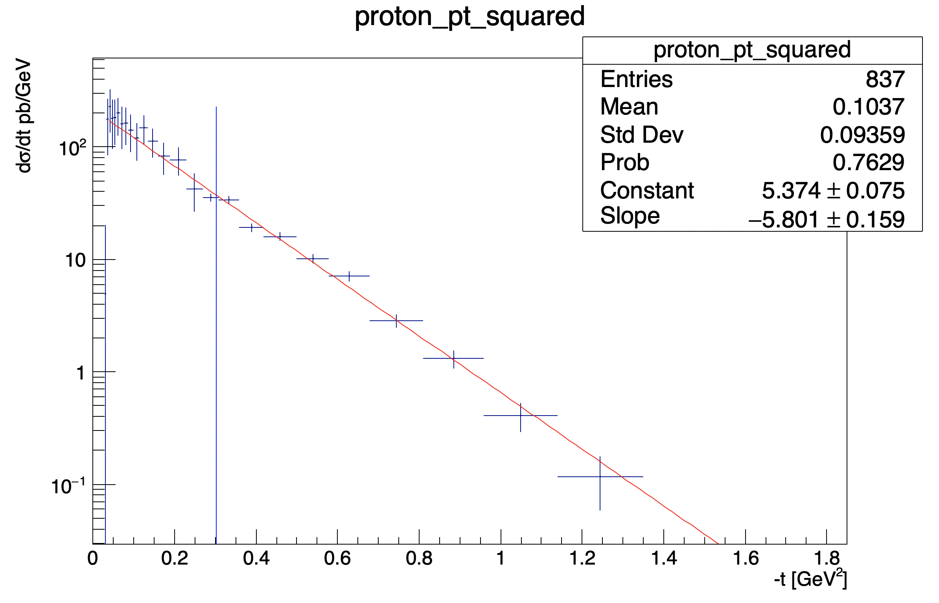
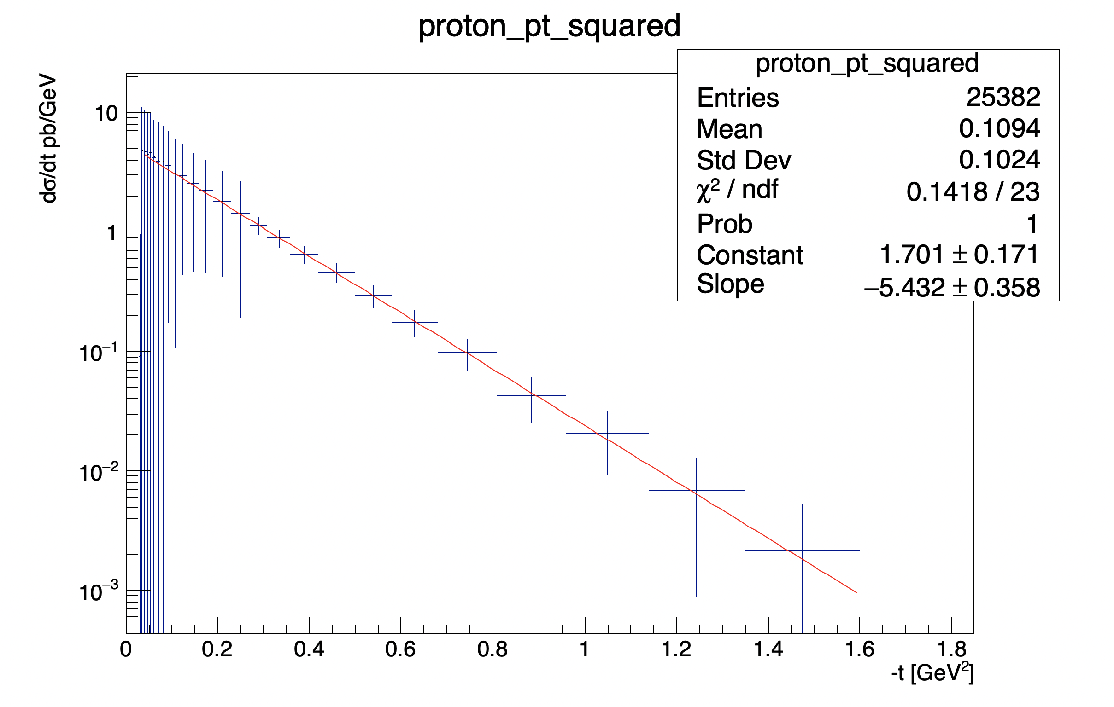
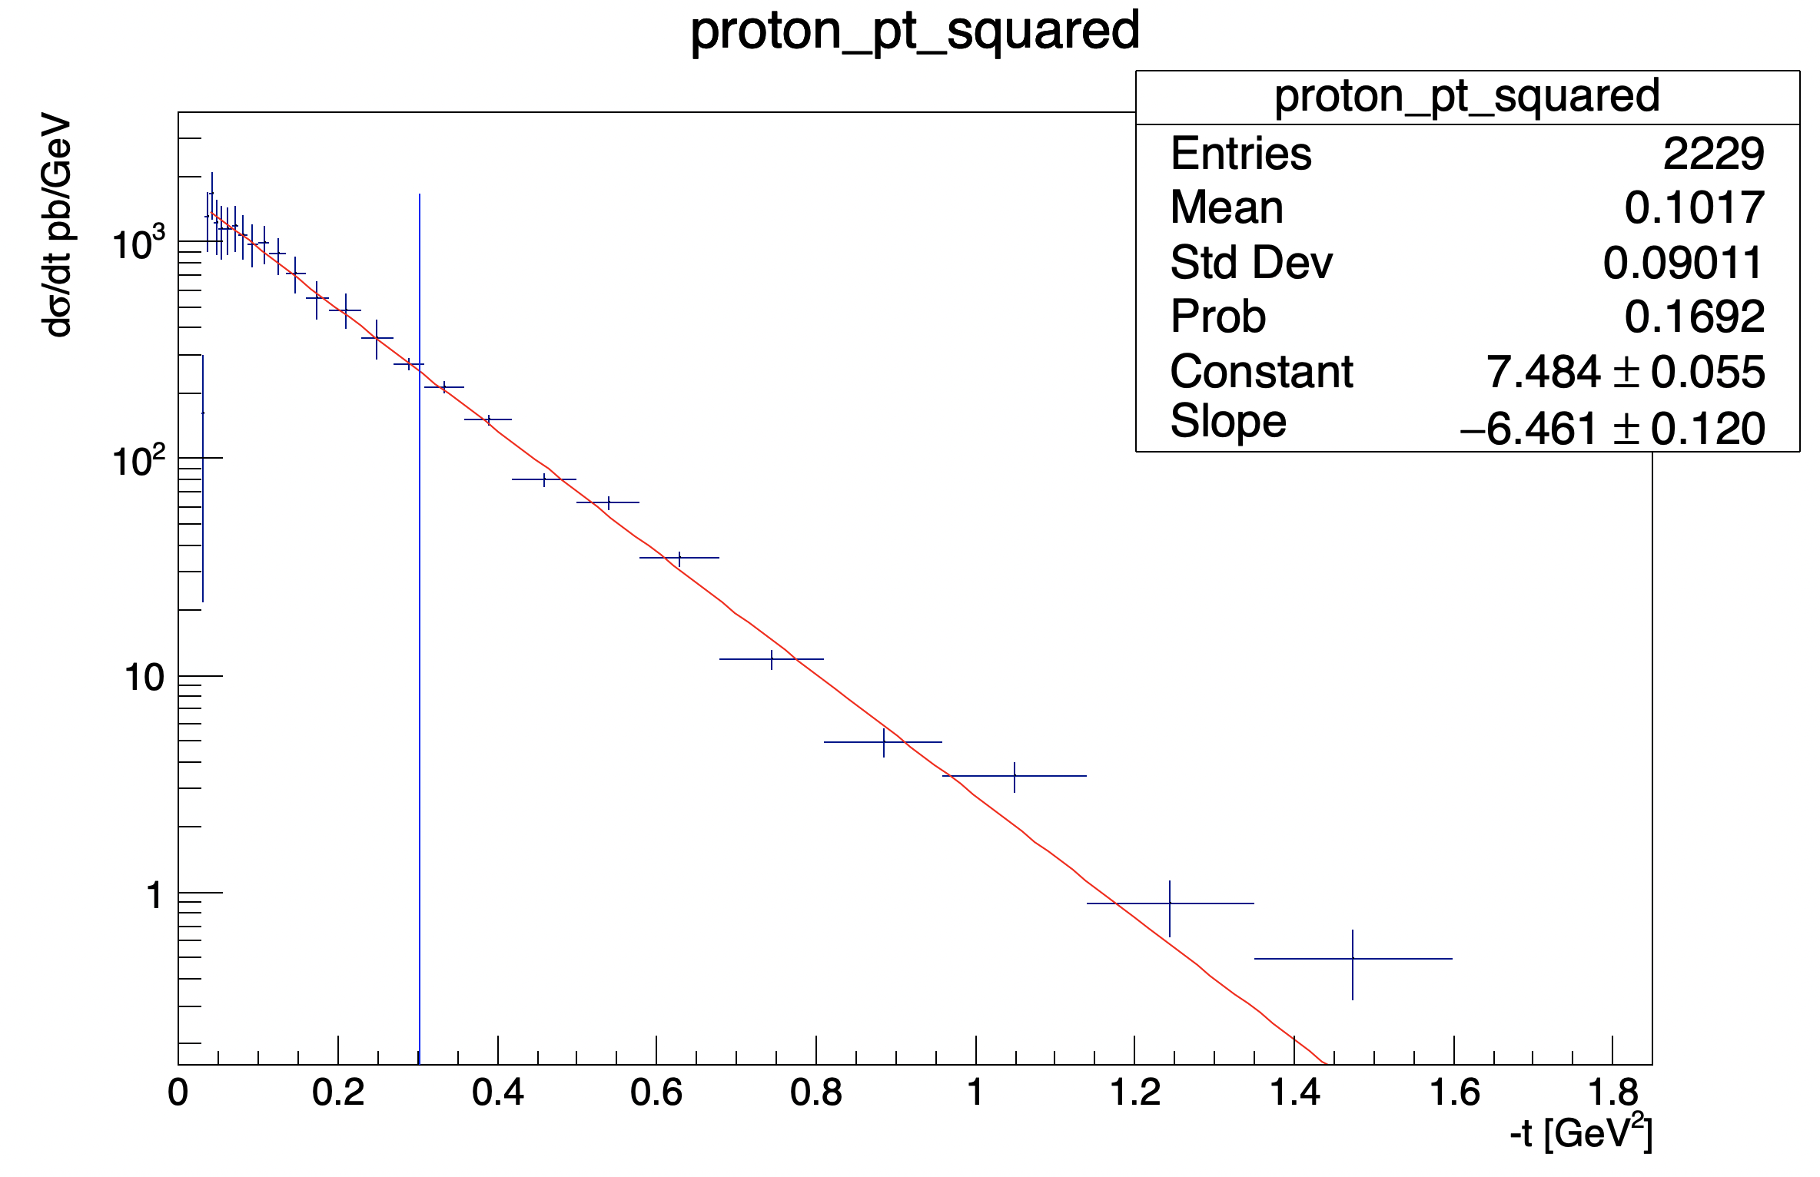
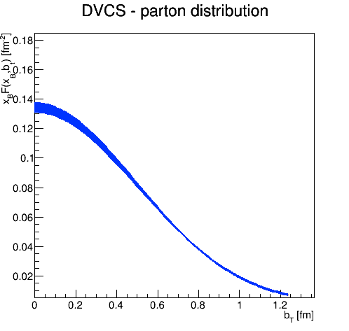
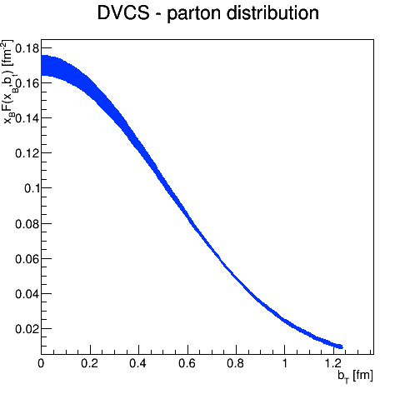
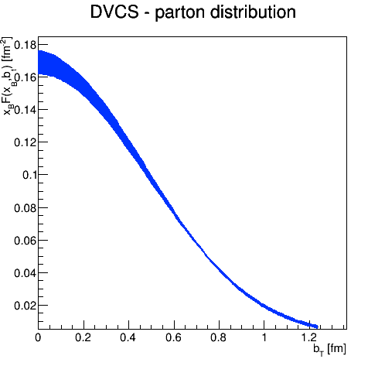
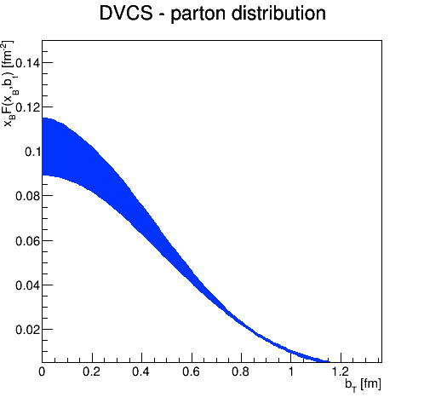
Science Impact from phasing Luminosity and SHC – Case-2
1.78 < Q2 < 2.47
0.00398 < x < 0.00514
2.47 < Q2 < 3.16
0.00398 < x < 0.00515
2.47 < Q2 < 3.16
0.01 < x < 0.0129
10.00 < Q2 < 13.89
0.01 < x < 0.0129
Minimum acceptance:
pT > 0.18 GeV/c
Minimum acceptance:
pT > 0.18 GeV/c
Minimum acceptance:
pT > 0.18 GeV/c
Minimum acceptance:
pT > 0.18 GeV/c

Slide 24
Forward Acceptance Impact
Measurement
Physics Obsevable
Plots from
EIC WP:
Requirement:
∫L_{int}=10fb⁻¹
0.18 < p_{t} (GeV) < 1.3
0.03 < |t| (GeV²)< 1.6
Fourier
Transform
Plots with
reduced
lower
p_{t}-acceptance
∫L_{int}=10fb⁻¹
0.44 < |p_{t}| (GeV) < 1.3
low p_{T} reach driven by beam divergence
uncertainty explodes as one increases uncertainty on normalization at t = 0
∫L_{int}=10fb⁻¹
0.18 < |p_{t}| (GeV) < 0.8
high p_{T} reach driven only by magnet bore size
Plots with
reduced
high
p_{t}-acceptance

